Slide 1

TravelMate
A smart application that provides users the ability to book any type of facility remotely
By: Abed alkareem salah & Ameer Yaish
Supervisor: Alaadin Al Masri

Slide 2
Roadmap
Introduction
Roles And Permissions
Future Work
1
3
5
2
4
Human Centered Design
Main Features

Slide 3

Introduction
The main idea of our project is to create a smart mobile application and a website dashboard for admins and owners of properties, it gives users the ability to remotely book houses, apartments, hotel rooms, etc. and for properties’ owners they can manage their hotels, apartments or any type of accommodation, as they can represent their properties with details so customers can view all changes, offers or other details.

Slide 4
Human Centered Design
Inspiration
Ideation
Implementation
Iteration And Measuring Success
Learning
Ideas And Testing

Slide 5
Inspiration:
Several meetings with facilities owners and citizens to determine the problem.
Ideation:
Gathering ideas and making possible suggestions to start the application development process.
Implementation:
Preparing the application to be ready for use by owners and citizens, and then hearing feedback from them.

Slide 6
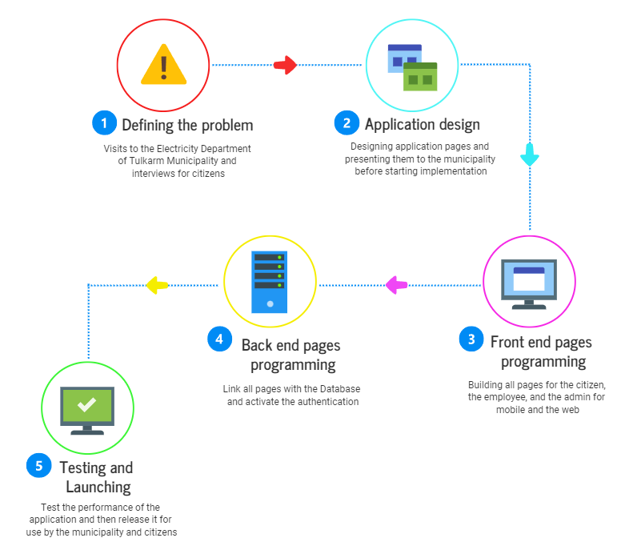
Process steps

Slide 7



Roles And Permissions
Admin
Owner
Citizens

Slide 8


Challenges
Recommendation
Earnings and
Payment method
Flutter web use

Slide 9
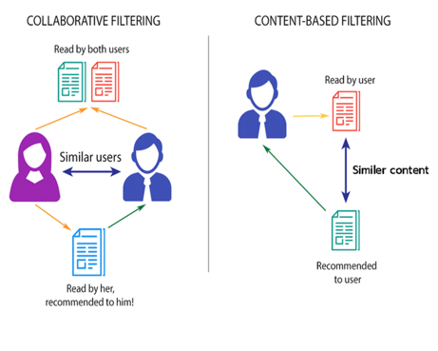
Recommendation
Basic technique
-content based recommendation
Another technique
- offers
- Top Booking
- Top Rating
- Nearby

Slide 10
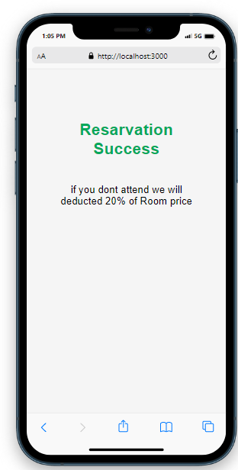
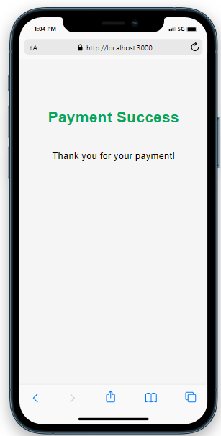
Earnings and
Payment method
Hotel earnings
Property earnings

Slide 11

Main Features
Smart system that uses machine learning for recommending rooms and other types for user
GPS was used to give a live location and get nearest facilities like hotels and houses, etc.
Users can ask for the services or send their feedbacks from the application
Sending notifications for the users to keep them aware of offers or any updates
Owners has a full control panel to lead the process from the application or the website

Slide 12


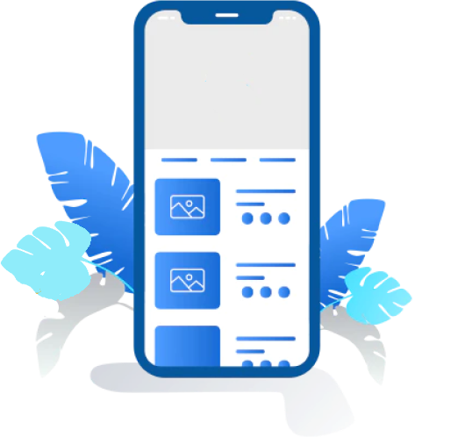






Technologies Used
Travel
Mate

Slide 13

Future work

Slide 14
Future Work
Developing the payment system as well as providing a monthly bill for owners
Add advertisement section in the application
Expand our application abroad
Chatbot Auto replying to users’ messages
Improve our application in different cases

Slide 15


