Slide 1


Slide 2


Slide 3
1. Objectives.
Outline
2. App life cycle.
3. Tools.
4. Constraints.
5. Future Work.
6. Demo.

Slide 4



Objectives:
Learning:
Communication:
Communicative environment for interested people.
Educative material and field guide.

Slide 5
App Life-Cycle:
Machine Learning.
Android Development.

Slide 6
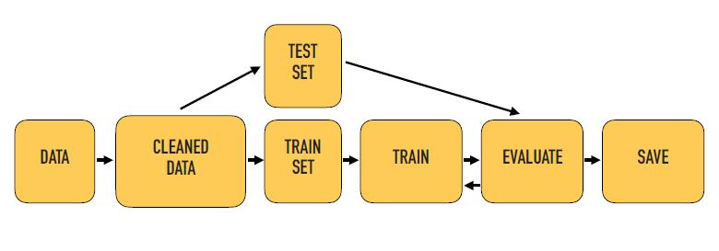
Machine Learning:
Machine Learning Architecture.

Slide 7
Training steps:
1. Install a TensorFlow Object Detection Model.
2. Gather and Label Pictures.
3. Train Object Detector.
4. Export Inference Graph.
5. Test The Output.

Slide 8
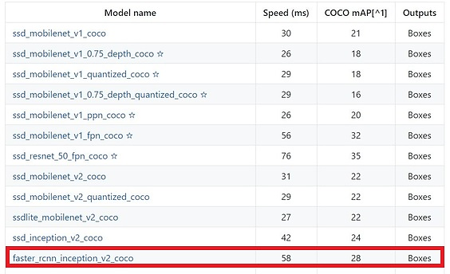
1. Install a TensorFlow Object Detection Model:

Slide 9


2. Gather and Label Pictures:
Gather Pictures:
700 picture.

Slide 10
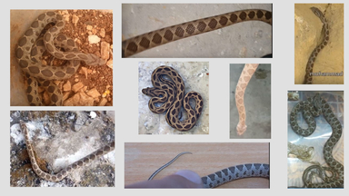
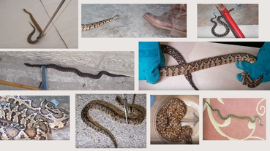
Baklava_Snake.
Palestine_Snake.

Slide 11
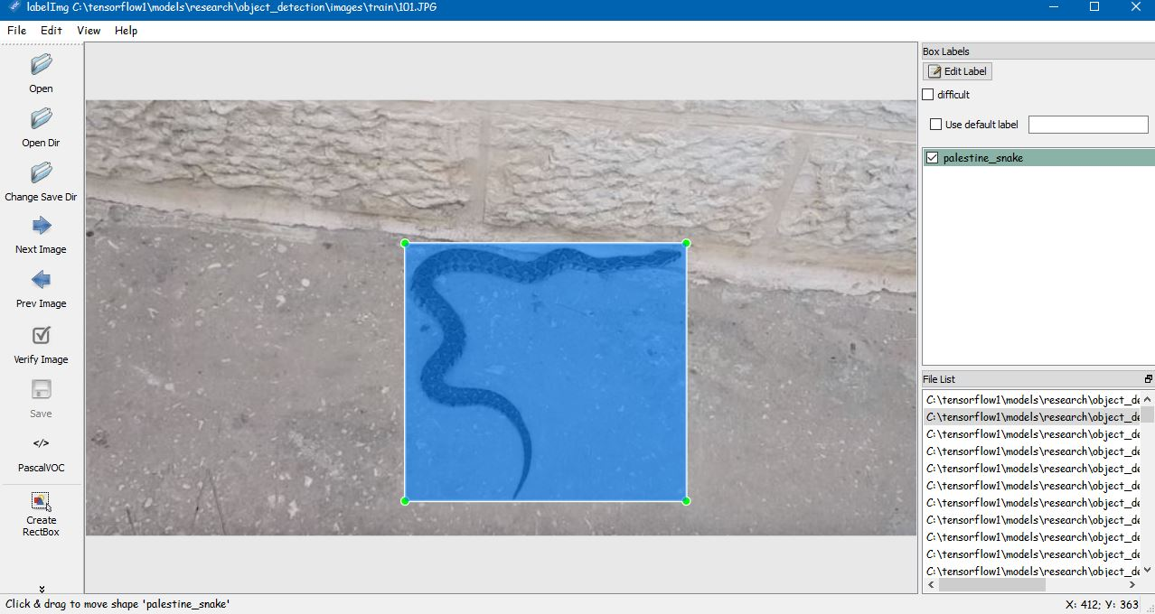
Label Pictures:

Slide 12
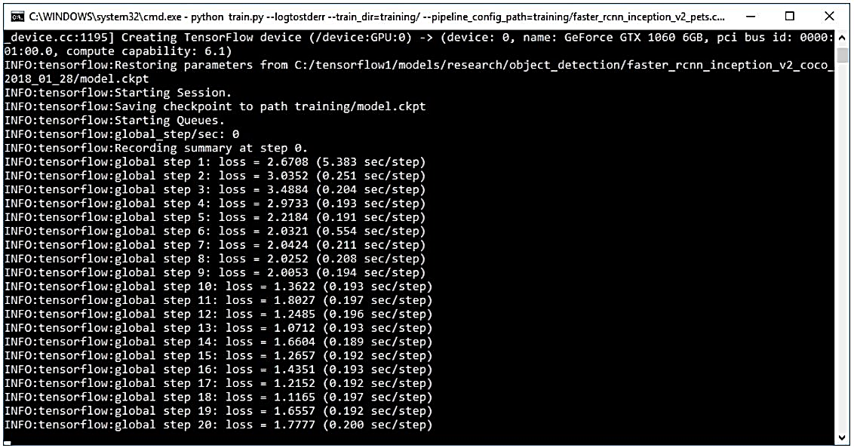
3. Train Object Detector:

Slide 13
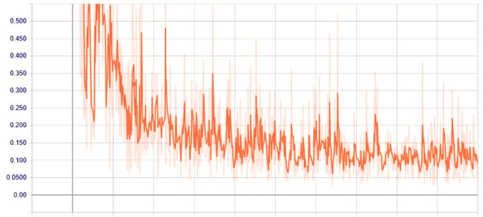
Total Loss Graph:

Slide 14
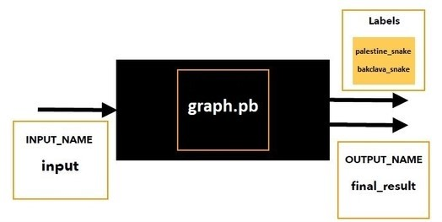
4. Export Inference Graph:
Frozen_inference_graph.pb

Slide 15
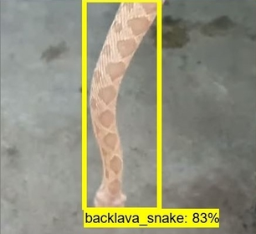
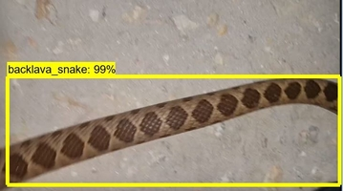
5. Test The Output:
Backlava_Snake.

Slide 16
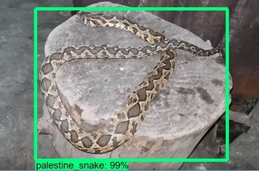
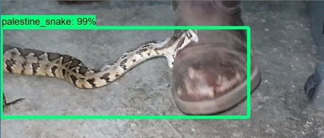
Palestine_Snake.

Slide 17
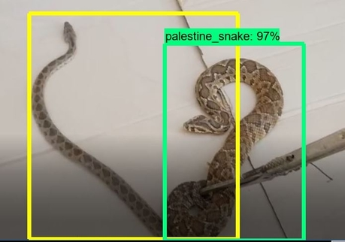
Palestine_Snake & Backlava_Snake.

Slide 18
1. Login and Registration.
2. User Profile.
Android development:
3. Palestine Map.
4. Camera.
5. Snakes Pages.
6. Help Call.
7. First Aids.
8. Log Out.

Slide 19
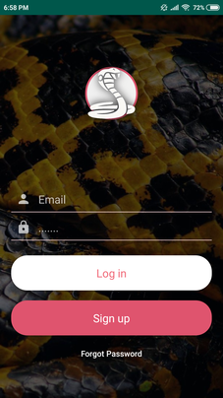
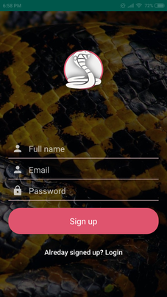
1. Login and Registration:
Login page.
Sign up page.
Forget password.
Login page.
Sign up page.

Slide 20
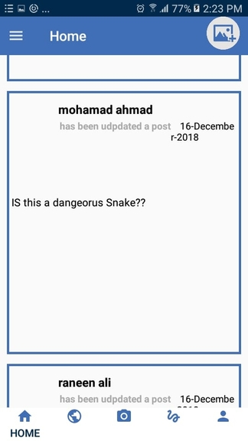
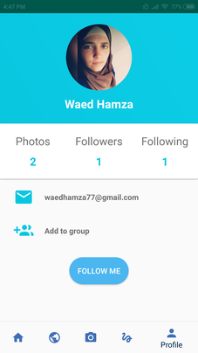
2. User Profile:
Home page.
Profile page.
Home page.
Profile page.

Slide 21
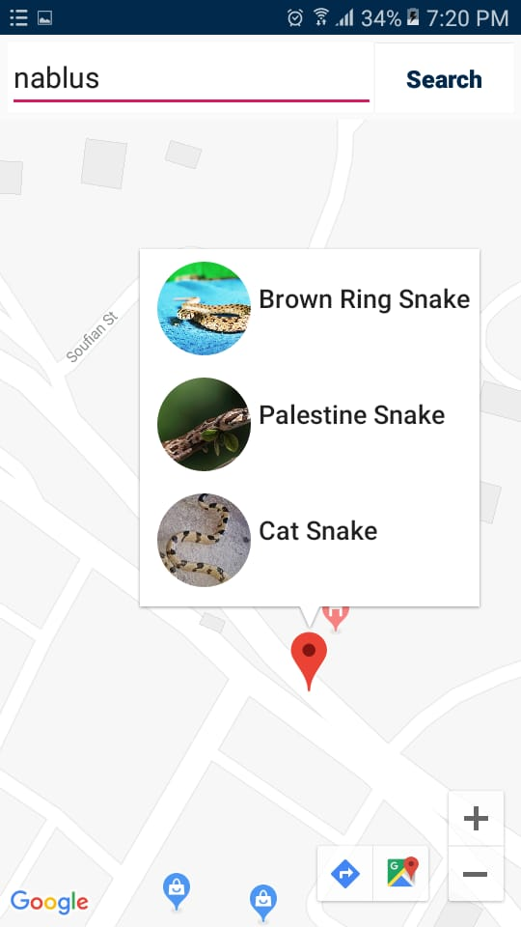
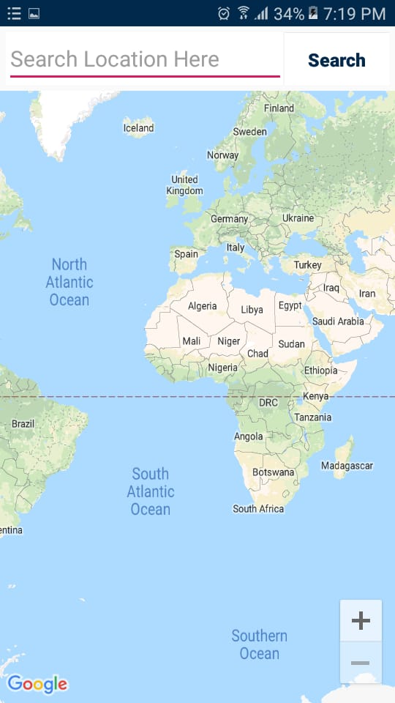
3. Palestine Map:
Google Map.
Searching:
Palestine cities.

Slide 22
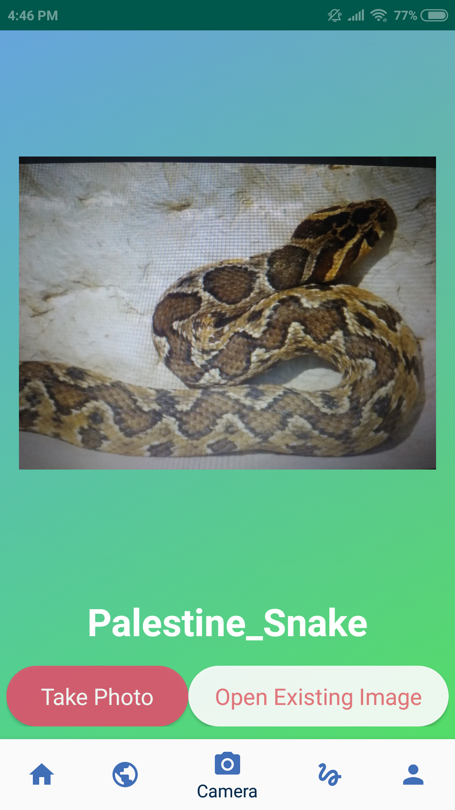
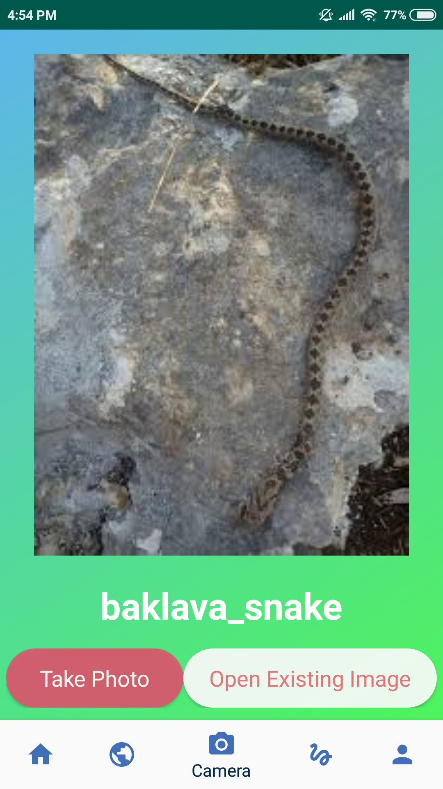
4. Camera:
Take photo.
Open Gallery.
Classifier (.pb).

Slide 23
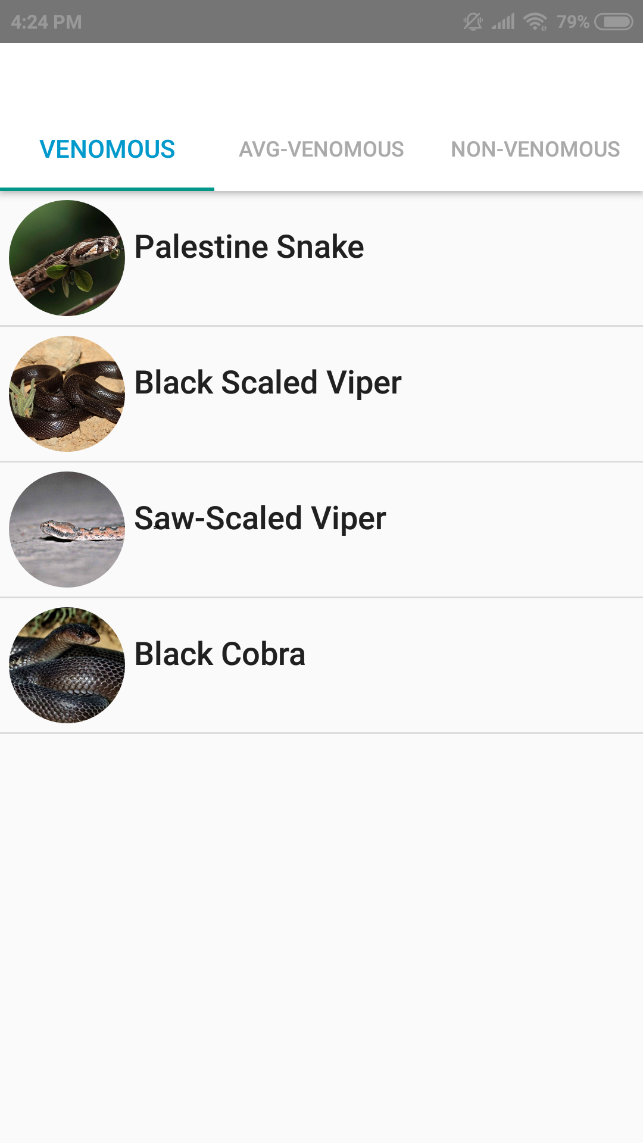
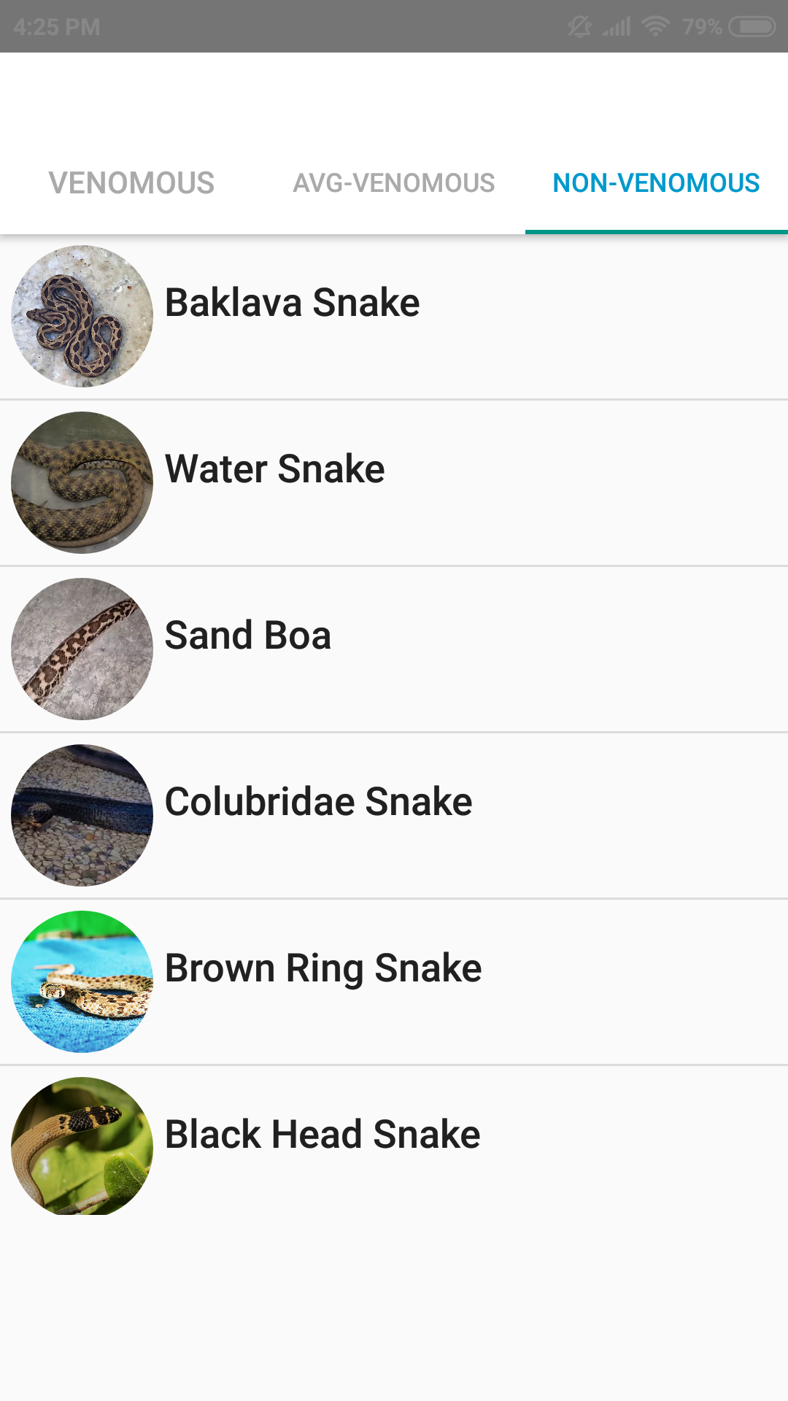
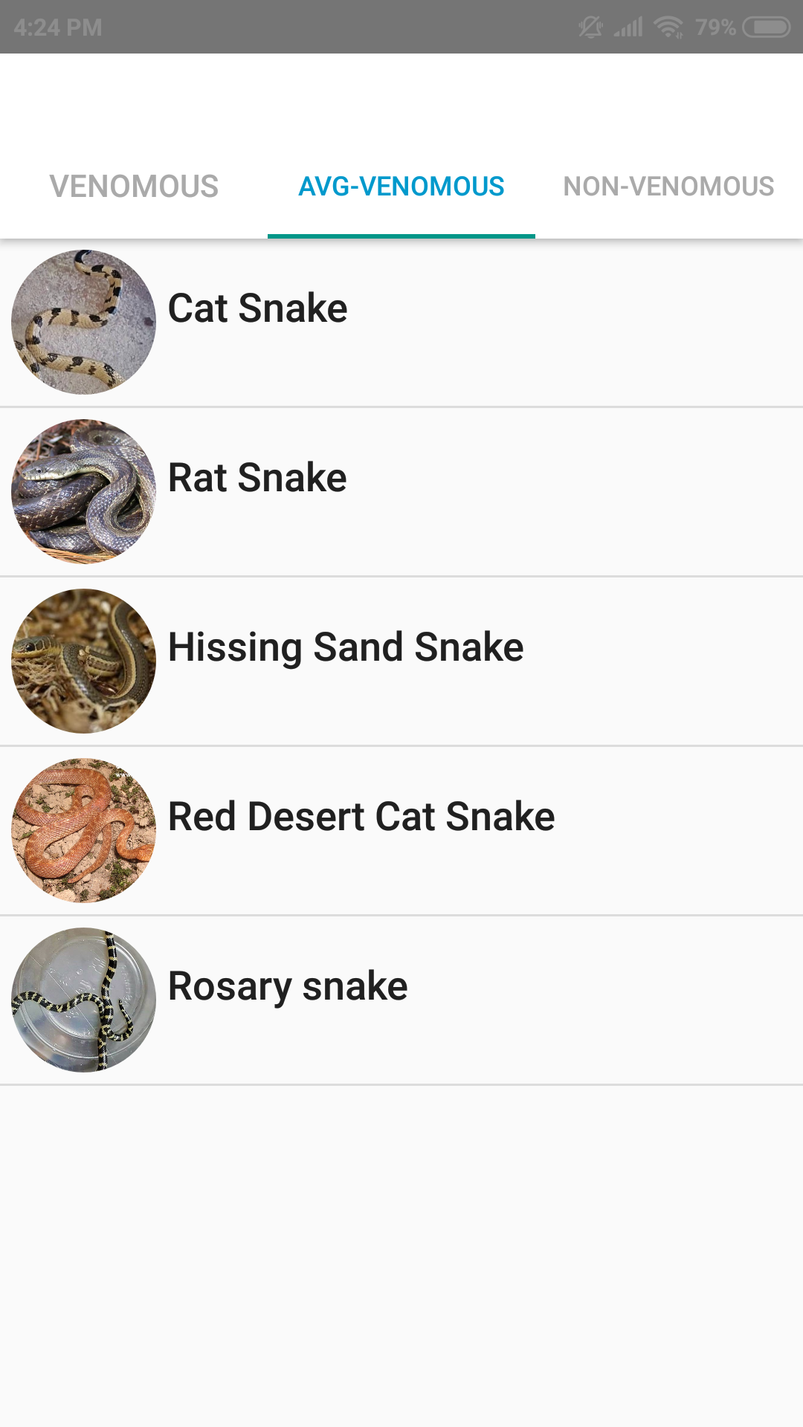
5. Snakes Pages:
VENOMOUS.
AVG-VENOMOUS.
NON-VENOMOUS.

Slide 24
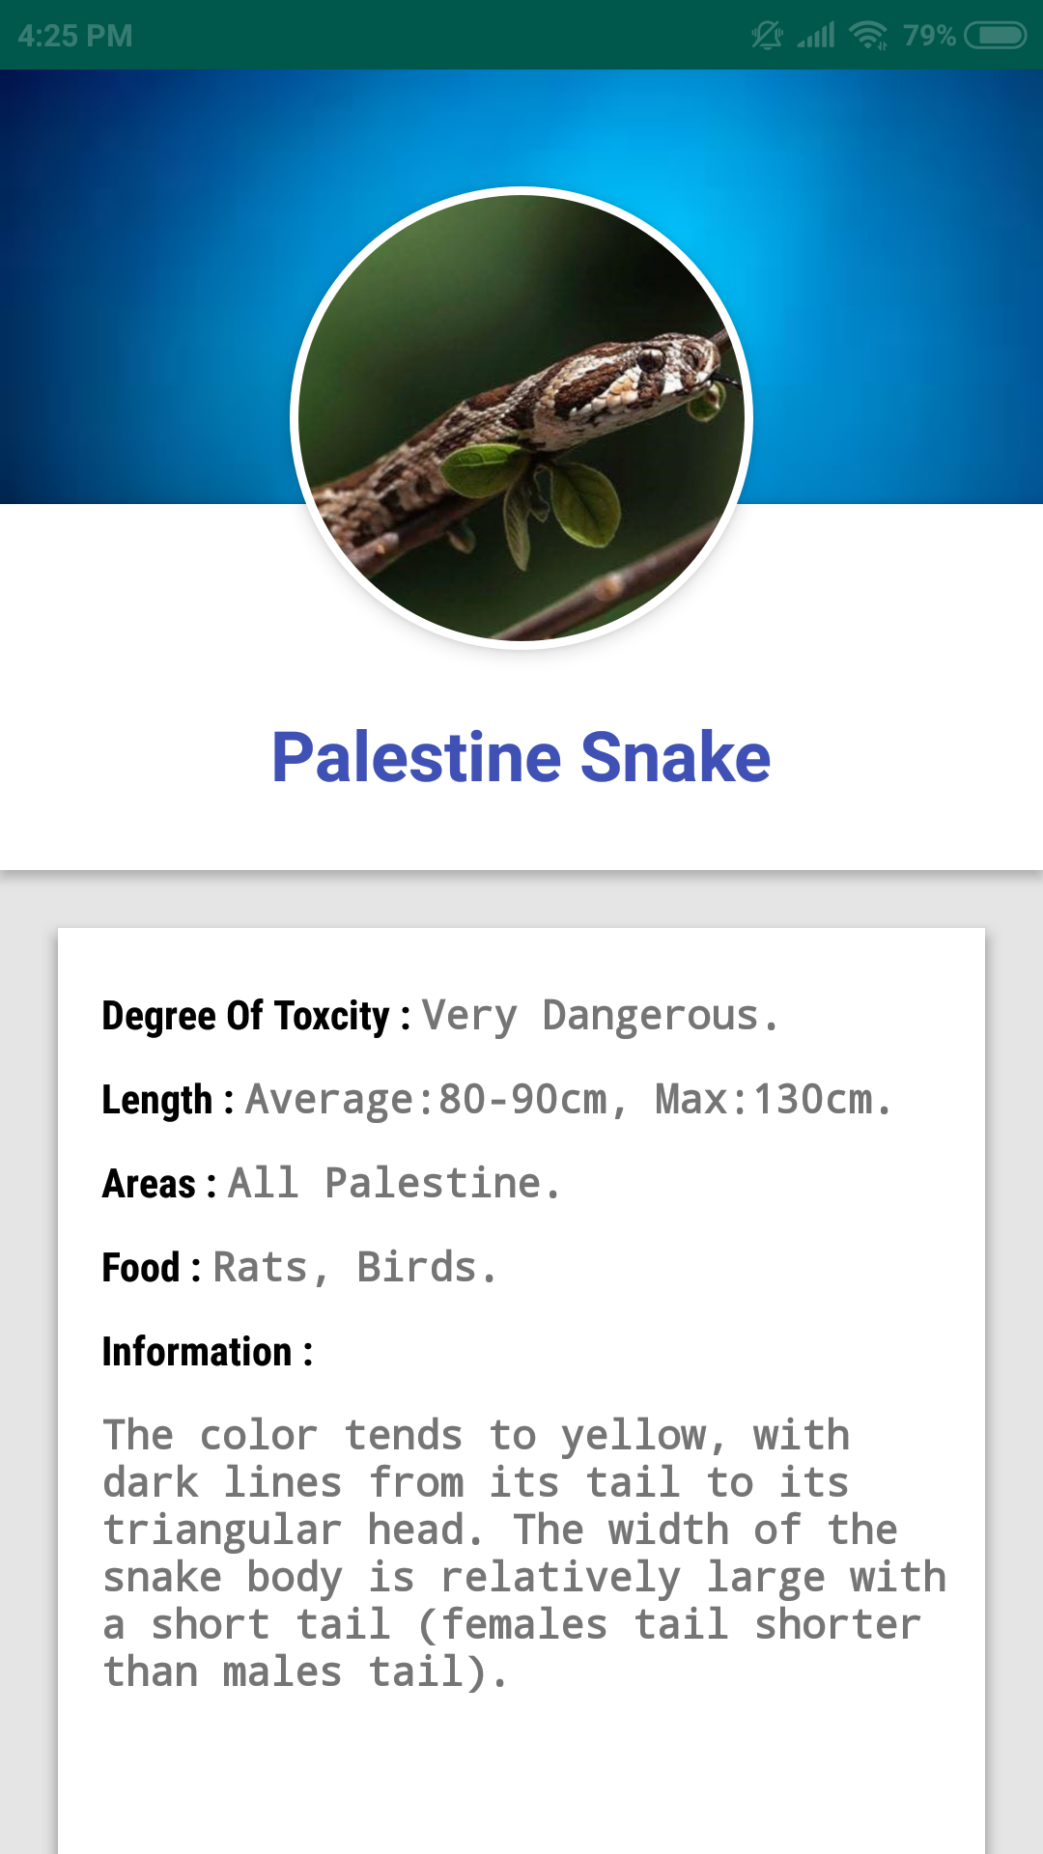
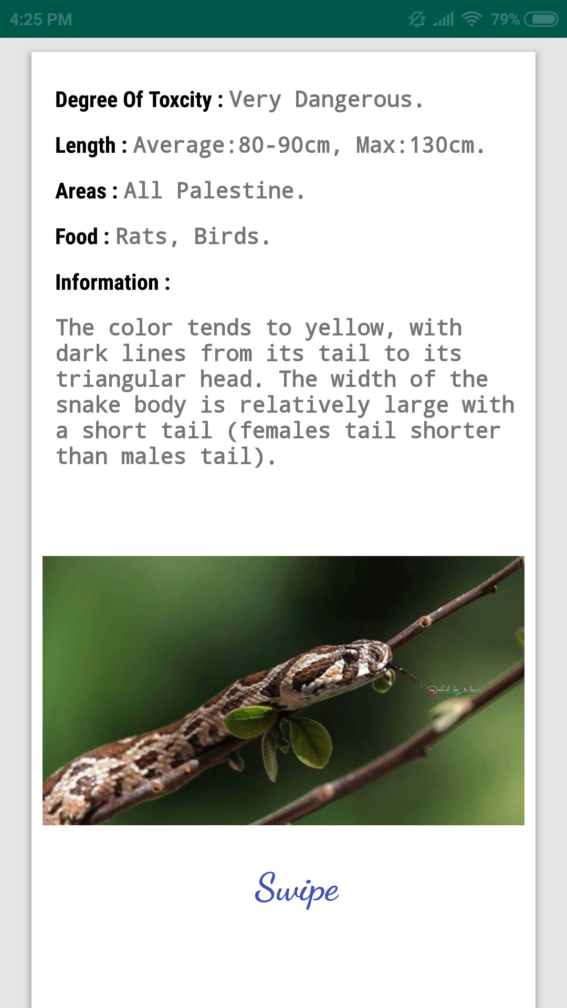
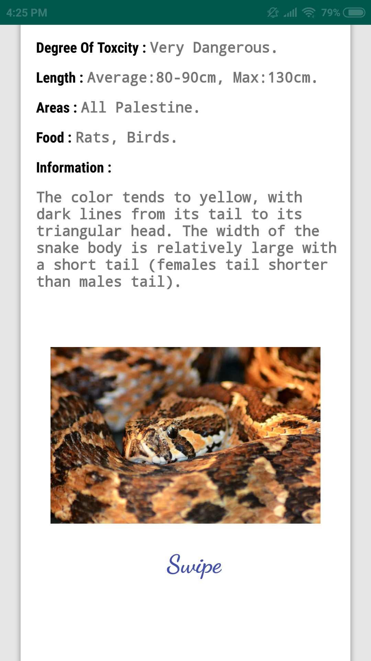
Palestine Snake information.

Slide 25
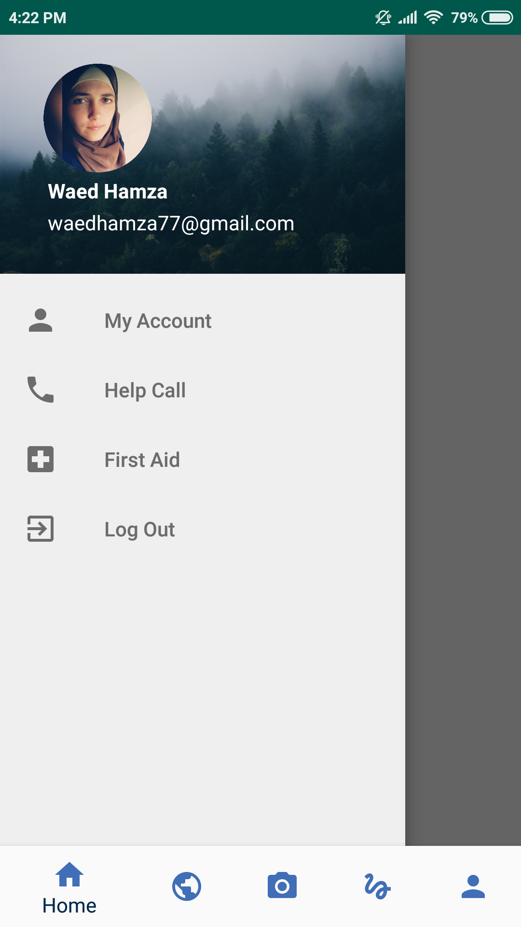
Drawer Navigator:
My Account.
Help Call.
First Aid.
Log Out.

Slide 26
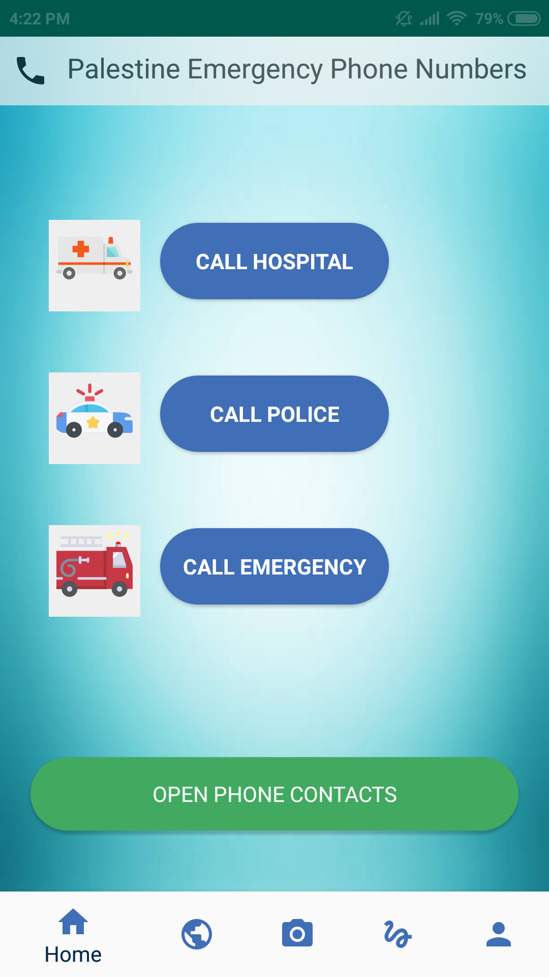
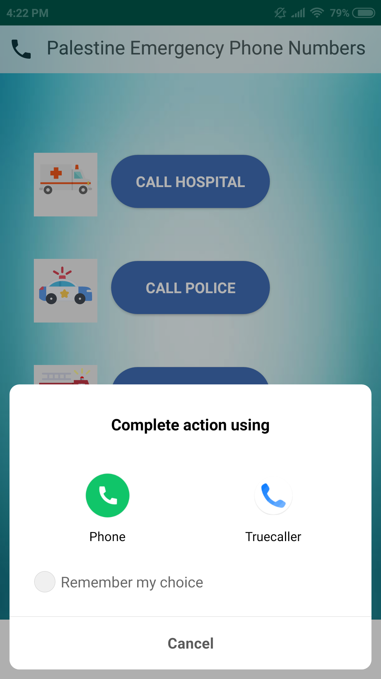
6. Help Call:
Palestine’s emergency phones numbers.
Open Contacts.

Slide 27
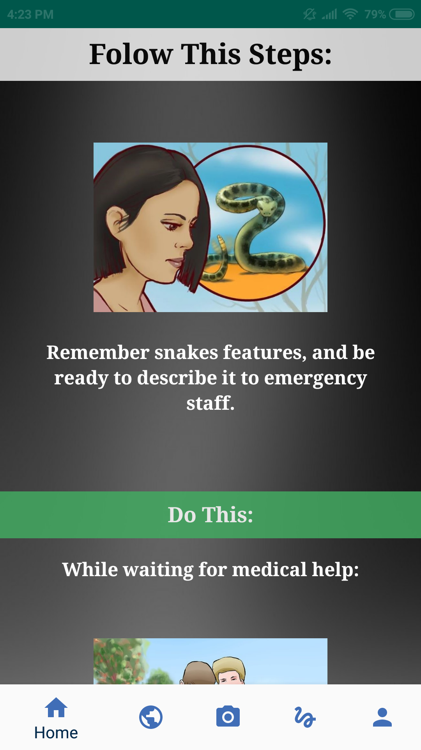
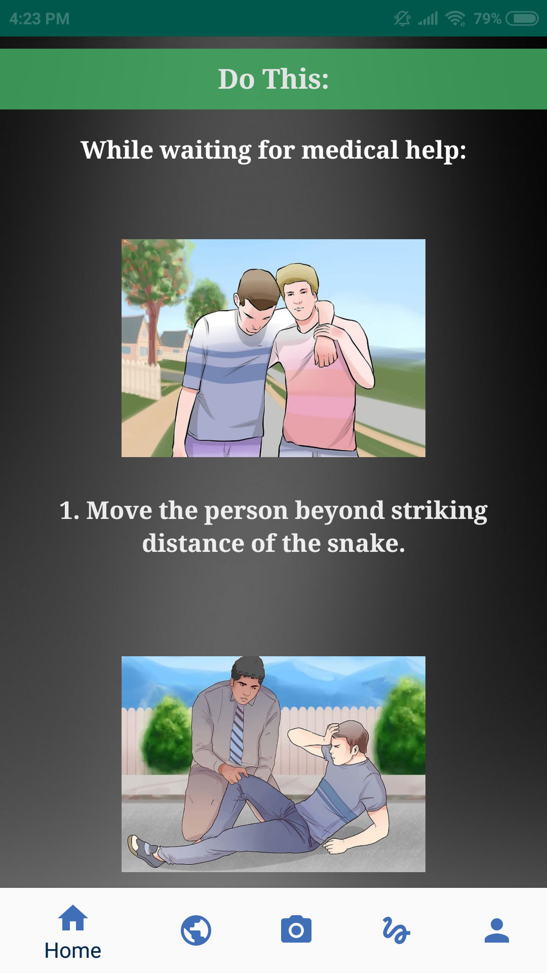
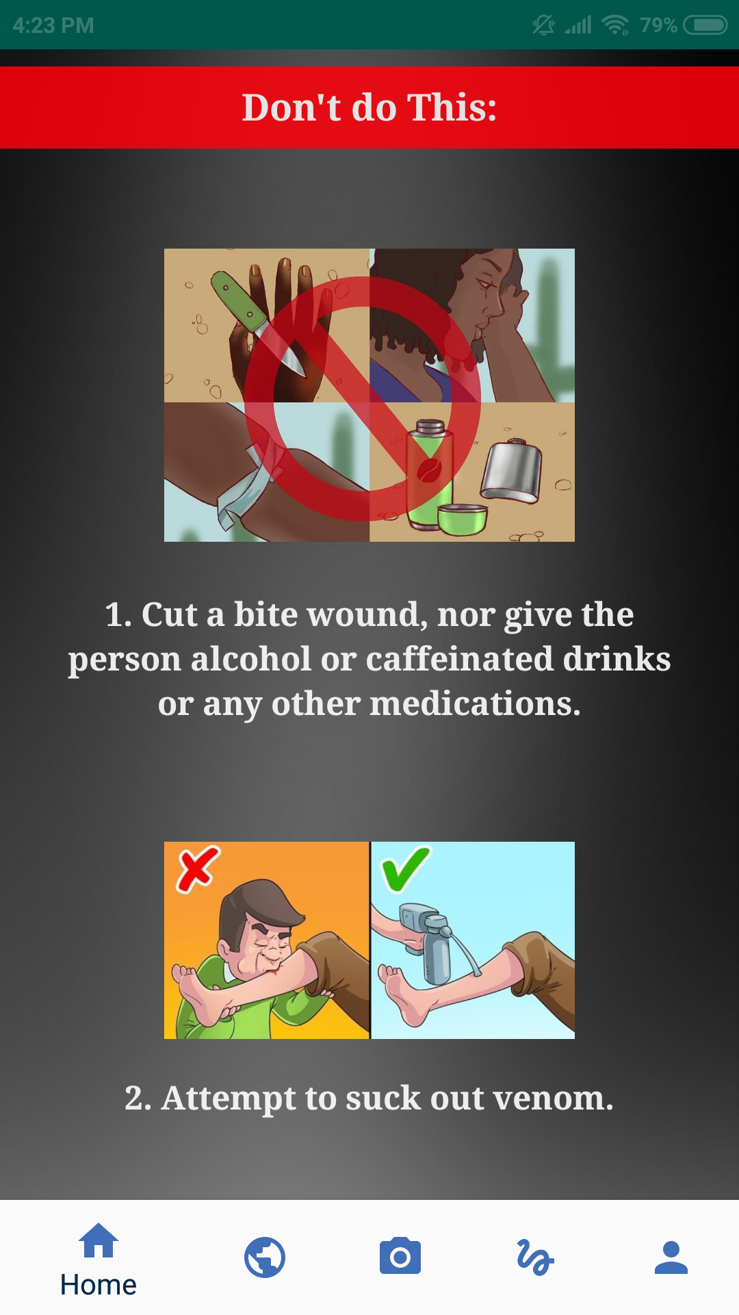
7. First Aid:
Guidelines.

Slide 28
8. Log Out:
Back to Log-In.

Slide 29
1. Android Studio.
2. TensorFlow (v1.12).
Tools:
3. Anaconda.
4. CUDA Tool Kit (v9).
5. CuDNN (v7).
6. NVIDIA Driver.
7. LabelImg.
8. PyCharm.
9. XAMPP.

Slide 30

1. Android Studio:
Develop the App.

Slide 31

2. TensorFlow (v1.12:
open source machine learning framework.

Slide 32

3. Anaconda:
An open source PYTHON distribution, we used it as an environment for TensorFlow that uses PYTHON 3.6v

Slide 33

4. CUDA Tool Kit (v9):
NVIDIA CUDA Deep Neural Network library (cuDNN).

Slide 34
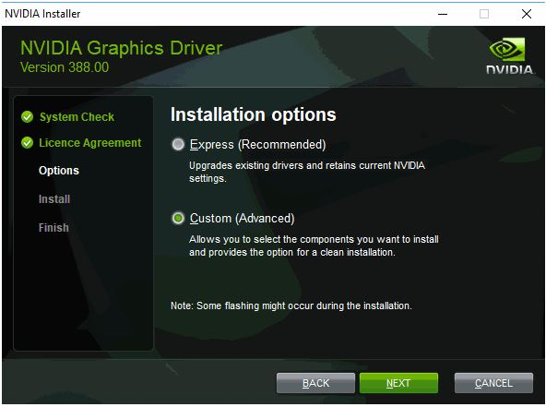
6. NVIDIA Driver:
Update GPU driver.

Slide 35
7. Label-Img:
An open source image labeling tool.

Slide 36

8. PyCharm:
Write PYTHON scripts.

Slide 37

9. XAMPP:
store users login and registration information.

Slide 38
Constraints:
1. Knowledge.
2. Time.
3. Resources

Slide 39
Future Work:
1. Developing an object detection classifier that can recognize all the snakes that lives in Palestine.
2. Adding the ability to recognize the snake by a live camera feature.
3. Developing the map, so it can presents the closest hospitals to the person by the GPS feature.

Slide 41
Questions:

