Slide 1

An-Najah National University
Computer Eng. Dpt.
EPH emergency pharmacy
finder
By: Ashwaq Zaid
Reema Abubaker
Supervised by:
Dr. Luai Malhis

Slide 2
Outline:
Introduction to EPF
EPF functionality
EPF features
Main components and tools
Limitations and future work
Notes:
////////////////////////////////////////////////////////////////////////////////////////////////
Now I will go quickly on the main points we will cover during our presentation , first we will explain the main idea of our project and who are the targeted group then we will explain the steps we followed to build the software , afterthat we will explain the main features and then we will go more technical and explain the main components and their functionalities

Slide 3

Introduction
EPF is a mobile application exclusively dedicated to research of pharmacies and emergency services.

Slide 4
Introduction(Contd…)
Nowadays, the number of people possessing and using Smartphone's increases rapidly, while their interest for mobile applications that enable the storage, analysis and visualization of the collected space time information is apparent.

Slide 5
Introduction(Contd…)
These details provide people an opportunity to find any pharmacy they wants, display it is location on a map and offer first aid quickly when need it.

Slide 6
Introduction(Contd…)
On other hands, it helps syndicates to do any updates and communicates with others easily without any significant efforts.

Slide 7
Functionality
Pharmacy Finder
First Aid
Notification
Update any changing occurs on any pharmacy
Notes:
We have focused in our project to give a simple representation for number of services:
1- pharmacy finder
2- First Aid
3- notification
4- update changing occurs on any pharmacy.
Now lets show how we can obtain these services using EPF

Slide 8
EPF
sequence diagram

Slide 9
Emergency and pharmacy Finder
Choose City
List of Pharmacies

Slide 10
Show pharmacies
Satellites view

Slide 11
First aid services
First Aid Kit
Medical advice

Slide 12
First Aid Guide
Description of the disease
Disease treatment steps

Slide 13
Notification

Slide 14
pharmacies syndicate
Syndicates must login with active accounts to have permission for add, delete and modify any changing occurs about any pharmacy.
Notes:
Now, we will talk about services that offer to pharmacies syndicate. In addition to users and pharmacies services, syndicates must login with active accounts to have permission for add, delete and modify any changing occurs about any pharmacy

Slide 15
Pharmacy Syndicate
Login page
Pharmacy Syndicate Controls

Slide 16
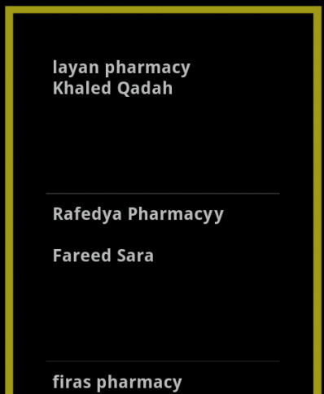
add new pharmacy to list

Slide 17
Most Features of EPF
Easy to use.
Offer several helpful services.
Automatic database updates.
Very useful for syndicates.

Slide 18


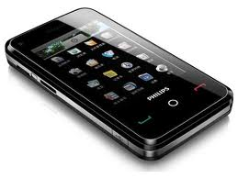

EPF features:
1-Easy to use

Slide 19

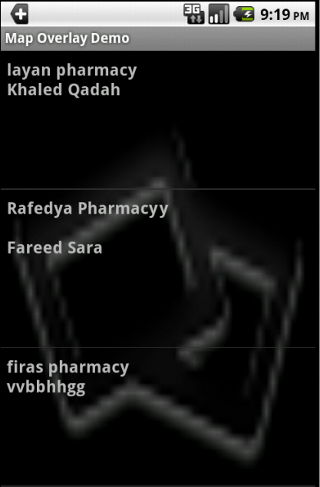
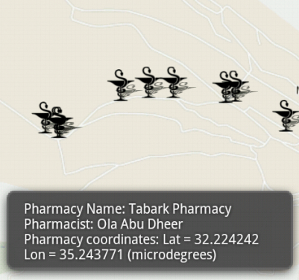
2- EPF services :
.Quickly finder and view information

Slide 20
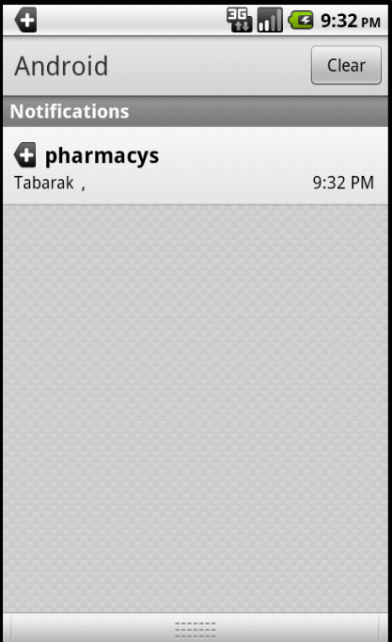
. Notification
Notify users about pharmacies on duty.

Slide 21
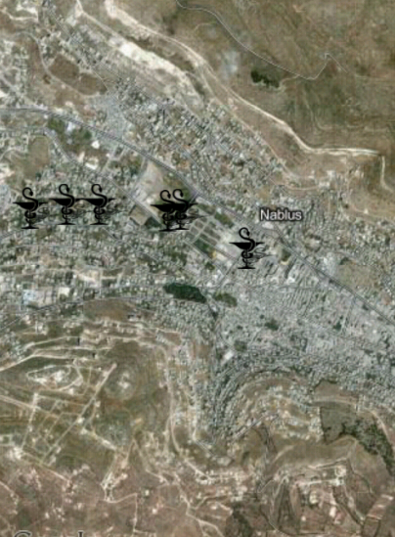
.Direct communication

Slide 22


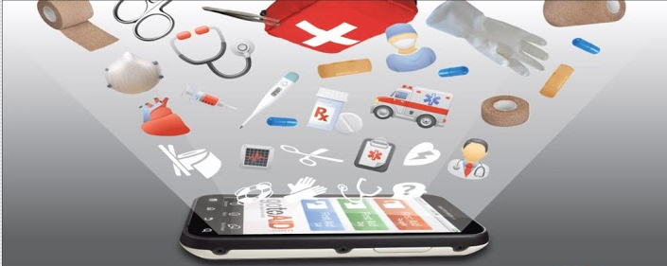
.First aid guidance

Slide 23


3- Automatic database updates

Slide 24




4- useful for syndicates
Login

Slide 25
Main Components and Tools

Slide 26

Eclipse IDE for Java EE Developers
SDK version 2.2 (API 8)
Google Maps API key
Notes:
The IDE(integrated development environment) is eclipse IDE for Java EE Developers.
the SDK version 2.2 level 8 (API 8) [7], that our Smartphone support it.
The Android SDK contains a debugger, libraries, an emulator

Slide 27
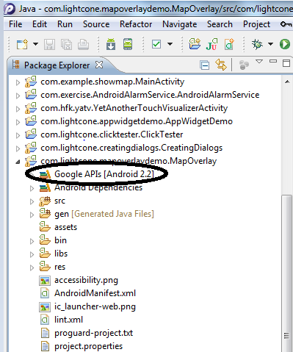
com.google.android.maps
Google Maps library.

Slide 28
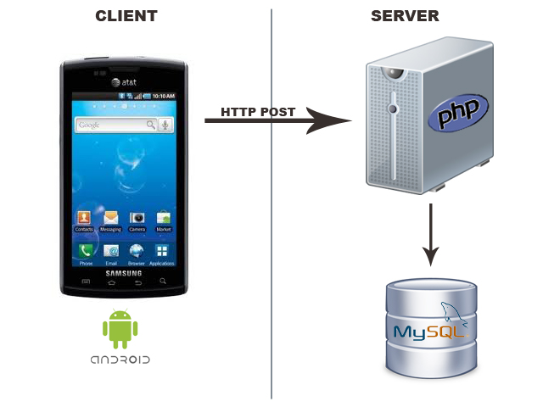

Smartphone and PHP server
Notes:
Request sent by the mobile App to PHP server then PHP script perform data operation (add, update, delete)

Slide 29
Limitations
EPF need the internet to be able to offer the services and display the map.
There is no clear maps for Palestine on Google Maps.

Slide 30
Future work
Route Tracker: to record a track and visualize it in real time on a map.
the user can choose the location that you want to go , and the current location reads by the GPS , then the route tracker is drawn on the map.
Ask a Doctor: "Ask a Doctor" enables you to ask personalized health questions and get quick answers and advice by simply tapping a button on your phone

Slide 31
Online demo

