Slide 1



Supervised by:
Dr.Ahmad Shraideh
Made by:
Dana Najjar
Raneen Samare
Sadeen Hmouda

Slide 2




Main Problem
Overwhelming
Lost
Confuse

Slide 3




Our Goal
Train Track
Clear Trusted Path

Slide 4
The Fast Track to Your Perfect Internship.

Slide 5

Business Model Canvas

Slide 6
Customer Segments
  University students
  Graduating students
  Universities aiming to improve internship placements
Business Model Canvas

Slide 7
Customer Segments
  University students
  Graduating students
  Universities aiming to improve internship placements
Business Model Canvas
Value Propositions
  Personalized internship recommendations
  Smart Recommendation system that matches companies prerequisite
  Easy-to-use wizard-based interface
  Guest mode + Google login for flexibility
  Exportable PDF reports for users
Cost Structure
  Scalable hosting (e.g. Render upgrades)
  ·Security & data compliance
  Marketing to attract universities & companies
  Support & maintenance

Slide 8
Customer Segments
Channels
Key Resources
Key Partnerships
  University students
  Graduating students
  Universities aiming to improve internship placements
  Web platform
  Recommendation system with smart matching logic
  Centralized internship database (MySQL)
  Flask backend with clean API endpoints
  Frontend using Laravel Blade (HTML/CSS/JS)
  Hosting on Render and Railway
  GitHub for version control and teamwork
  University faculties (CS, MIS, CE, etc.)
  Local companies & startups offering internships data
  Recruiter , Tech advisors and mentors (like Dr. Ahmad Shraideh😄)
  GitHub , Railway and Render for deployment tools
Business Model Canvas
Value Propositions
  Personalized internship recommendations
  Smart Recommendation system that matches companies prerequisite
  Easy-to-use wizard-based interface
  Guest mode + Google login for flexibility
  Exportable PDF reports for users
Key Activities
Cost Structure
  Matching algorithm development & testing
  Collecting real data from companies
  Frontend design and UX optimization
  Maintaining backend APIs
  Continuous user feedback to develop the demo
  Scalable hosting (e.g. Render upgrades)
  ·Security & data compliance
  Marketing to attract universities & companies
  Support & maintenance

Slide 9
Customer Segments
Channels
Key Resources
Key Partnerships
  University students
  Graduating students
  Universities aiming to improve internship placements
  Web platform
  Recommendation system with smart matching logic
  Centralized internship database (MySQL)
  Flask backend with clean API endpoints
  Frontend using Laravel Blade (HTML/CSS/JS)
  Hosting on Render and Railway
  GitHub for version control and teamwork
  University faculties (CS, MIS, CE, etc.)
  Local companies & startups offering internships data
  Recruiter , Tech advisors and mentors (like Dr. Ahmad Shraideh😄)
  GitHub , Railway and Render for deployment tools
Customer Relationships
Business Model Canvas
  Self-service via wizard interface
  Help popups & guided steps
  Optional login to save progress
Value Propositions
  Personalized internship recommendations
  Smart Recommendation system that matches companies prerequisite
  Easy-to-use wizard-based interface
  Guest mode + Google login for flexibility
  Exportable PDF reports for users
Key Activities
Cost Structure
  Matching algorithm development & testing
  Collecting real data from companies
  Frontend design and UX optimization
  Maintaining backend APIs
  Continuous user feedback to develop the demo
  Scalable hosting (e.g. Render upgrades)
  ·Security & data compliance
  Marketing to attract universities & companies
  Support & maintenance

Slide 10
Customer Segments
Channels
Key Resources
Key Partnerships
  University students
  Graduating students
  Universities aiming to improve internship placements
  Web platform
  Recommendation system with smart matching logic
  Centralized internship database (MySQL)
  Flask backend with clean API endpoints
  Frontend using Laravel Blade (HTML/CSS/JS)
  Hosting on Render and Railway
  GitHub for version control and teamwork
  University faculties (CS, MIS, CE, etc.)
  Local companies & startups offering internships data
  Recruiter , Tech advisors and mentors (like Dr. Ahmad Shraideh😄)
  GitHub , Railway and Render for deployment tools
Customer Relationships
Business Model Canvas
  Self-service via wizard interface
  Help popups & guided steps
  Optional login to save progress
Value Propositions
  Personalized internship recommendations
  Smart Recommendation system that matches companies prerequisite
  Easy-to-use wizard-based interface
  Guest mode + Google login for flexibility
  Exportable PDF reports for users
Revenue Streams
Cost Structure
  Free for students
  Subscription model for universities to track student placements
  Tiered plans for companies to post training offers
  Custom reports or dashboards as paid features
  Scalable hosting (e.g. Render upgrades)
  ·Security & data compliance
  Marketing to attract universities & companies
  Support & maintenance

Slide 11
Customer Segments
Channels
Key Resources
  University students
  Graduating students
  Universities aiming to improve internship placements
  Web platform
  Recommendation system with smart matching logic
  Centralized internship database (MySQL)
  Flask backend with clean API endpoints
  Frontend using Laravel Blade (HTML/CSS/JS)
  Hosting on Render and Railway
  GitHub for version control and teamwork
  3M Visual Attention Software
Customer Relationships
Business Model Canvas
  Self-service via wizard interface
  Help popups & guided steps
  Optional login to save progress
Value Propositions
  Personalized internship recommendations
  Smart Recommendation system that matches companies prerequisite
  Easy-to-use wizard-based interface
  Guest mode + Google login for flexibility
  Exportable PDF reports for users
Revenue Streams
  Free for students
  Subscription model for universities to track student placements
  Tiered plans for companies to post training offers
  Custom reports or dashboards as paid features

Slide 12
Customer Segments
Channels
Key Resources
  University students
  Graduating students
  Universities aiming to improve internship placements
  Web platform
  Recommendation system with smart matching logic
  Centralized internship database (MySQL)
  Flask backend with clean API endpoints
  Frontend using Laravel Blade (HTML/CSS/JS)
  Hosting on Render and Railway
  GitHub for version control and teamwork
Customer Relationships
Business Model Canvas
  Self-service via wizard interface
  Help popups & guided steps
  Optional login to save progress
Value Propositions
  Personalized internship recommendations
  Smart Recommendation system that matches companies prerequisite
  Easy-to-use wizard-based interface
  Guest mode + Google login for flexibility
  Exportable PDF reports for users
Revenue Streams
Key Activities
  Free for students
  Subscription model for universities to track student placements
  Tiered plans for companies to post training offers
  Custom reports or dashboards as paid features
  Matching algorithm development & testing
  Collecting real data from companies
  Frontend design and UX optimization
  Maintaining backend APIs
  Continuous user feedback to develop the demo

Slide 13
Customer Segments
Channels
Key Resources
Key Partnerships
  University students
  Graduating students
  Universities aiming to improve internship placements
  Web platform
  Recommendation system with smart matching logic
  Centralized internship database (MySQL)
  Flask backend with clean API endpoints
  Frontend using Laravel Blade (HTML/CSS/JS)
  Hosting on Render and Railway
  GitHub for version control and teamwork
  University faculties (CS, MIS, CE, etc.)
  Local companies & startups offering internships data
  Recruiter , Tech advisors and mentors (like Dr. Ahmad Shraideh😄)
  GitHub , Railway and Render for deployment tools
Customer Relationships
  Self-service via wizard interface
  Help popups & guided steps
  Optional login to save progress
Value Propositions
  Personalized internship recommendations
  Smart Recommendation system that matches companies prerequisite
  Easy-to-use wizard-based interface
  Guest mode + Google login for flexibility
  Exportable PDF reports for users
Revenue Streams
Key Activities
  Free for students
  Subscription model for universities to track student placements
  Tiered plans for companies to post training offers
  Custom reports or dashboards as paid features
  Matching algorithm development & testing
  Collecting real data from companies
  Frontend design and UX optimization
  Maintaining backend APIs
  Continuous user feedback to develop the demo

Slide 14
Customer Segments
Channels
Key Resources
Key Partnerships
  University students
  Graduating students
  Universities aiming to improve internship placements
  Web platform
  Recommendation system with smart matching logic
  Centralized internship database (MySQL)
  Flask backend with clean API endpoints
  Frontend using Laravel Blade (HTML/CSS/JS)
  Hosting on Render and Railway
  GitHub for version control and teamwork
  University faculties (CS, MIS, CE, etc.)
  Local companies & startups offering internships data
  mentors (like Dr. Ahmad Shraideh😄),Recruiter , and Tech advisors
  GitHub , Railway and Render for deployment tools
Customer Relationships
  Self-service via wizard interface
  Help popups & guided steps
  Optional login to save progress
Value Propositions
  Personalized internship recommendations
  Smart Recommendation system that matches companies prerequisite
  Easy-to-use wizard-based interface
  Guest mode + Google login for flexibility
  Exportable PDF reports for users
Revenue Streams
Key Activities
Cost Structure
  Free for students
  Subscription model for universities to track student placements
  Tiered plans for companies to post training offers
  Custom reports or dashboards as paid features
  Matching algorithm development & testing
  Collecting real data from companies
  Frontend design and UX optimization
  Maintaining backend APIs
  Continuous user feedback to develop the demo
  Scalable hosting (e.g. Render upgrades)
  ·Security & data compliance
  Marketing to attract universities & companies
  Support & maintenance

Slide 15
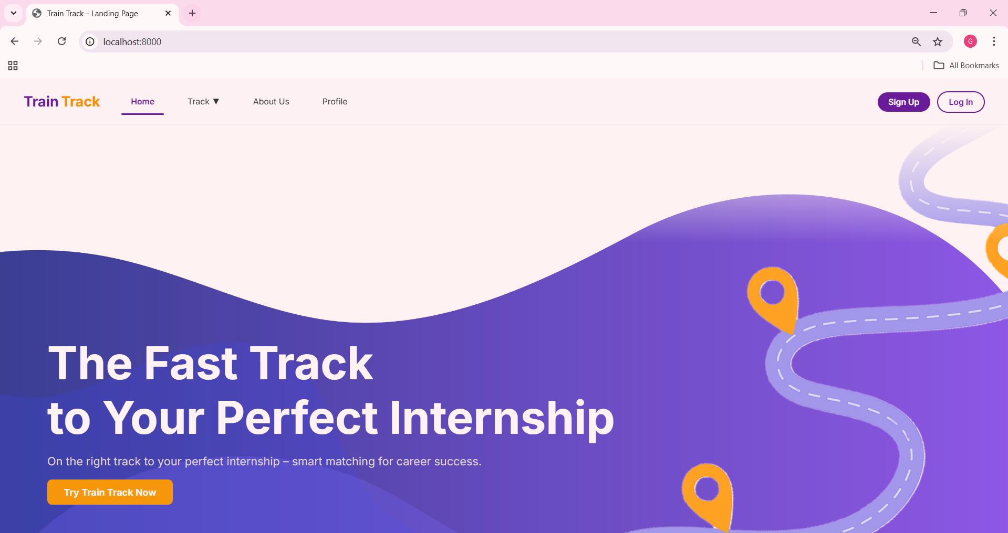

Slide 16
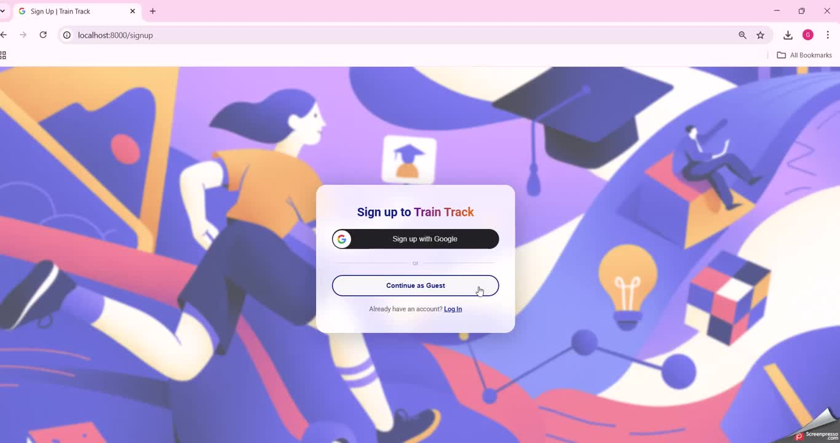

Slide 17
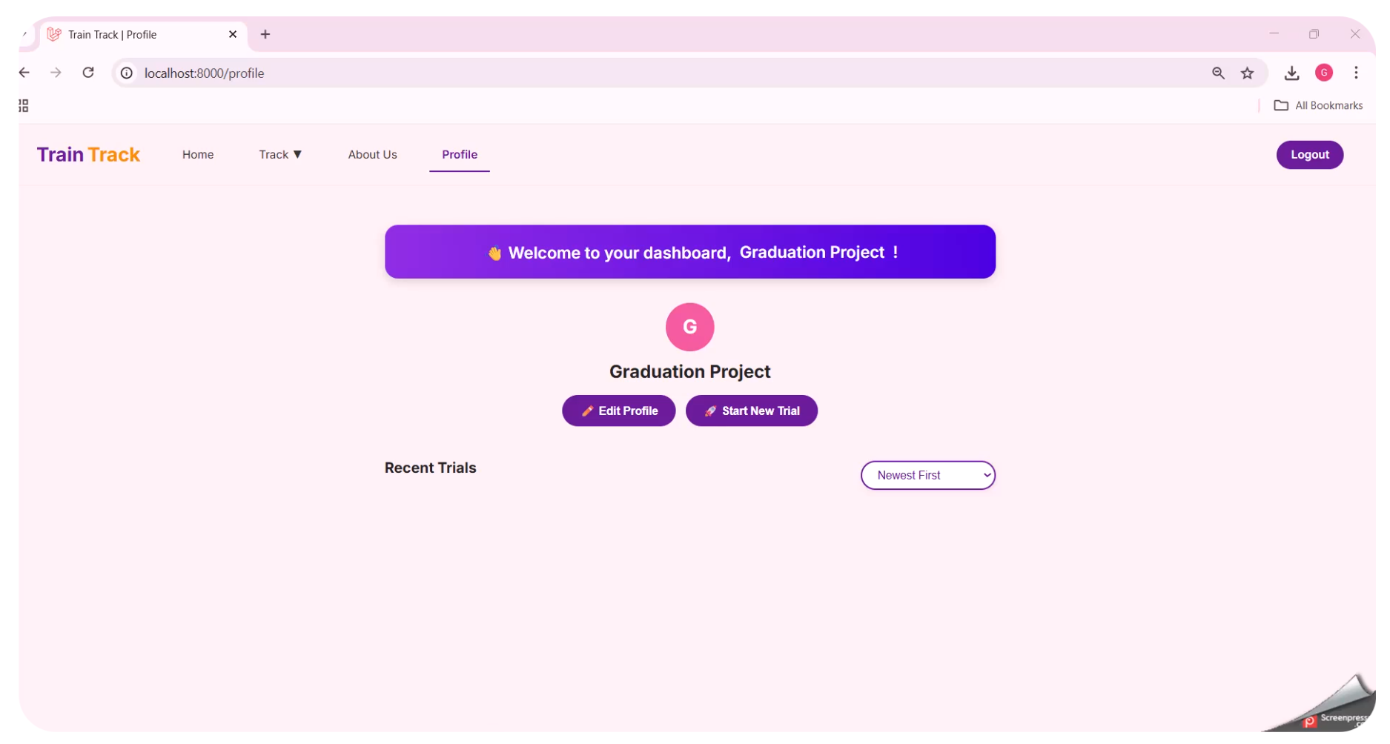


Slide 18

Let's start the journey !
Start
To
Finish

Slide 19
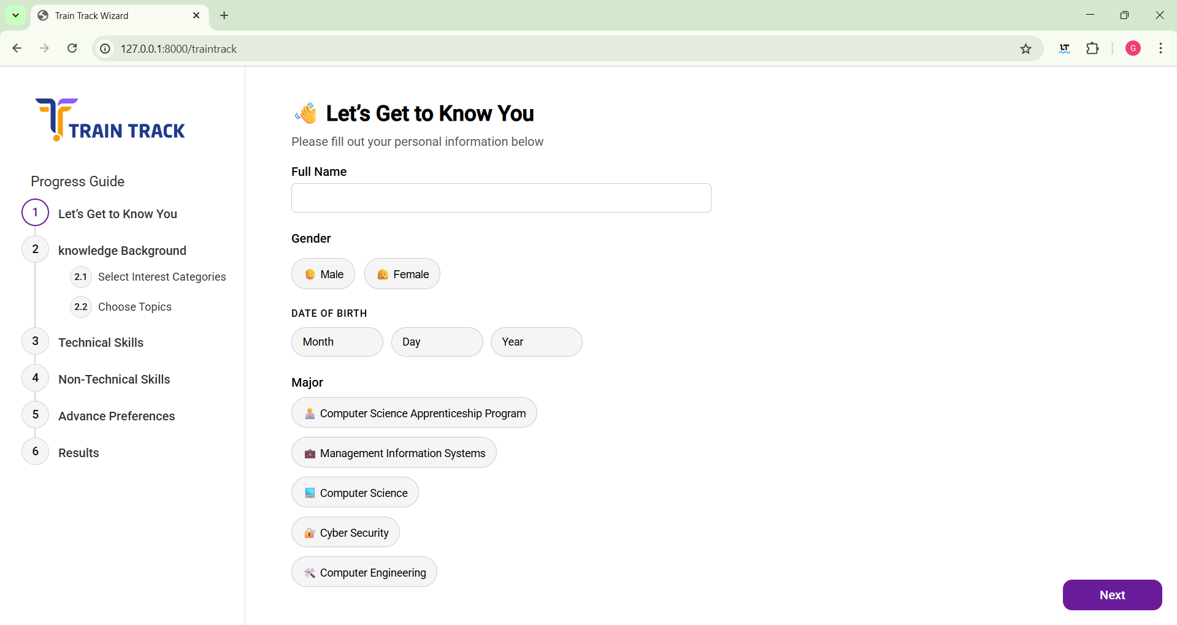

Slide 20


Slide 21
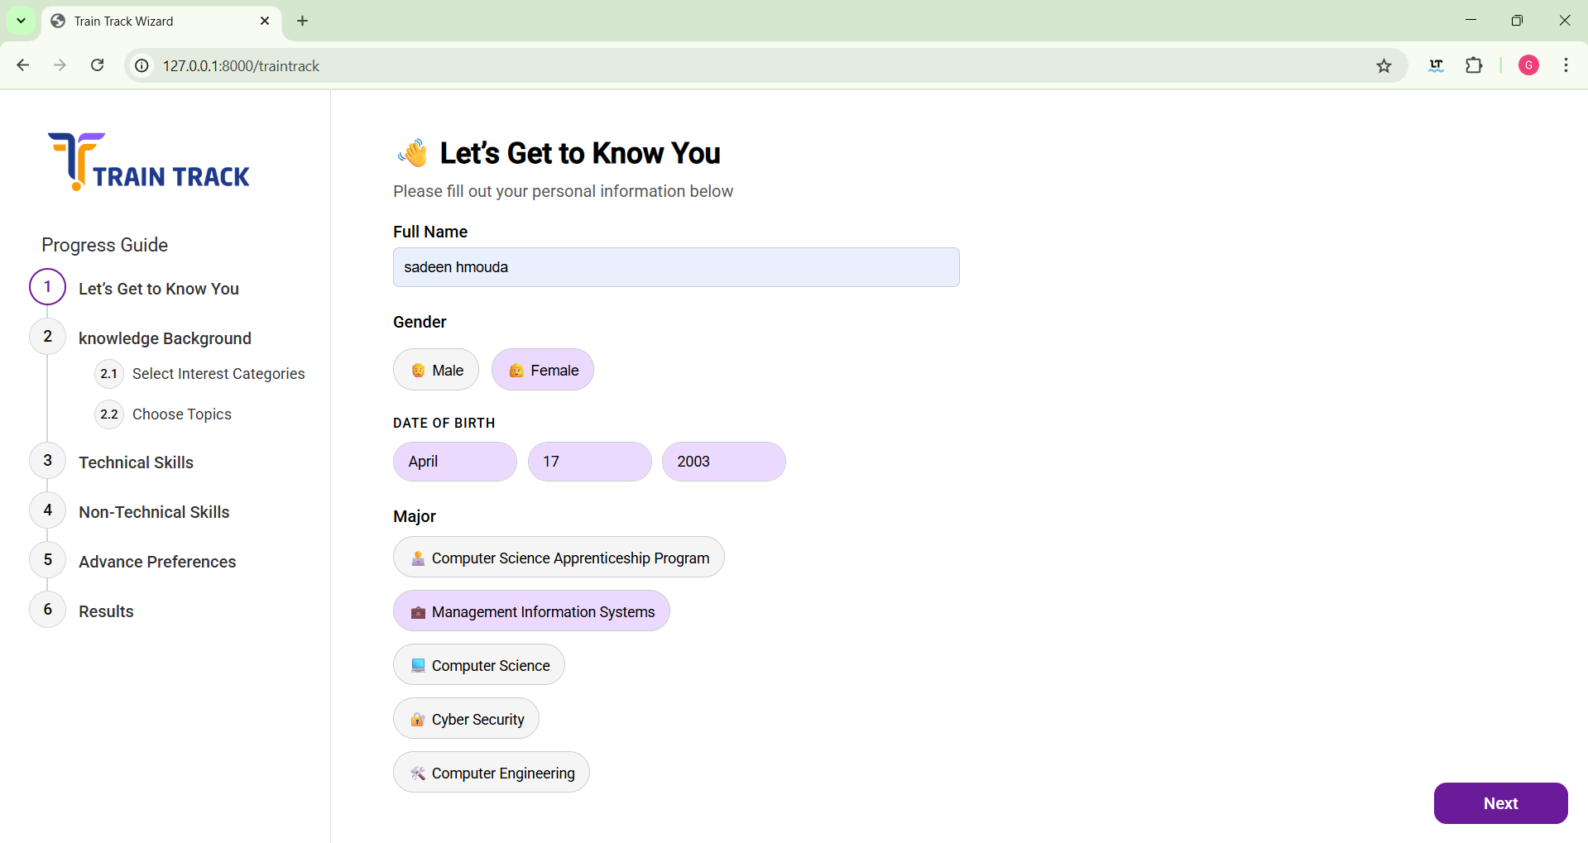

Slide 22

NOT Filled !

Slide 23
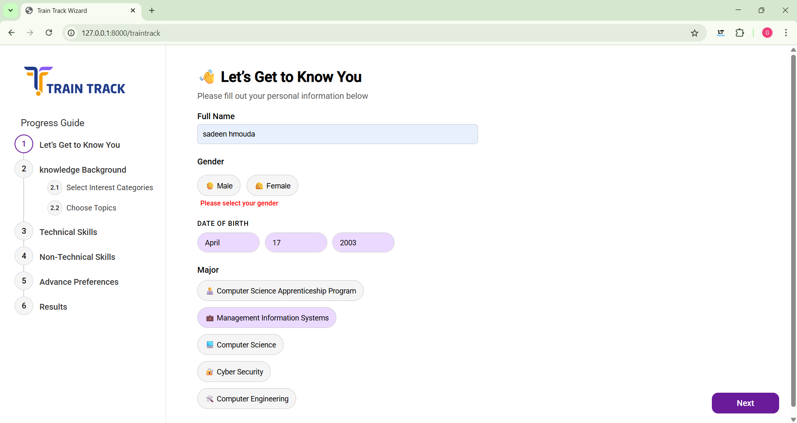

Slide 24


M
A
L
E
F
E
M
A
L
E
Gender

Slide 25
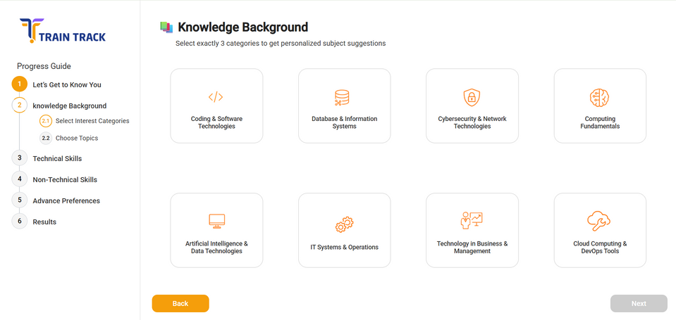
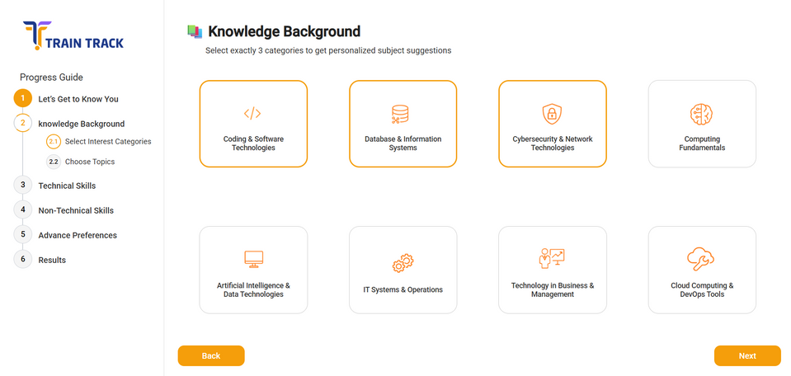
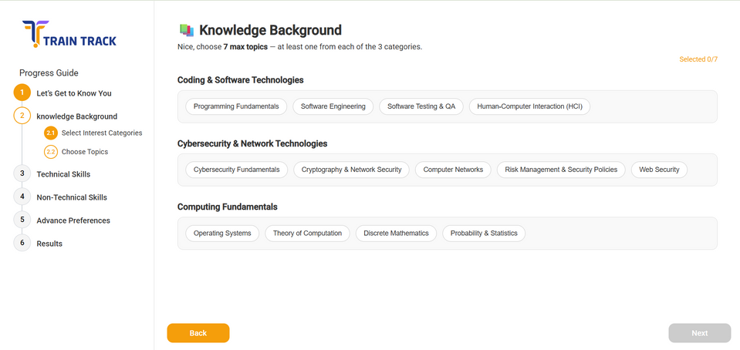
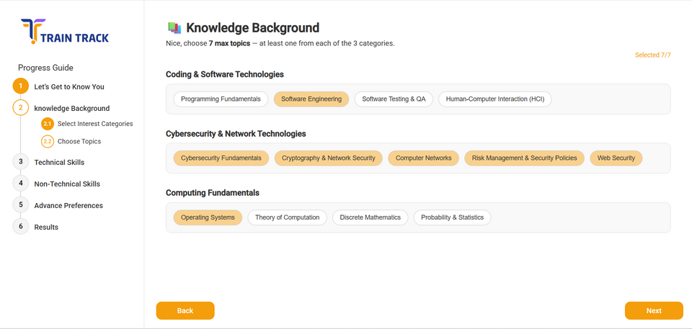
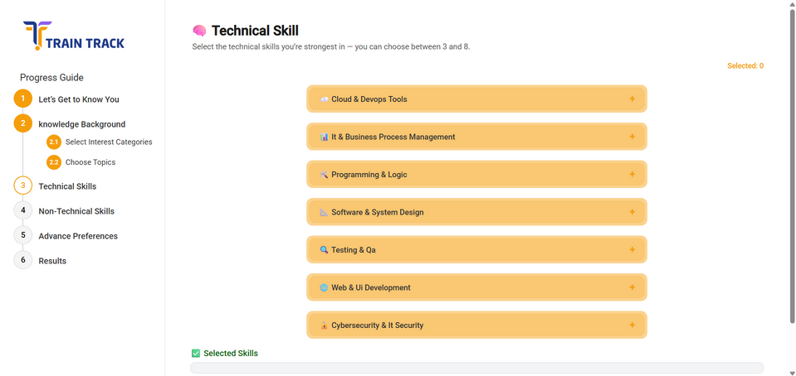
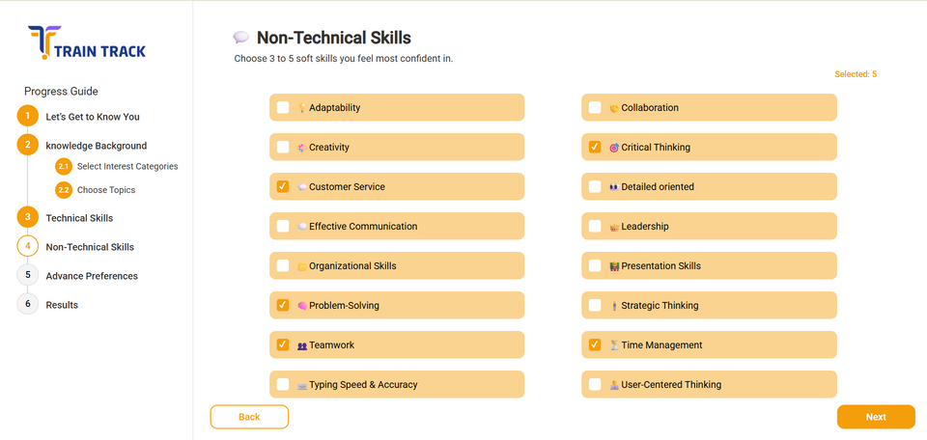
M
A
L
E

Slide 26
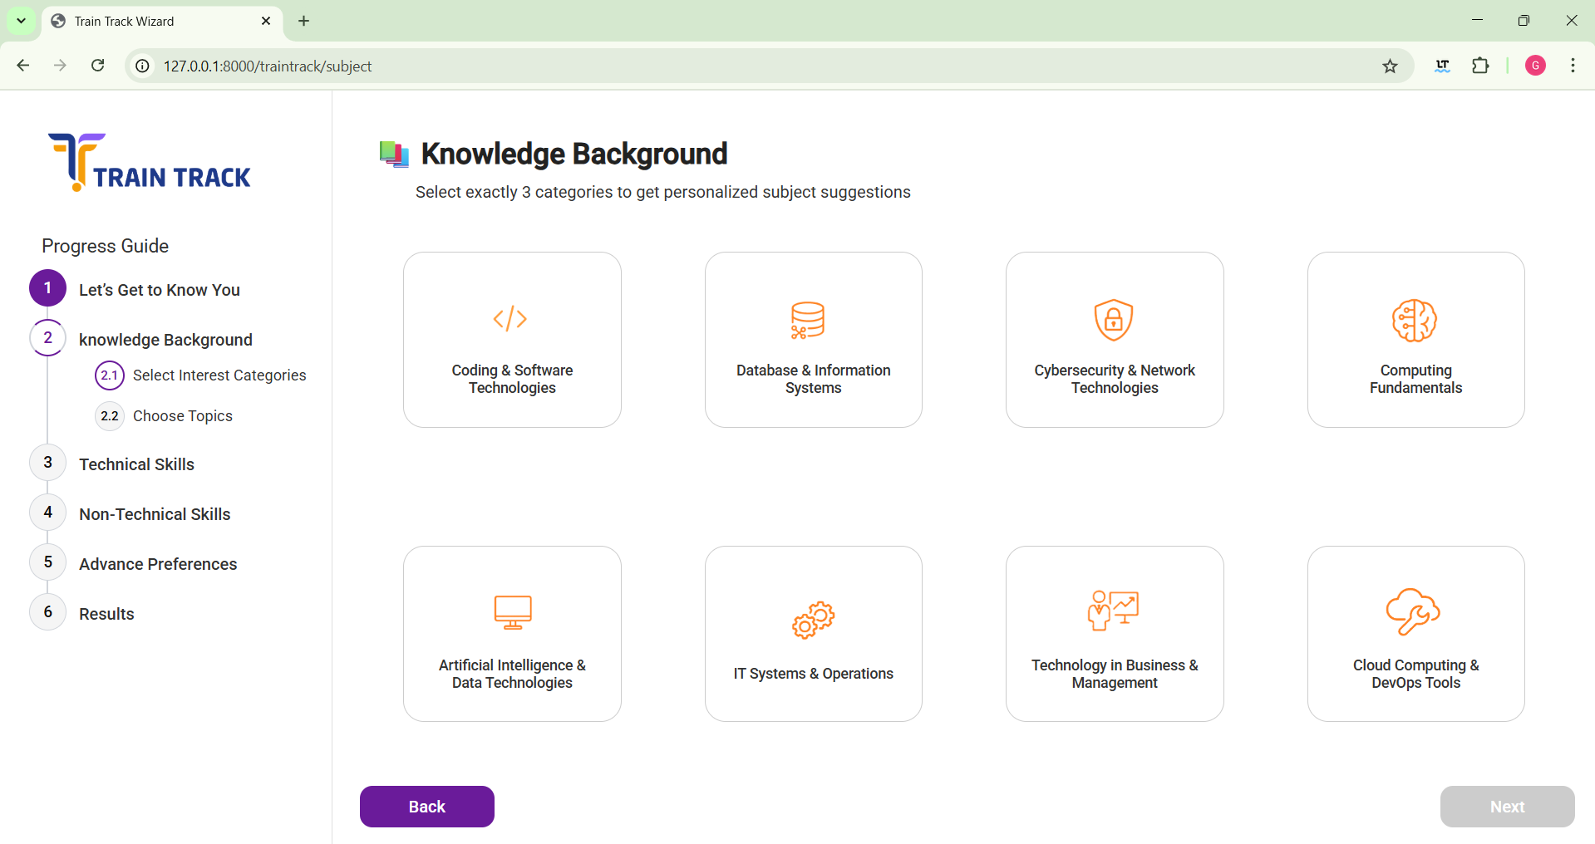
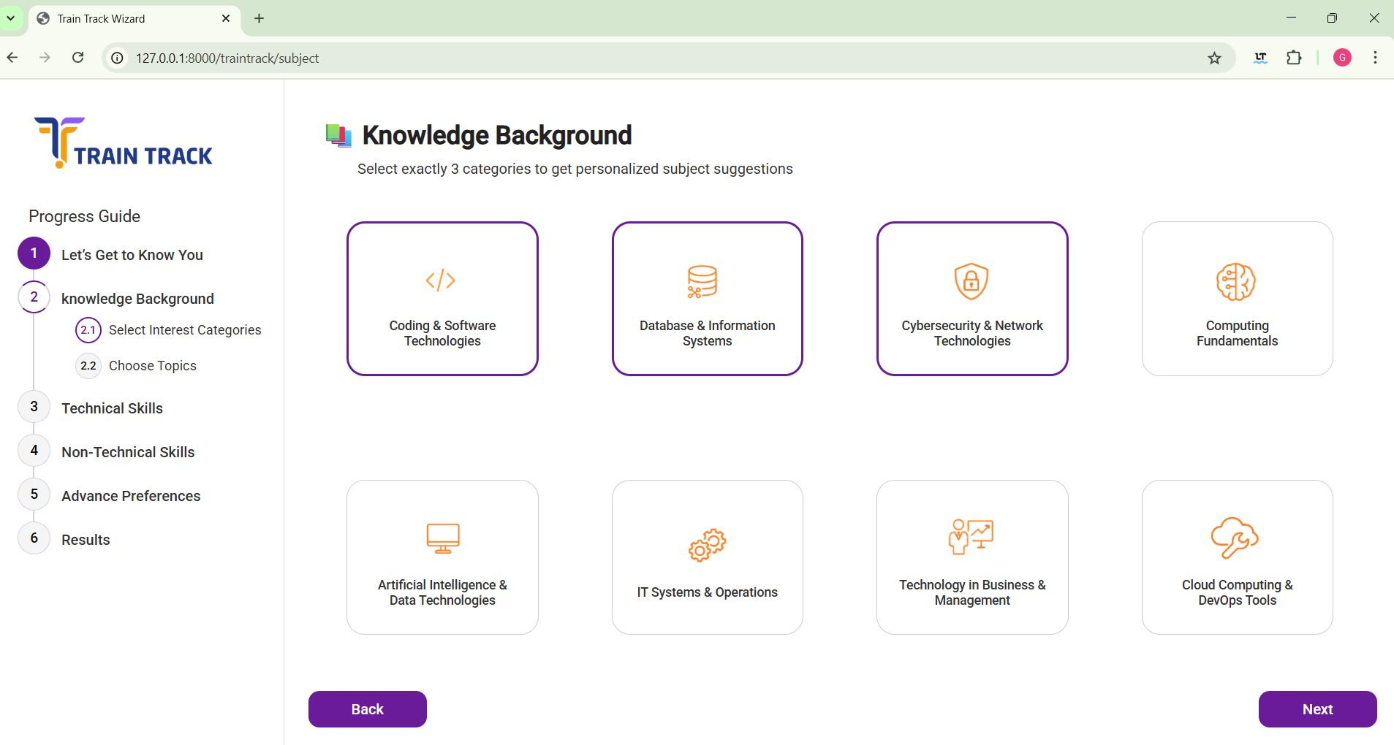
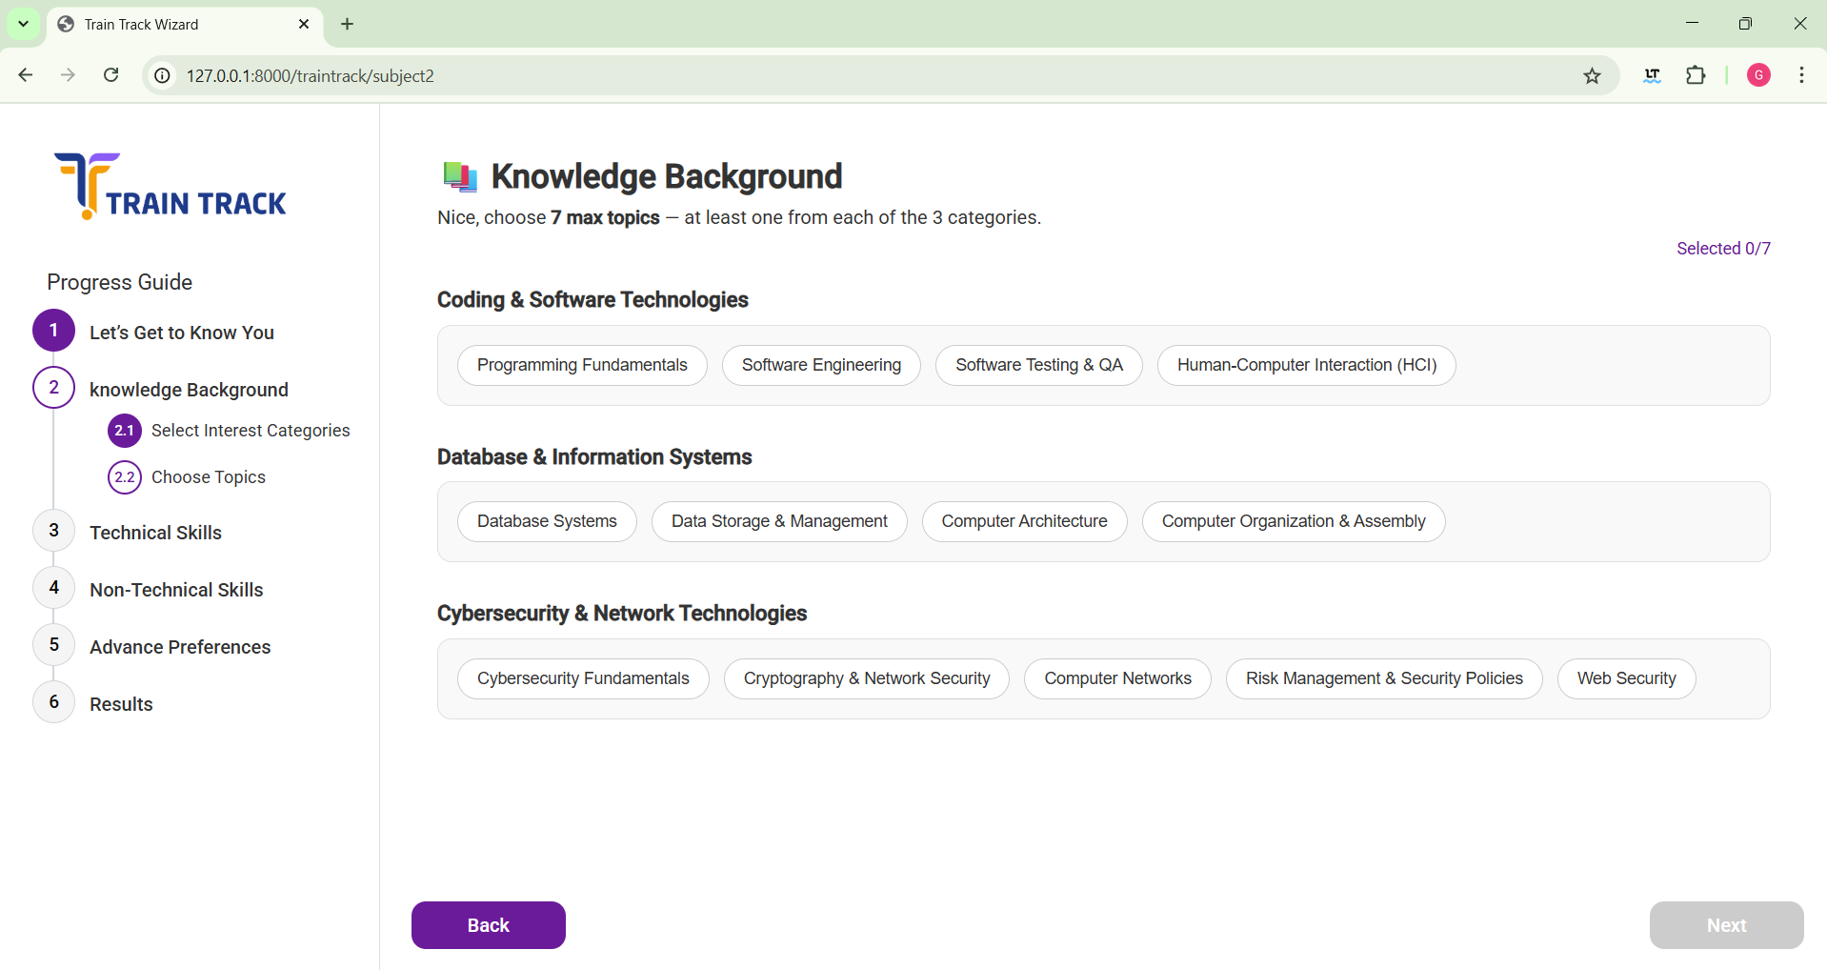
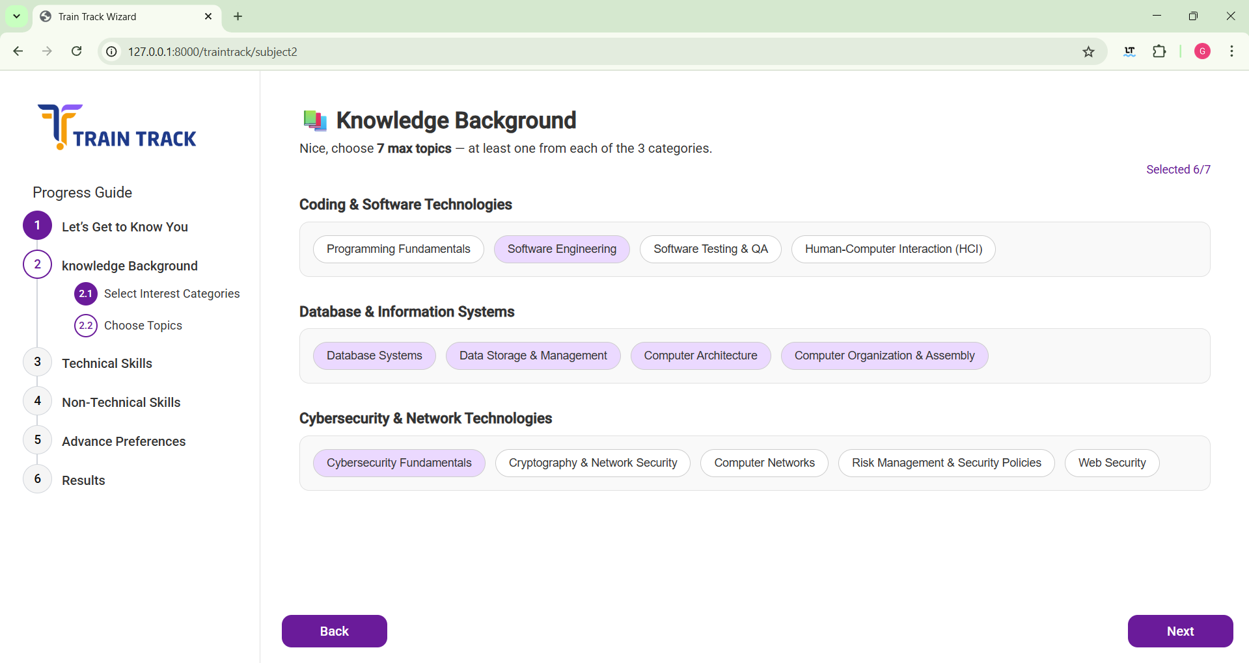
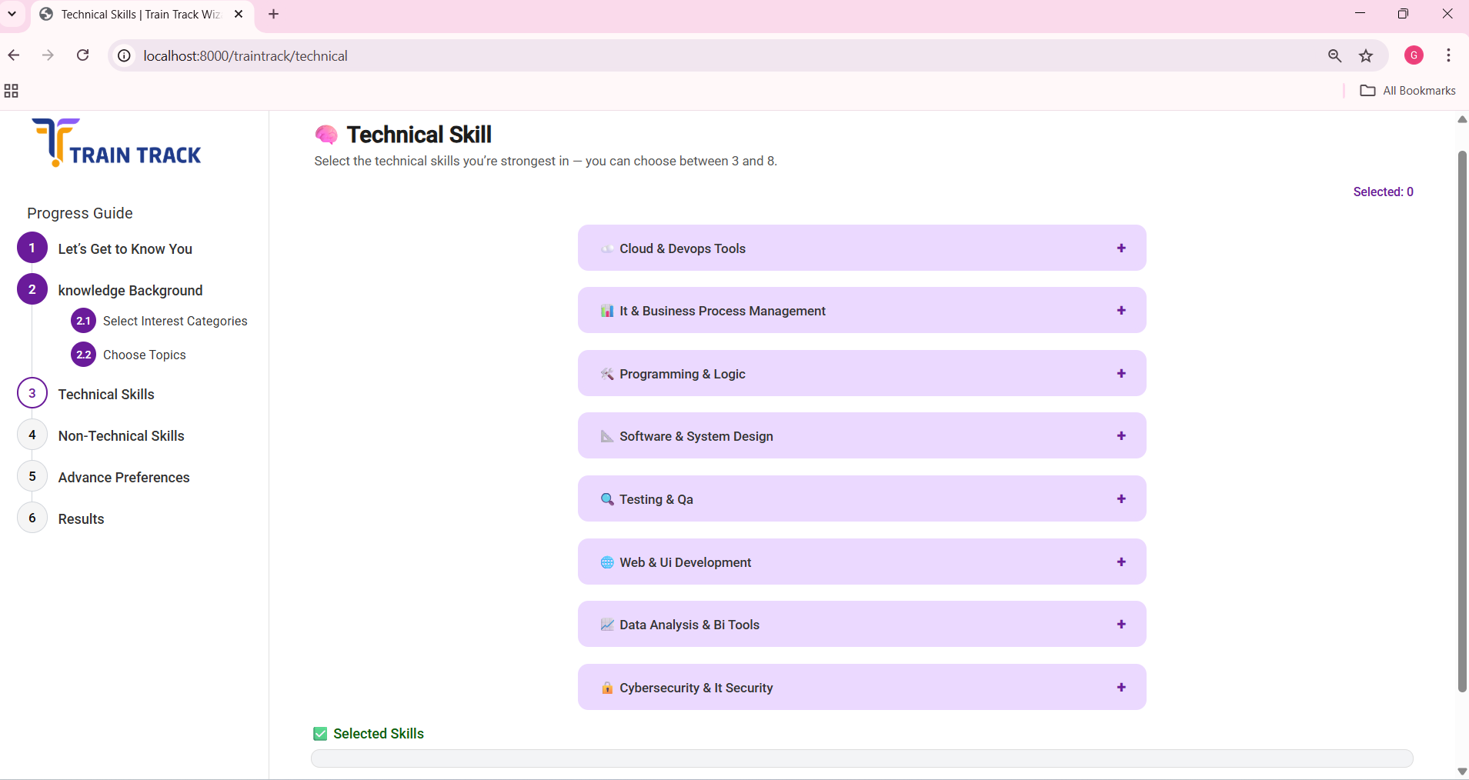
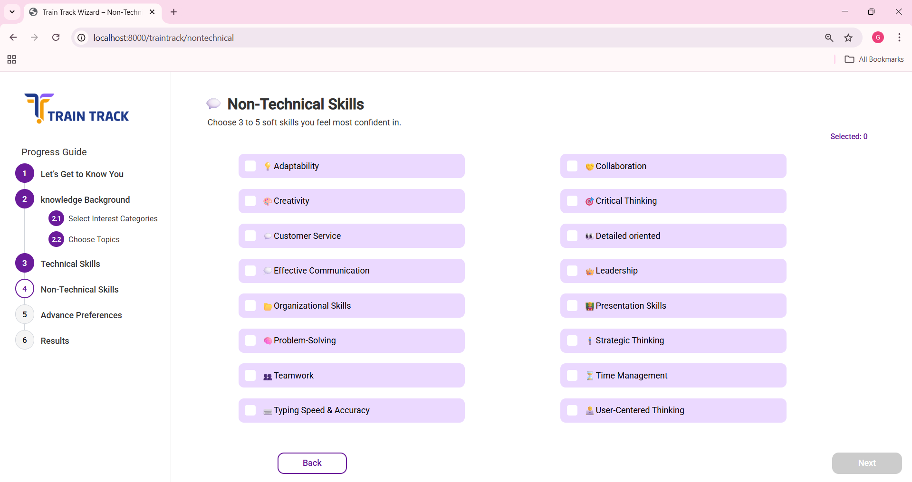
F
E
M
A
L
E

Slide 31
s

Slide 32
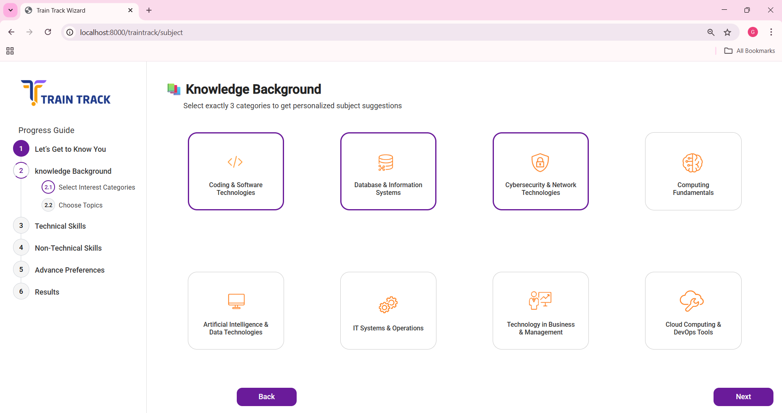


Slide 33
s

Slide 34
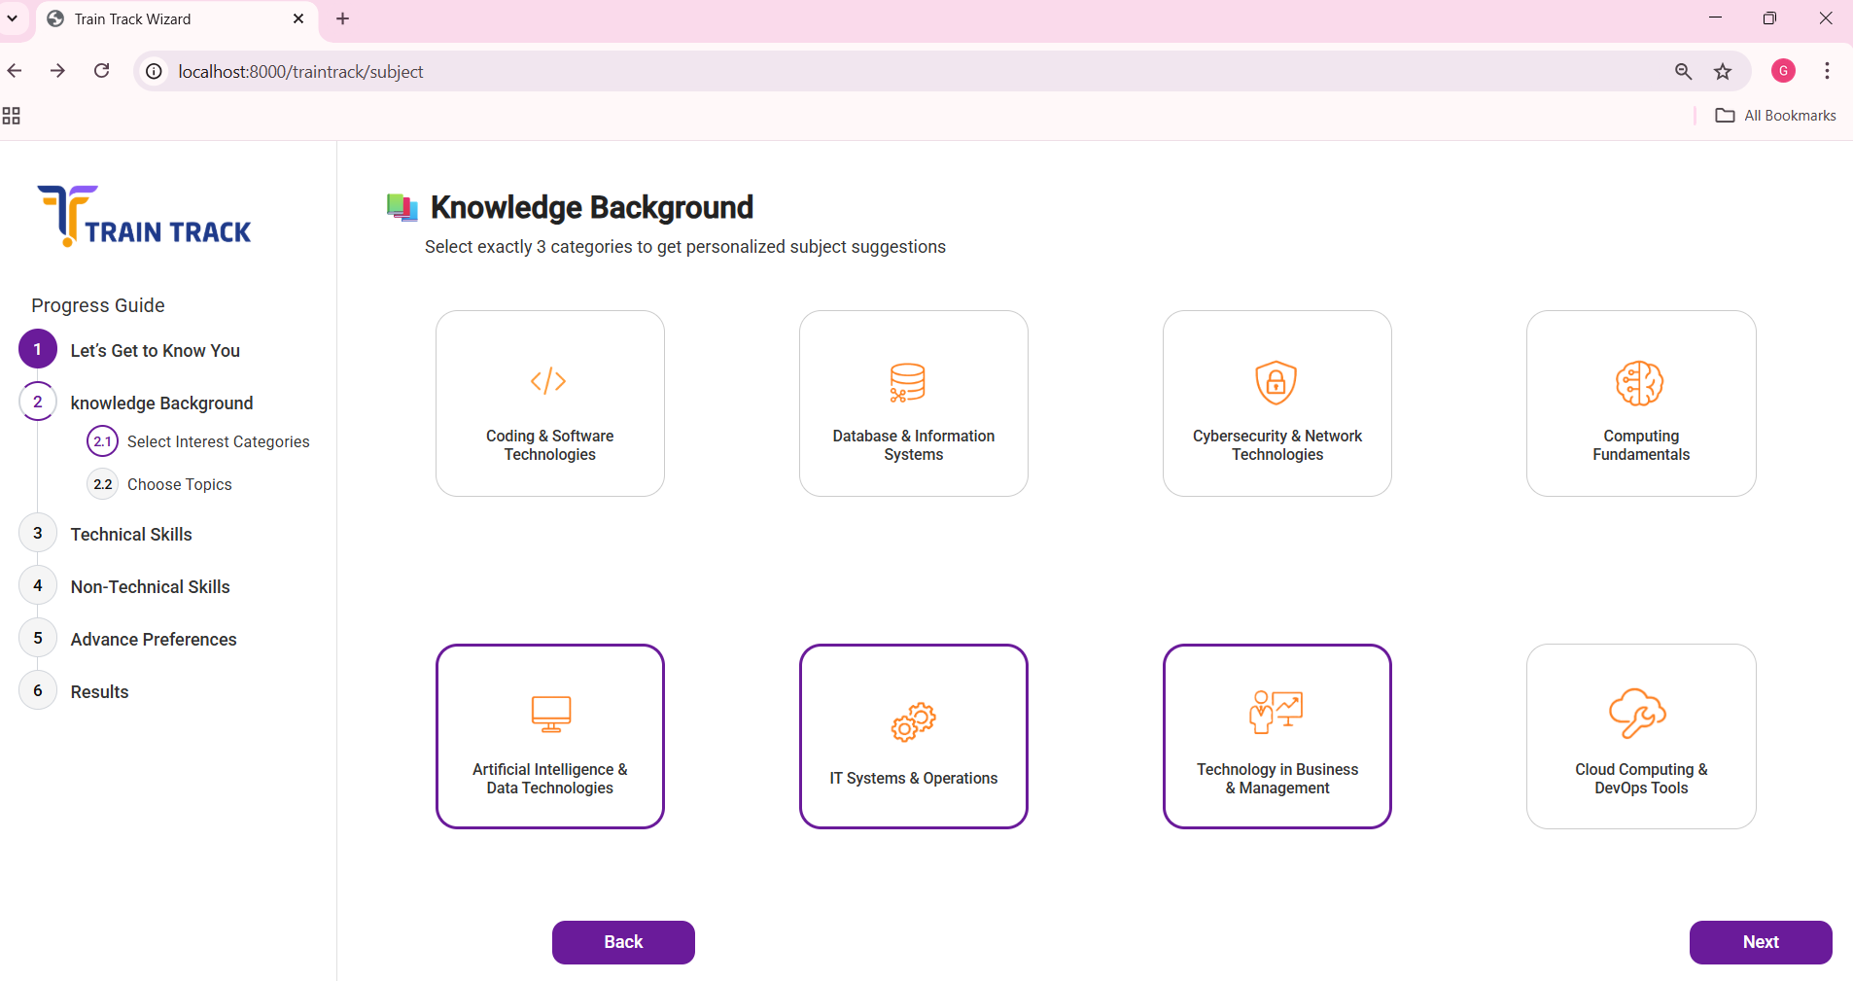

Slide 35
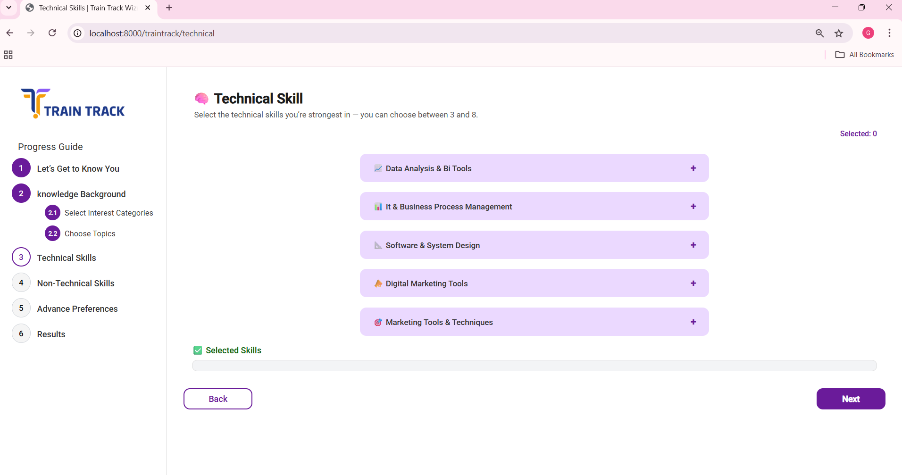
s

Slide 36
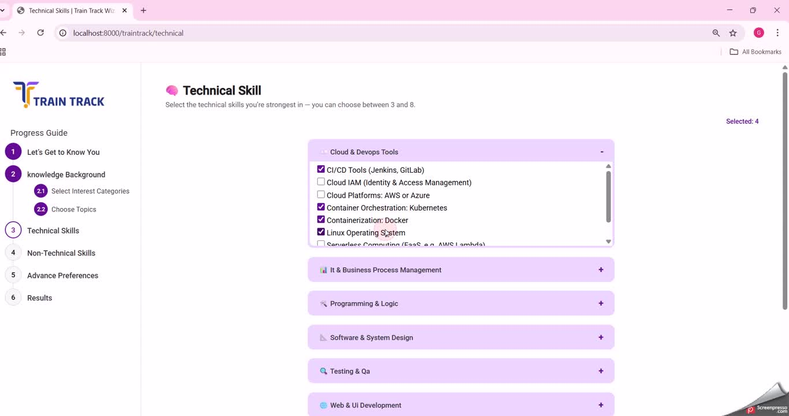

Slide 38
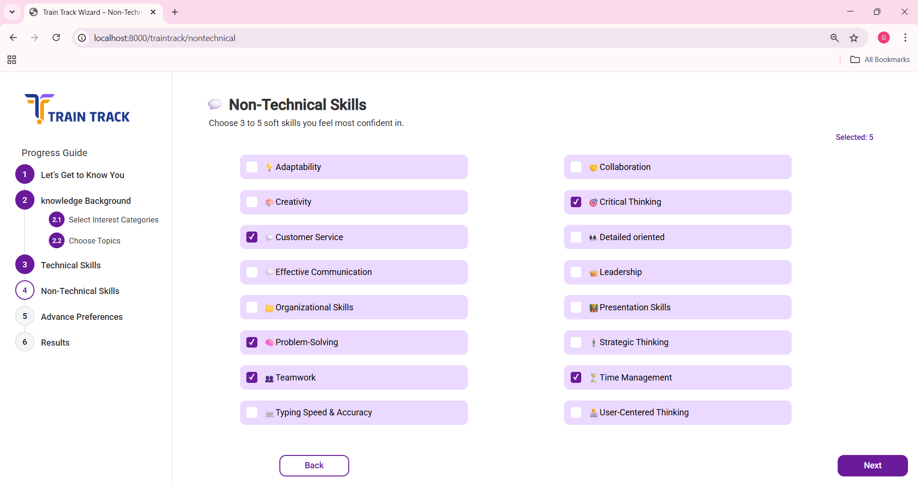

Slide 39
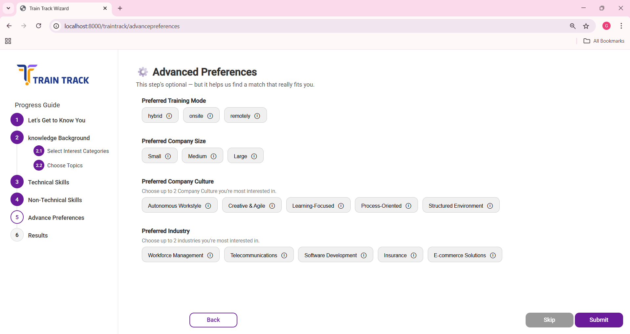

Slide 41
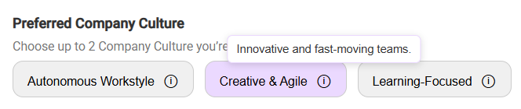


Hover Over Icon to View Details

Slide 42
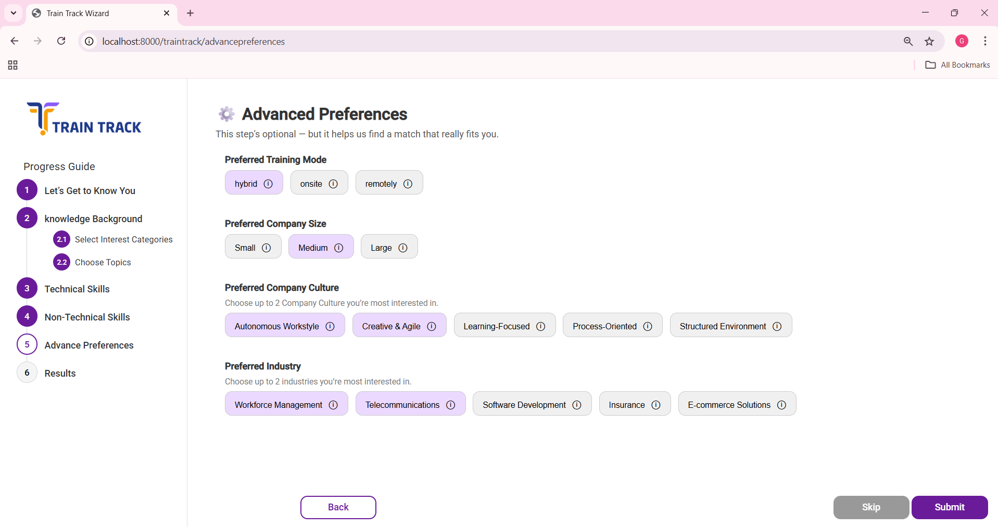

Slide 43
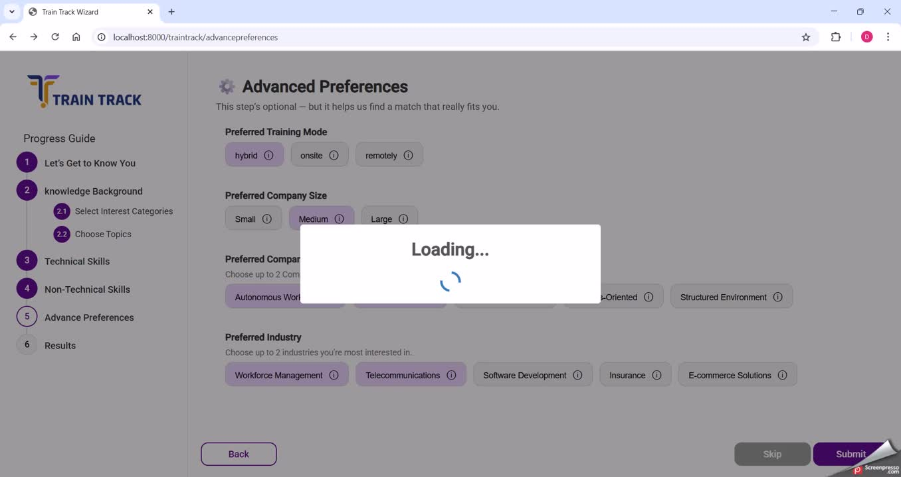

Slide 44
3 Layers

Slide 45
3 Layers
Calculation for the Selection
1

Slide 46
3 Layers
Total Score
Calculation for the Selection
1

Slide 47
3 Layers
ratio score =
total score ÷ minimum fit score
2
Total Score
Calculation for the Selection
1

Slide 48
3 Layers
ratio score =
total score ÷ minimum fit score
Ratio score>= Min Fit Score
2
Total Score
Calculation for the Selection
1

Slide 49
3 Layers
Advance Preference
Page
Is Filled Or Not
3
ratio score =
total score ÷ minimum fit score
Ratio score>= Min Fit Score
2
Total Score
Calculation for the Selection
1

Slide 50
Match Result Levels Based on Score
Receive the Mature Stage
🌟
❌
Fit Level:
Perfect
Match
Very
Strong
Match
Strong
Match
Partial
Match
Fallback
Match
No Match

Slide 51

Match Result Levels Based on Score
Receive the Mature Stage
🌟
❌
Fit Level:
Perfect
Match
Very
Strong
Match
Strong
Match
Partial
Match
Fallback
Match
No Match

Slide 52
Match Result Levels Based on Score
Did not Receive the Mature Stage
🌟
❌
Fit Level:
Perfect
Match
Very
Strong
Match
Strong
Match
Partial
Match
Fallback
Match
No Match

Slide 53
Match Result Levels Based on Score
Ratio score:
≥ 1.9
1.75 – 1.89
1.25 – 1.74
1.0 – 1.24
0.75 – 0.99
< 0.75
🌟
❌
Fit Level:
Perfect
Match
Very
Strong
Match
Strong
Match
Partial
Match
Fallback
Match
No Match
1

Slide 54
Match Result Levels Based on Score
Ratio score:
≥ 1.9
1.75 – 1.89
1.25 – 1.74
1.0 – 1.24
0.75 – 0.99
< 0.75
🌟
❌
Fit Level:
Perfect
Match
Very
Strong
Match
Strong
Match
Partial
Match
Fallback
Match
No Match
1

Slide 55
Match Result Levels Based on Score
We Took a Step Back and Decided
to Normalize the Ratio Score
Ratio score:
≥ 1.9
1.75 – 1.89
1.25 – 1.74
1.0 – 1.24
0.75 – 0.99
< 0.75
🌟
❌
Fit Level:
Perfect
Match
Very
Strong
Match
Strong
Match
Partial
Match
Fallback
Match
No Match

Slide 56
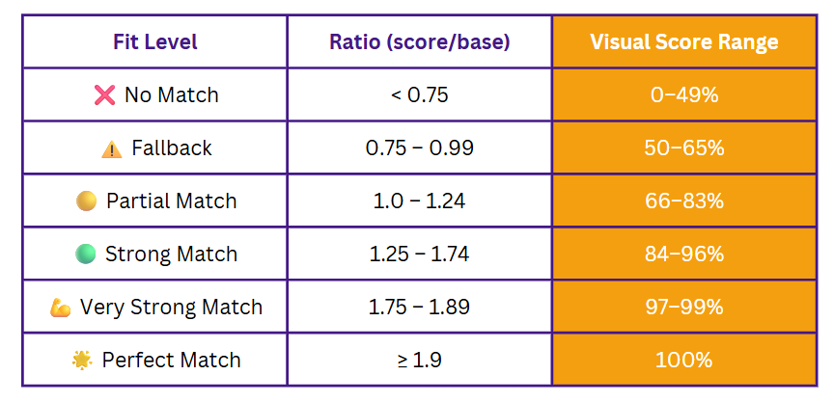
From Raw Score to Visual Score %

Slide 57
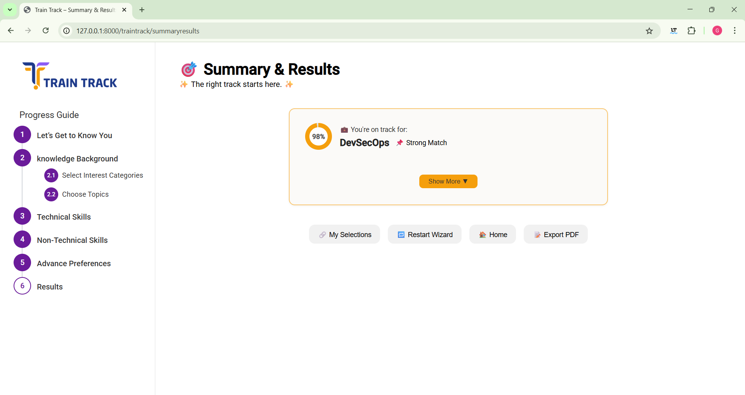
📌 Very Strong Match

Slide 58
📌 Very Strong Match

Slide 59
📌 Very Strong Match

Slide 60
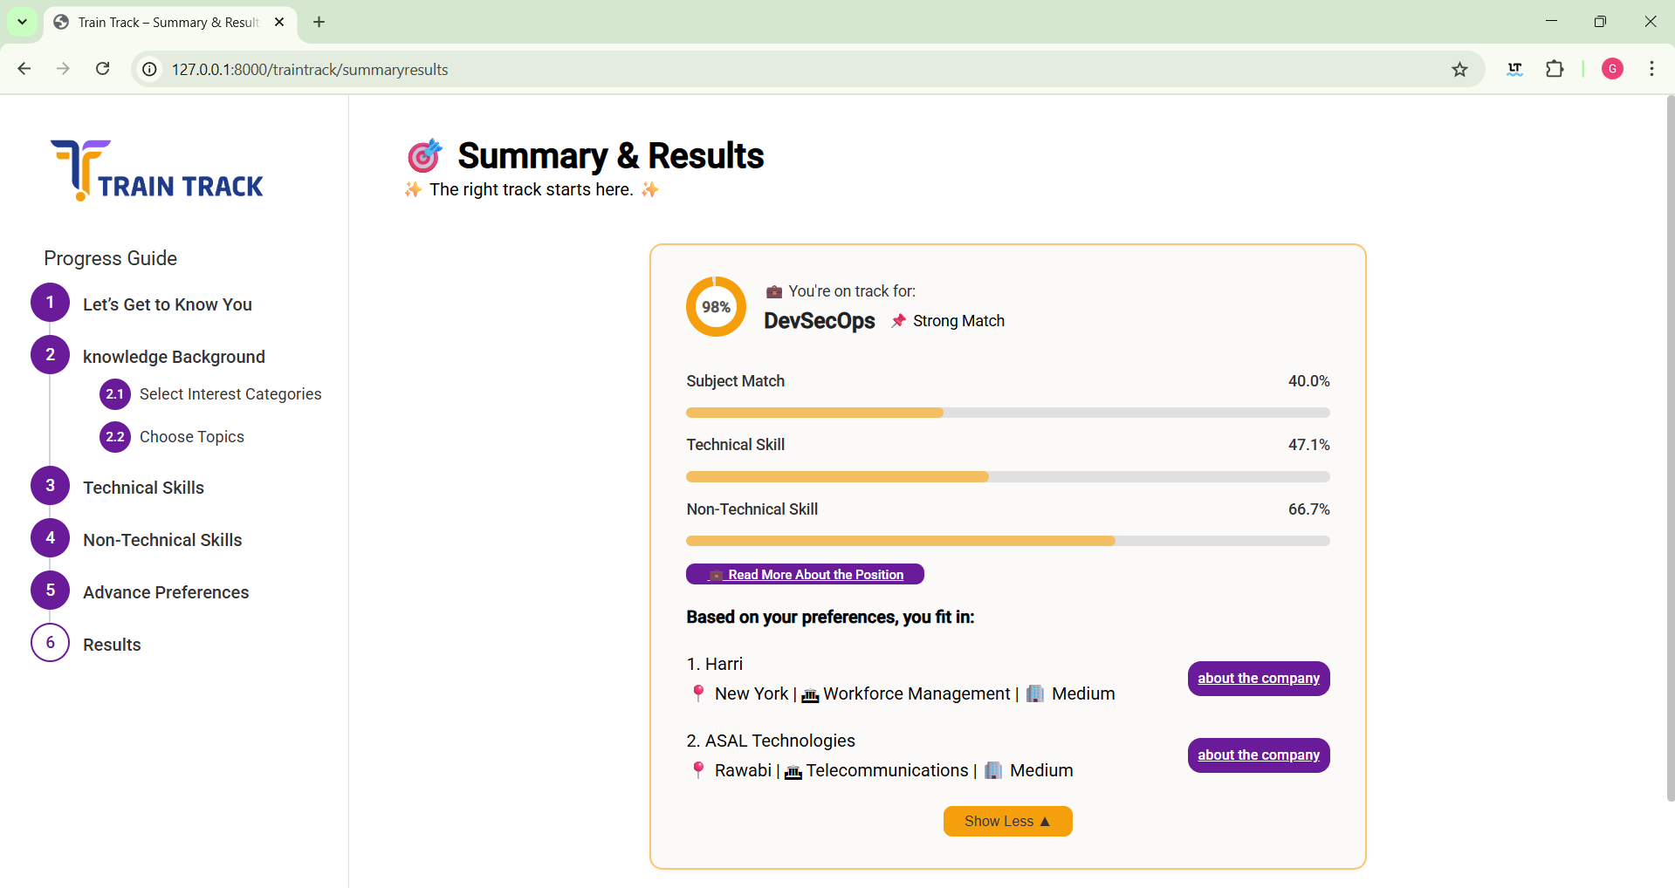
📌 Very Strong Match

Slide 61
📌 Very Strong Match

Slide 62
📌 Very Strong Match

Slide 63
📌 Very Strong Match

Slide 64
📌 Very Strong Match

Slide 65
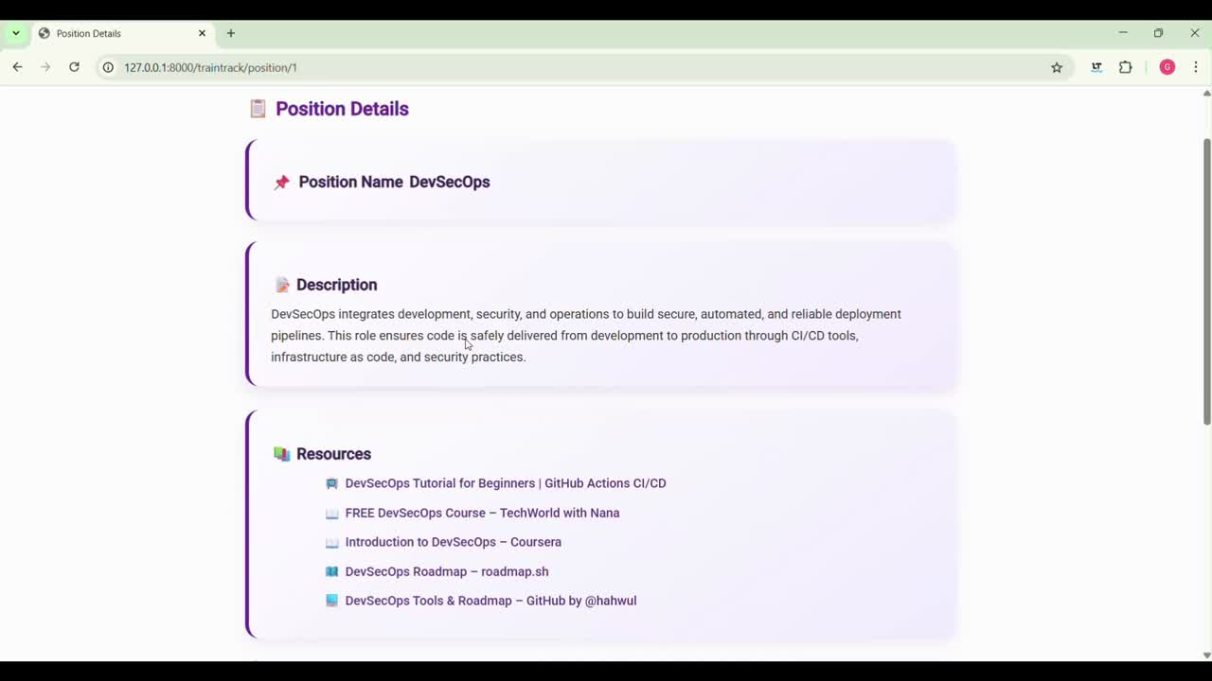

Slide 66
📌 Very Strong Match

Slide 67
📌 Very Strong Match

Slide 68
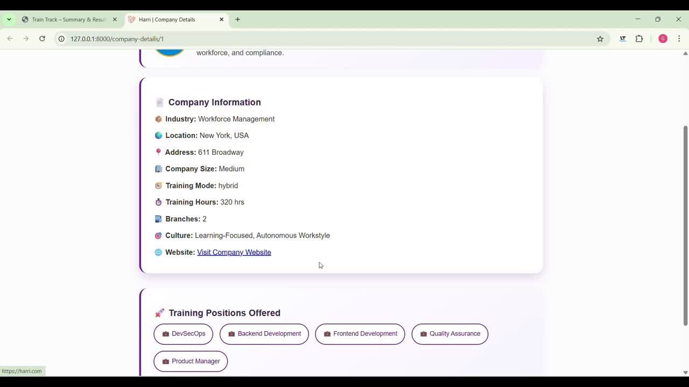

Slide 69

📌 Very Strong Match

Slide 70
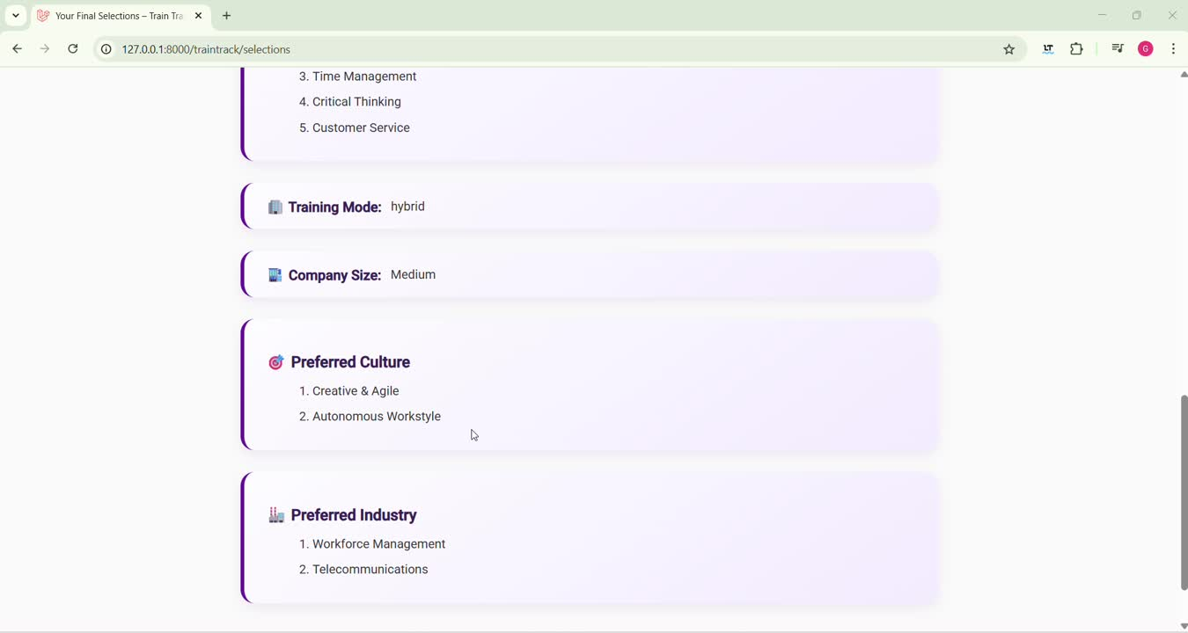

Slide 71
📌 Very Strong Match

Slide 72
📌 Very Strong Match

Slide 73
📌 Very Strong Match

Slide 74
Take a Step Back
Let’s Try another scenario!

Slide 75
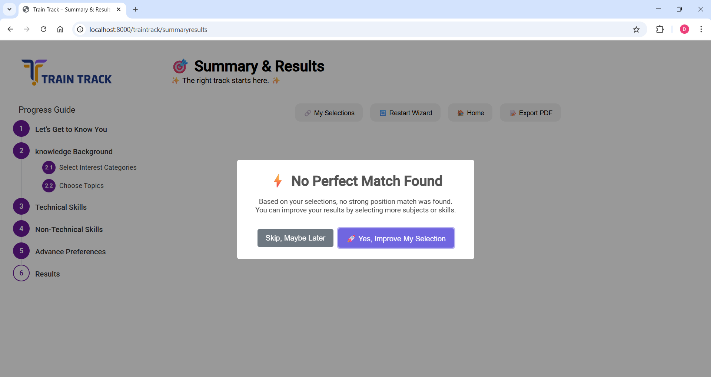

Slide 76
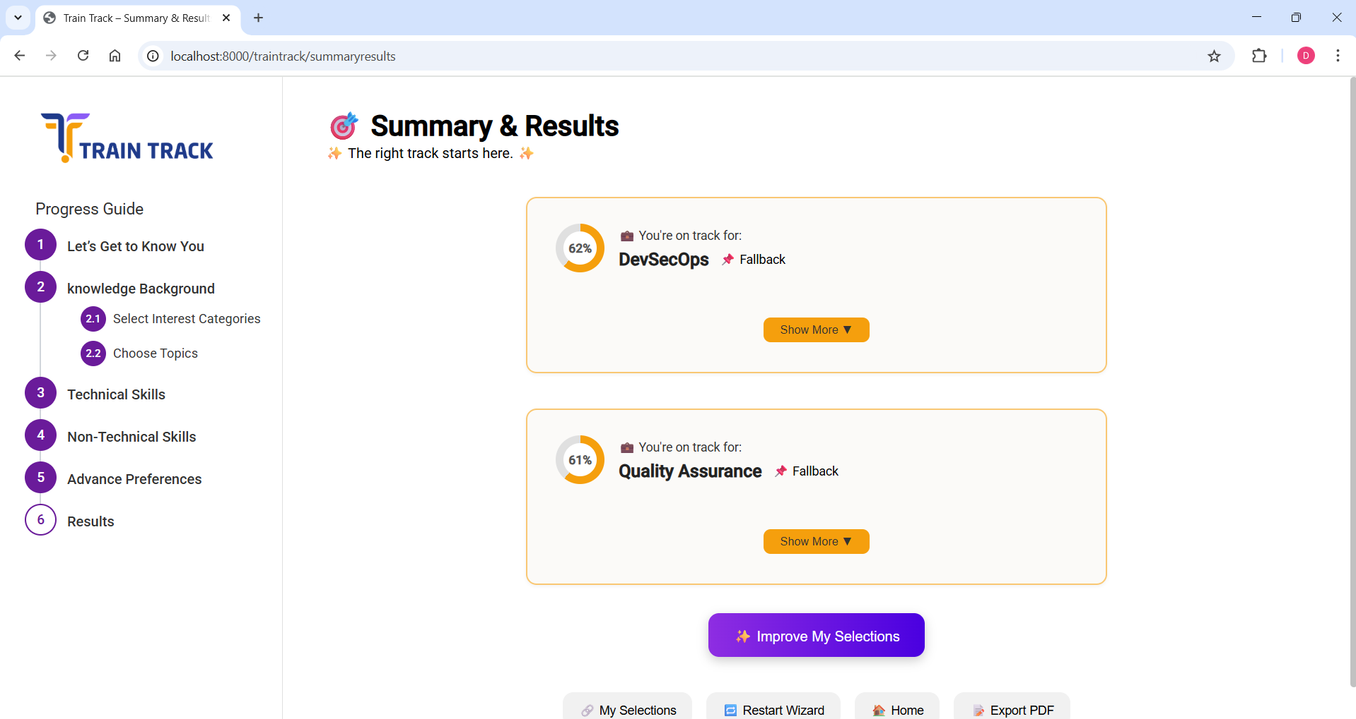

Slide 77
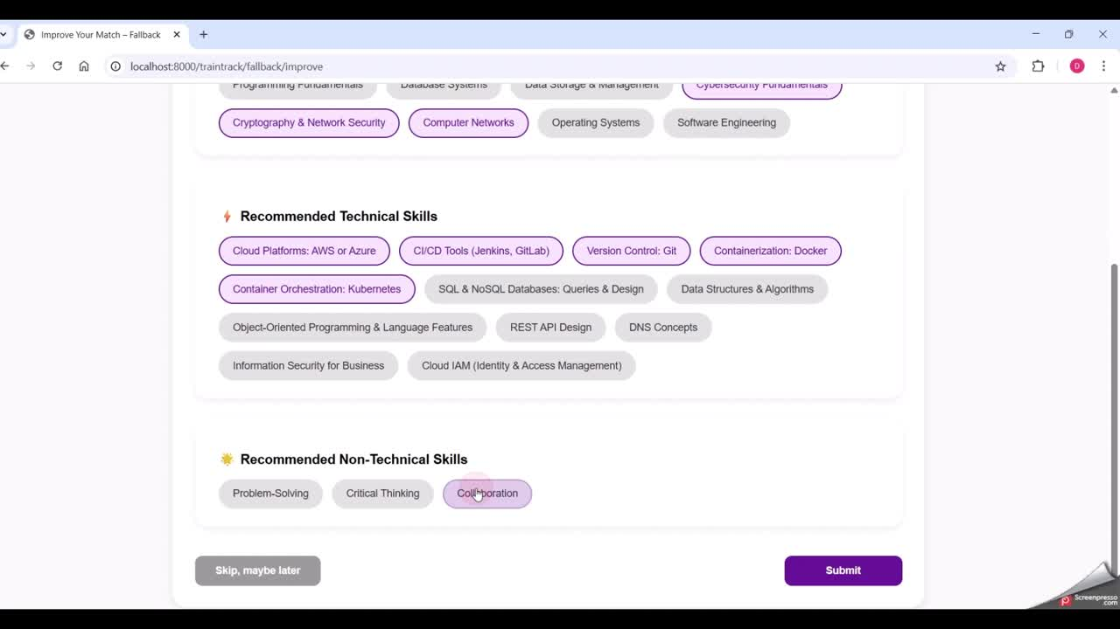

Slide 78
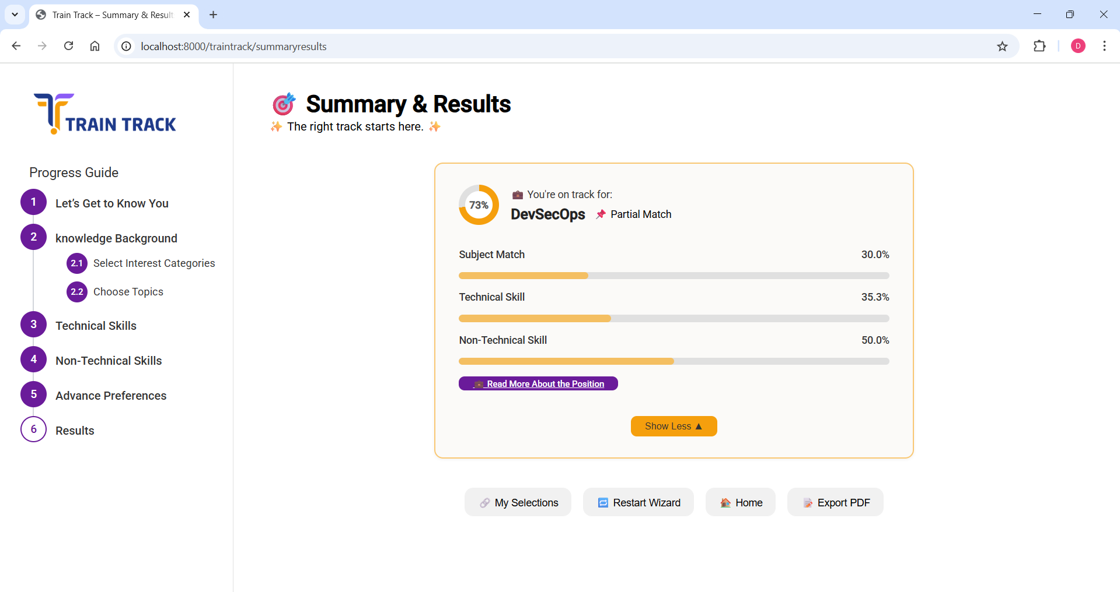

Slide 79
Final scenario!

Slide 80
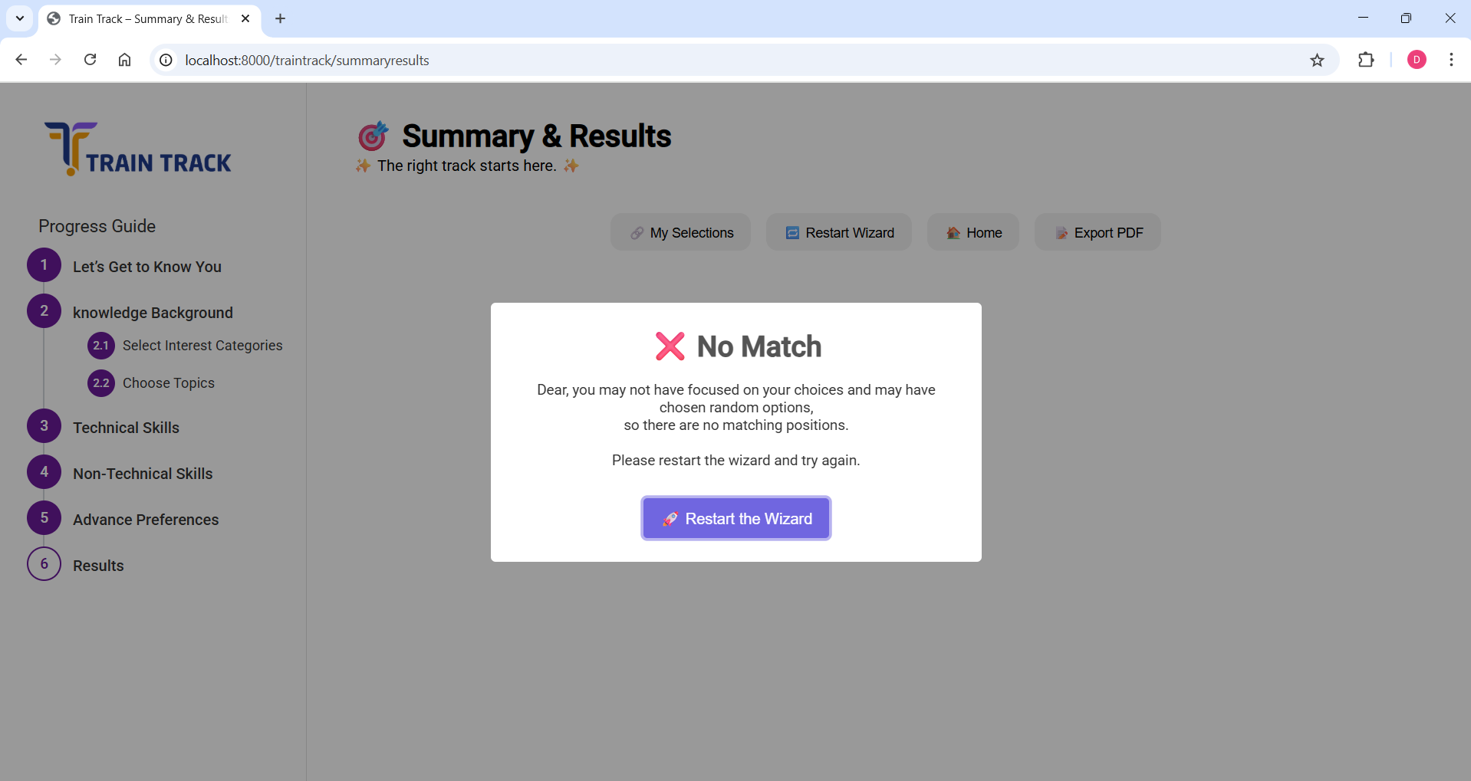

Slide 81
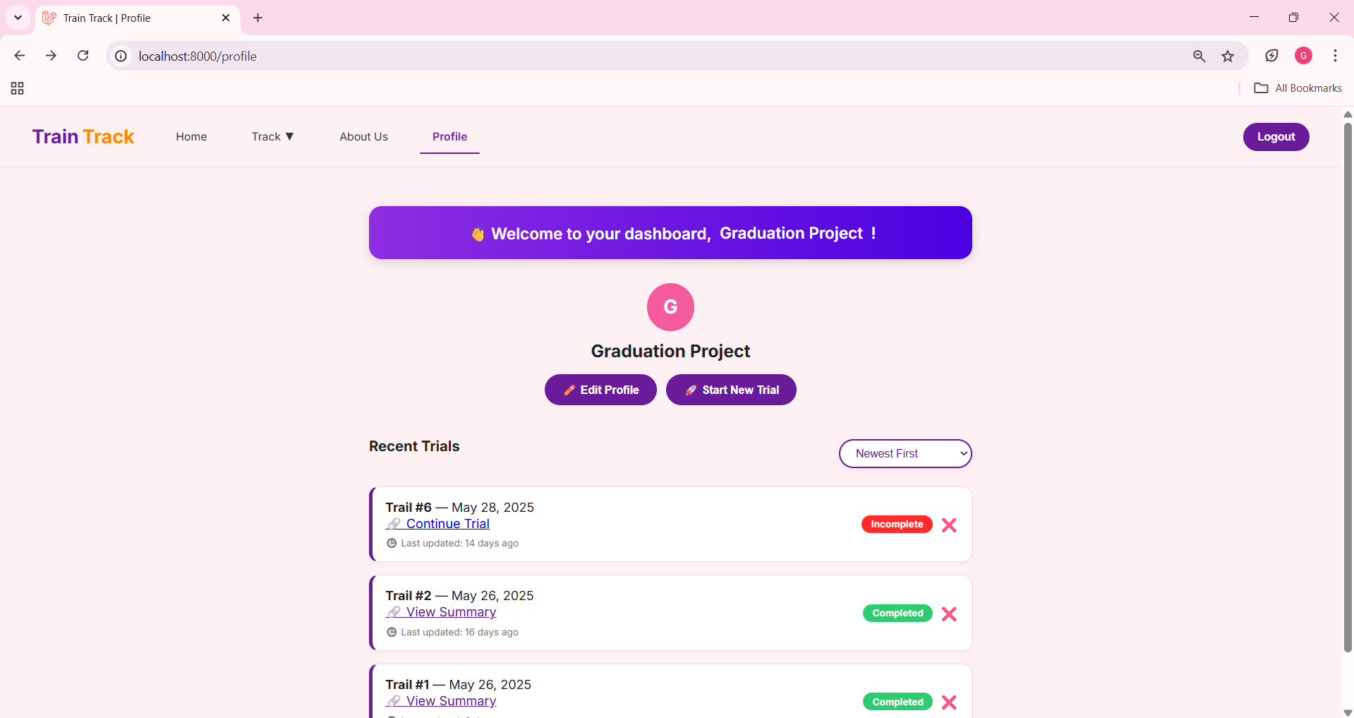

Slide 82
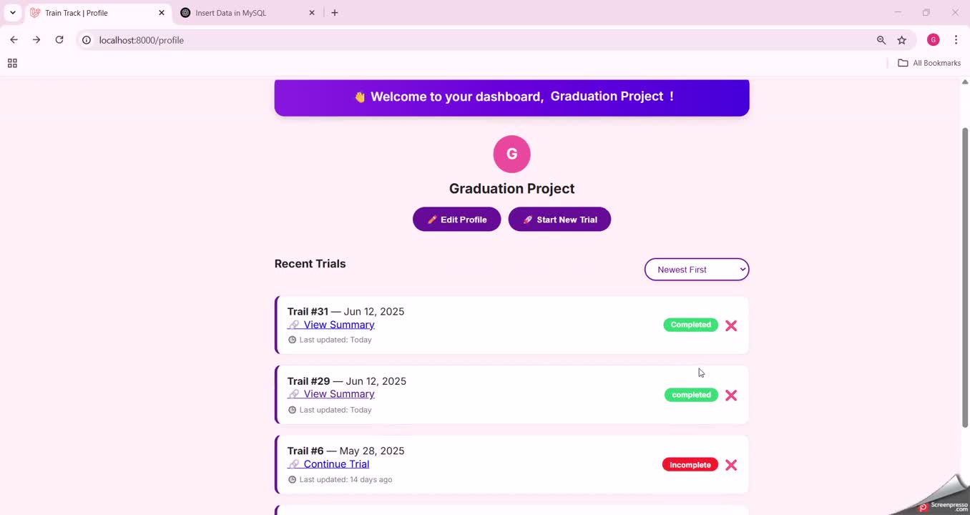

Slide 83




Future Work
Company Accounts and Internship Management
Resume Upload and Keyword Extraction
Mobile Application
Expansion to Non-Tech Majors

Slide 84


The End

