Slide 1


Notes:
انا اسمي الطالب المنتصر بالله المسلماني وبالتعاون مع زملائي عبد الفتاح شحادة ووضاح قرطلو من قسم الميكاترونكس

Slide 2

RevPack A novel way of mixing
An-Najah National University Faculty of Engineering & Information Technology Industrial and Mechanical Department
Graduation Project -2-
Team members:
Wadah Qartallo
Montaser Al-Maslamani
Abdul-Fattah Shehadeh
Revolutionizing Packaging Machine for Identical Mixes within the Packages (RevPack) Case-of-Study for Ezz Al-Maslamani Co.
Supervisor: Dr.-Ing. Mohammad Abuabiah
7/6/2023

Slide 3

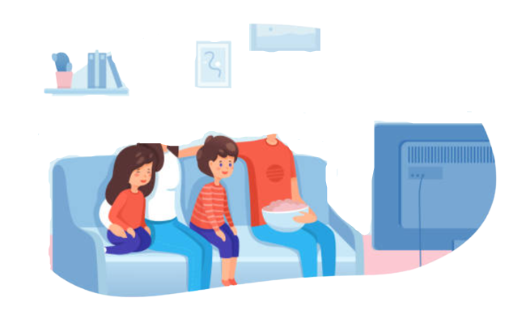


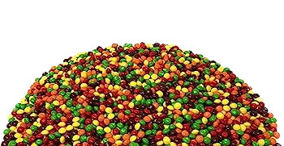
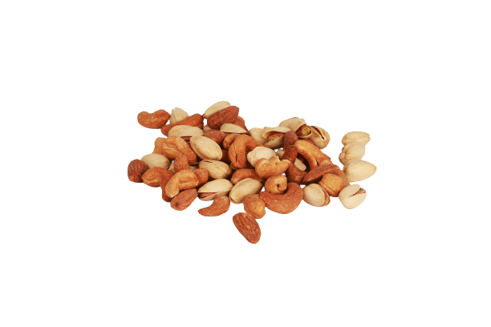
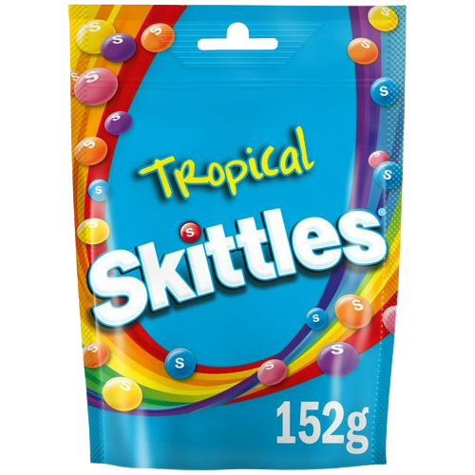
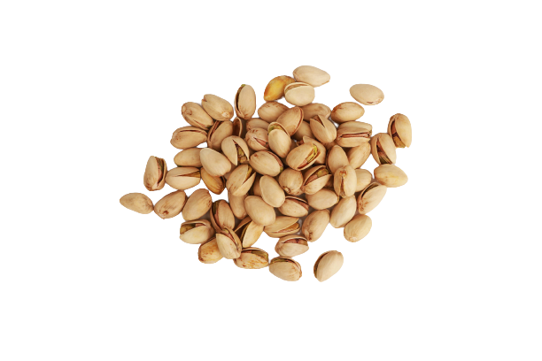
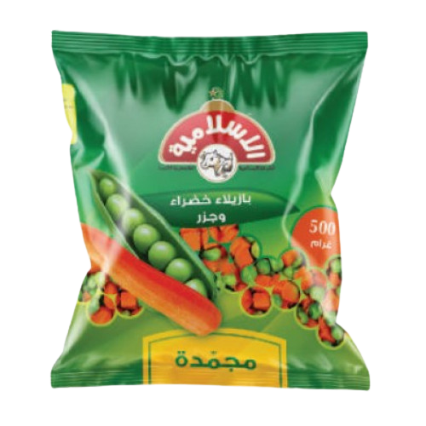
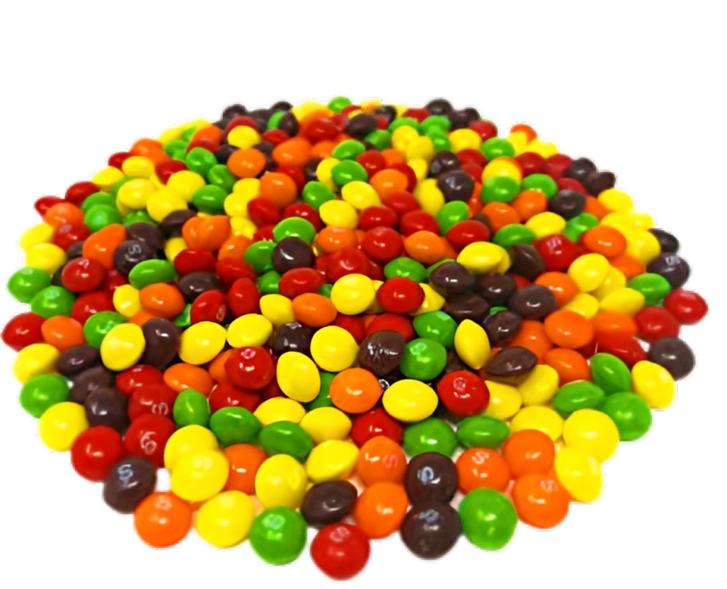
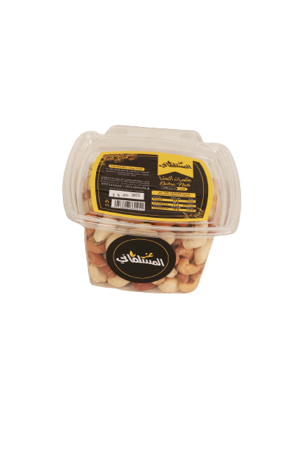
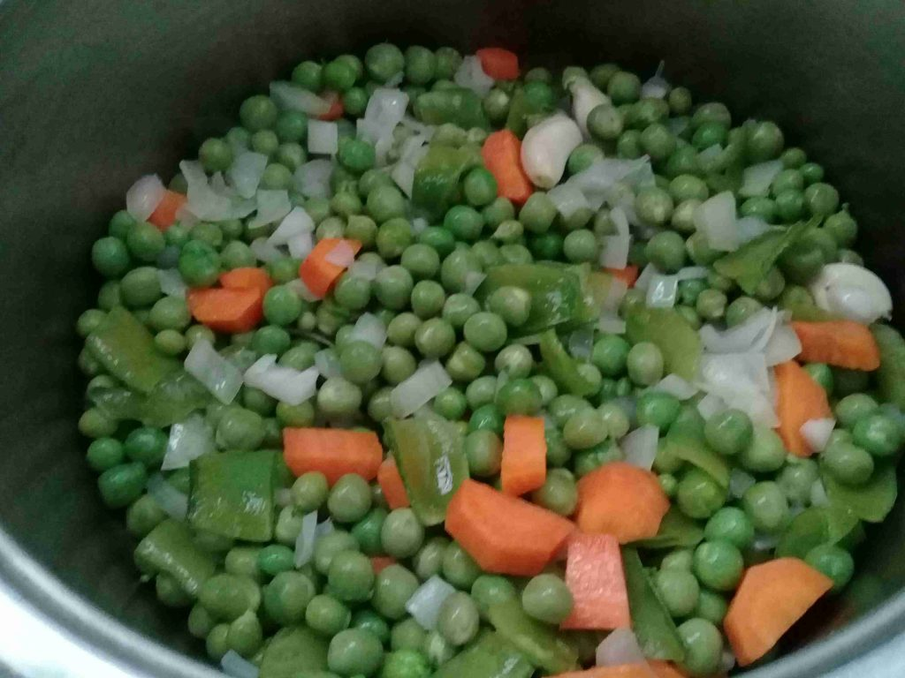
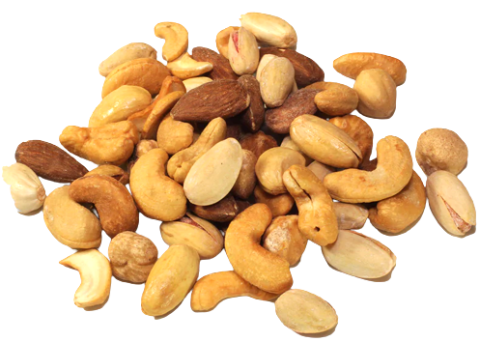
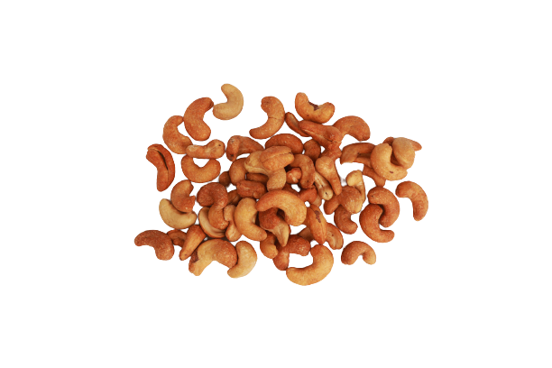
Introduction
ZOOM-X20
ZOOM-X10
ZOOM-X10
ZOOM-X20
ZOOM-X20
Notes:
تخيل انت رايح على السوبرماركت بدك تنقرش زي هاد الشخص.
الله. في مكسرات عز المسلماني تشتري المكسرات وتروح تفتح العلبة تحط المباراة تحضر هب خلص اكتر اشي بتحبو الكاشو. انتا هون تضايقت وحكيت ما رح اشتري كمان مرة لكن الرغبة طغت عليك بس هاي المرة انتا كنت ذكي. صرت تضور على العلب الي فيها كاشو اكتر نفقد هاي وهديك وتزيح العلبة تشوف الي وراها ولقيت الي بدك اياها واكلت وقضيت سهرتك وانتا مبسوط
لكن يا ترا هل هذا منطق؟ هل انتا شريت بقيمة العلبة اول مرة بجد؟ طب ليش انا اضور على العلبة الي بدي اياها؟
وهون تكمن مشكلتنا ومش بس احنا. هاي مشكلة عالمية بحت وسببها؟ طريقة الخلط والتعبئة التقليدية.
انا اسمي الطالب المنتصر بالله المسلماني وبالتعاون مع زملائي عبد الفتاح شحادة ووضاح قرطلو من قسم الميكاترونكس قررنا مش نطور الموجود ولكن نعمل ثورة بعالم الخليط والتعبئة وهون بيجي اسمنا!
Revolutionized packaging…… RevPack

Slide 4

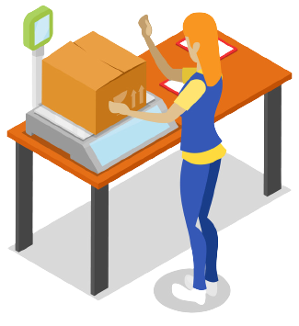
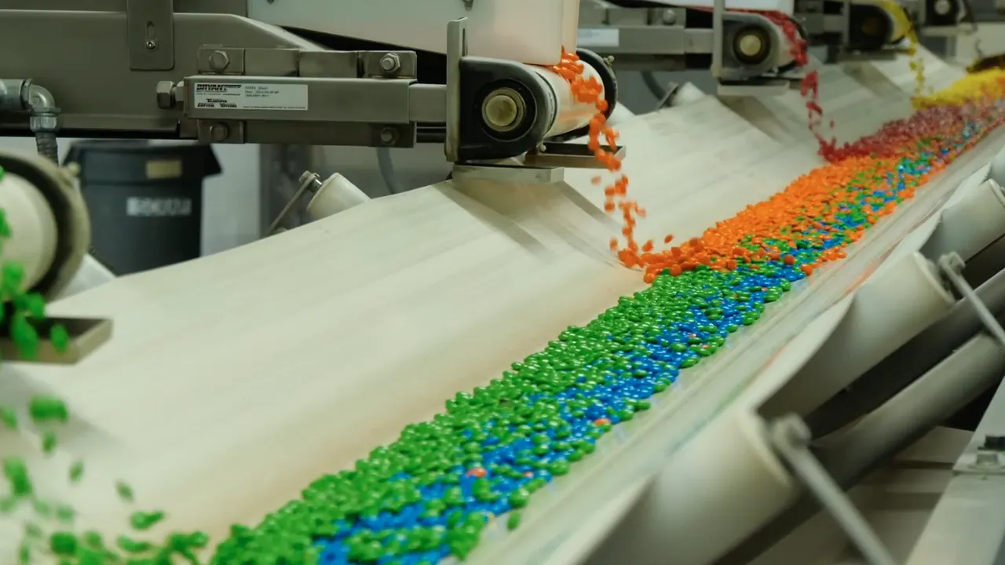

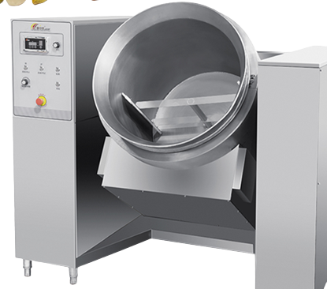
Problem
A
There are No New Methods of mixing and packing.
B
Lack of Technical Development in this field.
C
Use Marketing to Cover Up These Issues.

Slide 5

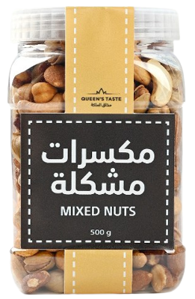
Facts
01
We pay More!
60%
Due to uneven mixing.
02
Identical packages
0.01%
Skittles sure are in trouble!
03
Sent Back!
10%
People tend to leave them, due to mixture is not up to their standard.
GP Research

Slide 6
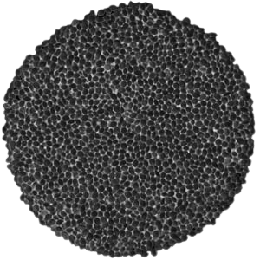
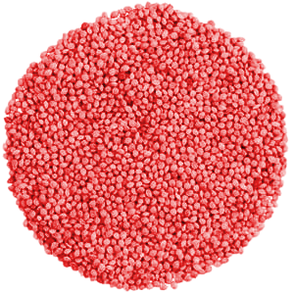
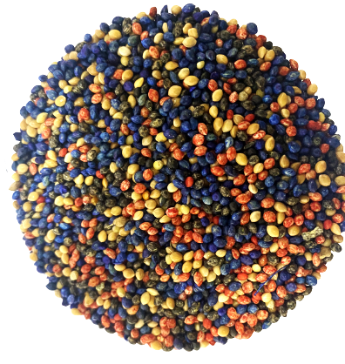
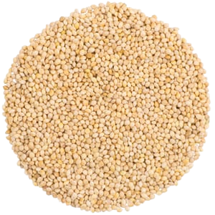
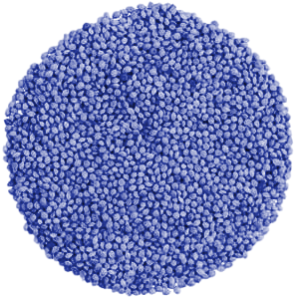
Solution
It is a RevPack Machine with a Special Mixing system, aimed to provide products with a Homogeneous Mixture and an Accurate Weight. It improves customers experience, and increase the efficiency of the packaging process.
Story
Appointments
that connects
86%

Slide 7

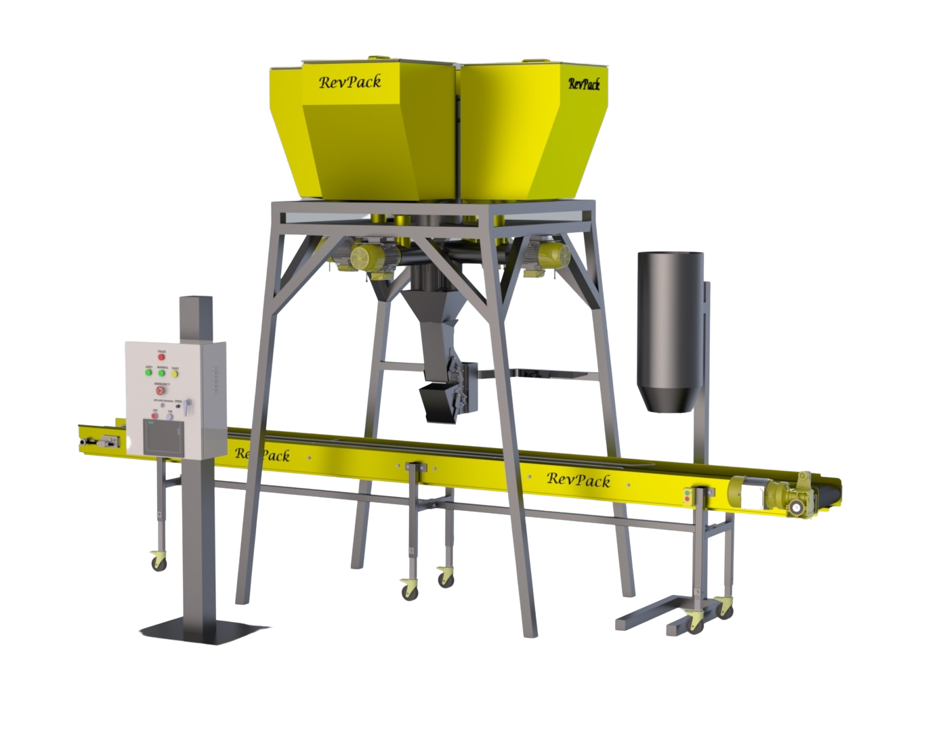
How RevPack Works
01
Recipe
02
Flow
03
Mixing
04
Weighing
05
Packaging

Slide 8

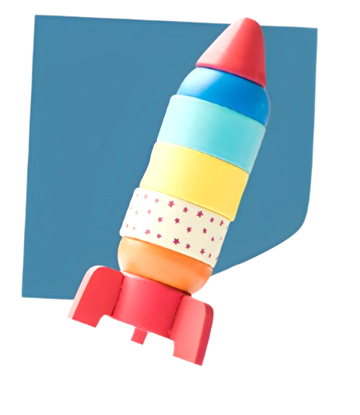
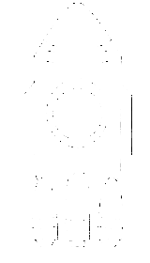
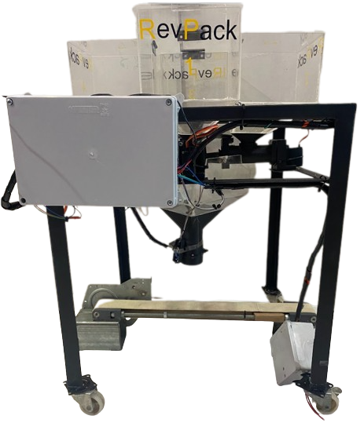
RevPack
Graduation Project 2
Conceptual Design
Proof the Concept
Prototype
Theory
Notes:
Our business model based on delivering hug services from nannies to the baby We guarantees timely and safe hugs for parents & provide Sustainable request for nannies, we pay 80% of hug value for nannies In this way we create sustainable business model!

Slide 9
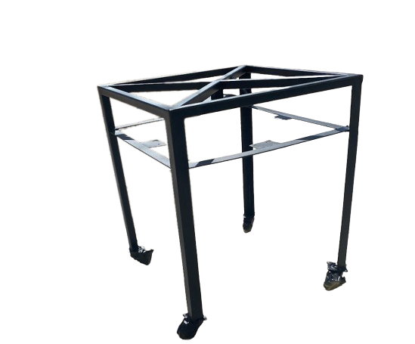
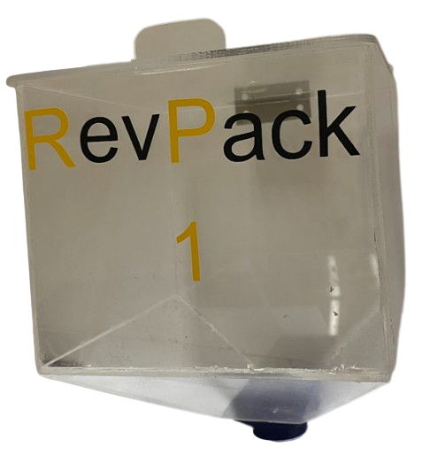
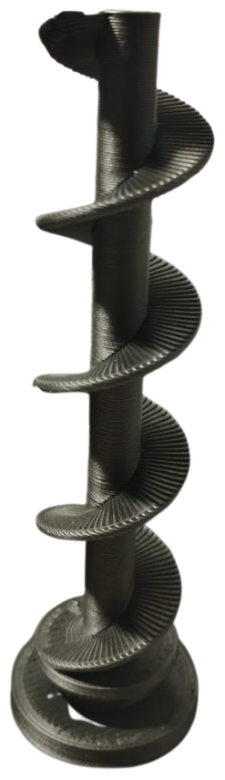
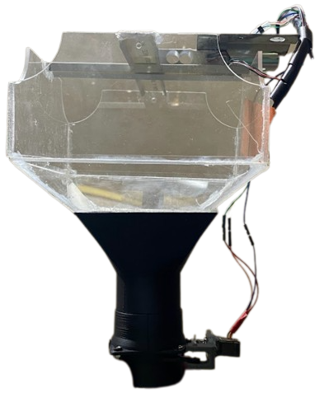
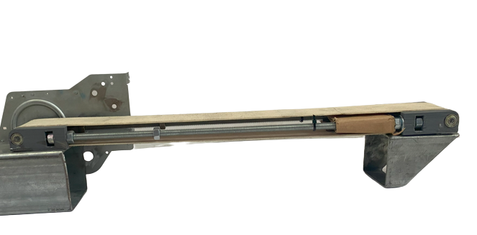
Prototype Design
Stand
Tanks
Helix
Weigher
Conveyor
Notes:
في قسم الديزاين راح نركز على أهم
5 components
وهي كالتالي (ذكرهم بالترتيب(حسي ترتيب البروسيس))
1- stand 2- tanks 3- helix 4- weigher 5- conveyor

Slide 10
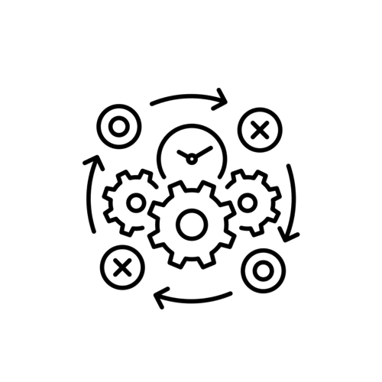
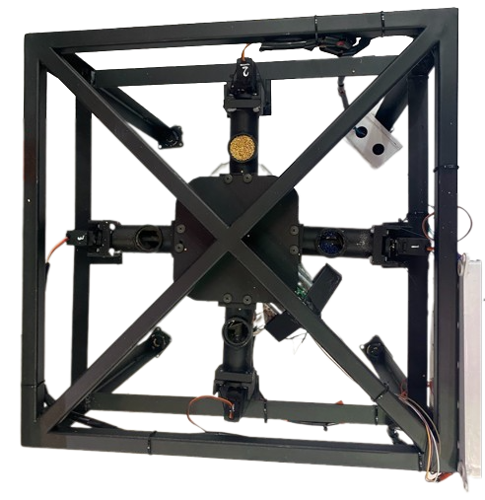
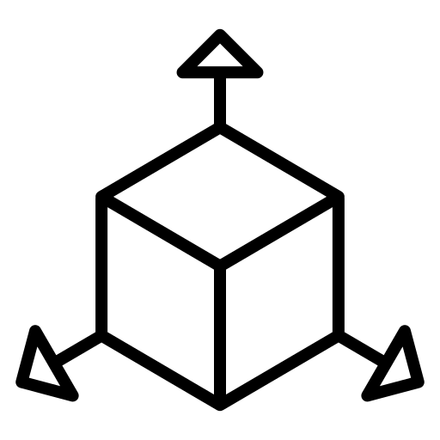
Stand
Function
Carries the following parts
The four tanks
The four helices
The four Servos
The weigher head
AISI 304 steel
Upper VIEW
ISO View
Dimensions
Shape selection
distribute the load on the legs.
The wheels utilized for moving the stand.
Length: 50 cm
Width: 50 cm
Hight: 60 cm

Slide 11
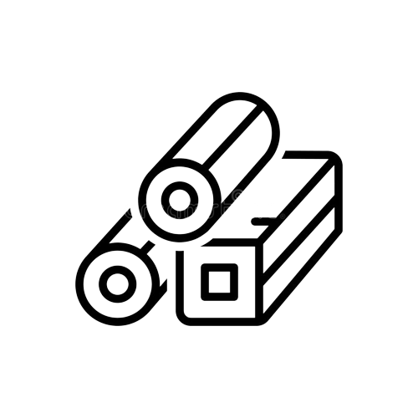
Tank
Helix
Weigher
Tank, Helix, Weigher Head
Function
Material type
The seeds stored in each tank, pass through its helix with the assigned speed into the weigher.
PVC
PLA carbon fiber
Shape selection
Dimensions
A slanted side in the tank reduces the load on the nuts and helps them down.
The helix’s used to translate the seeds.
Tank
Length: 15cm
Width: 15cm
Hight: 17cm
Helix
Length: 12cm
Diameter: 5cm
Weigher
Length: 17cm
Width: 17.5cm
Hight: 30cm

Slide 12
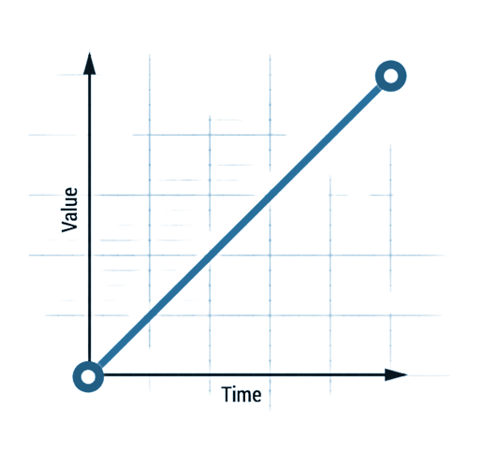
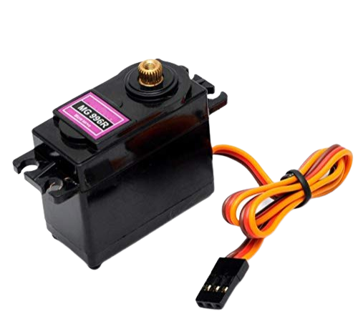
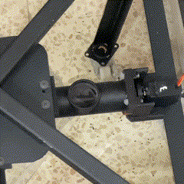
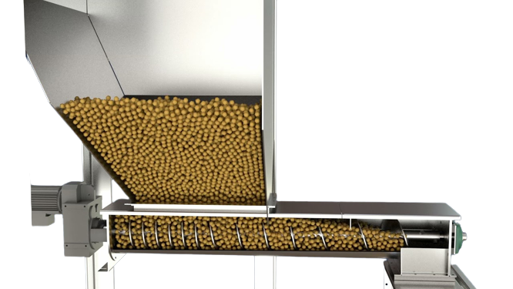
CONTROL
Flow (L/S) = Ꞷ (REV/S) x V (L/REV)
Ꞷ: Angular Velocity V: Volume/Revolution
Constant product filling time
T-1
100 RPM
Heliex speed (RPM)
Heliex speed (REV/S)
S-1
Nuts Weight (Gram/Sec)
Nuts Flow (L/s)

Slide 13
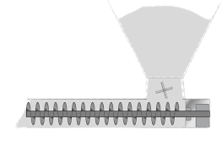
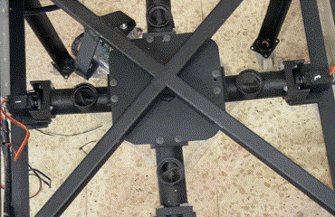
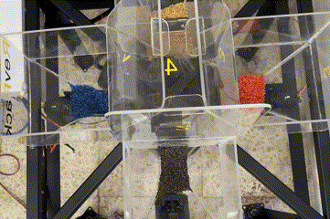
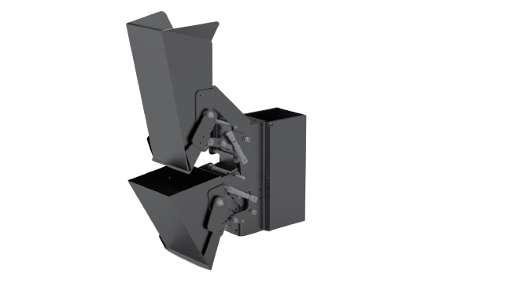
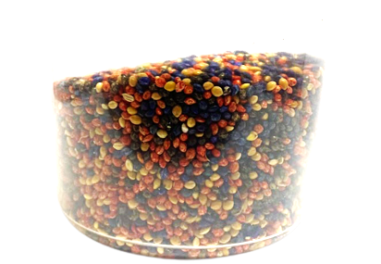
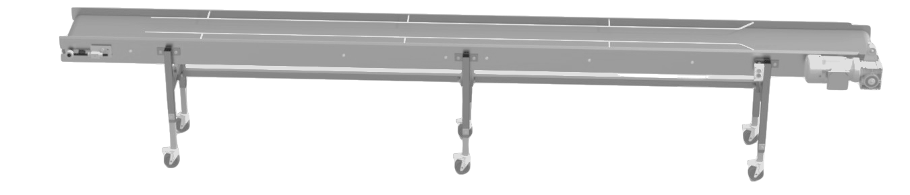
Speed Control & Weighing
50 RPM
S-2
S-3
T-2
T-3
25 RPM
100 RPM
T-1
T-4
40
S-1
100 RPM
S-4
30
Nuts Weight (Gram)
20
Ideal Mixing
Correct proportions
Accurate weight
10
Constant Product filling time (sec)

Slide 14
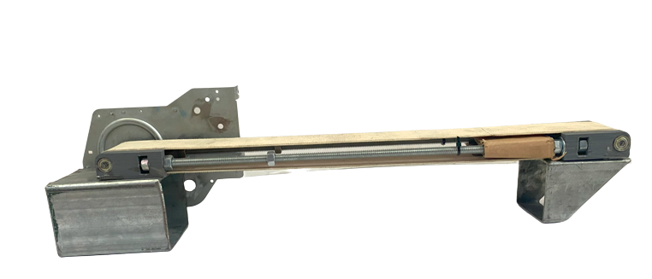
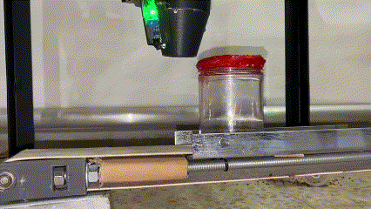
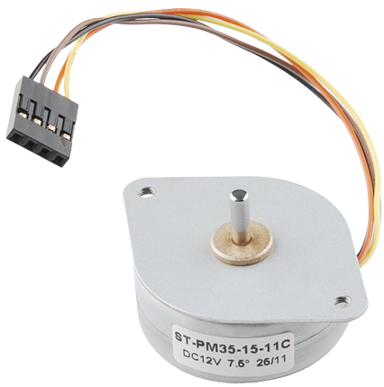
Conveyor
Function
Material type
Move the packaging box.
Steel
3D PETG Plastic
PVC Belt
Shape selection
Dimensions
It has two rods to center the boxes below the weigher.
Length: 50cm
Width: 7 cm
Hight: 10cm

Slide 15


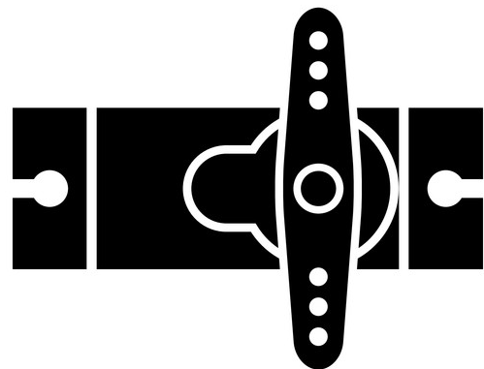

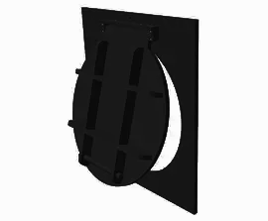

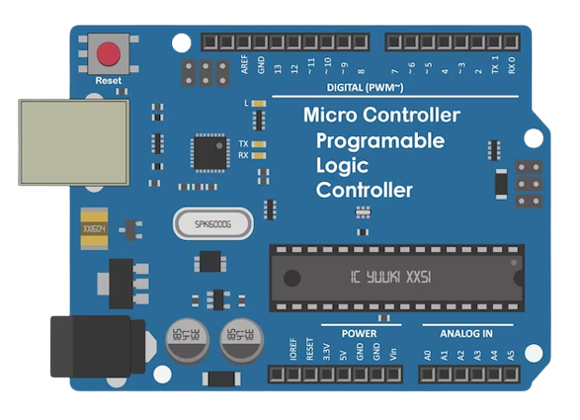


ARDUINO
(Microcontroller Board)
Arduino used type
UNO
Sensors
Servo
1
Analog
0
6 Analog inputs
Switches
Valves
Digital
14 Digital inputs/outputs
Push Button
Contactors & Relays
Notes:
What is PLC (باختصار وانها بمثابة العقل)
ذكر احتواءها على موديول ادخال و اخراج وكيف بتصير العلاقة بينهم
Why we use PLC/ and for what
PLC type
واضافة ال(ب ل س) وبرمجتها جزء اساسي من مشروع التخرج وانها جزء من تميز مشروع التخرج وبديل عن الكلاسيك كنترول التقليدي
7ada fekom entabah eno ana 7aket bs kabse wa7de 3ena bel PLC inputs??
Sa7ee7 had 3ashan RevPack ma feh buttons!!

Slide 16

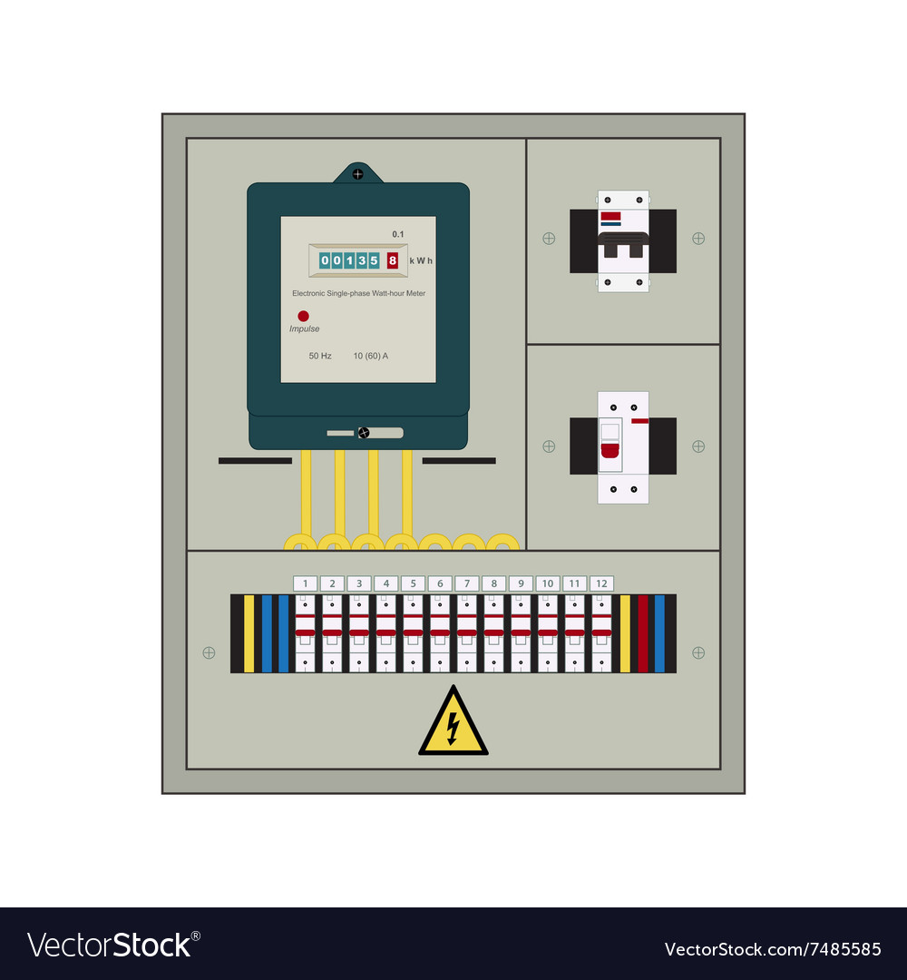




MATLAB! . How?
Master
Scale
Conveyor
Panel
Notes:
The HMI used by RevPack is ”TP1200 Comfort INOX PCT”. This HMI has a stainless steel front and a protection class of IP69K. This is the highest IP level that can be achieved. It is fully dust-protected and can withstand high-pressure water up to 100 bar and high temperatures up to 80 degrees. This level of protection is ideal for our study company, where cleaning is done with high water pressure and this IP level was used as a precaution

Slide 17

User Interface
Run Mode

Slide 18


RevPack
Development Cycle
Theory
Conceptual Design
FeedPack
Proof the Concept
UpGrade & Troubleshooting
Implement
Rating
Prototype
Industrial
Notes:
Our business model based on delivering hug services from nannies to the baby We guarantees timely and safe hugs for parents & provide Sustainable request for nannies, we pay 80% of hug value for nannies In this way we create sustainable business model!

Slide 19




Industrial Design
Stand
Tanks
Helix
Weigher
Conveyor
Notes:
في قسم الديزاين راح نركز على أهم
5 components
وهي كالتالي (ذكرهم بالترتيب(حسي ترتيب البروسيس))
1- stand 2- tanks 3- helix 4- weigher 5- conveyor

Slide 20



Control Hardware
M
G
I
S
S
Motors
Gears
Inverter
Type: 3- Phase Motor HorsePower: ⅛-½ HP
Speed: 1400 RPM
Type: Mechanical Gearbox Turn Ratio: 1/15 REV
Angle: 90 Degree
System:3-Phase Inverter Conection: Analog con
Lood: 1000 watt

Slide 21
Add Value
Improve mixing process & increase products homogeneity.
Automise packaging process & reduction of the labor force.
RevPack
Enhance customers experience & enrich products value.
Growing profits by reducing the error rate & reducing losses.

Slide 22
Future work
A
Building The Industrial RevPack machine.
B
The utilization of machinery in the production of the aforementioned goods as well as novel merchandise.
C
Upgrade & Troubleshooting.

Slide 23

Dr.Ing. Mohammad Abuabiah
RevPack Supervisor
Assistant Professor of Mechatronics Engineering
Faculty of Engineering and Information Technology
An-Najah National University

Slide 24






RevPack Team
Montaser
Wadah
Abdul Fattah
Research & Programming
Management & Design
Technical & Financial
Notes:
5

Slide 25
Backup Slides

Slide 26





Electric Wiring

Slide 27

Sensors
Approximately Sensor
Open-Close door sensor

Slide 28

Strain Gage sensor

Slide 29


The Servo Gate

Slide 30
Stand
Function
Material type
Carries the following parts
The four tanks
The four helices
The four motors
The weigher head
AISI 304 stainless steel
AISI 304 steel
Shape selection
Dimensions
To distribute the load on the legs. (about 500Kg)
Save space.
Length: 1.6m
Width: 1.1m
Hight: 2.4m

Slide 31

Tank
Helix
Weigher
Tank, Helix, Weigher Head
Function
Material type
The nuts stored in each tank, pass through its helix with the assigned speed into the weigher.
Stainless steel 316L
Shape selection
Dimensions
A slanted side in the tank reduces the load on the nuts and helps them down.
The helix’s used to translate the nuts.
Tank
Length: 51cm
Width: 50cm
Hight: 83cm
Helix
Length: 37cm
Diameter: 7cm
Weigher
Length: 12cm
Width: 38cm
Hight: 50cm

Slide 32
Conveyor
Function
Material type
Move the packaging box.
Steel
plastic
rubber
Shape selection
Dimensions
It has two rods to center the boxes below the weigher.
Length: 390cm
Width: 31cm
Hight: 78cm

Slide 33

Speed motor and the output weight test

Slide 35


Slide 36



Calculations
Maximum Load
516 Kg
Maximum stress
𝞼 = 137.87MPa
Safety factor
2
Weigh head accuracy
± 0.1g

Slide 37

Calculations
Empty tank mass: 28Kg
Tank Mass with maximum load : 101.3 Kg
Rod length: 14.9 cm
The force at point A: 632.7 N
The moment at point A: 94.3 N.m
The force at point B: 5132.6 N

Slide 38

Calculations
The force at points A,B,C, and D= 2746 N
The Moment at points A,B,C, and D= 1066.9 N.m
(A and B rotates C.C.W about Y-axis)
(C and D rotates C.W about Y-axis)
The force at point O=5206 N
Z
X
Notes:
حللت القوة اللي عند(O) على محاور (X) و (Z) وبعدين اخدت المحصلة تاعتهم

Slide 39

Calculations
Flow rate
The volume between two helix blades= 95 (µL/REV)
Helix speed = 93 (REV/MIN)
⇨ Flow rate = Volume X Speed
⇨ Flow rate = 8.84 (mL/min)
Notes:
حللت القوة اللي عند(O) على محاور (X) و (Z) وبعدين اخدت المحصلة تاعتهم

Slide 40

Calculations
Safety factor
Using distortion-energy theory:
M= 94.3 N.m
Sy= 276 MPa
C= 0.01 m,
I= 0.684 cm^4
𝞼 = 137.87 MPa
⇨ Safety Factor = 2
C=0.01m
Notes:
حللت القوة اللي عند(O) على محاور (X) و (Z) وبعدين اخدت المحصلة تاعتهم

Slide 41

Full design dimensions

Slide 42

Helix and helix cover dimensions

Slide 43

Stand dimensions

Slide 44


Tank dimensions
Weigher dimensions

Slide 45

Weigh Head Mechanism

Slide 46


Slide 47
RevPack A novel way of mixing
An-Najah National University Faculty of Engineering & Information Technology Industrial and Mechanical Department
Graduation Project -2-
Supervisor:
Dr.-Ing. Mohammad Abuabiah Team members:
Wadah Qartallo, Montaser Al-Maslamani, Abdul-Fattah Shehadeh

Slide 48



Ingress protection used.

Slide 49

Menu Screen

Slide 50

Main Control Screen

Slide 51

Recipes Screen

Slide 52


User Interface
Choosing Recipe
Run Mode
Choosing Users
Maintenance

Slide 53

Settings Screen

Slide 54
User Administration Screen

Slide 55
Maintenance Screen

Slide 56
PLC Modules
1
0
Analog
Digital
AI 8x12bit AO 8x12bit
DI 16x24VDC DO 8x24VDC

Slide 57

Analog Input

Slide 58

Analog Output

Slide 59

Digital Input

Slide 60

Digital Output

Slide 61

PLC Flowchart

Slide 62
Backup Slides

Slide 63
RevPack
Graduation Project 2
Conceptual Design
Proof the Concept
Prototype
Theory
Notes:
Our business model based on delivering hug services from nannies to the baby We guarantees timely and safe hugs for parents & provide Sustainable request for nannies, we pay 80% of hug value for nannies In this way we create sustainable business model!

Slide 64









Slide 65



Speed Control & Weighing
50 RPM
S-2
S-3
T-2
T-3
25 RPM
100 RPM
T-1
T-4
40
S-1
S-4
30
100 RPM
Nuts Weight (Gram)
20
Ideal Mixing
Correct proportions
Accurate weight
10
Constant Product filling time (sec)

Slide 66

Design
Tanks
Notes:
في قسم الديزاين راح نركز على أهم
5 components
وهي كالتالي (ذكرهم بالترتيب(حسي ترتيب البروسيس))
1- stand 2- tanks 3- helix 4- weigher 5- conveyor

Slide 67
Conveyor
Function
Material type
Move the packaging box.
Steel
3D printing PETG Plastic
PVC Belt
Shape selection
Dimensions
Length: 50cm
Width: 7 cm
Hight: 10cm
It has two rods to center the boxes below the weigher.

Slide 68
RevPack
Graduation Project 2
Conceptual Design
Proof the Concept
Prototype
Theory
Notes:
Our business model based on delivering hug services from nannies to the baby We guarantees timely and safe hugs for parents & provide Sustainable request for nannies, we pay 80% of hug value for nannies In this way we create sustainable business model!

Slide 69

Conveyor
Function
Material type
Move the packaging box.
Steel
3D PETG Plastic
PVC Belt
Shape selection
Dimensions
It has two rods to center the boxes below the weigher.
Length: 50cm
Width: 7 cm
Hight: 10cm

Slide 70
Conveyor
Function
Material type
Move the packaging box.
Steel
3D PETG Plastic
PVC Belt
Shape selection
Dimensions
It has two rods to center the boxes below the weigher.
Length: 50cm
Width: 7 cm
Hight: 10cm

Slide 71
Stand
Dimensions
Length: 1.6m
Width: 1.1m
Hight: 2.4m
Function
Material type
Carries the following parts
The four tanks
The four helices
The four motors
The weigher head
AISI 304 stainless steel
AISI 304 steel
Shape selection
Dimensions
To distribute the load on the legs. (about 500Kg)
Save space.
Length: 1.6m
Width: 1.1m
Hight: 2.4m

Slide 72

Stand
Function
Carries the following parts
The four tanks
The four helices
The four motors
The weigher head
AISI 304 steel
Upper VIEW
ISO VIEW
Dimensions
Shape selection
To distribute the load on the legs. (about 500Kg)
Save space.
Length: 1.6m
Width: 1.1m
Hight: 2.4m

Slide 73
RevPack
Development Cycle
Theory
Conceptual Design
FeedPack
Proof the Concept
UpGrade & Troubleshooting
Implement
Rating
Prototype
Industrial
Notes:
Our business model based on delivering hug services from nannies to the baby We guarantees timely and safe hugs for parents & provide Sustainable request for nannies, we pay 80% of hug value for nannies In this way we create sustainable business model!

Slide 74
RevPack
Development Cycle
Theory
Conceptual Design
FeedPack
Proof the Concept
UpGrade & Troubleshooting
Implement
Rating
Prototype
Industrial
Notes:
Our business model based on delivering hug services from nannies to the baby We guarantees timely and safe hugs for parents & provide Sustainable request for nannies, we pay 80% of hug value for nannies In this way we create sustainable business model!

Slide 75




No Buttons! . How?
Screen Type
TP1200 Comfort INOX (PCT)
Panel
UI
UI
Notes:
The HMI used by RevPack is ”TP1200 Comfort INOX PCT”. This HMI has a stainless steel front and a protection class of IP69K. This is the highest IP level that can be achieved. It is fully dust-protected and can withstand high-pressure water up to 100 bar and high temperatures up to 80 degrees. This level of protection is ideal for our study company, where cleaning is done with high water pressure and this IP level was used as a precaution

Slide 76

MATLAB! . How?
Panel
Notes:
The HMI used by RevPack is ”TP1200 Comfort INOX PCT”. This HMI has a stainless steel front and a protection class of IP69K. This is the highest IP level that can be achieved. It is fully dust-protected and can withstand high-pressure water up to 100 bar and high temperatures up to 80 degrees. This level of protection is ideal for our study company, where cleaning is done with high water pressure and this IP level was used as a precaution

Slide 77

Introduction
ZOOM-X10
ZOOM-X20
ZOOM-X20
Notes:
تخيل انت رايح على السوبرماركت بدك تنقرش زي هاد الشخص.
الله. في مكسرات عز المسلماني تشتري المكسرات وتروح تفتح العلبة تحط المباراة تحضر هب خلص اكتر اشي بتحبو الكاشو. انتا هون تضايقت وحكيت ما رح اشتري كمان مرة لكن الرغبة طغت عليك بس هاي المرة انتا كنت ذكي. صرت تضور على العلب الي فيها كاشو اكتر نفقد هاي وهديك وتزيح العلبة تشوف الي وراها ولقيت الي بدك اياها واكلت وقضيت سهرتك وانتا مبسوط
لكن يا ترا هل هذا منطق؟ هل انتا شريت بقيمة العلبة اول مرة بجد؟ طب ليش انا اضور على العلبة الي بدي اياها؟
وهون تكمن مشكلتنا ومش بس احنا. هاي مشكلة عالمية بحت وسببها؟ طريقة الخلط والتعبئة التقليدية.
انا اسمي الطالب المنتصر بالله المسلماني وبالتعاون مع زملائي عبد الفتاح شحادة ووضاح قرطلو من قسم الميكاترونكس قررنا مش نطور الموجود ولكن نعمل ثورة بعالم الخليط والتعبئة وهون بيجي اسمنا!
Revolutionized packaging…… RevPack

Slide 78
Facts
01
We pay More!
60%
Due to uneven mixing.
02
Identical packages
0.01%
Skittles sure are in trouble!
03
Sent Back!
10%
People tend to leave them, due to mixture is not up to their standard.
GP Research

Slide 79
Solution
It is a Nuts Packing Machine with a Special Mixing system, aimed to provide products with a Homogeneous Mixture and an Accurate Weight. It improves customers experience, and increase the efficiency of the nuts packaging process.
Story
Appointments
that connects
86%

Slide 80


theoretical and conceptual design

