Slide 1

Foundation System Analysis and Design of Alawneh Building
An-Najah National University
Faculty of Engineering
Civil Engineering Department
Graduation Project II
Prepared By:
Ahmad Bustami Supervisor :
Osama Al-Zayed Dr. Isam Jardaneh
Osaid Abu Diak
Amir Thabet

Slide 2
Presentation Outline
Chapter 5 : Foundation Design
5.1 Introduction
5.2 Single Footing Option Check
5.3 Mat Foundation Option Check
5.4 Mat Foundation Design
5.3 Quantities Take-Off
5.4 Settlement Check

Slide 3
Introduction
After calculating the loads on each column (analyzing phase), the next step is the design phase.
in this phase the engineer must think firstly about the lesser cost option, which is Single (isolated) footing.
if the summation of areas of single footings are equal or bigger than 50% from the building area, or if there is an overlapping in the footings, then Mat foundation should be used.

Slide 4
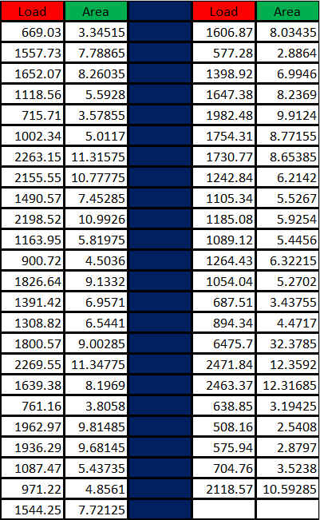

Single Footing Option Check
The total area for all columns is 343 $m^{2}$, while 50% of the building area is 316 $m^{2}$.
Because of total footing areas > 50% of building area, raft foundation is needed.

Slide 5
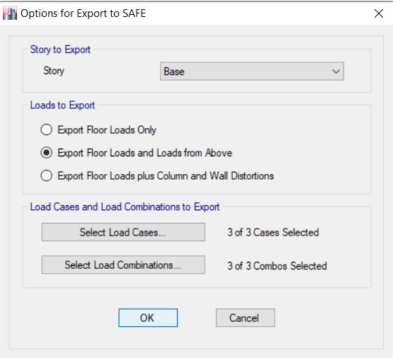
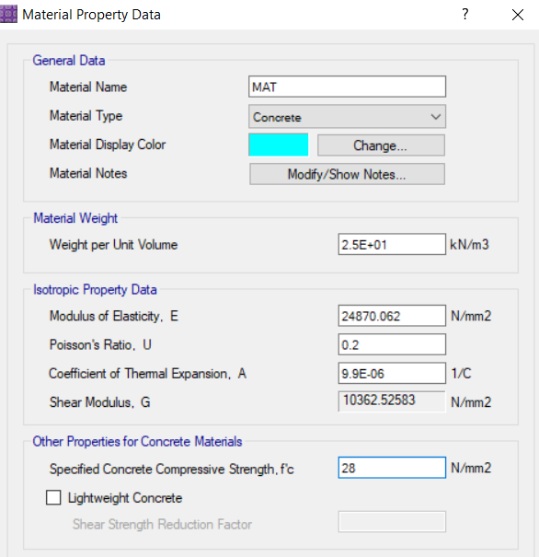
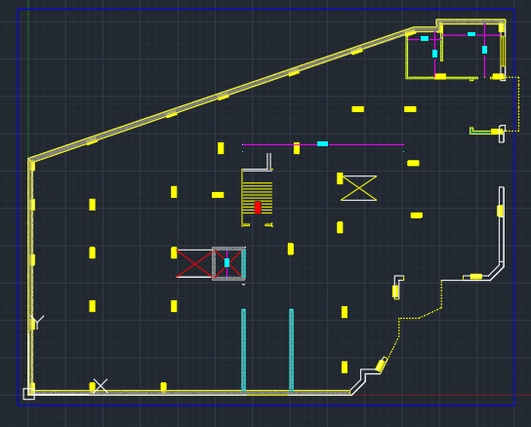
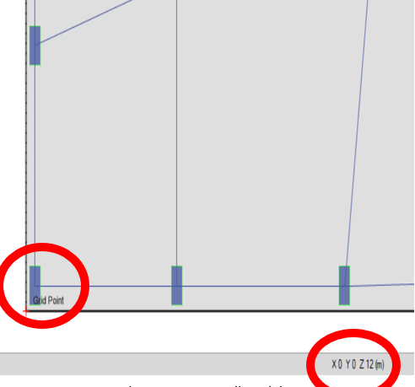
Mat Foundation Option Check

Slide 6
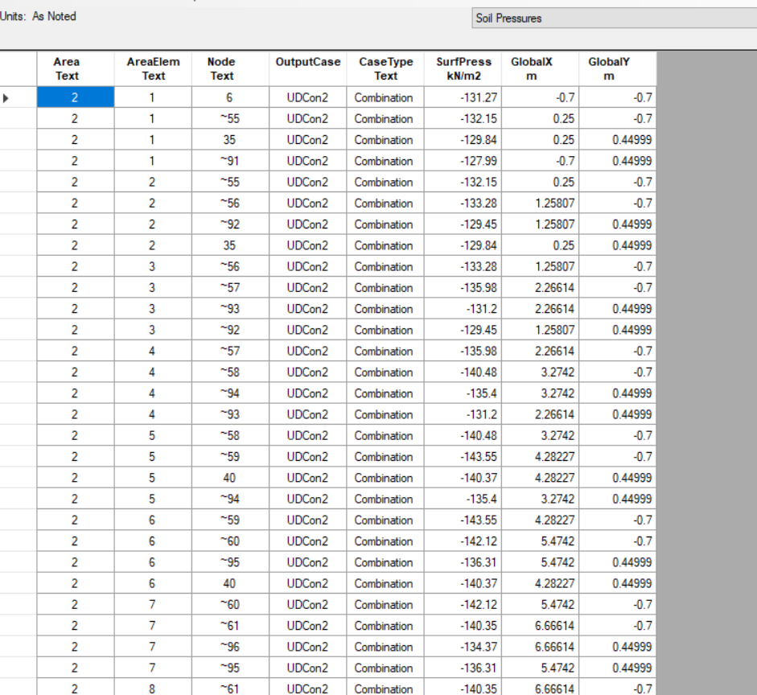
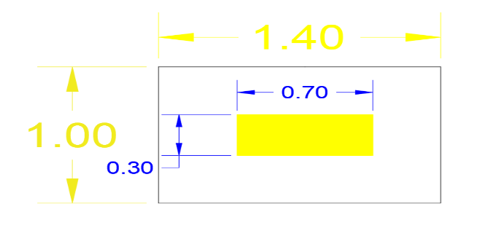

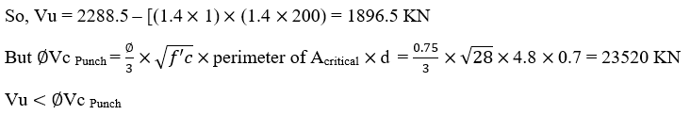
Mat Foundation Option Check

Slide 7
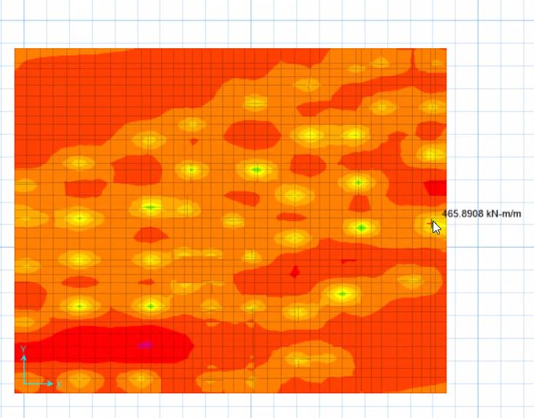
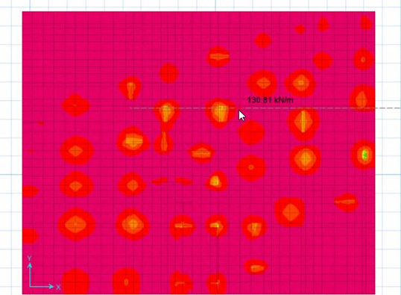

Mat Foundation Design
Use 8Ꝋ18/m
Use 1Ꝋ8/250 mm

Slide 8
Quantity Take-Off for Foundation (Concrete and Steel)
Concrete Quantity
The entered and obtained data in and from software shows that the plan area is equal to 881.24 m², and a thickness of 0.7m, henceforth, the total concrete quantity is = 616.87 m³.
For wastage considerations the preceding value is multiplied by 1.073, so the adopted quantity is 662 m³ of ready-mix concrete.

Slide 9
Quantity Take-Off for Foundation (Concrete and Steel)
Steel Quantity
According to SAFE reinforcing results, the required area of steel for one meter width of footing is 2005 mm², therefore 8 bars of 18 mm in diameter with a spacing of 10cm is selected, these results are applied for both directions X and Y based on the maximum moment value.
To estimate steel quantity in Tons, the total number of bars, its length and its density per meter are required. Assuming that bars of 10 meters in length to be used, accordingly:

Slide 10
Quantity Take-Off for Foundation Flexural Reinforcement:-
Steel quantity in Y-direction for bottom steel (spacing is in X-direction), thus the number of bars is equal to [1+(the total length for one strip in Y-direction = 26.54 m divided by the spacing =10 cm)], so the total number of bars in direction 2 is = 333 bars. The initial length of bars is 26.54 m which is the same as the second dimension, but the used length for each bar is 10 meters, thus, splicing should take a place and an additional length to be counted in each strip of reinforcing as 1.5 meter in each line.
Steel quantity in X-direction for bottom steel (spacing is in Y-direction), thus the number of bars is equal to [1+(the total length for one strip in X-direction = 33.2 m divided by the spacing =10 cm)], so the total number of bars in direction 1 is = 265 bars. The initial length of bars is 33.2 m which is the same as the first dimension, but the used length for each bar is 10 meters, thus, splicing should take a place and an additional length to be counted in each strip of reinforcing as 1.5 meter in each line.
Steel | Length (m) | Diameter (mm) | No. of bars | D²/162 | Total length | Quantity in (Kg)
Top | 32.2 | 18 | 265 | 2 | 8930.5 | 17861
Bottom | 32.2 | 18 | 265 | 2 | 8930.5 | 17861
Steel | Length (m) | Diameter (mm) | No. of bars | D²/162 | Total length | Quantity in (Kg)
Top | 26.54 | 18 | 333 | 2 | 9337 | 18674
Bottom | 26.54 | 18 | 333 | 2 | 9337 | 18674

Slide 11
Quantity Take-Off for Foundation Shear Reinforcement:-
Maximum shear value was taken to design for shear reinforcement, therefore 8 mm in diameter stirrup each 250 mm will be used.
Stirrups will be placed in X-direction, so the total number of stirrups is equal to [1+ (X-dimension =33.2 m divided by the spacing = 250 mm)], so the total number of stirrups in one strip is = 130 stirrups.
Steel | Length (m) | Diameter (mm) | No. of bars | D²/162 | Total length | Quantity in (Kg)
Stirrups | 2.5 | 8 | 4306 | 0.395 | 10765 | 4252

Slide 12
Quantity Take-Off for Foundation
Total steel quantity in raft footing is 77.25 Tons.
Total Concrete quantity in raft footing is 662 m³

Slide 13
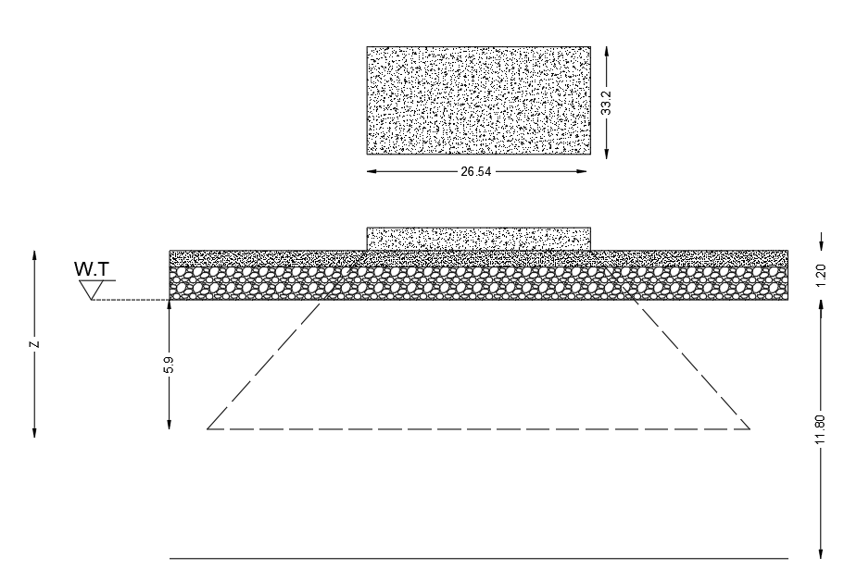
Settlement Check
Compression Index (Cc) = 0.26
Swelling Index (Cs) = Cc/5 = 0.052
Initial void ratio (e) = 0.67
Precompression Pressure (σc) = 110 kN/m²
Compression Index (Cc) = 0.26
Swelling Index (Cs) = Cc/5 = 0.052
Initial void ratio (e) = 0.67
Precompression Pressure (σc) = 110 kN/m²

Slide 14
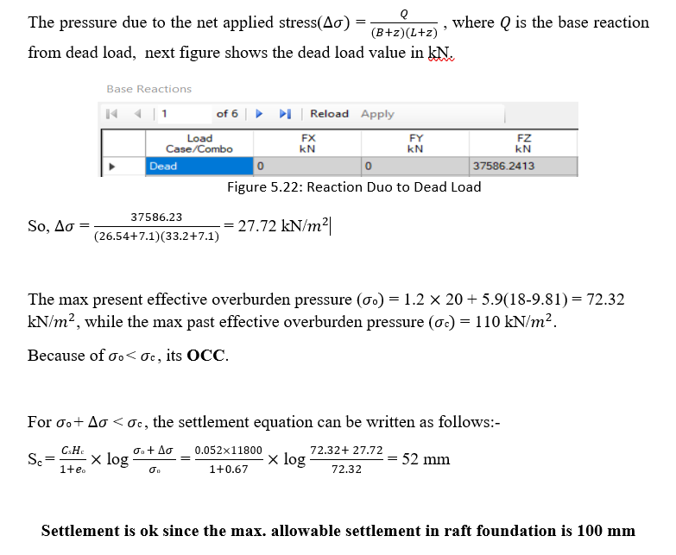
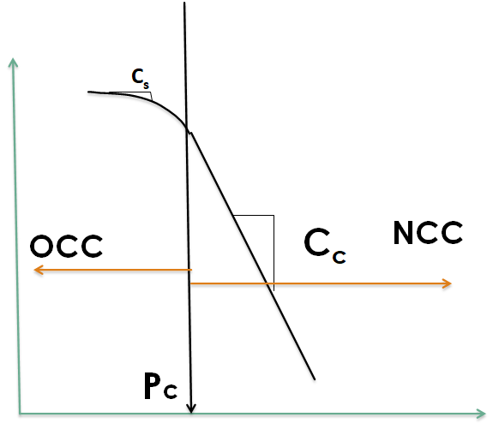
Settlement Check

Slide 15
Thank You for Listening

