Slide 1
Palestinian tourist guide
P.T.G
Presented by: Takreem Abdallah
Aya Yaseen
Supervisor : Dr. Asma Afifi

Slide 2
Outlines
Introduction.
Features.
Technologies.
Methods and Techniques .
Constrains .
Future work and Recommendation.

Slide 3
What is Palestinian tourist guide?
Palestinian tourist guide is a website that helps tourists
to choose the hotel they want to stay in , according to the available cities in the website , in addition to choose appropriate restaurants and tourist places, and other features which is provided to the tourist in his trip .

Slide 4
Features
Show the current weather conditions.
Book a hotel .
Booking and Ordering from restaurant.
Show the taxi offices in each city with their numbers.
Show a Map for the Hotels.
Translate the pages for other languages.
Like and dislike buttons for the website.
Showing the number of Visitors
Rating for the Places , restaurants and hotels.
Comments “feedback” for the Places , restaurants and hotels.
Help users to find the suitable place -and recommend- it using dynamic chat
by asking them some questions.

Slide 5
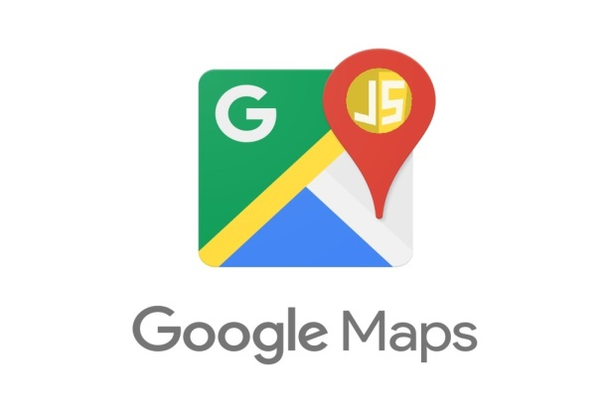
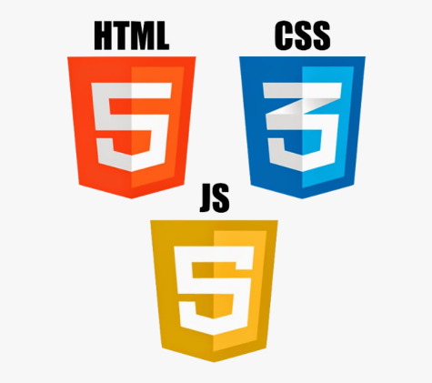


Technologies

Slide 6
Methods and Techniques
Sign up.
Login
Main Page.
Restaurants .
Hotels.
Weather.
Find a Taxi .
Recommended Hotels .
Recommended Restaurants.
Comment from users.
Order and Booking.
User Profile.
Chat .
Rating .
Language translation within the site.

Slide 7
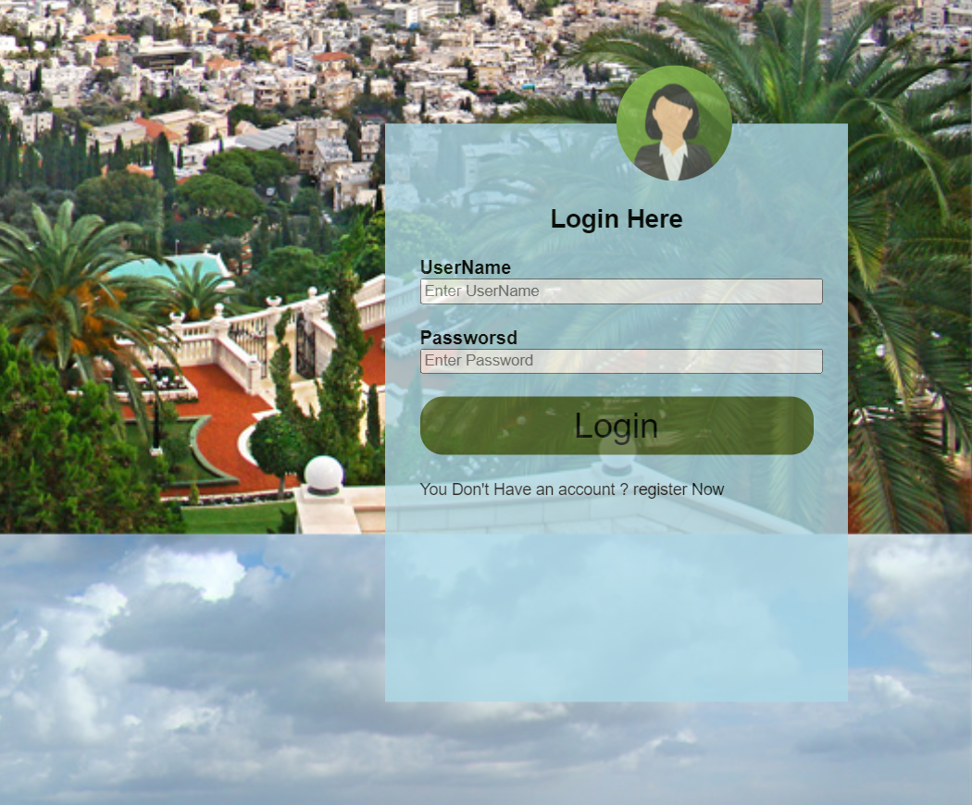
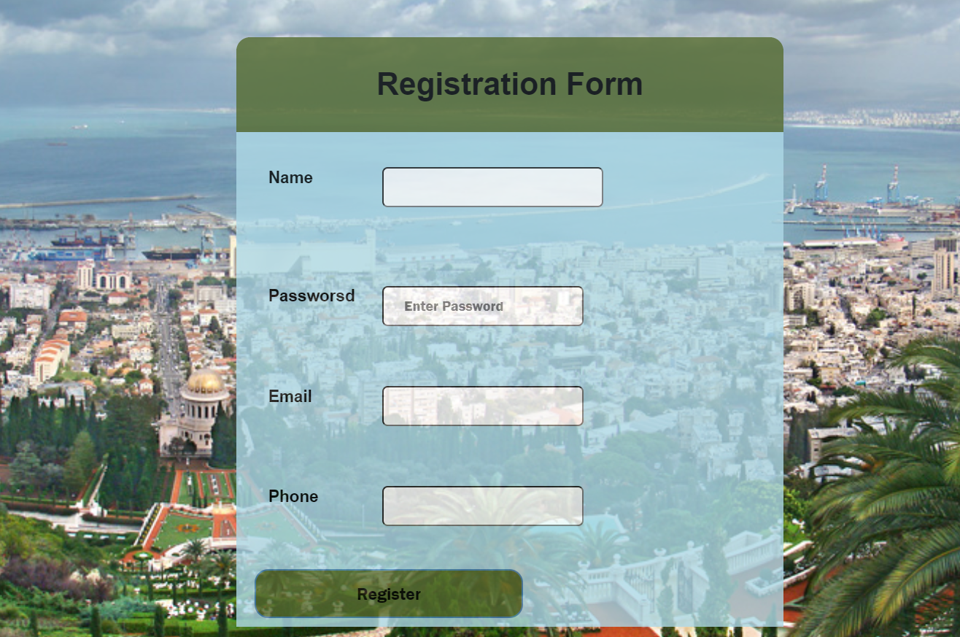
Sign Up/Login

Slide 8
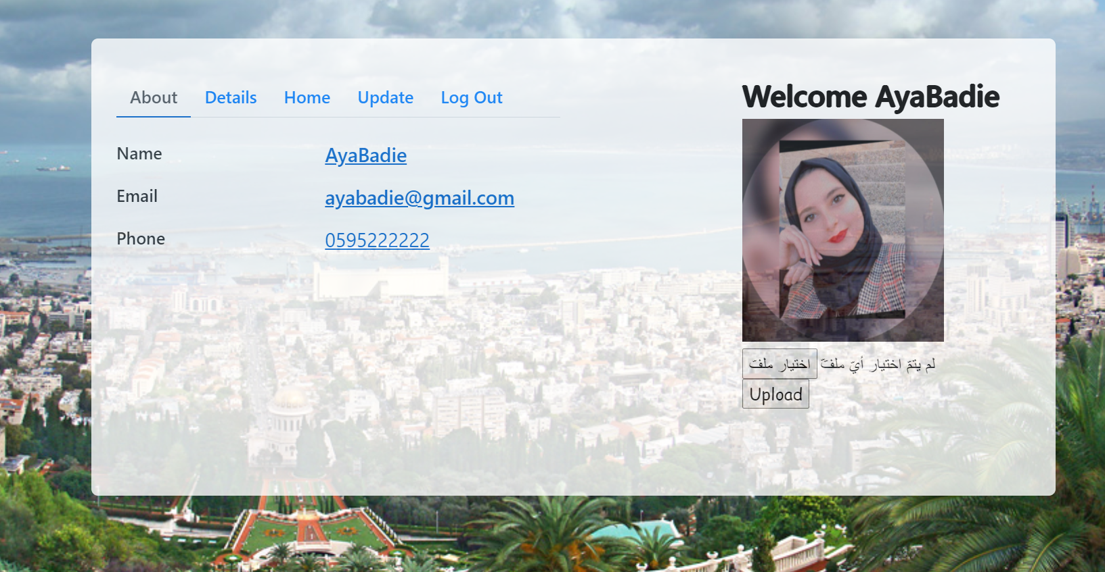
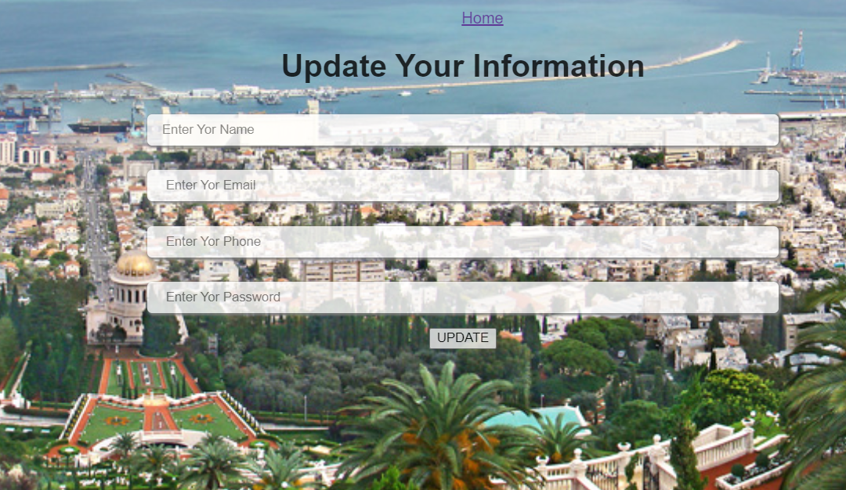
User Profile

Slide 9
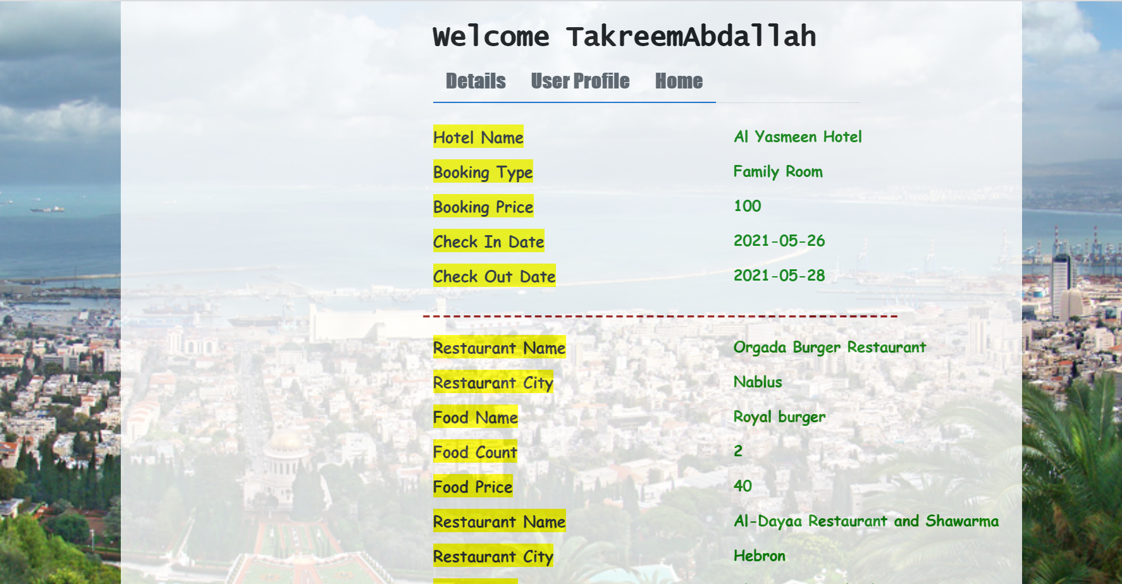

Slide 10
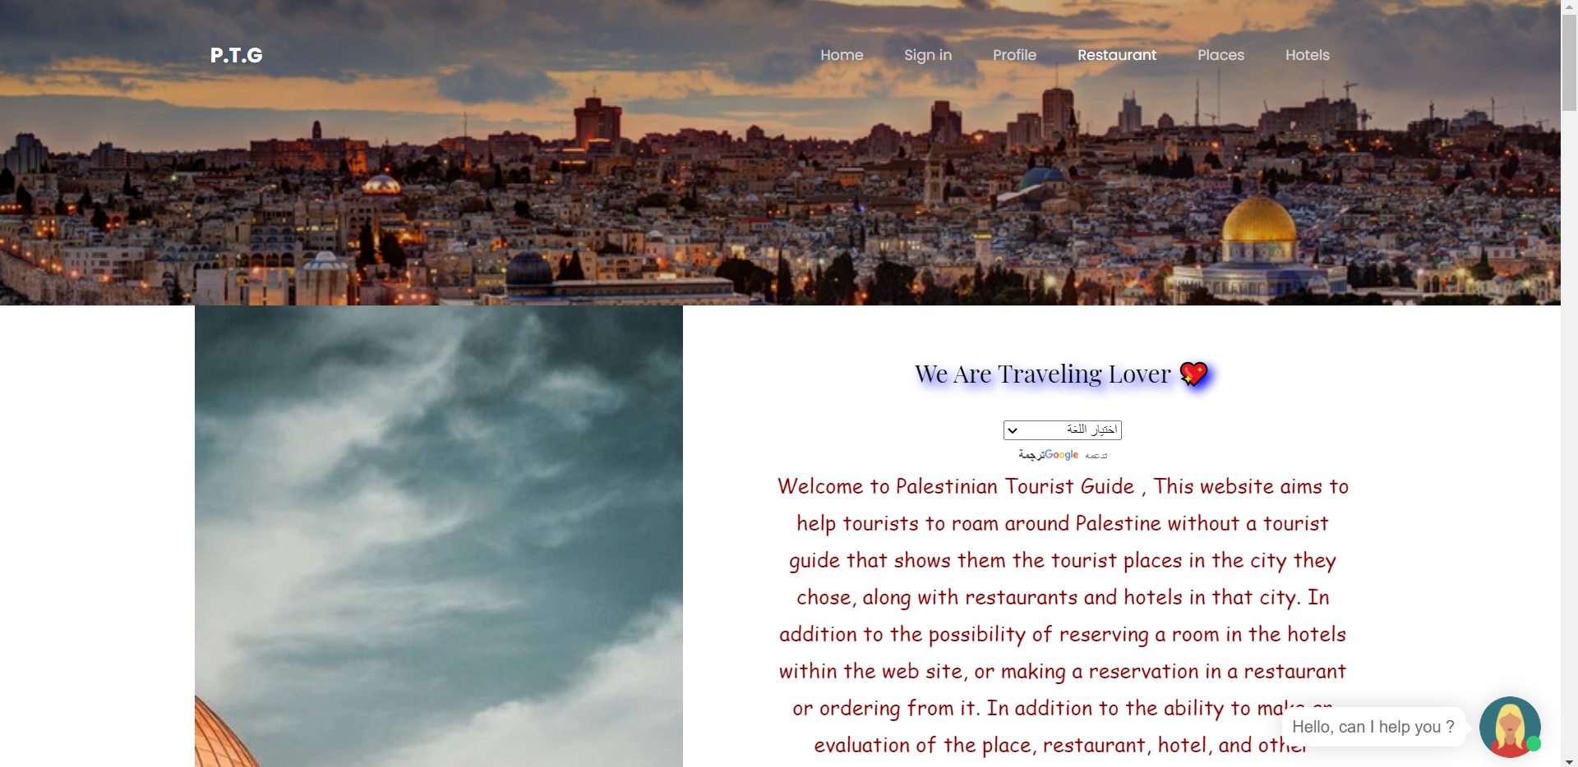
Main page

Slide 11
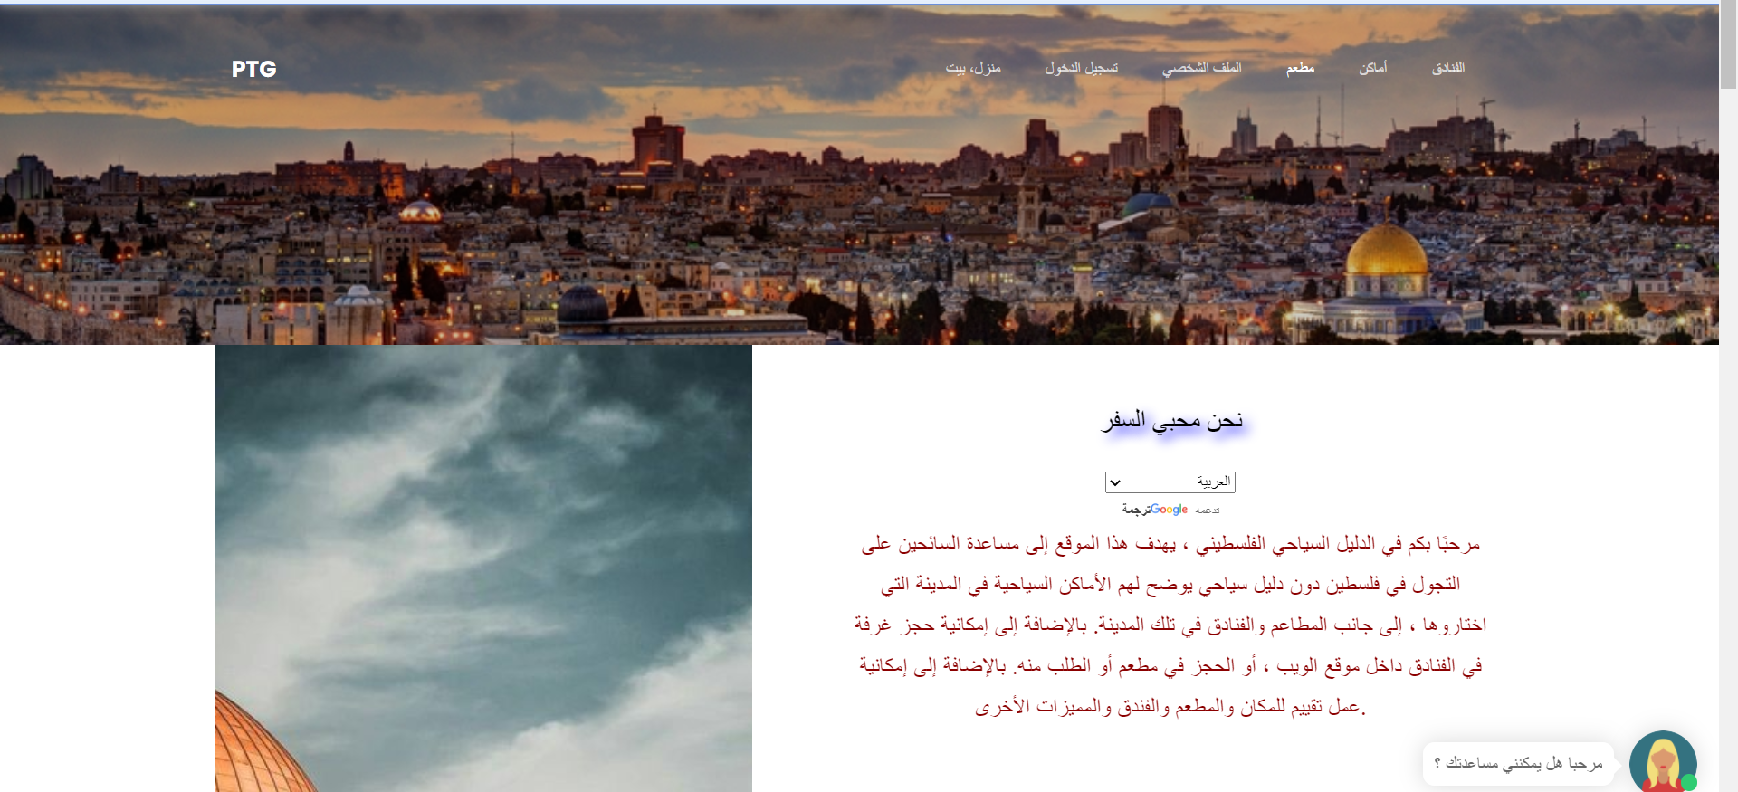

Slide 12
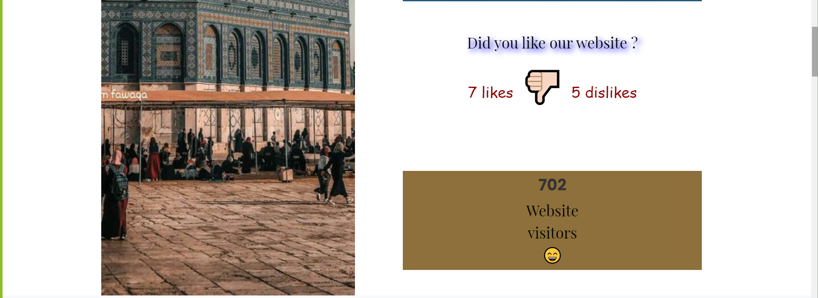

Slide 13
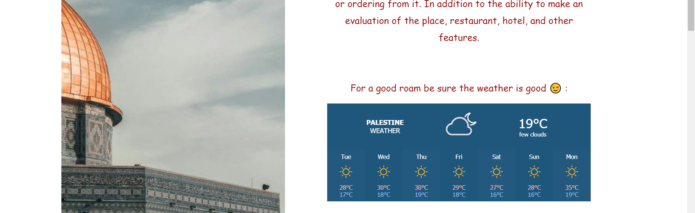
Weather

Slide 14
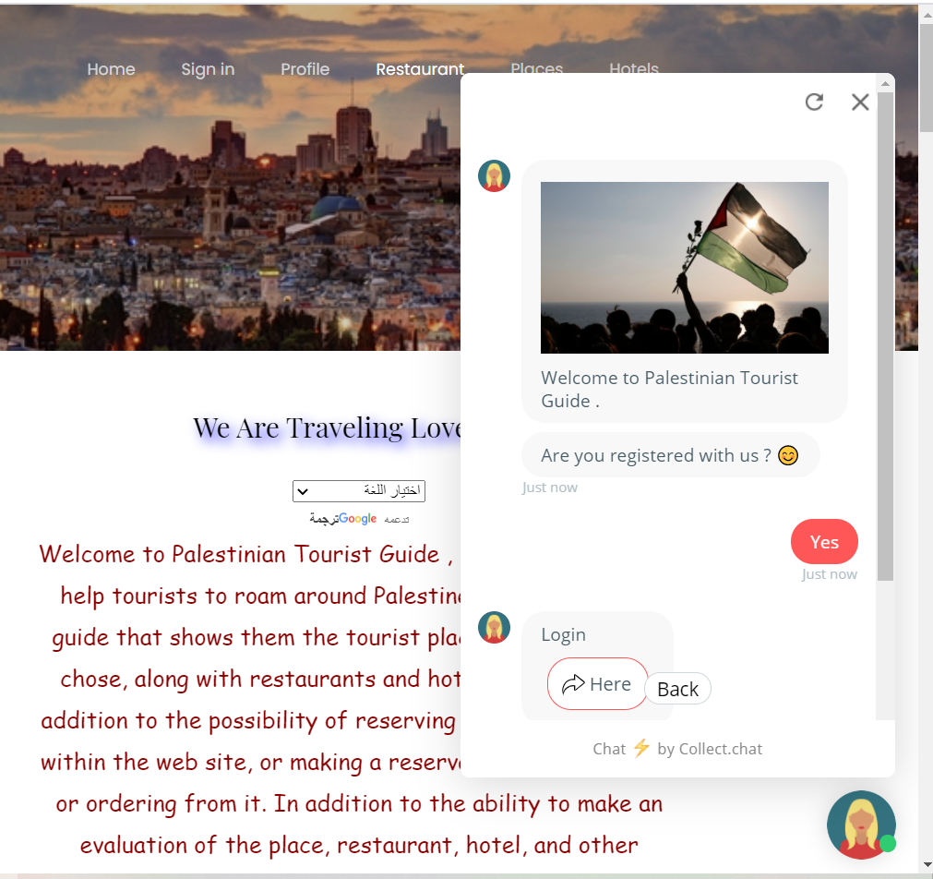
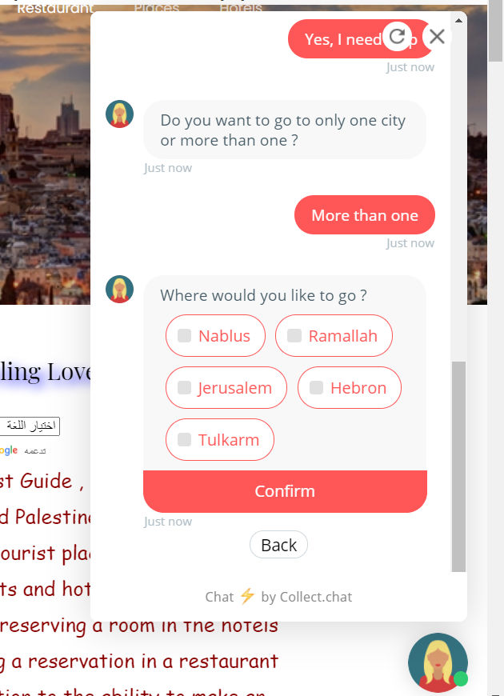
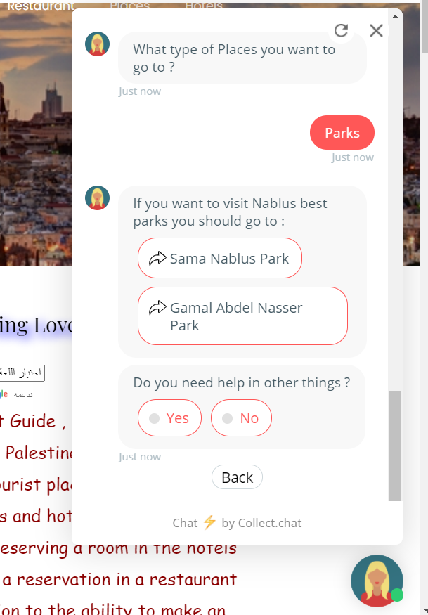
Chat

Slide 15
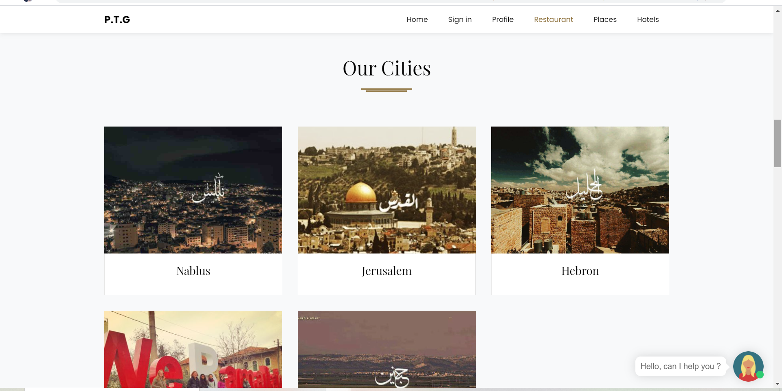

Slide 16
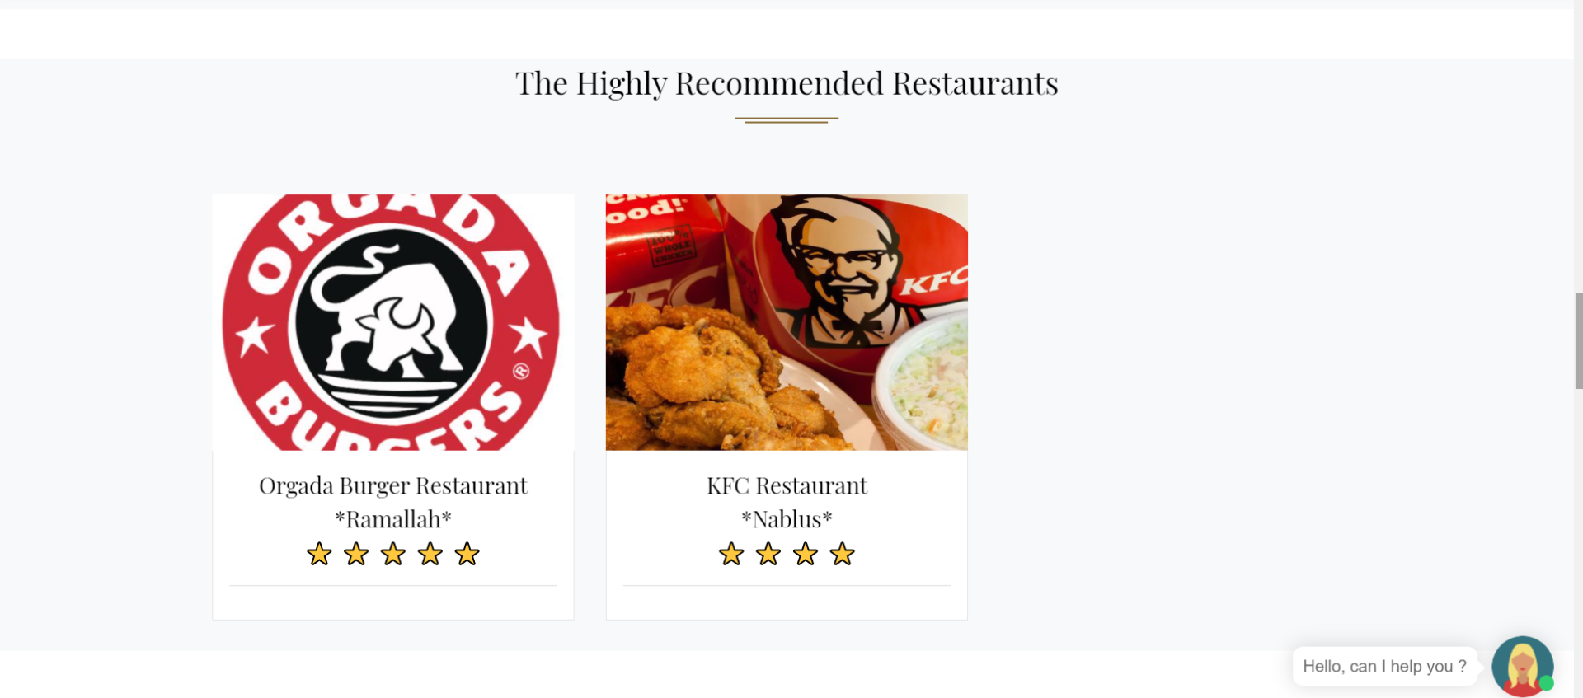
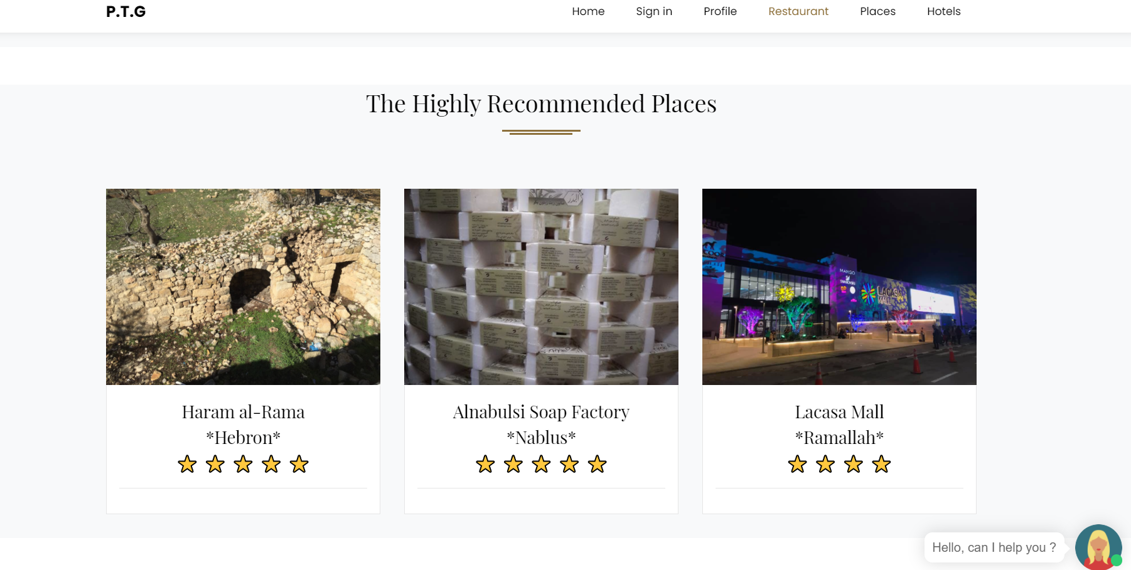

Slide 17
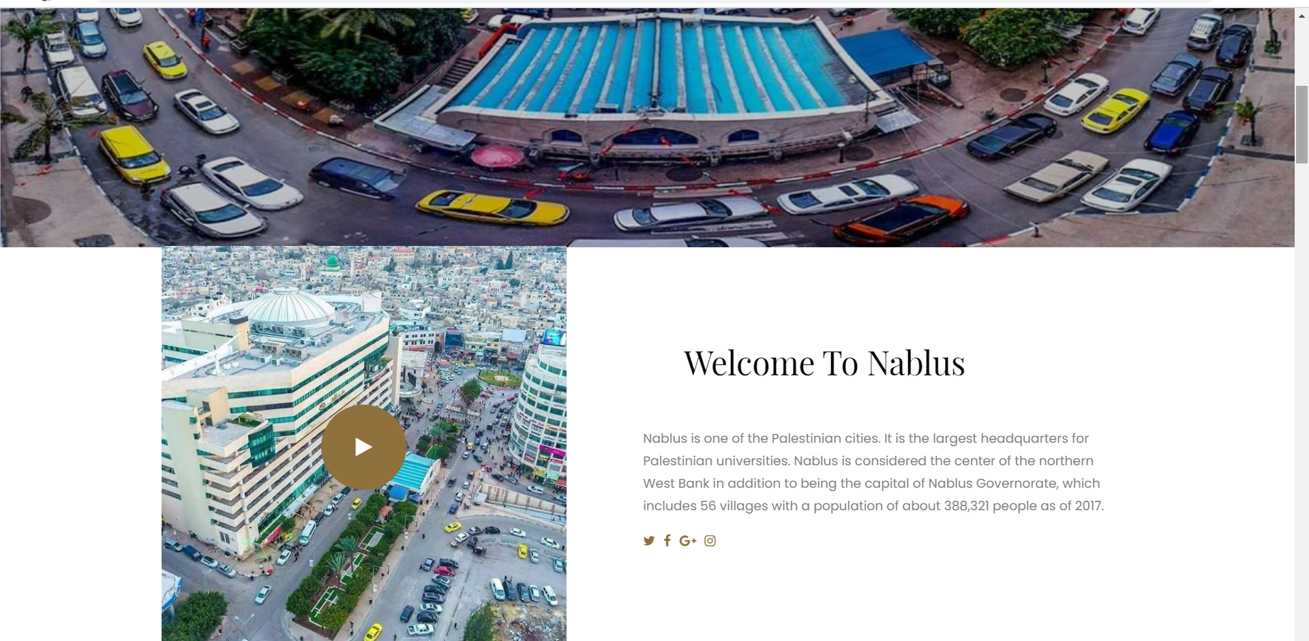

Slide 18
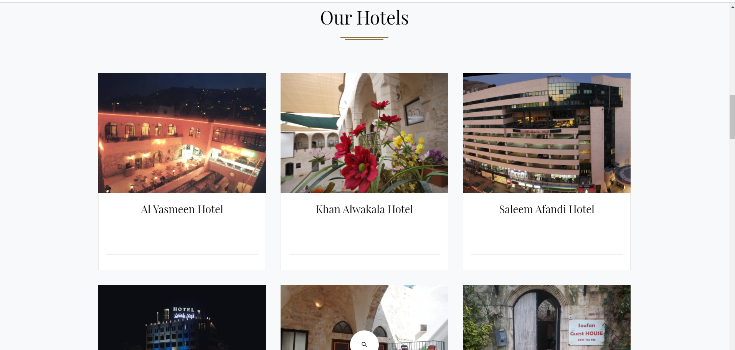

Slide 19
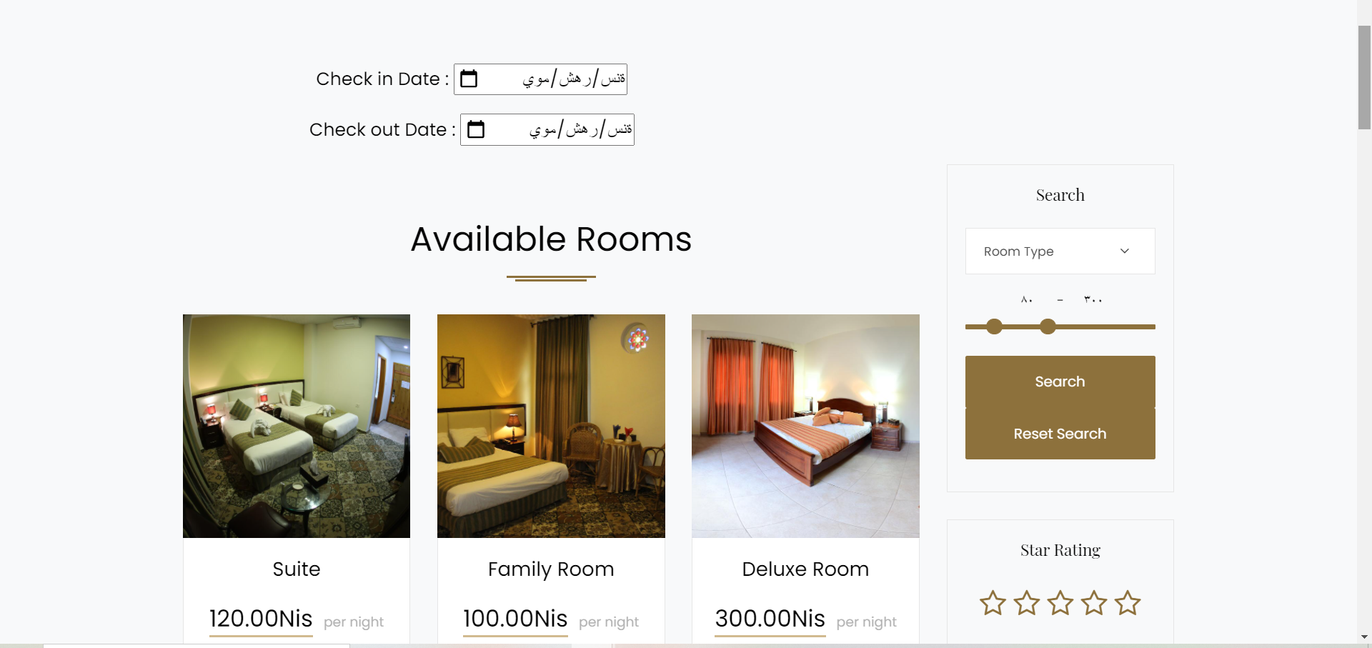
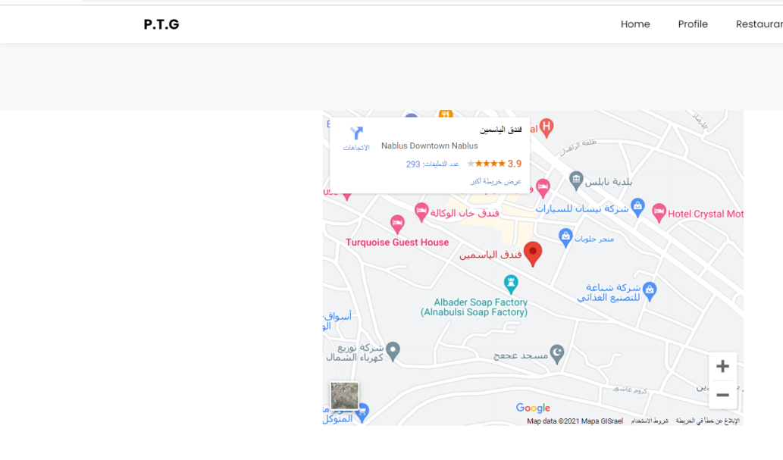
Hotels

Slide 20
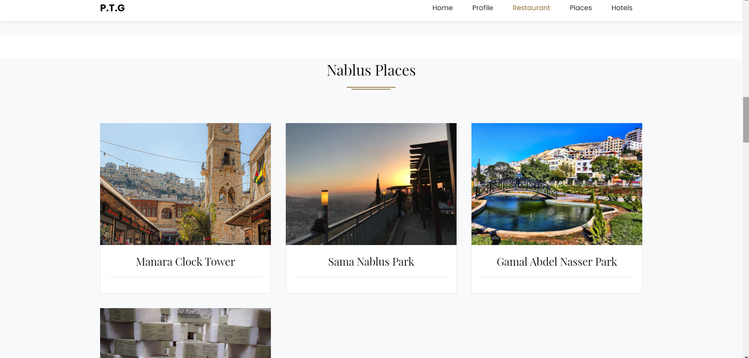
Tourist Places

Slide 21
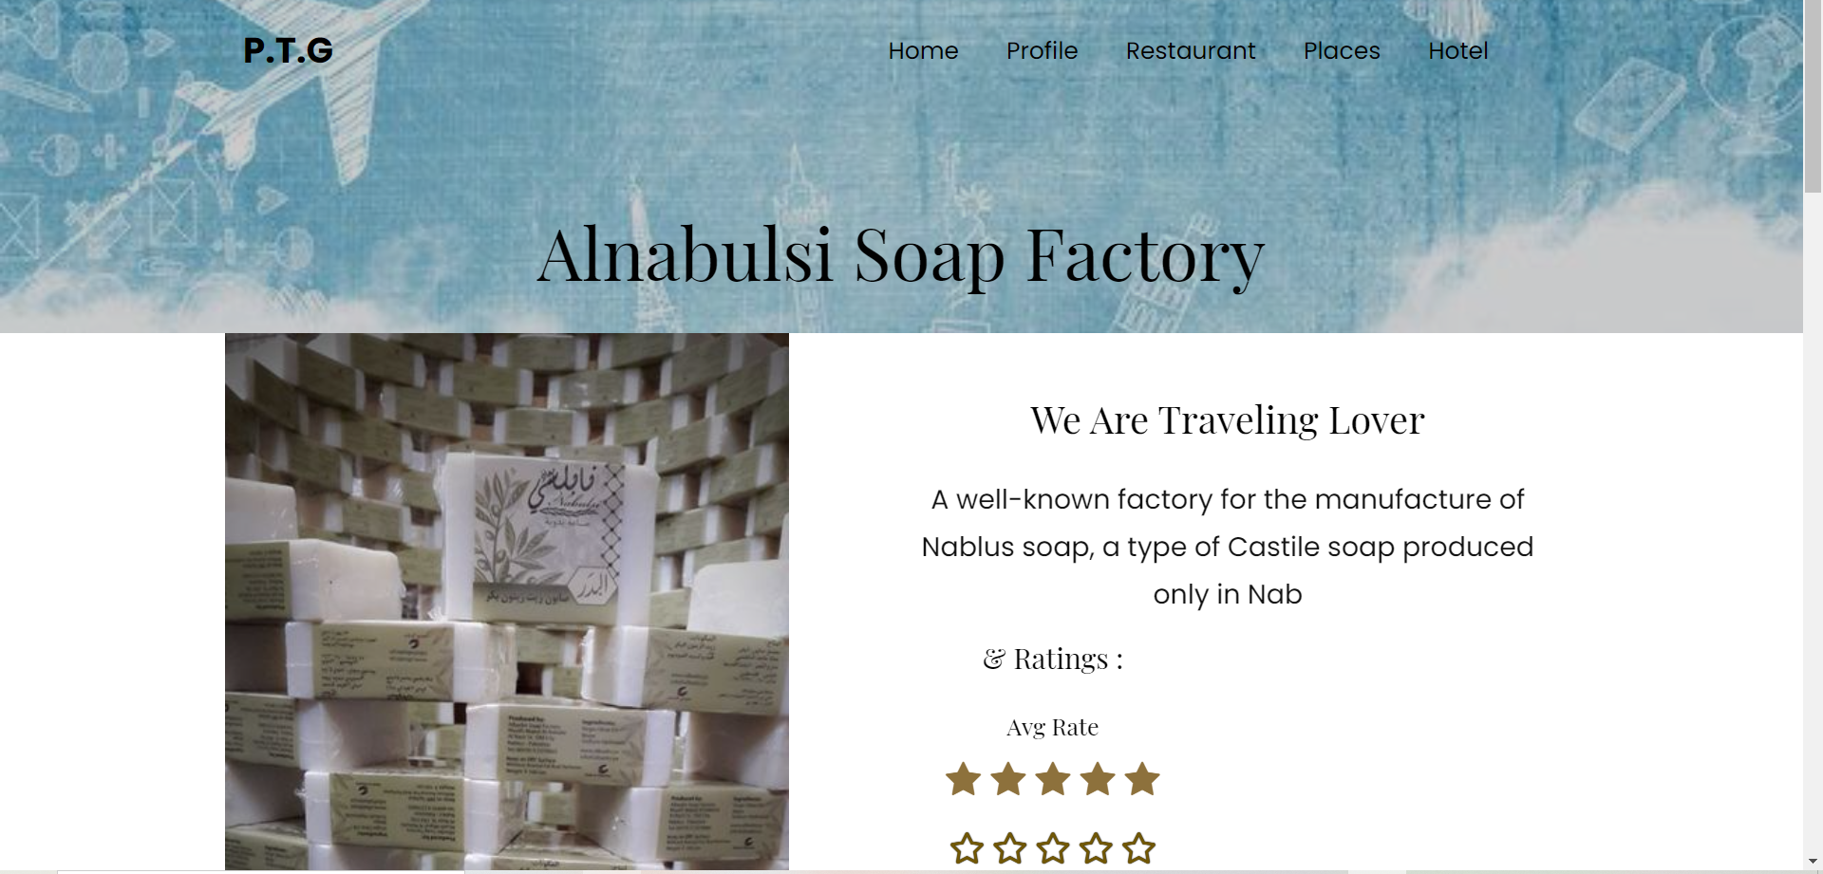

Slide 22
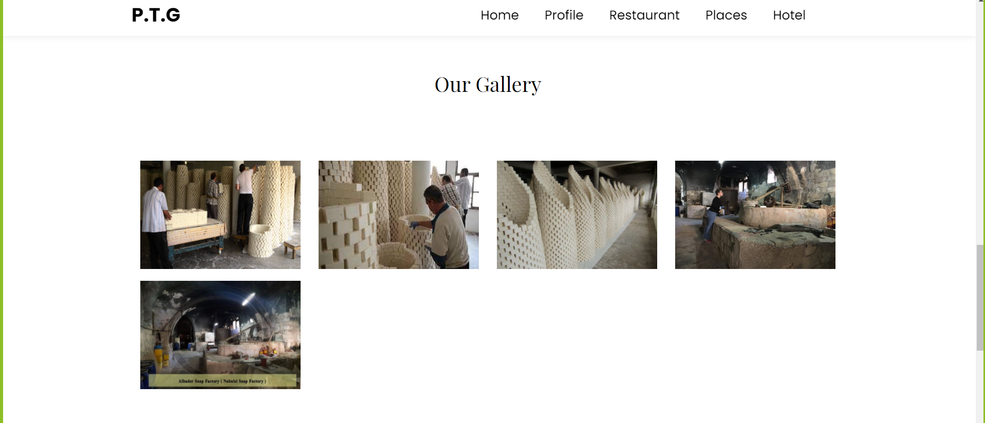

Slide 23
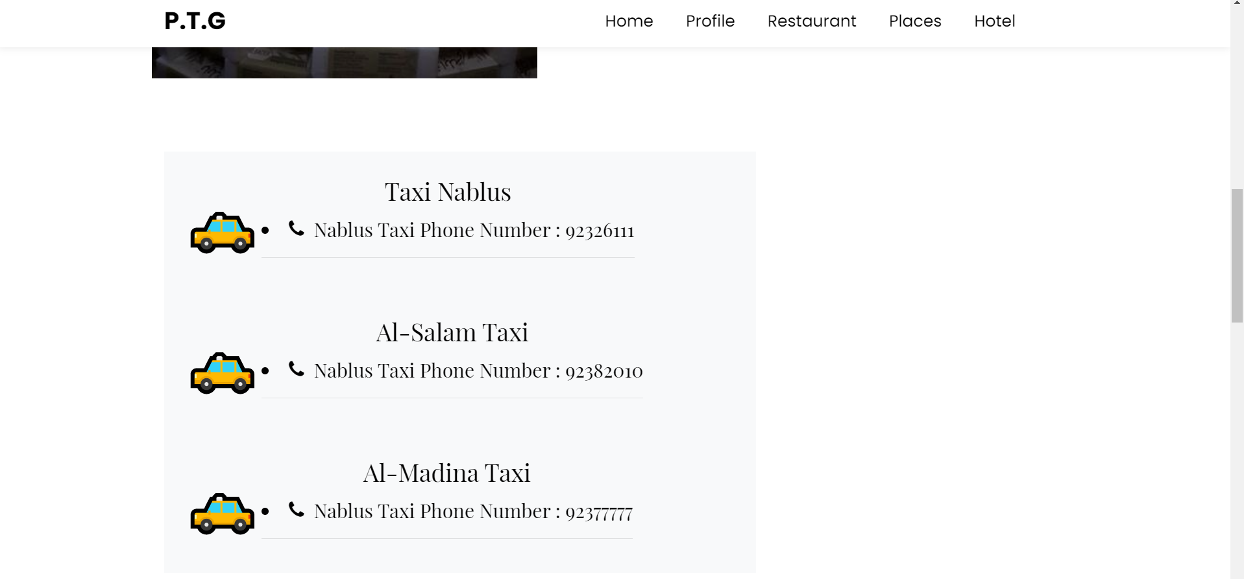
Taxi

Slide 24
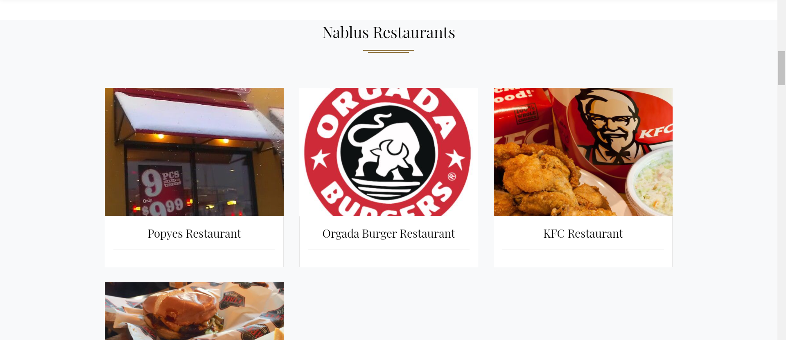
Restaurants

Slide 25
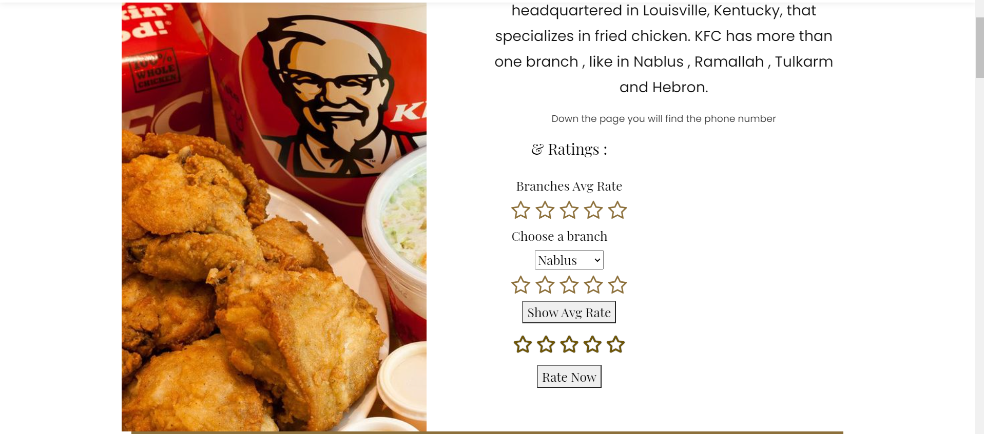
Rating

Slide 26
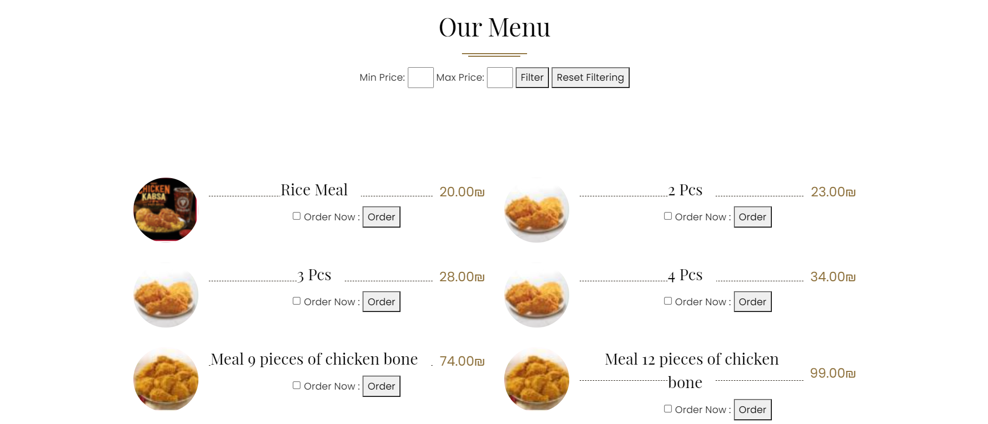
Order +Booking

Slide 27
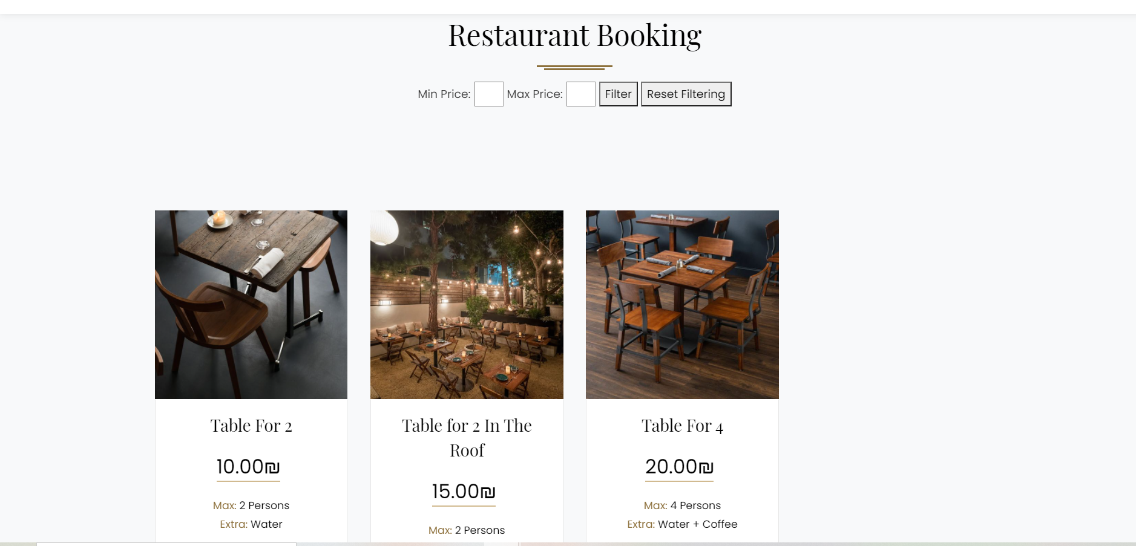

Slide 28
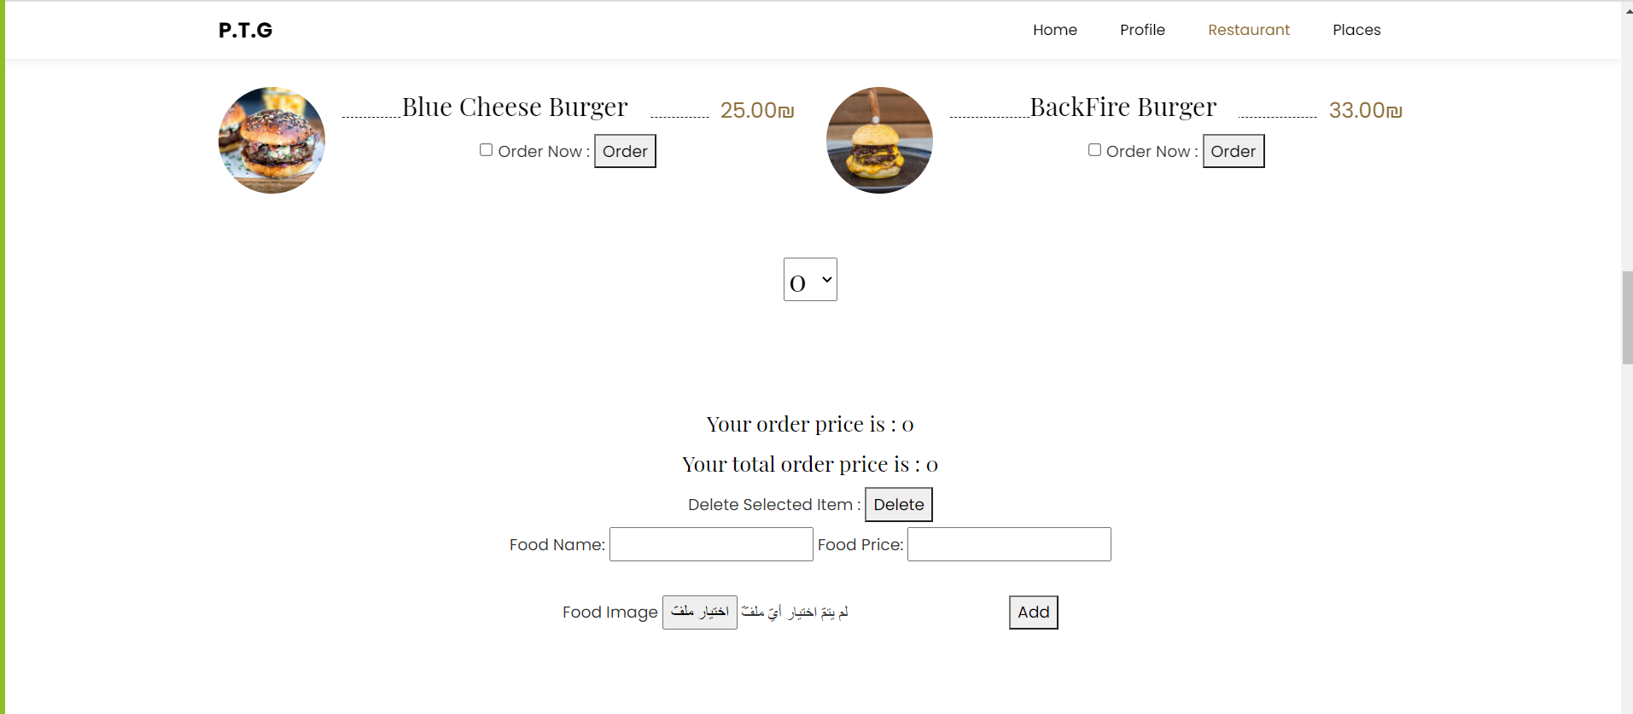
Admin

Slide 29
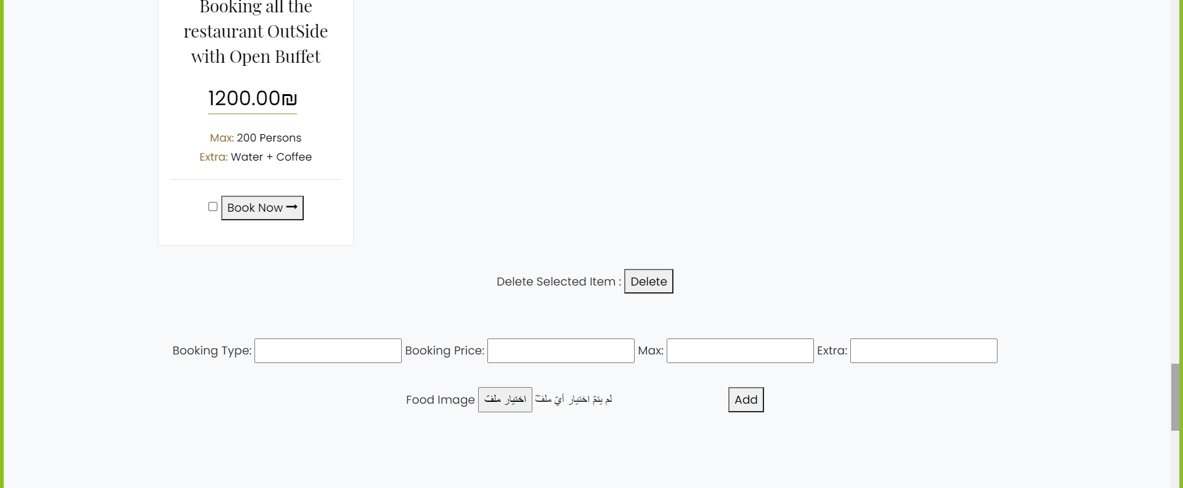

Slide 30
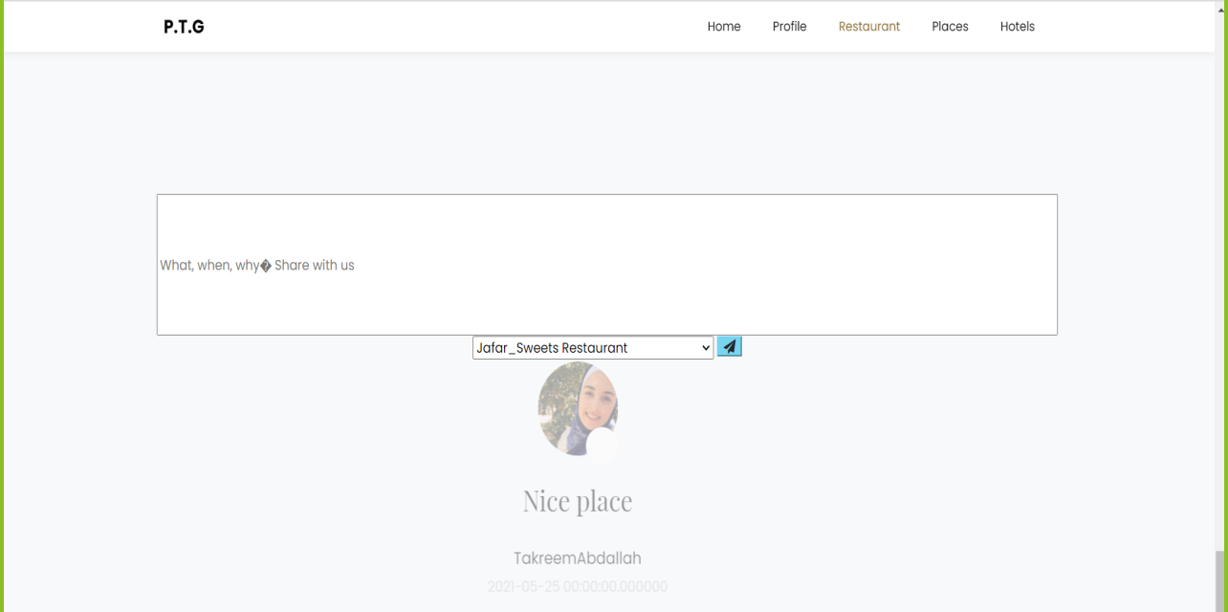
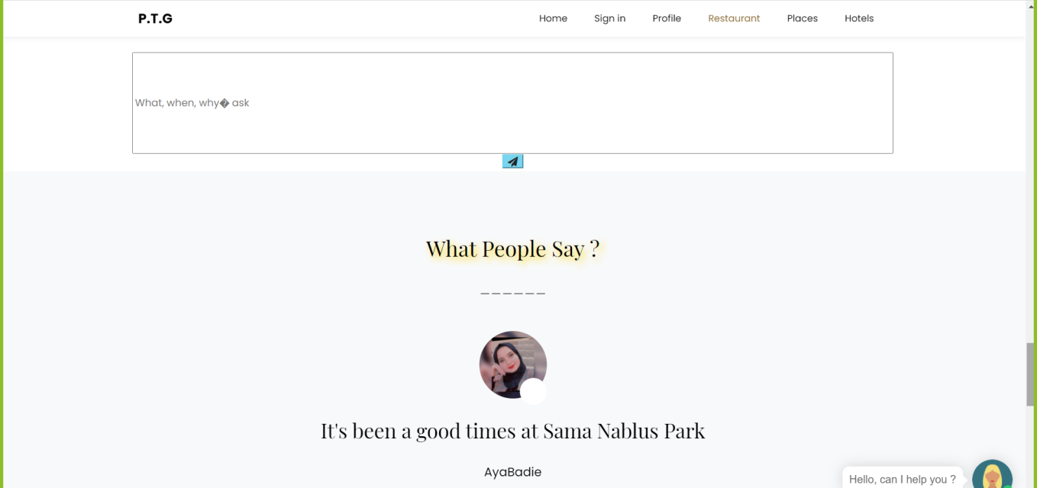
Comments/Feed Back

Slide 31
Constrains
Learning new things.
Health conditions in the country (COVID-19).
Study pressure in online mode:

Slide 32
Future work
Add a property that allows site users to communicate with each another.
Access to health clinics and hospitals.
Currency convertor .
Adding new cities on the site, such as Acre, Haifa and Jaffa .
Add the possibility to pay with a credit card.

Slide 33
The End
Thank You ☺

