Slide 1
Measuring Palestinian labors productivity Rates for Block, Steel and excavation works
Supervisor:
Eng. Luay Dwaikat
Prepared by:
Abdul-Wahab Al-Madani
Azzam Abu Jalbosh
Khalil Al Masri
Mohammed Fares

Slide 2
Outline
Introduction
Methodology & Data Analysis
Results & Discussion
Conclusion & Recommendation

Slide 3
Introduction

Slide 4
Overview :
We have chosen this study due to a problem exist in our country “none availability of a reference for Palestinian labors` productivity rates”, our aim at this research was to know how to solve this problem in order to produce a reference for Palestinian labors’ productivity rates for Block, reinforcement and Excavation works.
Notes:
nfor

Slide 5
Productivity Rate Definition:
A productivity rate is the quantity produced or constructed over a specific time period.
Productivity rates may vary considerably depending on project size, geographic location, even for the same item of work.

Slide 6
Scope of Work:
The purpose of this research is to obtaining labor productivity rates for three types of work, which are reinforcement, block work and excavation work.
In general, divide the three type of work into several sections of the work.

Slide 7
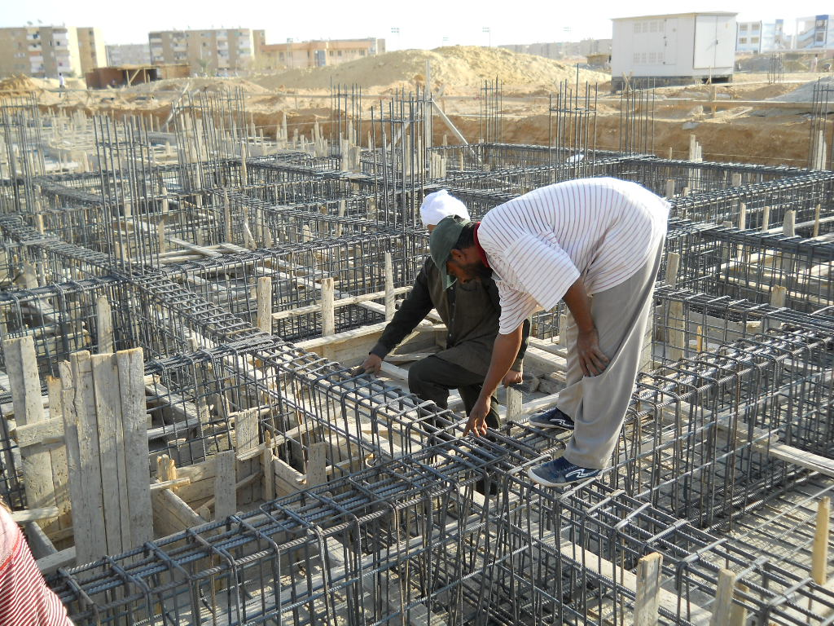
Reinforcement Work
Footings
Columns
Slabs
Tie Beams
Column Necks
Beams
Ground Slabs
Shear Walls

Slide 8
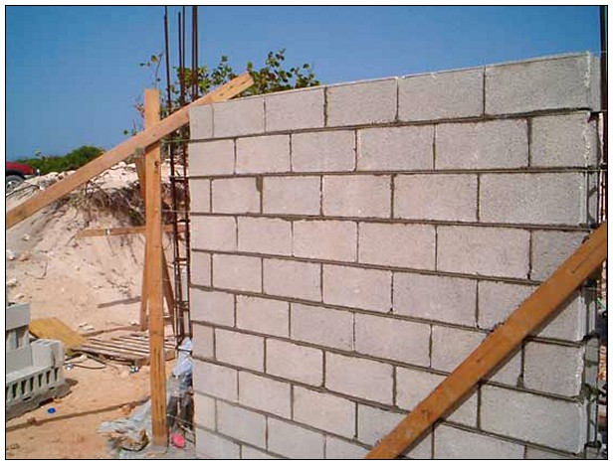
Block Work
10 Cm Block size
15 Cm Block size
20 Cm Block size

Slide 9
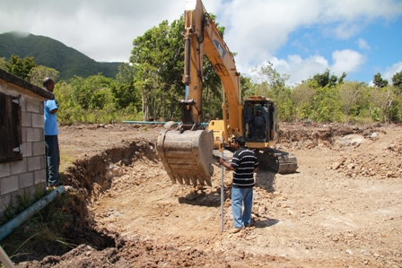
Excavation Work
Back hoe
Plate excavator
Wheel excavator
Pile excavator

Slide 10
Methodology

Slide 11
Data collection:
The data was collected by visiting many projects and construction sites in several Palestinian cities.
Data collection methods:
1- Questioner method.
2- Direct observation method.

Slide 12
Questioner
This method was applied by making interviews with contractors ,engineers and foremen, by asking them many questions such that :
1- Crew size of every type of work.
2- The quantity of work per day for that crew size.
3- Number of working hours per day.

Slide 13
Direct Observation Method
At this method the amount of work that performed till the beginning of the day was recorded, after that the work performed at the end of that day was recorded, the difference between these records is the work accomplished at that day.
The division of the amount of accomplished work by the time that have been needed to finish that work is the productivity rate for the considered crew size

Slide 14
Data Collection Procedures
1-According to a statistic, the minimum number of observations is 30, at a 90% confidence level.
2-A data form sheet that we have used in questioner method was designed, as shown in the next slide.
3-Many Construction sites were visited, then we tried to obtain productivity rates for type of works mentioned earlier.

Slide 15
Data Sheet For Block Work
productivity rate sheet
2. block work
surveyor: |  |  | Site: |  |  | Tempreture:
Date: / / |  | city : | time
Item |  | crew size | from | to | Hours | Quantity (unit ) | PR(unit/day)
2.1 | 10 cm block
2.2 | 15 cm block
2.3 | 20 cm block

Slide 16
Data Analysis
All of data had been taken under normal distribution.
Minitab15 software is a statistical program was used to analyze data.

Slide 17
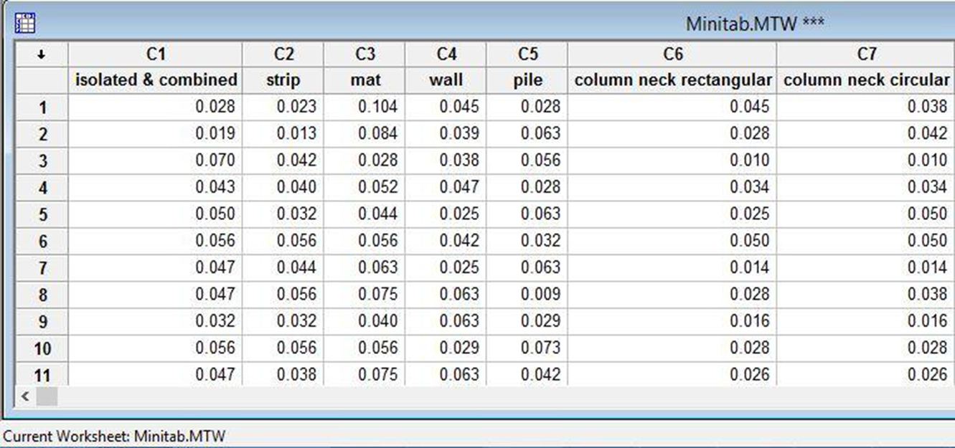
Data In Minitab

Slide 18
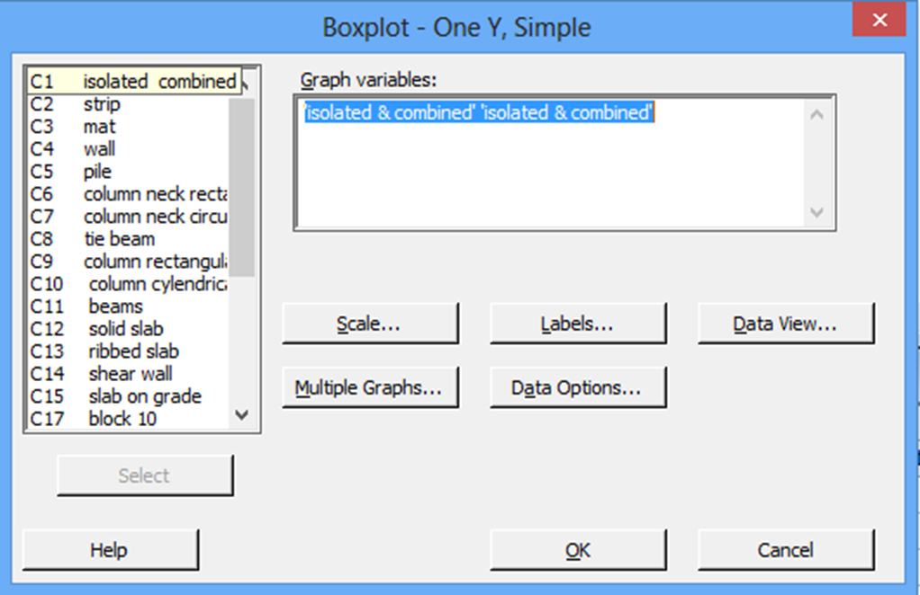
Find outliers for each work item using boxplots

Slide 19
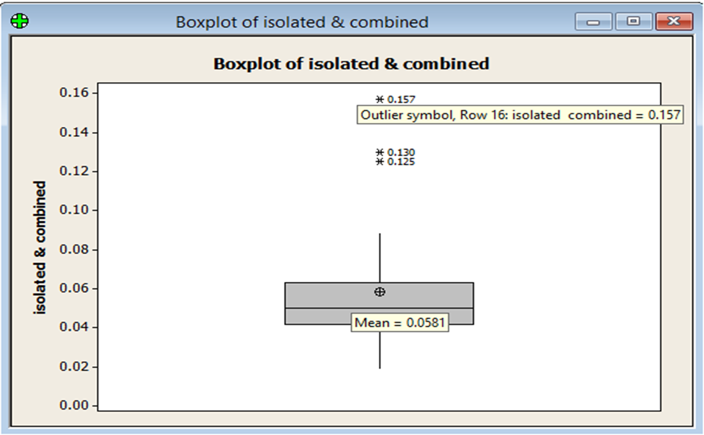
excluding outliers

Slide 20
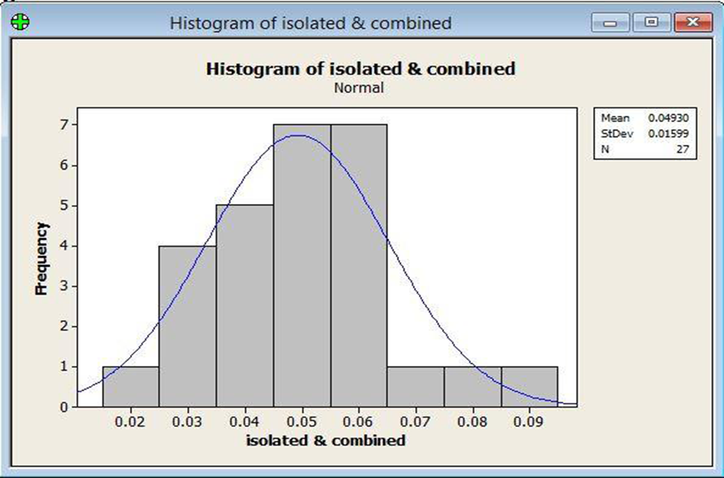
Arithmetic Mean was got using normal distribution curve from Minitab

Slide 21
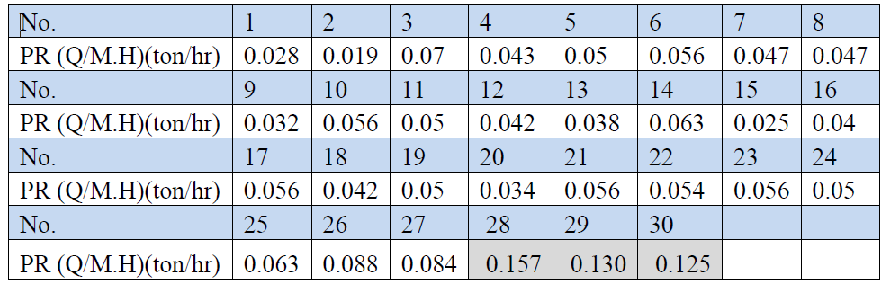
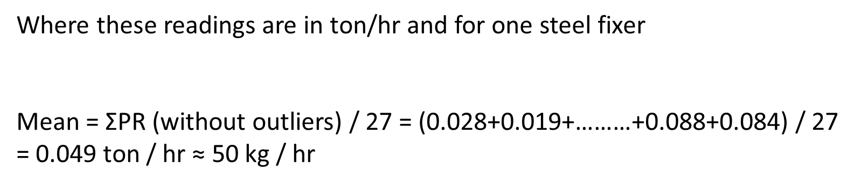
Mean from Minitab was checked manually after excluding outliers

Slide 22
Results
&
Discussion

Slide 23
samples’ outliers and crew size determination
After data analysis using Minitab software, the results shown in the table next slide were obtained; which represent the analytical results of Productivity Rates for specific types of construction work

Slide 24
Samples |  |  | Information |  |  | Before excluding Outliers |  |  | After excluding Outliers
1 | Reinforcement Work |  | Crew size | Unit |  | per hr | per day |  | per hr | per day
1.1 | Footing
1.1.1 | Isolated & Combined |  | 4 workers | Kg |  | 236 | 1888 |  | 200 | 1600
1.1.2 | Strip |  | 4 workers | Kg |  | 200 | 1600 |  | 160 | 1280
1.1.3 | Mat |  | 4 workers | Kg |  | 312 | 2496 |  | 272 | 2176
1.1.4 | Wall |  | 4 workers | Kg |  | 220 | 1760 |  | 220 | 1760
1.1.5 | Pile |  | 4 workers | Kg |  | 208 | 1664 |  | 192 | 1536

Slide 25
Crew size selection
Crew size should be unified for same type of work
For select the most appropriate crew size number, a figure was obtained for each type of work by getting the relation between crew size and its productivity rate
Table in the next slide shows one of these figures

Slide 26
Crew size effects on productivity rates

Slide 27
This figure also illustrates the effect of crew size on the productivity rates. As the crew size increases the productivity rates increases too, until it reaches the optimum value where the productivity rate start decreasing.
After that we get that the most appropriate crew sizes are as follows :
Reinforcement Work → crew size (4 workers)
Block work → crew size (2 workers)
Excavation work → crew size (excavator and operator)

Slide 28
Mean Productivity rates for the specific work item and crew size were obtained as discussed in this representative table:
eg. Reinforcement Work – Strip Footings
PR (Q/Mh) | crew size | PR (C.Q/Mh) | w.hr/d | PR (Q.C/d)
40 kg/hr | 4 workers | 4x40=160 kg/hr | 8 | 200x8=1280 kg/d

Slide 29
Confidence Intervals Determination
Contractors have to check their labors productivity, usually there is a confidence interval for each work item productivity rate, so that this table was attached to give lower and upper limits for confidence intervals.

Slide 30
Samples |  |  | Mean | Units |  | CI 95% (Minitab) |  |  | CI 95% (Manual)
 |  |  | (Q/hr) |  |  | Lower limit | upper Limit |  | Lower limit | upper Limit
1 | Reinforcement Work
1.1 | footing
1.1.1 | isolated & combined |  | 197.2 | Kg |  | 171.89 | 222.48 |  | 173.08 | 221.32
1.1.2 | strip |  | 156.6 | Kg |  | 138.04 | 175.15 |  | 138.91 | 174.29
1.1.3 | mat |  | 269.56 | Kg |  | 233.95 | 305.2 |  | 235.53 | 303.59
1.1.4 | wall |  | 217.72 | Kg |  | 195.36 | 240.11 |  | 196.28 | 239.16
1.1.5 | pile |  | 191.04 | Kg |  | 161.41 | 220.66 |  | 162.69 | 219.39

Slide 31
Final Results
The next table shows the final results that obtained after excluding outliers and also after calculations depends on crew size determined.
This is the main table at this research, Palestinian contractors are recommended to use this table to make sure that their labors are working as required.

Slide 32
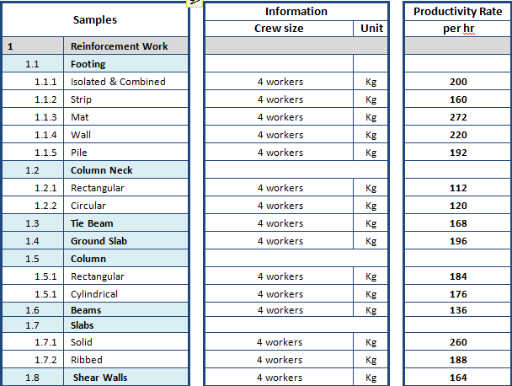

Slide 33
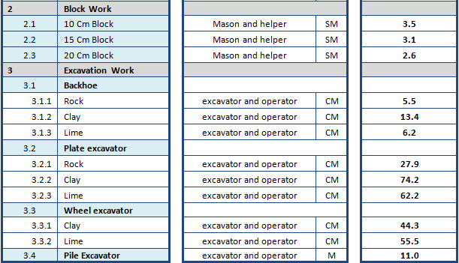

Slide 34
Conclusion
&
Recommendations

Slide 35
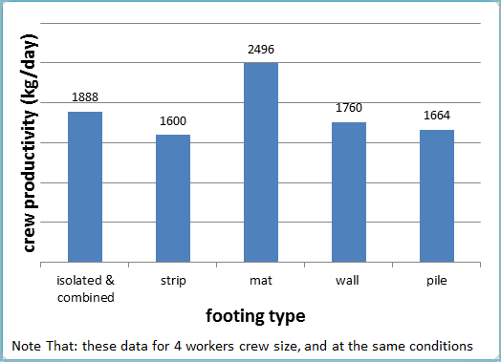
Conclusion
•Type of work effects on productivity rates

Slide 38
Factors
In order to get accurate results for any study, main factors that affect the study have to be taken in consideration
Work timings and working hours:
Material shortage at project site
Change order by consultants causing project delay

Slide 39
Main challenge
Since productivity rates measuring is a complicated topic in construction management, many difficulties were faced.
• Difficulty in finding any reference about Palestinian
labor productivity rates.
• Challenge in defining factors that affect labor productivity rates in construction projects.
• There are many aspects that could not be considered due to precise details.

Slide 40
Recommendation
Find suitable conditions for the workers to help them complete their work quickly and in a good quality.
Breaks.

Slide 41
Thanks for attention.
Questions

