Slide 1




CHAIR UP

Slide 2
Table Of Content
Introduction
Implementation
Abstract
Constraints
Problen and Objectives
Future Work

Slide 3


Introduction
People with physical disabilities need more mobility and independence to meet their needs and pursue their goals.

Slide 4
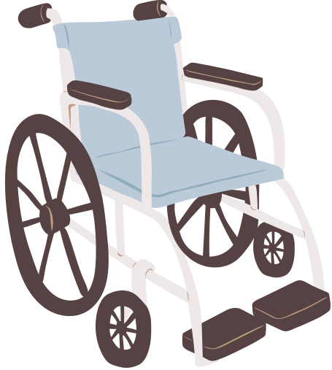

Abstract
Our innovative smart wheelchair enhances mobility and independence for individuals with disabilities. It offers multiple control modes, including voice commands, mobile app. Key features include obstacle detection, stair ascension, and a seat-lifting mechanism. It also monitors vital signs with real-time data display, ensuring continuous health tracking and safety. This project provides users with greater freedom and confidence in their daily lives.

Slide 5

Problem
Traditional wheelchairs lack modern technology.
Need for smooth navigation and reliable seat-lifting mechanism.

Slide 6

Integrate modern control modes.
Objective
Reliable performance and ease of use.
Ensure continuous health tracking.
Develop obstacle detection and stair ascension features.

Slide 7
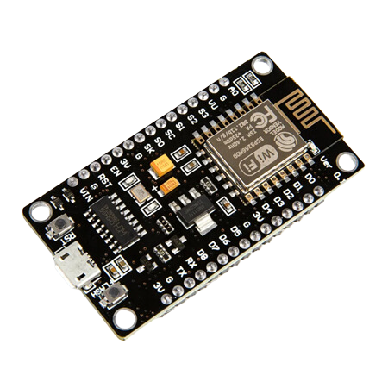
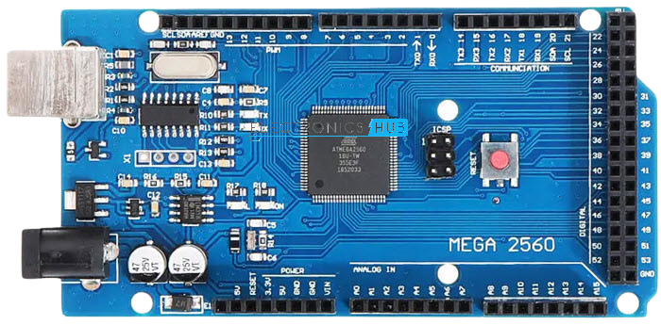


Hardware Component
Arduino Mega
Esp 8266

Slide 8
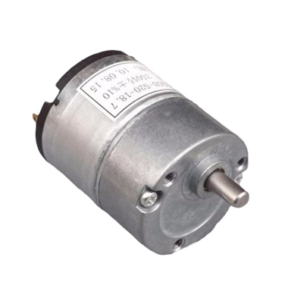
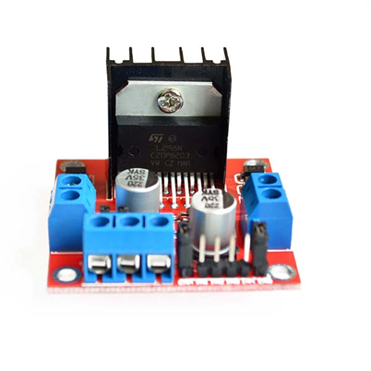
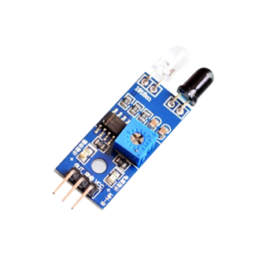



Hardware Component
DC Motor
H-Bridge
IR Sensor

Slide 9
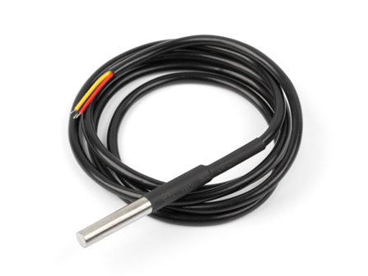
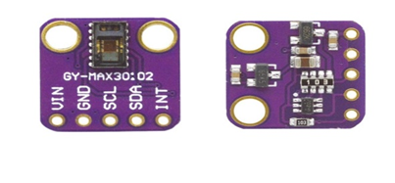
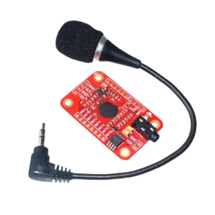



Hardware Component
Temperature Sensor (DS18B20)
Oximeter Max
GY-30102
Voice Recognation V3

Slide 10

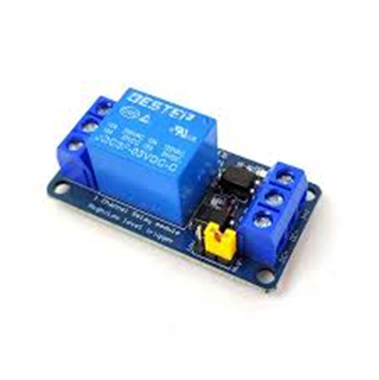
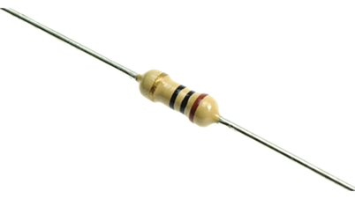



Hardware Component
Relay
Resistors
Battery 12 volt

Slide 11
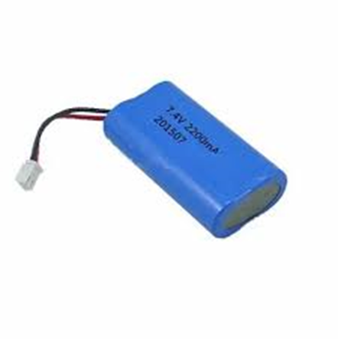
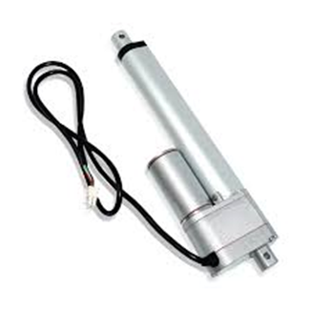


Hardware Component
Lithium Battery
Air Linear Actuater

Slide 12



Software Application
Arduino IDE
APP INVENTOR

Slide 13
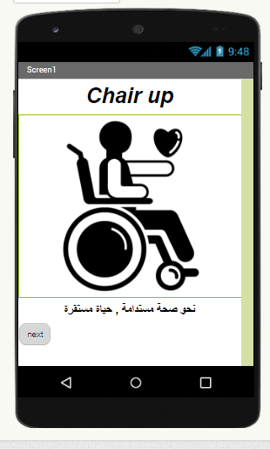
Software

Slide 14
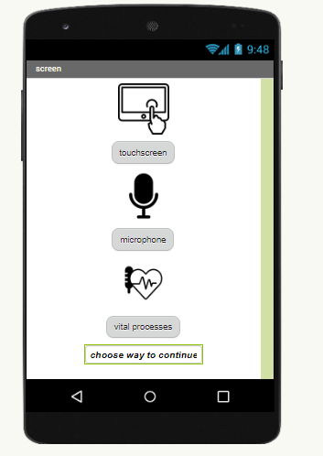
Software

Slide 15
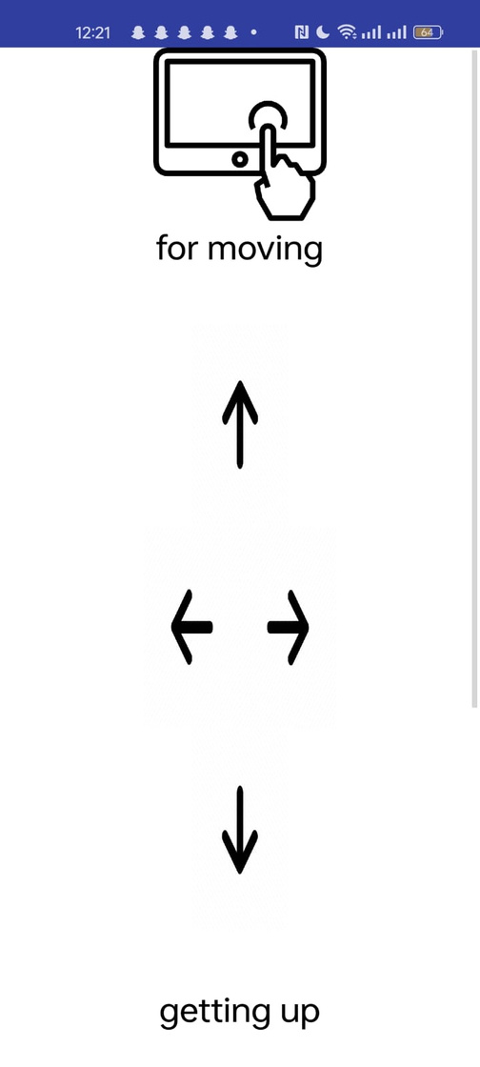
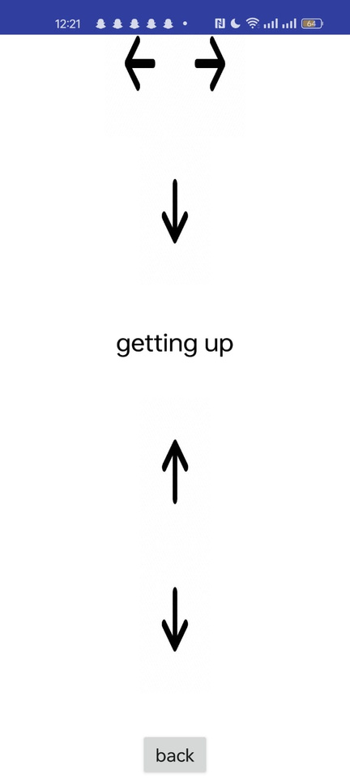
Software

Slide 16
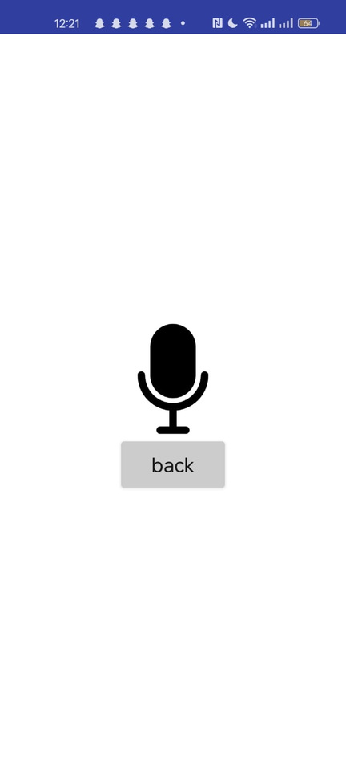
Software

Slide 17
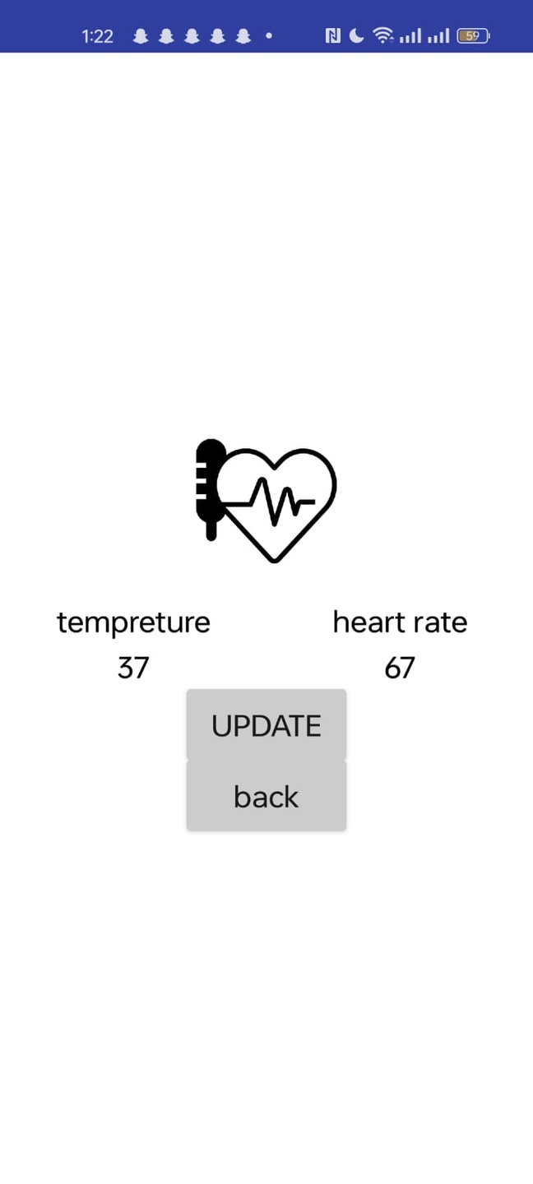
Software

Slide 18
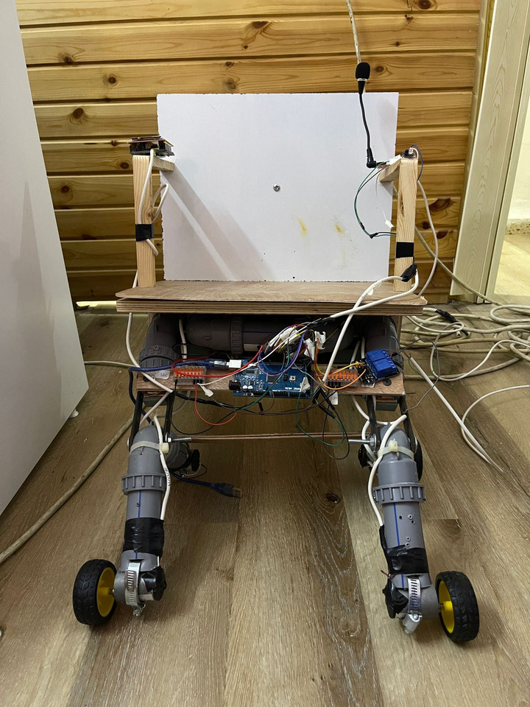

Constraints
01
Price
02
Size
Limited budget led to using wood and plastic, making the wheelchair a prototype, not a real-life product.
The machine's size is not life-sized; it's a representative example with additional features.

Slide 19
Future Work
01
02
03
Add a camera for obstacle recognition, navigation, and visual feedback
Implement machine learning for
adaptive user needs.
When a patient falls or is exposed to danger, he sends a notification to one of his family for help

Slide 20

THANK YOU

