Slide 1
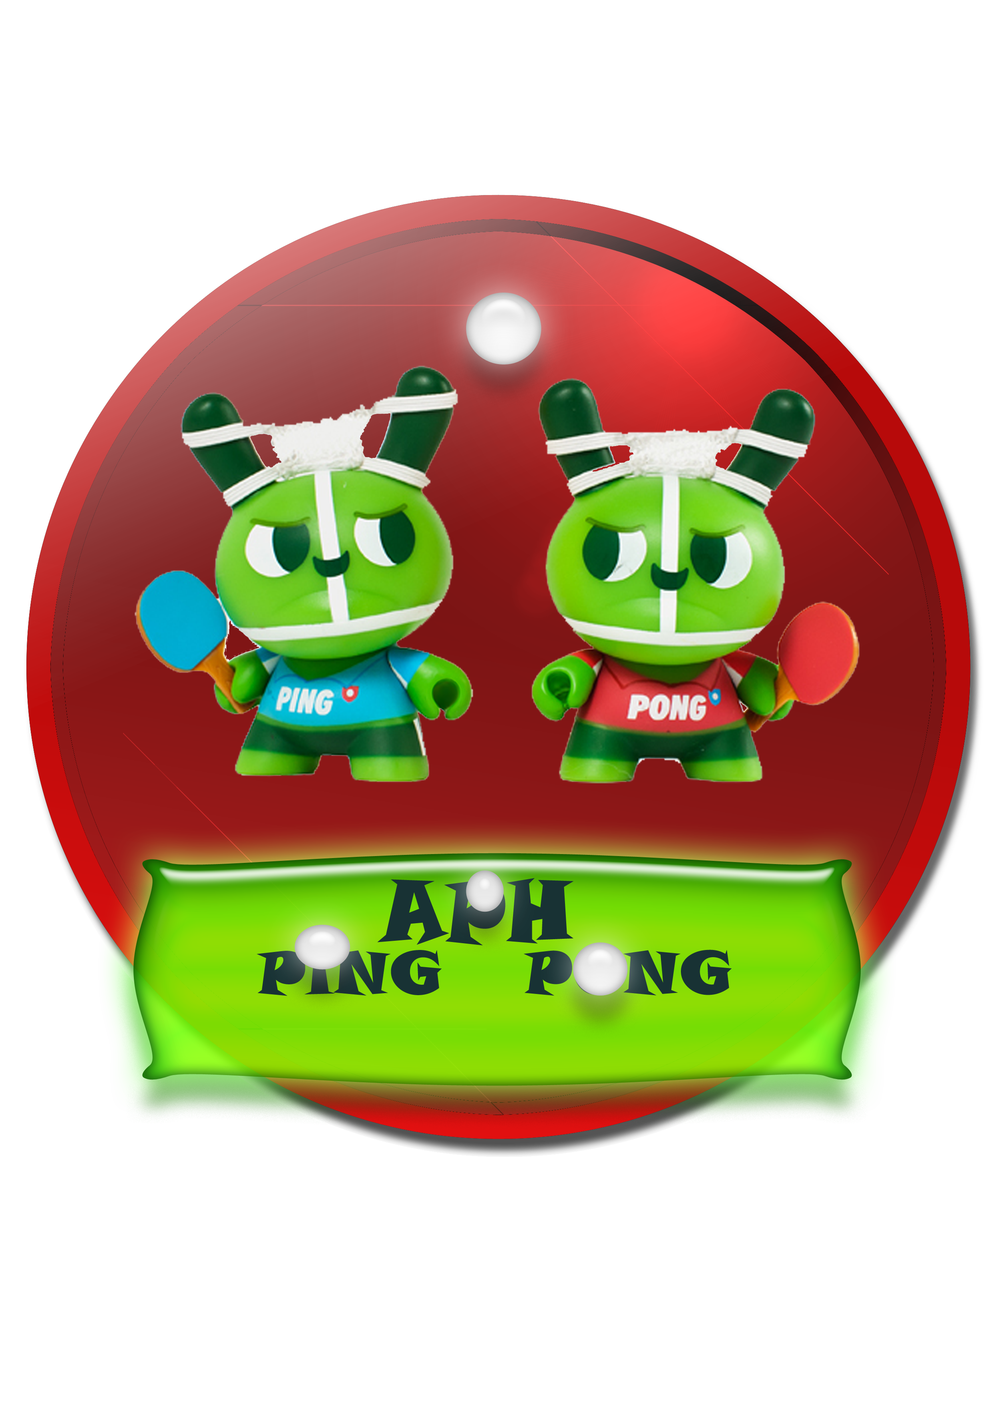
APH Ping Pong

Slide 2

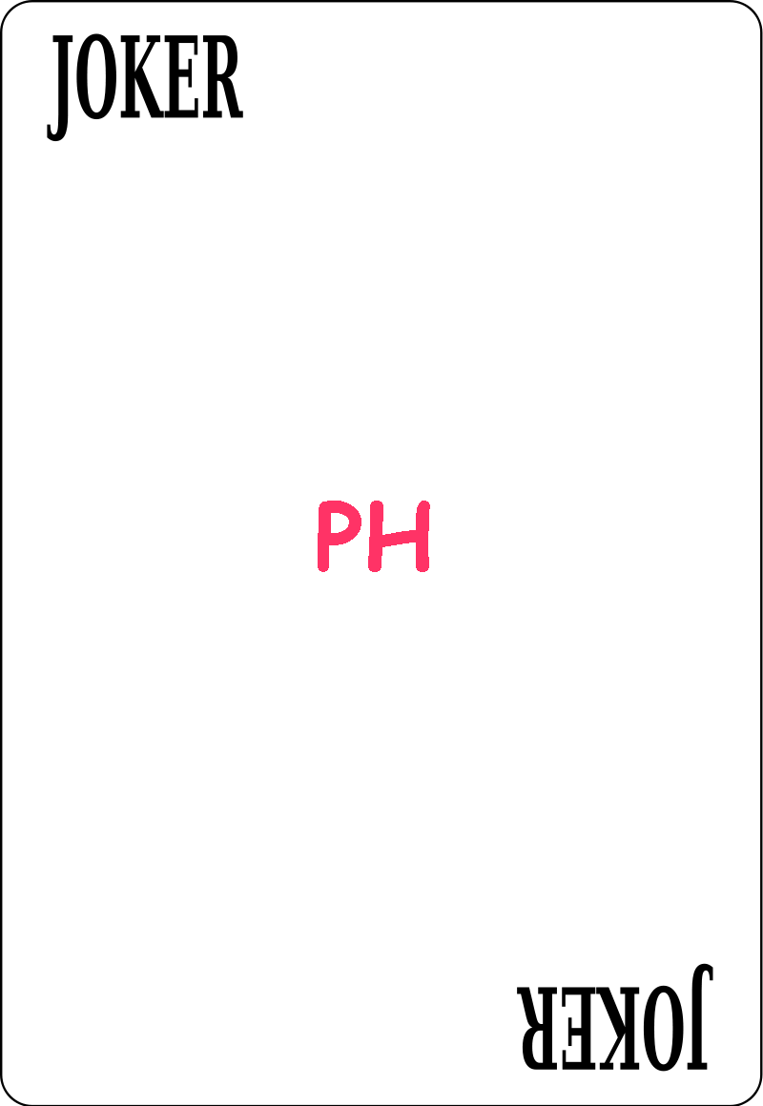

The Team
Ala'eddeen Awwad
Mohammad Ihmouda
Dr. Ashraf Armosh

Slide 3
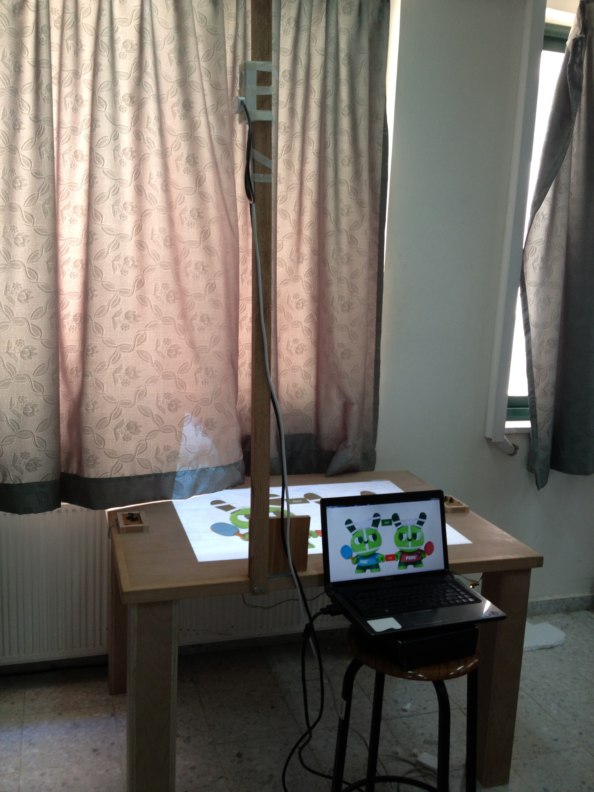
APH Ping Pong
APH Ping Pong is a funny interactive projected game played between two players on hardware table.

Slide 4
Game Strategy
Interactive game played between two players each one keeps track of the ball direction and try to hit the ball toward his opponent before entering his goal.
Notes:
Points are scored when a player fails to return the ball before entering his goal.

Slide 5
Game Strategy…. Cont.
APH Ping Pong Players choose which type of control is:
1. Normal one by using keypad 4-directions.
2. IPhone mobile application .

Slide 6
Game Strategy…. Cont.
The game start by deciding who is the first service (Player) which is defined by Randomly Coin flipping for the first player.
Notes:
control strike movement on the game.

Slide 7
Game Strategy…. Cont.
The two players take their positions and the game start .
Notes:
such that The first player strike the ball to his opponent direction and the second keeps track of the ball before entering his goal.

Slide 8
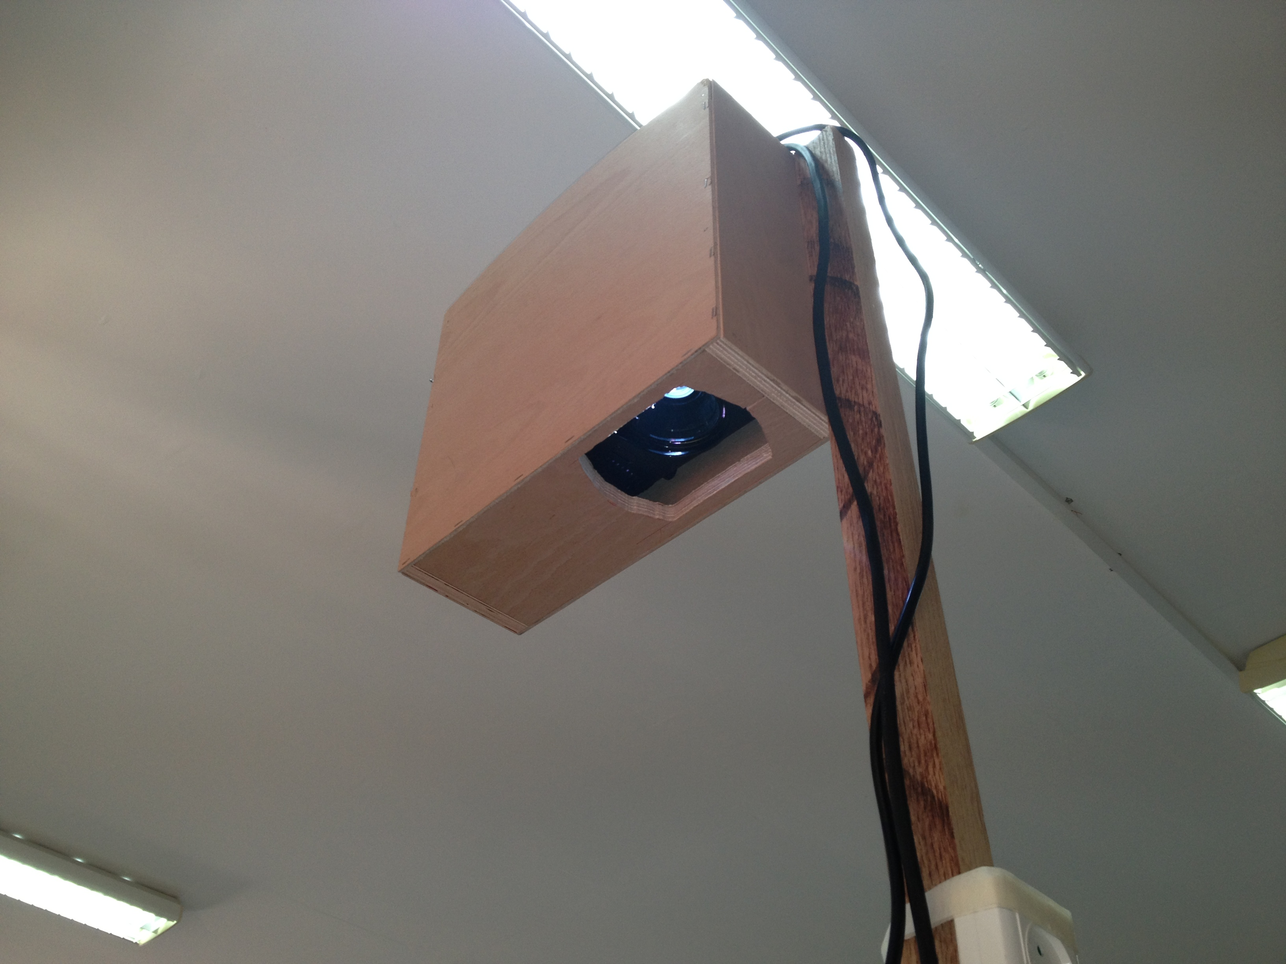
Playing Field Details
Ping Pong game projected on a hardware table using a projector .
Notes:
Our playing field is smooth, low fraction wood table
120cm long, 90 cm wide and 70 cm height
The game projected by a projector inside a projector box connected with the table by a pole
with 160 cm tall from the edge of the table.

Slide 9
Why APH Ping Pong
Is an interactive funny game has two types of control.
Table touch or interactivity feature for well-known positions on table.
Contains many features and customizable user options.
  Contain interaction animations and accessory.
Notes:
➔ APH Ping Pong is simulation of traditional Ping Pong by adding many features as a result more wonderful game :
to control movement and power of striker.
Such that it’s a circuit for 4 push buttons (up/down and left/right).
Iphone app using accelerometer and gyroscope hardware build in sensors in iphone to control movement.
We have used 4 special type of LDR sensors. Such that when the user try to choose any projected button option on these sensor the game respond and interactive by present his choice .
Setting the ball speed.
Setting number of rounds.
Randomly Coin flipping for the first player.
Like scoring new point.
Winner during 5 rounds.
And other projected graphics and animations.

Slide 10
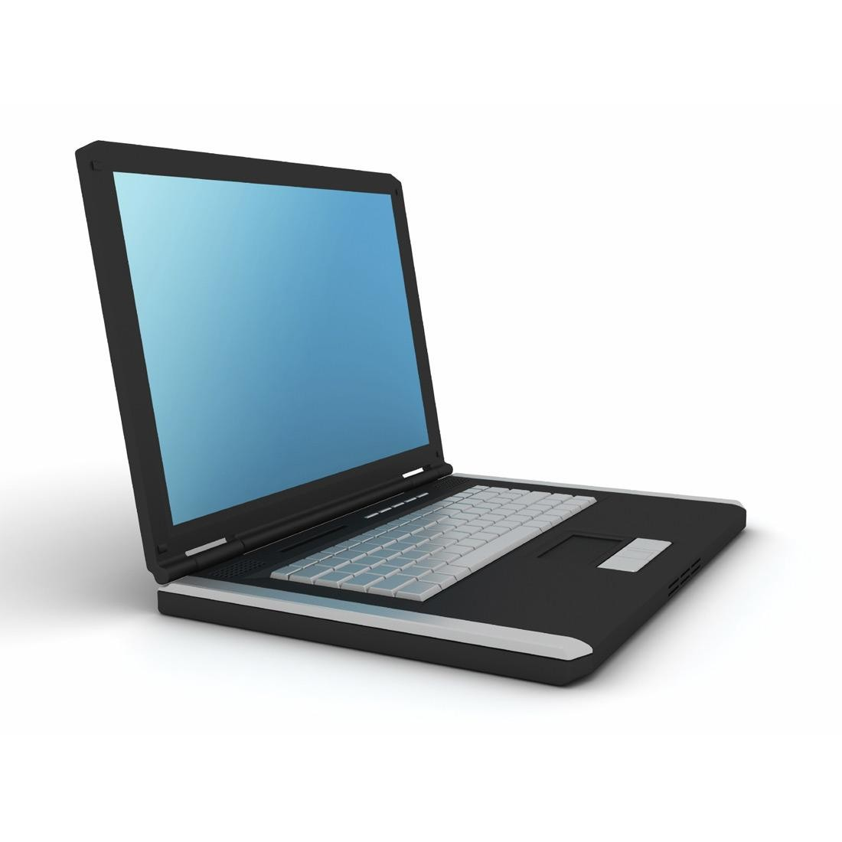
Sending Data
Data transferred Inputs to the PIC.
PIC send the right command.
Java App algorithm handle the command.
Inputs
PIC 18F4620
Notes:
Data transferred from the keypads and LDR sensors to the pic18f4620 40 pins which translate these inputs and send the right command to the java application on pc using serial-usb port.

Slide 11
Software Tools
Java Programming Language
IOS mobile programming language
NetBeans IDE

Slide 12
Game Stages
New Game
Game Mode(paddles, Mobile)
Number Of Rounds
Select the Starter Player
Game is Running
Winner Stage

Slide 13
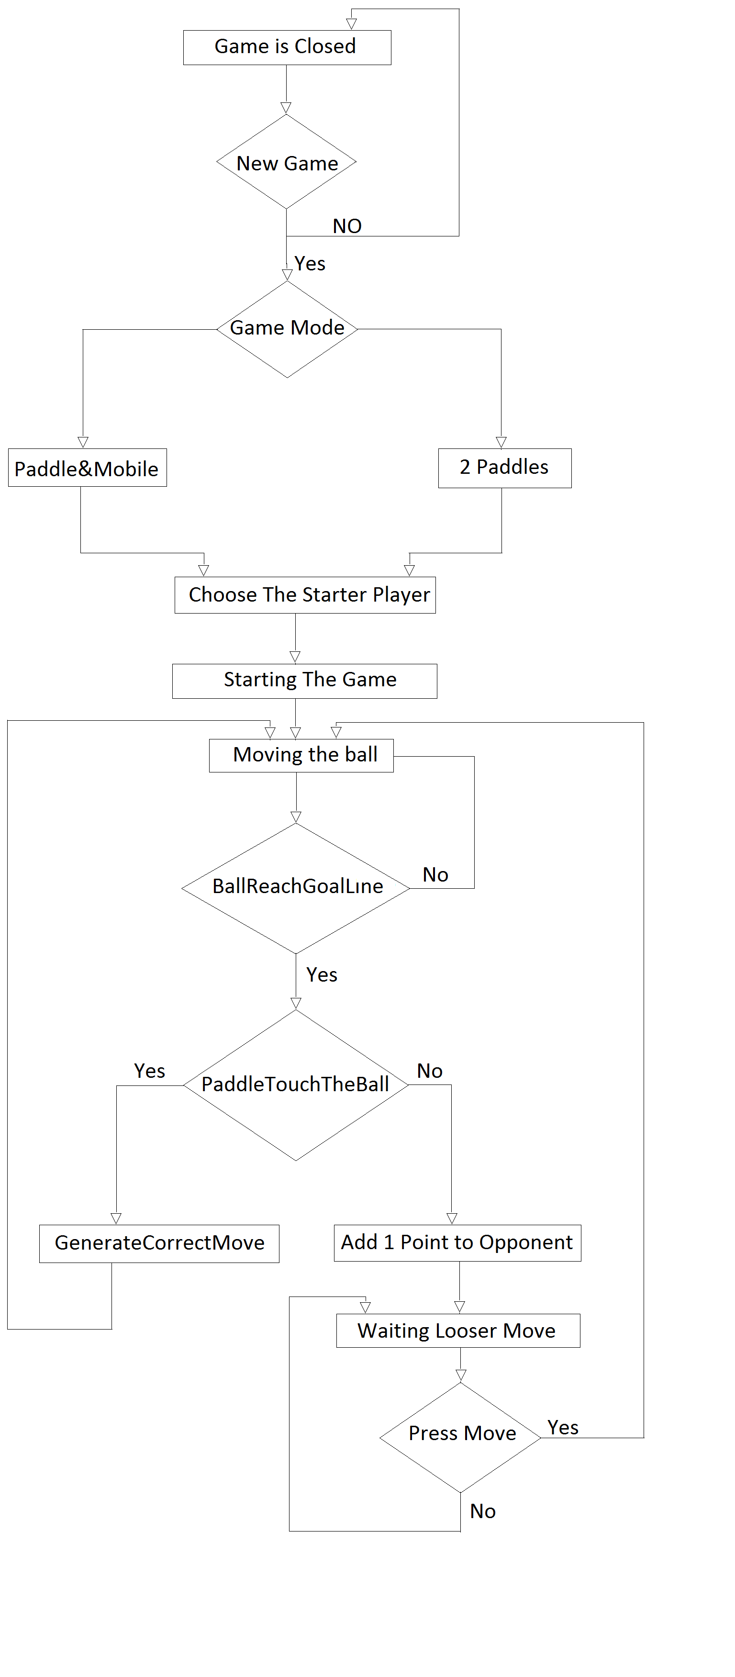

Slide 14
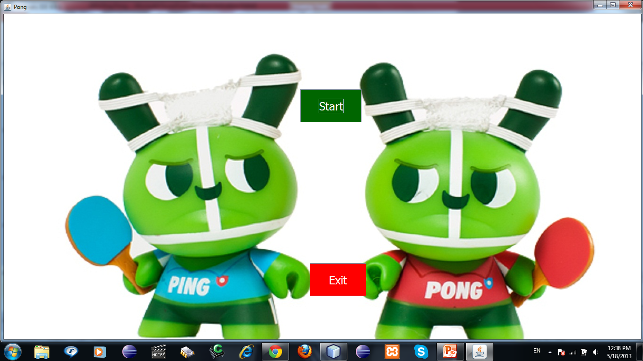
1- New Game

Slide 15
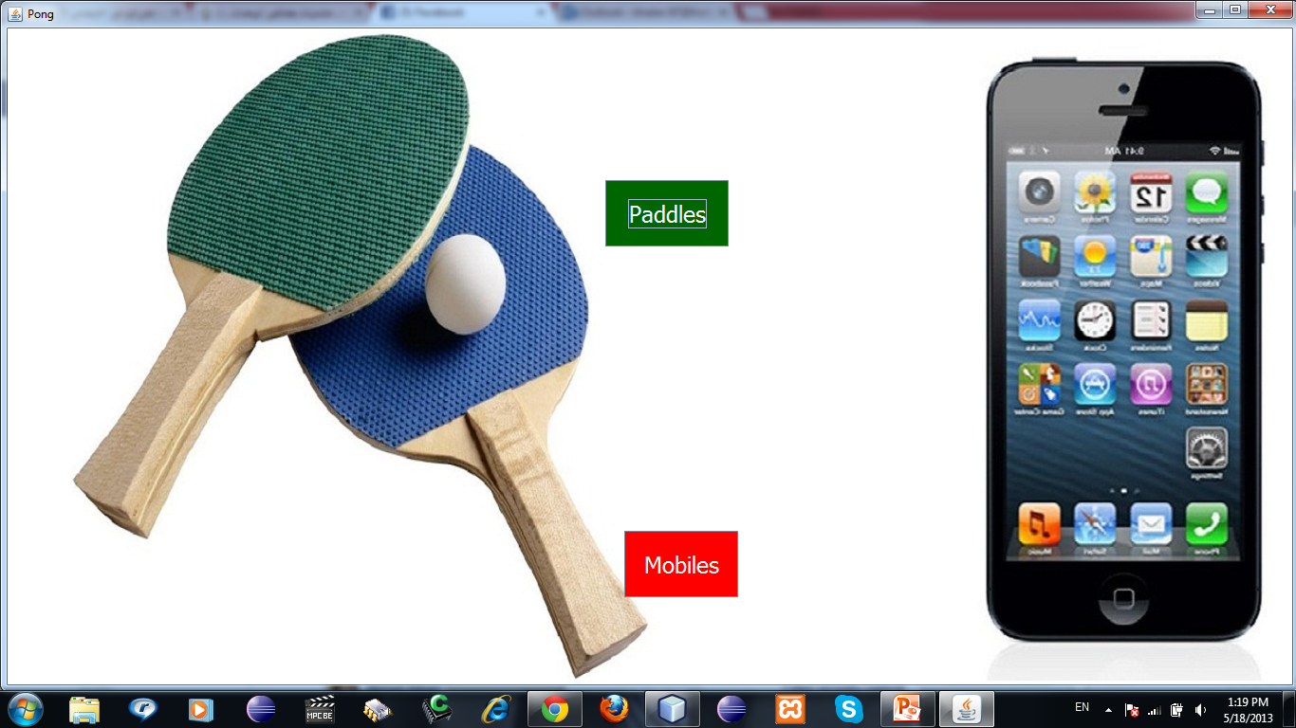
2- Game Mode

Slide 16
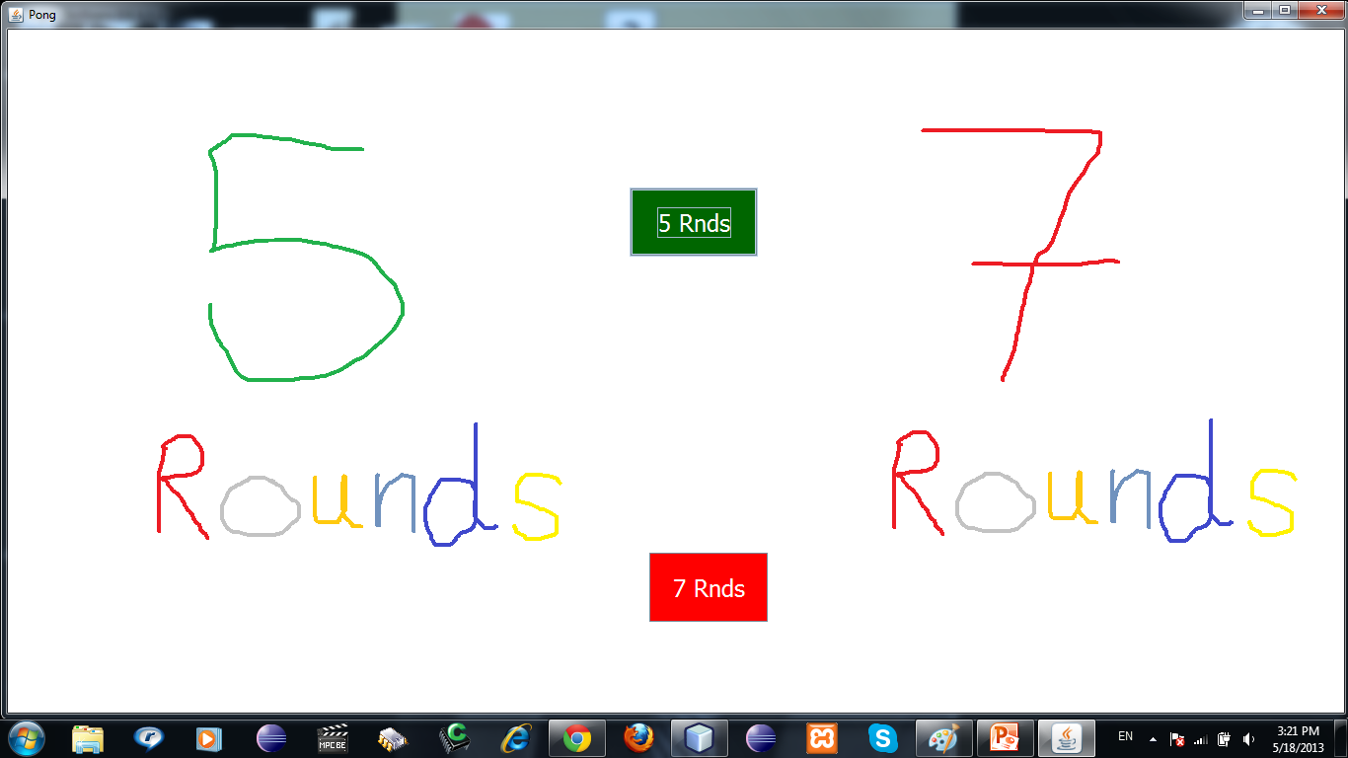
3-Number Of Rounds

Slide 17
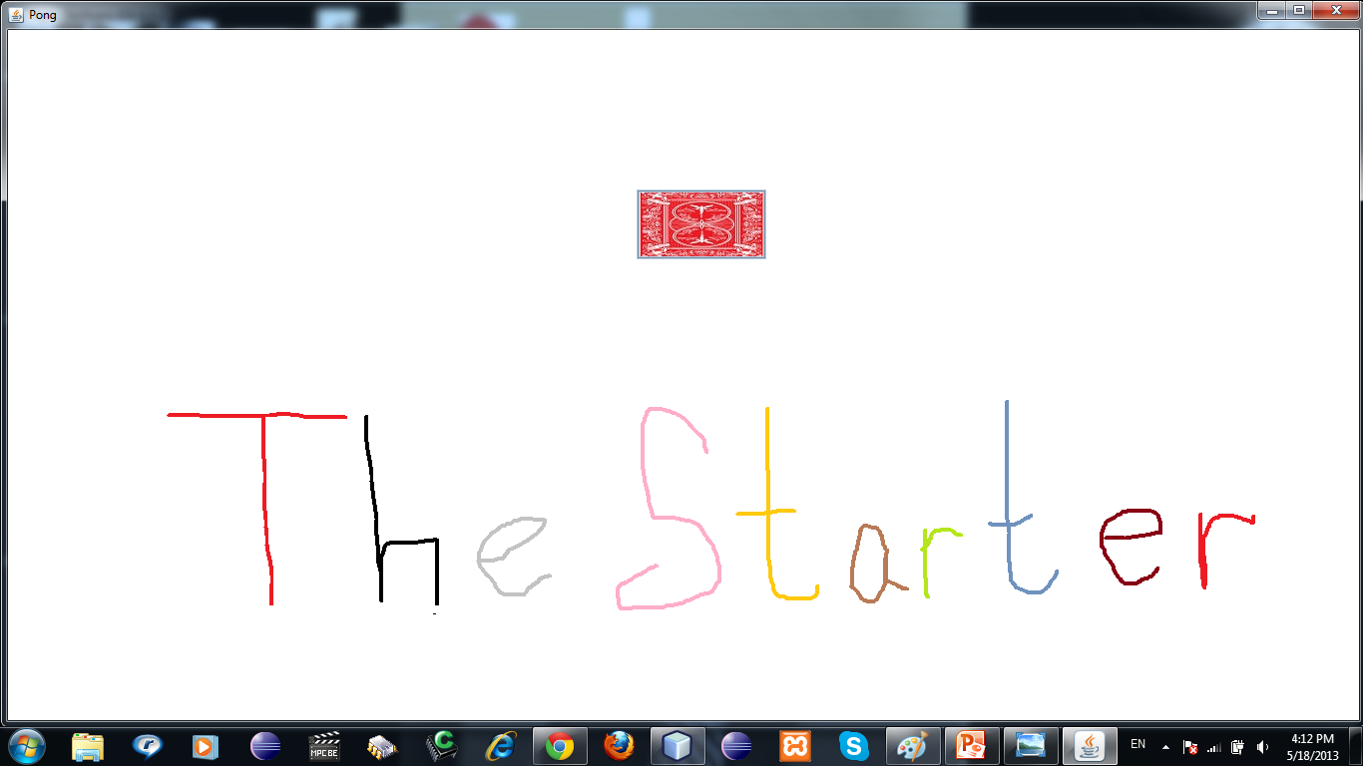
4- The Starter Player

Slide 18
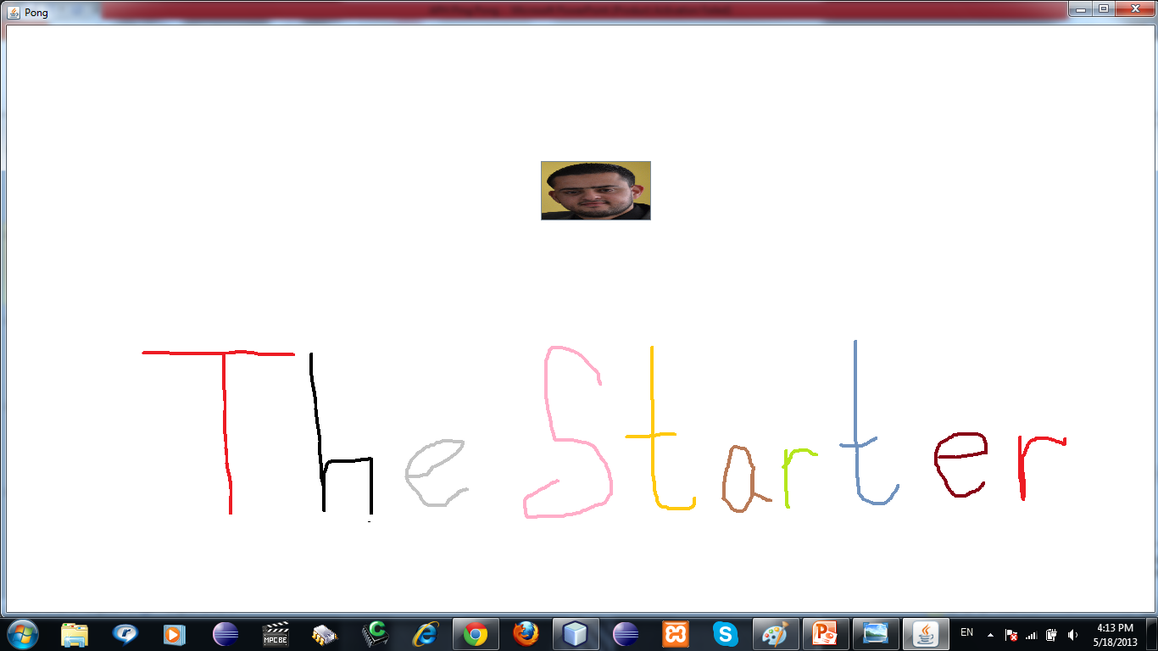
5- The Starter Player (2)

Slide 19
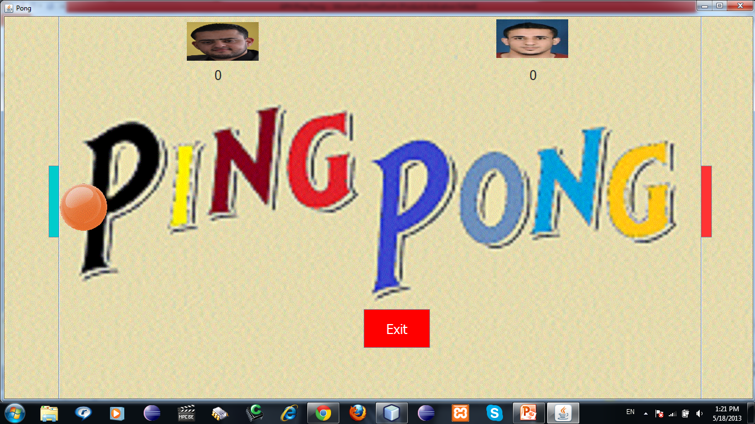
6- Running Stage

Slide 20
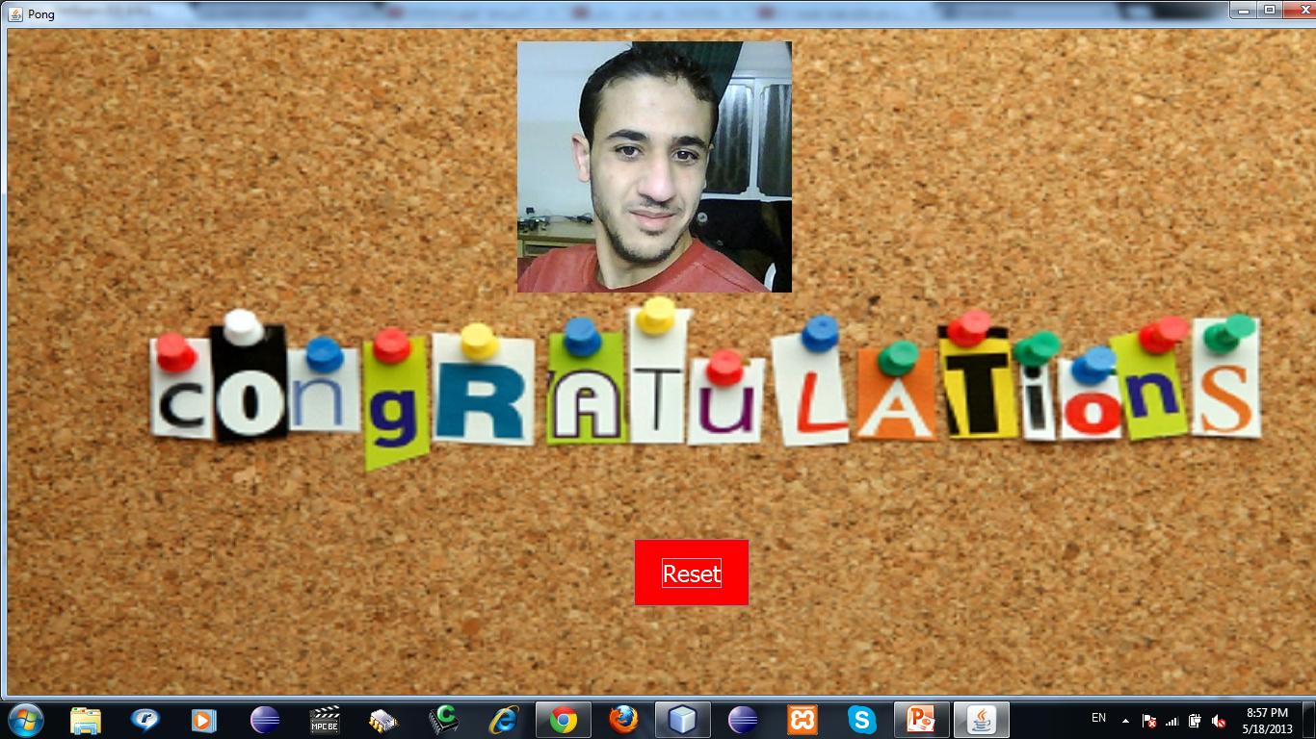
7- Winner Stage

Slide 21


