Slide 1
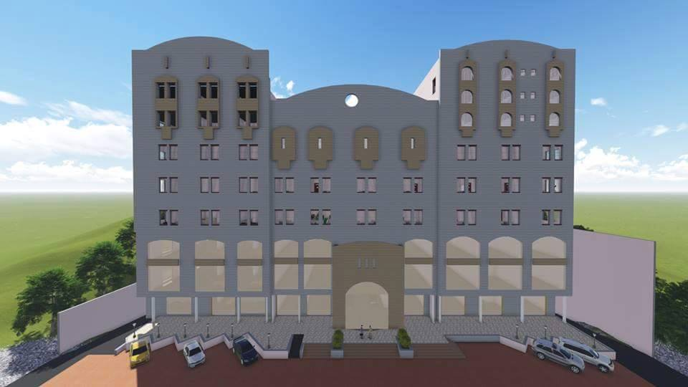

An-Najah National University
Faculty of Engineering
Building Engineering Department
Graduation Project – 2
(غرفة تجارة وصناعة - نابلس)
Chamber of Commerce & Industry
(COC)
Prepared By:
Deena Jetawi
Hadeel Qawasmi
Manar Da’ana
Project supervisor:
Arch-Moayad Salhab
2015 - 2016

Slide 2
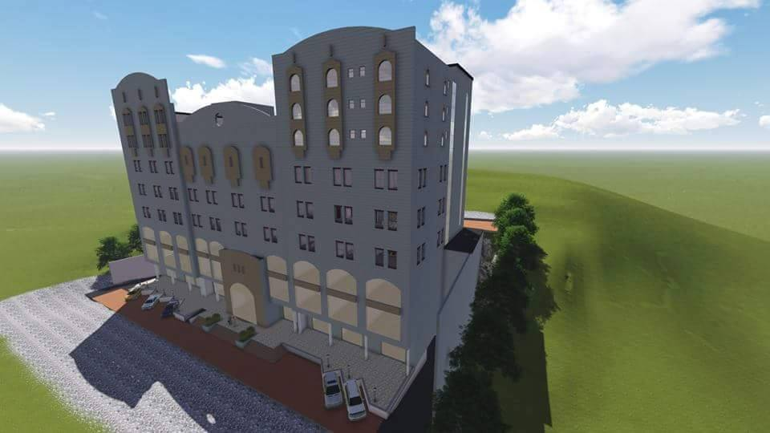
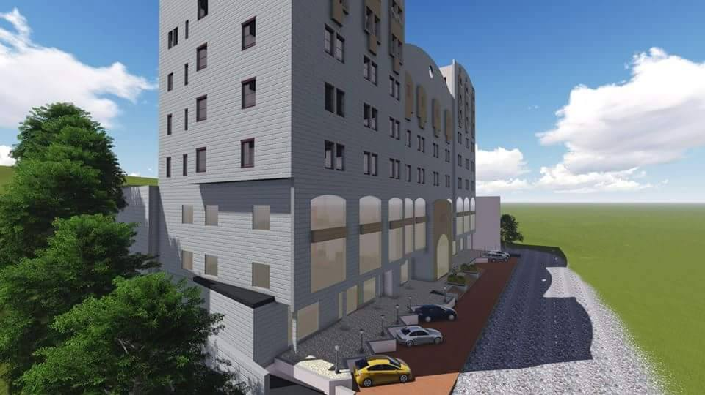
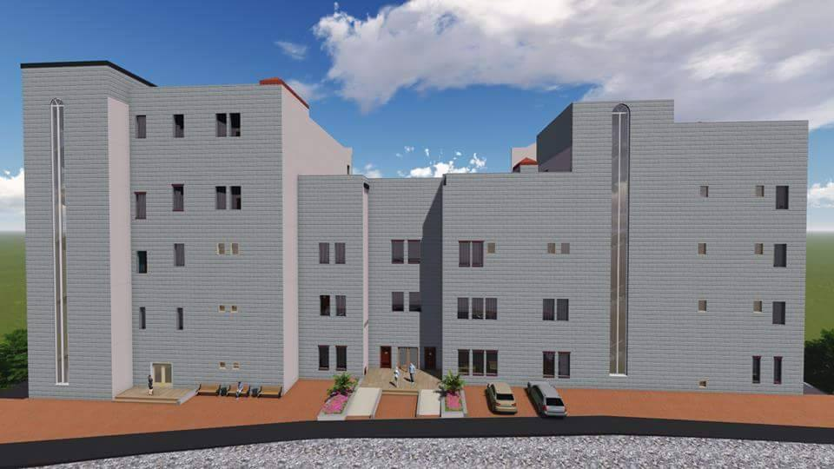
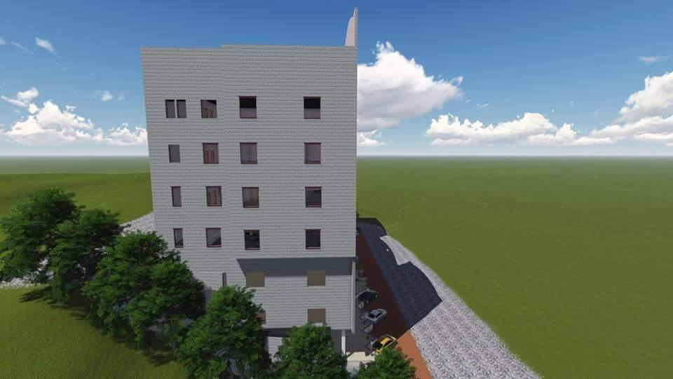
Outline and Contents
Site of the project
Architectural Design
Environmental Design.
Structural and Seismic Design
Mechanical Design
Electrical Design
Cost Estimation

Slide 3

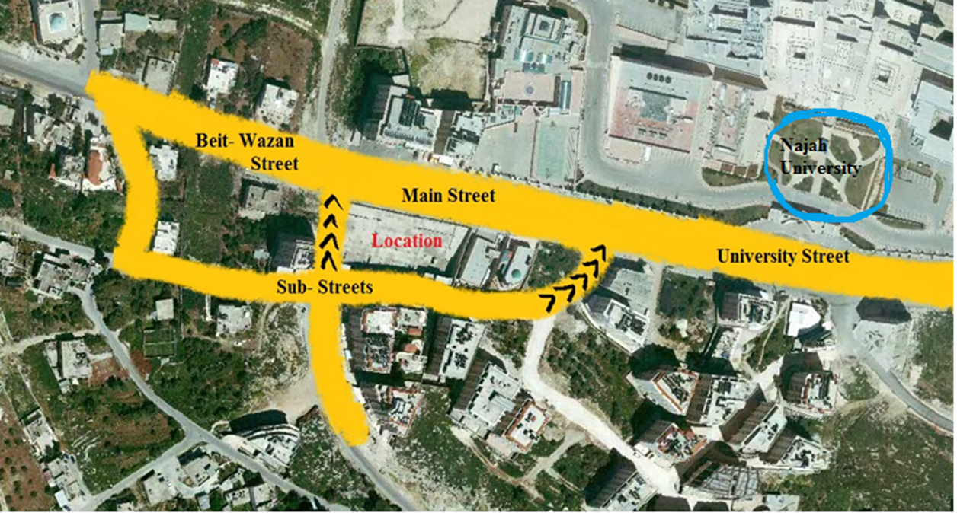
Project Location:
Nablus, between Beit wazan and An- Najha National University
N

Slide 4
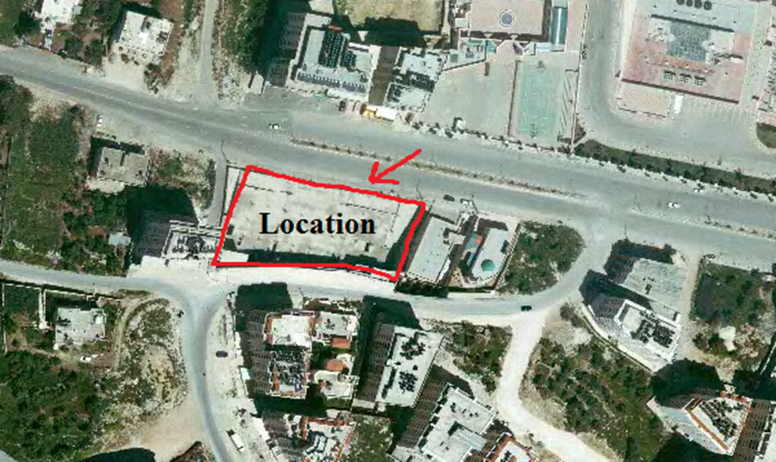
Site location:
Site Area = 3000 square meter

Slide 5
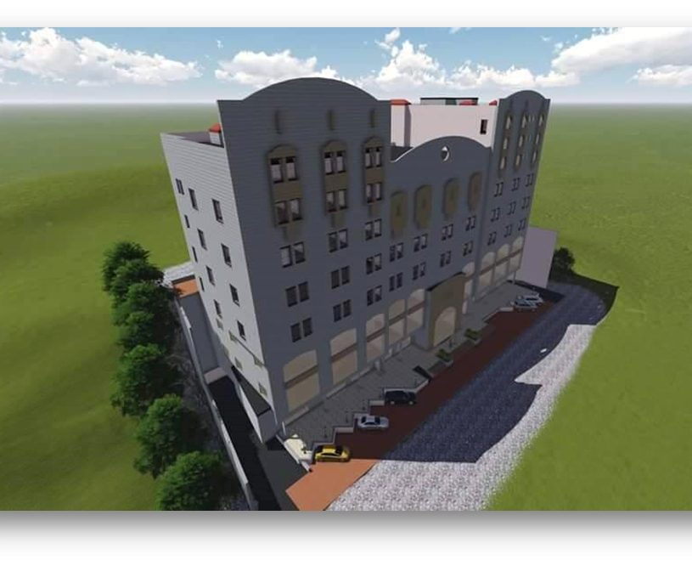
ARCHITECTURAL
DESIGN

Slide 6
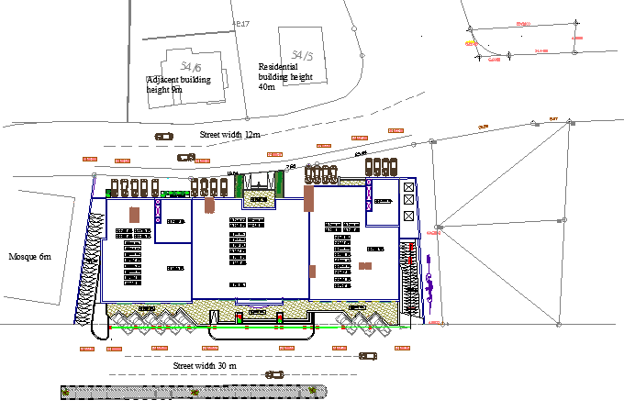

Site plan

Slide 7
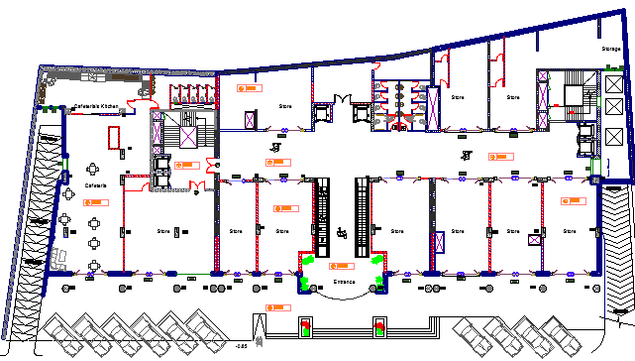
Ground floor
Ground Floor Area = 2500 m²

Slide 8
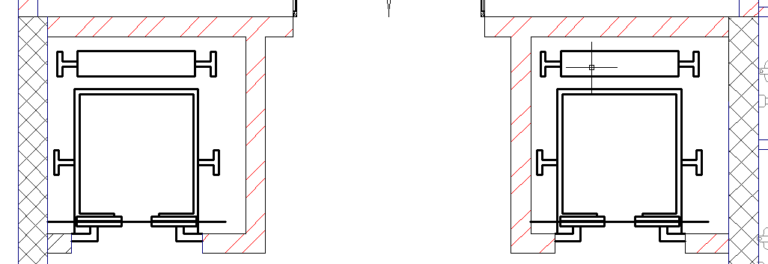
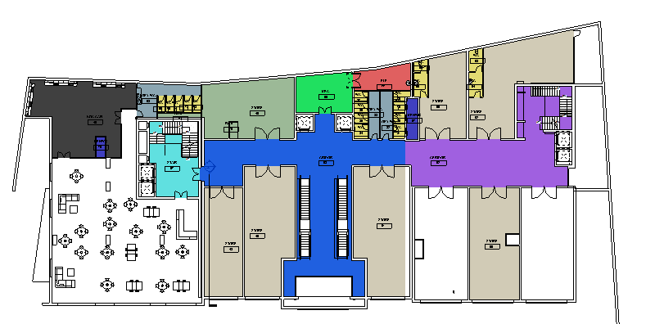
Circulation Area for the first three floors

Slide 9
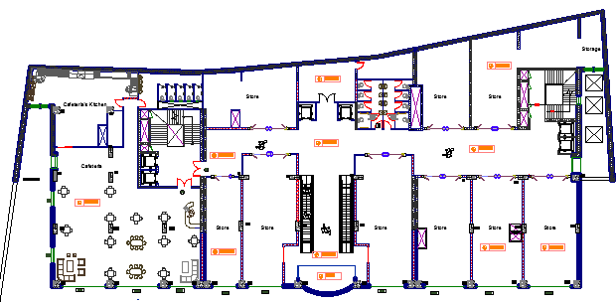
First & second Floors
First Floor Area = 2500 m².

Slide 10
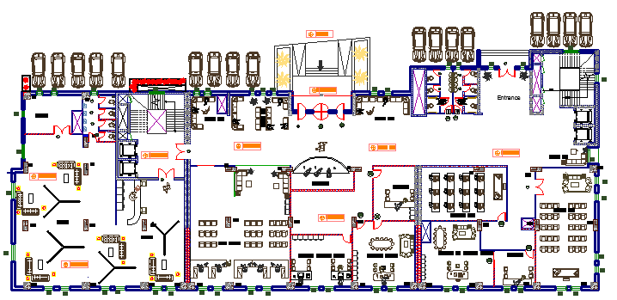
Third floor(COC):
Third Floor Area = 1500 m².

Slide 11
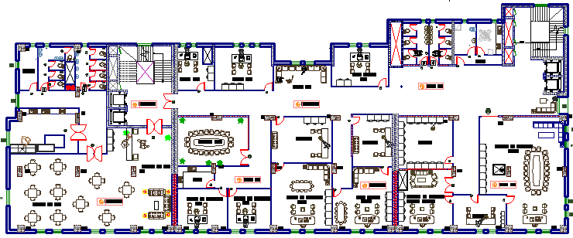
Fourth Floor(COC):
Fourth Floor Area = 1500 m²

Slide 12
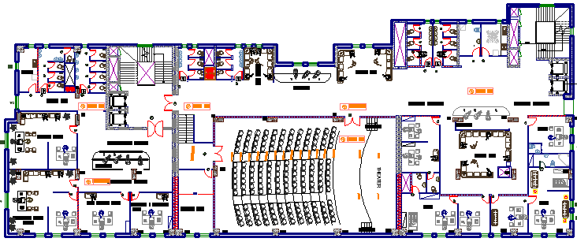
Fifth floor(COC):
Fifth Floor Area = 1500 m².

Slide 13
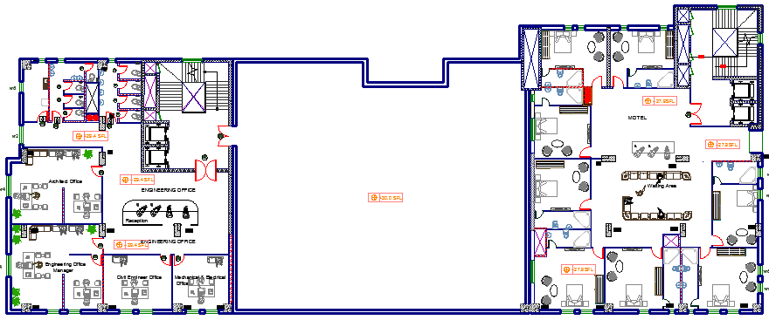
Sixth Floor(Motel &offices):

Slide 14
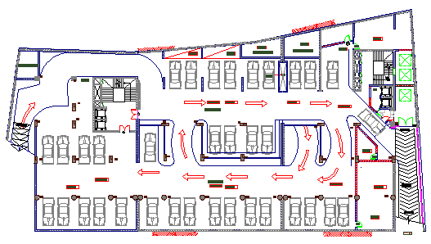
Parking
Parking B1
Parking B1

Slide 15
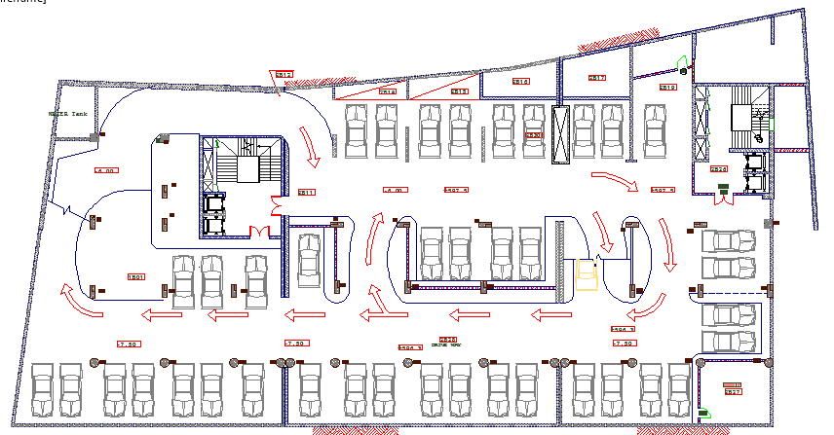
Parking
Parking B2

Slide 16
Architectural design:
North Elevation

Slide 17
Architectural design:
South Elevation

Slide 18
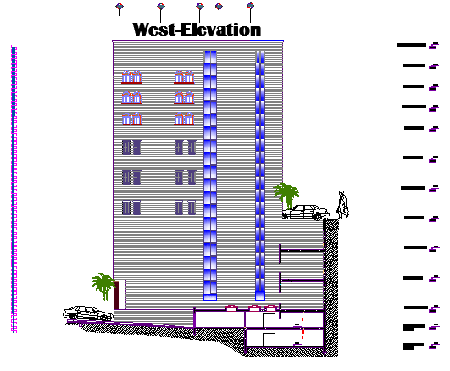
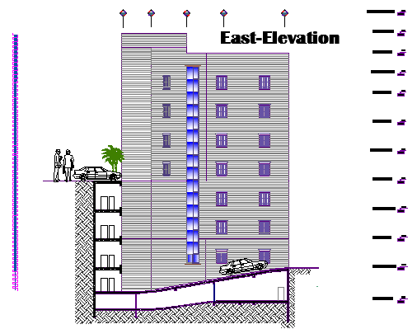
Architectural design:
West Elevation
East Elevation

Slide 19
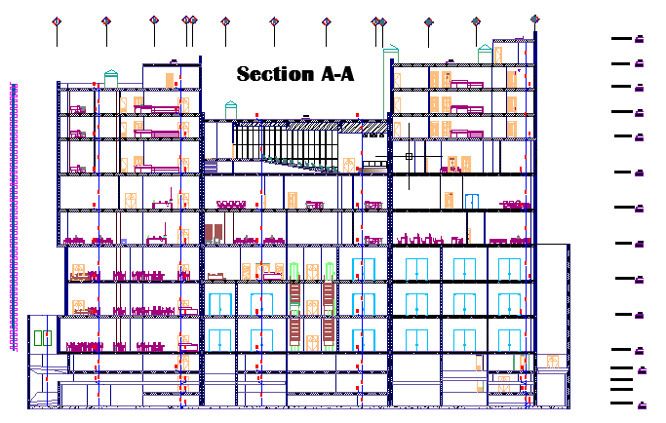
Architectural design:
section

Slide 20
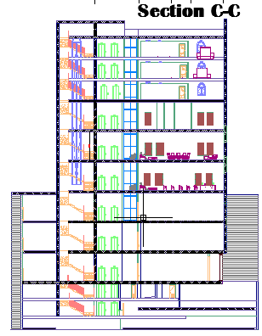
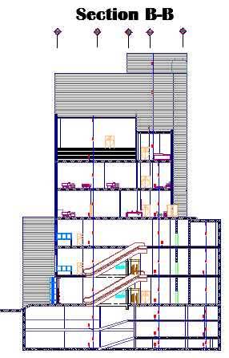
Architectural design:
section

Slide 21
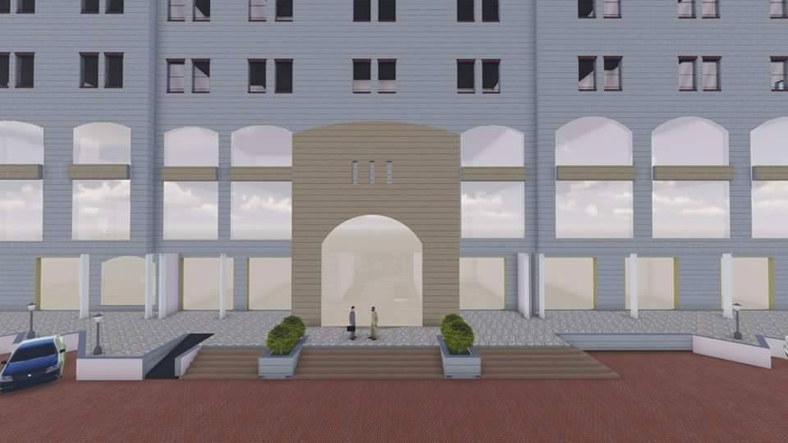
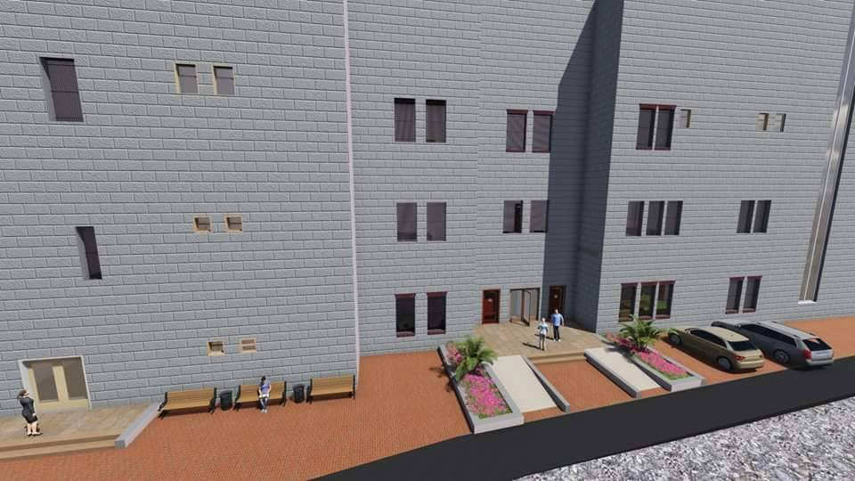

Architectural design:
Handicap utilities and circulation were studied well.

Slide 22
Environmental Design

Slide 23
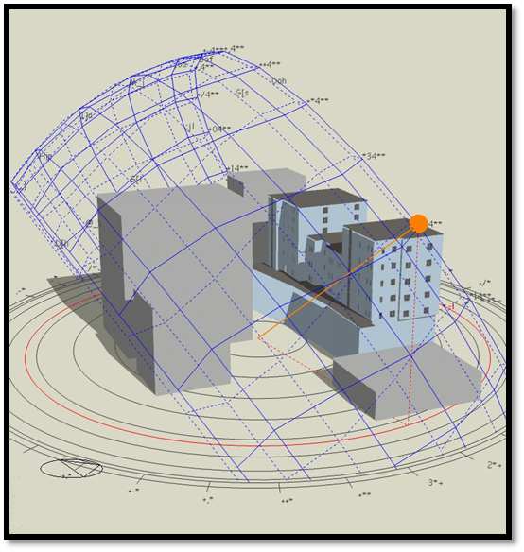
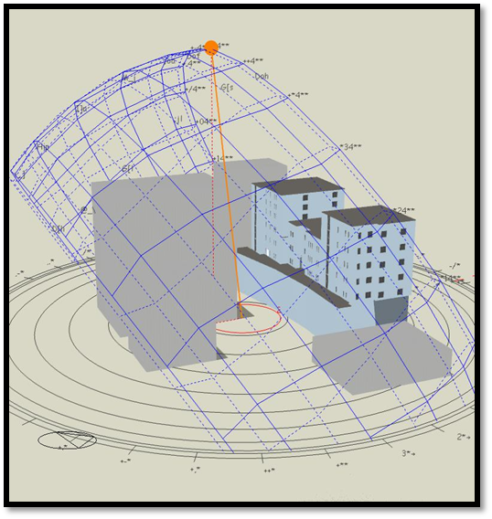
Environmental Design:
Sun path
June at 8.00 AM
June at 12.00PM

Slide 24
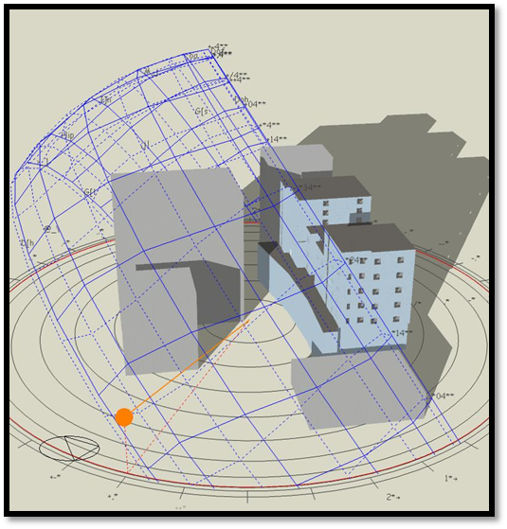
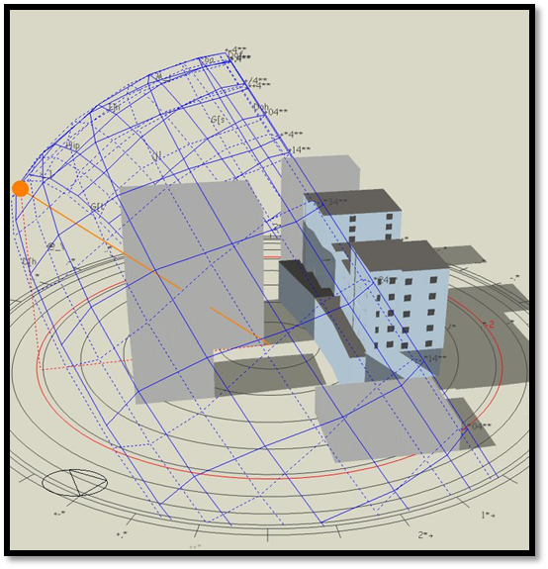
Environmental Design:
Sun path
January at 8.00 AM
January at 12.00 AM

Slide 25
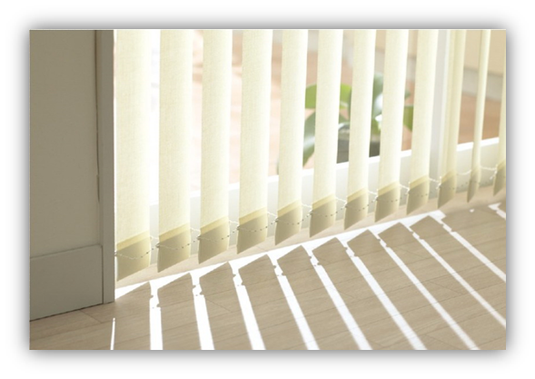
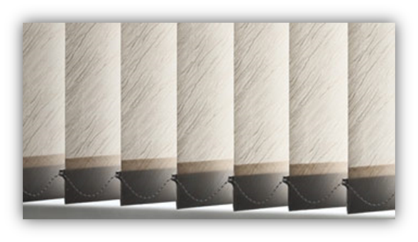

West East and South windows internal vertical shutters
internal horizontal shutters

Slide 26
Environmental Design:
Thermal Insulation:
The goal: The achieved thermal coefficient U for all new and air-conditioned buildings should be not more than the U-value of the specified code
 | highest value for U | Outer structural elements of the building |  | Number
 | 0.5 | The External wall |  | 1
 | 0.39 | Exposed horizontal roof |  | 2
 | 0.39 | Exposed leaning roof |  | 3

Slide 27
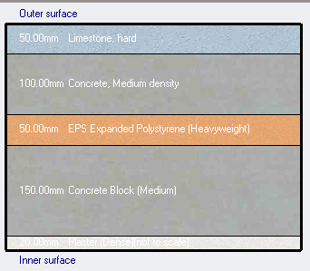
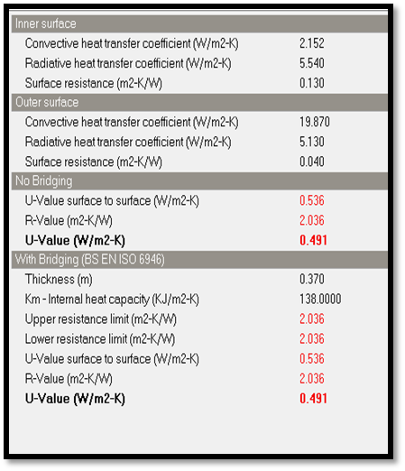
Environmental Design:
Thermal Insulation:
Exterior wall
U = 0.49 < .5

Slide 28
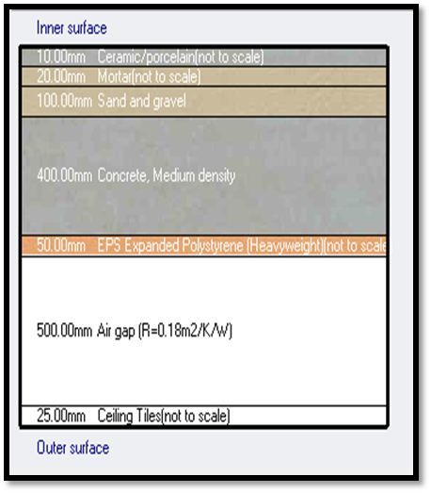
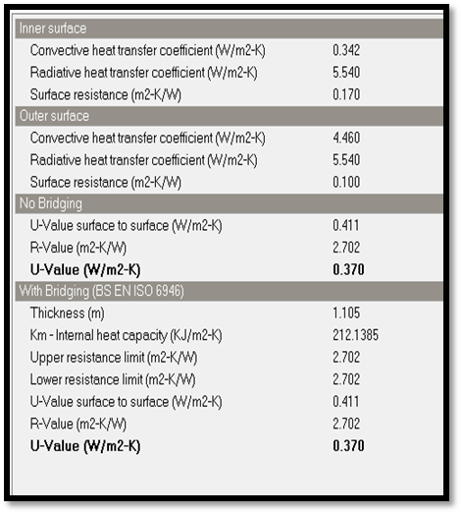
Environmental Design:
Thermal Insulation:
Ceiling
U = .37< .39

Slide 29
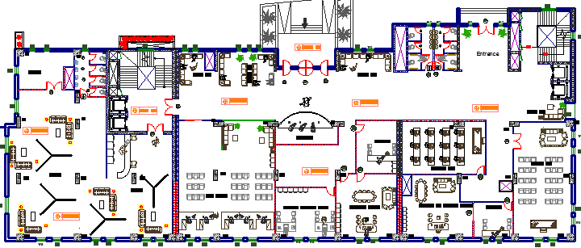
Environmental Design:
Heating and cooling:
→ Total heating load for the third floor = 40.50 KW
Total cooling load for the third floor = 58.77 KW
Total (Heating and Cooling) load from Design Builder per meter = 66.18 KWh/ m²
The acceptable range from 30 to 80 KWh/ m²

Slide 30
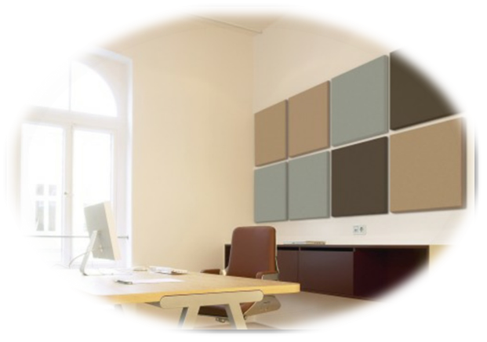
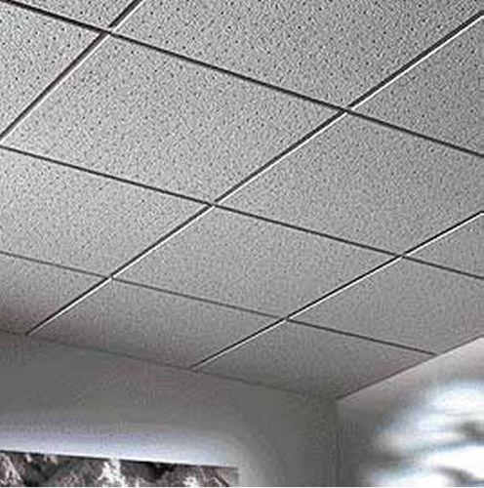
Environmental Design:
Acoustical Design:
One goal of acoustical engineering can be the reduction of unwanted noise, which is referred to as noise control.
According to specifications of offices the required RT60 is ( 0.4 – 0.8 ) s
Office
RT60 after modification 0.67
Acoustic tiles
Wall acoustic panel

Slide 31
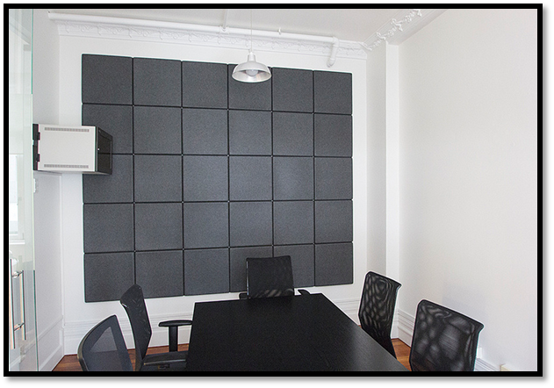
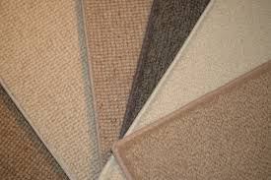
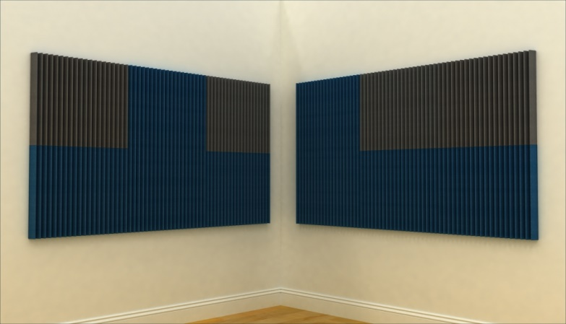
Meeting room
RT60 after modification 0.6
Motel
RT60 after modification 0.66
Carpet
Wall acoustic panel

Slide 32
Environmental Design:
Acoustical Design:
STC Calculations:
Dense hollow block ( thick 10 cm ). ↔ STC=43db
Plaster to both side ↔ STC=4db
required STC 45-50
47 db

Slide 33
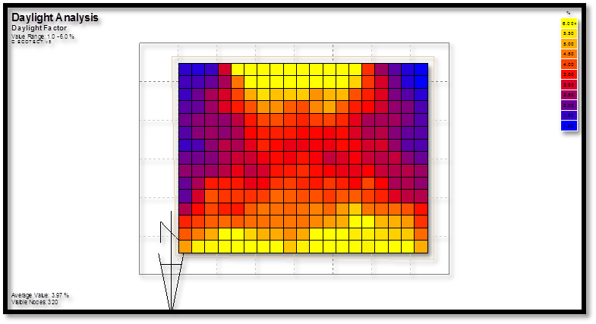
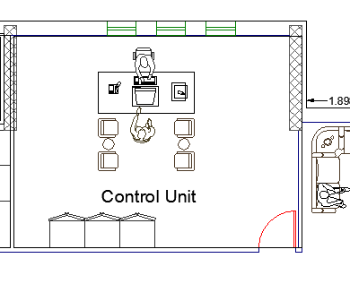

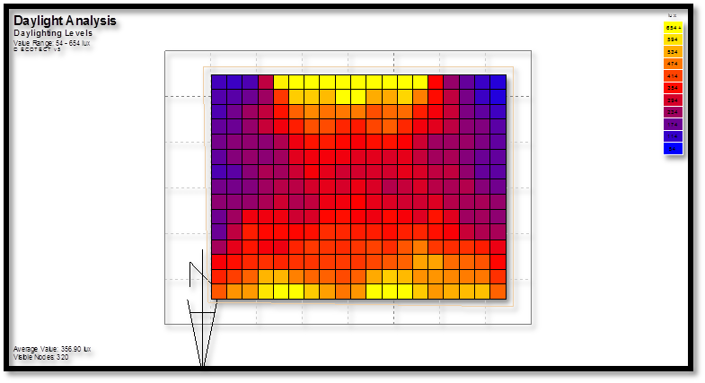
Environmental Design:
Daylight factor & daylight level (Ecotect analysis)
  Offices
  Daylight factor distribution is
  about 2-5 %
DF = 3.97%
DL=356.9
Glass partition

Slide 34
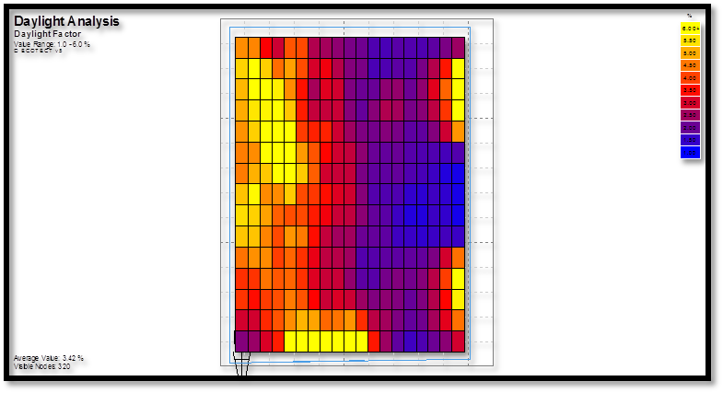
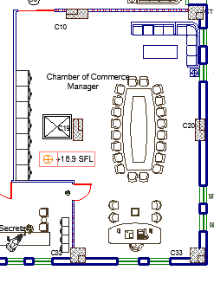
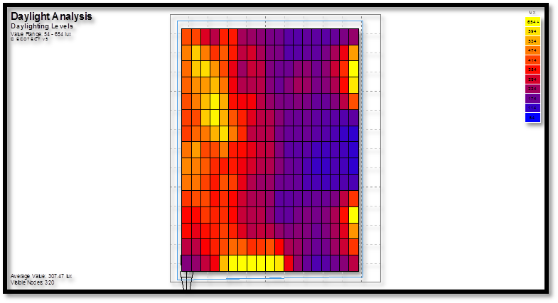
Environmental Design:
Daylight factor & daylight level
DF = 3.42%
Glass partition
DL=307.5

Slide 35
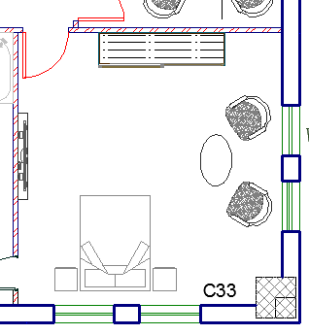
Environmental Design:
Daylight factor & daylight level
DF = 2.98%
DL=300%

Slide 36
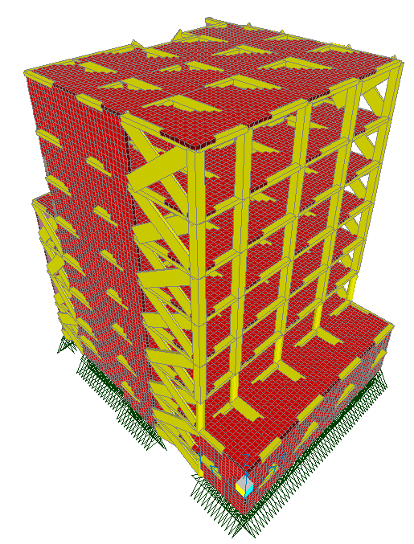

STRUCTURAL
DESIGN

Slide 37
DESIGN CODES
ACI -318-2011 for reinforced concrete structural design.
UBC -97 for earthquake and wind load computations.
ASCE for load computations.
SAP 2000 program for analysis and design.

Slide 38
MATERIALS PROPERTIES
Compressive strength of Concrete (fc`) = 28 Mpa (B350kg/cm²)
Yielding strength of steel fy = 420 MPa
SOIL PROPERTIES
Soil bearing capacity = 400 KN/m2
Soil profile = S_{B} (Rock)

Slide 39

Column axis layout

Slide 40


SEISMIC JOINT
Seismic joint = 10 cm

Slide 41

3D Model – SAP For Block (B)

Slide 42
Structural system Used:
One way ribbed slab with Hidden beams
And drop Beam for theater
Thickness of slab:
The longest span(one end continues) = 700 cm.
The thickness of slab (h) = Ln/18.5 = 700/18.5 = 38 cm
The thickness of slab (h) = 40 cm

Slide 43
Beams dimension
Columns dimension
Beam Type | Dimensions(mm)
Main Beam | 700*400
Secondary Beam | 600*400
Dropped Beam | 500*900
Column Type | Dimensions(mm)
Square Columns | 800*800
Circular Columns | 850 mm diameter
Rectangular Columns | 1200*500

Slide 44
DESIGN and REINFORCEMENT of STRUCTURAL ELEMENTS
Slab (one way)
Beams
Columns
Shear wall
Stair
Footings (wall , single , strap and mat )

Slide 45

Model checks
1-Compatibility
The Structure moves as one part
‘Compatable’

Slide 46
Model checks
2- Equilibrium
The error percentage is acceptable, less than 10 %
Loads | SAP (KN) | Manual (KN) | % of error
Dead | 96624 | 96509 | 0.119 %
Super imposed | 19645 | 18587 | 5.6%
Live | 25689 | 24456 | 5%

Slide 47

Model checks
3- Internal forces
a. for slab
Number | Manual moment (kN.m) | SAP moment (kN.m) | of Error %
1 | 108.5 | 120 | 10%
2 | 113.63 | 121.5 | 7%
3 | 117.5 | 116 | 1.2%
4 | 115.5 | 103 | 10%
5 | 106.8 | 105 | 1.6%
6 | 126 | 135.5 | 7.5%

Slide 48

Model checks
3- Internal forces
a. for beam
Number | Manual moment (kN.m) | SAP moment (kN.m) | of Error %
B1 | 973.5 | 954.5 | 1.95%
B2 | 947.6 | 935.8 | 1.24%
B3 | 556.4 | 525.4 | 5.57%
B4 | 576.6 | 615.5 | 6.8%
B5 | 673.56 | 690 | 2.4%
B6 | 451.5 | 408.75 | 9%

Slide 49
Model checks
3- Internal forces
a. for column
Number | Manual axial load(kN) | SAP axial load(kN) | of Error %
C2 | 8229.8 | 7454.22 | 10%
C3 | 7283 | 7922 | 8.7%
C4 | 6139.4 | 6487 | 5.6%

Slide 50

Seismic Design
Soil type Sb
Z = 0.2
Cv = 0.2
Ca = 0.2
I = 1.25
R = 5.5
 | From SAP | From SAP EQ | From Manual
Period (sec) | 0.828 | 0.993 | 0.739 sec
 | Equivalent static | LinResSpe | % of error
Base shear in x-direction | 7546.5 | 7538 | 0
Base shear in y-direction | 7546.5 | 7731 | 0

Slide 51

Structural System Design
    1-Slab design:

Slide 52


Structural System Design
    1-Slab design:

Slide 53


Structural System Design
    2-Beam design:

Slide 54


Structural System Design
    3-Column design (square column):

Slide 55


Structural System Design
    3-Column design (circular column):

Slide 56


Structural System Design
    3-Column design (rectangular column):

Slide 57

    Footings Design (Mat Footing):
    Reinforcement Details
if Mat used for whole building:
-Extra Concrete (1000m3)
- Extra Steel (36 ton)

Slide 58


Structural System Design
    4-Footing design ( Mat )

Slide 59

    Footings Design (Mat Footing):
    Reinforcement Details

Slide 60


Structural System Design
    4-Footing design ( Isolated )

Slide 61


Structural System Design
    4-Footing design ( Strap )

Slide 62

    Shear Wall Design

Slide 63

    Shear Wall Design

Slide 64

Reinforcement details around openings:

Slide 65


Stair Reinforcement Details
Section A-A

Slide 66



MECHANICAL
DESIGN

Slide 67



Mechanical Design
Water Supply System
Drainage System
HVAC System

Slide 68
Supplying Water for Building
Three Underground water tank :
Capacity = 185 cubic meter.
Small nine water tanks on the roof
Capacity = 14 cubic meter.
Pump between the underground tank and the small tanks on the roof

Slide 69




Supplying Water for Building

Slide 70

Blocks (A,B, and C) Water Demand
Firstly, finding F.Us to find pipe diameters
Water Supply Calculation were made for each Block
Water Demand (gpm) | Number of F.U | Supply Control | Main Feeder
75 | 391 | Flush Tank | Block A
68 | 214 | Flush Tank | Block B
75 | 439 | Flush Tank | Block C

Slide 71

First Floor Water Supply

Slide 72

Third Floor Water Supply

Slide 73
Pipes Diameter ‘Block A’
Calculations
Water demand (gpm) | Number of F.U | Type of supply control | Main feeder
75 | 391 | Flush Tank | Block A
68 | 214 | Flush Tank | Block B
75 | 439 | Flush Tank | Block C
Pipes Diameter for Block A:
Main vertical feeder (steel) = 2.5 inch
Main horizontal feeder (PVC) = 1.2 5inch
Branches (PVC) = 3\4 inch

Slide 74


Drainage System
Grey water
First Floor Drainage System
Black water

Slide 75


Drainage System
Third Floor Drainage System

Slide 76

Drainage System
Storm Water Drainage

Slide 77

Drainage System
The vertical stack pipe diameter = 4 inch.
Horizontal pipes for Grey water = 2 inch @ ¼ inch per foot slope.
Horizontal pipes for Black water = 4 inch @ 1/8 inch per foot slope
The diameter of vent = 4 inch
The main drain pipes (underground pipes) diameter = 6 inch @ 1% slope

Slide 78
HVAC System
The system used in COC is (Variable Air Volume) dual duct VAV

Slide 79


HVAC System

Slide 80

HVAC System
Supply Diffuser
Return Diffuser
lighting

Slide 81

Fire Safety System
Fire Sprinklers for COC floor

Slide 82


ELECTRICAL
DESIGN

Slide 83


Clothes Store Artificial Lighting

Slide 84


Gallery Artificial Lighting

Slide 85


Gallery Artificial Lighting

Slide 86

Computer Lap Artificial Lighting

Slide 87

Office Artificial Lighting

Slide 88

QUANTITIES
SURVEYING

Slide 89
Quantity surveying
(NIS)
Unit Cost /m² = 1555.6 NIS
Unit Cost /m² = 398.88 $
Steel Quantity (Ton) | Concrete Quantity (m³) | Structural elements
….. | 37846 | Excavation
51 | 1747.2 | Footing
96 | 760 | Column
145 | ..... | Beam
144 | ...... | Slab
..... | 4158.3 | Slab+ Beam
120 | 1771 | Shear wall
16 | 197.2 | Stir
31 | 417.7 | Basement wall
5 | 32 | Tie Beam
..... | 503.6 | External wall
..... | 79193# | Ribs

Slide 90
Thank You

