Slide 1
Graduation Project 2
Operation Improvement at Al-HEJAZ Factory
Prepared By:
Farah Younes
Aya Salhi
Rinad Bizreh
Rama Hassouna
Supervised By:
Dr. Suleiman Daifi

Slide 2
Outline:
Introduction
01
02
Lean Definition
02
03
Updated production procedures
04
Order Fulfilment
05
Conclusions and Recommendations

Slide 3
Introduction
Overview about the company
AL-Hijaz Company was established in 2005. It is a chocolate factory that has its own signature recipes of chocolate mixtures. It produces a high quality chocolate with Exceptional flavours and variety of shapes and stuffing, using modern machines with advanced technologies.

Slide 4






Gourmet
Products
Drajee
Choco madjool
Rivera
Best
Lorka

Slide 5
A brief look at graduation project 1
In graduation project 1 we talked about:
Analysis for the production lines in the factory.
Initial draft for the flow charts.

Slide 6
Lean Definition
Lean manufacturing is consider as doing more with less. It involves efforts to eliminate or reduce Muda (waste), in other words, Lean aims to perform production with :
minimum manpower
minimum production area
consuming minimum resources
holding inventories at the minimum level
making minimum defects
producing products at the shortest time
Improve customer satisfaction

Slide 7
Problem Statement
The factory encountered a problem with the order tracking mechanism, when they receive the order from the client to the moment they deliver it
Solution
Order Tracking Mechanism

Slide 8
Updated production procedures
The flow charts that were done before were improved by:
Make the sequence smoother
Add instructions for each activity
Add problems for each activity
Suggest possible solutions

Slide 9
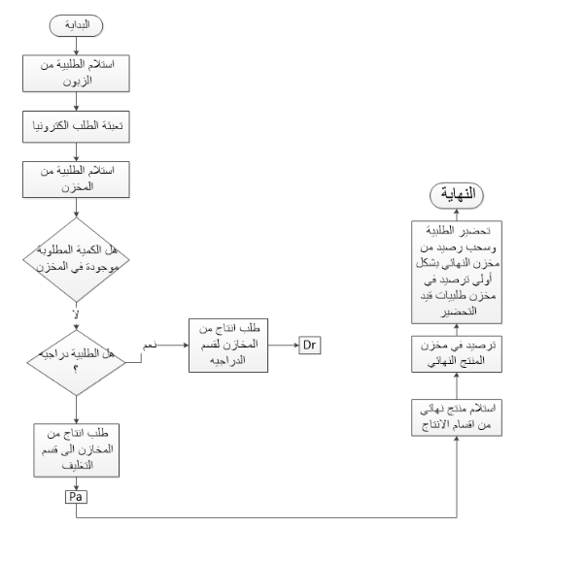
The final product stock procedure before improvement

Slide 10
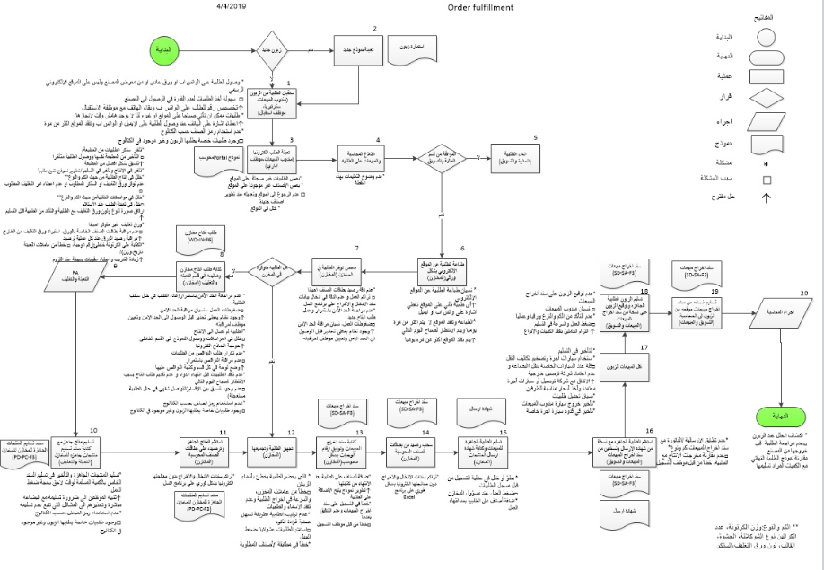
The final product stock procedure after improvement

Slide 11
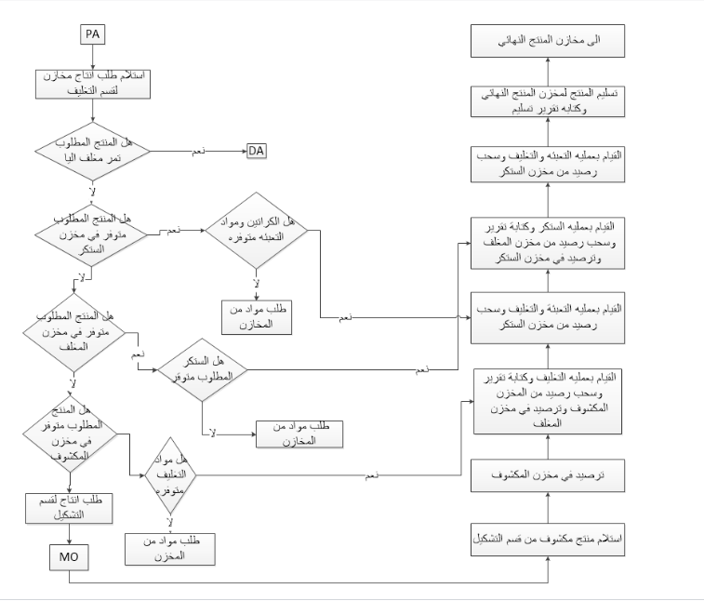
The packaging procedure before improvement

Slide 12
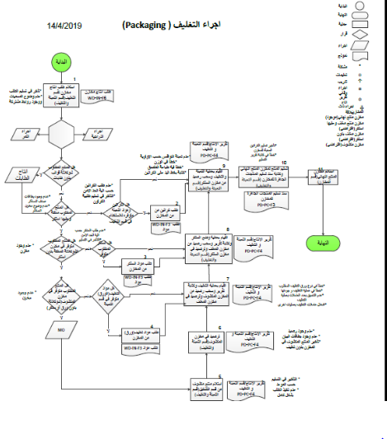
The Packaging Procedure after improvement

Slide 13
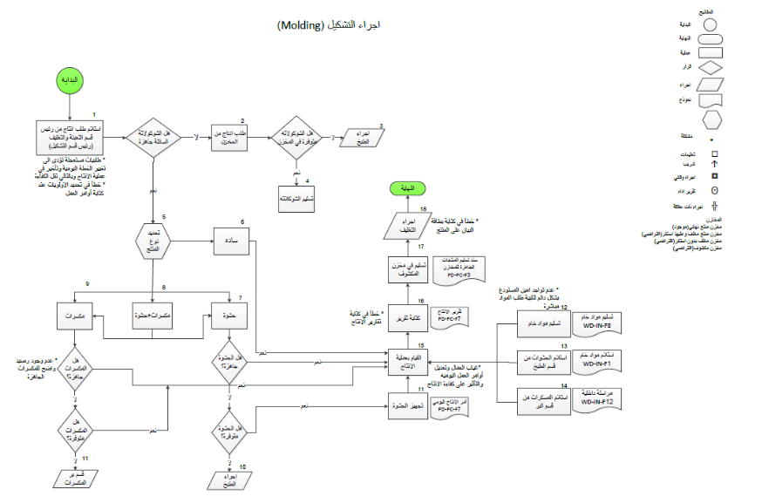
The Molding Procedure after improvement

Slide 14
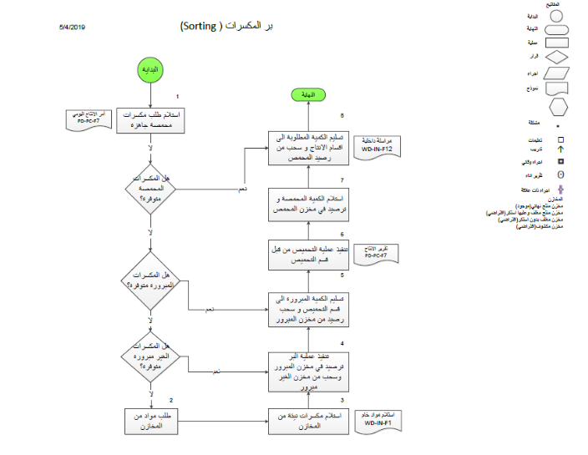
The Sorting Procedure after improvement

Slide 15
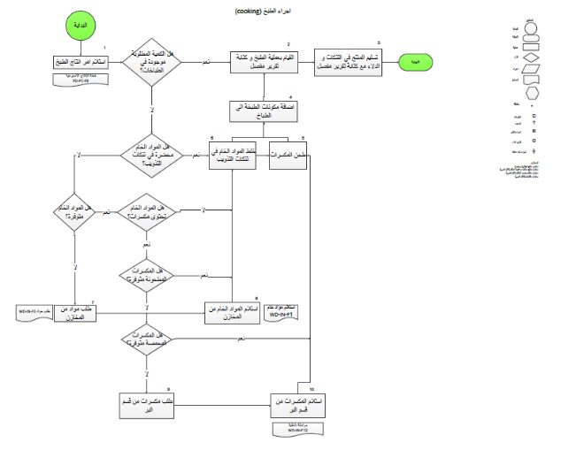
The Cooking Procedure after improvement

Slide 16
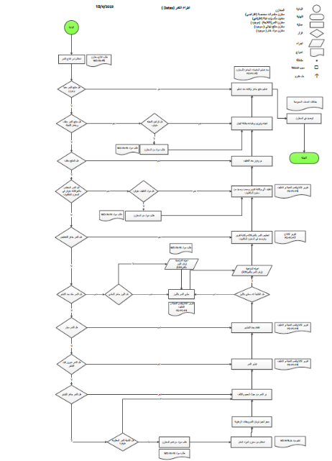
The Dates Procedure after improvement

Slide 17
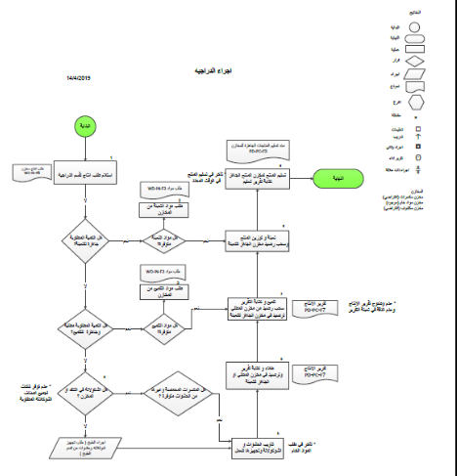
The Dragee Procedure after improvement

Slide 18

Order Fulfilment
This section discusses the problems that may badly affect the procedures in the factory and solutions that can help to get rid of them.
Problem
Solution

Slide 19
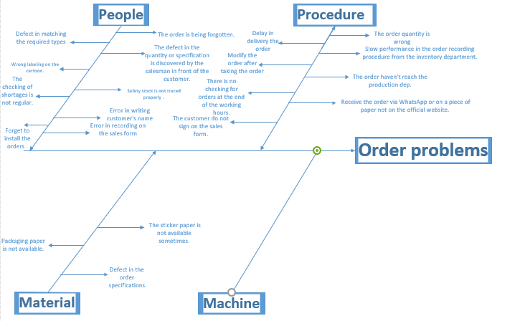
Cause and effect diagram

Slide 20
Problems in the Order Fulfilment
2. Problems due to lack of commitment of employees
1. Problems related to receiving the order

Slide 21
1.Problems related to receiving the order
Problems related to receiving the order from the employees | 1 | The order quantity is wrong. (20% of total orders) | Receiving and tracking form
 | 2 | Defect in the order specifications (wrong packaging paper type or color). ( 15% of total orders) | Receiving and tracking form
 | 3 | The order is being forgotten. | Receiving and tracking form
 | 4 | Delay in delivery the order | Receiving and tracking form
 | 5 | The defect in the quantity or specification is discovered by the salesman in front of the customer. | Receiving and tracking form
 | 6 | There is no checking for the order quantity and the order type practically | Receiving and tracking form
 | 7 | Slow performance in the order recording procedure from the inventory department. | Receiving and tracking form
 | 8 | Defect in matching the required types | Receiving and tracking form
 | 9 | Modify the order after taking the order | Receiving and tracking form
 | 10 | The order haven't reach the production dep. | Receiving and tracking form
 | 11 | Some orders come in the morning so it can’t be ready by the time the salesman comes. | Receiving and tracking form
 | 12 | Receive the order via whatsapp or on a piece of paper not on the official website. | integration the place of receiving the order

Slide 22
2. Problems due to lack of commitment of employees
Problems due to lack of commitment of employees | 13 | Safety stock is not traced properly as the orders flows in and out of the inventory. | Traning the workers professionally
 | 14 | Wrong labeling on the cartoon. | Traning the workers professionally
 | 15 | The checking of shortages is not regular. | Traning the workers professionally
 | 16 | There is no checking for orders at the end of the working hours. | Traning the workers professionally
 | 17 | The customer do not sign on the sales form. | Traning the workers professionally
 | 18 | Delaying in deliver the form related to the delivered quantity. | Traning the workers professionally
 | 19 | Forms accumulation without processing through excel immediately. | Traning the workers professionally
 | 20 | Error in writing customer's name by the person who prepare the order | Traning the workers professionally
 | 21 | Error in recording on the sales form and not checking after recording. | Traning the workers professionally
 | 22 | Forget to install the orders . | Traning the workers professionally

Slide 23
Suggested solutions
1. Receiving and tracking form
Detailed information about the customer in order to avoid the problems related to the customer.
The order is in details (brand name, code, product name, stuffing type, packaging type and color).
Any modifications on the order, this column helped to avoid the problems related to the addition or deleting anything from the order.
Weight and quantity.
Production column: to check the uncovered inventory and make the production order. .
Inventory column: to check whether the quantity is available or not.
Packaging column: to check if the type and color of the package is available.
Delivery column: to double check the weight, quantity and packaging.
Date and time
Signature of all the departments’ managers, to make sure of taking responsibilities.
Customer’s signature.

Slide 24
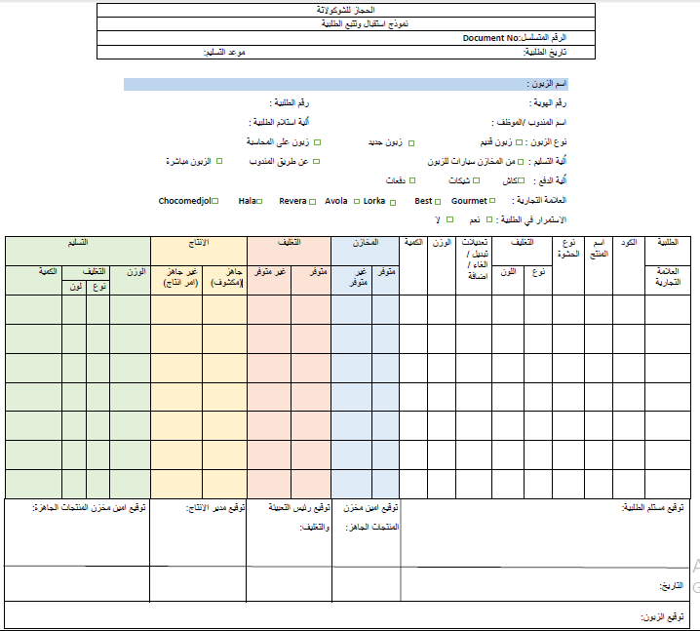

Slide 25
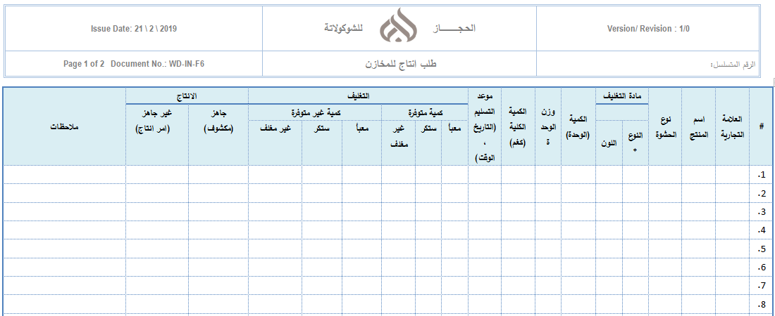
2. Modified forms
The first one(modified inventory command form)

Slide 26
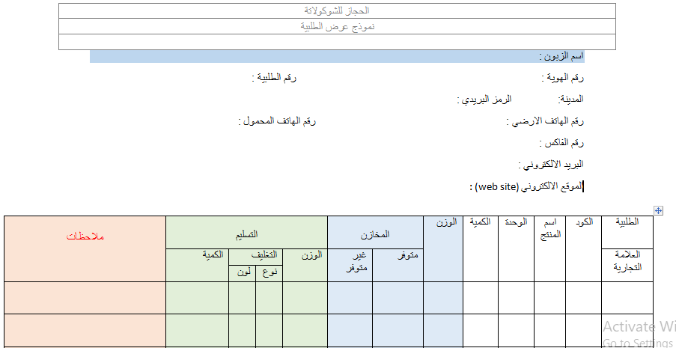
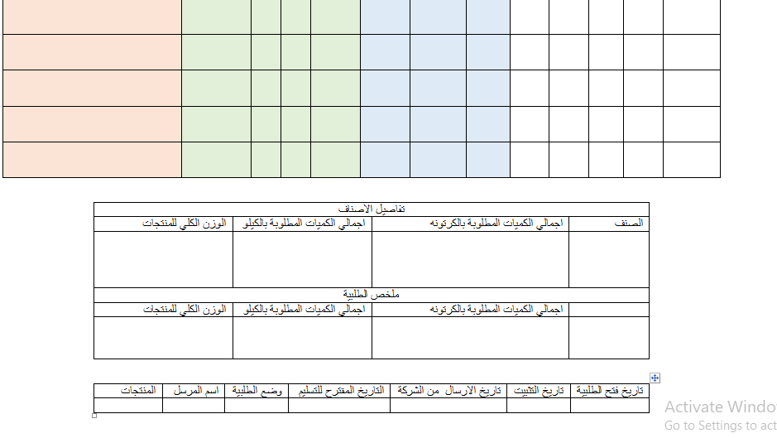
The Second one: (Modified Order Form)

Slide 27
Conclusions and Recommendations
Conclusion
AL-Hijaz Company has a superior technology and techniques
They have a centralized management system.
Despite of their advanced manufacturing techniques, a flow chart that combine all the operations together in appropriate sequence was missed
ISO 22000 is adopted but not fully implemented yet.

Slide 28
Recommendations
Convert the forms to a computerized system
Try to apply the receiving and tracking form
Develop training courses for the workers
Create a system that will increase the efficiency of inventory and warehouses.

Slide 29


