Slide 1
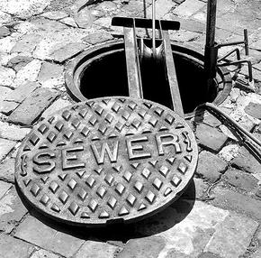
Design of a wastewater network for Al-Swani - Tulkarm
Prepared by :
Ahmad Adas
Fayed Atatri
Amjad Shayeb
Supervisor :
Dr. Lubna El-Haj Hamad

Slide 2
Outline
Introduction
Objectives
Methodology
Study area
Design
Results

Slide 3
Introduction
Tulkarem is one of the Palestinian cities that are incompletely have sewage networks , these networks collect wastewater by pipes and manholes and transit it to a certain location usually treatment plant .

Slide 4
Objectives
Design a sewage network for Al-Swani to serve people who live there .
Reduce the bad effect of cesspits tanks .

Slide 5
Methodology
Select the study area
Collect data
Start using sewerCAD
Design and analysis sewage network
make preliminary run
get the results

Slide 6
Study area
Location
Climate
Population
Water resource
Water supply
Topography

Slide 7
location
Al-Swani is located in the south east of Tulkarm.
The area land of Al-Swani is about 1.5 km² .

Slide 8
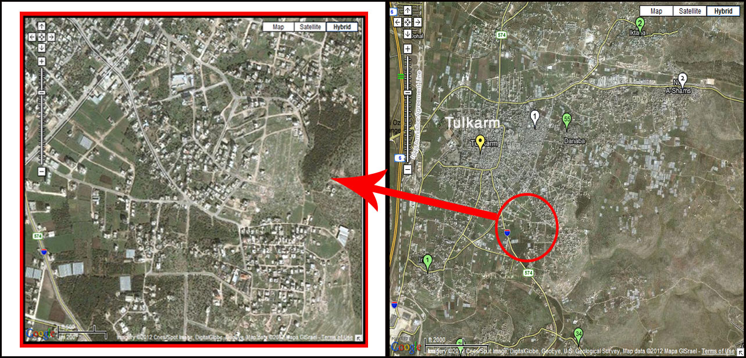

Slide 9
Climate
The climate of Tulkarm is Mediterranean and subtropical as the area surrounding it, with rainfall limited to the winter.
The climate could be explained as :
Temperature.
Humidity .
precipitation .

Slide 10
Population
Al-Swani has population about 5550 capita .

Slide 11
Water resource
There are 6 underground water wells distributed in Tulkarm area .

Slide 12
water supply:
In summer : well number 6.
In winter : Attayah reservoir.

Slide 13
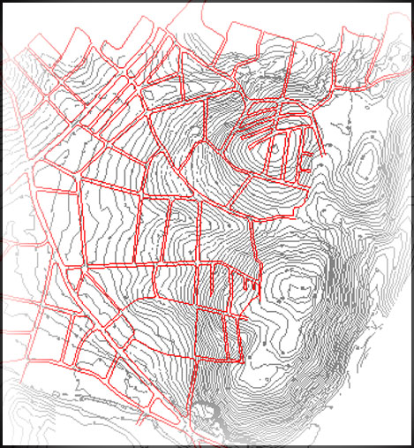
Topography
Al-Swani has a maximum elevation of a 144m above the sea level , and the minimum elevation is 60m above the sea level.

Slide 14
Design
Design Considerations :
Manning equation | V=1/n(R^{2/3})*S^{1/2}
Design for | 25 years
Velocity | ( 0.6 – 3 ) m/s
Slope | ( 1% - 12% )
Cover | ( 0.8 – 4 ) m
Distance between manholes | Maximum 50m
Diameter of pipe | 8’’ or more

Slide 15
year | 2010-2015 | 2015-2025 | 2025-2037
Increasing per year in (l/c/d) | 4 | 2 | 1.5
Water consumption in 2012 | 100 l/c.d
Water consumption in 2037 | 150 l/c.d

Slide 16
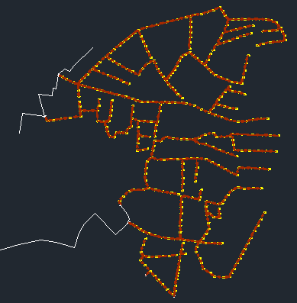
Design
Design steps :
(1) Draw pipes and manholes using SewerCAD.

Slide 17
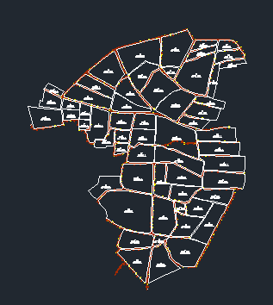
Design steps :
(2) Divide Al-Swani zone into many parcels .

Slide 18
Design steps :
(3) Calculate the unit sanitary load of each manhole by the following excel sheet .
Excel sheet

Slide 19
Design steps :
(4) Insert all data to sewerCAD.
(5) Make the preliminary run after checking all data and get results.

Slide 20
Results
slope | (1-12)%
Velocity | (0.2-1.9) m/s
Diameter of pipe ( inch) | 8’’ and 10’’
Diameter of manhole | 1 m
cover | (0.9-3.5) m
Depth of manoles ( max.) | (1.12-3.84) m
# of manholes | 407

Slide 21
Results
Pipe diameter | Length (m) | % from network | # of pipes
8 in | 10632.5 | 91.7 % | 373
10 in | 960.5 | 8.3 % | 34
total | 11593 |  | 407

Slide 22
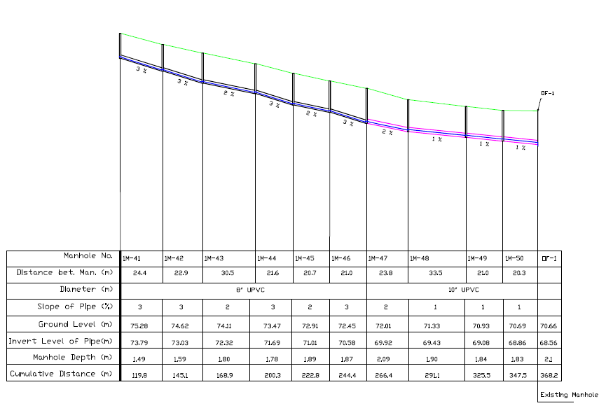
Profile

Slide 23
Thank you

