Slide 1



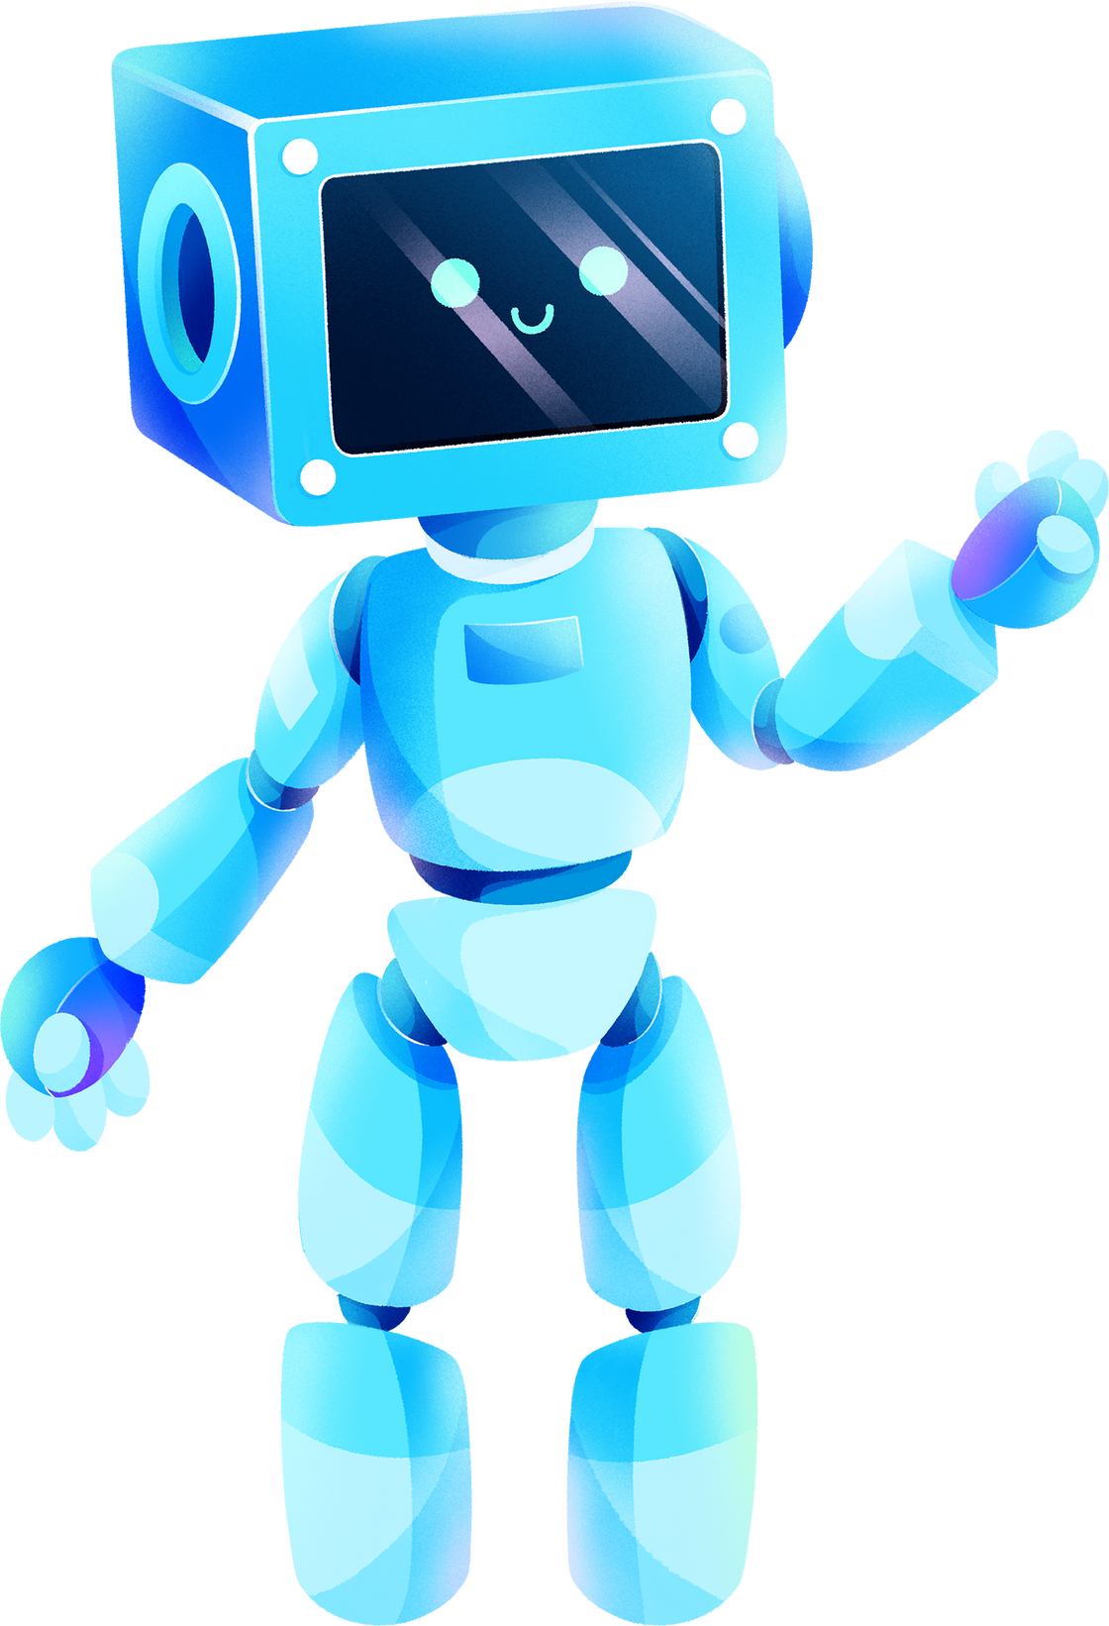

FRIENDLY ROBOT
supervisor:Dr.sufian samara
Yafa Nada
Salsabeel Dwikat

Slide 2
AGENDA
  Introduction
  main features
  constraint and challenges
  Hardware component
  future work
  Demo
01
02
03
04
05
06

Slide 3
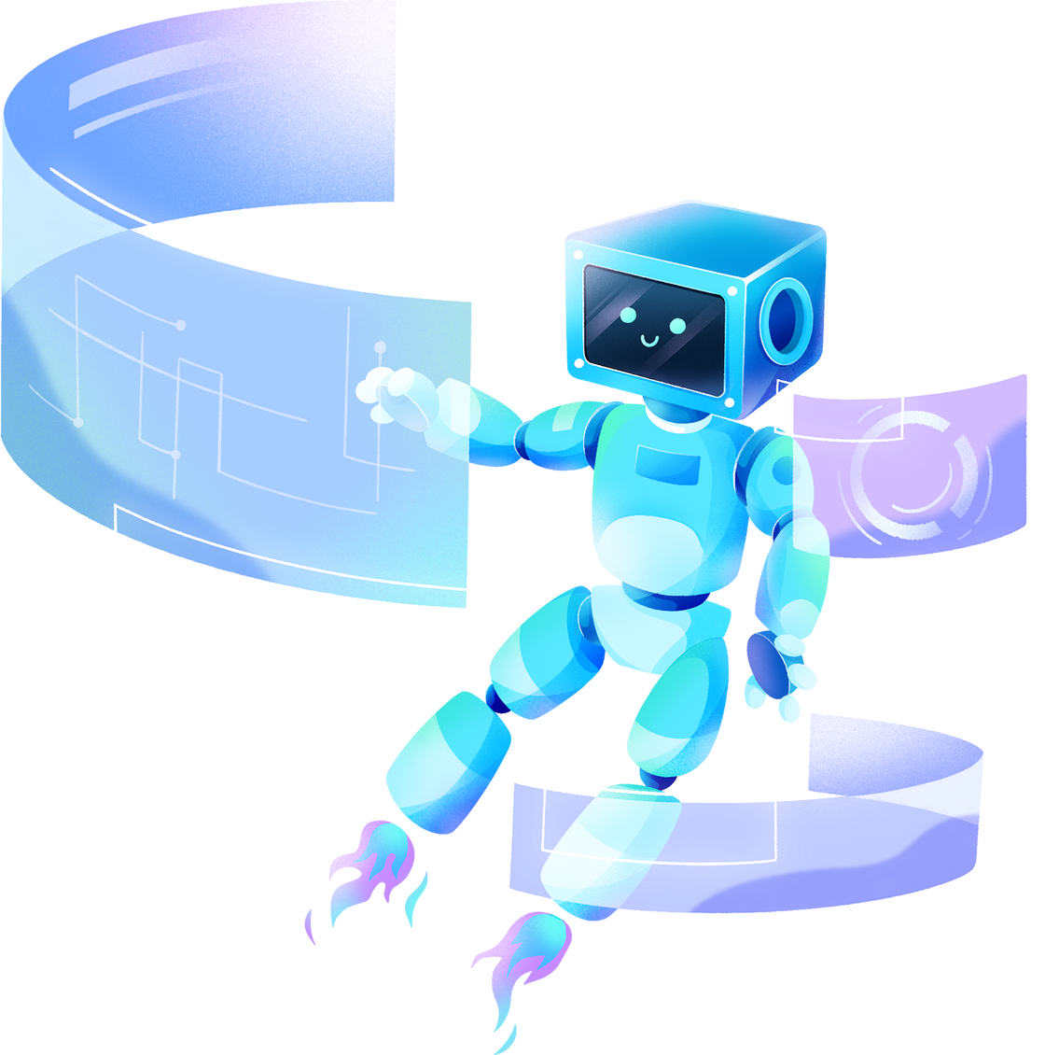
INTRODUCTION
Our special project is a smart interactive
robot intended for children. It can be considered
as a babysitter or companion for the child. It is characterized by its smoothness and ease of use, in addition to being a safe device within the standards of children’s devices. It enhances the child’s communication skills and encourages him to practice his daily tasks in addition to entertainment and learning.

Slide 4







MAIN FEATURES
3 MODES
VOICE RECOGNITION
LIVE STREAMING

Slide 5

CONSTRAINTS AND CHALLENGES
01
02
03
04
Quality of devices
COST
CODE
power supplies

Slide 6
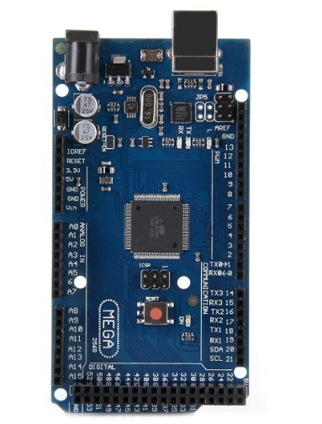
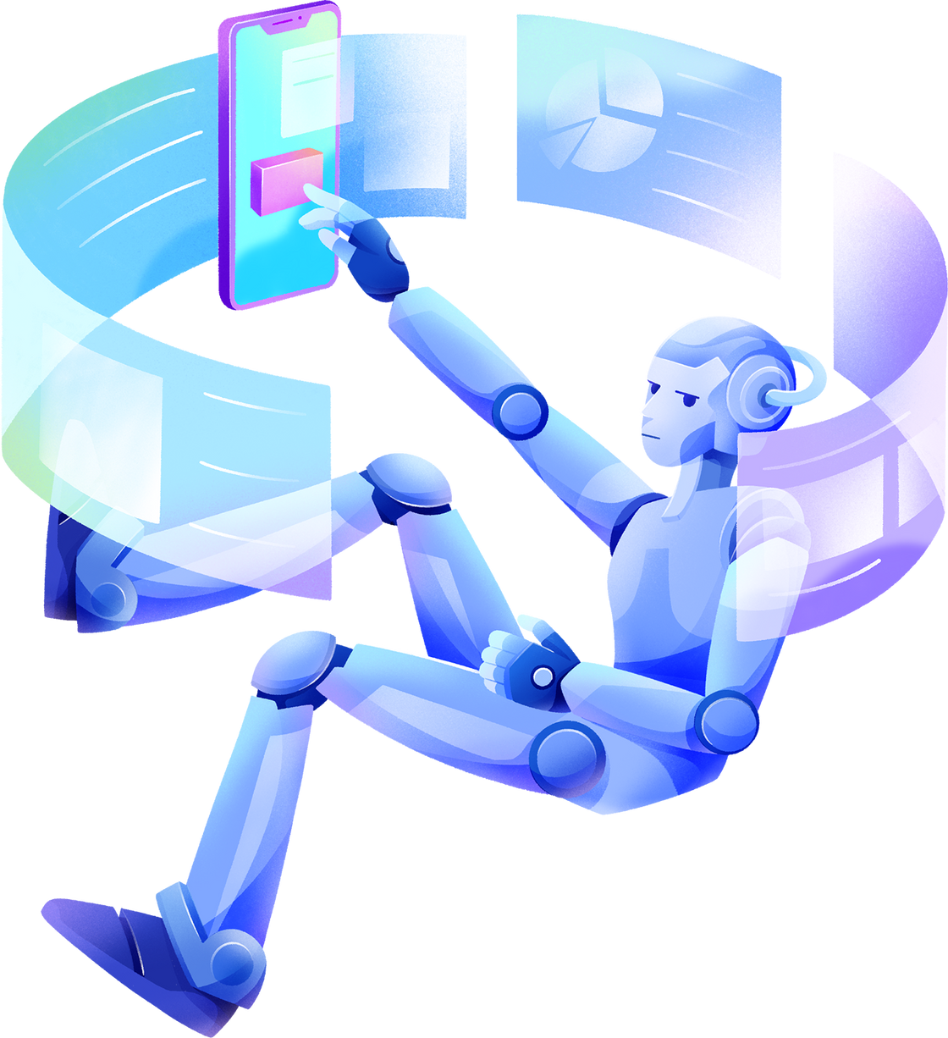

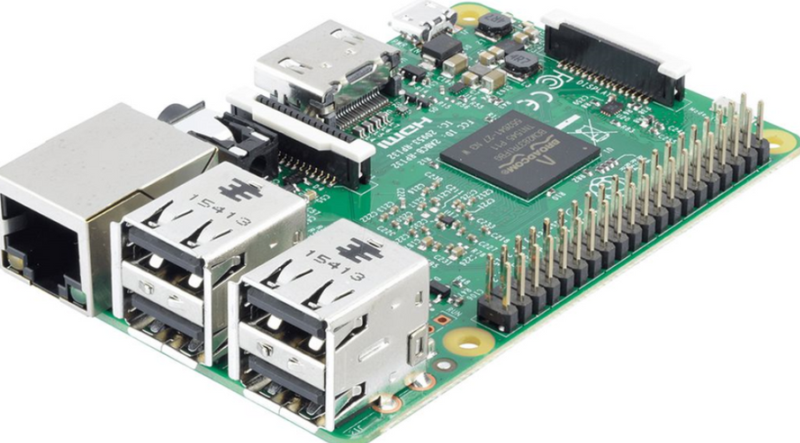
HARDWARE COMPONENTS
ARDUINO MEGA
RASPBERRY PI

Slide 7
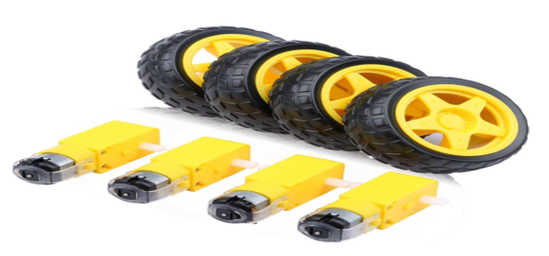
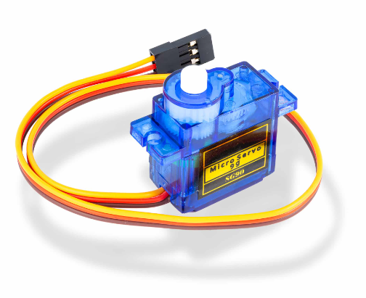
DC MOTOR
SERVO MOTOR

Slide 8
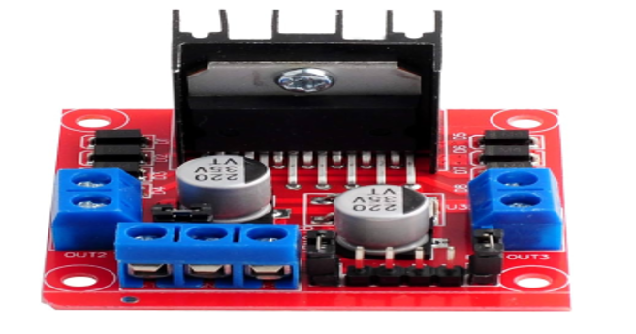
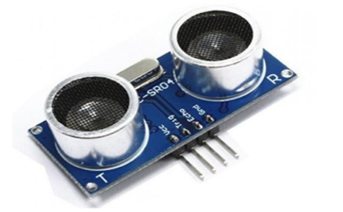
H-BRIDGE
ULTRASONIC

Slide 9
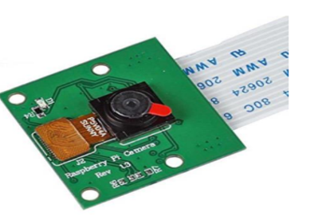
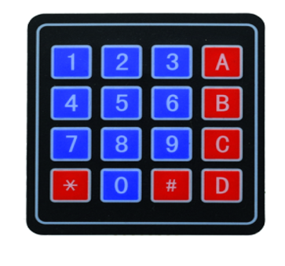
PASPBERRY PI CAMERA
KEYPAD

Slide 10
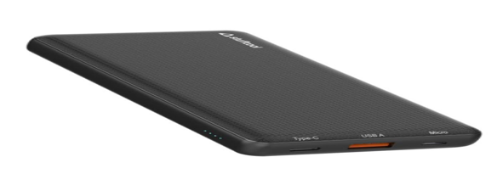
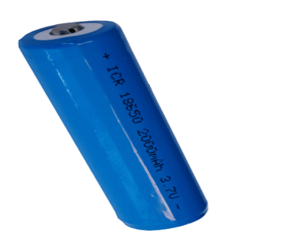
POWER BANK
LITHUIM BATTERIES

Slide 11
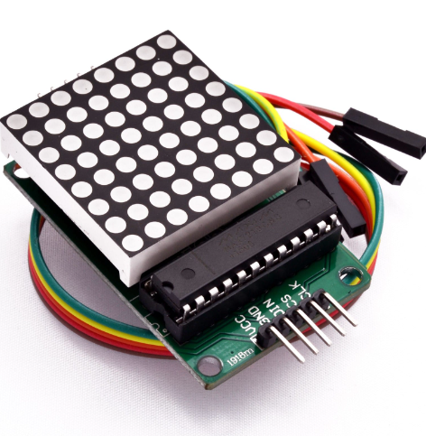
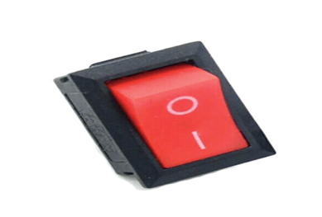
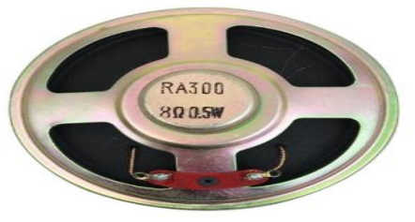
DOT MATRIX DISPLAY
ON/OFF SWITCH
SPEAKER

Slide 12


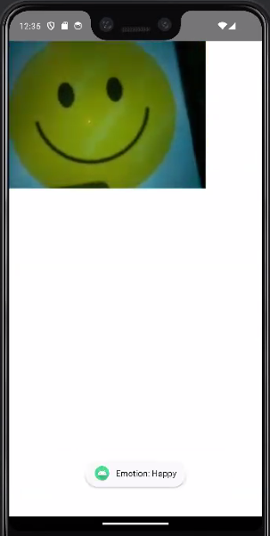
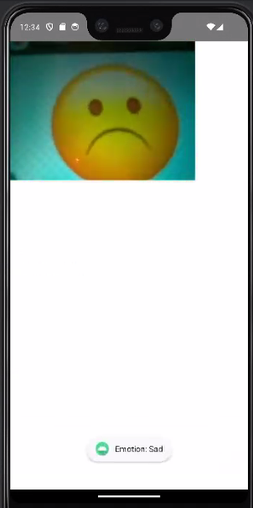
MOBILE APPLICATION

Slide 13






FUTURE WORK
ADDING EXTRA MODS
ADD ANOTHER SENSORS
ADDING EXTRA GAMES
ADD TOUCH SCREEN AND LCD SCREEN

Slide 14
DEMO

Slide 15





THANK YOU

