Slide 1
Med_Aid

Slide 2
outlines
01
04
What is Med_Aid Application
The Admin Page
02
05
Problems we had during the creating process
Why we created the Application
How we created the Application
03
06
Future Plans

Slide 3

A Mobile Application
To ease the access of users for pharmacies and medications

Slide 4
What does a Med_Aid do?
A map-linked search area that allows users to search for medications and shows which pharmacy that contain the medication closest to the user's current location.
Track what each pharmacy have in medicine categories so users can see drugs and see their description, price and form.
An online order section where the user can order certain types of medicines online on quickly way.
Conversation section with Auto answer for quick medical advice and access to appropriate medications.
The application has advertisement space for companies to take advantage of.
Keeps track of a set of timers that each user sets for medicines ,and notifies the user when it’s time for their medicines, according to the information that the user sets.

Slide 5







What we used in creating the application
Flutter
Node JS
MySQL
VS code
Android Studio
Dialogflow API
Google Map

Slide 6
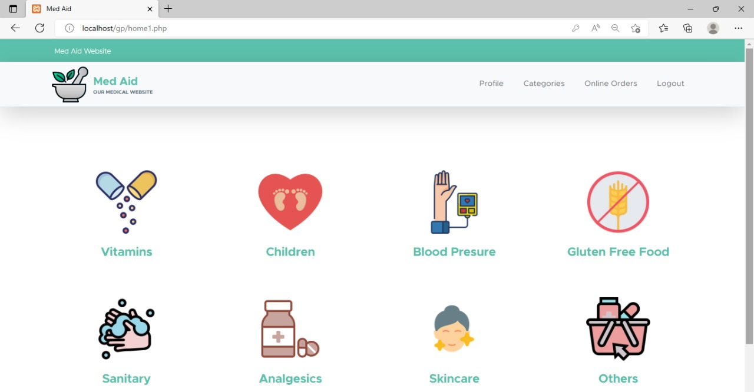
Pharmacies Page

Slide 7
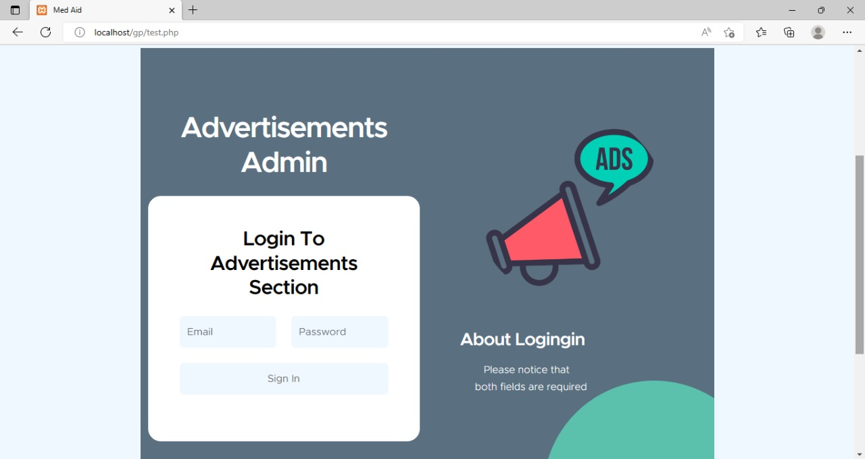
AdminPage

Slide 8


Problems along the way
Learning new skills
Lack of data

Slide 9
Future Plans
01
02
03
made this app available for all Palestine cities not only in Nablus
Implement AI personalized ads according to each person's interest.
gave the user ability to see the nearest pharmacy that opens on Fridays

Slide 10
Our Team
Manar Saleh
Marah Dmaide

