Slide 1


An-Najah National University | 2025
College of Engineering and Information Technology
Department of Energy Engineering and Environmen
Simulation of a Solar Assisted Heat Pump System for Heating An-Najah National University Closed Swimming Pool.
Supervisor: Dr. Abdalrahim Abusafa
Students name:
Aseel Amarni
Naheel Shtiwi
Sajed Methqal
Tamara Sawalha

Slide 2
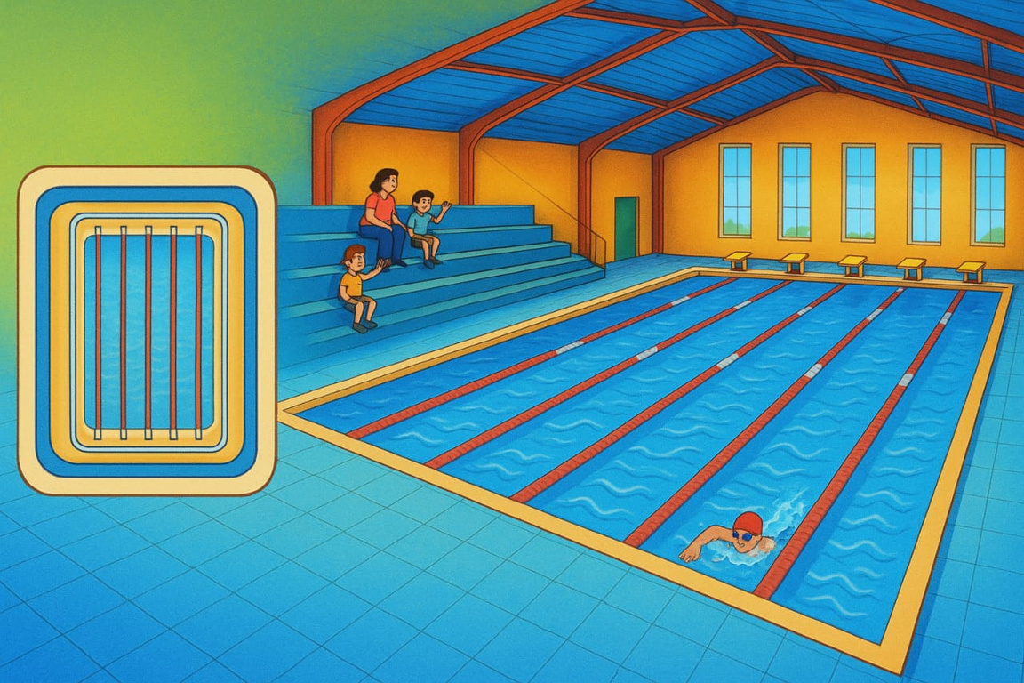
Swimming Pool Heating:
Swimming pool heating is essential for maintaining comfortable water temperatures year-round. Choosing the most efficient and sustainable method ensures energy savings and environmental benefits.

Slide 3









Objectives:
Thermal Losses Analysis
Quantify thermal losses in the pool system under varying conditions and propose reduction strategies.
Environmental Impact Assessment
Assess environmental benefits by estimating emission reductions and supporting sustainability goals.
System Design
Control System Simulation
Design a hybrid solar-assisted heating system integrating collectors, heat pumps, and storage for efficient pool heating.
To simulate the control strategy of the hybrid system using MATLAB/Simulink, ensuring optimal performance.
Thermal Comfort and Scalability Improvement
Economic Analysis
conduct an economic assessment covering costs, payback period, and comparison with conventional heating.
Ensure user comfort with stable water temperature and design for future scalability.

Slide 4
Swimming Pool Heating Systems:
Fossil fuel heaters
Electric heaters
Solar Pool Heater
1
2
3
One of the most popular ways to heat a pool is with gas heaters.
Easy to install and efficient for small spaces, but may consume significant electrical power over extended use.
It uses sunlight for heating—very sustainable but sunlight-dependent.
Heat pumps
Hybrid Pool Heating Systems
4
5
It relies on harnessing heat from the air or ground, making it an energy-saving and environmentally friendly option.
Hybrid systems combine solar, gas, or heat pump for efficient, smart heating.

Slide 5
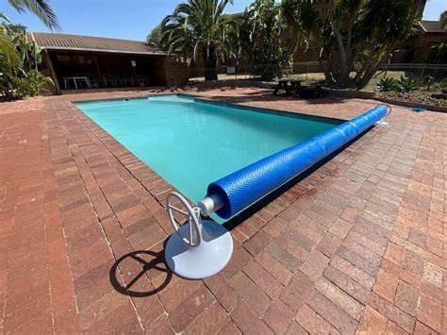
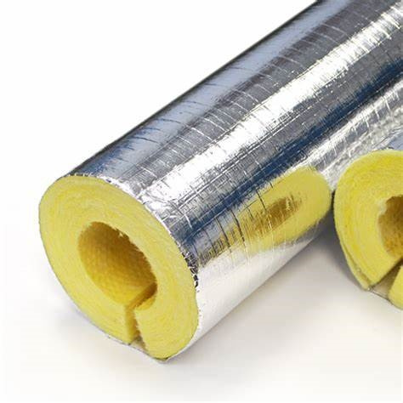
Solutions to improve the efficiency of swimming pool heating:
Pool Covers (Passive Heating Support):
While not a heating system
Cover the basin when not in use.
Fiberglass insulation procedures:
Pipe insulation is essential for pool heating.
Benefits:
Benefits:
Application
steps:

Slide 6
Methodology:
CASE STUDY:
  Current University Swimming Pool Heating System
  High operational cost
  environmental pollution in the current system.
PROBLEM STATEMENT
CURRENT SYSTEM ANALYSIS
  Data analysis showed excessive fuel consumption, far more than needed to compensate for thermal losses
  We started using TRNSYS but couldn't find the required components.
SEARCHING FOR SOLUTIONS
  It requires detailed information (such as heat pump size) and does not allow accurate simulation without prior experience, making it impractical.
TRNSYS
RetScreen
PROPOSED SOLUTION:
  We decided to build our own algorithm using MATLAB and Excel to analyze the scenarios more accurately.
  We designed several systems and compared them economically and environmentally.
COMPARISON OF SYSTEMS:
CHOOSING THE BEST SYSTEM:
  We chose the system that achieves the best balance between economic efficiency and reduced environmental impact.

Slide 7
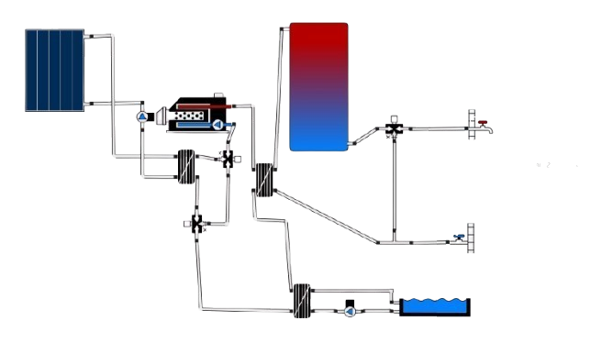
Case Study:
Temperature: 45°C
Average volume withdrawal: 200 l/day
Temperature setting: 29 °C
Length: 25 m
Width: 12.5 m
Average depth: 12.5 m

Slide 8
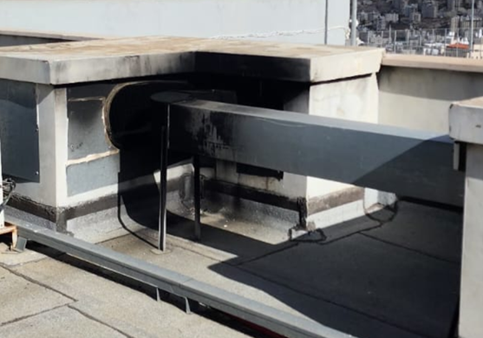
Effects of incomplete combustion on system cleanliness and efficiency
Smoke deposits impair combustion, increase energy losses and reduce operational efficiency.

Slide 9
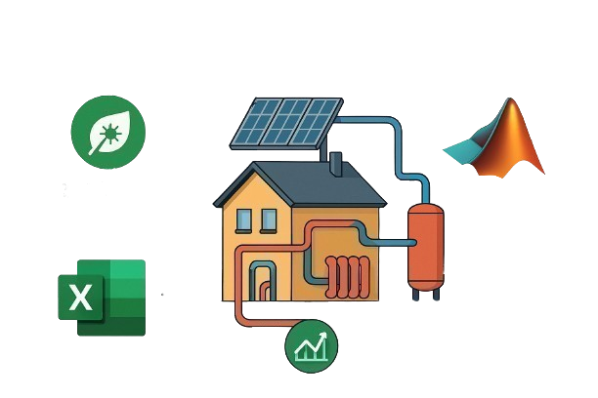

Evaluation and analysis methodology for a hybrid heating system
using:
RETScreen program:
Excel:
RETScreen
MATLAB
MATLAB:
Excel

Slide 10
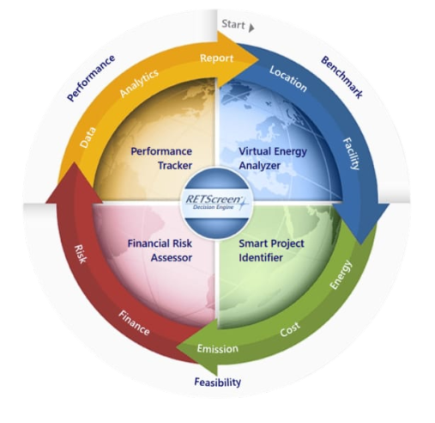
RETScreen program:
A platform developed by Natural Resources Canada for planning, analyzing, and monitoring low-cost renewable energy and energy efficiency projects.
Application features:
Project Feasibility & Financial Analysis:
1
Performance Analysis:
2
GHG Emission Analysis:
3
Decision Support:
4

Slide 11

Excel :
Why was Excel used as an analysis tool?
why wasn't it sufficient on its own?
Accurate Time Control:
Excel allows data to be entered and broken down into hourly intervals
Dynamic Heat Loss Analysis:
Excel thermal equations estimate heat loss and hourly energy needs year-round.
Flexibility to Modify and Customize:
The model can be tailored to the geometric characteristics of the pool and surrounding building
Better integration
with real-world data:
Excel allows you to enter real climate data or import it from external sources.
Data presentation lacks
clarity and interactivity.
Excel displays results in the form of tables and numbers, which makes analyzing trends and detecting errors more difficult.
Lack of support for complex
dynamic modeling (loops):
Excel struggles with simulating feedback loops and component interactions.

Slide 12










MATLAB:
MATLAB was chosen for its advanced capabilities for accurate data processing and analysis, along with its ability to provide dynamic visualization and support for complex algorithms.
Ability to Use Complex Equations and Algorithms
Powerful Data Control
MATLAB supports the implementation of precise algorithms for more professional data analysis.
We can manipulate data using accurate and effective feedback.
Creating a Large Number of Graphs
Provides powerful visual tools for presenting and analyzing data from different perspectives.
Displaying Data Over Different Time Periods
Advanced Methods for Presenting Results
Data can be represented over multiple time periods to understand performance evolution or changes.
MATLAB allows us to create custom and clear graphs that make results easier to understand.

Slide 13

Hybrid Heating System Evaluation: MATLAB vs. Excel:
FEATURE
MATLAB
EXCEL
Purpose
Full hybrid system design, simulation, and optimization were performed.
Simplified thermal loss and cost analyses were carried out.
Complexity
High – control strategies and physical modeling were included.
Medium – formula-based calculations were utilized.
Data Processing
Loops, conditions, and weather file parsing were used.
Direct formulas and structured worksheets were employed.
Customization
Multiple user scenarios were supported.
Focus was placed on insulation and cover impact analyses.
Outputs
Graphs, CSV files, and economic metrics (NPV, IRR) were generated.
Direct numerical values, basic graphs, and payback periods were produced.

Slide 14



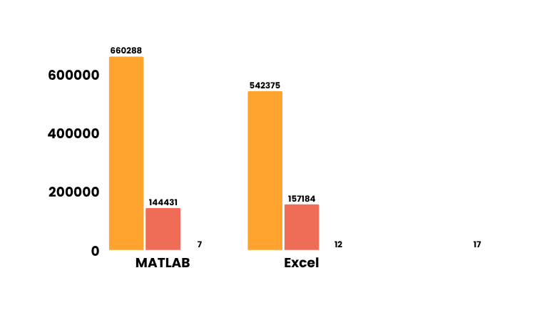


MATLAB vs Excel Simulation Results
M
TOTAL LOSSES
M
PRODUCTIVE SOLAR ENERGY
660,288.48 kWh
144,431.26 kWh
E
TOTAL LOSSES
E
PRODUCTIVE SOLAR ENERGY
Total Losses
542,375.23 kWh
157,184 kWh
Productive Solar Energy

Slide 15

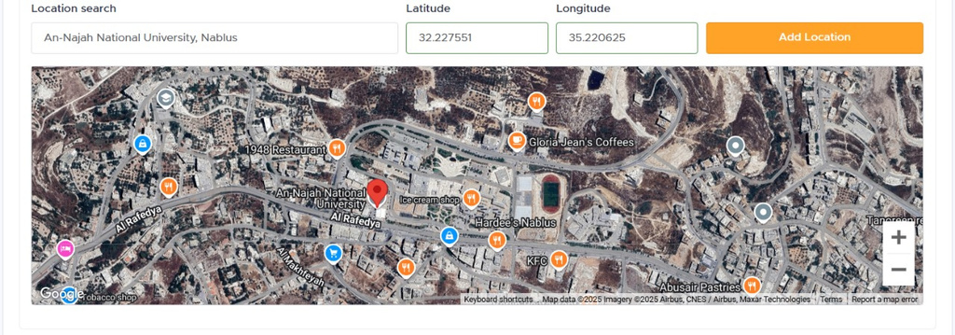

Data collection:
  Environmental and solar radiation data based on geographic location were obtained from Solcast (a DNV company), a reliable source for high-resolution solar resource information.
Location-Based Environmental Data Collection
To ensure accuracy in our solar energy analysis, we selected the precise location of An-Najah National University in Nablus, using its geographic coordinates:
Latitude: 32.227551
Using Solcast (a DNV company), we extracted high-resolution, hour-by-hour environmental data for this site, including:
Longitude: 35.220625
  Different types of solar radiation
  Ambient temperature
  Solar zenith angle
This data enabled us to perform detailed analysis tailored to the specific climatic and solar conditions of the site.

Slide 16
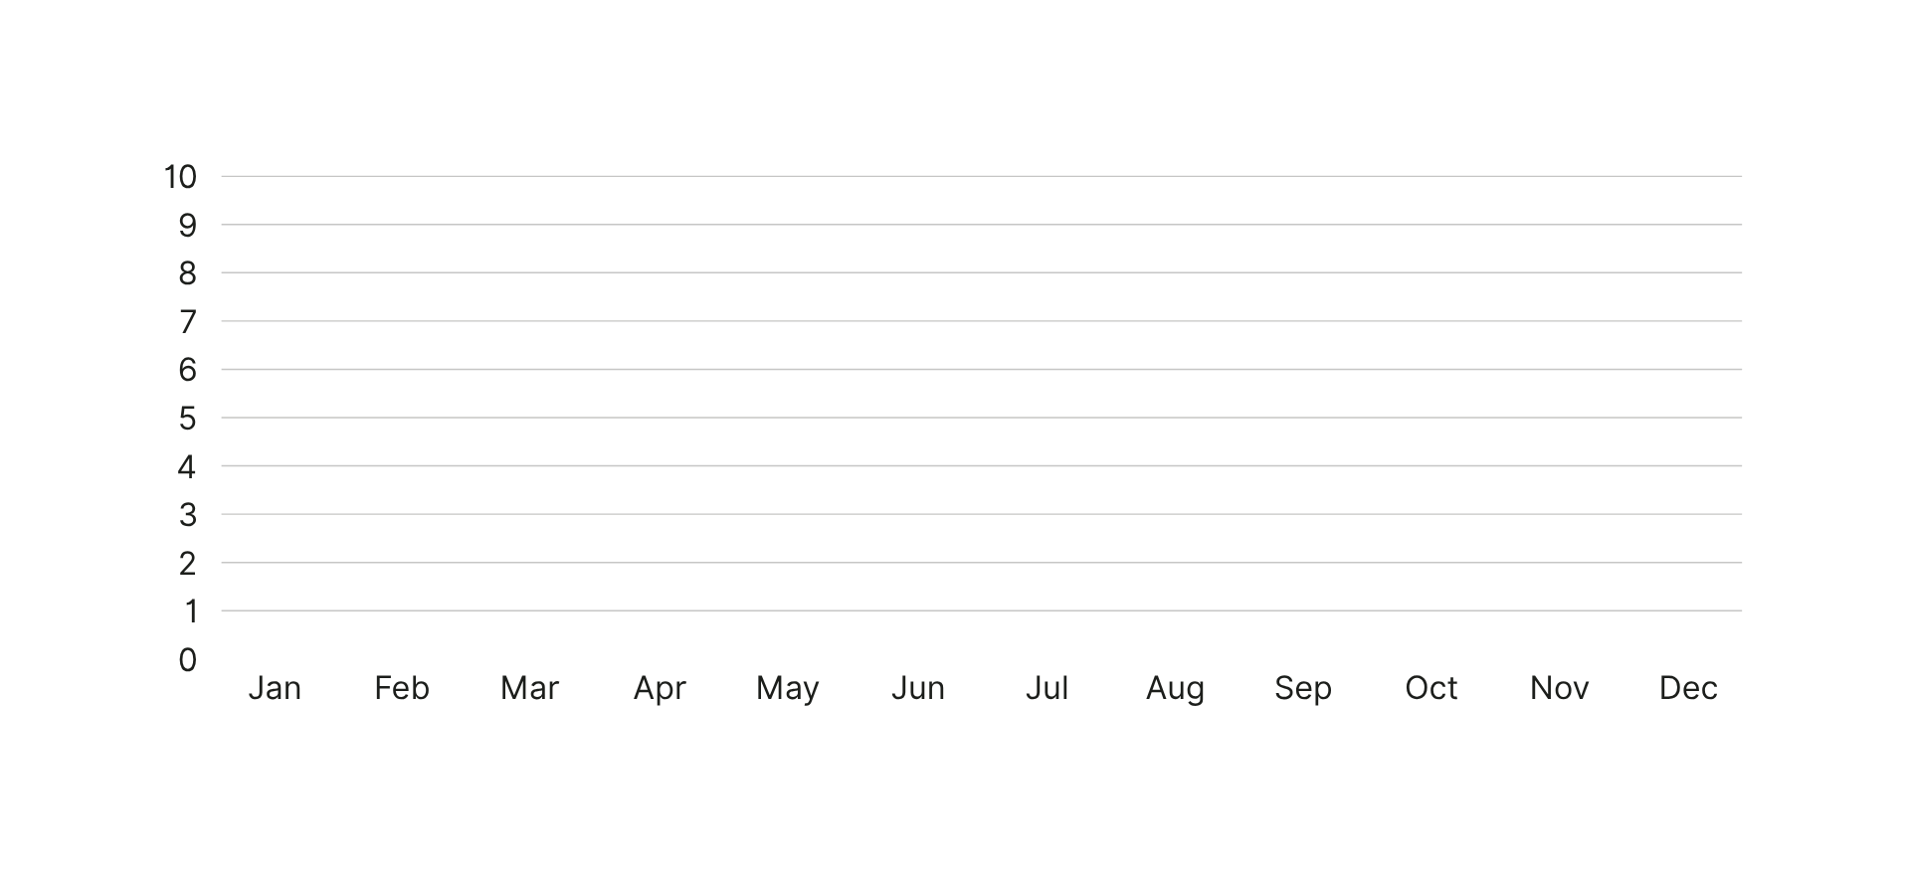
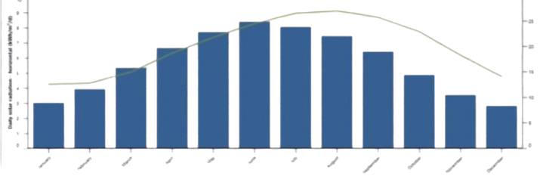
Solar Radiation and Air Temperature visualized data from RETScreen.
Daily Solar Radiation (kWh/m²/day)

Slide 17
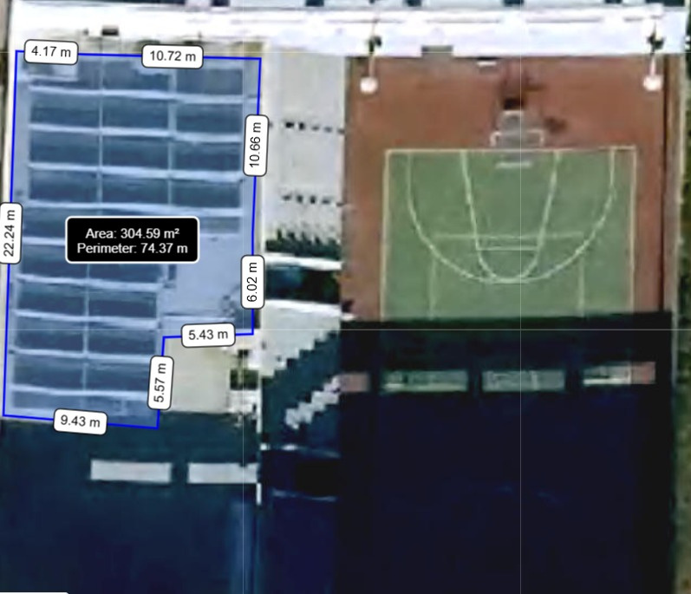
Data collection:
The GeoMolg tool was used to determine the available space on the building's rooftop.
Total usable area: 300 square meters
Total perimeter: 74.37 meters
Actual area allocated for installation (after accounting for maintenance corridors and safe distances): 280 square meters
Reasons for reducing effective space:
  The need to provide safe maintenance aisles.
  Ensuring easy access to equipment for routine maintenance.
  Compliance with technical safety requirements.
A screen shot from Geomolg showing the Available areas for solar collector installation.

Slide 18

Data collection:
Evaporation (WH): 10.07
Radiation (NWH) :6.52
Walls (NWH): .67
Convection Loss (20.12%): 20.12
Pipes (WH): 6.52
Radiation Loss (12.26%): 12:26
Working Hours Demand: 57.63
Convection (NWH): 10.05
376364kwh
Walls Loss (1.27%):1.27
Total Energy Demand:100
Evaporation (WH): 27.92
Pipes Loss (12.38%) 12:38
Total Losses: 94.07
660,288.48 kWh
Radiation (NWH) 5.74
Non-Working Hours Demand: 42.37
Walls (NWH): .6
Evaporation Loss (48.04%) 48.04
Pipes (NWH): 5.86
283924kwh
Shower Demand (WH) 5.93
Evaporation (NWH): 20.12
Total Shower Demand: 5.93

Slide 19
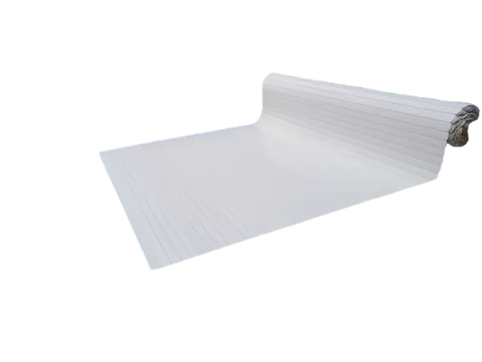
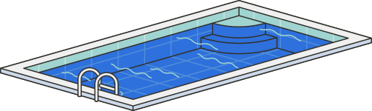
Results :
Improve the efficiency of the thermal system by insulating the pipes and using a pool cover.
  the Effect of Pool Cover on Heat Transfer Coefficients:
Parameter
Uncovered Pool
Covered Pool
Impact of Pool Cover
Significant reduction (↓70%) in convective heat loss, enhancing thermal efficiency.
Convection Heat Coefficient (hc)
10 W/m²·K
3 W/m²·K
Major reduction (↓80%) in evaporative heat loss, decreasing energy consumption.
Evaporation Heat Coefficient (he)
25 W/m²·K
5 W/m²·K

Slide 20
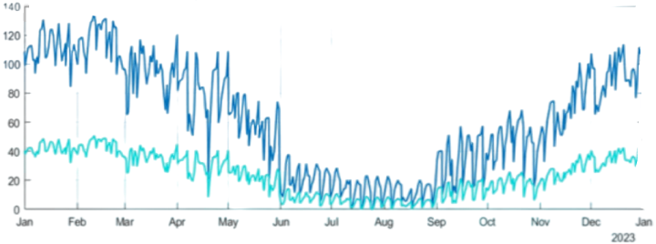

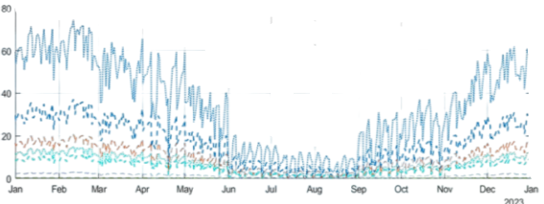
The role of the cover in reducing heat losses:
Hourly Total Losses during Non-Working Hours (Subsampled)
Total Losses (kW)
Total Loss (No Cover)
Total Loss ( Cover)
Hourly Detailed Losses during Non-Working Hours (Subsampled)
Convection (No Cover)
Convection (Cover)
Evaporation (No Cover)
Detailed Losses (kW)
Evaporation (Cover)
Radiation
Walls
Pipes

Slide 21
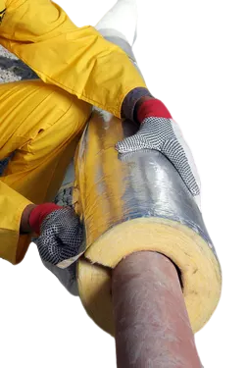
Results :
  Effect of Pipe Insulation on Heat Loss and System Efficiency
Thermal Conductivity
Heat Loss (Qpipe)
Impact on System Efficiency
Condition
More heat lost → lower efficiency → higher energy use and costs
Without Insulation
Higher
13 W
Less heat lost (↓29%) → improved efficiency → lower energy consumption
With Insulation
Reduced
9.2 W

Slide 22
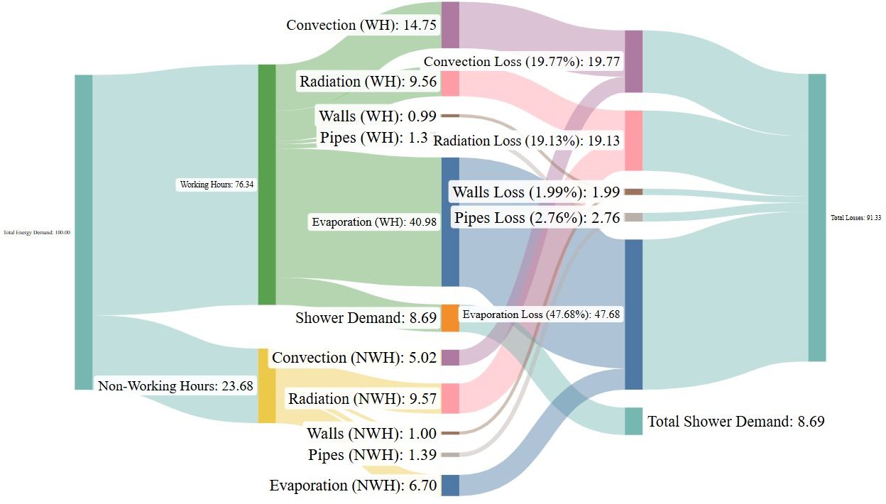
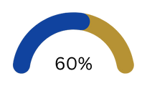
Analysis of energy loss in water heating system during working and non-working hours
397804kwh

Slide 23









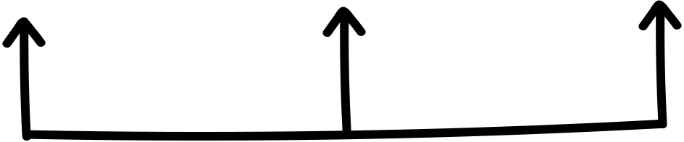




Strategies for compensating for heat loss during pool downtime
Cyclic Operation
Preheat
Max Pump Output:
157.55
138.14
Max Pump Output:
Pump Cost:
7877.59
Pump Lifetime
Pump Lifetime
Pump Cost:
22.95
6907.13
Early Start
25.06
Max Pump Output:
193.12
Pump Cost:
Full Night Operation
9656.10
Pump Lifetime
30.37
Max Pump Output:
Pump Cost:
134.52
Uniform Operation
Max Pump Output:
Pump Lifetime
6726.11
173.34
16.10
Pump Cost:
8667.10
Pump Lifetime
25.06

Slide 24
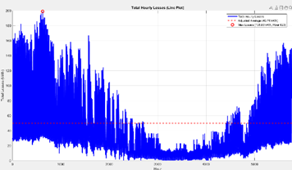
Comprehensive thermal analysis of system losses over time periods.
Total Hourly Losses
Time (Hours)

Slide 25
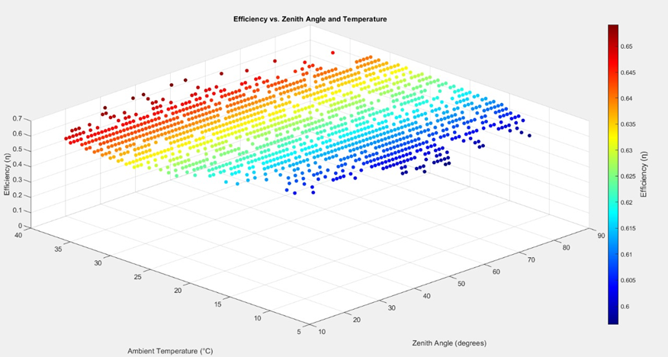
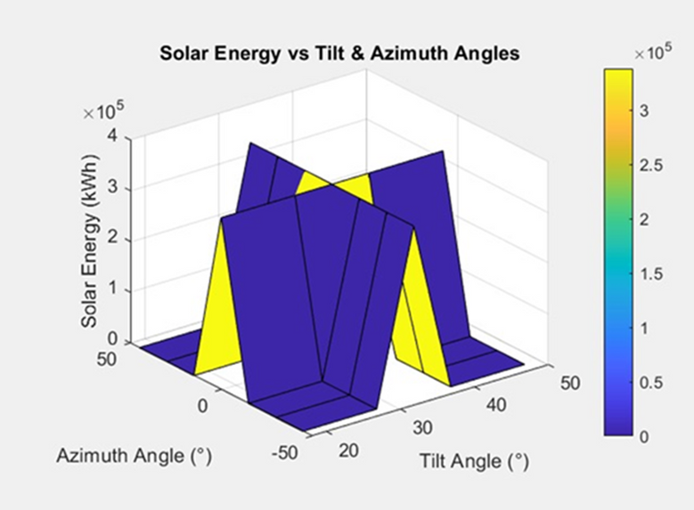
Simulation of Angle and Temperature Effects on Solar Collectors
Solar Energy vs. Tilt & Azimuth Angles
The highest solar production (3 × 10⁵ kWh) is achieved at an inclination of 30°–40° and an azimuth close to 0°, while it decreases at extreme angles due to poor sun exposure.
Efficiency vs. Zenith Angle and Temperature
The efficiency of the solar collector increases with increasing temperature and decreases with increasing zenith angle.

Slide 26
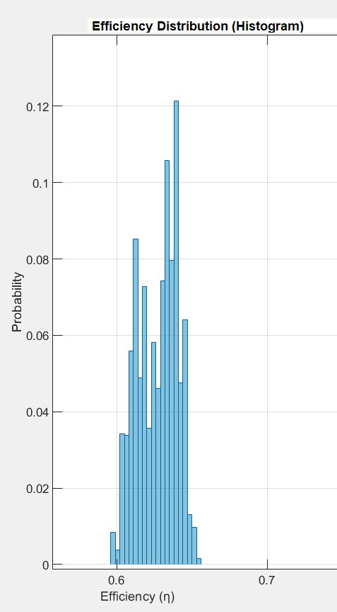
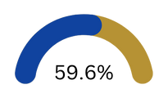
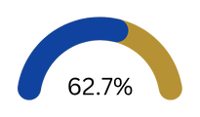
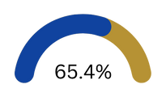
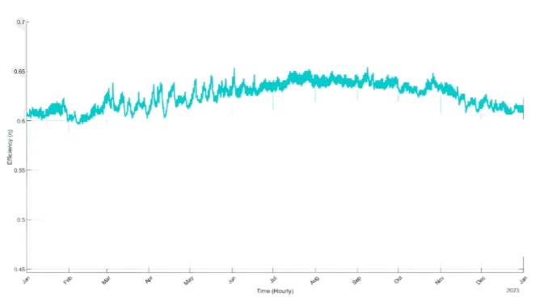
Probability Distribution of Solar Collector Efficiency
Min
Mean
Max
Displays basic statistical values ​​for efficiency:

Slide 27
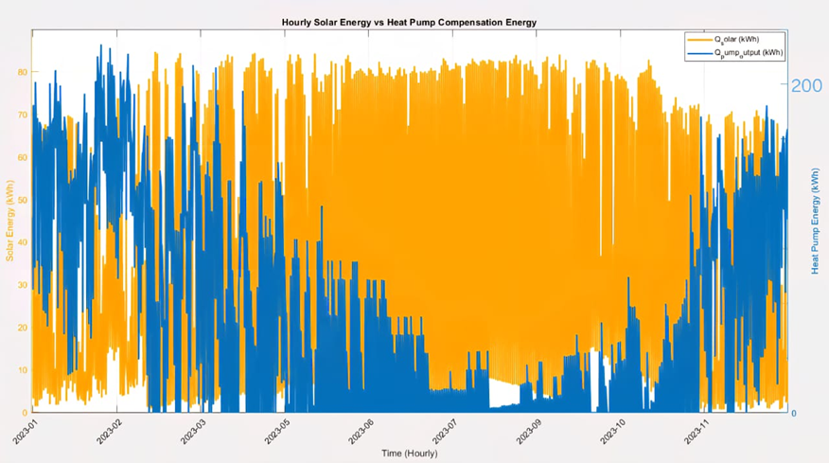
Pump Energy Demand After Solar Energy Compensation.
The figure shows how solar energy contributes to covering a large part of the pump's consumption.
🌧️
Minimum Q solar: 0.53 kWh
Maximum Q solar: 84.62 kWh
Average Q solar: 44.92 kWh
☀️
⛅
Maximum Q losses:198.45 kW
Average Q losses: 49.9 kWh
Maximum Q pump:194 kW

Slide 28
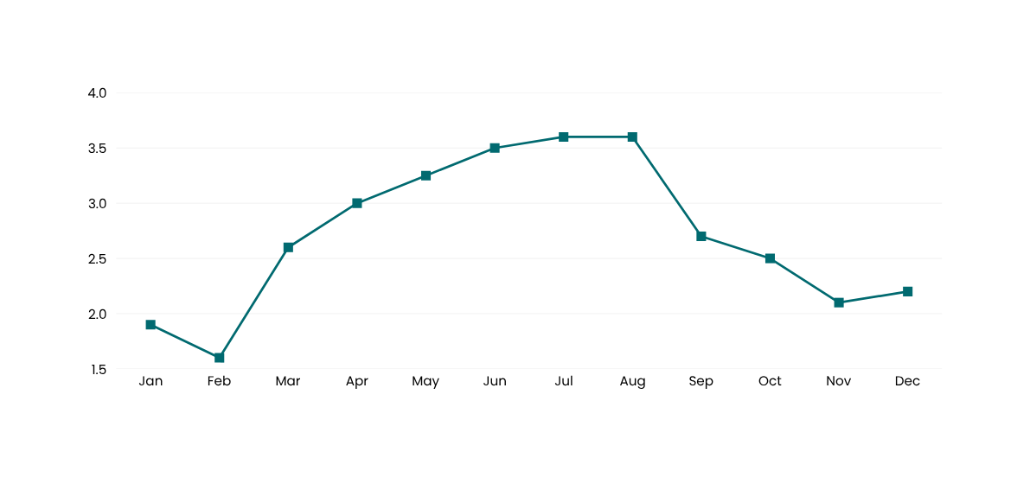
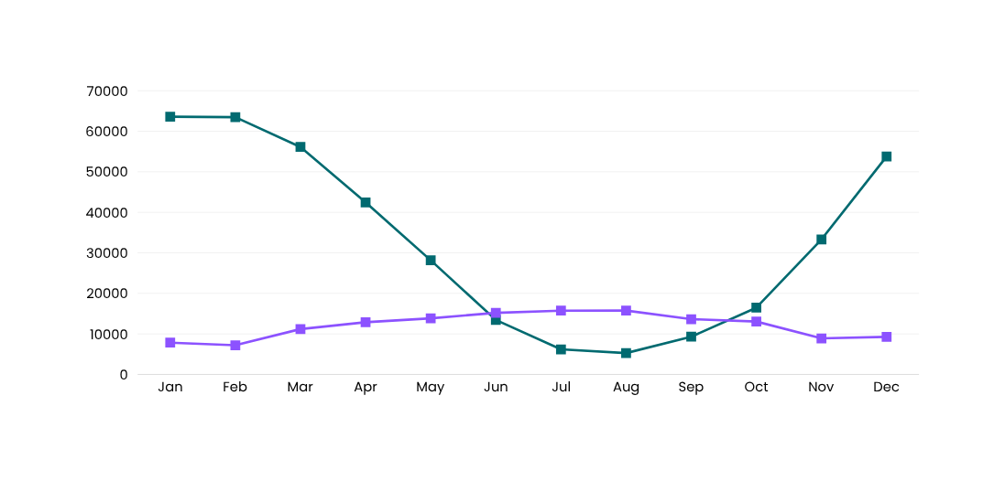
Monthly solar energy production and heat losses
Energy KWH
Monthly Solar Energy Production
Energy KWH
monthly heat loss profile.

Slide 29


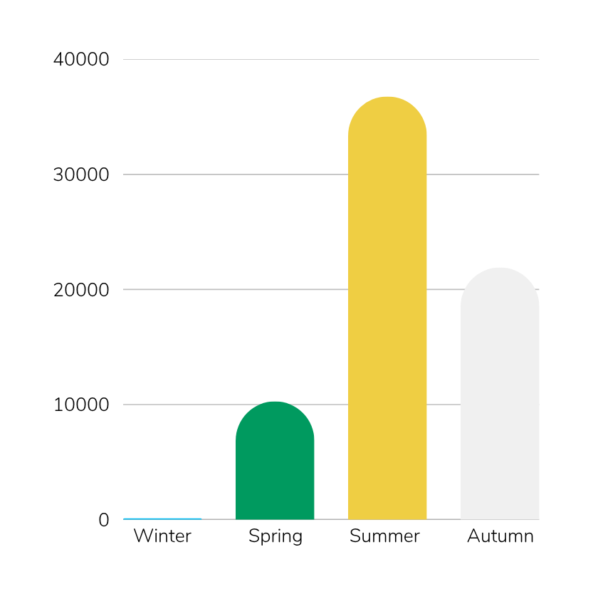

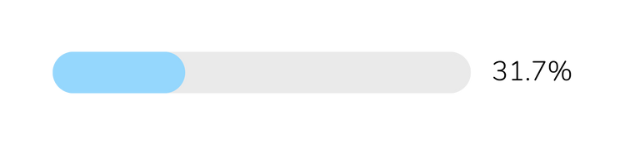
Seasonal Solar Surplus
Winter
(kWh)
Spring
Summer
Autumn
🌨️ Winter
🌼 Spring
The lowest surplus was recorded over the year at 0%, reflecting weak solar inspections in the quarter.
Provide a moderate surplus of 15% due to increased radiation hours and improved weather conditions.
🔥 Summer
🍂 Autumn
It achieved the highest surplus of 53.23% thanks to the abundance of solar radiation and long daylight hours.
It recorded a good surplus of 31.71% thanks to the balance between temperature and radiation.

Slide 30
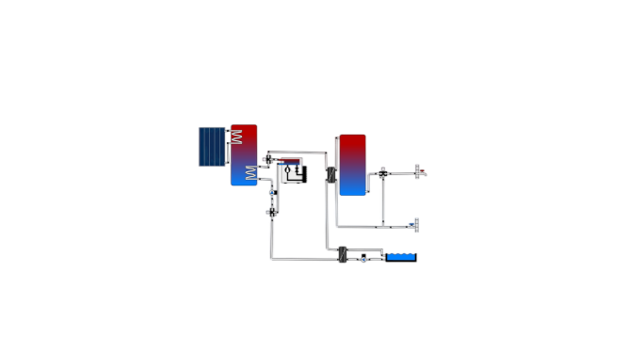
Engineering Diagram of the Solar Heating System.
Thermal storage tank:
Capacity: 6.01 cubic meters
The system contains two heat pumps, each with a capacity of 97 kilowatts thermal (kWth).
The average coefficient of performance (COP) for the pumps is estimated at 5.

Slide 31
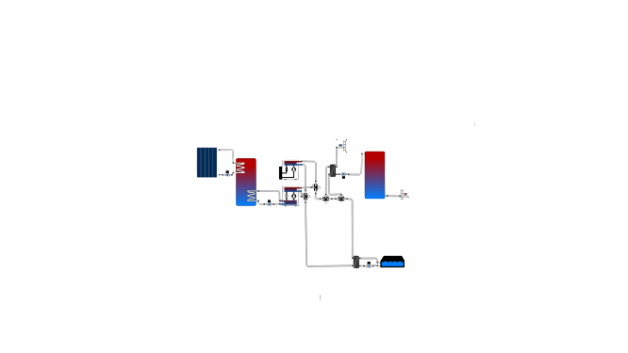
Energy Flow Diagram of the Hybrid Heating System.
Thermal storage tank:
Capacity: 7 cubic meters
The system consists of two air-to-air heat pumps, each with a capacity of 97 kW, with an average Coefficient of Performance (COP) of 5.
The system also includes an 85 kW water-to-air heat pump, and the average Coefficient of Performance (COP) for the entire system is 8.

Slide 32
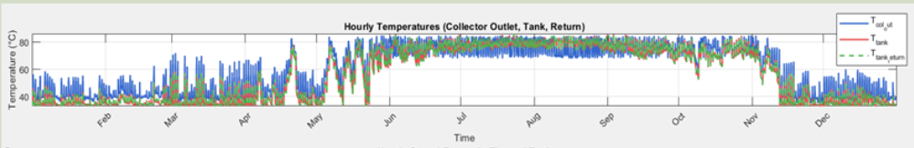
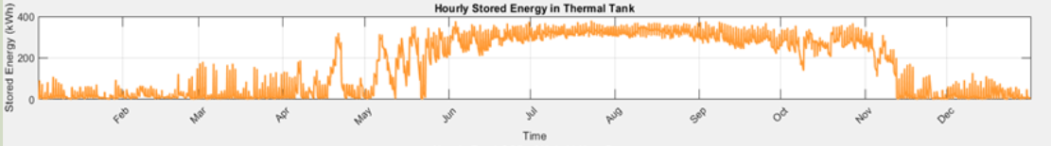
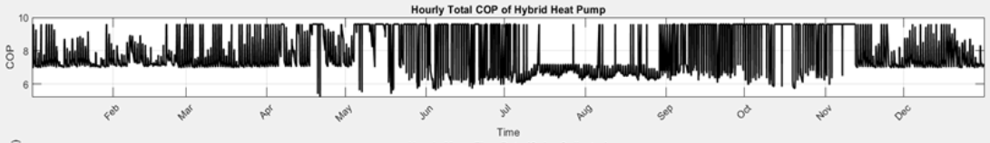
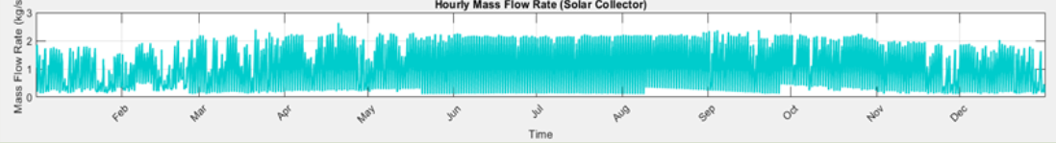
Dynamic Variations in the Performance of the Hybrid Heat Pump System
  Temperature Variations in the System
  Thermal Energy Stored in the Tank
  Coefficient of Performance (COP) of the Heat Pump
  Solar Collector Mass Flow Rate

Slide 33

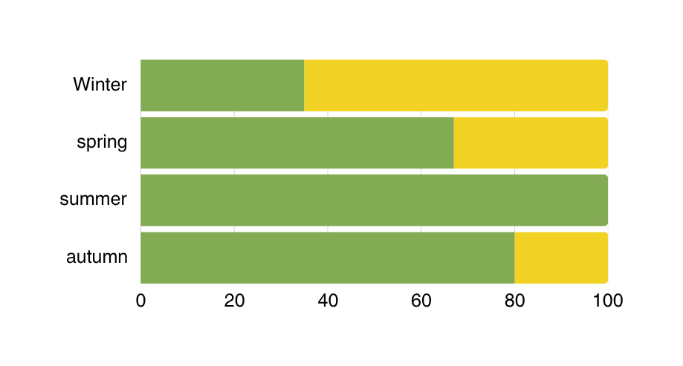
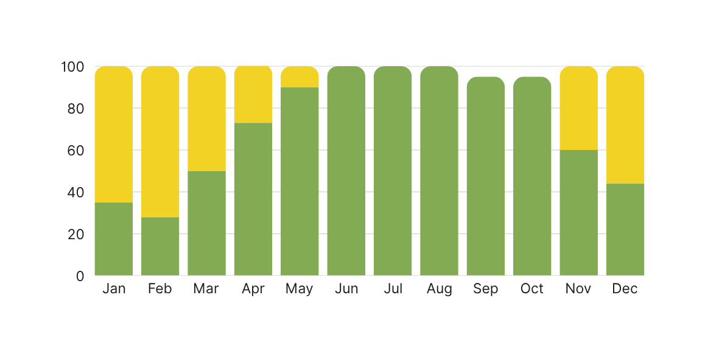
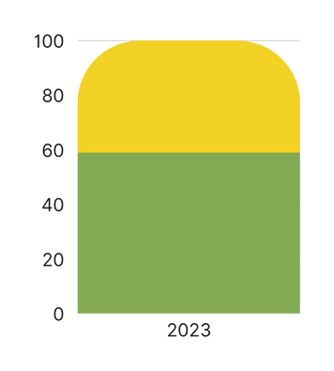
Distribution of Source Dependency in the Hybrid Heat Pump System: Monthly, Seasonal, and Annual Analysis.
Seasonal Contribution of Each Source (Hybrid Heat Pump)
Water
Air
Contribution (%)
Contribution (%)
Contribution (%)
Annual Contribution of Each Source (Hybrid Heat Pump)
Monthly Contribution of Each Source (Hybrid Heat Pump)

Slide 34
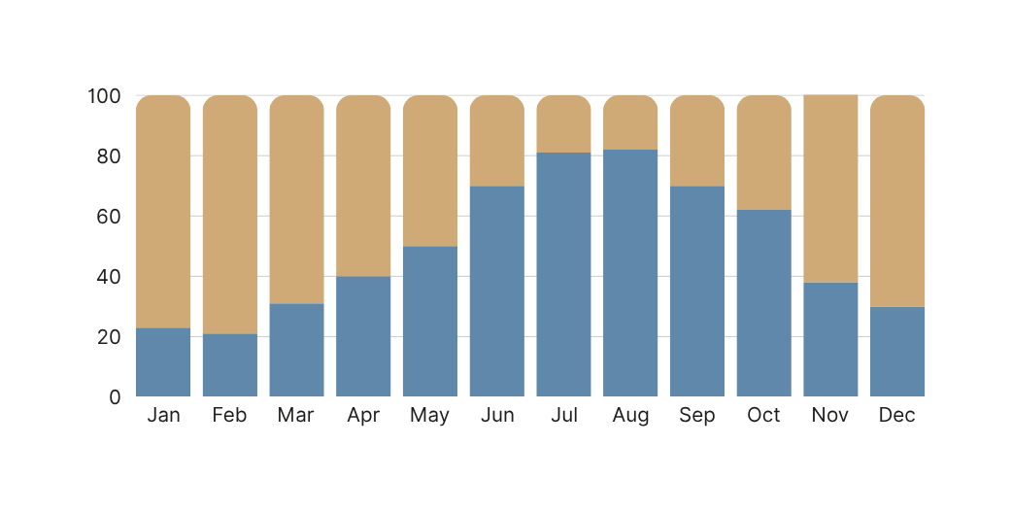
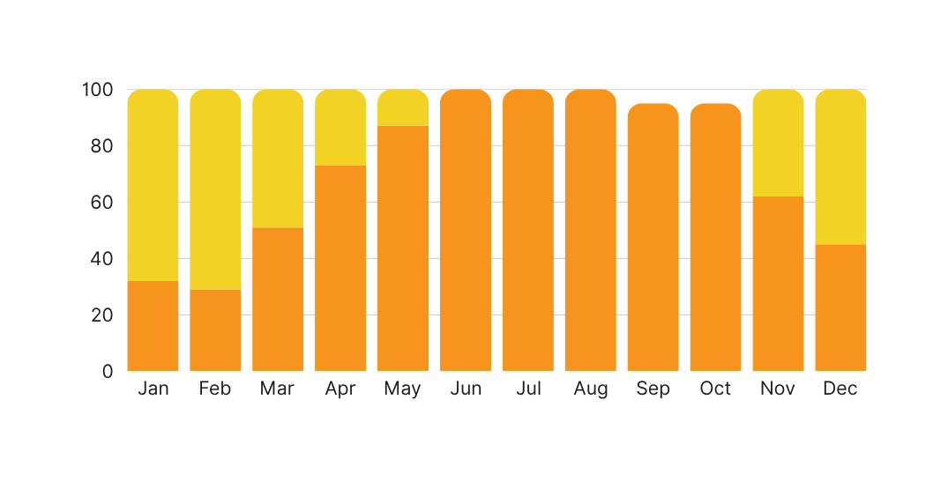
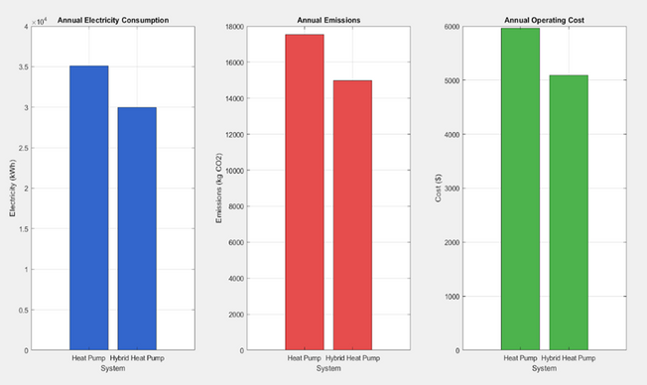
Heat Pump vs. Hybrid Heat Pump: A Comparison
Heat Pump: Source Contribution (Solar vs Heat Pump)
Heat pump
Solar
Contribution (%)
Contribution (%)
air
Annual Performance Comparison between Heat Pump System and Hybrid Heat Pump System.
water
Hybrid Heat Pump: Source Contribution (Water vs Air)

Slide 35
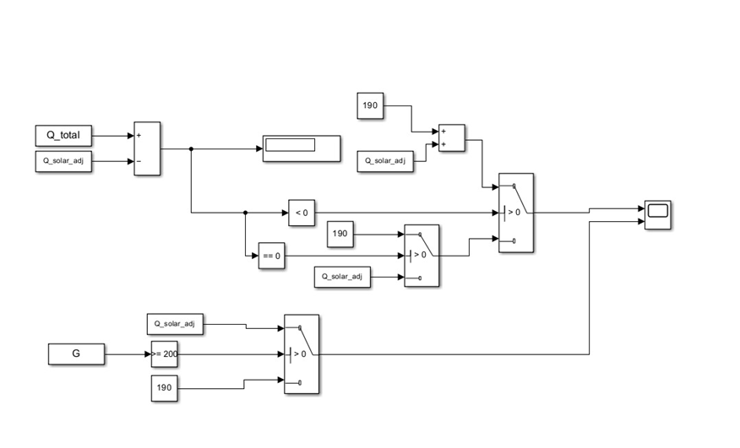
Smart control system for efficient heating using solar energy and heat pump

Slide 36
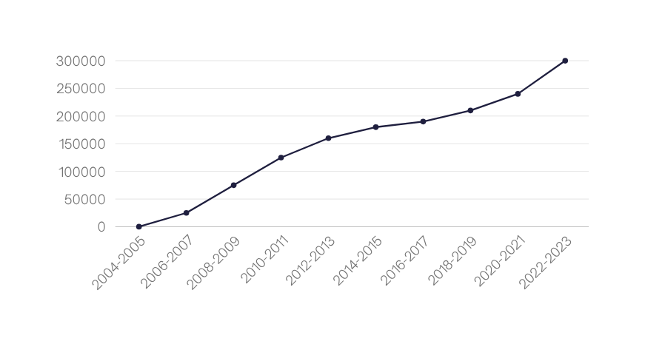
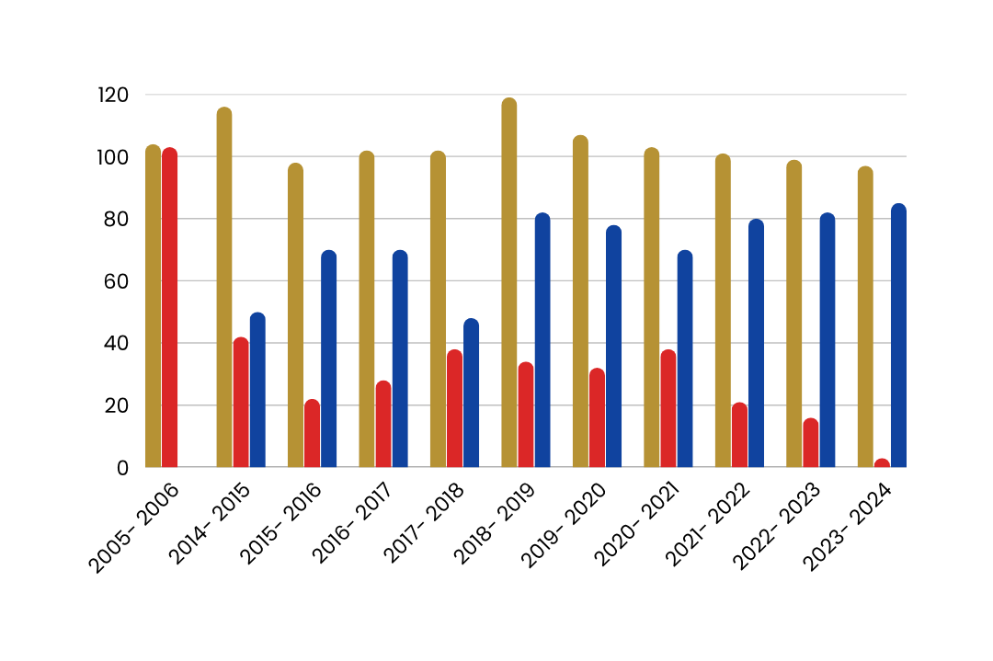
RETScreen Overview: GHG Emissions and Cumulative Savings
Total GHG emissions predicted, actual and savings by RETScreen software.
Savings Cumulative
Cumulative Savings summary by RETScreen.
Predicted
Actual
Savings

Slide 37
Analysis of the cost of different heating systems and their operation
Item
Heat Pump (HP)
Hybrid Heat Pump
Electric Heater
Diesel Boiler
Gas Boiler
Developed System
Equipment
38400
89.4857
32400
21400
437.329
0
Installation
12000
12000
12000
12000
12000
12000
Control System
3000
4000
3000
3000
3000
3000
Insulation
2000
2000
2000
2000
2000
2000
Cover
4000
4000
4000
4000
4000
4000
Thermal Storage
6600
8500
6600
6600
6600
6600
Total
66000
86800
60000
49000
51000
17600
Operating Cost
+Maintenance(USD)
6164
5383
30613
41264
14109.54
46551

Slide 38
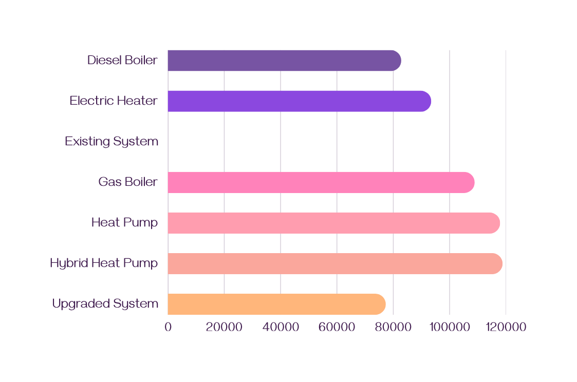

Annual Savings by System (Compared to Highest Cost System)
The graph illustrates that both the heat pump and hybrid heat pump systems offer the highest annual savings, positioning them as the most cost-effective heating solutions among the compared systems.
Type of Heating System
Annual Savings (USD)

Slide 39

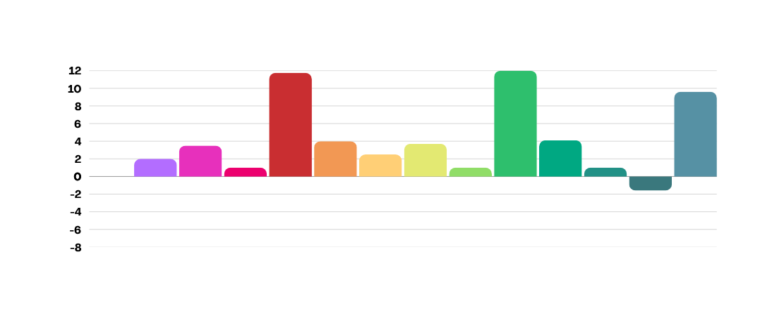

Pairwise Annual Savings Difference Between Various Heating Systems
*10⁴
savings difference in US
Heat Pump vs Hybrid Heat Pump
Hybrid Heat Pump vs Diesel Boiler
Electric Heater vs Upgraded System
Heat Pump vs Electric Heater
Hybrid Heat Pump vs Gas Boiler
Diesel Boiler vs Gas Boiler
Hybrid Heat Pump vs Existing System
Diesel Boiler vs Existing System
Heat Pump vs Diesel Boiler
Heat Pump vs Gas Boiler
Diesel Boiler vs Upgraded System
Hybrid Heat Pump vs Upgraded System
Gas Boiler vs Existing System
Heat Pump vs Existing System
Electric Heater vs Diesel Boiler
Gas Boiler vs Upgraded System
Heat Pump vs Upgraded System
Electric Heater vs Gas Boiler
Existing System vs Upgraded System
Hybrid Heat Pump vs Electric Heater
Electric Heater vs Existing System

Slide 40

Annual CO₂ Footprint and Tree Offset for Pool Heating Options
number of trees required for compensation
CO2 emissions
tons/year

Slide 41

Break-even Subscriptions and Return on Equity Analysis
Return on Equity
Break-even
Heat Pump
772.561
89.4857
Hybrid Heat Pump
590.969
78.3286
Electric Heater
792.634
437.329
Diesel Boiler
872.995
591.629
Gas Boiler
1046.2
218.671
Existing System
0
1770
Upgraded System
1899.2
669.3

Slide 42

Comprehensive Comparison of Heating Systems
Total
HEAT PUMP
55.5
HYBRID
51.5
ELECTRIC
31.8
DIESEL
42.8
GAS
55
DEVELOPED
52.2

Slide 43


Integrated Simulation of Swimming Pool Heating System with Solar Collectors and 3D Visualization
  It displays an interactive 3D simulation interface of a swimming pool heating system, enabling the user to adjust parameters and monitor real-time results such as efficiency, energy losses, and final tank temperature.
  The panel represents the data input and numerical results of a basin heating system simulation, showing the effect of environmental and structural variables such as the angle of inclination and the number of collectors on the system performance.

Slide 44





Thank You
Innovation is seeing change as an opportunity, not a threat.

