Slide 1

Nablus Medical Complex
Where Your Health Comes First!

Slide 2

Introduction
1
2
Establishment and History
Medical Services
Founded in 1986 and renovated in 2014, the Nablus Medical Complex was expanded in 2016 with modern facilities. Funded by the Munib Rashid Al-Masri Foundation and other philanthropists, it offers affordable healthcare to orphans, low-income families, and marginalized communities. Located in Rafidia near Al-Rawdah Mosque, it operates as a charitable institution under the Nablus Zakat Committee.
The medical complex provides a range of services across various departments, including orthopedics, pediatrics, ENT (Ear, Nose, and Throat), general medicine, ophthalmology, dentistry, obstetrics and gynecology, emergency care, laboratory services, and a pharmacy.

Slide 3



Current Working System
Phone Calls
Recieption
Messenger
The patient contacts the clinic, provides their details, selects a doctor or clinic, chooses an available appointment, confirms it, and attends at the scheduled time.
The patient contacts the clinic to book an appointment, providing their details and selecting a doctor or clinic. The receptionist reviews available slots, and the patient chooses a suitable time. The booking is confirmed.
The patient accesses the center’s Messenger page, selects a service, chooses a doctor or clinic, and books an available appointment. They receive confirmation details and attend the clinic on the scheduled date.

Slide 4
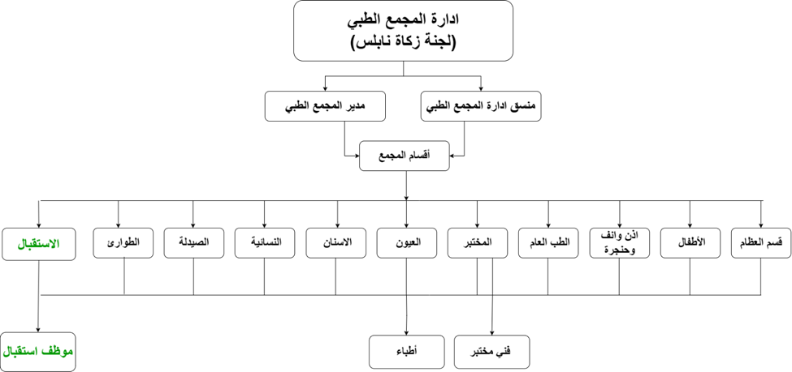
Organizational Chart

Slide 5
Weaknesses in the current system
1
Poor booking
2
Outdated reservation
3
Slow information access
The booking process is disorganized, leading to confusion and delays in scheduling appointments.
The current reservation system is not advanced enough to meet the needs of a modern medical center.
Information retrieval takes too long, causing inefficiencies in the workflow.
4
No information sharing
5
Registration errors
6
Lack of system integration
Difficulty in sharing patient data and appointment details between departments or staff members.
Frequent mistakes or lost information during the registration process, leading to potential miscommunications.
The system is not integrated with other modern tools or technologies, limiting efficiency and data management.

Slide 6
Objectives of the project
01
04
02
05
03
06
Improving Booking Organization
Enabling Information Sharing
Modernizing the Reservation System
Minimizing Registration Errors
Enhancing Information Access Speed
Integrating Modern Systems

Slide 7
Objectives of the project
1
2
Improving Booking Organization
Modernizing the Reservation System
The current system requires improvement in the organization of the booking process, which will help streamline procedures and reduce confusion caused by delays or poor coordination. By enhancing the booking organization, the time spent scheduling appointments can be minimized, ensuring a smoother workflow.
The current reservation system needs to be updated to keep up with modern technological advancements. By introducing an advanced and user-friendly booking system, patients can have a better experience with online bookings or through the medical center's app, addressing their needs more effectively.

Slide 8
Objectives of the project
3
4
Enhancing Information Access Speed
Enabling Information Sharing
The speed at which information is accessed is crucial for improving system efficiency. By utilizing advanced data storage and retrieval techniques, the time required to access medical records and other essential information can be reduced, leading to faster and more accurate medical services.
The current system faces challenges in sharing information between different departments. By developing a centralized system that allows staff members to easily access and share data, coordination between doctors and administrators will improve, ensuring that necessary information is available at the right time.

Slide 9
Objectives of the project
5
6
Minimizing Registration Errors
Integrating Modern Systems
Errors in registration and the loss of information are major issues in the current system. By adopting an accurate, automated system, human errors in data entry can be minimized, ensuring that information is securely and correctly stored, which ultimately improves the accuracy of medical records.
To achieve optimal performance, it is essential to integrate the current system with modern technologies. Integrating systems will improve workflow efficiency, ensure seamless data continuity between departments, and reduce reliance on manual processes, leading to better quality of service and more reliable operations.

Slide 10
Services Offered by the Enhanced System (Solutions)
1
Improving Booking Organization
2
Modernizing the Reservation System
3
Providing Analysis of Data
This project aims to unify and simplify appointment scheduling, improving accessibility and visibility for seamless management by patients and staff.
Using cutting-edge technology, this project will create a unified system for managing patient records and appointments, enhancing efficiency and user experience at Nablus Medical Complex.
This project leverages data analysis to improve diagnostic accuracy and optimize clinical workflows, enabling better patient care at Nablus Medical Complex.

Slide 11
Tools Used
WordPress
A
B
Google Sheets
Google Anlytics
C
D
Google Data Studio
Tools Used
Rapid Miner
E
F
Visual Studio Code
Power Point
G
H
Xampp

Slide 12
PlugIns Used
Bookly
A
B
Bookly Pro
Elementor
C
D
Code Snippit
PlugIns Used
Front End PM
E
F
Ultimate Member
Woocommerce
G
H
Google Analyticcs

Slide 13
Patients
View

Slide 14
Registration
System

Slide 15

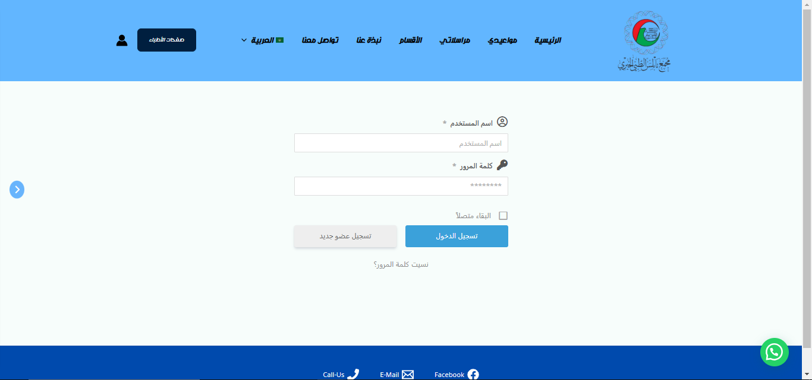
Log-In Form

Slide 16
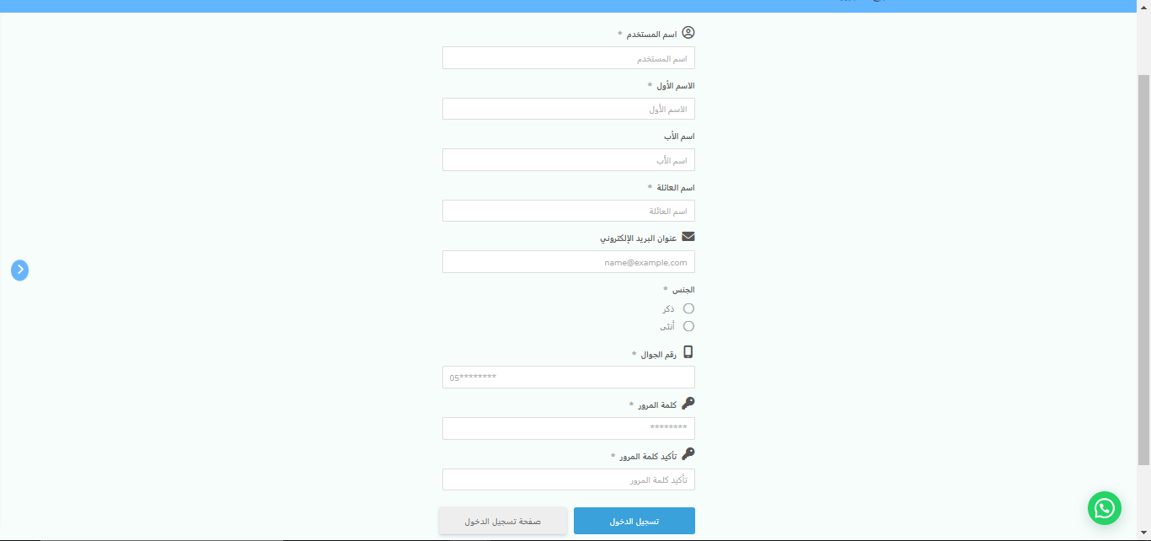
Sign-Up Form

Slide 17
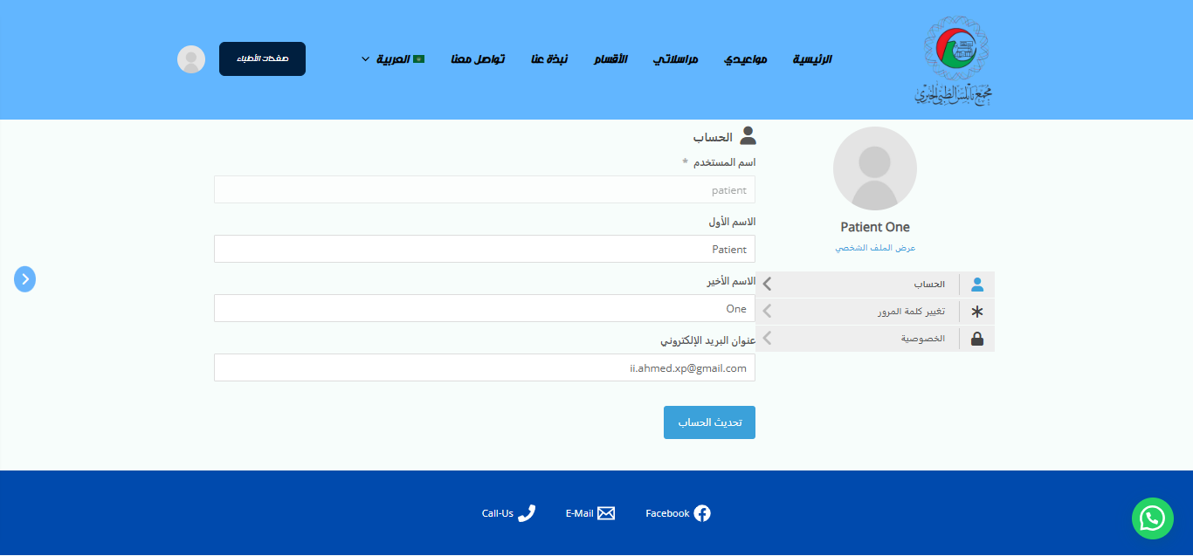
Acoount’s View

Slide 18
Reservation
System

Slide 19
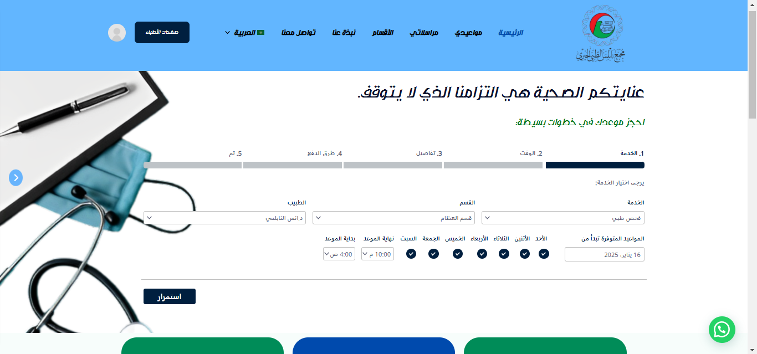
Reservation Form – Step 1

Slide 20
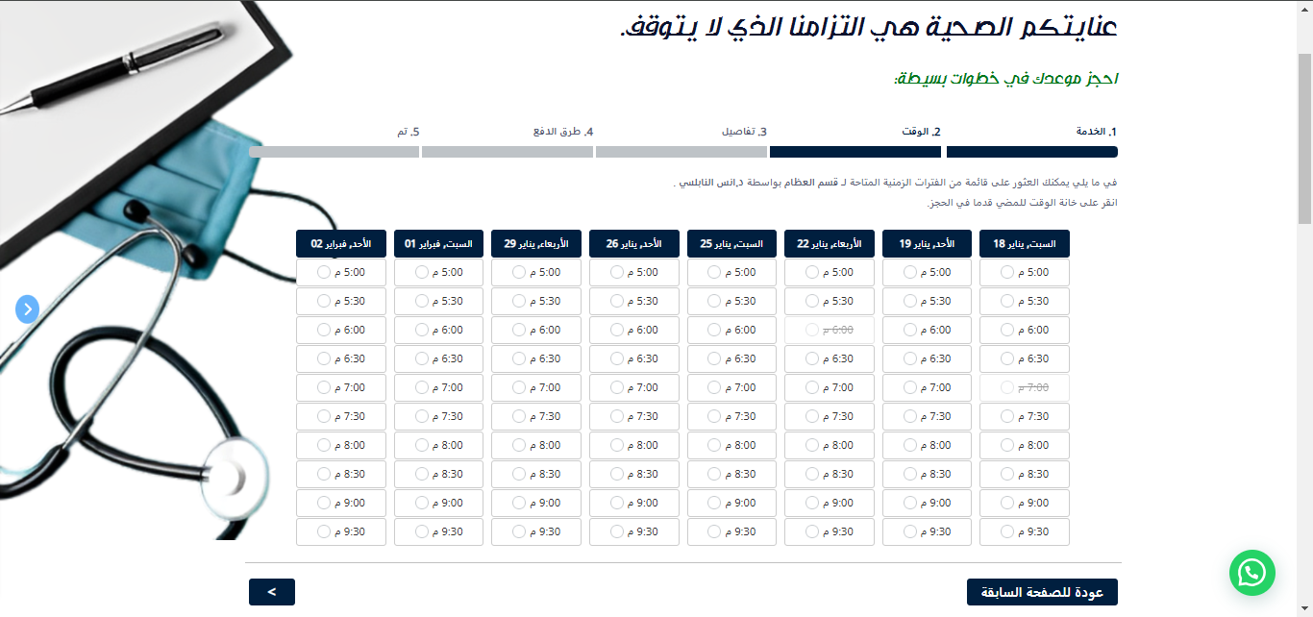
Reservation Form – Step 2

Slide 21
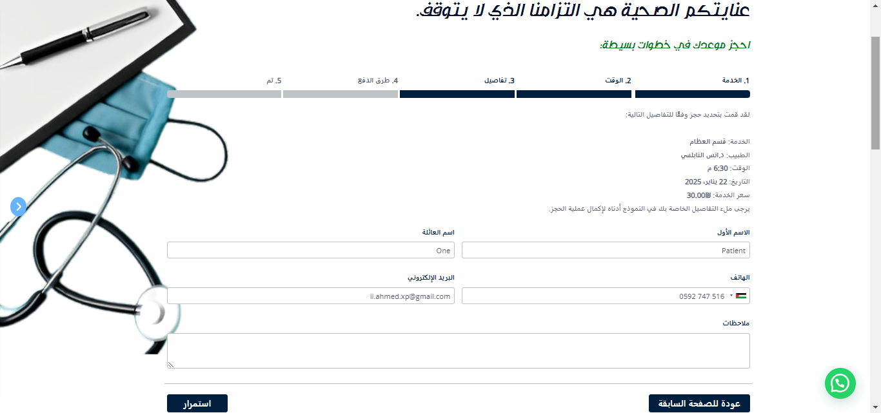
Reservation Form – Step 3

Slide 22
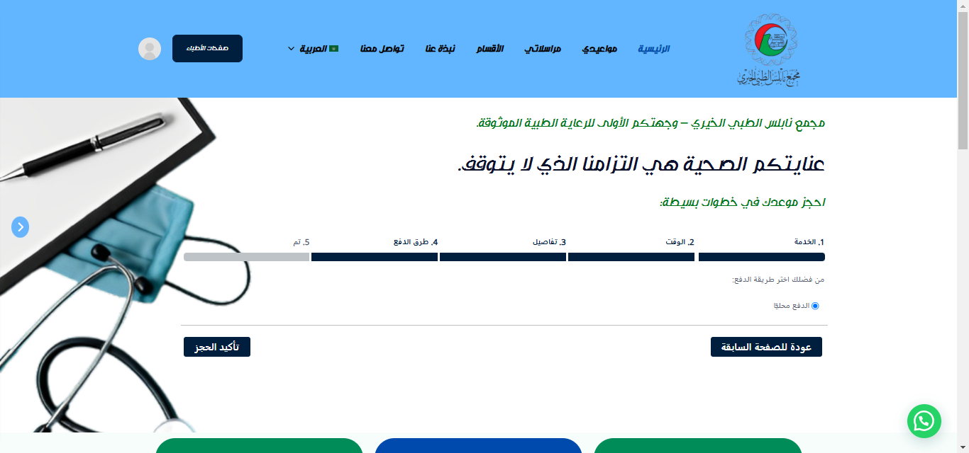
Reservation Form – Step 4

Slide 23
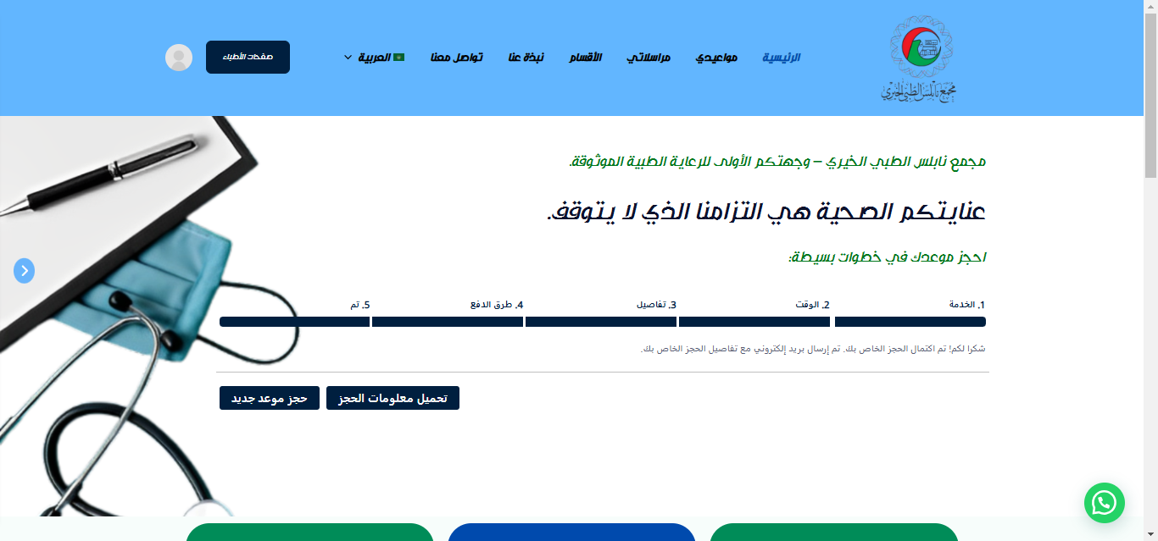
Reservation Form – Step 5

Slide 24
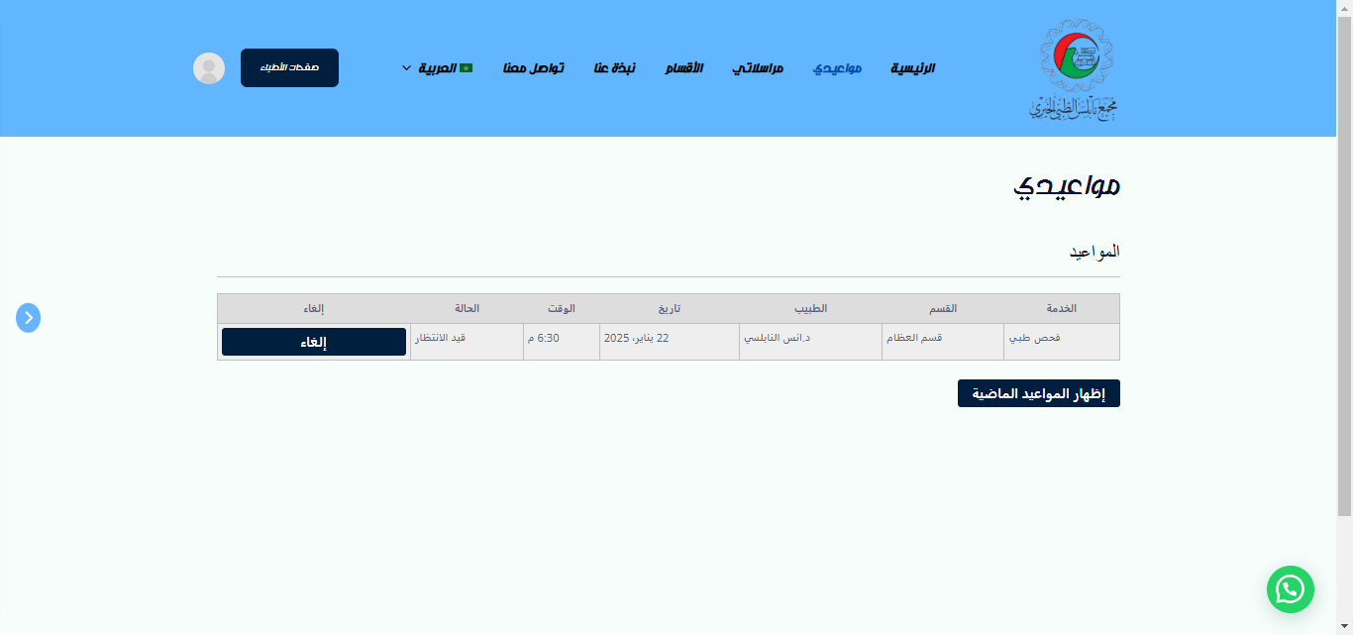
Reservation Table

Slide 25
Messaging
System

Slide 26
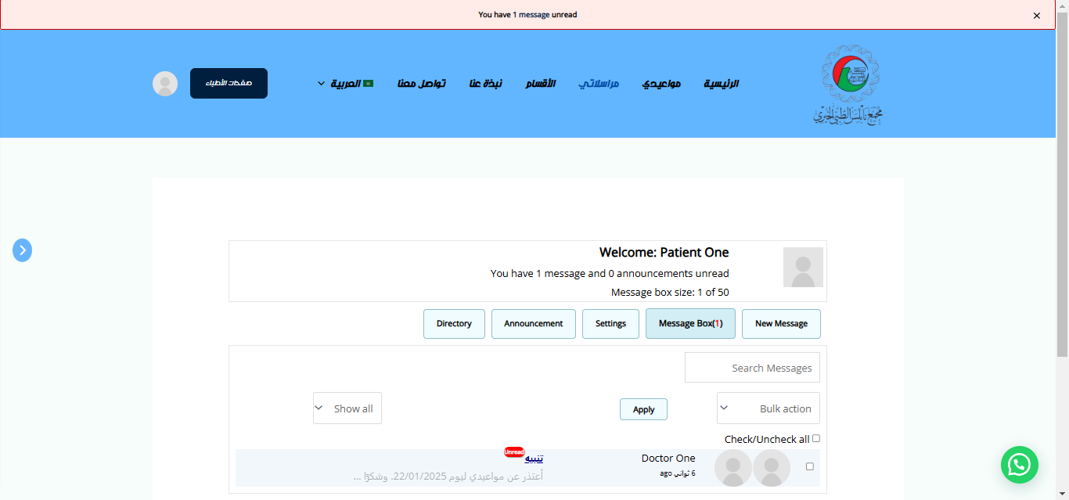
Inbox

Slide 27
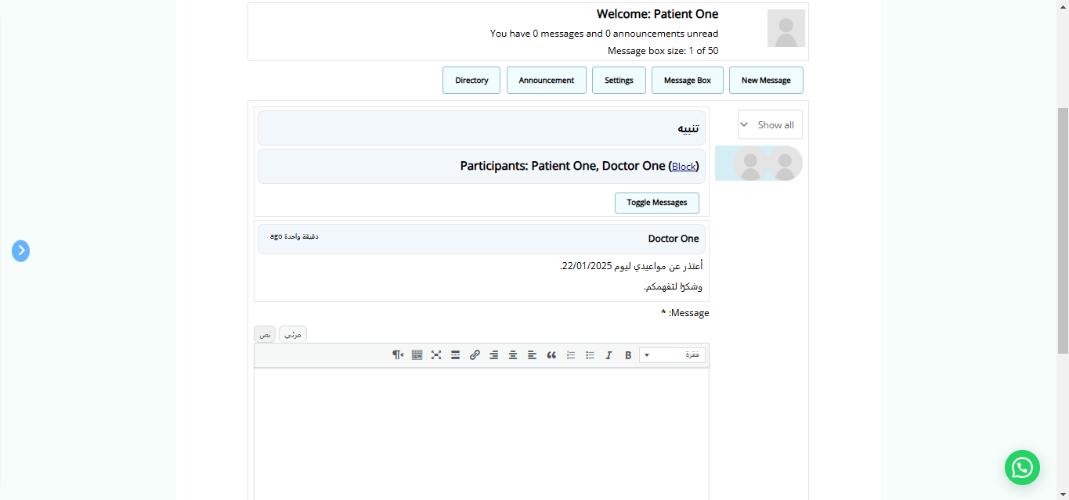
Received Message

Slide 28
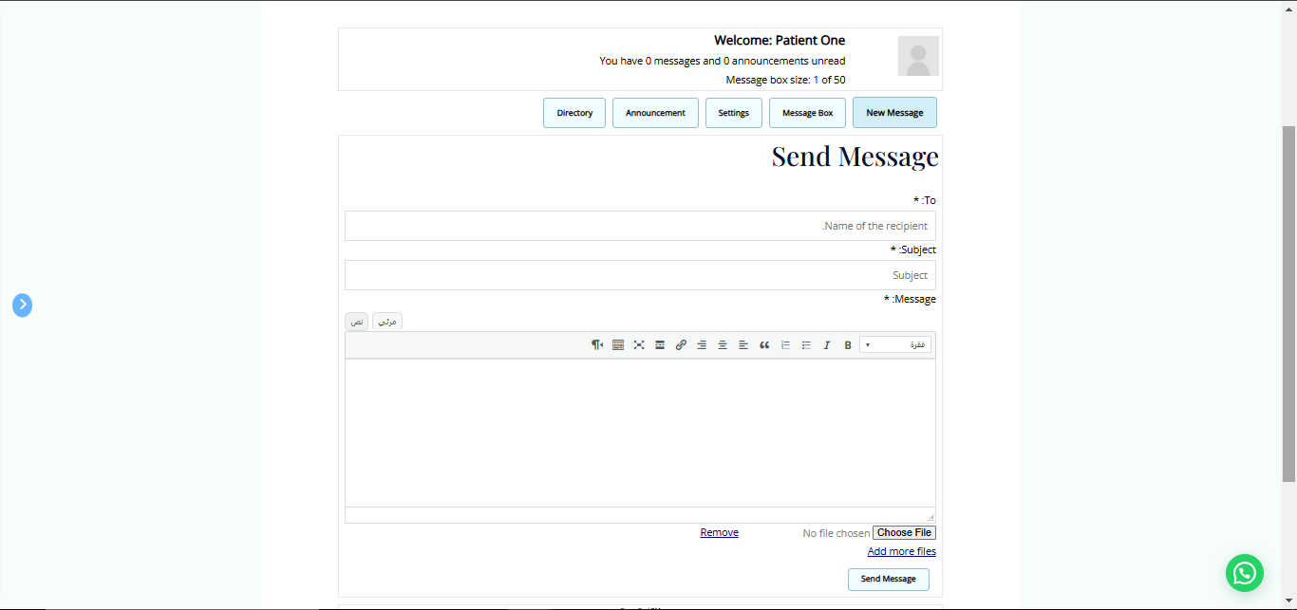
Send Message

Slide 29
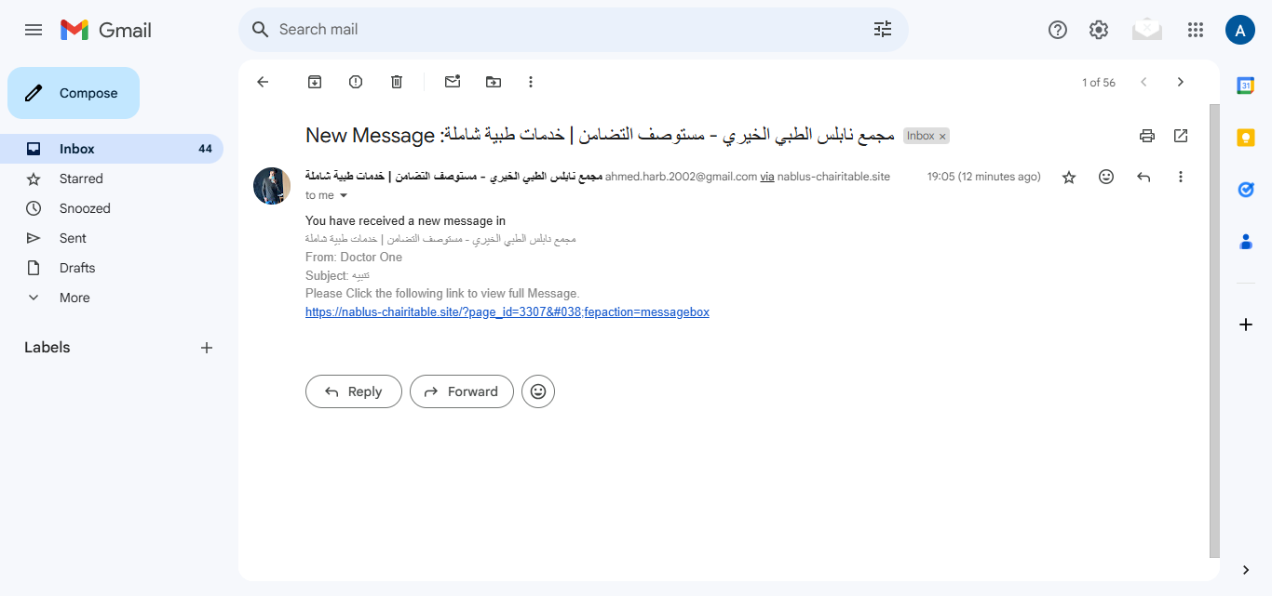
E-mail Notification
P

Slide 30
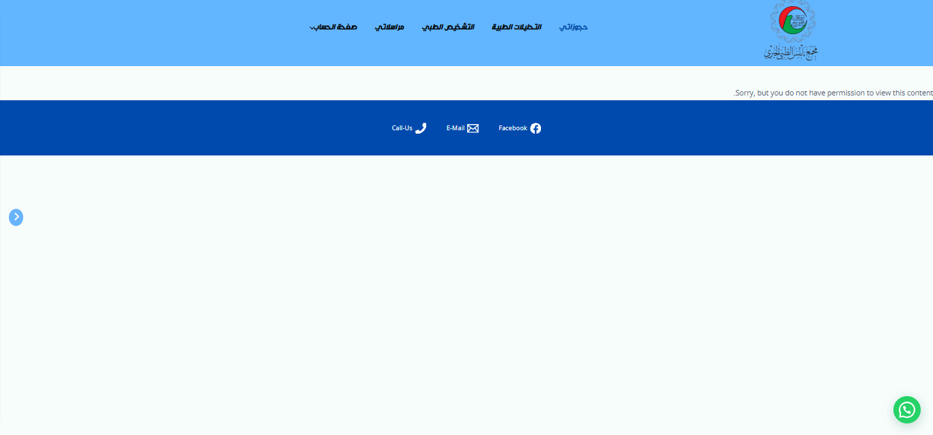
Patient enters doctors pages

Slide 31
Doctors
View

Slide 32
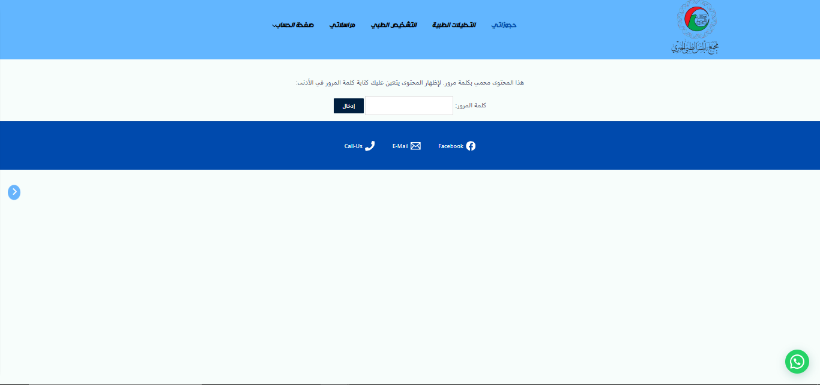
Doctors Schedule

Slide 33
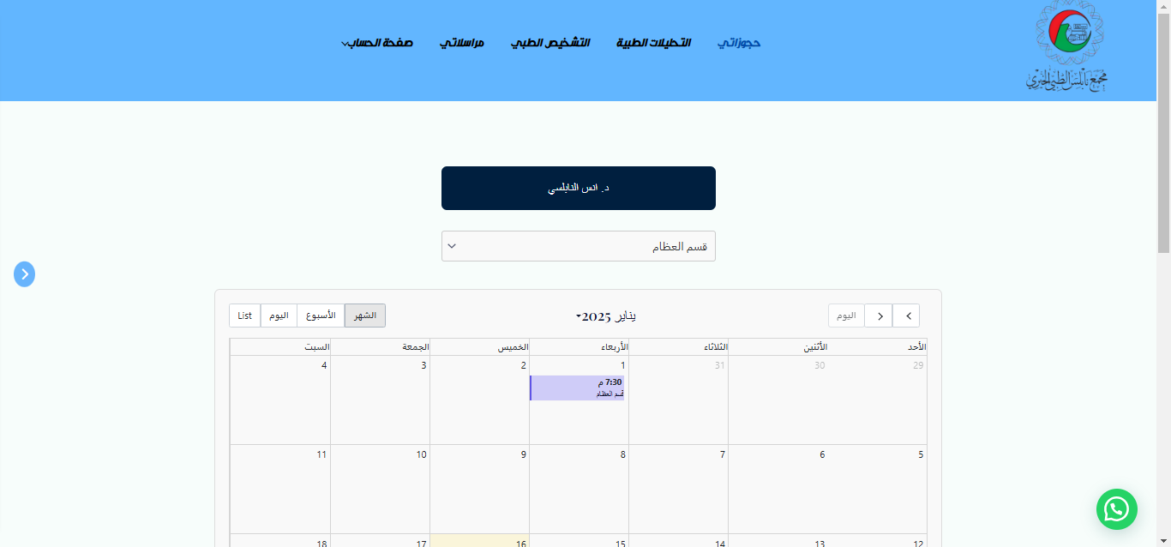
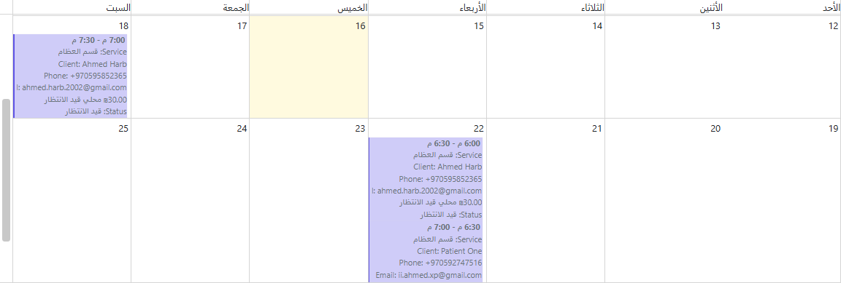
Doctors Schedule

Slide 34
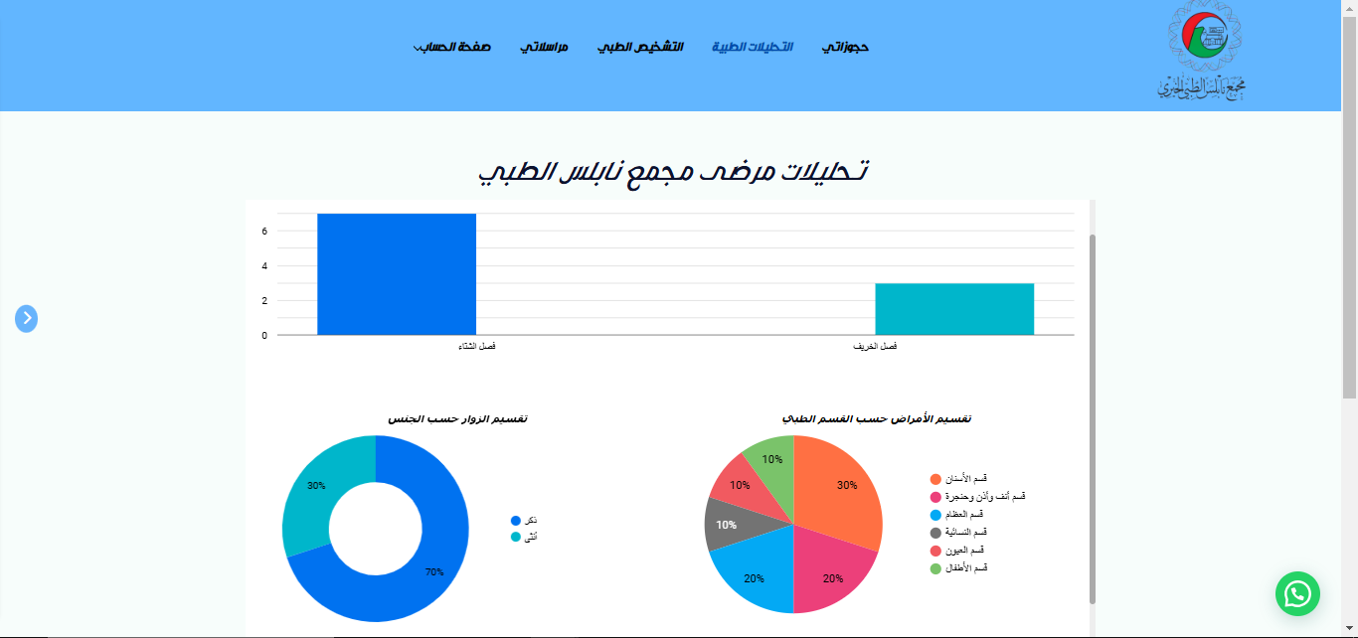
Medical Analysis

Slide 35
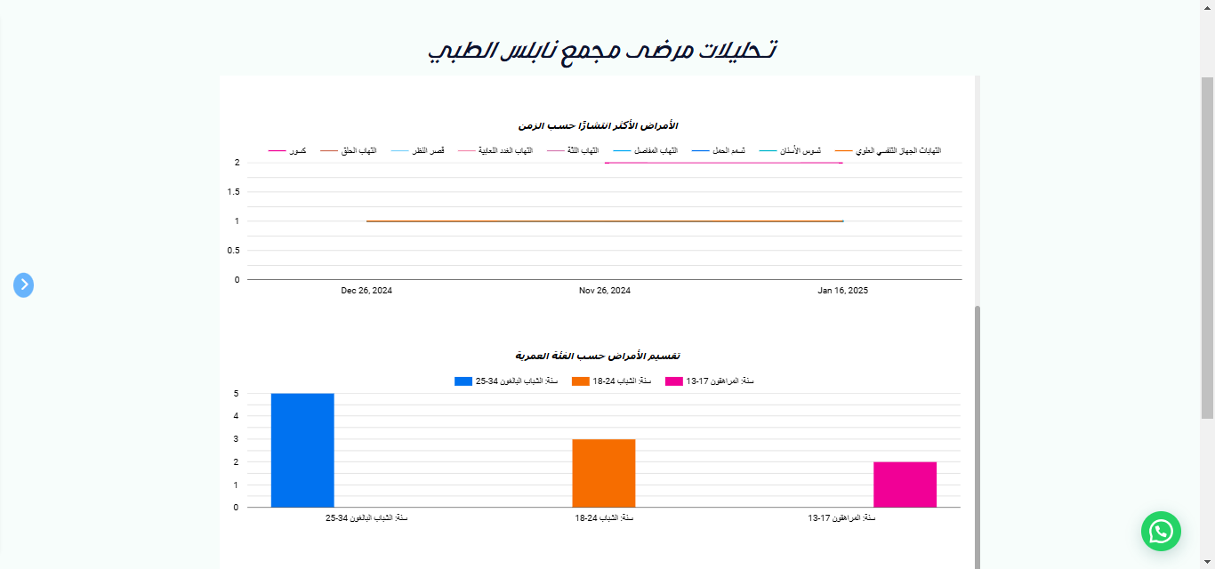
Medical Analysis 2

Slide 36
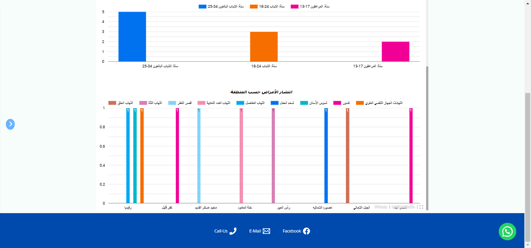
Medical Analysis 3

Slide 37
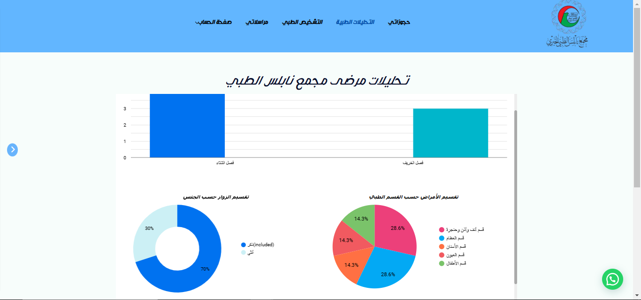
Medical Analysis – Filtered by “Males”

Slide 38
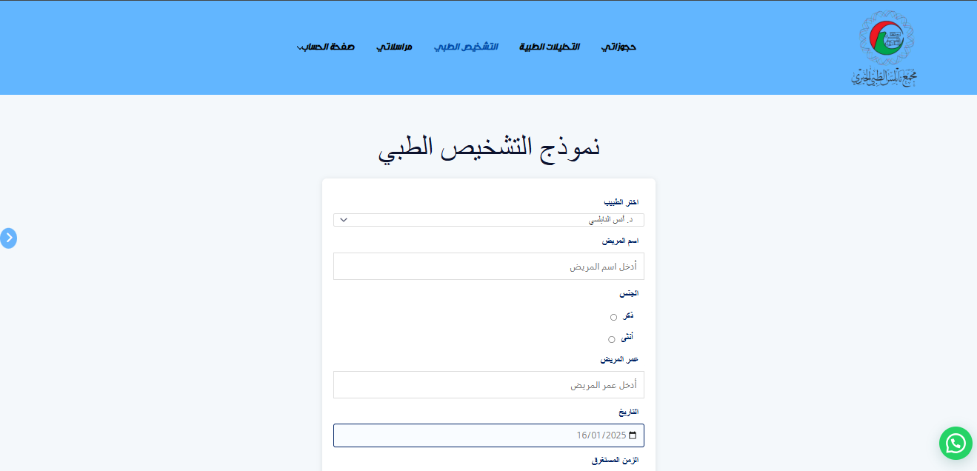
Medical Diagnosis Form

Slide 39
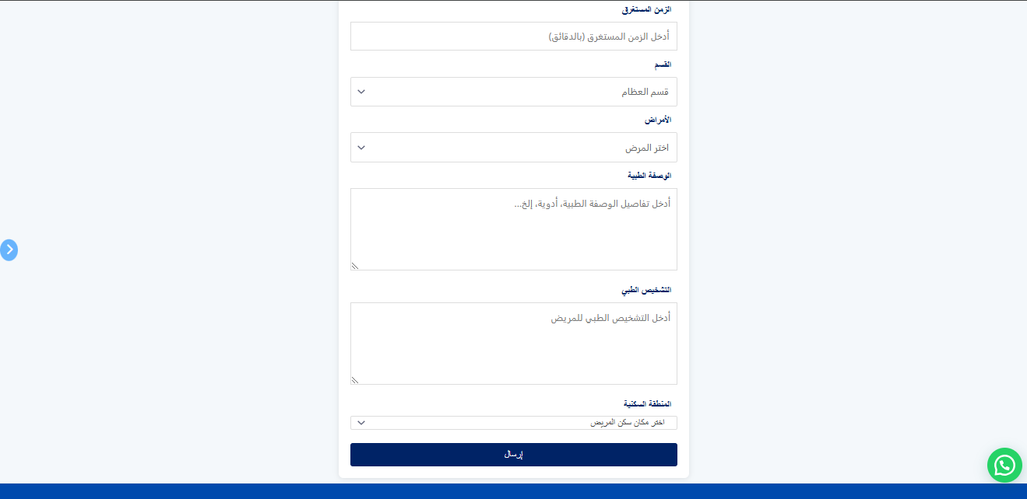
Medical Diagnosis Form

Slide 40
Integration with
Google Sheets

Slide 41
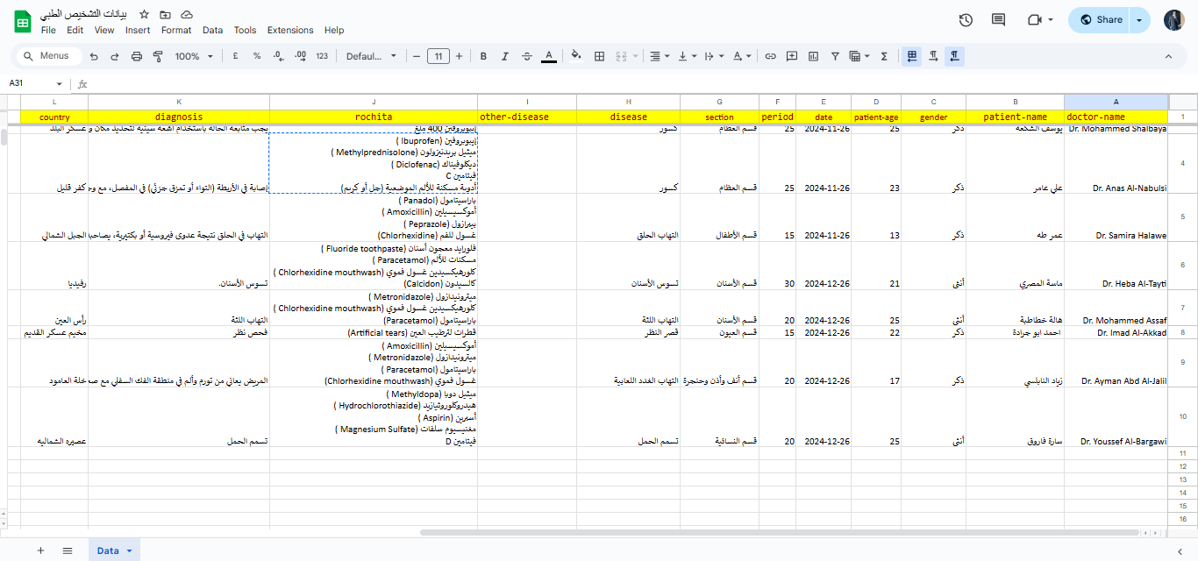
Form Before Entry

Slide 42
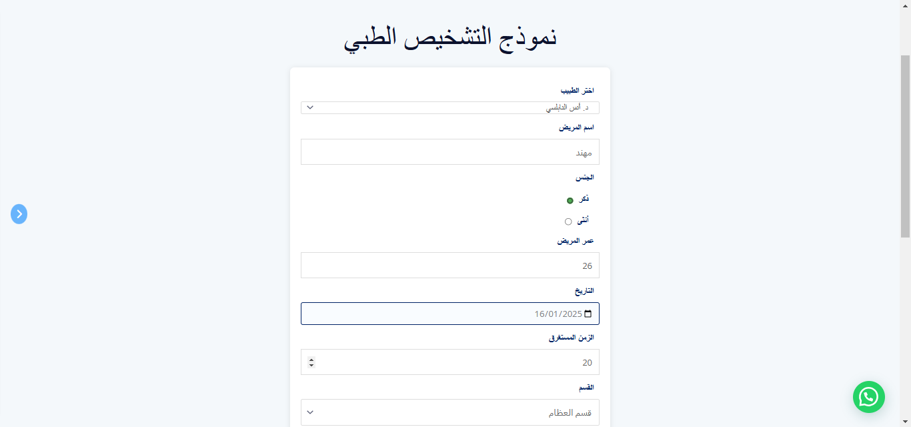
Entered Data

Slide 43
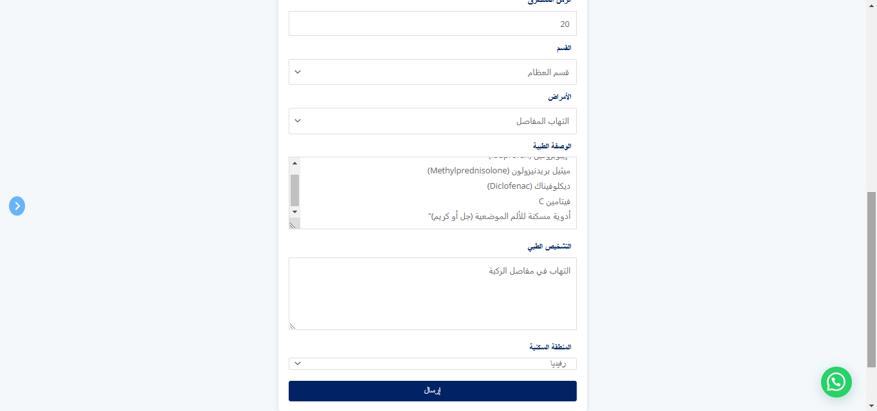
Entered Data

Slide 44
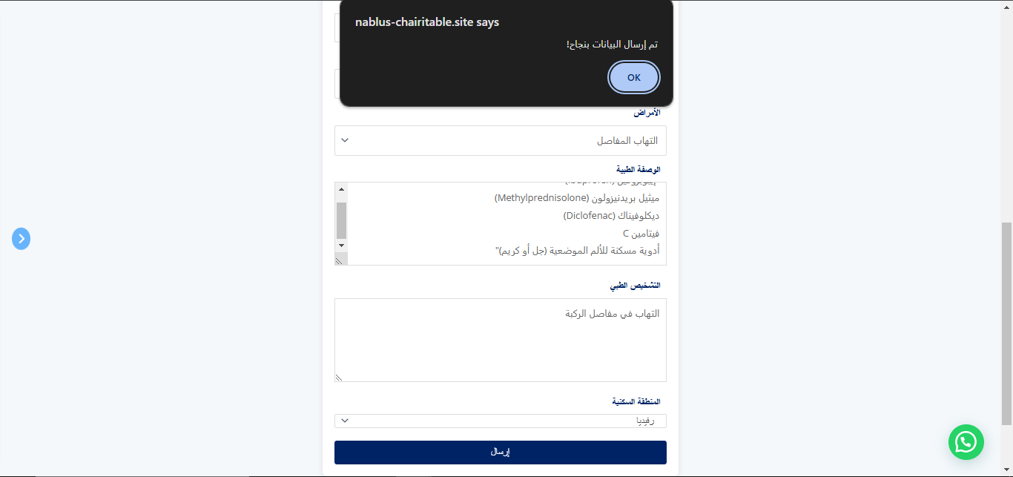
Successful Message

Slide 45
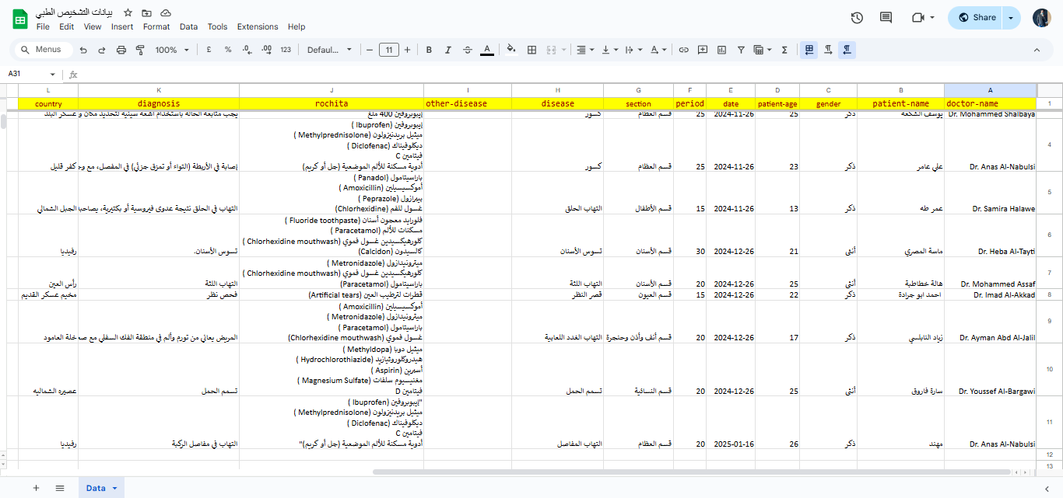
Entered Data

Slide 46
Messaging
System

Slide 47
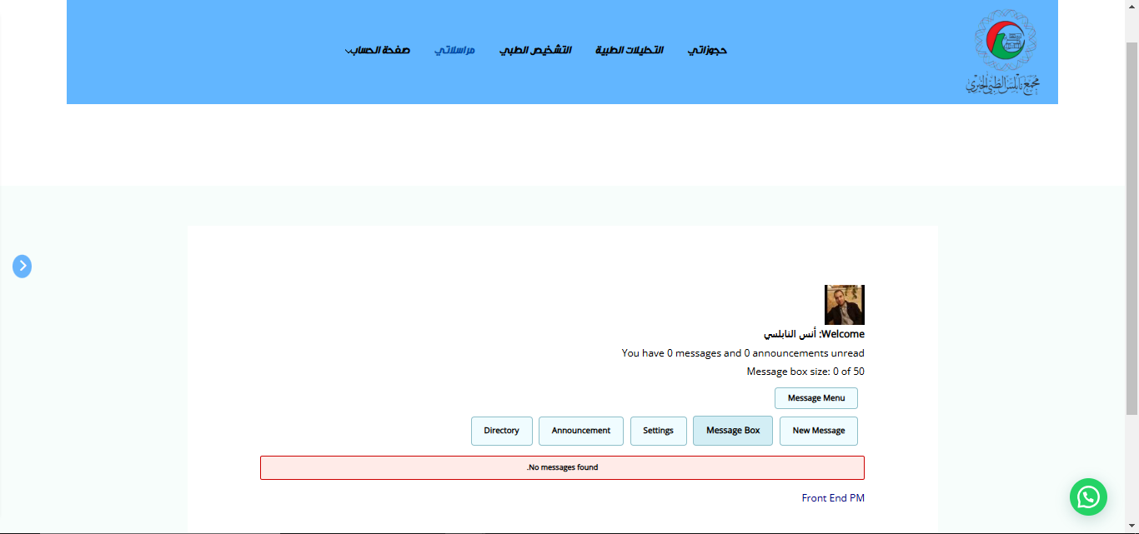
Inbox

Slide 48
Admins
View

Slide 49
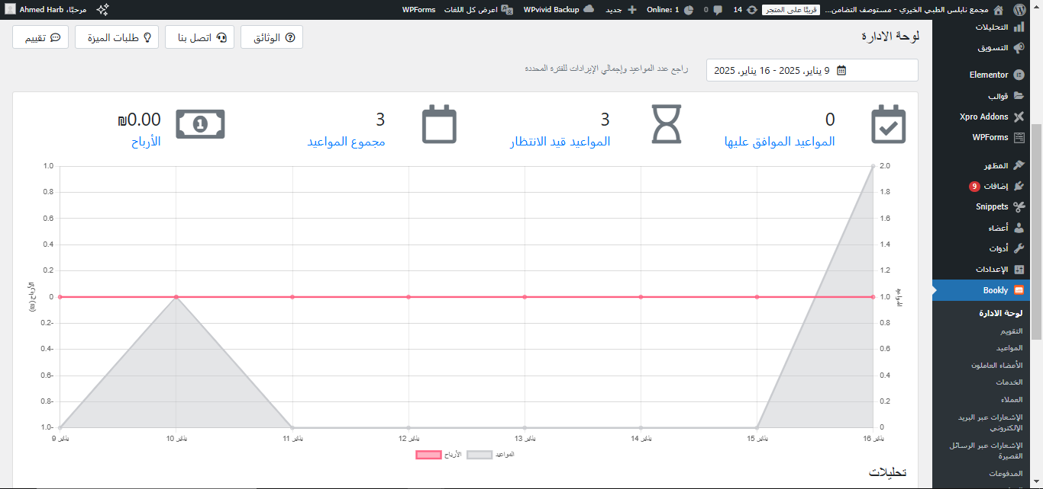
Dashboard

Slide 50
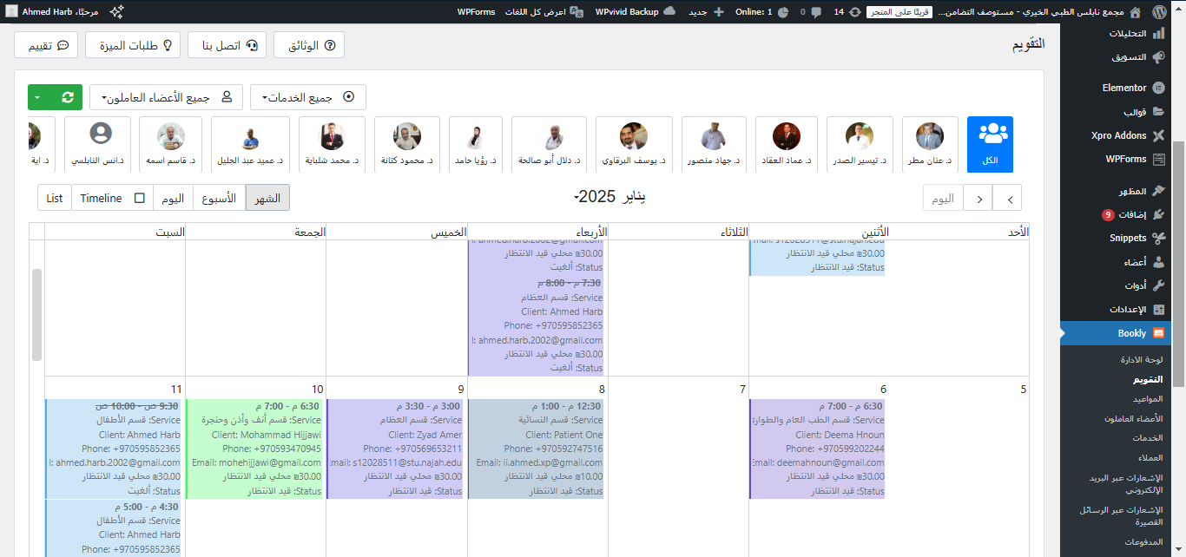
Calendar

Slide 51
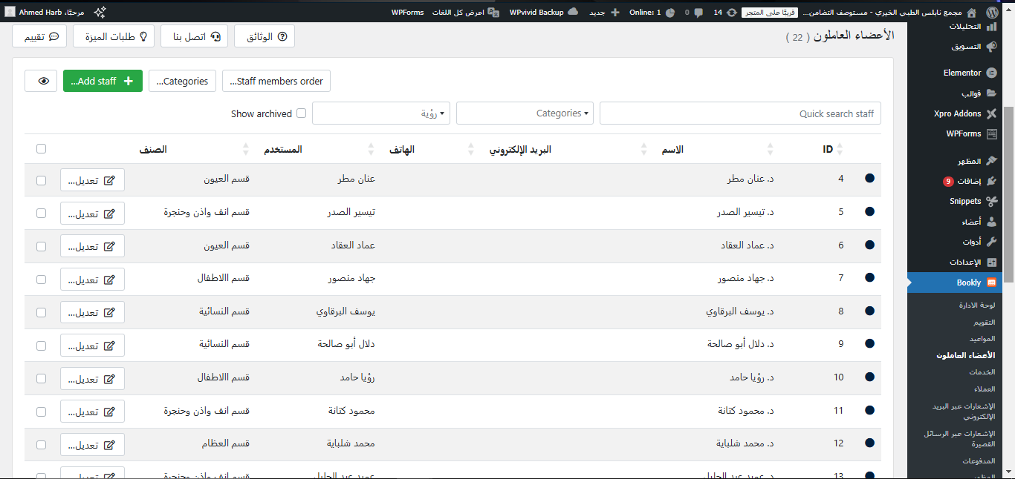
Staff Members

Slide 52
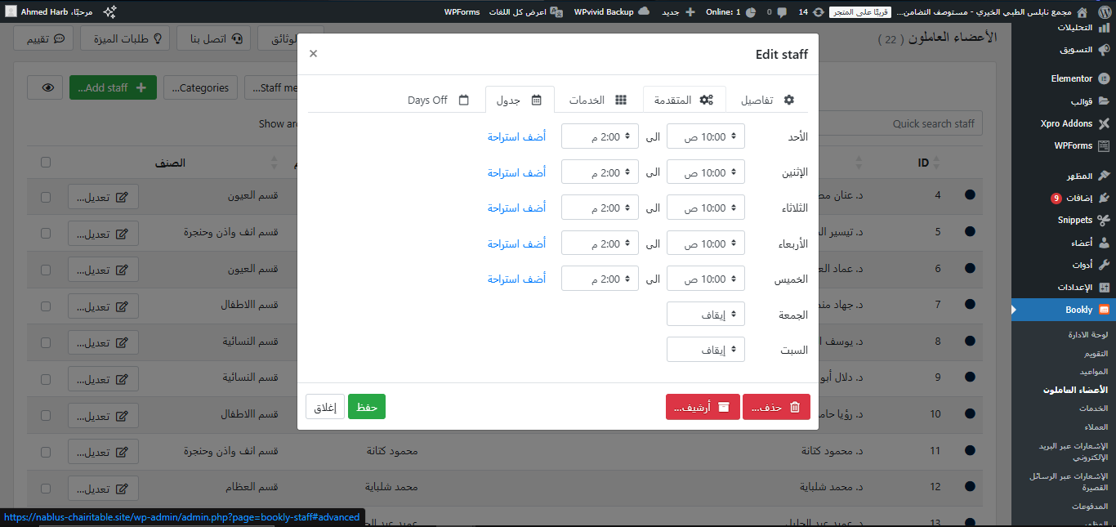
Staff Members Edit

Slide 53
Additional
Functions

Slide 54
Reservation
System

Slide 55
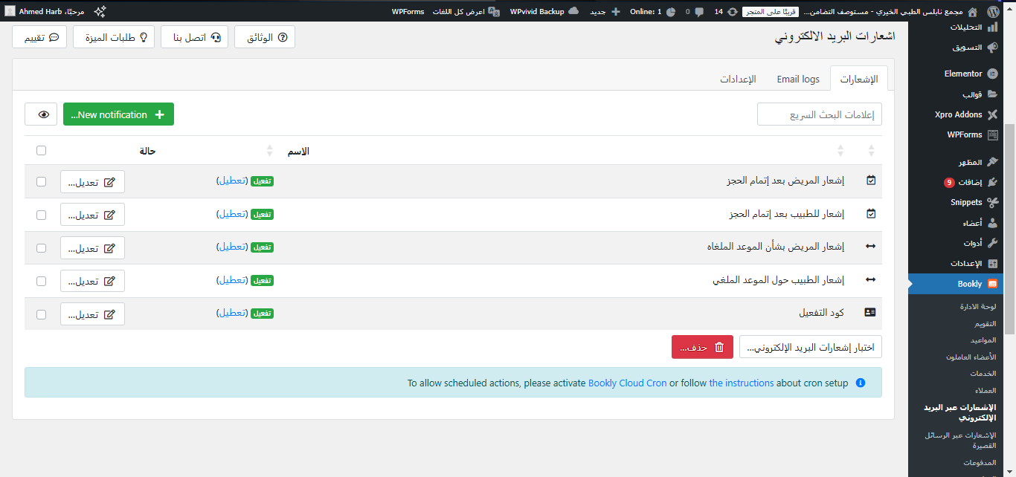
E-mail Notifications

Slide 56
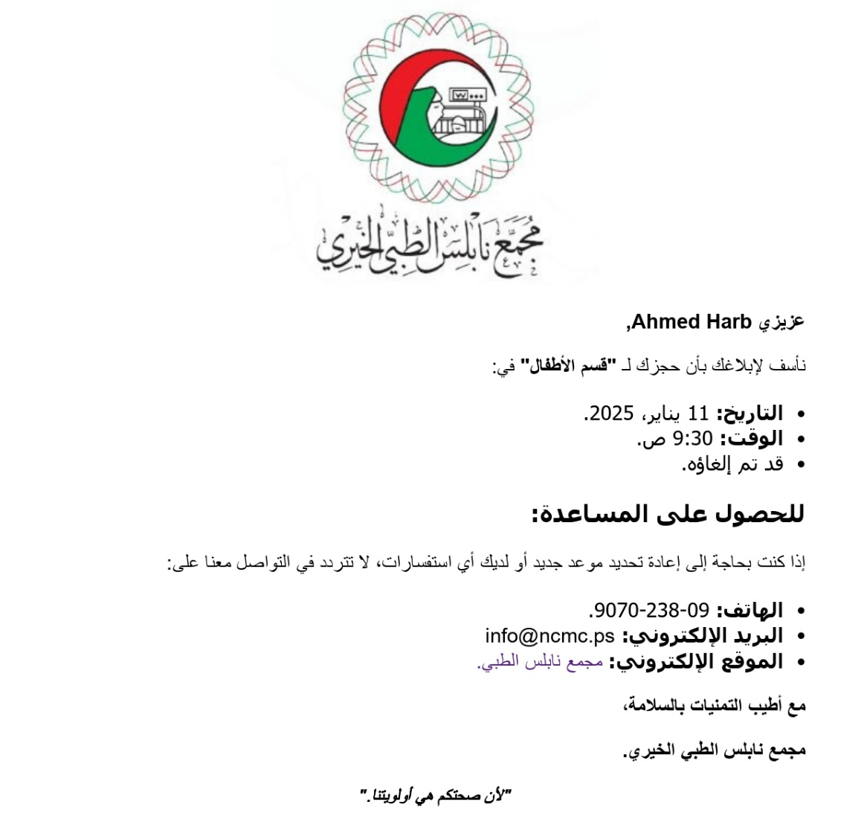
E-mail Notifications

Slide 57
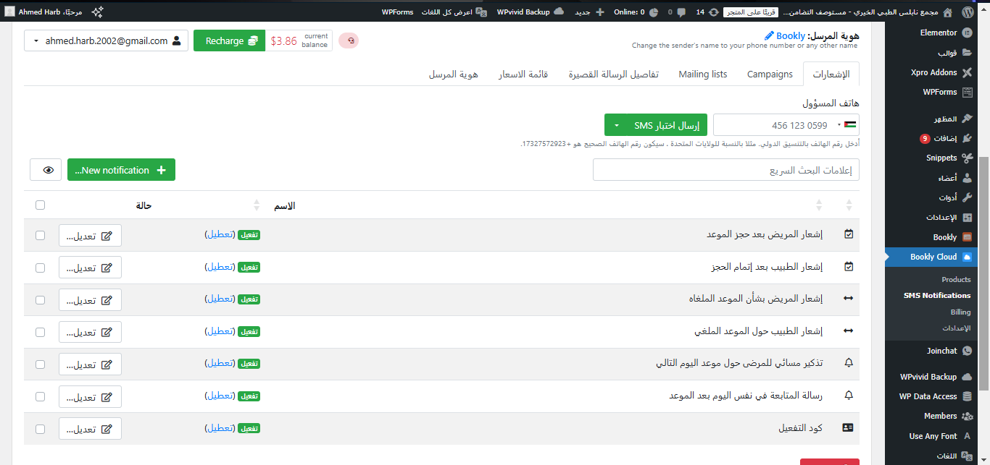
SMS Notifications

Slide 58
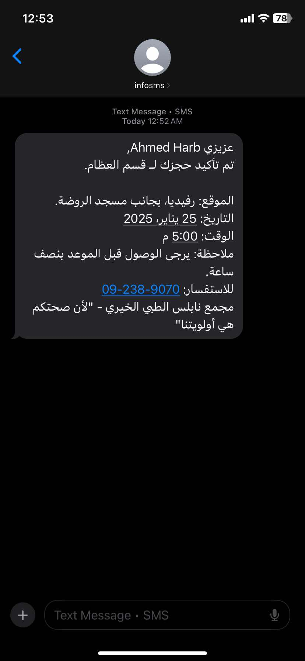
SMS Notifications

Slide 59
WhatsApp
Integration

Slide 60
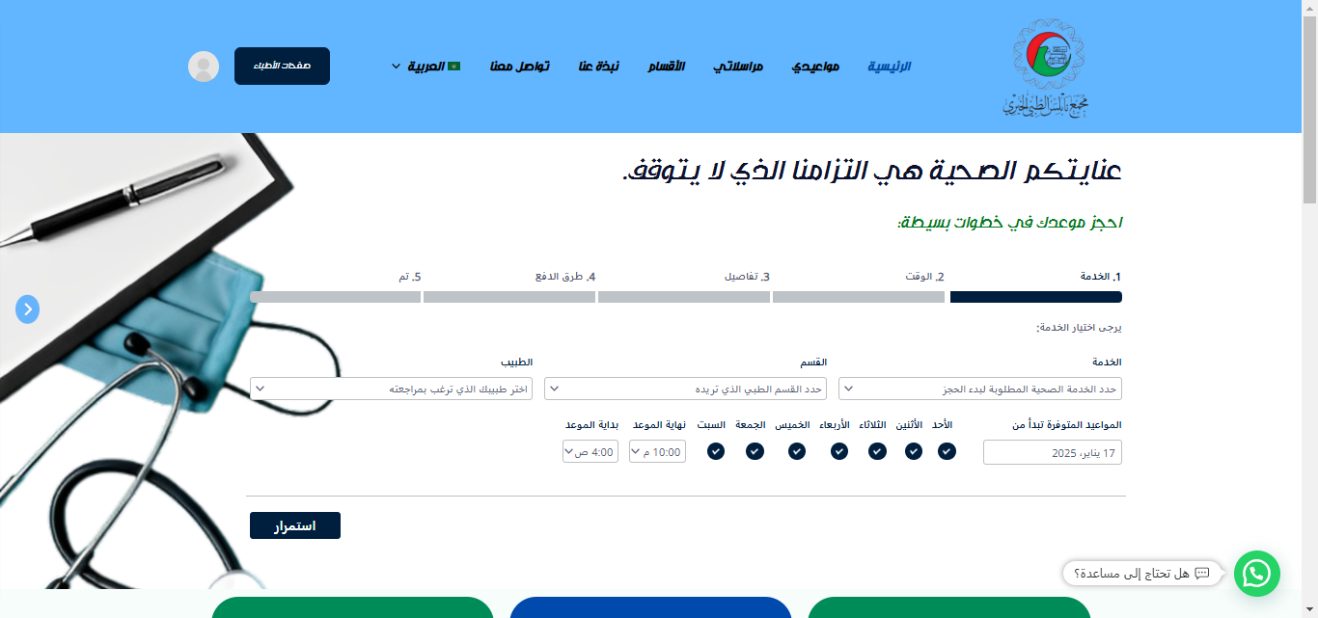
WhatsApp Integration

Slide 61
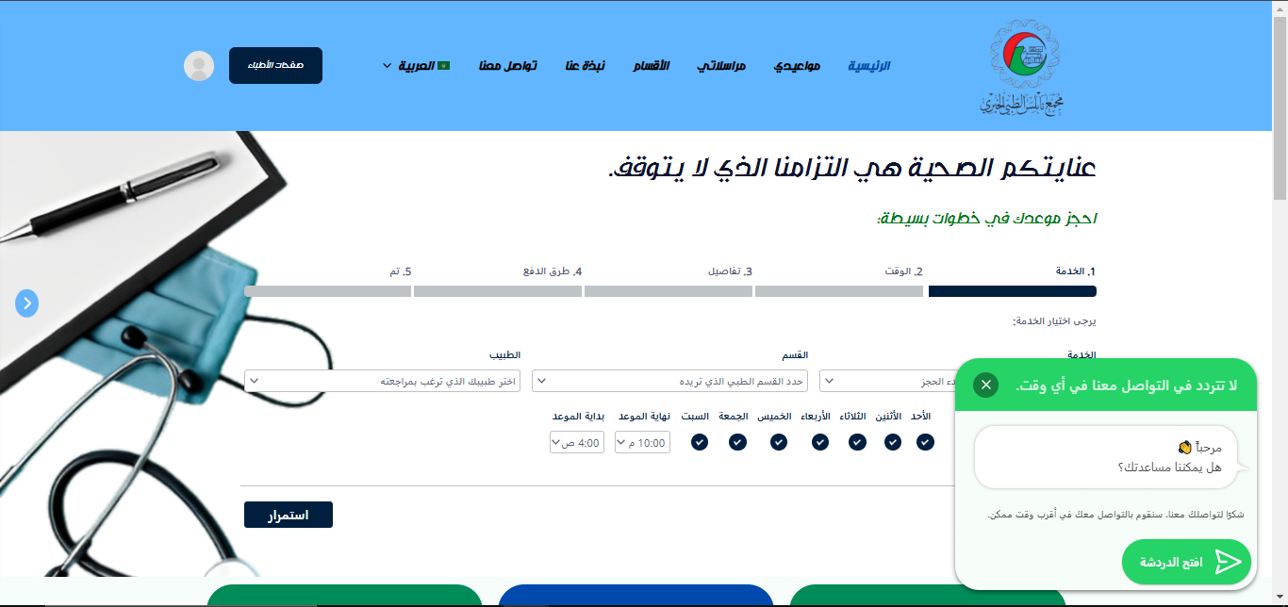
WhatsApp Integration

Slide 62
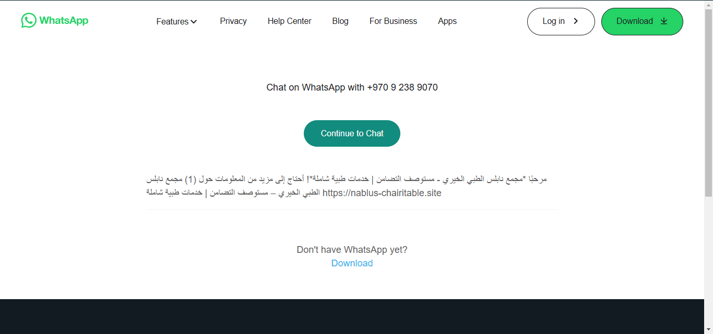
WhatsApp Integration

Slide 63
Integration With
Google Analytics

Slide 64
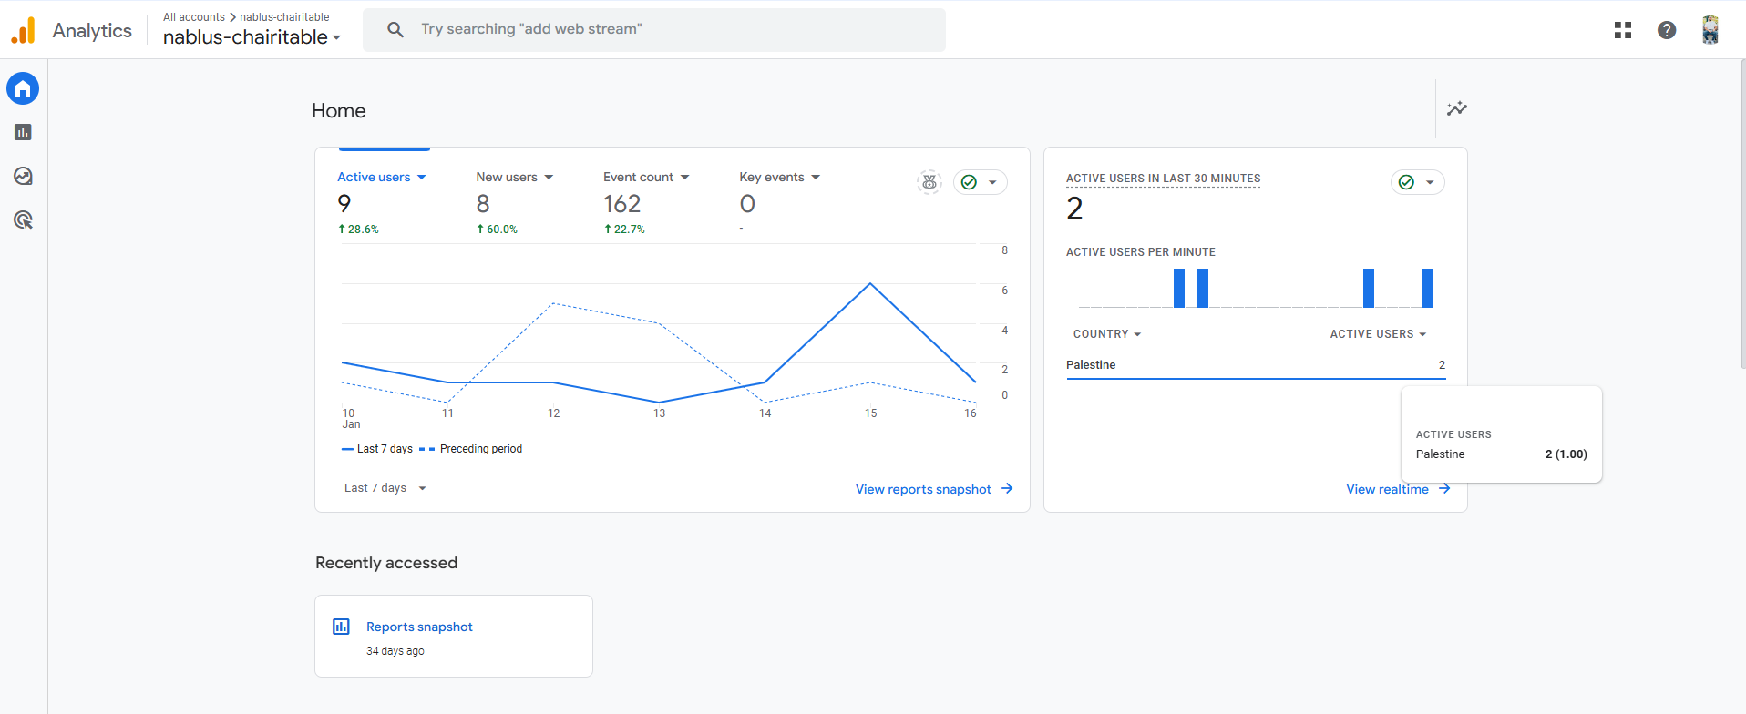
Google Analytics

Slide 65
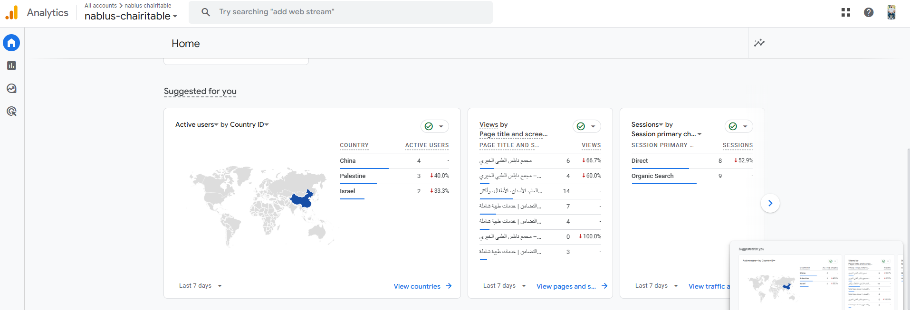
Google Analytics

Slide 66
Search Engine
Optimization

Slide 67
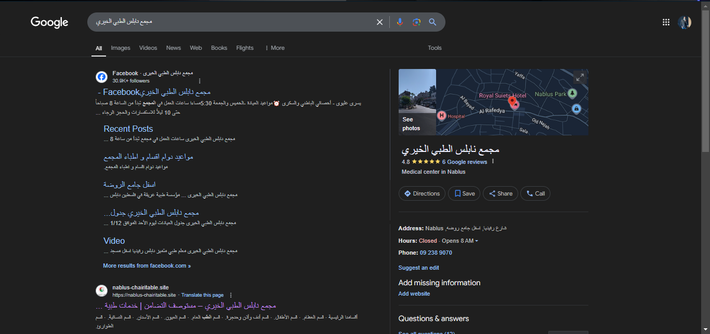
SEO

Slide 68
Home
Page

Slide 69
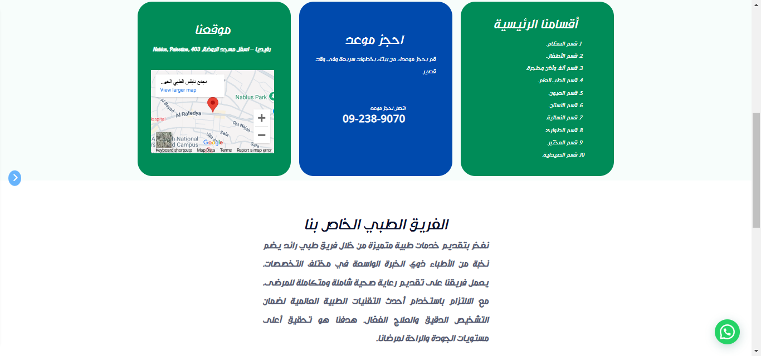
Home Page

Slide 70
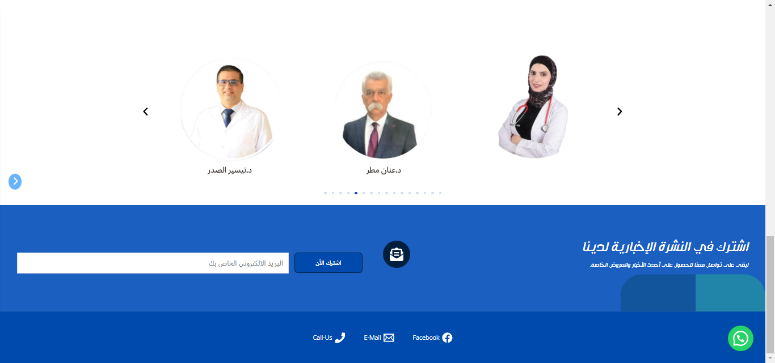
Home Page

Slide 71
Departments
Page

Slide 72
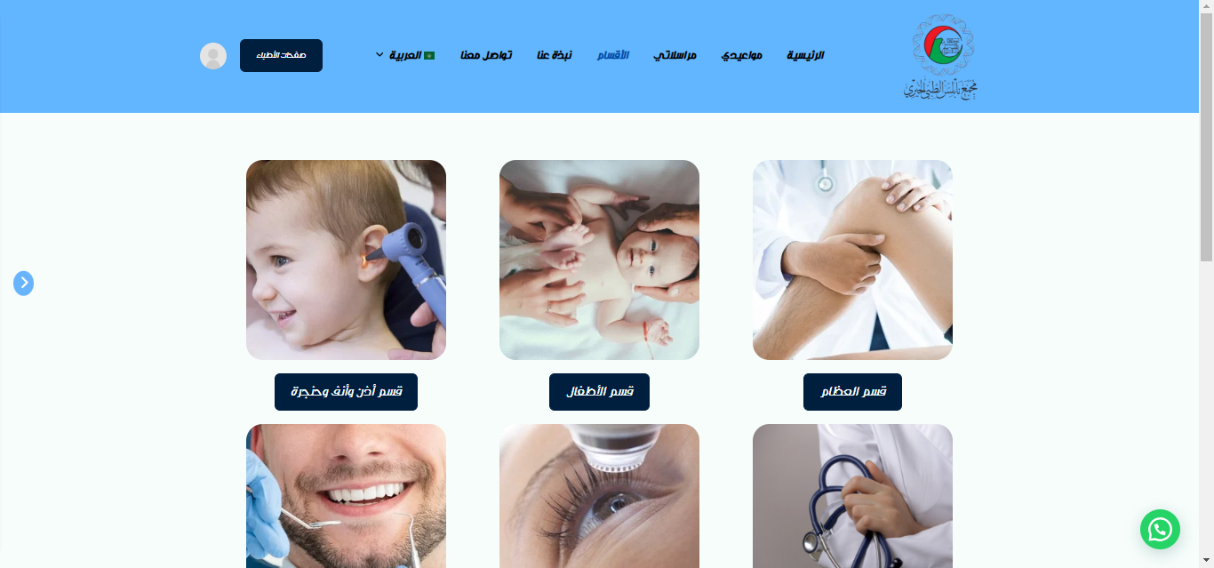
Departments Page

Slide 73
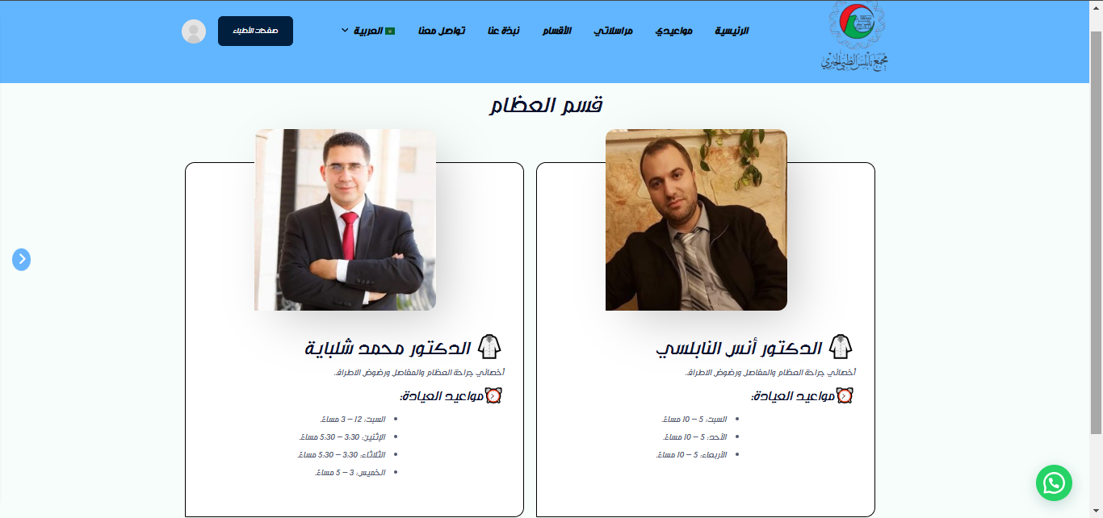
Departments Page

Slide 74
About-Us
Page

Slide 75
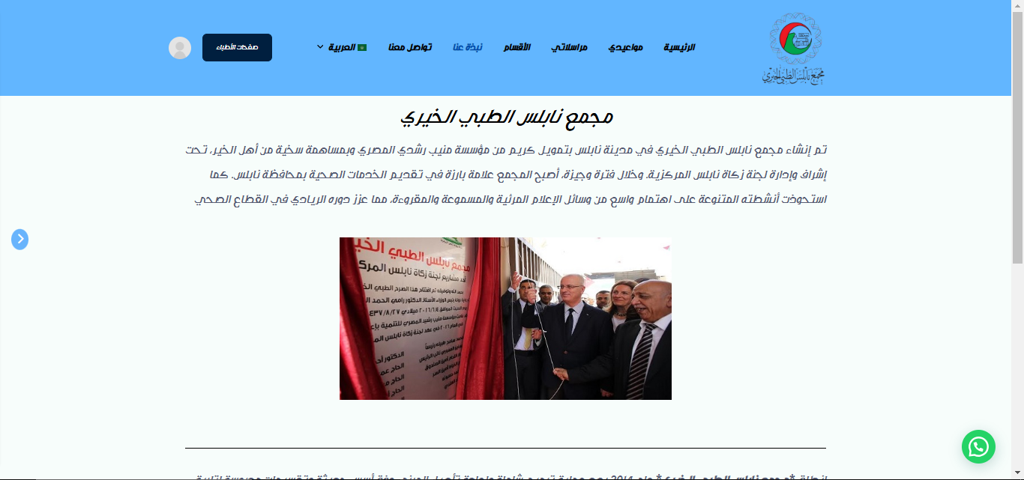
About-Us Page

Slide 76
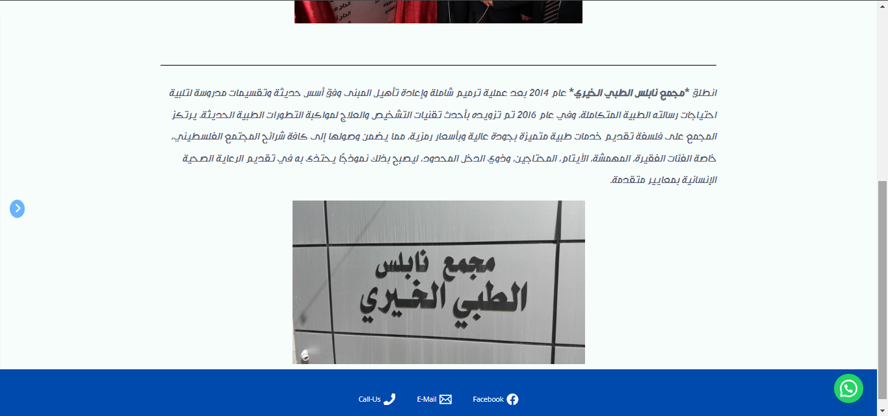
About-Us Page

Slide 77
Contact-Us
Page

Slide 78

Contact-Us Page

Slide 79
Translation of
Pages

Slide 80

Arabic

Slide 81

English

Slide 82
Predection
Rapid Miner

Slide 83

Predicting Period for a Specific Section

Slide 84

Prediction Using Rapid Miner

Slide 85

Phone
View

Slide 86

What Did You
So
Notice !

Slide 87
Side Bar

Slide 88

Color Blind Mood

Slide 89
Future Work
Visualizing the Data in a Table with a Filter.
Data Mining Techniques.
Make it a Mobile Application.

Slide 90
Thank You!
Supervised By:
Dr. Najwan Deleq
Dr. Maher Abu Baker

Slide 91




Produces By
Ahmed Abu Jaradeh
Ahmad Taha
Zyad Amer

