Slide 1

An-Najah National University
Engineering college
Building Engineering Department
Graduation project ||
Integrated design of Environmental friendly villa in Tubas
Submitted by :
Mustafa Daraghmeh
Amar Abu-Hijla
Marwa Hindi
Supervisor : Eng . Ameer Aker

Slide 2
Outline
1
Introduction.
2
Site analysis.
3
Architectural design.
4
Structural design.
5
Environmental design .
6
Mechanical design .
7
Electrical design .
8
Safety and fire system design .
9
Quantity and surveying cost.

Slide 3
Introduction
1
Project definition .
Objectives of the work:
Integrated design.
Comfortable.
Affordable .
Energy efficient .

Slide 4
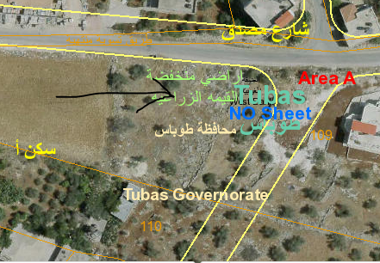
Site analysis .
2

Slide 5
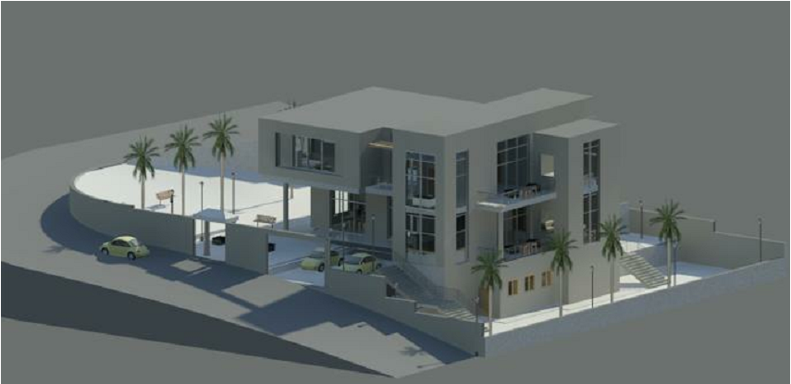
Architectural design
3

Slide 6
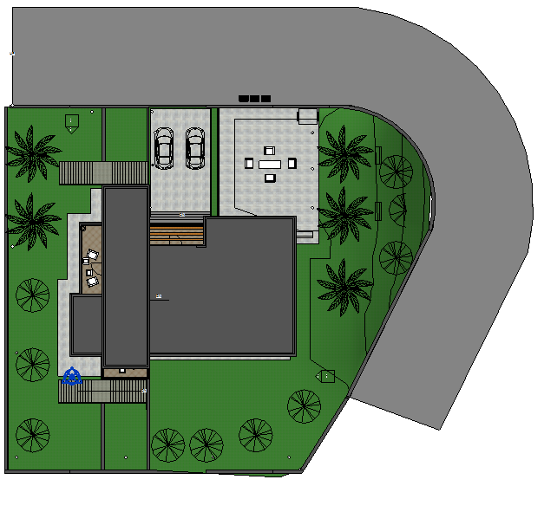
Architectural design
Site plane

Slide 7
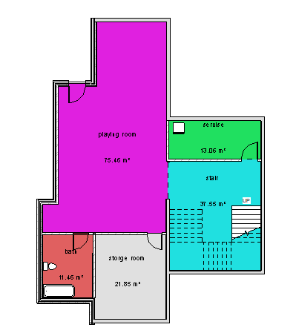
Architectural design
Basement floor

Slide 8
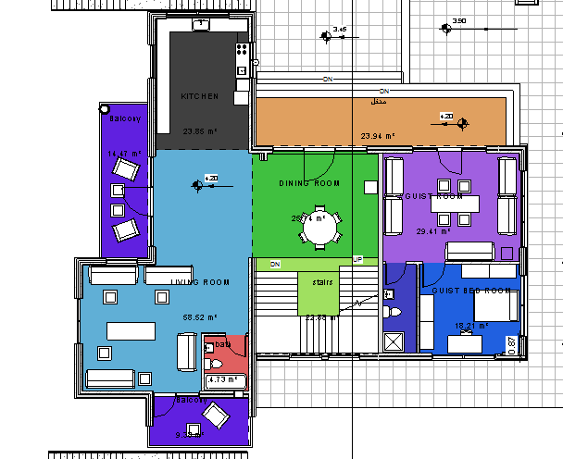
Architectural design
Ground floor

Slide 9
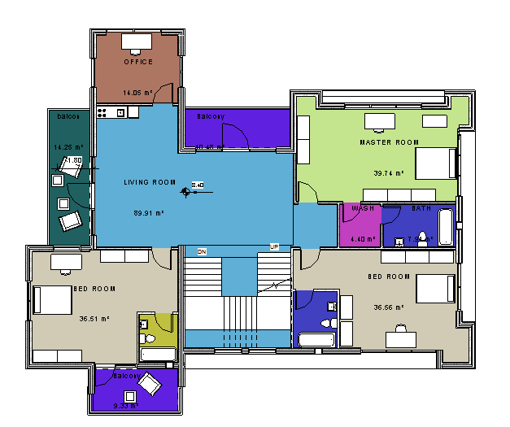
Architectural design
First floor

Slide 10
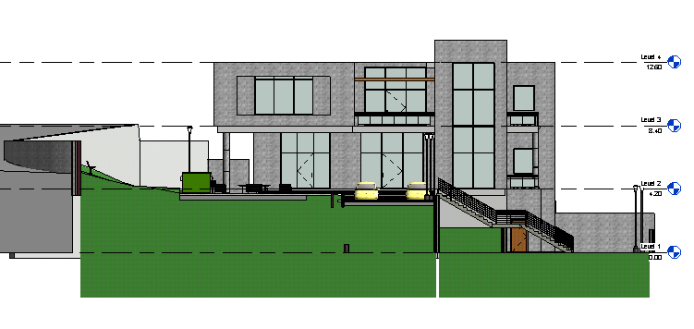
Architectural design
South elevation

Slide 11
Architectural design
North elevation

Slide 12
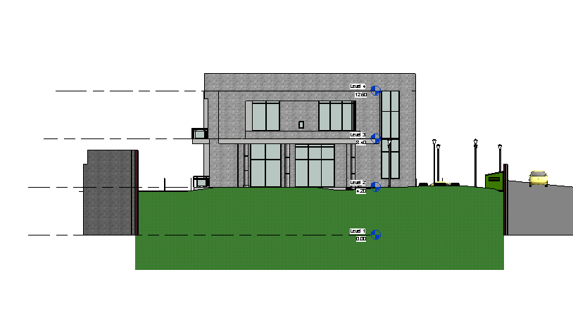
Architectural design
East elevation

Slide 13
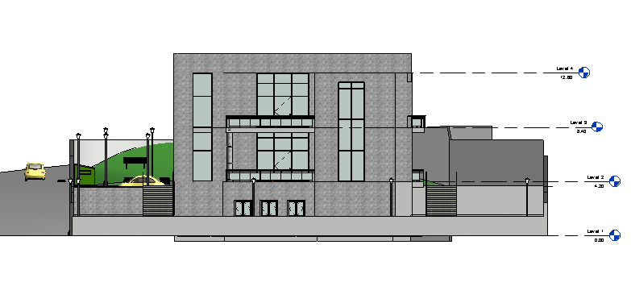
Architectural design
West elevation

Slide 14
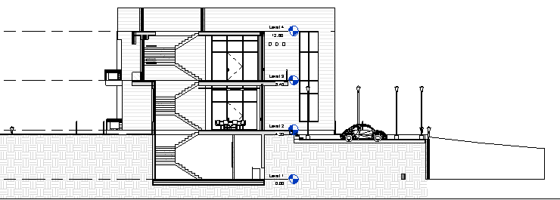
Architectural design
Section A-A

Slide 15
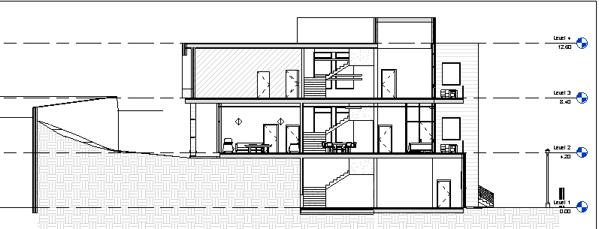
Architectural design
Section B-B

Slide 16
Structural design
4
Codes and Standards:
ACI-318-11.for.reinforced concrete structural design.
UBC -97 for earthquake design.
ASCE.7.2010.for.load combinations

Slide 17
Structural design
Codes and Standards:
ACI-318-11.for.reinforced concrete structural design.
UBC -97 for earthquake design.
ASCE.7.2010.for.load combinations

Slide 18
Structural design
Design data:
Concrete strength for slabs and beams,
f’c=24 mpa.
Concrete strength for columns and shear walls ,f’c=28 mpa.
Steel yield strength fy=420 mpa.
Bearing capacity for soil = 250 kN/m2

Slide 19
Structural design
loads :
Load type | Ribbed slab
Live load | 3 KN/M^2
SID | 7.2 KN\M^2

Slide 20
Structural design
Lateral loads:
The city of structure is Tubas.
The seismic zone factor. Z=0.3
The soil profile is type Sp .
The acceleration seismic coefficient Ca=0.3
The velocity seismic coefficient Cv=0.3
The Seismic importance factor is 1.
The structural design type is intermediate, R=5.5

Slide 21
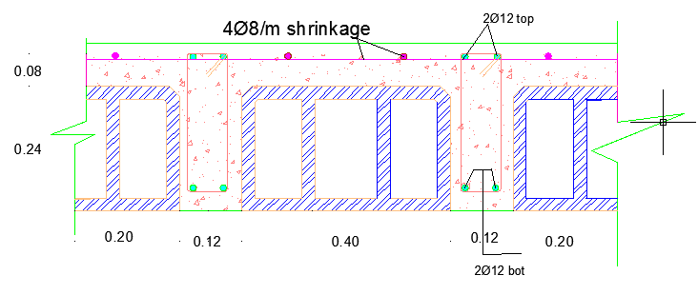
Structural design
Ribbed slab with 32 cm thickness.

Slide 22
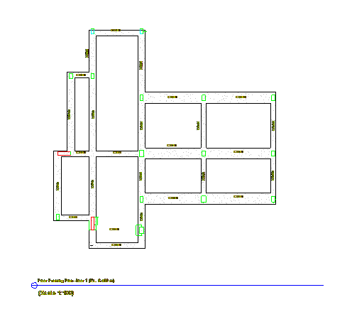
Structural design
Beams:

Slide 23
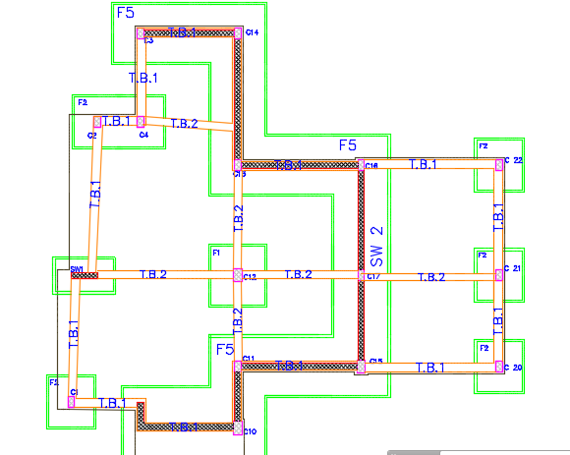
Structural design
column and footing :

Slide 24
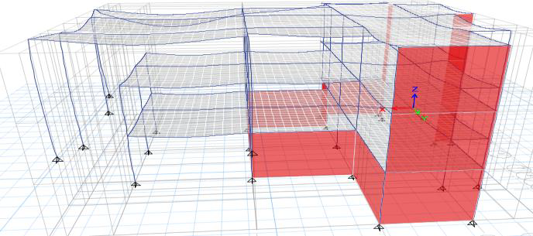
Structural design
ETABS molding :

Slide 25
Structural design
Validation of ETABS model:
Compatibility check
Equilibrium check
Internal force check
Deflection check
Drift check
Period check
Model participating mass ratio check

Slide 26
Structural design
Compatibility check: By starting animation for the MODAL deformed shape, the whole structure was moving as one unit.

Slide 27
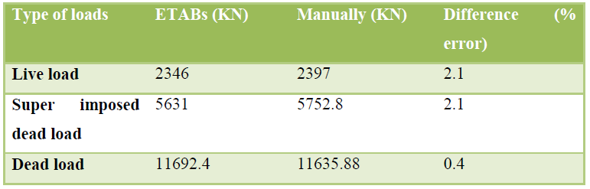
Structural design
Equilibrium check:

Slide 28
Structural design
Internal force check
Type | ETABS (KN.M) | MANUALLY | % OF EROR
Column | 1288.9 | 1303 | 1.15
Beam “secondary” 0.32*0.5 | 66 | 59.2 | 10
Slab | 5.1 | 4.9 | 4

Slide 29
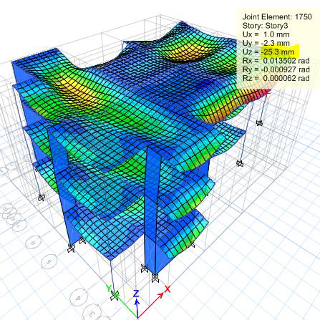
Structural design
Deflection check

Slide 30
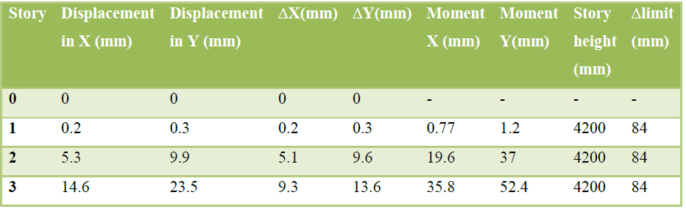
Structural design
Drift check

Slide 31
Structural design
Period check:
عمااااار

Slide 32

Structural design
Model participating mass ratio check

Slide 33
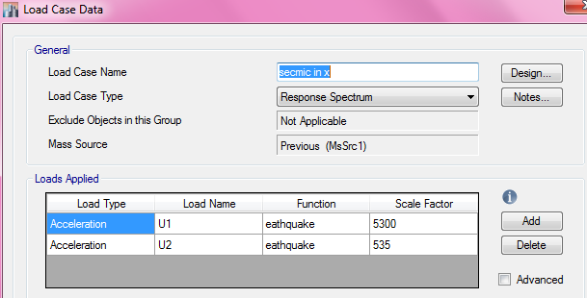
Structural design
Seismic design Using response spectrum

Slide 34
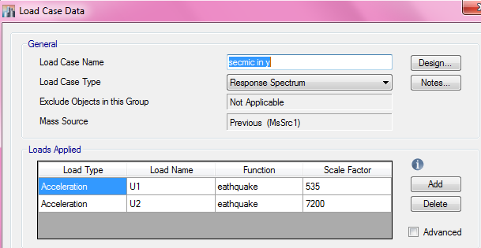
Structural design
Seismic design Using response spectrum

Slide 35
Structural design
Design for flexure moment
Slab reinforcement

Slide 36
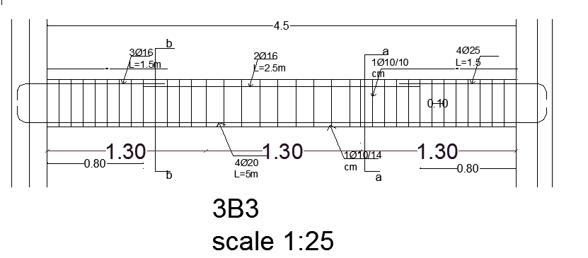
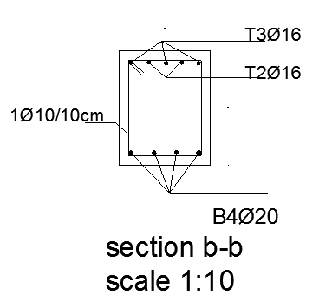
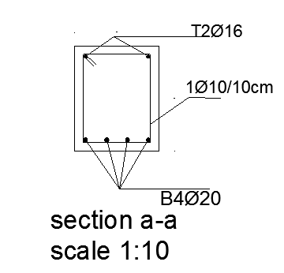
Structural design
Beams reinforcement:

Slide 37
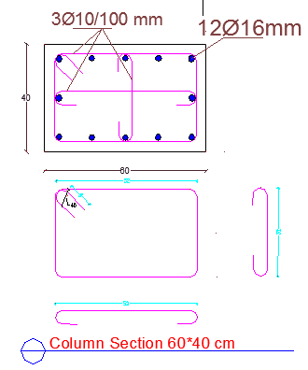
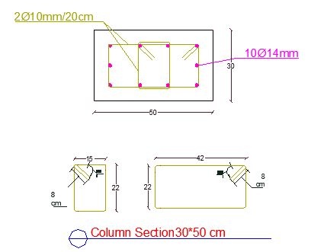
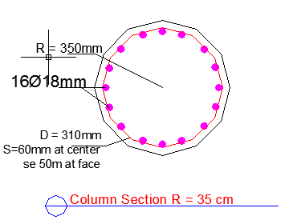
Structural design
columns

Slide 38
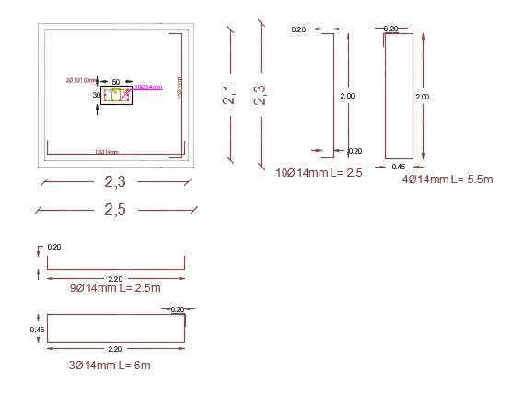
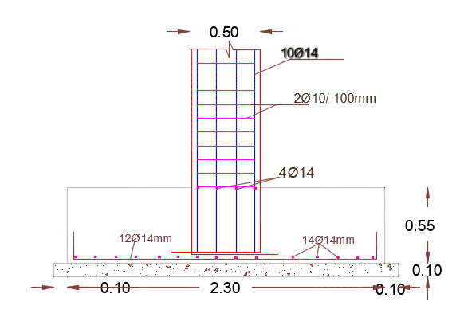
Structural design
Design for flexure moment
Footing reinforcement:

Slide 39
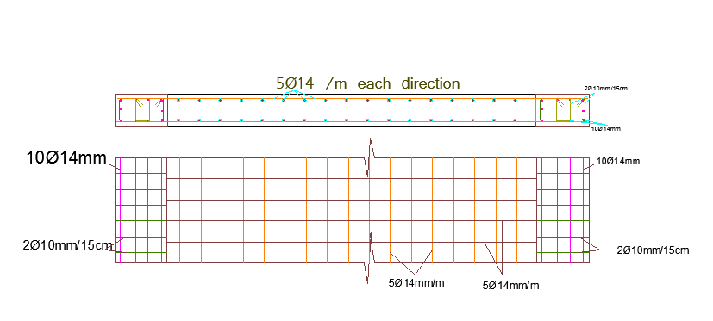
Structural design

Slide 40
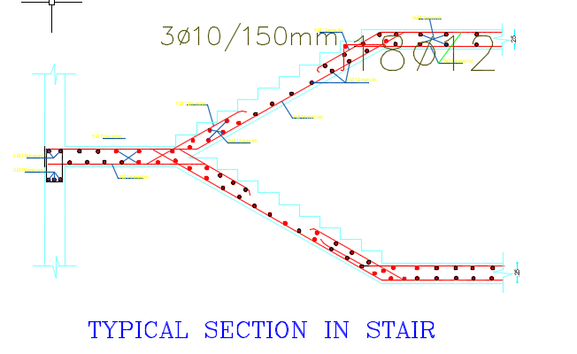
Structural design
Design for flexure moment
Stair reinforcement:

Slide 41
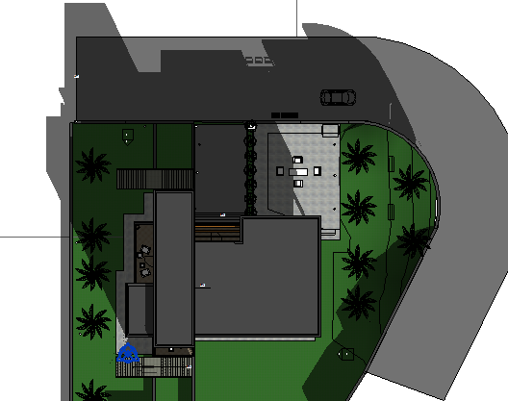
Environmental design
5
Shading in winter

Slide 42
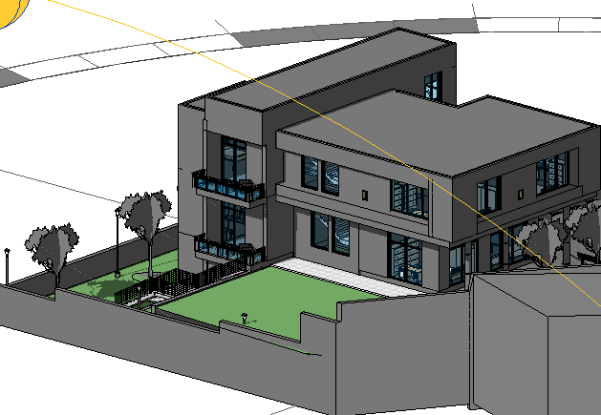
Environmental deign
Shading analysis

Slide 43
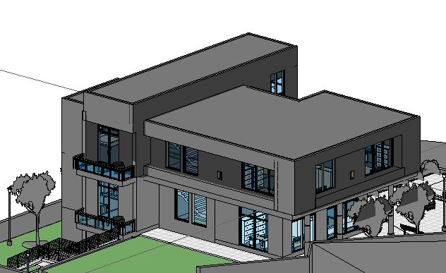
Environmental deign
Shading analysis

Slide 44


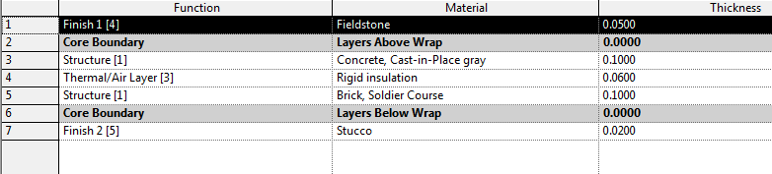
Environmental design
Thermal analysis
External wall layers

Slide 45
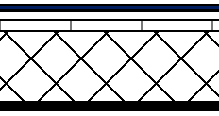
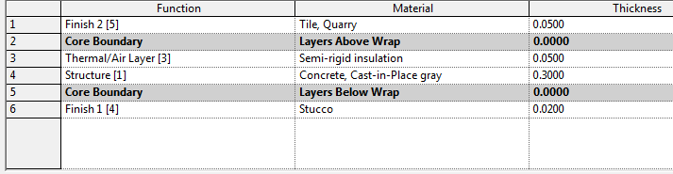
Environmental design
Thermal analysis
Celling layers

Slide 46
Environmental design
Thermal analysis
U- values
Type | U-value
Walls | 0.51
Floor | 0.58
Doors | 1.98
Windows | 1.98

Slide 47
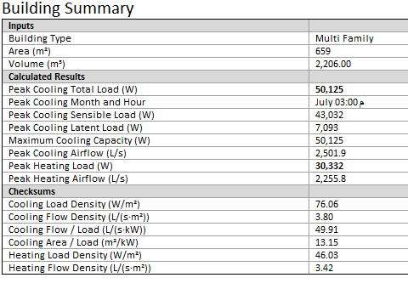
Environmental design
Thermal analysis
Cooling and heating load

Slide 48
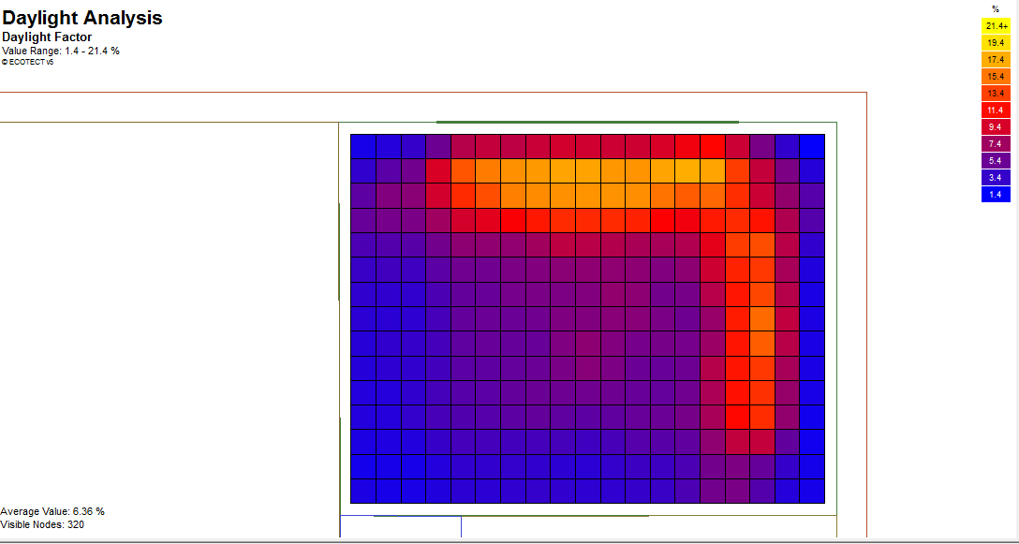
Environmental design
Day light analysis
Master Bed room average day light factor is 6.36 %.

Slide 49
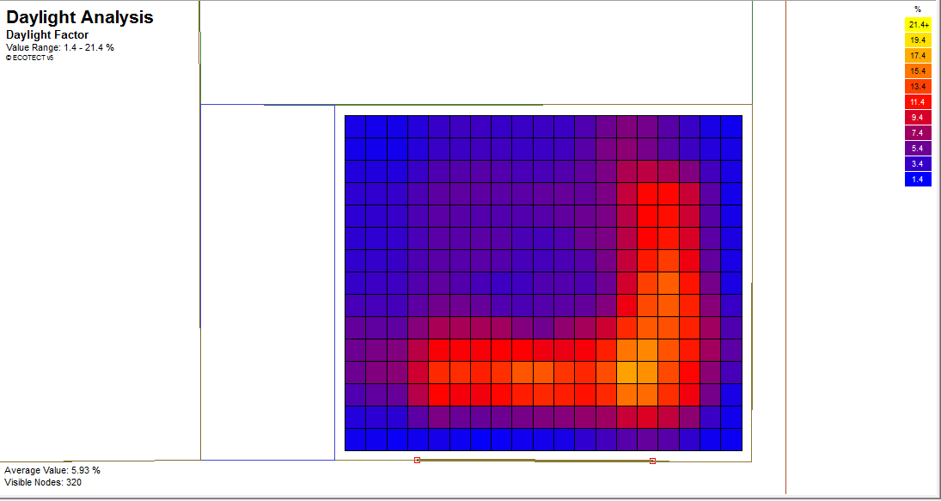
Environmental design
Day light analysis
Bed room average day light factor is 5.39 %.

Slide 50
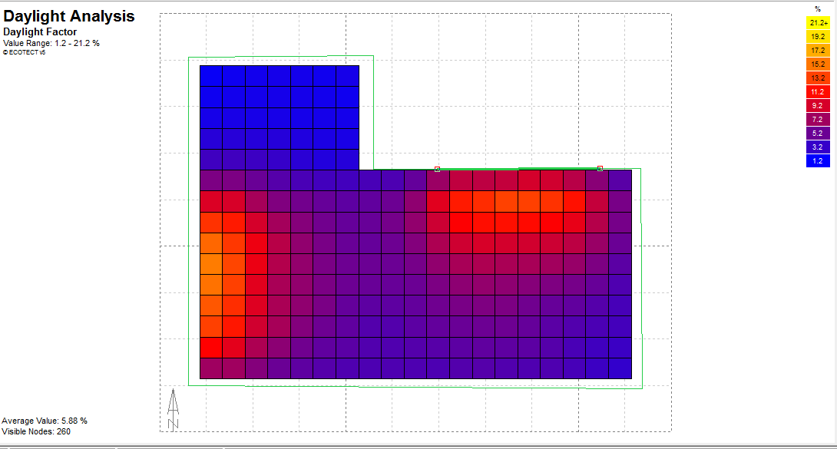
Environmental design
Day light analysis
Living room and kitchen average day light factor is 5.88 %.

Slide 51
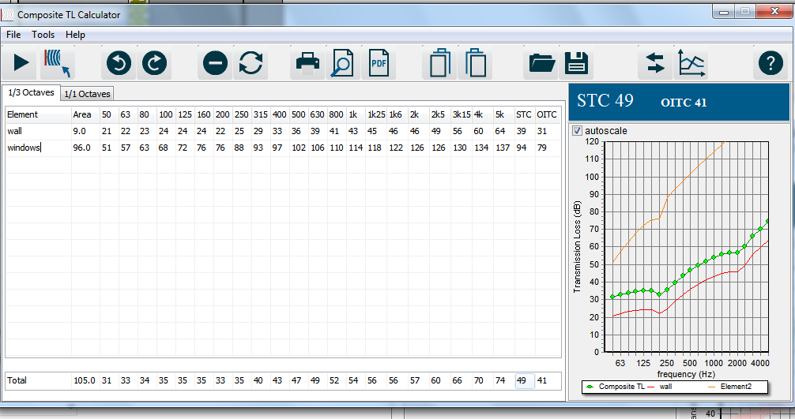
Environmental design
Acoustical analysis
STC value in master bed room for external wall

Slide 52
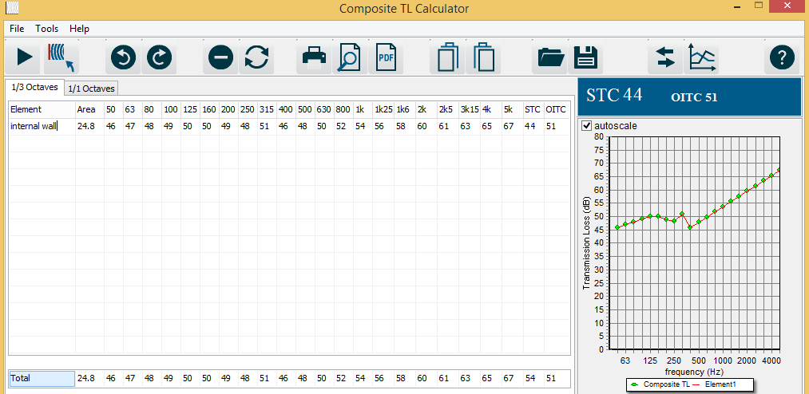
Environmental design
Acoustical analysis
STC value in master bed room for internal wall

Slide 53
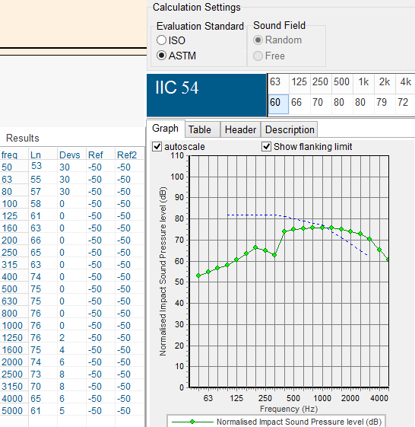
Environmental design
Acoustical analysis
IIC value in master bed room

Slide 54
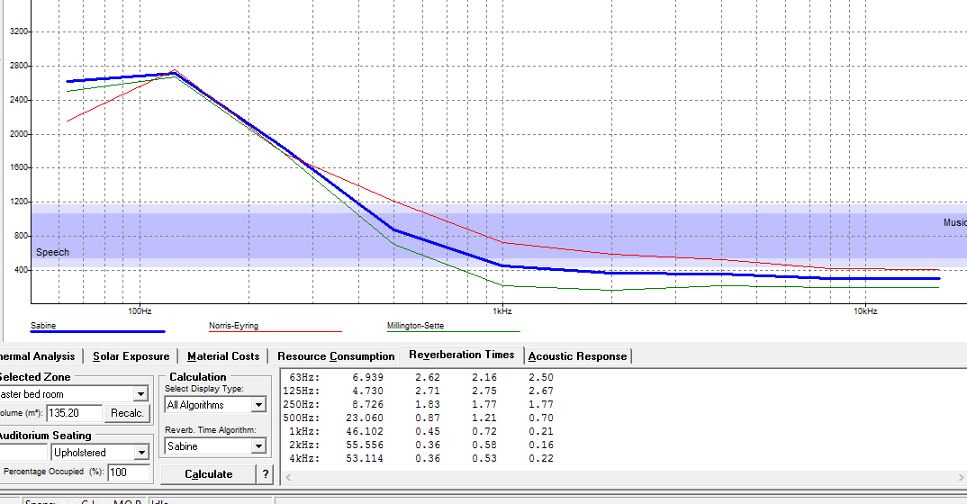
Environmental design
Acoustical analysis
RT-60 value in master bed room

Slide 55
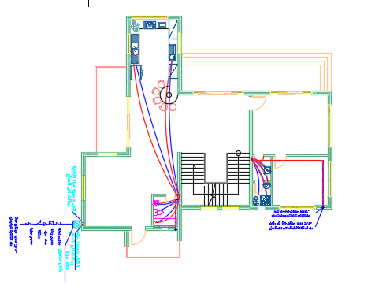
Mechanical design
6
Water supply system

Slide 56
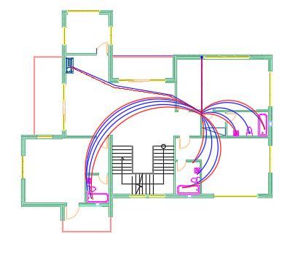
Mechanical design
Water supply system

Slide 57
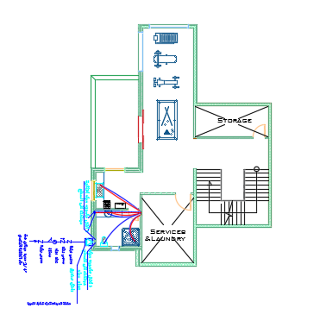
Mechanical design
Water supply system

Slide 58
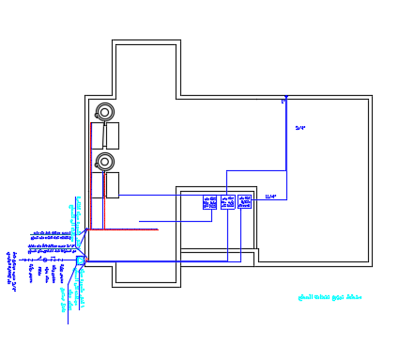
Mechanical design
Water supply system

Slide 59
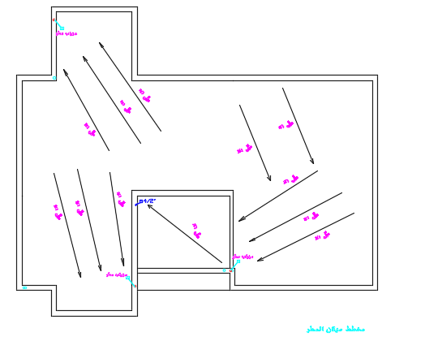
Mechanical design
Rain water

Slide 60
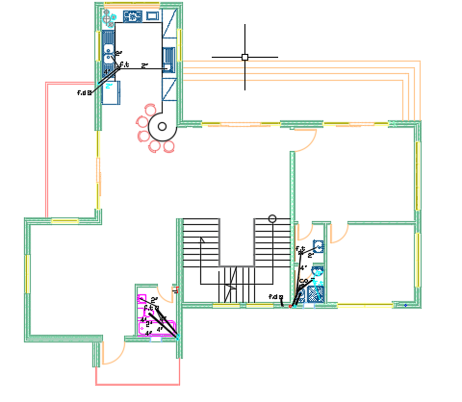
Mechanical design
Drainage system

Slide 61

Mechanical design
Drainage system

Slide 62

Mechanical design
Drainage system

Slide 63
Mechanical design
HVAC system
Space name | Peak cooling load | Peak heating load | Capacity of indoor unite
Gest room | 2759 | 2261 | 1.25
Gest bed room | 1698 | 1705 | 1.25
Living room | 5244 | 3770 | 2.5
Kitchen | 2568 | 2428 | 1.25
Master bed room | 3542 | 3583 | 1.25
Office | 1979 | 1892 | 1.25
Bed room | 3261 | 2288 | 1.25

Slide 64

Electrical design
7

Slide 65

Electrical design
Artificial light design

Slide 66
Electrical design
Artificial light design

Slide 67

Electrical design
Earthling system

Slide 68

Electrical design
Socket distribution

Slide 69

Electrical design
Socket distribution

Slide 70

Electrical design
Main distribution board

Slide 71

Electrical design
Photovoltaic system

Slide 72


Electrical design
Photovoltaic system

Slide 73

Electrical design
Photovoltaic system

Slide 74


Safety and fire system design
8

Slide 75

Quantity and surveying cost.
9

Slide 76

Thank You
All

