Slide 1

Growify
Amplifies the Growth for both companies/organizations and individuals
Done By
Ahmad Othman Obaida Aws
Supervisor
Dr. Sufyan Samara

Slide 2

What is the problem?
Many organizations, companies, and individuals face challenges represented by the need to use a large number of applications/sites to organize their work.
As they usually need sites to disseminate their experience and information, search and apply for jobs, identify local and international companies, organize the communication process between individuals and groups, Organizing their calendar and personal tasks, organizing their company’s/organization's structure and distributing it into groups that contain multiple communication channels and features.

Slide 3

Our Solution
Our application focuses on providing users interested in organizing their professional work with the access to a large network of other users/pages with the same interests.
The application provides a huge number of features that can be used to save time and effort to manage tasks, profiles, connections, and business structuring for people, companies, and organizations.

Slide 4
Features
User
Organizations/Companies
Professional profiles
Social networks
Real-time communication
Task management
Apply for jobs
Create pages
Add admins and employees with custom fields
publishing jobs
View job applications an communicate with the applicant
Create groups represented as tree
Add admins and members
A group calendar containing events
A page for distributing tasks to group members
Group chat
Video/audio meeting with screen sharing feature

Slide 5





Technical
SSE

Slide 6
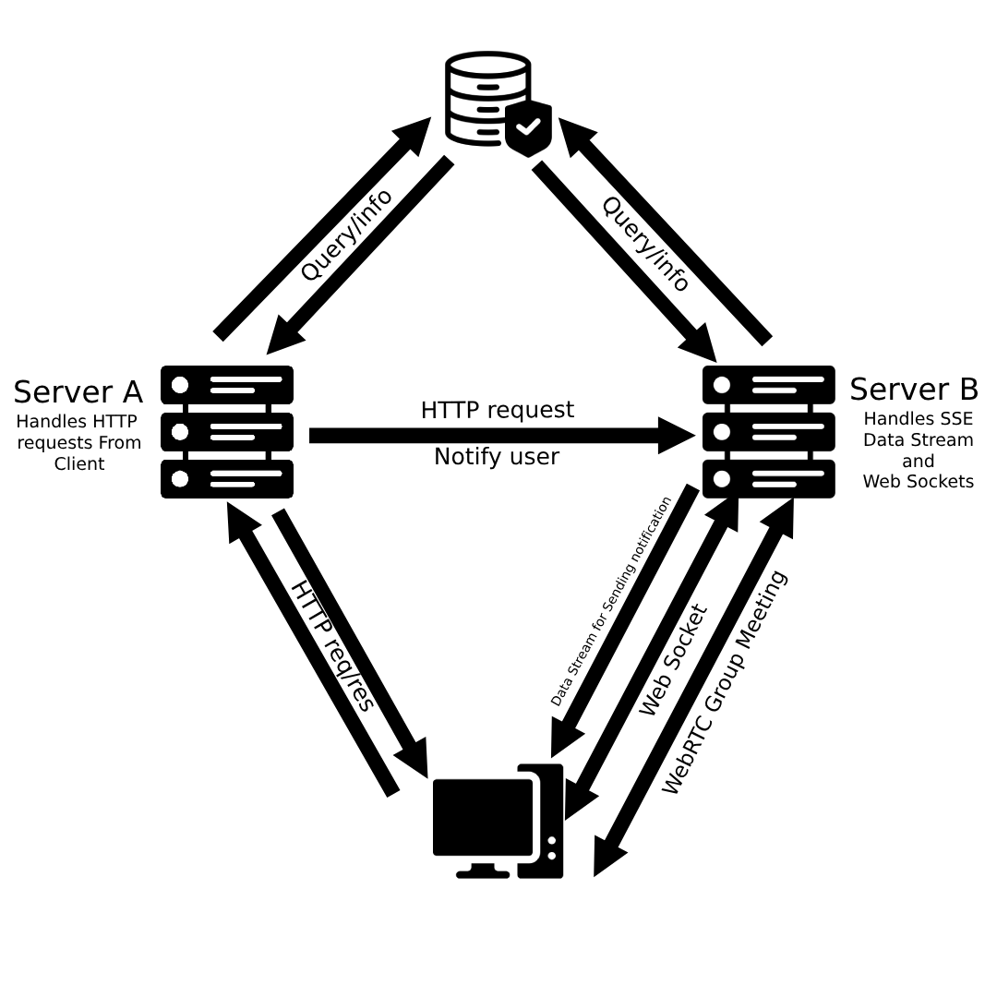
Back-End

Slide 7
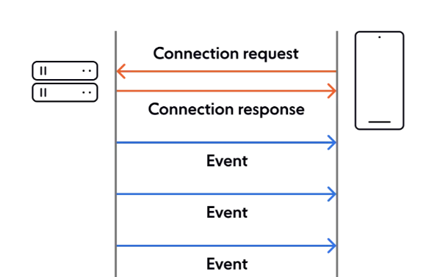
Server-Sent Events (SSE)

Slide 8
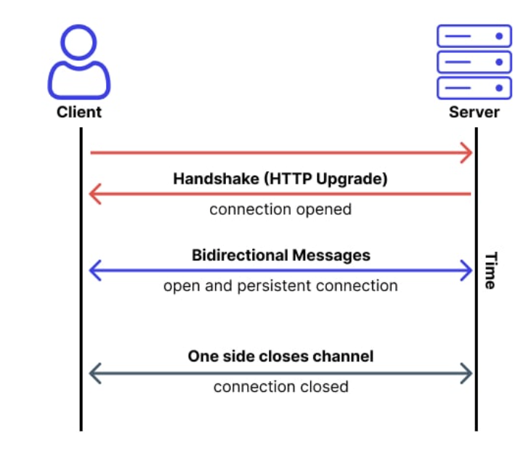
Socket IO

Slide 9
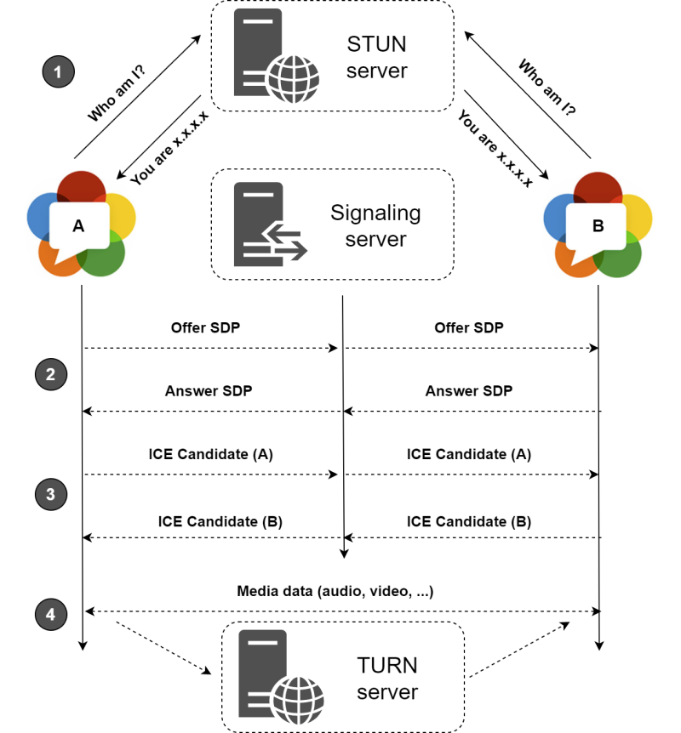
WebRTC

Slide 10
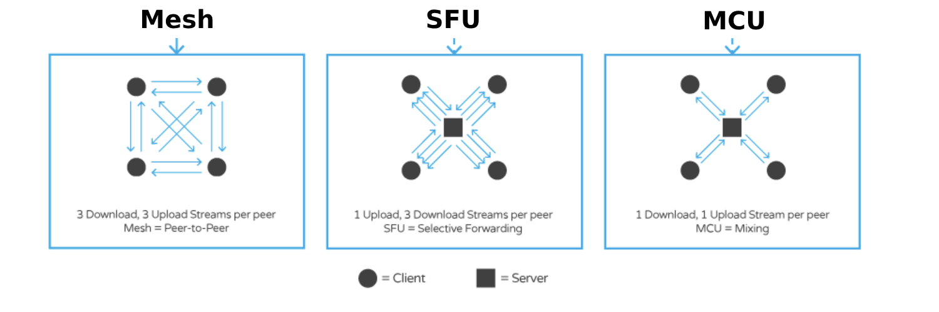
WebRTC architectures

Slide 11
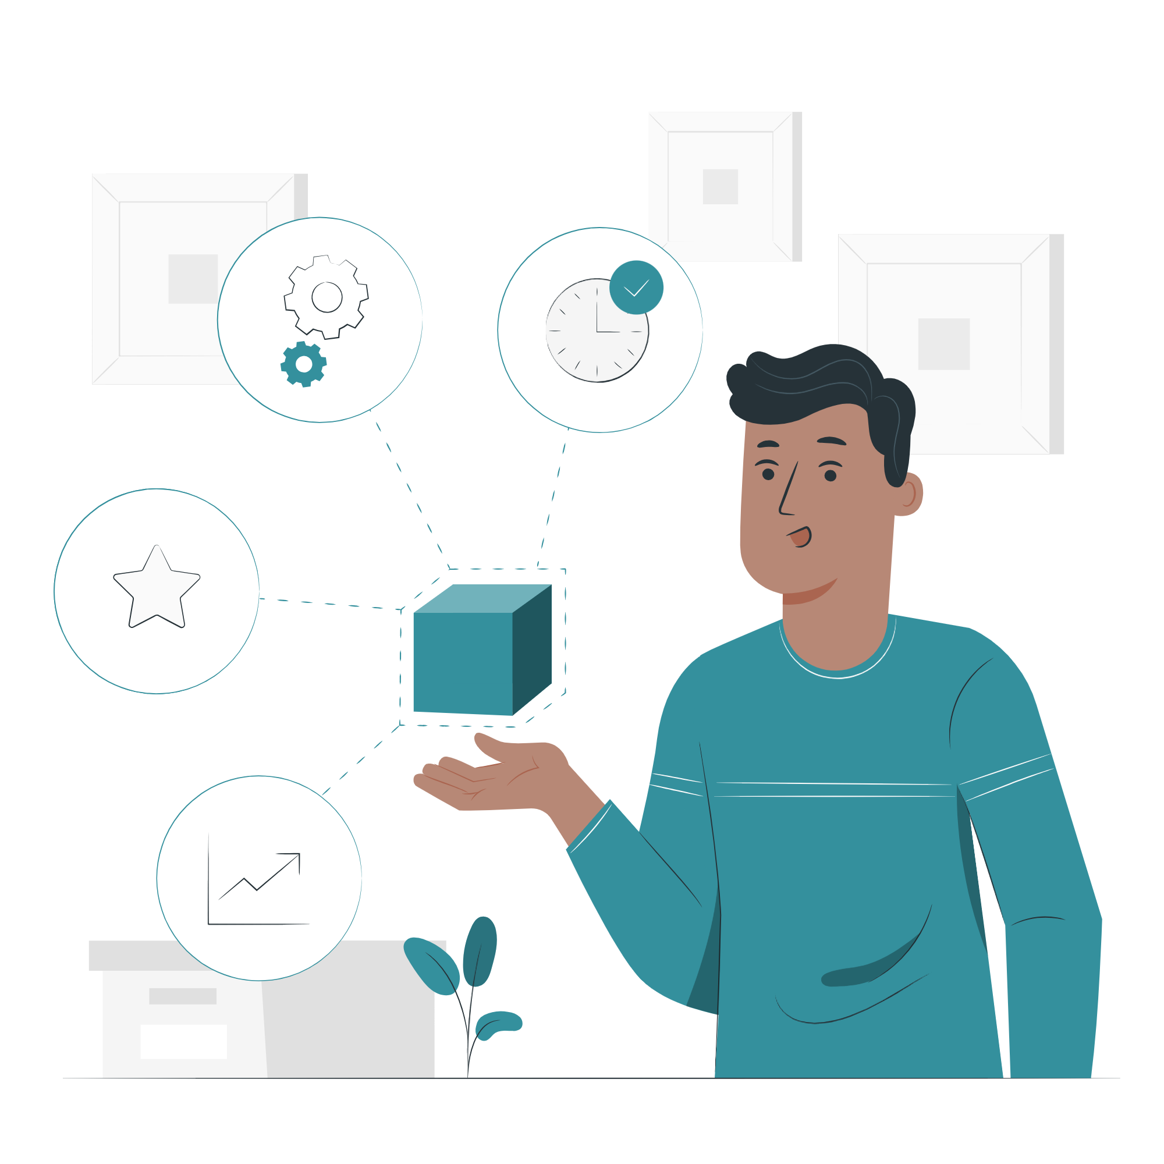
Features

Slide 12
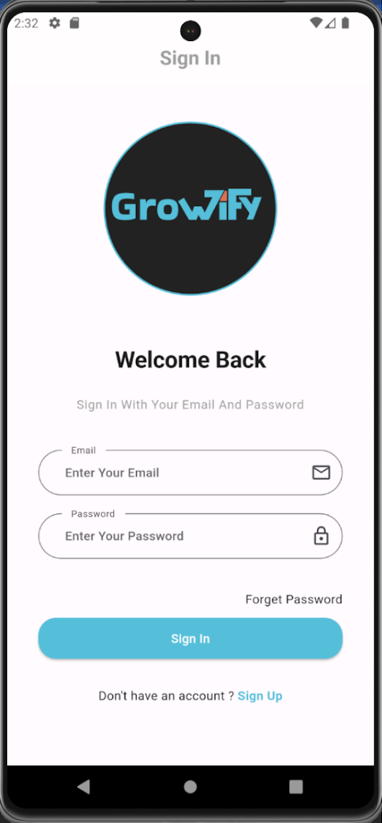
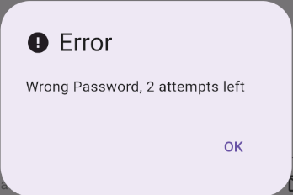
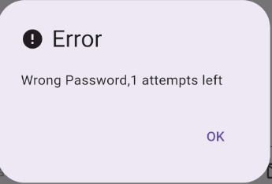
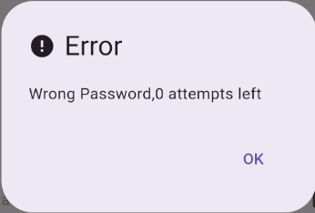
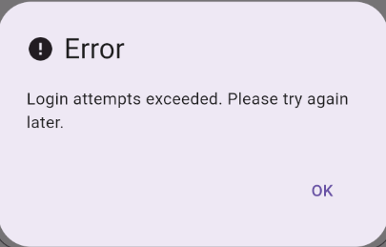
Login

Slide 13
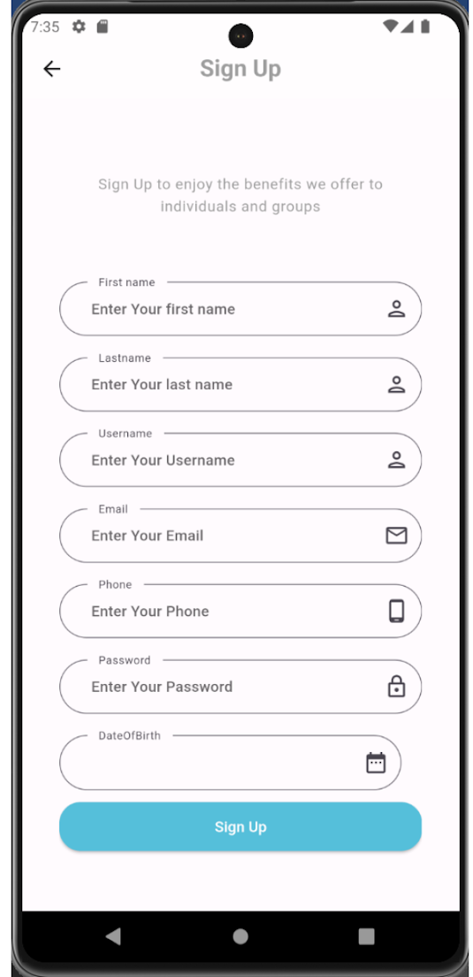
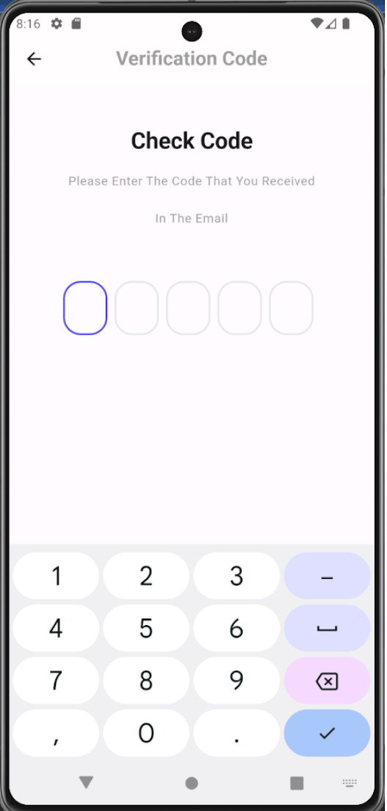
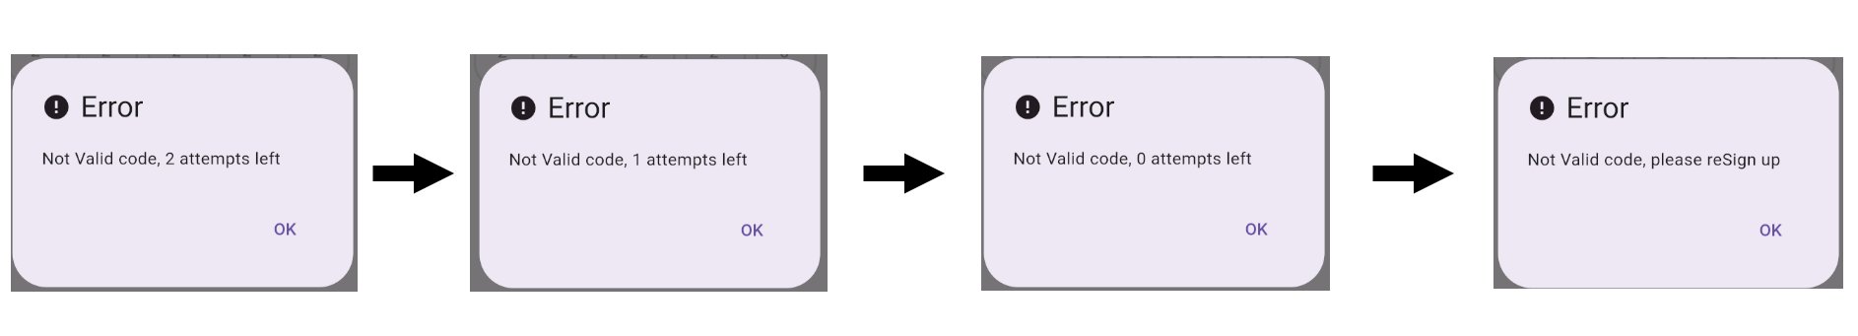
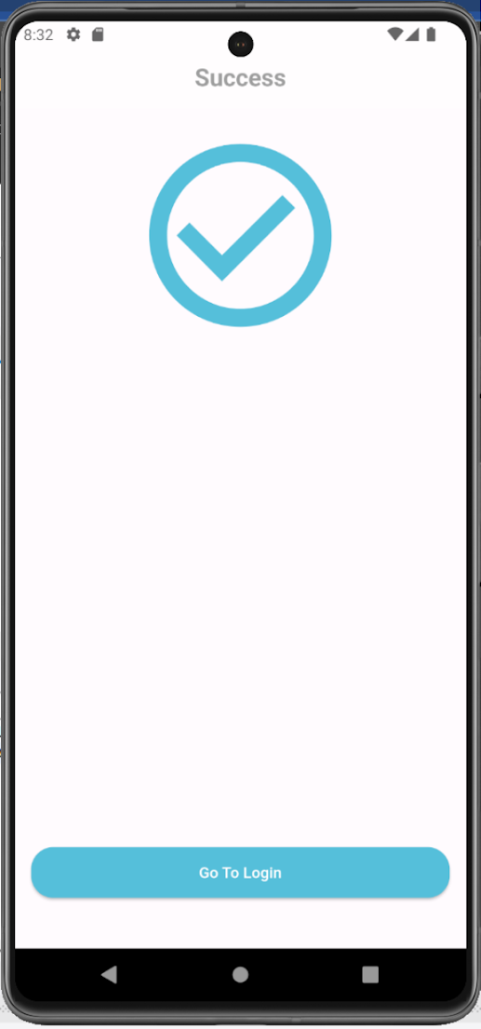
Sign Up

Slide 14
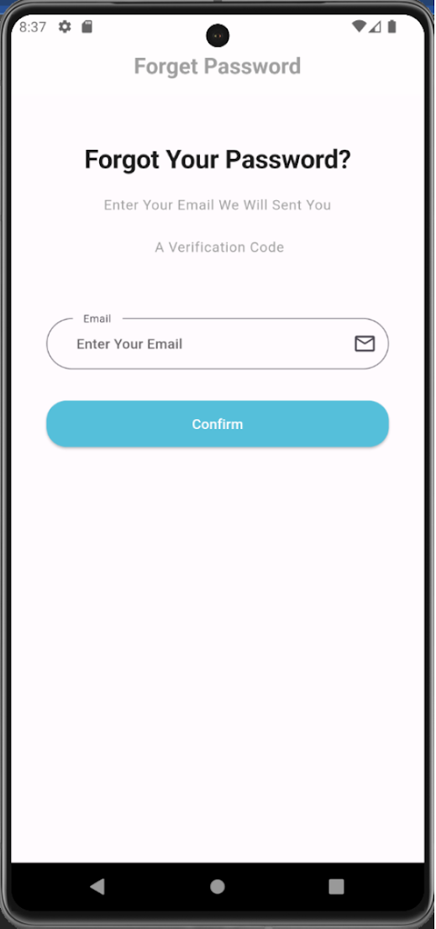
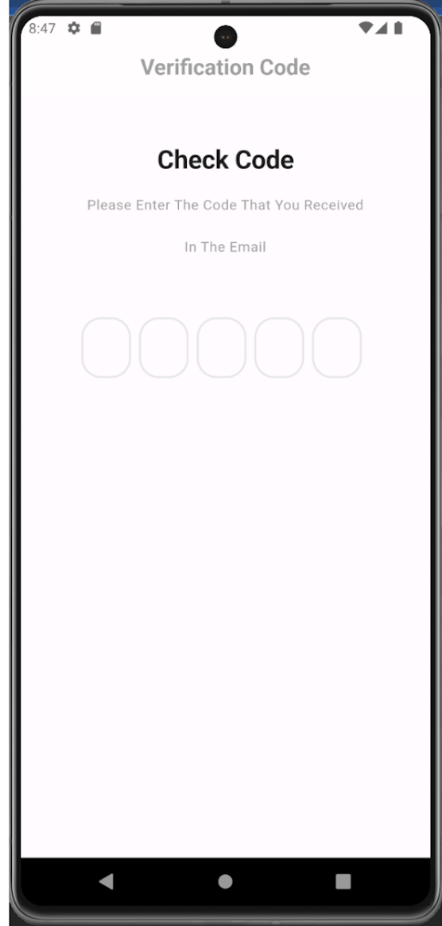
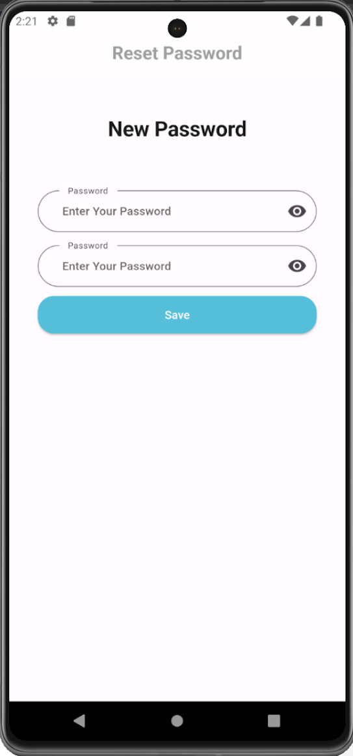
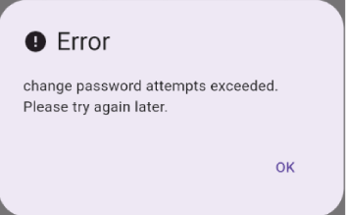
Forgot password

Slide 15
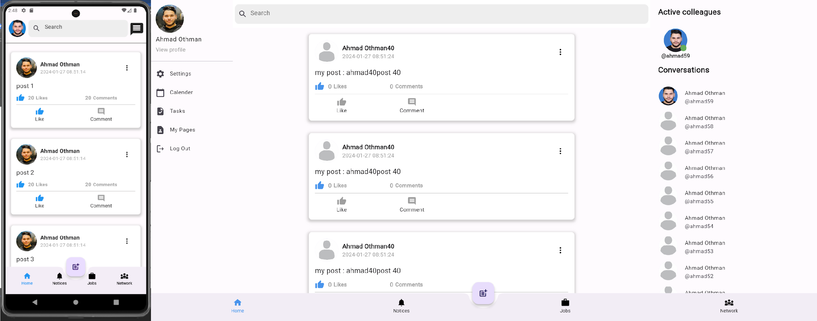
Home Screen

Slide 16
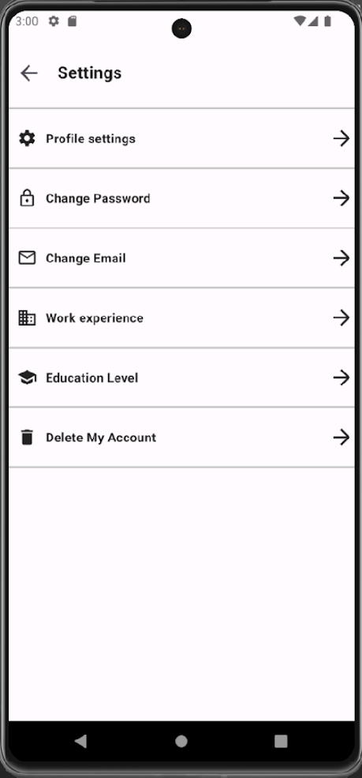
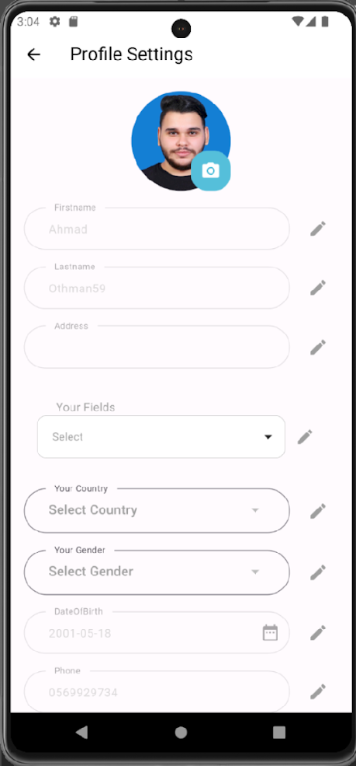
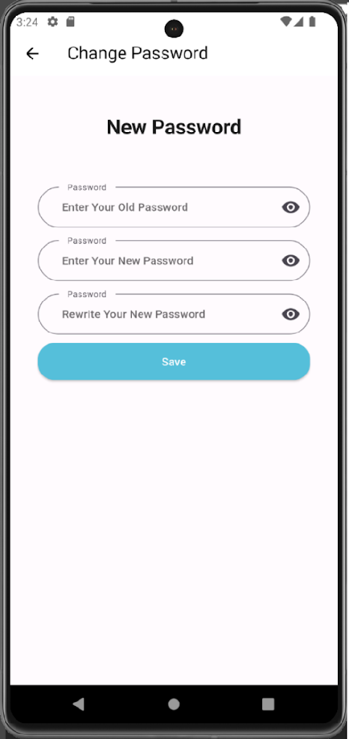
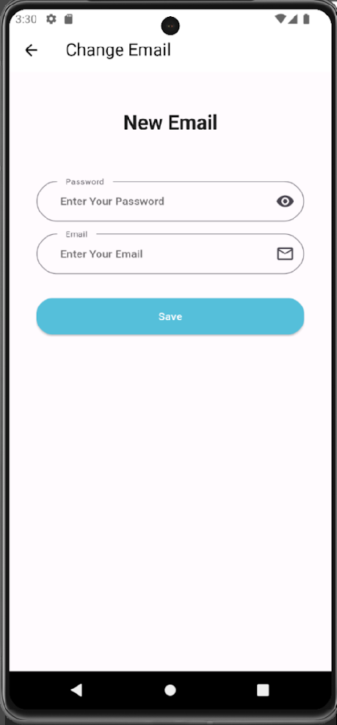
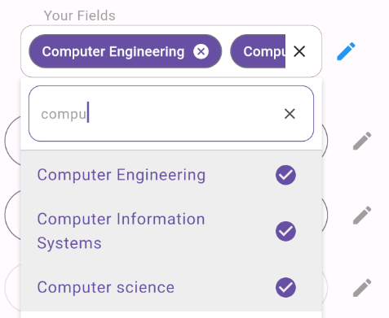
User Settings

Slide 17
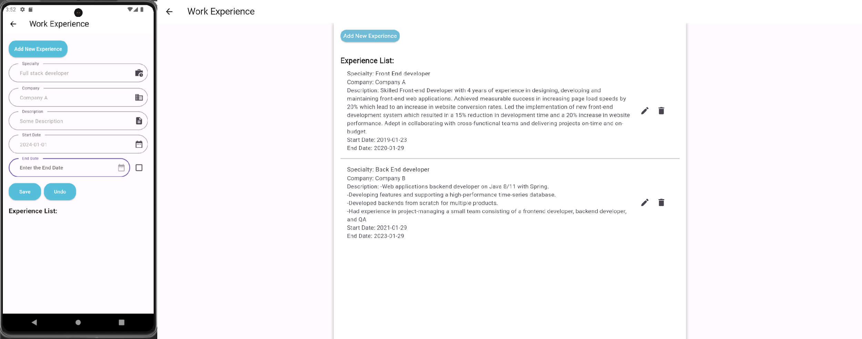
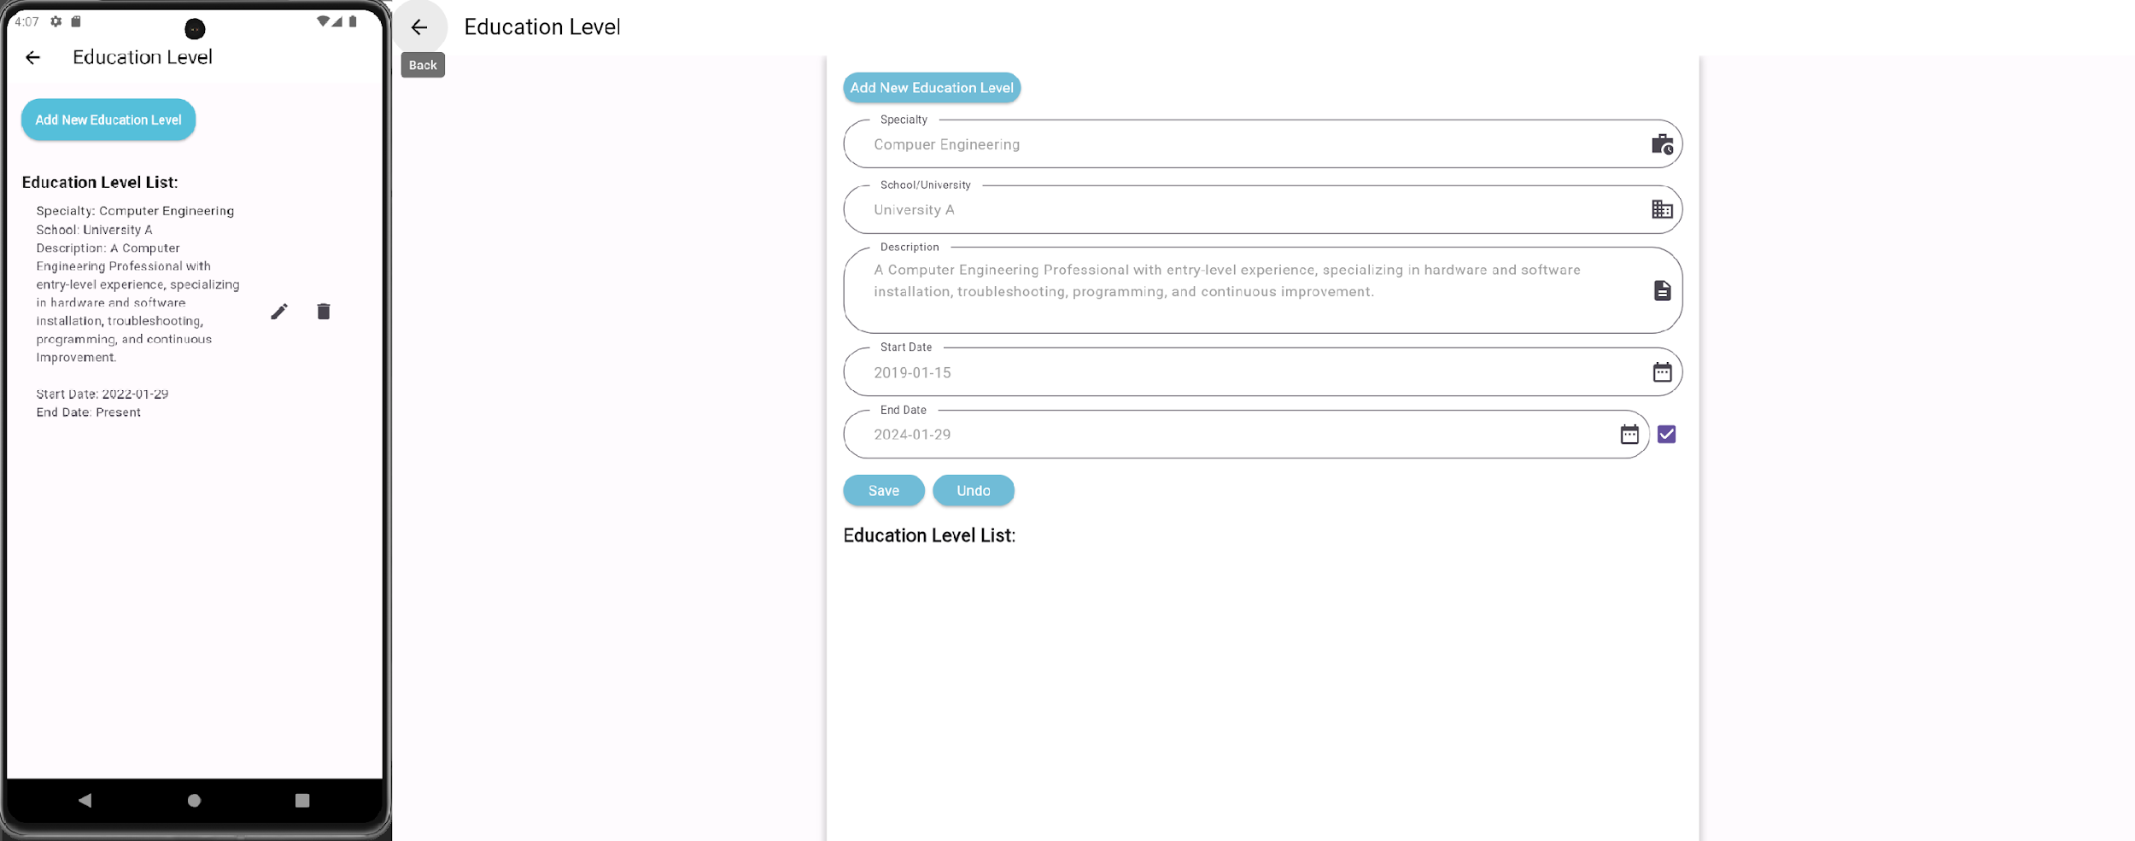
Work Experience / Education Level

Slide 18
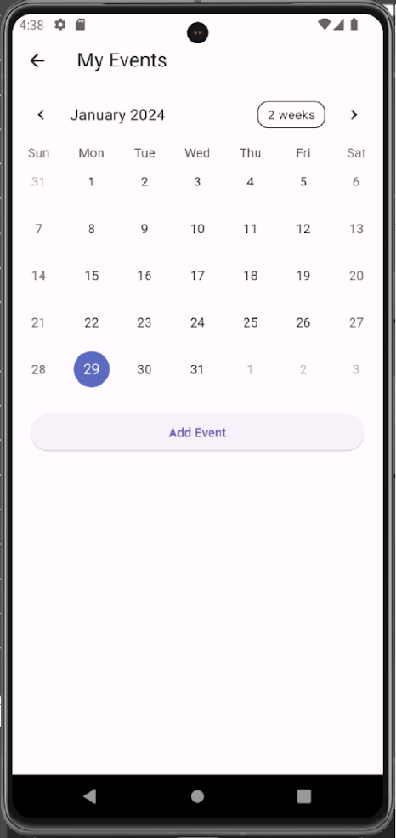
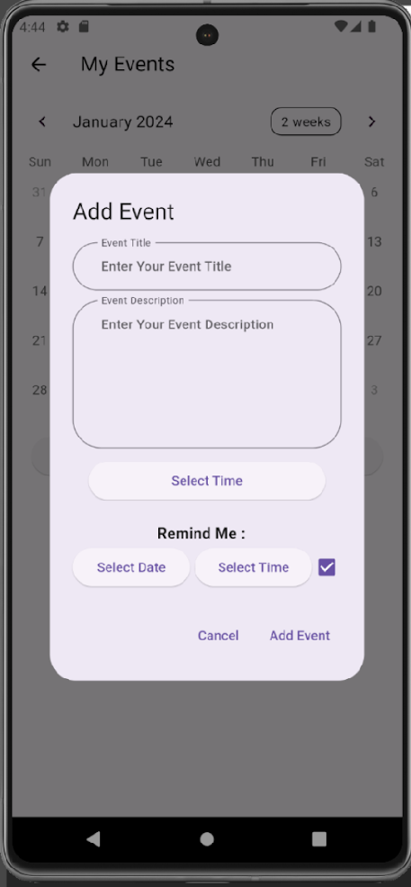
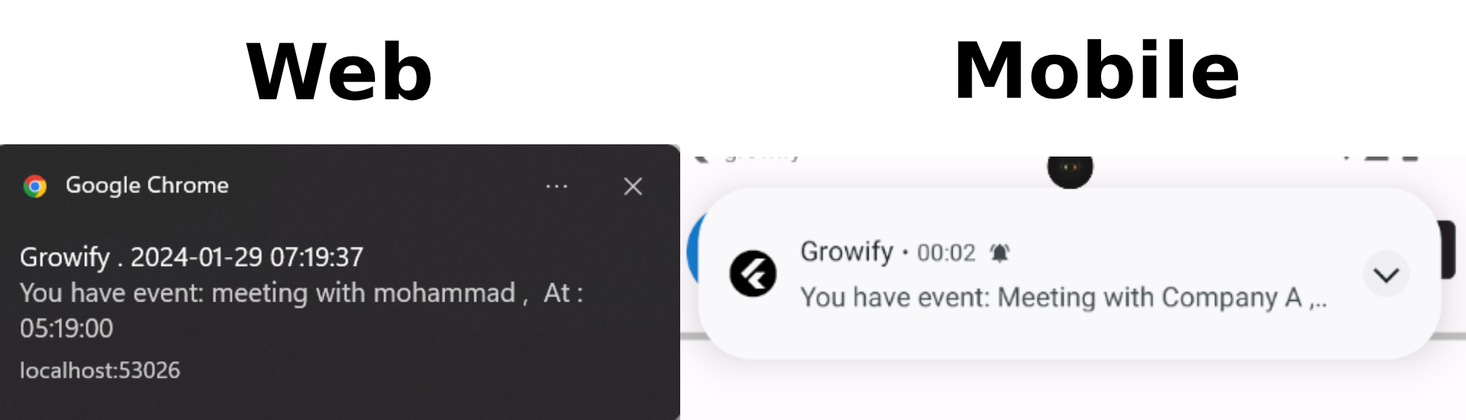
User Calendar

Slide 19
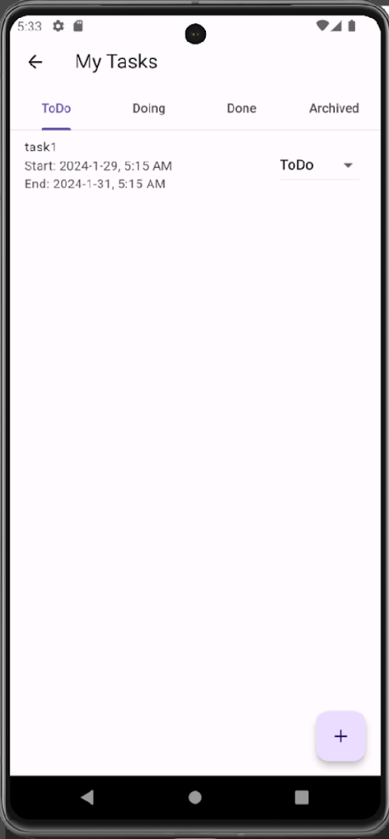
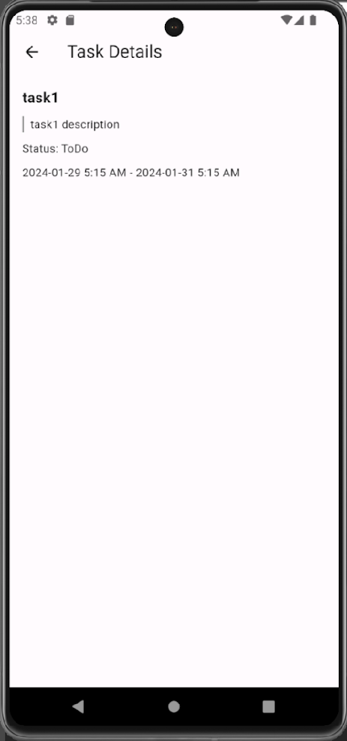
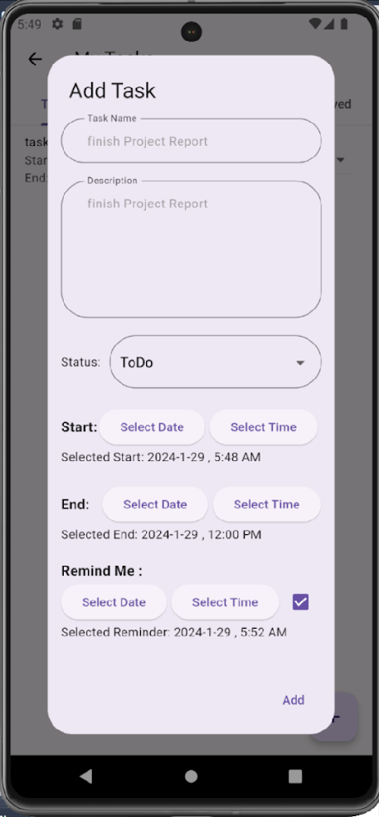
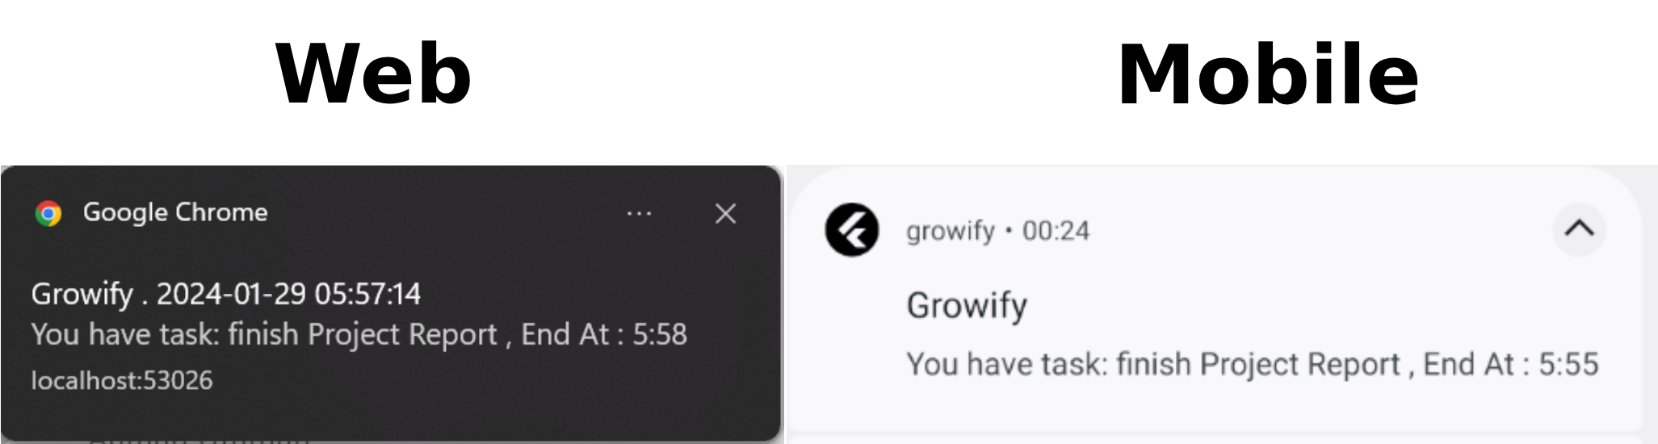
User Tasks

Slide 20
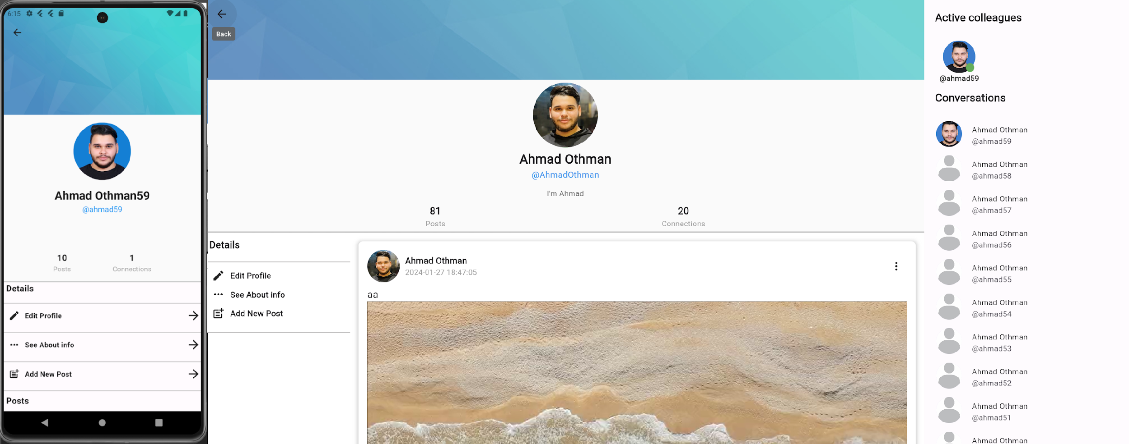
User Profile

Slide 21
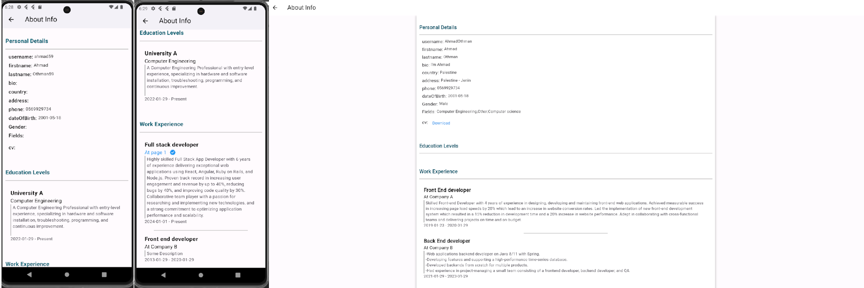
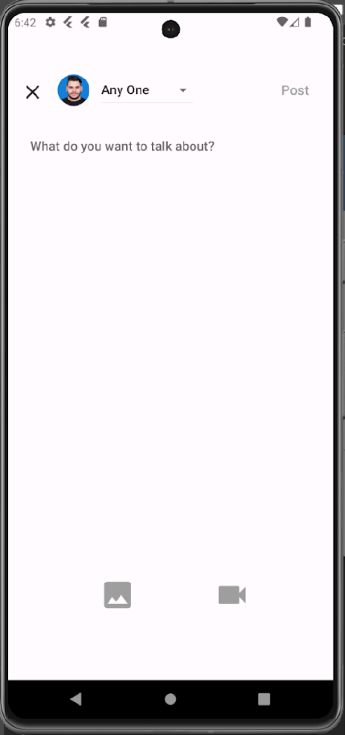
User Profile

Slide 22
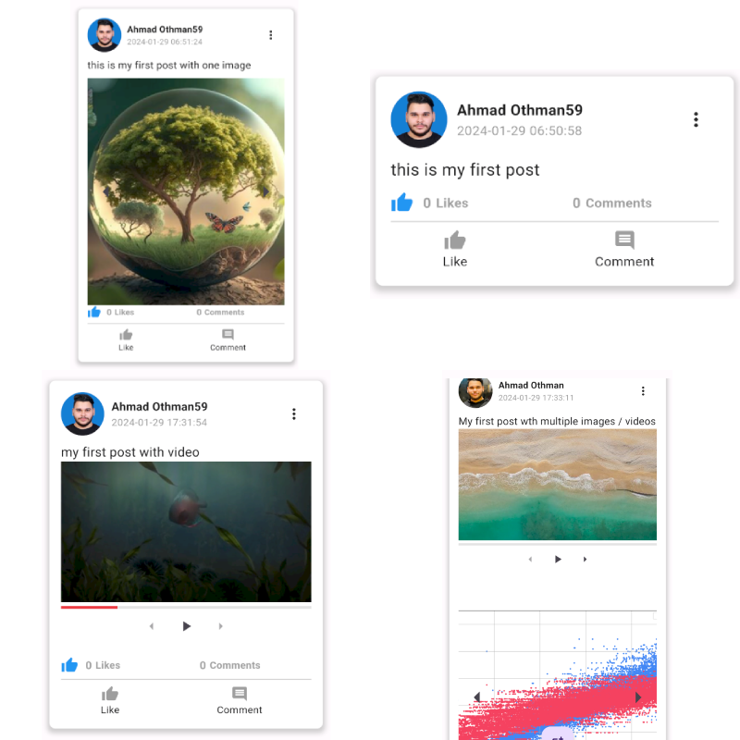
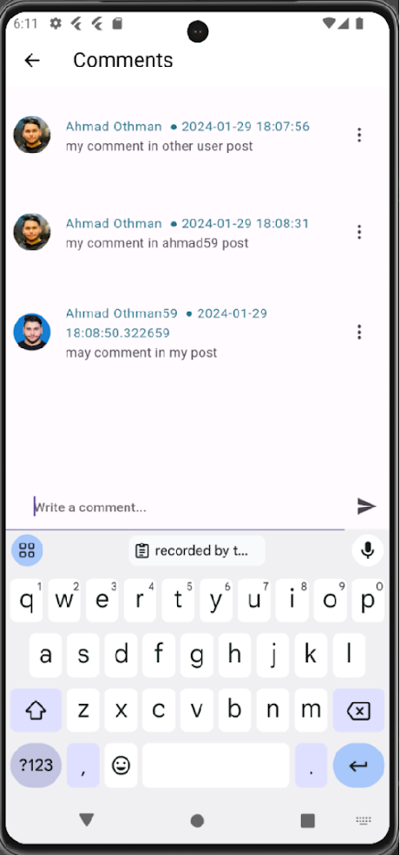
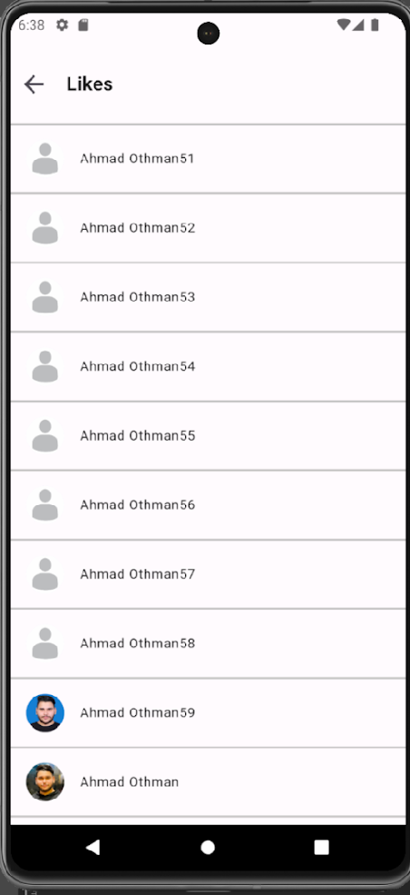
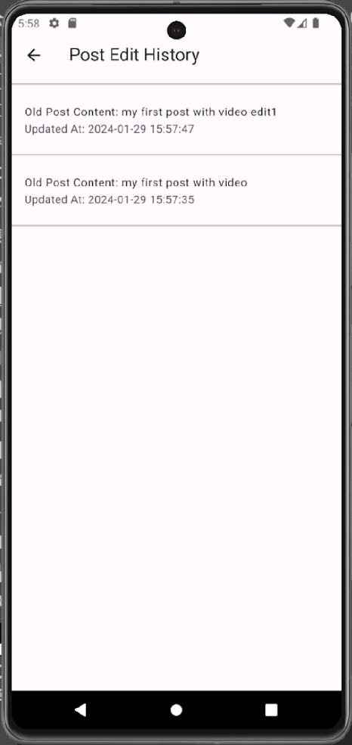
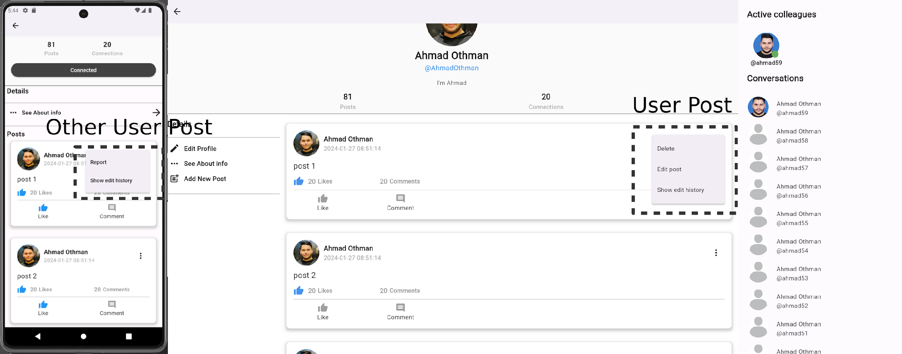
Posts

Slide 23
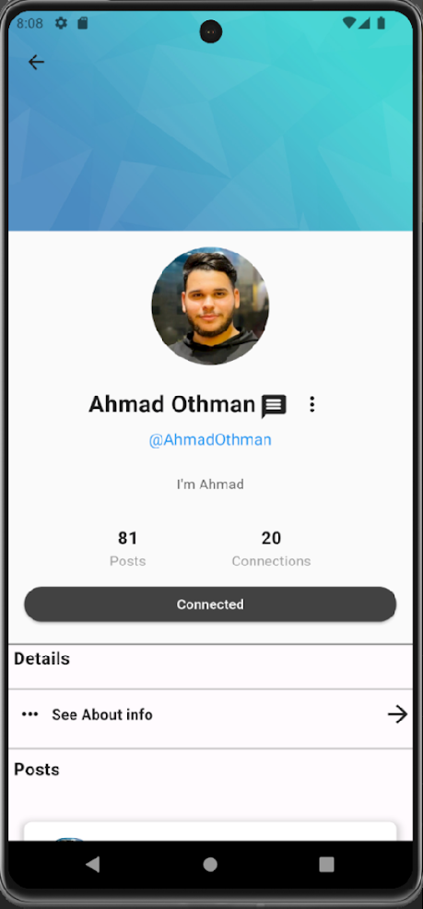
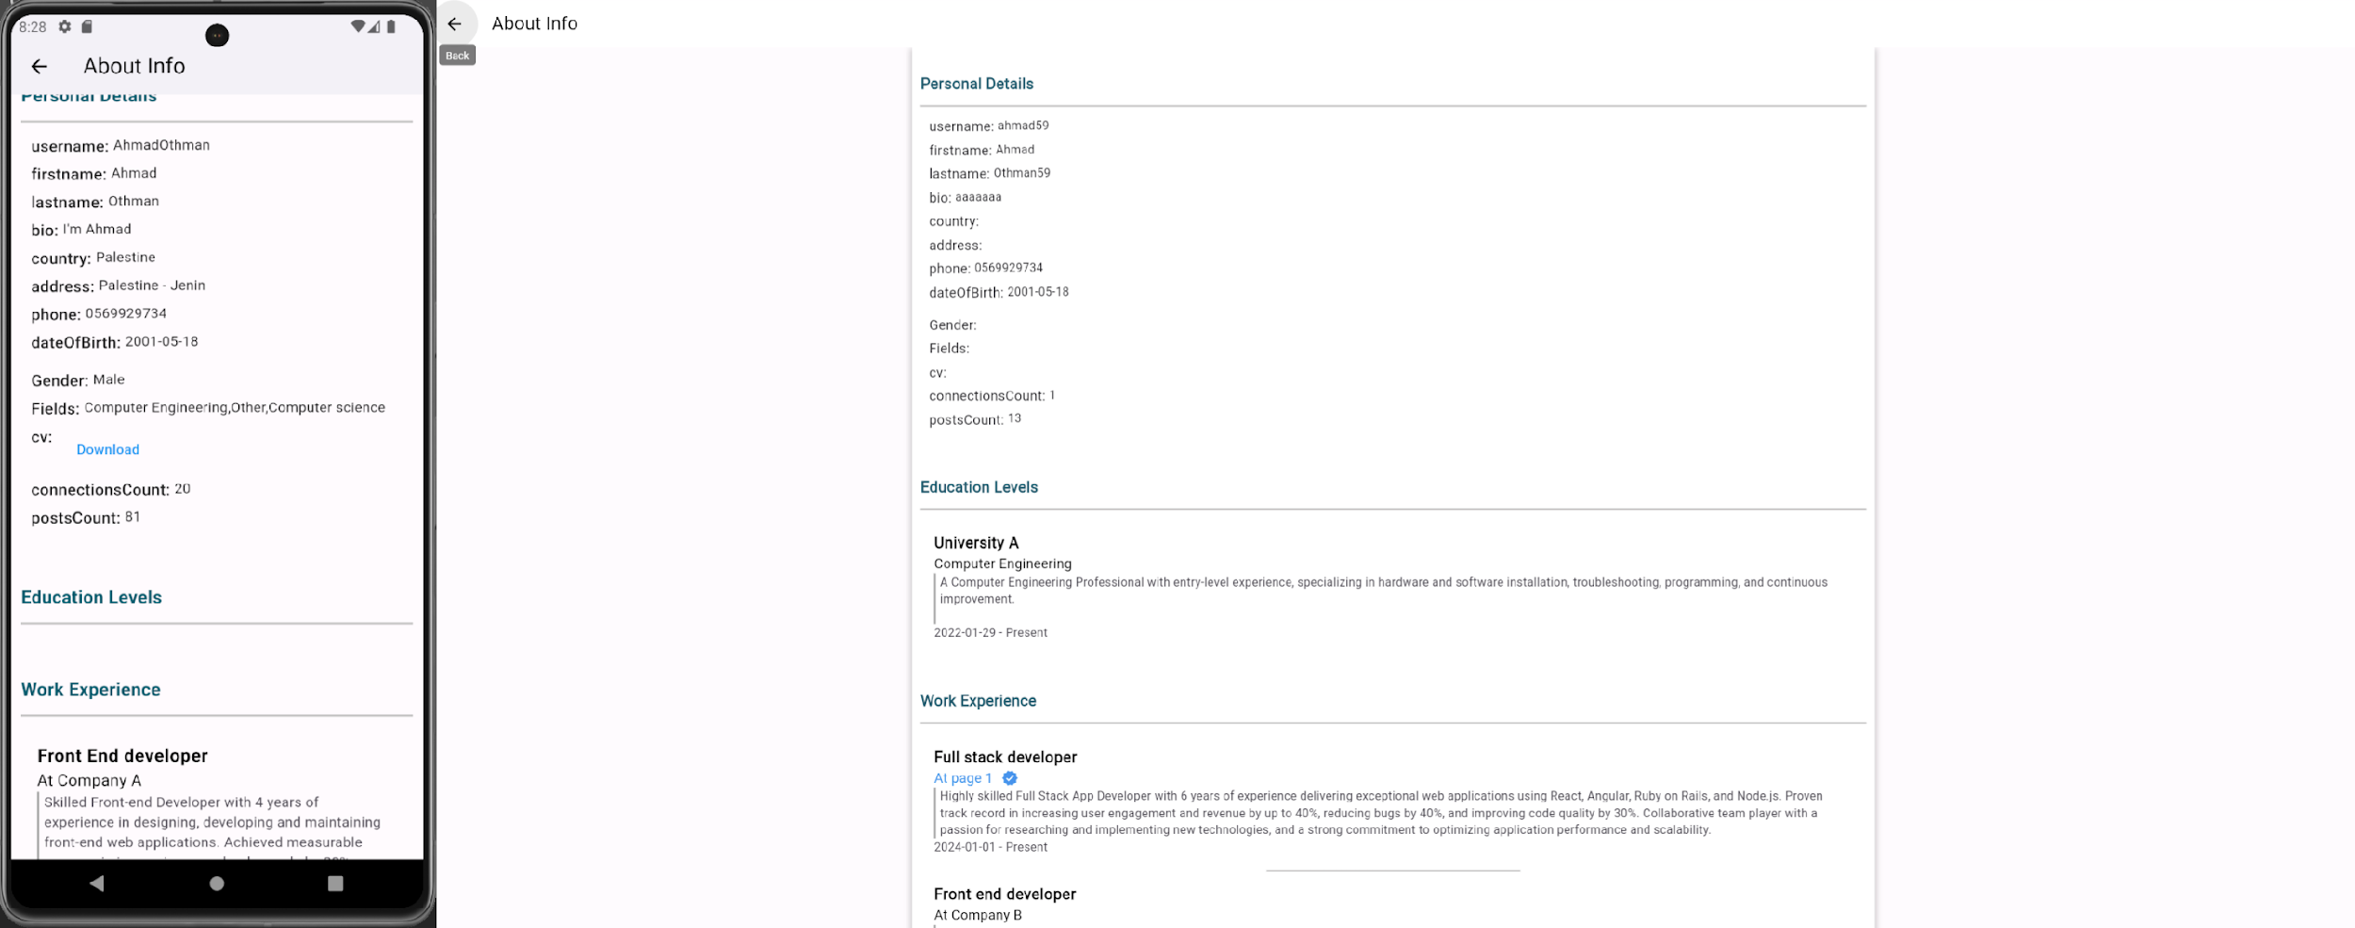
Other Users Profile

Slide 24
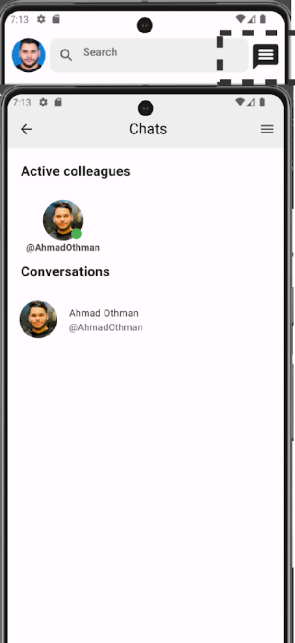
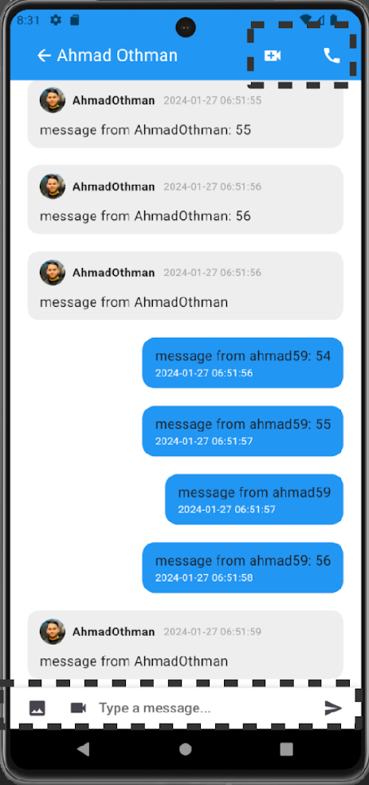
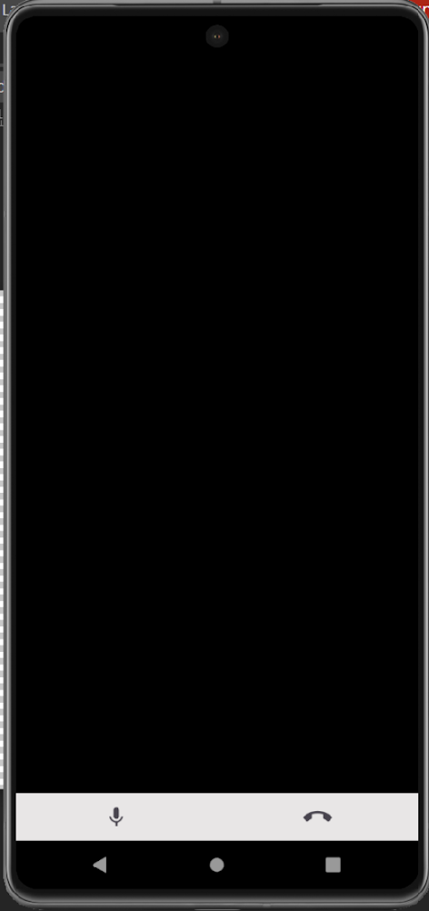
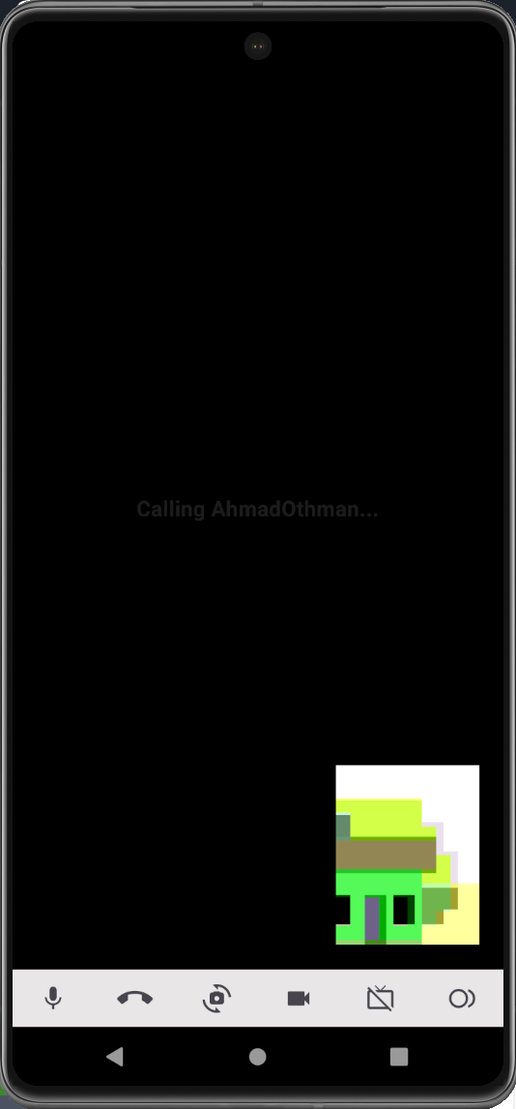
Chats

Slide 25
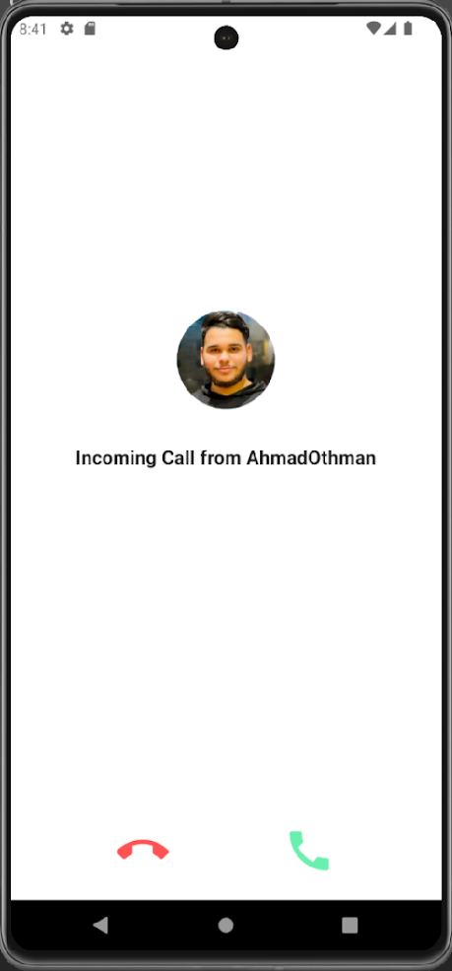
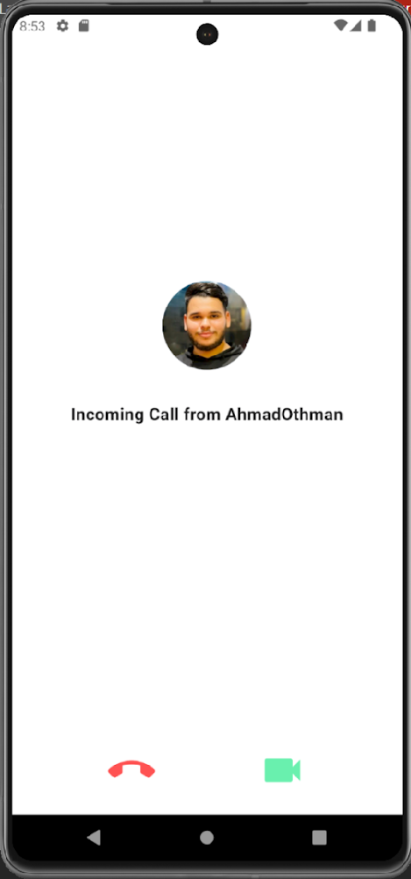


Chats

Slide 26

Calling Process

Slide 27




User Pages
Public
Private

Slide 28


Admin Types
Admin View
Publisher View
Publisher View

Slide 29




Page Features

Slide 30





Page Jobs

Slide 31




Page Groups

Slide 32



Group Tasks / Calendar

Slide 33




Group meeting

Slide 34





Meeting process
1
4
2
5
3

Slide 35

Divide groups
A proposal to divide groups for a university

Slide 36

Divide groups
A proposal to divide groups for a company

Slide 37







Networks

Slide 38



Jobs

Slide 39

Search

Slide 40

Search

Slide 41

Notification process
The user receives notifications when:
Gets a new like/comment on his post.
Receives a connection request.
User approves his connection request.
A user/page sends him a message.
User is calling him (with a ringing sound playing for 25 seconds).
Page he follows publishes a job such that at least one of the job's fields matches one of the user's fields.

Slide 42

User Notification

Slide 43




Admin panel

Slide 44
Future Work
1. Add more privacy settings.
2. Add more search and filtration on screens.
3. Increase security.
4. Expand the features to include a larger number of features of other sites .
5. Development on video meeting to be reliable every time a user enters the meeting.
6. Record the meeting by recording the stream on the server itself and not on the user’s device.

Slide 45
Thanks!
Do you have any questions?

