Slide 1

An-Najah National University
Faculty of Engineering & Information Technology
Civil Engineering Department
Graduation Project
Updating of the Existing Regional Master Plan for Water Supply in
Tubas
By:
Sohib Rushdi Jayyuosi
Hamdan Essa Dababat
Anas Haj-Mahmoud
Supervisor:
Dr. Anan Jayyuosi

Slide 2




Analyze water supply system belonging to Tubas joint water service and sanitation council and redesign WDS to meet the requirements for the next 20 years (2022-2042)
An updated and improved GIS database and a GIS map for the sections of the water supply system instead of the AutoCAD used in the Council currently
Maps including the locations of each well, the locations of the conveying lines and the locations of the reservoirs.
Develop the existing water sources to bridge the future water gap.
Develop a master plan for the next 20 years with a description of the different proposed interventions. In addition, the project will prioritize the different interventions and develop a cost estimate for the different plan components.

Slide 3
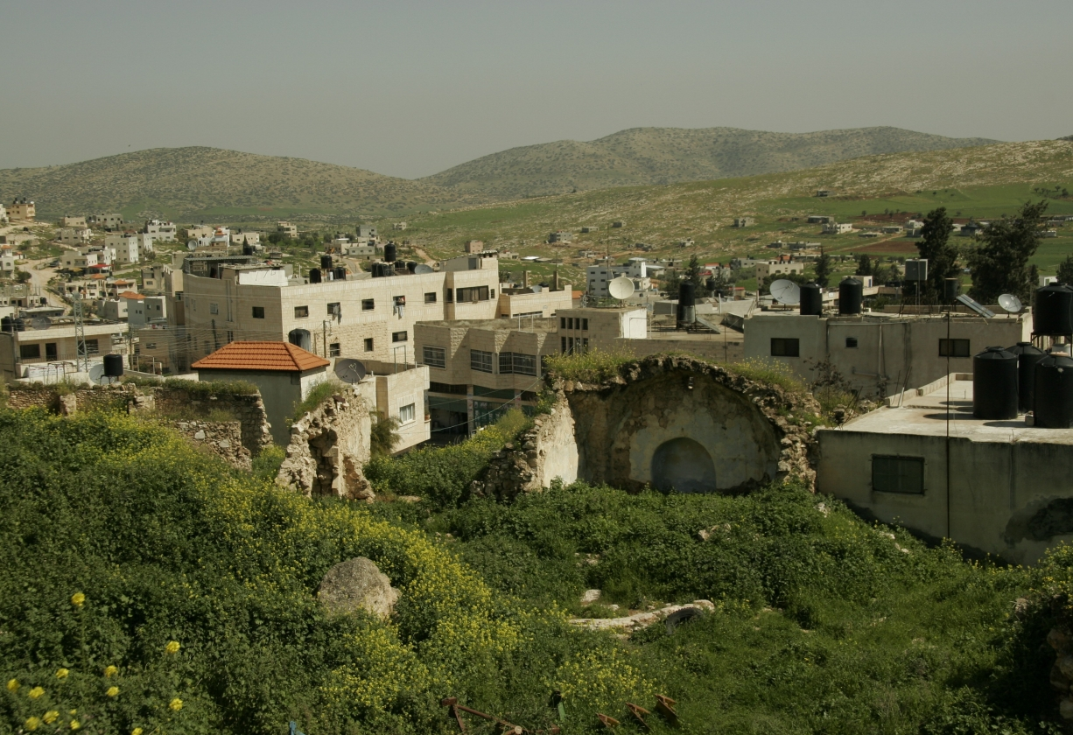




STUDY AREA
Tubas is a Palestinian governorate located in the northeast of West Bank, has a population of 66000 and has an area of 402 Km^{2.}
Tubas communities varies in its elevations, in general Tubas governorate has an altitudes within the range of (-325 - 600) meters.
Tubas joint water and sanitation services council serves seven clusters which are: Tubas, Tayaseer, Aqaba, Ras al Far’a, Khirbet ‘Atuf , Al-Aqaba, and Tammun with a total area of 107 Km² and a total population of 55000.
Tubas is characterized by a mild climate, hot dry summer and cold rainy winter, the average annual rainfall in Tubas is 415 mm.

Slide 4
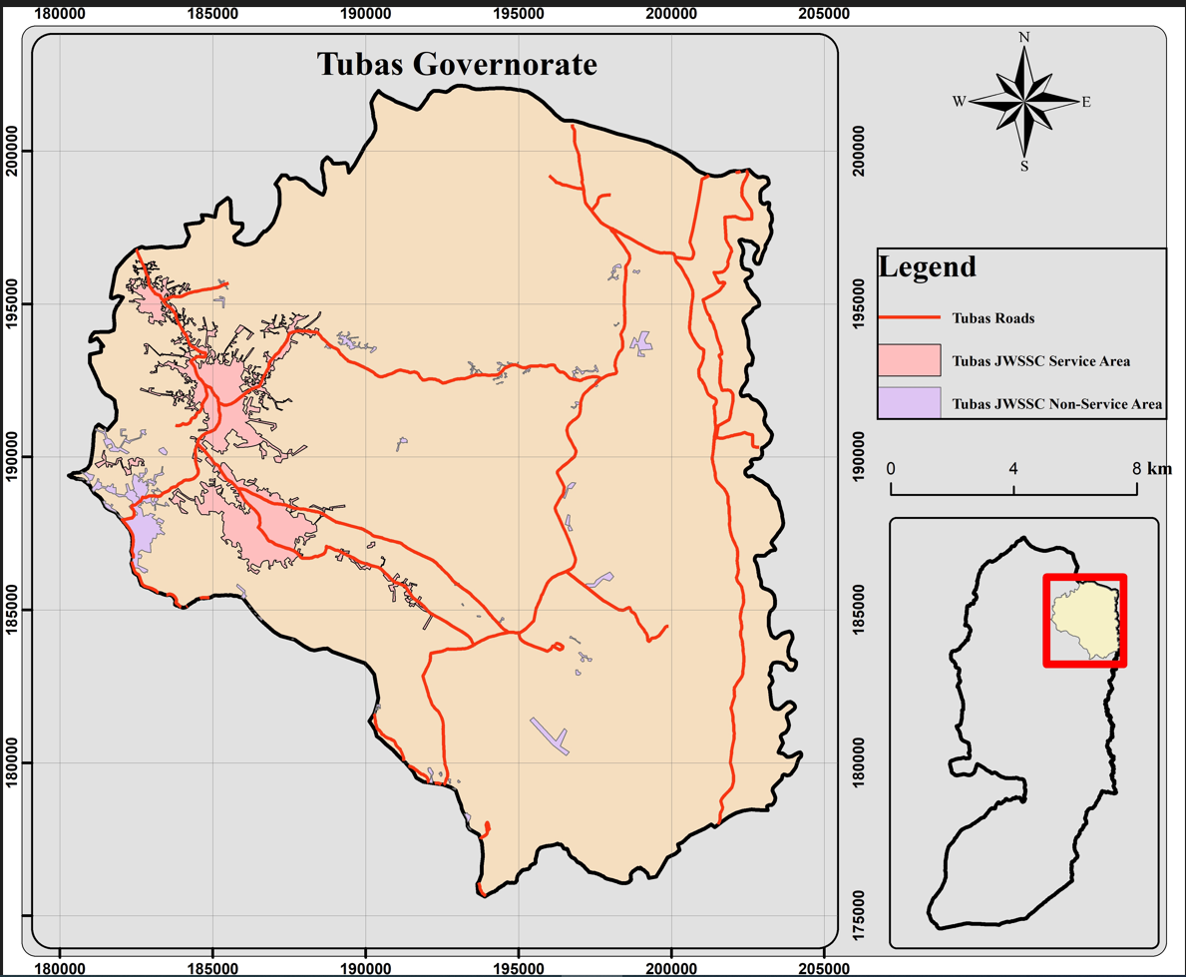
STUDY AREA

Slide 5
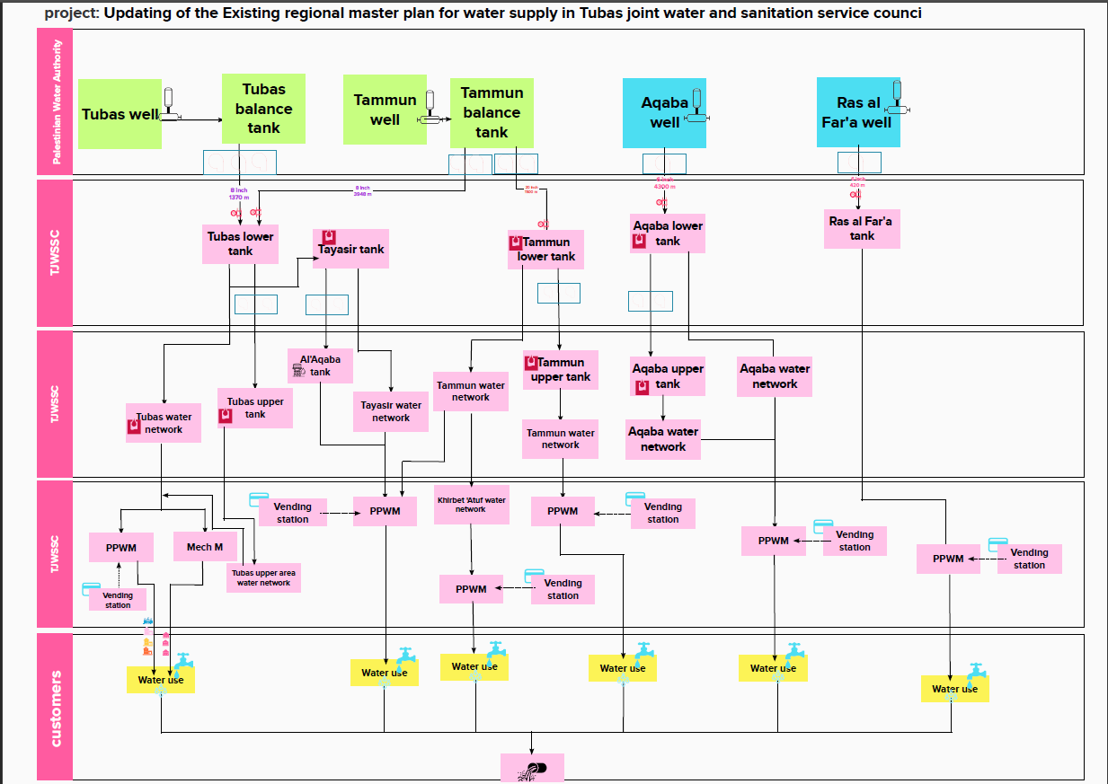
Water distribution system

Slide 6
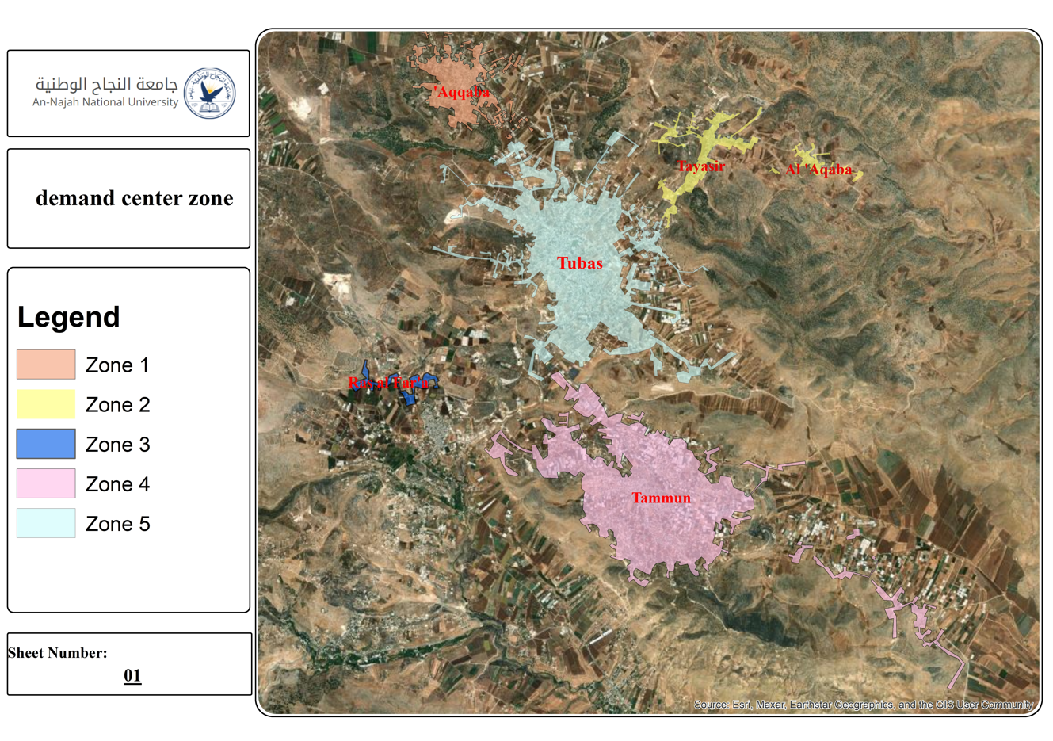
Demand control centers

Slide 7
Future population forecasting
Zone | 2020 | 2027 | 2032 | 2042
Tubas zone | 22690 | 26420 | 29460 | 36620
Aqaba zone | 8720 | 10150 | 11320 | 14070
Ras Al Fara'a zone | 1330 | 1540 | 1720 | 2140
Tayaseer and AL-Aqaba zone | 3230 | 3750 | 4190 | 5200
Tammun and Khirbet Atouf zone | 14130 | 16440 | 18330 | 22770
Future Population Forecasting
constant growth rate with annual compounding:
P_{f} = P_{n}(1+i)^{n}
P_{f} : Future population
P_{n}: Current population
i: population growth rate
n: number of years

Slide 8
Future Consumption estimation
Zone | 2020 | 2027 | 2032 | 2042
Tubas zone | 70 | 88 | 100 | 120
Aqaba zone | 80 | 95 | 105 | 120
Ras Al Fara'a zone | 76 | 90 | 110 | 120
Taysir and AL-Aqaba zone | 75 | 85 | 110 | 120
Tammun and Khirbet Atouf zone | 76 | 90 | 110 | 120
A visit to TJWSSC was conducted to gather recorded data about water consumption for the year of 2020, the consumption range for a capital per day is within (70-80) liter, however, in the design plan it’s assumed that the consumption will be improved gradually up to 120-liter per capita per day at 2042 year which is the recommended Palestinian specification.

Slide 9
FUTURE DEMAND
Zone | 2020 | 2027 | 2032 | 2042
Tubas zone | 802100 | 1116600 | 1344100 | 1887000
Aqaba zone | 363700 | 451200 | 535600 | 725000
Ras Al Fara'a zone | 61300 | 72300 | 90400 | 110300
Taysir and AL-Aqaba zone | 117900 | 145400 | 202700 | 268000
Tammun and Khirbet Atouf | 529600 | 692000 | 897100 | 1206700
Demand for each zone was computed by multiplying the estimated population for each design year by the recommended specification for individual water share which is 120-liter per capita per day, it is assumed that supply is equal to demand in the base year (2020).

Slide 10
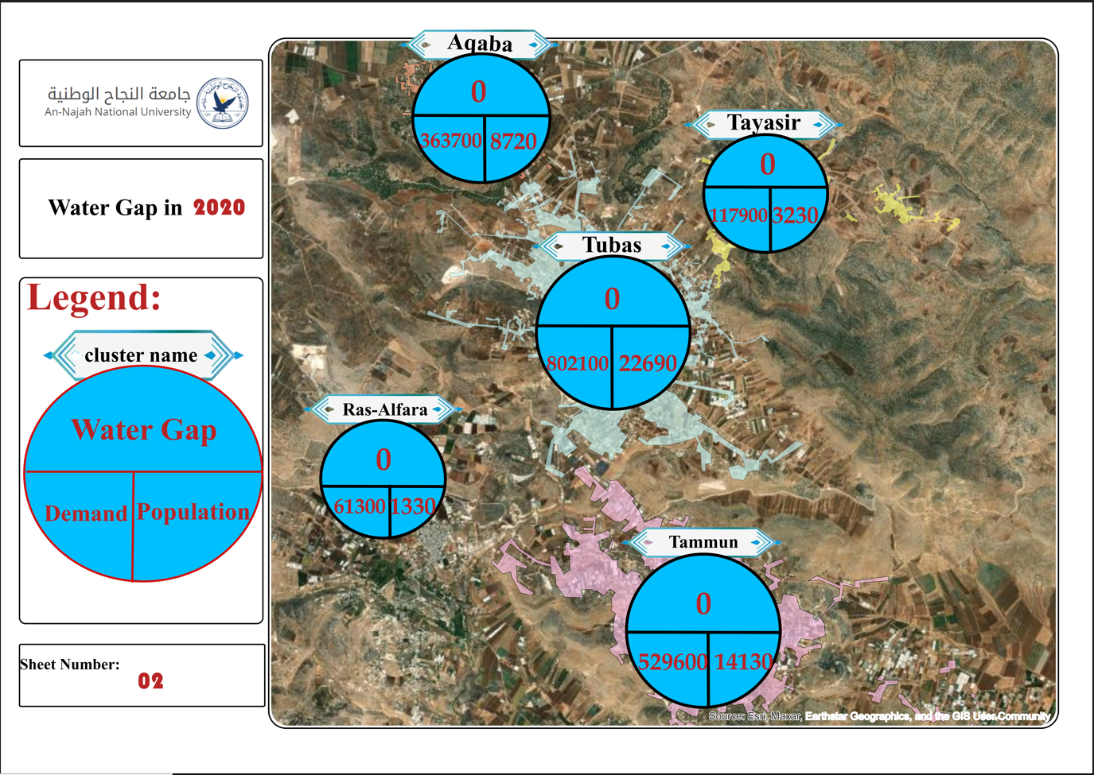
Supply-demand gap

Slide 11
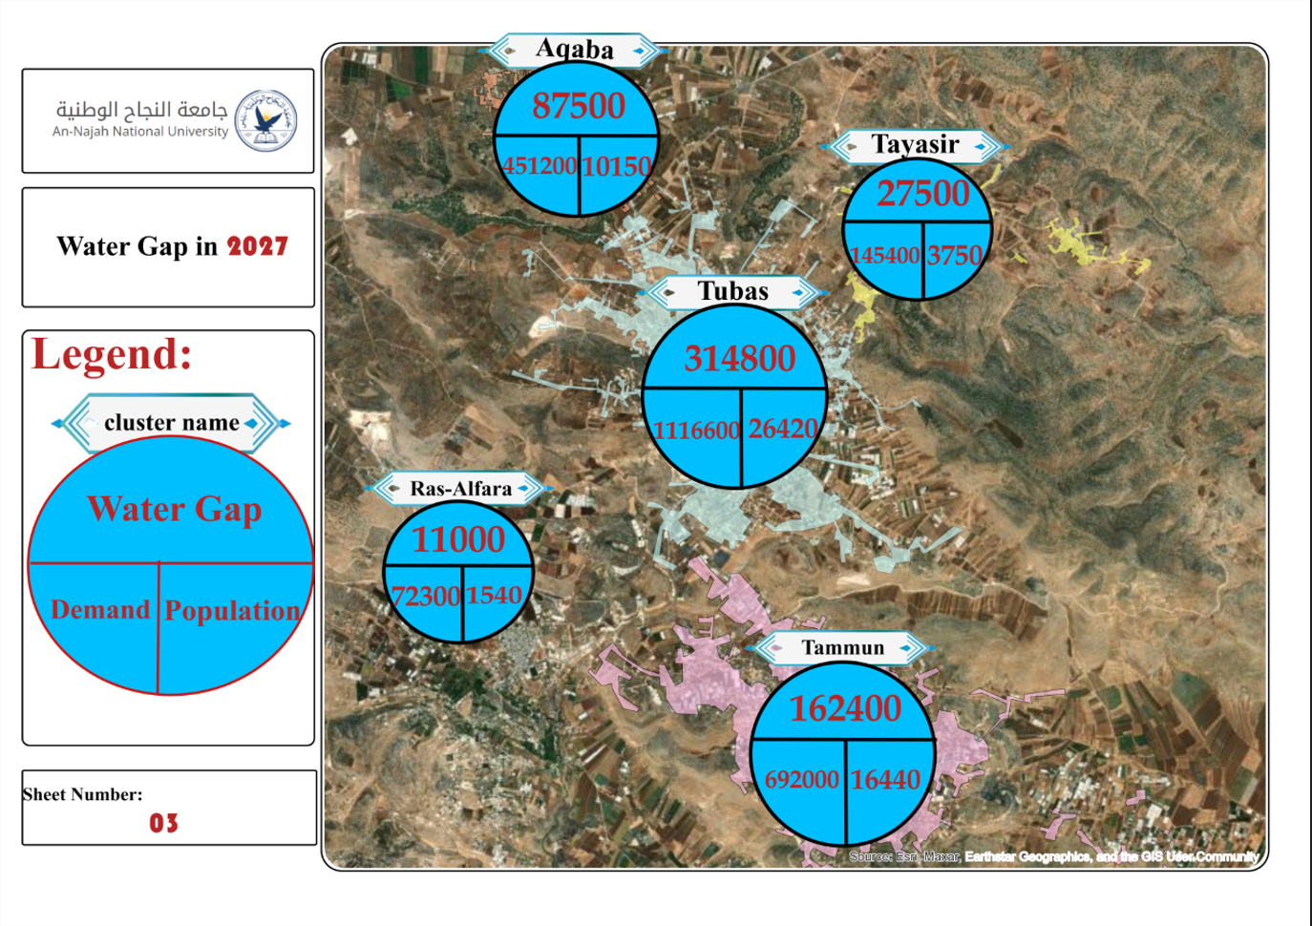
Supply-demand gap

Slide 12

Supply-demand gap

Slide 13

Supply-demand gap

Slide 14
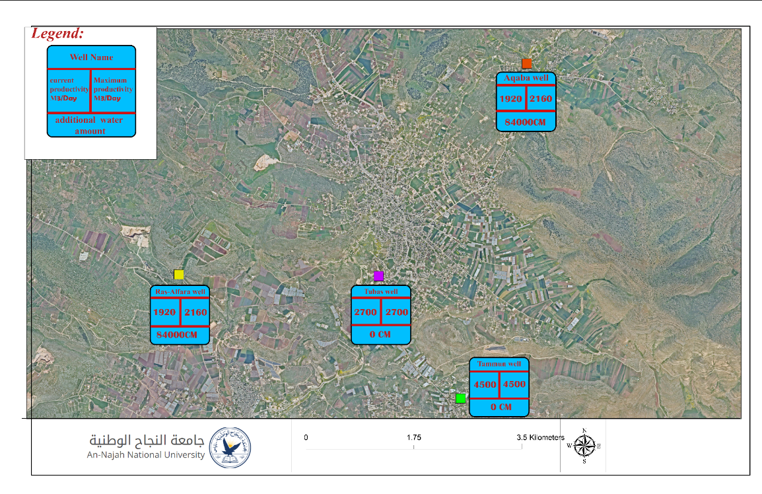
Operating Existing Operated Wells to Its Fullest productivity

Slide 15
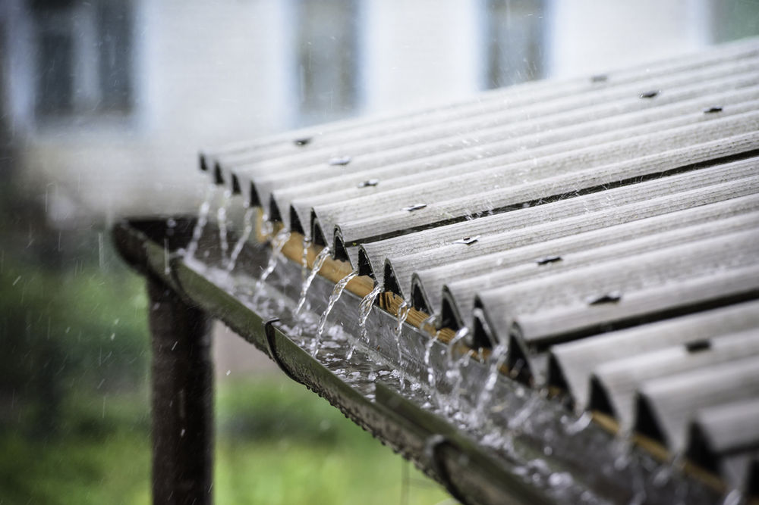
Rainwater harvesting
Zone | HW 2027 | HW 2032 | HW 2042
Aqqaba | 8911 | 7291 | 17136
Tayaseer | 3240 | 2742 | 6294
Tubas | 23242 | 18943 | 44616
Ras Al-Fara | 1309 | 1122 | 2617
Tammun | 14394 | 11777 | 27667
Water harvesting from roofs involves collecting and storing rainwater that falls on rooftops for later use. This is typically done by installing gutters and pipes on the roof, which channel the rainwater into storage tanks. The collected water can then be used for various purposes, such as irrigation, and washing clothes
R: Collecting factor = 0.7
Area: Average plan area = 143 m².
Average rainfall: 415 mm
Amount of harvested rainwater =
R * Average Area * Average rainfall

Slide 16
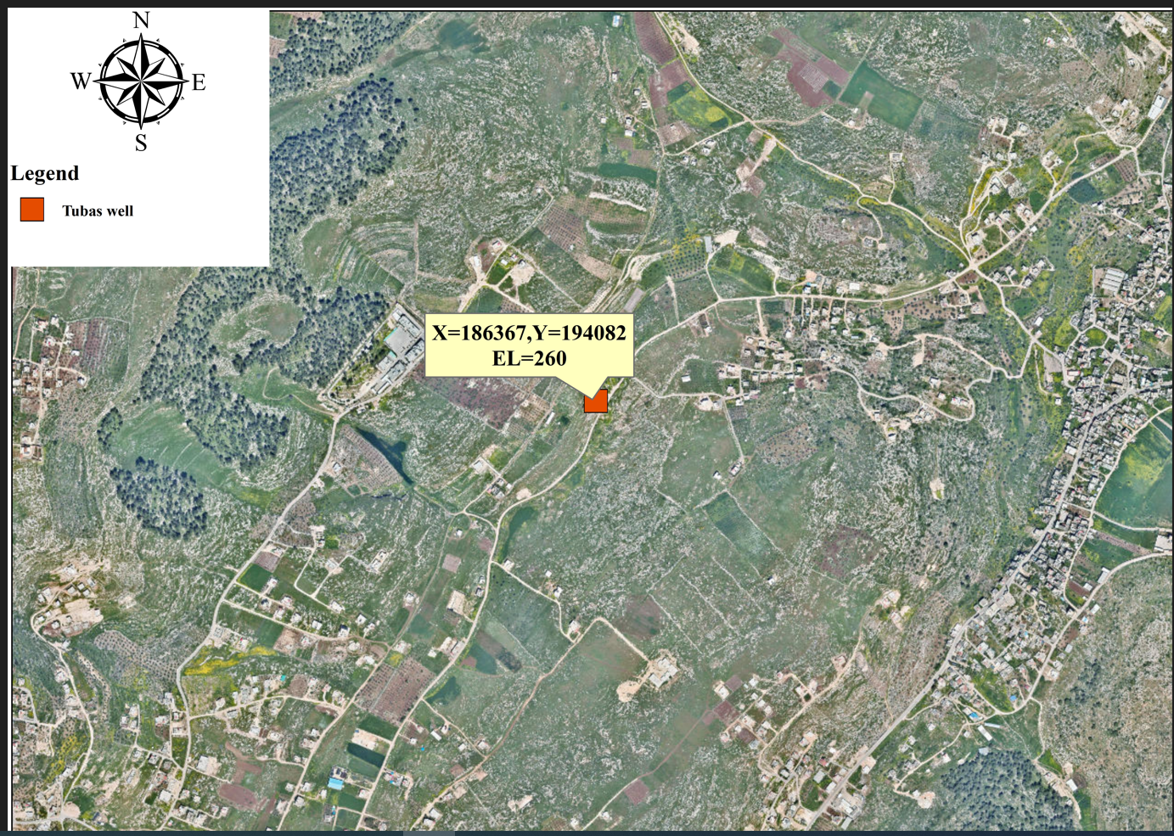
Agricultural well

Slide 17
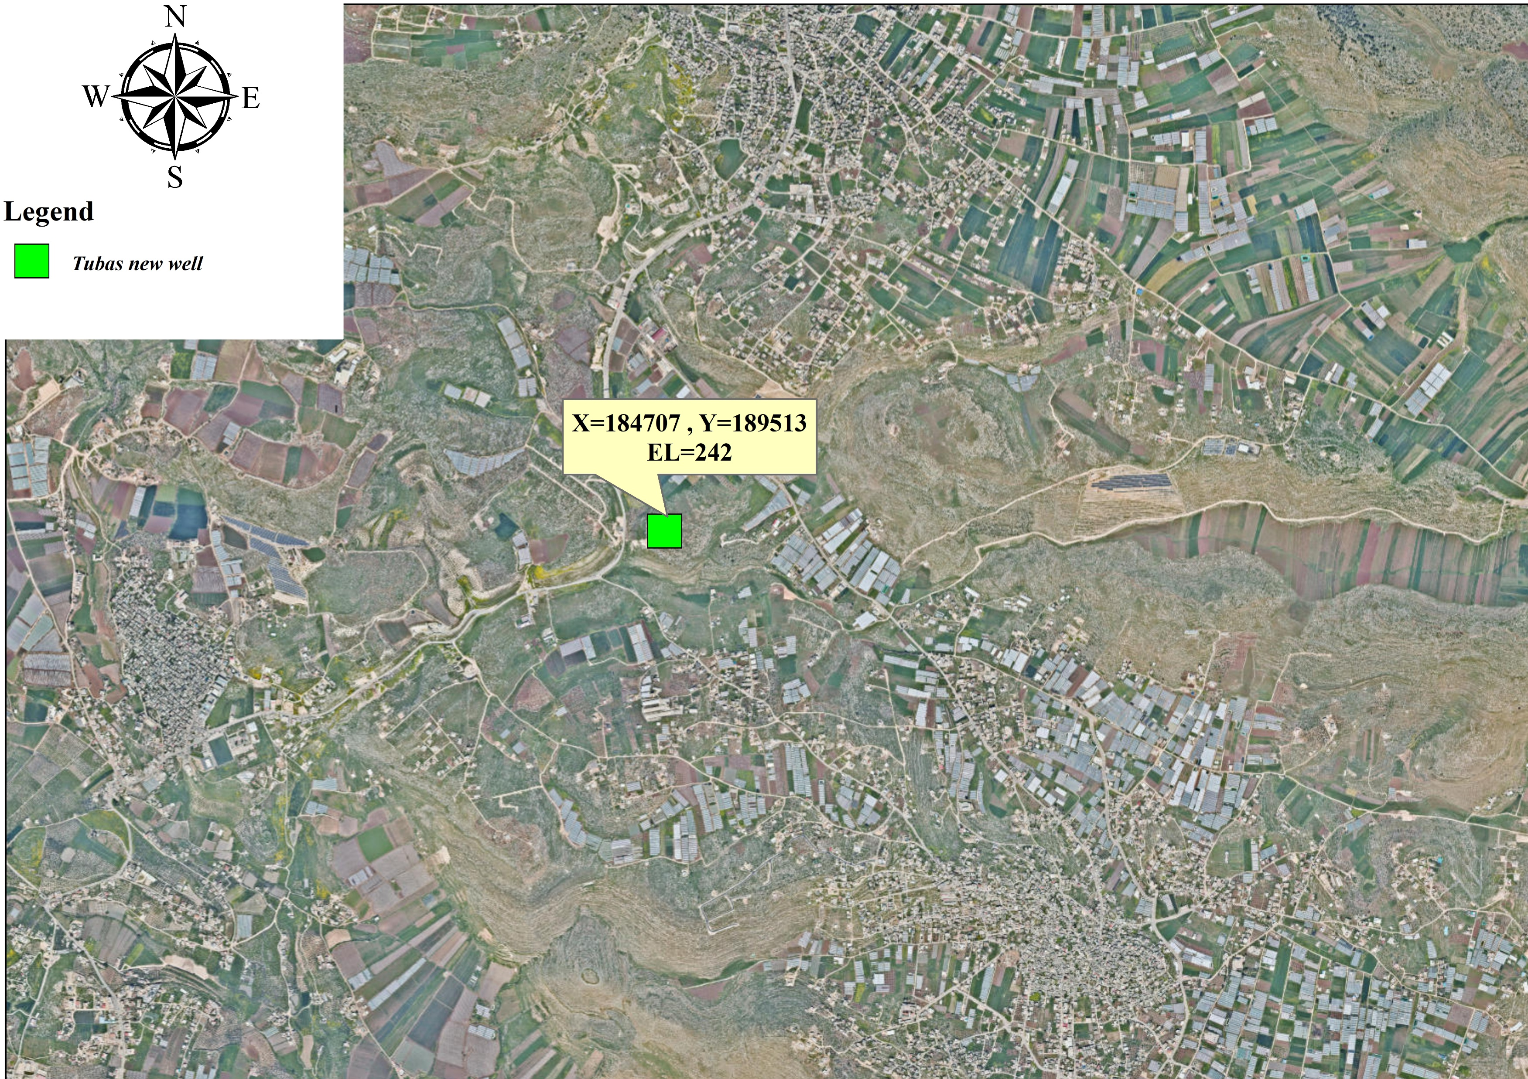
Tubas new well

Slide 18
Remaining gap after proposing solutions
Cluster Name | Gap in 2027 CM | Gap in 2032 CM | Gap in 2042 CM
Ras Al-Fara | 0 | 0 | 0
Aqqaba | 0 | 80,609 | 268,389
Tubas | 0 | 0 | 0
Tayaseer and Aqaba | 0 | 0 | 0
Tammon and Atuf | 0 | 0 | 0
Unfortunately, gap in Aqaba cluster seems to be unsolved depending on the available resources. Numbers say that in 2032 in Aqqaba, citizens will be provided with water as 100 liters per capita per day, in spite of this amount doesn’t comply with Palestinian standards but still accepted according to WHO standards. The real challenge comes with 2042 when the delivered amount is as 70 liters per capita per day.

Slide 19

Cost and design Assumptions
The cost estimates for the proposed components of the water system facilities consist of two main elements:
Construction costs
Operation and Maintenance (O&M) costs
Pumps should be designed with an efficiency greater than 70% during the design period, and pumps should be selected so that they operate near peak efficiency during average pumping.
All costs calculated on the basis of previous projects
Cost of land acquisition is not included.
Costs of administration and engineering of the works (project administration, project design and construction management) are included at 15% of the total construction cost.
All taxes and customs are not included.
It is assumed that the local contractors will carry out the construction works.
Costs are in dollars at the following exchange rate:
In the design, the flow equations were used, and it was assumed that the water velocity in the conveyance lines is (1 - 2) m/s.
head loss was considered to be 1% of the length of the conveyor line

Slide 20
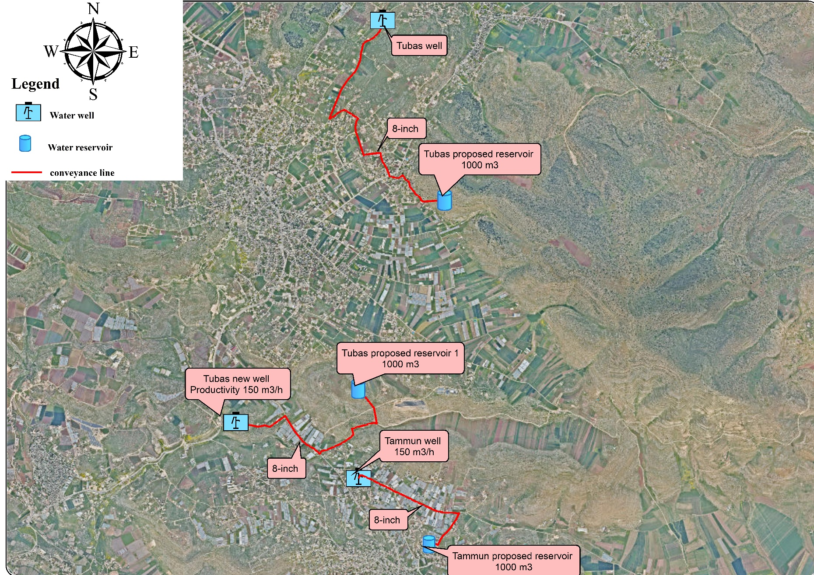
Designed components

Slide 21
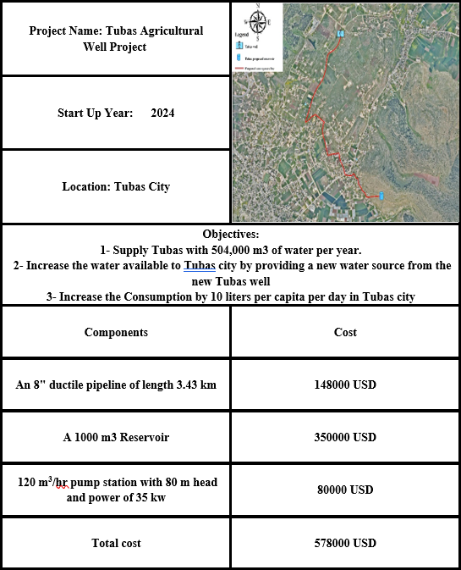
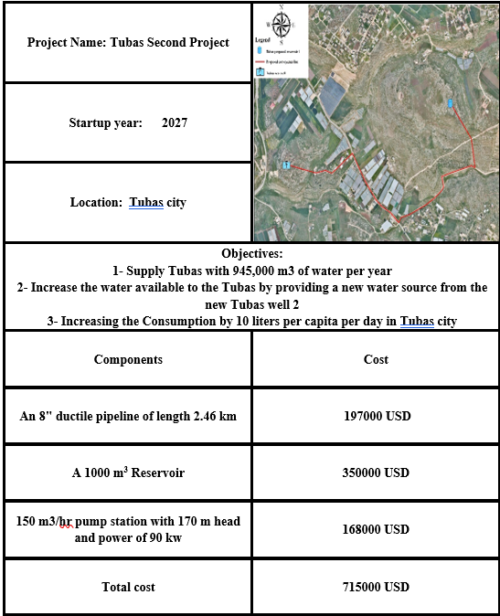
Work packages

