Slide 1
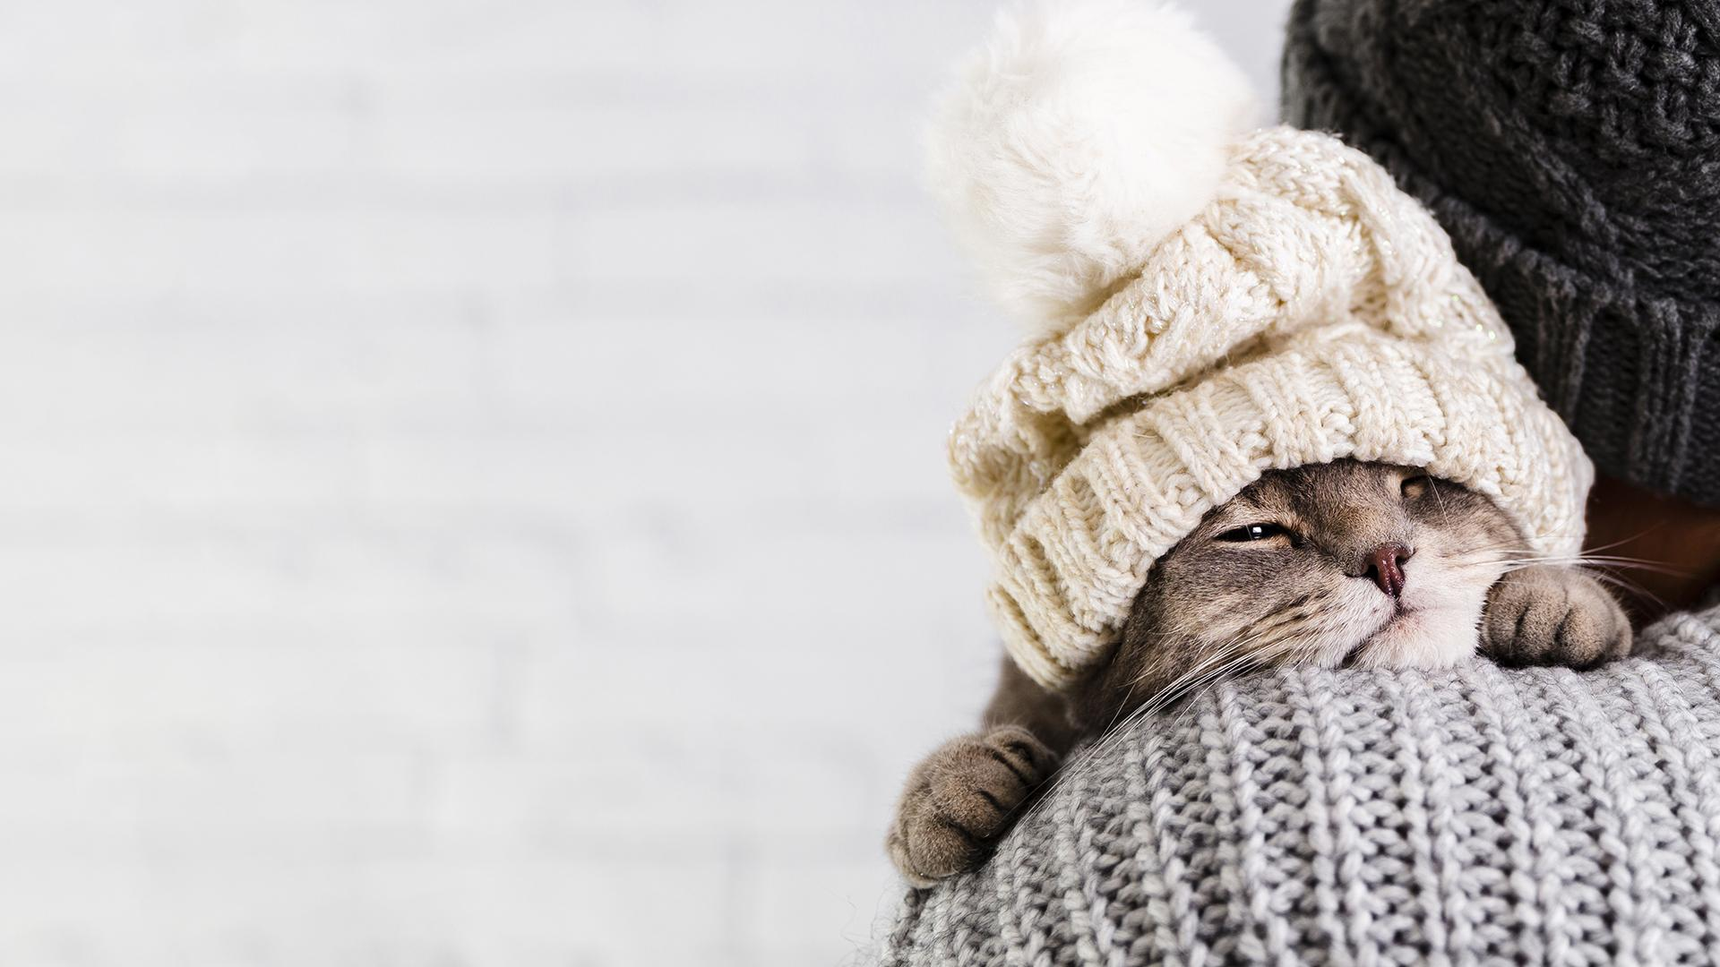
Pet
Mate

Slide 2
Table of Contents
Motivation
The problem we fixed
Customer
The technologies used
Main features
Demo

Slide 3
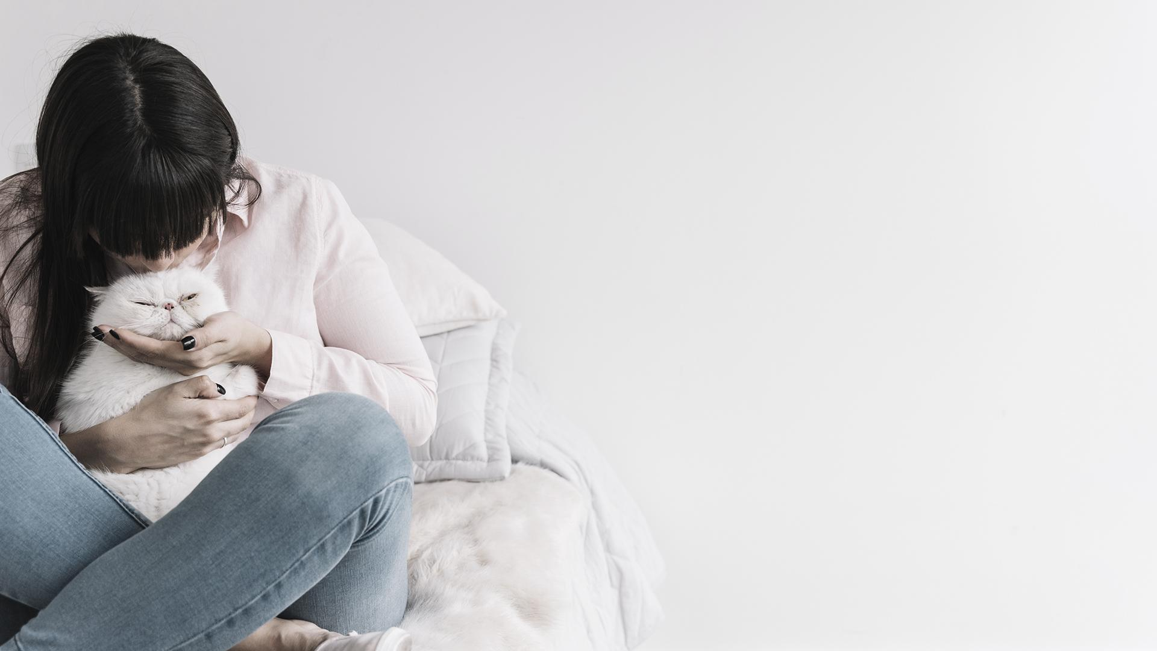
Are you interested in pets?

Slide 4
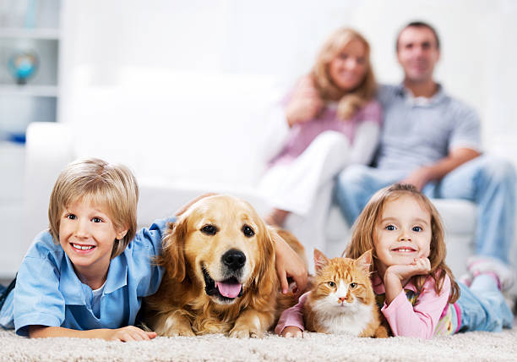
Do you like pets?
Is it your dream to own a pet?
Would You like to have pets?
Or,
you are a pet owner
!

Slide 5
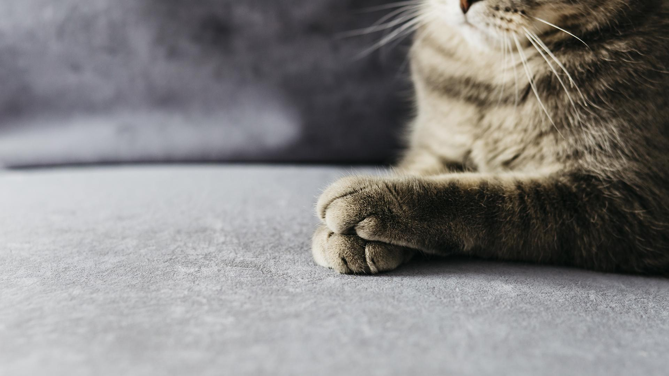
Our motivation for choosing this idea?

Slide 6

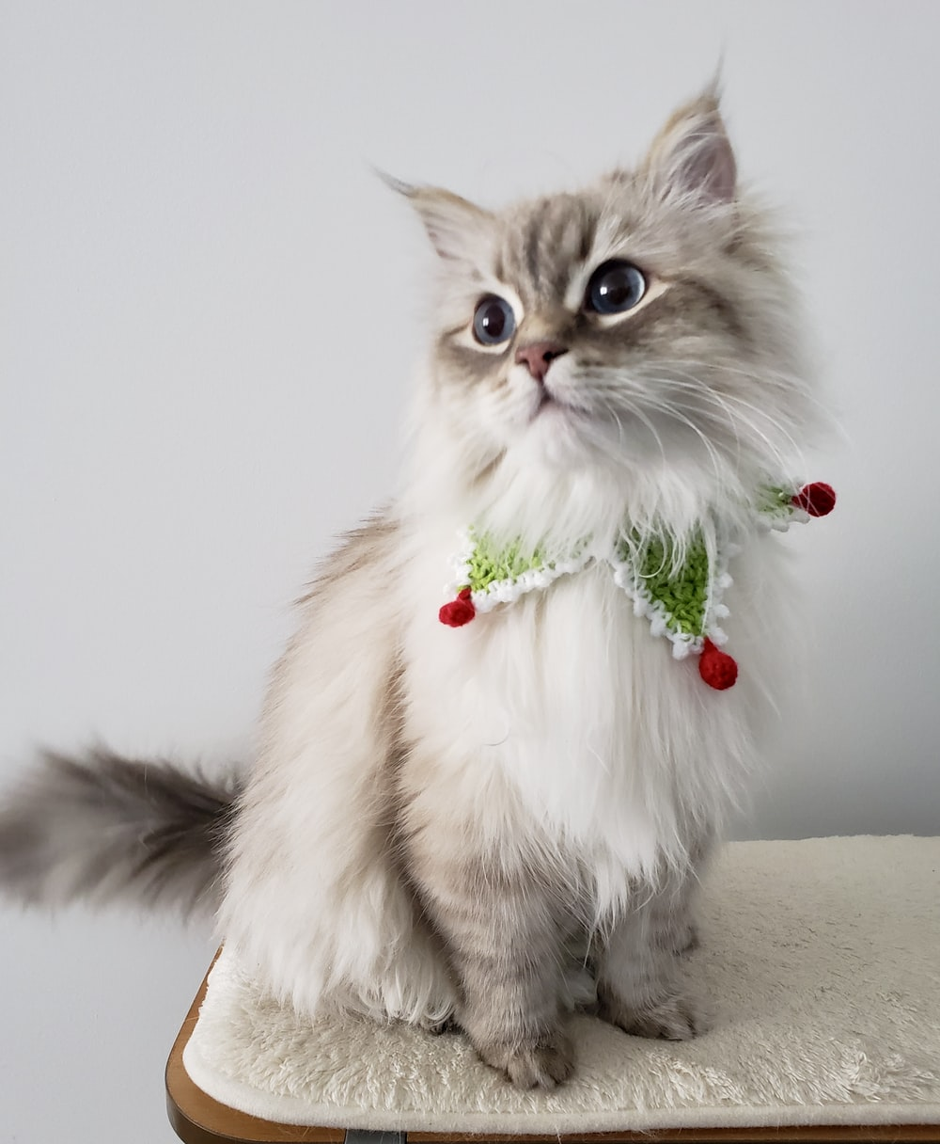
Our motivation for choosing this idea?
The love of animals !
Dr. Emad's cat !

Slide 7
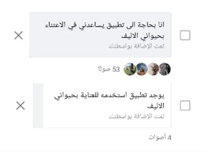
Our motivation for choosing this idea?
Currently, there is no approved application that highlights pets and cares about their affairs.
So we are the first mover.

Slide 8
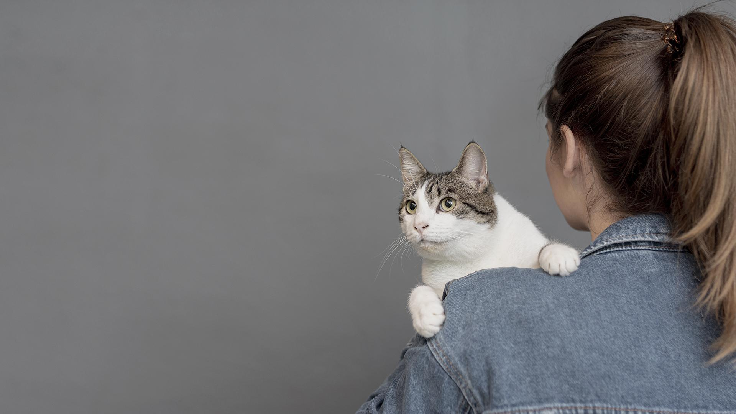
The problem we fixed

Slide 9
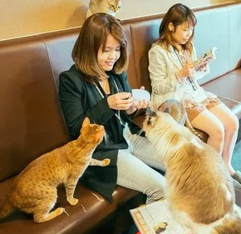
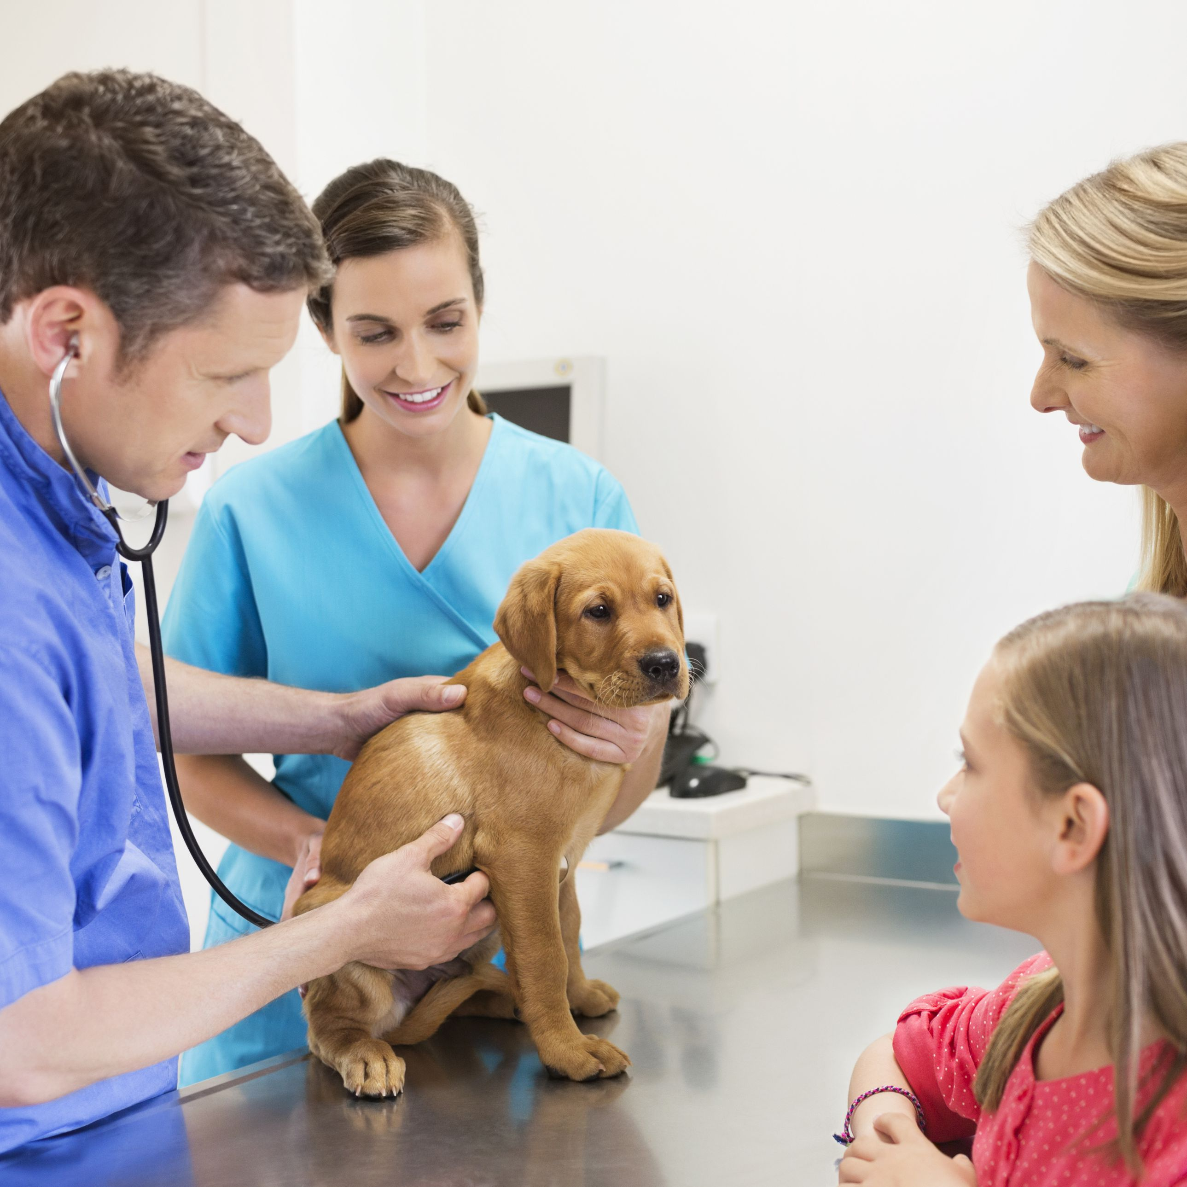
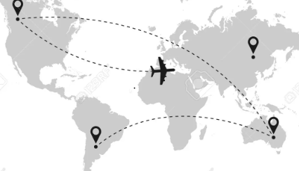
01
03
02
Bring pet owners together in a common area to facilitate communication between each others
It is a perfect solution for pet owners who move to a new place and need to find all the requirements of their pets
Ensures easy communication between vet and pet owners by Offering an online services reservation system

Slide 10
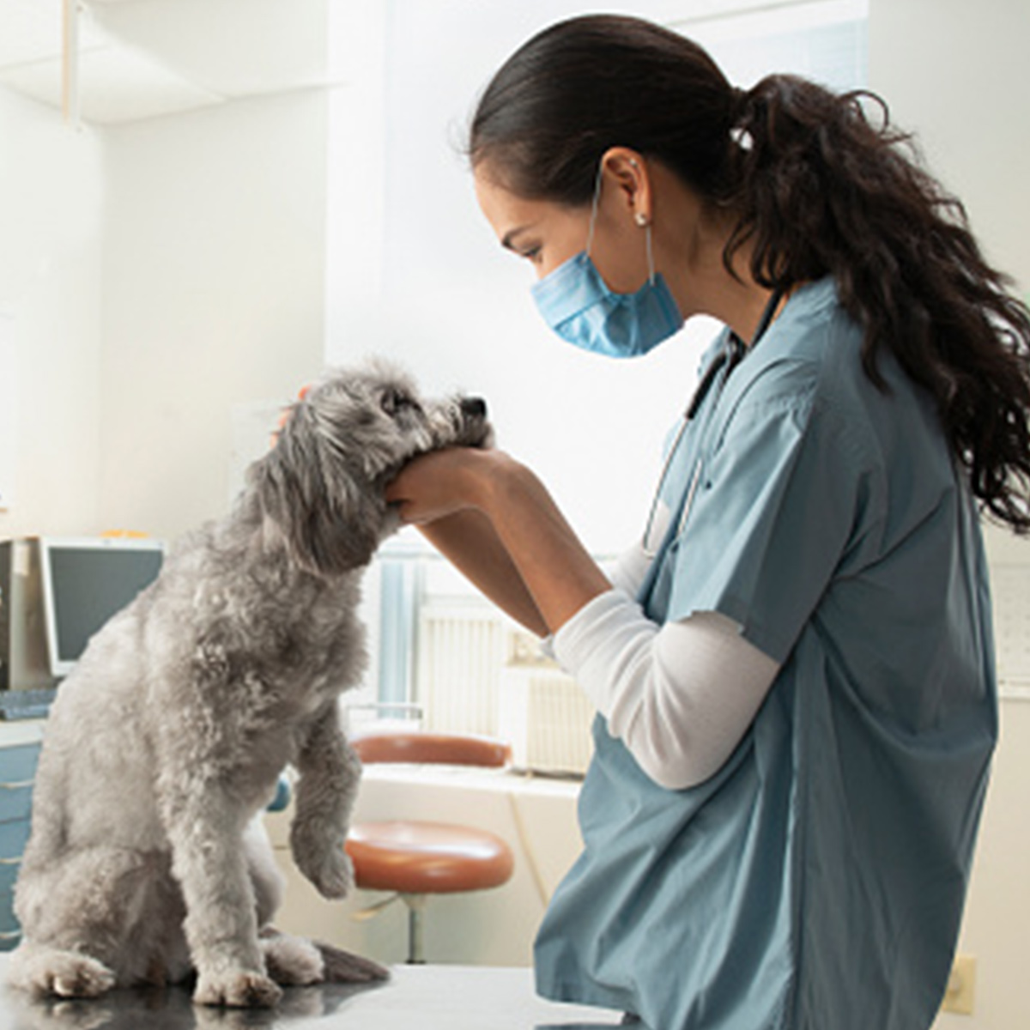
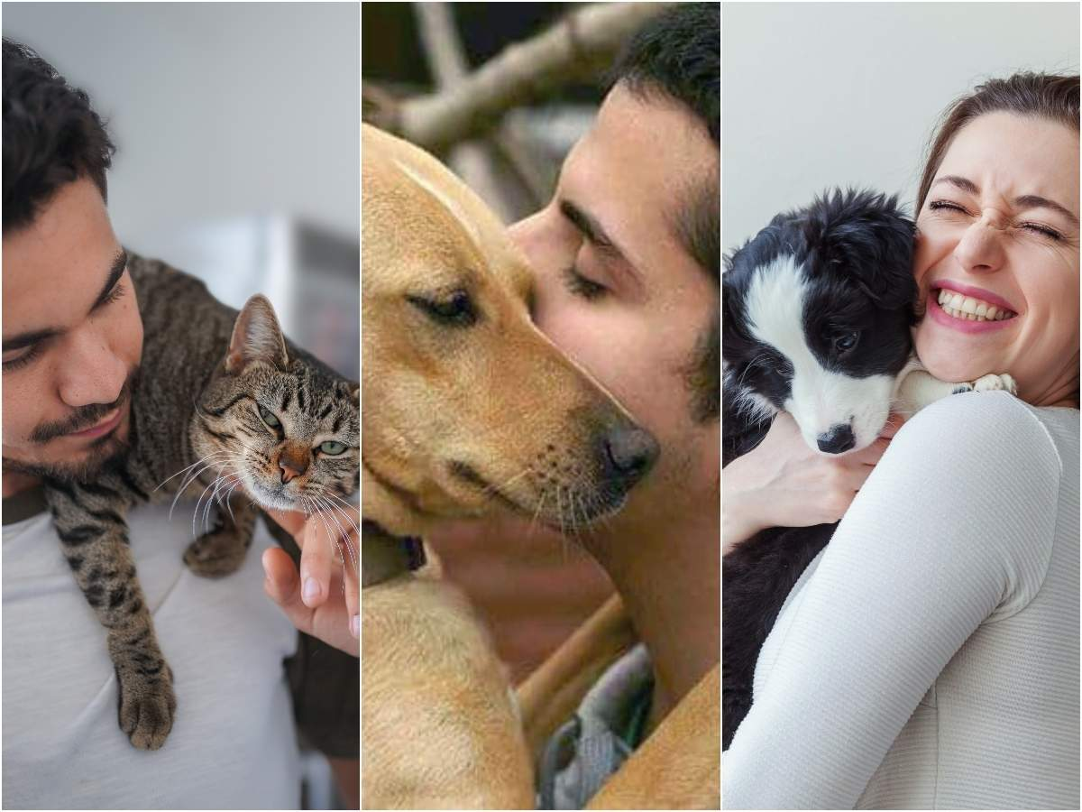
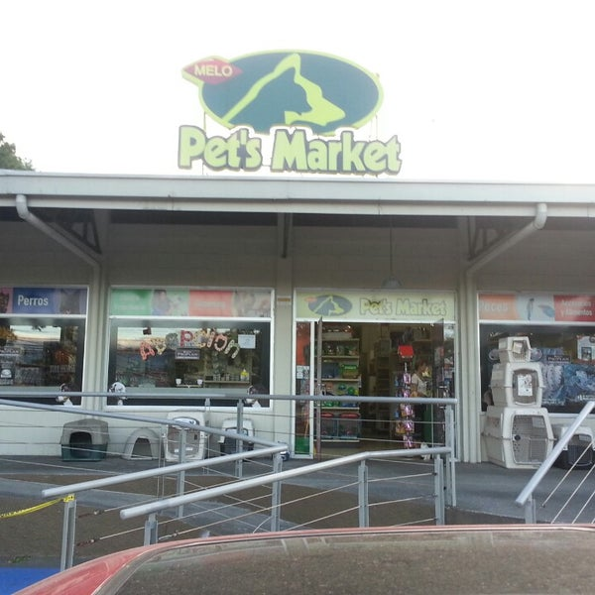
Our Customers
Vet
Pet owners
Shops

Slide 11





The technologies used

Slide 12
For web Application:
For Front-end:
HTML, CSS language,
and bootstrap
For Backend:
PHP

Slide 13
For Mobile Application:
For Front-end:
Dart language
Flutter framework
For Backend:
NodeJS,
Express framework
For DataBase:
MongoDB

Slide 14
For Recommendation System we use Flask framework written in Python.
We use REST API to implement the connection of request and response between :
1- front-end and backend
2- Backend and database

Slide 15
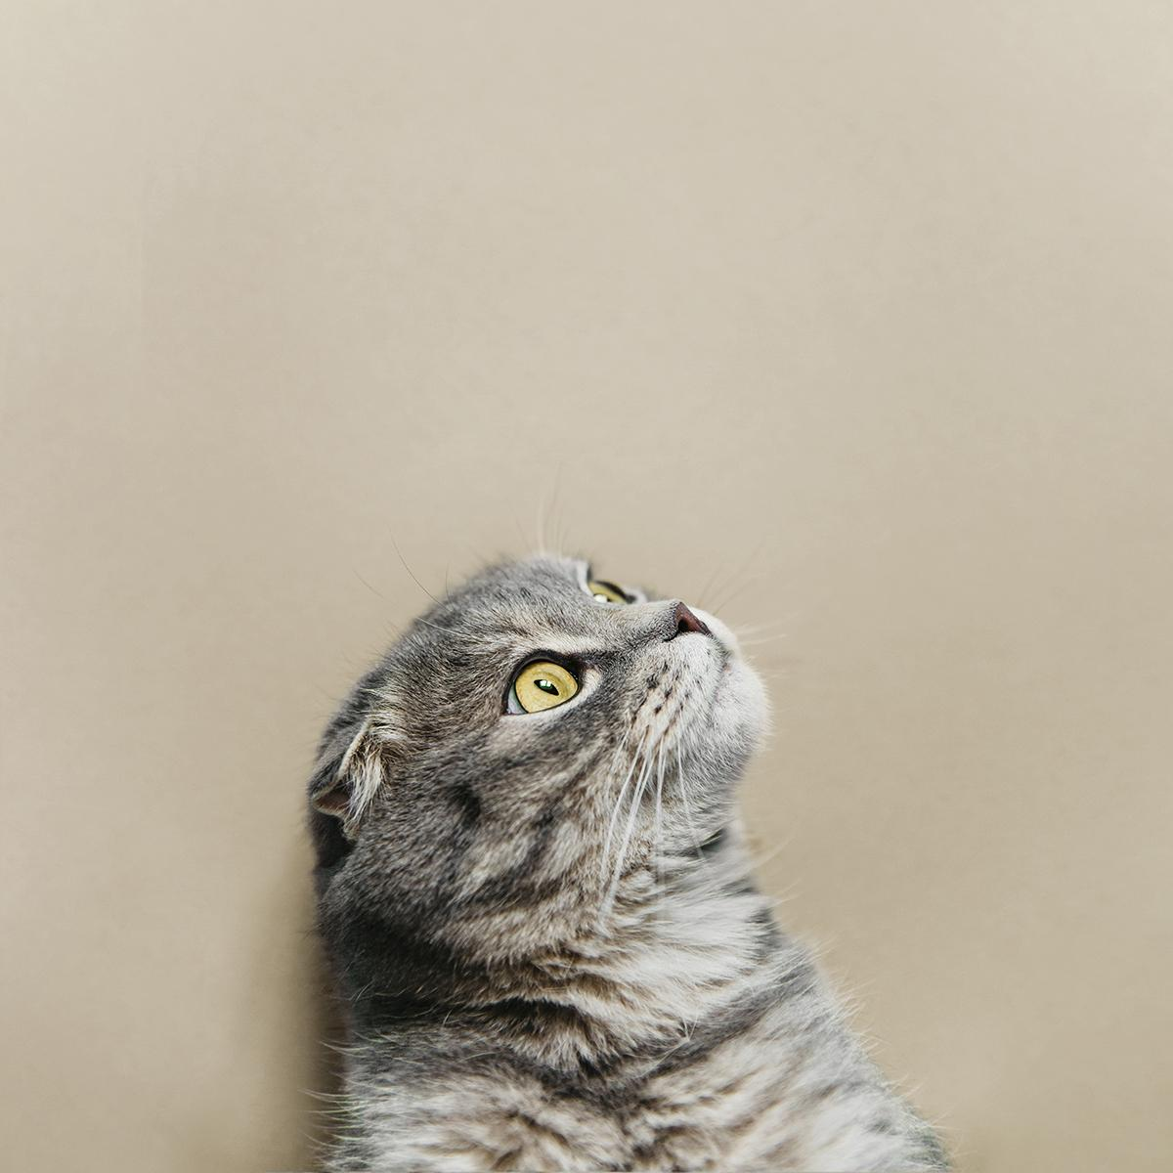
Main Features:

Slide 16
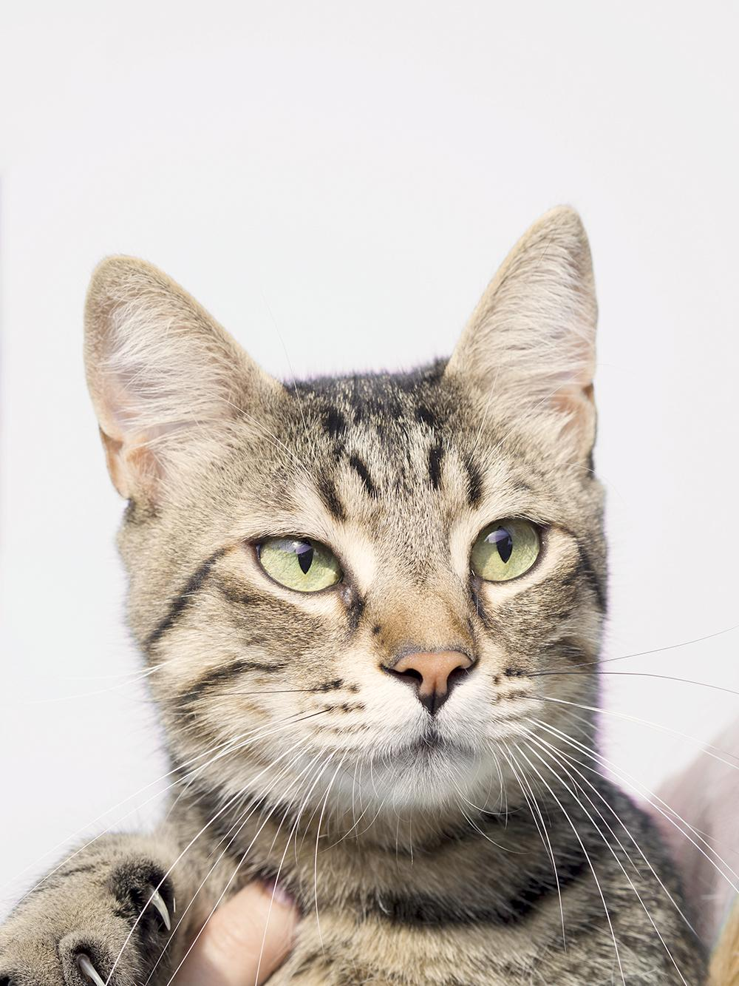
A service reservation system for veterinarians in which pet owners can book services, such as blood tests and surgeries or daily services such as hygiene, online.
Keep the pet's health file and take it to the new vet in case the pet's record is transferred to another vet.

Slide 17
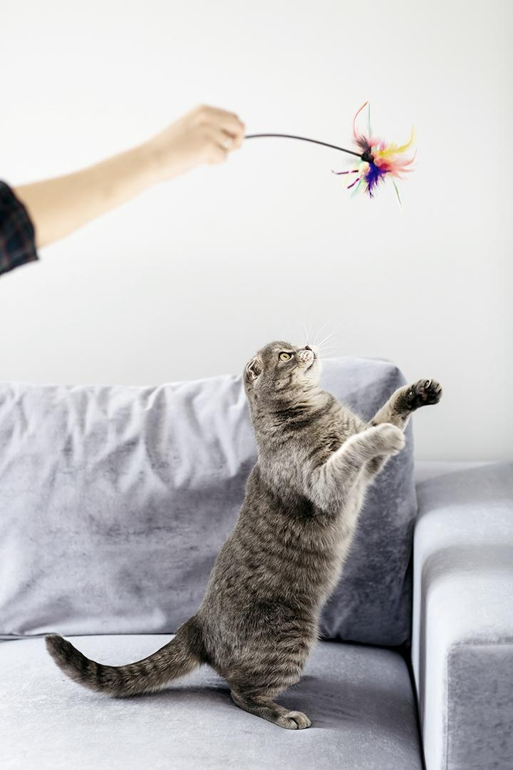
Develop a product recommendation system that suggests new products based on the animal owner's interests.
We did this by content based algorithm.
Use a map to show shops and vets near us so that we can obtain services faster.
pet owner pages side features. Like, add friends, follow vets and shops, posts, search, etc.

Slide 18
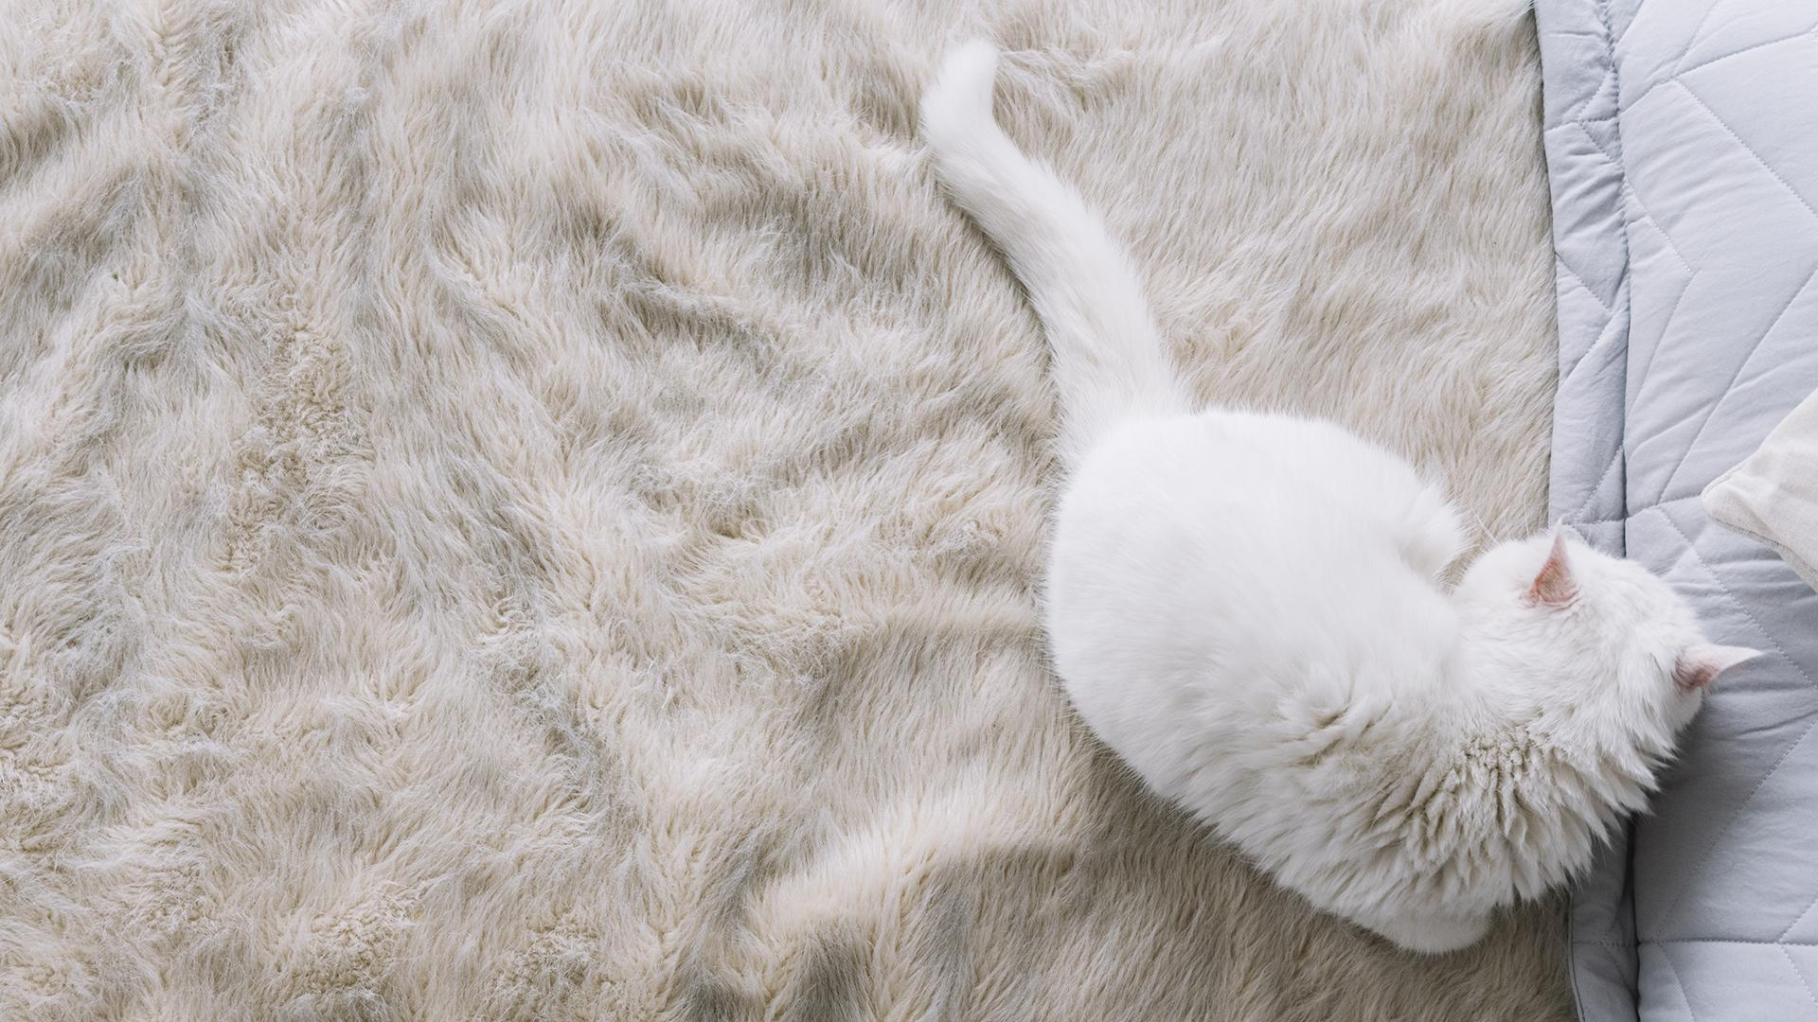
Thanks!

