Slide 1


An-Najah National University
Faculty of Engineering
Industrial Department
Cost Reduction Program for St.Luks Hospital

Slide 2
Prepared by:
Nour Mansuor
Samya Hasson
Feda Faqeh
Hana Shuqqo
Reema HajAli
Supervisor:
Eng. Suliman Al- Daifi

Slide 3
Cost Reduction Program

Slide 4
What we want to discuss
First
CR Definition
Advantages
Second
Gathering Data
Pareto Analysis & Finding areas
Third
Generating Ideas
C.R.P & C.R.R
Strategies
Fourth
Conclusion

Slide 5

Cost Reduction Definitions :
The efforts business managers and Industrial Engineers make to monitor, evaluate, and reduce expenditures.
Cost reduction may be defined as the achievement of Real and Permanent Reduction in the unit cost of goods manufactured or services rendered without impairing their suitability for the use intended or diminution in the quality of the product.
Cost reduction is actions taken in the present to decrease cost in the future.
The process of looking for finding and removing unwarranted expenses from a business to increase profits without having a negative impact on product quality.

Slide 6

Myths with Cost Reduction
If it will save a lot of money we should just does it no matter what.
Reducing cost will have a negative impact on quality
Only for-profit organizations will benefit.
Only large companies will benefit
CRP's cost a lot.
CRP's only work for manufacturing companies
Programs have to be complex

Slide 7
Causes motivate hospitals to reduce cost
There are three causes motivate hospitals to reduce cost:
Internal motivation
External motivation
competitors

Slide 8
Tactic or strategy ?!
following types of tactics can reduce costs:
Quality improvements
Smarter buying - lower purchase price, different materials, etc.
Waste reduction
Productivity improvement
Inventory reduction
Reengineering operations

Slide 9
Tactic or strategy ?!
Main steps must be followed to start such strategy, these steps are:
Define the problem
Current Situation
Objectives
Data Collection
Interpret Data
C.R.P. alternative
Optimum C.R.P
Developing solution
Selecting a solution
Implementation.
results.
Feedback

Slide 10
Cost Center VS Profit Center
A cost center is part of an organization that does not produce direct profit and adds to the cost of running a company. Cost centers only contribute to a company's profitability indirectly, unlike a profit center which contributes to profitability directly through its actions.

Slide 11

Cost Reduction for St.Luks Hospital
Collection of Data

Slide 12
St.Luks hospital was visited by a group of our
project.
Administration department gave us all
relevant data and information of
year 2011 that relates to
“the statement of income
and expenses”.
Collection of
Data

Slide 13

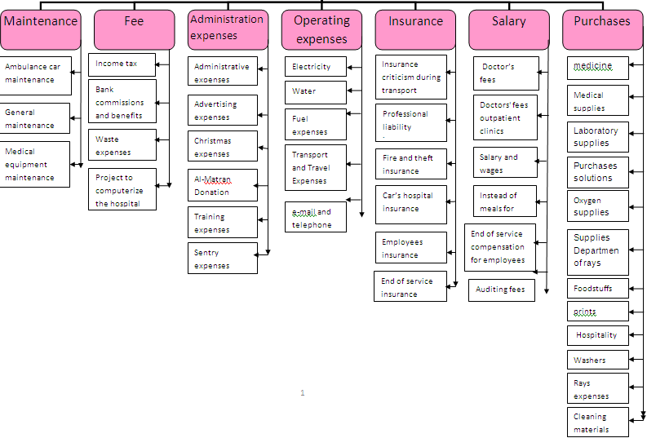
Re-Engineering Process

Slide 14
Pareto Analysis
Pareto analysis is statistical technique in decision making that is used for selection of limited number of tasks that produce significant overall effect.
This technique helps to identify the top portion of causes that need to be addressed to resolve the majority of problem

Slide 15
Pareto Analysis

Slide 16
Pareto Analysis
The Areas that need further study are:
Procurement
Salaries and Wages
Operating Expenses
apply Pareto for previous areas to find where come the lion share of expenditures then thinking about solutions to reduce cost for these specific areas.

Slide 17
Pareto Analysis
1) Procurement :

Slide 18
Pareto Analysis
2) Operating Expenses

Slide 19
Pareto Analysis
3) Salaries and Wages

Slide 20
Pareto Analysis
We now specialize in Medicine, Solutions, Medical Supplies, Electricity and fuel so collect data from hospital for their consumption in theses thing for year 2011
Let's Start by Procurement (Solutions- Medicines- Medical supplies) we insert data
from appendix B to excel sheet and make graphs of them to apply 80/20 rule again
The output of this process was: Medicine expenditures graph we

Slide 21
Pareto Analysis

Slide 22
Pareto Analysis

Slide 23
Pareto Analysis

Slide 24
Pareto Analysis

Slide 25
Pareto Analysis

Slide 26
Pareto Analysis

Slide 27
Pareto Analysis

Slide 28

Ways to reduce cost of Medicines ,Solution and Medical Supplies :
Generic brand are the way to go by choosing generic drugs, you can save a great deal of money in the long run.
Shop around for doctors and hospitals, which mean to deal with hospitals especially private one and try to buy the same medication at once which allows them to buy I lower cost or take bonus then distribute them.
compare between different suppliers and take the least price.
Negotiating with suppliers to obtain
Discounts in purchase prices.
Buy medication on large quantities and save these quantities on store taking into
account the expire date of some types of drugs.

Slide 29
Ways to reduce cost of Electricity :
Turning Things Off
Lights
Computers
Air-handling system
Check air-conditioning temperature
Change filters
Install occupancy sensors
Laundry control

Slide 30
Ways to reduce cost of Fuel :
Maintain appropriate internal temperature :
Room type | Temperature ºC
Bed heads/wards | 22–24
Circulation spaces/wards | 19–24
Consulting/treatment rooms | 22–24
Nurses’ stations | 19–22
Operating theatres | 17–19
Check Controls.
Zoning .
Keep system clean.
Localize control.
Using thermal insulation.

Slide 31
Ways to reduce cost of Salaries :
Tying wages to production, ensuring that a specific amount of works is done for every dollar paid.
Hiring and training carefully, particularly when the employee
is salaried, to ensure that the salary dollar is used most effectively.
Setting up an efficient method of payment which include:
-Frequency of payment
-Time of payment
-Method of payment
-Additional payments
Wage freeze

Slide 32
Apply cost reduction program at St.luks hospital
Apply C.R.P. start by asking hospital what it can apply or not using Checklist
The output of this step is COST REDUCTION PLAN
By applying the solution discussed before and apply it give the COST REDUCTION REPORTS

Slide 33
Cost Reduction Plan
# | Rooms for improvement | Responsible | 1 | 2 | 3 | 4 | 5 | 6 | 7 | 8 | 9 | 10 | 11 | 12
1 | Shop around for doctor and hospital | Pharmacy
2 | Automated schedule | Pharmacy
3 | Buy drugs , Solution and medical supplies in large quantities and store them. | Pharmacy
4 | Check air conditioning temperature | Administration
5 | Change filters | Administration
6 | Use sun power to heat water | Administration
7 | Cut off salary | Administration
8 | Tying wages to production | Administration
9 | Wage freeze system | Administration
10 | The hospital make zoning | Administration
11 | Use thermal insulation(ANZ Paints) | Administration
12 | Hospital check the control | Administration
13 | Make standardized price for outside doctors | Administration

Slide 34
Cost Reduction Report for Medicines
# | Item | Alternatives | Supplier | Old price | New price | % change | Reason of Change
1 | Forane vial 100ml | Halothane 100 ml | شركة التوريدات الطبية | 91.6 Nis. | 85.88 Nis. | 5.72 Nis. | Found alternative
2 | Tavanic IV vial 500 gm | Tavanic 500 gm tablet | شركة التوريدات الطبية | 178.62 Nis. | 115.878 Nis. | 62.742 Nis. | Found alternative
3 | Nexium 40 mg | - | شركة اومنيبال | 42.62 Nis. | 38.37 Nis. | 4.25 Nis. | The Mother company reduce price of this type.
4 | Human Albumin* | Aminoplasma Bott. | مديفارم رشماوي | 212.97 Nis. | 51.75 Nis. | 161.22 Nis. | Found alternative
5 | Rociphen Vial 1gm | - | - | - | - | - | -
6 | Targocid vial 200gm | - | شركة التوريدات الطبية | 178.62 Nis. | 122.4 Nis. |  | The Mother company reduce price of this type
7 | Infusurf* | - | شركة صيام الدولية | 2061.0 Nis. | 1902.461 Nis | Cant App. | Bounaces
8 | Zinex 750 mg شركة بيرزيت للأدوية | Zinacef vial750mg | شركة التوريادات الطبية | 8.02 Nis. | 6.98 Nis. | 1.04 Nis. | Alternative & different suppliers
 |  | Zinaxim750mg | شركة القدس للمستحضرات | 8.02 Nis. | 6.00 Nis. | 2.2 Nis

Slide 35
Conclusion
Cost Reduction Cycle
Areas
Implement 20%_80% rules
Analyze
expenditure
Improvement

Slide 36
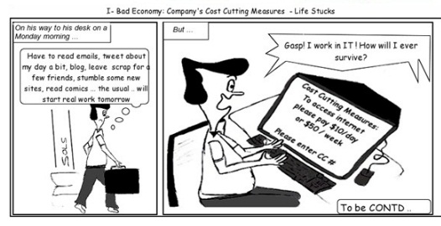

Slide 37



