Slide 1

An Najah National University
Faculty of Engineering
Design of Smart On- Street Parking facilities in Jaffa Street
Prepared by: Zainab Atatra
Eman Abuarra
Shaymaa Al-Shamali
Dr.Amjad Issa

Slide 2
Outline
Introduction.
Methodology.
Data Collection and Analysis.
Smart Parking System.
Study of Parking Meter System.
Cost estimation.
Mobile Application.
Conclusions and Recommendations

Slide 3
Introduction
Background.
Study Area.
Importance of the project.
Objectives of the study.
Report structure.

Slide 4
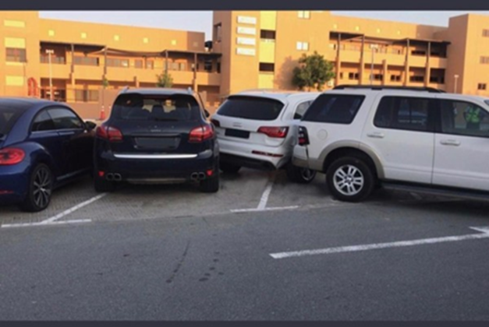
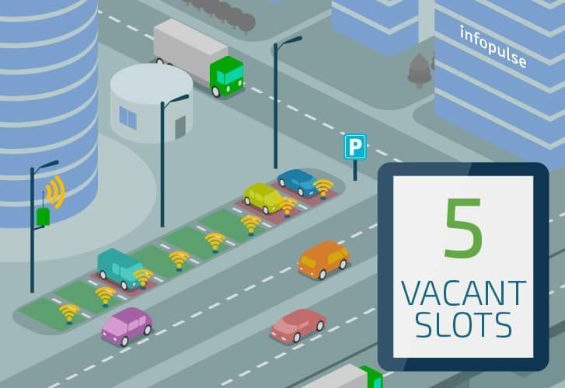
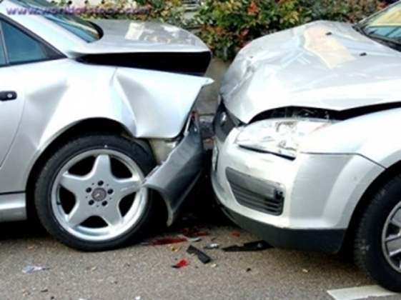
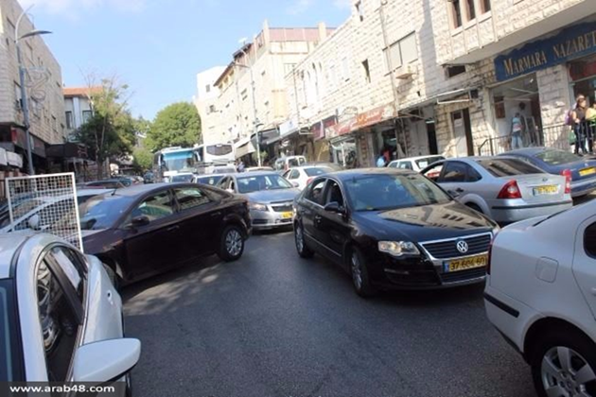
Background:

Slide 5
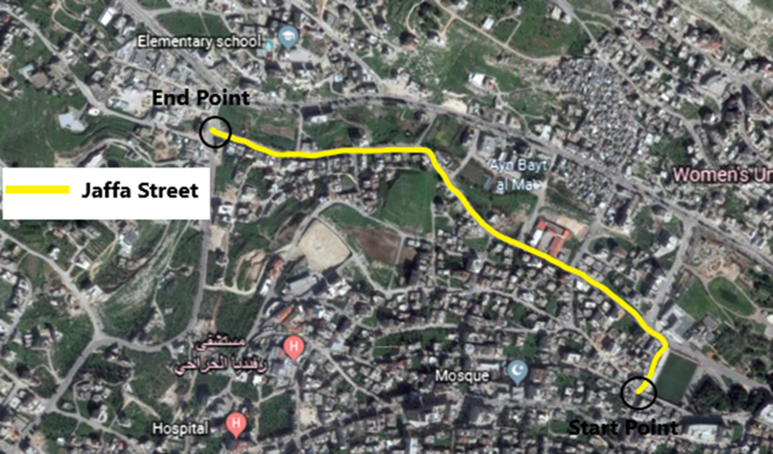
Study Area:
Importance and Objectives of the project:

Slide 6
Methodology
Data collection about smart parking system.
Survey visit.
Data collection about parking space.
Mobile Application Testing and Development

Slide 7
Data collection about smart parking system
Smart Parking System Categories: It can be divided into five main categories:
Parking Guidance and Guidance System (PGIS).
Public Transportation Information System.
Smart Payment System.
Electronic Parking.
Automated Parking.
The project team have combined the smart payment system and the E-parking system to produce a new parking system called Smart Parking System.

Slide 8
Comparative study on the sensors
Parameters | Sensitivity | Detection | Power Consumption | Cost | Sensitivity to traffic
Active Infrared | Bit | No | Moderate | Moderate | No
Passive Infrared | Moderate | Yes | Moderate | Moderate | No
Ultrasonic | Extreme | No | Low | Low | No
Piezoelectric Sensor | Not sensitive | Yes | Moderate | High | Highly Sensitive
The GP team proposed that the ultrasonic sensor is most suitable one

Slide 9
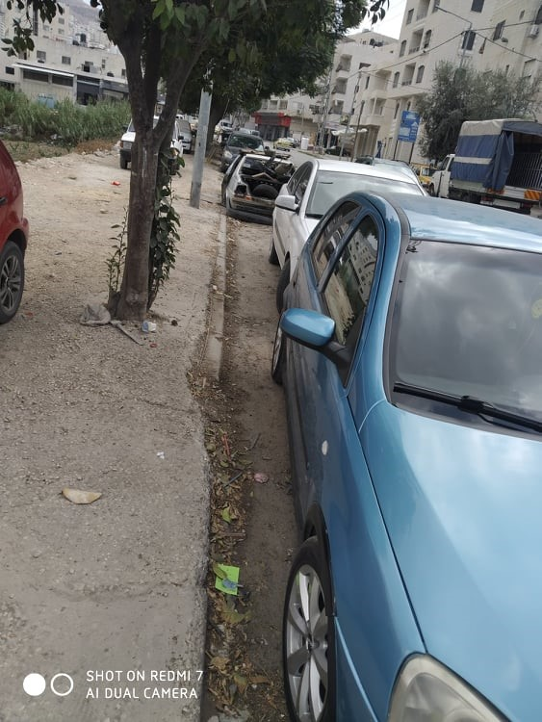
Survey visit:
We the project team, visited the road and identified the study area in order to get a good idea of ​​the parking spaces on the street.

Slide 10
Data collection about parking space:
The project team collected the parking data by counting parking vehicles for two days.
  Mobile Application Testing and Development:
We designed a new application in several stages

Slide 11
Data Collection And Analysis
Collection of Maps and Information.
Parking study Data Analysis:

Slide 12
Collected parking data in Jaffa Street
Quarter number | Legality/ Time | Legal | Illegal | Quarter number | Legality/ Time | Legal | Illegal
1 | 7:00-7:15 | 55 | 2 | 19 | 11:30-11:45 | 126 | 31
2 | 7:15-7:30 | 51 | 1 | 20 | 11:45-12:00 | 127 | 32
3 | 7:30-7:45 | 59 | 3 | 21 | 12:00-12:15 | 124 | 31
4 | 7:45-8:00 | 63 | 3 | 22 | 12:15-12:30 | 128 | 23
5 | 8:00-8:15 | 65 | 3 | 23 | 12:30-12:45 | 128 | 23
6 | 8:15-8:30 | 73 | 4 | 24 | 12:45-1:00 | 127 | 22
7 | 8:30-8:45 | 77 | 4 | 25 | 1:00-1:15 | 125 | 22
8 | 8:45-9:00 | 93 | 17 | 26 | 1:15-1:30 | 122 | 21
9 | 9:00-9:15 | 110 | 19 | 27 | 1:30-1:45 | 127 | 23
10 | 9:15-9:30 | 122 | 22 | 28 | 1:45-2:00 | 137 | 15
11 | 9:30-9:45 | 133 | 24 | 29 | 2:00-2:15 | 121 | 14
12 | 9:45-10:00 | 134 | 45 | 30 | 2:15-2:30 | 128 | 14
13 | 10:00-10:15 | 129 | 43 | 31 | 2:30-2:45 | 126 | 14
14 | 10:15-10:30 | 136 | 45 | 32 | 2:45-3:00 | 103 | 12
15 | 10:30-10:45 | 123 | 41 | 33 | 3:00-3:15 | 96 | 11
16 | 10:45-11:00 | 116 | 29 | 34 | 3:15-3:30 | 87 | 10
17 | 11:00-11:15 | 107 | 27 | 35 | 3:30-3:45 | 89 | 10
18 | 11:15-11:30 | 116 | 29 | 36 | 3:45-4:00 | 74 | 8

Slide 13
Parking Analysis Calculations
Legality/ | Legal | Illegal | Total | Demand | Legality/ | Legal | Illegal | Total | Demand
Time |  |  |  |  | Time
7:00-7:15 | 55 | 5 | 60 | 15 | 11:30-11:45 | 126 | 31 | 157 | 39
7:15-7:30 | 51 | 7 | 58 | 15 | 11:45-12:00 | 127 | 32 | 159 | 40
7:30-7:45 | 59 | 6 | 65 | 16 | 12:00-12:15 | 124 | 31 | 155 | 39
7:45-8:00 | 63 | 5 | 68 | 17 | 12:15-12:30 | 128 | 23 | 151 | 38
8:00-8:15 | 65 | 8 | 73 | 18 | 12:30-12:45 | 128 | 23 | 151 | 38
8:15-8:30 | 73 | 12 | 85 | 21 | 12:45-1:00 | 127 | 22 | 149 | 38
8:30-8:45 | 77 | 15 | 92 | 23 | 1:00-1:15 | 125 | 22 | 147 | 37
8:45-9:00 | 93 | 17 | 110 | 28 | 1:15-1:30 | 122 | 21 | 143 | 36
9:00-9:15 | 110 | 19 | 129 | 32 | 1:30-1:45 | 127 | 23 | 150 | 38
9:15-9:30 | 122 | 22 | 144 | 36 | 1:45-2:00 | 137 | 15 | 152 | 38
9:30-9:45 | 133 | 24 | 157 | 39 | 2:00-2:15 | 121 | 14 | 135 | 34
9:45-10:00 | 134 | 45 | 179 | 45 | 2:15-2:30 | 128 | 14 | 142 | 36
10:00-10:15 | 129 | 43 | 172 | 43 | 2:30-2:45 | 126 | 14 | 140 | 35
10:15-10:30 | 136 | 45 | 181 | 45 | 2:45-3:00 | 103 | 12 | 115 | 29
10:30-10:45 | 123 | 41 | 164 | 41 | 3:00-3:15 | 96 | 11 | 107 | 27
10:45-11:00 | 116 | 29 | 145 | 36 | 3:15-3:30 | 87 | 10 | 97 | 24
11:00-11:15 | 107 | 27 | 134 | 34 | 3:30-3:45 | 89 | 10 | 99 | 25
11:15-11:30 | 116 | 29 | 145 | 36 | 3:45-4:00 | 74 | 8 | 82 | 20
Total number of vehicles at any time = Legal parked vehicles + Illegal parked vehicles
Total Demand = parked vehicle at any time × that period of time

Slide 14
Survey results and analysis:

Slide 15
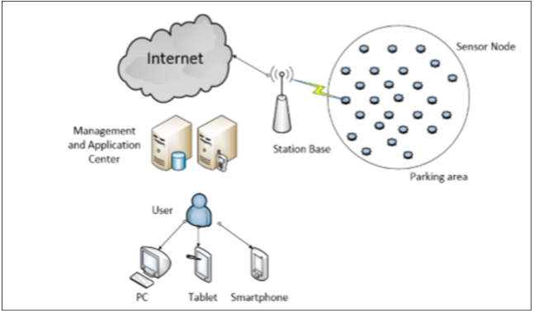
What is smart parking system
Smart parking systems are systems that manage the difﬁculty of parking in the city in public or private areas, using several recent technologies.

Slide 16
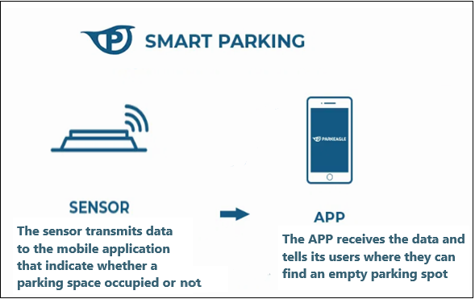
Smart system is applied on Jaffa street
Primary components :
Parking Sensors
Mobile Application
Additional supplies: Server and Hosting, in order to operate the server all the time.

Slide 17
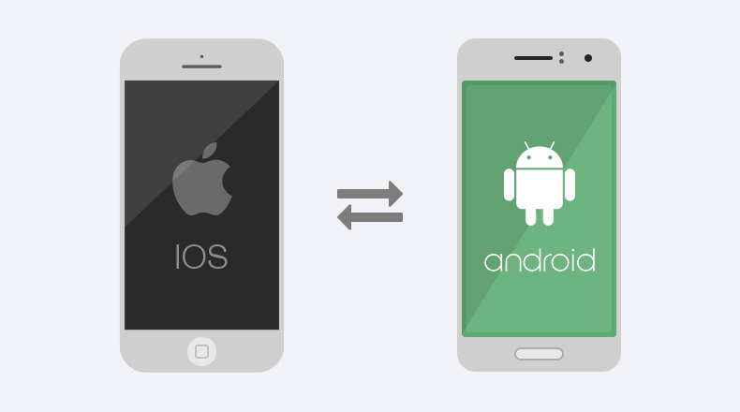
Smart Phone (Android or iPhone)

Slide 18
Project scope:
Smart Parking System
The proposed project should be able to:
Determine the nearest available parking space to the destination that is intended to be reached.
Be easy to download and use by any driver.
Collect all information from sensors by using server.

Slide 19
System boundaries:
1. By using sensor networks, the system will be able to figure out and specify the unoccupied spaces.
2. By using server, the system will be able to collect all information from network sensors.
3. Connection with driver phone through application to tell him where the nearest space is.

Slide 20
System Input:
Drivers demand for the location of vacant space for his car.
Signals from sensors that indicates the location of vacant space.
Demand for statistics and data from parking managers.
Drivers demand for reservation location in the parking.
System Output:
Locating the vacant space in the parking at the application on smart phones or at real time.
Increase the comfortable of using the parking and decrease time, effort and cost.

Slide 21
Components of smart parking system:
Presence sensor network module: it collects data and checks parking space state in real-time then sends parking space information to embedded web-server.
Web-server: receive information from presence sensors networks then sends them to smart phone.
Mobile device: connect to micro web server and receive parking space information from it.
Android application: we will program an application using android environment which will be installed at the smart phone.

Slide 22
Project Assumptions:
In our project we assume that each space contain ultrasonic sensor, motion sensor and light emitting diode (Led), Which indicates to drivers if the site is reserved or not.
Project Constraints and Limitations:
We will face some restrictions when applying this project. One of the main limitations of smart parking is that we need a sensor, Microcontroller at each parking slot and wireless module.

Slide 23
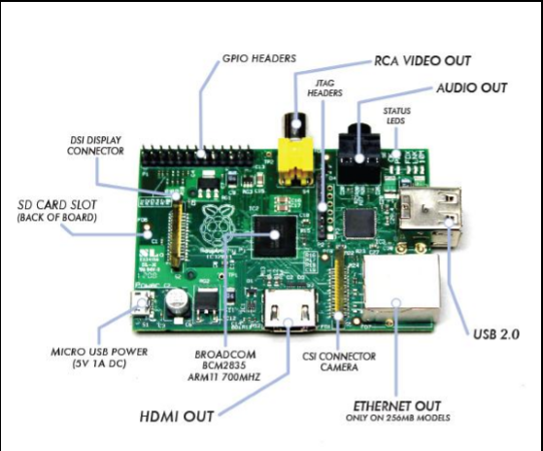
Project Components:
1- Hardware components:
Sensors
Micro controllers
Wireless USB

Slide 24
2- Software components
Android Application
Web Application
3- other components
Wires
Box
plug
LED
Transistor

Slide 25
Project Requirements:
1- Functional Requirements
2- Non-Functional Requirements
Problem when implementing the project:
1- integrating Internet-connected sensors into urban infrastructure may raise many questions about the potential uses of this data.
2-responsibility in covering the costs of smart sensors and the accompanying infrastructure.
3- devices may be stolen due to the circumstances and the lack of control over them.

Slide 26
  General results when applying the smart parking system:
1- Address the increasing parking problems, based on:
Efficient management
It also reduces the time to enter and leave the parking spaces Web Application
2- Increasing the operational efficiency of parking lots
3- reduce environmental pollution

Slide 27

Study of Parking Meter System
Parking meters:
Parking meter: is a device used to collect money in exchange for the right to park a vehicle in a particular place for a limited amount of time.

Slide 28
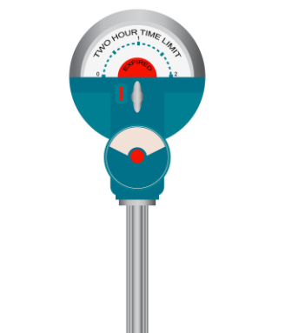
Parking Meters:
Meter Head
Consist of two units "flag" unit and a coin collection unit.
A metal post to the ground on curb side
supports a meter head.

Slide 29
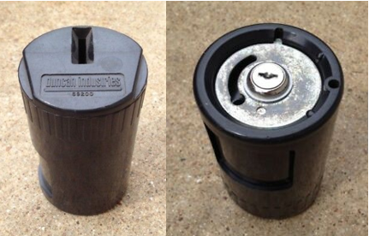

Parking Meters System:
Installation
Maintenance:
Parking enforcement officers
Coin Collecting
Violations:
Insufficient payment
Exceeding time limit

Slide 30
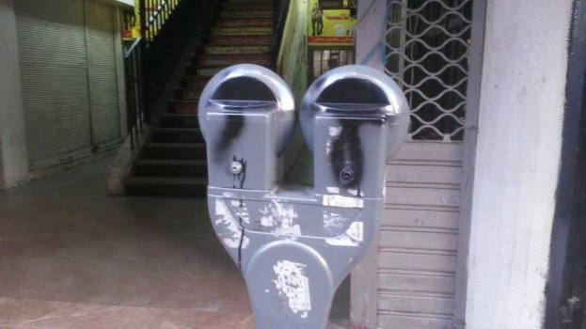
Vandalism:
Caused by three conditions :
Isolation from public view.
Poor lighting.
Low level of police activity.
Recommendations can be used to avoid Vandalism:
1)Telephones (easy access to a telephone ).
2) Video camera surveillance.
3) Signage to indicate emergency and/or police number.
The smart parking system is proposed for solving the existing problems of on-street parking meter systems(which are vandalism, ambiguity in enforcement, scandal, etc.)

Slide 31
Design Development
smart parking system offer solutions:
To get rid of parking meter vandalism.
To provide better control in short-term parking
To facilitate the work of human labour in the parking meter system.
To help drivers to find on-street parking spaces easier.
To provide flexible ways in paying charges.

Slide 32
Cost Estimation:
Cost estimation for parking meter system:
The process of managing meters is divided into several sections
First, the Roads and Traffic division
Second, the Guarding and Inspection Department
Third, the collection department

Slide 33
Cost of parking meter system
Parking Meter System Cost |  | Cost | Note | Quantity | Total Cost
1- Parking Meter Cost | Single space meter | 750$ | This is a cost that does not include installation fees, the cost of pipes, or anything related to operating the system | 11 | 8,250
 | Double space meter | 1,500$ |  | 118 | 177,000
 | Parking meter operation system | 30,000$ |  | 1 | 30,000
Total Direct Cost = 215,250$
2- Operating Cost/Month | Maintenance workers | 700$ | It is responsible for the process of meters management in terms of technical, programming and maintenance | 3 | 2,100
 | Guard and inspection workers | 700$ | It is responsible for following up on violators and editing violations | 3 | 2,100
 | Manager | 700$ | Person responsible for guiding workers | 1 | 700
Total Operating Cost/Month = 4,900$

Slide 34
2. Cost estimation for smart parking system:
To manage the smart parking system we need:
maintenance workers
Guard and inspection workers
Manager to manage the operation and program the system

Slide 35
Cost estimation for smart parking system
Smart Parking System Cost |  | Cost (Nis) | Quantity | Total Cost(Nis) | Note
1-Direct Cost | Ultrasonic Sensor | 25 | 247 | 6175 | This is a cost that does not include installation fees, the cost of pipes, or anything related to operating the system
 | Controller | 40 | 247 | 9880
 | Wireless Module | 70 | 247 | 17290
 | Low Supply | 25 | 247 | 6175
 | Wires | 10 | 247 | 2470
 | Box | 10 | 247 | 2470
 | Plug | 5 | 247 | 1235
 | Led | 20 | 247 | 4940
 | Transistor | a5 | 247 | 1235
 | Motion Sensor | 10 | 247 | 2470
 | Mobile Application | 1500 | 1 | 1500
 | Total Direct Cost = 55,840 Nis
2- Operating Cost / Month | Maintenance workers | 2500 | 3 | 7500 | This is cost that does not include WiFi cost
 | Guard and inspection workers | 2500 | 2 | 5000
 | Manager | 2500 | 1 | 2500
 | Total Operating Cost/Month = 15,000 Nis

Slide 36
Comparison between the systems
Total cost of parking meter system during one year = 215,250 + (4,900×12) =274,050(USD) =959,175 NIS.
Total cost of smart parking system during one year = 55,840 + (15,000 × 12) = 235,840 (NIS)
We have noticed that the cost of parking meter system is approximately four times the cost of smart parking system.

Slide 37
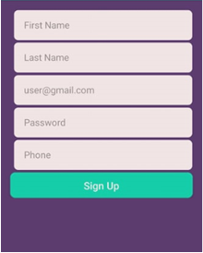
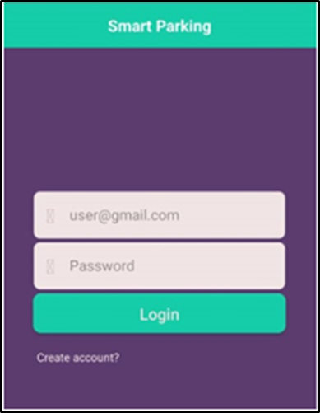
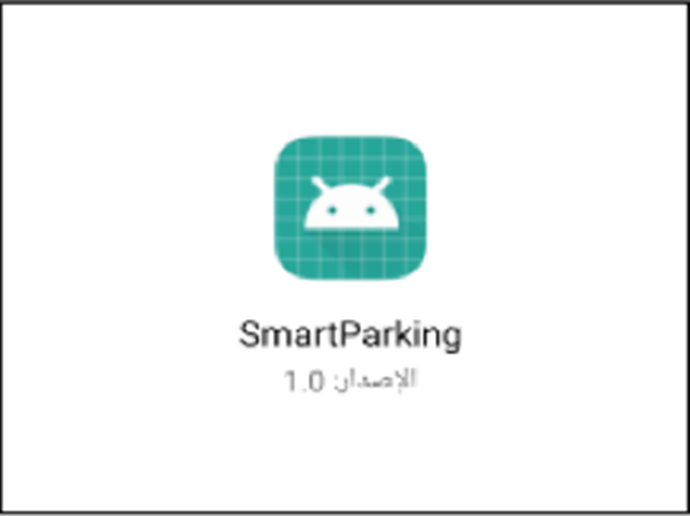
How to use smart parking application as driver

Slide 38
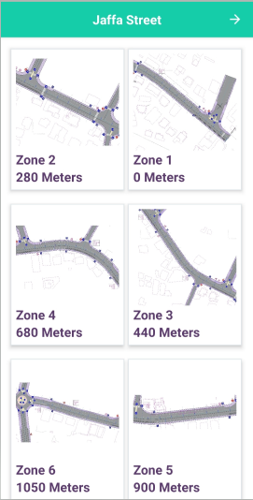
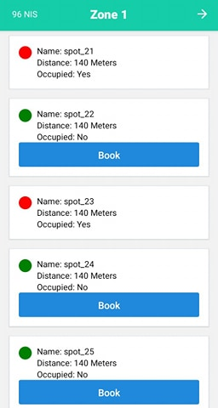
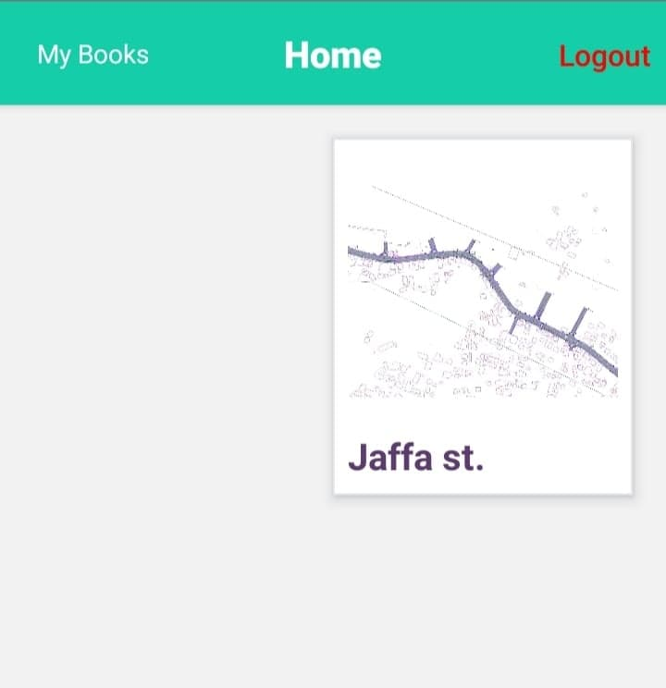

Slide 39
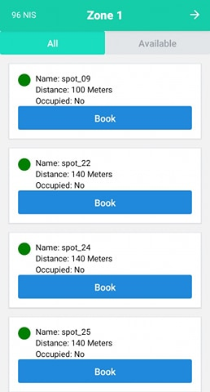
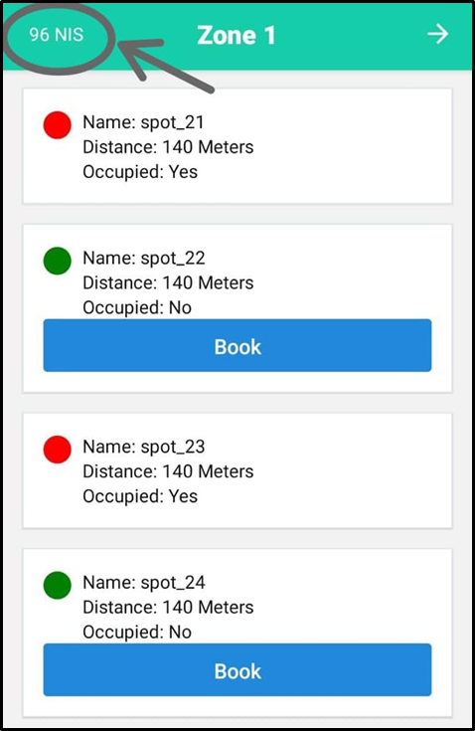
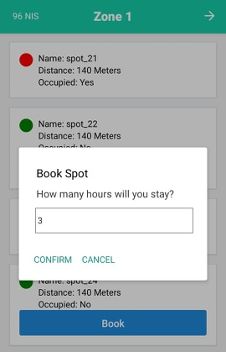

Slide 40
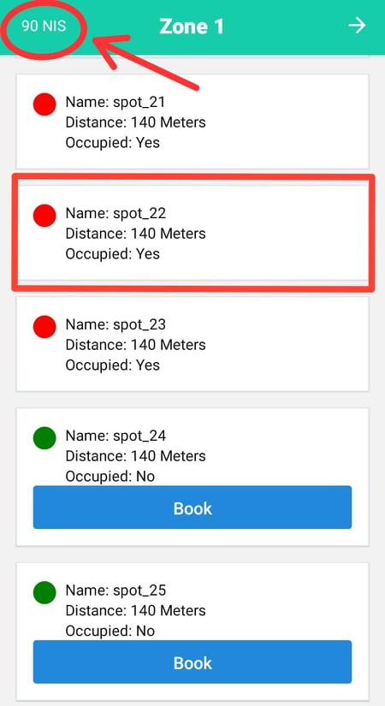
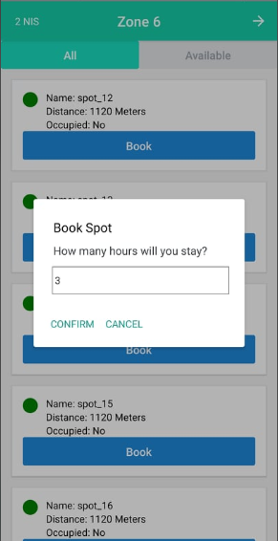
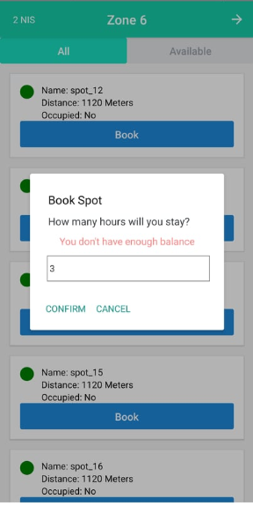

Slide 41
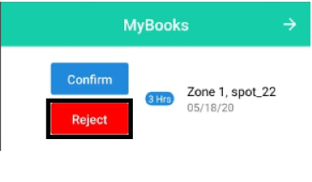
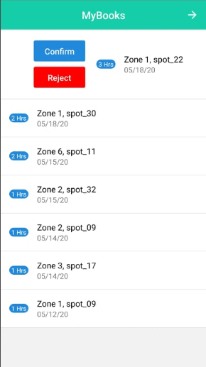
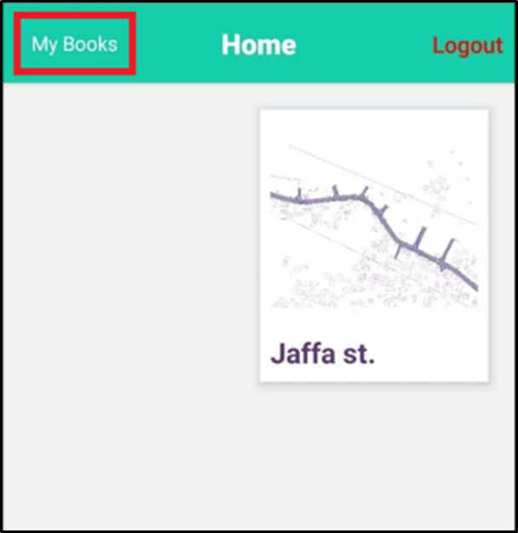
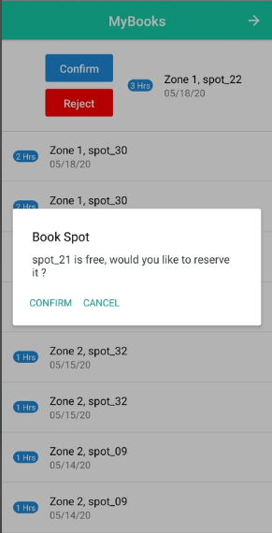

Slide 42
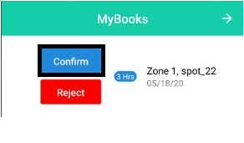
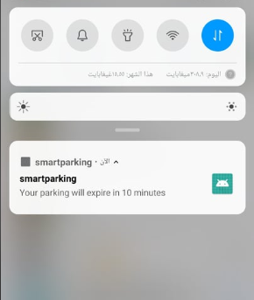
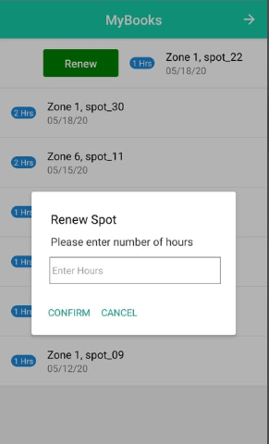
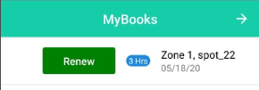

Slide 43
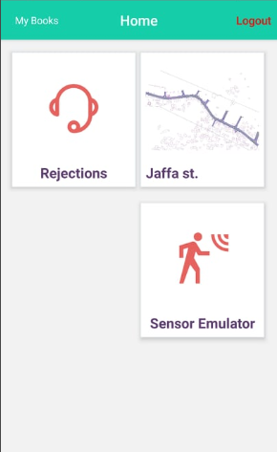

How to use smart parking application as Guard workers:

Slide 44
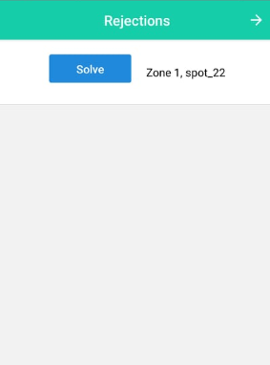

Slide 45
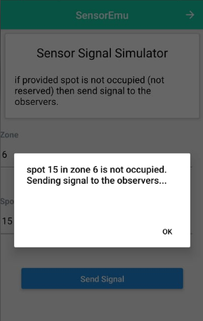
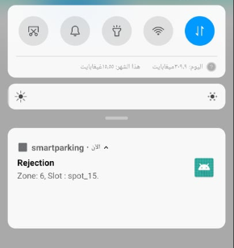
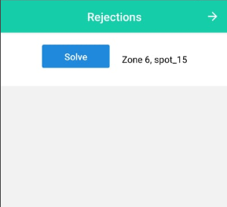

Slide 46
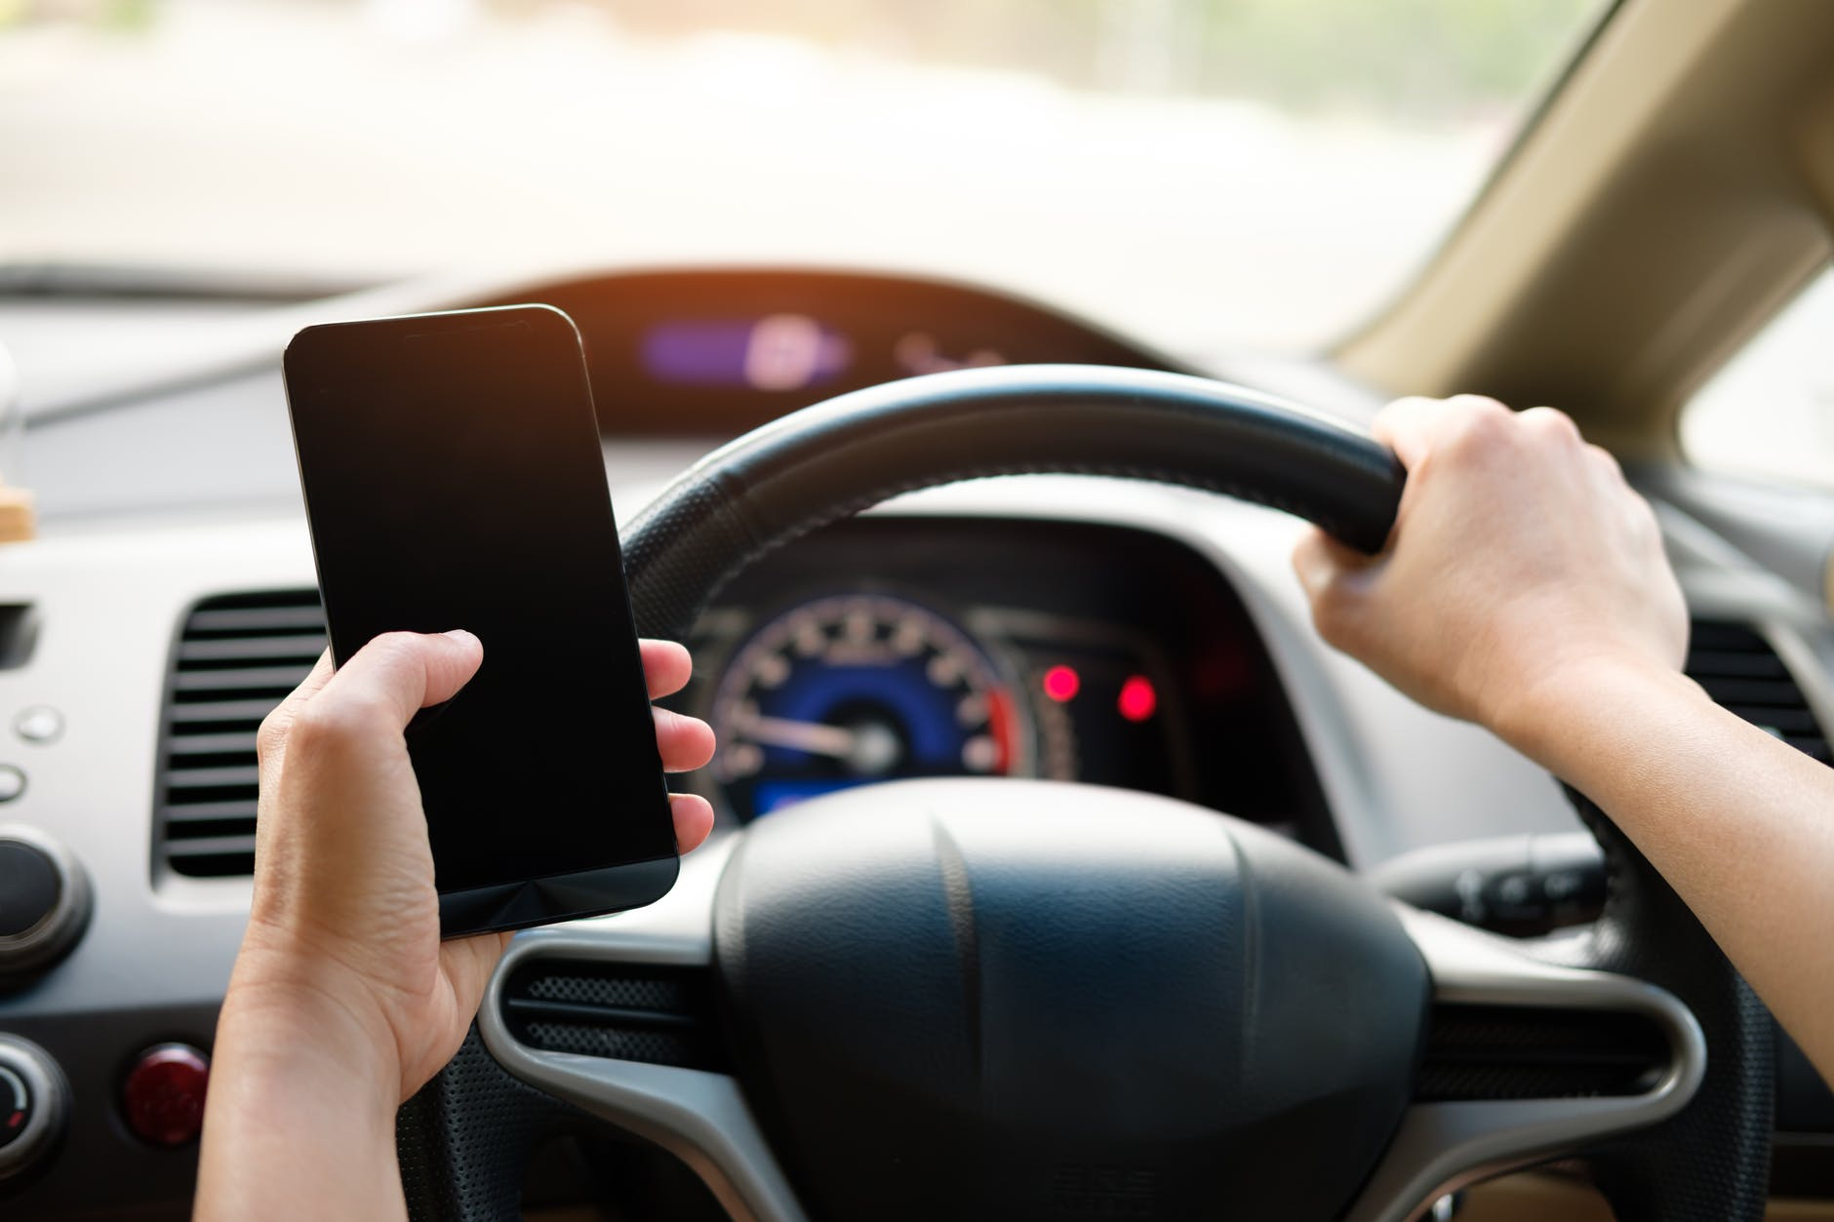
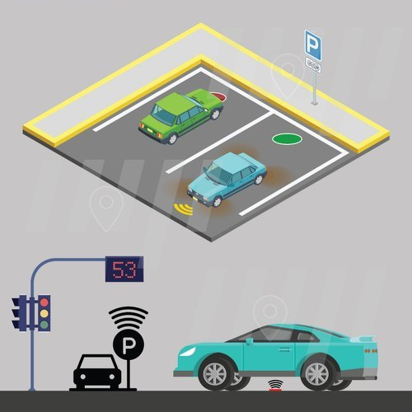
Conclusion and Recommendations

Slide 47
Thank you

