Slide 1

Smarty Planets
Abeer Hamadneh
Sabeen Khuffash
Dr. Sufyan Samara

Slide 2
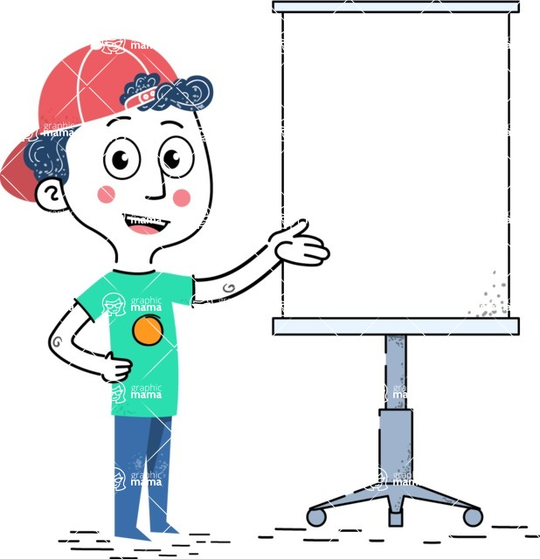
Why
Children face difficulty in learning, which is a common problem among them, so we decided to make an application in Arabic which children use and learn the basic things, especially in the first levels of their education, this application will combine education and entertainment in order to encourage the children to learn and comprehend, in addition our project contains various educational options containing levels and stages from the primary stage to the pre-kindergarten stage, each level will be arranged sequentially and gradually according to the age of the children which is between 3-5 years old

Slide 3
With early learning stages in kindergartens, it is critical to develop simple items from the start.
There are a variety of learning strategies that can be used to focus the attention of kindergarten students on a particular topic. A computer game or smartphone application is one of these ways. As a result, Smarty Planets is proposed in this study.

Slide 4

Parent Dashboard
Keep parents informed about why your app is good for their children. • You can show them information regarding their children progress or what values have your app for them. • Be sure to include a parental gate to access

Slide 5

Creating UI
For children, an explicit gaming aim is required so that they can quickly comprehend what they should perform.

Slide 6

Make mockups of the user interfaces before you start coding or designing your app.
An app for children is not the same as an app for adults; keep it as simple as possible, free of distracting components.

Slide 7
The primary menu should be visually appealing, intuitive to use, and well-organized. If the app has many games, they should be kept together. Buttons should be distinguishable visually so that toddlers understand they are interactive.

Slide 8
We can't just start designing and building an app for kids without first obtaining adequate information about them.

Slide 9
Understand Who will Install Your App
While building a mobile app for children, we must ask ourselves the following questions:
Who will download your children's app from the Play Store or the App Store?
Will it be their children or their parents?
Who will be the panel of judges for the apps?

Slide 10

What age group of kids will use your app?
Toddlers in this age range enjoy exploring colors, music, rhymes, and little forms of engagement, among other things.

Slide 11


Activities
Learning and discovering
Discover the numbers, colors, shapes, and much things with the App in a fun way with gifs and colors
quiz
Matching games for colors, animals and numbers

Slide 12

Before starting to play, learning will be a good way to show children how the game works and how to solve them.

Slide 13

Colors & Animations
Children's attention will be drawn to brightly colored and dynamic objects, yet they will be distracted if they need to concentrate on an activity.

Slide 14
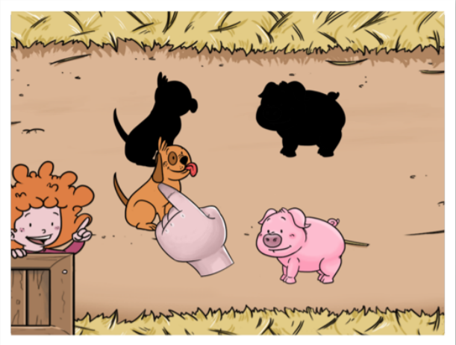
There are a lot of gestures to interact with an app
For children, the most basic gesture is touch.
Drag: Move an object around the screen.
Slide: Like the last one, however this one is used to scroll or turn a page.

Slide 15
Text and instructions
When children begin to play, they need visual and audio instructions to understand what they have to do.
Interactions
To show that an element is interactive it can be highlighted or it
can shake or make a sound, so children know there is something to do with that.

Slide 16
Sounds
Background music: It can create engagement and encourage children to play but you should choose the music carefully so it should not distract them.
Sound effects: It will help to give feedback or away to interact with objects.
Stories become more credible when they use concrete details such as the specific complex moves Alberto learned through Translate and his 30 goals in 21 games performance stats.

Slide 17



Development of the App
App engine
Flutter
Dart
Microsoft Android studio is the IDE used for coding
Database
MySql
Feedback
The data about the children is stored in the database to decide whether the children is understood or not

Slide 18
Feedback
It’s important for learning that children have a feedback when they make a mistake or pass the game
• Positive Feedback: Congratulate the child, this will keep him motivated, also you can use it to reinforce learning like: “Well played! This is the blue color!”
• Negative Feedback: If the child makes a mistake, give him a feedback to encourage him to keep trying without saying that his answer was wrong or he doesn’t know the answer: “You were close! Try again!”. Also you can give him a clue to help him.

Slide 19





Object Detection
Challenges
Sounds
Sign in
Language

Slide 20
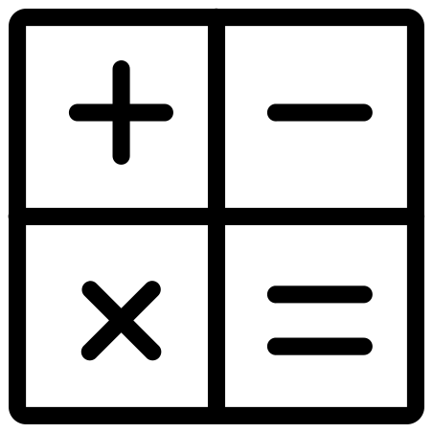



Future work
Expand the mathematical with more numbers, learn the mathematical operation and add more quizzes for each one
Add more activities for each planets in order to make the child never get bored from learning.
Add a new planet for learning letters and alphabets.
Add more objects for object detection method.

