Slide 1

Environmental status in Tulkarm city
BY: Tawfiq Saleh, Shadid Hanini, Ahmad Abu Saleh, Mutaz Abu Daher and Mahmoud Drubi
Supervisor: Dr. Abdelhaleem Khader

Slide 2

Introduction
water
Solid waste
Air quality
wastewater

Slide 3
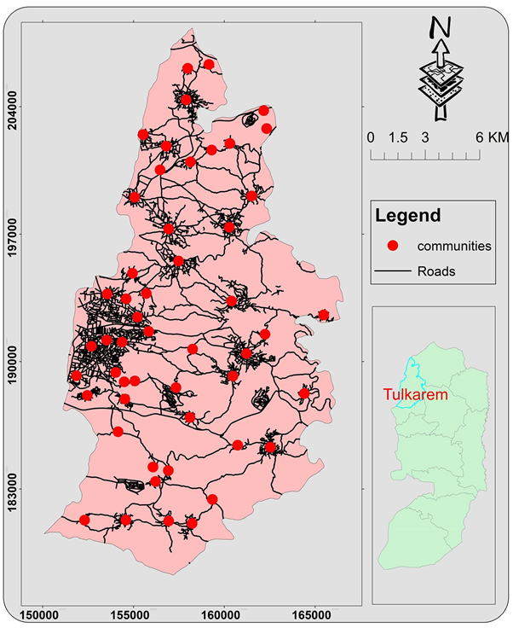
Study area
Area: 2.45 km2
Elevation: 55-600 m AMSL
Population (2017): 64,532 capita

Slide 4
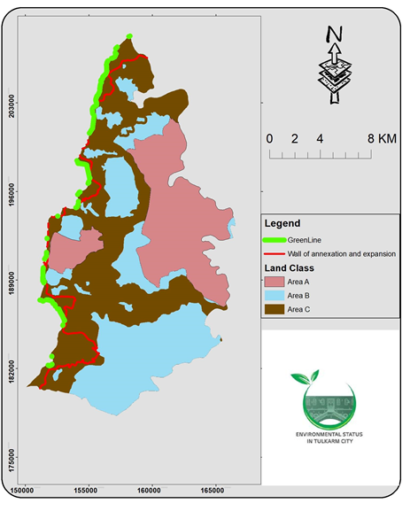
POLITICAL SITUATION
Dangerous factories
Stealing and polluting water
Exploitation of wastewater
Air pollution

Slide 5
Water Management
Quality and quantity

Slide 6
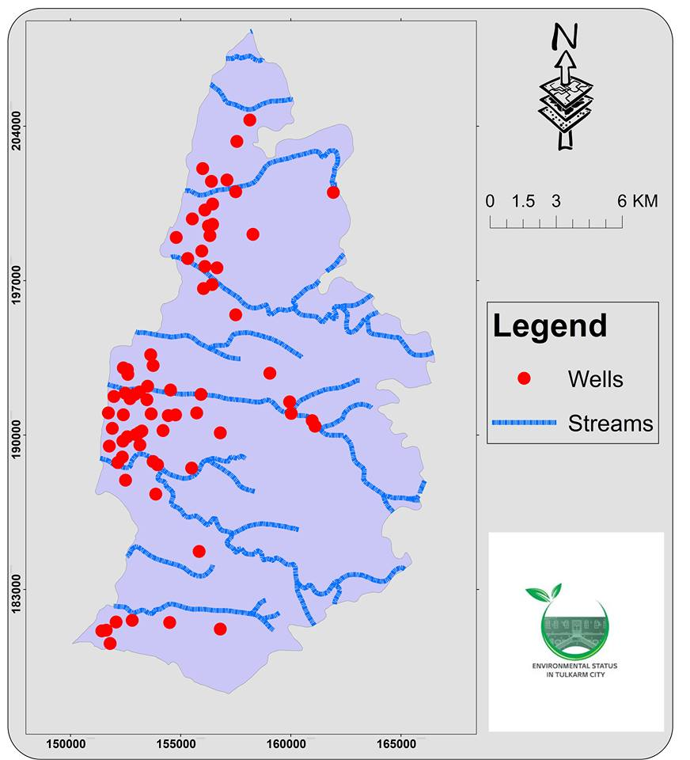
Water Resources
Israel
85%
250 l/c/d
15%
100 l/c/d
palestine

Slide 7
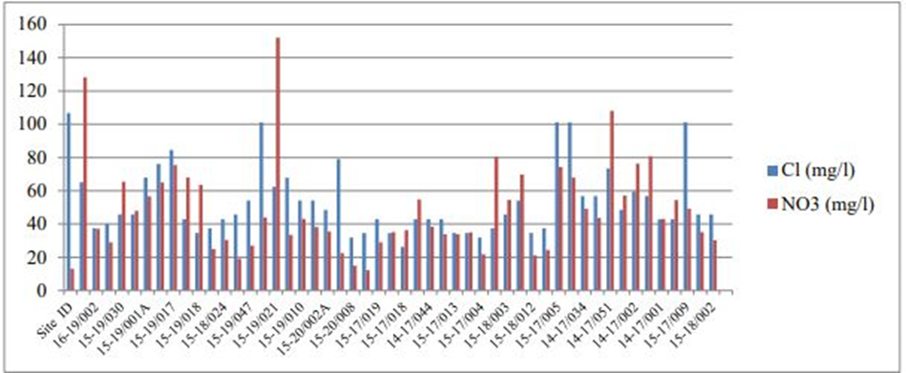
ground water quality

Slide 8
Wastewater management

Slide 9

Waste Water Management
Collection
Treatment
Final disposal

Slide 10
Until 2007
Sewage Network
70% of the city as well as refugee camps and Anabta village
Cesspits
Iktaba
Bal'a
Kafr el Labad
Rameen
Beit Leed

Slide 11
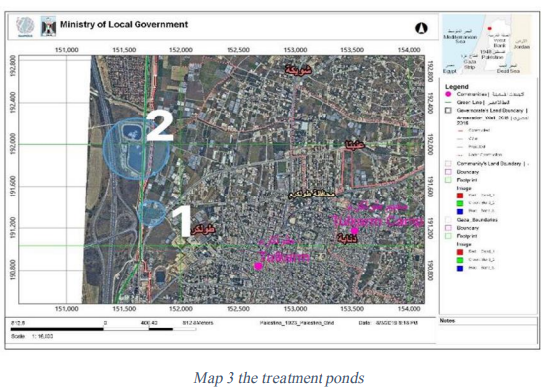
Average flow now = 11400 m3/day
Average flow in 2032=14390 m3/day
Cost for cubic meter =1.25 NIS

Slide 12
Assumption
Design period = 13 years
Growth rate = 2.5%
Water consumption =97.8 L/c.d

Slide 13
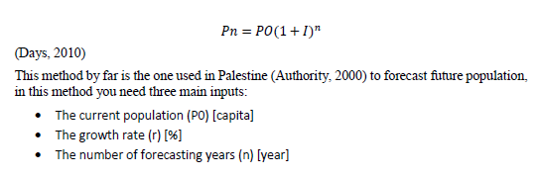
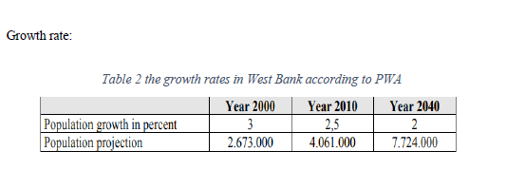
Population Analysis

Slide 14

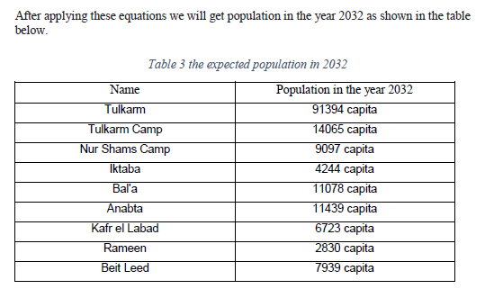
Sample Calculation

Slide 15
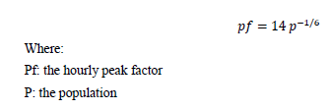
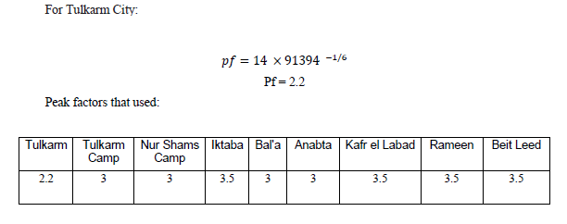
Peak Factor Calculation

Slide 16
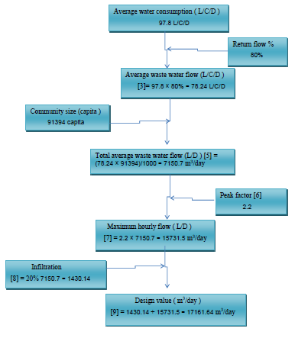
Design Flow Rates Quantification
Total Q.design = 37200 m3/day

Slide 17
Characteristics of wastewater
Parameter (all concentrations are in mg/l)
Data | Value
BOD5 | 140
COD | 449
TSS | 315
Total nitrogen Kj-N + NO | 90
Phosphate | 2.3

Slide 18
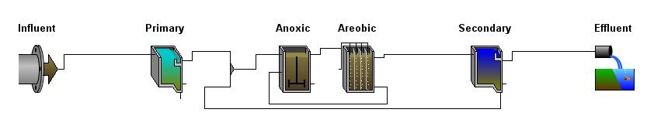
WWTP Layout

Slide 19
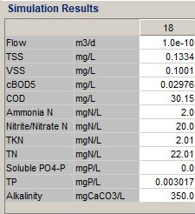
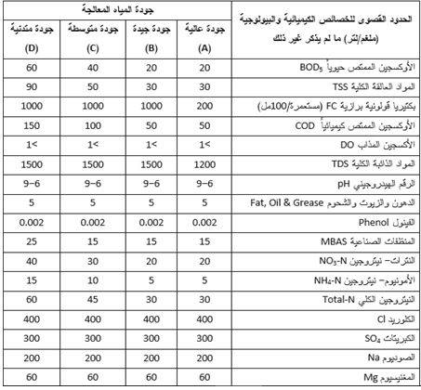
Results & Standards
Flow = 35200 m3/day
Quality A

Slide 20
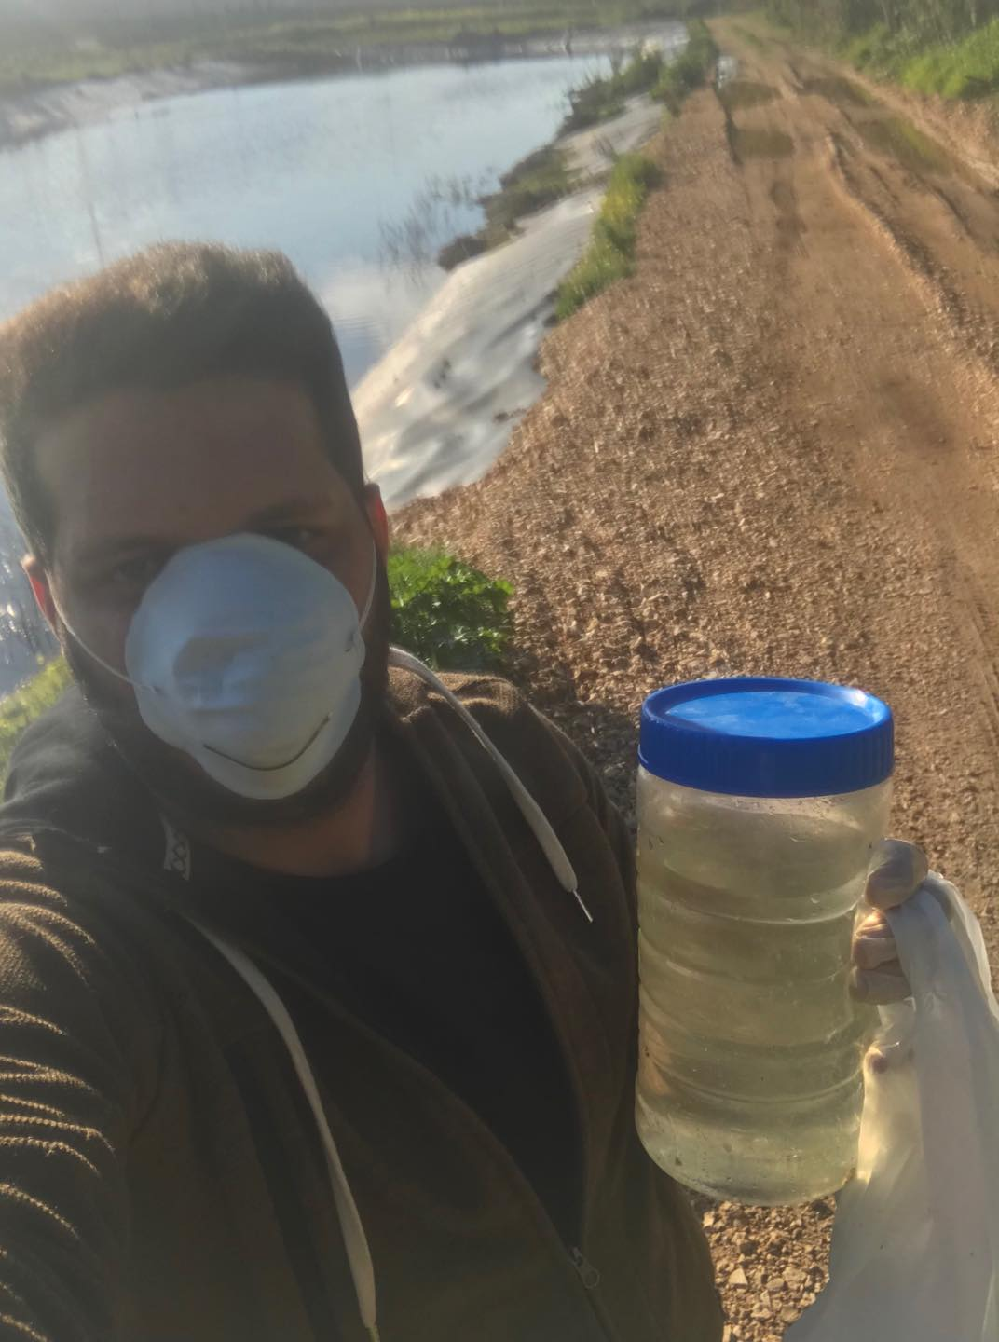

Slide 21

SOLID WASTE management

Slide 22
62000 tons!
in the city 1.29 kg/day,
in the villages 0.4 to 0.9 kg/day.
33 NIS/ton for Zahrat Al-Finjan

Slide 23
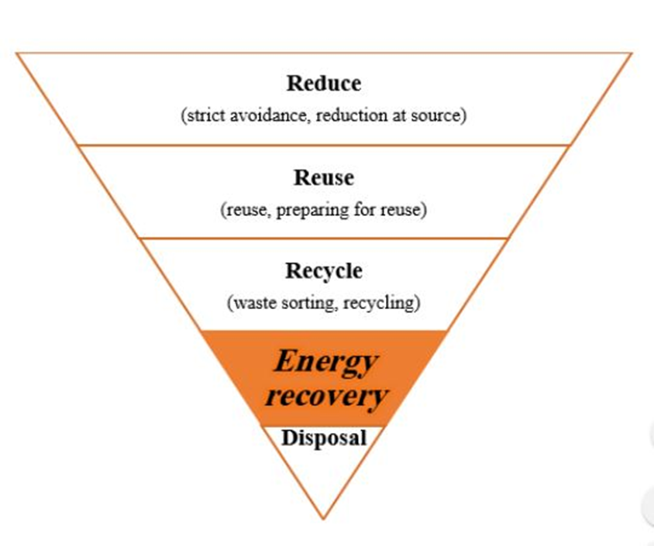

Slide 24
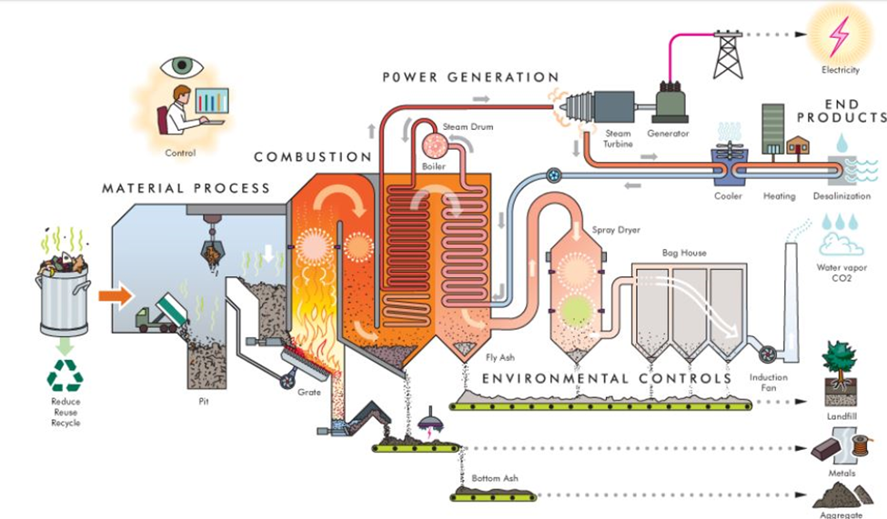

Slide 25
29,443 MWh's per year which means 17.6 million NIS per year
cost = 50 million$.

Slide 26

AIR QUALITY

Slide 27
Objectives
To study the effects of Particulate matter on the lung function for people in different areas.
compare the results with other Referenced limits in the world.
To measure the air pollutants in each area especially particulate matter using AIR-U device.

Slide 28
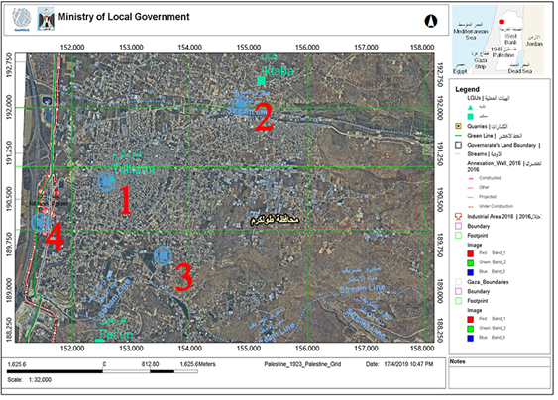

Slide 29
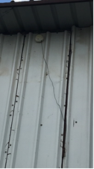
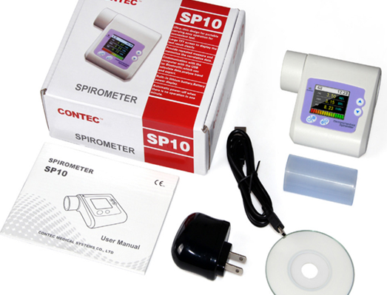
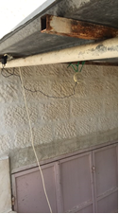
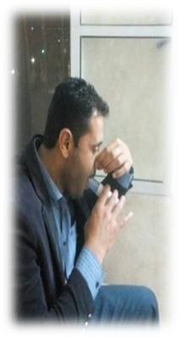

Slide 30
Forced vital capacity

Slide 31
Forced expiratory volume in one second

Slide 32
The percent of the lung size (FVC) that can be exhaled in one second

Slide 33
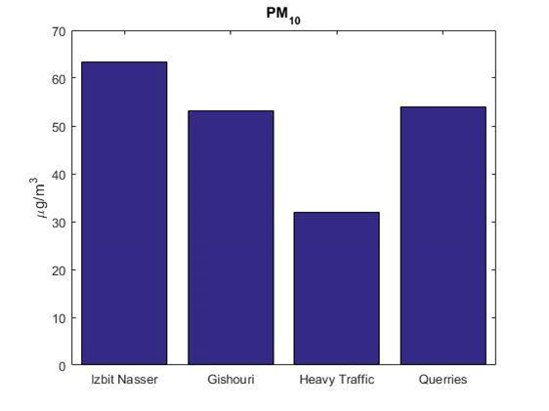
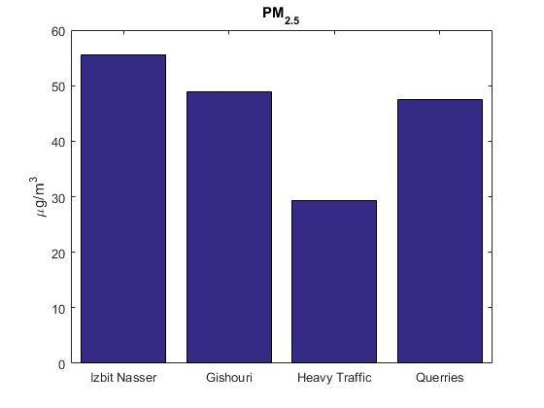
Particulate matter

Slide 34
recommendations
The water network in the city have to be fixed urgently
The wastewater issue must be solved
Solid waste is a national wealth that can be directly exploited for power generation
For air pollution, a comprehensive national policy must be taken to solve this serious problem. The situation in the city is catastrophic.

Slide 35




