Slide 1
Graduation Project(II)
Competency Assurance Management System (CAMS)
3-6-2020

Slide 2




Project Team
Supervised by:
Prepared by:
Eng. Suleiman Daifi
Ahmad Daraghma
Dima Khalifa
Motasem Khater
karmel Abu yacoub
Saif Ismail
External Supervisor:
Dr. Muntassr Khater

Slide 3
Outlines
Introduction
Literature Review
Detailed CAMS Components
Developing Standard Operational Manual for CAMS
Conclusion & Recommendation

Slide 4
Introduction

Slide 5
Problem Statement
Educational Background.
Incompetent employees.
Corporations in Palestine lack for a system to ensure that all work is performed by competent people.
Due to large projects, new facilities and new technologies there’s a big need for employees who are competent.

Slide 6


Project Objectives
The main purpose of this project is to build a system that help the Palestinian companies to make sure newly recruited are meeting the critical skills of their target position.
Aspire to achieve the following: All works are performed by competent people. Job progression is based on competencies & performance not on time. Increasing profitability by building a competitive advantages. Create a creative environment. Increase employee affiliation to the workplace. Reducing mistakes and complaints.

Slide 7

Definition
Competency Assurance Management System (CAMS) :
Is a system used to facilitate the development of the newly recruited competencies, set valid and reliable controls in place with a view to have reasonable assurance. CAMS considered as the most comprehensive system available nowadays for managing human capabilities and learning & development.

Slide 8
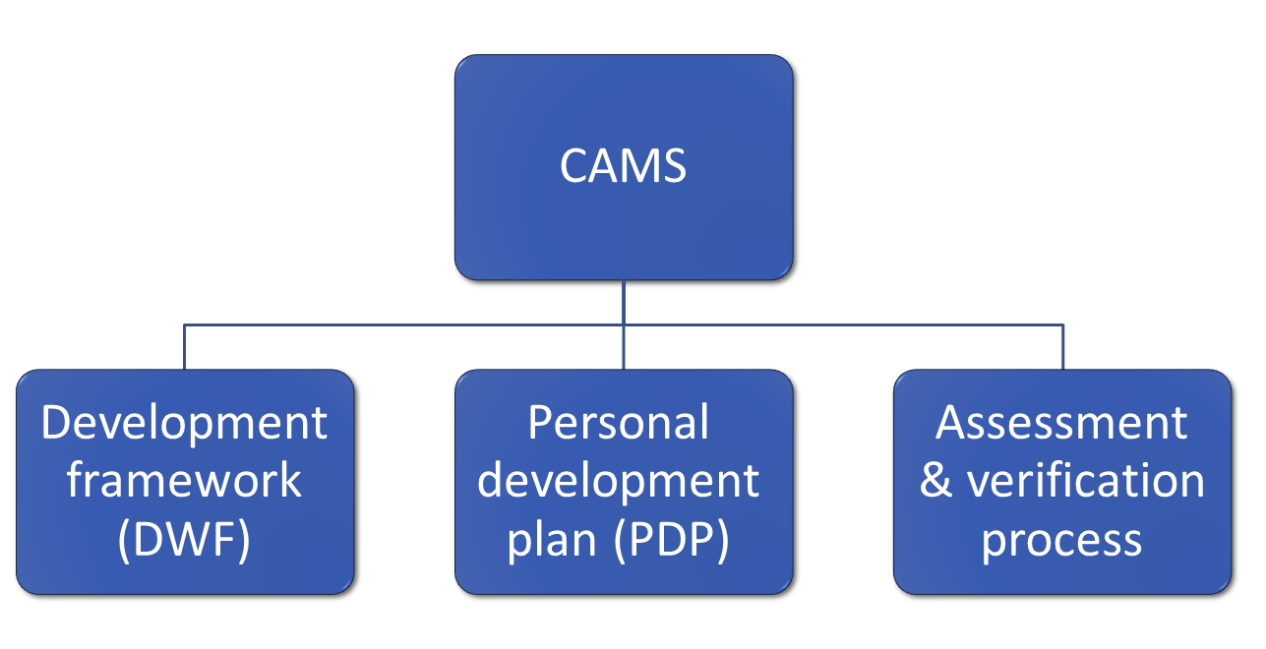
CAMS Components

Slide 9
Literature Review

Slide 10
Literature Review
The main topics necessary to understand and develop the CAMS system are :
Human Resource Management
Capacity Building
Development Frame Work (DFW)
Personal Development Plan (PDP)
Assessments & Verifications Process
Standard Operation Procedures Manual (SOPs)

Slide 11
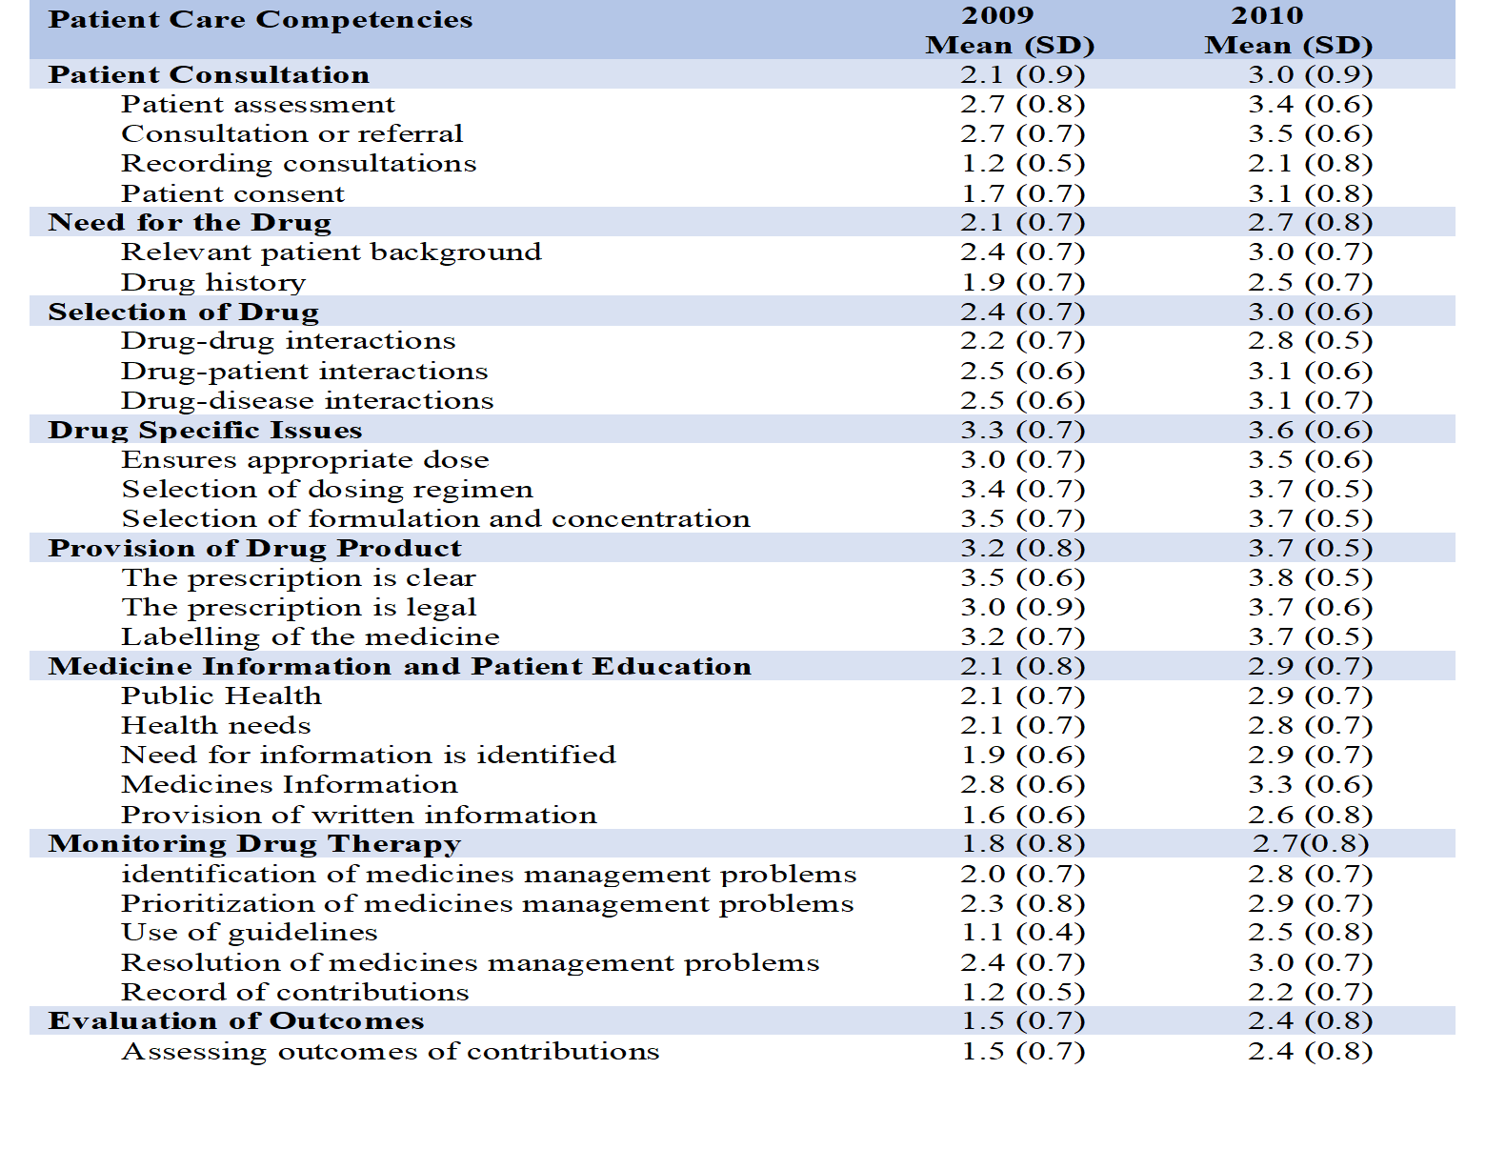

Slide 12
Detailed CAMS Components

Slide 13



Development Framework
Skill Profile
Each job title has a skills framework consisting of:
Type of competency.
Level of each competency.
Performance Criteria.
Development Framework
The competency framework acts as a "guideline" for moving a graduate from employment to proficiency and tells the graduate not only the skills to be acquired, but also how these skills can be acquired.
Job Assignments
Each job title has four job assignments.
Road Map
Guide the employee to take it step by step from the starting point to the efficiency point.

Slide 14

Development Framework Process
Fresh Graduate
Skill Profile
Newly Recruited
Job Assignment
Road Map
Previous Experience

Slide 15








Supporting Team
Supervisor
Target Position
Supervisor
Competency Assurance
Advisor
Skill Pool Expert (SPE)
Mentor
Coaching
Training coordination
Assessor & verifier

Slide 16
Personal Development Plan (PDP)
PDP specifies real work development activities and priorities that are aimed at identified competence 'gaps' where an individual does not meet the job standard and follows SMART principle.
Taking into consideration the previous experience, competencies and either he is a high potential or not, these can be known by assess the employee a primary assessment when he recruited “Base line Assessment & On Board Courses “, the tool used in the base line assessment stage is SWOT & Skill Gap Analysis.

Slide 17




Identify Development
Needs
Base line assessment and identification of strengths and weaknesses.
Planning
Prioritize development needs in consultation with the supervisor and draw up an action plan.
Assessment &Verification
Review the results and evaluate the achievements and progress.
Personal
Development
Plan
Implementation
Carrying out pre-defined tasks and functions within the framework of competencies.

Slide 18
Assessment & Verification
Assessment & Verification
Systematic methods of gathering data under standardized conditions and reaching a conclusion regarding the knowledge, qualification and potential of an employee.
Assessment &
Verification Event
Graduate.
Assessor.
Verifier.
Verification Planning
Assessor.
Verifier.
Assessment Planning
Graduate.
Assessor.

Slide 19
Developing Standard Operational Manual for CAMS

Slide 20
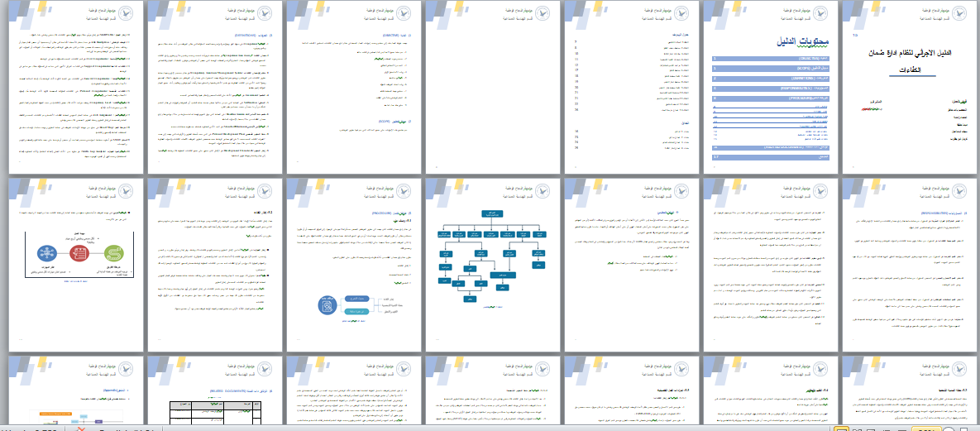

Slide 21
Developing Standard Operational Manual for CAMS
Standard Operating Procedures manual (SOPs) is a written document that lists the instructions, step-by-step, on how to complete a job task or how to handle a specific situation when it arises in the workplace, this manual may include tasks for the entire company, or separate manuals may exist for each department.
The main deliverables of Project 2 was a comprehensive Standard Operating Procedures (SOP’S) Manual for Competency Assurance Management System (CAMS) and its schemes & all essential documented to implement the system efficiently.

Slide 22
(SOPs) Manual for CAMS consist of six components, which are as follows:
Purpose
Scope
Definitions
Responsibilities
Detailed Procedures
Related Documents

Slide 23
Benefits of SOPs Manual
As workers obey the SOPs for a specific job, they create a reliable and straightforward product. Therefore, if your aim is to deliver the same output in the long run and maximize the profitability of your company, adopting SOPs will offer several benefits:
Readiness for Future Growth.
Simplify Performance Management.
Control the Quality and Consistency of Your Product.
Protect Yourself from Knowledge Loss.
Save on Training Costs.
Reduce errors and enhance productivity.

Slide 24
Development Methodology
The following points explain the methodology of work which the team uses to design the Standard Operation Procedures Manual for Competency Assurance Management System:
Collect and Analysis of Information
Design and Development
Description and Definitions
Discuss the Way of Apply of Competency Model
Detailed Work Procedures
Review the Model

Slide 25
Flowcharting
General Outline Flowchart
In this Flowchart we represents the structure of the competency assurance management system (CAMS) and the flow of steps in a three processes Previously explained ,for depiction the steps there are used specific shapes and graphic symbols which are linked by lines and directional arrows and is a convenient way to observe the follow the process from beginning to end ،also Some pictures are designed to illustrate some steps in a detailed way.

Slide 26
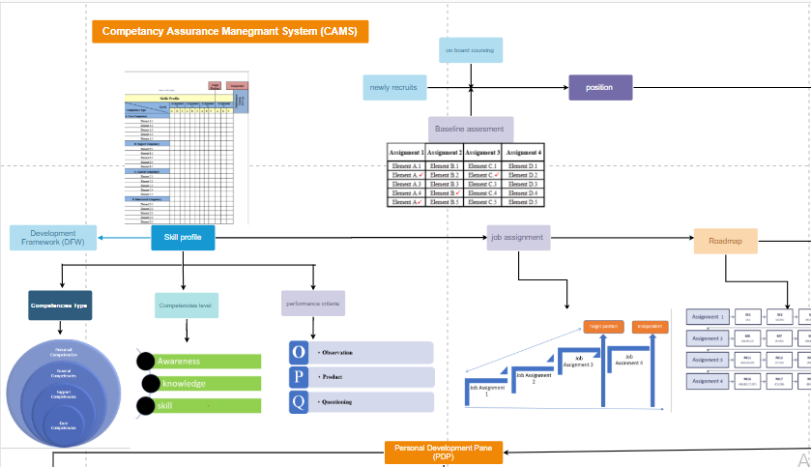

Slide 27
Flowchart of the DFW
Flowchart of a PDP
Flowchart of the Assessment & Verification Process

Slide 28
Organizational Structure
Organizational Structure of Competency Assurance Management System that defines vertical relations (from top to bottom; that is, between the presidents and subordinates) and horizontal relations (i.e. between employees at the same level). Responsibility can be determined on the basis of hierarchy, on the basis of jobs, or both.

Slide 29
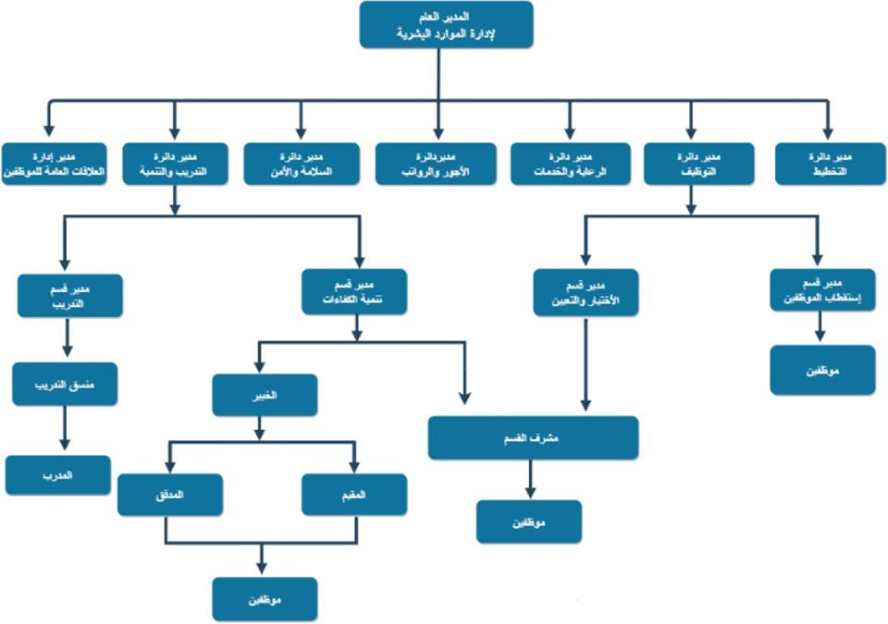

Slide 30
Documented Procedural Manual
Documenting your standard operating procedures facilitates the training of new employees, saves time, makes your business more scalable, reduces your liability risks, and adds market value to your business.
Here's a closer look at some of the causes the company's wants a documented manual of operations:
Training New Hires.
Saving Time.
Making Your Business More Scalable.
Reducing Liability.
Adding Market Value to Your Company.

Slide 31
Forms
We used different forms of manual documentation procedures, which are listed as follows:
Pre-Requisite Form (CAMS-01-03).
Road Map Form (CAMS-01-05).
From-To Form (CAMS-01-02).
Skill Profile Form (CAMS-01-04).
Job Description Form (CAMS-01-01).

Slide 32
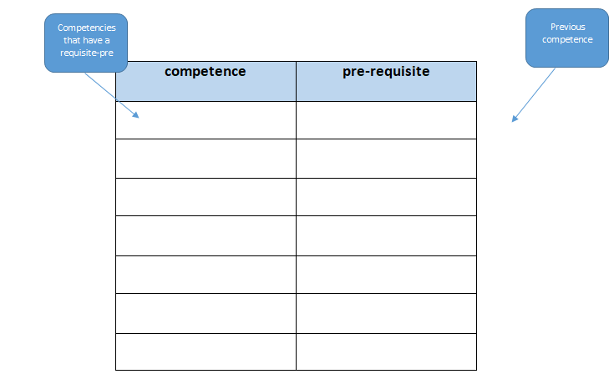
Pre-Requisite Form

Slide 33
Road Map Form
Assignment 1
M1
(A1)
M2
(A2,B1)
M3
(B3,C1,A3)
Assignment 2
M6
(A6,B4,C2)
M12
(C7,D4)
M13
(A9,C8)
M16
(A6,B2,C7)
M17
(C3,D8)
M18
(B5,C4)
M19
(C10,D9)
M20
(D10)
M8
(A8,B7,C4)
M9
(B8,C5,D1)
M10
(B9,D2)
M11
(B10,C6,D3)
Assignment 3
Assignment 4
M15
(B4,C2,D6)
M14
(A10,B7,C9)
M4
(A4,B2)
M5
(A5,B6,C3)
M7
(A7,B5)

Slide 34
From -To Form

Slide 35
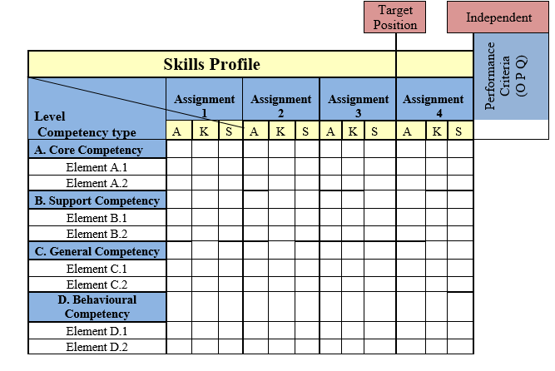
Skill Profile Form

Slide 36
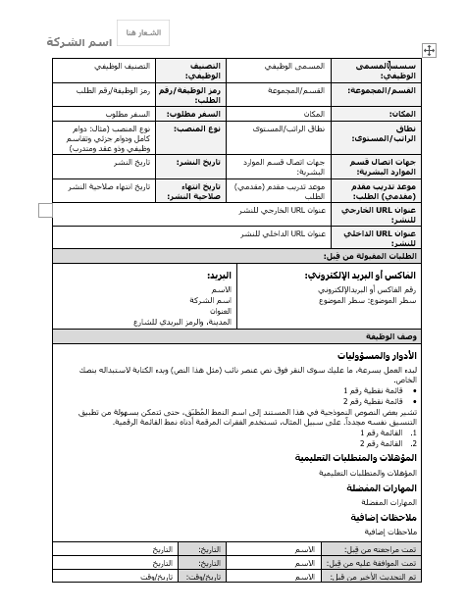
Job Description Form

Slide 37
Conclusion & Recommendation

Slide 38
Conclusion & Recommendation
CAMS considered as a Learning & Development System, which is the best system to develop competency newly recruits (fresh graduates).
In this project, we designed the templates and documents for the Standard Operating Procedures (SOPs) Manual for the each component of Competency Assurance Management System (CAMS).

Slide 39
Conclusion & Recommendation
Project group members advise the Palestinian companies to implement the Competency Assurance Management System to ensure that all works are performed by competent people and improve their employee’s competencies and ensure their progression, in order to increase the company’s performance.

Slide 40


