Slide 1

Graduation Project II
Faculty of Engineering & Information Technology
Department of Building Engineering
Design of New Generation Secondary School
Prepared by : Odai Abo-Aishe
Mostafa Al-Haj Qasem
Supervisor: Dr.Mutasim Baba

Slide 2
Outline:
Introduction.
Site location.
Architectural design.
Environmental design.
Structural design.
Electro-Mechanical design.
Safety design.
Quantity survey and cost.

Slide 3
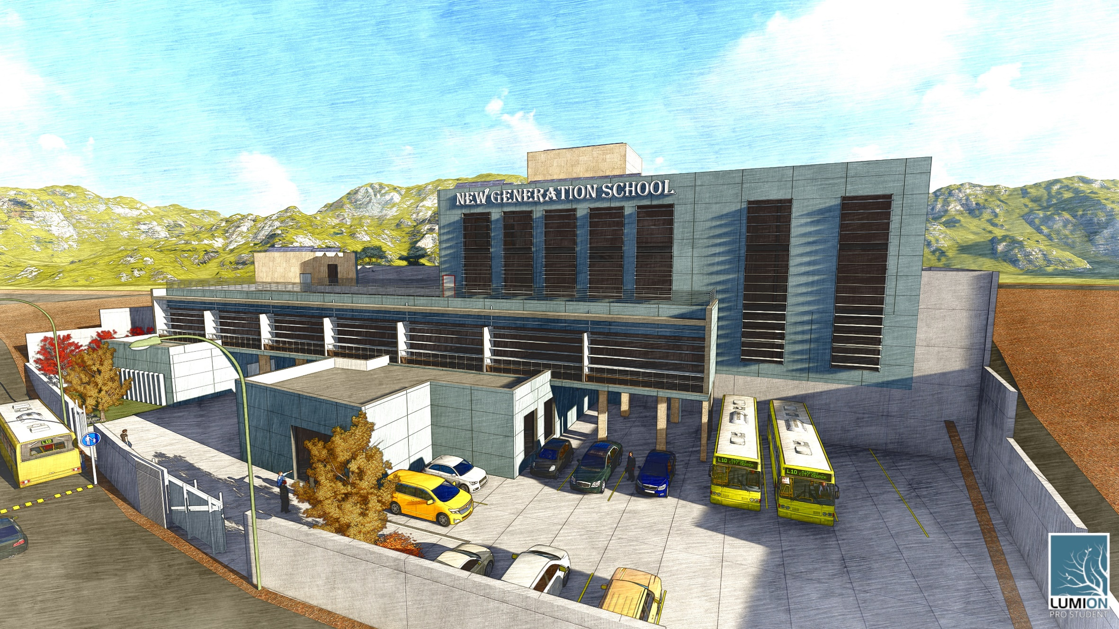
Introduction:

Slide 4
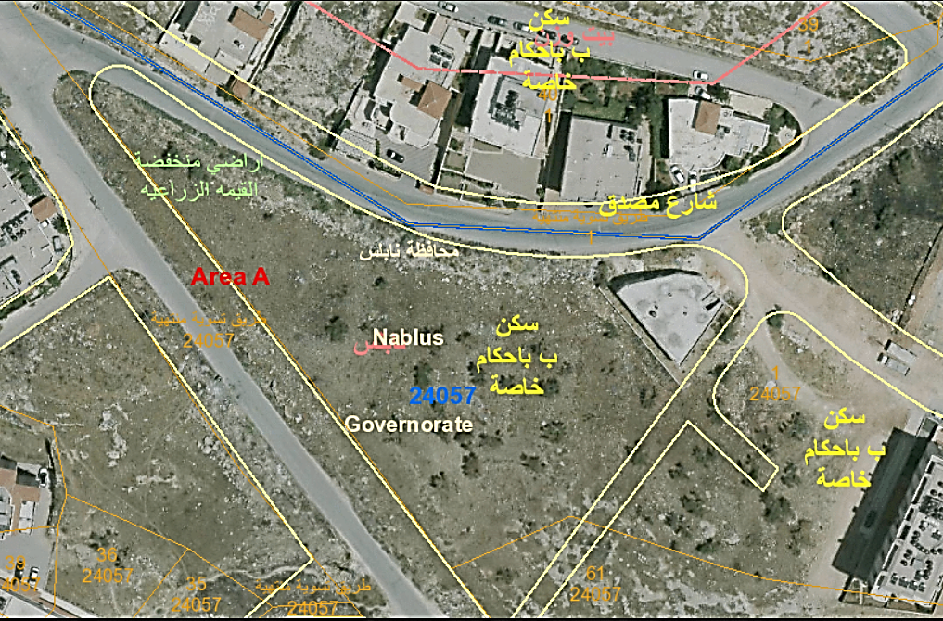
Site location:
The land located at the Al- Ma'ajin suburb about 3 Km west of the city center, on latitude 32.23° north and longitude 35.25° east.

Slide 6
Architectural design

Slide 7
Architectural design:
Entrance
Reception
Headmaster room
Social worker room
Clinic
Multipurpose hall
Classrooms
Science lab.
Library
Toilets
Teachers room
Secretary room
Computer lab.
Stores
New Generation secondary school spaces

Slide 8

Area=708.5 $m^{2}$
Ground floor

Slide 9

Area=1031 $m^{2}$
First floor

Slide 10

Area=390 $m^{2}$
Second floor

Slide 11

Area=619 $m^{2}$
Third floor

Slide 18
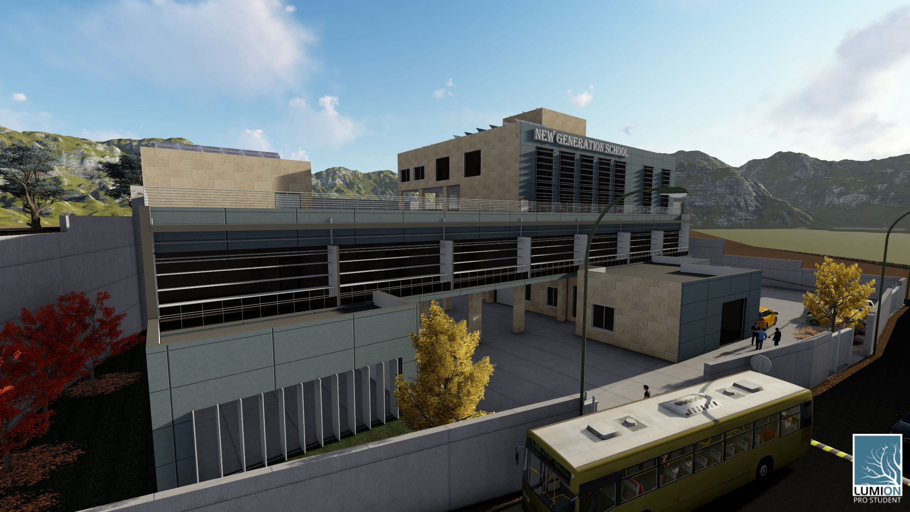
3D model

Slide 19
Area spaces:

Slide 20
Environmental design

Slide 21
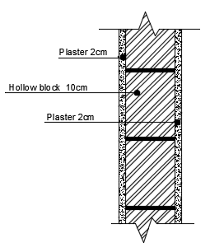
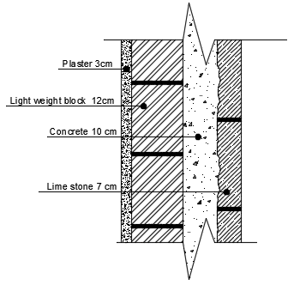
Thermal design:
Walls layer:
External wall layers
Internal wall layers

Slide 22
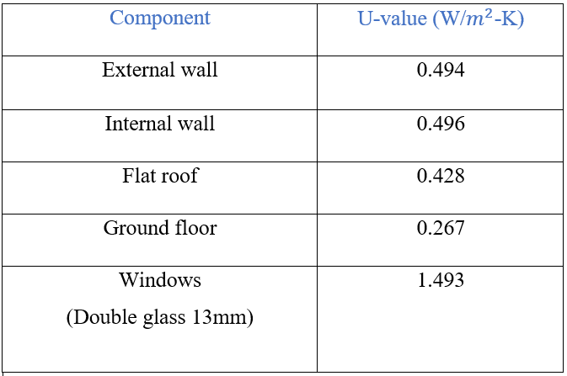
U-values:

Slide 23
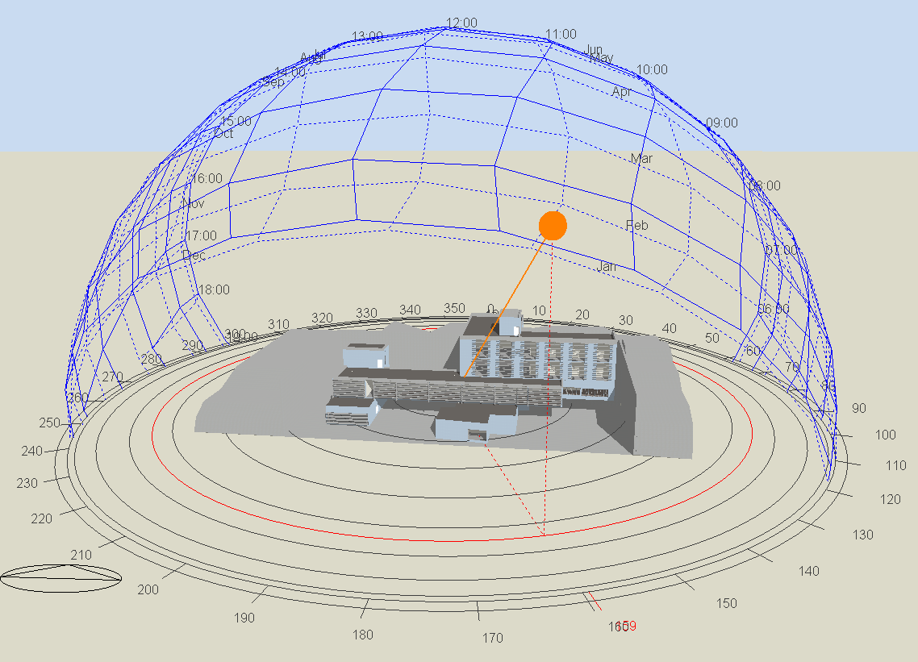
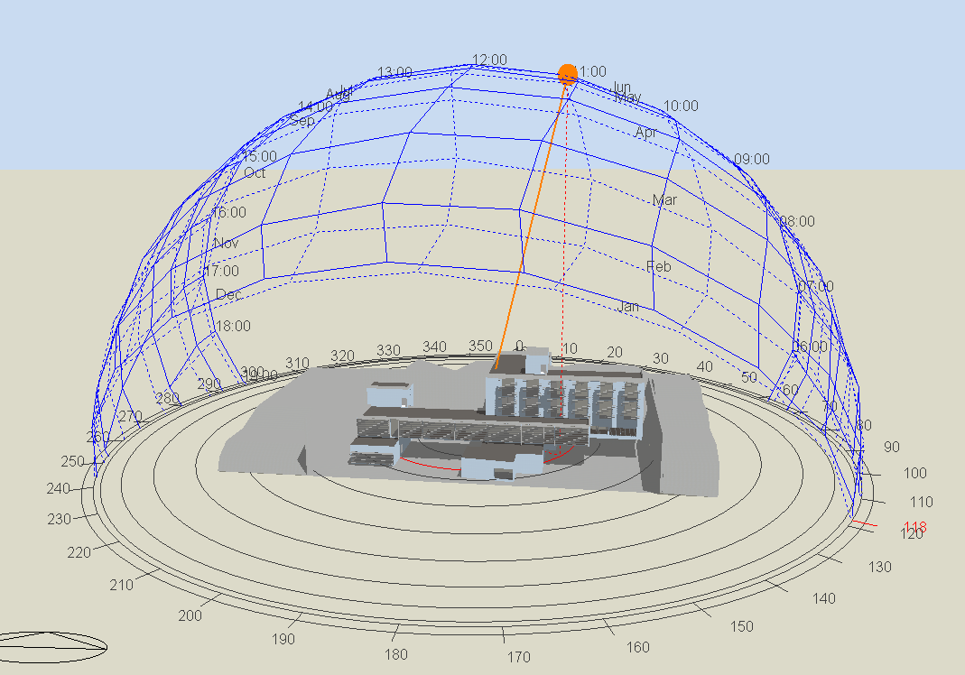
Sun path at 21st Jan.
11:00am
Sun path at 21st June
11:00am

Slide 24
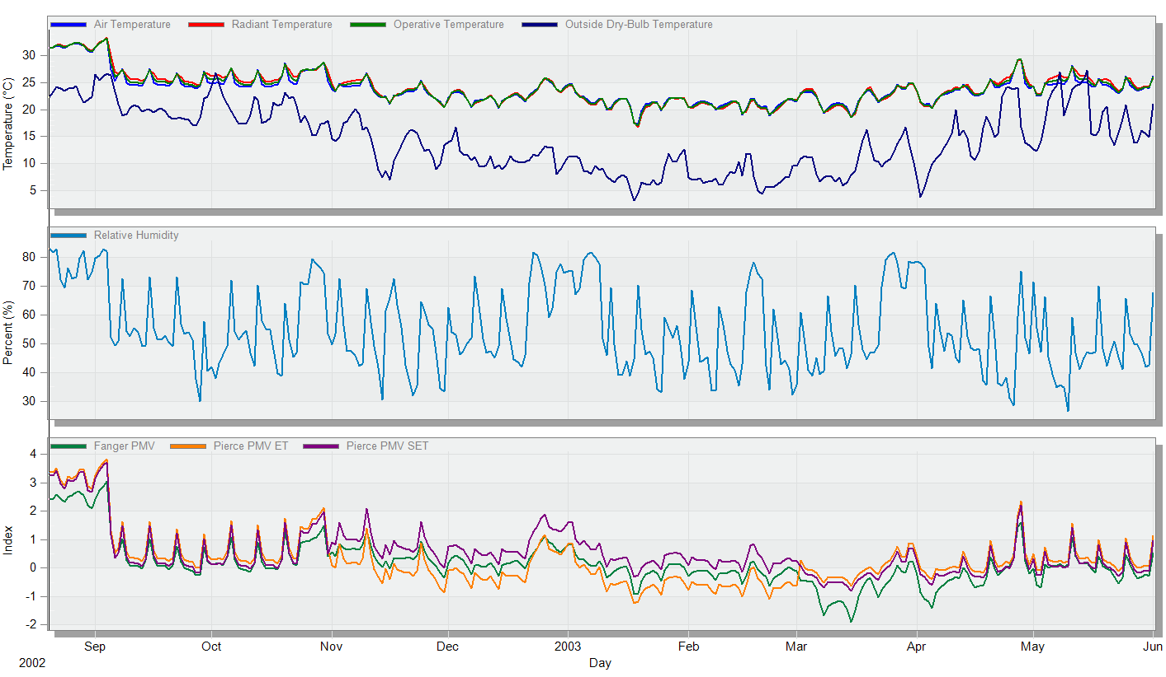
Design builder results:

Slide 25
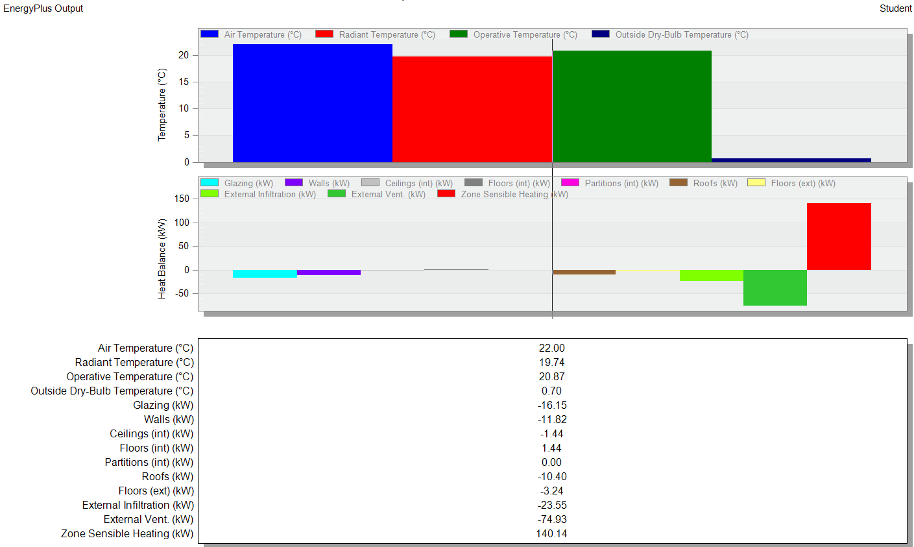
Design builder results:

Slide 26
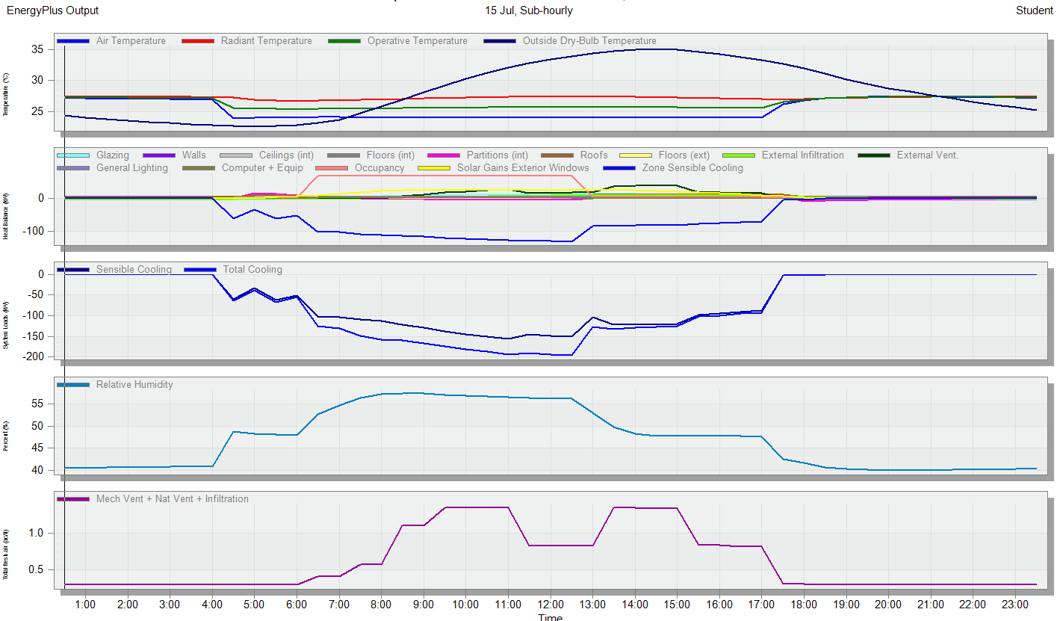
Design builder results:

Slide 27
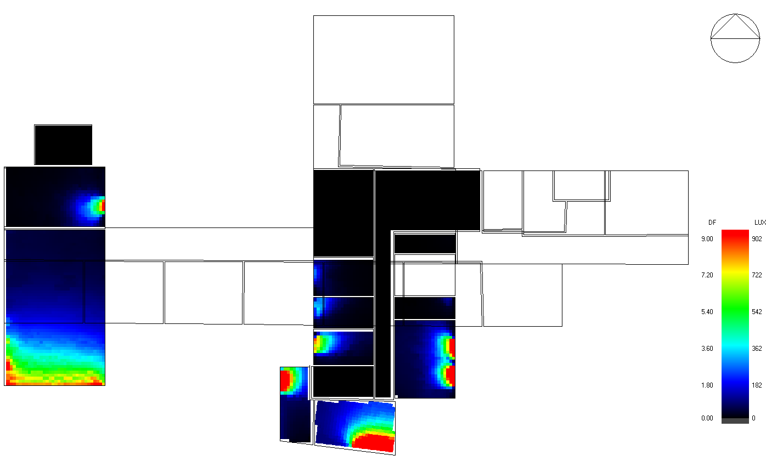
Daylight factor:
Ground floor

Slide 28
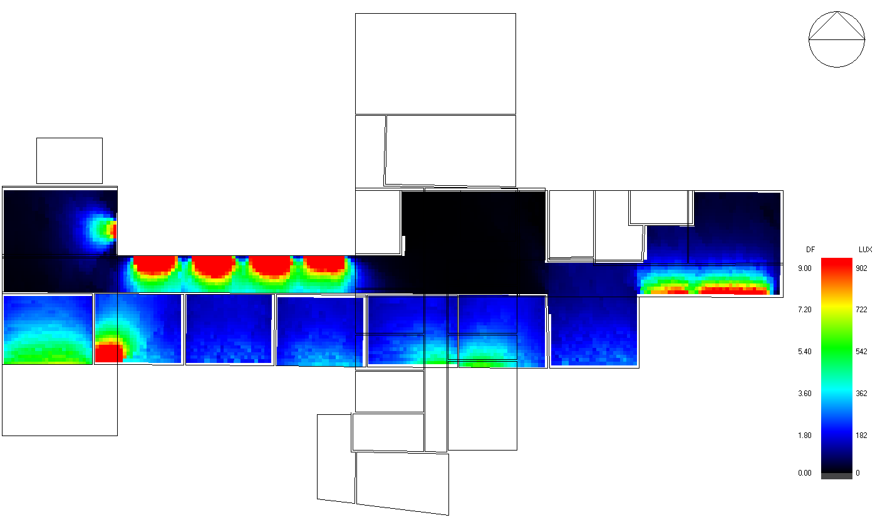
First floor

Slide 29
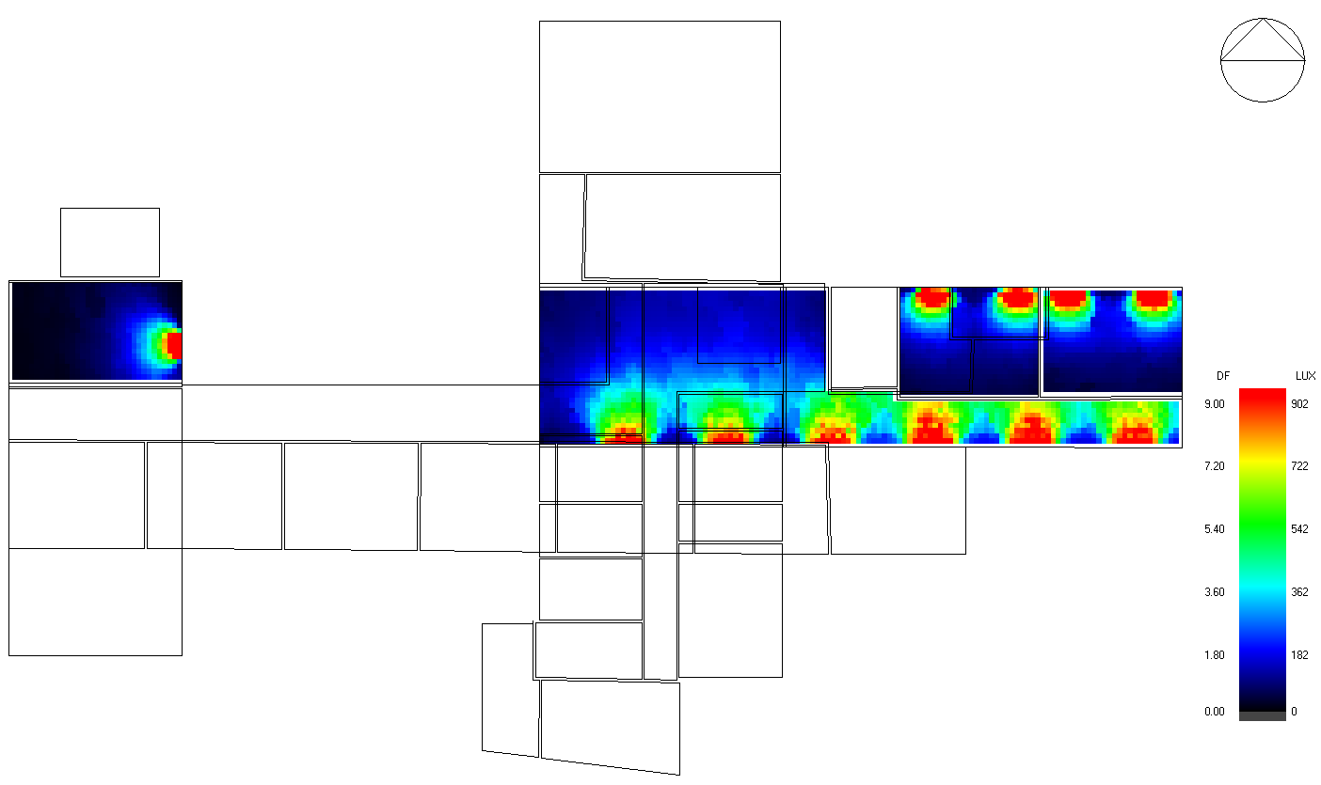
Second floor

Slide 30
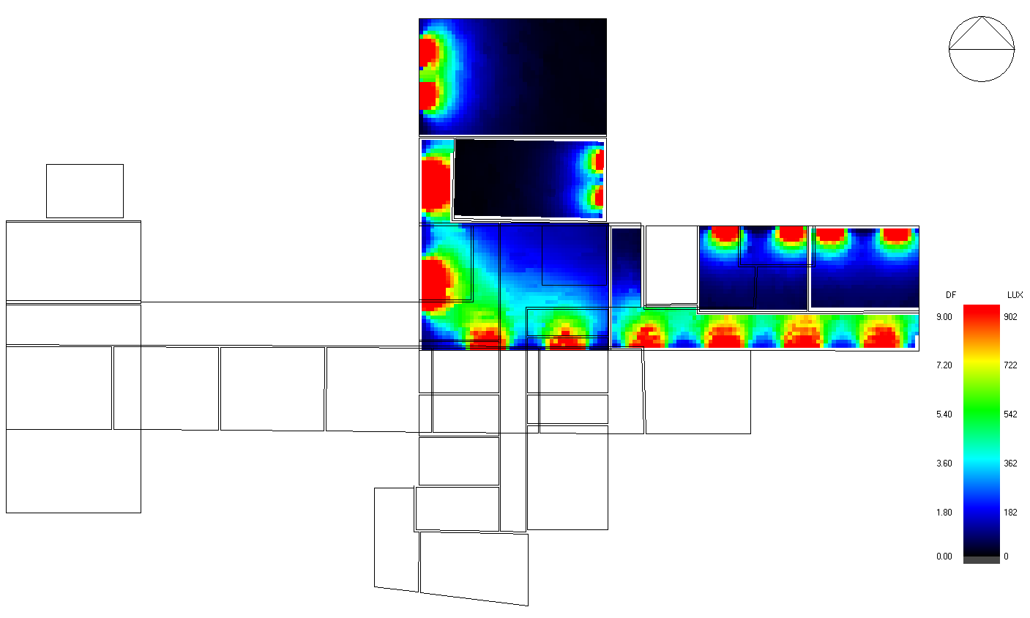
Third floor

Slide 31
Acoustical analysis:
Acoustical ceiling absorption

Slide 32
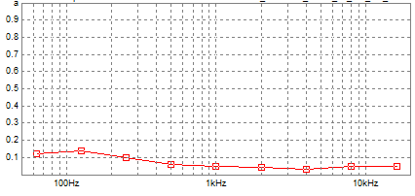
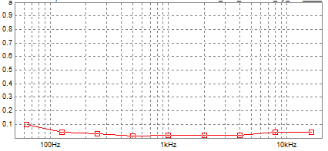
Plaster absorption
Tile absorption

Slide 33
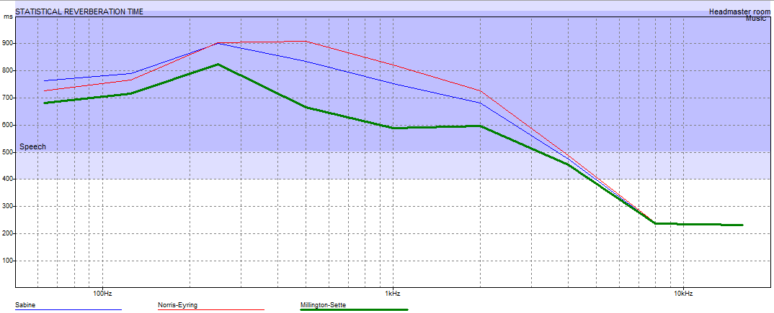
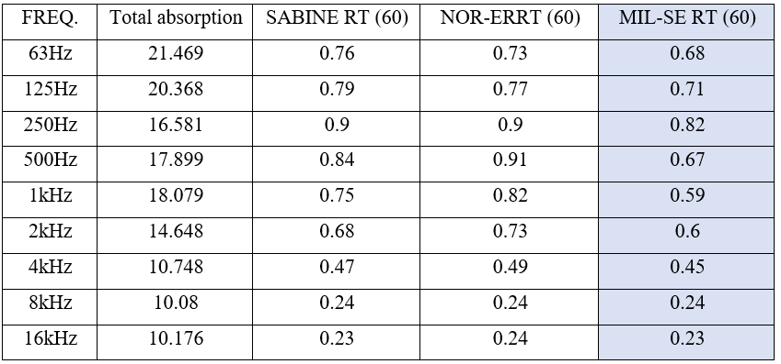

Reverberation time ${RT}_{60}$:
Head master room:
RT60 standard at (500- 1000) Hz = 0.5 to 0.8
Depending on Millington-sette curve at
(500-1000) Hz Rt60 = 0.67 and 0.59 which it within the required range.

Slide 34
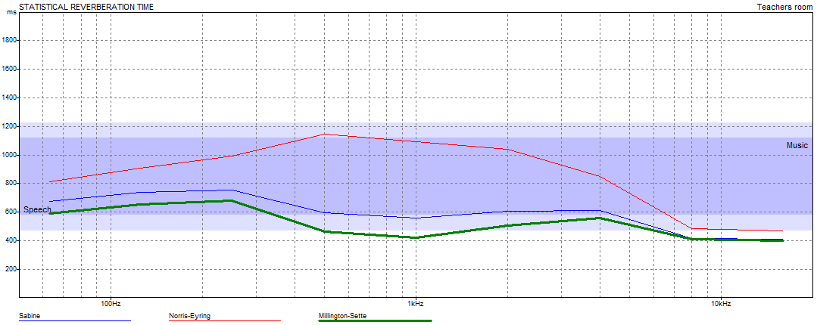
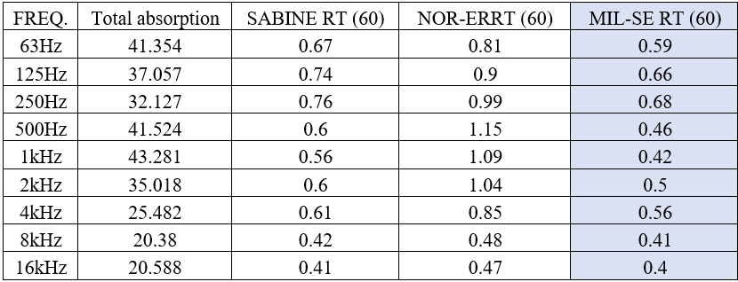
Teachers room:
RT60 standard at (500- 1000) Hz = 0.4 to 0.8
Depending on Millington-sette curve at
(500-1000) Hz Rt60 = 0.46 and 0.42 which it within the required range.

Slide 35
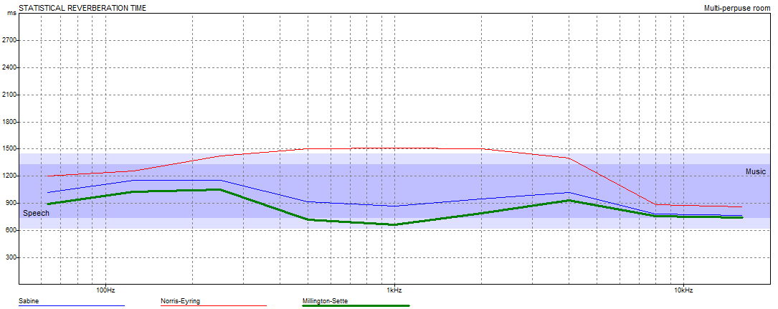
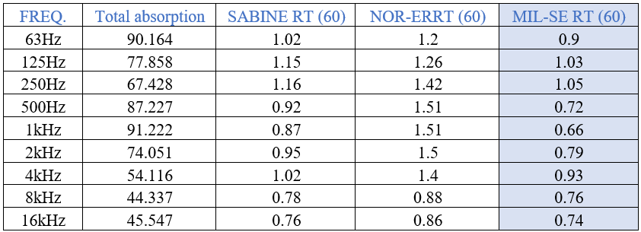
Multipurpose hall:
RT60 standard at (500- 1000) Hz = 0.6 to 0.9
Depending on Millington-sette curve at
(500-1000) Hz Rt60 = 0.72 and 0.66 which it within the required range.

Slide 36
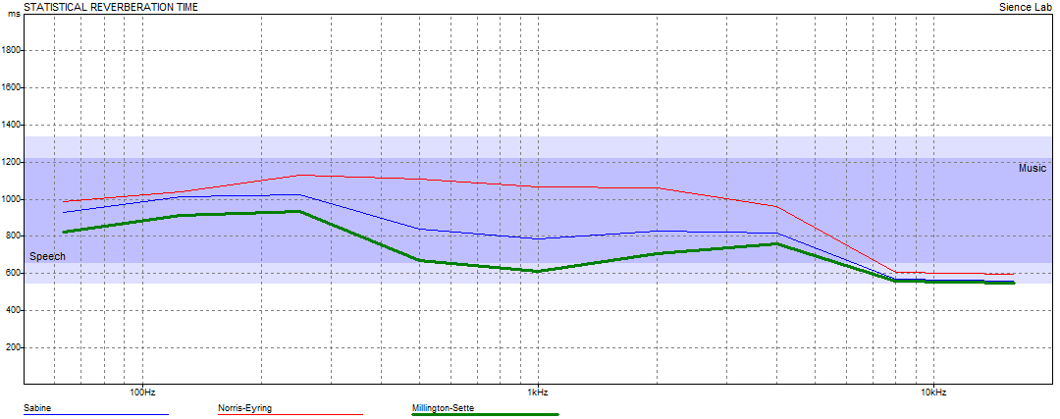
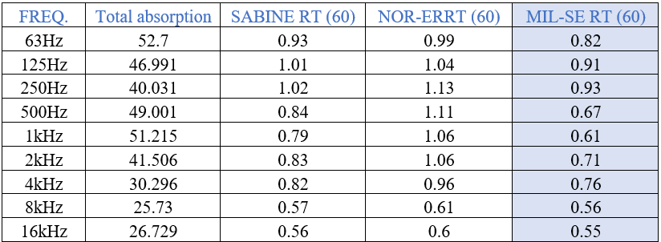
Science lab.:
RT60 standard at (500- 1000) Hz = 0.6 to 0.8
Depending on Millington-sette curve at
(500-1000) Hz Rt60 = 0.67 and 0.61 which it within the required range.

Slide 37
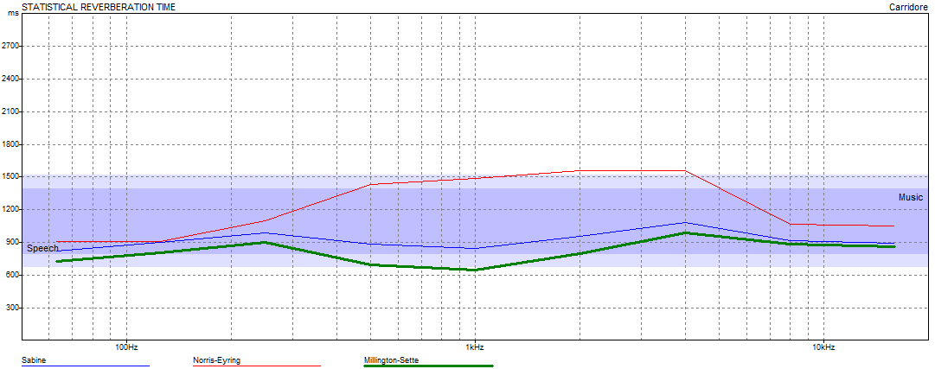
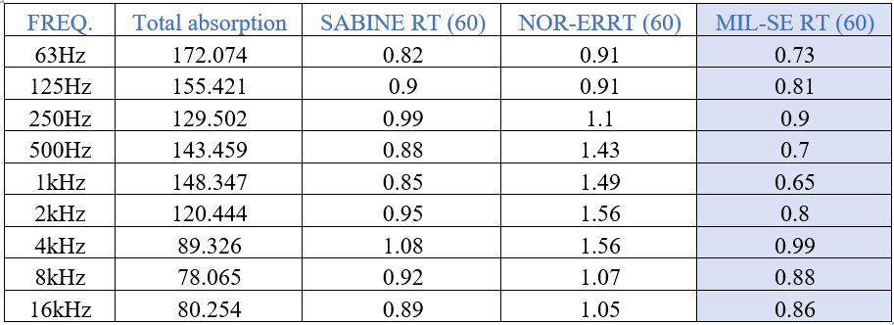
Corridor:
RT60 standard at (500- 1000) Hz = 0.6 to 0.9
Depending on Millington-sette curve at
(500-1000) Hz Rt60 = 0. 7 and 0.65 which it within the required range.

Slide 38
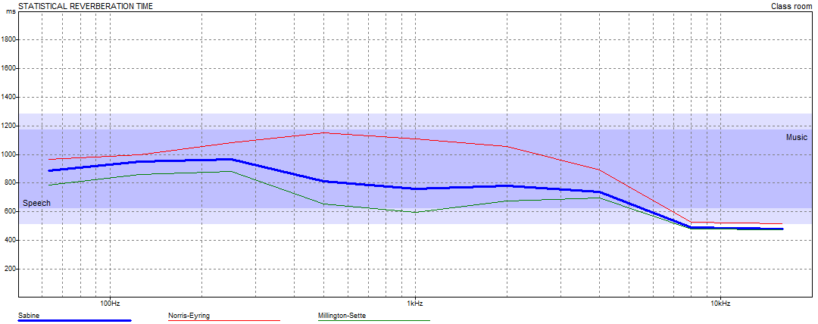
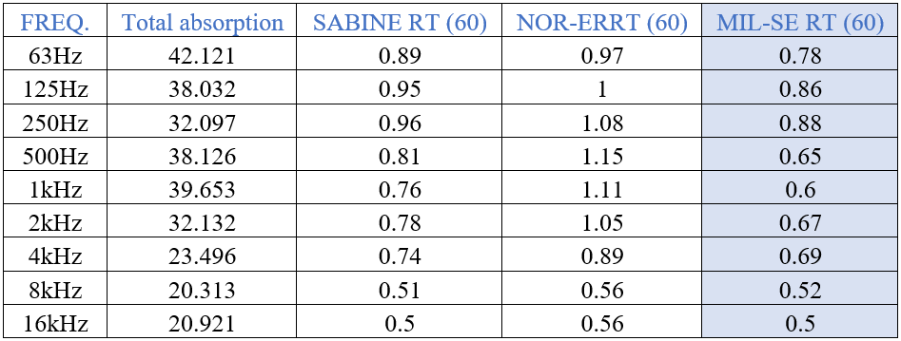
Class room:
RT60 standard at (500- 1000) Hz = 0.6 to 0.8
Depending on Millington-sette curve at
(500-1000) Hz Rt60 = 0. 65 and 0.6 which it within the required range.

Slide 39
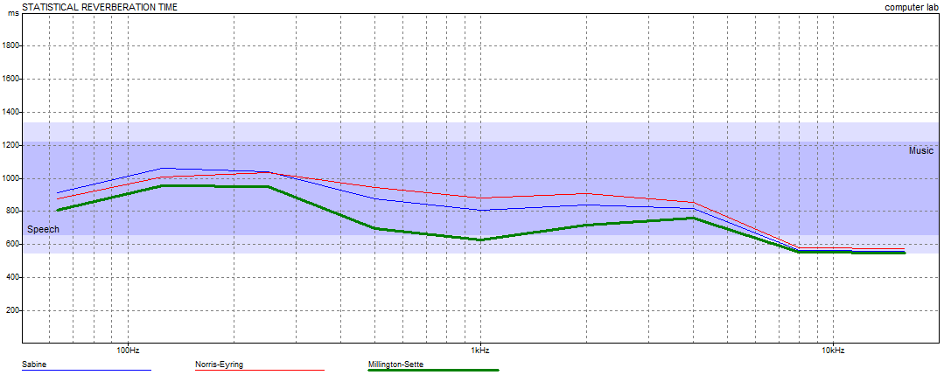
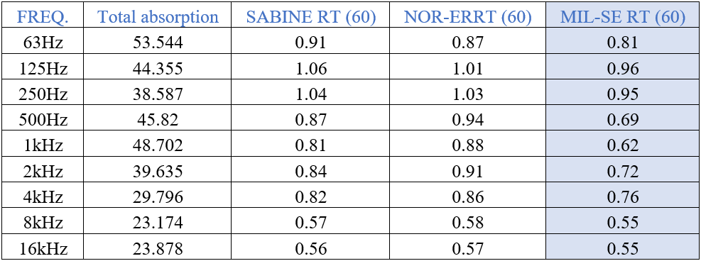
Computer lab.:
RT60 standard at (500- 1000) Hz = 0.6 to 0.8
Depending on Millington-sette curve at
(500-1000) Hz Rt60 = 0. 69 and 0.62 which it within the required range.

Slide 40
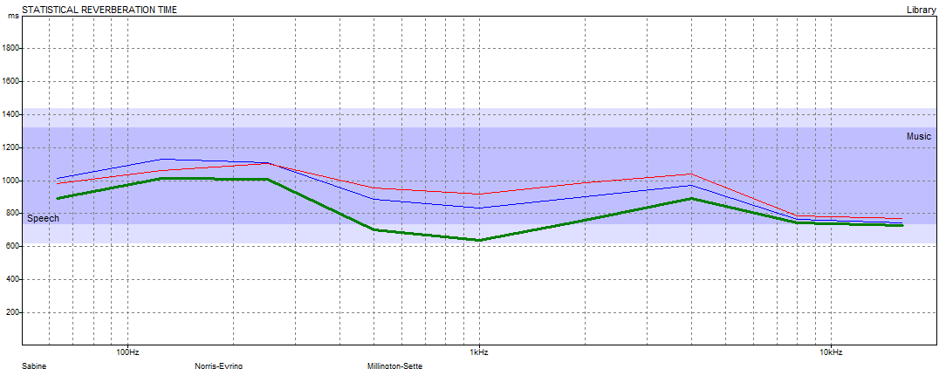
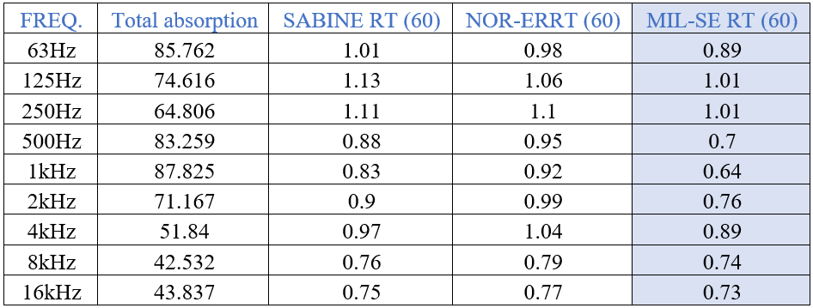
Library:
RT60 standard at (500- 1000) Hz = 0.6 to 0.8
Depending on Millington-sette curve at
(500-1000) Hz Rt60 = 0. 7 and 0.64 which it within the required range.

Slide 41
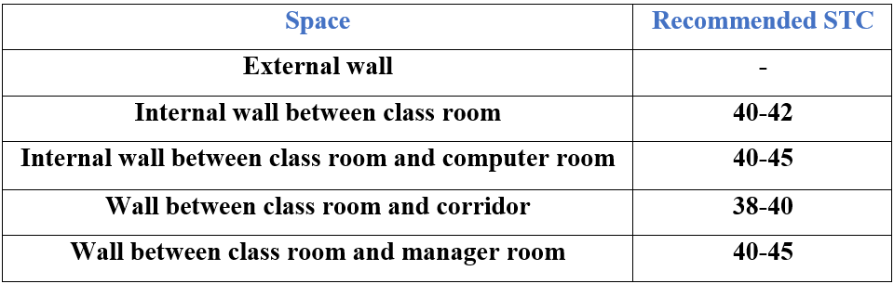
Sound transmission class (STC):
Recommended values for STC:

Slide 42
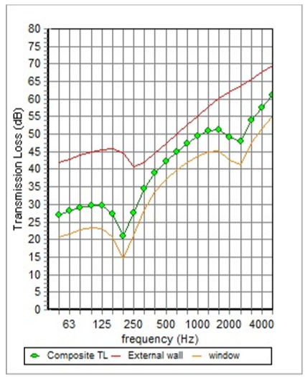
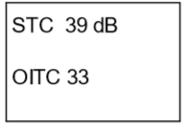
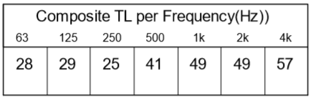
External wall :

Slide 43
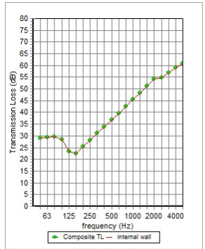


Internal wall :

Slide 44
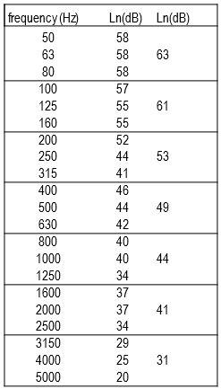
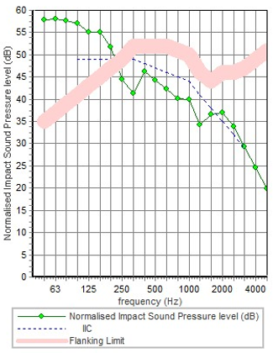
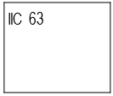
IIC for slab between floors:

Slide 45
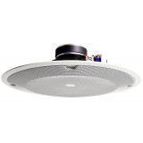
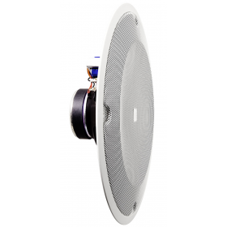
Loudspeakers:
Internal loudspeakers:
JBL 8138 4PC 8 inch In-Ceiling Speakers

Slide 46
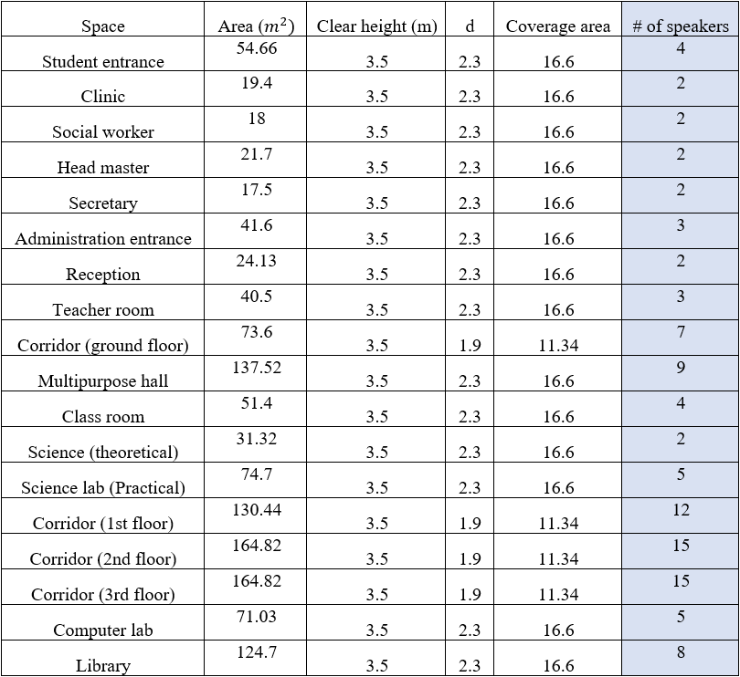

Slide 47
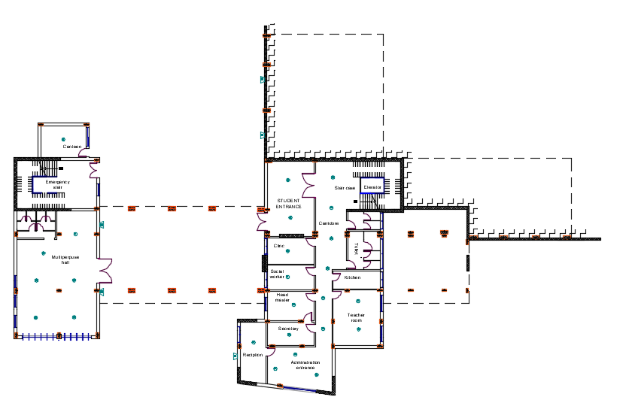
Loudspeakers distribution
Louadspeakers distribution for Ground floor

Slide 48
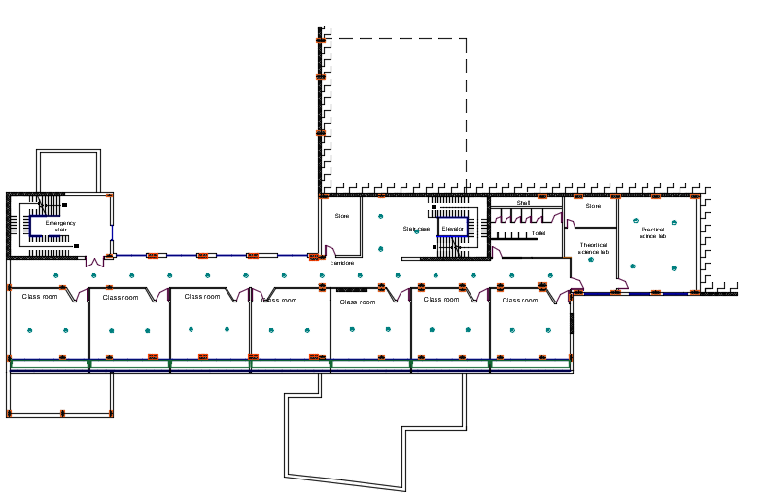
Louadspeakers distribution for first floor

Slide 49
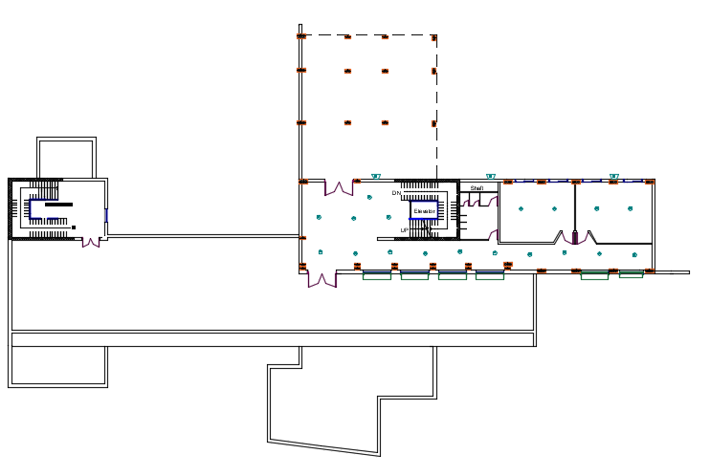
Louadspeakers distribution for second floor

Slide 50
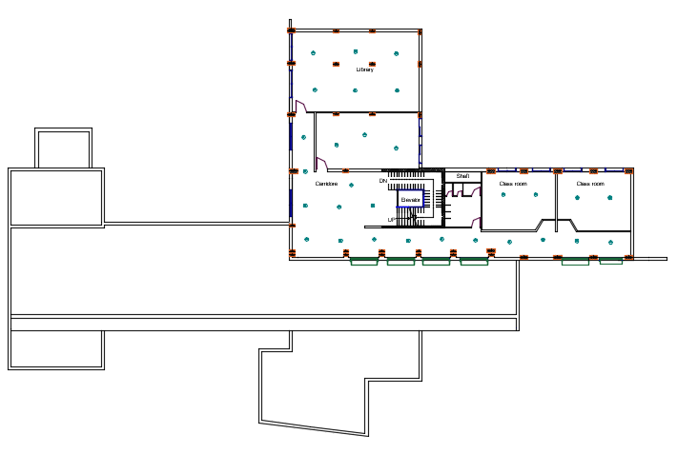
Louadspeakers distribution for third floor

Slide 51
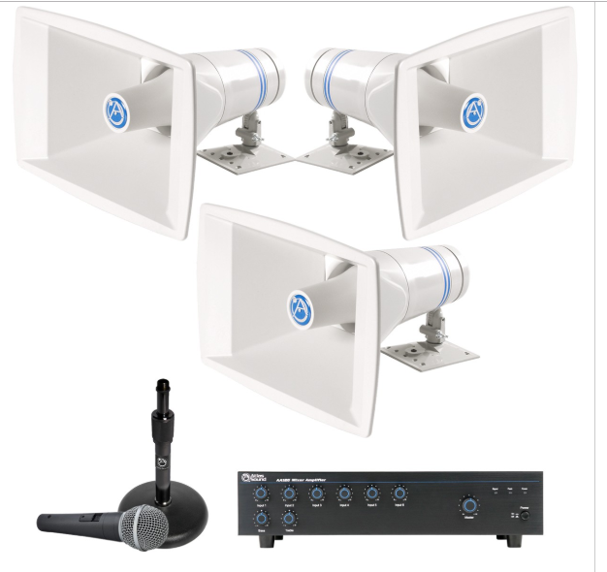
External loudspeakers:
Stadium Sound System Atlas Sound Paging Horn Loudspeakers and Mixer Amplifier

Slide 52
Structural design

Slide 53
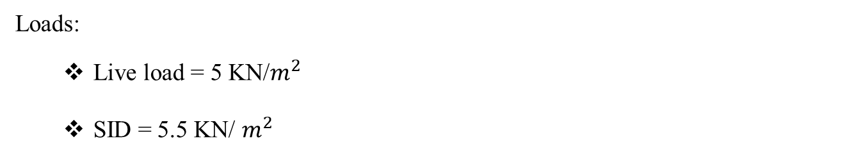
Codes & Loads:
Codes:
  ACI -318-14 for reinforced concrete structural design.
  UBC -97 for seismic design.
  ASCE for load combinations.
Loads:
  Live load = 5 KN/$m^{2}$
  SID = 5.5 KN/ $m^{2}$

Slide 54

Seismic Load:
  The city of structure is Nablus.
  The seismic zone factor ( Z = 0.2).
  The soil profile is type $S_{c}$.
  The acceleration seismic coefficient $C_{a}$ = 0.24
  The velocity seismic coefficient $C_{v}$ = 0.32
  The Seismic importance factor = 1.25
  The structural design type is intermediate, R=5.5

Slide 55

Structural system:
One way ribbed slab with drop beams.
Two way solid slab with drop beams.
Materials:
Concrete:
$f_{c}^{ˋ}$ = 24 mpa (B300)
Steel:
$f_{y}$ = 420 mpa

Slide 56

We divided our building into 3 blocks by structural breaker because of difference in levels of building.
3D model-Block1

Slide 57

3D model-Block 2

Slide 58

3D model-Block 3

Slide 59

Model checks:
Compatibility check:
It’s OK

Slide 60

Equilibrium check:
Internal forces check:
Done for 3 samples of slab strip, beams and columns within difference less than 10%

Slide 61


Deflection check:
Limit = $\frac{L}{240}$
= $\frac{10.5}{240}$ = 43mm

Slide 62


Period check:
Period from manual calculation = 0.355 second
From ETABS = 0.35
So, it’s OK.
Base shear check:
$V_{manual}$ = 1950.5 KN
V from ETABS:
EQx = 1950.75 KN> $V_{manual}$
EQy = 1950.54 KN> $V_{manual}$
OK.

Slide 63


Drift check:
$∆_{M}$ = 0.7* R $∆_{S}$
Limit = 0.025 * Height of story, T < 0.7 sec.
OK.

Slide 64


Section dimensions:

Slide 65

Reinforcement:
Slab reinforcement:
Ground slab:

Slide 66


First floor slab:

Slide 67

Beams reinforcement:
Main beams:

Slide 68



Slide 69

Secondary beams:

Slide 70



Slide 71

Columns reinforcement:

Slide 72



Slide 73

Shear walls reinforcement:

Slide 74



Slide 75

Footings reinforcement:

Slide 76


Slide 77


Slide 78

Retaining wall reinforcement:
Reinforce by minimum steel
$ρ_{min}$ = 0.0033
$A_{s}$ = 990 ${mm}^{2}$/m = 5 ø 16 /m
= ø 16 @ 200 mm

Slide 79



Slide 80
Electro-Mechanical System design

Slide 81


Water supply system:

Slide 82

Water sypply system for first floor

Slide 83

Water sypply system for second floor

Slide 84

Water consumption:
Water consumption per day in school = 6300 liter/day

Slide 85
Water Supply system
Due to Palestine's water problems, there is a need to design a water tank to store water,
Palestinian school it is open 5 day so we need a sufficient water tank during this period
Water tank capacity = 6300 liter/day * 5day = 31500 liter.
In our project, we relied on municipal water as a main water supply, where it are collected in water tanks with ( 4 * 4 * 5 )meter dimension 80 cube

Slide 86
And for daily consumption we use:
1- For cold water 4 tanks.
2- For hot 2 tanks.
3- For recycled water 2 tanks.

Slide 87

Water tanks

Slide 88

Water drainage system:

Slide 89

Water drainage system for first floor

Slide 90

Water drainage system for ground floor

Slide 91

Rain water drainage system:

Slide 92

Radiator system:
Hot water heating system used is two - pipe reversed return system in first, second and third floor.

Slide 93

Hot water heating system in ground floor as showen in the figure.
Radiator system for ground floor

Slide 94

Radiator system for first floor

Slide 95

Radiator system for second floor

Slide 96

Radiator system for third floor

Slide 97





Type of radiator was selected from stelrrad cast-iron radiators catalogue.
Model name: Soft line H P+-Brag box.

Slide 98

Number of Radiators:
For ground floor:

Slide 99

For First floor:

Slide 100


For Second floor:
For third floor:

Slide 101
Fire fighting system

Slide 102






Fire extinguisher.
Hose station.
Heat detector.
Smoke detector.
Warning signs.
Manual alarm.

Slide 103


Fire fighting system for ground floor

Slide 104

Fire fighting system for first floor

Slide 105

Fire fighting system for second floor

Slide 106

Fire fighting system for third floor

Slide 107

Emergency egress system:
Ground floor

Slide 108

First floor

Slide 109

Second floor

Slide 110

Third floor

Slide 111

Elevator design:
Use 1 panorama elevator with 2500 capacity and 350 fpm .

Slide 112
Electrical system

Slide 113
Artificial lighting:
DIALux evo 8.0 software was used for design following spaces.
Multipurpose hall.
Clinic.
Head master, Secretary, Social worker, and teacher room.
Corridor.
Class room.
Library.
Computer lab, and science lab.

Slide 114
Luminaire types:
Five type of luminaire used for design the school:
Thorn lighting – 96535734 DUOPRF 2*28W T16 HF.
Thorn lighting - 96629737 OMEGA PRO LED4200-830.
Thorn Lighting – 96629743 OMEGA LED 3300-840 HF.
Thorn lighting – 96629747 OMEGA LED 3300-840.
2*13W PL GLOBE LIGHT.

Slide 115





Slide 116


3D rendering View for selected rooms:
Class room
Computer lab

Slide 117

Ground floor lighting plan:

Slide 118

Ground floor socket plan:

Slide 119

First floor lighting plan:

Slide 120

First floor socket plan:

Slide 121

Second floor lighting plan:

Slide 122

Second floor socket plan:

Slide 123

Third floor lighting plan:

Slide 124

Third floor socket plan:

Slide 125

Distribution board design:

Slide 126

Main distribution board:

Slide 127
Quantity Survey

Slide 128


Slide 129
Thank You

