Slide 1
An-Najah National University
Civil Engineering Department
Analysis and Design of the Attil's Waterworks
Prepared by :
Ameed Heshme
Hossni Jallad
Hisham Hamad
Alaa Demide
Supervision : Dr. Abdel-fattah Hassan

Slide 2
outline
Introduction
Objectives
Description of study area
Methodology
Software programs
analysis of existing water distribution network (review)
Design of Wastewater Collection Network
Design of waste water treatment plant
Results

Slide 3
Introduction
Water take a great importance to humans in everyday life most of the activities we do need water. So that demand is continuously increasing, this means increasing the wastewater production, where wastewater constitutes about (80%-90%) of water demand

Slide 4
Objectives
Analysis and redesign of existing water distribution network.
Design of Wastewater collection network that have life period of 30 years.
Design of waste water treatment plante that have life period of 30 years.

Slide 5
Significance of the work
To supply water in the future at an adequate pressure and flow.
To get rid of wastewater in safe and healthy ways instead of cesspits.
To benefit from treated water and reuse in the field of agriculture
To have an economic design as possible for all networks.

Slide 6
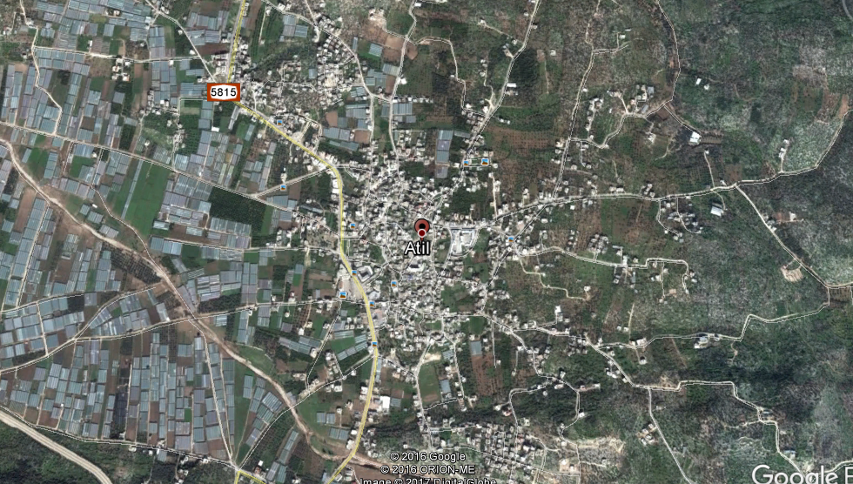
Study Area

Slide 7
Area Description
Study area | Attil's town in the Tulkarm government
Area | 7337 dunams
Current population | 12000 capita
Topography | 100 m above mean sea level
Water recourses | Abu sabha well

Slide 8
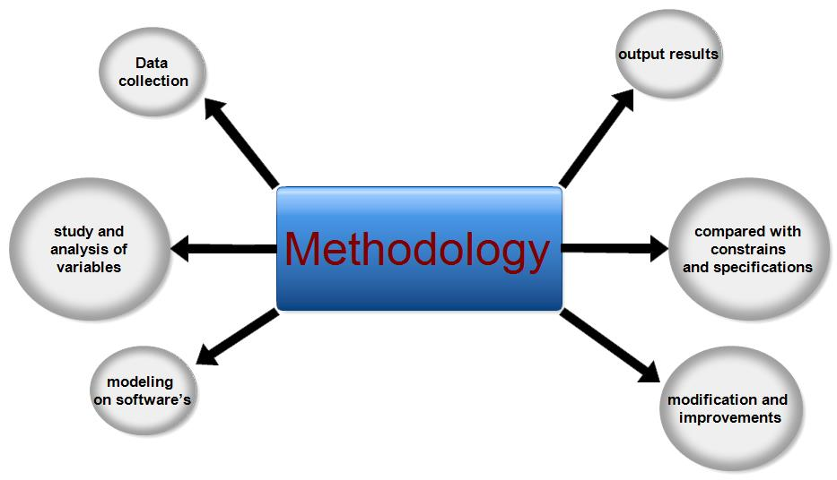
Methodology

Slide 9
Software program
We conducted the analysis of water net work by using a software program is (Water CAD) , which used in graduation project 1 .
We conducted the design of sewerage network by using a software program is (Sewer CAD) , and the GPS-X for mathematical modeling, simulation, optimization and management of wastewater treatment plant

Slide 10
Part 1: analysis of existing water distribution network (review)
In the Graduation Project 1 we analysis the water distribution network of Attil's town that is consist of junctions , pipes, one reservoir , one storage tank(100 m3).
It’s a Combination of both Branched and Looped network.
The Water peak demand =7260 m³/Day.

Slide 11
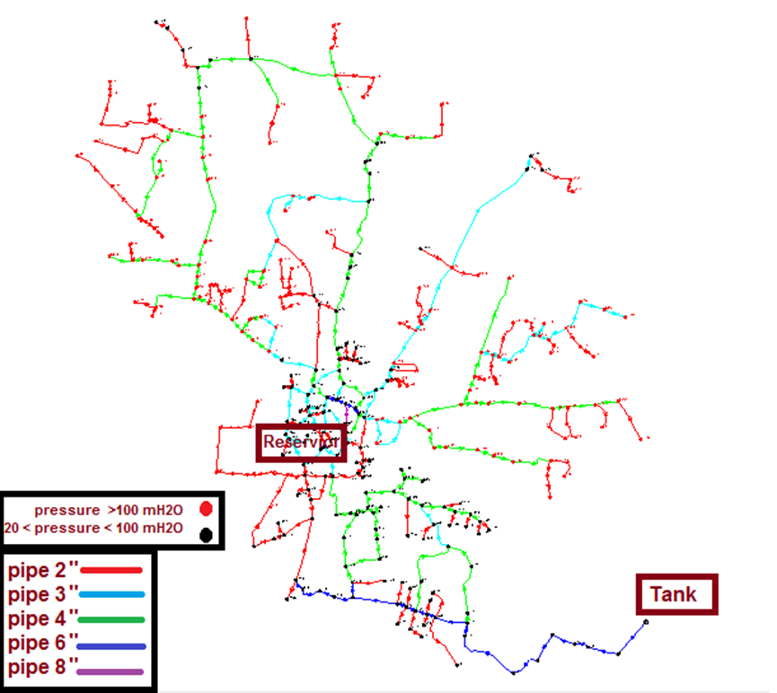
Modeling and analysis of water distribution network

Slide 12
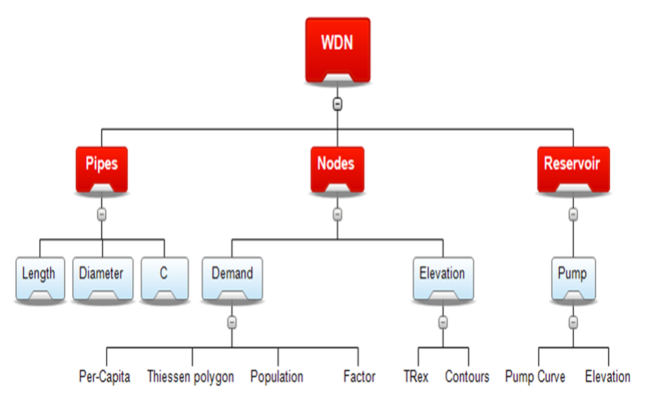
Water Distribution Network

Slide 13
Water Distribution Network
Elements | Number of the elements
Reservoir | 1
Storage tank | 1
Nodes | 300
Pipes | 329

Slide 14
Water Distribution Network
Design constraints
Velocity in pipes (0.3 – 3) m/s.
Pressure at junctions (20-100) mH20.

Slide 15
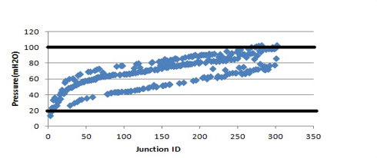
Results of modeling:
After run the model we get the following results:
Pressure at nodes (m H2O(

Slide 16
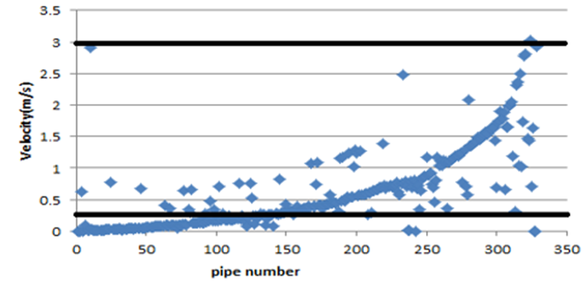
Results of modeling:
Velocity in pipes (m/s)

Slide 17

Part 2: Design of Wastewater Collection Network

Slide 18
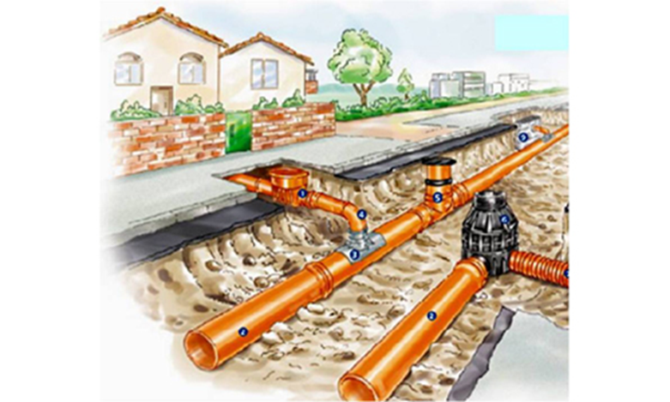
Waste Water Network Components
Manholes
Conduits
Outfall

Slide 19
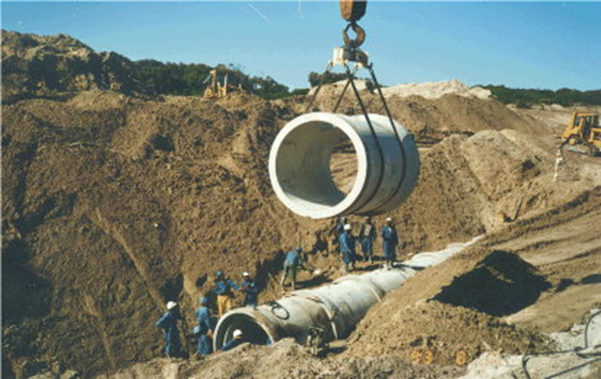
Waste Water Network Components
Manholes
Manholes are used for making connections, performing maintenance on underground and buried public utility including sewers and storm drains, and for inspection.
Distance between manholes varies with 30-50 m
Made of Concrete material

Slide 20
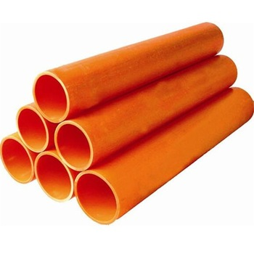
Waste Water Network Components
Conduits (Sewage)
Sewage: the liquid waste conveyed by a sewer and may include domestic and industrial discharges as well as storm sewage and infiltration.
Made of PVC material.

Slide 21
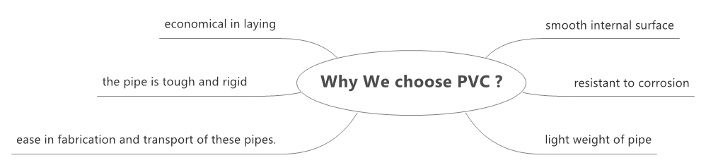
Waste Water Network Components
Why was the PVC material selected?

Slide 22
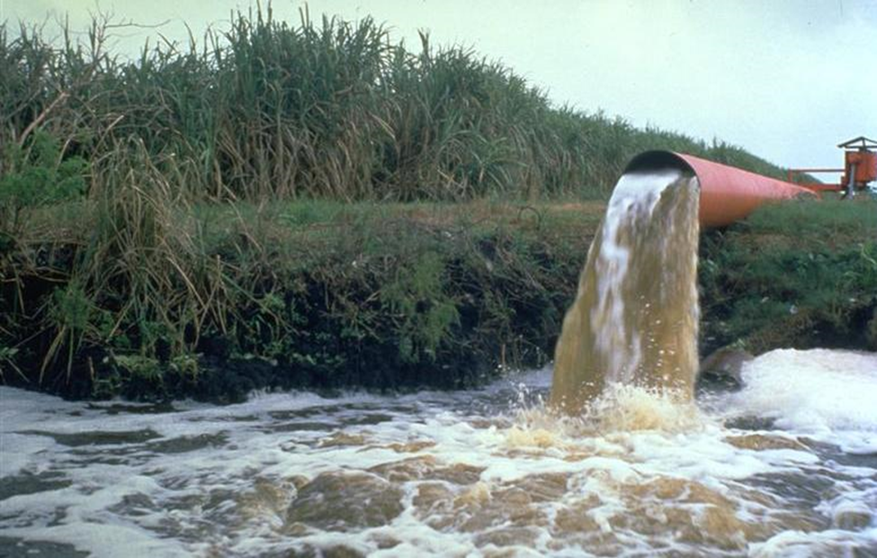
Outfall
Point where wastewater discharges out of particular area usually being at lowest elevation, with looking forward a good position to construct treatment plant.

Slide 23
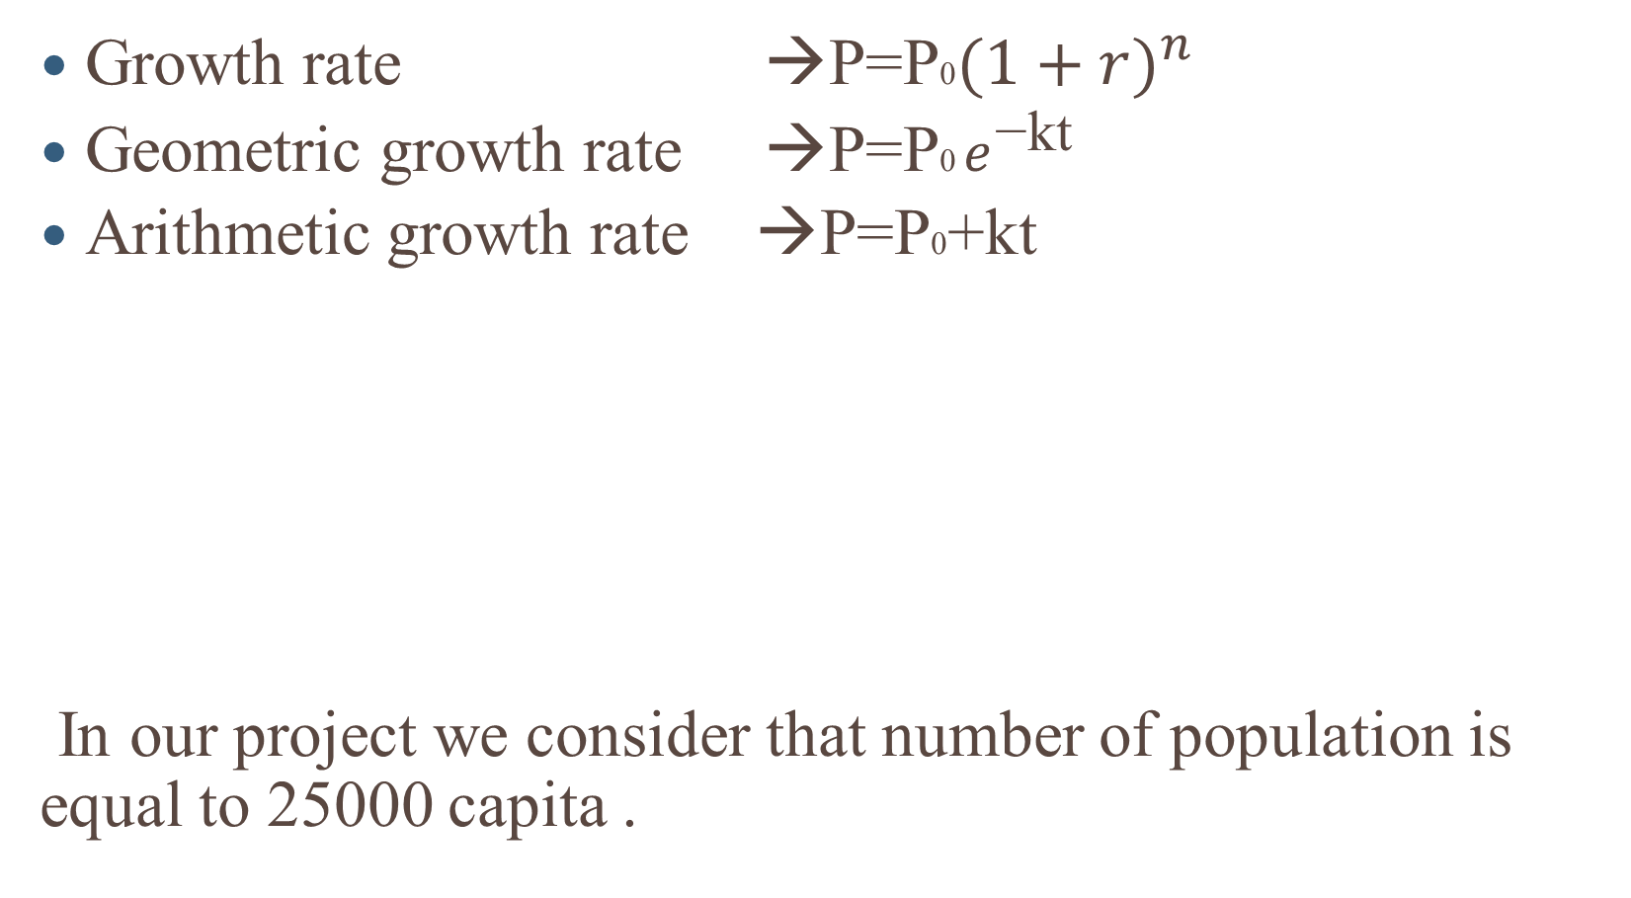
Population prediction Formulas
Growth rate →P=P0${(1+r)}^{n}$
Geometric growth rate →P=P0 $e^{\text{−}\text{kt} }$
Arithmetic growth rate →P=P0+kt
In our project we consider that number of population is equal to 25000 capita .
method used | (capita ) Number of population
Growth rate | 24036
Geometric growth | 16810
Arithmetic growth | 14245

Slide 24

Load calculation
We calculated the manholes loads by preparing excel sheet after counting and estimating the number of houses expected to be present in the town in the future period.
Total load ($Q_{design})=sanitary load+infiltration load$
= $25000∗\frac{120}{1000}∗0.85∗3+0.2∗( 25000∗\frac{120}{1000}$* 0.85) = 8160 $\frac{m^{3}}{day}$
water consumption | 120 L/C.d
wastewater generation | 85%
infiltration rate | 20%
Maximum hourly factor | 3
design period | 30 years

Slide 25
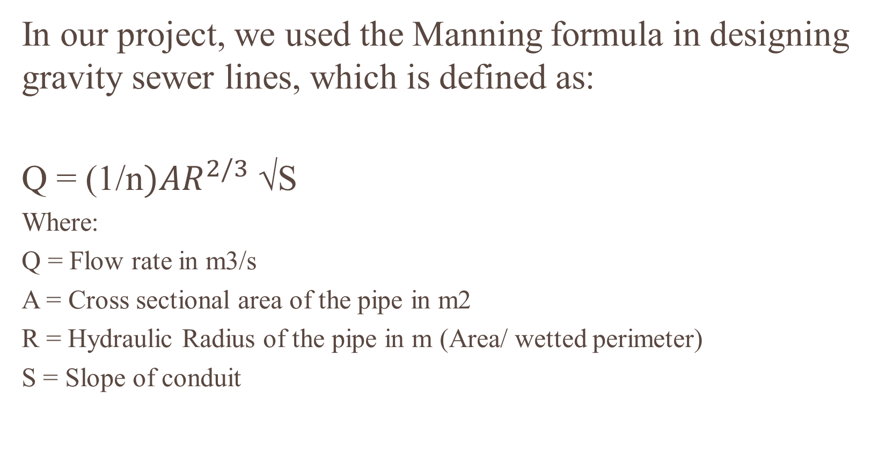
Hydraulic equations
In our project, we used the Manning formula in designing gravity sewer lines, which is defined as:
Q = (1/n${)AR}^{2/3}$ √S
Where:
Q = Flow rate in m3/s
A = Cross sectional area of the pipe in m2
R = Hydraulic Radius of the pipe in m (Area/ wetted perimeter)
S = Slope of conduit

Slide 26
Design Constrains for sewerage networks
Velocity :the velocity range is between (0.6-3) m/s
Slope : the slope range is between (1-12)%
Cover depth : the cover range is between (1-5) m

Slide 27
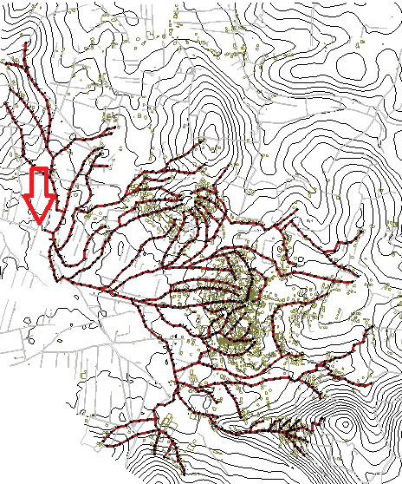
sewerage network layout

Slide 28
General results
After we adjusted the network in SewerCAD informed that the calculations were successful. That means that the design of the network was logical.
Number of manholes | Number of conduits | Number of outfall | Total length of conduits | Diameters of pipes | Lowest elevation | Highest elevation
820 | 820 | 1 | 29,507 m | 8,10,12,15 inch | 70 m | 152.09 m

Slide 29
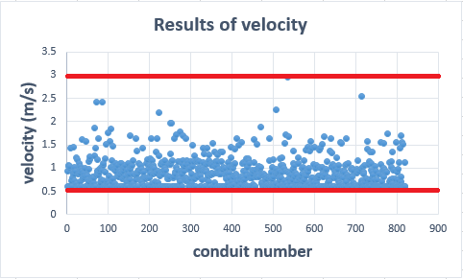
Results of velocities in conduits (m/s)
The figure below show that all velocities were within range and it's acceptable .

Slide 30
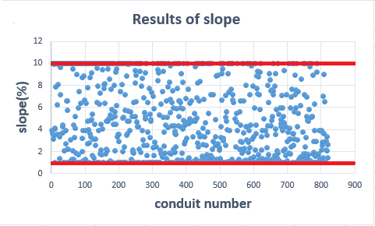
Results of Slope in conduits (%)
The figure below show that all values of slope were within range and it's acceptable too .

Slide 31
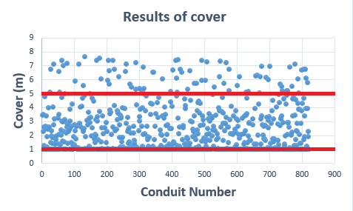
Results of Cover depth in conduits (m)
The problem that we faced is some conduits have cover depth more than 5m at the outfall point and it's acceptable in reality .

Slide 32
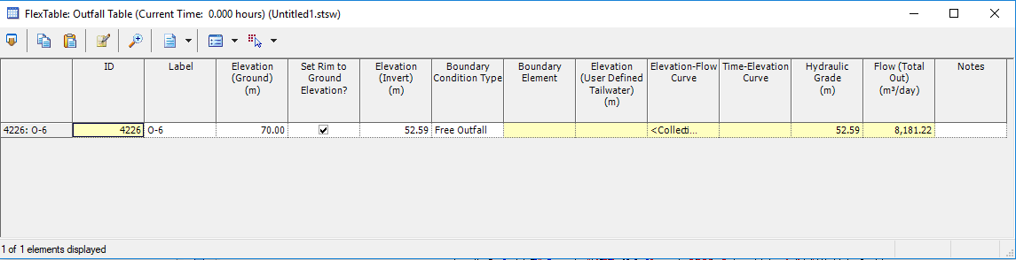

Outfall
the amount of flow out that will be discharged from the sewerage network is 8181 $m^{3}/day$.

Slide 33
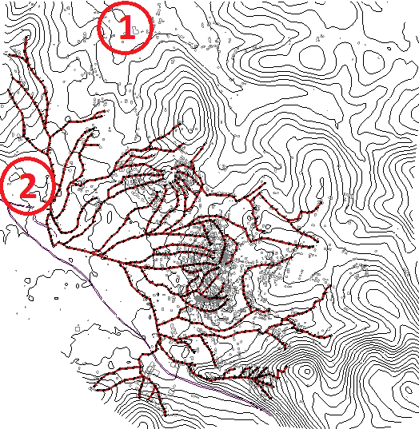
Waste water treatment plant location
Proposed locations to construct the treatment plant

Slide 34
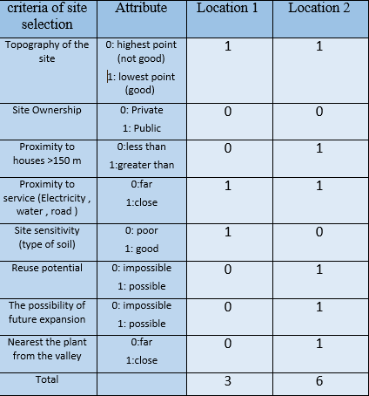
Waste water treatment plant location
Criteria for selection the site for wastewater treatment plant

Slide 35
Waste water treatment plant location
After studying the suggested two sites it is expected to set up plant on the western side of the town (location 2 ) , for several important reasons :
lower of the zone About mean sea level
Stay away from the center of the city and to avoid happen any flooding
proximity as much as possible from the outfall of water drainage network
proximity the location from the valley Which passes from the town.

Slide 36
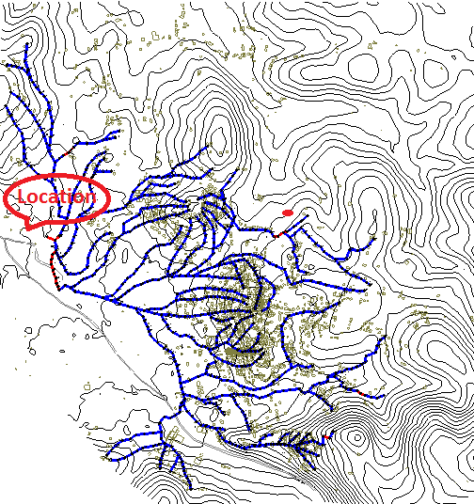
Waste water treatment plant location
WWTP location by contour map

Slide 37
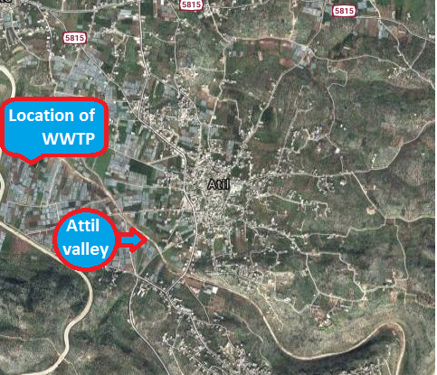
Waste water treatment plant location
WWTP location by satellite

Slide 38
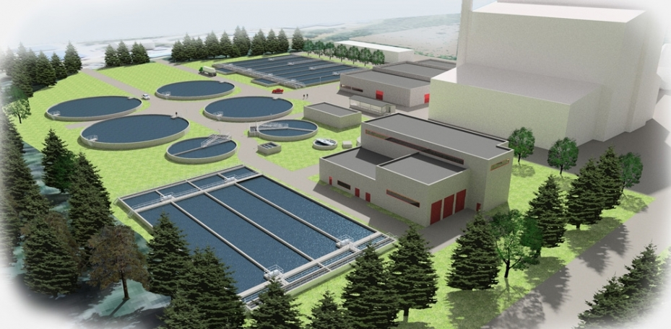
Part 3 : Design of waste water treatment plant

Slide 39
Introduction
After Analysis and design stage were done for Attil networks , and because of use water in domestic residences, commercial properties, and agriculture, this produces a huge amount of wastewater and this wastewater contains a wide range of contaminants so the ideal solution to dispose from these contaminants is to collect and treat it

Slide 40
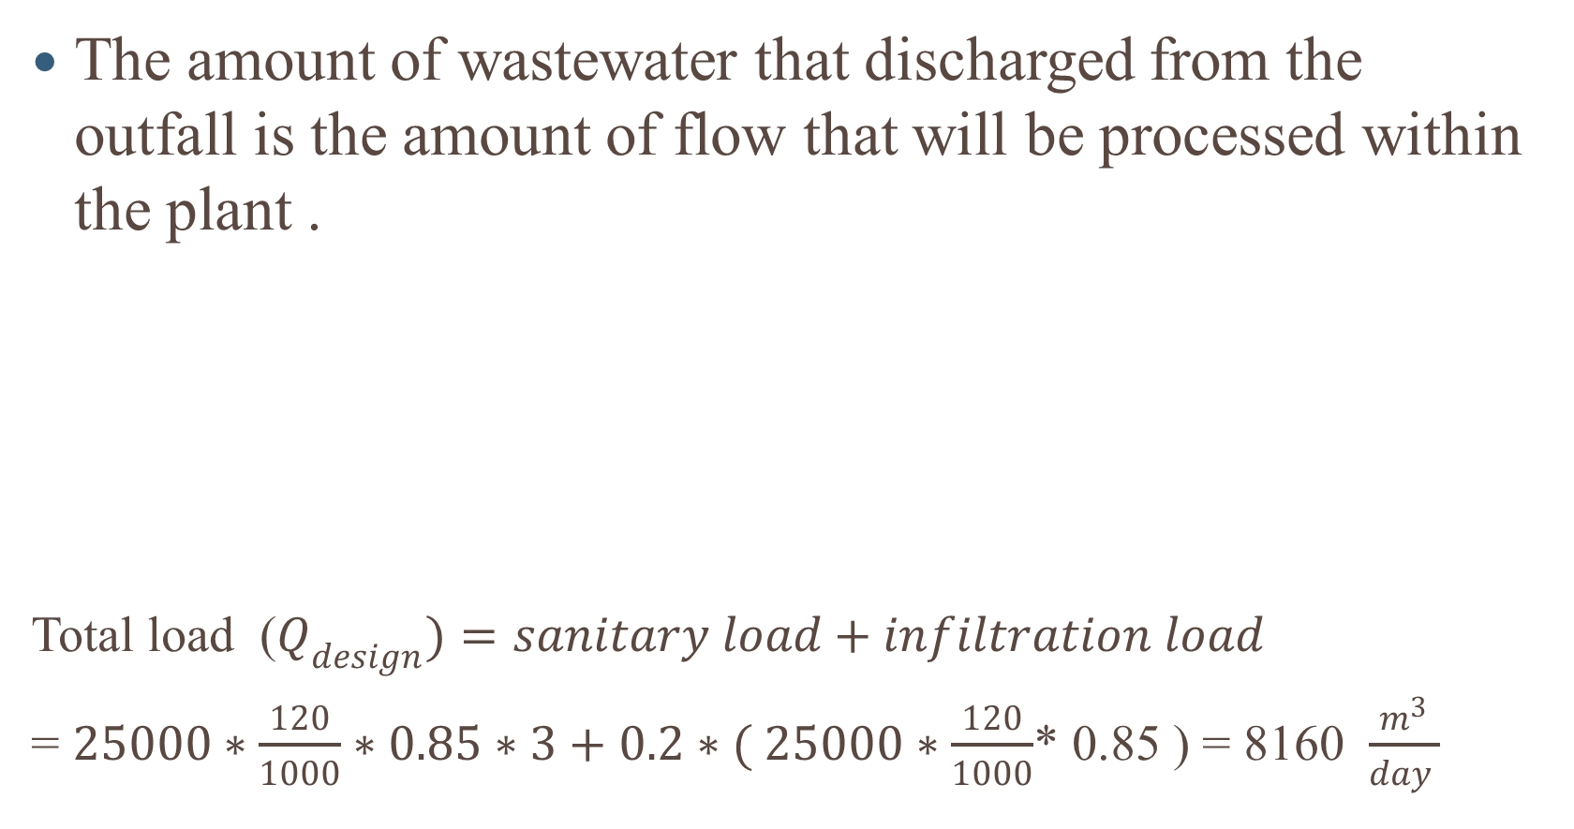
Calculation of influent flow
The amount of wastewater that discharged from the outfall is the amount of flow that will be processed within the plant .
Total load ($Q_{design})=sanitary load+infiltration load$
= $25000∗\frac{120}{1000}∗0.85∗3+0.2∗( 25000∗\frac{120}{1000}$* 0.85 ) = 8160 $\frac{m^{3}}{day }$
Future water consumption | 120 L/c.d
Wastewater generation | 85 %
Maximum hourly factor | 3
Infiltration | 20 %

Slide 41
Characteristics of the plant’s influent
Assumptions
Characteristic | Value in (g/c.d) | Value in (mg/liter)
BOD₅ | 50 | 490
COD | 60 | 588
COD/BOD₅ | 1.2 | 1.2
TSS | 60 | 588
TKN | 6 | 59
NH₃ | 4.5 | 44

Slide 42
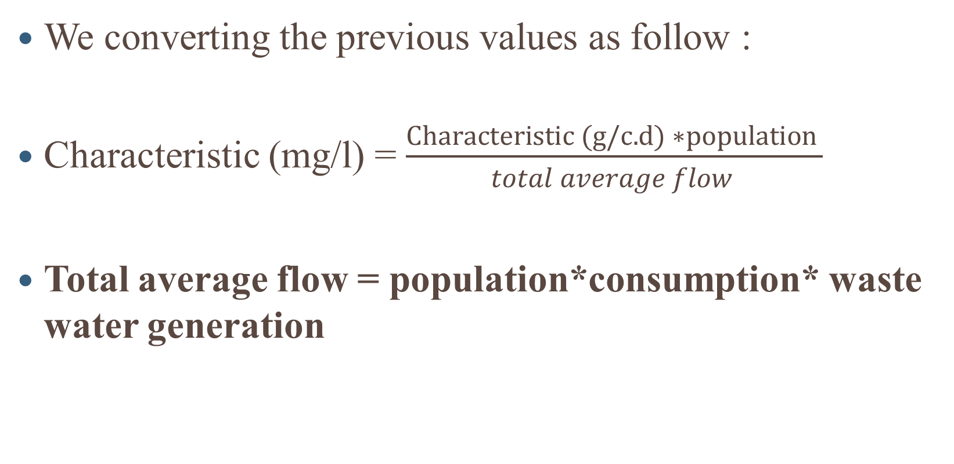
Characteristics of the plant’s influent
We converting the previous values as follow :
Characteristic (mg/l) = $\frac{Characteristic (g/c.d) ∗population }{total average flow }$
Total average flow = population*consumption* waste water generation

Slide 43
WWTP Elements and Processes
Preliminary Treatment
Primary Treatment
Secondary Treatment

Slide 44
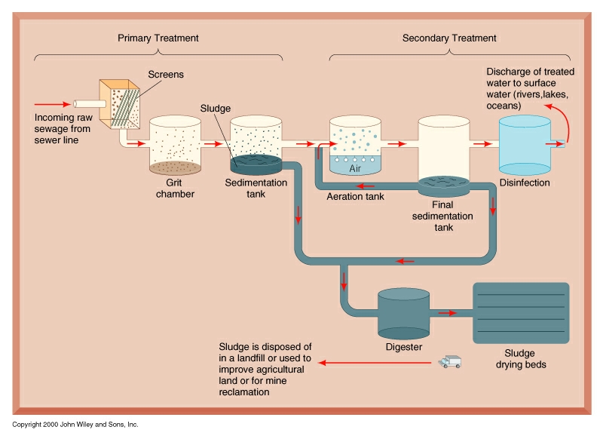
WWTP Elements and Processes

Slide 45
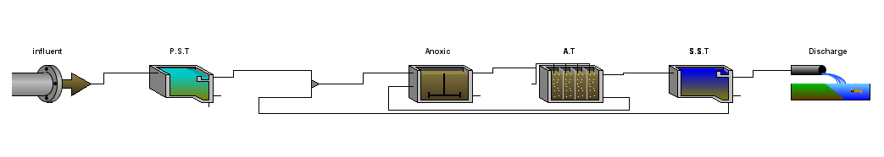
plant layout

Slide 46
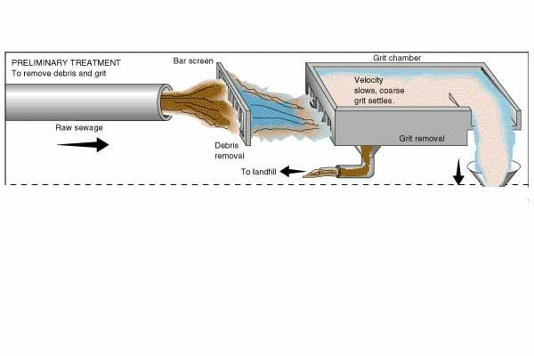
Preliminary Treatment
At most plants preliminary treatment is used to protect pumping equipment and facilitate subsequent treatment processes .

Slide 47
Preliminary Treatment
Preliminary devices
Coarse screens
Fine screens
Grit chamber

Slide 48
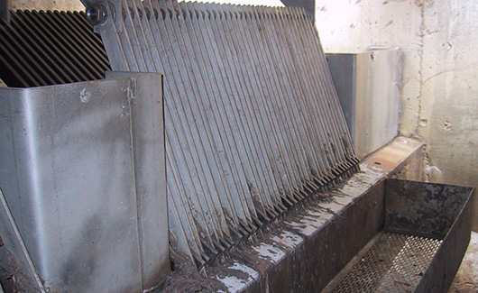
Preliminary Treatment
Bar screens
Bar screens are used to retain solids found in the influent wastewater to the treatment plant. The principal role of screening is to remove coarse materials from the flow stream.

Slide 49
Preliminary Treatment
Grit chamber
Grit chambers are long narrow tanks that are designed to slow down the flow so that solids such as sand, coffee grounds, and eggshells will settle out of the water. Grit causes excessive wear and tear on pumps and other plant equipment.

Slide 50
Primary Treatment
A physical process.
Wastewater flow is slowed down and suspended solids settle to the bottom by gravity.
The material that settles is called sludge.
Sludge from the primary sedimentation tanks is pumped to the sludge thickener.

Slide 51
Primary Treatment

Slide 52
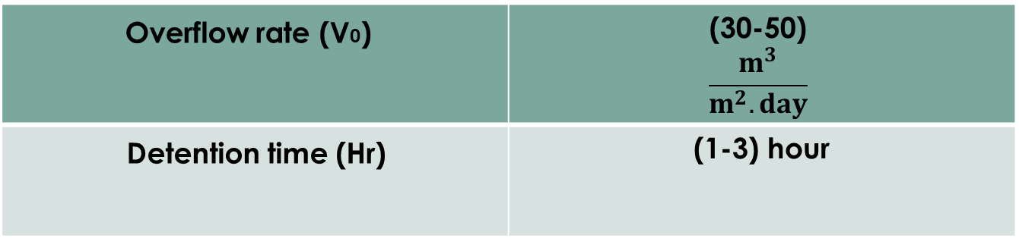
Primary Treatment
The efficiency of COD/BOD removal in primary sedimentation tank is between 30~50 % while TSS removal between 50~70%.
Criteria and standards
Overflow rate (V0) | (30-50) $$\frac{m^{3}}{m^{2}.day}$$
Detention time (Hr) | (1-3) hour

Slide 53
Secondary Treatment
Secondary treatment is a biological process
Utilizes bacteria and algae to metabolize organic matter in the wastewater

Slide 54
Secondary Treatment
Anoxic tank
Aeration tank
Secondary sedimentation tank

Slide 55
Secondary Treatment
Anoxic Tank
Anoxic mixers are used as de-nitrification basins in waste water treatment plants .
Anoxic tank breaks down the nitrate in the waste to use as an oxygen source (energy source).
The oxygen is consumed by the bacteria and the nitrogen gas releases to the atmosphere.

Slide 56
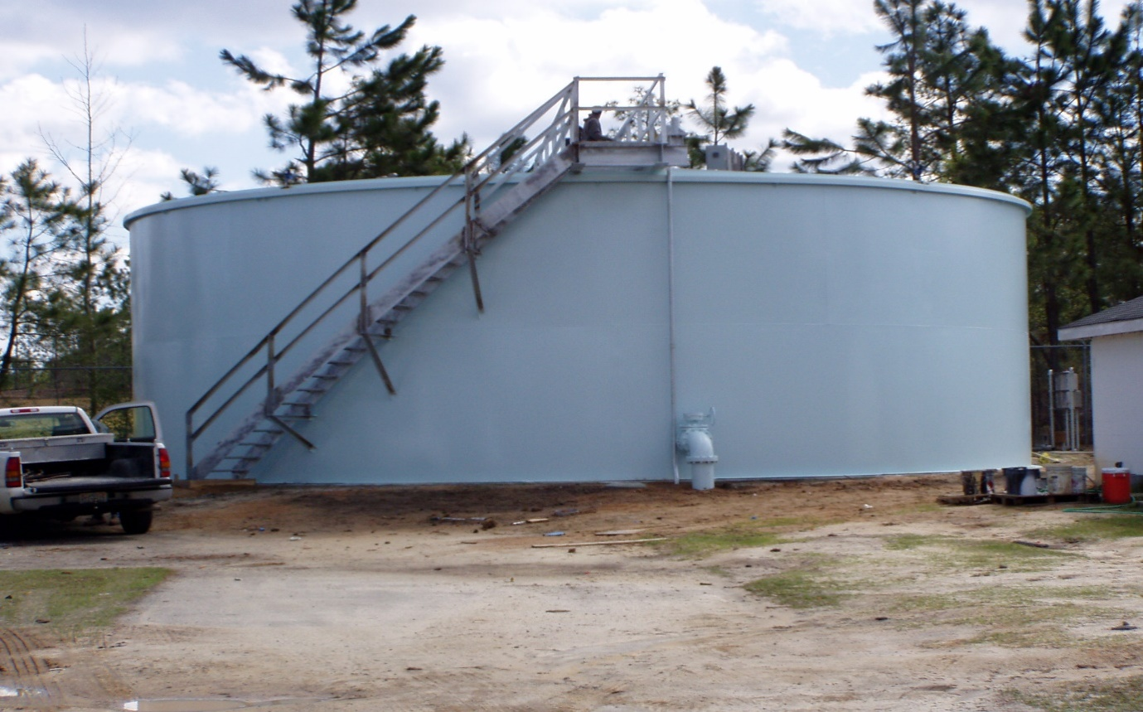
Secondary Treatment

Slide 57
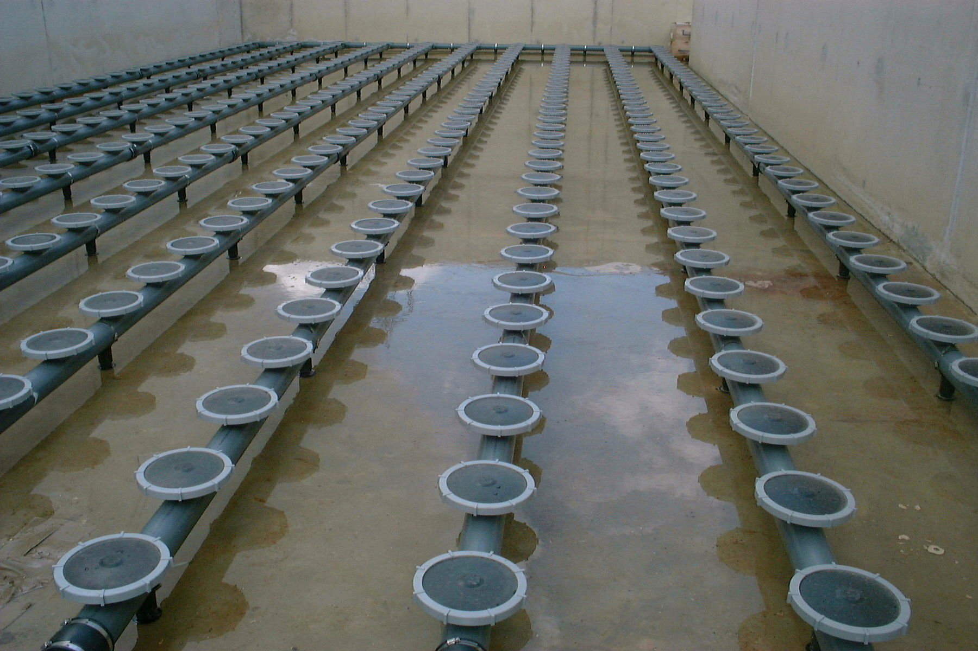
Secondary Treatment
Aeration tank: (Activated Sludge)
The main purpose from activated sludge process is to oxidizing carbonaceous biological matter, oxidizing nitrogenous matter: mainly ammonium and nitrogen in biological matter, removing nutrients.

Slide 58
Secondary Treatment
Criteria and standards
process | BOD Loading (gBOD/m3.d) | MLSS (mg/l) | F/M Ratio (gBOD/gMLSS.d) | Aeration Period (hr)
extended aeration | 320-160 | 2000-8000 | 0.05-0.2 | 20-30

Slide 59
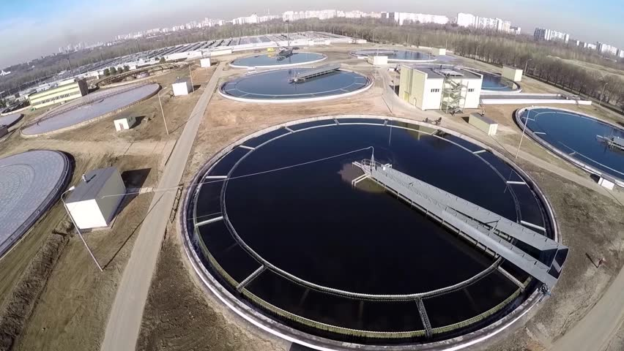
Secondary Treatment
Secondary sedimentation tank
Secondary treatment is a treatment process for wastewater to achieve a certain degree of effluent quality , At this stage the BOD may be reduced to approximately (80 – 85)% of the influent level and (90-95)% suspended solids are removed .

Slide 60

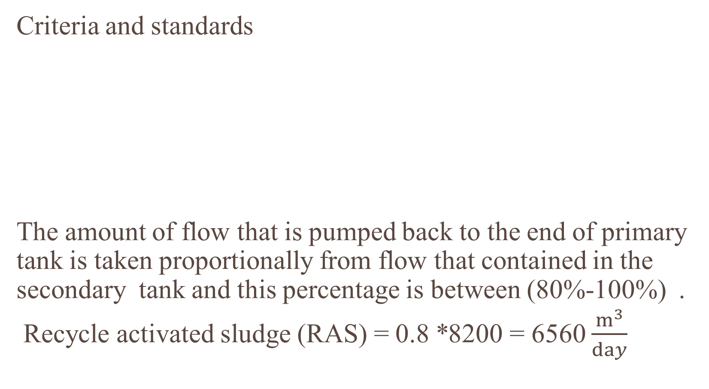
Secondary Treatment
Criteria and standards
The amount of flow that is pumped back to the end of primary tank is taken proportionally from flow that contained in the secondary tank and this percentage is between (80%-100%) .
Recycle activated sludge (RAS) = 0.8 *8200 = 6560 $\frac{m^{3}}{day}$
Overflow rate (V0) $$\frac{m^{3}}{m^{2}.day}$$ | 15-32
Detention time ( Hr) | 2-4

Slide 61
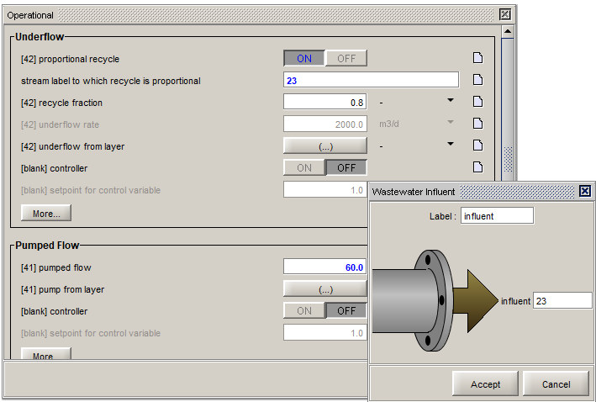
Secondary Treatment

Slide 62
Secondary Treatment
Sludge disposal
Sludge is mostly water with lesser amounts of solid material.
Sludge treatment is focused on reducing sludge weight and volume to reduce disposal costs and reducing potential health risks of disposal options.
The choice of a sludge treatment method depends on the volume of sludge generated.

Slide 63
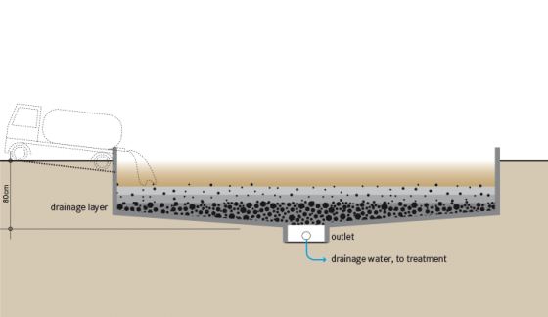
Secondary Treatment
Drying beds
Drying beds is suitable for rural communities, while limited land availability
Most widely used method for sludge dewatering.
Cheap and simple method to dispose from sludge

Slide 64
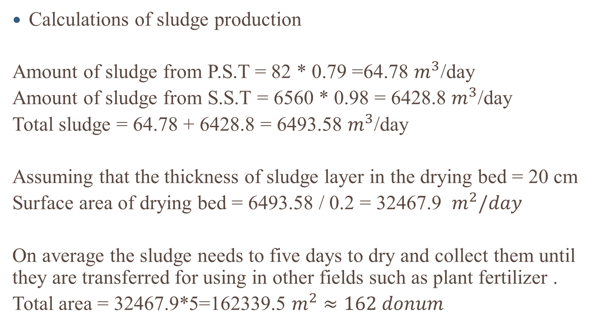
Secondary Treatment
Calculations of sludge production
Amount of sludge from P.S.T = 82 * 0.79 =64.78 $m^{3}$/day
Amount of sludge from S.S.T = 6560 * 0.98 = 6428.8 $m^{3}$/day
Total sludge = 64.78 + 6428.8 = 6493.58 $m^{3}$/day
Assuming that the thickness of sludge layer in the drying bed = 20 cm
Surface area of drying bed = 6493.58 / 0.2 = 32467.9 $m^{2}/day$
On average the sludge needs to five days to dry and collect them until they are transferred for using in other fields such as plant fertilizer .
Total area = 32467.9*5=162339.5 $m^{2}$ $≈162 donum$

Slide 65
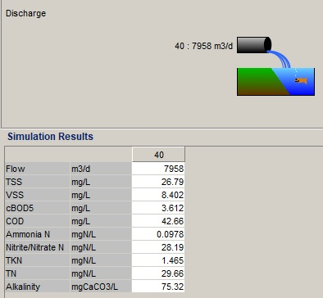
Results

Slide 66
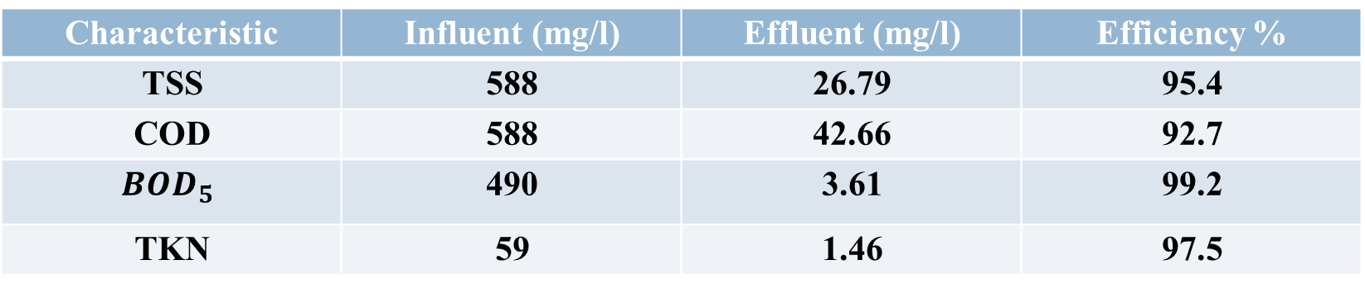
Effectiveness of removing contaminants
Characteristic | Influent (mg/l) | Effluent (mg/l) | Efficiency %
TSS | 588 | 26.79 | 95.4
COD | 588 | 42.66 | 92.7
$${BOD}_{5}$$ | 490 | 3.61 | 99.2
TKN | 59 | 1.46 | 97.5

Slide 67
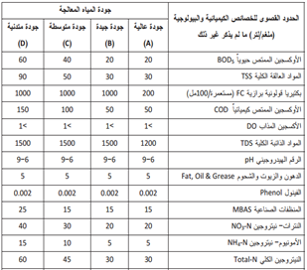
Palestinian standard and specification for water (TR34-2012)

Slide 68
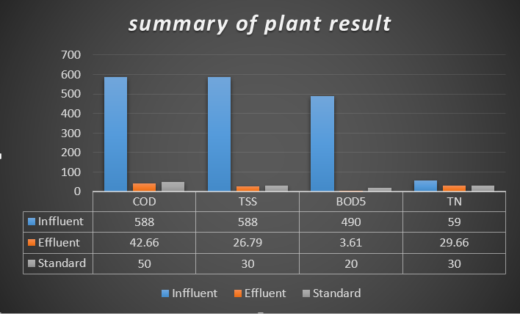
Comparing finally results with specification

