Slide 1

Website & Marketing
معرض سالم للفرش المنزلي

Slide 2
Introduction
Website
Inventory
Marketing
Conclusion
1
2
Table Of Content
1
3
4
5

Slide 3
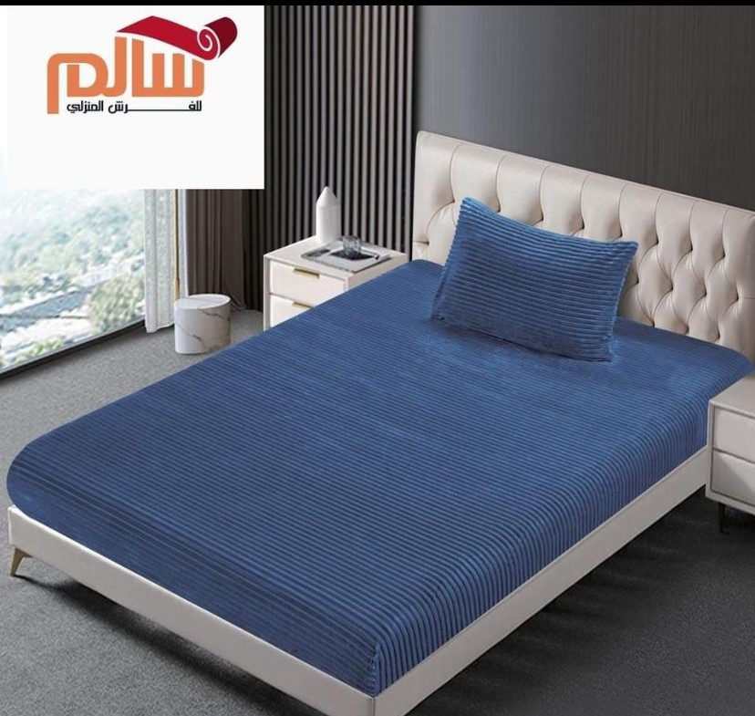
Introduction
About The Place:
A store offering a variety of home furnishings, carpets and curtains
Located in Nablus
Problems
Difficulty processing transactions.
Difficulty managing clients.
Difficulty displaying all products in the store.
Data loss.
Difficulty in reaching all sectors of interest.
Difficulty managing inventory.

Slide 4
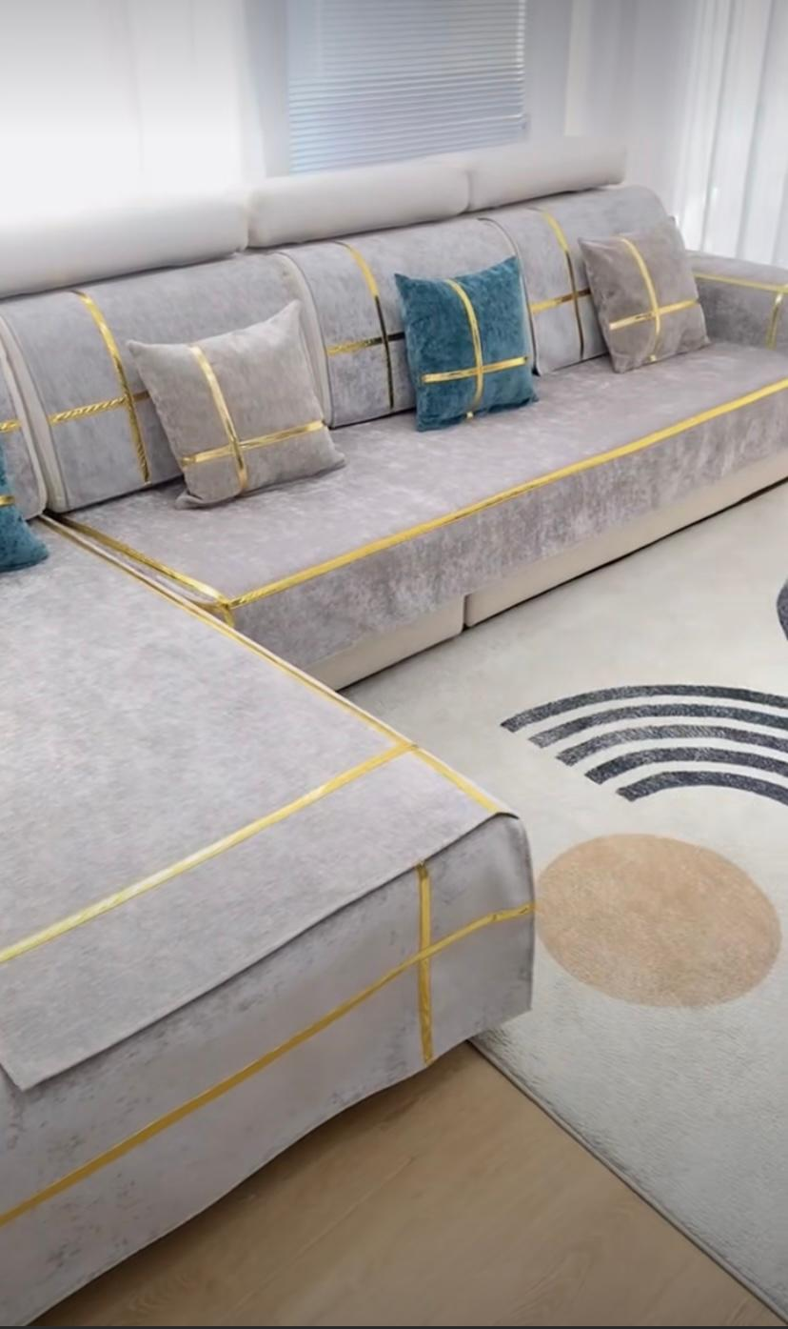
Introduction
Objectives:
Facilitating the buying and selling process.
Improve analysis and decision-making ability.
Reaching the largest segment of customers.
Create an integrated website.
Integrating the inventory management system with the website.
Create reports and statistics.

Slide 5

Introduction
Vision & Mission
Vision:
To be the first destination for customers looking for high-quality and elegant furniture.
To provide a distinctive and innovative shopping experience by
converting the work system from paper to computerized to better
meet the needs of our customers.
Mission:

Slide 6
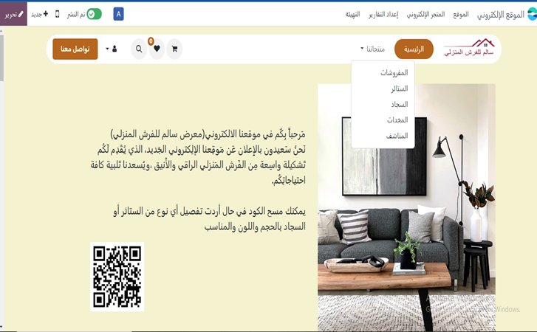
Website

Slide 7
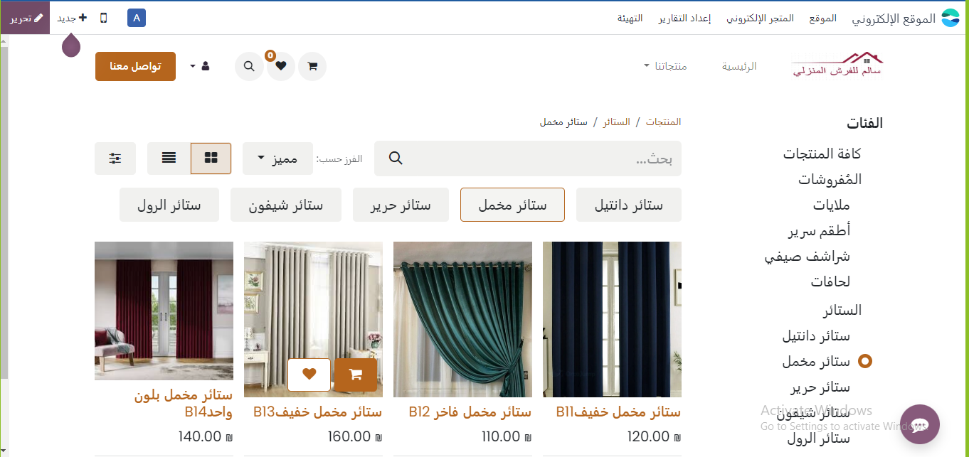

Slide 8
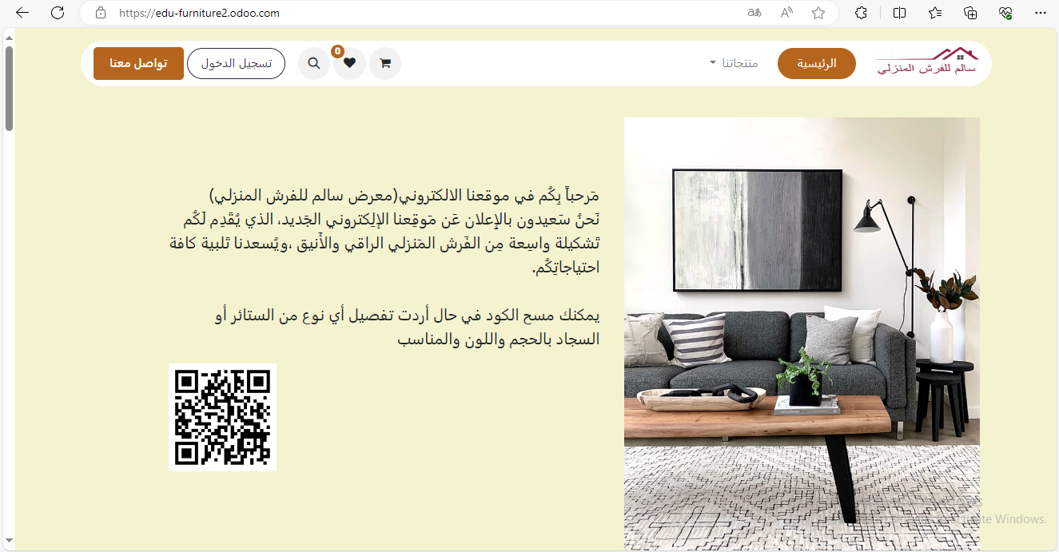
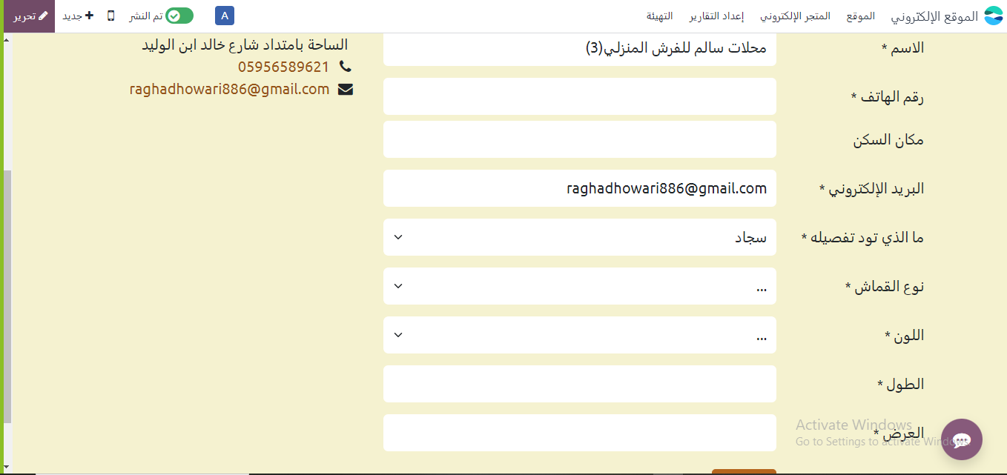

Slide 9
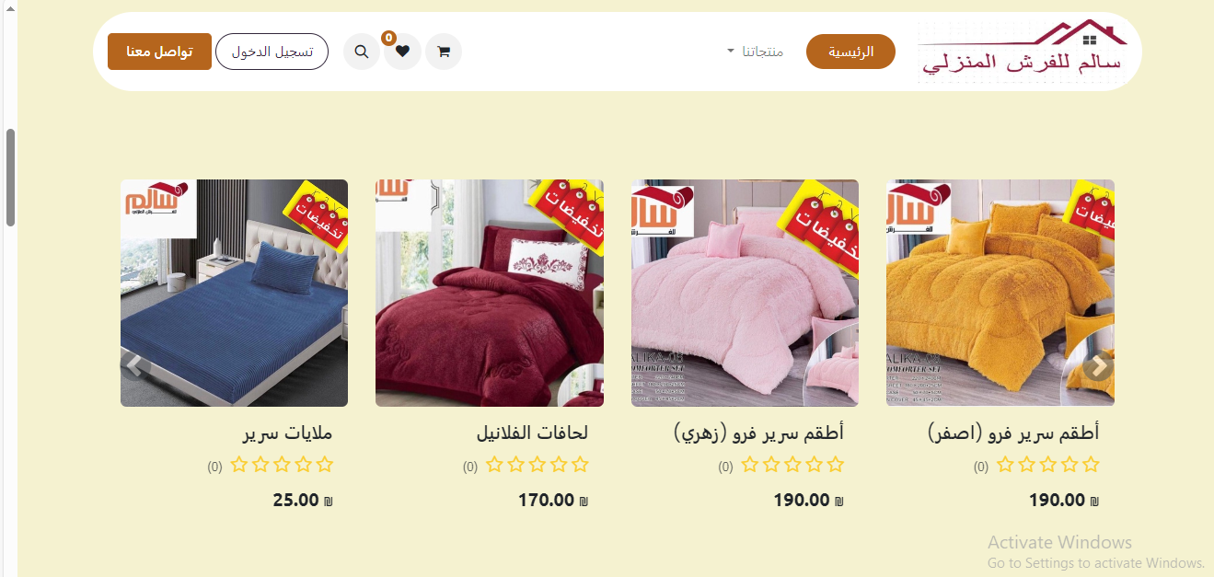

Slide 10
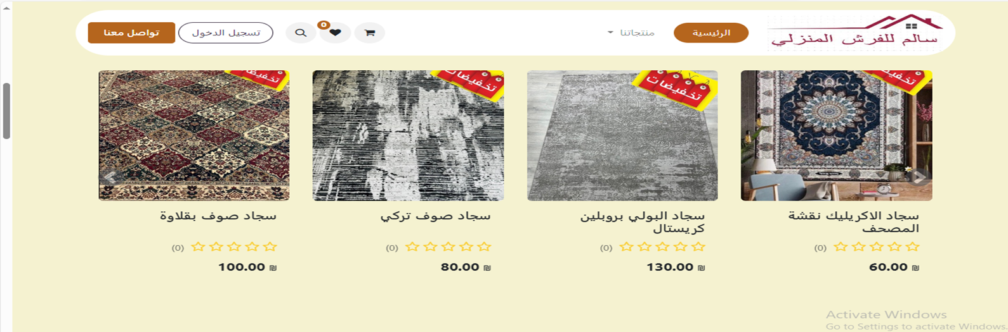
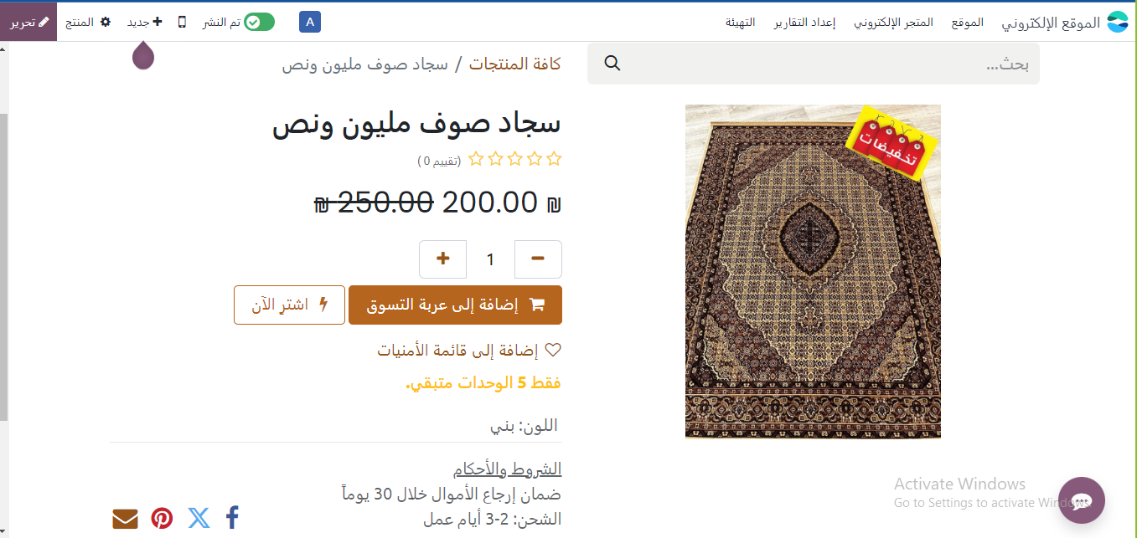

Slide 11
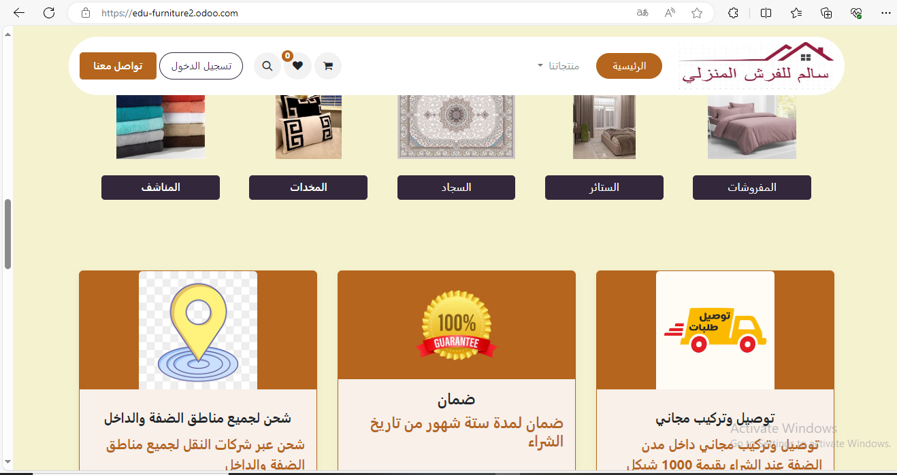

Slide 12
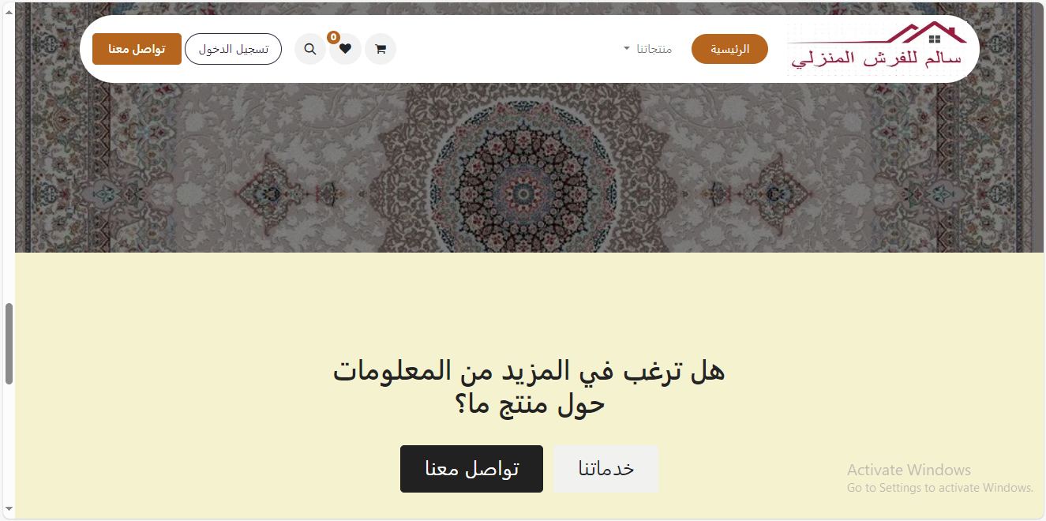

Slide 13
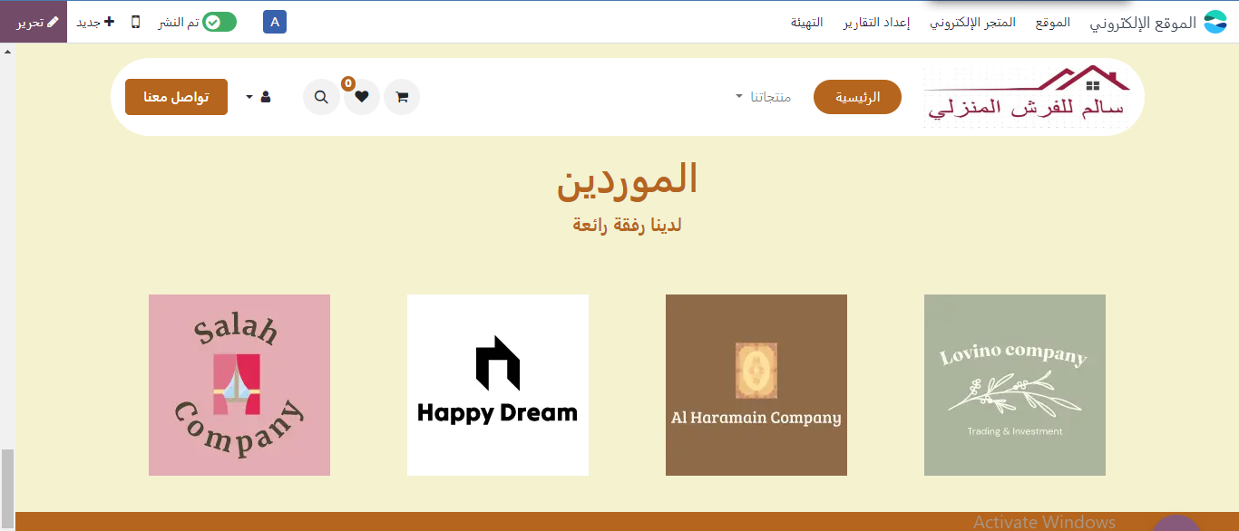
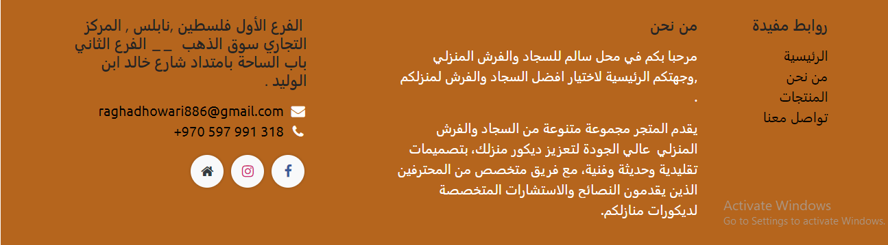

Slide 14
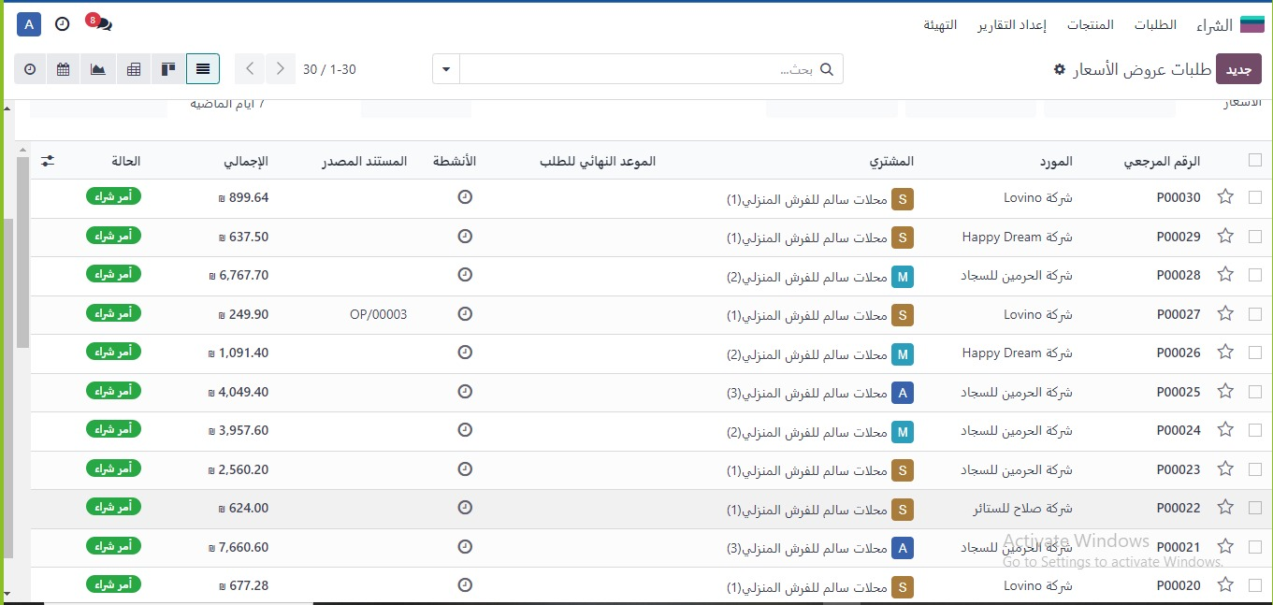
Purchase module

Slide 15
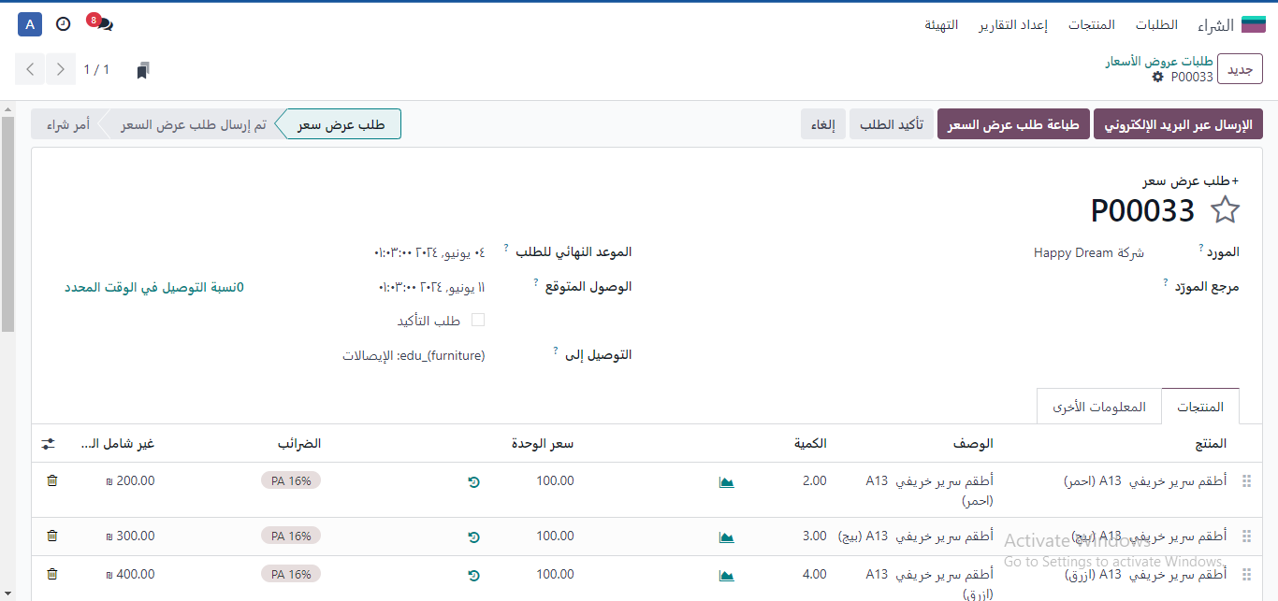

Slide 16
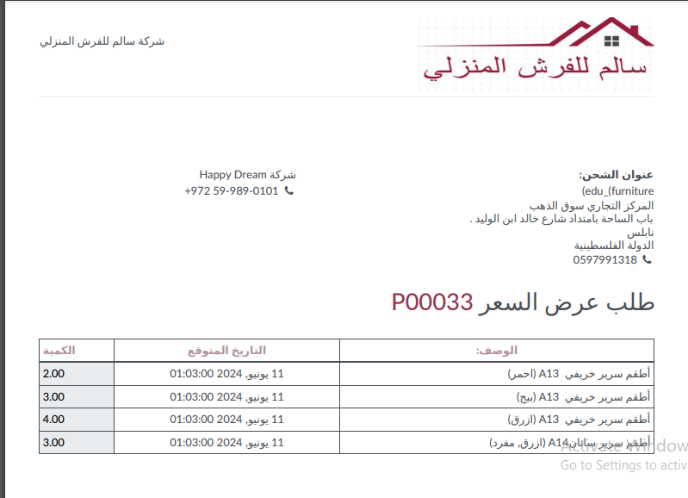

Slide 17
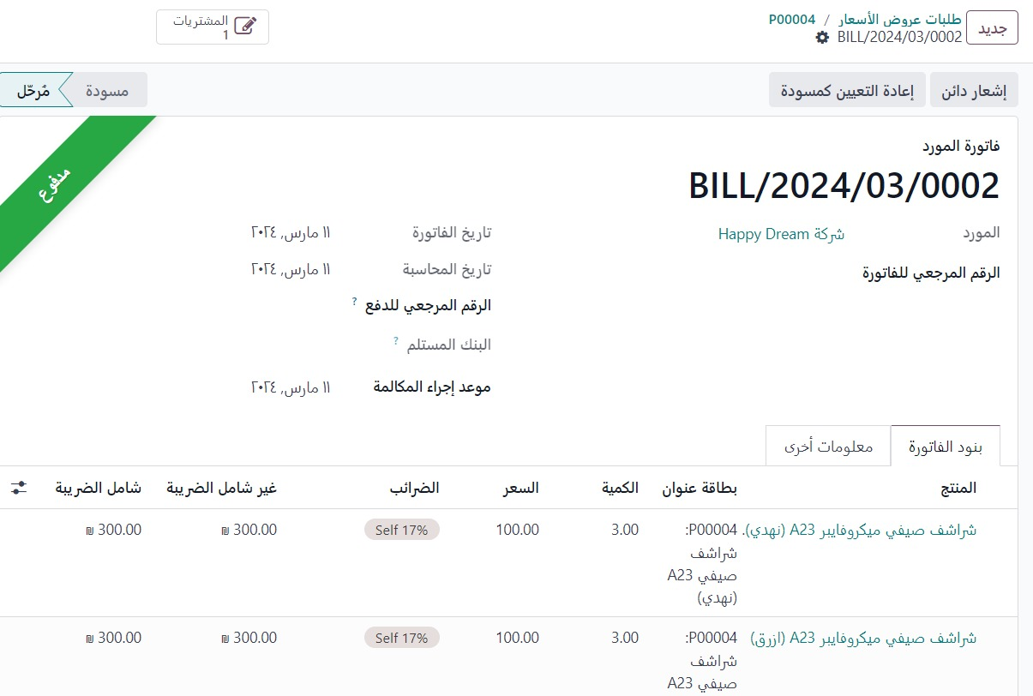
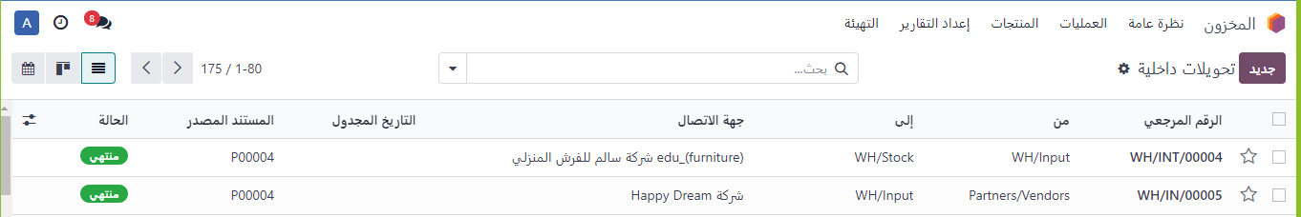

Slide 18
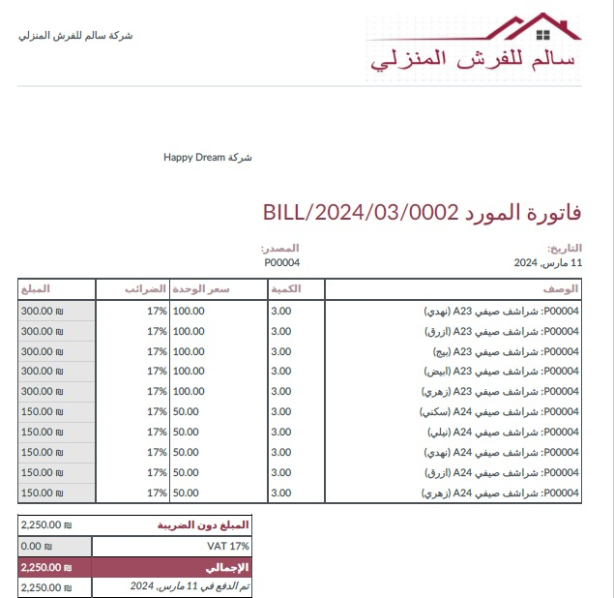

Slide 19
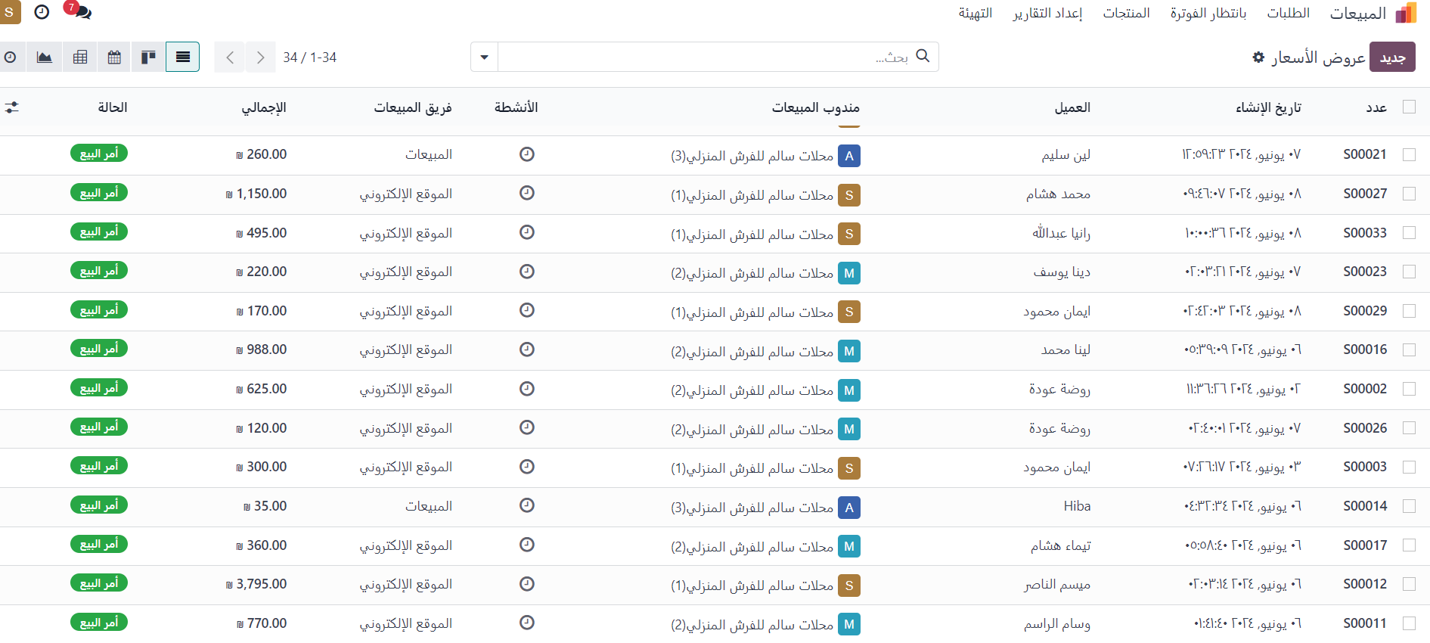
Sales module

Slide 20
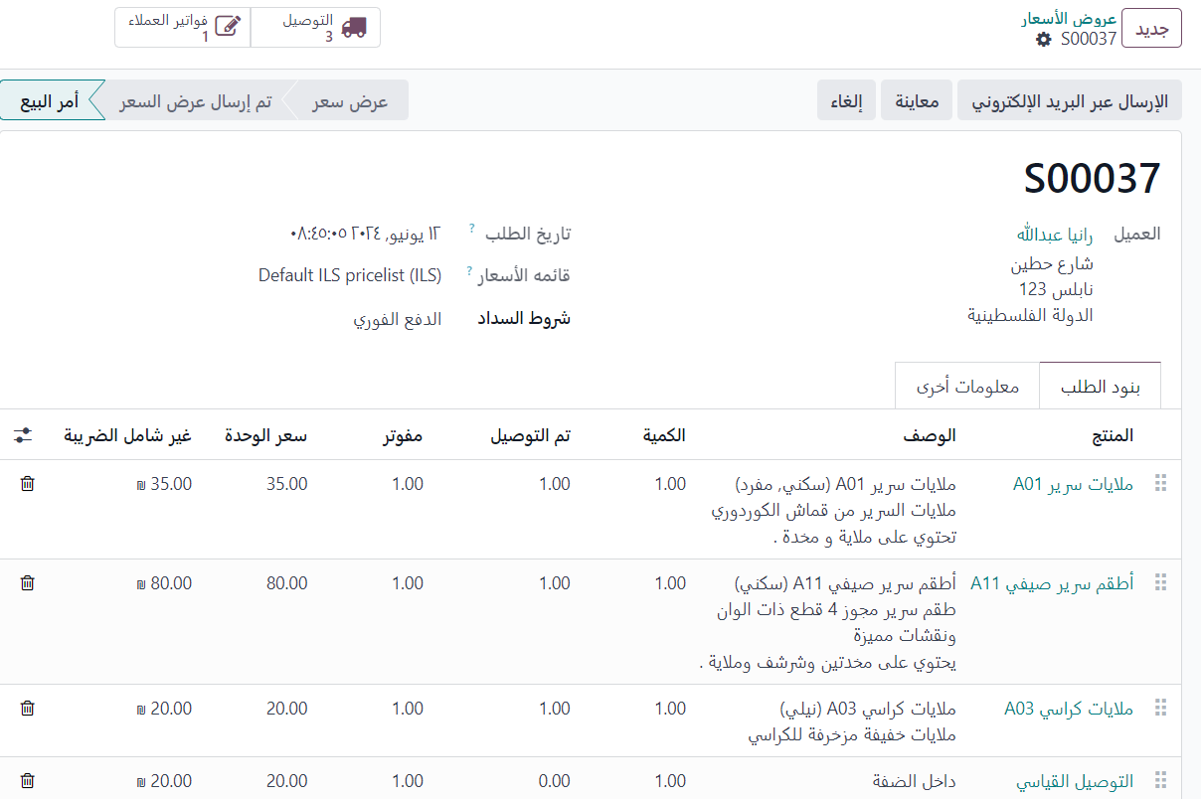
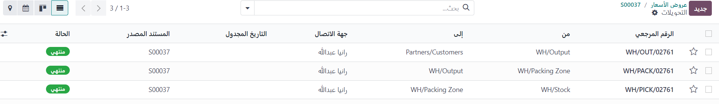
Sales Module

Slide 21
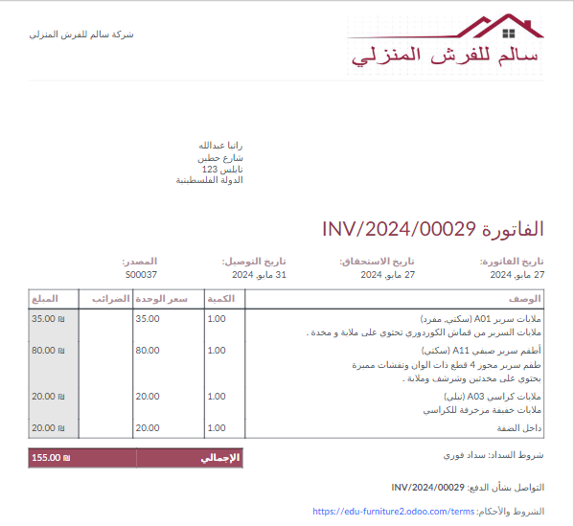
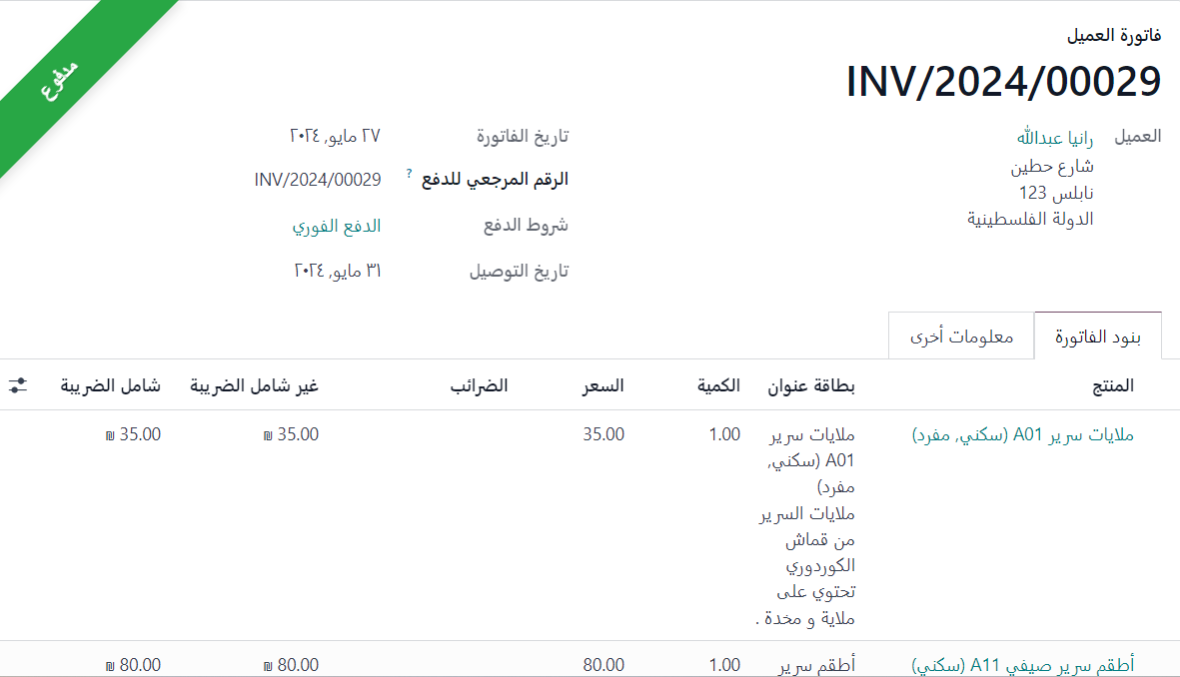

Slide 22
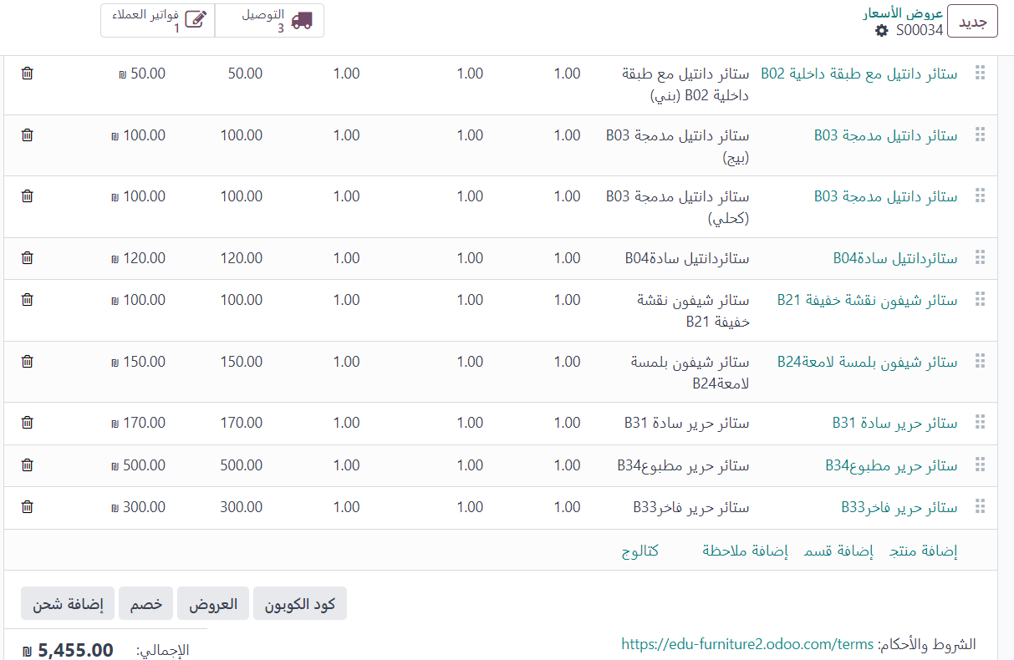
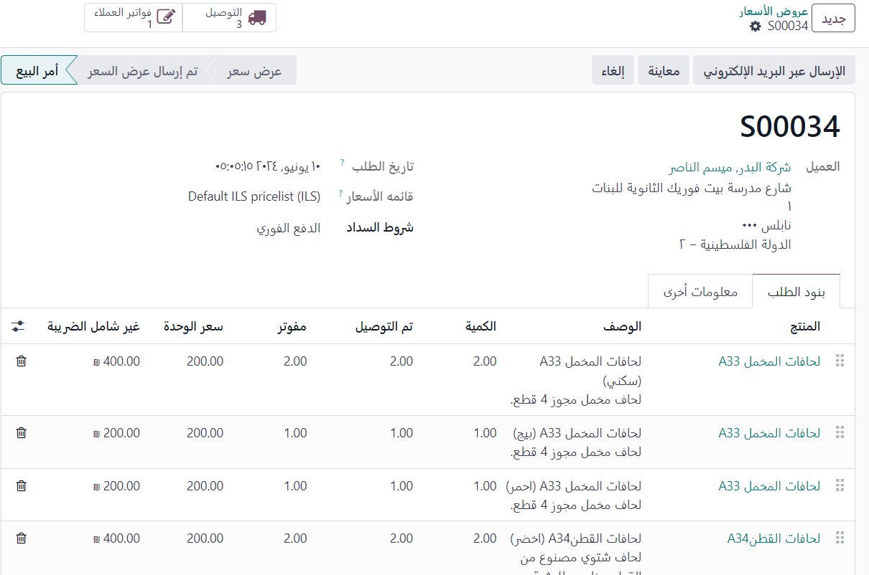
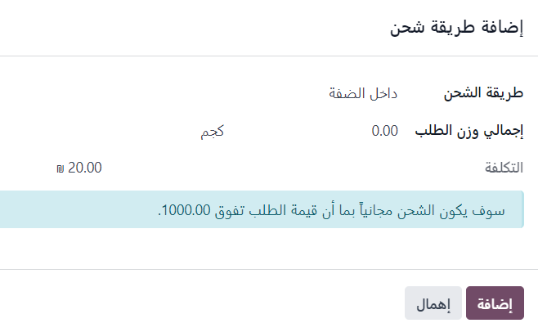

Slide 23
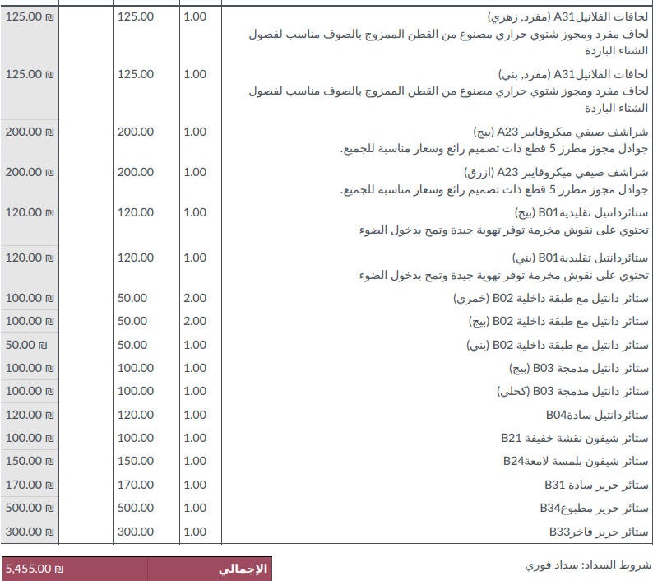
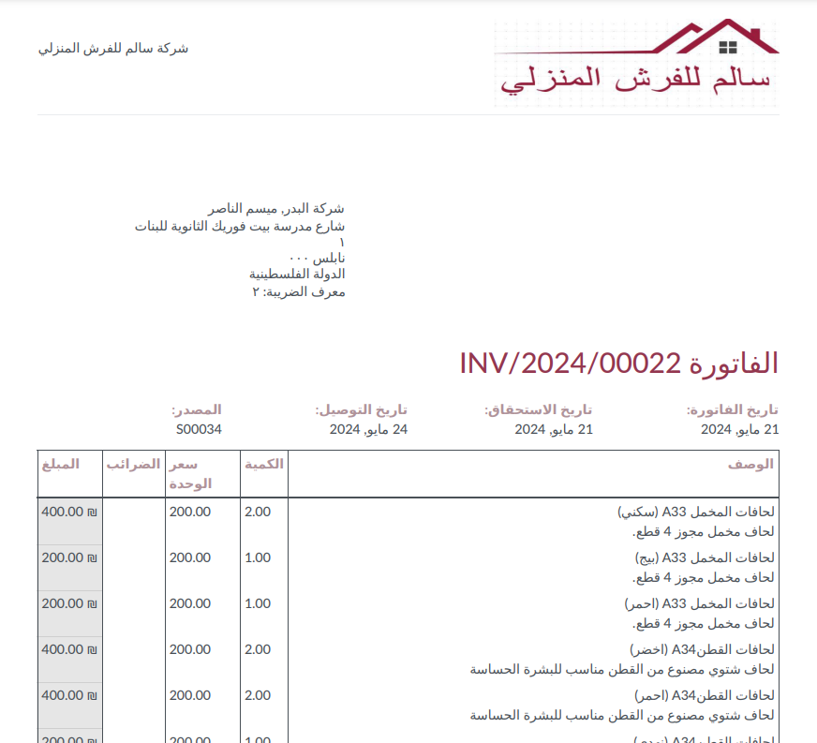

Slide 24
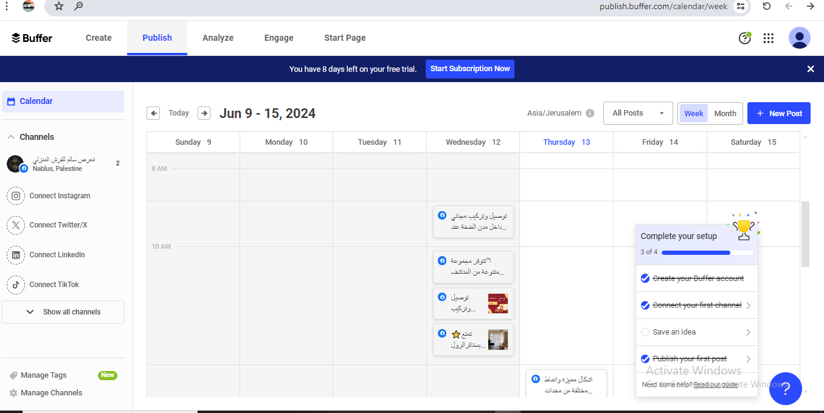
Marketing tool
buffer

Slide 25
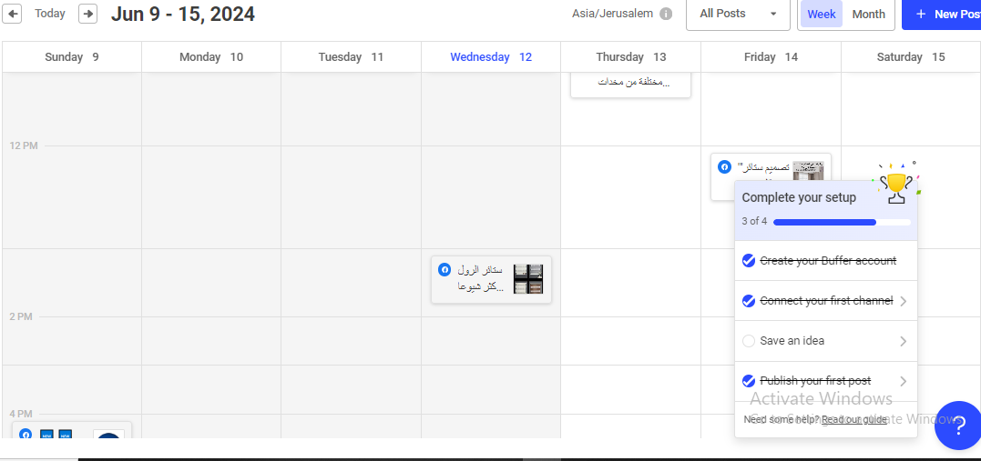

Slide 26
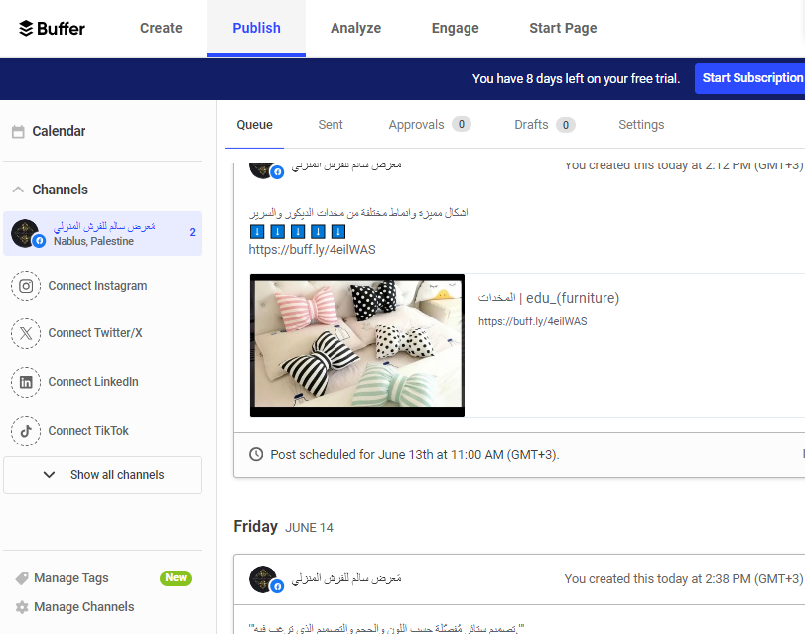

Slide 27
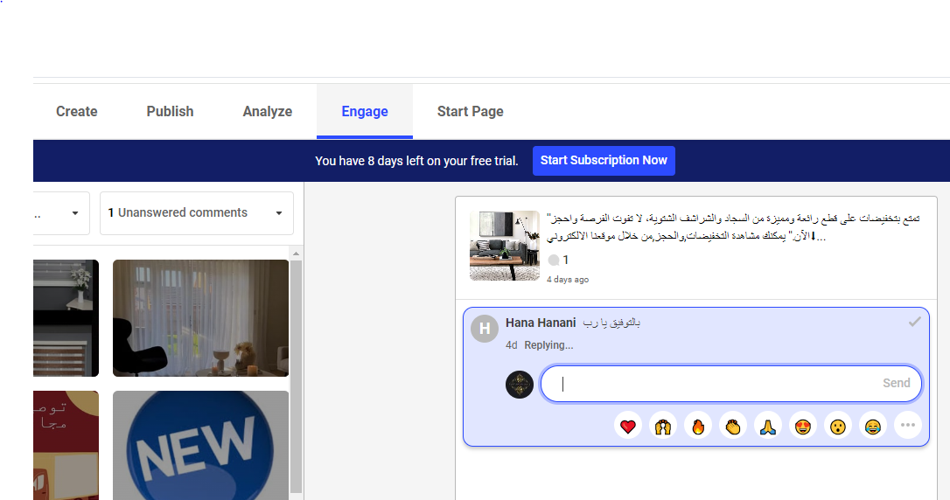

Slide 28
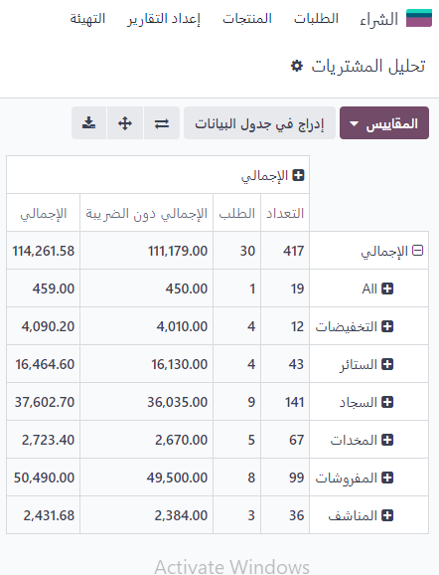
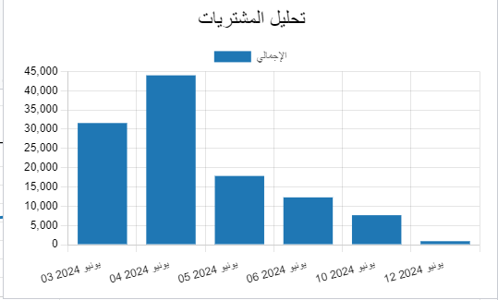
Purchase Module Analysis

Slide 29
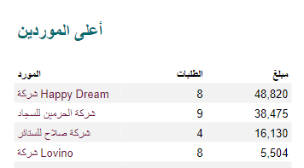
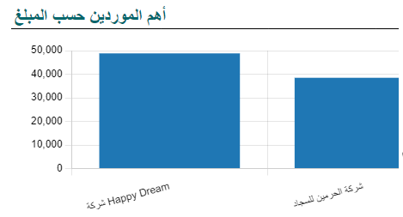

Slide 30
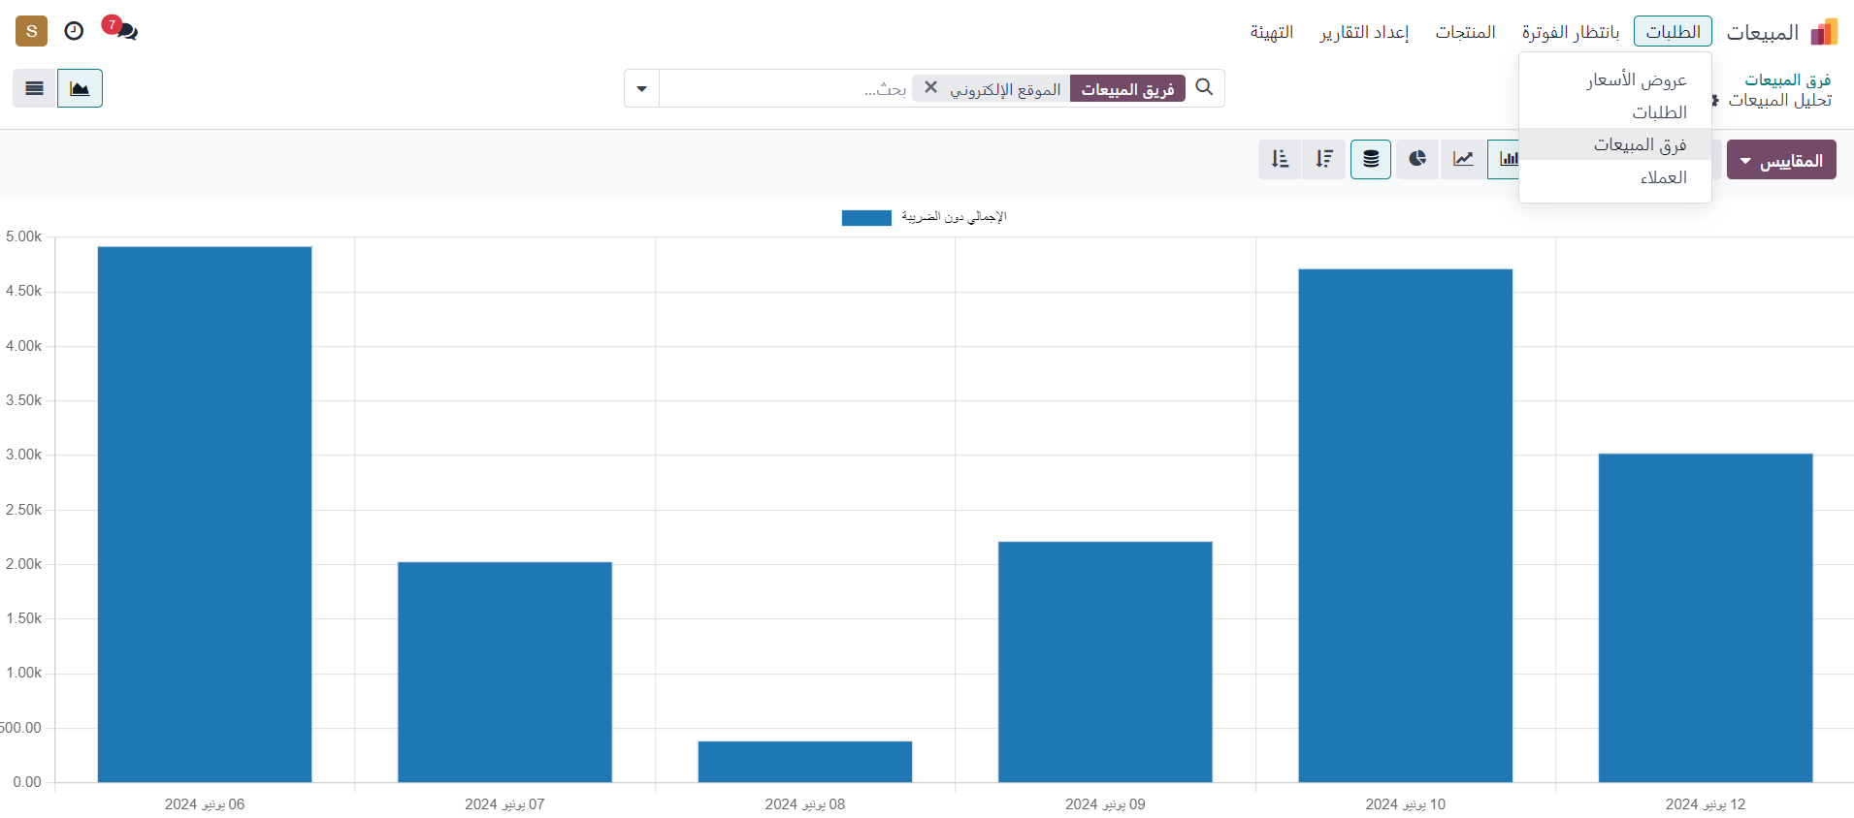
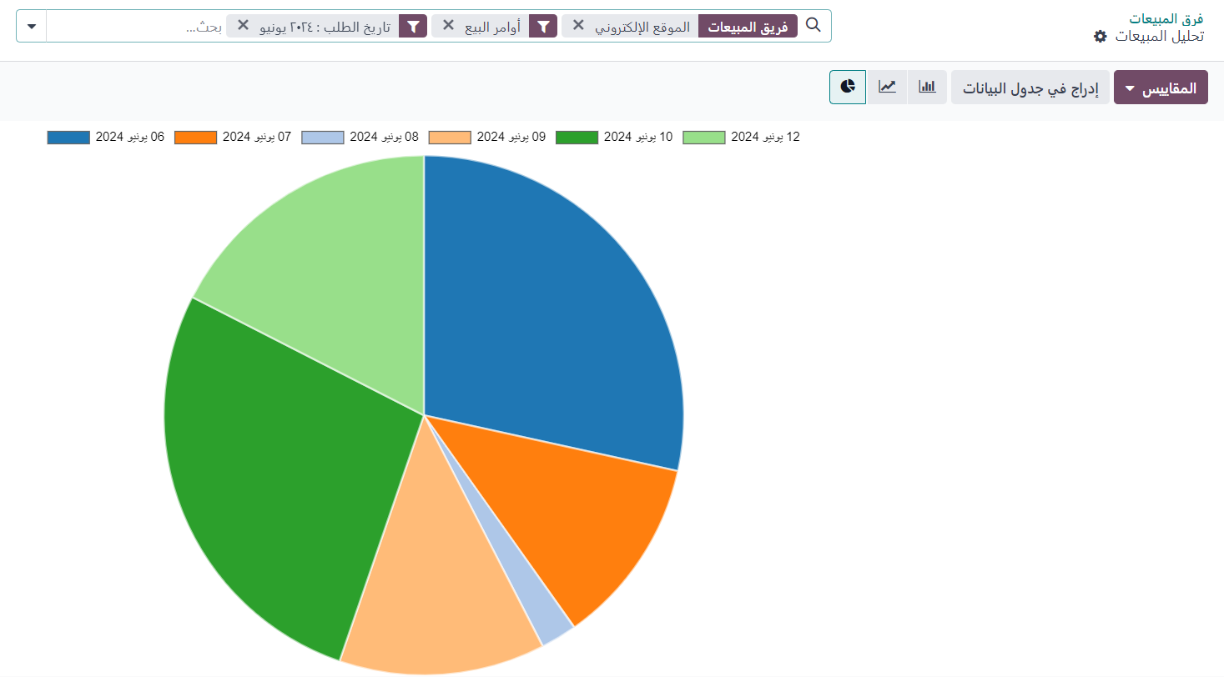
Sales Module Analysis

Slide 31
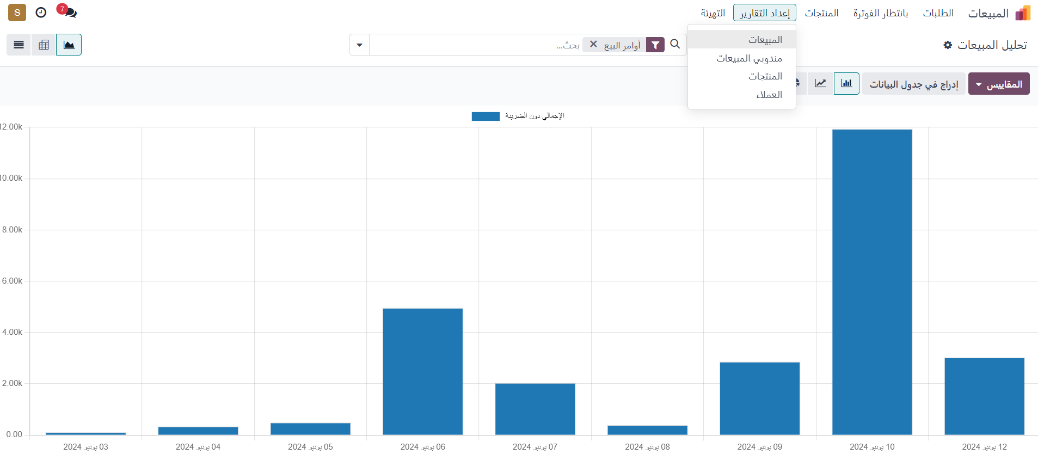
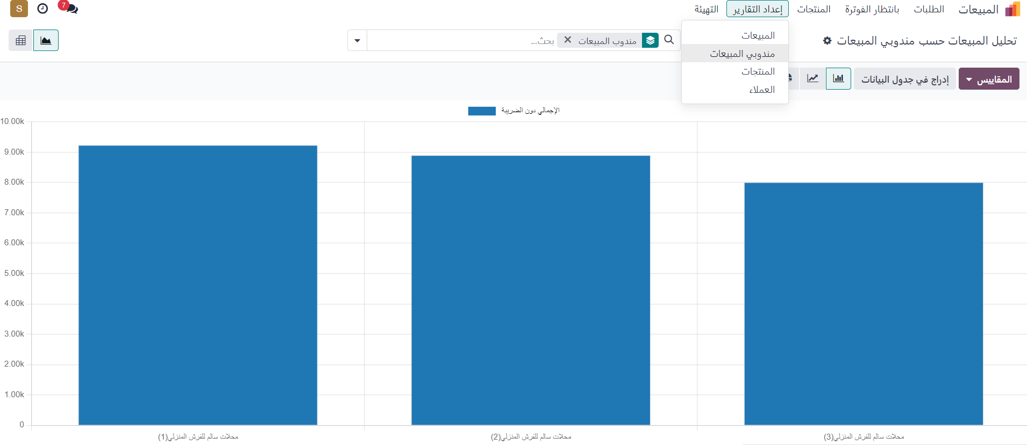

Slide 32
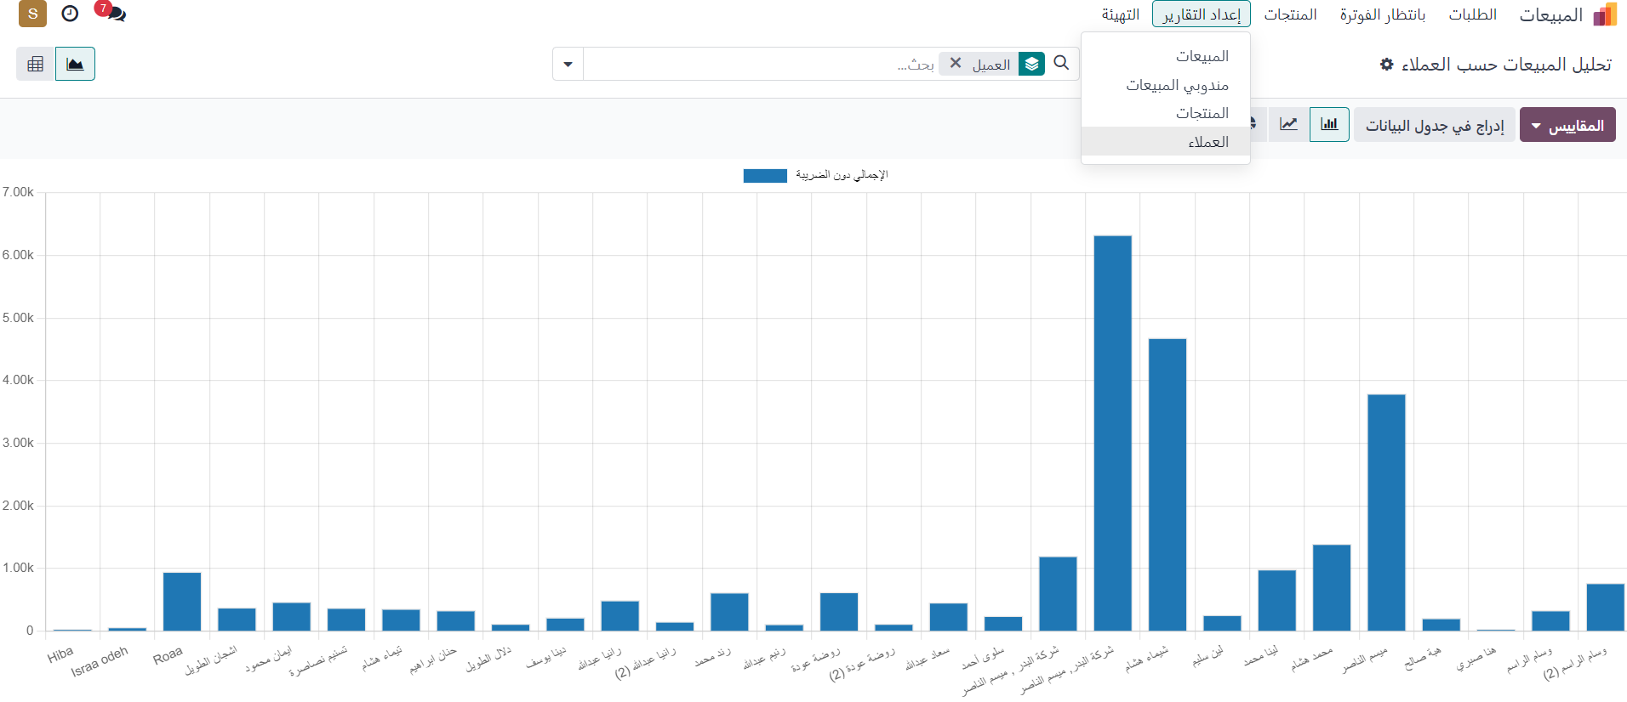
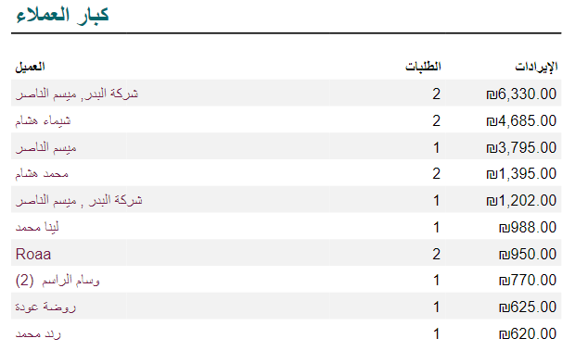

Slide 33
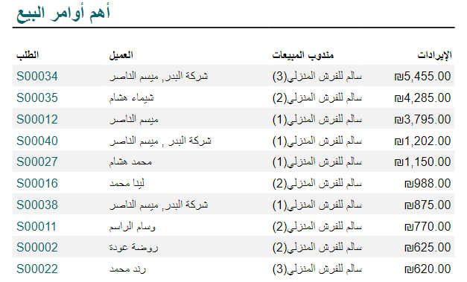
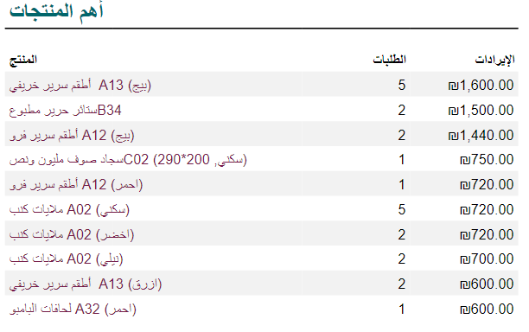
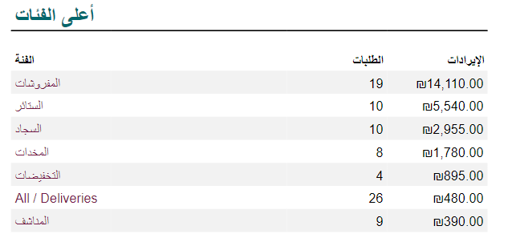

Slide 34
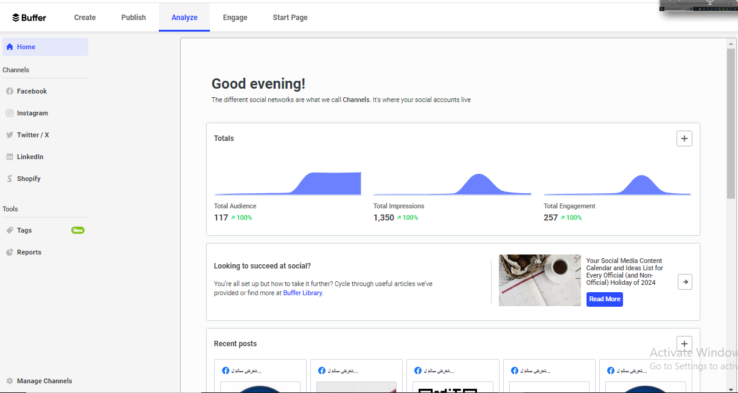
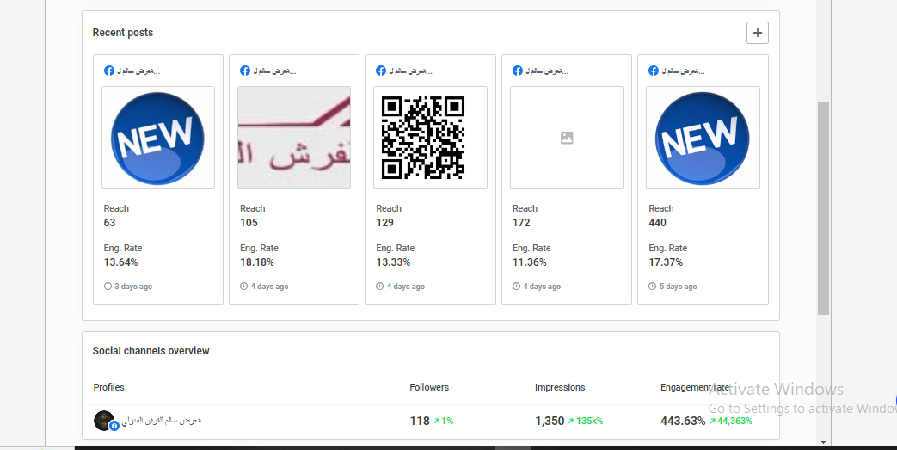
Marketing Analysis

Slide 35
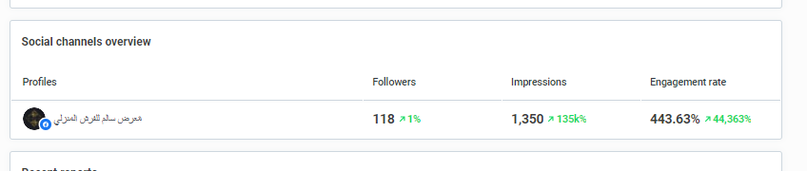
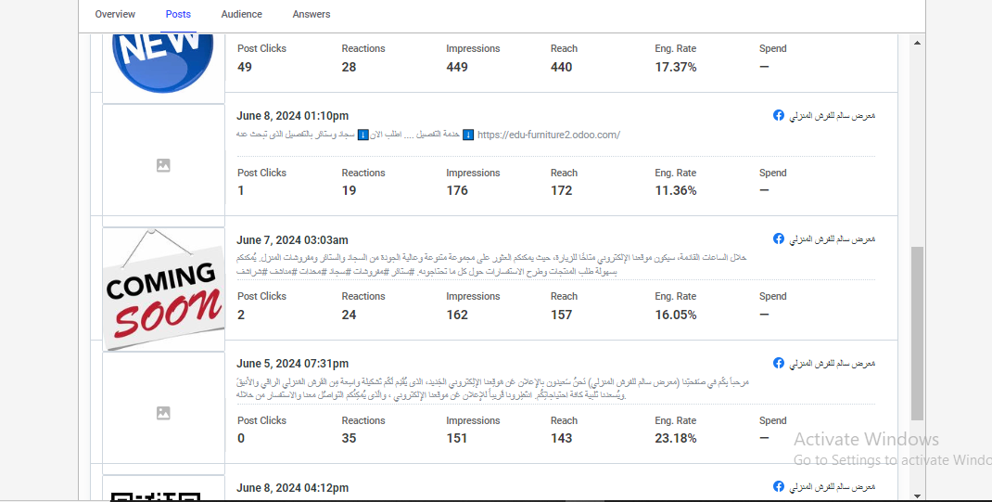

Slide 36


Slide 37


Slide 38

Website Analytics

Slide 39


Slide 40


Slide 41


Slide 42




Slide 43



Slide 44

Marketing tool
google keywords planner

Slide 45


Slide 46


Slide 47


Slide 48

Supervised By: Dr. Najwan Deleq , Dr. Maher Arafat
Created By : Raghad Odeh ,
Maysam Nasser ,
Shaima’ Hisham .

