Slide 1

An-Najah National University
Engineering & IT Faculty
Civil Engineering Department
Structural Design of the Faculty of Allied Medical Sciences in Arab American University –Jenin
By:
Ra’fat Abo Morad (11107047)
Yazan Abo Tahnat (11106029)
Under supervision of : Dr.Suhaib Salawdeh

Slide 2
Outline:
Introduction.
Gravity and Lateral loads.
3D modeling using SAP.
Design of Slab.
Design of Beams.
Design of Columns and Shear walls.
Design of Footings and Ground Beams.

Slide 3
INTRODUCTION

Slide 4
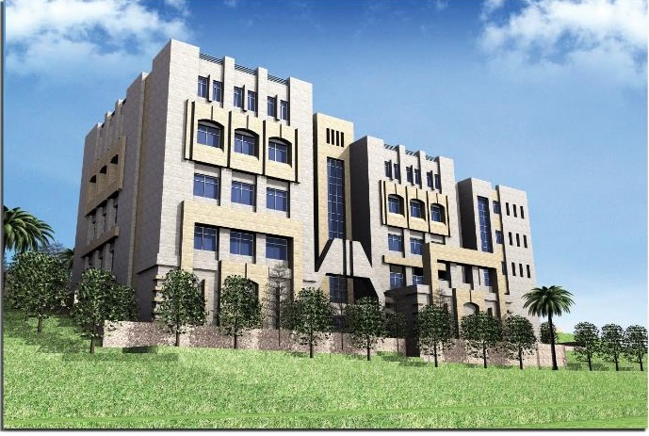
The Faculty of Allied Medical Sciences
Location : Zababdeh – Jenin
4 Floors: Basement , 1st ,2nd , and 3rd floors.
Floor area : 1713 m²
Total Area : 6852 m²

Slide 5
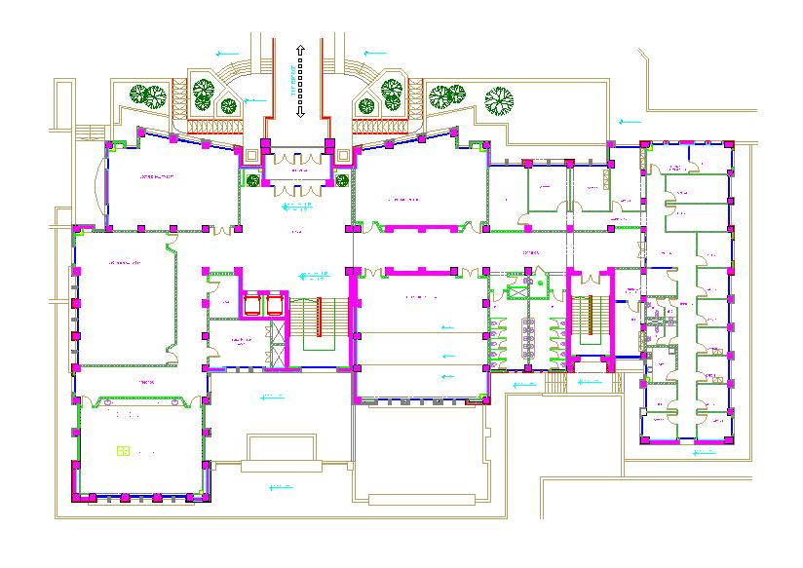
Floors consists:
Offices.
Lecture’s halls.
Laboratory.
Meeting rooms.
Mechanical and
Electrical rooms.

Slide 6
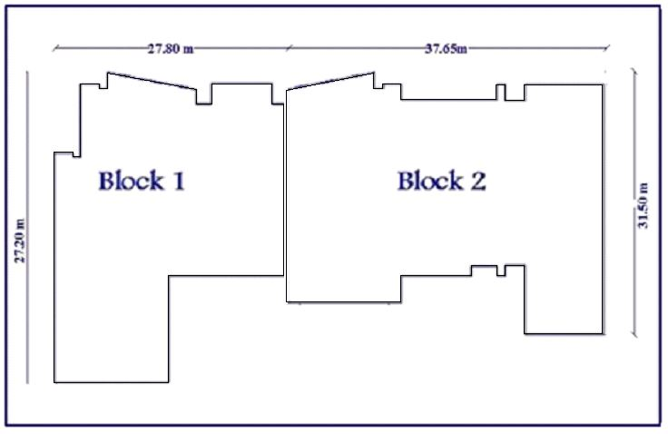

Slide 7
Codes
ACI 318-11 (American Concrete Institute)
IBC-2012 (International Building Code)
UBC-97 (Uniform Building Code)
ASCE-2010 (American Society of Civil Engineers).
Israeli Standards SI 413
Jordanian National Building Code.

Slide 8
GRAVITY & LATERAL
LOADS

Slide 9
Loads
Gravity
Lateral
Seismic
Dead
live
Superimposed

Slide 10
Block 1:
super imposed dead load (KN/m^2) | live load (KN/m^2) | Floor
5 | 5 | Basement
5 | 5 | Ground
5 | 5 | First
0.5 | 1 | Second
2.5 | 1 | Staircase
Block 2:
super imposed dead load (KN/m^2) | live load (KN/m^2) | Floor
7 | 2.5 | Basement
7 | 2.5 | Ground
7 | 2.5 | First
0.5 | 1 | Second
The perimeter walls have a superimposed load equal to 5.5 kN/m².

Slide 11
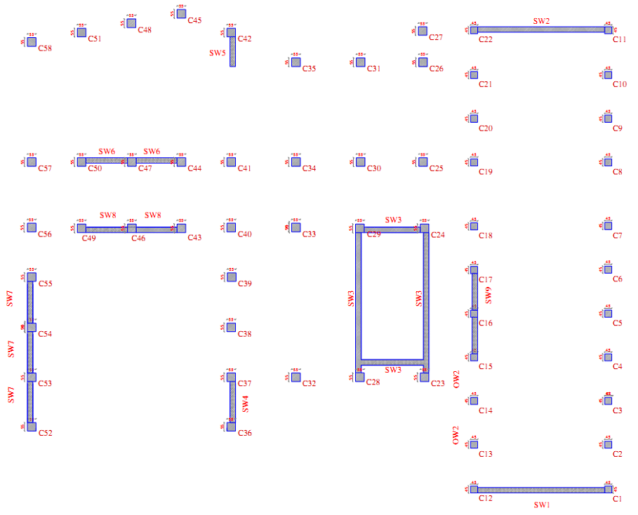
Moment resisting
frame system
( Intermediate Reinforced
Concrete Moment Frames)

Slide 12


Center of mass:
$X^{′}=\frac{\left(0.25∗11019.4∗16.532\right)+ (81784.57∗19.05)}{0.25∗11019.4+81583.32}=19.01 m.$
$Y^{′}=\frac{\left(0.25∗11019.4∗16.613\right)+ (81583.32∗15.84)}{0.25∗11019.4+81583.32}=15.86 m.$
$X^{′′}= 17.90 m$
$Y^{′′}= 15.65 m$
Eccentricity: ex = 1.11 m. , ey = 0.21 m.

Slide 13
SDS=2/3*SMS
SMS= Fa * Ss
R
System
I
Fa→
site class(B), Ss
Ss= 2.5 *Z
Z→ site class(B)→ soil type
Risk category (III)
Use of Buildings and Structures

Slide 14
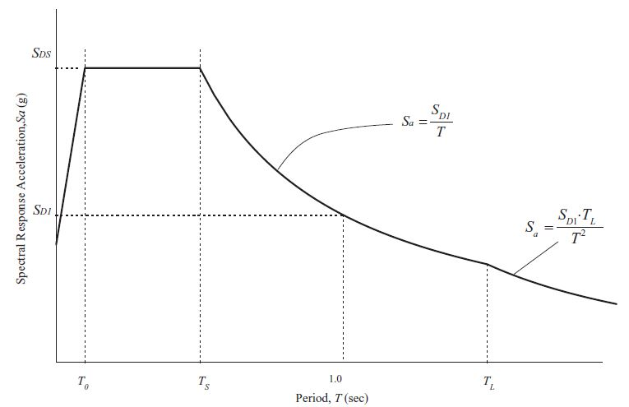
Response spectrum
  A response spectrum is a plot of the maximum response amplitude (displacement, velocity, or acceleration) versus the modal period

Slide 15
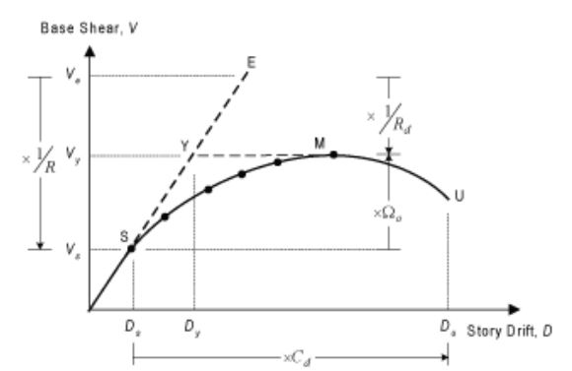
Seismic design factors
R= Modification factor
Cd= Deflection Amplification Factor

Slide 16
Block 2
Code | Value of base shear (Hand Calc.)(kN)
IBC-2012& Israeli code | 6473.74
UBC-97 | 6005.76
IBC-2012& ASCE-website | 13805.44

Slide 17
Load combinations
U = 1.4D
U = 1.2D + 1.6L + 0.5(Lr or S or R)
U = 1.2D + 1.6(Lr or S or R) + (1.0L or 0.5W)
U = 1.2D + 1.0W + 1.0L + 0.5(Lr or S or R)
U = 1.2D + 1.0E + 1.0L + 0.2S
U = 0.9D + 1.0W
U = 0.9D + 1.0E

Slide 18
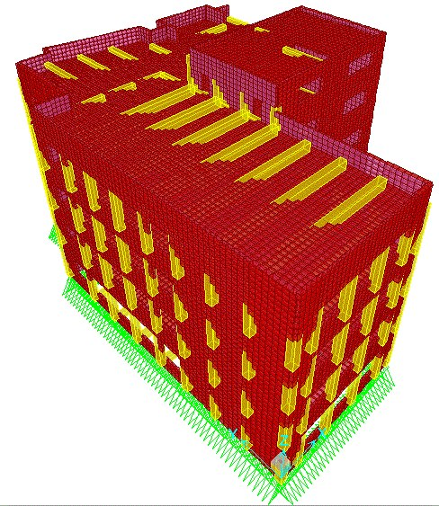
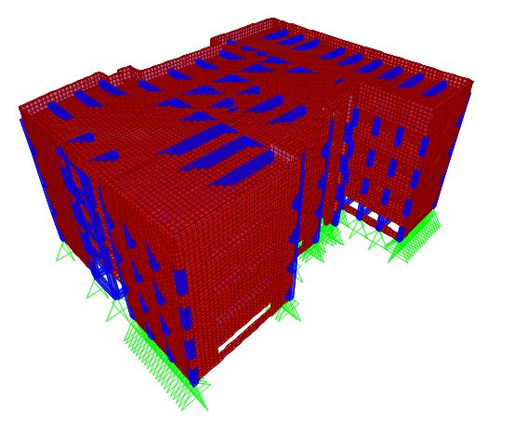
THREE DIMENSIONAL STRUCTURAL
ANALYSIS

Slide 19
Modifiers for each element
Modifier | Element
0.7 | Column
0.35 | Beam
0.35 | Slab
0.7 | Shear wall

Slide 20
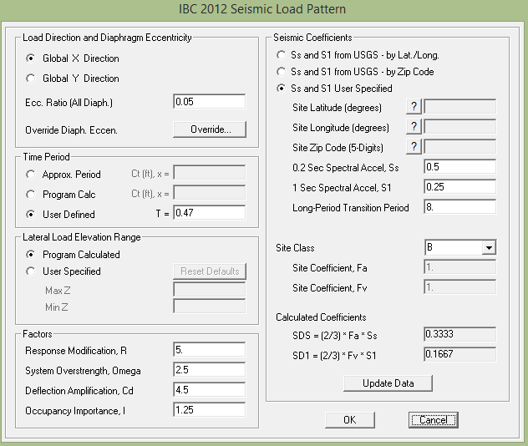

Slide 21
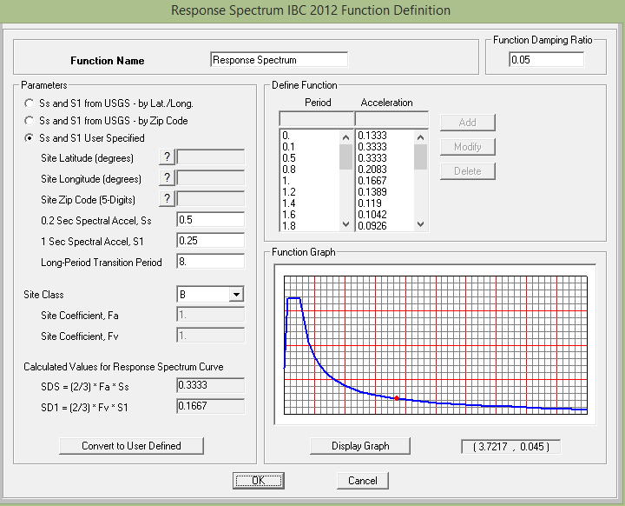

Slide 22
Strength check
Shear & torsion
No red elements
No problems
Rebar percentage
All is okay

Slide 23
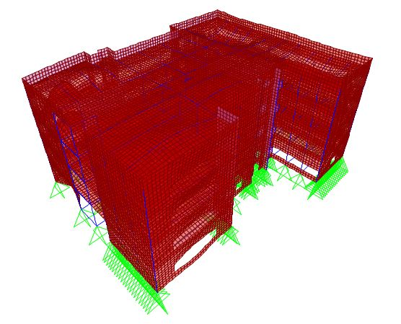
Compatibility of structural model

Slide 24

Equilibrium
Load type | Hand results kN | SAP results kN | Difference %
Dead | 53098 | 52275.99 | 1.57
SD | 29337.56 | 29260.97 | 0.26
Live | 11014.5 | 11019.4 | 0.045

Slide 25
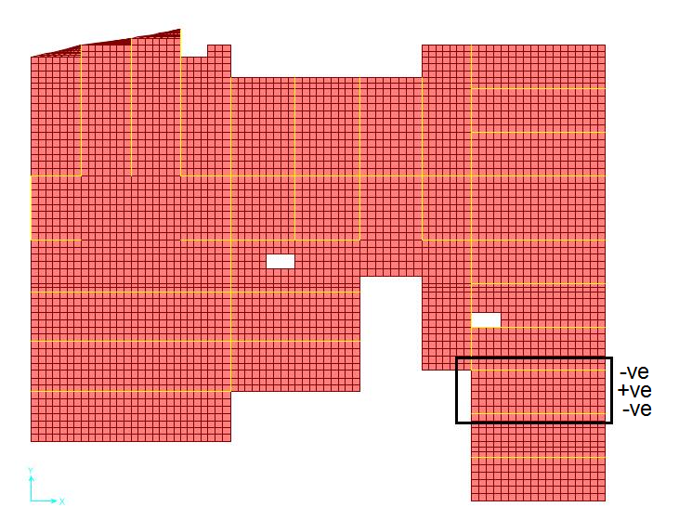

Stress Strain relationship
(internal equilibrium)
Slab moments
$\frac{3.86+3.91}{2}+2.62=6.51 KN.m$
$$\frac{w_{u L^{2}}}{8}=\frac{7∗{2.8}^{2}}{8}=6.86 KN.m$$
The difference percentage is 5.1 %, which is less than 10%, OK.

Slide 26
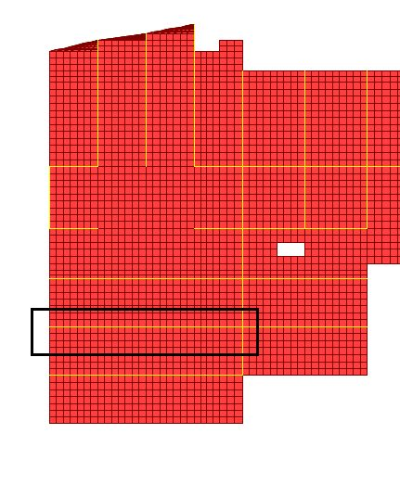
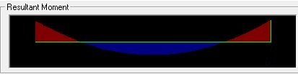

Beams moments
$$M_{SAP}= \frac{273.5385+257.5757}{2}+161.1287 =426.73 KN.m$$
$M= \frac{w_{u L^{2}}}{8}= \frac{22.4∗{12.8}^{2}}{8}=458.7 KN.m$
The difference percentage is 6.97%, which is less than 10%, OK.

Slide 27

Lateral loads check
Seismic load, IBC
Direction | Hand calculation base shear(kN) | Sap base shear (kN)
X | 6473.74 | 7024
Y | 6473.74 | 7024

Slide 28
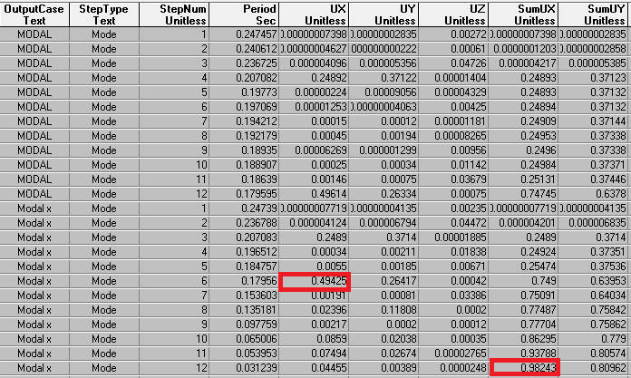
Period and modal participation ratio

Slide 29
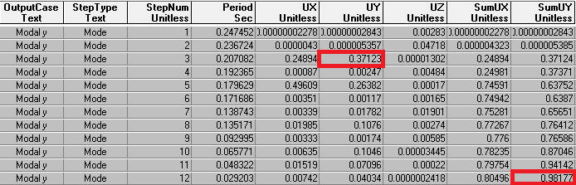

Slide 30


Structural period( hand calculation)
$T=2π\sqrt{\frac{\sum_{i=1}^{n}{f_{i}{Δ_{i}}^{2}}}{g\sum_{i=1}^{n}{f_{i}Δ_{i}}}}$ ASCE, Equation 15.4-6
Floor | Area (𝒎𝟐) | Mass (ton) | Δ (𝒎) | Δ𝟐 (𝒎𝟐) | Force (𝒌𝑵) | Force* Δ 𝒌𝑵.𝒎 | Mass*Δ𝟐 𝒕𝒐𝒏.𝒎𝟐
Basement | 946 | 2325 | 0.0001397 | 1.9488E-6 | 946 | 0.13206 | 4.11E-05
Ground | 946 | 2325 | 0.0003317 | 1.1002E-7 | 946 | 0.313788 | 2.21E-04
First | 946 | 2325 | 0.0005087 | 2.591 E-7 | 946 | 0.451514 | 4.77E-04
Second | 946 | 1658.26 | 0.0006495 | 4.212E-7 | 946 | 0.5566644 | 5.11E-04
𝑇𝑥=0.182 Sec
$Error \%=\frac{ 0.182−0.179∗100\%}{0.182}=1.648 \%$

Slide 31
DESIGN OF SLAB

Slide 32
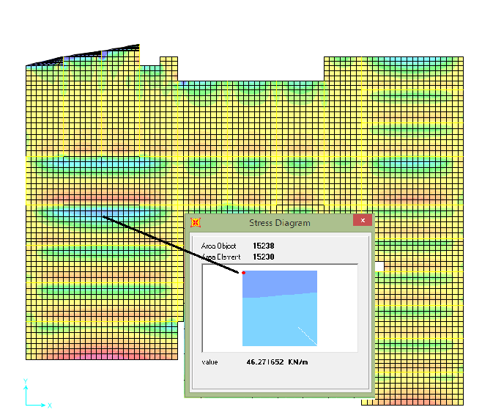

Solid slab.
Thickness = 17 cm.
Shear on slab:
Max Vu = 46.27 kN
$∅$Vc = 86 kN
86 >46.27, so, shear is OK

Slide 33

Steel reinforcement:
Using a uniform steel mesh with 4Ø12/ 1m (Top and Bottom) for all floors and roof.
$ΦMn =Φ Asfy(d)$
$ΦMn =(0.9)(113∗4)(420)(170−\frac{50+7.98}{2})(10−6) = 24 kN.m/m$ (Negative and possitive)
When the moment exceeds 24 kN.m/m , use 8Ø12/ 1m (Top and Bottom)

Slide 34
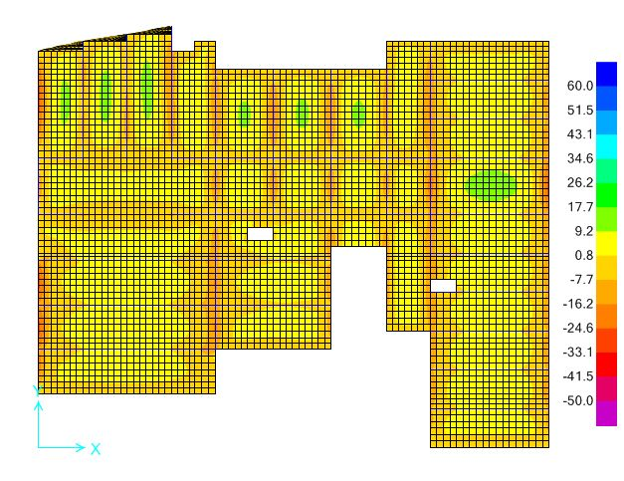
My : All moment less than 24 kN.m/m

Slide 35
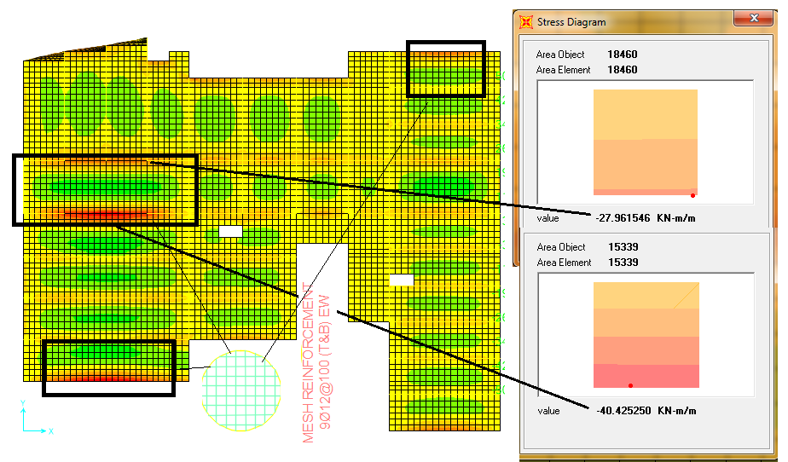
Mx : double the mesh in 3 spans

Slide 36
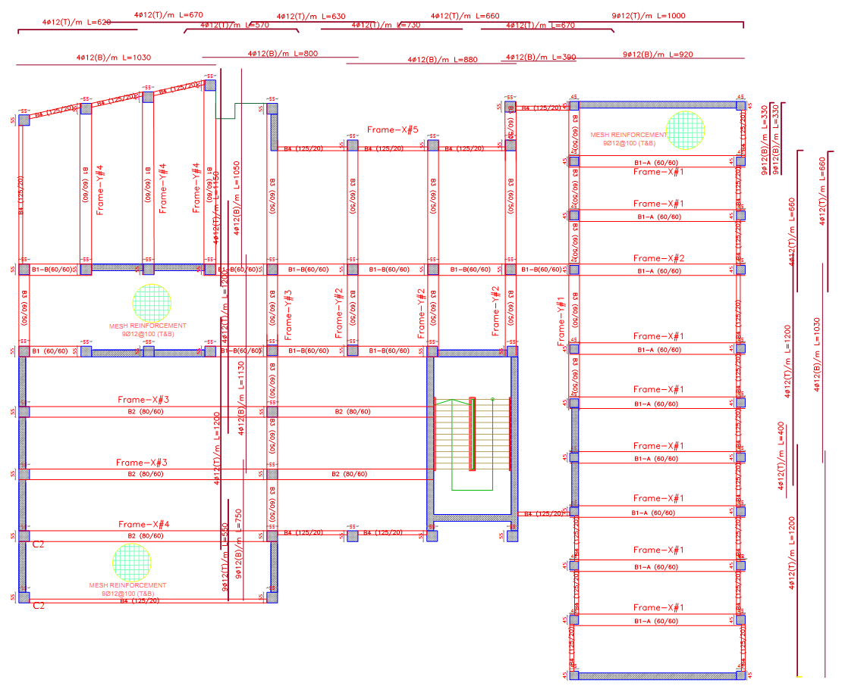

Slide 37
DESIGN OF BEAMS

Slide 38
All beams are drop beams.
Beams in structure classified to:
  Beam 1-A (B1-A) : (600/600).
  Beam 1-B (B1-B) : (600/600).
  Beam 2 (B2) : (800/600).
  Beam 3 (B3) : (600/500).
  Beam 4 (B4) : (1250/200).

Slide 39
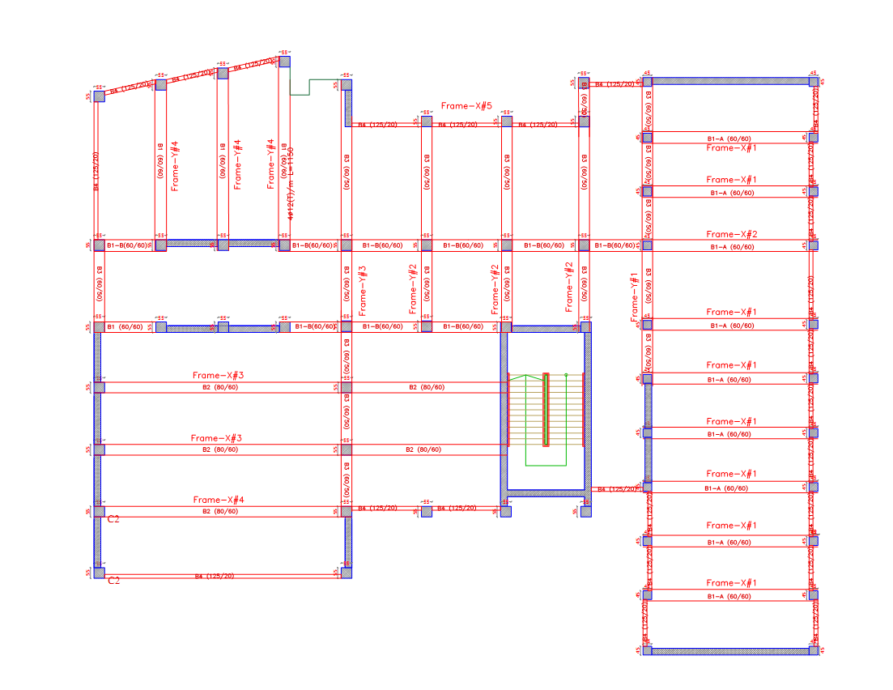

Slide 40
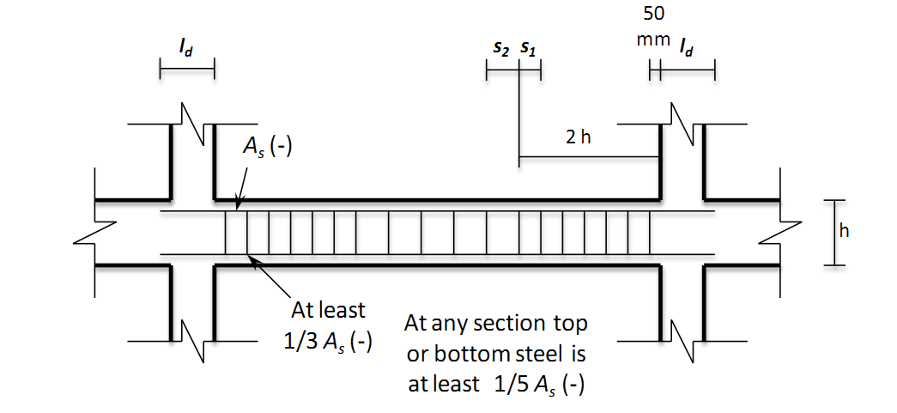

ACI318-11 Code requirements:
The value of moment and shear
computed by taking twice the
earthquake load in the load
combinations.
The first hoop shall be located not more than 50 mm from the face of a supporting member.
  $S_{1}=min\left\{\begin{aligned}\frac{d}{4} \\ 8 d_{b} \\ 24ds \\ 300 mm\end{aligned}\right.$
  $S_{2} =\frac{d}{2}$ .

Slide 41
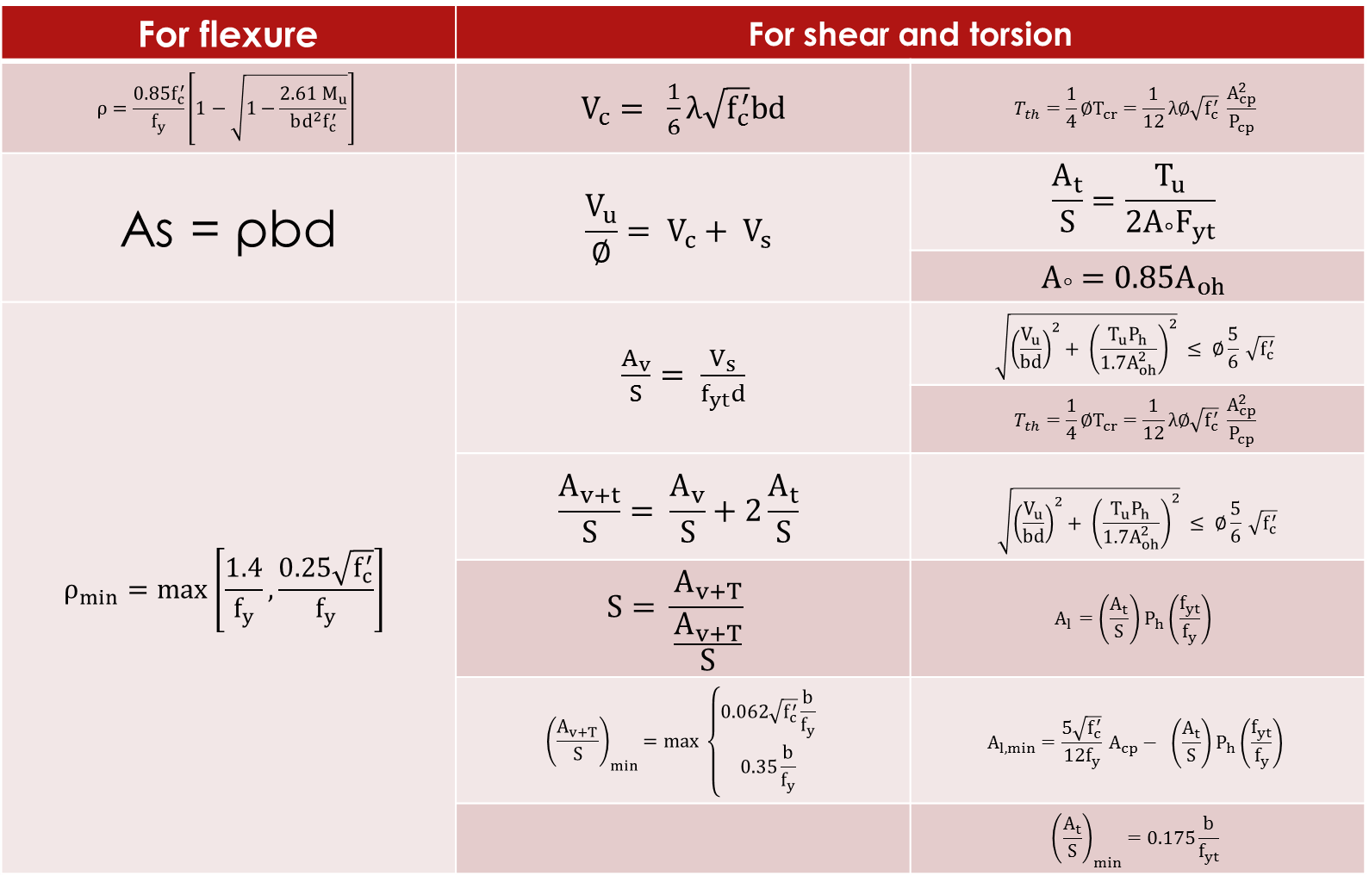
Equations:
For shear and torsion |  | For flexure
$$T_{th}={\frac{1}{4}∅T}_{cr}=\frac{1}{12}λ∅\sqrt{f_{c}^{′}} \frac{A_{cp}^{2}}{P_{cp}}$$ | $V_{c}= \frac{1}{6}λ\sqrt{f_{c}^{′}}bd$ | $$ρ=\frac{0.85f_{c}^{′}}{f_{y}}\left[1−\sqrt{1−\frac{2.61 M_{u}}{bd^{2}f_{c}^{′}}}\right]$$
$$\frac{A_{t}}{S}=\frac{T_{u}}{{2A}_{°}F_{yt}}$$ | $$\frac{V_{u}}{∅}= V_{c}+ V_{s}$$ | As = ρbd
$$A_{°}=0.85A_{oh}$$
$$\sqrt{{\left(\frac{V_{u}}{bd}\right)}^{2}+ {\left(\frac{T_{u}P_{h}}{1.7A_{oh}^{2}}\right)}^{2}} ≤ ∅\frac{5}{6} \sqrt{f_{c}^{′}}$$ | $\frac{A_{v}}{S}= \frac{V_{s}}{f_{yt}d}$ | $$ρ_{min}=max\left[\frac{1.4}{f_{y}},\frac{0.25\sqrt{f_{c}^{′}}}{f_{y}}\right]$$
$$T_{th}={\frac{1}{4}∅T}_{cr}=\frac{1}{12}λ∅\sqrt{f_{c}^{′}} \frac{A_{cp}^{2}}{P_{cp}}$$
$$\sqrt{{\left(\frac{V_{u}}{bd}\right)}^{2}+ {\left(\frac{T_{u}P_{h}}{1.7A_{oh}^{2}}\right)}^{2}} ≤ ∅\frac{5}{6} \sqrt{f_{c}^{′}}$$ | $$\frac{A_{v+t}}{S}= \frac{A_{v}}{S}+2\frac{A_{t}}{S}$$
$$A_{l}=\left(\frac{A_{t}}{S}\right)P_{h}\left(\frac{f_{yt}}{f_{y}}\right)$$ | $$S= \frac{A_{v+T}}{\frac{A_{v+T}}{S}}$$
$$A_{l,min}=\frac{5\sqrt{f_{c}^{′}}}{12f_{y}} A_{cp}− \left(\frac{A_{t}}{S}\right)P_{h}\left(\frac{f_{yt}}{f_{y}}\right)$$ | $${\left(\frac{A_{v+T}}{S}\right)}_{min}=max \left\{\begin{aligned}0.062\sqrt{f_{c}^{′}}\frac{b}{f_{y}} \\ 0.35\frac{b}{f_{y}}\end{aligned}\right.$$
$${\left(\frac{A_{t}}{S}\right)}_{min}=0.175\frac{b}{f_{yt}}$$

Slide 42
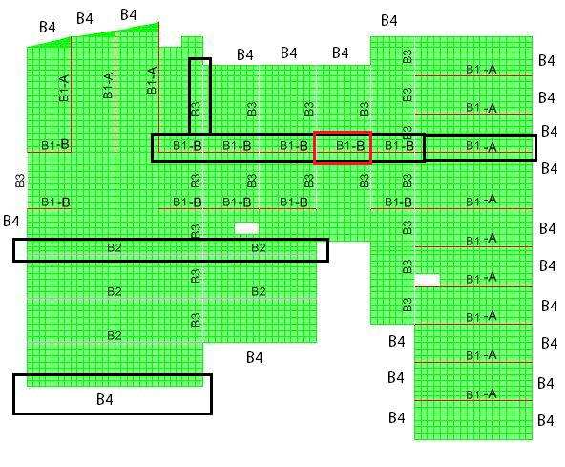

Slide 43
transverse steel (S2) | transverse steel until 2h(S1) | Longitudinal Steel |  | Dimension(h/d) | Beam ID
5Ø10/m | 9Ø10/m | 5Ø25 | Top | (600/600) | B1-A
 |  | 4Ø22 | Mid
 |  | 5Ø25 | Bottom
5Ø10/m | 9Ø10/m | 3Ø22 | Top | 600/600 | B1-B
 |  | 2Ø16 | Mid
 |  | 3Ø22 | Bottom
6Ø10/m | 8Ø10/m | 5Ø32 | Top | (800/600) | B2
 |  | 6Ø22 | Mid
 |  | 3Ø32 | Bottom
5Ø10/m | 9Ø10/m | 3Ø22 | Top | (600/500) | B3
 |  | 4Ø16 | Mid
 |  | 3Ø22 | Bottom
6Ø12/m | 6Ø12/m | 3Ø22 | Top | (1250/200) | B4
 |  | 8Ø16 | Mid
 |  | 3Ø22 | Bottom

Slide 44
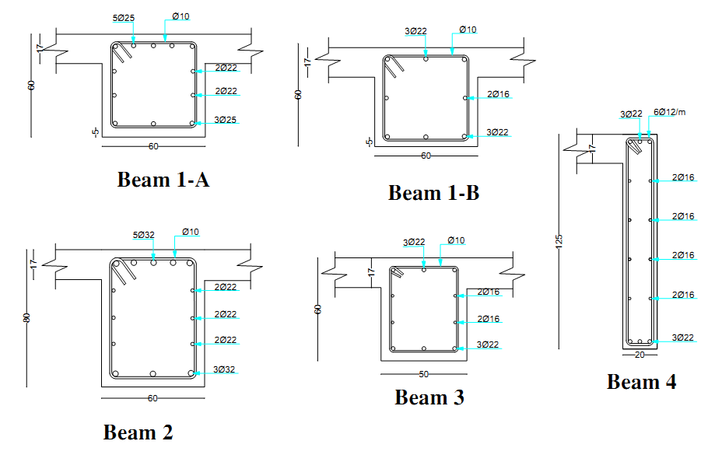
Beams sections: (On Face of Joints)

Slide 45
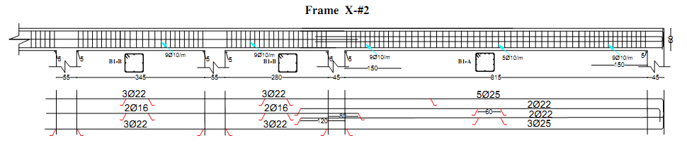
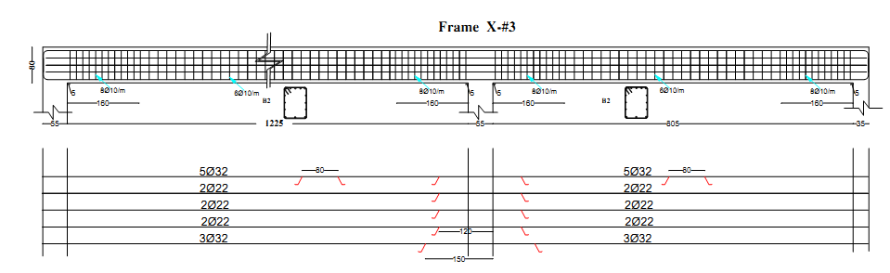
Frames longitudinal sections:

Slide 46
DESIGN OF COLUMNS AND SHEAR WALLS

Slide 47
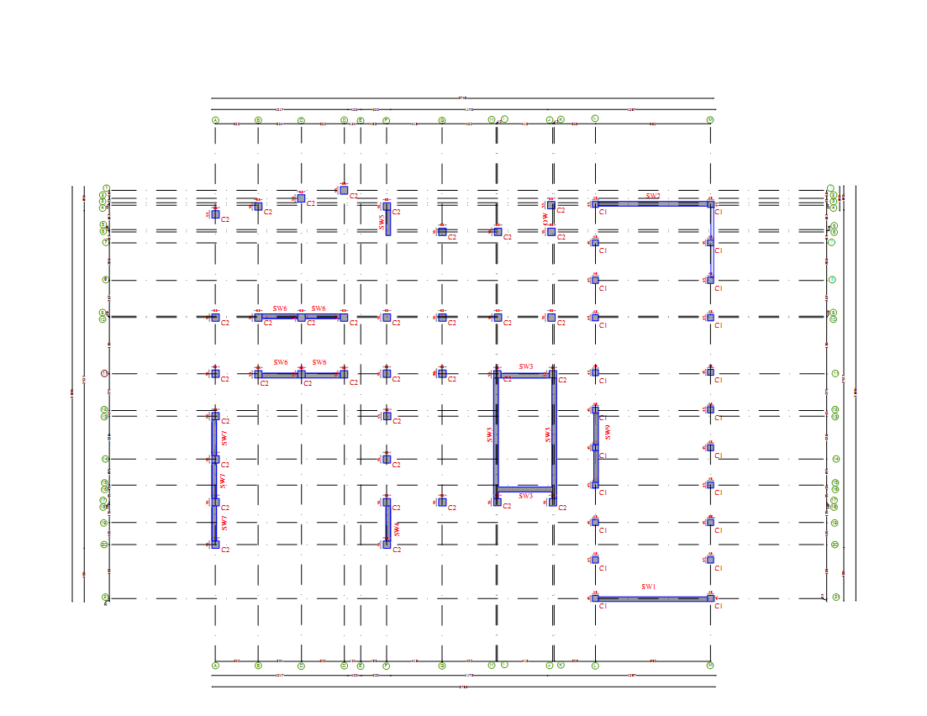

Slide 48
Two columns in the project:
1. C1: (450x450), 22 columns.
2. C2: (550x550), 36 columns.
Design methodology:-
The design based on taking the critical edge, intermediate, and corner columns of C1 and C2.
Drawing the interaction diagram for C1 and C2.
Using SAP to get the axial force and moments on each column.
Choosing the proper steel ratio.
Determining the spacing between hoops.

Slide 49
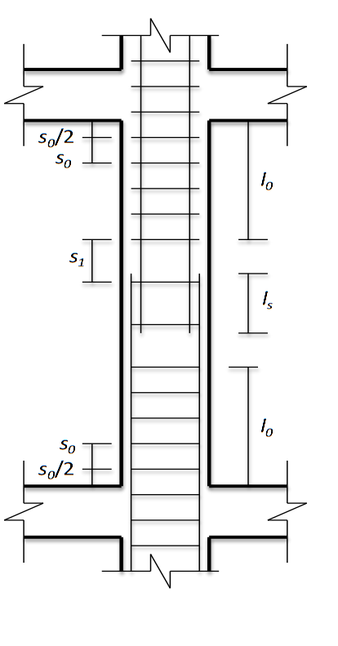

ACI318-11 code requirements:
The value of moment and shear computed by taking 3 times the earthquake load in the load combinations.
Hoops Equations (ACI318-11):
$Sο=min \left\{\begin{aligned}\frac{least column dimension}{2} \\ 8d_{b} \\ 24d_{s} \\ 300 mm\end{aligned}\right.$
$S_{1}=min \left\{\begin{aligned}least column dimension \\ 16d_{b} \\ 48d_{s}\end{aligned}\right.$
$Lο=max \left\{\begin{aligned}clear height of column/6 \\ maximum column dimension \\ 450 mm\end{aligned}\right.$

Slide 50
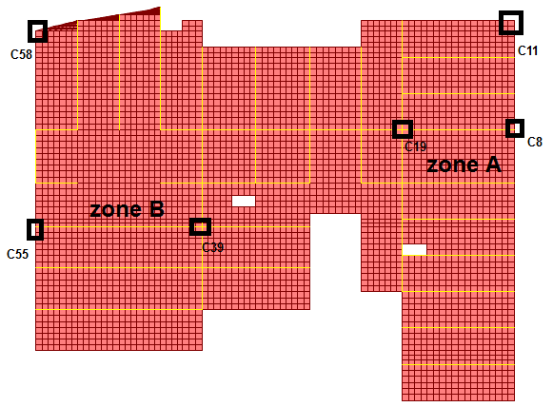

Slide 51
Vu(kN) | Mu (kN.m) | Pu (kN) | Dimensions (m) | Zone | Colum ID
84 | 138 | 1860 | 0.45 x 0.45 | A | C8
43 | 95 | 2038 | 0.45 x 0.45 | A | C11
24 | 11 | 2407 | 0.45 x 0.45 | A | C19
325 | 328 | 3092 | 0.55 x 0.55 | B | C39
57 | 151 | 3554 | 0.55 x 0.55 | B | C55
65 | 60.5 | 3688 | 0.55 x 0.55 | B | C58

Slide 52
1%
The distribution of (M,P) point for checked 450mm-square columns on C1 interaction diagram

Slide 53
1%
The distribution of (M,P) point for checked 550mm-square columns on C2 interaction diagram

Slide 54

Using a steel ratio of 1% is safe and economical for all columns.
The longitudinal steel is:
8 $∅$ 18 for C1 (450 x 450).
12 $∅$ 18 for C2 (550 x 550).
Hoops:
For All columns: provide 8 Ø10/m at a distance of 0.7 m from the top
and bottom joints of columns, and 5 Ø10/m on mid of column.
Start with hoops at a distance of 5 cm from the face of supports.
Provide a lap splice length = 0.7 m.
The splicing of bars is made on the middle of columns.

Slide 55
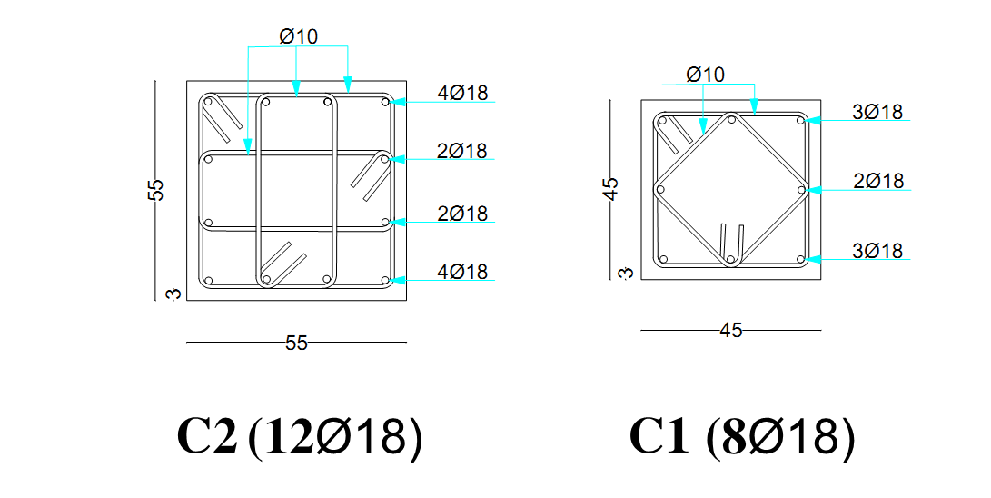

Slide 56
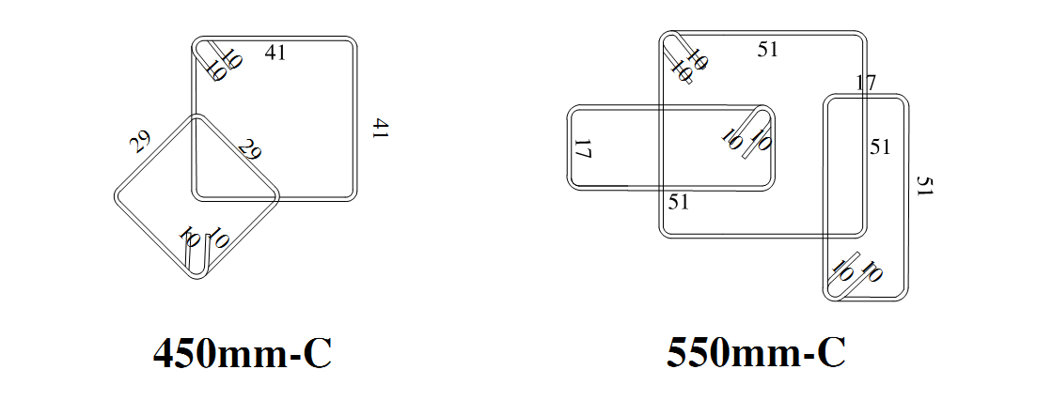

Hoops in column ($∅$10/m)

Slide 57
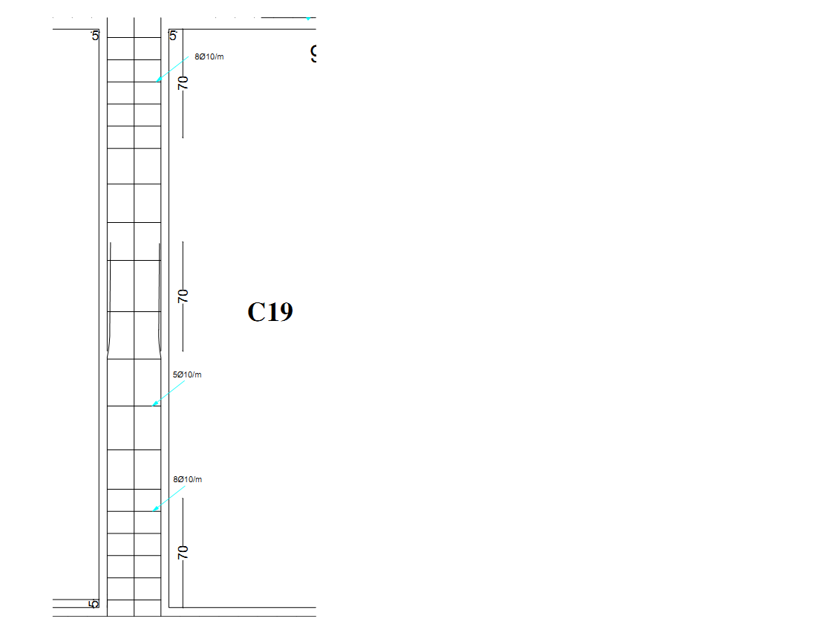
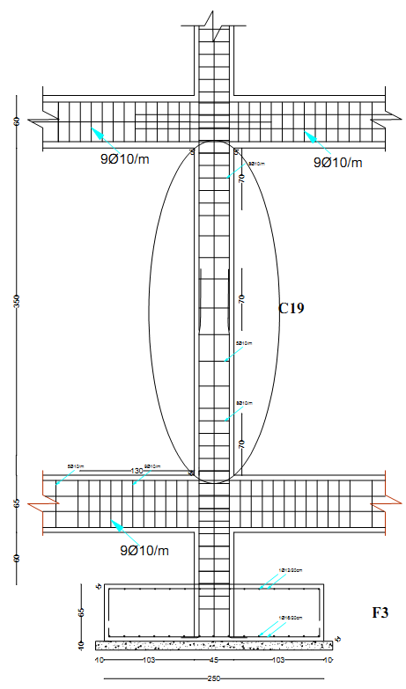

Slide 58
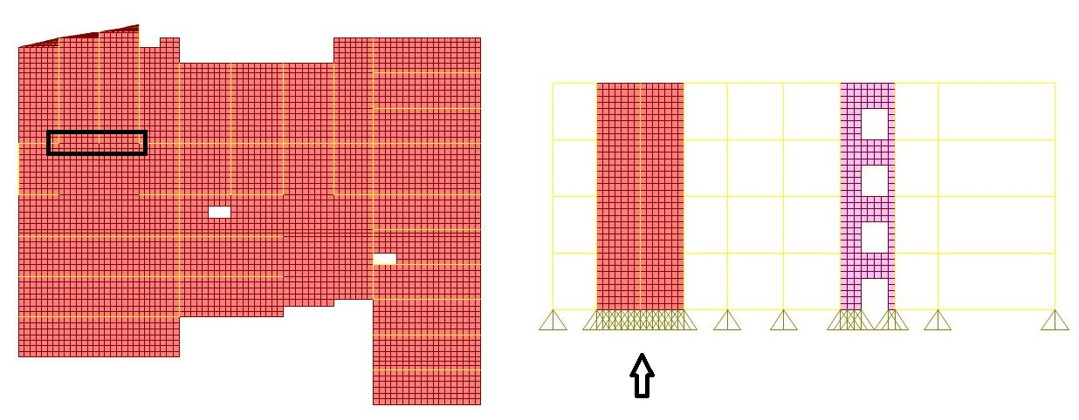
Design of shear wall 6 :

Slide 59
Minimum reinforcement in shear walls according to ACI318-11
Minimum ratio of vertical reinforcement area area, ρ, shall be:
  0.0012 for deformed bars not larger than 16mm in diameter with F_{y} not less than 420 MPa.
Minimum ratio of horizontal reinforcement area, ρ, shall be:
  0.002 for deformed bars not larger than 16mm in diameter with F_{y} not less than 420 MPa.
Vertical and horizontal reinforcement shall not be spaced farther apart than three times the wall thickness, nor farther apart than 450 mm.

Slide 60

Equations:
  Compressive strength:${∅P}_{n}={0.55∅f}_{c}^{′}A_{g}\left[1−{\left(\frac{{kl}_{c}}{32h}\right)}^{2}\right]$
  $Thickness b≥ \left\{\begin{aligned}\frac{h}{25} \\ \frac{L}{25} \\ 100mm\end{aligned}\right.$
  $A_{s}=\frac{M_{uy}}{{∅f}_{y}(d−d^{′})}$
  $V_{c}= \frac{1}{6}λ\sqrt{f_{c}^{′}}bd$
  $\frac{V_{u}}{∅}= V_{c}+ V_{s}$
  $\frac{A_{v}}{S}= \frac{V_{s}}{f_{yt}d}$
  $V_{s,max}={4V}_{c}$

Slide 61

Length of SW6 = 6.4 m.
Thickness of SW6 = 0.35 m (assumed previously)
  $350 mm≥ \left\{\begin{aligned}\frac{h}{25}=\frac{4160}{25}=166.4mm \\ \frac{L}{25}=\frac{6400}{25}=256 mm \\ 100mm\end{aligned}\right.$ …. The thickness is accepted
Using SAP :
Vu (kN) | Muy (kN.m) | Mux (kN.m) | Pu (kN) | SW ID
2810 | 147 | 20150 | 7718 | SW6

Slide 62

Use total cover = 40 mm.
$V_{c}=11853 kN$
$\frac{V_{u}}{∅}=\frac{2810}{0.75}=3746 kN$
$V_{c}>\frac{V_{u}}{∅}$ , therefore, use the minimum horizontal steel according to ACI318-11:
$A_{s,horizontal}=0.002\left(350\right)\left(1000\right)=700 {mm}^{2}$
Then, for each face of wall, $A_{s,horizontal}=\frac{700}{2}= 350 {mm}^{2}$→ use 1Ø10/250 mm

Slide 63
1%
0.75%
0.5%

Slide 64
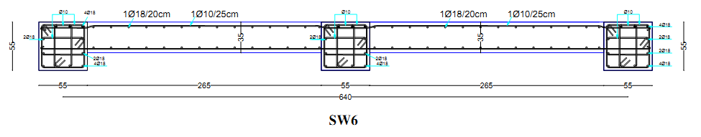

$A_{s,long.1}=0.75\% \left(6400\right)\left(350\right)=16800 {mm}^{2}$ on the two sides.
$A_{s,long.2}=\frac{M_{uy}}{{∅f}_{y}(d−d^{′})}=\frac{147({10}^{6})}{0.9\left(420\right)(310−40)}=1440 {mm}^{2}$ on each side.
The total longitudinal steel in SW6 for each side = $\frac{16800 }{2}+1440=9840 {mm}^{2}$
→ Use 1Ø18/20cm, or 6Ø18mm/1m.

Slide 65
DESIGN OF FOOTING

Slide 66
Soil type : Rock.
Allowable Bearing Capacity: 300 kN/m²
Grouping of footings are shown in table below:
under column/wall | dimensions (LxB) | Number of footing | Type | Footing ID
C2,C10,C13,C14,C56 | 150 X 150 | 5 | single | F1
C3, C4, C5, C6, C9, C21, C31, C32, C33, C35, C40, C51 | 200 X 200 | 12 | single | F2
C7,C8, C18, C20, C25, C30, C41, C48, C57,C58 | 230 X 230 | 10 | single | F3
C19, C34, C45 | 250 X 250 | 3 | single | F4
SW1 , C1, C12, SW2 , C11, C22 | 1010 X150 | 2 | wall | F5
SW9,C15,C16,C17 | 760 X 200 | 1 | wall | F6
SW8 ,C43,C46,C49 | 800 X 180 | 1 | wall | F7
SW6, C44,C47,C50 | 800 X 220 | 1 | wall | F8
SW7,C52,C53,C54,C55 | 1160 X 250 | 1 | wall | F9
SW5,C42 | 400 X 250 | 1 | wall | F10
C26,C27 | 400 X 200 | 1 | Combined | F11
SW4,C36,C37,C38,C39 | 1240 X 300 | 1 | Continuous | F12
SW3 ,C32,C24,C28,C29 | 1160 X 670 | 1 | Mat | F13

Slide 67
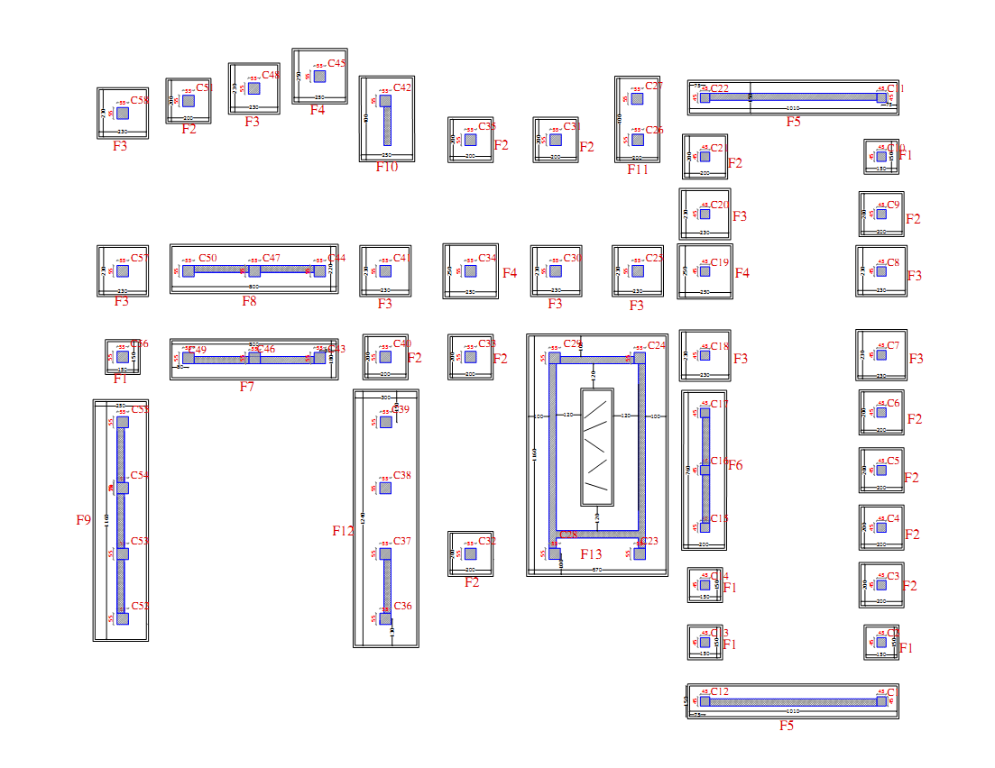

Slide 68
Design of Footing F4
Maximum load on F4 comes from C19.
Ultimate load(1.4D) (kN) | Ultimate load(1.2D+1.6L) (kN) | Service load(kN) | Live load (kN) | Dead Load | Footing Dim. | Column Dim. | Footing ID | Column ID
1869 | 2045.2 | 1612 | 277 | 1335 | 2.5 x 2.5 | 0.45 x 0.45 | F4 | C19
Ultimate Moment (kN.m) | Service load(kN.m) | Live Moment(kN.m) | Dead Moment(kN.m) | Footing Dim. | Column Dim. | Footing ID | Column ID
45.68 | 36.5 | 4.7 | 31.8 | 2.5 x 2.5 | 0.45 x 0.45 | F4 | C19

Slide 69
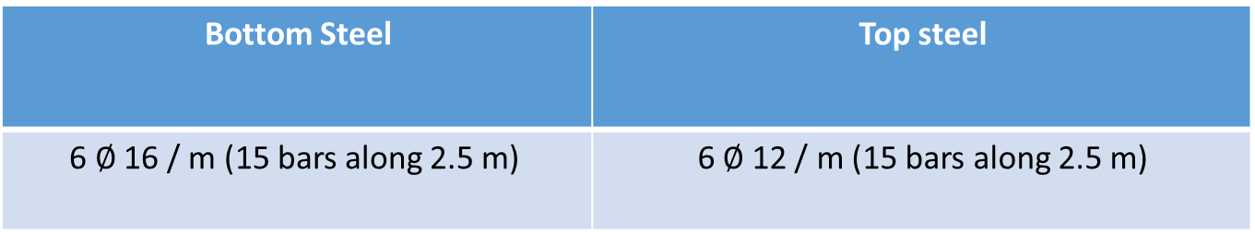
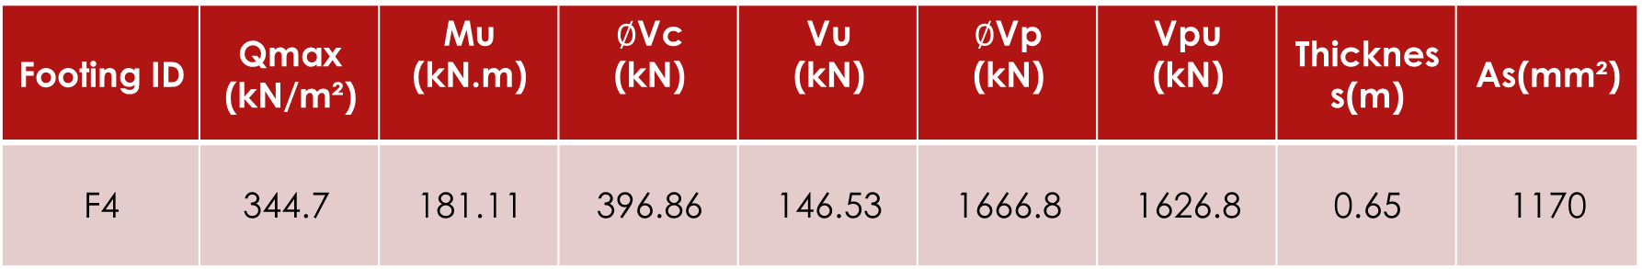
As(mm²) | Thickness(m) | Vpu (kN) | $∅$Vp (kN) | Vu (kN) | $∅$Vc (kN) | Mu (kN.m) | Qmax (kN/m²) | Footing ID
1170 | 0.65 | 1626.8 | 1666.8 | 146.53 | 396.86 | 181.11 | 344.7 | F4
Top steel | Bottom Steel
6 $∅$ 12 / m (15 bars along 2.5 m) | 6 $∅$ 16 / m (15 bars along 2.5 m)

Slide 70
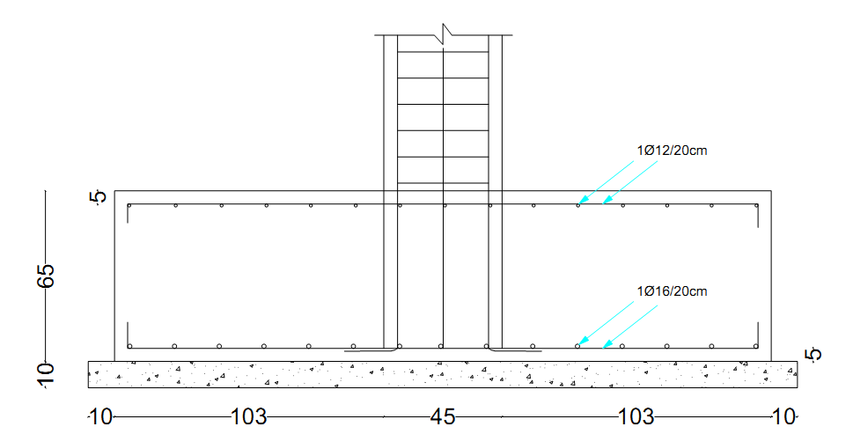
Cross section in F4

Slide 71
DESIGN OF GROUND BEAMS

Slide 72
Ground beams:
- GB1 : (650/450).
- GB2 : (650/550).
Design philosophy:
By applying a 2 mm displacement at a joint under a footing that have the tallest ground beam.
Then, determine the area of steel by using a half of steel ratio resulting from the moment.

Slide 73
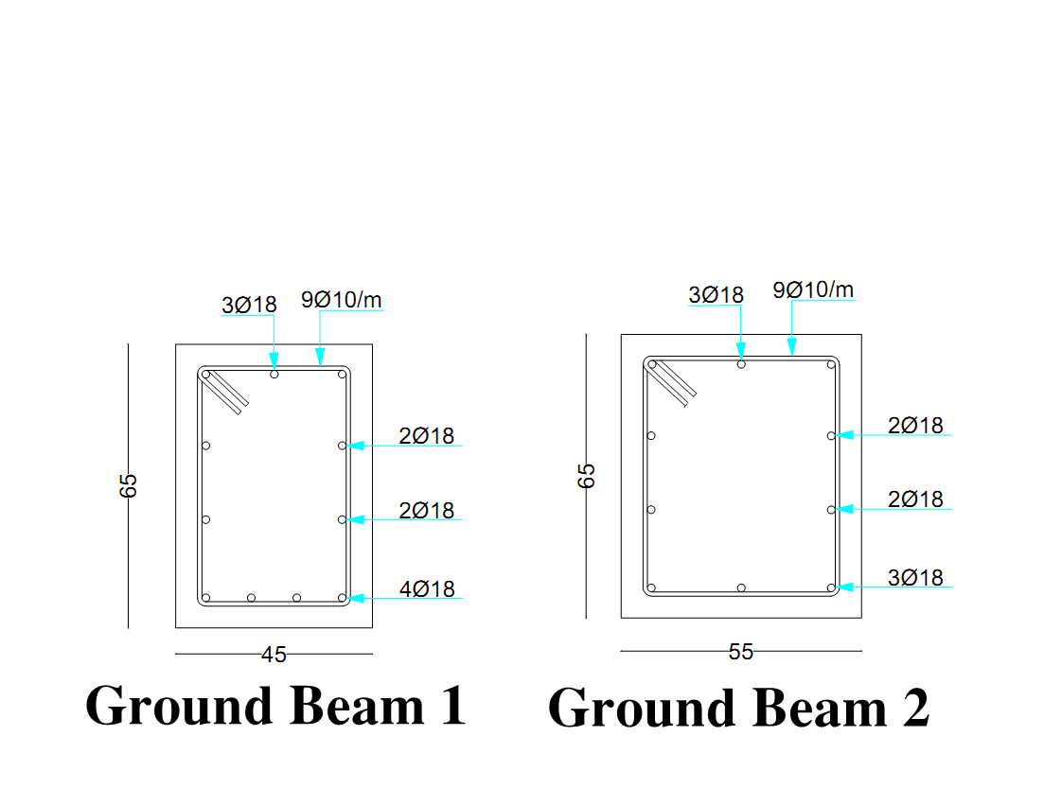
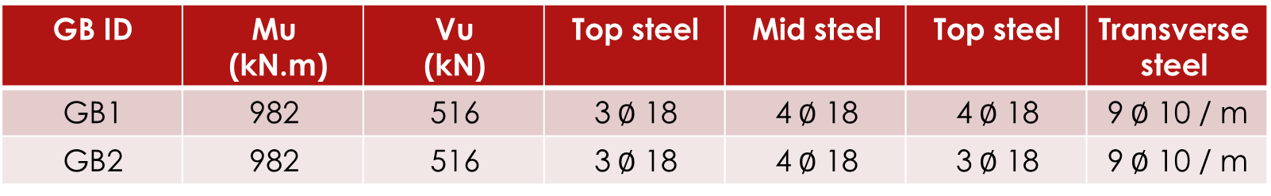
Transverse steel | Top steel | Mid steel | Top steel | Vu (kN) | Mu (kN.m) | GB ID
9$∅$ 10 / m | 4$∅$ 18 | 4$∅$ 18 | 3$∅$ 18 | 516 | 982 | GB1
9$∅$ 10 / m | 3$∅$ 18 | 4$∅$ 18 | 3$∅$ 18 | 516 | 982 | GB2

Slide 74


