Slide 1

An-Najah National University
Faculty of Engineering and Information Technology
Industrial Engineering Department
Graduation Project (2)
Sustainability Assessment of the Palestinian Ready-Mixed Concrete Industry

Slide 2
Prepared by:
Marah Raee
Noor Shami
Raghad Jadi
Shatha Amer
Supervised by:
Dr. Ahmad Al-Ramahi

Slide 3
OUTLINE:
Introduction
Problem statement
Objectives
Methodology
Result & analysis
Conclusion
Recommendations

Slide 4
Introduction
The concept of sustainability emphasizes reducing environmental pollution and large amounts of waste and recycling it, as well as rationalizing the consumption of materials and reusing them in an environmentally friendly way to make products more sustainable, and this also includes packaging and distribution processes, as sustainability reduces the cost of raw materials and increases the quality of production.
This project aims to assess the current situation of ready-mix concrete plants in the northern West Bank. To achieve this goal, we developed a methodology and followed it, which we will talk about later. We developed several hypotheses and tested them using the SPSS statistical program. Some of these hypotheses were accepted and others were rejected.

Slide 5
Problem statement:
Despite the fact that the ready-mixed concrete industry is extremely important, it causes environmental, economic and social problems.
Environmental problems
Economic problems
Social problems

Slide 6
Project Objectives :
Discuss the problems and challenges that facing the ready-mix concrete industry and provide solutions to these problems.
Develop an assessment tool (questionnaire) to detect the gaps in this industry and to collect the data with the aim of assessment the extent of application of sustainability requirements, in order achieve a preliminary conceptualization of the sustainability framework of the ready-mix concrete industry in the northern west bank.
Sustainability practices in ready-mixed concrete provide some recommendations that contribute to application of the plants.
Provide some recommendations that contribute to application of the sustainability practices in ready-mixed concrete plants.

Slide 7
METHODOLGY
By following this methodology, the data will be able to collect, analyze, and predict the results in principle.
Study tool
(Questionnaire)
Collecting data
Analysis of data

Slide 8
Difficulties :
The difficulty of collecting data and finding sources or references about the problems facing factories
We faced difficulty in making face-to-face meetings between us and the project supervisor due to the current situation due to the Corona virus
The difficulty to reach the ready-mixed concrete factories to fill out the questionnaire and the difficulty of conducting interviews with the owners of factories due to the epidemic crisis (Virus Corona). We contacted with the factories owners and sent the questionnaire electronically via e-mail
Time, but we have been able to overcome this obstacle by working hard, divided tasks among team members, organizing and scheduling time in an ideal way, and taking advantage of all free time to work on the project and deliver it on time.

Slide 9
Study Constraints
This study includes the West Bank without the Gaza Strip.
This study includes only licensed factories.
This study contains a random sample, not all factories.
This study does not include the impact of the cement industry, because cement is imported from abroad.

Slide 10
Standards
OECD
Palestinian laws relating to the protection of the environment and safety

Slide 11
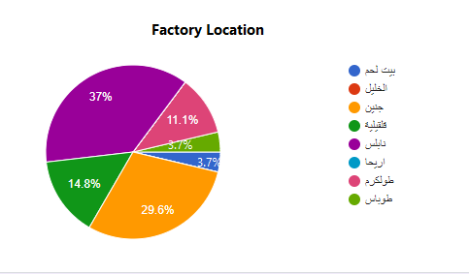
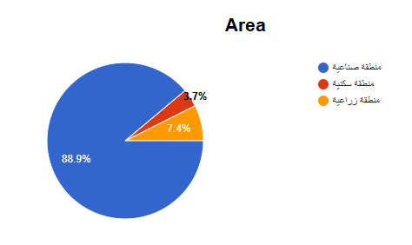
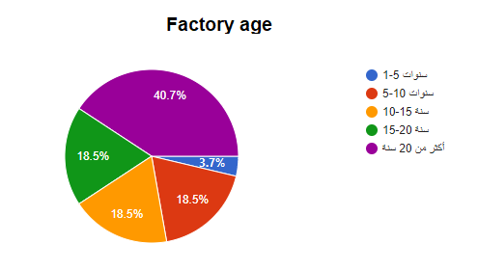
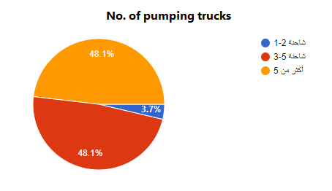
Results and Analysis
Demographic data:

Slide 12
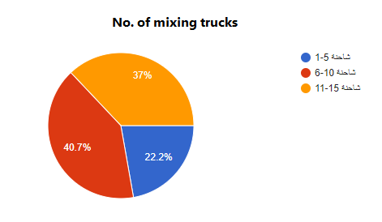
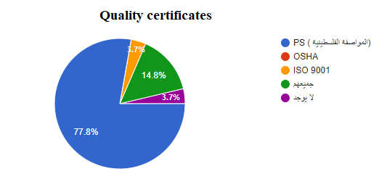
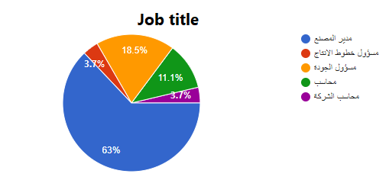
Cont.

Slide 13
Distribution of concrete plants according to the number of employees.
 | Number of factories | Less value | Highest value | Mean | Standard deviation | Total number of employees
The number of employees in the facility | 27 | 13 | 55 | 28.22 | 10.718 | 762

Slide 14
The five Likert scale correction switch.
The arithmetic Mean | Degree
1.00-1.80 | Very low
1.81-2.60 | low
2.61-3.40 | medium
3.41-4.20 | high
4.21-5.00 | Very high

Slide 15
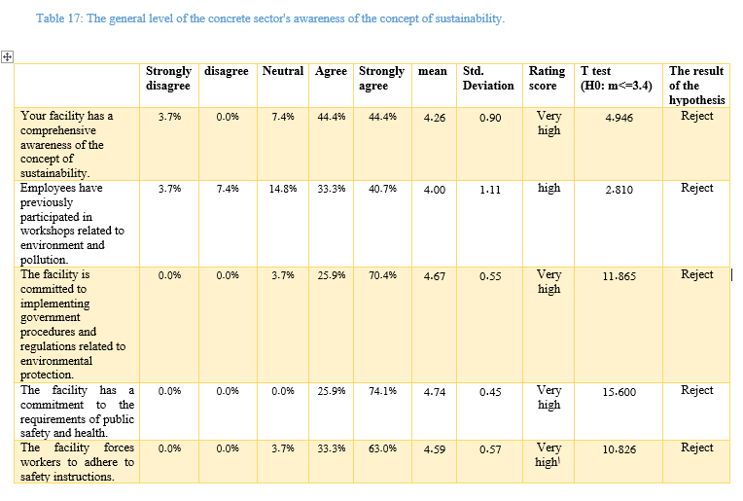
awareness of the concept of sustainability

Slide 16
Result of awareness assessment
1
the degree of evaluation of the level of awareness of the ready-mixed concrete sector with the concept of sustainability is very high.
2
the highest evaluated paragraphs refer to the facility's commitment to safety and public health with an average of 4.74
3
the least evaluated paragraphs refers to the paragraph related to following measures to reduce costs by reducing waste with an average amount 4.07.
followed by that paragraph that indicates the establishment's commitment to implementing government procedures and regulations related to environmental protection with an average of 4.67
and comes in the eleventh place the paragraph related to the previous participation of employees in workshops related to the environment and pollution, with an average of about 4.

Slide 17
Results of the Cronbach alpha coefficient of reliability of the study tool:
Domain | Number of paragraphs | Stability coefficient Cronbach alpha
The level of awareness of the ready-mixed concrete sector of the concept of sustainability | 12 | 0.826

Slide 18
The five Likert scale correction switch to the Environmental, economical and social Practices Assessment.
Degree | Arithmetic mean
very low | 1.00-3.60
Low | 3.61-5.20
Medium | 5.61-6.80
High | 6.81-8.40
Very High | 8.41-10.0

Slide 19
Environmental Practices Assessment
Results of the Cronbach alpha coefficient for consistency of environmental practices assessment:
Reliability factor Cronbach alpha | Number of paragraphs | Domain
0.755 | 2 | Materials
0.762 | 3 | Water
0.820 | 4 | Energy consumption
0.848 | 2 | Emissions
0.748 | 2 | Waste Management
It does not apply to one paragraph | 1 | Transportation
It does not apply to one paragraph | 1 | environmental system
0.703 | 3 | Site Administration
0.952 | 18 | All paragraphs

Slide 20
Cont.
Assessment of the range of materials within environmental practices:
 | arithmetic mean | Std. deviation | Rating score | Null hypothesis | T test | The result of the null hypothesis
The extent to which your facility uses non-renewable materials (sand, gravel) compared to the total amount of materials used in mixing concrete | 5.48 | 3.44 | Medium | M <=6.8 | 1.995- | Acceptance
The extent to which your facility uses recycled / reused materials as input to the concrete mixing process compared to the total amount of materials used in mixing concrete | 4.15 | 3.24 | Low | M <=6.8 | 4.249- | Acceptance

Slide 21
Assessment of the water field within environmental practices:
 | arithmetic mean | Std. deviation | Rating score | Null hypothesis | T test | The result of the null hypothesis
The extent to which your facility uses drinking water to mix concrete compared to the total amount of water consumed | 5.37 | 3.31 | Medium | M <=6.8 | 2.247- | Acceptance
The extent to which your facility uses treated water as an input to the concrete mixing process compared to the total amount of water consumed | 4.33 | 3.10 | low | M <=6.8 | 4.133- | Acceptance
The extent to which your facility collects rainwater for use in mixing concrete compared to the total amount of water consumed | 4.74 | 3.10 | low | M <=6.8 | -3.456 | Acceptance

Slide 22
Assessment of the field of energy consumption within environmental practices:
 | arithmetic mean | Std. deviation | Rating score | Null hypothesis | T test | The result of the null hypothesis
The extent to which your facility consumes electrical energy annually compared to the total annual energy consumption | 5.22 | 3.02 | medium | M <=6.8 | -2.717 | Acceptance
The extent to which your facility uses renewable energy in its production processes compared to the total electricity consumption | 3.63 | 3.05 | low | M <=6.8 | 5.396- | Acceptance
The extent to which principles of optimal use of energy resources (such as the sun) are taken into account throughout the design of the factory building | 3.59 | 2.90 | low | M <=6.8 | -5.749 | Acceptance
To what extent your facility uses an energy consumption monitoring and management system (monitoring energy consumption and using it to manage data) | 5.0 | 3.20 | low | M <=6.8 | -2.924 | Acceptance

Slide 23
Assessment of the range of emissions within environmental practices:
 | arithmetic mean | Std. deviation | Rating score | Null hypothesis | T test | The result of the null hypothesis
The extent to which your facility sprinkles materials (sand and gravel) with water compared to the full spray needed to completely prevent dust emissions | 4.44 | 3.09 | Low | M <=6.8 | 3.958- | Acceptance
The extent to which your facility uses filters to reduce emissions compared to the total number of filters needed to completely prevent dust emissions | 4.89 | 3.43 | Low | M <=6.8 | 2.891- | Acceptance

Slide 24
Assessment of the field of waste management within environmental practices:
 | arithmetic mean | Std. deviation | Rating score | Null hypothesis | T test | The result of the null hypothesis
The extent to which your facility recycles waste compared to the total amount of waste produced by the facility | 4.48 | 3.14 | low | M <=6.8 | 3.834- | Acceptance
The extent to which wastewater is treated before discharge compared to the total amount of wastewater produced by the facility | 4.96 | 3.46 | low | M <=6.8 | 2.760- | Acceptance
Assessment of the field of transportation within environmental practices:
 | arithmetic mean | Std. deviation | Rating score | Null hypothesis | T test | The result of the null hypothesis
Monthly diesel expenses paid for transport and logistical purposes | 181,250 | 139,123 | - | - | - | -
Proportion of truck mixers that use a stopper to prevent concrete spillage during transport | 5.15 | 3.30 | Low | M <=6.8 | -2.600 | Acceptance

Slide 25
Assessment of the ecosystem domain within environmental practices:
 | arithmetic mean |  | Std. deviation | Rating score | Null hypothesis | T test | The result of the null hypothesis
The impact (%) of the facility's activities and products on biological diversity (agriculture and animals) in the surrounding environment |  | 3.00 | 1.54 | Very low | M <=6.8 | 12.787- | Acceptance
Evaluation of the scope of site management within environmental practices:
 | arithmetic mean | Std. deviation | Rating score | Null hypothesis | T test | The result of the null hypothesis
How easy it is to reach the site so that it is linked by easy and paved transportation methods | 5.81 | 3.42 | Medium | M <=6.8 | 1.497- | Acceptance
How far is the facility from residential areas (kilometers) | 3.81 | 2.91 | Low | M <=6.8 | 5.332- | Acceptance
The percentage of natural green cover surrounding the facility compared to the facility's available area for greening | 4.85 | 3.02 | low | M <=6.8 | 3.350- | Acceptance

Slide 26
Economical Practices Assessment
Results of the Cronbach alpha coefficient of reliability of the study tool:
Reliability factor Cronbach alpha | Number of paragraphs | Domain
0.70 | 4 | Financial performance
It does not apply to one paragraph | 1 | Investment
It does not apply to one paragraph | 1 | Risk Management
0.64 | 2 | Quality assessment
0.72 | 8 | All paragraphs

Slide 27
Evaluation of the field of financial performance within economic practices.
 | arithmetic mean | Std. deviation | Rating score | Null hypothesis | T test | The result of the null hypothesis
The percentage of annual profit in sales | 3.96 | 2.81 | Low | M <=6.8 | -5.250 | Acceptance
The ratio of the cost of materials, goods and services compared to the total unit cost | 5.07 | 2.92 | Low | M <=6.8 | -3.070 | Acceptance
The percentage of annual bonuses in salaries and benefits, including wages, pensions, and other benefits | 4.30 | 2.69 | Low | M <=6.8 | -4.843 | Acceptance
The percentage of the fine borne by the facility for violating environmental standards compared to the total penalty payments | 2.56 | 2.42 | Very low | M <=6.8 | -9.838 | Acceptance

Slide 28
Evaluation of the field of quality assessment within economic practices.
 | arithmetic mean | Std. deviation | Rating score | Null hypothesis | T test | The result of the null hypothesis
Number of complaints endorsed by concrete quality supervision regulators | 2.07 | 1.90 | Very low | M <=6.8 | -12.925 | Acceptance
The percentage of cases of non-conformity with the Palestinian standard for ready-mixed concrete compared to the number of corresponding tests conducted annually | 2.00 | 1.84 | Very low | M <=6.8 | -13.557 | Acceptance

Slide 29
Evaluation of the investment field within economic practices.
 | arithmetic mean | Std. deviation | Rating score | Null hypothesis | T test | The result of the null hypothesis
To what extent the facility achieves financial returns as a result of investing in environmental aspects (using alternative energy, recycling waste, or reusing wastewater | 3.48 | 2.67 | Very low | M <=6.8 | -6.469 | Acceptance
Evaluation of the risk management field within economic practices.
 | arithmetic mean | Std. deviation | Rating score | Null hypothesis | T test | The result of the null hypothesis
To what extent managers make plans to study potential risks and determine mitigation measures | 5.15 | 3.26 | Low | M <=6.8 | -2.637 | Acceptance

Slide 30
Social Practices Assessment
Results of the Cronbach alpha coefficient of reliability of the study tool:
Reliability factor Cronbach alpha | Number of paragraphs | Domain
0.77 | 4 | Health and safety
It does not apply to one paragraph | 1 | Training and education
It does not apply to one paragraph | 1 | Human rights
It does not apply to one paragraph | 1 | Child labor
0.76 | 7 | All paragraphs

Slide 31
Evaluation of the field of health and safety assessment within social practices
 | arithmetic mean | Std. deviation | Rating score | Null hypothesis | T test | The result of the null hypothesis
The extent to which the facility adheres to the procedures for monitoring and documenting accidents | 6.15 | 3.86 | Medium | M <=6.8 | -0.877 | Acceptance
Percentage of workers covered by health insurance compared to total facility employees | 6.48 | 3.98 | Medium | M <=6.8 | -0.415 | Acceptance
The extent to which safety conditions (such as safety signs and alarms) are provided to workers and to ensure compliance with safety procedures that are in line with official (government) requirements | 6.67 | 3.78 | Medium | M <=6.8 | -0.183 | Acceptance
The number of work accidents that have occurred in the last 3 years | 2.96 | 1.65 | Very low | M <=6.8 | -12.068 | Acceptance

Slide 32
Evaluation of the field of evaluation of training and education within social practices.
 | arithmetic mean | Std. deviation | Rating score | Null hypothesis | T test | The result of the null hypothesis
Annual number of training courses on policies and practices related to sustainability aspects | 3.81 | 2.82 | Low | M <=6.8 | -5.510 | Acceptance
Evaluation of the field of evaluation of human rights within social practices.
 | arithmetic mean | Std. deviation | Rating score | Null hypothesis | T test | The result of the null hypothesis
To what extent does the establishment deal with workers in accordance with the labor law | 6.93 | 3.89 | High | M <=6.8 | 0.168 | Acceptance
Evaluation of the field of assessing child labor within social practices.
 | arithmetic mean | Std. deviation | Rating score | Null hypothesis | T test | The result of the null hypothesis
The percentage of child labor compared to the total number of workers in the factory | 2.30 | 2.18 | Very low | M <=6.8 | -10.732 | Acceptance

Slide 33
Hypothesis testing
1- There is a positive impact of the factory’s commitment to safety conditions and procedures consistent with official government requirements (such as safety signs, alarms, and warning signs for workers) on reducing the number of accidents in the factory.
Pearson coefficient test between the availability of safety conditions and the number of work accidents.
 |  | The number of work accidents that have occurred in the last 3 years
Availability of safety conditions | Pearson Correlation | .010
 | Sig. (2-tailed) | .960
 | N | 27

Slide 34
2- Investing in environmental aspects (using alternative energy, recycling waste, or reusing wastewater) positively affects the profit of the factory (that is, it reduces costs).
Pearson Coefficient Test between Investment in Environmental Aspects and Cost Ratio of Materials, Goods and Services.
 |  | Investing in the environment
The ratio of the cost of materials, goods and services | Pearson Correlation | .262
 | Sig. (2-tailed) | .187
 | N | 27

Slide 35
3- There is a positive effect between the quality certificates obtained by the factory and the number of complaints supported by the regulatory authorities to supervise the quality of concrete.
One way ANOVA test between the quality certificates obtained by the manufacturer with the number of complaints supported by the regulatory authorities.
 | Sum of Squares | df | Mean Square | F | Sig.
Between Groups (Combined) | 7.185 | 3 | 2.395 | .636 | .600
Within Groups | 86.667 | 23 | 3.768
Total | 93.852 | 26
The average percentage of the number of complaints according to the quality certificates obtained by the factory.
Quality certificates | Mean | N | Std. Deviation
PS, ISO 9001, OSHA | 1.00 | 4 | .000
There is no | 2.00 | 1 | .
ISO 9001 | 1.00 | 1 | .
PS (Palestinian Standard) | 2.33 | 21 | 2.082
Total | 2.07 | 27 | 1.900

Slide 36
4- There is a significant relationship between the location of the factory and the level of rainwater collection in the factory.
One way ANOVA test between the factory site and the rainwater harvesting level in the factory.
 | Sum of Squares | df | Mean Square | F | Sig.
Between Groups (Combined) | .685 | 2 | .343 | .033 | .967
Within Groups | 248.500 | 24 | 10.354
Total | 249.185 | 26
Average level of rainwater harvesting by location of the plant.
The factory is located at | Mean | N | Std. Deviation
Agricultural area | 5.00 | 2 | 4.243
Residential area | 4.00 | 1 | .
Industrial area | 4.75 | 24 | 3.166
Total | 4.74 | 27 | 3.096

Slide 37
5- There is a significant relationship between the educational level of the factory workers and the level of awareness of the factory.
Pearson coefficient test between the educational level of factory employees and the level of factory awareness.
 |  | Percentage of holders of a Bachelor's degree out of total employees
awareness | Pearson Correlation | .604
 | Sig. (2-tailed) | .001
 | N | 27

Slide 38
6- There is a significant relationship between the certificates obtained by the factory and the level of awareness of the factory.
One way ANOVA test between the certificates obtained by the factory and the level of awareness of the factory.
 | Sum of Squares | df | Mean Square | F | Sig.
Between Groups (Combined) | 1.790 | 3 | .597 | 2.786 | .064
Within Groups | 4.925 | 23 | .214
Total | 6.715 | 26
The average level of awareness according to the certificates obtained by the factory.
Factory quality certificates | Mean | N | Std. Deviation
PS, ISO 9001, OSHA | 4.8333 | 4 | .33333
There is no | 4.4167 | 1 | .
ISO 9001 | 5.0000 | 1 | .
PS (Palestinian Standard) | 4.2063 | 21 | .47916
Total | 4.3364 | 27 | .50820

Slide 39
7- There is a significant relationship between the certificates obtained by the factory and its commitment to implementing sustainability practices.
One way ANOVA test between the certifications obtained by the manufacturer and the commitment to apply sustainability practices.
 | Sum of Squares | df | Mean Square | F | Sig.
Between Groups (Combined) | 1.580 | 3 | .527 | 2.646 | .073
Within Groups | 4.577 | 23 | .199
Total | 6.157 | 26
The average level of commitment to implementing sustainability practices according to the certificates obtained by the factory.
Factory quality certificates | Mean | N | Std. Deviation
PS, ISO 9001, OSHA | 5.0000 | 4 | .00000
There is no | 3.7500 | 1 | .
ISO 9001 | 5.0000 | 1 | .
PS (Palestinian Standard) | 4.5476 | 21 | .47840
Total | 4.6019 | 27 | .48665

Slide 40
8- There is a significant relationship between the age of the factory and the level of awareness of the factory.
One way ANOVA test between the age of the plant and the level of awareness of the plant.
 | Sum of Squares | df | Mean Square | F | Sig.
Between Groups (Combined) | .403 | 4 | .101 | .351 | .840
Within Groups | 6.312 | 22 | .287
Total | 6.715 | 26
The average level of awareness of the factory according to the age of the factory.
Age of the plant | Mean | N | Std. Deviation
1-5 years | 4.1667 | 1 | .
10-15 years | 4.3500 | 5 | .59628
15-20 years | 4.5500 | 5 | .62249
5-10 years | 4.1667 | 5 | .33850
More than 20 years old | 4.3258 | 11 | .53678
Total | 4.3364 | 27 | .50820

Slide 41
9- There is a significant relationship between the age of the factory and its commitment to implementing sustainability practices.
One way ANOVA test between the plant’s age and its commitment to implementing sustainability practices.
 | Sum of Squares | df | Mean Square | F | Sig.
Between Groups (Combined) | 1.001 | 4 | .250 | 1.067 | .396
Within Groups | 5.157 | 22 | .234
Total | 6.157 | 26
Average commitment to applying sustainability practices by plant age.
Age of the plant | Mean | N | Std. Deviation
1-5 Years | 5.0000 | 1 | .
10-15 Year | 4.5000 | 5 | .58630
15-20 Years | 4.9500 | 5 | .11180
5-10 Years | 4.4500 | 5 | .44721
More than 20 years old | 4.5227 | 11 | .54146
Total | 4.6019 | 27 | .48665

Slide 42
10- There is a positive impact of the distance of the facility from residential areas in kilometers on the application of environmental sustainability practices.
Pearson coefficient test between the distance of the facility from residential areas in km and the application of environmental sustainability practices.
 |  | Distance of the facility from residential areas in kilometers
Implementing environmental sustainability practices | Pearson Correlation | .175
 | Sig. (2-tailed) | .383
 | N | 27

Slide 43
11- The factory has awareness about the concepts of sustainability.
One sample t test for having a high awareness of sustainability concepts.
 | Test Value = 3.4
 | T | df | Sig. (2-tailed) | Mean Difference | 95% Confidence Interval of the Difference
 |  |  |  |  | Lower | Upper
awareness | 9.574 | 26 | .000 | .93642 | .7354 | 1.1375

Slide 44
Conclusions
1
Concrete factories' awareness of the concept of concrete was very high
2
Awareness of factories has not been positively reflected on factories' evaluation of social, environmental and economic practices
3
There was a clear gap between the current situation of ready-mix concrete factories and the requirements of sustainability

Slide 45
Recommendations
Attention to workers training on the application of sustainability practices and educating them more about the concept of sustainability.
Develop water conservation systems that collect rainwater and decrease waste in the water used in the cleaning process by re-collecting it for use in the manufacturing process. And the possibility of setting awareness programs to raise the percentage of rainwater collection.
Pay attention to the activities and methods that seek to reduce the environmental effect of dust caused by industrial operations such as paving roads for the plants as well as plants floor, covering materials, planting trees, etc.
The provision of safety equipment (workers' obligation to wear helmets, protective glasses, shoes, gloves, and protective glasses at work), warning signs, and instructions should all be followed.
The requirement for an integrated system that contributes in the reduction of main energy usage (solar cell systems).
Create an approved system at the plants for documenting any accidents both inside and outside the plants, and commit to compensate workers in the event of an accident.
Providing a system for the disposal of excess concrete within the plants, as well as a system for the disposal of industrial waste and periodic cleaning of the surrounding area of the plants.
Work to bring new vehicles that are both fuel efficient and environmentally friendly, as well as the necessity to perform periodic maintenance and merge chemical materials with the fuel used in these vehicles to decrease emissions.

Slide 46


