Slide 1
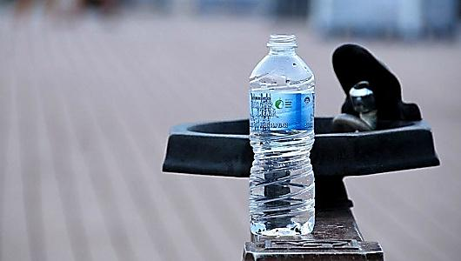

An-Najah National University
Faculty of Engineering
Civil Engineering Department
Graduation Project
Analysis and redisgn of Zawata
Water distribution
network
Prepeared by:
Nidal Safarini
Supervisor:
Dr. Anan Jayyousi

Slide 2

Introduction:

Slide 3
Facts:
Recomended consumption 100 L/C.d
Avrage Palestenian consumption is 70 L/C.d
Water recources are decreasing as people numbers incresing
Increase in demand
Lack of accessibility to clean water recources
High losses

Slide 4
Objectives:
Analyse the existing network by collecting data
Build a model for it
Redisgn it

Slide 5
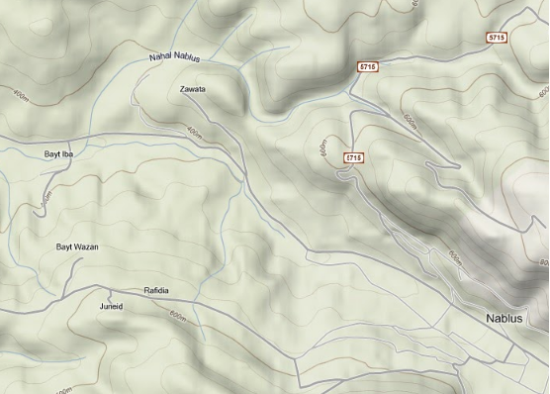
Study area:

Slide 6
Study area:
Number of residents 2000 in 2010
Temprature 9.4 in January and 26.5 in August
Humidity is about 50% in may minimum and 71% maximum in january and february
Avrage rainfall is 658mm
Avrage consumption 77 L/C.d

Slide 7
Average consumption with family size

Slide 8
Satisfaction of water quantities supplied

Slide 9
Satisfaction of the quality of water provided (%)

Slide 10
Satisfaction of water price (%)

Slide 11
Network characteristics:
Source is Nablus municipality
Pipe material is cast iron
The network is old
A reservoire is built
Fed twice weekly
Population density is 3.92 Capita/dunum

Slide 12
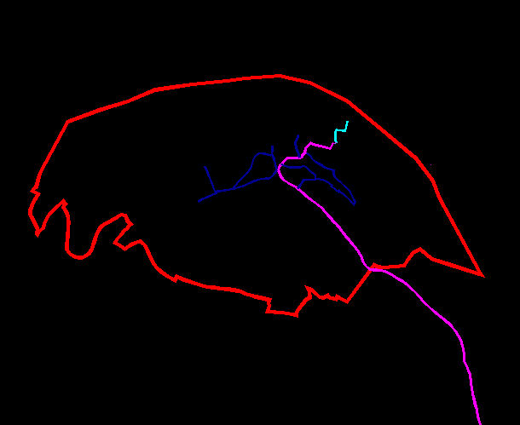
Network map:

Slide 13
Calculations:
AUTOCAD map.
Numbering nodes.
Numbering pipes.
Deviding area.
Assign node contribution on each area.
Calculate demand on each node.
Building a model on EPANET program.

Slide 14
EPANET program
Is a modeling program.
Reservoirs.
Tanks.
Junctions (Nodes).
Pipes.
Pumps.
Valves.

Slide 15
Steady state analysis
Minimum pressure head is 129 m.
Maximum pressure head is 193 m.
Minimum speed is 0 m/s.
Maximum speed is 0.37 m/s

Slide 16
Unsteady state analysis
Pattern multiplier is 3.6.
Minimum pressure head is 31 m.
Maximum pressure head is 102 m.
Minimum velocity is 0.01 m/s.
Maximum velocity is 1.41 m/s.

Slide 17
Future network design
Growth rate 2%.
Future population in 2040 will be 3623 capita.
Future population density 8 capita/dunum.
Future demand 100 l/c.d.

Slide 18
Results on the existing network
Minimum pressure head is -91 m.
Maximum pressure head is -4 m.
Minimum velocity is 0.01 m/s
Maximum velocity is 3.35 m/s

Slide 19
Results after changing pipe diameters
Minimum pressure is 4 m.
Maximum pressure is 65 m.
Minimum velocity 0.11 m/s
Maximum velocity 1.93 m/s.
Cost of the modified network is 309000 JD.

Slide 20
Designing a new network
The old network is worn out.
Doesn´t represent the reality.
Doesn´t cover the future inhabited areas.
There is need to redesign a new network

Slide 21
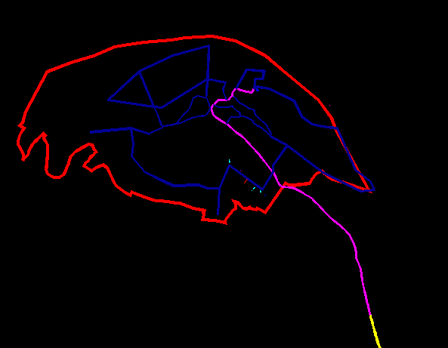
New network map

Slide 22
Results of the new network
Minimum pressure head 2 m.
Maximum pressure head 119 m.
Minimum velocity 0.08 m/s.
Maximum velocity 1.86 m/s.
Cost of the new network will be 542500 JD.

Slide 23
Thank you for listening

