Slide 1

ISO 50001:2011 Preparing Specialized Arab Hospital –Nablus for ISO 50001:2011 STANDARD
Project team:
Lana Ghannam Nidal Amer Omar Othman Waseem Shanabli Zaid Sayeh
Supervisors:
Eng. Suleiman Daifi Dr. Mohammed Alsayed

Slide 2
Agenda
Introduction
Background
Problem Statement
Energy management & ISO 50001
Methodology
PDCA
Developed work
Gap Analysis
Energy Analysis
ISO 50001 Implementation
Management and structural framework
Energy planning
Implementation and operation
Conclusion & Recommendations

Slide 3
INTRODUCTION

Slide 4

Specialized Arab Hospital
Health sector
Rafedia/Nablus
Multiple medical departments

Slide 5



Slide 6
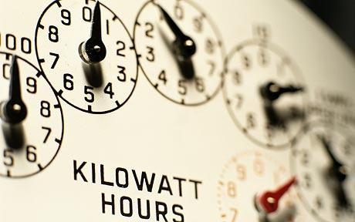

Problem Statement

Slide 7


Solving the problem
Many Energy Management Systems were addressed

Slide 8
Energy management & ISO 50001
Energy management is the process of
Monitoring,
Controlling, and
Conserving
“energy” in a building or organization.

Slide 9
Energy Management
Energy Consumption
Collecting data
Finding Opportunities
Taking Action
Tracking the progress

Slide 10
Methodology

Slide 11

ISO 50001:2011 Standard uses a management approach tool called the PDCA cycle.

Slide 12
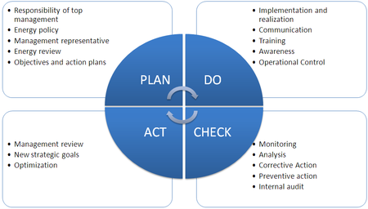

Slide 13
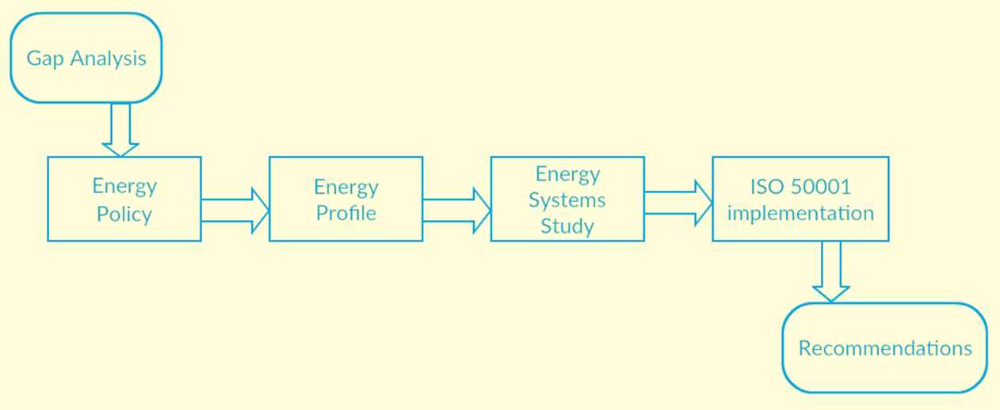
Followed Steps

Slide 14
Gap Analysis

Slide 15
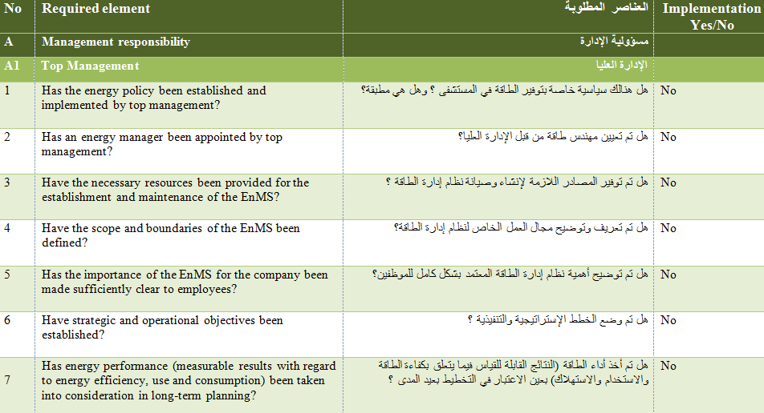
Gap Analysis is a technique that businesses use to determine what steps need to be taken in order to move from its current state to its desired, future state.

Slide 16
Energy Policy
What is Energy Policy?

Slide 17
Energy Profile

Slide 18
Electricity Profile

Slide 19
Gas Profile

Slide 20
Energy Consumption Systems

Slide 21
Lighting System
Operating hours = 24 hours
Number of installed units = 500 unit
Rated Power = 45W
250-500 lumens/m2

Slide 22
Boilers
Three Water Tube Boilers
LPG
50-100 Liters

Slide 23
Chillers
One 160ton Petra chiller
Variable Frequency

Slide 24
Air Conditioners
22 AC’s
24 hours
(18 – 25) C◦

Slide 25
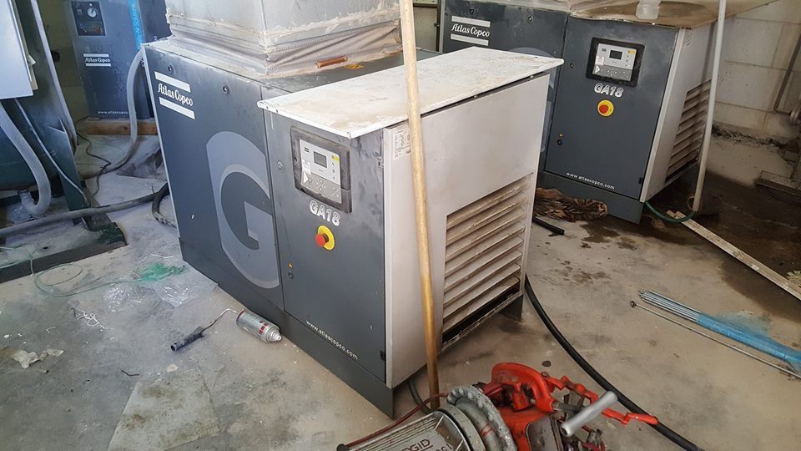
Oxygen Station
Constant Consumption 3800-3900 NIS/month

Slide 26
Laundry
Two Washing Machines
One Dryer

Slide 27
Elevators
Two Large Elevators
One Small Elevators

Slide 28
ISO 50001 Implementation

Slide 29
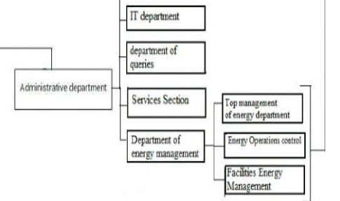
Management and Structural Framework

Slide 30
Energy Planning
Legal Requirements and Other Requirements
Energy review
Energy Baseline
Action plans

Slide 31
Action Plans
Rebuilding the hospital managerial structure, power management section to the maintenance section
Hiring an internal auditor to take the responsibility of applying and keeping a track on everything related about the ISO 50001
Defining what is needed and required to apply the (EnMs) and taking the ISO 50001 certificate
Setting Energy Indicators
Hiring and specifying a technical team
Following Recommendations
Building and establishing the Energy Policy and the Energy Baseline
Documentation
Training
Evaluation

Slide 32
Documentation

Slide 33
Conclusion
Energy consumption in Specialized Arab Hospital is a bit more than the international standards with an average cost value of 107$/ m2 while the standard average is 95$/ m2.
Total energy saving will be more than 20% by applying the suggested recommendations.

Slide 34
Recommendation

Slide 35
Lighting
A cleaning schedule should be established
The using of photoelectric daylight sensors
Turn off lamps when the space is not occupied.
Reducing the overall lighting levels to allow for patients to rest

Slide 36
Boilers
Clean boiler tubes and combustion surfaces of fouling.
Don’t dispose of hot water directly if the heating process is still going on.
Don’t heat for more than the necessary temperature
Clean heat transfer coils

Slide 37
Air Conditioners
Closing doors, windows and curtains when the air conditions are used
A thermostat can be programmed to control heating and cooling systems
Heat to the lowest acceptable temperature and cool to the highest acceptable temperature in the summer
Turn off conditions when the space is not occupied
Turn off conditions at the last half hour of work every day

Slide 38
Laundry
Use washing machines at full load only
Use water that is already warm from other applications

Slide 39
Chiller
From time to time, clean heat transfer coils on chillers
A periodic maintenance will keep the efficiency as much high as possible

Slide 40
SOLAR WATER HEATERS
Install solar water heaters that will save very large amount of energy

Slide 41
END

