Slide 1


Slide 2
HHO Generator Kit For Car
by
Mohammad Qanadilo
Mohammad Al-Bzoor
Lo'ai Khayyat
Ameer Alaswad
"Mohammad Yassin" Tanbour
Supervision
Dr. Ramez Al-khaledi

Slide 3
OUT LINE
CELL DESIGN
Safety system
Controlling
Installing
Results
Challenges
Conclusion

Slide 4
CELL DESIGN
Specification Plates:
- 16 metal plate from material Stainless steel plate 316.
- Dimensions (11.5 cm x 7 cm).
- Thickness of 1.9 mm per sheet.
Composition Cell:
- Tube a diameter of 6" and 2 covers.
- Screw 8 mm plastic length of 11.5 cm.
- Two Screws 8 mm Stainless Steel length of 5 cm.
- The number of nuts Stainless steel, plastic washers.
- Hose Different sizes, elbow.
-One way valve, Bubbler.

Slide 5
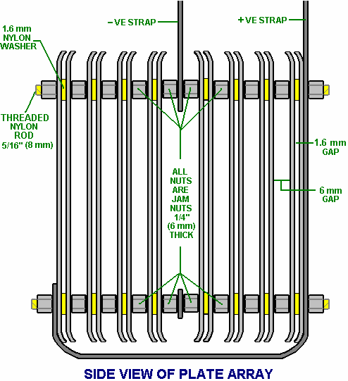
CELL DESIGN

Slide 6
CELL DESIGN
Catalysts for interaction:
Distilled water is mixed with a certain amount of sodium hydroxide so that the amounts of 20 grams of hydroxide per liter of distilled water.

Slide 7
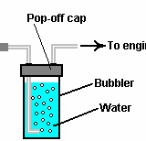
Safety system
Safety devices in the kits:
Bubbler:
Components.
It works on filtering the resulting gases.
Prevent backfire to cell
The plastic cap of the water trap:
Prevent flame out.

Slide 8
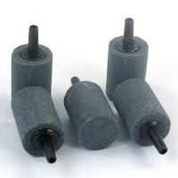
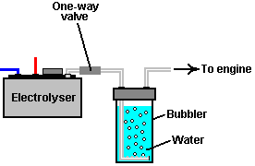
Safety system
One-way valve:
Dehumidify.
Prevent backfire to bubbler.
Prevent water being drawn into the
hydrogen generator .
Check your wires and connectors regularly:
Connect the wires properly.
Selection of resistant wire for 30 A.
Distribution wires are installed so that the power 20 -30 A.

Slide 9
Safety system

Slide 10
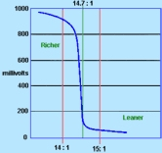
Controlling
1- Oxygen sensor.
HHO EFIE for O2 sensor (Electronic Fuel Injection Enhancer )
The principle of his work??

Slide 11
Controlling

Slide 12
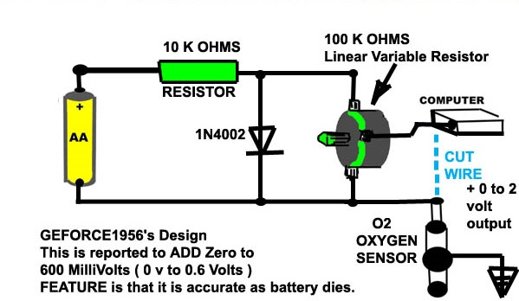

Controlling

Slide 13
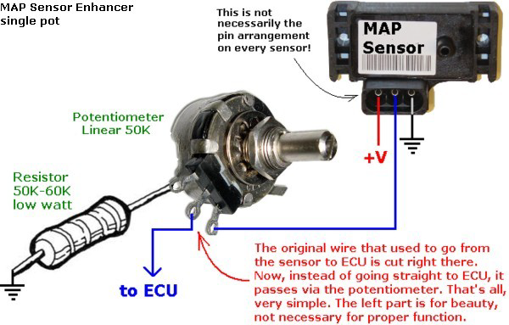
Controlling
2- MAP sensor.
MAP Sensor Enhancer (Manifold Absolute Pressure ) .
The principle of his work??

Slide 14
Installing
Installing through a mechanical connection.
It is then insert into the system, after the air filtering system and before the engine, the system has taken from the car.

Slide 15
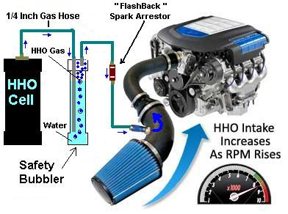
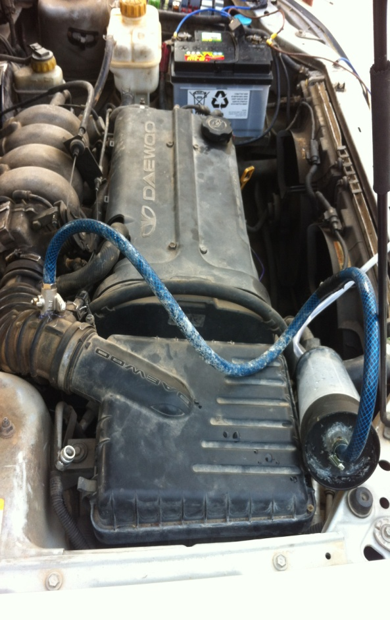

Installing

Slide 16
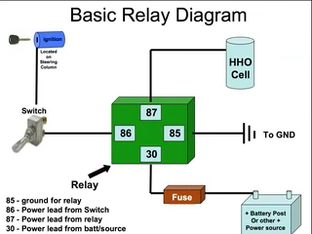
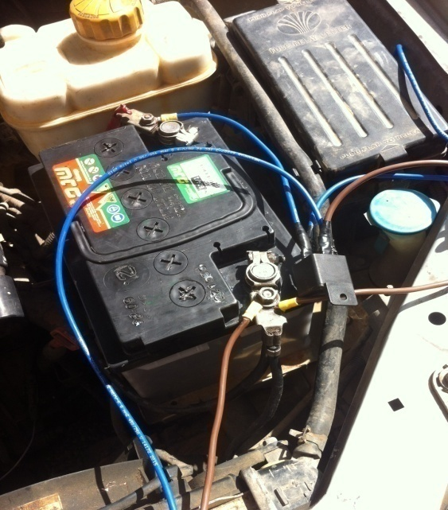
Installing
Installing through electrical conductivity (Relay).

Slide 17

Installing

Slide 18
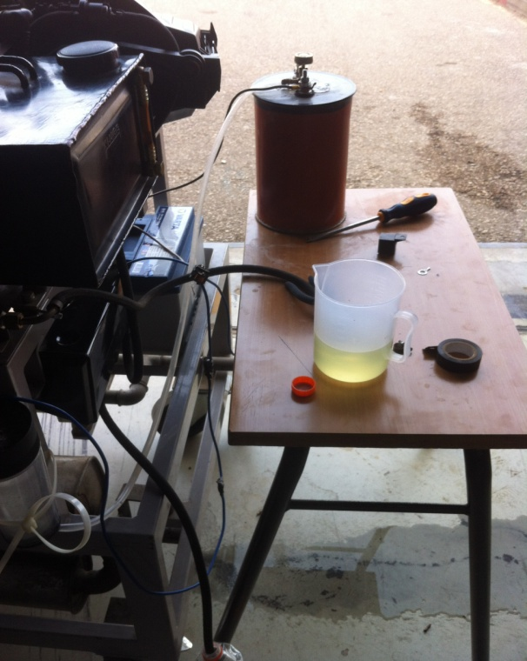
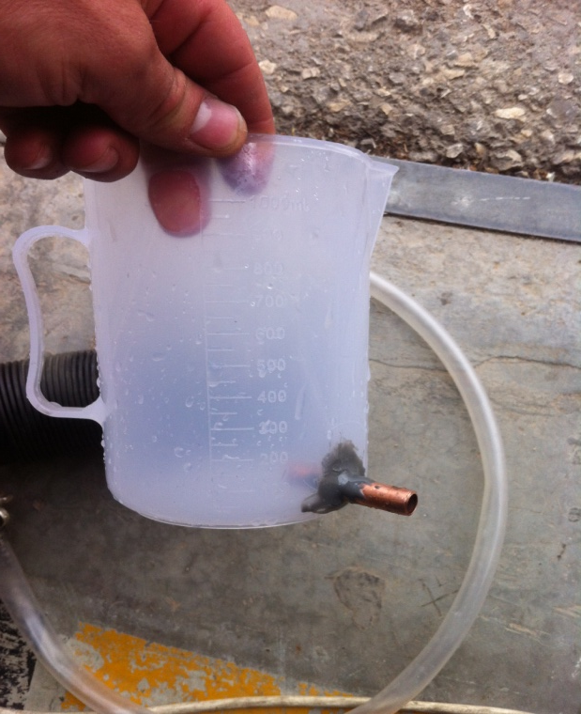
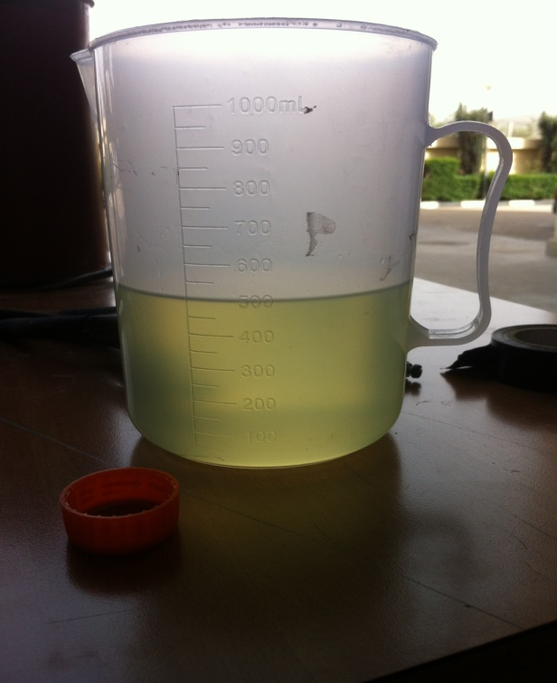
Results
1) Mechanical Performance result:
decrease in Specific fuel consumption S.F.C of up to about 7.5%.

Slide 19
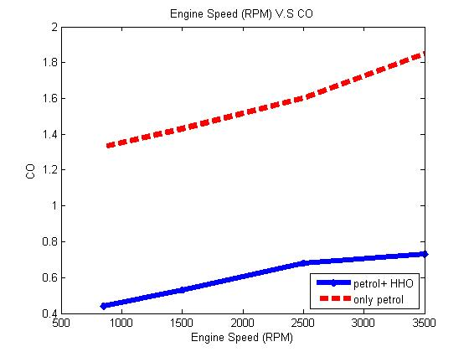
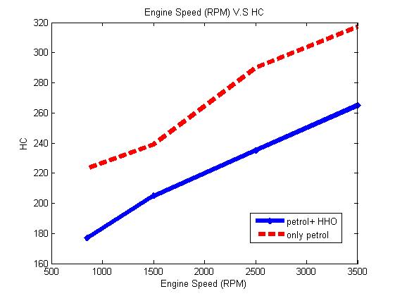
Results
2) Emission Performance result:
decreases in the amount of gas CO about 71%.
drop in the amount of HC to about 67.5 % .
CO Emission
HC Emission

Slide 20
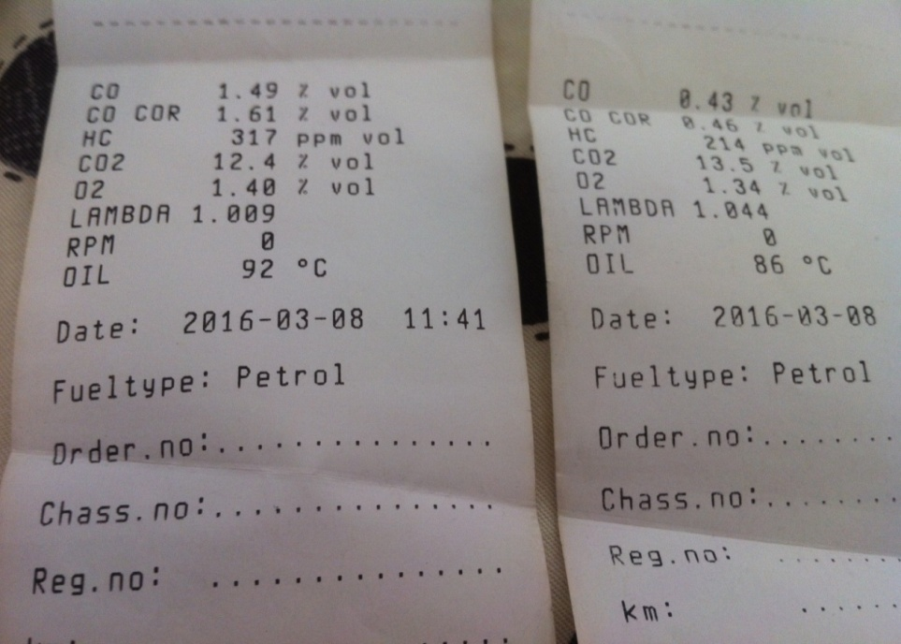


Results

Slide 21
Challenges
Finding the car for the application of the project.
The process of entering into hydrogen combustion engine room.
Choose the filtered stone or cotton instead back spark.
For a cell to become his rival in terms of cost and sustainability.
How to measure consumer gasoline.

Slide 22
Conclusion
In this work, FC for HHO gas generation was designed, manufactured and tested. The generated HHO gas was introduced to engine , and the Petrol engine performance and emission analysis are conducted with Petrol + HHO and petrol respectively.
1) The use of HHO in gasoline engines enhances combustion efficiency, consequently reducing fuel consumption and thereby decreasing pollution.
2) The FC which can be used is simple, easily constructed, and easily integrated with existing engines at low cost (approximately 60 US dollars for each cylinder).

