Slide 1



E-Governance in Palestine and the MENA region (INDIGO) Project
Water and You

Slide 2
Our Team
Done by:
Sabah Baraa | Computer Engineering Department
Walaa Dweikat | Computer Engineering Department
In cooperation with:
Mohammed Youns | Urban Planning Department
Iman Salah | Urban Planning Department
Sara Fitain | Urban Planning Department
Supervisors:
Dr. Anas Toma | Computer Engineering Department
Dr. Ihab Hijazi | Project Specialist / Urban & Regional Planning Unit
Eng. Saleh Qanazi | Project Coordinator / Urban Planning Department
Dr. Samah Abu Assab | Human Centered Design Expert
This Project done in cooperation between:
Computer Engineering Department
Urban Planning Department
Urban & Regional Planning Unit
Jamain Municipality
GIZ

Slide 3
Water and You

Slide 4
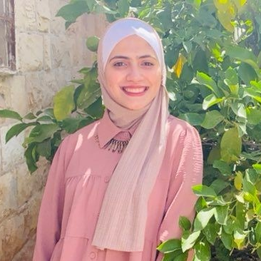

Hello!
We are Sabah Baraa
and Walaa Dweikat

Slide 5
Introduction
Targeted Users
Objectives
Technology
Results and Discussion
Main Features
Future Work
Human Centered Design

Slide 6
Introduction
1

Slide 7
Introduction
Discovering the problem
The municipalities informed us about the situation of their various sectors.
The main issue in the municipality of Jama'in is the water sector. There is a need to discover a solution for it, Because of its importance..

Slide 8
Introduction
Problem
The lack of water resources, the increasing demands for water and the disproportional water distribution, all of these have led to water lack that provided for citizens from their municipalities.

Slide 9
Objectives
2

Slide 10
Objectives
Create a dynamic water distribution system
Automate the process of communication between the citizens and their municipalities
Create a database to store and document the municipalities data
Show all of the complaints, new water orders and water network on the map

Slide 11
Human Centered Design
3

Slide 12
Human Centered Design
Inspiration Phase
Interviews with targeted users(citizens and employees) to get more information about the problem, the expected solution from their opinion view, and if they are willing to use a mobile app or a website for the water service.

Slide 13
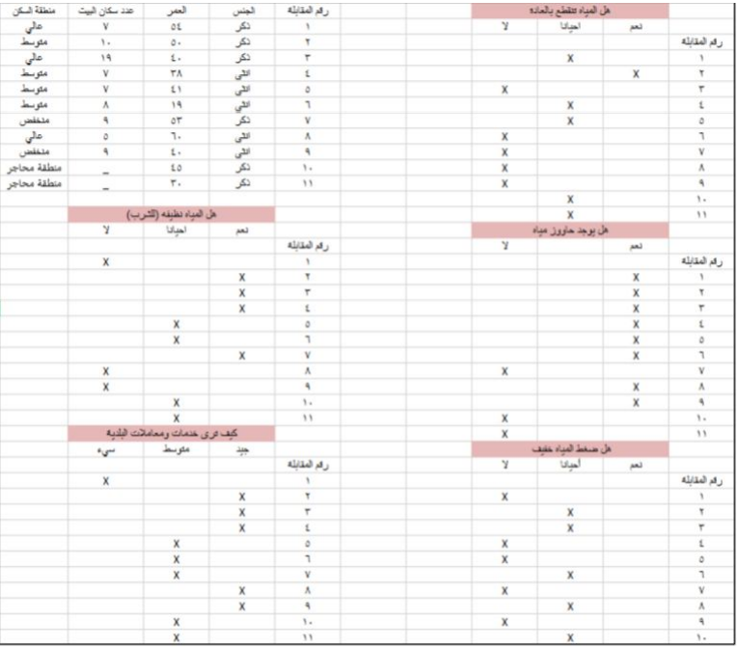
Human Centered Design
Interviews Summary

Slide 14
Human Centered Design
Ideation Phase
Building prototypes of the solution so that it can be developed and modified based on the outcomes of interviews and discussions, as the main objective of the solution is to serve the citizens

Slide 15
Human Centered Design
Implementation Phase
Having a mobile application and a website that both provide services to solve the water sector problem.

Slide 16
Main Features
4

Slide 17
Main Features
A distribution system which calculate the time needed for pumping enough amount of water for every distribution area.
Assigning work for the employees fairly
Sending notifications for the citizens to provide the system with their feedback after every water pumping
Citizens can send new orders and complaints for the municipality
Projecting the complaints, new orders and water network on the map

Slide 18
Main Features
A distribution system which calculate the time needed for pumping enough amount of water for every distribution area.
Assigning work for the employees fairly
Sending notifications for the citizens to provide the system with their feedback after every water pumping
Citizens can send new orders and complaints for the municipality
Projecting the complaints, new orders and water network on the map

Slide 19
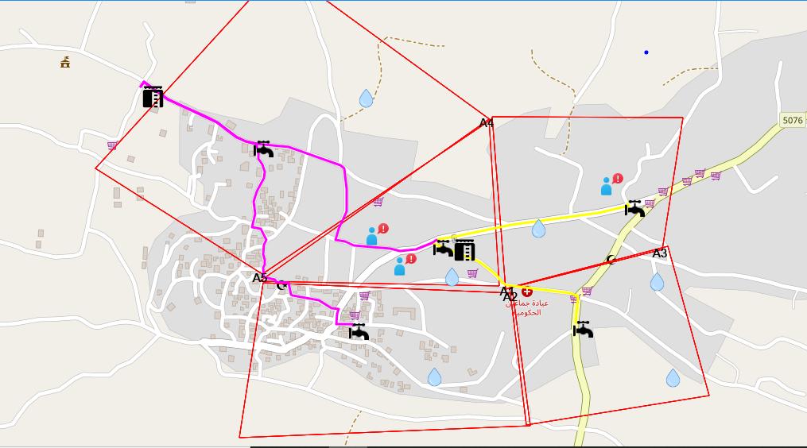
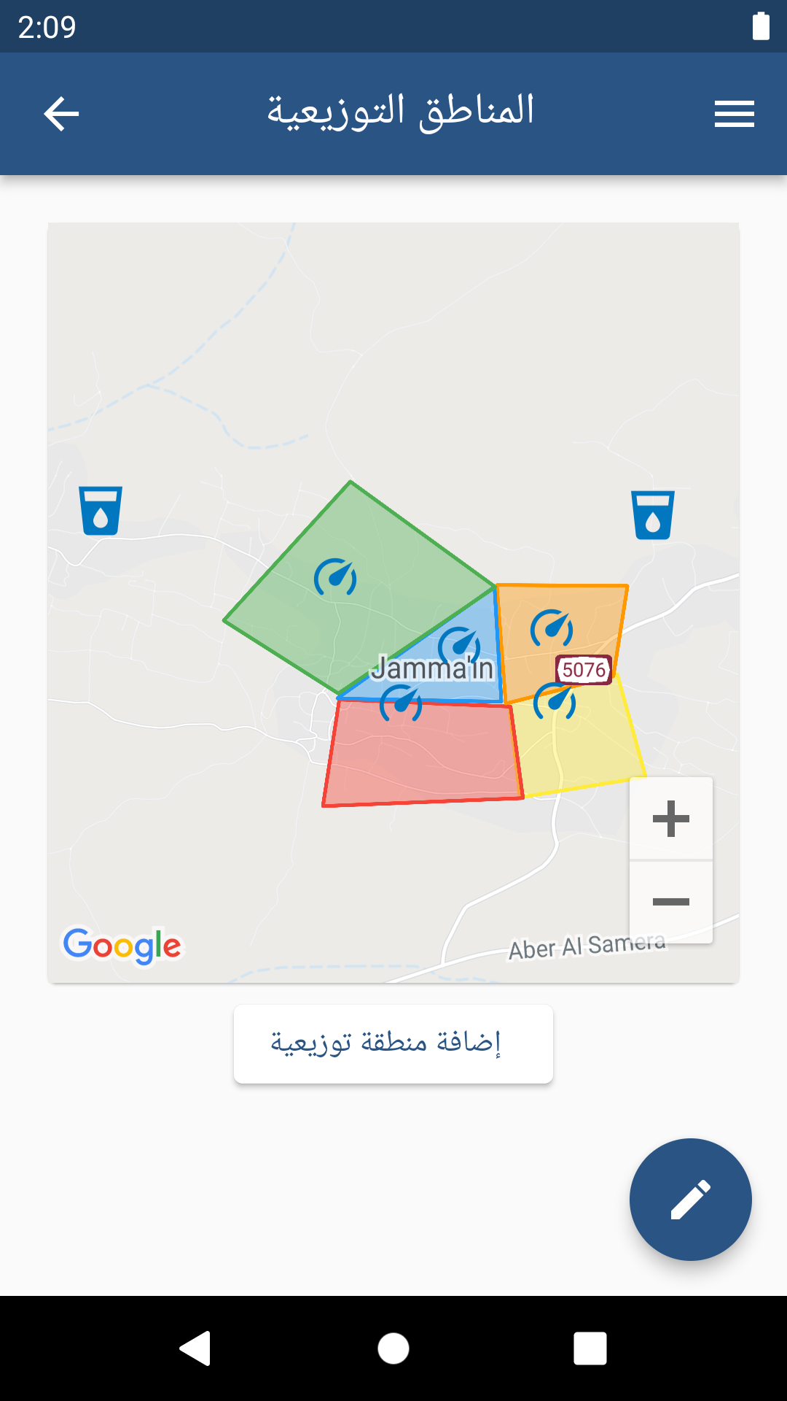
Main Features
First, Water Engineer determines the distribution areas by drawing them on the map

Slide 20
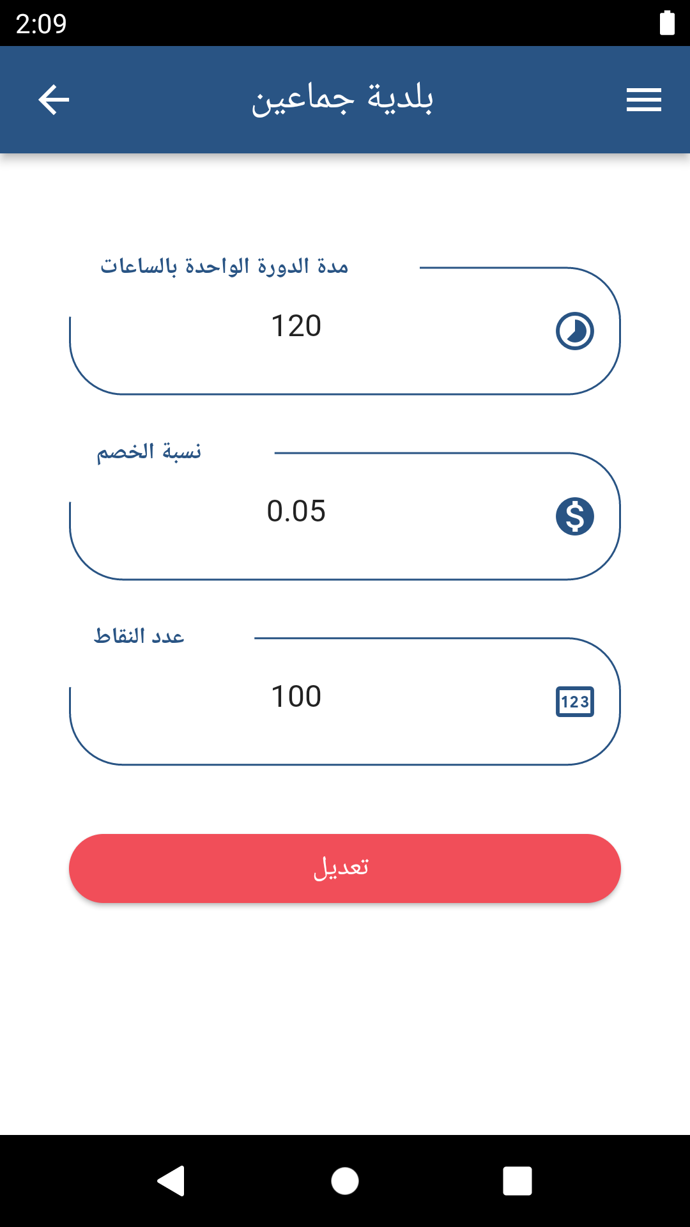
Main Features
Second , the admin specify the time needed for the water cycle

Slide 21
Main Features
Third , the system calculate the initial solution which depends on:
The number of main tanks in the municipality
The number of stopcocks
The average water daily consumption for the person
The number of people in every service

Slide 22
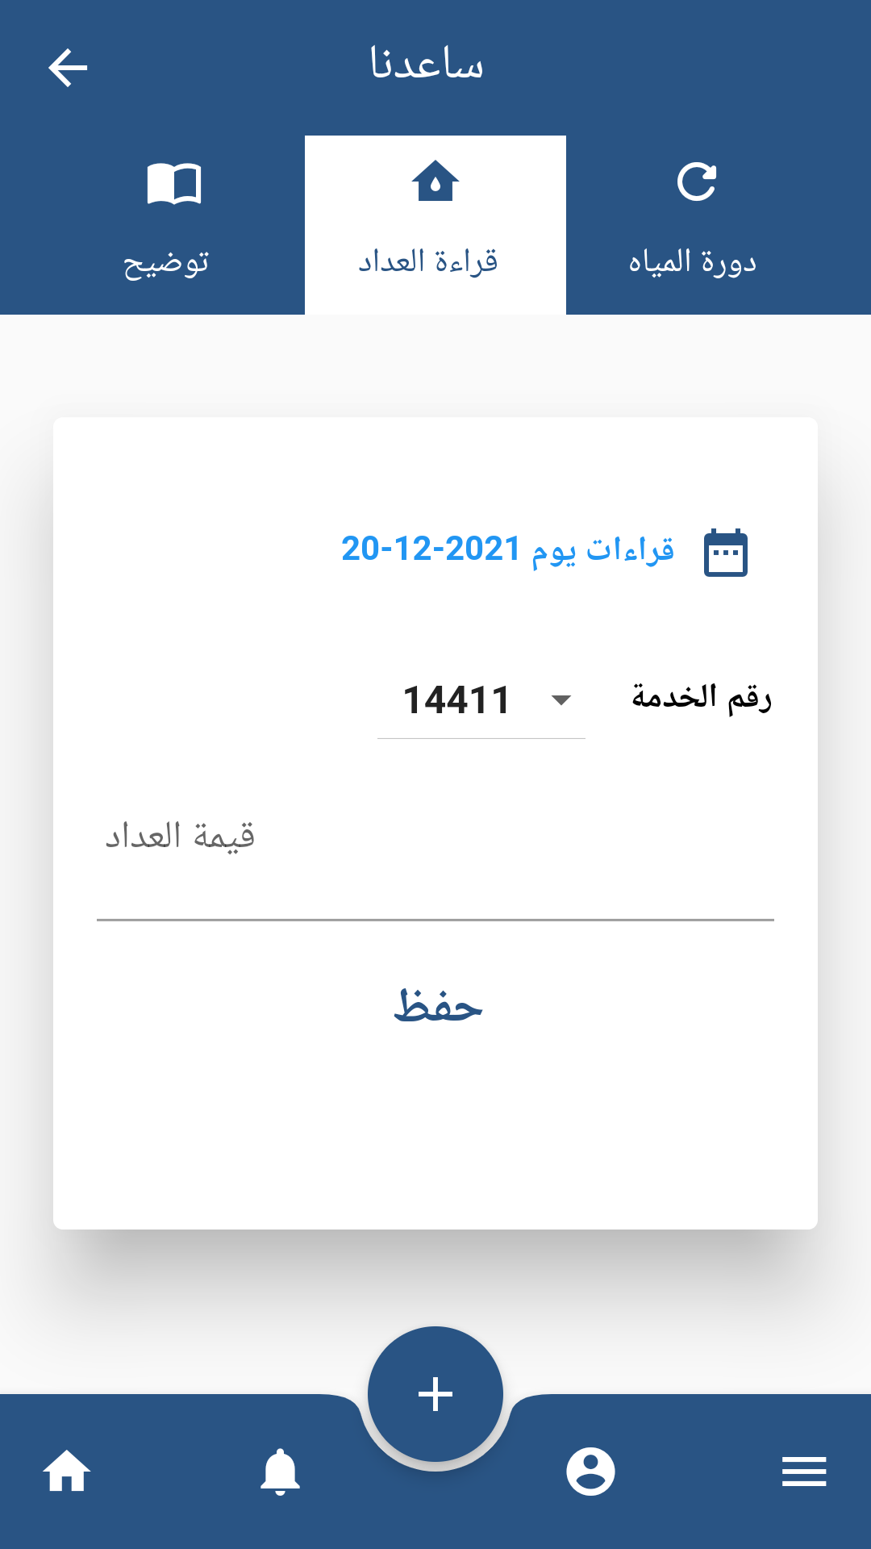
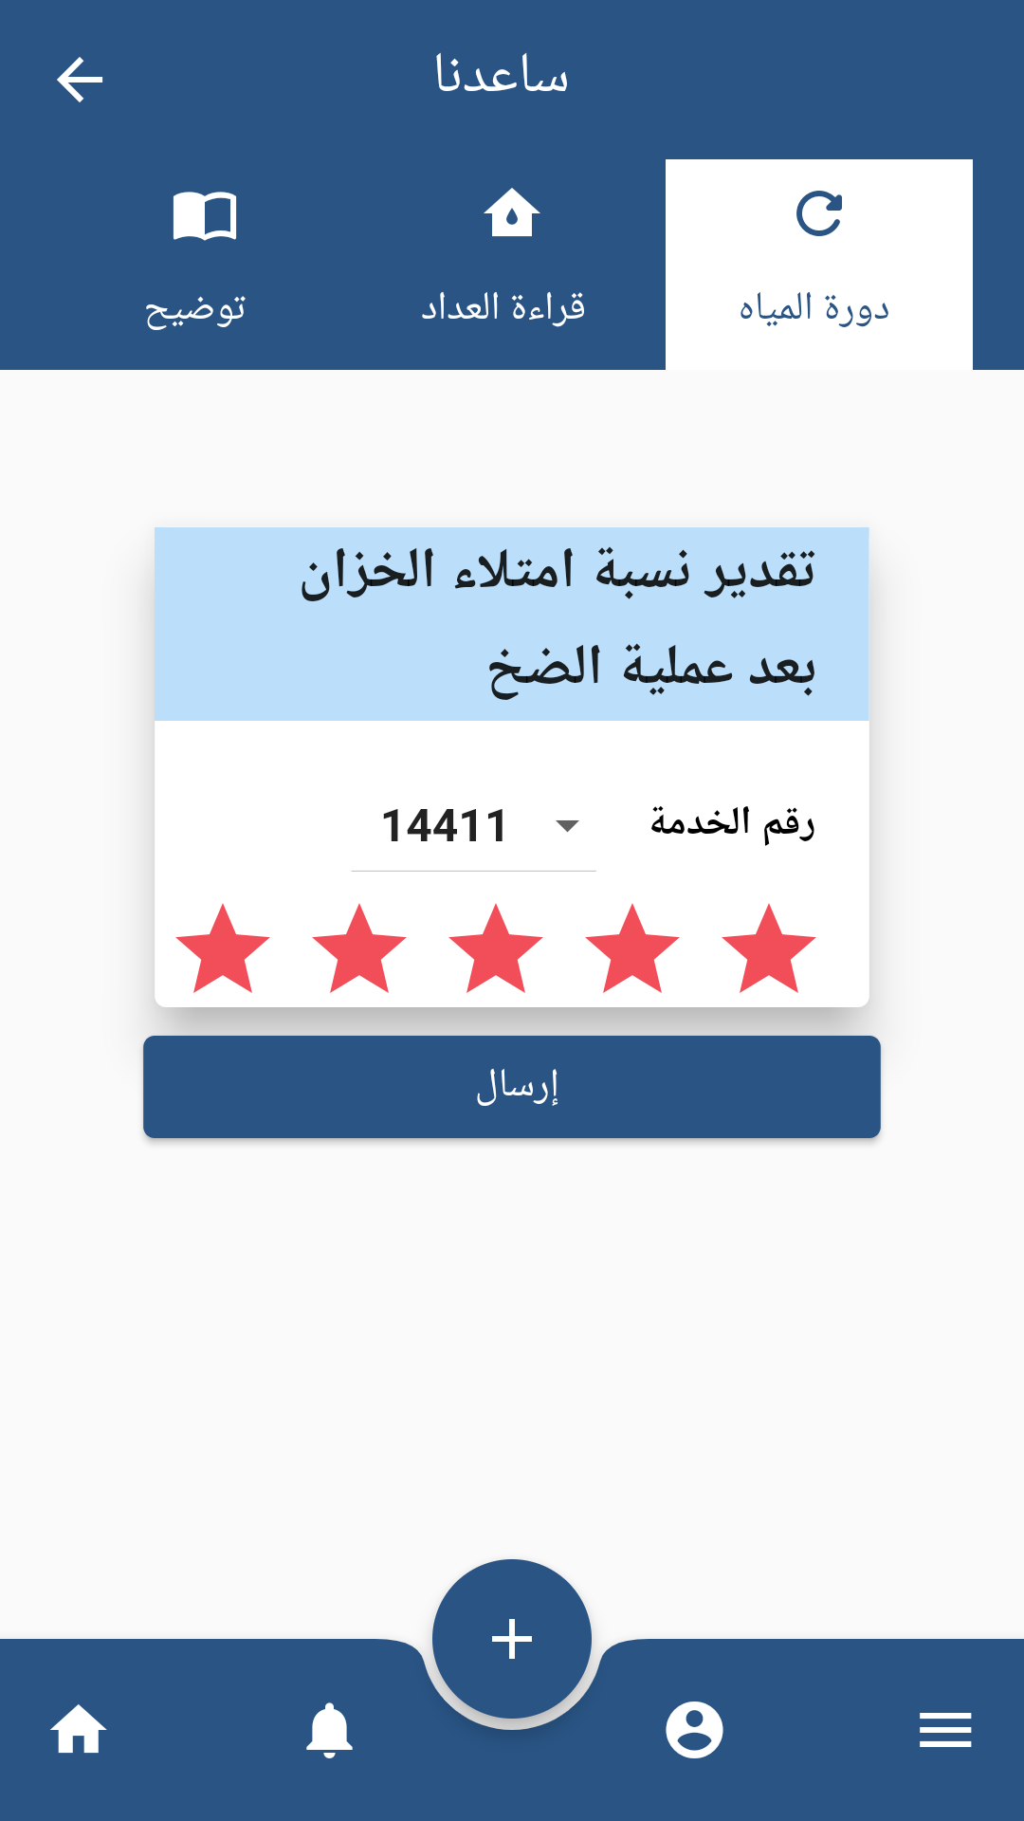
Main Features
Fourth , The system improves the initial solution and it depends on the complaints received citizens from every service

Slide 23
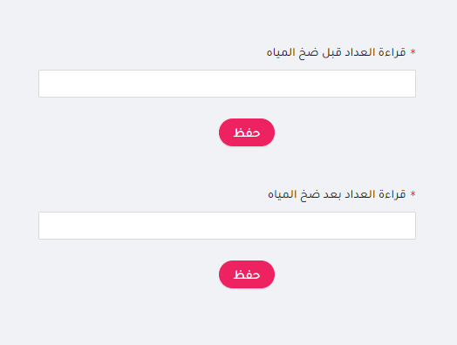
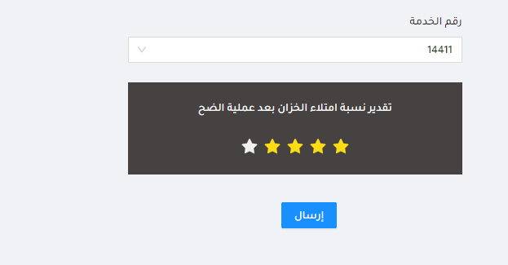
Main Features

Slide 24
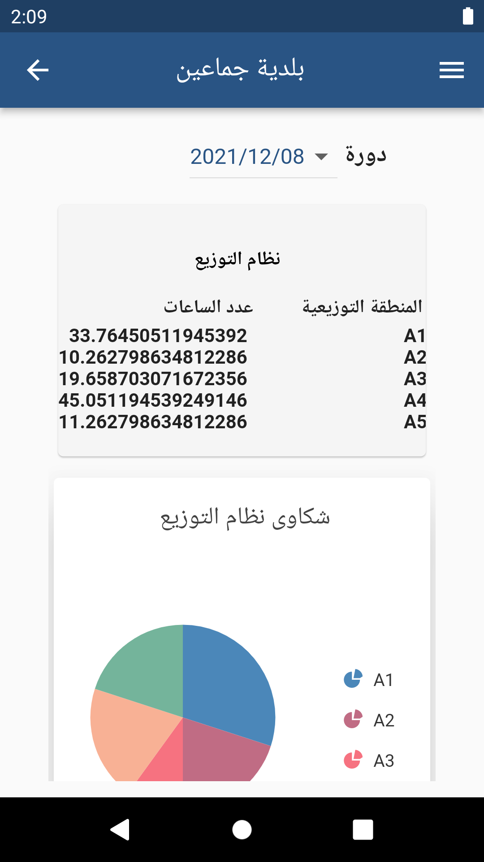
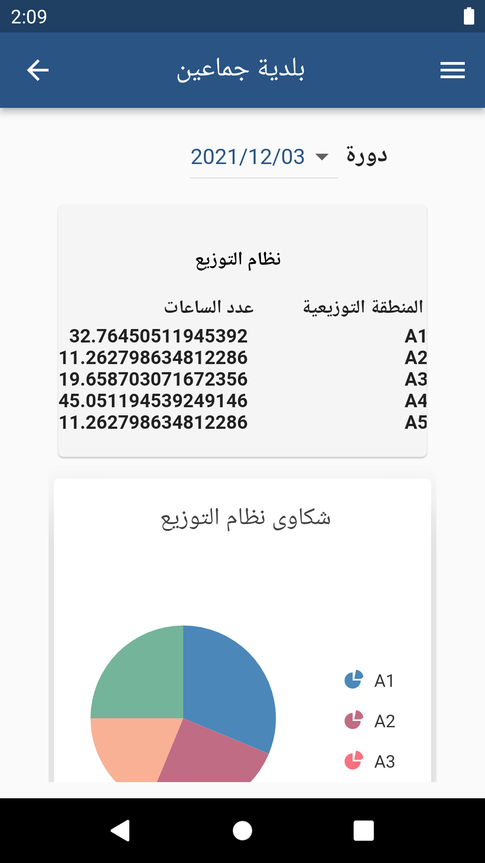
Main Features

Slide 25
Main Features
A distribution system which calculate the time needed for pumping enough amount of water for every distribution area.
Assigning work for the employees fairly
Sending notifications for the citizens to provide the system with their feedback after every water pumping
Citizens can send new orders and complaints for the municipality
Projecting the complaints, new orders and water network on the map

Slide 26
Main Features
A distribution system which calculate the time needed for pumping enough amount of water for every distribution area.
Assigning work for the employees fairly
Sending notifications for the citizens to provide the system with their feedback after every water pumping
Citizens can send new orders and complaints for the municipality
Projecting the complaints, new orders and water network on the map

Slide 27
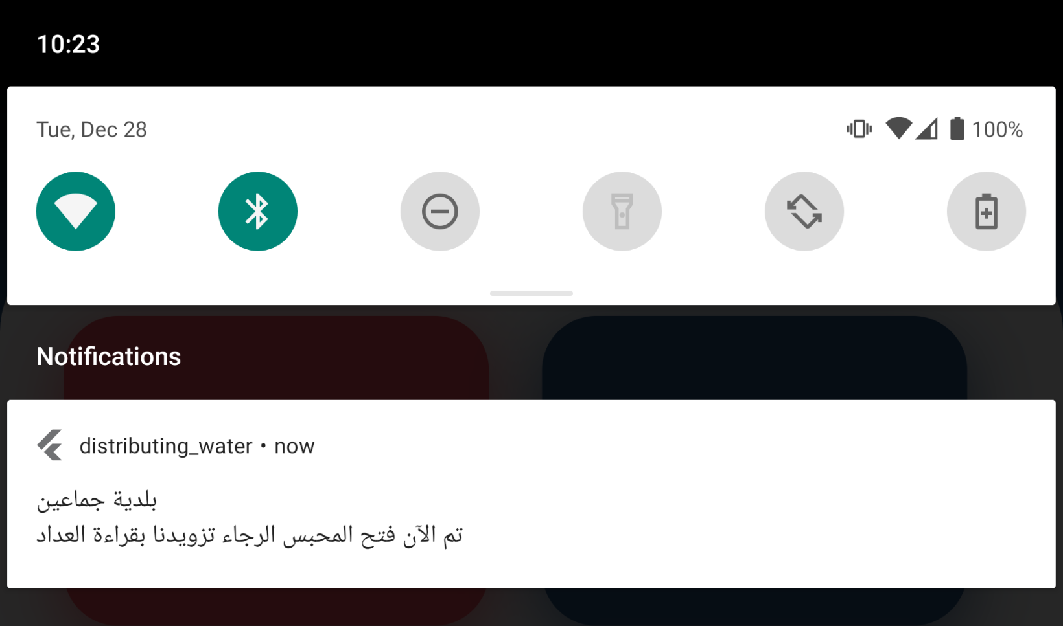
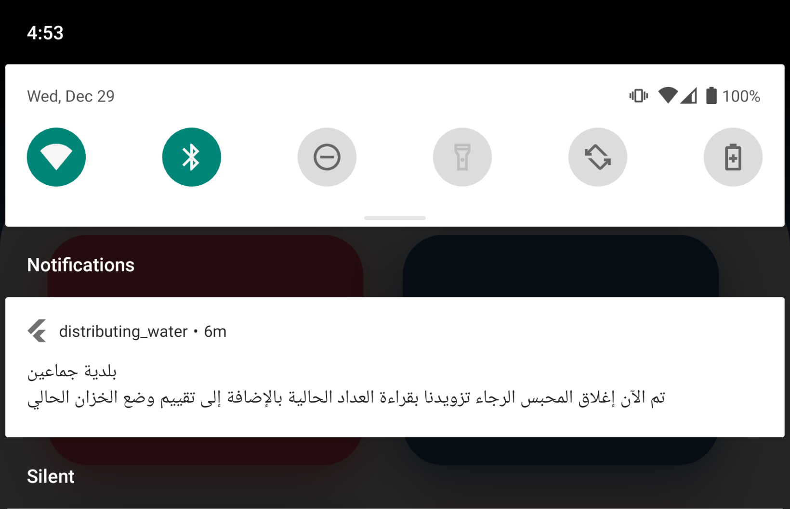
Main Features
Notification sent when the pumping starts and ends in order to get citizens' feedback.

Slide 28
Main Features
A distribution system which calculate the time needed for pumping enough amount of water for every distribution area.
Assigning work for the employees fairly
Sending notifications for the citizens to provide the system with their feedback after every water pumping
Citizens can send new orders and complaints for the municipality
Projecting the complaints, new orders and water network on the map

Slide 29
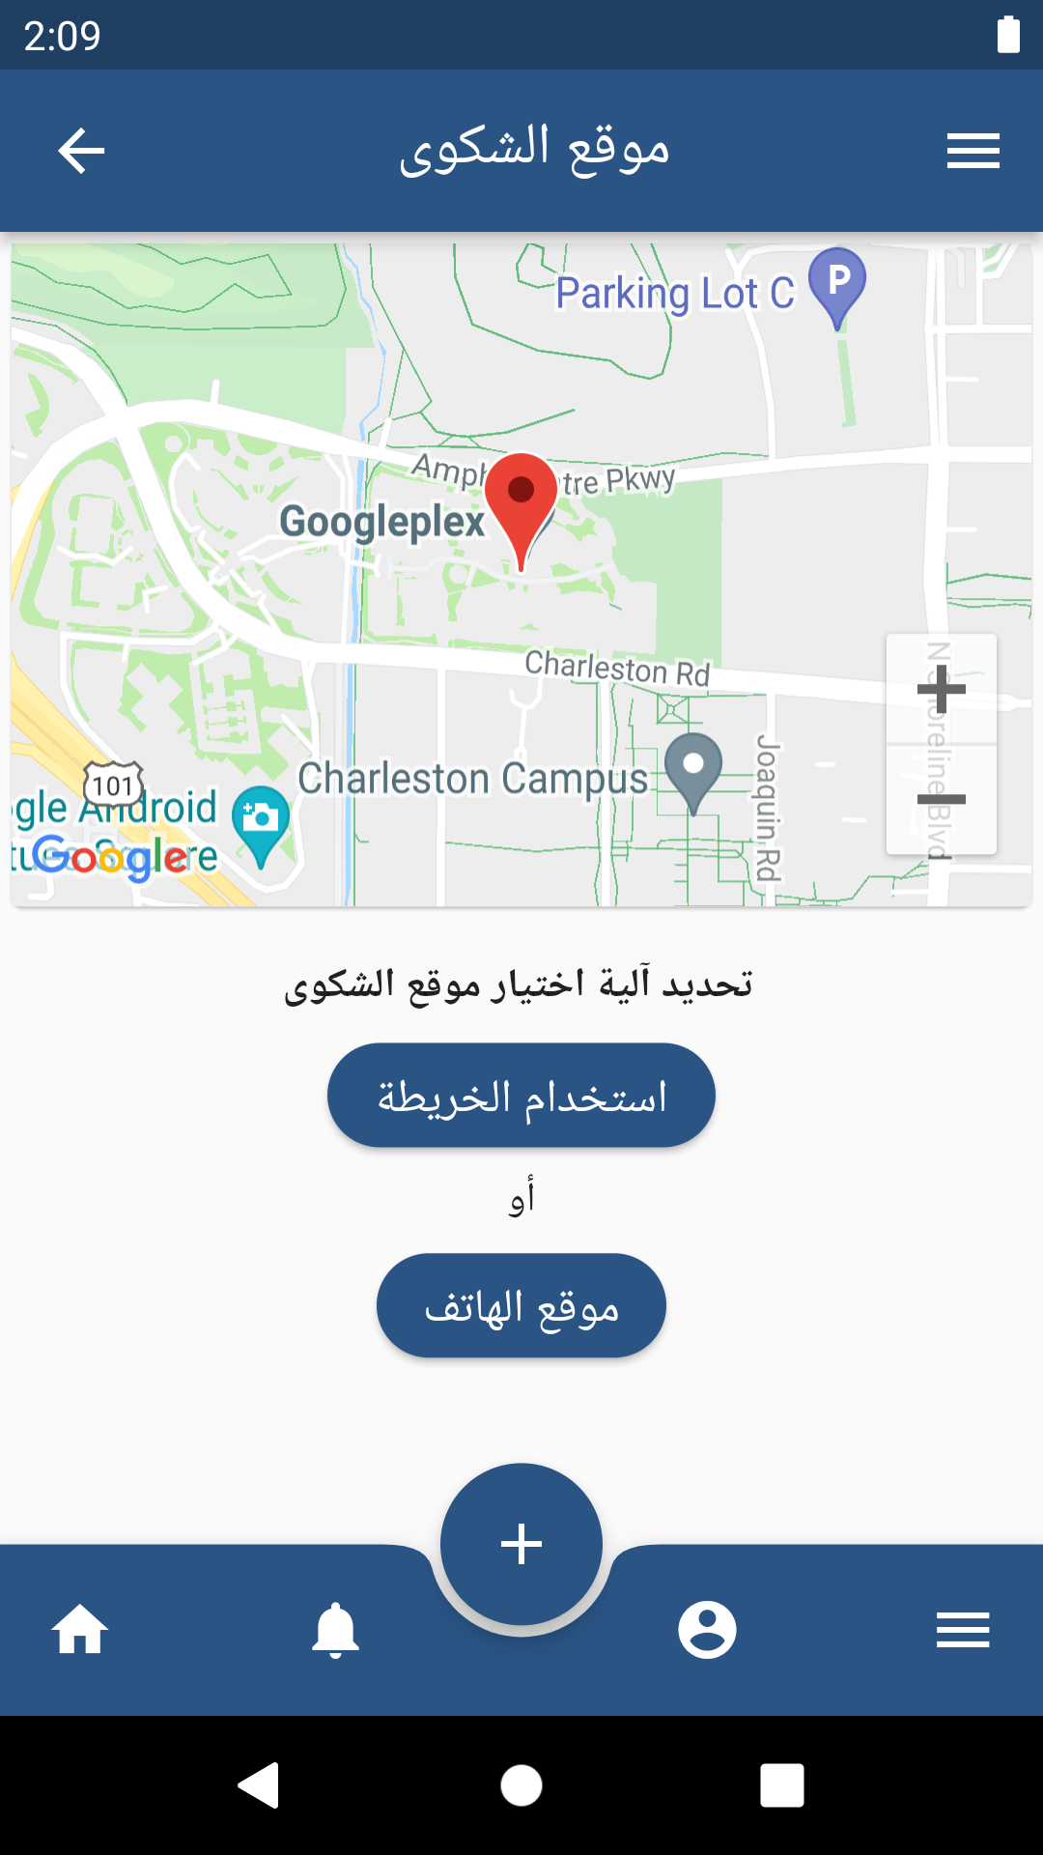
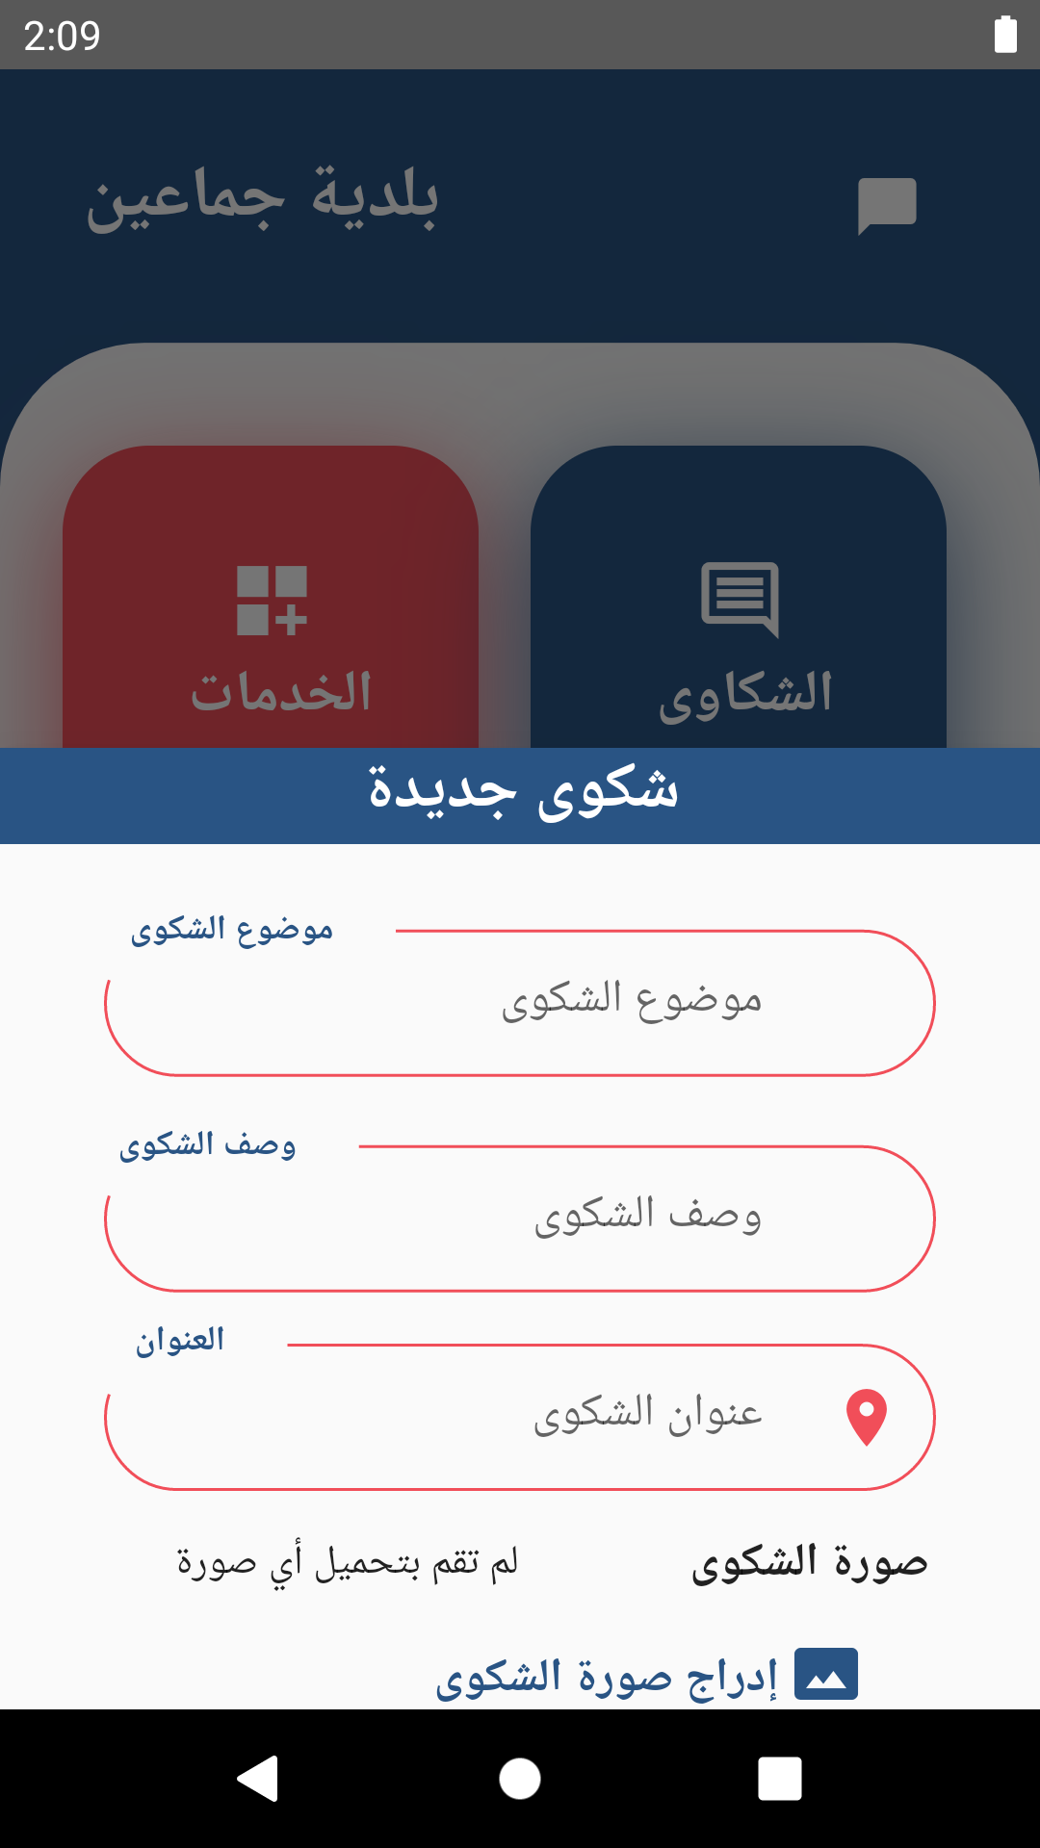

Slide 30
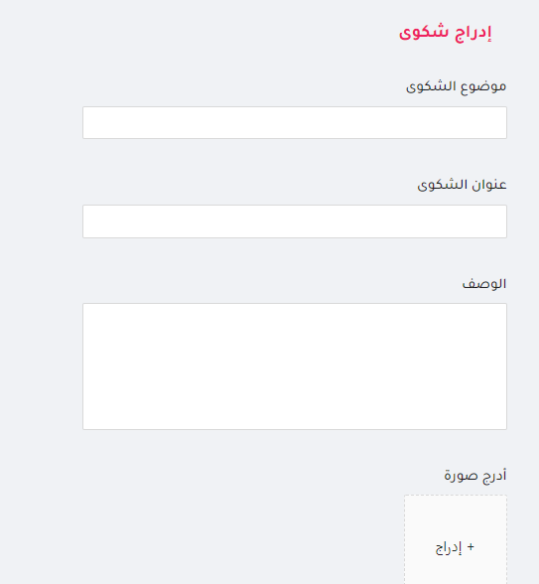
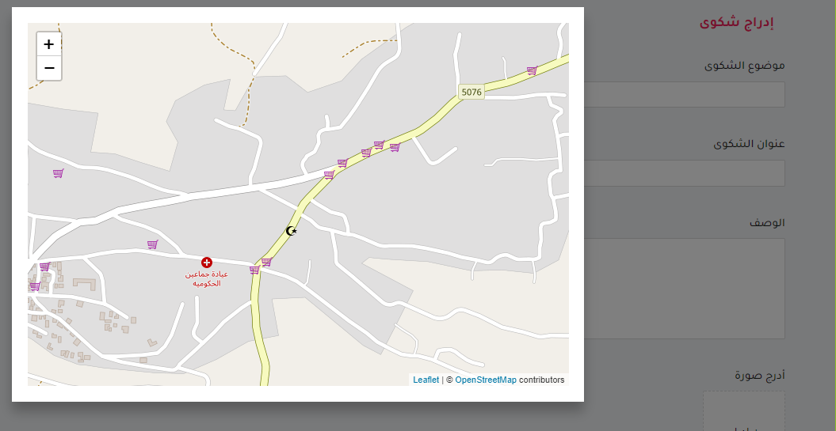
Main Features
Determine the complaints address

Slide 31
Main Features
A distribution system which calculate the time needed for pumping enough amount of water for every distribution area.
Assigning work for the employees fairly
Sending notifications for the citizens to provide the system with their feedback after every water pumping
Citizens can send new orders and complaints for the municipality
Projecting the complaints, new orders and water network on the map

Slide 32
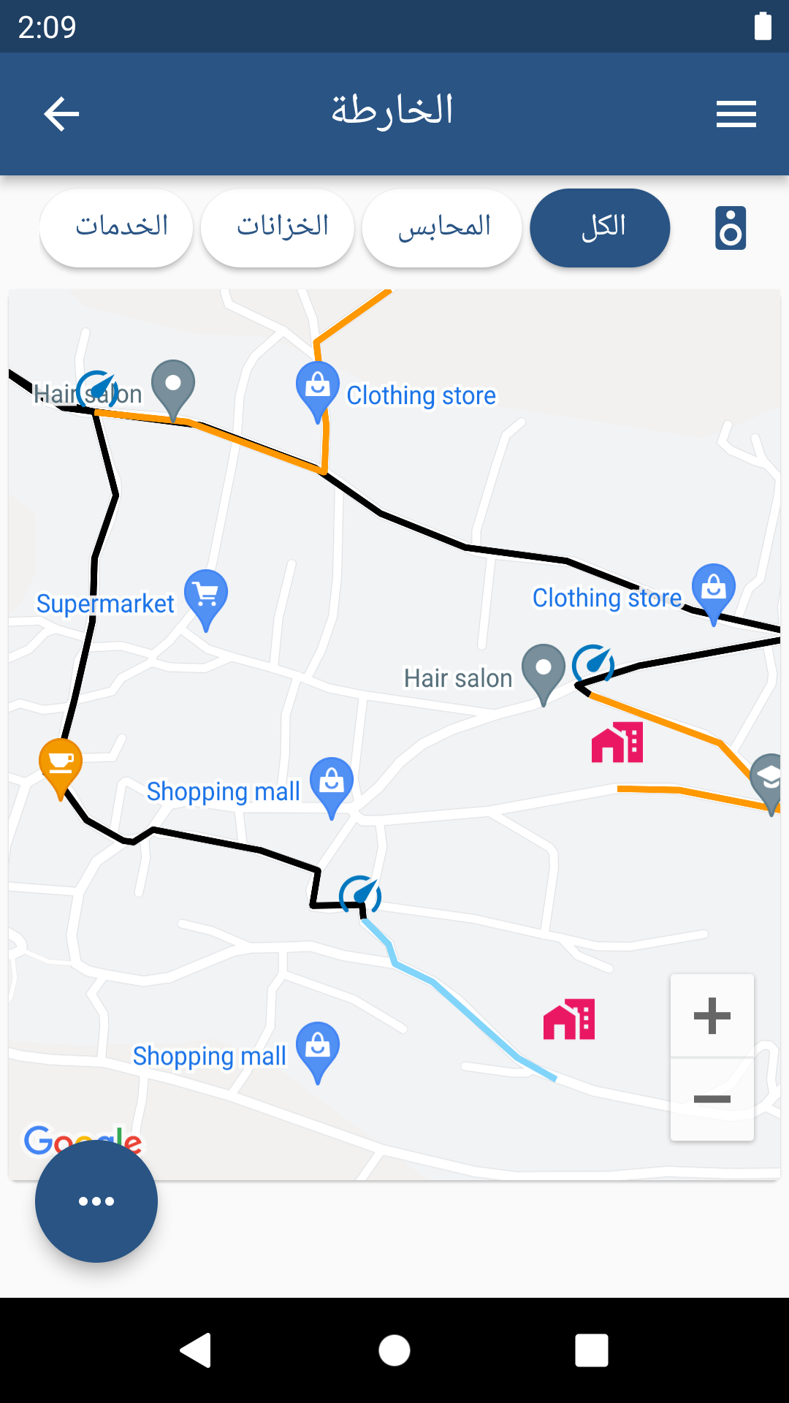
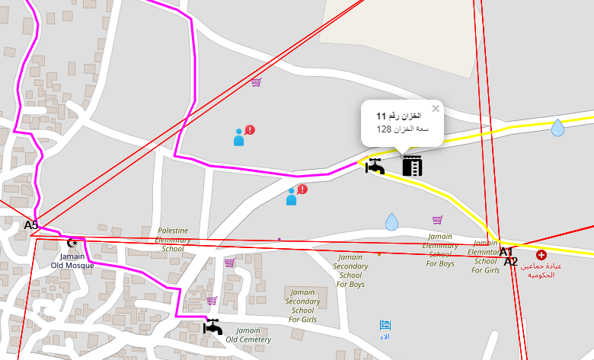
Main Features

Slide 33
Targeted Users
5

Slide 34
Targeted Users
The system has three types of users
Employees
Citizens
The admin

Slide 35
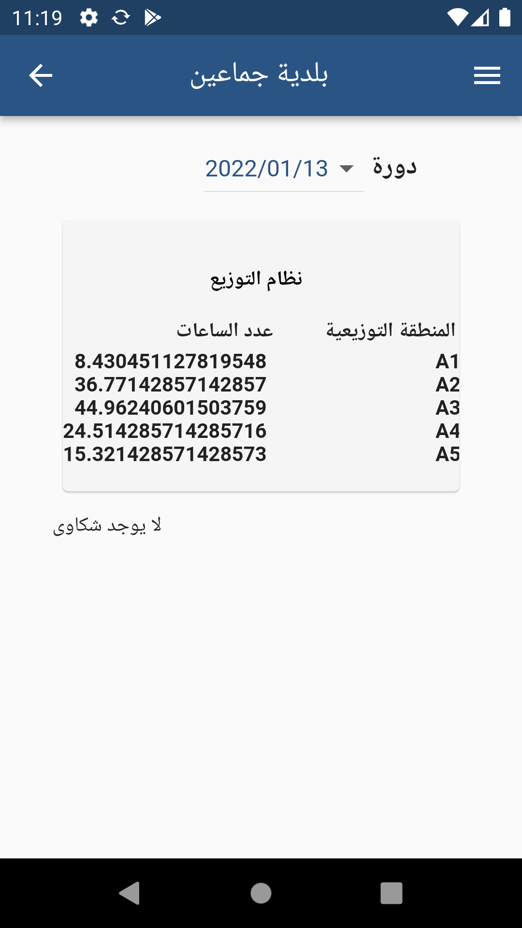
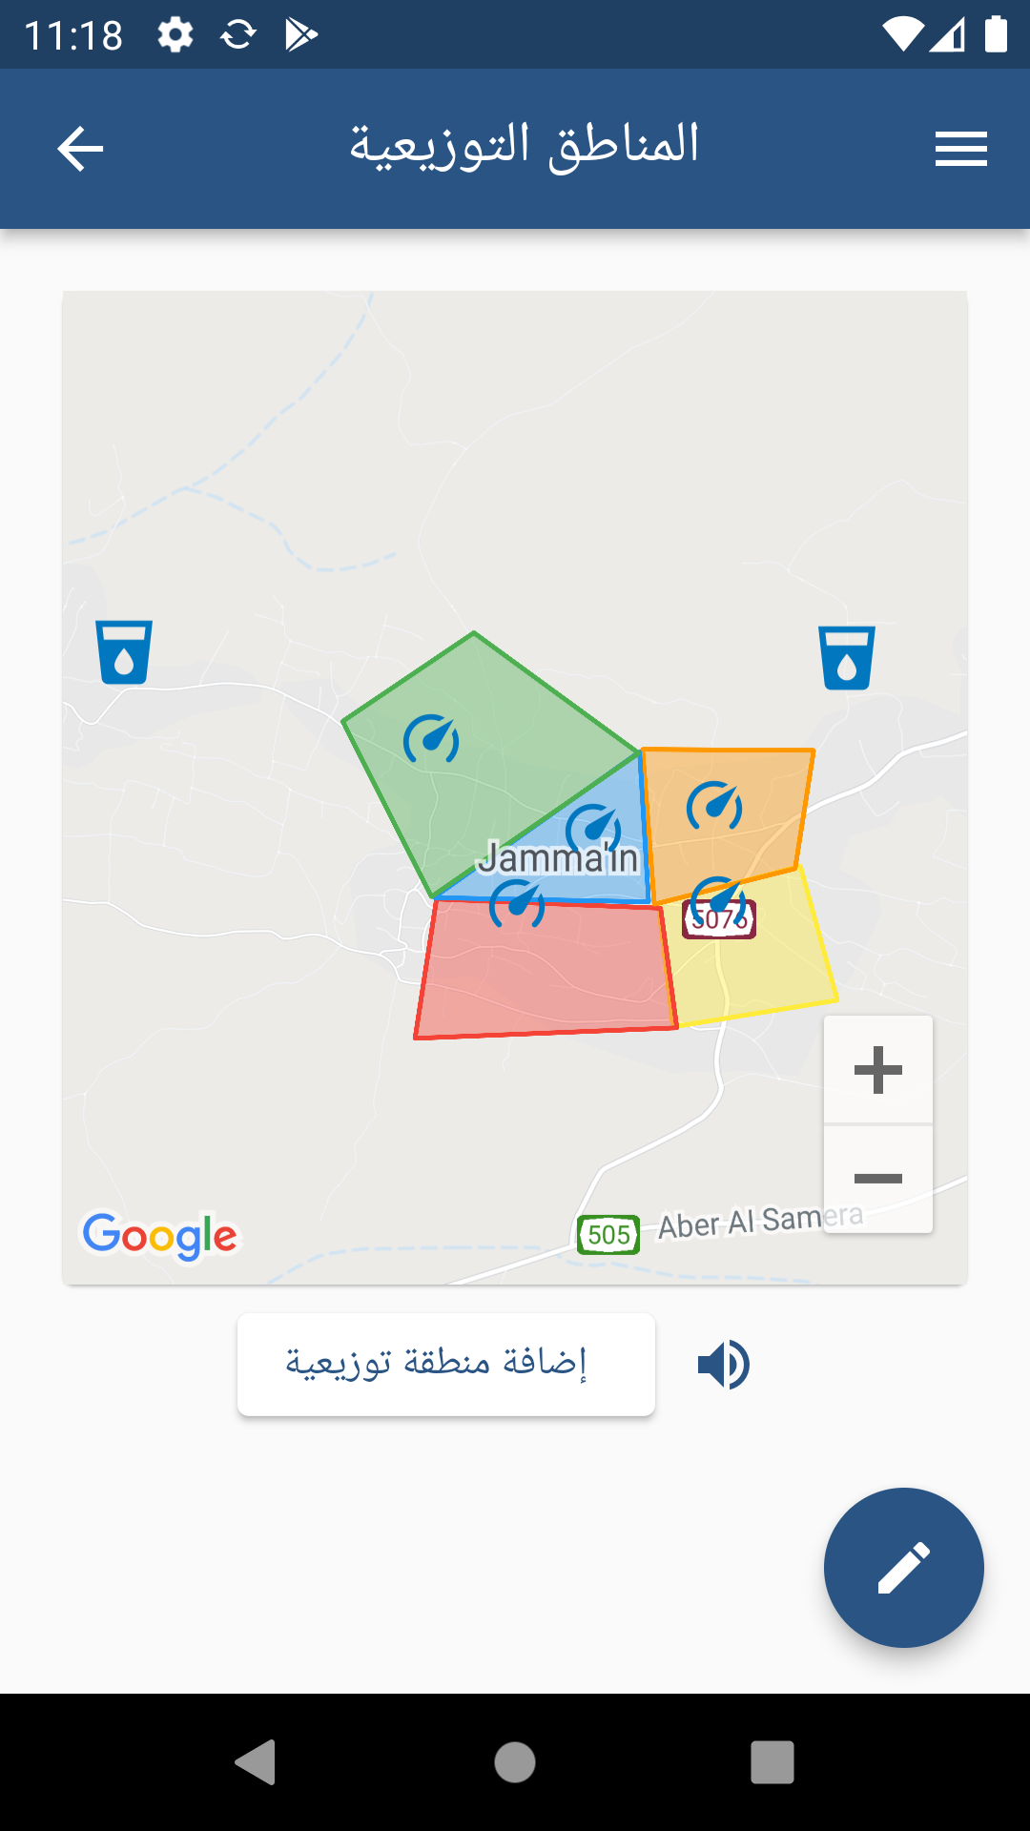
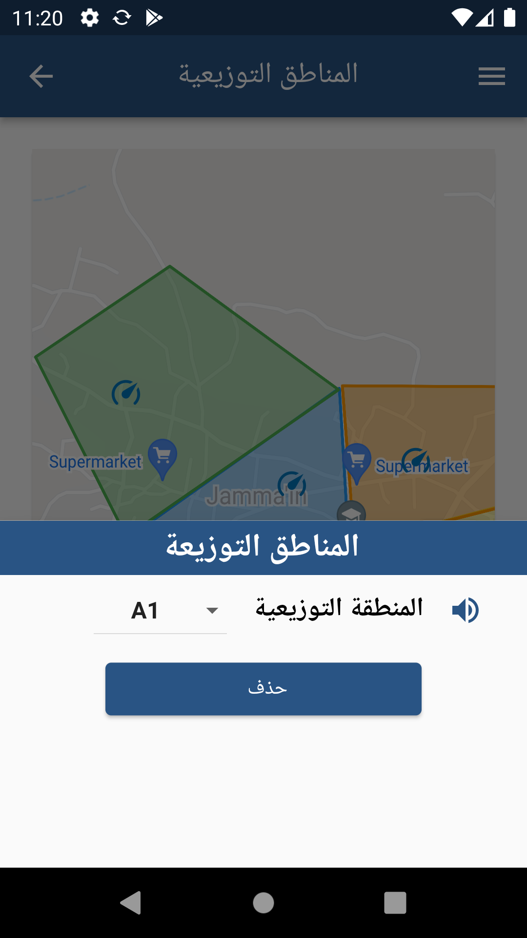
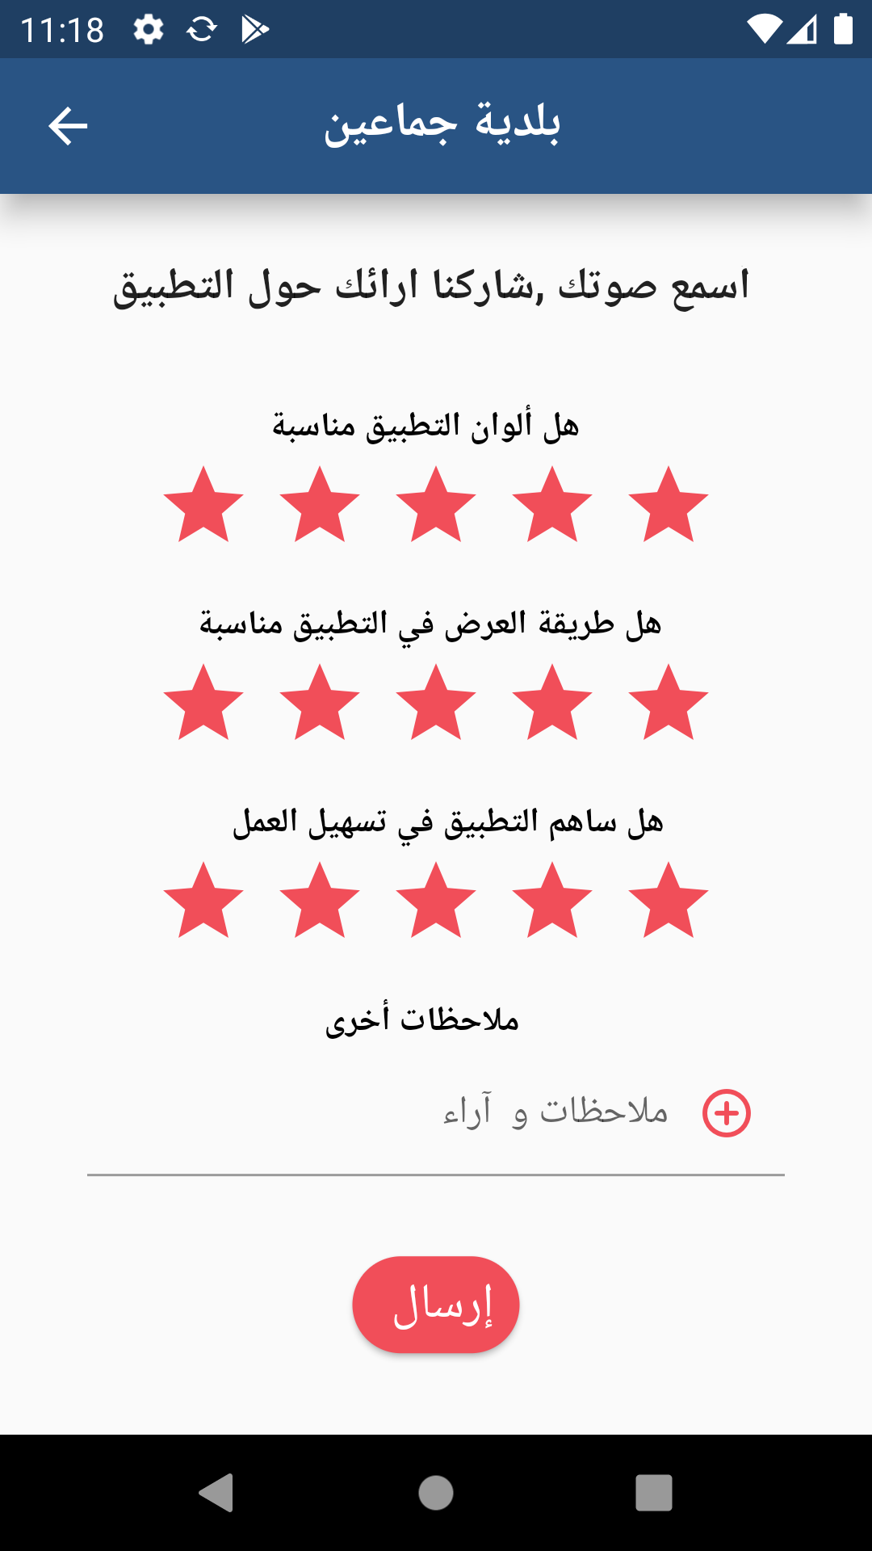
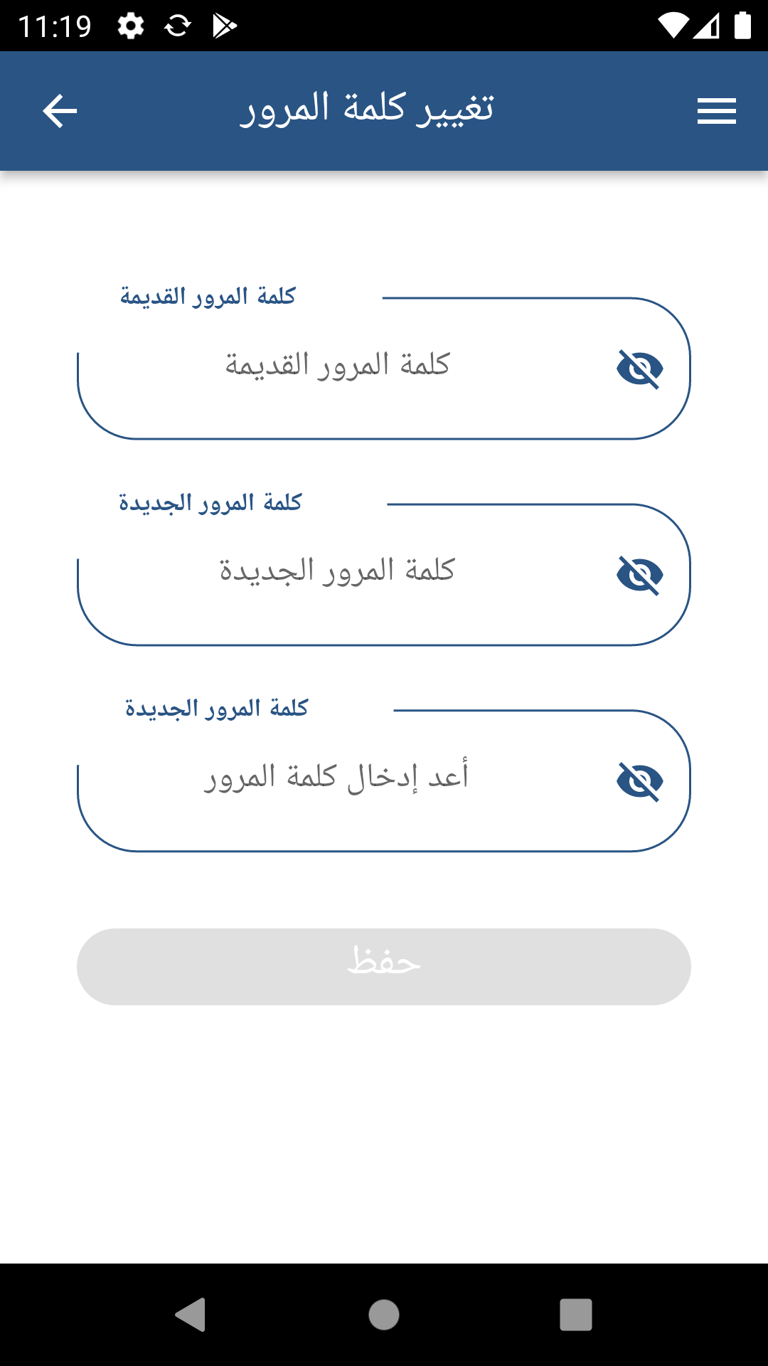
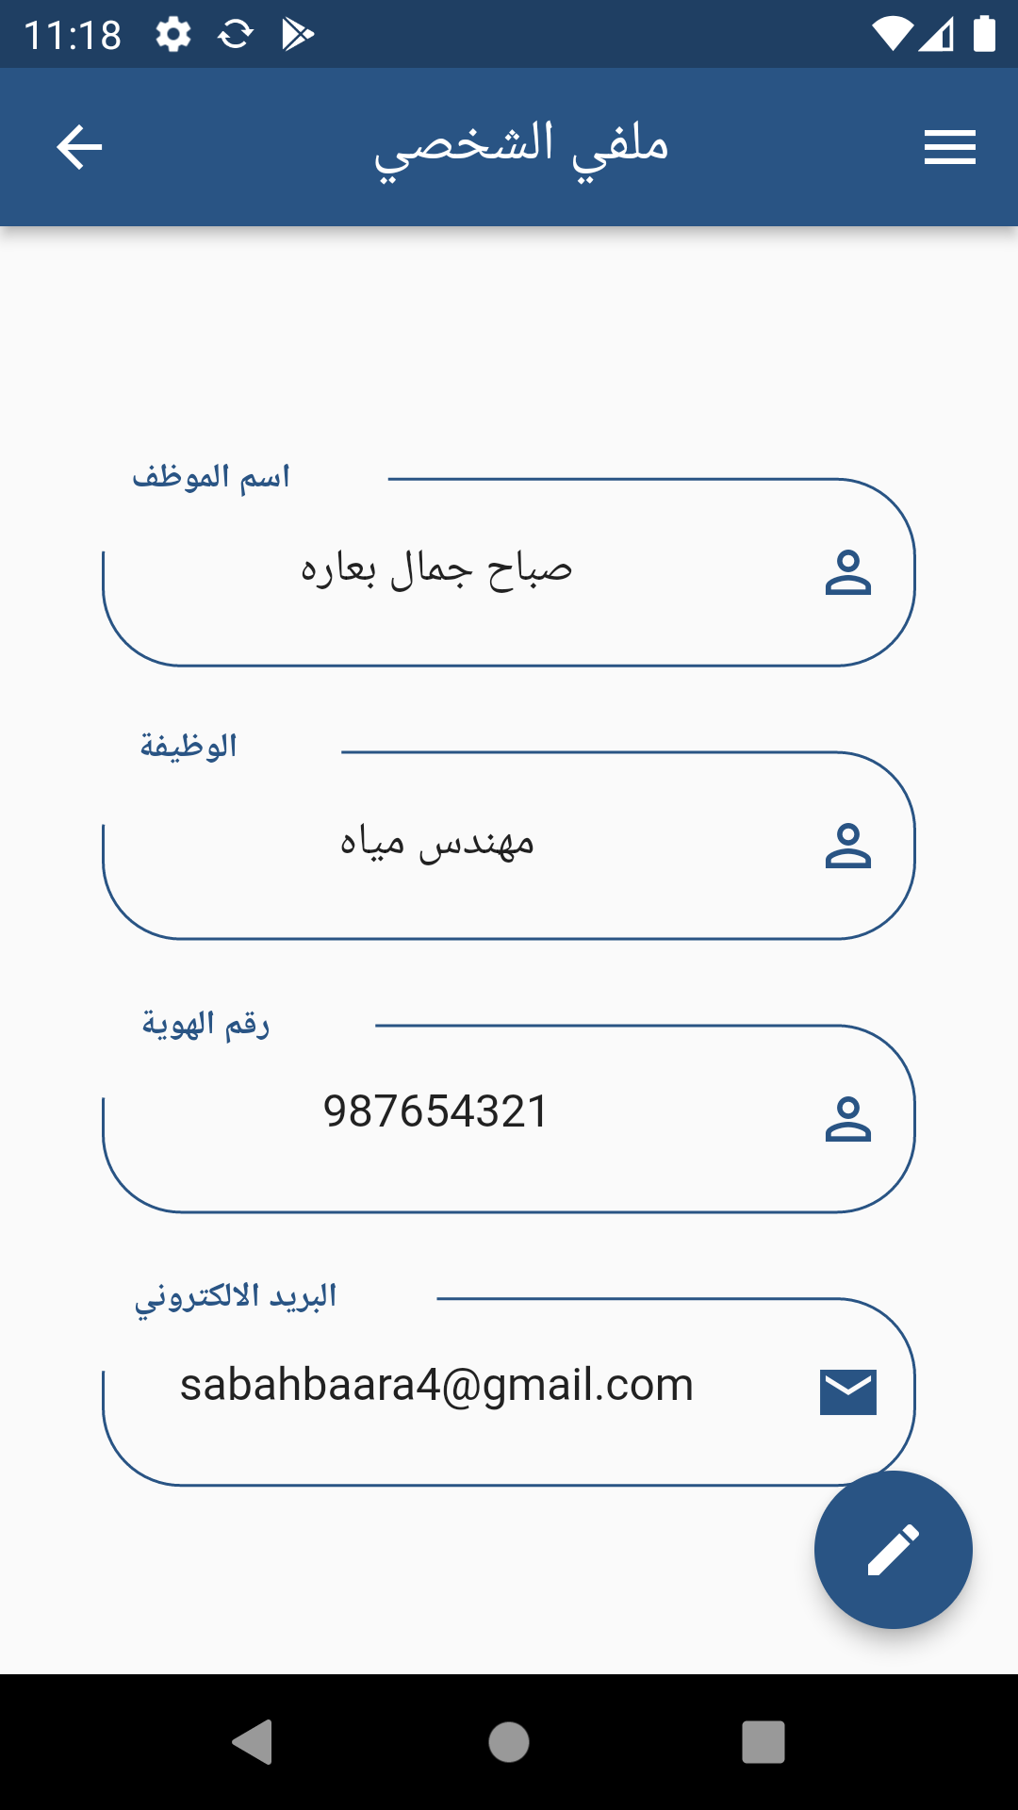
Targeted Users
Water Engineer

Slide 36
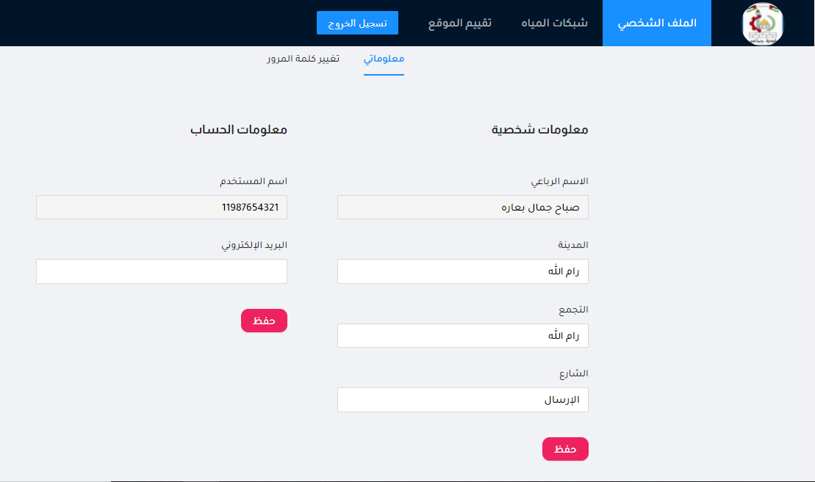
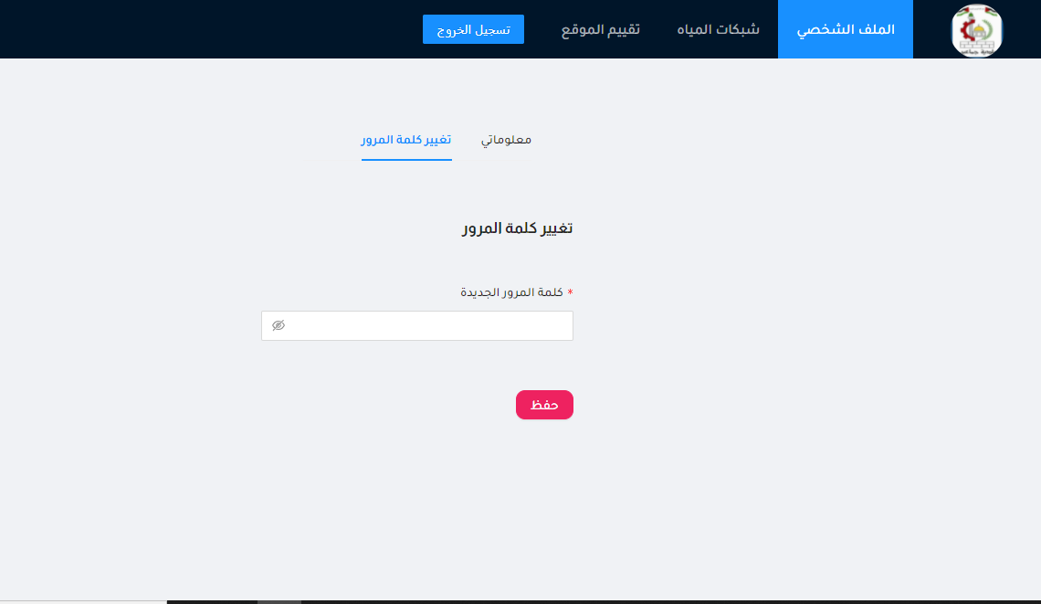
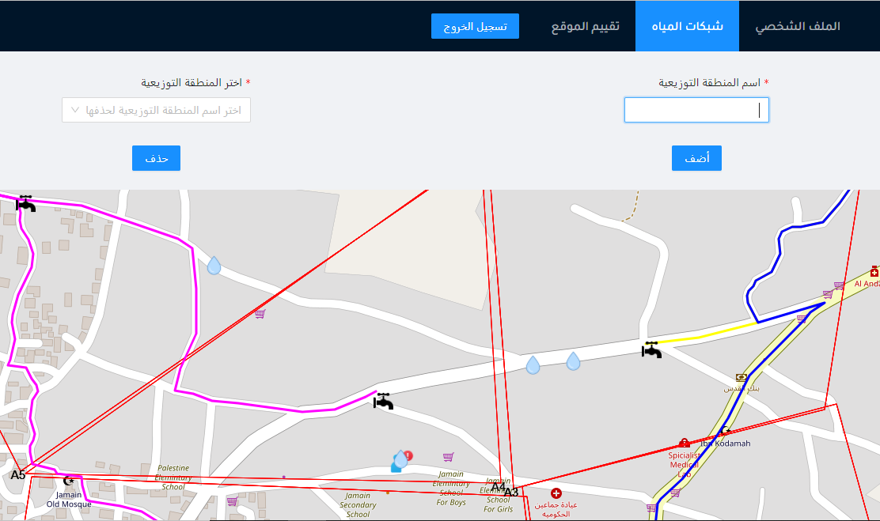
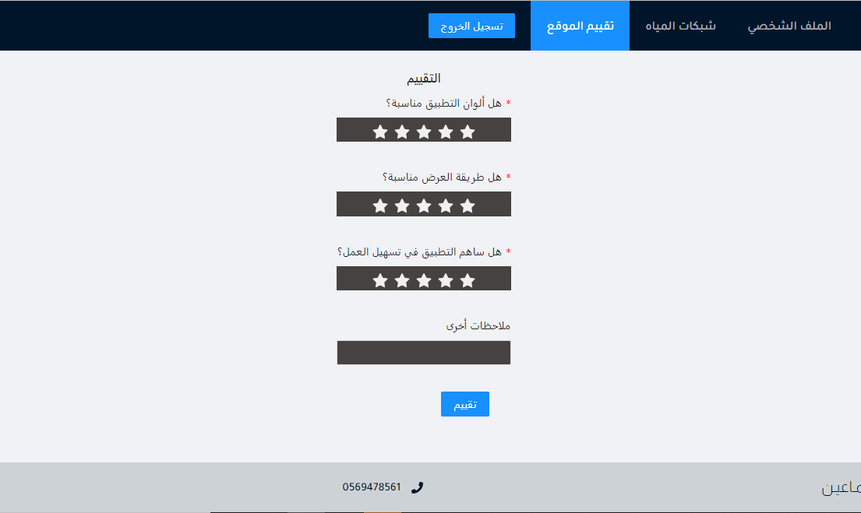
Targeted Users
Water Engineer

Slide 37
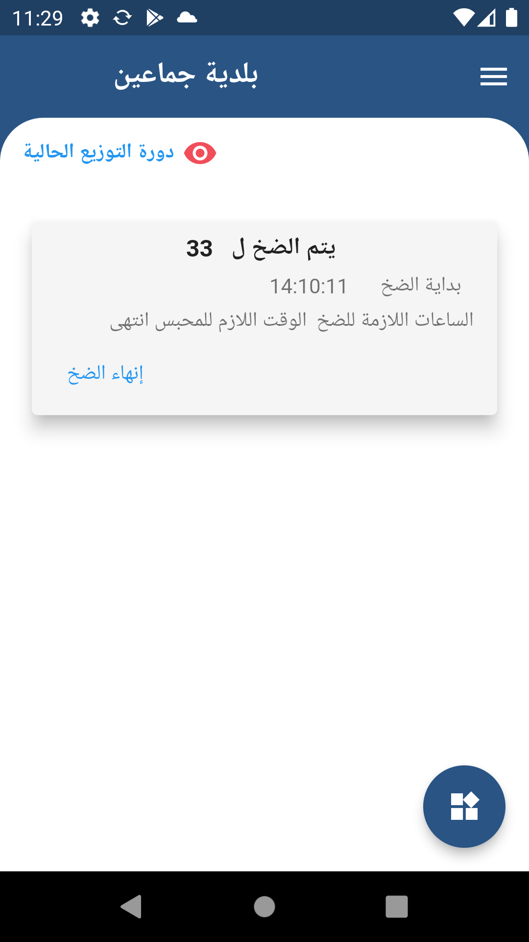
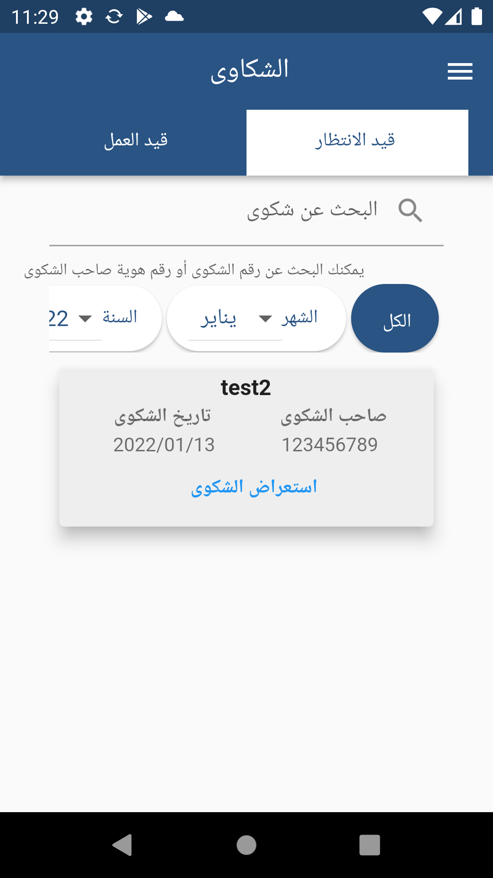
Targeted Users
Water Technician

Slide 38
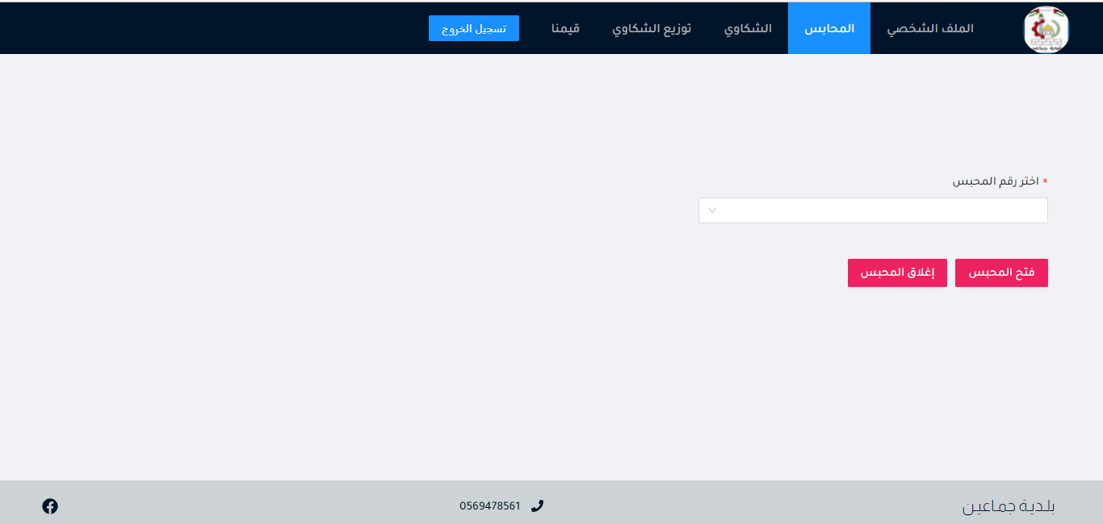
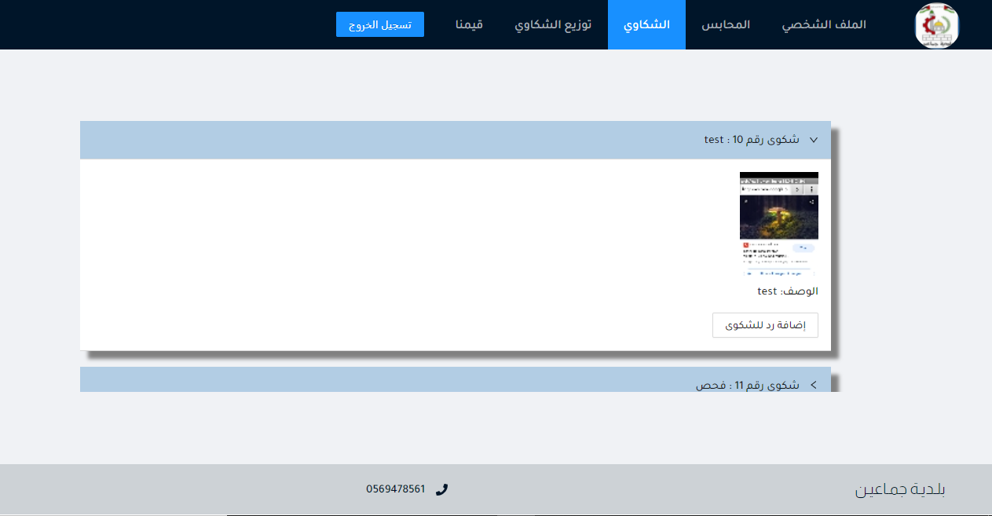
Targeted Users
Water Technician

Slide 39
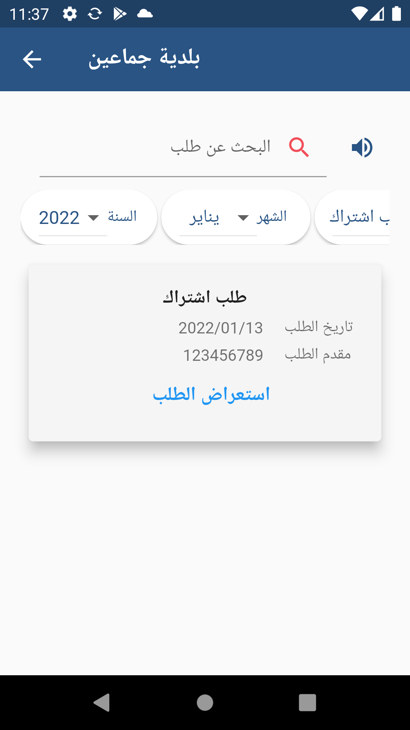
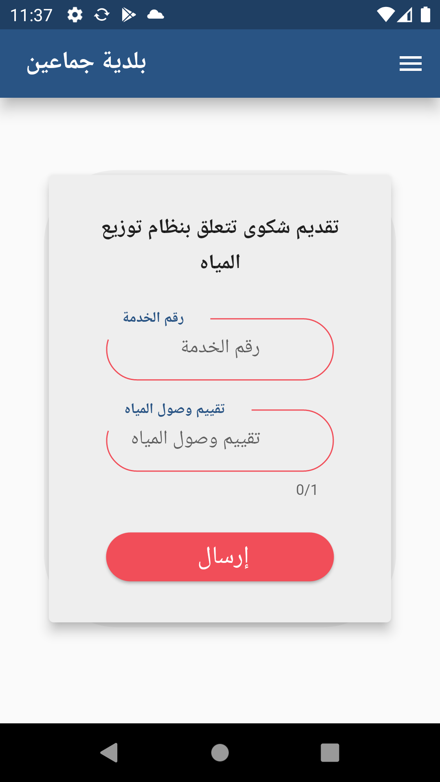
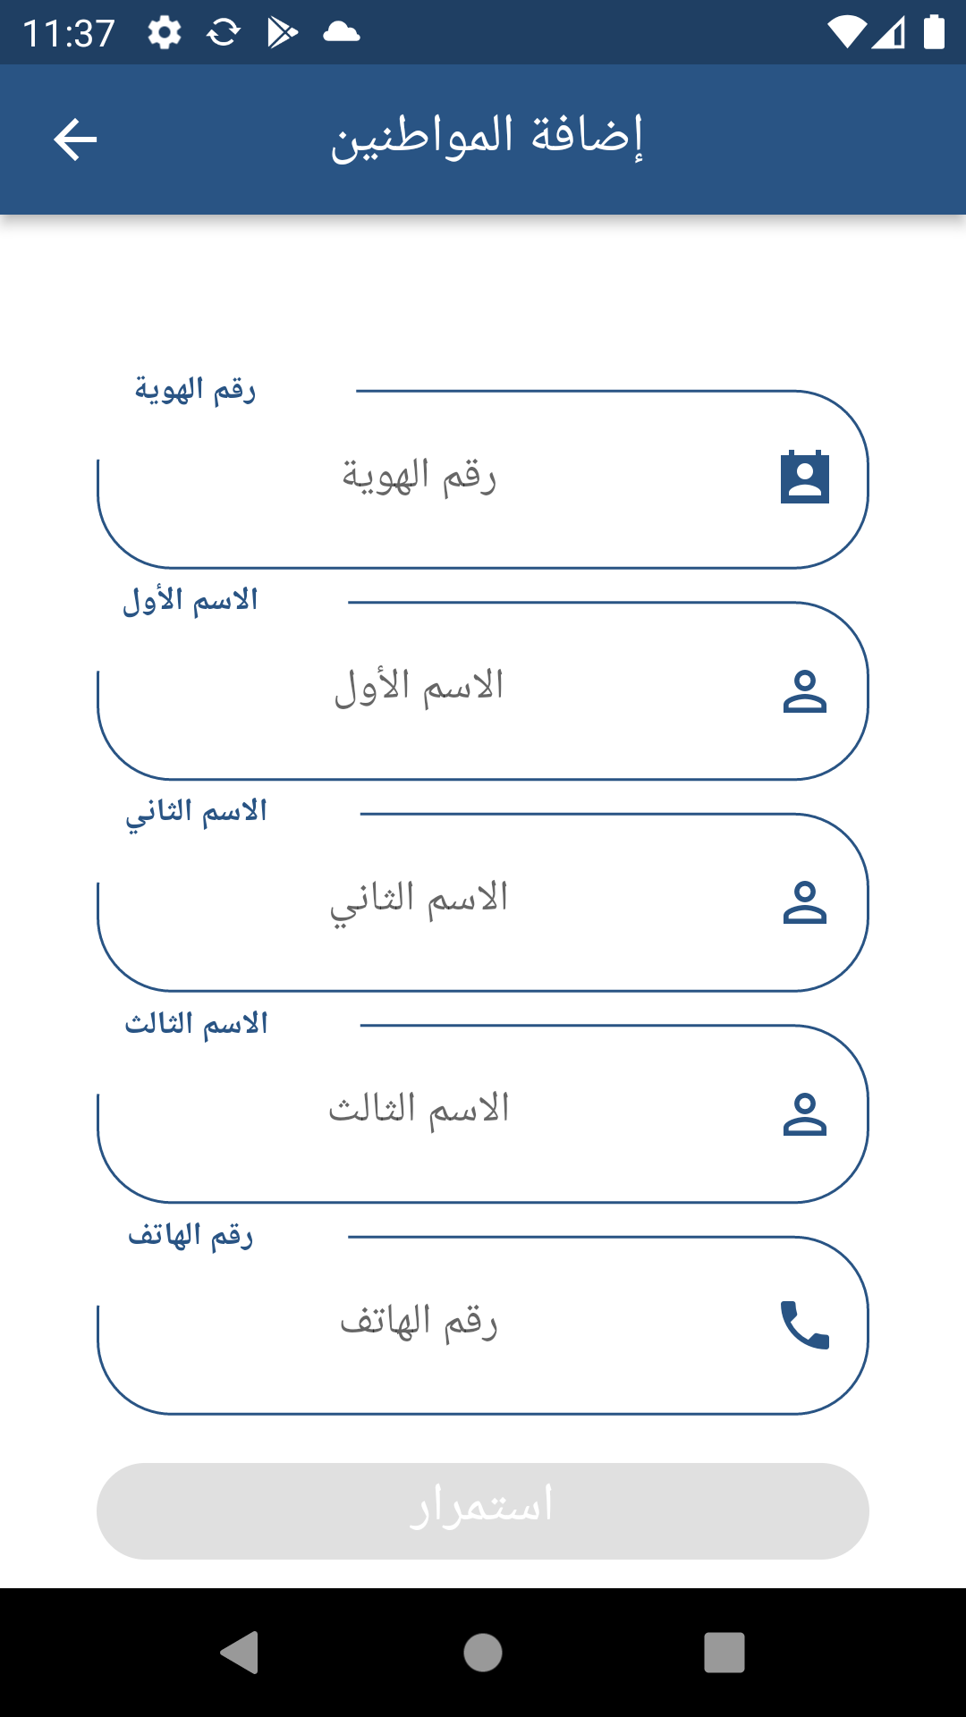
Targeted Users
Service Employee

Slide 40
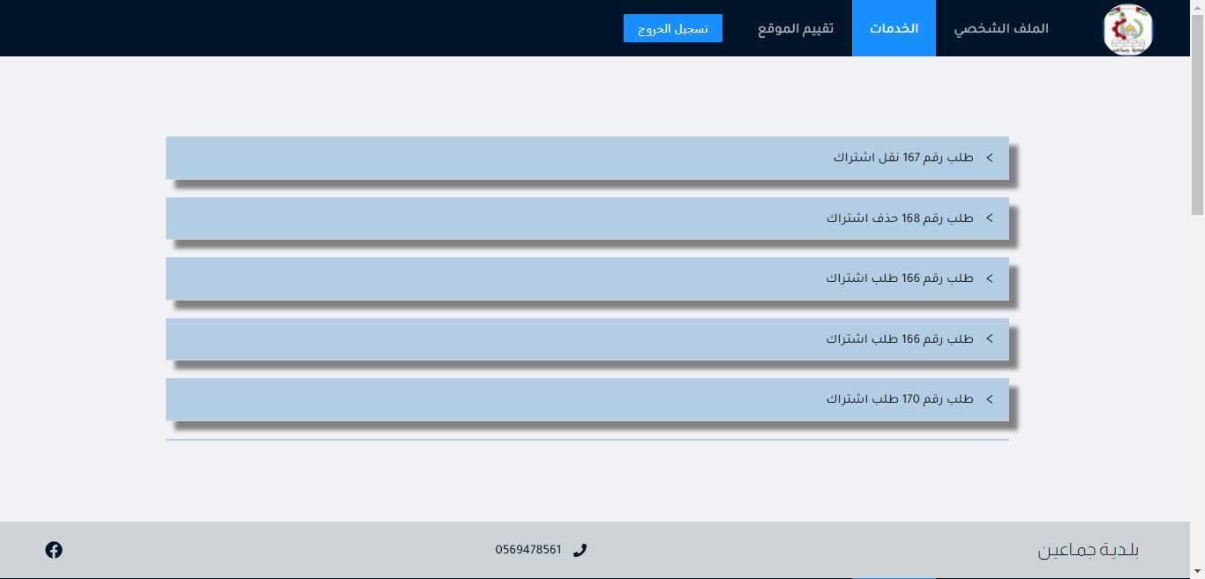
Targeted Users
Service Employee

Slide 41
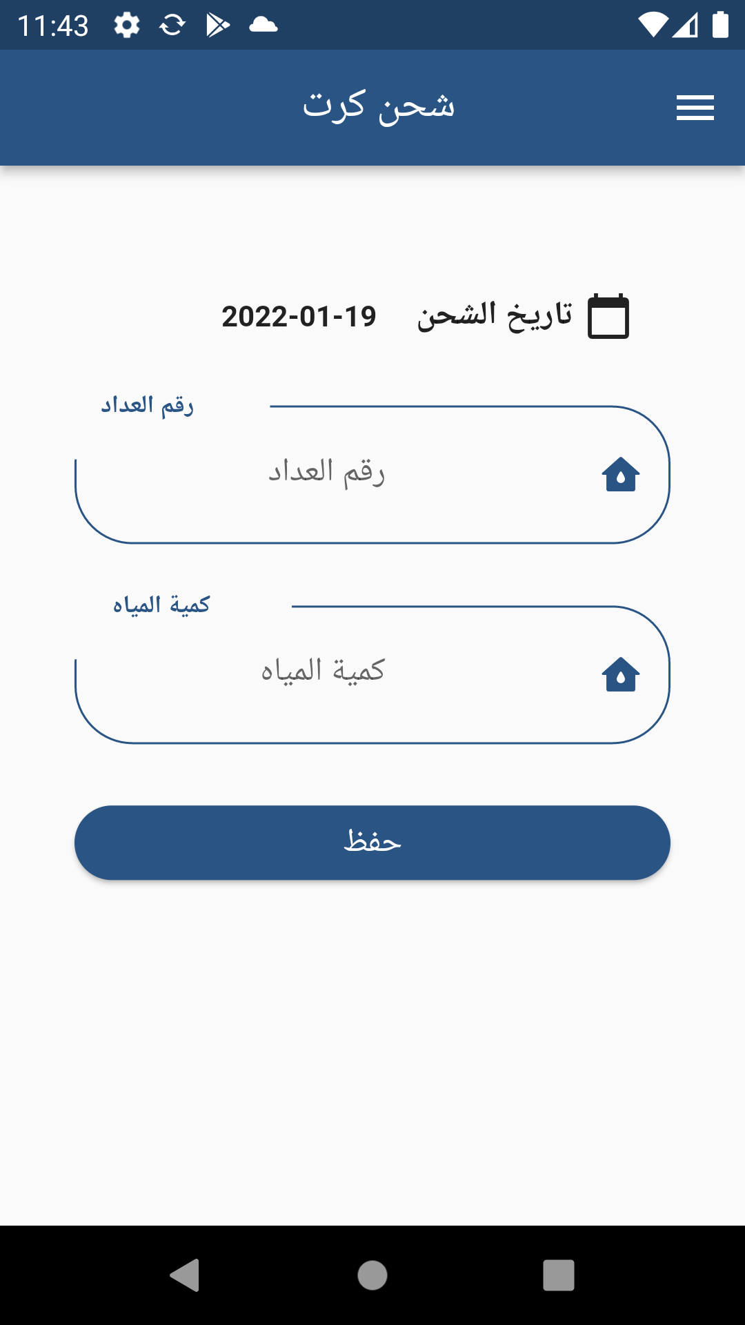

Targeted Users
Other Employees

Slide 42
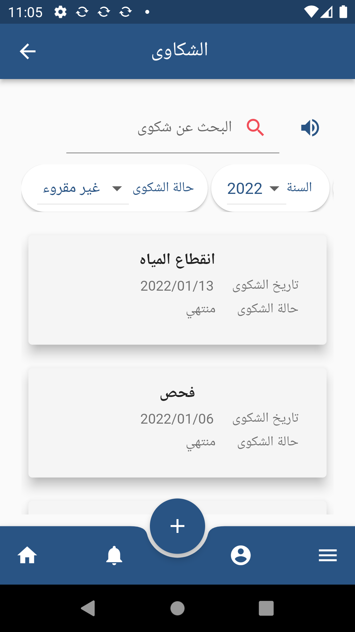
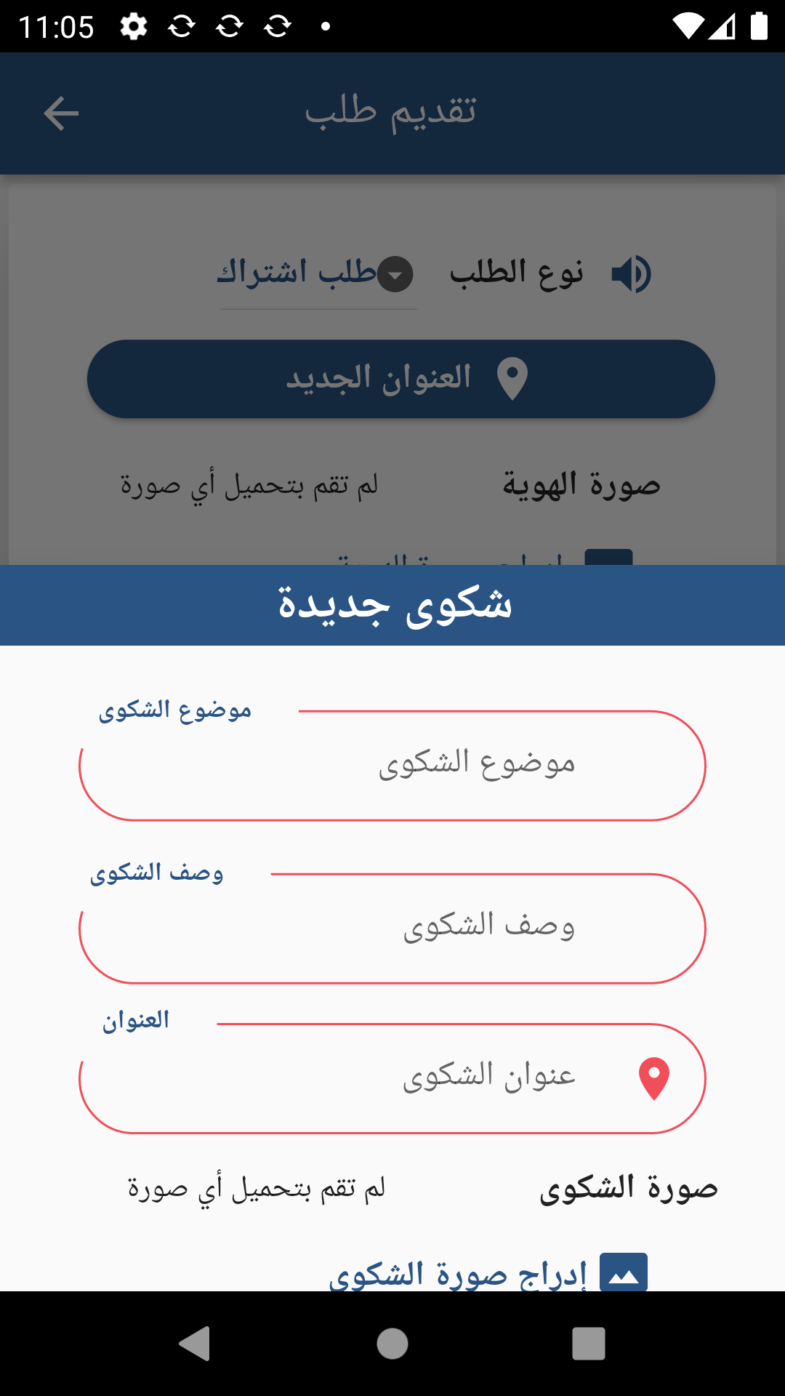
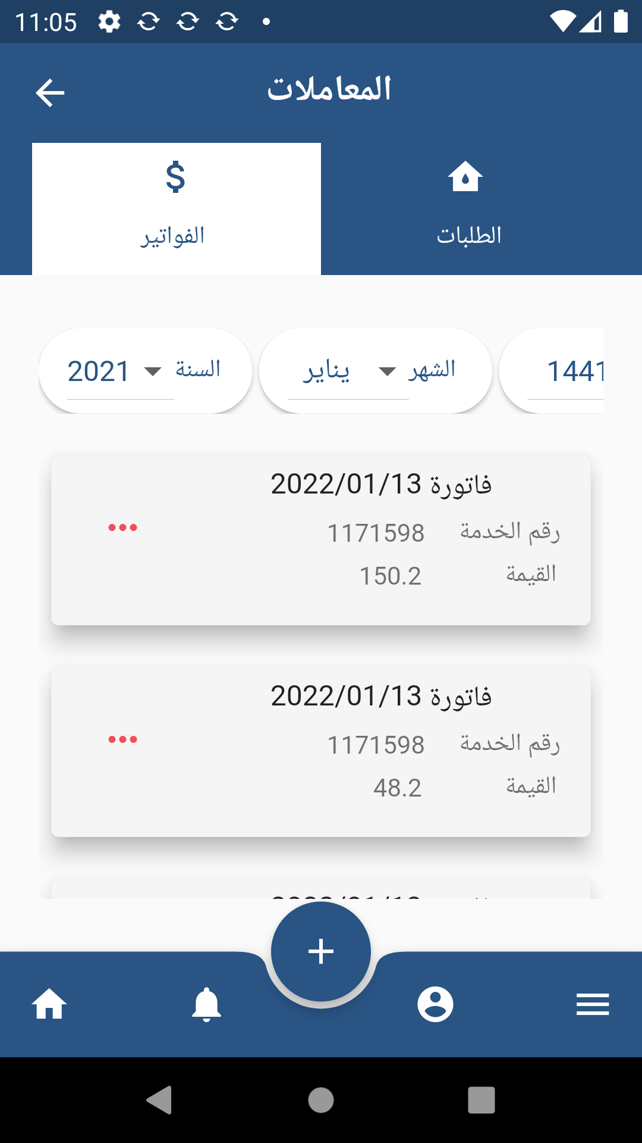
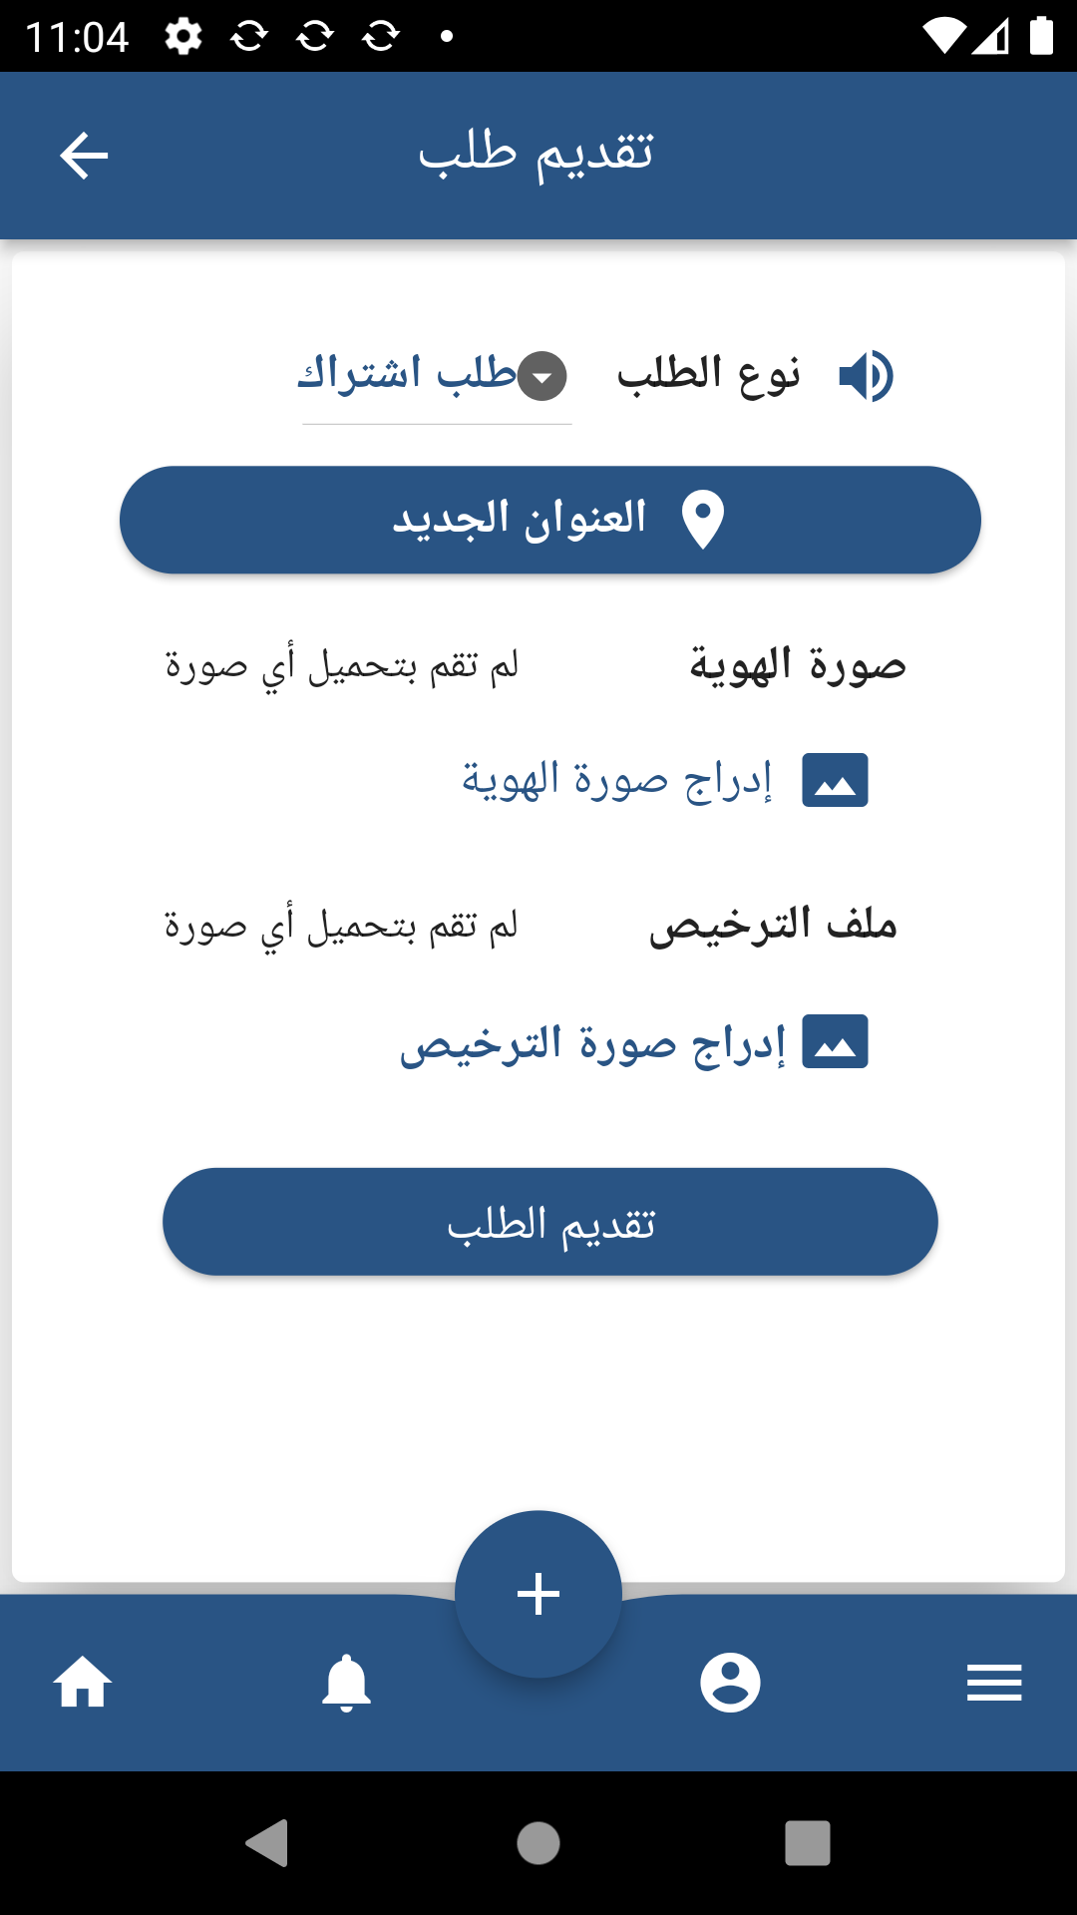
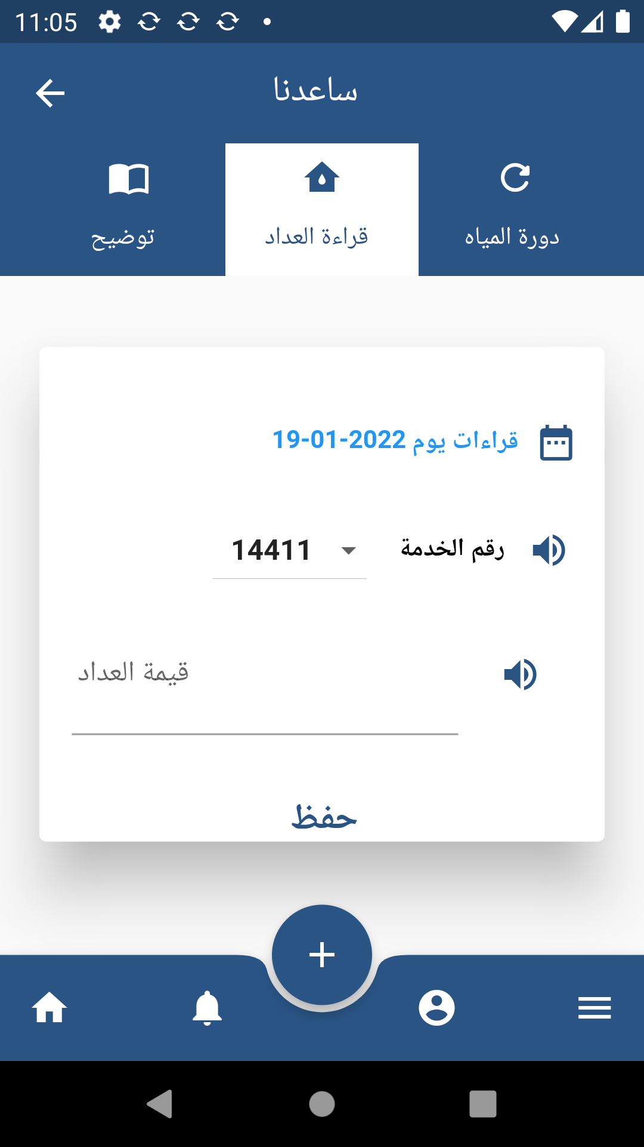
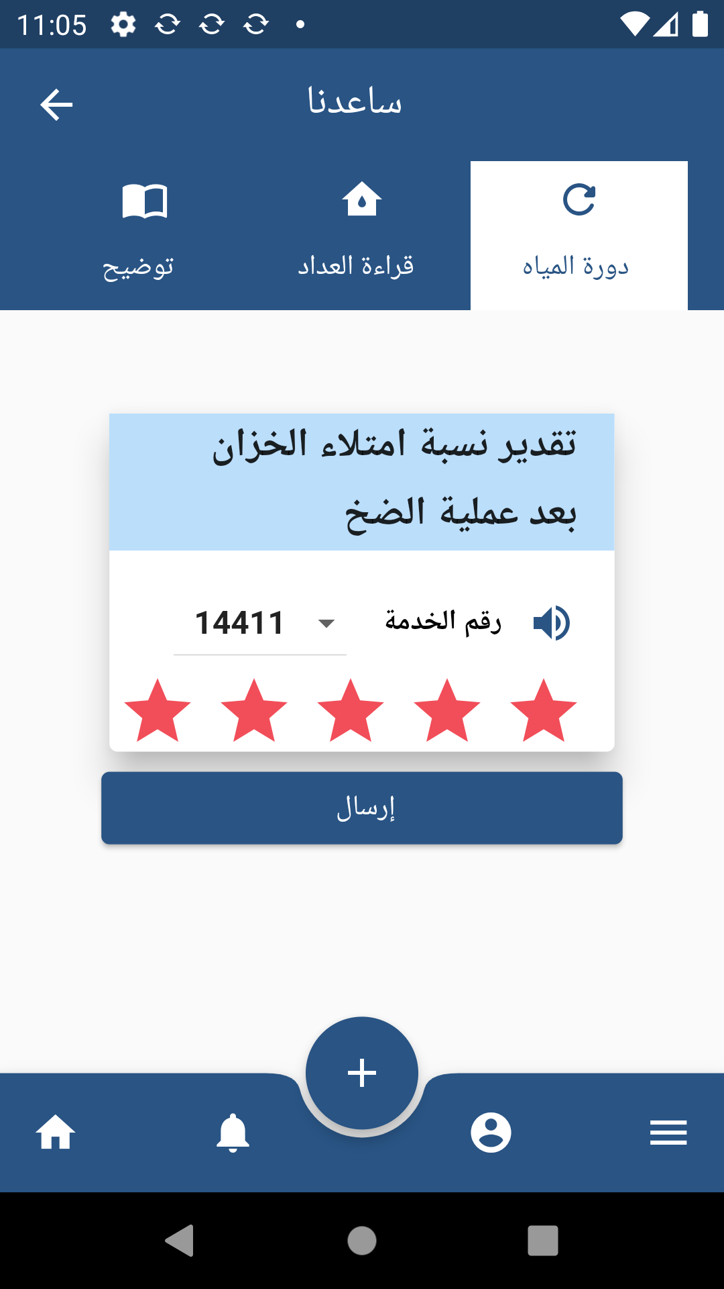
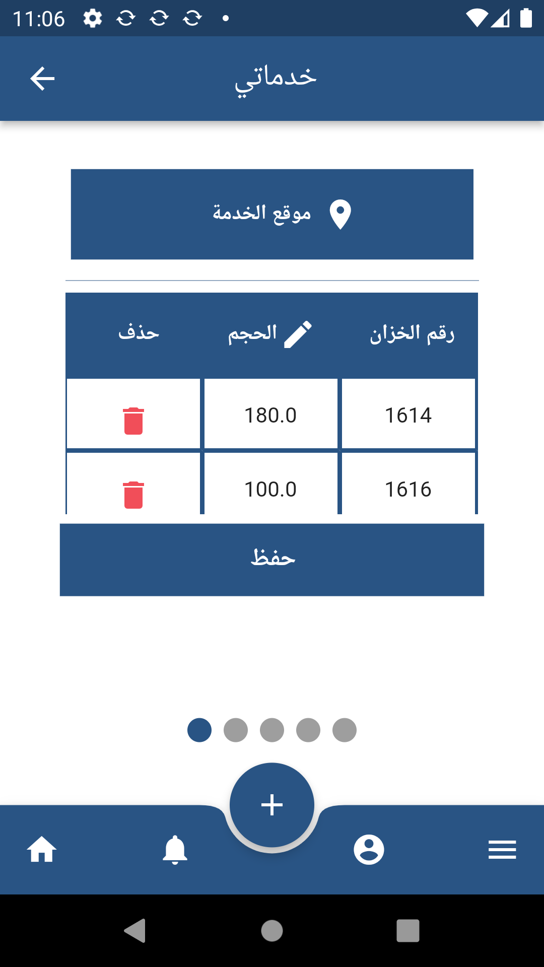
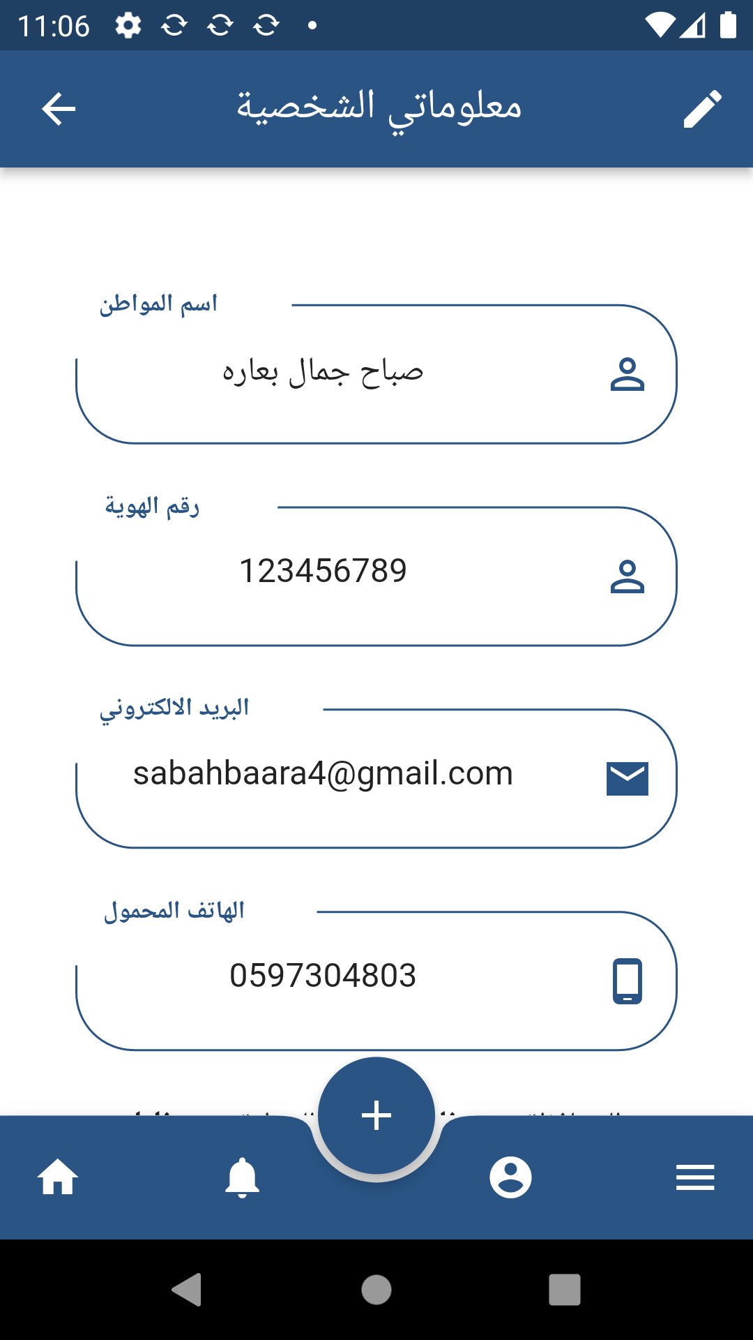
Targeted Users
The Citizen

Slide 43
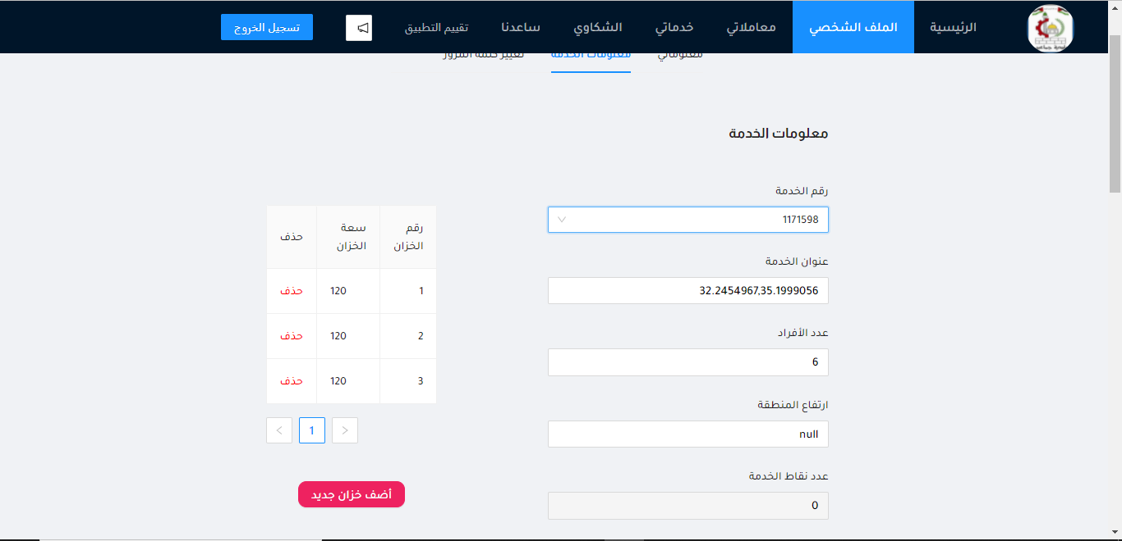
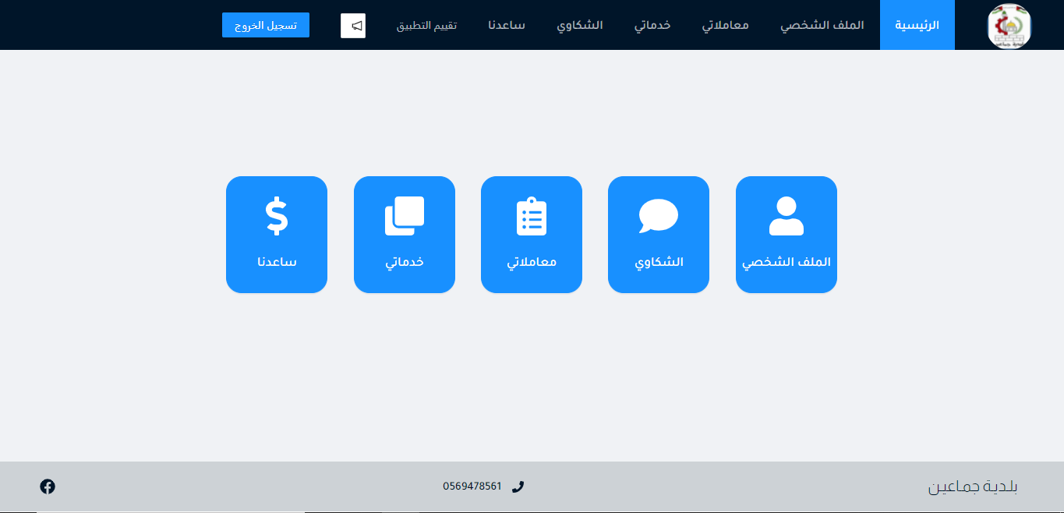
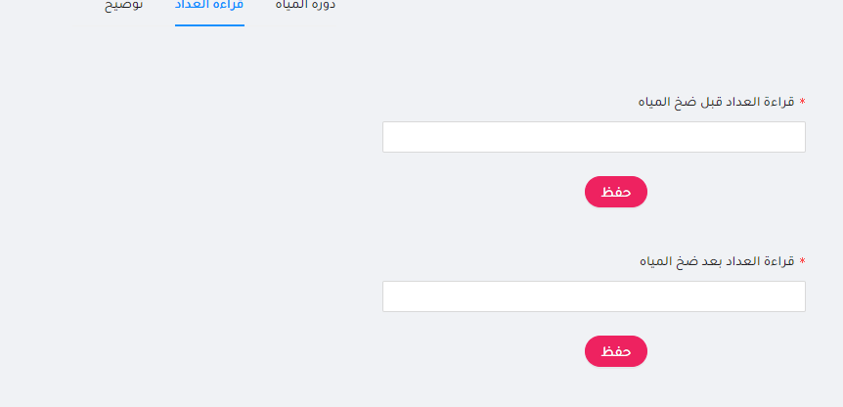
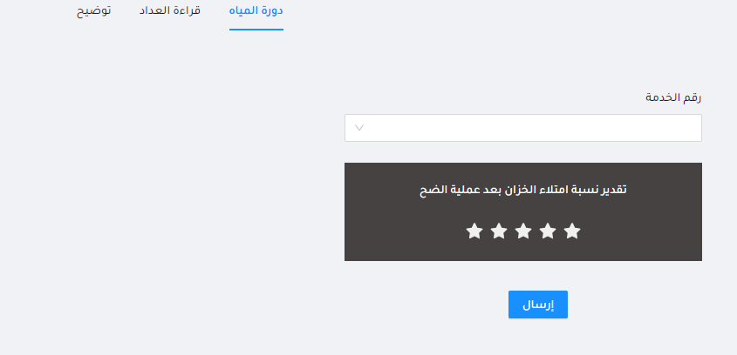



Targeted Users
The Citizen

Slide 44






Targeted Users
The Admin

Slide 45




Targeted Users
The Admin

Slide 46

Targeted Users
Special Needs
To support people with special needs, a text-to-speech feature has been added.

Slide 47
Technology
6

Slide 48
Technology
React Js for the website interface
Flutter for the mobile app interface
Flask server backend
Leaflet maps for the website and google maps for the mobile app
MYSQL database with apache server

Slide 49
Technology
Constraints Satisfaction Problem is used for the distribution system
Initial solution is built according to the person average water consumption and the number of people for the service
The improvement for the system is depending on the citizens complaints

Slide 50
Results and Discussion
7

Slide 51
Results and Discussion
Build a fair distribution system that will be modified according to the citizens complaints and needs of water.
Facilitating and accelerating communication between citizens and municipalities.

Slide 52
Future Work
8

Slide 53
Future work
Adding an electronic payment system
Enhancing the system after getting feedback from users
Encoding other municipalities services to the system.

