Slide 1
Smart Sense
Studets: Tala Isleem
Iman Abu Abiah
Supervisor: Dr Raed AL-Qadi

Slide 2
Outline
Introduction
Smart Sense Idea
Techniques & Tools
Methodology
future work

Slide 3
Introduction
At houses, offices, schools and other locations that have electrical machines, the people who are used to be there (like owners) need to know about everything in those places.

Slide 4
Smart Sense Idea
Website to inform the user of the full
information about its electrical machine
when it start/stop working, consumption
for all machines, and ability to add
machines to the System.

Slide 5
Techniques & Tools
Approach 1 :
Angular 6
TypeScript
Webstorm
PZEM 004T
Approach 2:

Slide 6
Methodology
Approach 1
Approach 2

Slide 7
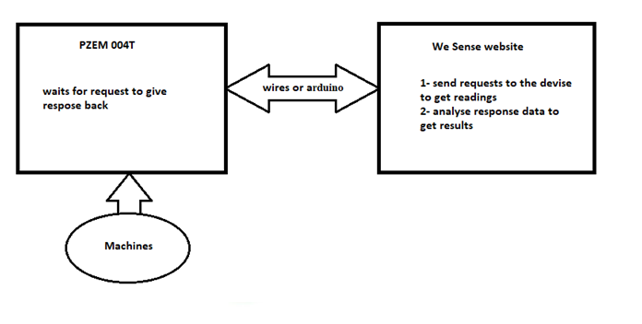
Approach 1

Slide 8
When System Read (positively)
Every 2 seconds, readings will updated:
Loop on machines list
Add first matching, modify “more”
Another loop to detect conflicting

Slide 9
Conflicting
If confliction detected, one of those machines will pushed to the working list.
The system send notification to the user with the list of the conflicting machines if the user want to edit the working one.

Slide 10
When System Read (negatively)
Loop on Working list
Test if the difference mach any, if so delete it from list, modify “more”
If not, test all working leveled machines if its level changed

Slide 11
Consumption
Calculate consumption for all machines and update it every 1 minutes
Per Hour, Per Day, Per Week and Per Month

Slide 12
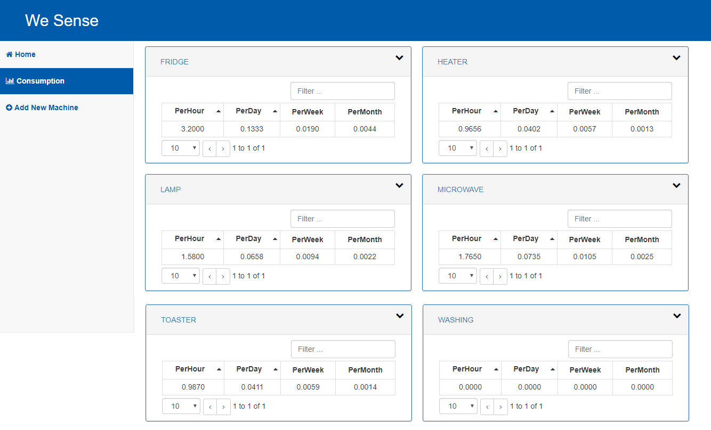

Slide 13
Add new machine
Manually
Automatically

Slide 14
Manually
Through input form to add new machine.
User should know every thing about machine and characteristics like power and current ranges and if it is leveled, every level ranges.

Slide 15
Automatically
Through Self Detection Property.
User shouldn’t know every thing about machine and its characteristics, but the number of levels.

Slide 16
Demo

Slide 17
Future Work
Wireless Reading and Bluetooth notification messages
more accurate decision
Mobile application android and ios

