Slide 1

Faculty of Engineering
Mechanical Engineering Department
Design of a Cooling System
for Recycling Copper Wires Using Pyrolysis Process
Presented by: Advisor:
Allan Shaar eng. Ramez khaldi
Al-Motasem Abu-Halimi
Mohannad Shakhshir
Mohammad Jaber

Slide 2
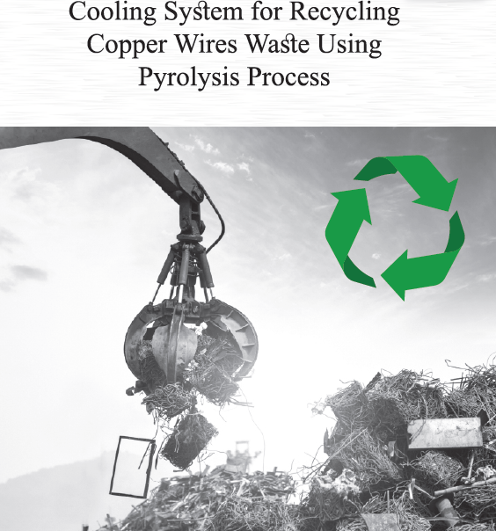

Slide 3
Outline
Goals
Introduction
Literature Review
Methodology
Applications
Benefits
Conclusion

Slide 4
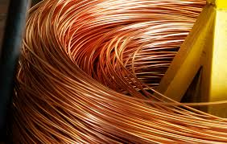
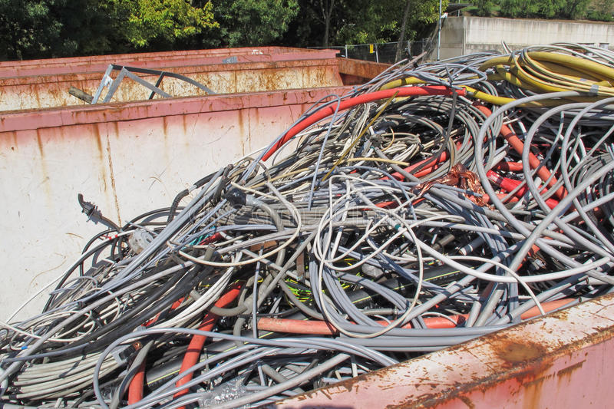
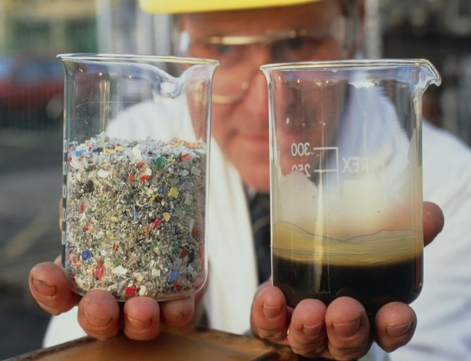
GOALS
EXTRACT PURE COPPER IN AN ENVIRONMENTALLY FRIENDLY WAY
PROPER UTILIZATION OF PALESTINE’S LANDFILLS
UTILIZATION OF OIL PRODUCED

Slide 5


Slide 6


Slide 7

What is Pyrolysis?
Heating with the absence of Oxygen

Slide 8
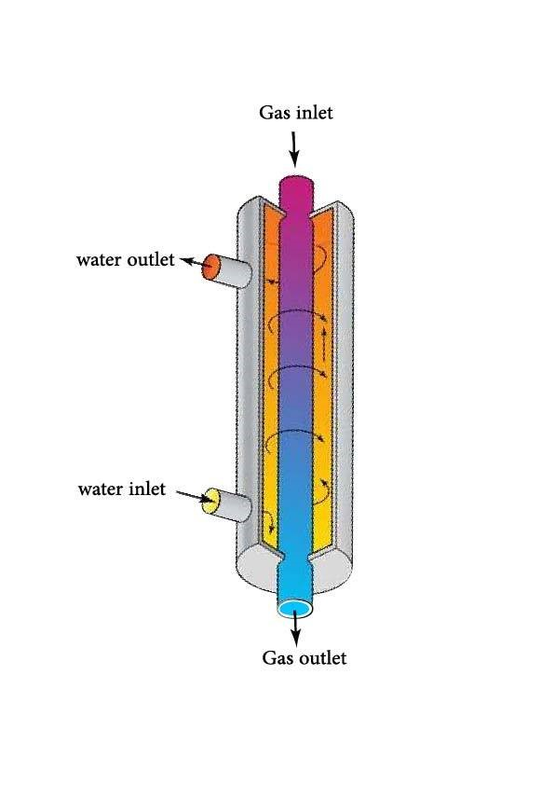
Shell And Tube Heat Exchanger
Cheap
Effective
Easy to construct
Simple

Slide 9
Literature Review
Pyrolysis of PVC
De-chlorination

Slide 10
Pyrolysis of PVC
PVC = 57% chlorine + 43% Hydrocarbons
Producing high HCL acid

Slide 11
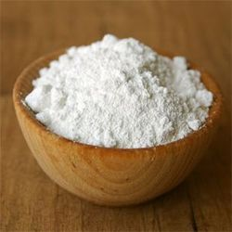
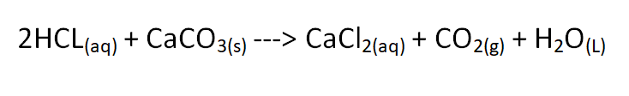
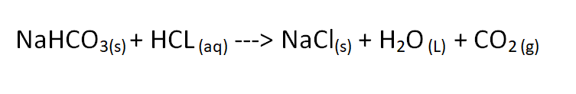
De-chlorination
Calcium carbonate (CaCO3)
Sodium bicarbonate (NaHCO3)

Slide 12


Slide 13
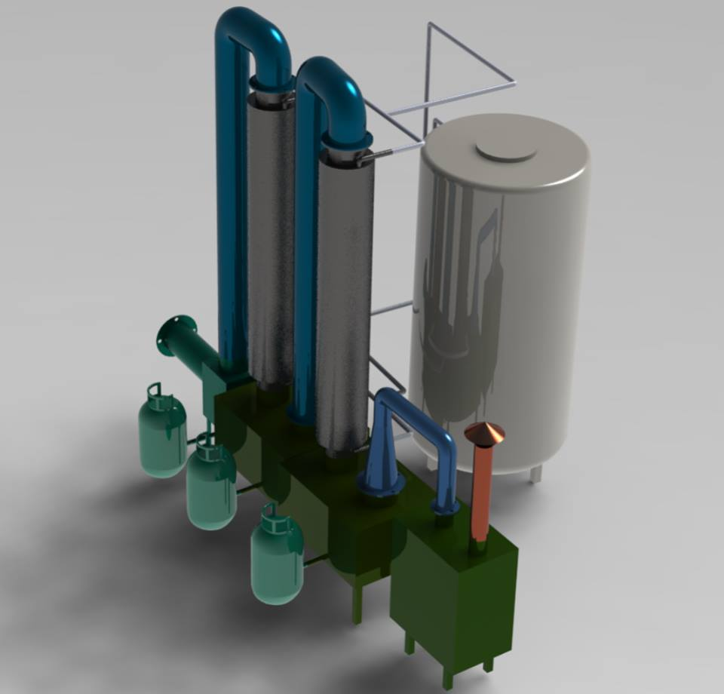
Design of Cooling System

Slide 14

How does it work?

Slide 15
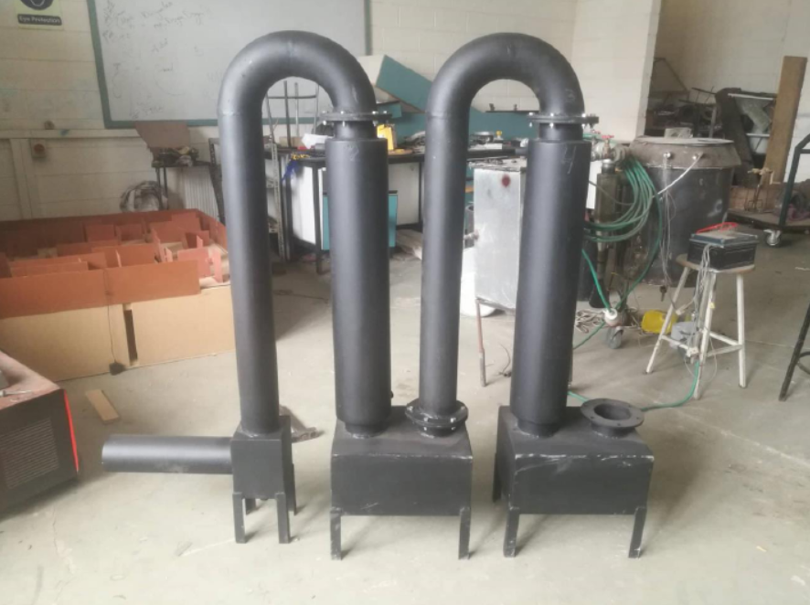
Real-life Footage

Slide 16
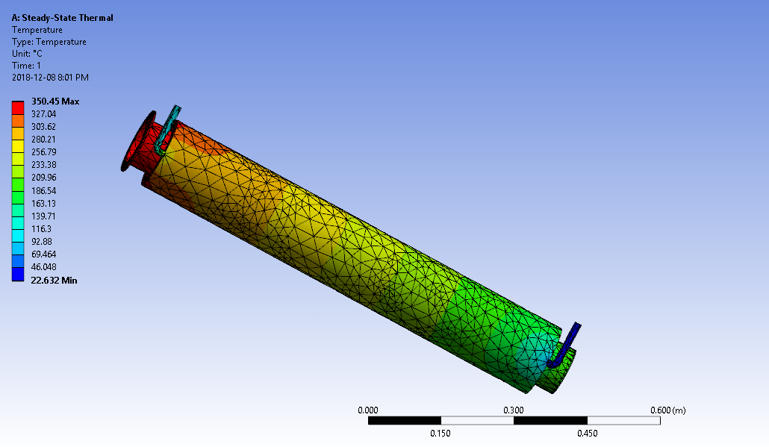
Thermal Simulation
Gas Temperature
(Phase one)
Tin (Cº) | Tout (Cº)
350˚C | 186.54˚C to 209.96˚C
Water Temperature
(Phase one)
Tin (Cº) | Tout (Cº)
22.6 | 116.3˚C to 139.71˚C

Slide 17

Thermal Simulation
Gas Temperature
(Phase two)
Tin (Cº) | Tout (Cº)
180˚C | 113 ˚C to 90.602 ˚C
Water Temperature
(Phase two)
Tin (Cº) | Tout (Cº)
23.4 | 68.203˚C to 79.403˚C

Slide 18
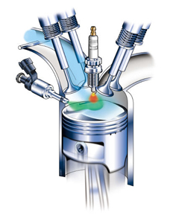
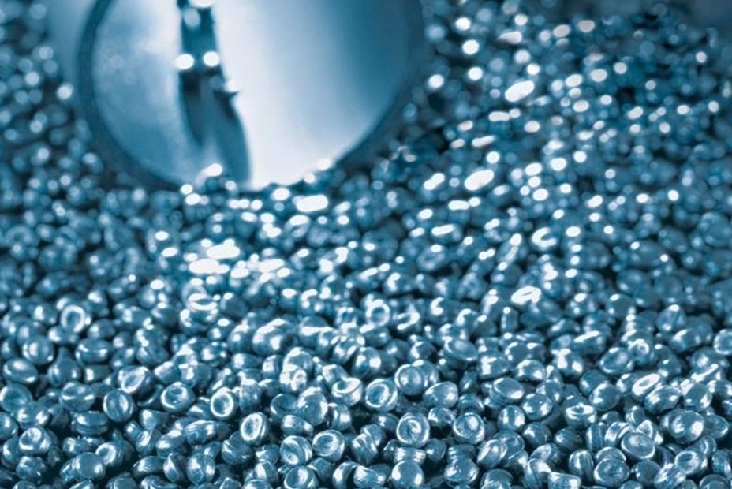
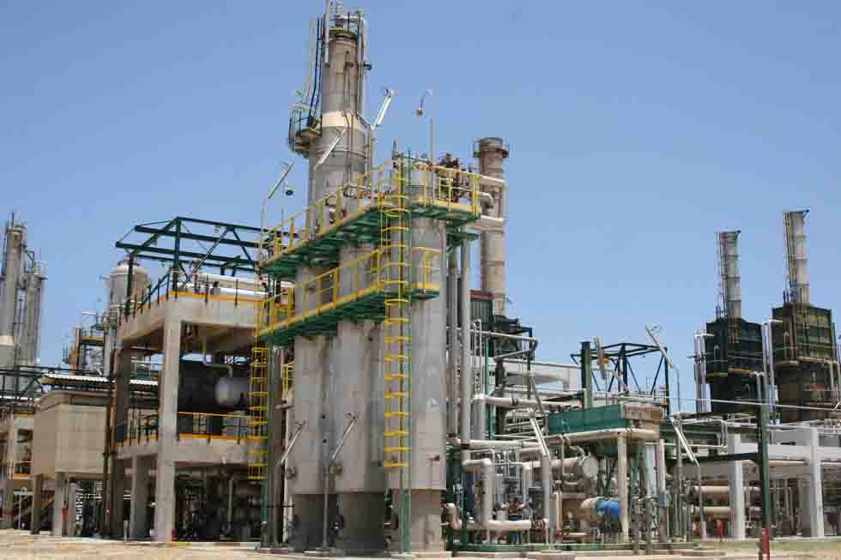
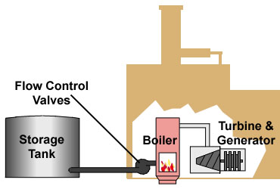
Applications

Slide 19


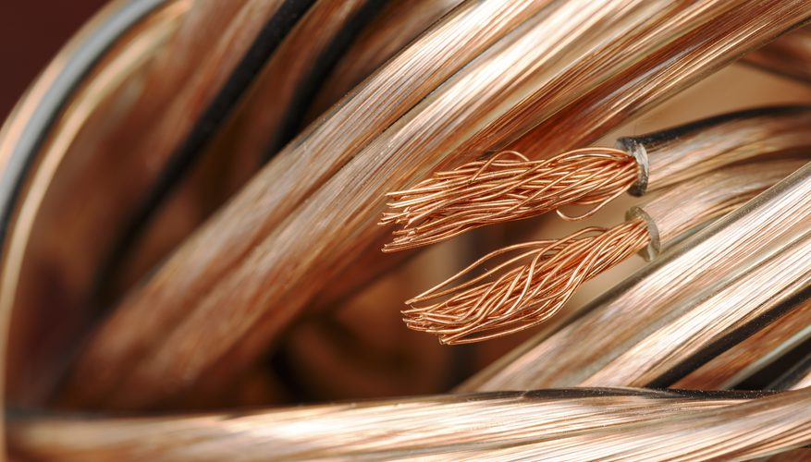
Benefits?
Relatively clean
Various applications
Beneficial for Palestine
Pure copper production

Slide 20


Conclusion

Slide 21


