Slide 1

Design and construction
We need to seek a design that Achieve the goal of the project
which should be :
compact
effective
So we need to know types of heat exchangers

Slide 2
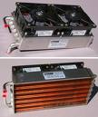

Heat exchangers type
There are two type of heat exchanger
Air water heat exchanger cross flow
Water- water system counter flow

Slide 3
Air-water system design
This type depend on water as refrigerant air as cooling agent
To design the cycle need to know :
cooling and heating load
Over all heat transfer coefficient
Logarithmic mean temperature
So we find the surface area of different componaent

Slide 4



Slide 5
As we saw from the previous slide we have to calculate U to get the surface area to construct the design for the components
As all the design is proceeded in the same method we will present the design of a sample which will be condenser

Slide 6
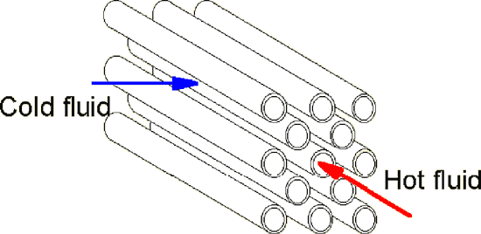
Condenser design Air-water system
This design is constructed by trial and error method
So we need to assume the initial values for U, and the temperature to be calculated
U is assumed based on reference

Slide 7
Assumptions
Assume U = 35 W/m² .C°
An initial value for the surface area is obtained

Slide 8


Equations
Mass and energy balance equation
To find velocity
Then find Reynolds number

Slide 9



After we find Reynolds number we decide whether its laminar or turbulent flow
If R_{e} < 500000 (Laminar)

Slide 10

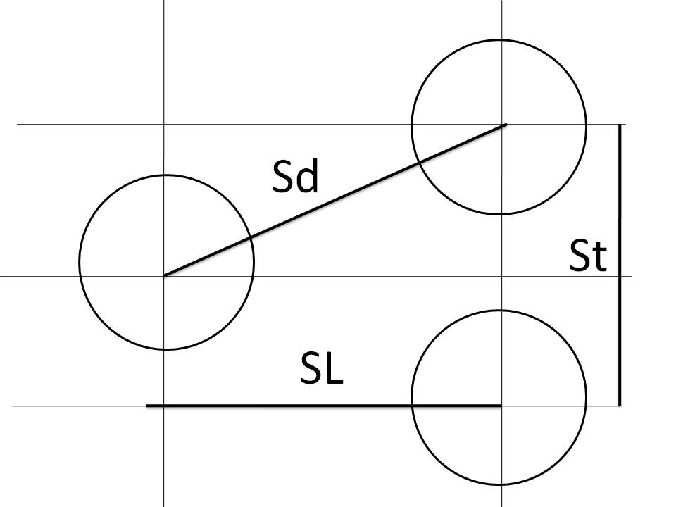
As the mass flow rate was for water we just calculate inside heat transfer coefficient
So repeating the previous steps for air we will find outside heat transfer coefficient
But :

Slide 11


Sd
The Nusslets number for outside heat transfer coefficient=
Substitute in over all heat transfer coefficient and with trial and error method the resulted surface area was 28.25 meter square

Slide 12
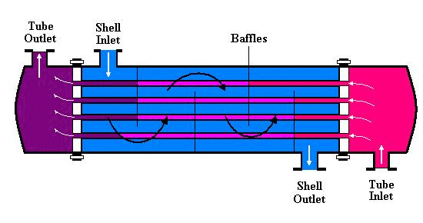
The resulted surface area was unsuitable for the construction so another design is proposed
Water -Water system
This design based on empirical equations
All of the values related to temperature
Same principle of the previous system but not the same evaluation

Slide 13
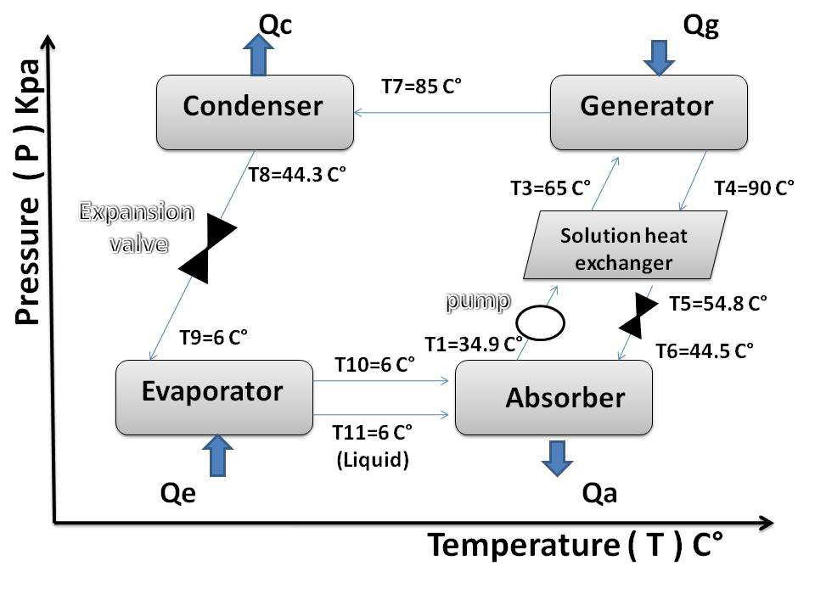
Cycle

Slide 14

Equations

Slide 15
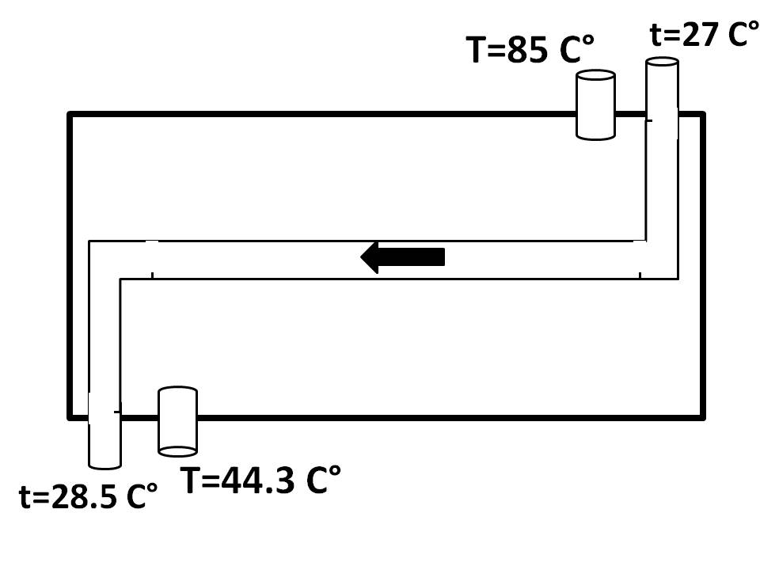
Q for the condenser = m`*(hf-hg)
=2.4 kw

Slide 16



for 10⁴<Red<5×10⁶ and 0.5<Pr<2000

Slide 17
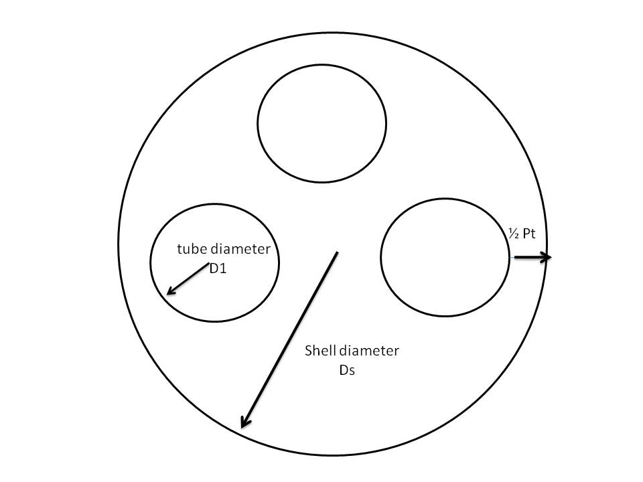
Sizing

