Slide 1

MyRecipe
Prepared by:
Diana khateeb Enas Adwan
Supervisor:
Dr.Samer Arandi

Slide 2
Outline:
What is MyRecipe?
Motivation
Main Goals
Languages and Tools
Future work.

Slide 3
What is MyRecipe?
It’s an Android application that Is interested in
topics related to recipes, and how to keep track your calories.
It provide different sections: add and show recipes ,communicate with other users in the application , keep track calories.

Slide 4
Motivation
People always need to learn more and more about food in their culture and even thought in different cultures.
Instead of going to nutrition specialist it’s a good idea To have an application that help you follow a specific diet and keep track your calories.

Slide 5
Main Goals
Attractive make users able to add recipes they know.
Simplicity: user Friendly.
Available :even if there is no internet connection you can see the last recipes.

Slide 6
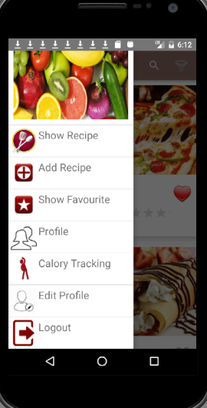
Sections
Different sections are available
you can choose what you
need from this navigation

Slide 7
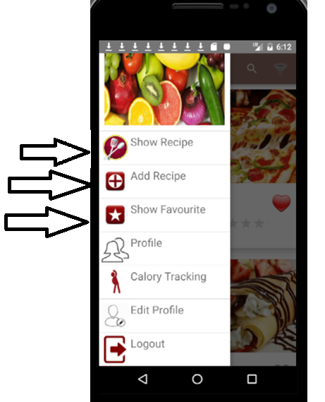
This sections talk about
recipes.
The first one for showing
all recipes
The second to add
your recipe
Last one to show recipes
you added to your favorite

Slide 8
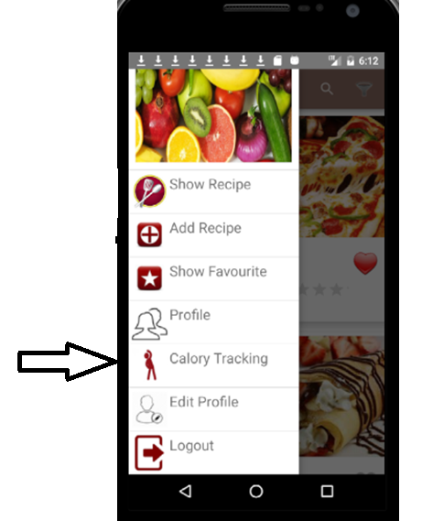
This sections help you
tracking your calories.

Slide 9
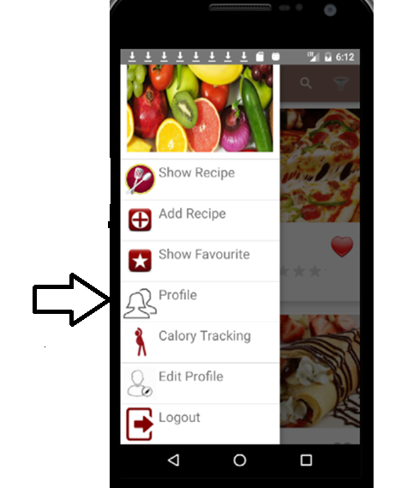
This section to communicate
with other, you can find different
information for each user.

Slide 10
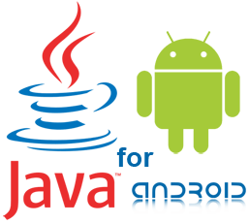
Languages and Tools
Server ( XamppServer3.2.2c).
Database ( MySQL).
PHP, JavaScript, AJAX , and HTML as programming languages .
Java

Slide 11
Future Work:
The application will be able to show the exercises needed to burn a specific recipe, depending on the calories for this recipe.
Include a web site for our application.
Have an ios version

