Slide 1
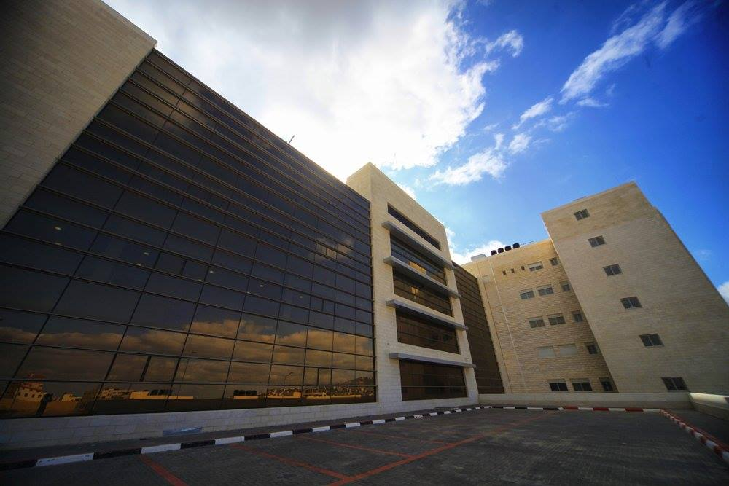
An-Najah National University
Faculty of Engineering & Information Technology
Industrial Engineering Department
Applying Lean Tools and Developing Improvements at NNUTH
Supervisor: Dr. Yahya Saleh

Slide 2

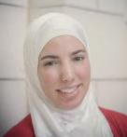
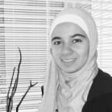
Our Team
Anan Aghbar
Industrial & Systems Engineering student
anan_aghbar@hotmail.com
00970598202857
Raya Shunnar
Industrial & Systems Engineering student
rayashunnar@gmail.com
00970597257862
Tasneem Arafat
Industrial & Systems Engineering student
tasneemarafat@hotmail.com
00970599397138

Slide 3
1
Overview
2
Problem Statement
3
Scope Of Work
Outline
4
Literature Review
5
Methodology & Results
6
Recommendations

Slide 4
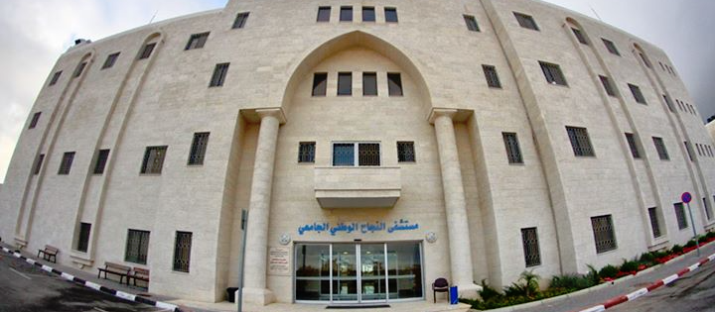



About NNUTH
Founded in 2012
17,000 m²
11 Med. Departments
120 Beds
5 Operating Rooms
5000+ Operations/year
Inpatients:
3000+ Admissions/month
Outpatients:
2000+ visits/month

Slide 5
Problem Statement
Long waits
Delays
Duplications
1
Patient Journey
NVA Activities
No clear instructions
Low utilization of OR
Operations scheduling
2
Departments Interaction
3
Low Layout efficiency
Backtracking
Patient waits long time for tests
Departments Interaction
No quality accreditations
Not utilizing competitive advantages
4
Quality, Safety & Reputation

Slide 6
Flowcharting
Communications Circle
Implementation Plan
JCI
Accreditation
Flow Optimization
VSM
Quality, Safety and Reputation
Patient Journey Smoothness
A3 Reports
Scope
Of
Work
Checklists
Departments Interaction
Ishikawa Diagram
Laboratory
Operating Rooms
Optimization Model
Layout Improvement (CRAFT)
Standard Operating Procedures (SOP’s)

Slide 7

Literature Review
Optimizing Patient Flow
Patient flow is the movement of patients between hospital’s diverse departments which includes various processes and services. The “efficiency” of service refers to the promptness of the care given to patients, including issues like waiting time before consultation, duration of consultation, amount of time spent with the doctor, quick response to emergencies, quick dispensation of drugs, fast and accurate laboratory tests.
Lean Thinking
The origins of lean thinking can be found on the shop‐floors of Japanese manufacturers and in particular, innovations at Toyota Motor Corp.
The emergence of lean in healthcare was discovered around the year of 2000.
The lean application in healthcare had been obvious as a medium to eliminate waiting time, repeat visits, errors & inappropriate procedures.
Implementing lean will greatly eliminate non-value added activities.
Peter Hines et al., 2004
Santillan D (2000)

Slide 8
Literature Review
Operating Rooms
Laboratory Layout
Deterministic and stochastic mathematical programming models, queuing models, simulation models, and heuristic approaches have all been used to investigate OR scheduling. The RCA is a structured approach to the investigation of patient safety incidents, particularly in acute hospital settings such as the operating rooms. An SOP is defined as a method for accomplishing policy. The details in an SOP standardize the process and provide step-by-step instructions that enable anyone within the system to perform the task in a consistent and correct manner.
Laboratories considering significant renovations or construction of a new facility have an exceptional opportunity to design space using Lean operations from start to finish. CRAFT considers The existing layout or new facility or any initial arbitrary layout is considered as a block layout. Now, the algorithm computes the department allocations and estimate the cost incurred on the layout.
JCI Accreditation
Founded in 1994 by The Joint Commission, JCI has touched more than 90 countries. JCI identifies, measures, and shares best practices in quality and patient safety with the world.
Bagian et al., 2002.
Joseph T.P. 2006

Slide 9


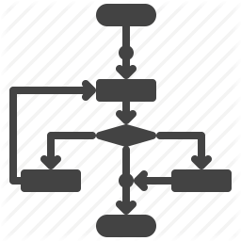



Stage 06
Stage 01
Results and Recommendations
Kick-off Meetings
Methodology
Stage 05
Stage 02
Tools Application
System Understanding
Stage 04
Stage 03
Data Analysis
Observation & Data Collection

Slide 10
Stage 01:
Kick-off Meetings
Held with Prof. Saleem Haj Yahya to gain approval
Methodology

Slide 11
Stage 02:
System Understanding
- Hospital Departments
- Administrative
- Financial Processes
- Medical Department
- HIS System
Methodology

Slide 12
Stage 03:
Observation & Data Collection
Interviews
Tracking
Stopwatches
IT Department
Archiving Department
Methodology

Slide 13
Stage 04:
Data Analysis
- Problems Identification
- Finding rooms for improvements
Methodology

Slide 14
Stage 05:
Tools Application
Process Flow Charts
Value Stream Mapping
Integer Programming Model for OR Scheduling
Communications Circles
A3 Reports
Fishbone Diagram
SOP’s
CRAFT Layout Improvement
Methodology

Slide 15
Stage 06:
Results and Recommendations
Results gained from applying each of the previous tools
Methodology

Slide 16
PFC
Optimizing Patient Flow
VSM
Operating Rooms
Laboratory
JCI Accreditation
CC
A3 Reports
Defining Entries
Processes Tracking
Emergency department entrance
Outpatient clinics entrances
Transferred patients’ entrances
Scope
Tracking Patients, proccesses, documents
Tracking
Building
Finalizing
Scenario Analysis
Reviewing with the crew
Tools Application
Validation & Verification
Using quality and lean tools

Slide 17
PFC
Optimizing Patient Flow
VSM
Operating Rooms
Laboratory
JCI Accreditation
Emergency Department
(Current)
CC
A3 Reports

Slide 18
PFC
Optimizing Patient Flow
VSM
Operating Rooms
Laboratory
JCI Accreditation
Outpatient Clinics
(Current)
CC
A3 Reports

Slide 19
PFC
Optimizing Patient Flow
VSM
Operating Rooms
Laboratory
JCI Accreditation
ED VSM
(Current)
CC
Process | Process Description | VA | NVA
Pricing and Agreements | Give basic price and wait for patient agreement | 8 | 2
Coordination with B.M | Calling BM and wait his reply to know where to send the patient | 20 | 30
Payment | Payment process; waiting his turn | 4 | 1
File creation | Take patient's info & add them to the system & print file & print stickers | 15 | 3
Coordination with receiving department and ED | Make phone calls with receiving dept. & ED to send patient to targeted dept. | 3 | 1
Sending patient to department | Sending patient to the decided department | 15 | 5
TOTAL |  | 66 | 42
A3 Reports
Example

Slide 20
PFC
Optimizing Patient Flow
VSM
Operating Rooms
Laboratory
JCI Accreditation
ED VSM
(Improved)
CC
A3 Reports
Improvements
NVA time Percentage | 52.3%

Slide 21
PFC
Optimizing Patient Flow
VSM
Operating Rooms
Laboratory
JCI Accreditation
OPC VSM
(Current)
CC
A3 Reports
Process | Process Description | VA | NVA
Pricing and Agreements | Give basic price and wait for patient agreement | 8 | 1
Coordination with B.M | Calling BM and wait his reply to know where to send the patient | 15 | 40
Payment | Payment process; waiting his turn | 4 | 1
File creation | Take patient's info & add them to the system & print file & print stickers | 13 | 2
Coordination | Make phone calls with receiving dept. & ED to send patient to targeted dept. | 4 | 1
Sending patient to department | Sending patient to the decided department | 5 | 5
TOTAL |  | 49 | 50
Example

Slide 22
PFC
Optimizing Patient Flow
VSM
Operating Rooms
Laboratory
JCI Accreditation
OPC VSM
(Improved)
CC
A3 Reports
Improvements
NVA time Percentage | 46.7%

Slide 23
PFC
Optimizing Patient Flow
VSM
Operating Rooms
Laboratory
JCI Accreditation
ED
Communications Circle
CC
A3 Reports
Current ED Communications Circle
Current ED From-To Table
Number of steps = 15
From | To | Description
Patient | ED nurse | To get treated
Companion | ED cashier | To pay
Companion | ED nurse | To give receipt
Resident Doctor | Patient | To checkup
Companion | Lab | To give requested lab tests note & pay
Companion | ED nurse | To give receipt
ED nurse | Patient | To take sample
Transporter | ED nurse | To take sample to lab
Transporter | Lab | To give sample
Companion | Lab | To get results
Companion | ED nurse | To give results
Resident Doctor | ED nurse | Evaluates results
Specialist | Patient | Coordination
Companion | Admission and finance | Pricing and agreement and paying
Patient | Department | For treatment
Number of steps = 9
To-Be ED Communications Circle
Future ED From-To Table
From | To | Description
Patient | ED nurse | To get treated
Companion | ED cashier | To pay
Resident doctor | Patient | To checkup
Companion | ED cashier | To pay
ED nurse | Patient | To take sample
Specialist | Patient | Coordination
Companion | Admission & Finance | Pricing, agreement and paying
Patient | Department | For treatment

Slide 24
PFC
Optimizing Patient Flow
VSM
Operating Rooms
Laboratory
JCI Accreditation
OPC
Communications Circle
CC
A3 Reports
Current OPC Communications Circle
Number of steps = 8
Current OPC From-To Table
From | To | Description
Patient | OPC Cashier | Take appointment, give info. and pay
OPC Cashier | OPC seats | Wait
OPC seats | Specialist’s clinic | Checkup
Specialist’s clinic | Lab | Give test request, pay, take receipt and lab takes sample
Lab | Lab seats | Wait for results
Lab seats | Specialist | Show results & coordination
Specialist | Finance & Admission | Pricing, agreement and payment
Finance & Admission | Department | Treatment
Number of steps =7
To-Be OPC Communications Circle
Future OPC From-To Table
From | To | Description
Patient | ED nurse | To get treated
Companion | ED cashier | To pay
Resident doctor | Patient | To checkup
Companion | ED cashier | To pay
ED nurse | Patient | To take sample
Specialist | Patient | Coordination
Companion | Admission & Finance | Pricing, agreement and paying
Patient | Department | For treatment

Slide 25
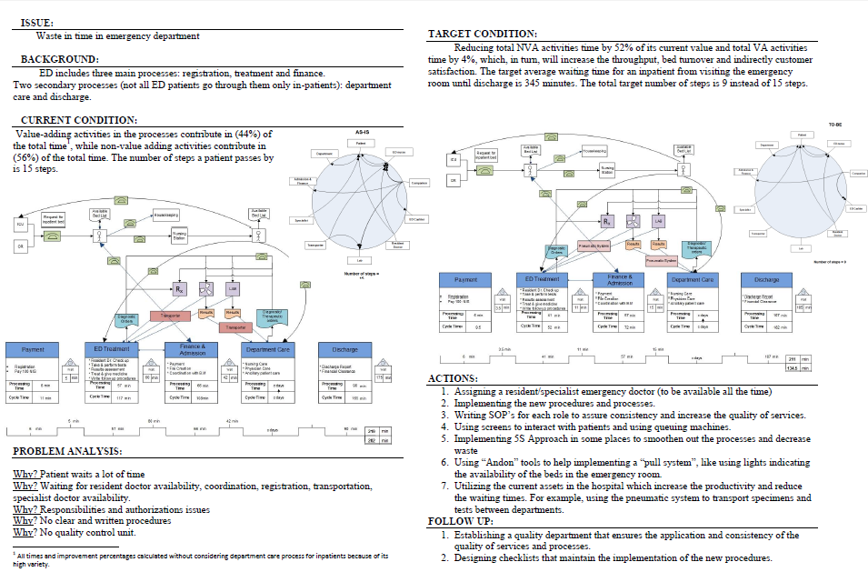
PFC
Optimizing Patient Flow
VSM
Operating Rooms
Laboratory
JCI Accreditation
CC
ED A3 Report
A3 Reports

Slide 26
PFC
Optimizing Patient Flow
VSM
Operating Rooms
Laboratory
JCI Accreditation
Emergency Department
(Improved)
CC
A3 Reports

Slide 27
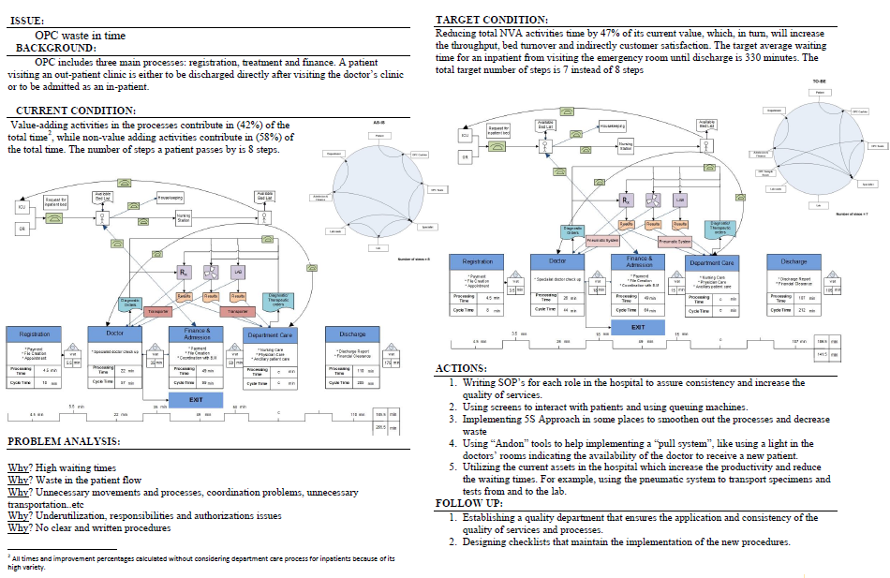
PFC
Optimizing Patient Flow
VSM
Operating Rooms
Laboratory
JCI Accreditation
OPC
A3 Report
CC
A3 Reports

Slide 28
PFC
Optimizing Patient Flow
VSM
Operating Rooms
Laboratory
JCI Accreditation
Outpatient Clinics
(Improved)
CC
A3 Reports

Slide 29
Ishikawa
Optimizing Patient Flow
Operating Rooms
SOP’s
Laboratory
JCI Accreditation
OR Model

Slide 30
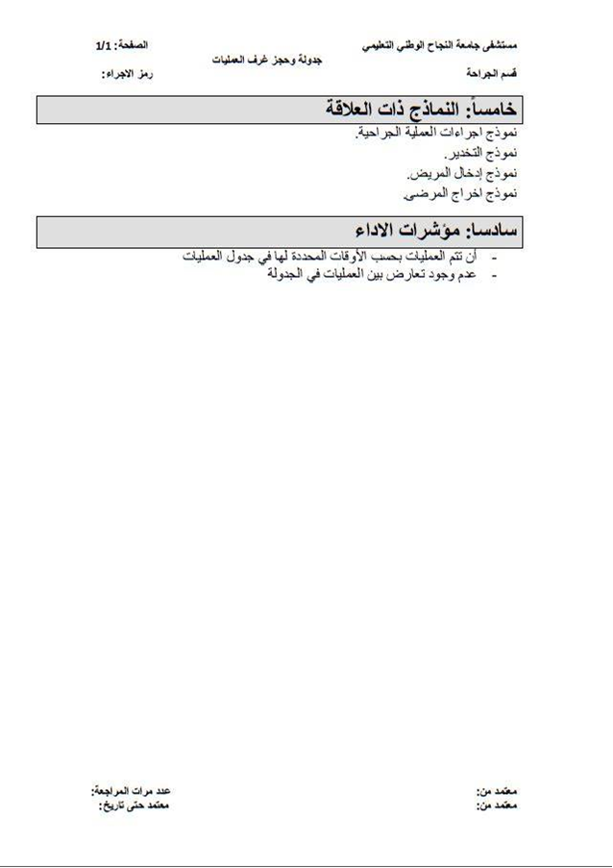
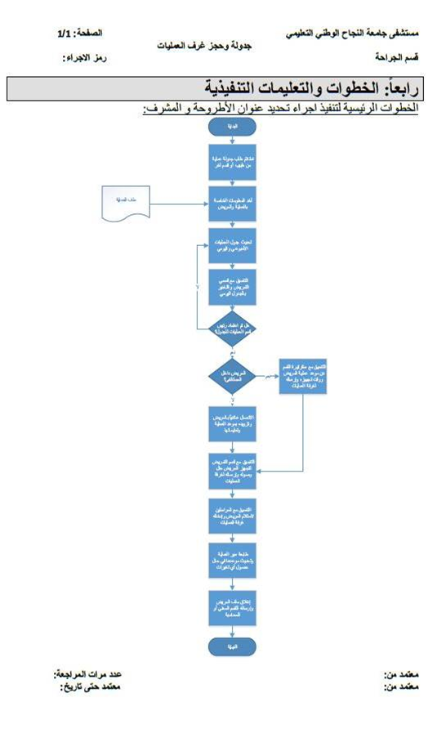
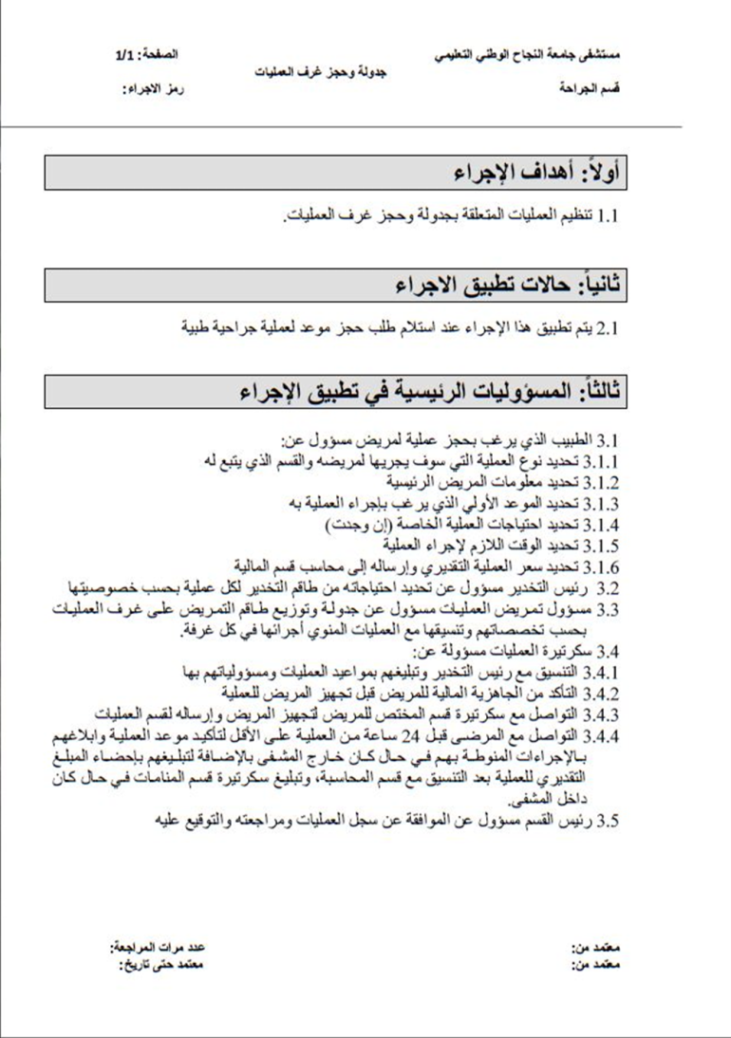
Ishikawa
Optimizing Patient Flow
Operating Rooms
SOP’s
Laboratory
JCI Accreditation
Scheduling Operations SOP
OR Model
Page 3
Page 2
Page 1

Slide 31

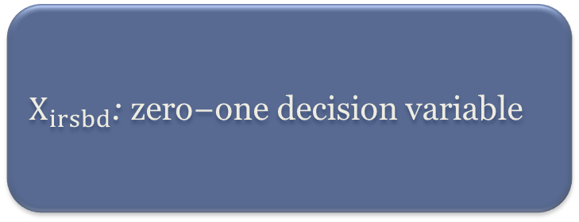

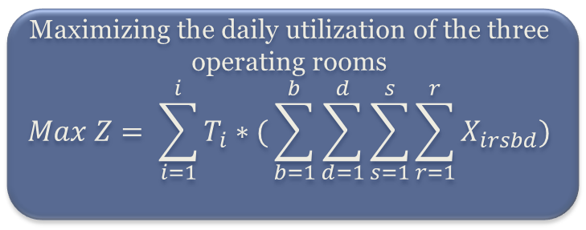


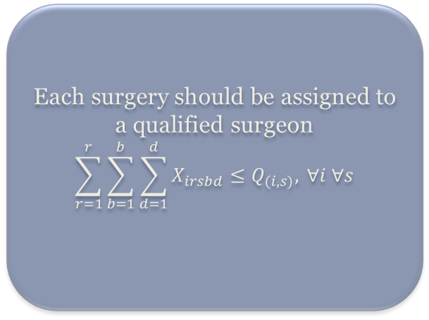
Ishikawa
Optimizing Patient Flow
Operating Rooms
SOP’s
Laboratory
JCI Accreditation
OR Model
$$Decision Variables$$
$$Sets$$
Cases ( i )
Surgeons ( s )
Operation Room ( r )
Days ( d )
Time Block ( b )
Duration d( i )
Qualification Q( s )=0,1
$X_{irsbd}$:$\text{zero}\text{−}\text{one} \text{decision} \text{variable}$
  OR
  Scheduling
  Model
  Each surgery should be assigned to a qualified surgeon
$$\sum_{r=1}^{r}{\sum_{b=1}^{b}{\sum_{d=1}^{d}{X_{irsbd}}≤Q_{(i,s)}, }∀i ∀s}$$
$$Constraints (ex.)$$
$$Objective Function$$
Maximizing the daily utilization of the three operating rooms
$$Max Z= \sum_{i=1}^{i}{T_{i}∗(}\sum_{b=1}^{b}{\sum_{d=1}^{d}{\sum_{s=1}^{s}{\sum_{r=1}^{r}{X_{irsbd}}}}})$$

Slide 32
Ishikawa
Optimizing Patient Flow
Operating Rooms
SOP’s
Laboratory
JCI Accreditation
OR Model
Parameters
#Parameters_Definitions
param duration[cases]:=<"Lithotripsy"> 3,<"Varicocelectomy"> 1,<"Tonsillectomy"> 3,<"SMR"> 3,<"Hypospaclius"> 3,<"Vephrectomy"> 5,<"Porta Cath"> 2,<"Shunt Revision"> 3,<"Minor Amputation"> 3,<"Nancy Nail">7,<"PNS">3,<"Cornea implant">3,<"White water">2;
param q[qualification]:=<"Lithotripsy","Mahmoud Matar">1,<"Varicocelectomy","Mahmoud Matar">1,<"Tonsillectomy","Mazen Kazlak">1,<"SMR","Mazen Kazlak">1,<"Hypospaclius","Kamal Abed">1,<"Vephrectomy","Kamal Abed">1,<"Porta Cath","Yaser Abu Yousef">1,<"Shunt Revision","Rajab Eid">1,<"Minor Amputation","Khalil Issa">1,<"Nancy Nail","Alaa Azmi">1,<"PNS","Abdulkarim Barqawi">1,<"Cornea implant","Mohammad Shehada">1,<"White water","Mohammad Akkawi">1 default 0;
#Objective_Function
maximize utilization: sum <i> in cases: duration[i]*(sum <i,r,s,b> in link: x[i,r,s,b]);
#Constraints
subto con2A:
forall <r> in operating_rooms do
forall <b> in blocks do
sum <i,s> in con2: y[i,r,s,b]<=1;
#Data_Entry_Sets:
set cases:= {"Lithotripsy","Varicocelectomy","Tonsillectomy","SMR","Hypospaclius","Vephrectomy","Porta Cath","Shunt Revision","Minor Amputation","Nancy Nail","PNS","Cornea implant","White water"};
set operating_rooms:={1..3};
set surgeons:={"Abdulkarim Barqawi","Alaa Azmi","Kamal Abed","Khalil Issa","Mahmoud Matar","Mazen Kazlak","Mohammad Akkawi","Mohammad Shehada","Rajab Eid","Yaser Abu Yousef"};
set blocks:={1..16};
#Linkink_Sets:
set qualification:=cases*surgeons;
set link:=cases*operating_rooms*surgeons*blocks;
#Variables_Definition
var x[link] binary;
var y[link] binary;
Sets
Sample of ZIMPL Code
Objective Fcn
Constraints
Variables

Slide 33
Ishikawa
Optimizing Patient Flow
Operating Rooms
SOP’s
Laboratory
JCI Accreditation
Optimal Daily Schedule
OR Model
* Average utilization increased by approx. 30%
DAY 1 | 8:00 | 8:30 | 9:00 | 9:30 |  | 10:00 |  | 10:30 | 11:00 | 11:30 | 12:00 | 12:30 | 13:00 | 13:30 | 14:00 | 14:30 | 15:00 | 15:30 | Utilization:
Room1 | Var. / Dr. MM | PortaCath / Dr. YAY |  |  | White Water / Dr. MAK |  |  | SMR / Dr. MK |  |  | Cornea Implant / Dr.MSh |  |  | Vephrectomy / Dr. KA |  |  |  |  | 100%
Room2 | Tonsillectomy / Dr.MK |  |  |  |  |  | Shunt Revision / Dr.RE |  |  |  | Lithotripsy / Dr. MM |  |  |  | Minor Amputation / Dr. KI |  |  |  | 75%
Room3 | Hypospaclius / Dr. KA |  |  |  |  |  | PNS / Dr. AB |  |  |  | Nancy Nail / Dr. AA |  |  |  |  |  |  |  | 81%
 |  |  |  |  |  |  |  |  |  |  |  |  |  |  |  |  |  |  | 85.30%
DAY 2 | 8:00 | 8:30 | 9:00 |  | 9:30 |  | 10:00 | 10:30 | 11:00 | 11:30 | 12:00 | 12:30 | 13:00 | 13:30 | 14:00 | 14:30 | 15:00 | 15:30 | Utilization:
Room 1 | Temp.Cath./Dr. YAY |  | Emptying eyeball/ Dr. YSh |  |  |  |  |  | Laser Lithptrispy/ Dr. MM |  |  |  |  | FESS/ Dr. MK |  |  |  |  | 75%
Room 2 | TAL/ Dr.AA |  |  |  | Total Colectimy/ Dr. KhD |  |  |  |  |  |  |  | Nephrectomy/ Dr. MM |  |  |  |  |  | 100%
Room 3 | THR/Dr.MA |  |  |  |  |  |  | Vascular Graft/ Dr.RE |  |  |  |  |  |  |  |  |  |  | 75%
 |  |  |  |  |  |  |  |  |  |  |  |  |  |  |  |  |  |  | 83.30%
DAY2+EMERGENCY | 8:00 | 8:30 | 9:00 |  | 9:30 |  | 10:00 | 10:30 | 11:00 | 11:30 | 12:00 | 12:30 | 13:00 | 13:30 | 14:00 | 14:30 | 15:00 | 15:30 | Utilization:
Room 1 | Emptying eyeball/ Dr. YSh |  |  |  | Nephrectomy/ Dr. MM |  |  |  |  |  |  | Total Colectimy/ Dr. KhD |  |  |  |  |  |  | 100%
Room 2 | Temp.Cath./Dr. YAY | TAL/ Dr. AA |  |  |  |  | FESS/ Dr. MK |  |  |  |  | THR/Dr.MA |  |  |  | Laser Lithptrispy/ Dr. MM |  |  | 100%
Room 3 | Vascular Graft/ Dr.RE |  |  |  |  |  |  |  |  |  |  | Scoliosis/ Dr.AA |  |  |  |  |  |  | 87.50%
 |  |  |  |  |  |  |  |  |  |  |  |  |  |  |  |  |  |  | 95.80%

Slide 34

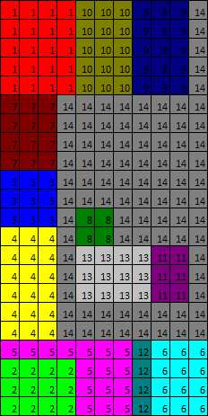
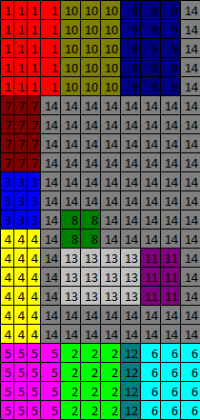
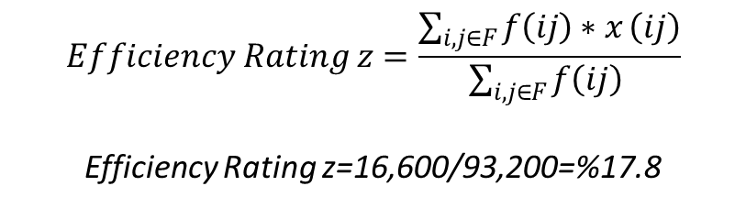
Methodology
Optimizing Patient Flow
Operating Rooms
Laboratory
Results
JCI Accreditation
Current Layout Evaluation
Applying the adjacency based evaluation method
Defining Relationship Matrix and Chart
Developing Adjacency table
Developing numerical matrix based on specific criteria.
Calculating Efficiency
Layout
Scope
Departments definition.
Analyzing no. of tests.
Developing Pareto Chart.
Pre Evaluation
Excel CRAFT Add-in
Layout Improving
Entering the current layout
Solving for improvements
Finalizing
Adjusting the proposed layout
Calculating efficiency
Post Evaluation
$$Efficiency Rating z=\frac{\sum_{i,j∈F}{f\left(ij\right)∗x}\left(ij\right)}{\sum_{i,j∈F}{f\left(ij\right) }}$$
Efficiency Rating z=16,600/93,200=%17.8
Efficiency Rating: Z = 21.03 %
Efficiency Increase = 3.23%

Slide 35
Implementation Plan
Optimizing Patient Flow
Operating Rooms
Laboratory
JCI Accreditation
Check-lists
Phase |  | Activity | Time Frame (months)
 |  |  | 1 | 2 | 3 | 4 | 5 | 6 | 7 | 8 | 9 | 10 | 11 | 12 | 13 | 14 | 15 | 16 | 17 | 18 | 19 | 20 | 21 | 22 | 23 | 24
1 | JCI Standards Understanding | Build a team
 |  | Policies and Procedures
 |  | JCI Manual and Survey Process Guide
 |  | Leadership Commitment
 |  | Sharing information with the crew
2 | Gap Analysis | Baseline assessment
 |  | Building an accreditation action plan
3 | Policies and procedures updating | ARPs checklists
 |  | Developing SOP's
4 | System Improvement | International Patient Safety Goals (IPSG) solutions assessment
 |  | Develop risks mitigation plans
5 | Staff training and engagement | Building the culture of safety
 |  | Training staff in new procedures
6 | Self-Assessment | Mock survey simulation
 |  | Conducting patient tracers
7 | Continuous Training | Staff motivation and procedures improvement
 |  | Issues resolution
8 | Process Evaluation | Brainstorming & staff engagement
 |  | Processes and systems evaluation
9 | Readiness Assessment | Final Mock Surveys
 |  | Spotting necessary improvements
 |  | Correction plans
10 | Final Modifications and preparation | E-App submission
 |  | JCI Survey completing

Slide 36
Implementation Plan
Optimizing Patient Flow
Operating Rooms
Laboratory
JCI Accreditation
Check-lists
Sample Checklist-
Anesthesia and Surgical Care
N.A- Not Applicable
N.T- Not Tested
Standard | Check | Checkpoint | Y | N | N.A | N.T
5 | 1 | The anesthesia care of each patient is planned and documented in the patient’s record
 | 2 | The anesthesia agent, dose (when applicable), and anesthetic technique are documented in the patient’s anesthesia record.
 | 3 | The anesthesiologist and/ or nurse anesthetist and anesthesia assistants are identified in the patient’s anesthesia record.
5.1 | 1 | The patient, family, and/or decision makers are educated on the risks, benefits, and alternatives of anesthesia.
 | 2 | The patient, family, and/ or decision makers are educated about postoperative analgesia.
 | 3 | The anesthesiologist or another qualified individual provides and documents the education.
5.2 | 1 | The frequency and type of monitoring during anesthesia and surgery are based on the patient’s Pre-anesthesia status, the anesthesia used, and the surgical procedure performed.
 | 2 | There’s a consistent monitoring of the patient’s physiological status with professional practice
 | 3 | There’s a patient record and the results are documented in it

Slide 37

Recommendations
Implementing the proposed: flowcharts, layout, OR schedule
Developing SOPs
Decentralized payments
Fundamentals
Establishing a quality unit
Seeking for certificates (JCI)
Quality
Setting up direction signs
Implementing 5S
Waste disposal
Improving warehouse (Planning)
Projects
Notes:
Quality: mesuring quality
Increasing the role of technology
*** Important:
1. Activating marketing
3. Computerized integration with Health ministry

Slide 38
Recommendations
Investing in the Uni. Students
Building the capacity of employees
IDs and dress-code
International internship program
People
Fully utilizing pneumatic system
Outsourcing of facilities
Enhancements: green, spiritual, chairs
Facility
Emergency response training
Critical situation Management
Establishing a triage system for ED
Emergency
Miscellaneous
Enhancing scientific research
Activating marketing
Computerized integration with the ministry of health

Slide 39
Thank You!

