Slide 1

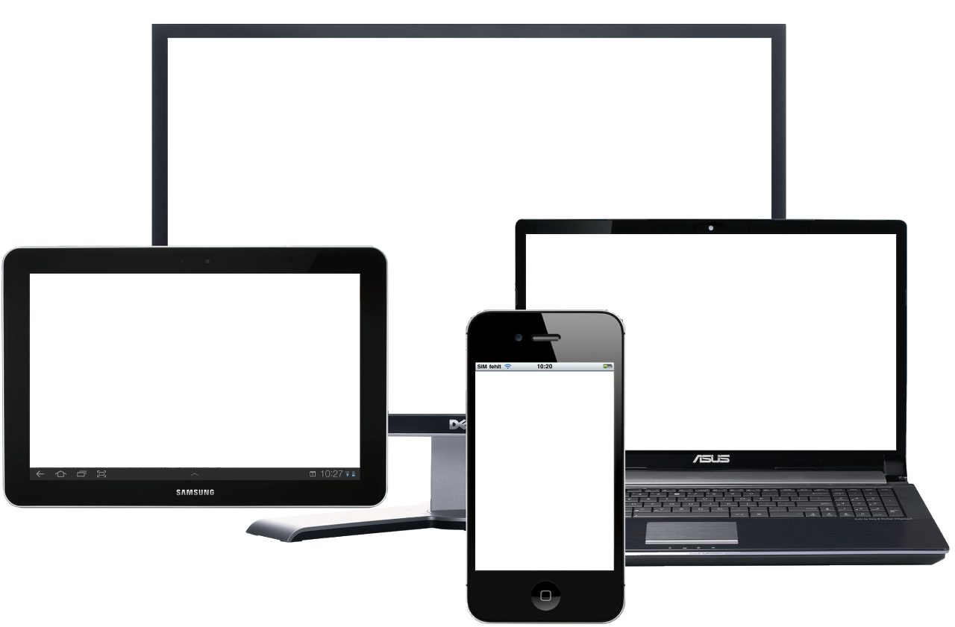
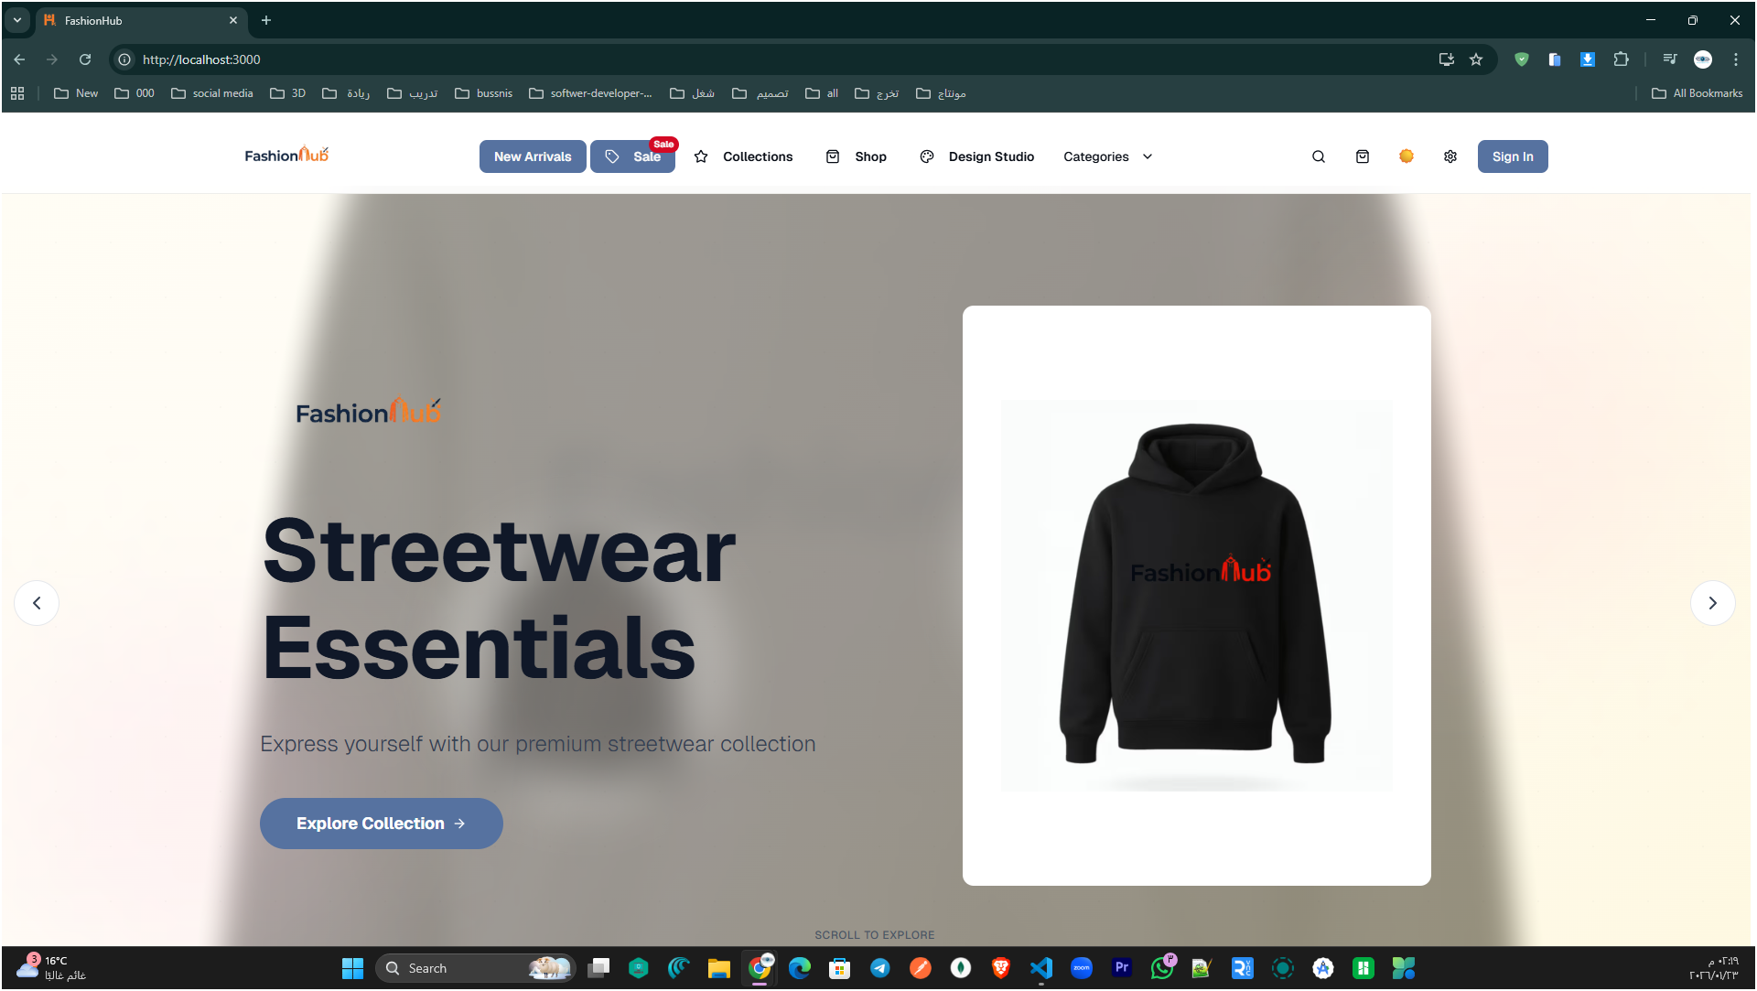
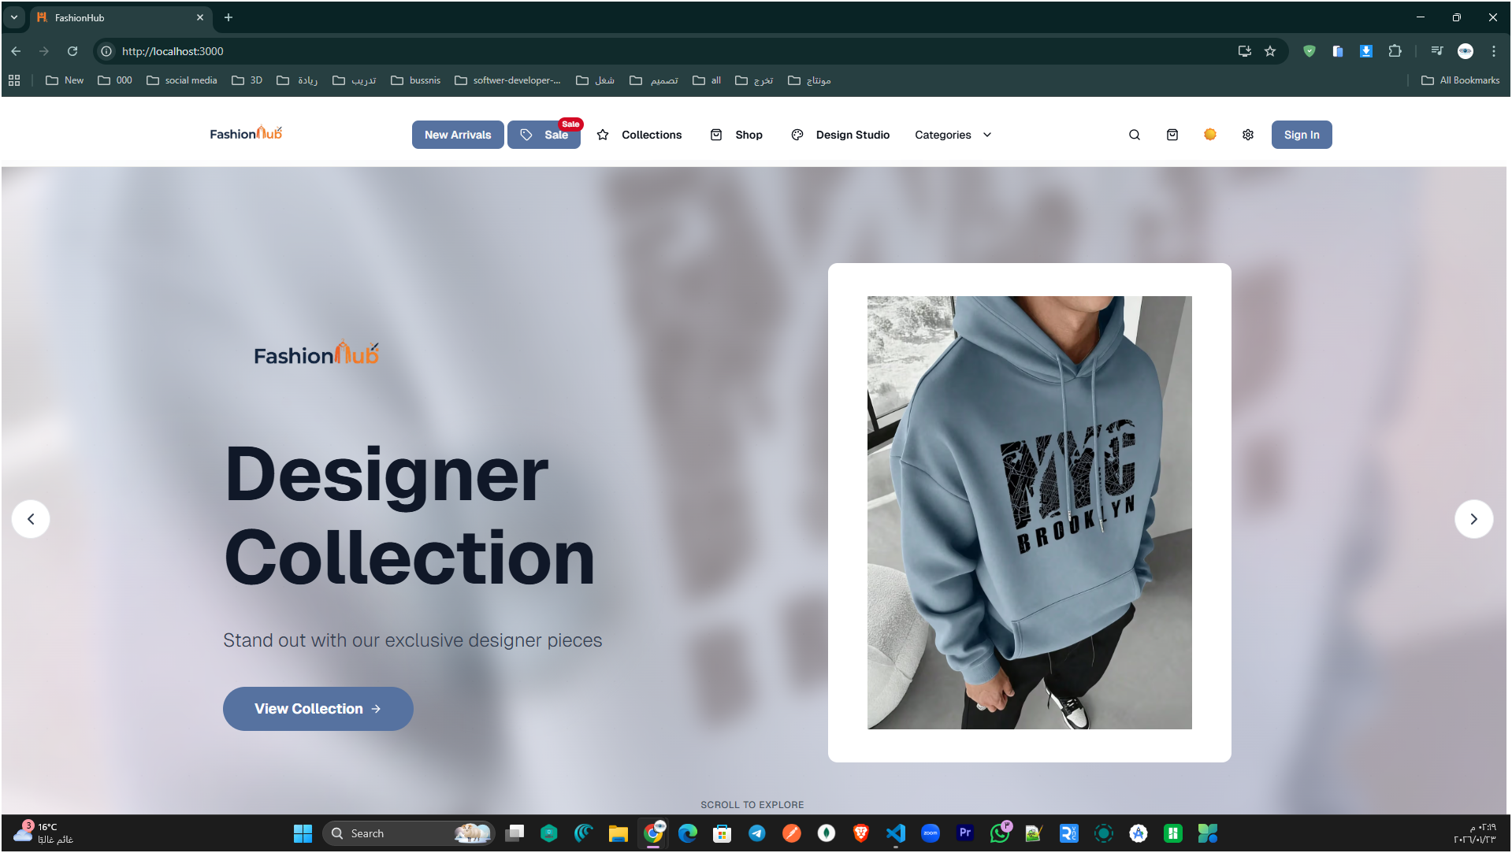
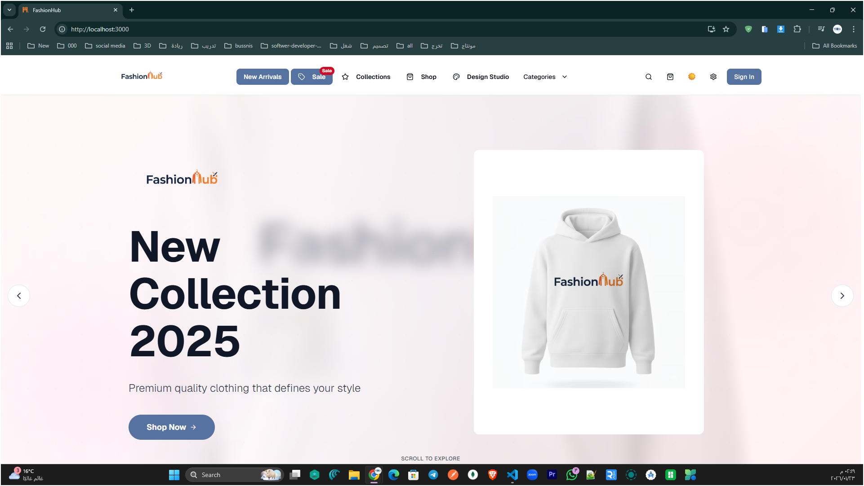
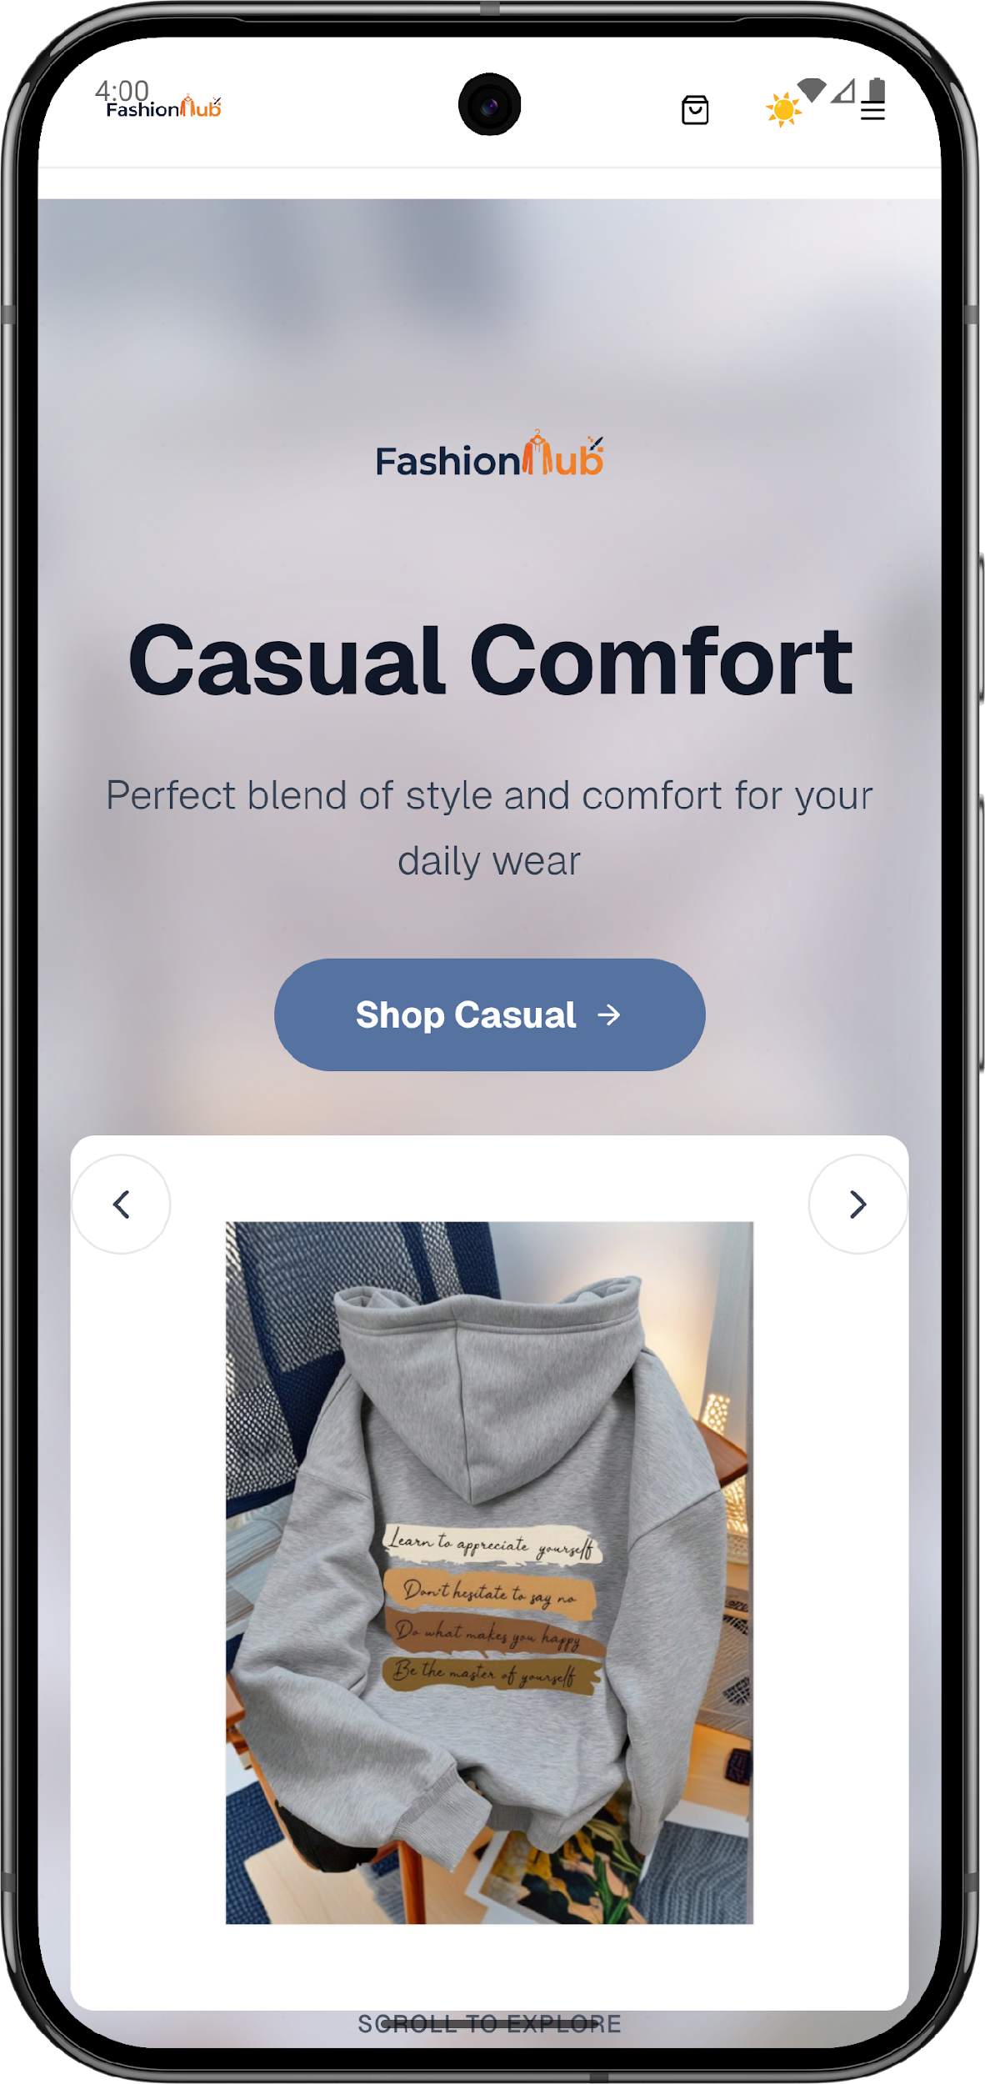
A modern fashion e-commerce platform
PRESENTED BY
Ahmad Hussain & Oday Yamak
SUPERVISED
Dr. Ola Mardawi
Fashion Hub
Notes:
[Sources]
- Project source code (user-provided ZIP).

Slide 2
Table of Content
Project overview
Key features(Website & Application)
Architecture and data flow
Technology stack
Security highlights
Results & future work
Fashion Hub — Presentation
Notes:
[Sources]
- Project source code (user-provided ZIP).

Slide 3
Project Overview
Fashion Hub is a full-stack fashion e-commerce platform that combines:
• A complete shopping flow (products → cart → checkout → orders)• A design Studio to customize apparel and save designs• A camera-based Virtual Try-On experience• Multi-role dashboards (admin / employee / customer ) and real-time staff chat
Goal: deliver a modern shopping experience with personalization + better product visualization.
Fashion Hub — Overview
Notes:
[Sources]
- Project source code (user-provided ZIP).

Slide 4
Key Features (Website & Application)
Shopping & Orders
Studio (Design)
Virtual Try-On
Product catalog
Cart & checkout
Order tracking
Text & image overlays
Save designs
Export / add to cart
Camera-based preview
Works in browser
Guided permissions
Accounts
Dashboards
Real-time
Email sign up / sign in
Forgot/reset password
Google sign-in
Admin / employee panels
Reports & settings
Staff chat (Socket.IO)
Instant updates
Better coordination
Fashion Hub — Features
Notes:
[Sources]
- Project source code (user-provided ZIP).

Slide 5

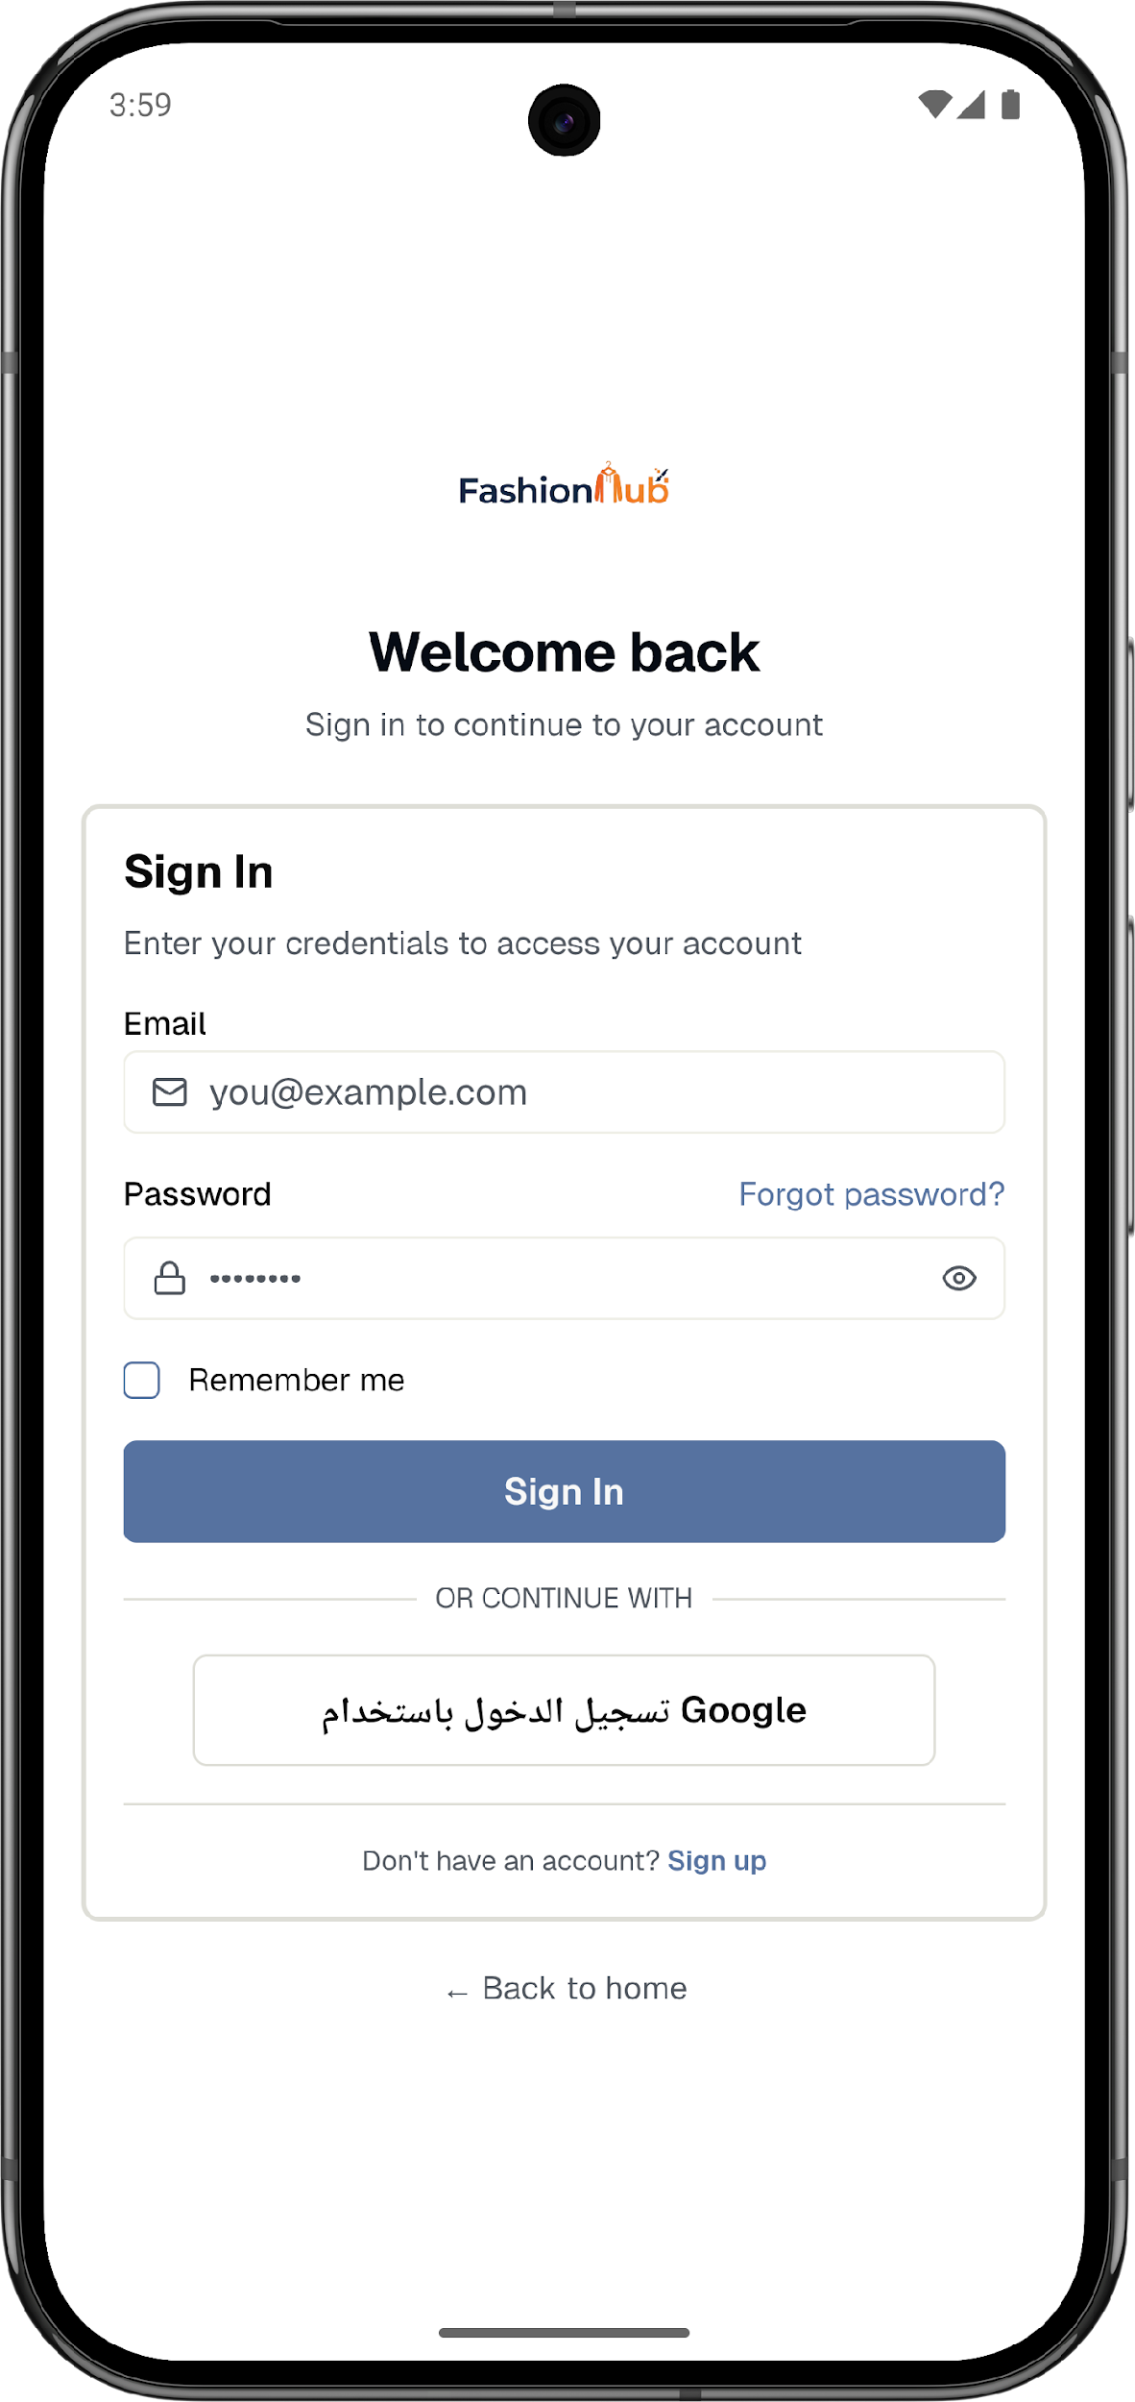
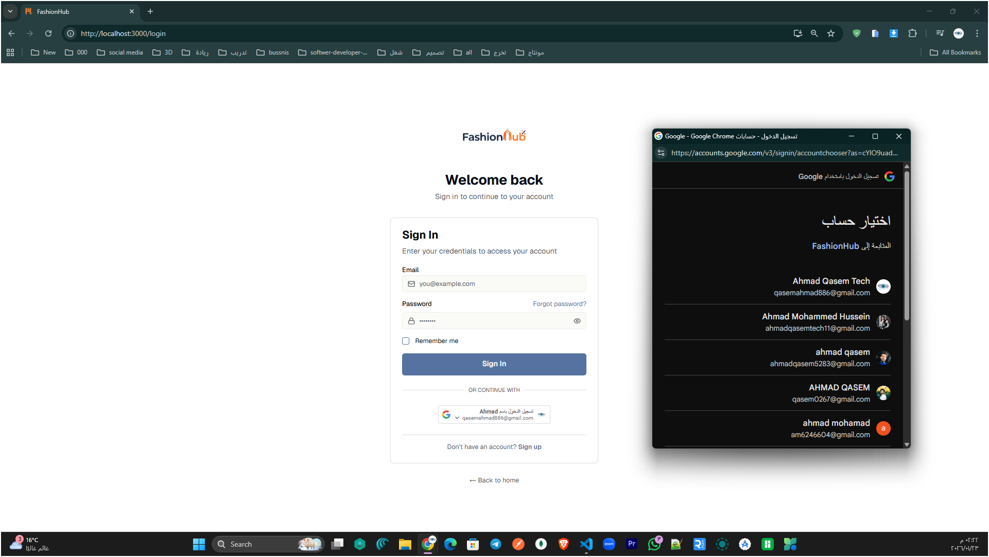
User Sign in (Email & Google)
Fashion Hub
Notes:
[Sources]
- Project source code (user-provided ZIP).

Slide 6
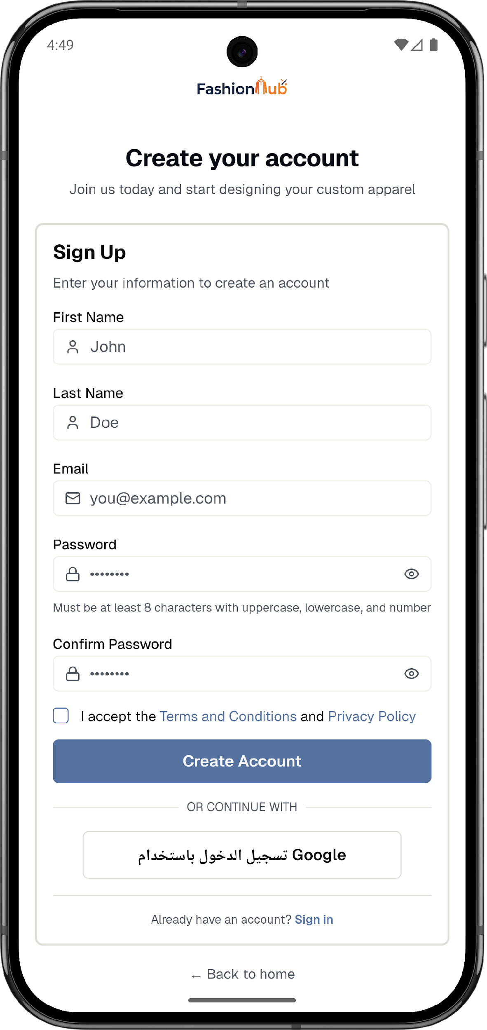
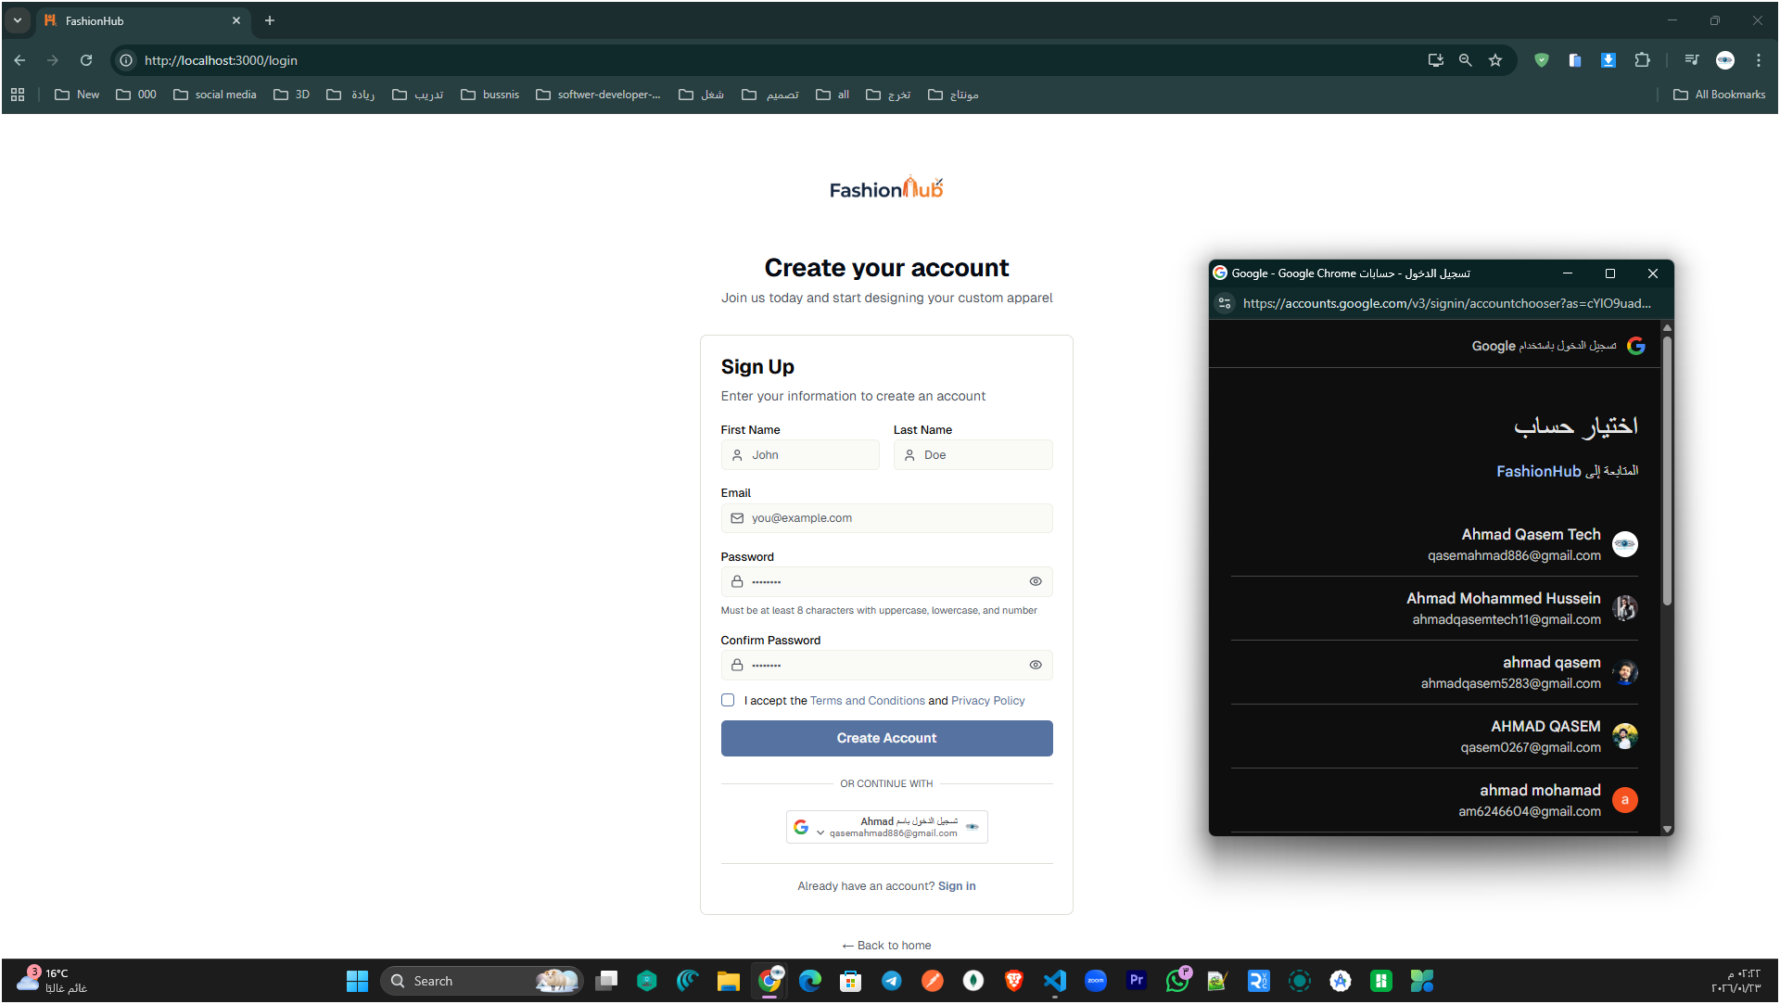
User Sign up (Email & Google)
Fashion Hub
Notes:
[Sources]
- Project source code (user-provided ZIP).

Slide 7
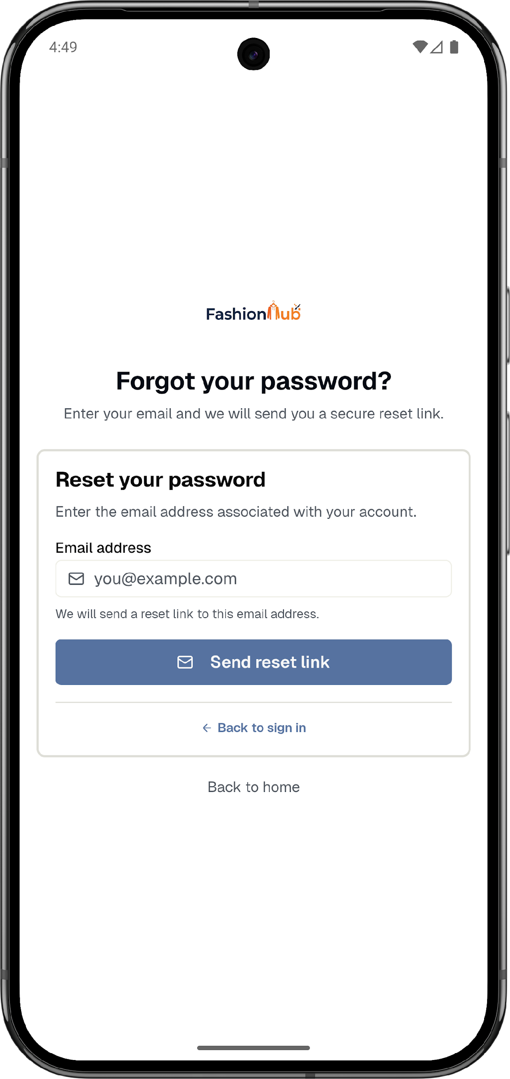
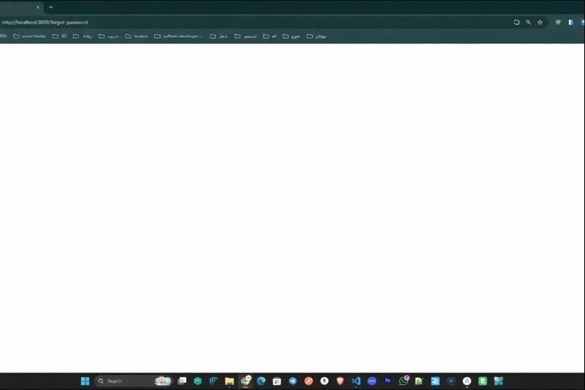
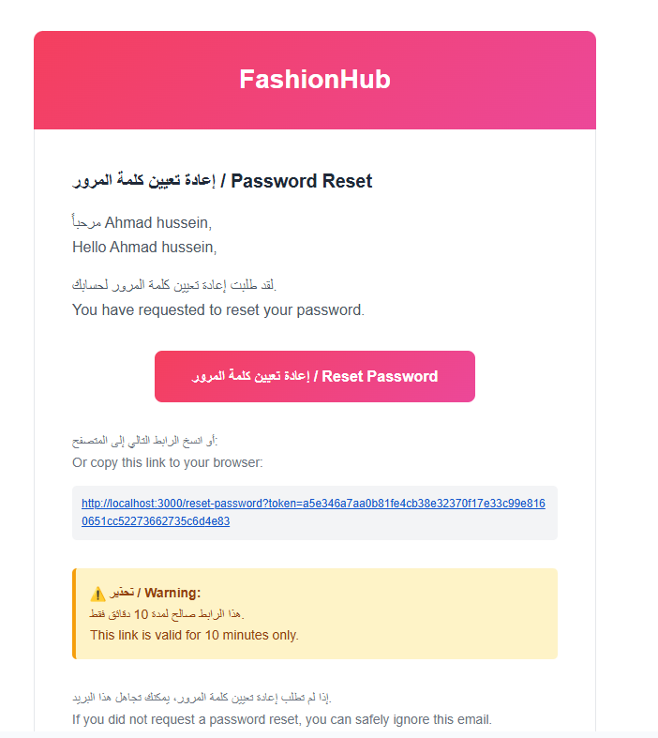
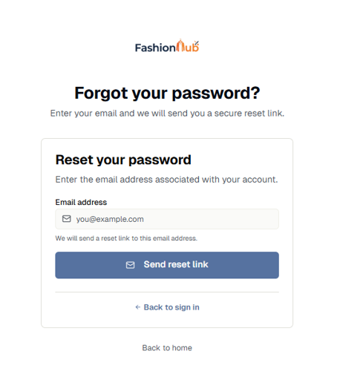
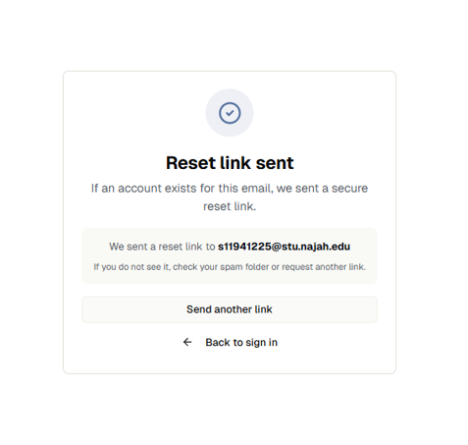
Forgot/Reset Password
Fashion Hub
Notes:
[Sources]
- Project source code (user-provided ZIP).

Slide 8
Visitors & Customers Side
Visitors (Guests): can browse products and view details without logging in.
Customers (Logged-in): get full access to features like shopping/checkout, order tracking, favorites, and saving Studio designs.
Fashion Hub
Notes:
[Sources]
- Project source code (user-provided ZIP).

Slide 9
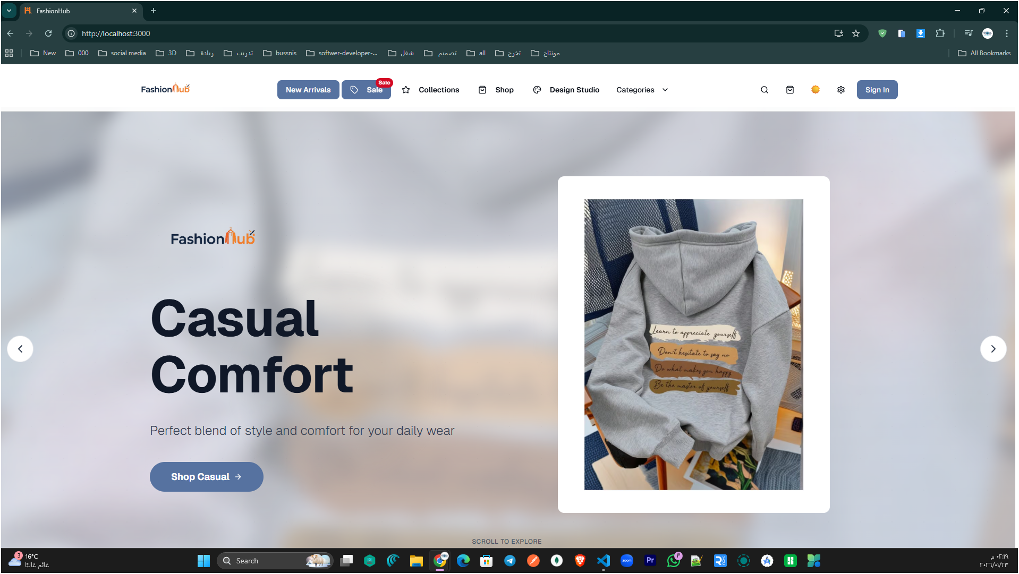
Landing/Home Page
Fashion Hub
Notes:
[Sources]
- Project source code (user-provided ZIP).

Slide 10
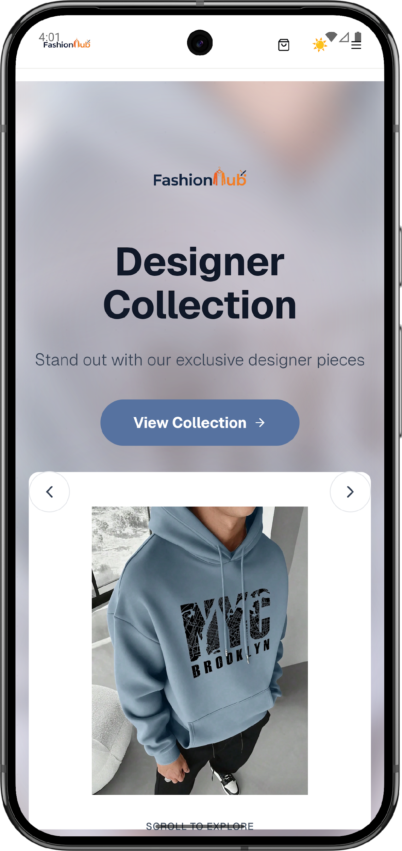
Landing/Home Page
Fashion Hub
Notes:
[Sources]
- Project source code (user-provided ZIP).

Slide 11
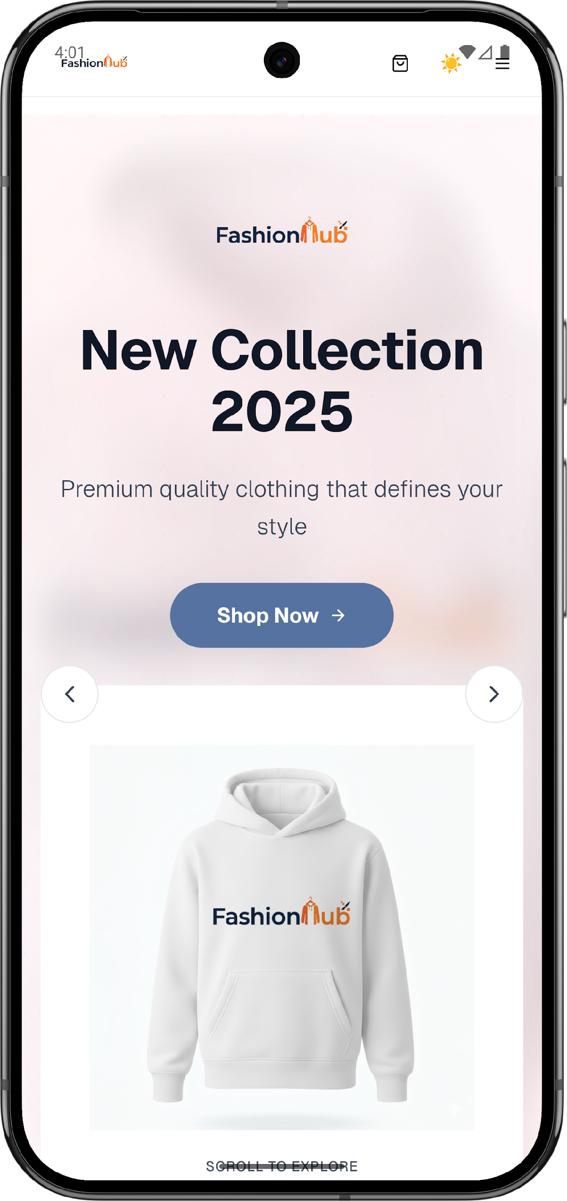
Landing/Home Page
Fashion Hub
Notes:
[Sources]
- Project source code (user-provided ZIP).

Slide 12
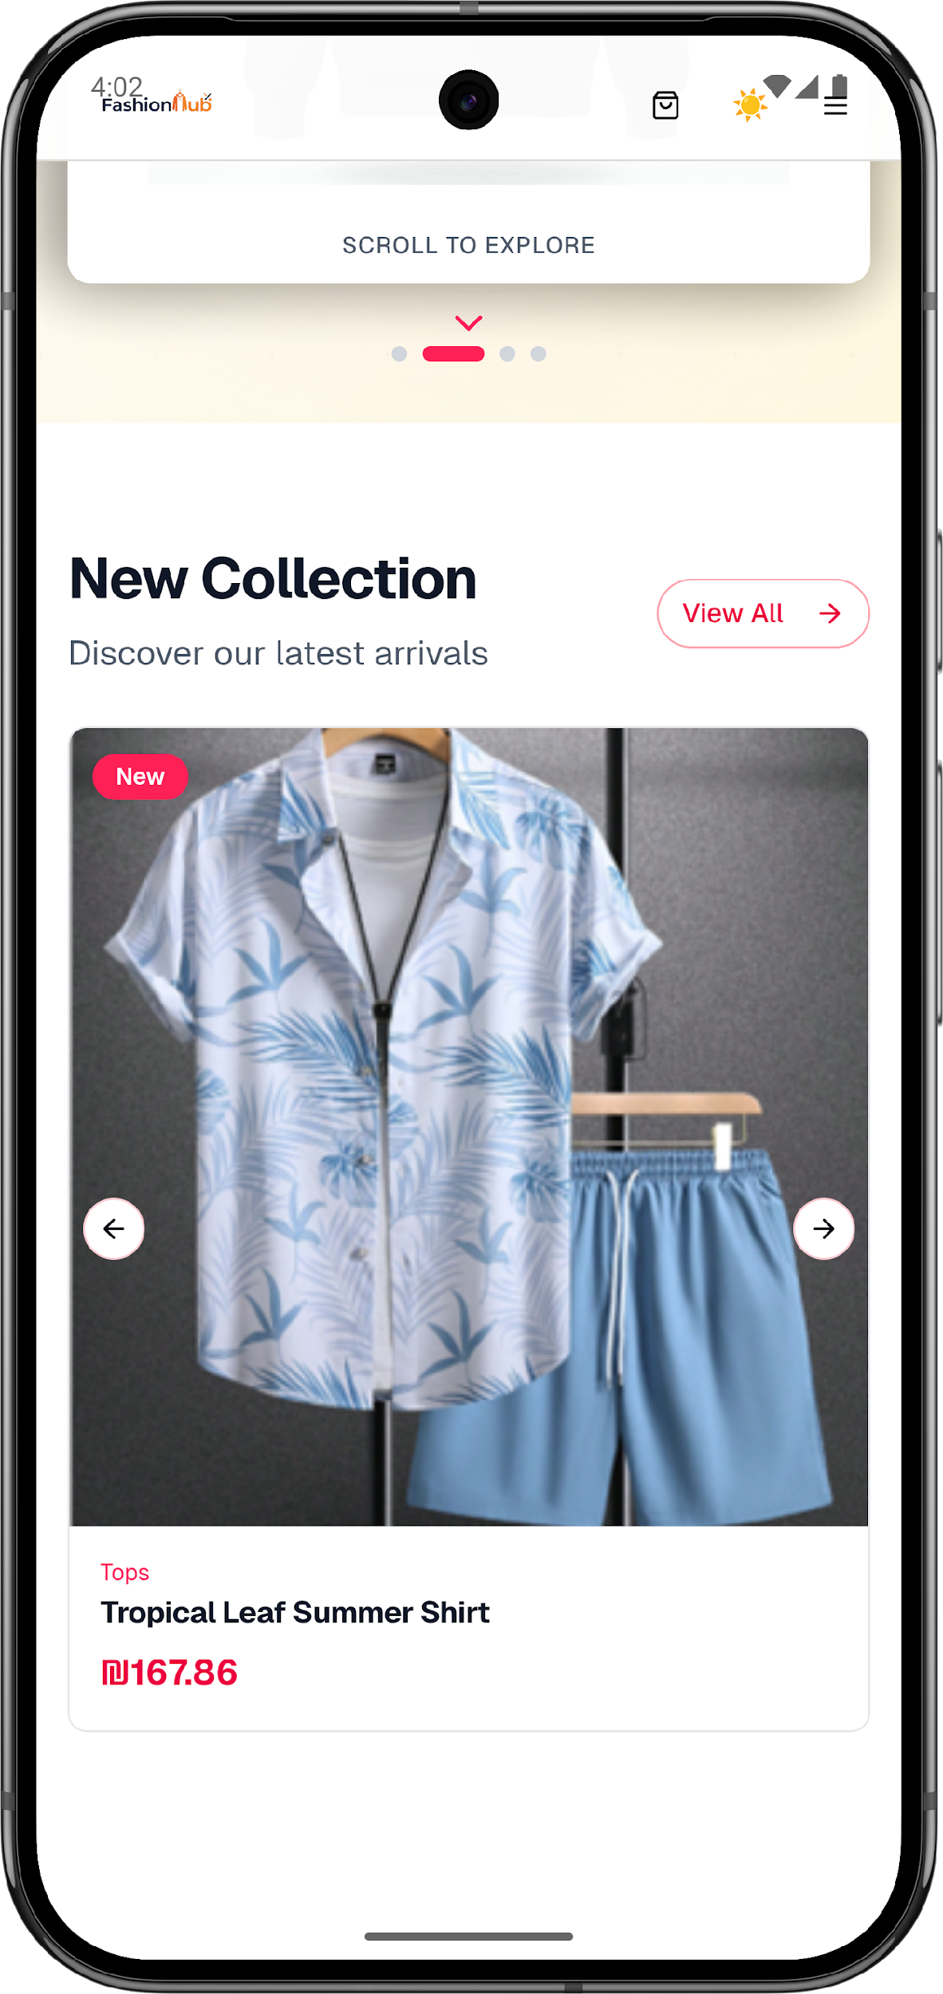
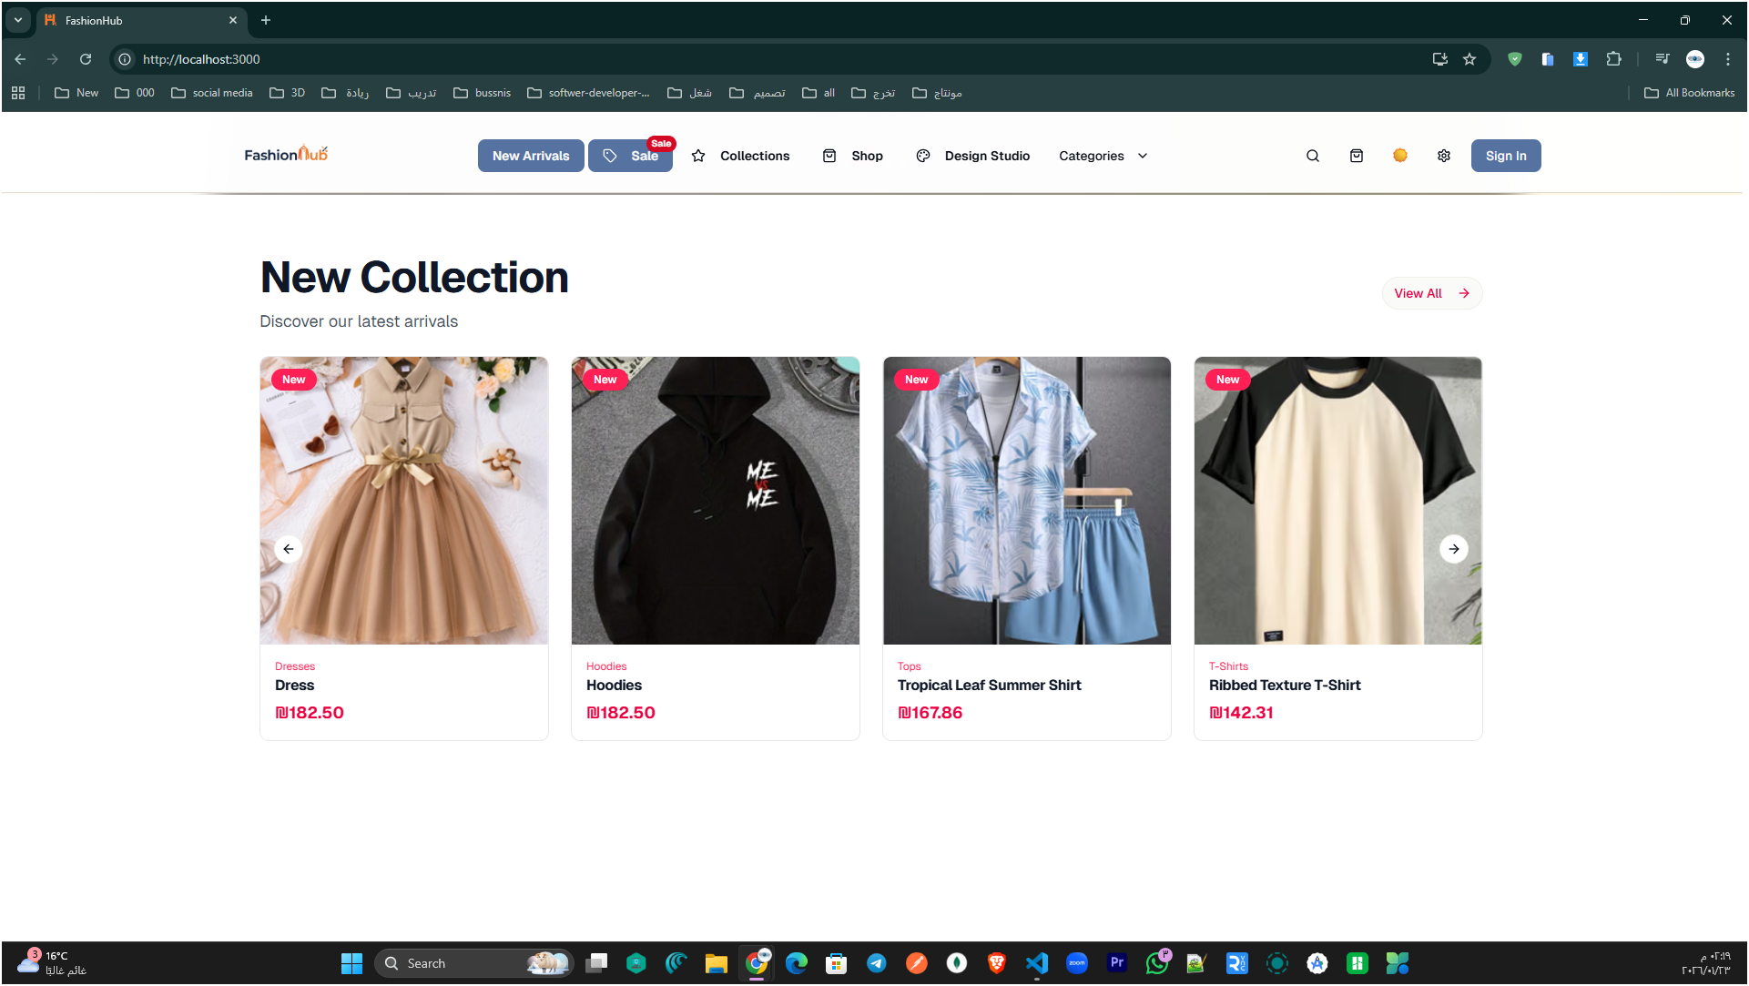
Home Page – New Collection
Fashion Hub
Notes:
[Sources]
- Project source code (user-provided ZIP).

Slide 13
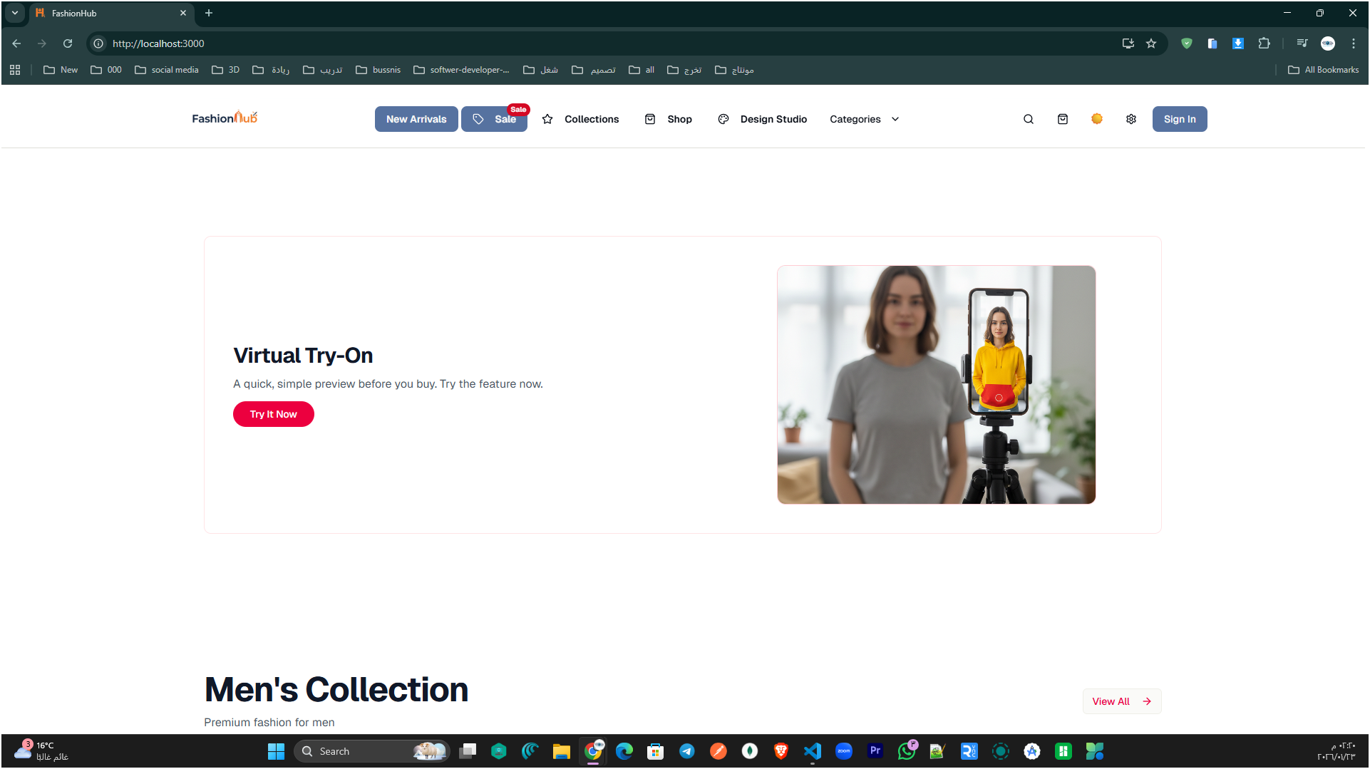
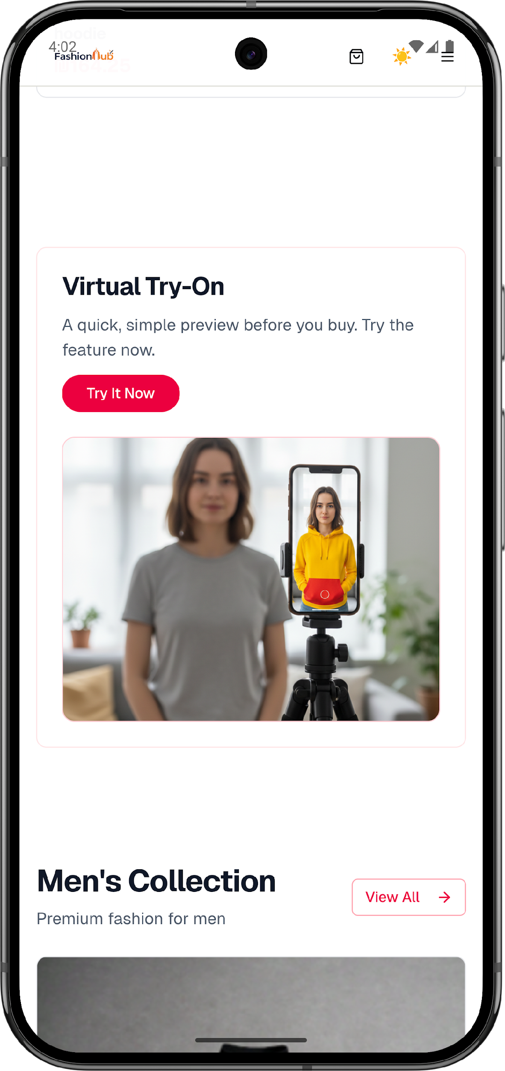
Home Page (Virtual Try-On Section)
Fashion Hub
Notes:
[Sources]
- Project source code (user-provided ZIP).

Slide 14
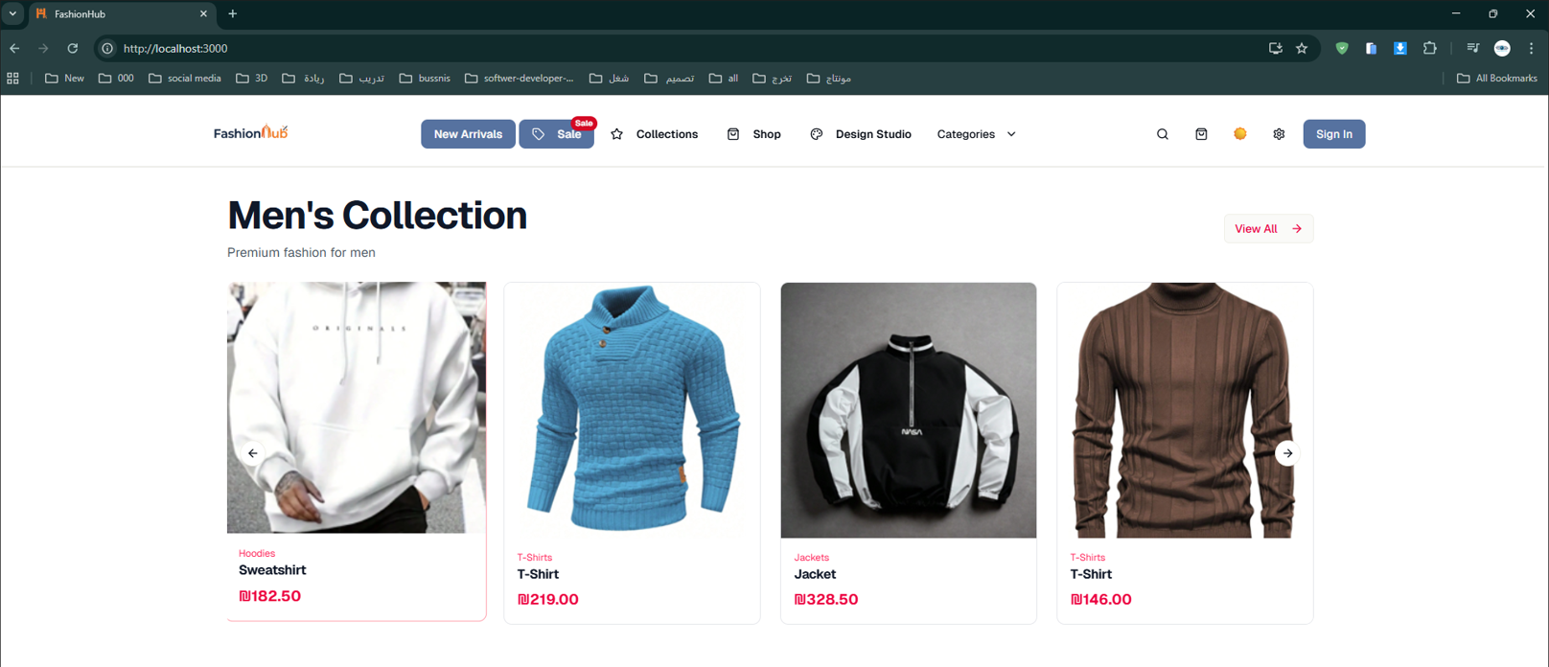
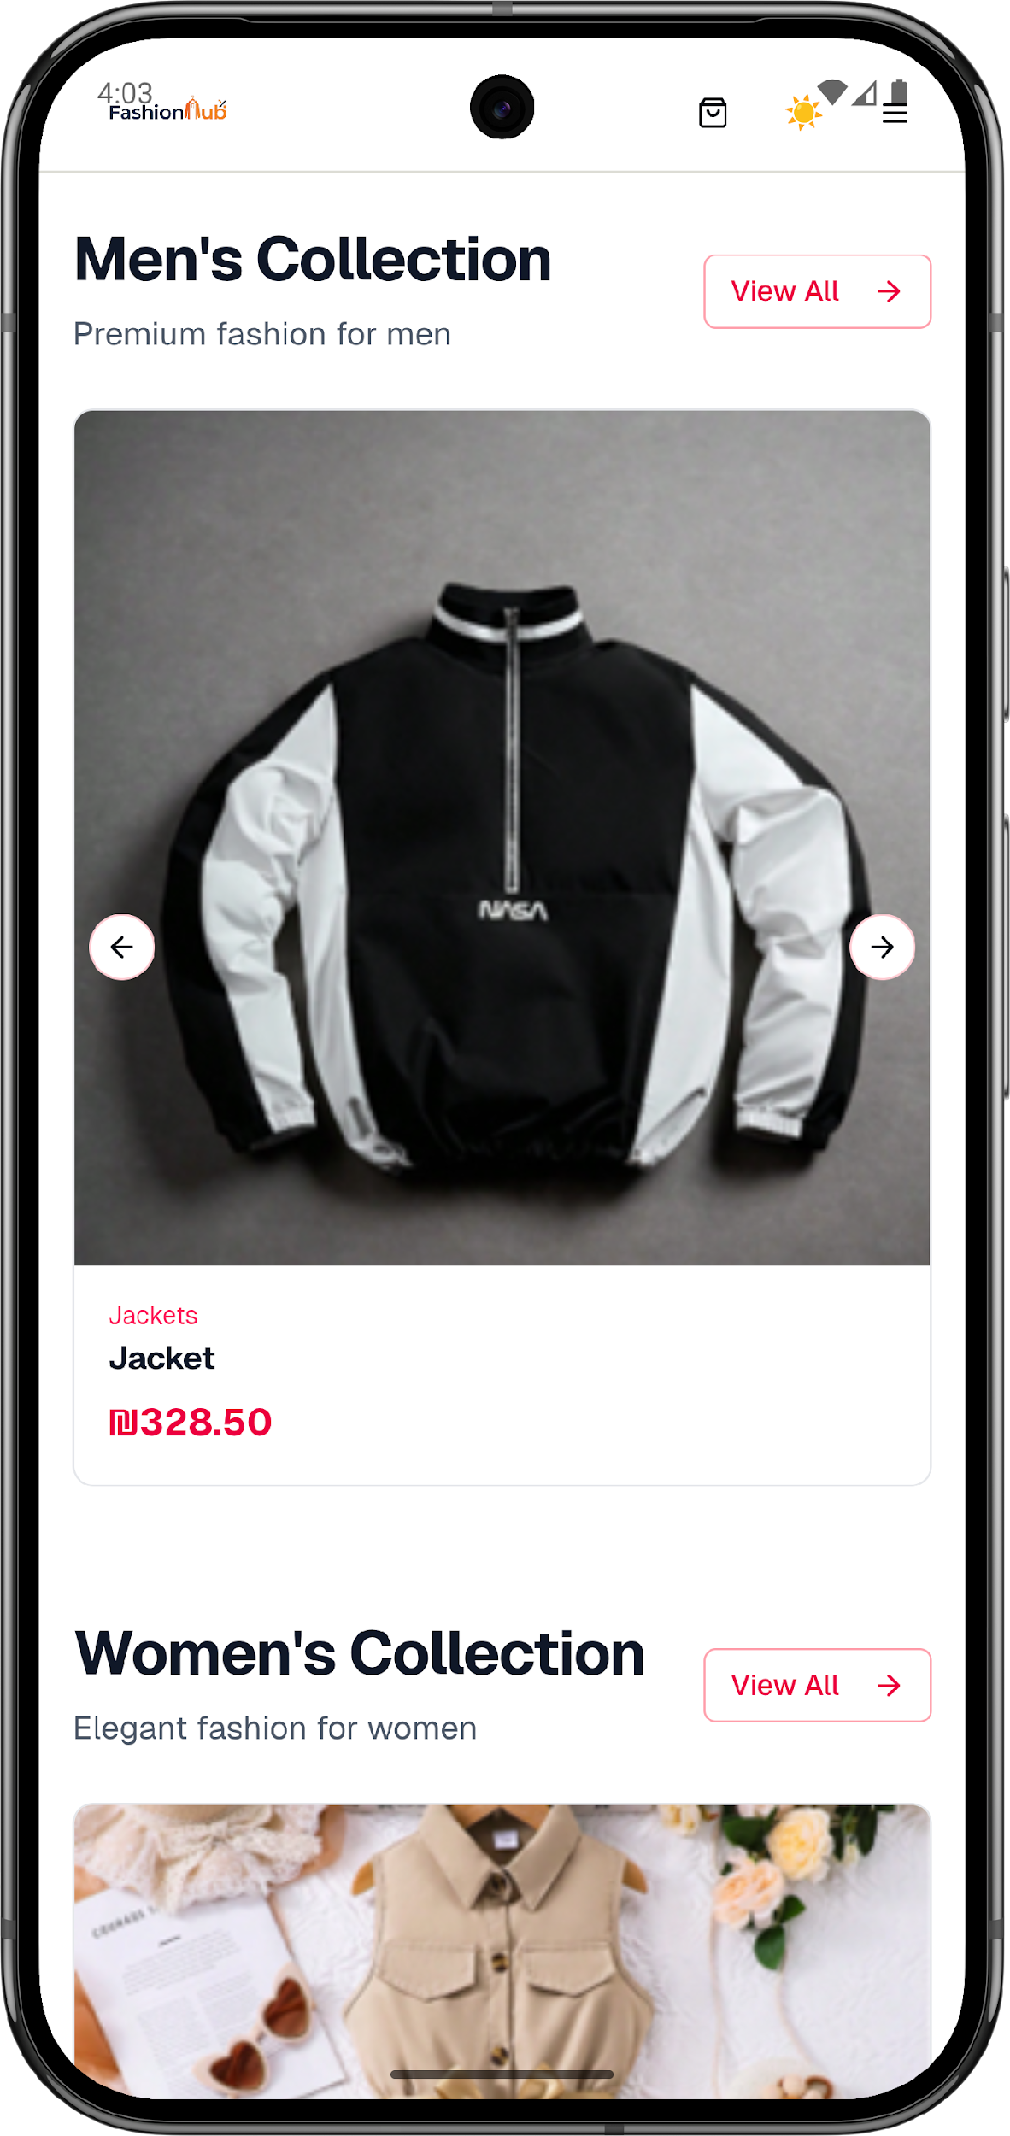
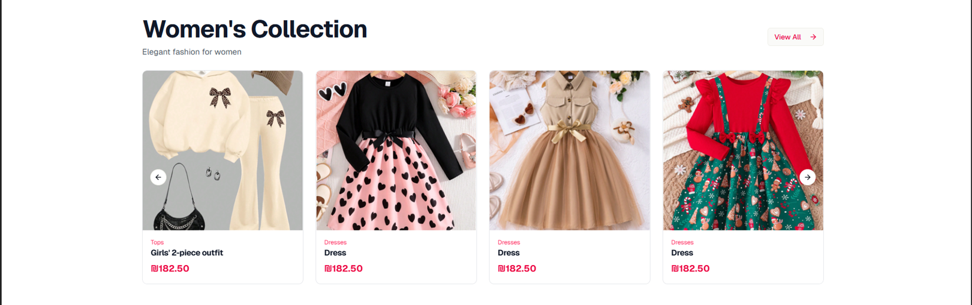
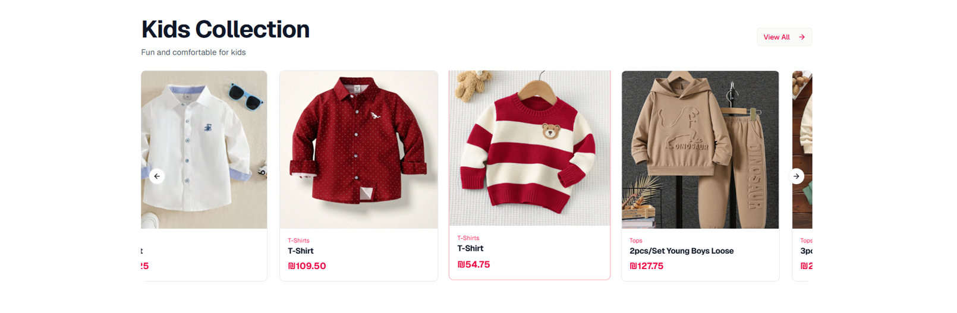
Home Page (Collections by Category)
Fashion Hub
Notes:
[Sources]
- Project source code (user-provided ZIP).

Slide 15
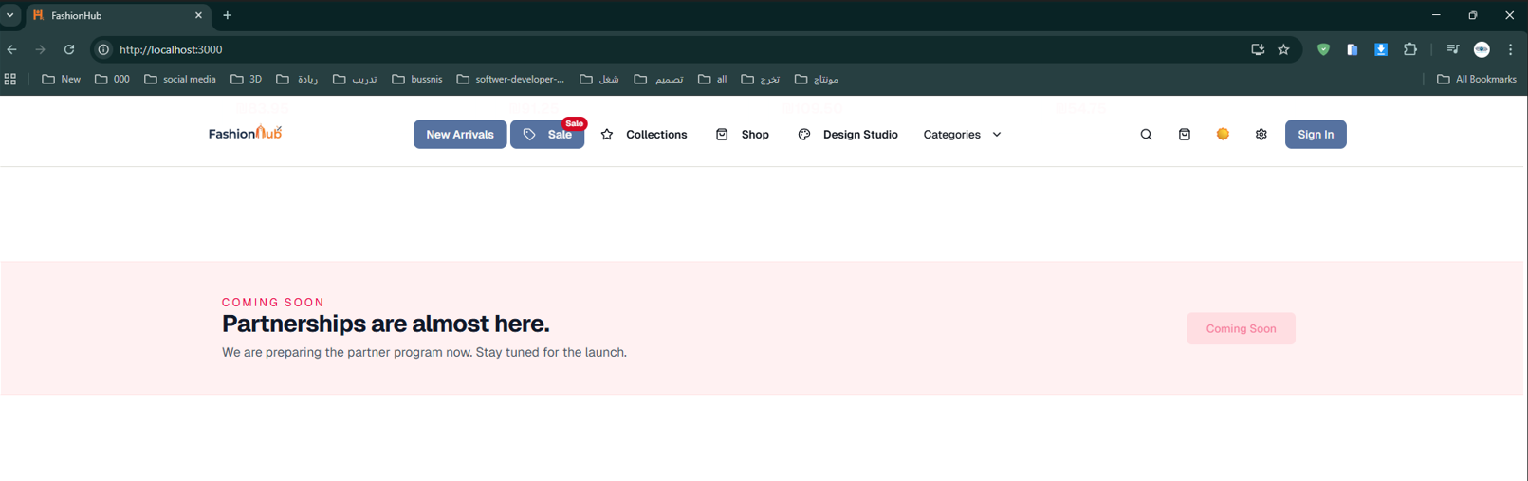
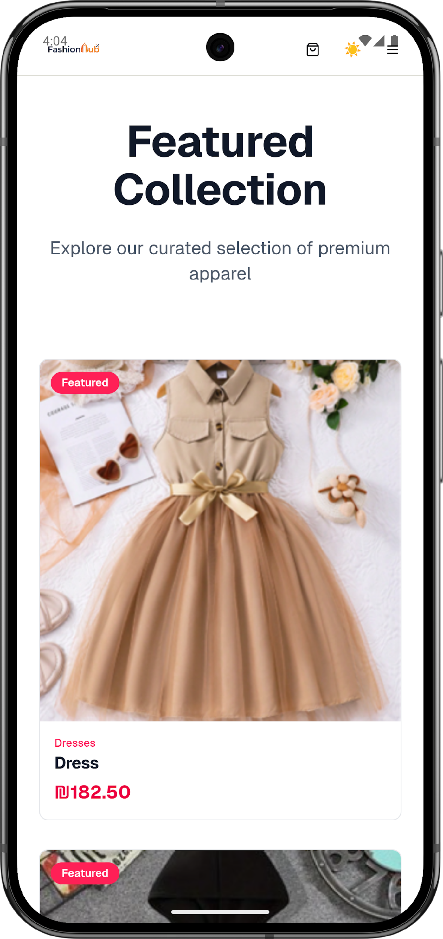
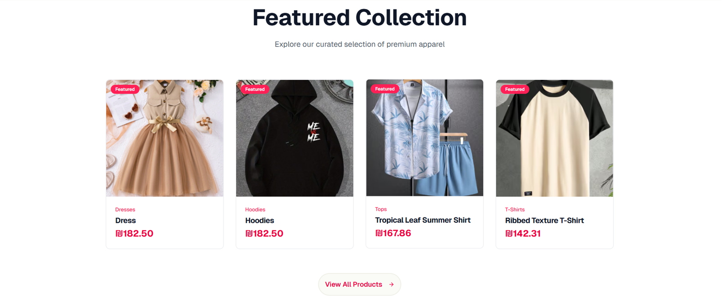
Home Page (Featured Collection)
Fashion Hub
Notes:
[Sources]
- Project source code (user-provided ZIP).

Slide 16
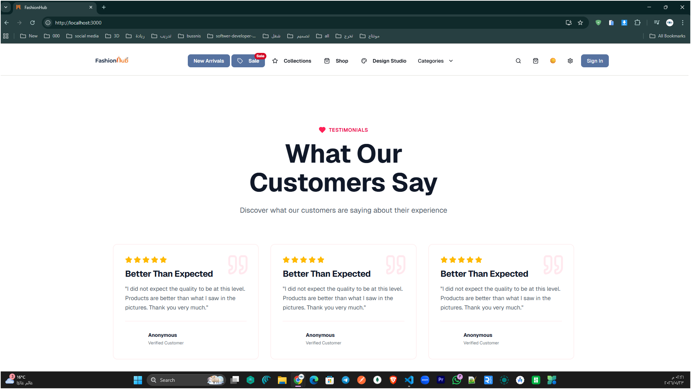
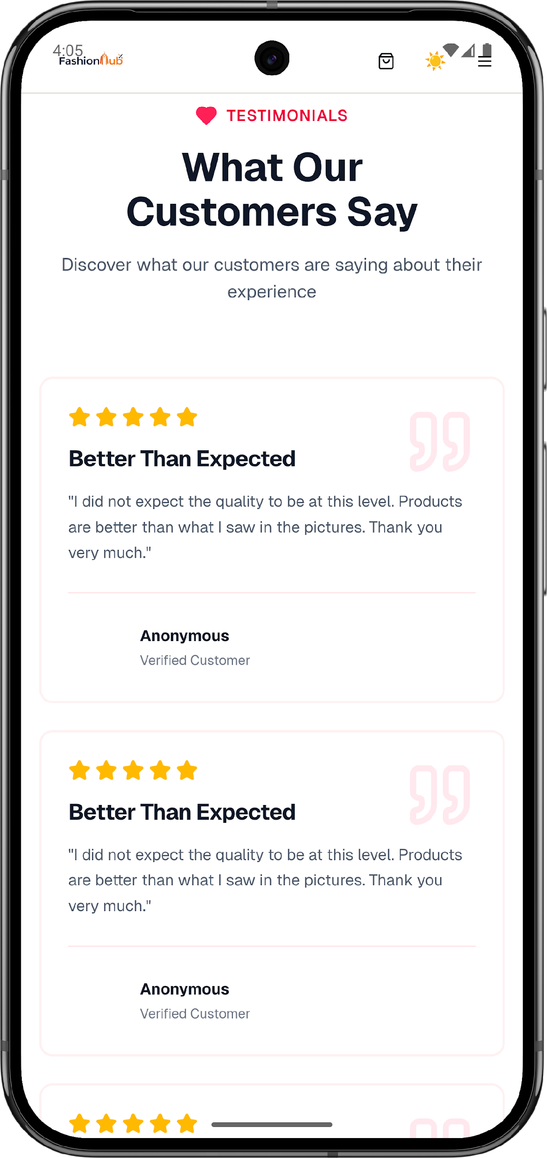
Home Page (Customer Testimonials)
Fashion Hub
Notes:
[Sources]
- Project source code (user-provided ZIP).

Slide 17
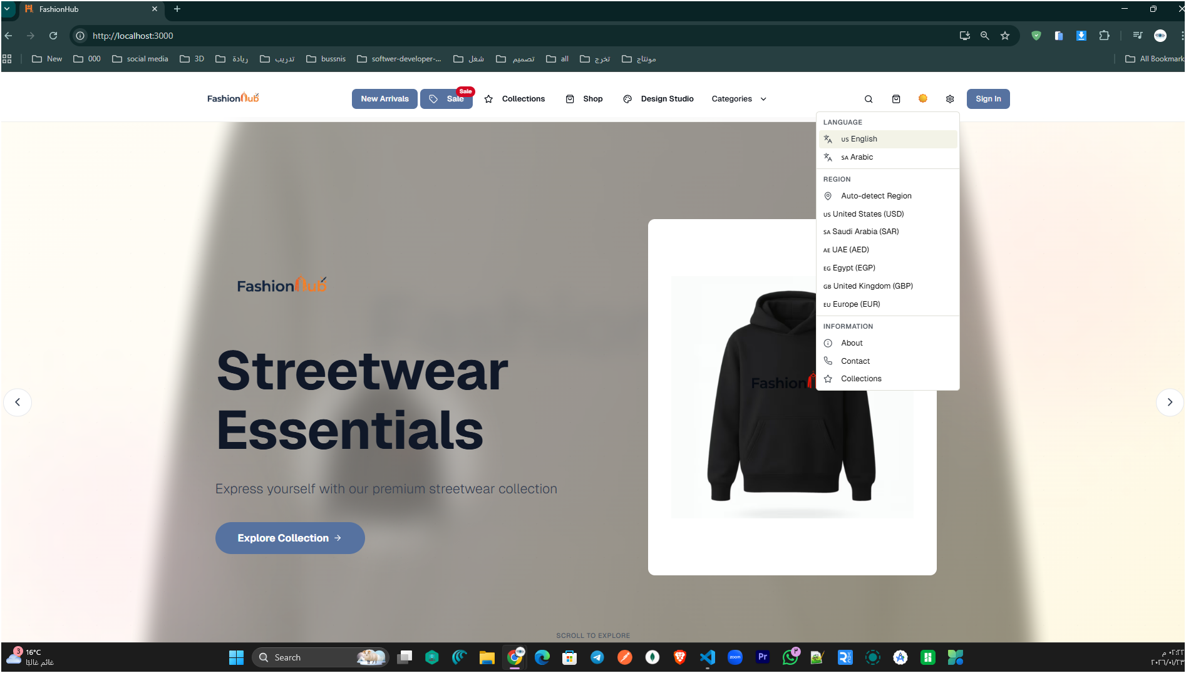
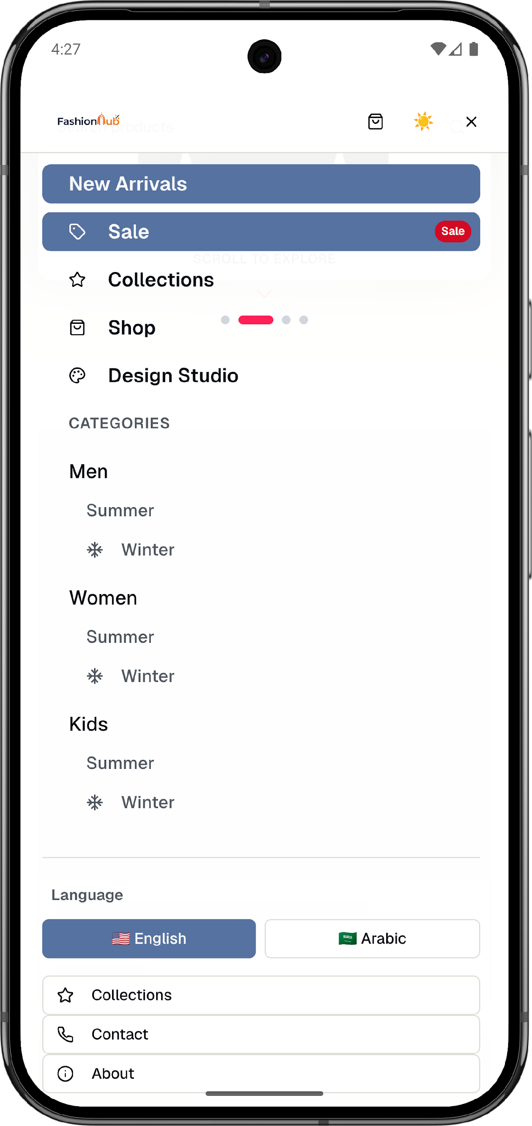
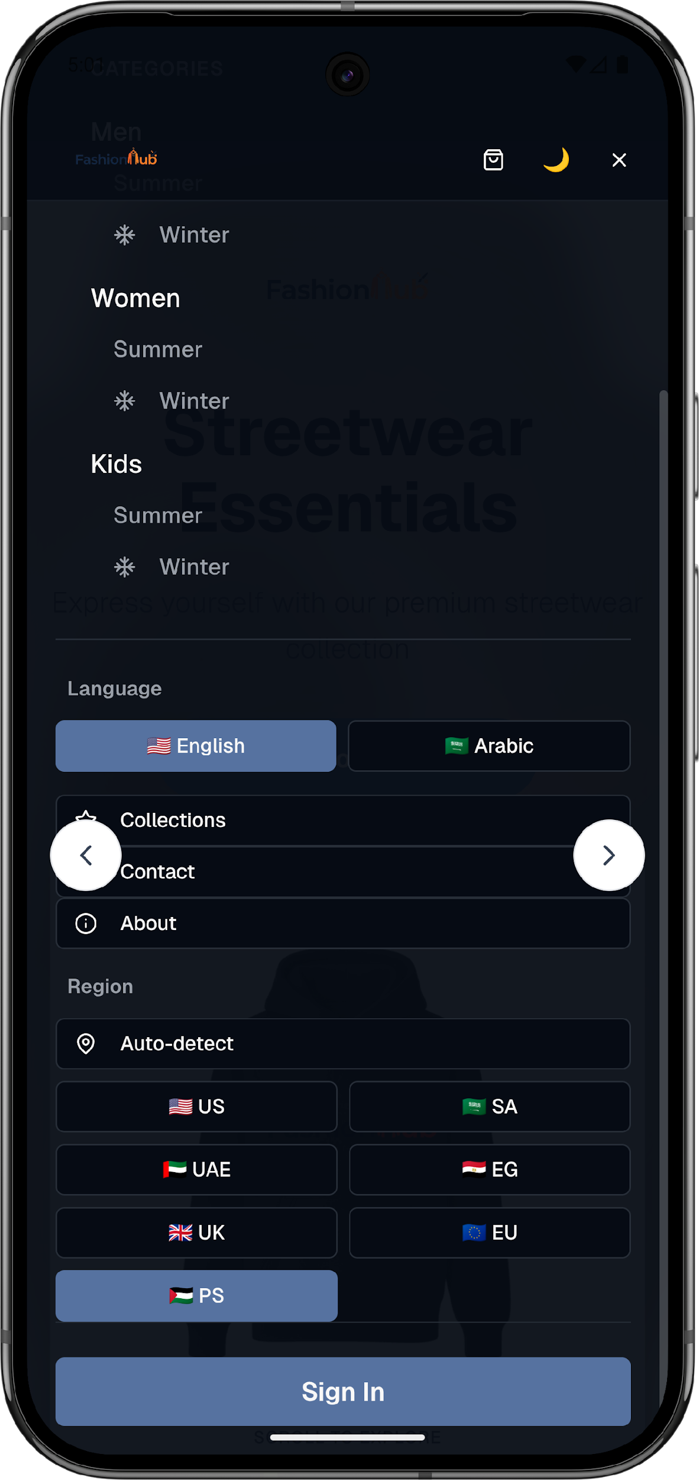
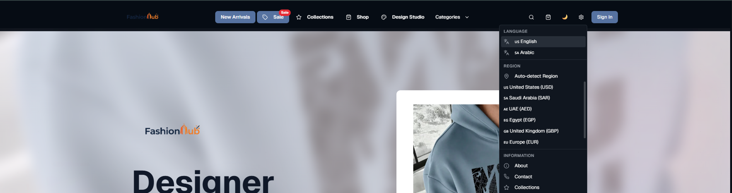
Home Page (Language, Region & Dark/Light Mode)
Fashion Hub
Notes:
[Sources]
- Project source code (user-provided ZIP).

Slide 18
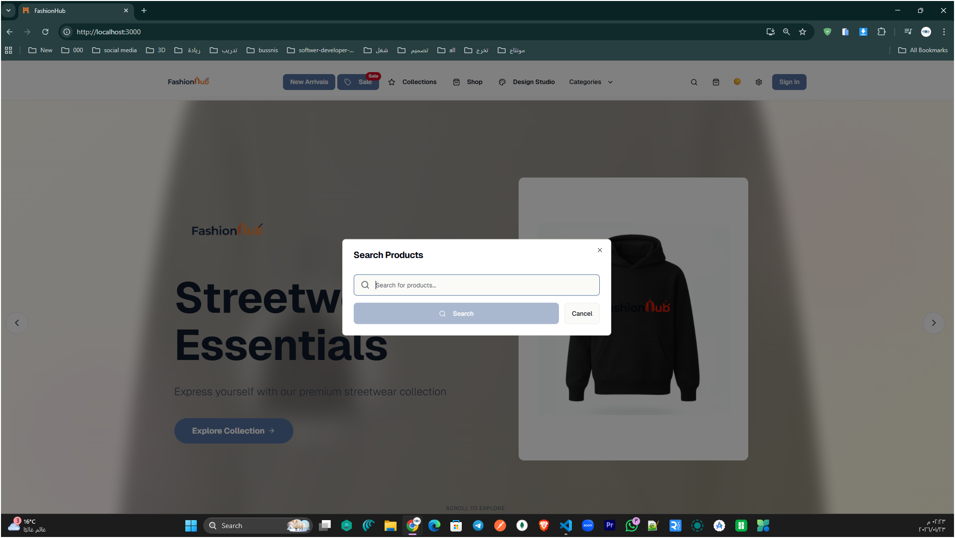
Home Page (Product Search)
Fashion Hub
Notes:
[Sources]
- Project source code (user-provided ZIP).

Slide 19
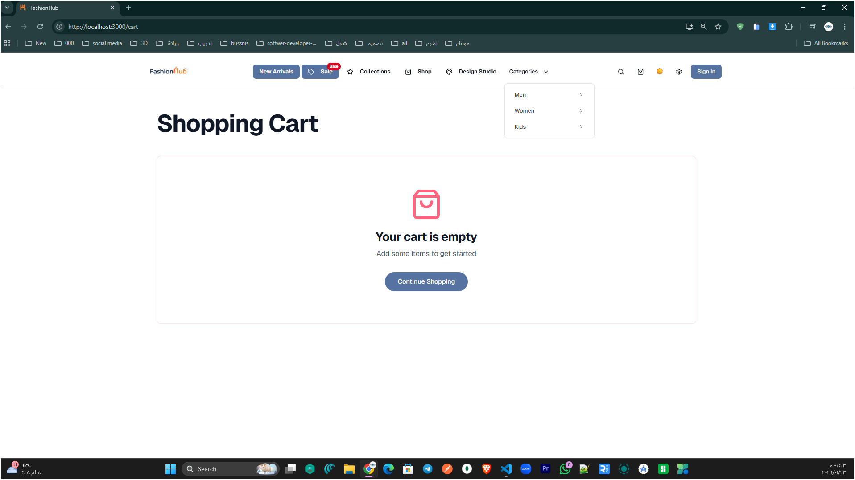
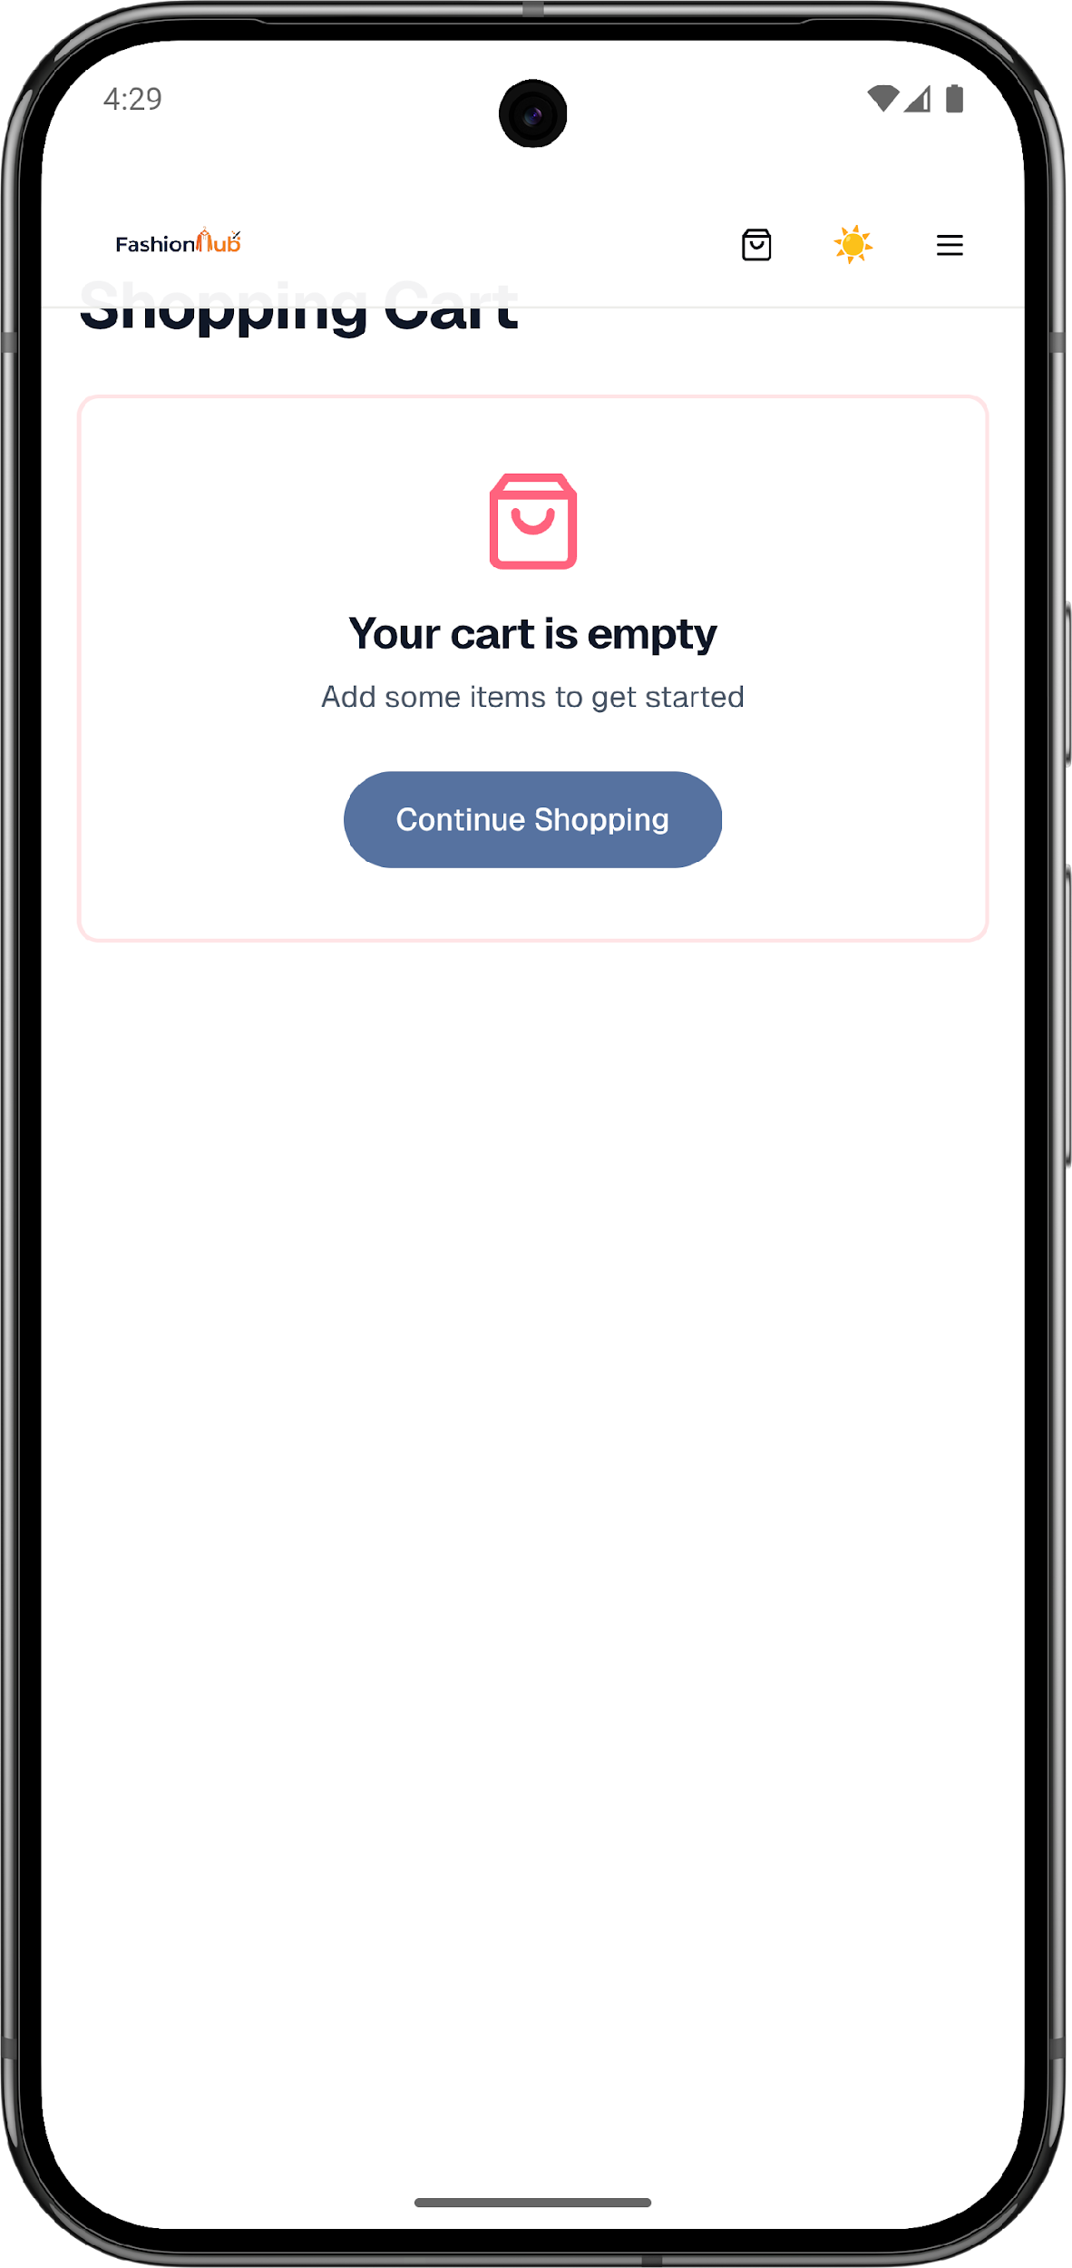
Shopping Cart
Fashion Hub
Notes:
[Sources]
- Project source code (user-provided ZIP).

Slide 20
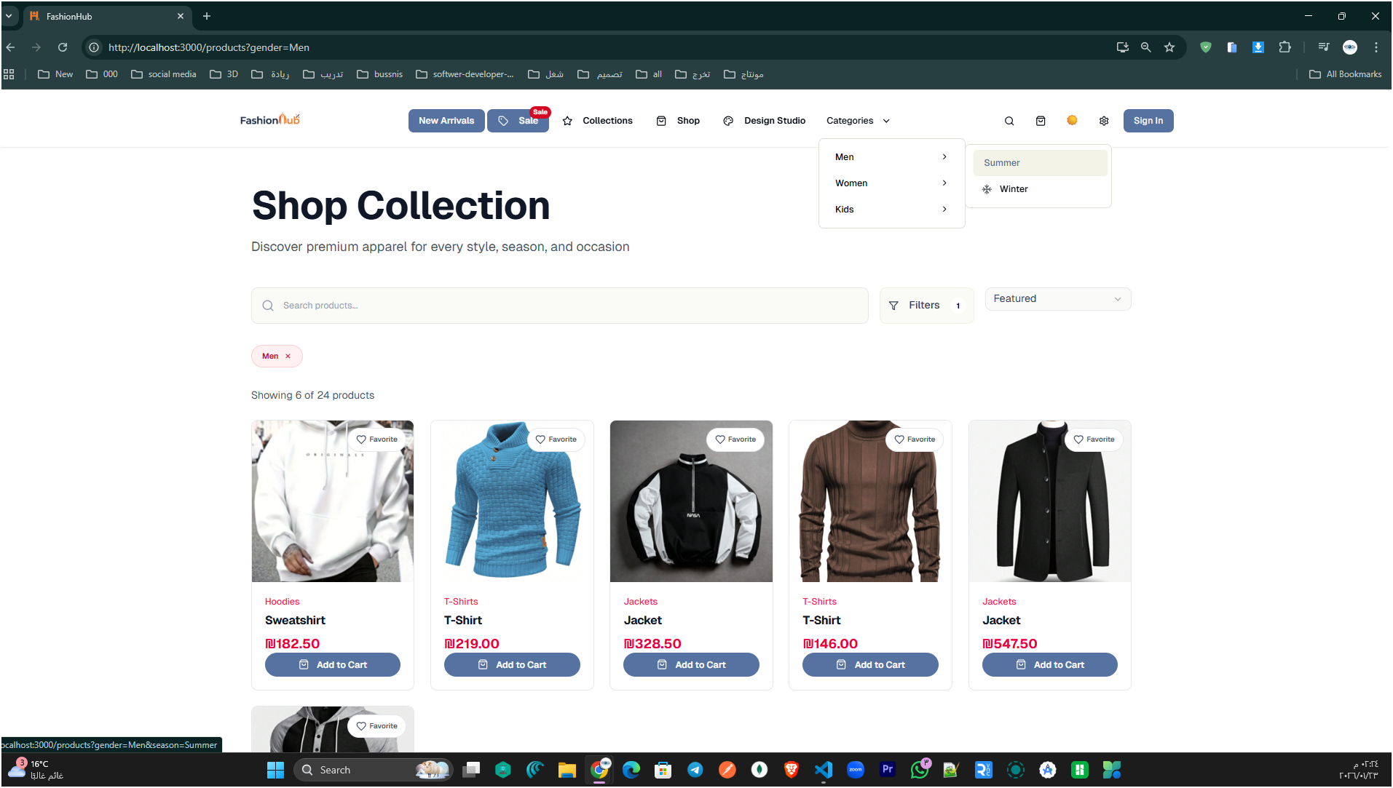
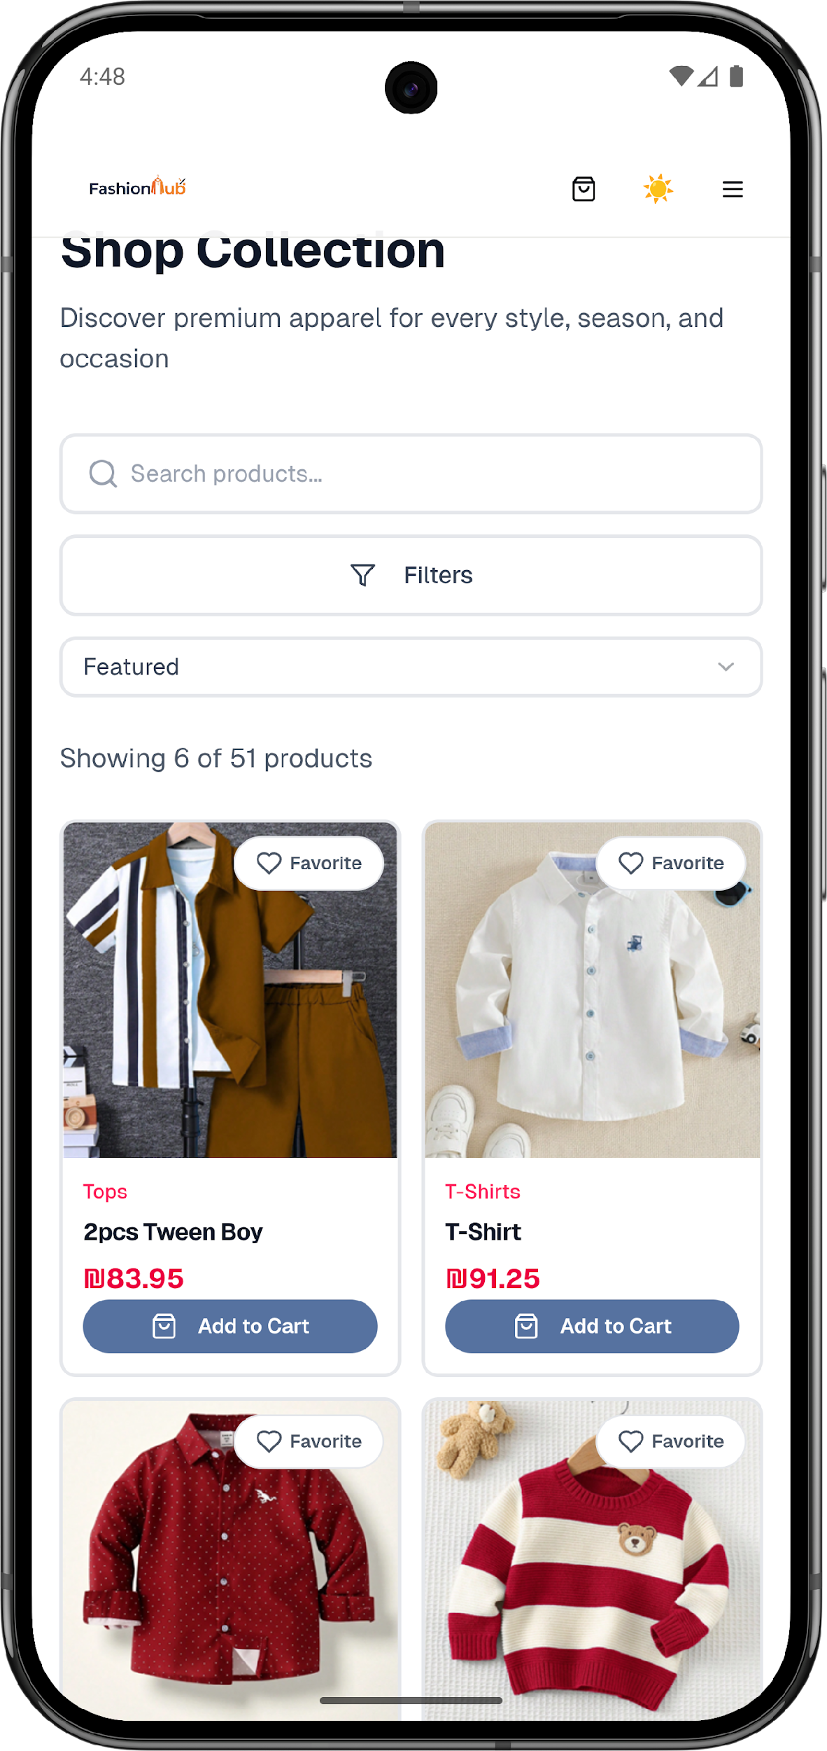
Product Catalog (Browse & Filters)
Fashion Hub
Notes:
[Sources]
- Project source code (user-provided ZIP).

Slide 21
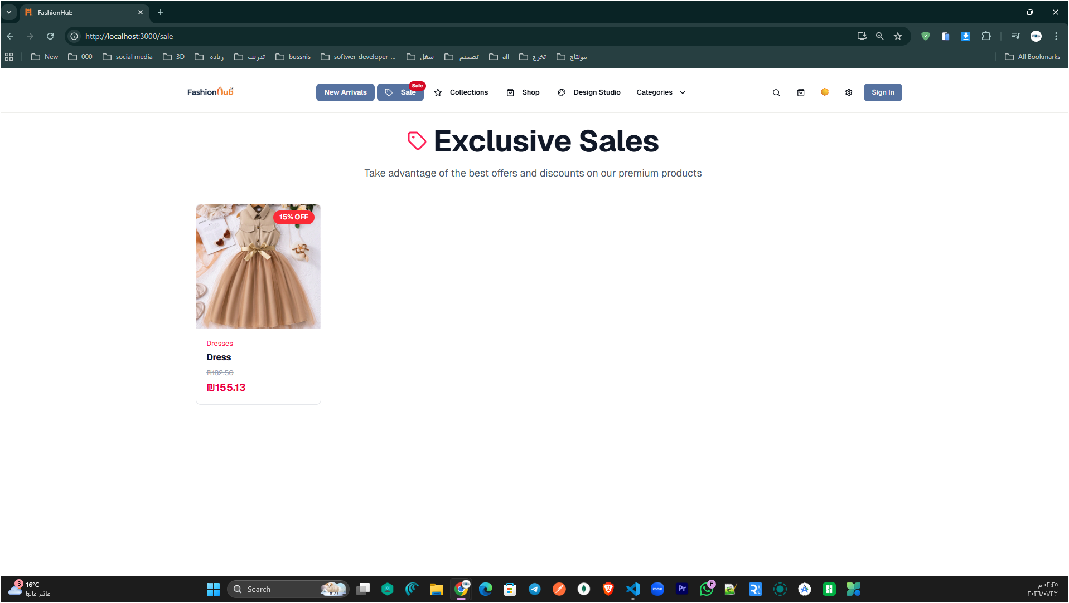
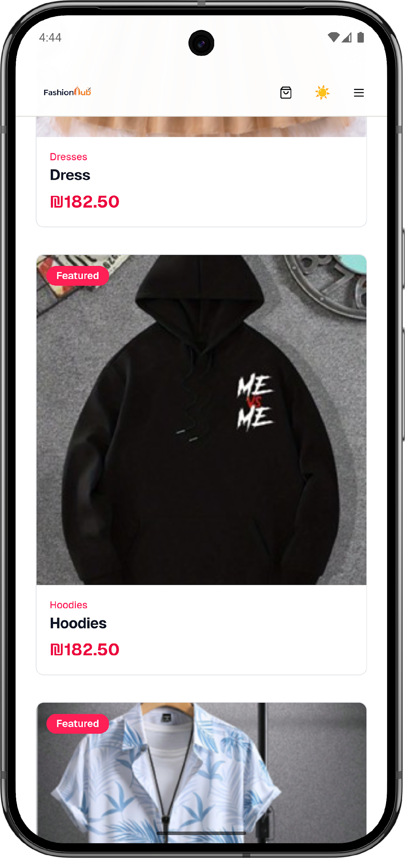
Exclusive Sales Page
Fashion Hub
Notes:
[Sources]
- Project source code (user-provided ZIP).

Slide 22
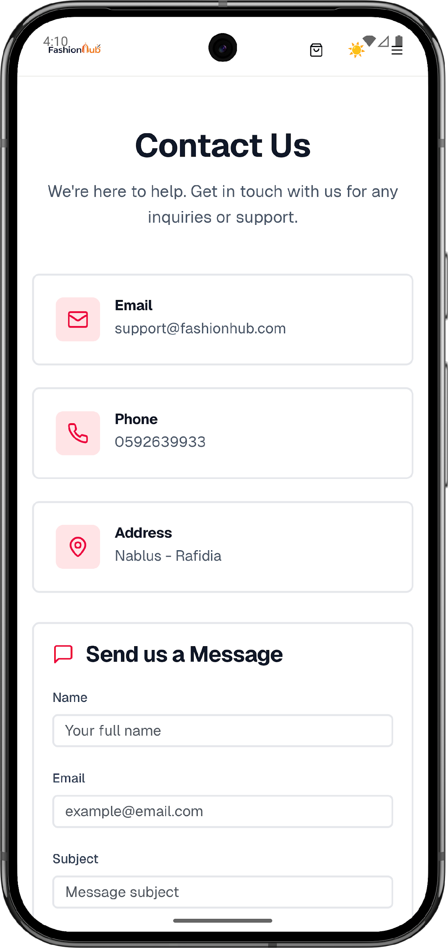
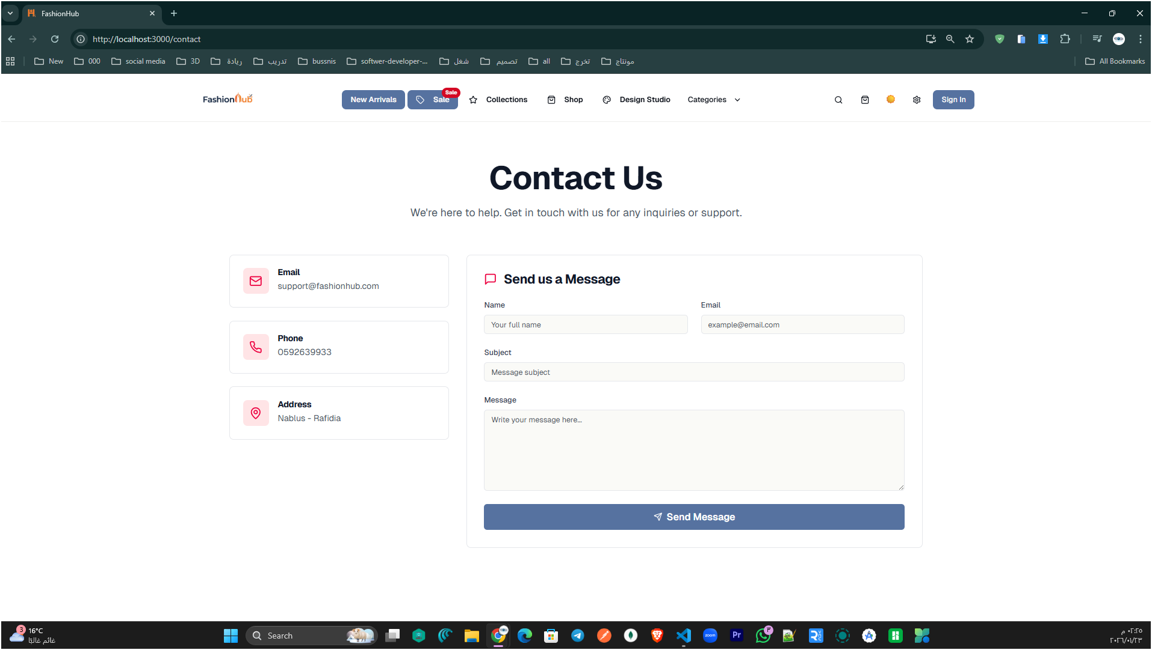
Contact Us (Support Form)
Fashion Hub
Notes:
[Sources]
- Project source code (user-provided ZIP).

Slide 23

Fashion Hub
Notes:
[Sources]
- Project source code (user-provided ZIP).

Slide 24
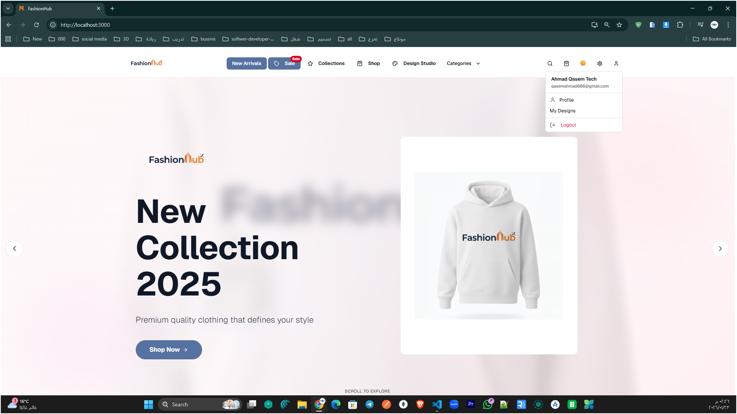
User Account Menu (Profile & My Designs)
Fashion Hub
Notes:
[Sources]
- Project source code (user-provided ZIP).

Slide 25
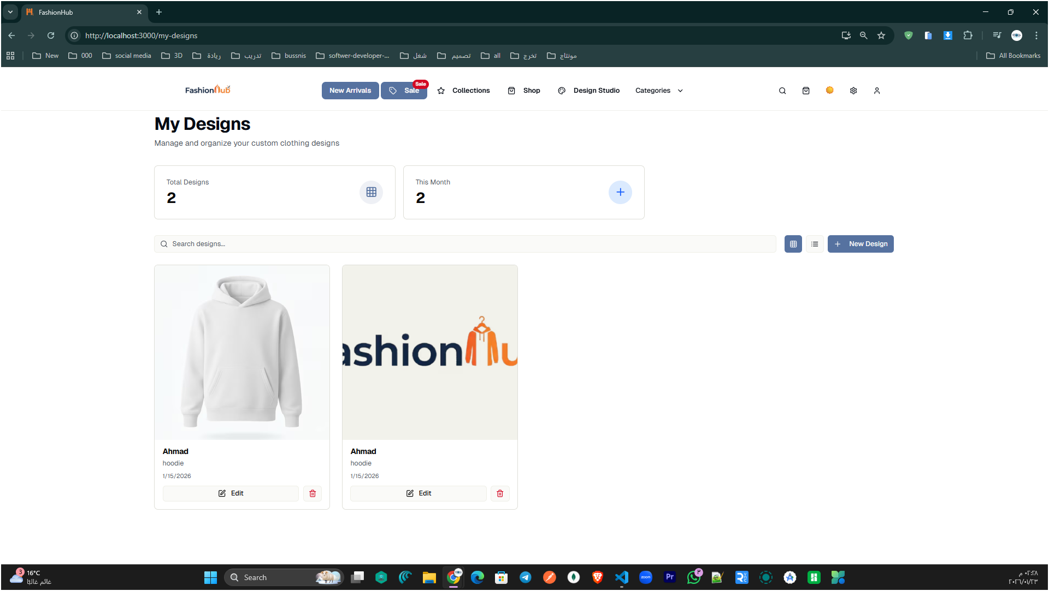
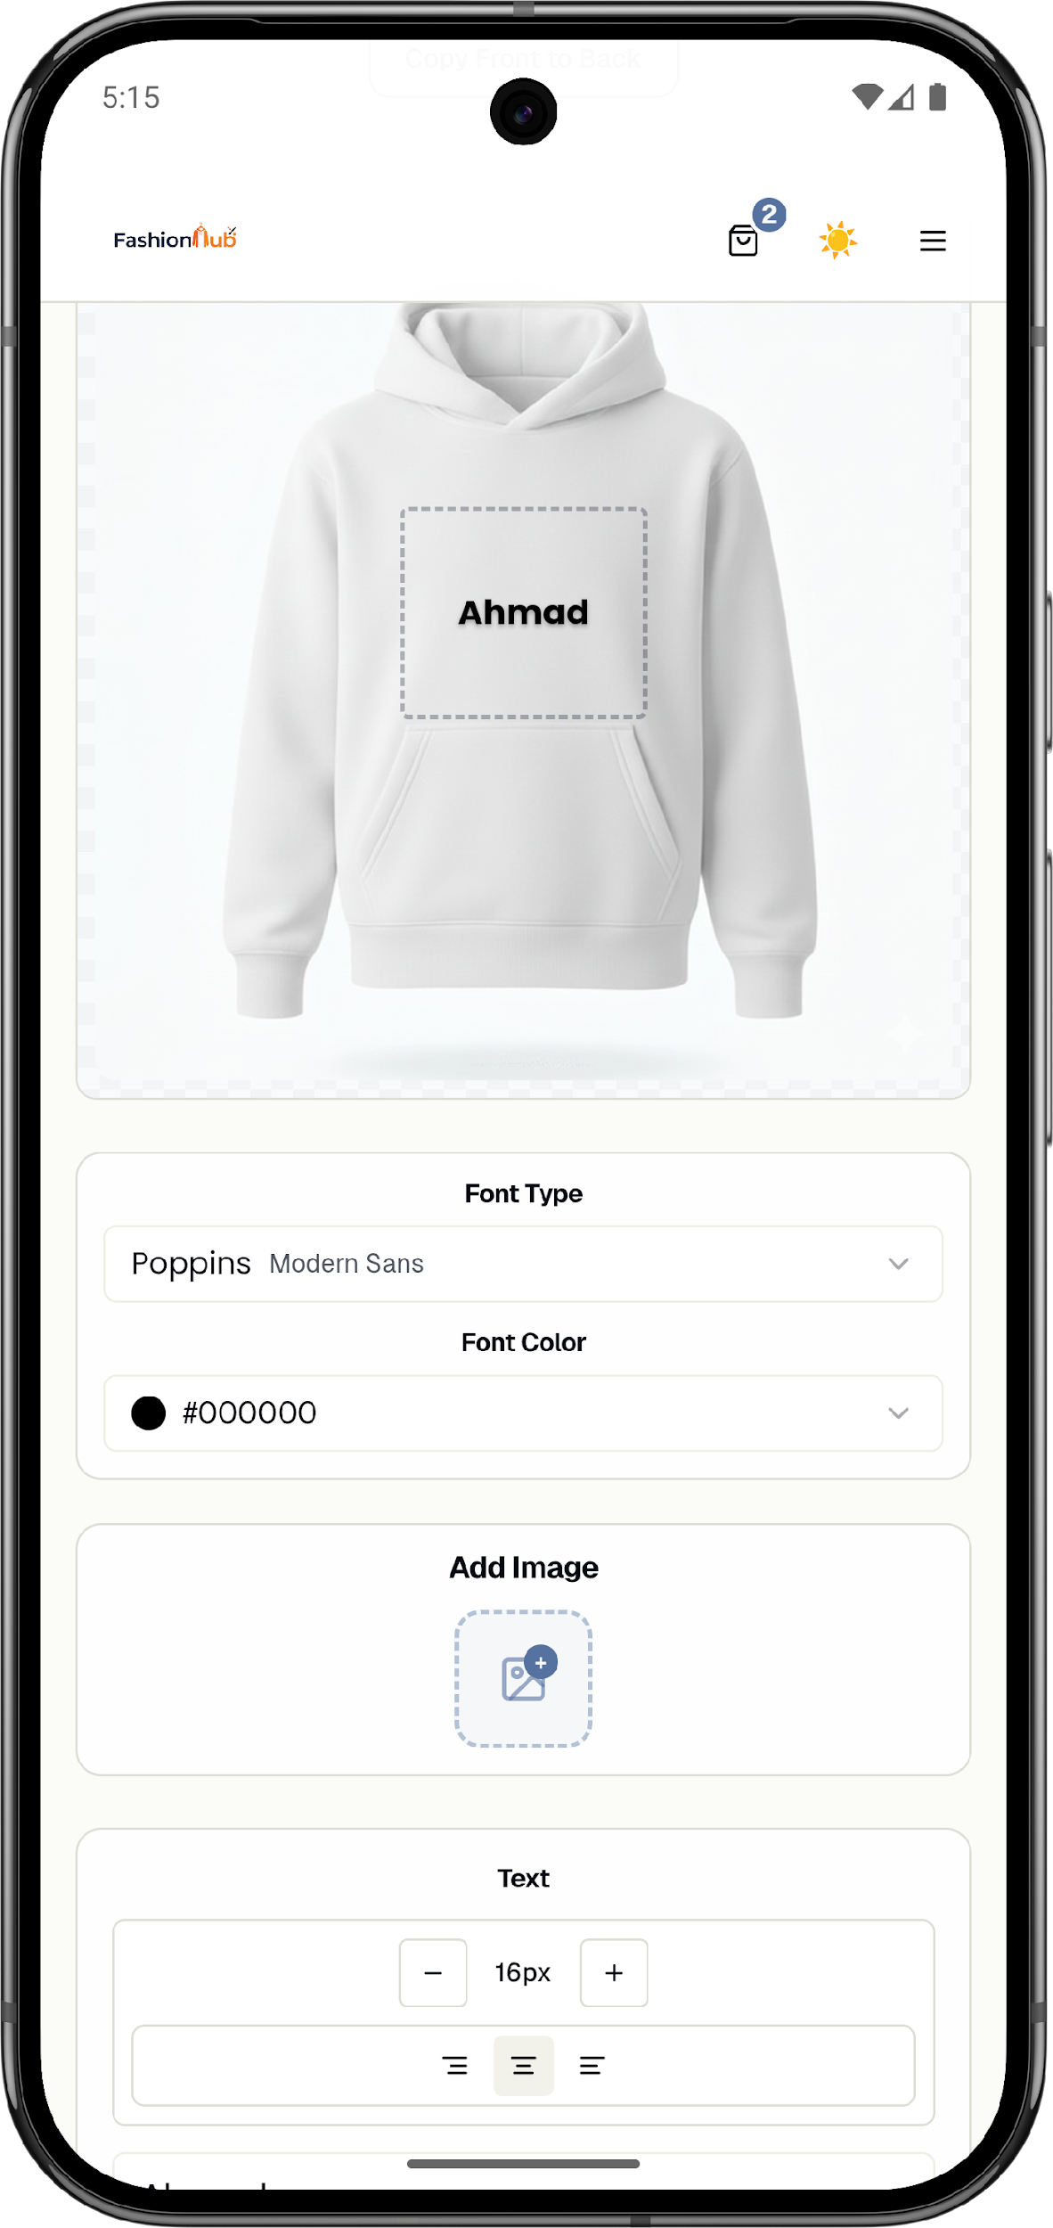
MY Designs
Fashion Hub
Notes:
[Sources]
- Project source code (user-provided ZIP).

Slide 26
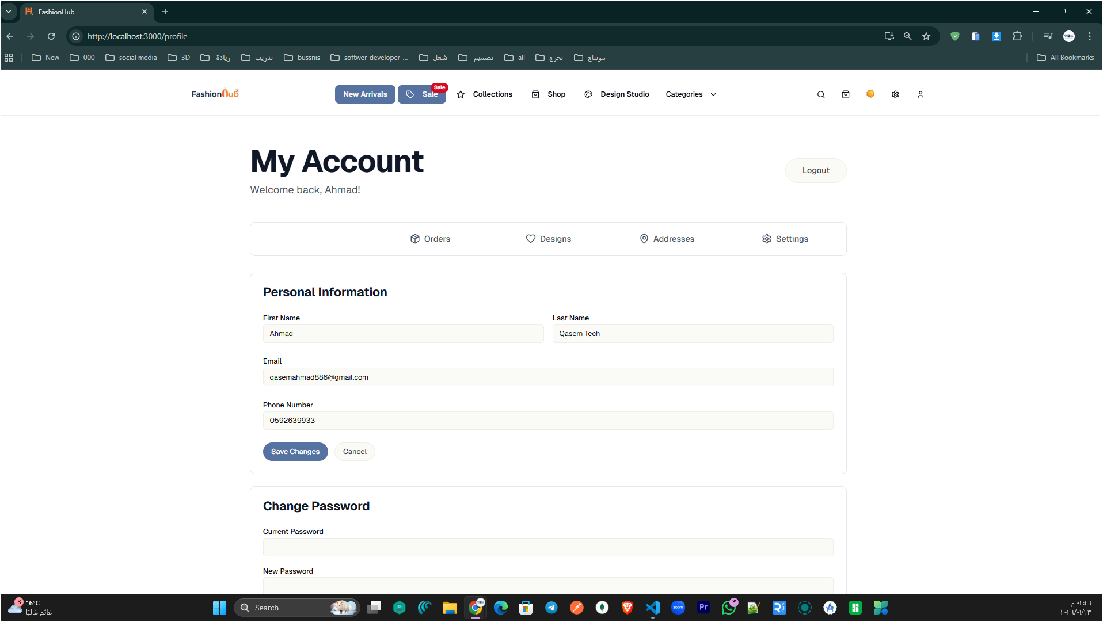
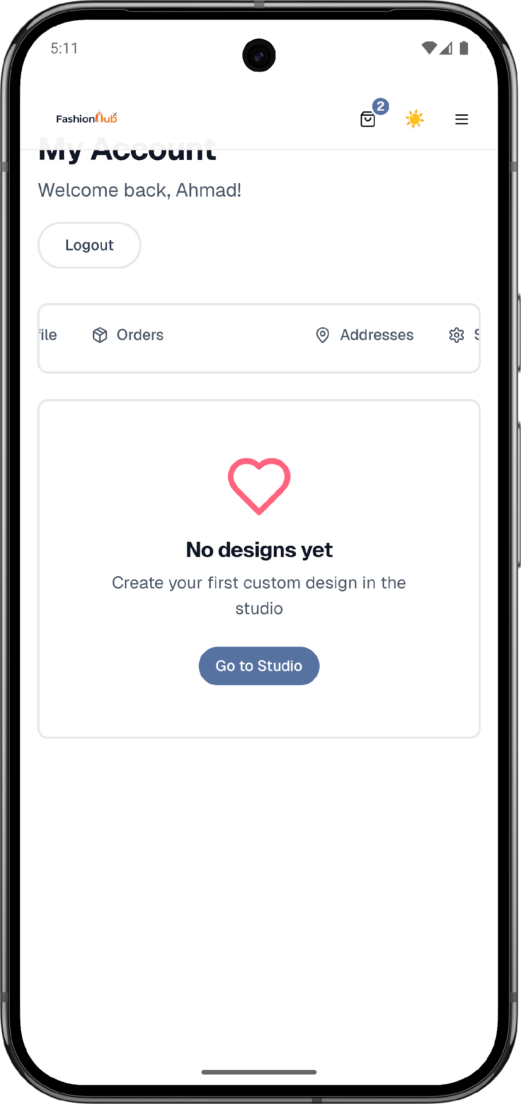
User Profile Management
Fashion Hub
Notes:
[Sources]
- Project source code (user-provided ZIP).

Slide 27
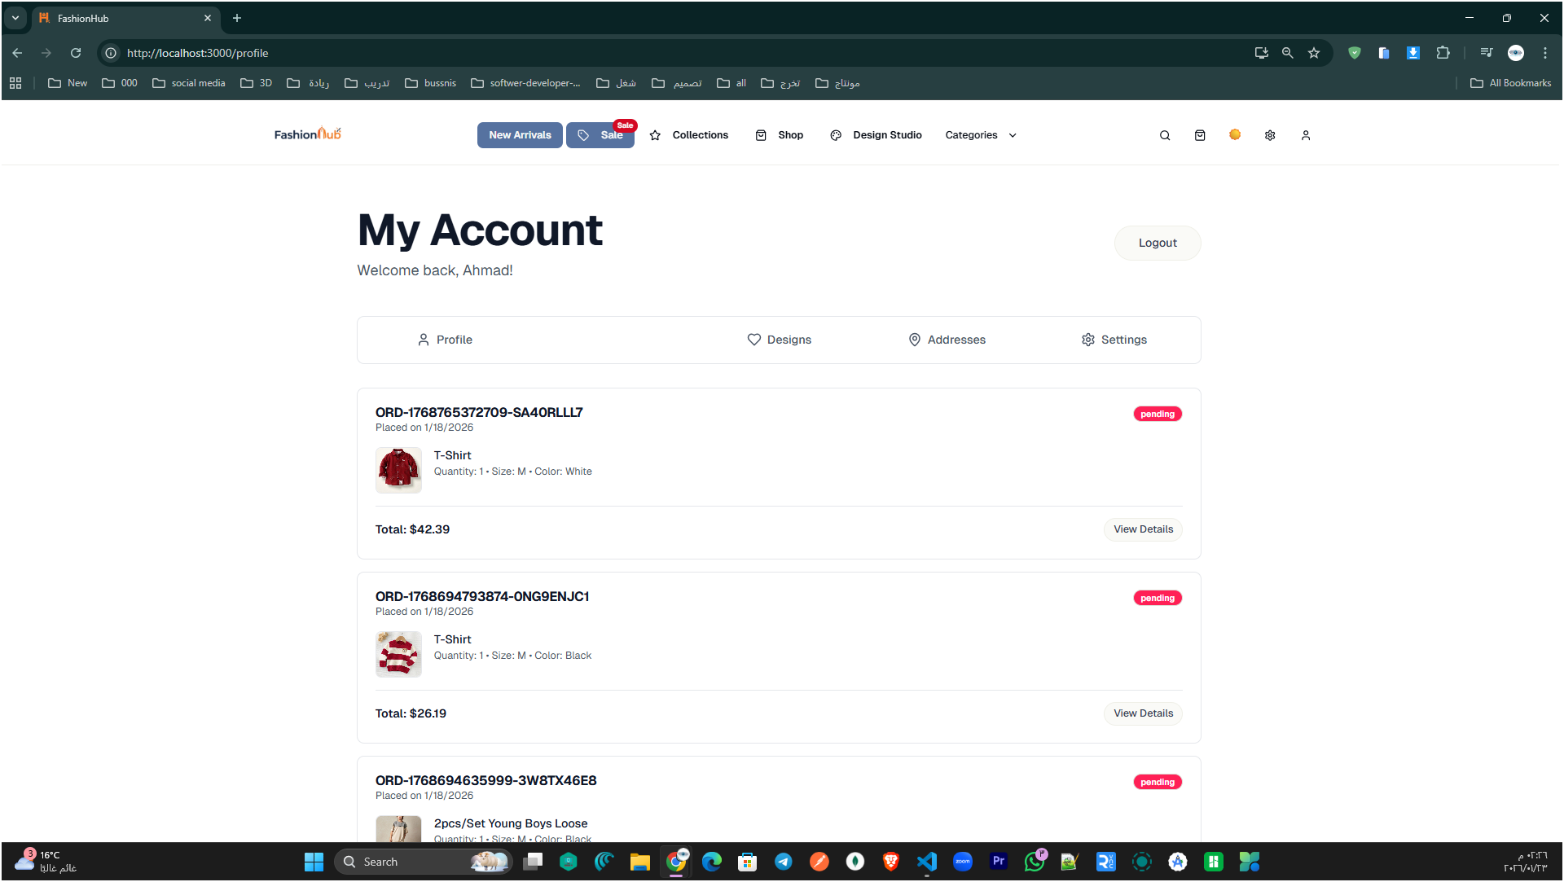
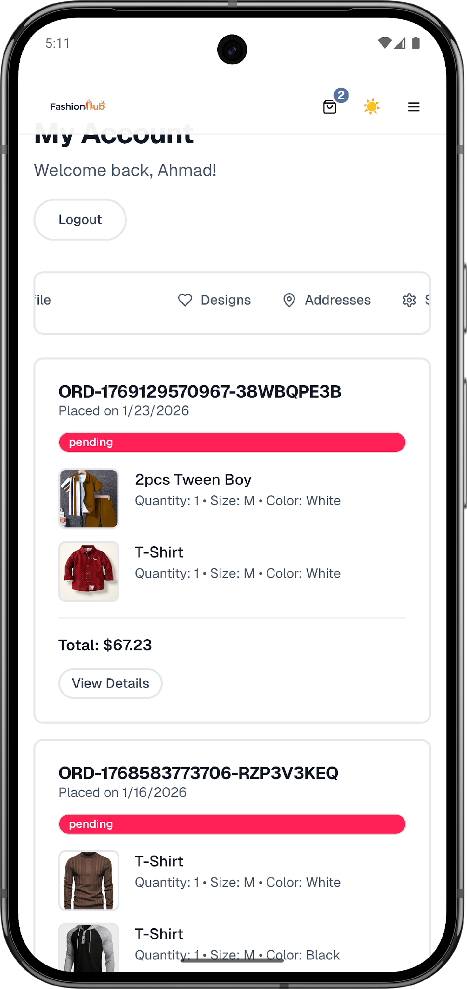
Orders History
Fashion Hub
Notes:
[Sources]
- Project source code (user-provided ZIP).

Slide 28


Saved Designs
Fashion Hub
Notes:
[Sources]
- Project source code (user-provided ZIP).

Slide 29


Shipping Address
Fashion Hub
Notes:
[Sources]
- Project source code (user-provided ZIP).

Slide 30


Account Settings
Fashion Hub
Notes:
[Sources]
- Project source code (user-provided ZIP).

Slide 31


Product Page (Add to Cart & Favorite)
Fashion Hub
Notes:
[Sources]
- Project source code (user-provided ZIP).

Slide 32



Product Page (Add to Cart & Favorite)
Fashion Hub
Notes:
[Sources]
- Project source code (user-provided ZIP).

Slide 33


Shopping Cart & Order Summary (Checkout Preparation)
Fashion Hub
Notes:
[Sources]
- Project source code (user-provided ZIP).

Slide 34

Checkout
Fashion Hub
Notes:
[Sources]
- Project source code (user-provided ZIP).

Slide 35

Processing
Fashion Hub
Notes:
[Sources]
- Project source code (user-provided ZIP).

Slide 36

Pay
Fashion Hub
Notes:
[Sources]
- Project source code (user-provided ZIP).

Slide 37

Fashion Hub
Notes:
[Sources]
- Project source code (user-provided ZIP).

Slide 38

Fashion Hub
Notes:
[Sources]
- Project source code (user-provided ZIP).

Slide 39

Design Studio (Custom Hoodie Designer)
Fashion Hub
Notes:
[Sources]
- Project source code (user-provided ZIP).

Slide 40



Virtual Try-On Feature
Fashion Hub
Notes:
[Sources]
- Project source code (user-provided ZIP).

Slide 41
Admin Side
Fashion Hub
Notes:
[Sources]
- Project source code (user-provided ZIP).

Slide 42



Admin Dashboard (Overview)
Fashion Hub
Notes:
[Sources]
- Project source code (user-provided ZIP).

Slide 43


Admin Dashboard (Analytics)
Fashion Hub
Notes:
[Sources]
- Project source code (user-provided ZIP).

Slide 44


Admin Dashboard (Reports)
Fashion Hub
Notes:
[Sources]
- Project source code (user-provided ZIP).

Slide 45


Admin Dashboard (Settings)
Fashion Hub
Notes:
[Sources]
- Project source code (user-provided ZIP).

Slide 46


Admin Dashboard (Products Management)
Fashion Hub
Notes:
[Sources]
- Project source code (user-provided ZIP).

Slide 47


Admin Dashboard (Studio Products)
Fashion Hub
Notes:
[Sources]
- Project source code (user-provided ZIP).

Slide 48


Orders Management
Fashion Hub
Notes:
[Sources]
- Project source code (user-provided ZIP).

Slide 49


Order Tracking
Fashion Hub
Notes:
[Sources]
- Project source code (user-provided ZIP).

Slide 50

Customer Management
Fashion Hub
Notes:
[Sources]
- Project source code (user-provided ZIP).

Slide 51


Customer Reviews
Fashion Hub
Notes:
[Sources]
- Project source code (user-provided ZIP).

Slide 52


Staff Management
Fashion Hub
Notes:
[Sources]
- Project source code (user-provided ZIP).

Slide 53


Staff Chat
Fashion Hub
Notes:
[Sources]
- Project source code (user-provided ZIP).

Slide 54


Virtual Try-On Products
Fashion Hub
Notes:
[Sources]
- Project source code (user-provided ZIP).

Slide 55


Slider Management
Fashion Hub
Notes:
[Sources]
- Project source code (user-provided ZIP).

Slide 56

Slider Management
Fashion Hub
Notes:
[Sources]
- Project source code (user-provided ZIP).

Slide 57
Employee side
Fashion Hub
Notes:
[Sources]
- Project source code (user-provided ZIP).

Slide 58


Employee Dashboard
Fashion Hub
Notes:
[Sources]
- Project source code (user-provided ZIP).

Slide 59


Orders Management
Fashion Hub
Notes:
[Sources]
- Project source code (user-provided ZIP).

Slide 60


Orders Management
Fashion Hub
Notes:
[Sources]
- Project source code (user-provided ZIP).

Slide 61


Orders Management
Fashion Hub
Notes:
[Sources]
- Project source code (user-provided ZIP).

Slide 62

Orders Management
Fashion Hub
Notes:
[Sources]
- Project source code (user-provided ZIP).

Slide 63


Production Workflow
Fashion Hub
Notes:
[Sources]
- Project source code (user-provided ZIP).

Slide 64

Products Management
Fashion Hub
Notes:
[Sources]
- Project source code (user-provided ZIP).

Slide 65

Studio Products Management
Fashion Hub
Notes:
[Sources]
- Project source code (user-provided ZIP).

Slide 66


Customer Management
Fashion Hub
Notes:
[Sources]
- Project source code (user-provided ZIP).

Slide 67


Staff Chat
Fashion Hub
Notes:
[Sources]
- Project source code (user-provided ZIP).

Slide 68
System Architecture
High-level
Frontend (React with Next.js framework)
Backend (Express API)
Storefront & dashboards
Studio + Try-On pages
Calls REST API + Socket client
HTTPS
Business logic & endpoints
Stripe sessions, email flows
Socket.IO server (staff chat)
CRUD via API
Data Layer
Integrations
MongoDB collections
Mongoose models
Orders, products, designs…
Stripe payments
Email (password reset)
Google sign-in (OAuth)
Fashion Hub — Architecture
Notes:
[Sources]
- Project source code (user-provided ZIP).

Slide 69
Technology Stack
Frontend
Backend
Next.js + React
Tailwind CSS + Radix UI
Studio tools + Try-On page
Node.js + Express API
Socket.IO for real-time
Stripe integration
Database
Auth & Security
MongoDB
Mongoose models & schemas
Indexes and relations via ObjectId
JWT sessions
bcrypt salting + hashing
Reset tokens hashed (SHA-256)
Fashion Hub — Stack
Notes:
[Sources]
- Project source code (user-provided ZIP).

Slide 70
Security Highlights
Key protections implemented in the project:
SECURITY
Authentication
Email login + Google sign-in
JWT-based session handling
Password & Recovery
bcrypt hashing with salt
Reset token stored hashed (SHA-256) + expiry
Authorization
Role-based access (customer/admin/employee/partner flows)
Protected routes for dashboards and actions
Fashion Hub — Security
Notes:
[Sources]
- Project source code (user-provided ZIP).

Slide 71
User Journey
Typical flow
1
2
3
4
5
Browse
Preview
Cart
Checkout
Track
Explore products
(guest supported)
Try-On or
Studio design
Add items/designs
+ quantities
Enter details
+ pay (Stripe)
View orders
+ status updates
This flow is implemented using dedicated pages and APIs for each stage.
Fashion Hub — Journey
Notes:
[Sources]
- Project source code (user-provided ZIP).

Slide 72
Discussion of Results
Objectives
Achievement of Objectives
Delivered a complete shopping workflow (browse, cart, checkout, orders).
Implemented Studio customization and saved designs.
Integrated camera-based Virtual Try-On.
Supported multi-role dashboards + real-time staff chat.
Implemented secure authentication flows and payment integration.
Fashion Hub — Results
Notes:
[Sources]
- Project source code (user-provided ZIP).

Slide 73
Future Work & Recommendations
Technical Enhancements
Feature Work
Improve Try-On accuracy & add fallbacks if camera is blocked.
Expand Studio with templates, layers, and better exports.
Stronger search/filtering and performance optimizations.
More automated testing for critical flows (auth, orders, payment).
External similar-product suggestions via partner integrations.
In-platform supplier workflow (offers → approvals → publish).
AI-assisted improvements for Studio designs (layout/color/typography).
Personalized recommendations and wishlist alerts.
Fashion Hub — Future
Notes:
[Sources]
- Project source code (user-provided ZIP).

Slide 74
Thank you!
Questions & Discussion
Fashion Hub — Full-Stack E-commerce Platform
Notes:
[Sources]
- Logo provided by user (project asset).

