Slide 1

An-Najah National University
Faculty of Engineering
Civil Engineering Department
Rainwater Harvesting to Alleviate Water Shortage in Wadi Abu-Nar Catchment
Supervisor:
Dr. Sameer Shadeed
Prepared by:
Waseem Samara
Ata' Zain Edeen
Ahmad Labadi
2012/2013

Slide 2
Contents:
1- Introduction
2- Objectives
3- Advantages of Rainwater Harvesting
4- Methodology
5- Study Area

Slide 3
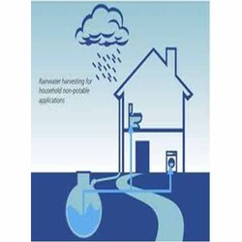
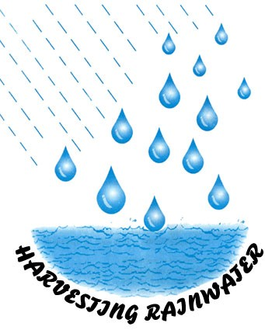
1- Introduction:
The scarcity of the water resources in the West Bank, due to arid to semi-arid climate and overexploitation, mismanagement as well as the fact that these resources are shared with Israel, gave us a motivation to develop a new techniques as rainwater harvesting (RWH) to overcome the problem of water shortage.
RWH is an unconventional water source that is increasingly adopted in the West Bank.

Slide 4
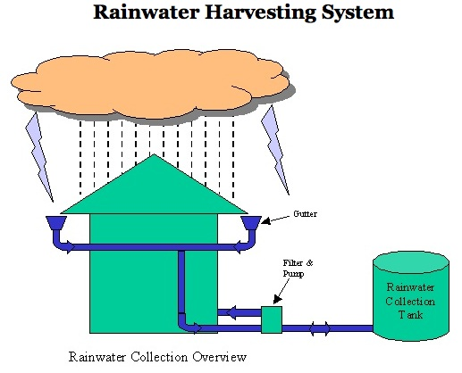
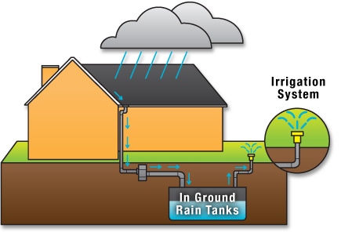
RWH in its broadest sense can be defined as the collection of run-off rainwater for domestic water supply, agriculture and environmental management. Water harvesting systems, which harvest runoff from roofs or ground surfaces fall under the term rainwater harvesting. Each RWH system consists of three basic components:
1- Catchment or roof surface to collect rainwater
2- Delivery system to transport the water from the roof to the storage reservoir (gutters and drainpipes)
3- Storage reservoir or tank to store the water until it is used.

Slide 5
2- Objectives:
1- Determine the amount of water that can be collected.
2- Use GIS-based SCS-CN method to estimate potential runoff generation in the Wadi.
3- Evaluate the potential of adopting RWH techniques to enhance the availability of water in the Wadi.
4- Utilize RWH techniques in Wadi Abu-Nar to halt the problems related to the frequent flood at the Wadi outlet.
5- Provide a sustainable, alternative water resource.

Slide 6
3- Advantages of Rainwater Harvesting:
1- It is environmentally safe and can be reasonably utilized
2- It provides a reliable renewable resource with special management and little investment.
3- In agriculture, comparing to the 10% increase in food production from irrigation, rainwater harvesting has demonstrated the potential of increasing food production by 100%.
4- The harvested water can be transported with little energy.

Slide 7
4- Methodology:
Problem Statement
Characterization of the study area
Data collection
Data analysis
Conclusion and recommendation

Slide 8
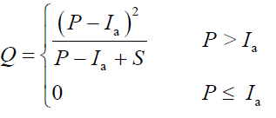


SCS-CN Method:
The runoff curve number (also called a curve number or simply CN) is an empirical parameter used in hydrology for predicting direct runoff or infiltration from rainfall excess
The runoff equation is
By removing I_{a} as an independent parameter, a combination of S and P to produce a unique runoff amount can be approximated. Substituting Ia= 0.2S gives and

Slide 9
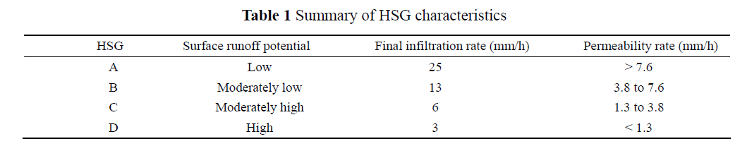
The HSG refer to the standard SCS soil classifications ranging from A, which refers to sand and aggregated silts with high infiltration rates, to classification D, which corresponds to soils that swell significantly when wet and have low infiltration rates. The HSG reflects a soil’s permeability and surface runoff potential. Table 1 summarizes the HSG characteristics (Schulze et al, 1992).

Slide 10
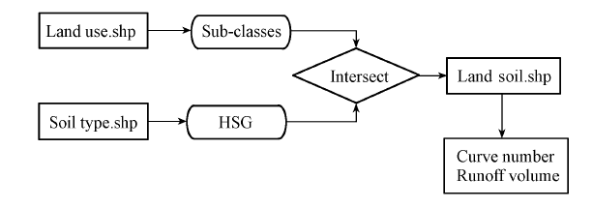
GIS-based SCS-CN Method:

Slide 11
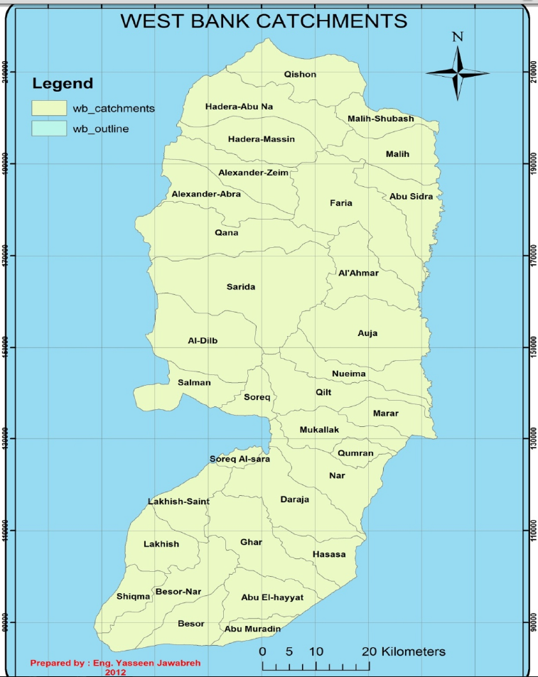
5- Study Area:

Slide 12
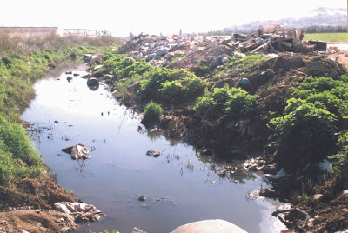
This research focuses on Wadi Abu-Nar catchment which is a drainage basin with an area of 247.5 km² is situated between Jenin and Tulkarem. It is part of the Jenin District which represents the northern part of the West Bank / Palestine.
It has hot, dry summers and cool, rainy winters. Temperature ranges from 5°C in the winter to 40°C in the summer, with an average annual temperature of 16°C. Average annual rainfall is approximately 500 mm. Wind speeds can reach up to 75 km/h.

Slide 13
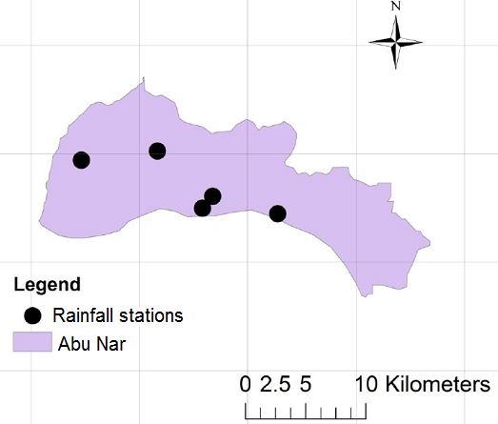
Rainfall stations locations in Wadi Abu Nar catchment

Slide 14
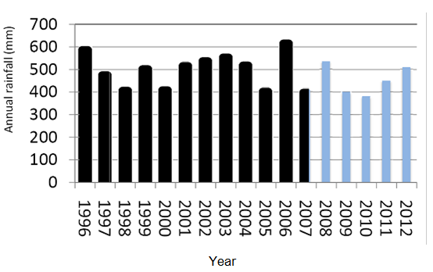
Annual rainfall for Wadi Abu Nar

Slide 15
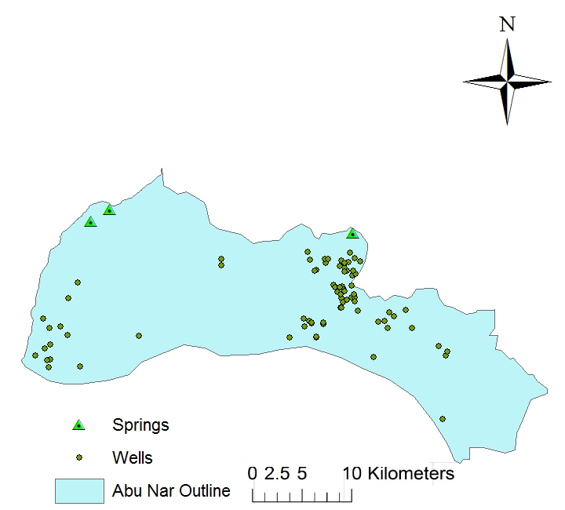
Abu Nar catchment has a 3 springs and 78 groundwater wells as shown in figure below:

Slide 16
Relative Humidity
Relative humidity is approximately 63%
according to PCBS recordings in 2007.

Slide 17
Geology
The area of Wadi abu nar lies in the seismic zone of the Dead Sea Transform Fault. The geological fault is positioned between the African Plate on the west and the Arabian Plate on the east

Slide 18
Soil type
Wadi Abu Nar drainage basin includes within its boundary two main soil associations: Terra Rossa stemming from dolomite and hard limestone

Slide 19
Thank you for listening

