Slide 1
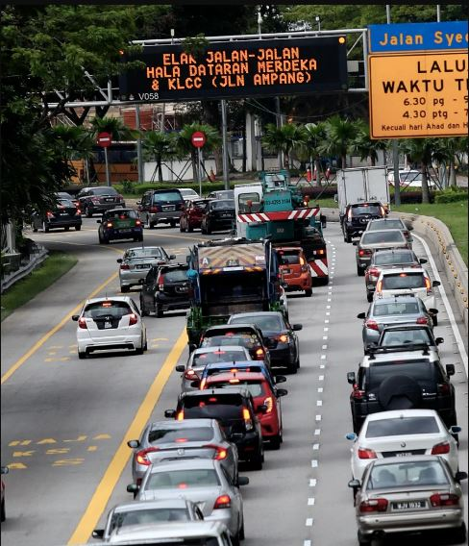
Evaluating the existing traffic condition and developing a traffic management plan for the eastern region of Nablus city – Design Al-Hurriah bridge
Ali Al-Otaibi
Hassan Sawalma
Ehab Hijab

Slide 2
Presentation contents
Methodology
Data collection
Data analysis
Scenarios
Design criteria
Quantity & Cost
Discussion
Introduction
Notes:
© Copyright Showeet.com – Creative & Free PowerPoint Templates

Slide 3
CHAPTER ONE
Introduction

Slide 4
Introduction
Study area description
Hypothesis
Problem statment
Research question
Objective

Slide 5
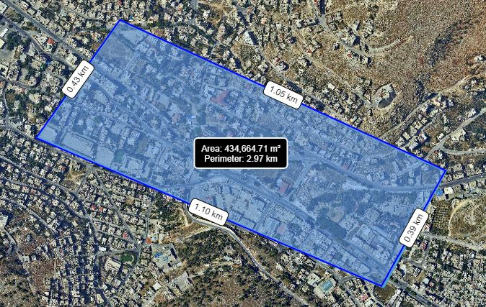

Slide 6
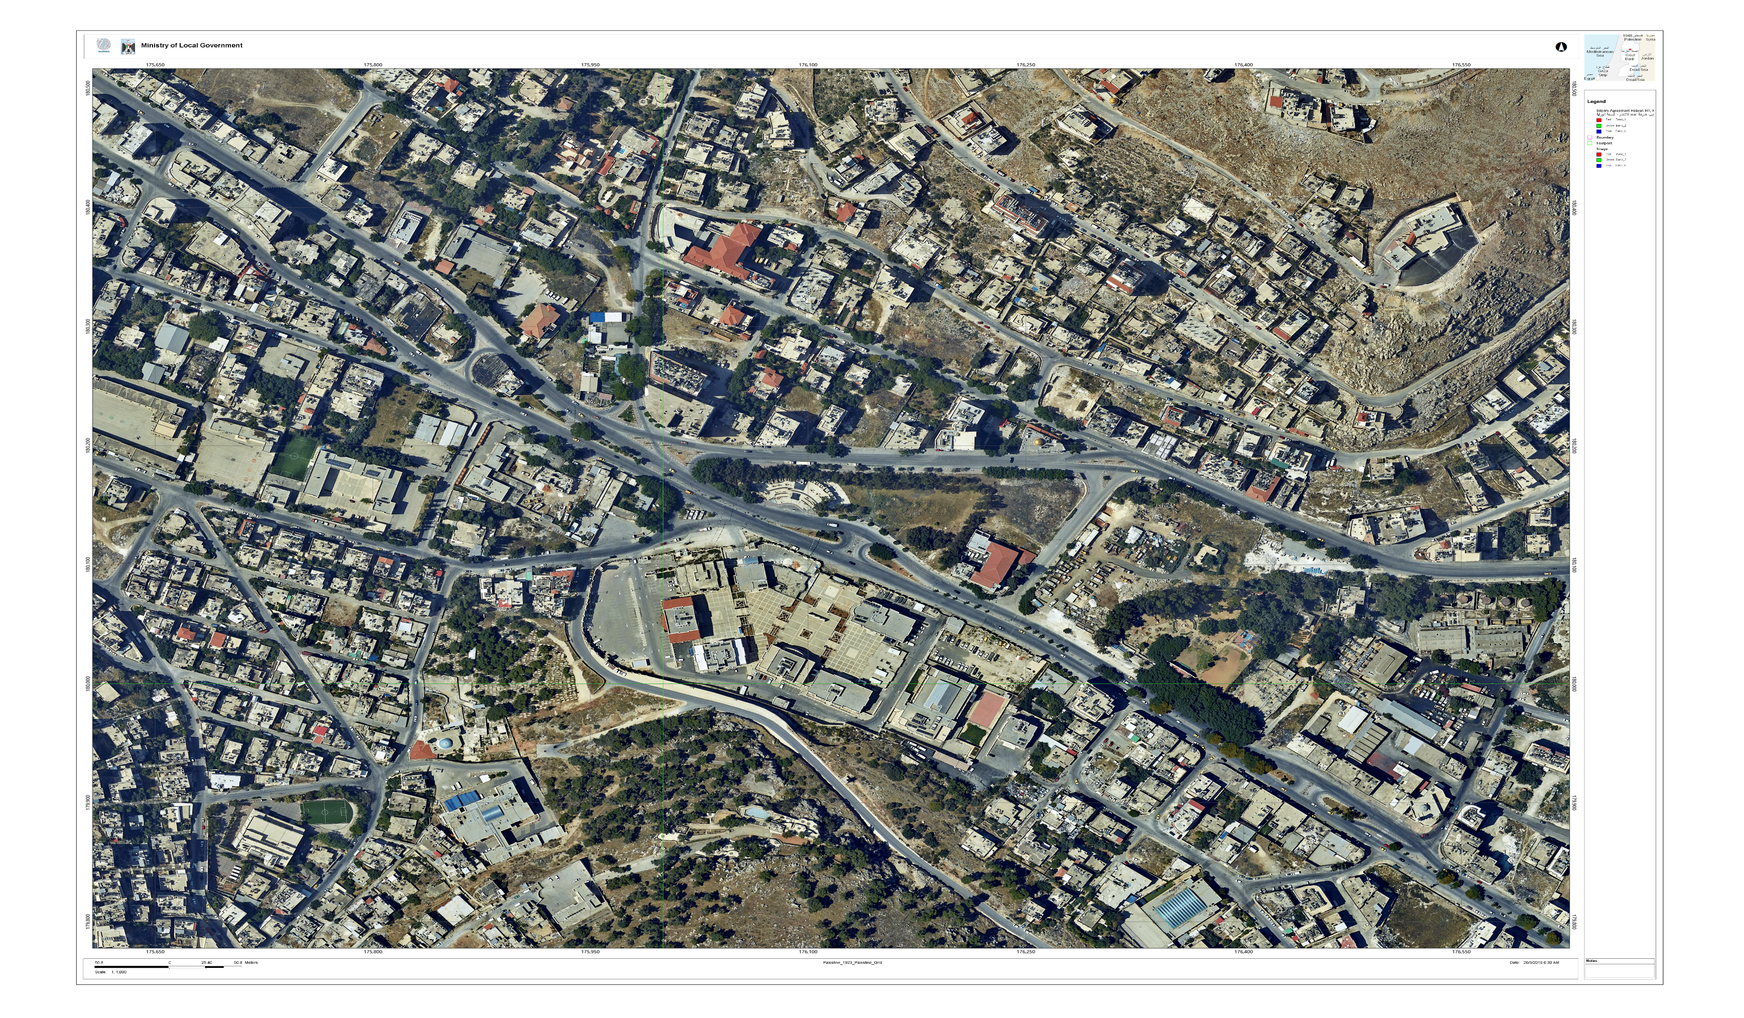
Faisal St.
Amman St.
Al-Ghazali St.
Balata St.

Slide 7
4
2
3
6
1
5
9
13
7
11
12
10
8
14
15

Slide 8
Problem statement and Hypothesis
Ministries
CBD
Schools
Pedestrian
Private cars
Corridor

Slide 9
Research questions
?
Causes of congestion
Traffic generators
Intersections geometry
Ministries Complex U-turn
Bridge
Pedestrian
Notes:
© Copyright Showeet.com – Creative & Free PowerPoint Templates

Slide 10
Objective
Improve LOS
Bridge Design
Pedestrian crossing
Notes:
© Copyright Showeet.com – Creative & Free PowerPoint Templates

Slide 11
CHAPTER TWO
Methodology

Slide 12
Methodology
6
Quantity and cost
Design
5
4
Results
3
Data analysis
Data collection
2
Define problems
1
Notes:
© Copyright Showeet.com – Creative & Free PowerPoint Templates

Slide 13
CHAPTER THREE
Data Collection

Slide 14
Inventory study
Types of collected data
Pedestrian count
Traffic count

Slide 15
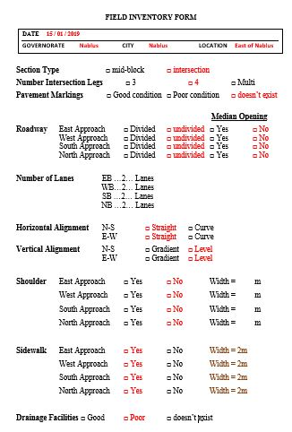
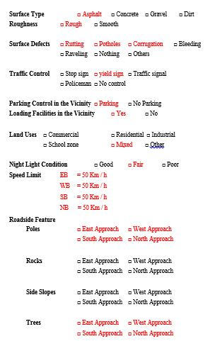

Slide 16
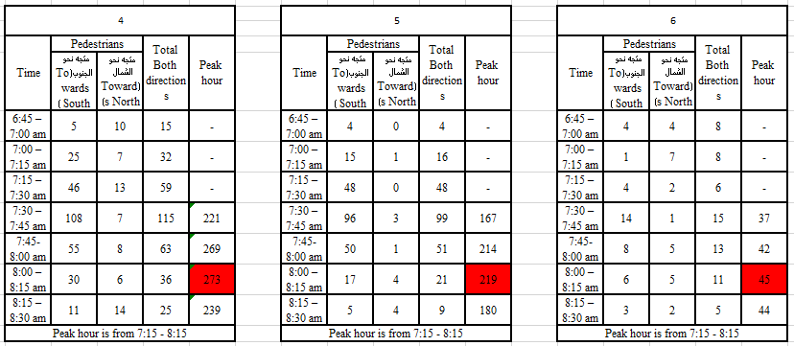

Slide 17
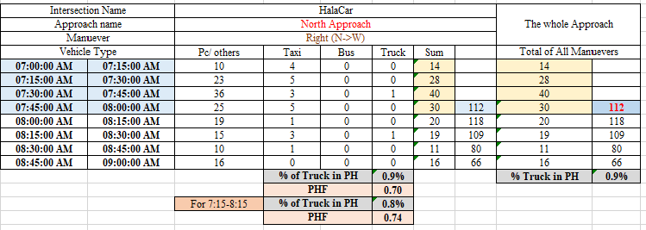

Slide 18
CHAPTER FOUR
Data Analysis

Slide 19
Data analysis
Vehicles
Pedestrian

Slide 20
Pedestrian Count Analysis

Slide 21
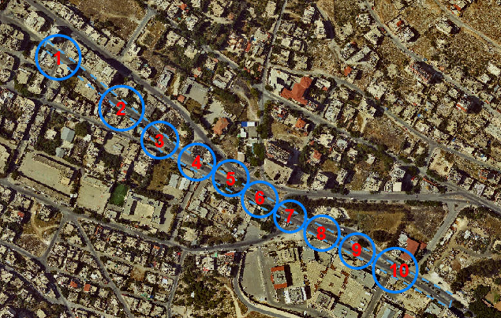
From…

Slide 22
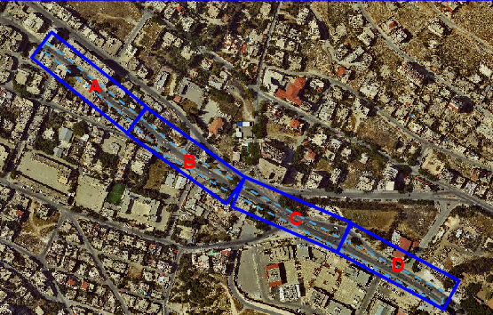
…To

Slide 23
Traffic volume Analysis
1
PH, PHV and PHF
2
√
Network Drawing
Synchro 10 software
√
ICU LOS Determination

Slide 24
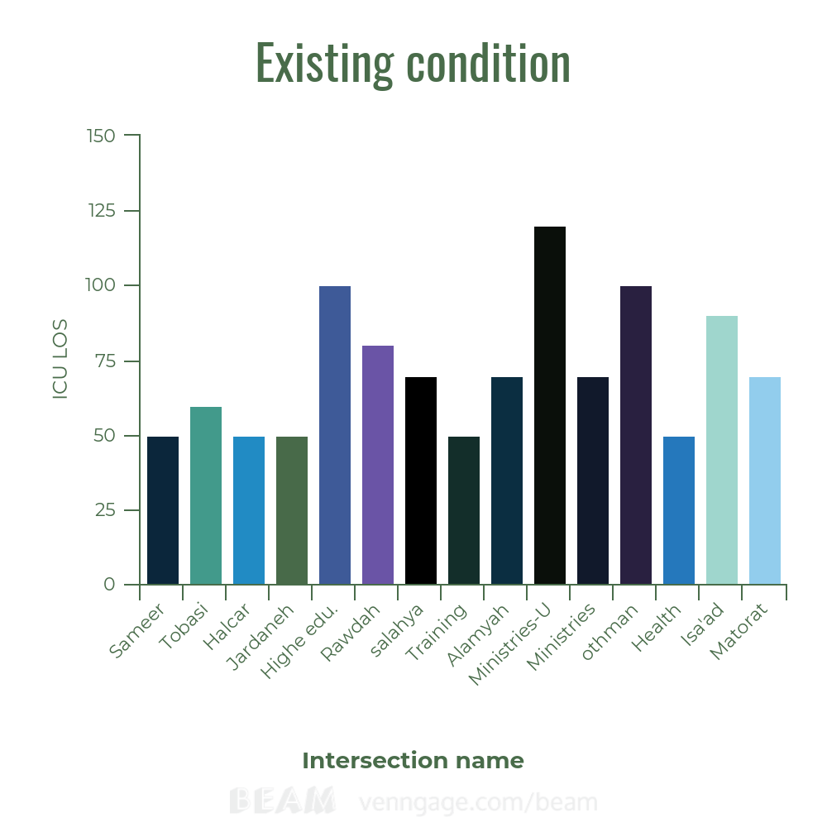
LOS E

Slide 25
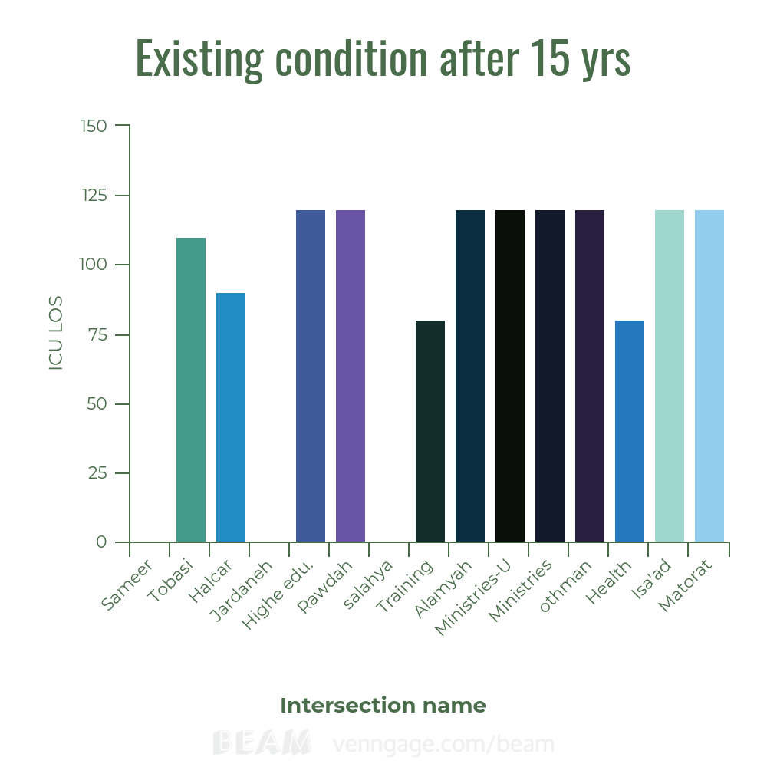
LOS E

Slide 26
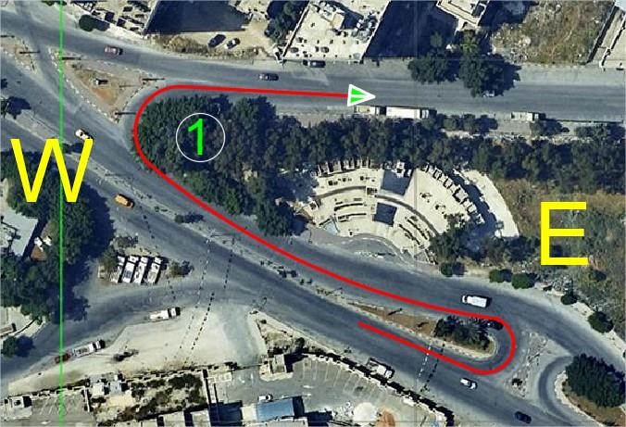
Movement of U-turn (W-W) corresponding to Government ministries complex,
then right turn at Al-Alamyah intersection

Slide 27
CHAPTER FIVE
Scenarios

Slide 28

Scenarios
6
5
4
Do Nothing
Changing Movements
3
Bridge
BRT System
2
1
Bridge-BRT
Movements -Bridge -BRT
Notes:
© Copyright Showeet.com – Creative & Free PowerPoint Templates

Slide 29
Do nothing
1
Keep existing network as the same
Notes:
© Copyright Showeet.com – Creative & Free PowerPoint Templates

Slide 30
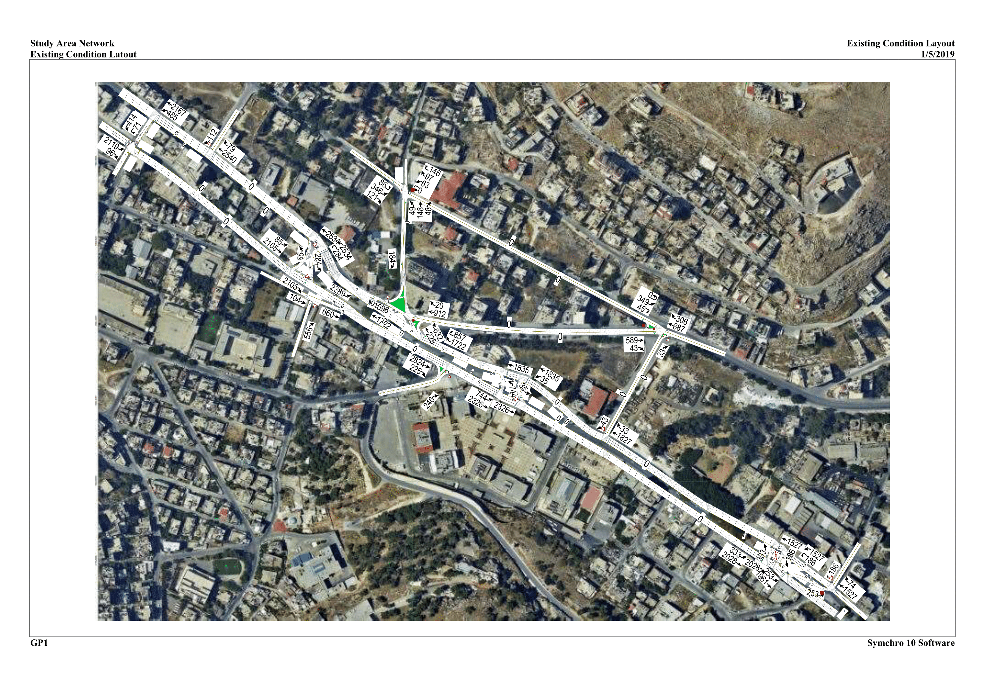

Slide 31
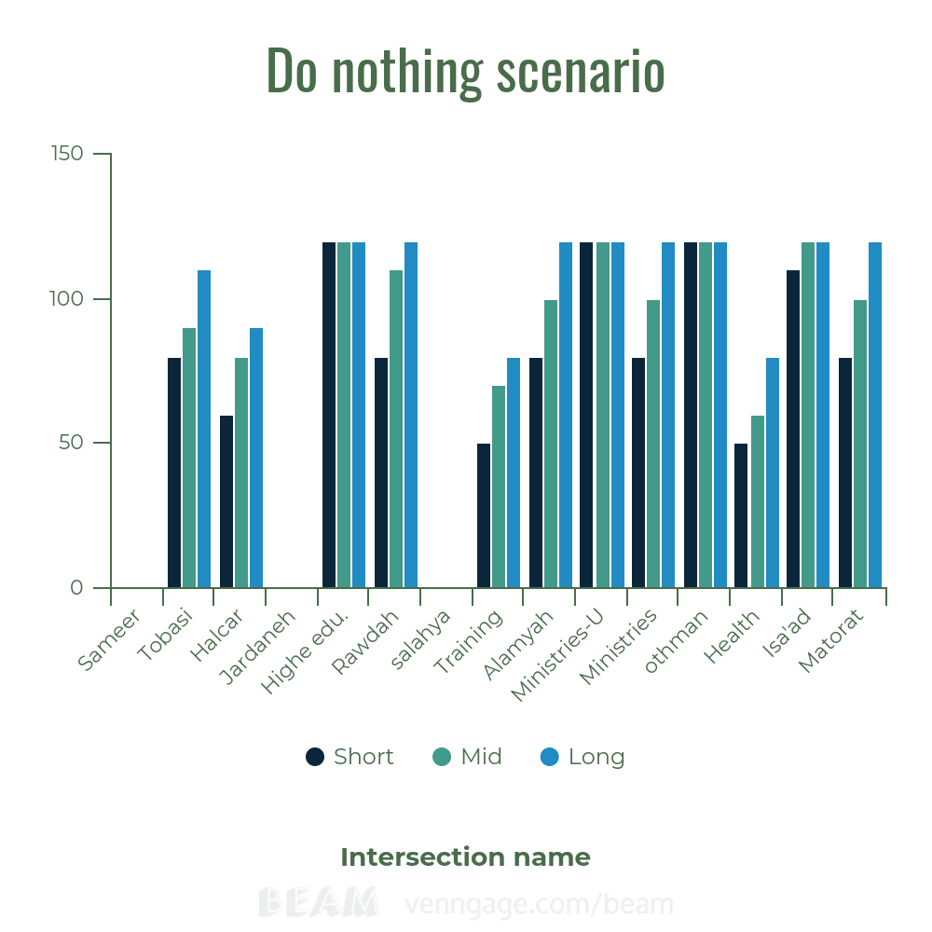
Do nothing Scenario
LOS E

Slide 32
Changing movements only
2
Propose redirection for some traffic movements as explained in the report.
Notes:
© Copyright Showeet.com – Creative & Free PowerPoint Templates

Slide 33
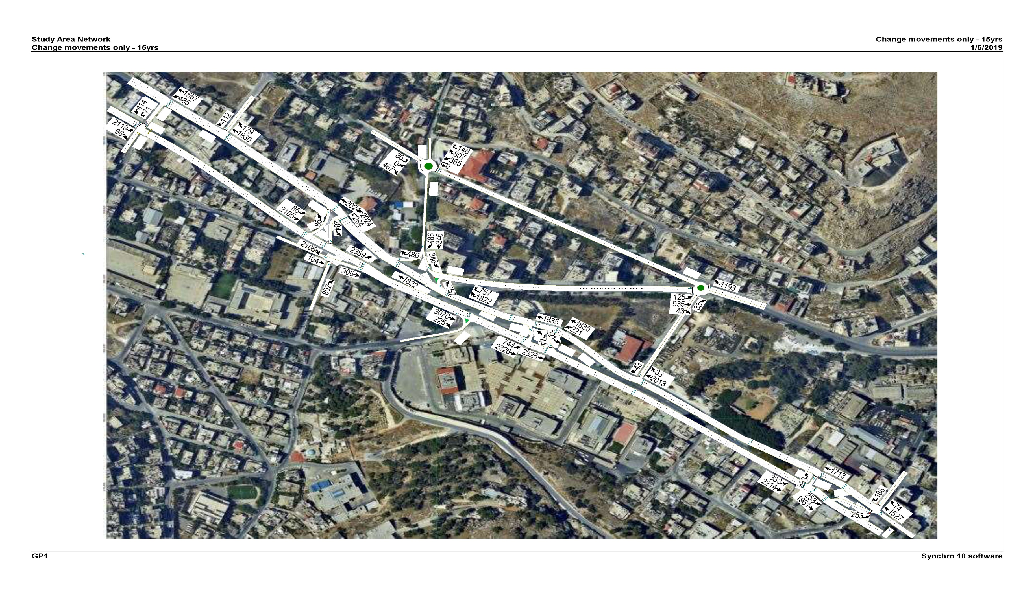

Slide 34
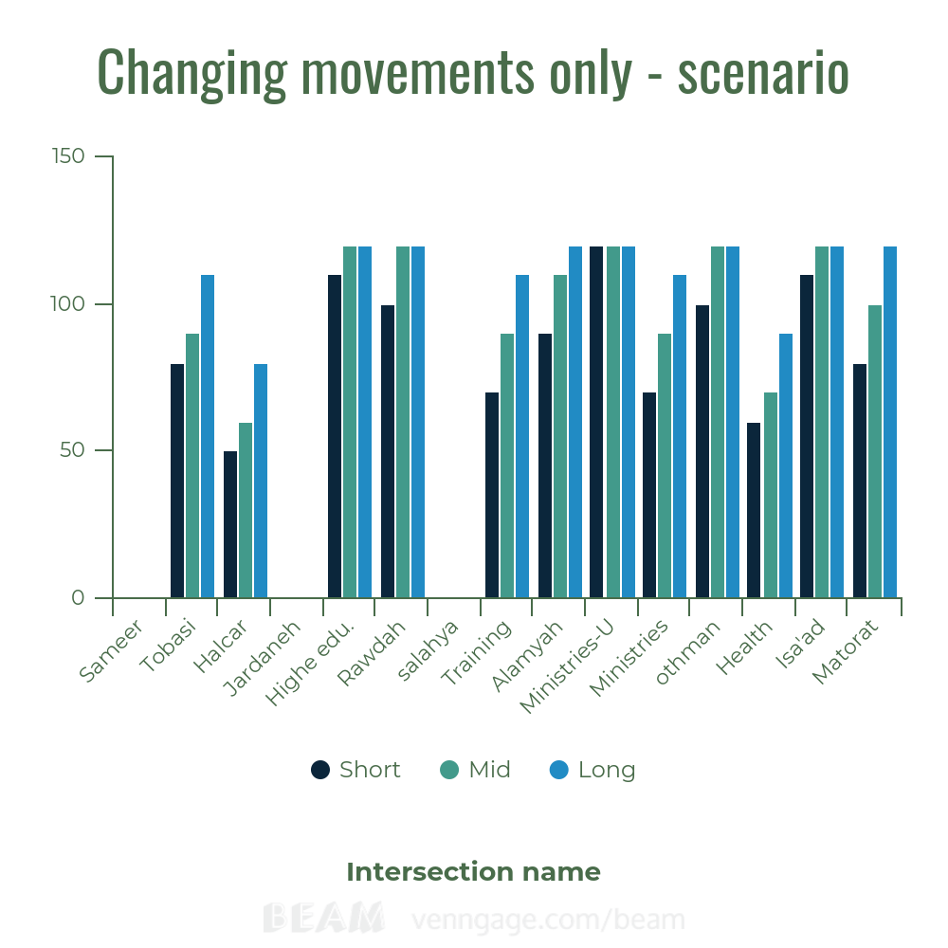
Changing movements only - scenario
LOS E

Slide 35
3
Bridge
For U-turns corresponding to ministries complex and Matorat.
Notes:
© Copyright Showeet.com – Creative & Free PowerPoint Templates

Slide 36
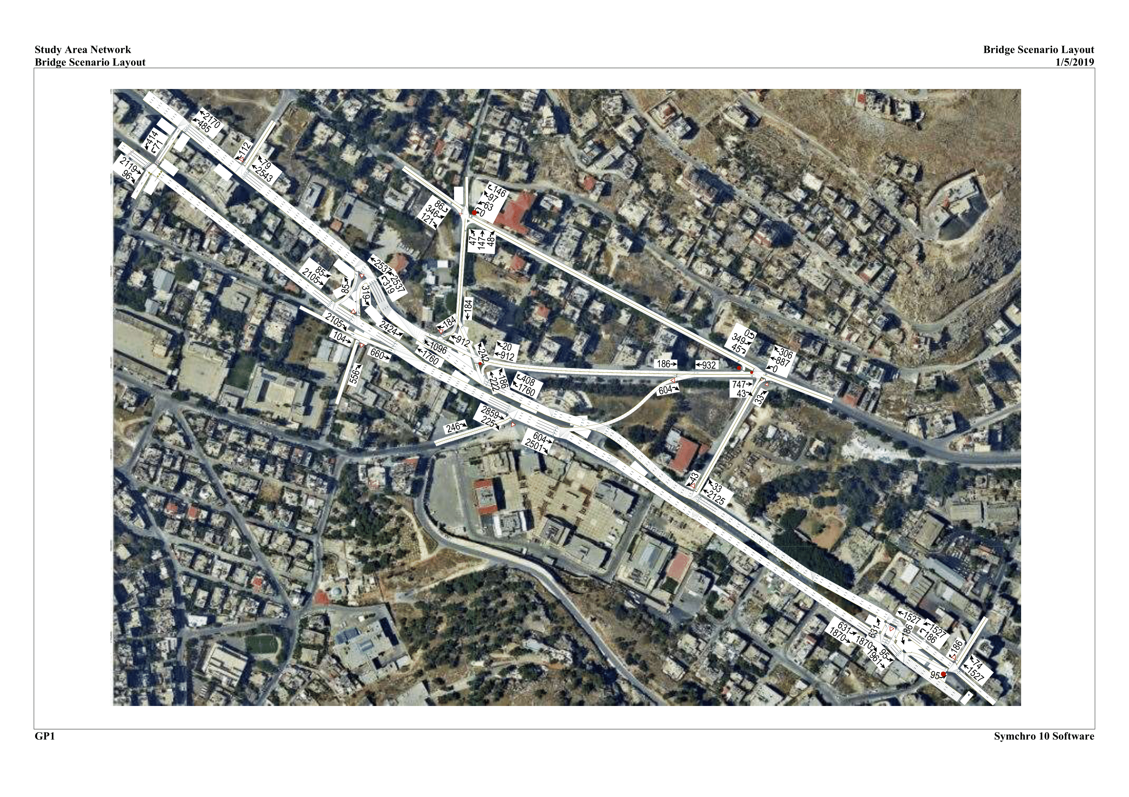

Slide 37
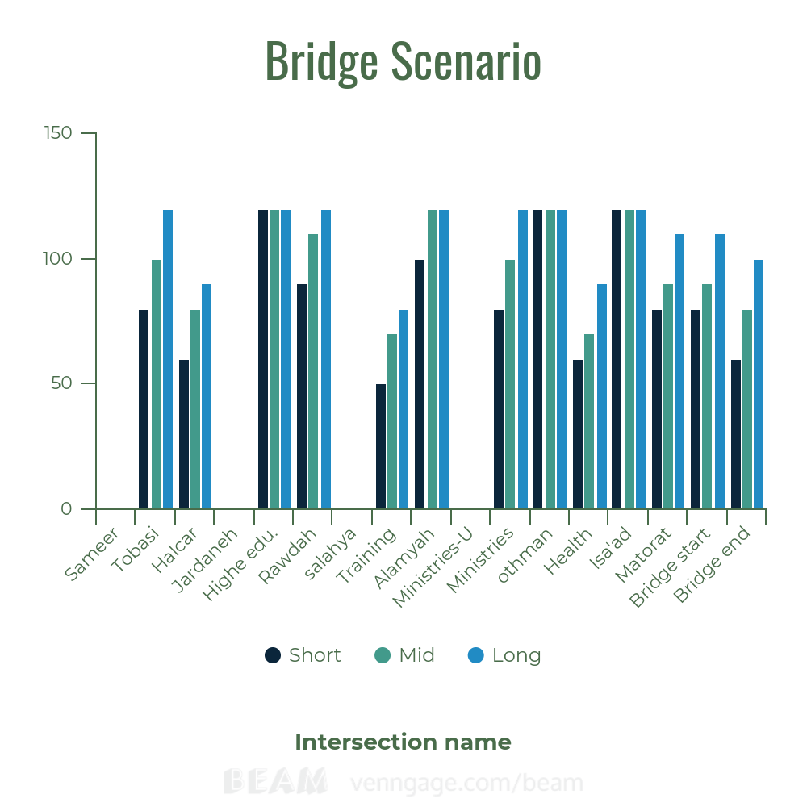
Bridge scenario
LOS E

Slide 38
4
BRT System
Reducing Traffic volume coming and leaving east and west terminals near CBD
Notes:
© Copyright Showeet.com – Creative & Free PowerPoint Templates

Slide 39
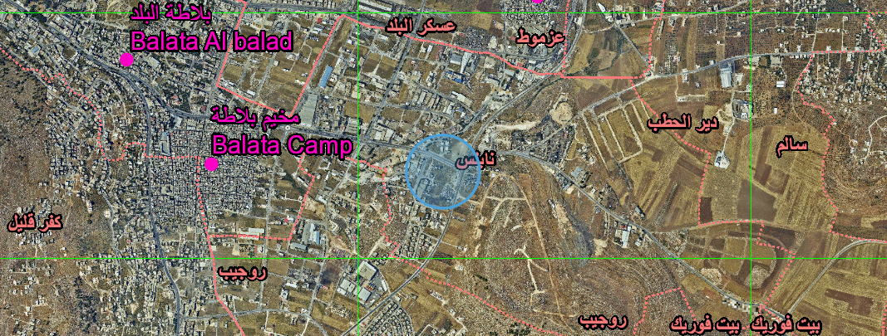

Slide 40
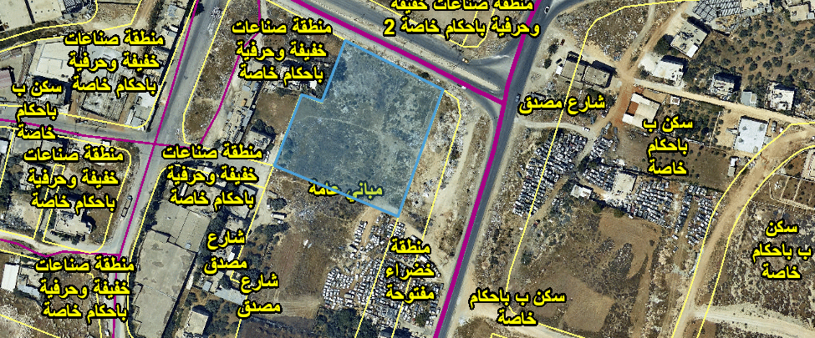

Slide 41


Slide 42
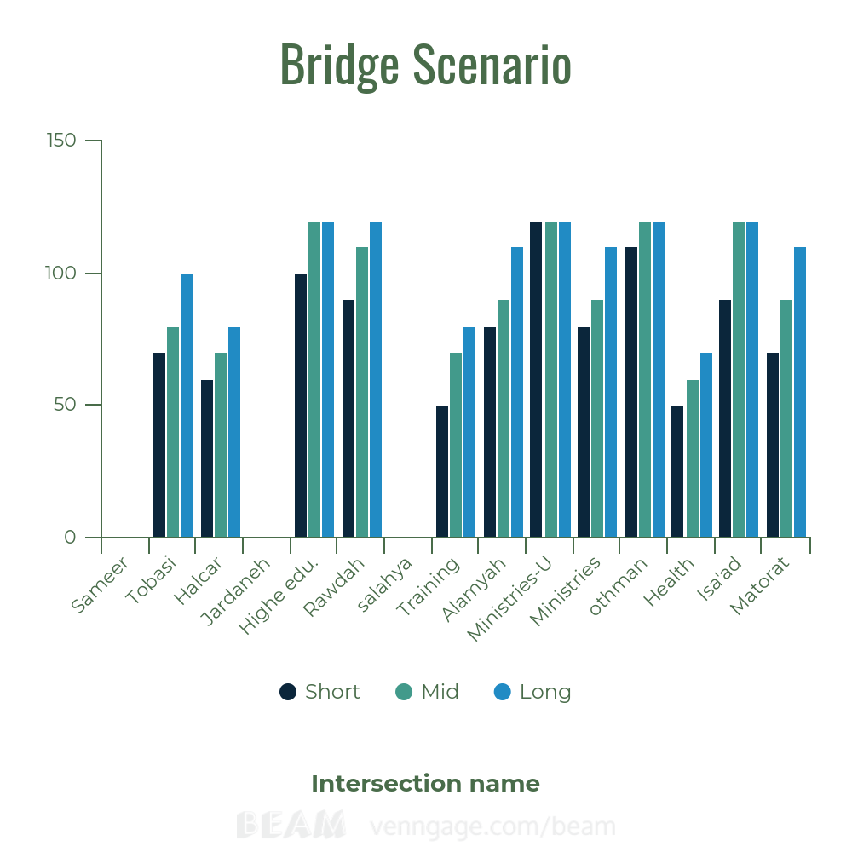
BRT System scenario
LOS E

Slide 43
5
Bridge – BRT Combination
Notes:
© Copyright Showeet.com – Creative & Free PowerPoint Templates

Slide 44
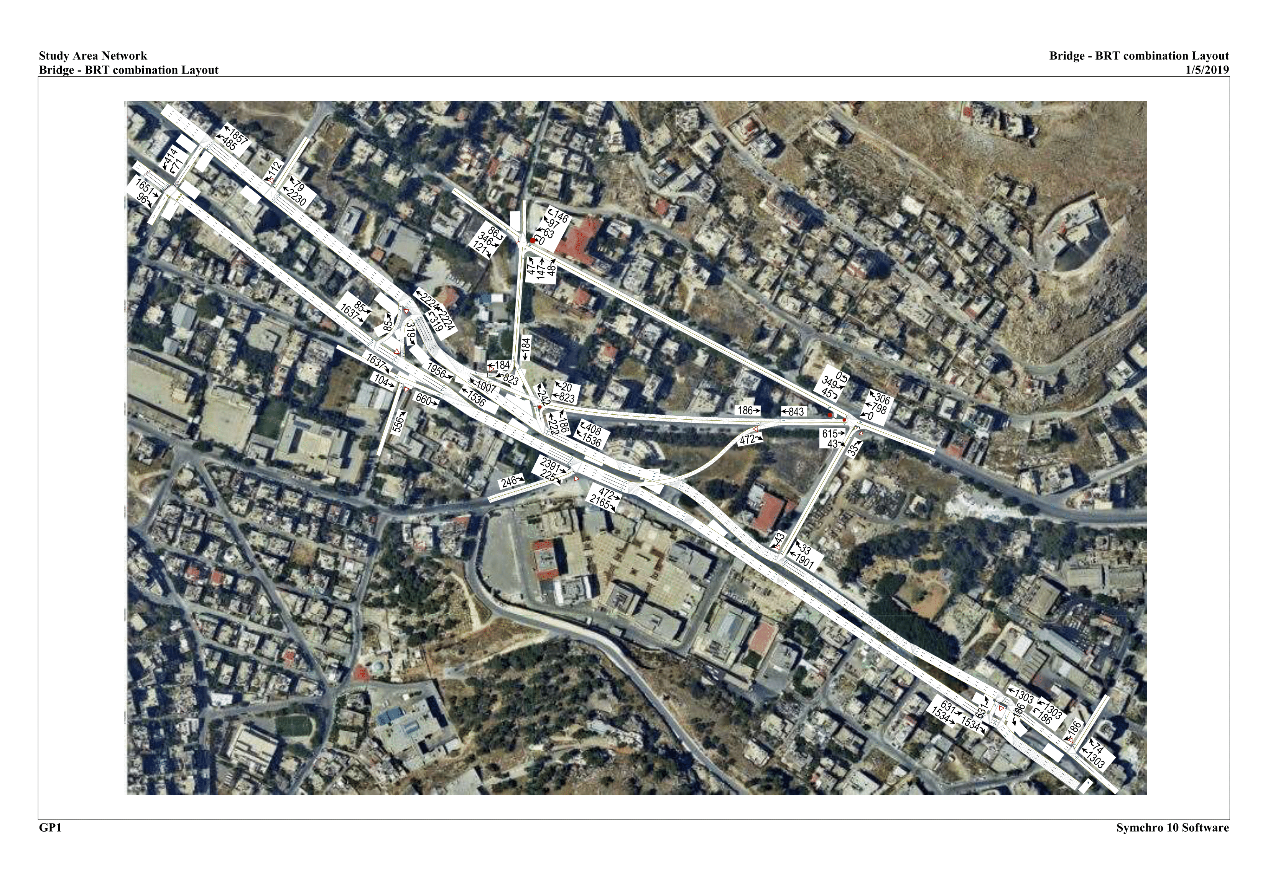

Slide 45
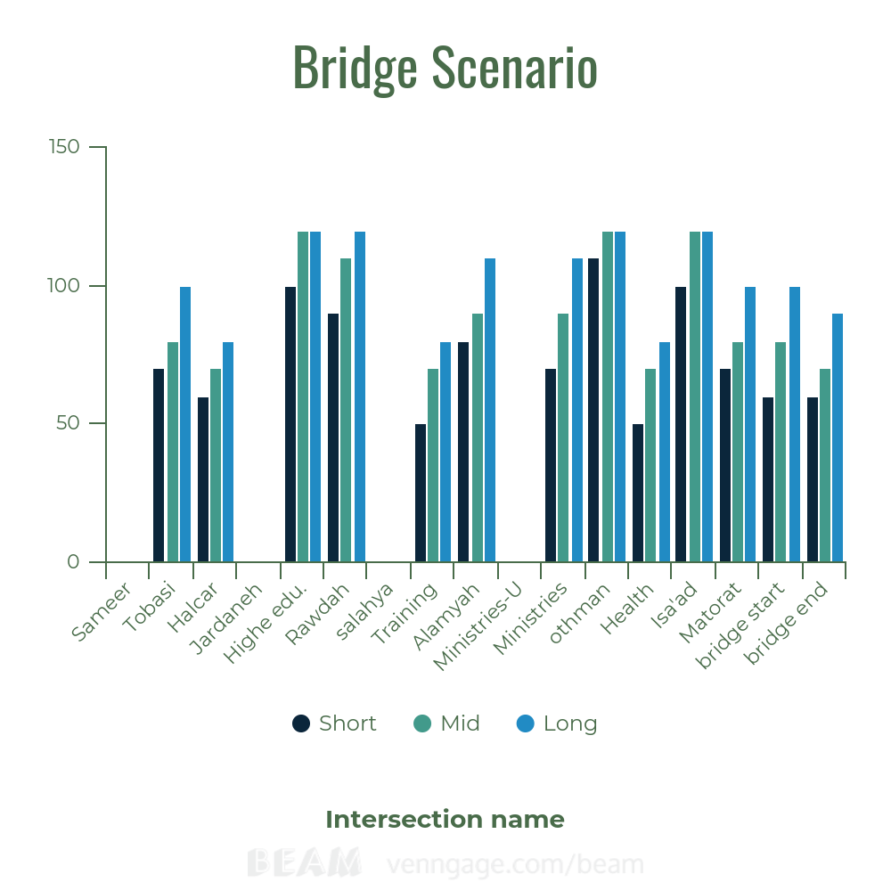
Bridge – BRT scenario
LOS E

Slide 46
Changing movements –Bridge -BRT
6
Notes:
© Copyright Showeet.com – Creative & Free PowerPoint Templates

Slide 47


Slide 48
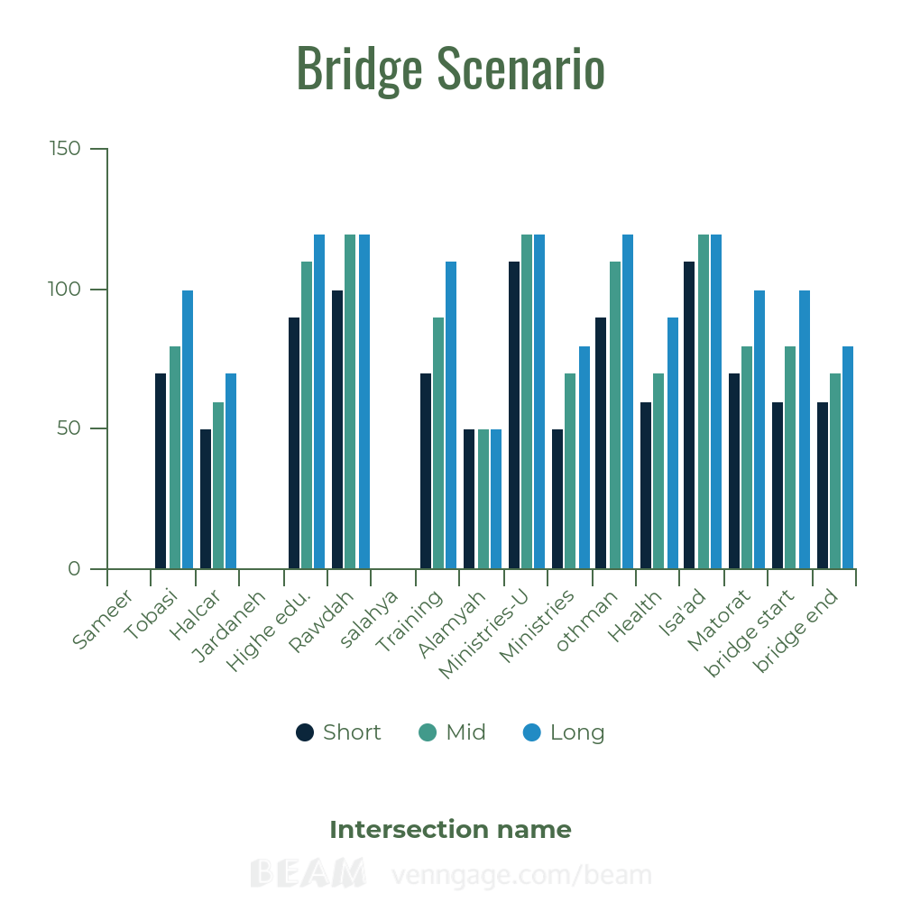
Changing movements –Bridge – BRT scenario
LOS E

Slide 49
Measure of Effectiveness
Avg. Travel speed
Total Delay
Emissions
Fuel consumption

Slide 50
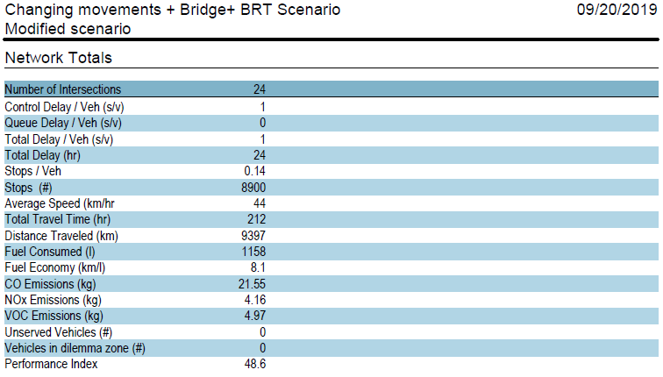

Slide 51
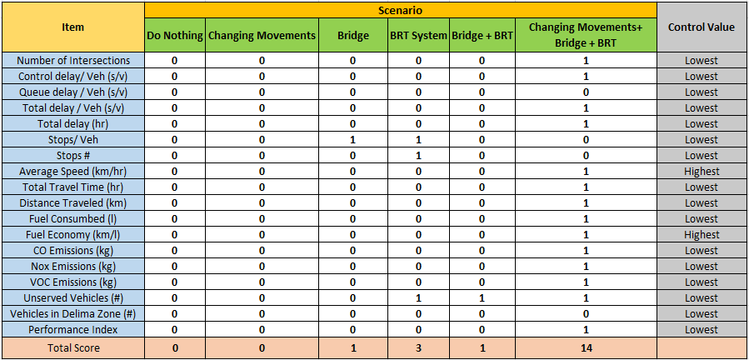

Slide 52
CHAPTER SIX
Design Criteria

Slide 53
This chapter is containing of 4 parts:
01
DESIGN OF THE BRIDGE
02
DESIGN OF THE BRIDGE ENTRANCE
03
DESIGN OF THE BRIDGE EXIT
04
RE-CHANNELIZATION OF OTHMAN INTERSECTION
Notes:
© Copyright Showeet.com – Free PowerPoint Templates

Slide 54

The design was accomplished according to the American Association of State Highway and Transportation Officials (AASHTO 2011)

Slide 55


SOFTWARE USED IN THE DESIGN PROCESS:
s
s

Slide 56
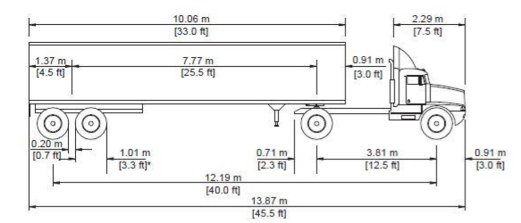
GENERAL DESIGN CONSIDERATION
The bridge is classified as an Urban Collector Road
The design speed is 50 km/hr
The design vehicle is WB-12

Slide 57
The following video represents an overview for the proposed scenario in this project

Slide 59
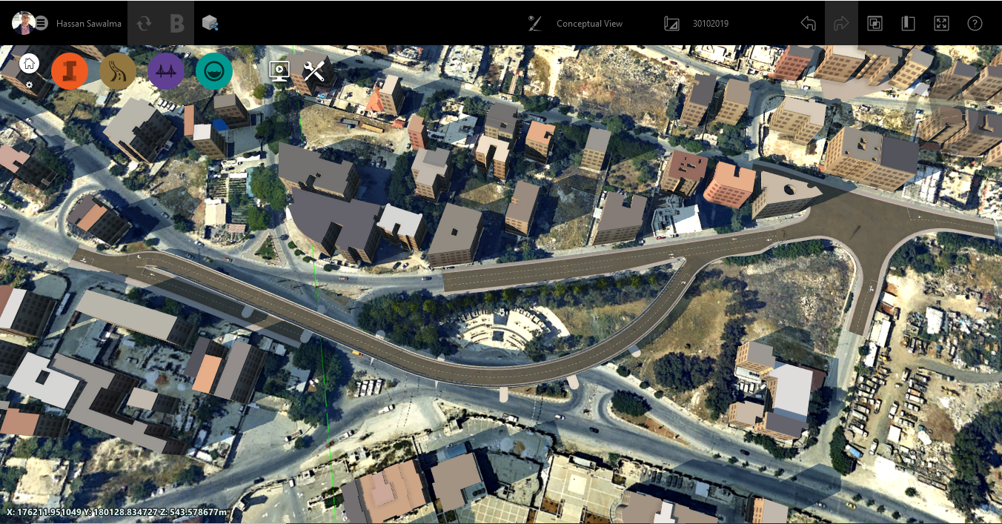
DESIGN OF THE BRIDGE

Slide 60



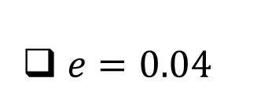
DESIGN OF THE BRIDGE
Design of the Horizontal Alignment
$R_{min}$ = $\frac{u^{2}}{127(e+f)}$ (SI units)
$u=50 km/hr$
$e=0.04$
$f=0.15$
The minimum Radius = 104 m

Slide 61


DESIGN OF THE BRIDGE
Design of the Horizontal Alignment
$L_{min}$ = $3  V_{d}$
$V_{d}=50 km/hr$
The minimum Curve length = 150 m

Slide 62
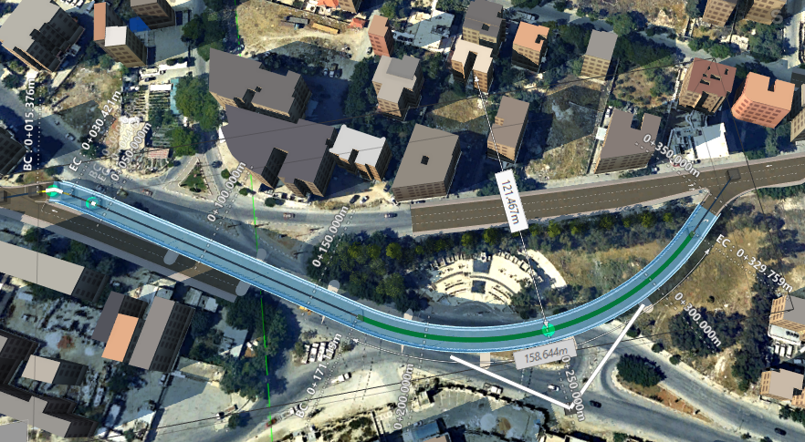
DESIGN OF THE BRIDGE
Design of the Horizontal Alignment

Slide 63
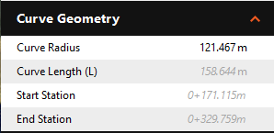
DESIGN OF THE BRIDGE
Design of the Horizontal Alignment

Slide 64
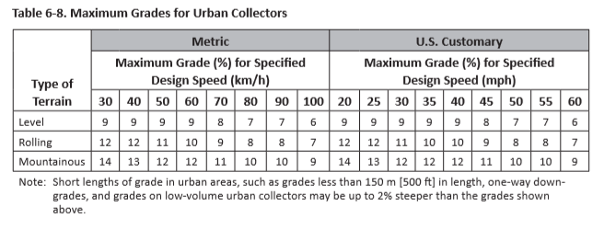
DESIGN OF THE BRIDGE
Design of the Vertical Alignment
Maximum Grade allowable is 11%

Slide 65
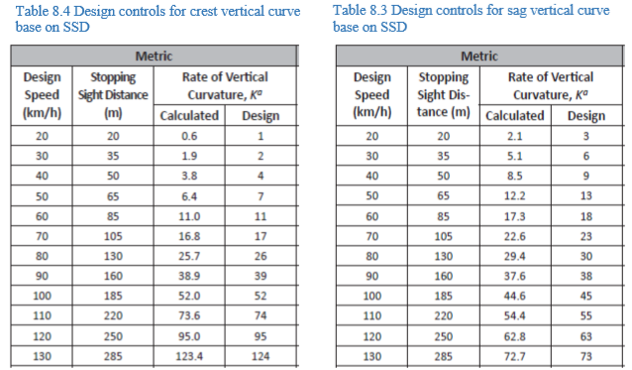

DESIGN OF THE BRIDGE
Design of the Vertical Alignment
Crest and Sag curves
$L$= $AK$

Slide 66
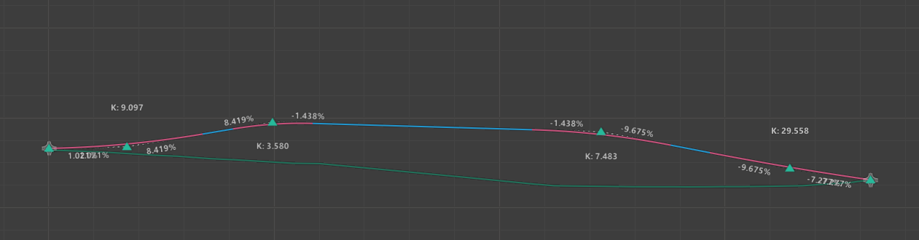
DESIGN OF THE BRIDGE
Design of the Vertical Alignment
Crest and Sag values for the vertical curves

Slide 67
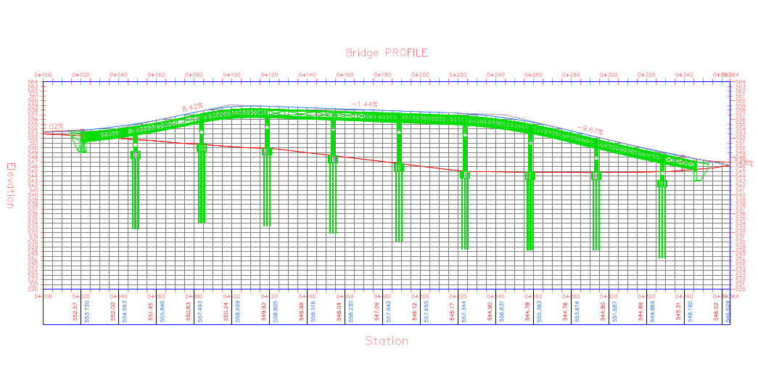
DESIGN OF THE BRIDGE

Slide 68
DESIGN OF THE BRIDGE
Cross Section Elements
A Two- Lane One- Way bridge is designed consisting of the following elements along the whole bridge:
Two lanes each of 3.6 m each
Lateral clearance of 0.5 m on each side
Curb and Gutter of 0.15+0.45 m on each side
Barriers and Guardrails
The Right Of Way for the bridge is 9.5 m
A 2% value of cross slope is used to consider surface drainage

Slide 69
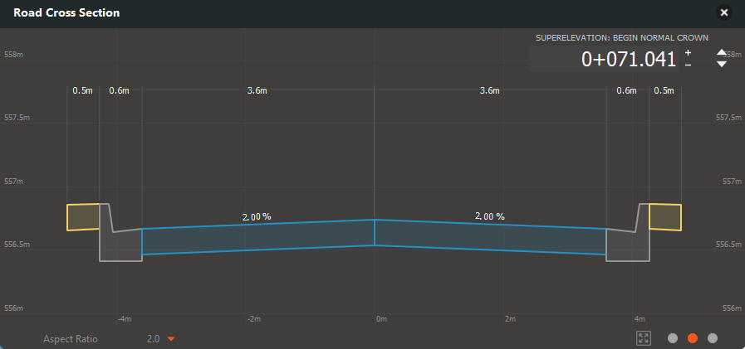
DESIGN OF THE BRIDGE
Cross Section Elements

Slide 70
DESIGN OF THE BRIDGE
Superelevation
A value of 4% is considered
Attaining the Superelevation

Slide 71
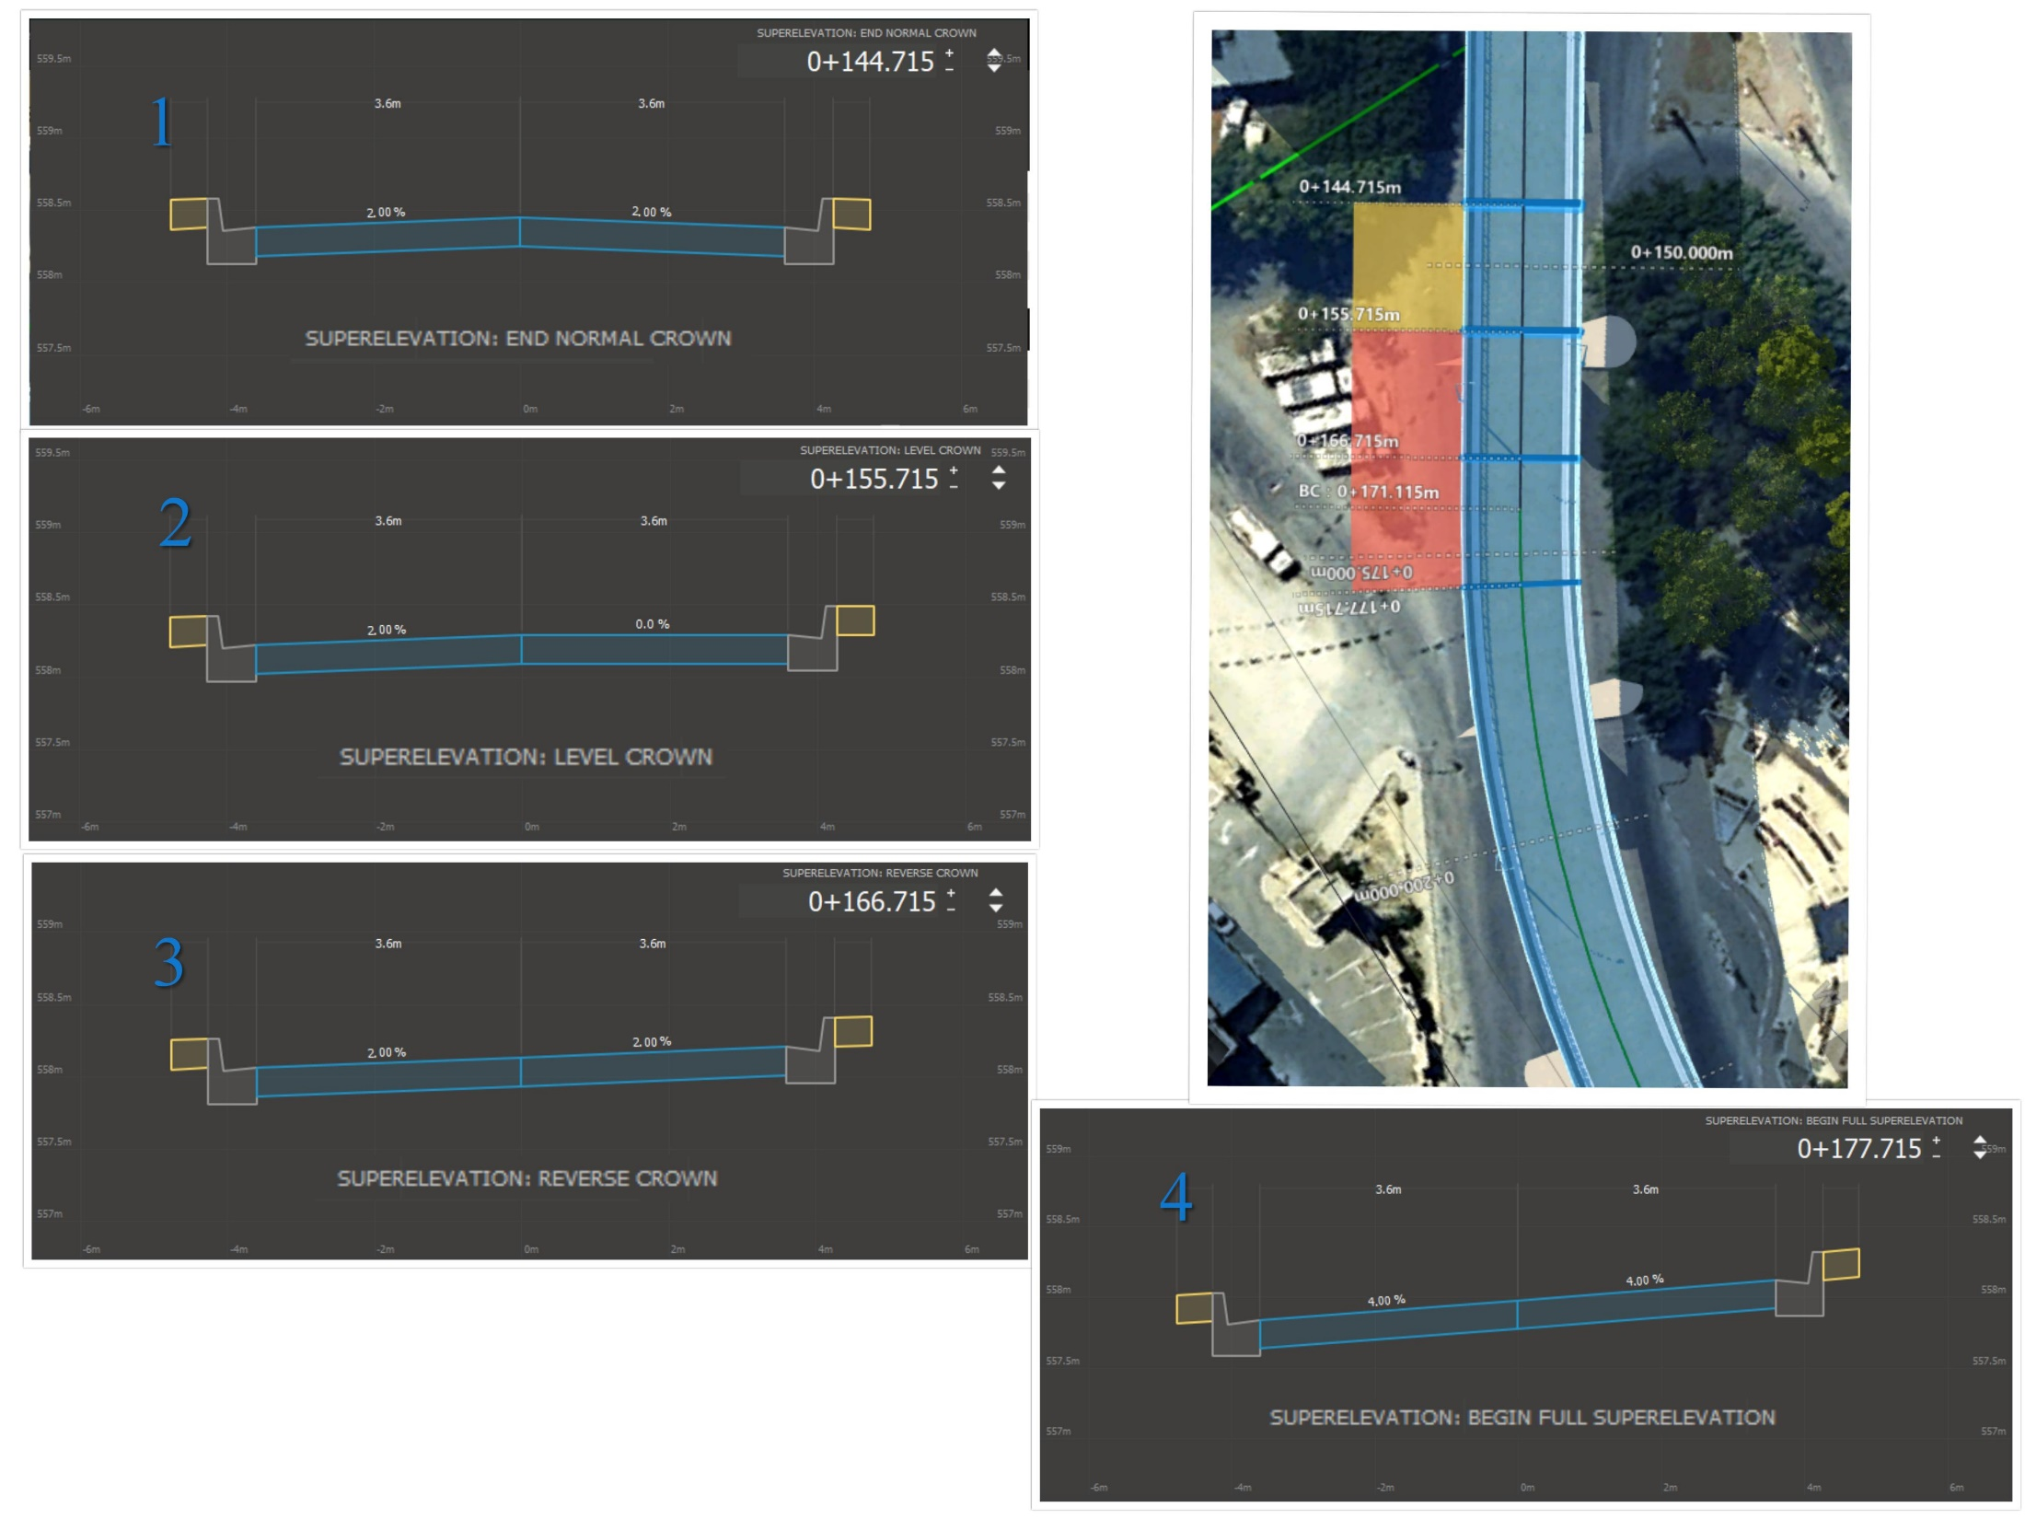

Slide 72
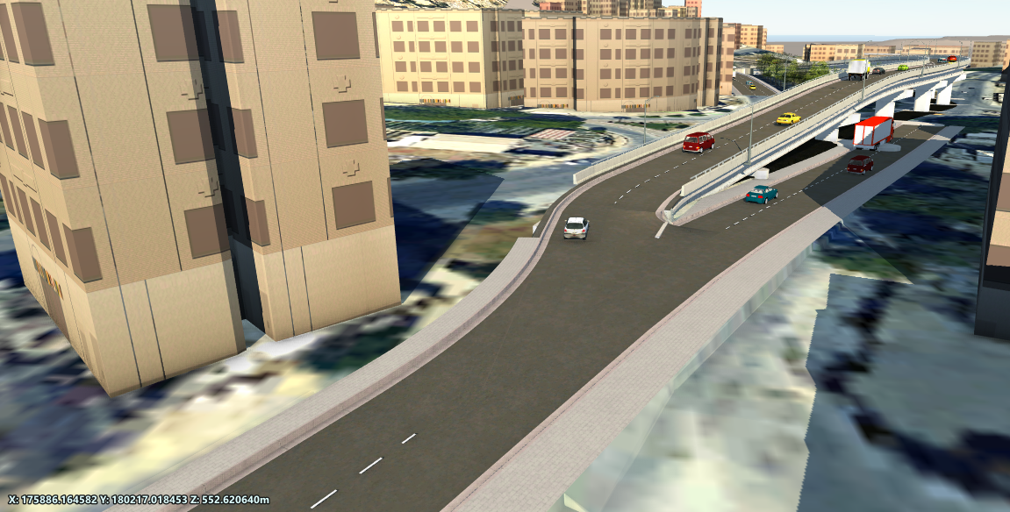
DESIGN OF THE BRIDGE ENTRANCE

Slide 73
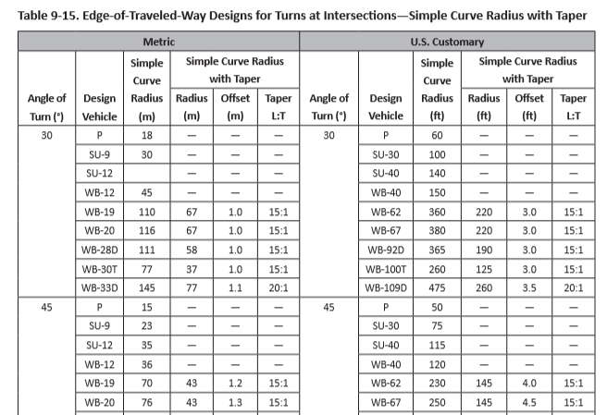
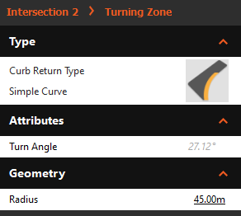
DESIGN OF THE BRIDGE ENTRANCE
Turning Roadway
Turn Angle is 27 °

Slide 74
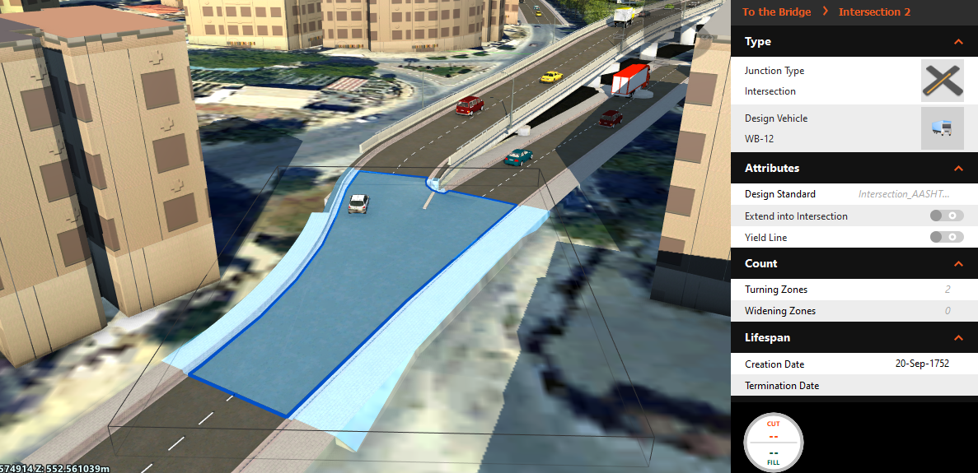
DESIGN OF THE BRIDGE ENTRANCE
Turning Roadway with simple curve R = 45 m

Slide 75
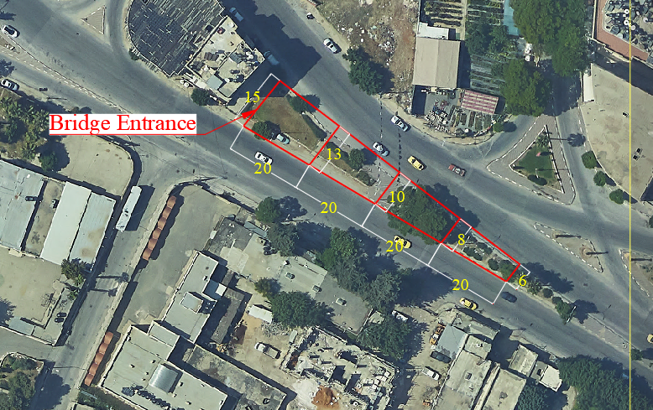
DESIGN OF THE BRIDGE ENTRANCE
Why This Location?
Available ROW

Slide 76
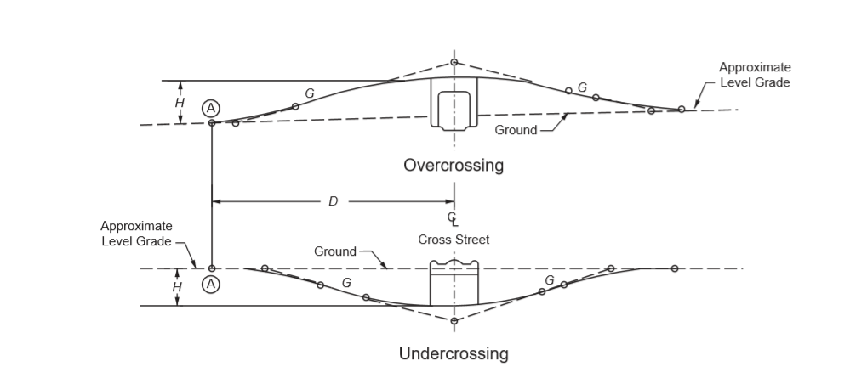
DESIGN OF THE BRIDGE ENTRANCE
Why This Location?
Vertical Clearance
Minimum H | 4.4 m
Desirable | 5 m
We take H = 7 m

Slide 77
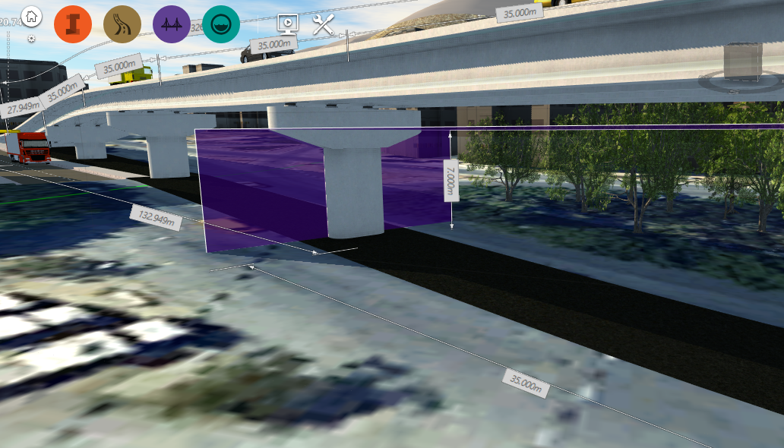
DESIGN OF THE BRIDGE ENTRANCE
Why This Location?
Vertical Clearance

Slide 78
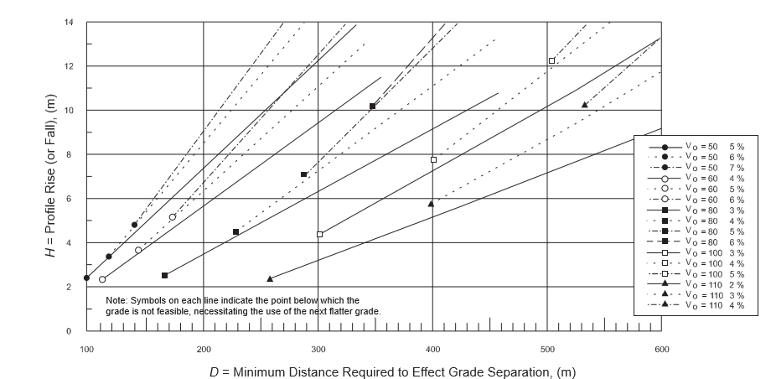
DESIGN OF THE BRIDGE ENTRANCE
Why This Location?
Distance needed for Grade Separation is about 150 m

Slide 79
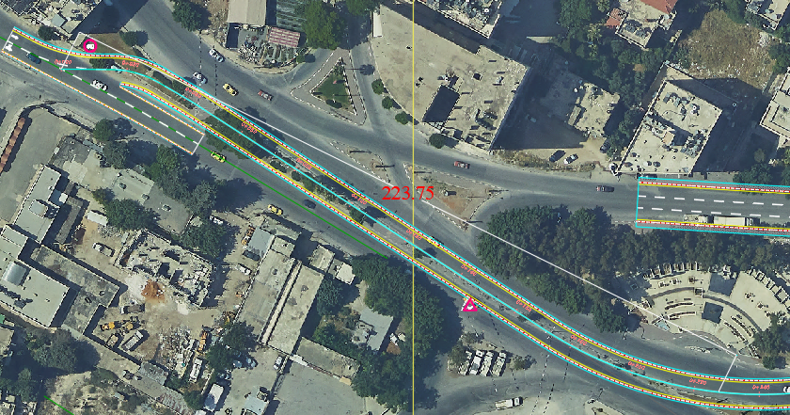
DESIGN OF THE BRIDGE ENTRANCE
Why This Location?
Distance needed for Grade Separation

Slide 80
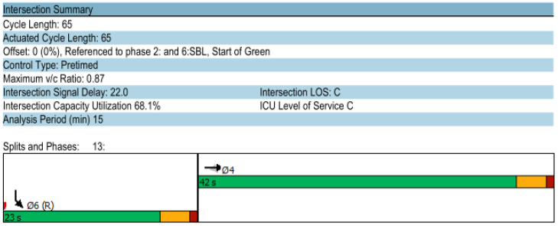
Traffic Signal installation
Directorate of Education
The intersection represents the point that precedes the bridge entrance.
To prevent interruption between vehicles, the team propose a traffic light.
Warranted intersection
Cycle length of 65 seconds, analyzed using Synchro 10 software

Slide 81
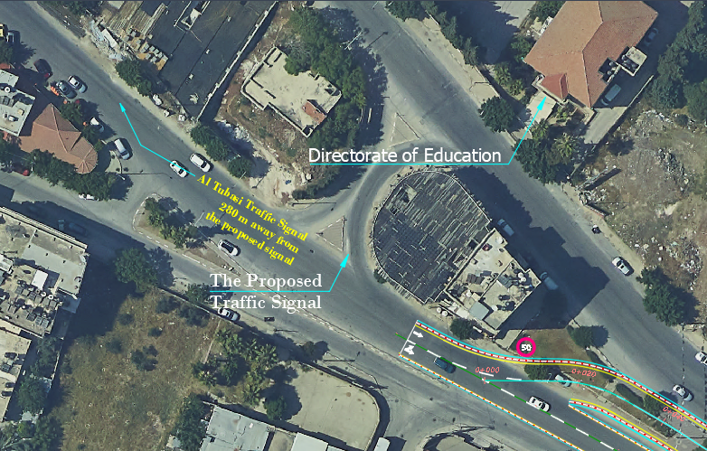
Traffic Signal

Slide 82
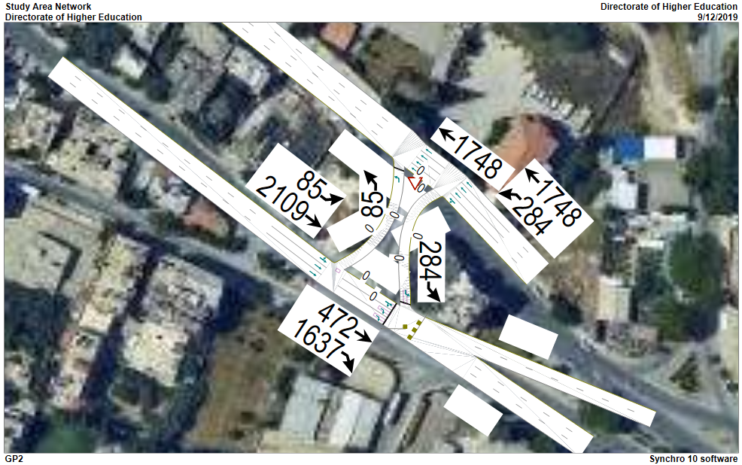

Slide 83



Slide 84

DESIGN OF THE BRIDGE EXIT

Slide 85

DESIGN OF THE BRIDGE EXIT
Turning Roadway
Turn Angle is 43 °
Minimum R =36 m

Slide 86

DESIGN OF THE BRIDGE EXIT
Turning Roadway with simple curve R = 45 m

Slide 87

DESIGN OF THE BRIDGE EXIT
More details were taken into consideration on the bridge exit design:
A Flushed Median
A Raised Median

Slide 88

DESIGN OF THE BRIDGE EXIT

Slide 89

DESIGN OF THE BRIDGE EXIT
Design of Auxiliary Lane
For safety consideration, an accelerating lane was designed at the exit of the bridge to ensure merging with the flow traffic with less disruption
Assumed exiting speed is 30 km/ hr
Assumed speed at Amman street is 60 km/ hr

Slide 90



DESIGN OF THE BRIDGE EXIT

Slide 91

DESIGN OF THE BRIDGE EXIT
Design of Auxiliary Lane
The minimum required length of the Accelerating lane = $65 ×0.6=39 m$

Slide 92
RE-CHANNELIZATION OF OTHMAN INTERSECTION

Slide 93

The Existing Layout

Slide 94

The Proposed Layout
More control
Adequate lane width
Green area

Slide 95

The Proposed Layout

Slide 96
CHAPTER SEVEN
Quantity and Cost Estimation

Slide 97
Bridge Elements
Pile Cap Footings
Piers
Girder Floor Beams
Deck
Barriers
Abutments
Curbs

Slide 98

Barrier
A structural wall element that is used to contain aberrant vehicles. They can be used on the bridge (parapet), or on the approach roadway.

Slide 99

Deck
The structural portion of a bridge that is directly beneath the wheels of passing vehicles.

Slide 100

Girder Floor-Beams
A bridge framing system that is composed of main girders that run parallel to the centerline of the roadway combined with transverse floor beams that support the deck. Often the system includes stringer beams that run between floor beams (parallel to the roadway).
.

Slide 101

Curb
A structural element that is constructed at the edge of the bridge deck that is used to contain rain water runoff. Curbs are often combined with structural railings to retain vehicles.

Slide 102


Pile Cap Footing
A footing that is supported by driven piles or drilled shafts.

Slide 103

Pier Columns
The vertical structural element in a bridge pier.

Slide 104

Abutment
A short cantilever type abutment that is constructed near the top of the approach embankment.
.

Slide 105
Quantities
Element | Type of material | Quantity (m3)
Footings | CIP concrete | 2420
Piers | CIP concrete | 513
Girders | Precast concrete | 904
Deck | CIP concrete | 930
Abutments | CIP concrete | 98
Total CIP concrete = 3961 m3
Total Precast concrete = 904 m3

Slide 106
Cost Estimation
In this section a roughly cost estimation is proposed to find the conceptual construction cost for bridge.
By knowing the unit cost per meter square for bridge, the approximately total cost for whole bridge was determined .

Slide 107
Unit Cost According to FDOT
FDOT: FLORIDA DEPARTMENT OF TRANSPORTATION.
A large proportion of the state-wide highway construction budget, usually in excess of 20%, is devoted to bridge construction. Typically, the FDOT completes between 100 and 200 bridges each year

Slide 108
According to FDOT, our bridge classified as Medium-Continuous span bridge.
The following table shows the cost per square foot of bridge span according to FDOT:

Slide 109


Slide 110
Final Conceptual cost
The unit cost of our bridge is the average value between low and high unit cost, which is assumed as 153 $/ft2
.
For our bridge: length = 326 m, width (right of way) = 9.5 m
the construction cost of proposed bridge = (326*9.5* 10.7639 ft2) *(153$/ft2) =
5,100,377 $

Slide 111
CHAPTER EIGHT
Discussion

Slide 113
Conclusions
Private cars ( Public , Purchase)
High volume with respect to intersections capacity
Limited ROW
Pedestrians
Scenarios – what else?

Slide 114
Recommendations
Encourages citizens to use public transportation
Restrict private cars purchasing – Air and noising pollution!
Grants provided by banks should be restricted
Apply BRT system – more closer to reality of country than tramway e.g.
Feasibility study for taxis of municipality
Using Ring roads

Slide 115
Notes:
© Copyright Showeet.com – Creative & Free PowerPoint Templates

