Slide 1
SUPPLY CHAIN MANAGEMENT
( National Beverages Company NBC) ( Coca Cola / Cappy )
23/5/2012
National Beverages Company

Slide 2
Presentation Outlines
Project Information
Supply Chain Management ( S.C.M)
S.C.M at NBC Co.
Literature Review
Problem Statement
Plan of Project and Methodology
Results and Conclusions
Inventory Dynamic Modeling
Information Flow System

Slide 3
Presentation Outlines
Project Information
Supply Chain Management ( S.C.M)
S.C.M at NBC Co.
Literature Review
Problem Statement
Plan of Project and Methodology
Results and Conclusions
Inventory Dynamic Modeling
Information Flow System

Slide 4
Project Information
Project Name :
Supply Chain Management
Project Supervisor :
Dr. Yahya Salih
Project Team :
Yazan Toma
Ala’a Yassin
Malik Ammar
Case Study’s Company :
National Beverage Company ( Coca Cola / Cappy )

Slide 5

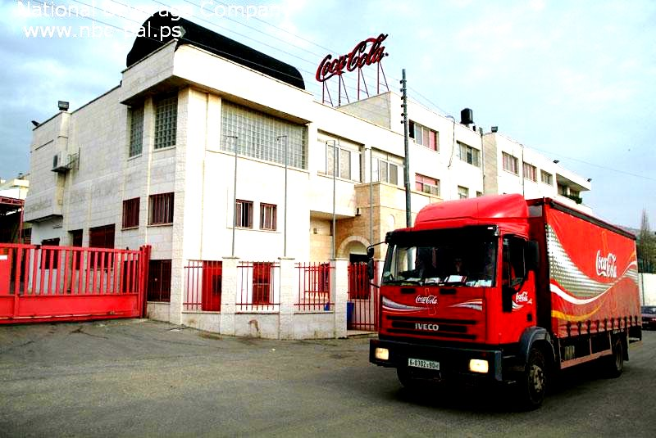
National Beverages Company (Coca Cola/ Cappy)
A group of Palestinian businessmen established the National Beverage Company Coca-Cola/Cappy in 1998.
The Company has acquired the license of producing carbonated soft drinks, mineral water and juices from the International Coca-Cola Company, with high quality according to the state of the art manufacturing technologies in the world.

Slide 6


National Beverage Company (Coca Cola/ Cappy)
In early 2005, the National Beverages Company acquired the production line of Jericho Water in Jericho along with the Palestinian Beverage Group.
In 2006, the Company acquired Cappy Production line in addition to the Cappy juices trademarks.
The Company gave the Palestinian market the chance to keep up with the general development in the global industry, especially the food and Beverage industries.

Slide 7
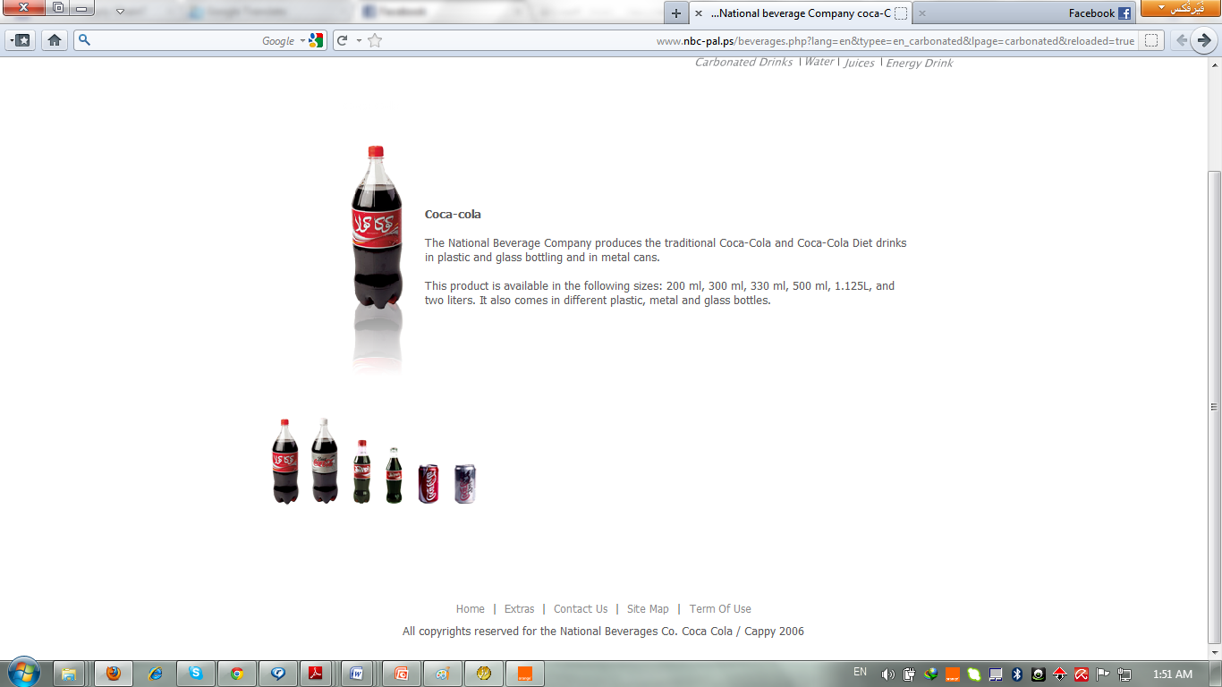
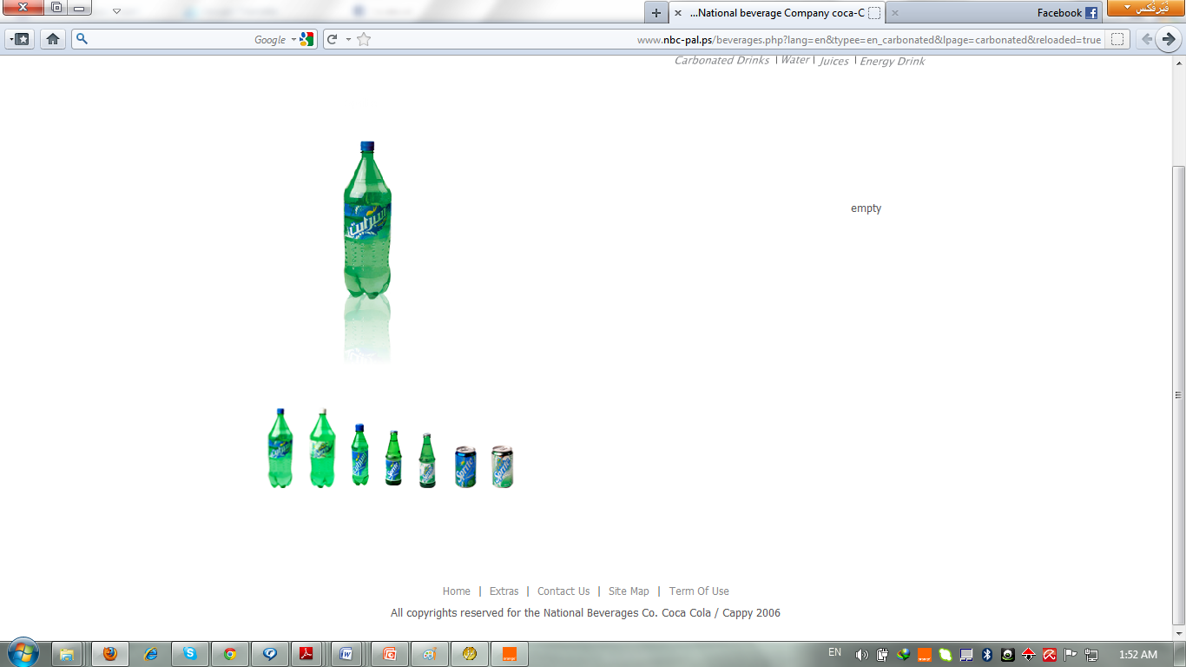
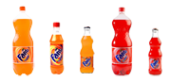
NBC Products
Carbonated Drinks

Slide 8
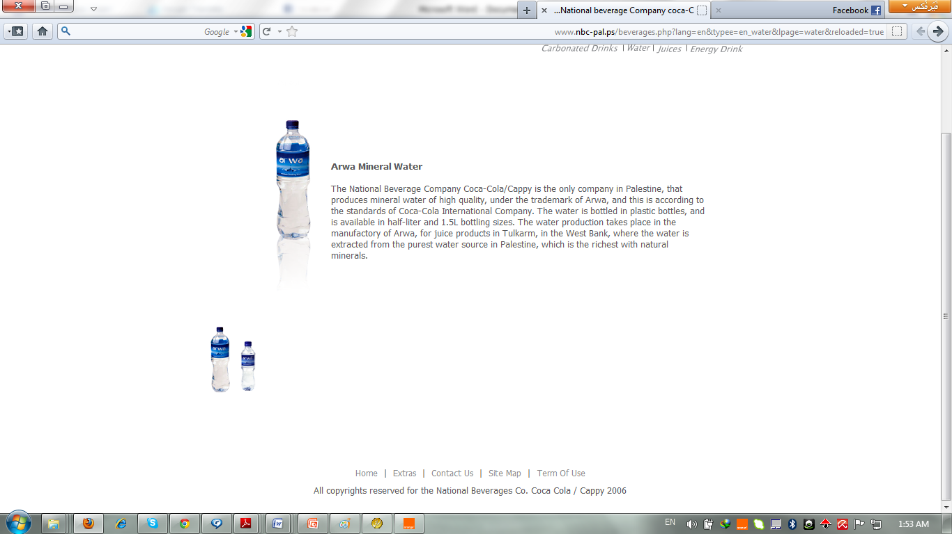
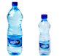
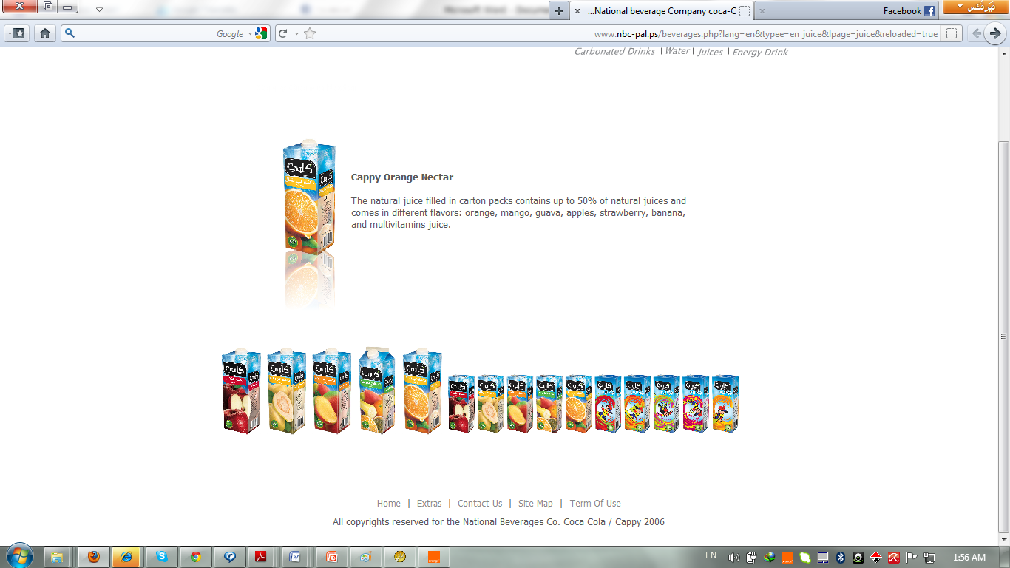
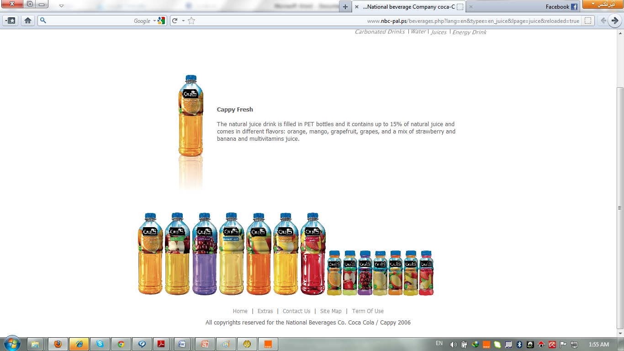
NBC Products
Water and Juices

Slide 9
Presentation Outlines
Project Information
Supply Chain Management ( S.C.M)
S.C.M at NBC Co.
Literature Review
Problem Statement
Plan of Project and Methodology
Results and Conclusions
Inventory Dynamic Modeling
Information Flow System

Slide 10
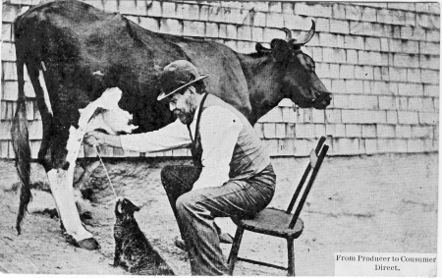
Comment on this Picture !

Slide 11
Supply Chain Management ( S.C.M)
What is S.C ?
Modern SC View
An effective SC ensures high level of Customer Service at optimum level of working capital and cost!
Business Partners/SC view
  An efficient supply chain that ensures products are on the shelf, available for sale, when Shoppers come to buy them ... all the time!

Slide 12
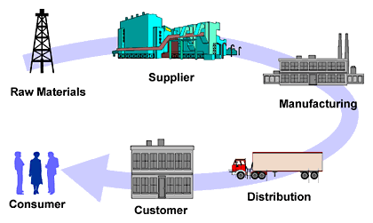
General Definition of S.C
The supply chain consist of “ suppliers, manufacturing centers, warehouses, distribution center and retail outlet, as well as raw material, work-in-process inventory, and finished products that flow between the facilities.”
[Simchi-Levi, 2003]

Slide 13
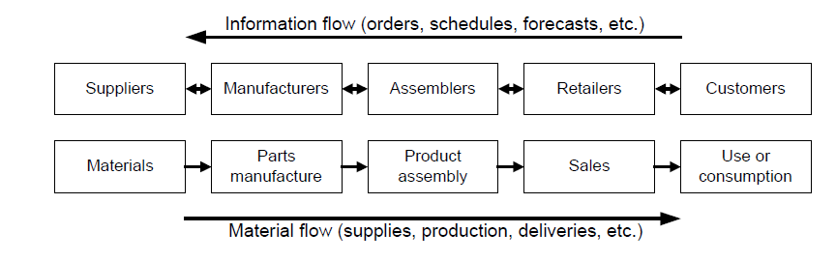
Generic configuration of a supply chain in manufacturing

Slide 14
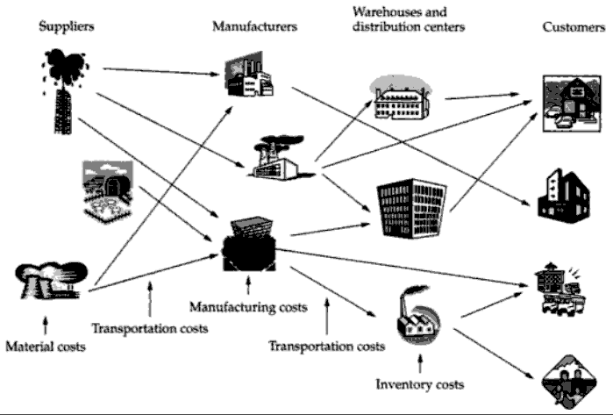
S.C Elements and Logistics Network

Slide 15
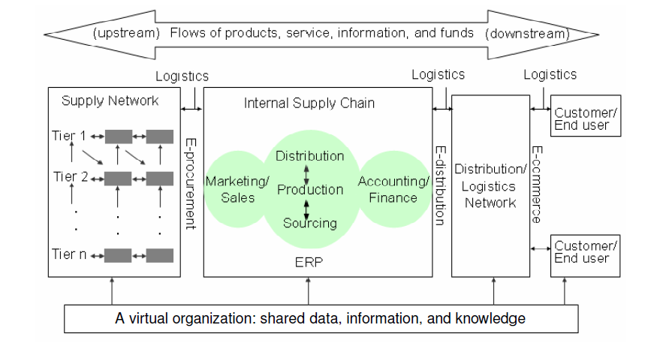
Supply Chain Stages
A typical supply chain may involve a variety of stages:
Customers
Retailers
Wholesales/distributors
Manufacturers/ Plants
Component/raw material suppliers

Slide 16
Supply Chain levels of activity
Forming strategic alliances
Make or buy decisions
Determining the number, location and capacity of facilities
Long Term
Strategic
  Intermediate term
    Determining inventory levels
    Quality-related decisions
    Logistics decisions
Tactical
  Near term
    Production planning and control decisions
    Goods and service delivery scheduling
    Some make or buy decisions
Operational

Slide 17


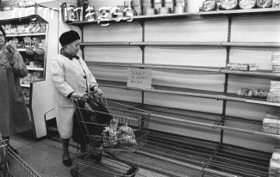
Why implementing a Supply Chain approach ?
Poor service
Its all about Managing Expectations……..
Empty shelves
Poor forecasting

Slide 18
What is the Supply Chain Concept ?
Demand
& Supply
Planning
Data
Integrity
Order
& Query
Mgmt
Stock
Mgmt
Warehousing
&
Delivery
CUSTOMER FOCUSSED

Slide 19
Presentation Outlines
Project Information
Supply Chain Management ( S.C.M)
S.C.M at NBC Co.
Literature Review
Problem Statement
Plan of Project and Methodology
Results and Conclusions
Inventory Dynamic Modeling
Information Flow System

Slide 20
Branches and Locations of NBC Company
Plants Location:
NBC Company has three production plants:
Ramallah plant for all CSDs products (Coca Cola).
Tulkarem (Kufr Zebad) plant for Cappy and Arwa water products (Cappy).
Jericho plant for Jericho water products (Jericho).
Warehouses Location:
Ramallah WH, Hebron WH, Tulkarem WH, Jericho WH and
Gaza WH.

Slide 21
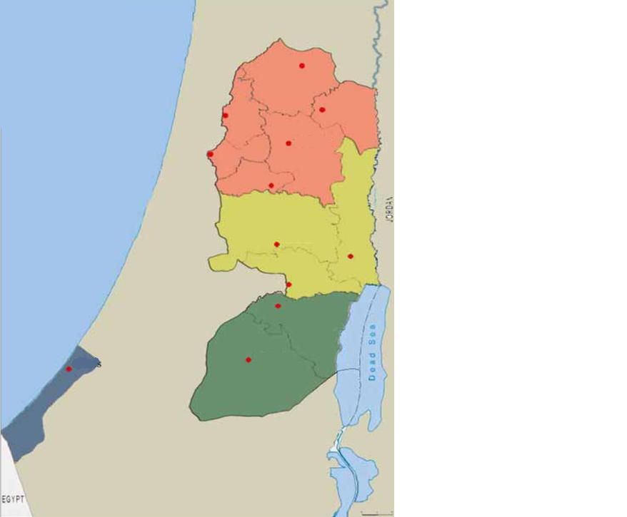
NBC Distribution Centers
.
Covered by Tulkarem DC
.
Covered by Ramallah DC
.
Covered by Hebron DC
.
Covered by Gaza DC

Slide 22
S.C Elements and Logistics Network at NBC company
Local and Outside supplier(s)
Recycle and remanufacture
Jericho/ Jericho
Coca Cola/ Ramallah
Cappy/ Tulkarm
Jericho WH
Hebron WH
Ramallah WH
Tulkarem WH
Gaza WH
Ramallah WH
retailer
retailer
retailer
retailer
retailer
Customer demand
Customer demand
Customer demand
Jericho has a special Company for marketing and distributing of Jericho products

Slide 23
Presentation Outlines
Project Information
Supply Chain Management ( S.C.M)
S.C.M at NBC Co.
Literature Review
Problem Statement
Plan of Project and Methodology
Results and Conclusions
Inventory Dynamic Modeling
Information Flow System

Slide 24
Literature Review
    All literature reviews have been gathered from international books, research papers and previous studies at NBC company.
Classification of the literature available on SCM
Classification Criteria | References
Supply Chain- Basic Information | Chopra & Meindl (2001), Novak & Simco (1991), Ganeshan & Harrison (1995), Lee & Corey (1995), Davis (1993), Lummus et al (1998) and Christopher (1998).
Supply Chain- Objectives | Simchi-Levi (2003), Cooper & Ellram (1993), Davis (1993), Lummus, Vokurka, & Alber (1998), Chopra & Meindl (2010).
ABC classification | Dub (1989), Christopher (1998), Needy & Kim (2003) and Fogelholm (2006).
Demand Forecasting | Jacobs (2011), Wirl &Szirucsek (1990), Hariharan & Zipkin (1995), Emmons & Gilbert (1998) and Tan (2008).

Slide 25
Literature Review
Classification Criteria | References
Production and Inventory Control | Porteus (2002), Chopra (2010), Tan et al (2007) and Wang and Toktay (2008).
Stock Keeping Unit (SKU) | Silver et al (1998) and Tan et al (2007).
Typical Inventory Control Policies | Silver et al (1998) and Christopher (1998).
Coordinated Replenishments – Stochastic Demand | Silver et al (1998) and Simchi-Levi (2003).
Multi-Echelon Inventories | Chopra & Meindl (2001 and Silver et al (1998) .
Strategic Planning | Hayes (1985), Hieber (2002) and Seuring (2003).
Information Flow System | Porter (1985), Currie (2000), Simchi-Levi (2003) and Powell and Zheng (2007).
Transportation models | Chopra (2010).

Slide 26
Presentation Outlines
Project Information
Supply Chain Management ( S.C.M)
S.C.M at NBC Co.
Literature Review
Problem Statement
Plan of Project and Methodology
Results and Conclusions
Inventory Dynamic Modeling
Information Flow System

Slide 27
Problem Statement
The problem selected to the analysis can be classified into two categories A and B:
Inventory and warehouses system at NBC company
Category A
Category B
  Information flow system

Slide 28
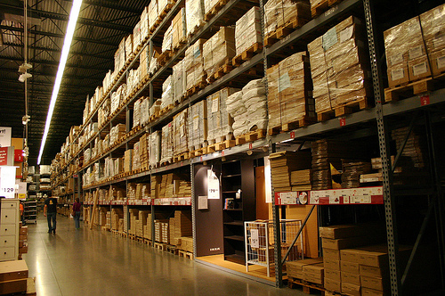
Category A:
Inventory and warehouses system at NBC company
The list of symptoms can be summarize into:
NBC company is using a stock level of inventory gained from old studies which is not applicant nowadays result of significant changes in Palestinian market during the second Intifada.
NBC company doesn’t use inventory control polices and coordinated Replenishments according to Stochastic Demand.
Warehouses and distribution centers at NBC company have been built to meet the demand based on old studies for Palestinian market in west bank and Gaza.

Slide 29
What are the objectives of studying the Inventory and warehouses at NBC ?
To have stock available as and when required.
To avoid both overstocking and under stocking of inventory.
To insure right quality goods at reasonable price.
To design proper organization for inventory management.
To bring down the inventory carrying cost.
Short and long term planning and control of inventory.
To decide which item to stock and which item to procure on demand.

Slide 30
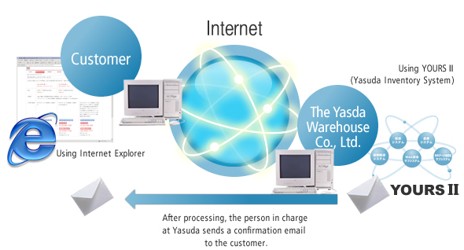
Category B:
Information flow system
The list of symptoms can be summarize into:
Uncertainties in NBC’s supply chains while every single members has a perfect information about itself.
Time wasting in decision making.
Poor coordination between the members of supply chains at NBC company.
Inefficient information security system while the Palestinian market is highly competition.
Notes:
Due to the expansions of NBC company which can be represented in three main plants ( Coca Cola, Cappy, Jericho), five main warehouses ( Ramallah, Gaza, Hebron, Tulkarm, Jericho) and diversity of retailers, the sharing of the information between these parties became harder and exhaustive.

Slide 31
Presentation Outlines
Project Information
Supply Chain Management ( S.C.M)
S.C.M at NBC Co.
Literature Review
Problem Statement
Plan of Project and Methodology
Results and Conclusions
Inventory Dynamic Modeling
Information Flow System

Slide 32
Plan of the project and methodology:
Methodology in General:
Palestinian market study : Collection of the essential information in order to forecast the demand.
Logistic study of the Coca cola network in Palestine.
Checking the international standards of Coca Cola.
Applying the supply chain strategies ( using mathematical applications) on our case-study ( Coca Cola ).
Ending up with the best solutions and strategies for Coca Cola company in Palestine which can be implement in order to achieve all objectives.

Slide 33
Plan of the project and methodology:
Inventory and Warehouses system
A-B-C classification
Studying the demand and finding the best method for forecasting.
Studying the inventory problems.
Building the dynamic inventory model.
Determination of economic order quantity.
Determination of stock level.
Determination of safety stocks.
Selecting the proper system of ordering for inventory.
Ending up with the final inventory model, which will be solution for our problem with numerical example.

Slide 34
Plan of the project and methodology:
Information Flow System
Studying the information flow system of the company.
Detecting and identifying the problems and the area for improvement.
Build the information system for the company with the improvements and modifications.
Ending up with final information flow system, which will be the solution for our problem.

Slide 35
Presentation Outlines
Project Information
Supply Chain Management ( S.C.M)
S.C.M at NBC Co.
Literature Review
Problem Statement
Plan of Project and Methodology
Results and Conclusions
Inventory Dynamic Modeling
Information Flow System

Slide 36
Results and Conclusions
Statistics and Figures
Number | Branchs | (Demand) L /Year
1 | Center Branch | 24161050.01
2 | North Branch | 19573643.92
3 | South Branch | 18026015.54

Slide 37
Results and Conclusions
Statistics and Figures

Slide 38
Results and Conclusions
Statistics and Figures

Slide 39
Results and Conclusions
Statistics and Figures

Slide 40
Results and Conclusions
Statistics and Figures
To
Excel

Slide 41
Inventory and Warehouses system:
A-B-C classification
A: Most important items, first 5-10 % of items. The items of center branch are:
Item | Description | Cum % of Total Usage
8 | Coca Cola (PET 2.0 LT) | 0.217181785
17 | Coca Cola (PET 1.125 LT) | 0.318062345
10 | Sprite (PET 2.0 LT) | 0.399504787
32 | Jericho (PET 1.5 Ltr (8)) | 0.472467991
1 | Coca Cola (330mL) | 0.544678998
20 | Sprite (PET 1.125 LT) | 0.59885585
23 | Coca Cola (NBR 300 mL) | 0.646789383
31 | Arwa Water (PET 0.5 Ltr) | 0.680781475
4 | Sprite (330mL) | 0.71211706
11 | Fanta Orange (PET 2.0 LT) | 0.739264679
25 | Sprite (NBR 300 mL) | 0.765004214

Slide 42
Inventory and Warehouses system:
A-B-C classification
B: Intermediate important items, 50 % of items. The items are:
Item | Description | Cum % of Total Usage
30 | Arwa Water (PET 1.5 Ltr) | 0.78656614
22 | Fanta Orange (PET 1.125 LT) | 0.80337939
53 | Orange Drink (PET 1.5 LT) | 0.819101613
6 | Fanta Orange (330mL) | 0.834088118
13 | Coca Cola (PET 0.5 LT) | 0.847508994
19 | Coke Zero (PET 1.125 LT) | 0.85871818
33 | Jericho (PET 0.5 Ltr) | 0.868529941
27 | Fanta Orange (NBR 300 mL) | 0.877377906
34 | Arwa Water (5 Gallons) | 0.886087716
54 | Strawberry & Banana Drink (PET 1.5 LT) | 0.893766335
55 | Mango Drink (PET 1.5 LT) | 0.900713167
3 | Coke Zero (330mL) | 0.907526644
9 | Diet Cola (PET 2.0 LT) | 0.914313549
15 | Sprite (PET 0.5 LT) | 0.920813825
37 | Mango Nectar (200 mL) | 0.925487582
7 | Fanta Strawberry (330mL) | 0.929611593
2 | Diet Cola (330mL) | 0.933699317
16 | Fanta Orange (PET 0.5 LT) | 0.937465598
57 | Grapefruit Drink (PET 1.5 LT) | 0.94112181
58 | Apple Drink (PET 1.5 LT) | 0.944571186
12 | Fanta Strawberry (PET 2.0 LT) | 0.947965677
59 | Orange Drink (PET 330 mL) | 0.951265974

Slide 43
Inventory and Warehouses system:
A-B-C classification
C: Least important, 40-45 % of items, only 20 % of value.
Item | Description | Cum % of Total Usage
5 | Sprite Diet Sprite (330mL) | 0.953991728
28 | Fanta Strawberry (NBR 300 mL) | 0.956655794
61 | Grape Drink (PET 330 mL) | 0.959295669
56 | Grape Drink (PET 1.5 LT) | 0.961855713
60 | Strawberry & Banana Drink (PET 330 mL) | 0.964384912
48 | Orange Drink (200 mL) | 0.966893599
35 | Arwa Water (5 L) | 0.969243116
49 | Mango Drink (200 mL) | 0.971417711
38 | Strawberry & Banana Nectar (200 mL) | 0.973569375
50 | Strawberry & Banana Drink (200 mL) | 0.975660007
41 | Guava Nectar (200 mL) | 0.977577772
21 | Diet Sprite (PET 1.125 LT) | 0.979451614
62 | Mango Drink (PET 330 mL) | 0.981320391
18 | Diet Cola (PET 1.125 LT) | 0.983188942
29 | Coke Zero (NBR 300 mL) | 0.984963978
40 | Apple Nectar (200 mL) | 0.986641493
51 | Apple Drink (200 mL) | 0.988231163
64 | Apple Drink (PET 330 mL) | 0.989637282
52 | Mixed Fruit (200 mL) | 0.990939076
43 | Mango Nectar (1.0 LT) | 0.992147431
24 | Diet Cola (NBR 300 mL) | 0.993035705
26 | Diet Sprite (NBR 300 mL) | 0.993923979
46 | Apple Nectar (1.0 LT) | 0.994790632
39 | Multivitamin Nectar (200 mL) | 0.997895131
47 | Guava Nectar (1.0 LT) | 0.998572487
63 | Grapefruit Drink (PET 330 mL) | 0.999232304
14 | Diet Cola (PET 0.5 LT) | 1

Slide 44
Inventory and Warehouses system:
To
Excel
A-B-C Diagram of all NBC Co. Products

Slide 45
Inventory and Warehouses system:
Studying the demand and finding the best method for forecasting.
Basic Approach
1- Understanding the objective of forecasting
2- Integrating demand planning and forecasting throughout the supply chain
3- Understanding and identifying the customer segments

Slide 46
Inventory and Warehouses system:
4- Identify major factors that influence the demand forecast
5- Determining the appropriate forecasting technique
6- Establishing performance and error measures for the forecast
 |  |  | Coca Cola (PET 2.0 LT)
Branch/Month | Jan | Feb | Mar | Apr | May | Jun | Jul | Aug | Sep | Oct | Nov | Dec | TOTAL
Center Branch | 19907 | 31009 | 36177 | 46513 | 51681 | 51681 | 63415 | 63415 | 52847 | 47562 | 31708 | 26423 | 522338
North Branch | 18248 | 23687 | 37899 | 37899 | 42637 | 52112 | 58087 | 53246 | 48406 | 43566 | 33884 | 29043 | 478714
South Branch | 15792 | 15792 | 27635 | 31583 | 39479 | 39479 | 48636 | 44583 | 40531 | 36478 | 32425 | 28372 | 400785

Slide 47
Inventory and Warehouses system:
Dynamic Models Derivations:
Finished Goods
Raw Material

Slide 48

Inventory and Warehouses system:
Needed Factors
Cost Factors
The Unit Value or Unit Variable Cost, $v$
The Cost of Carrying Items in Inventory, $r$
The Ordering or Setup cost, $A$
The Costs of Insufficient Capacity in the Short Run
Other important factors
Replenishment Lead Time, $L$

Slide 49

Inventory and Warehouses system:
Raw Material Dynamic Model Derivations ( EOQ)
Parameters and Variables
$A$: Fixed cost of ordering (independent of the magnitude of the replenishment quantity).
$v$: Unit variable cost of procurement, in $/ unit.
$r$: carrying charge, in $/$/unit time.
$Q$: The replenishment order Quantity, in units.
$D$: Demand rate of the item, in units/ unit time.
$TRC (Q)$: Total relevant costs per unit time, in $/ unit time.

Slide 50
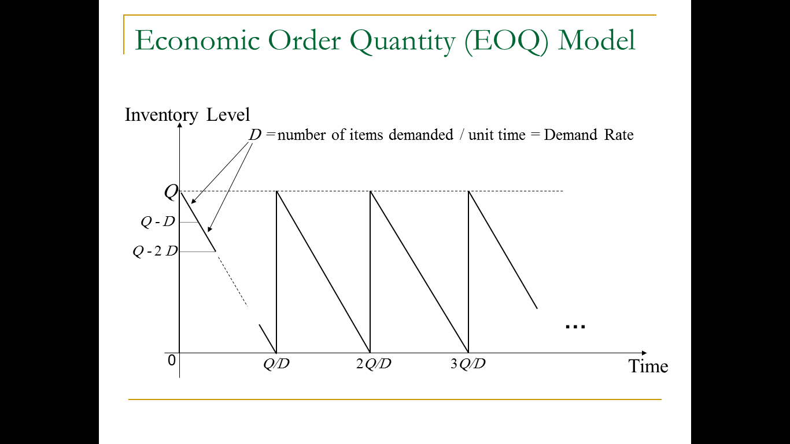
Inventory and Warehouses system:
Raw Material Dynamic Model Derivations

Slide 51
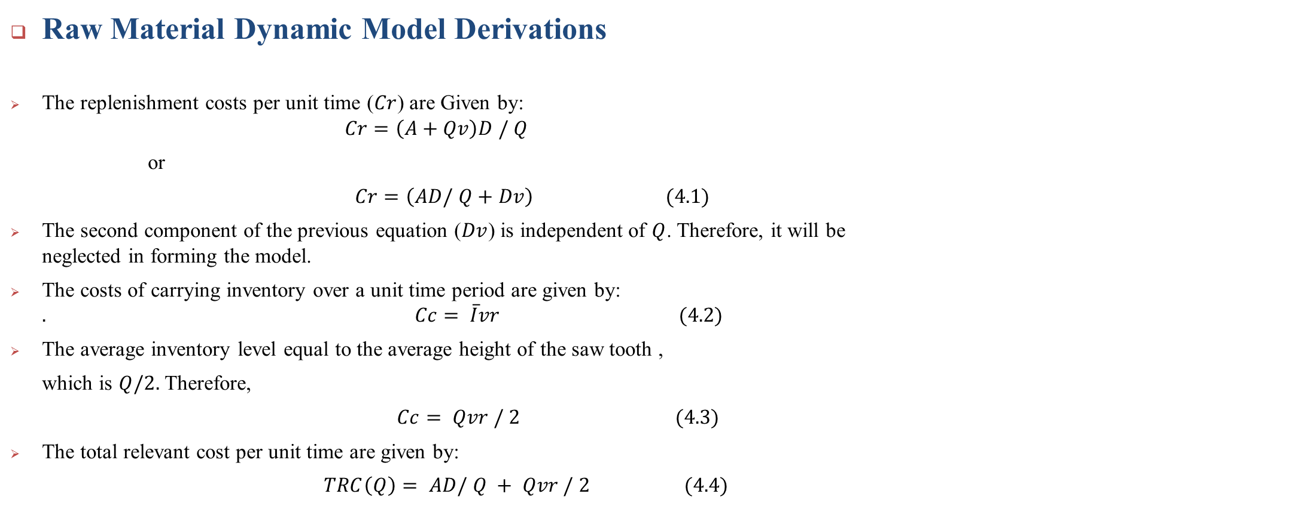
Inventory and Warehouses system:
Raw Material Dynamic Model Derivations
The replenishment costs per unit time ($Cr$) are Given by:
$$Cr=\left(A+Qv\right)D / Q$$
or
$Cr=\left(AD/ Q+Dv\right) (4.1)$
The second component of the previous equation ($Dv$) is independent of $Q$. Therefore, it will be neglected in forming the model.
The costs of carrying inventory over a unit time period are given by: $. Cc= \overline{I}vr (4.2)$
The average inventory level equal to the average height of the saw tooth ,
which is $Q/2.$Therefore,
$Cc= Qvr / 2 (4.3)$
The total relevant cost per unit time are given by:
$TRC\left(Q\right)= AD/ Q + Qvr / 2 (4.4)$

Slide 52
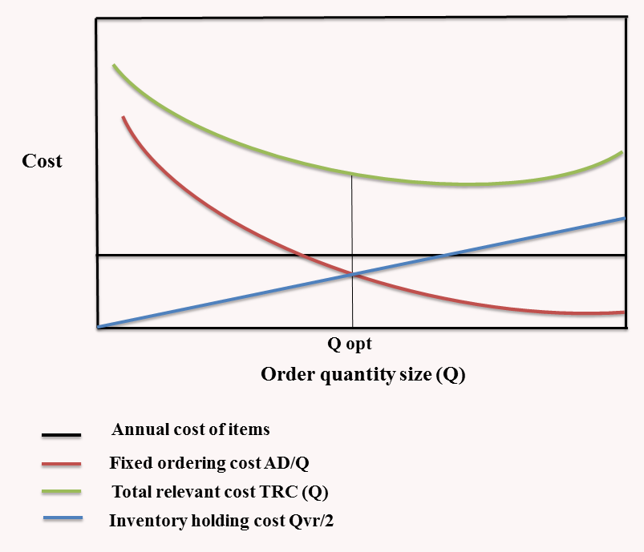
Inventory and Warehouses system:
Raw Material Dynamic Model Derivations

Slide 53

Inventory and Warehouses system:
Raw Material Dynamic Model Derivations
Q optimum : Economic Order Quantity (EOQ)
$$EOQ= \sqrt{\frac{2AD}{vr}} (4.5)$$
Total replenishment cost:
$$TRC\left(EOQ\right)= \sqrt{2ADvr} (4.6)$$
Turnover ratio (annual demand rate divided by the average inventory level):
$$TR= \frac{D}{\overline{I}}=\frac{D}{EOQ/2}=\sqrt{\frac{2Dvr}{A}} (4.7)$$
Cycle time when operating with EOQ:
$$\frac{EOQ}{D}=\sqrt{\frac{2AD}{D^{2}vr}}=\sqrt{\frac{2A}{Dvr}} (4.8)$$

Slide 54

Inventory and Warehouses system:
Finished Goods Dynamic Model Derivations (EPQ)
Parameters and Variables
$A$: Fixed cost of ordering (independent of the magnitude of the replenishment quantity).
$v$: Unit variable cost of producing the SKU, in $/ SKU.
$r$: carrying charge, in $/$/unit time.
$Q$: The replenishment order Quantity, in SKUs.
$D$: Demand rate of the item, in SKUs/ unit time.
$TRC (Q)$: Total relevant costs per unit time, in $/ unit time.
$m$: Production rate of the machinery used to produce the SKUs.

Slide 55
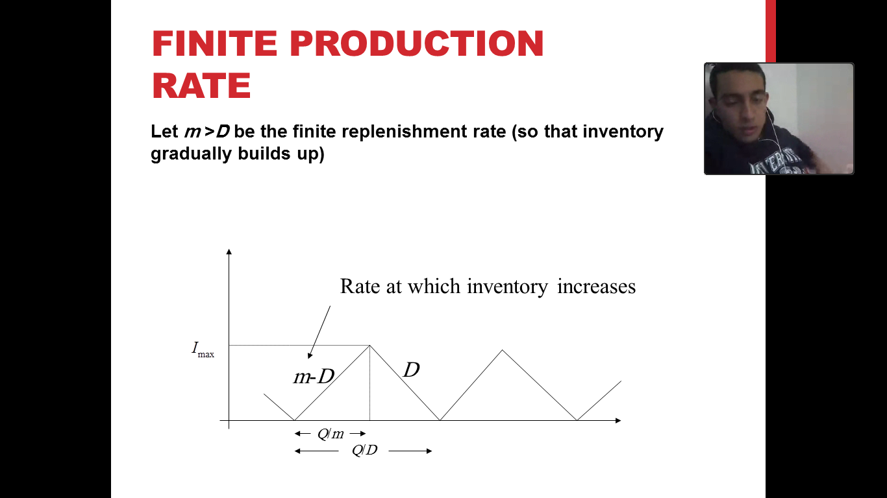
Inventory and Warehouses system:
Finished Goods Dynamic Model Derivations (EPQ)

Slide 56

Inventory and Warehouses system:
Finished Goods Dynamic Model Derivations (EPQ)
The replenishment costs per unit time ($Cr$) are Given by:
$$Cr=\left(A+Qv\right)D / Q$$
or
$Cr=\left(AD/ Q+Dv\right) (4.1)$
The second component of the previous equation ($Dv$) is independent of $Q$. Therefore, it will be neglected in forming the model.
The costs of carrying inventory over a unit time period are given by: $. Cc= \overline{I}vr (4.2)$
Average inventory:
$$\overline{I}=Q \frac{(1−\frac{D}{m} )}{2} (4.9)$$
Total replenishment cost :
$$TRC\left(Q\right)= \frac{AD}{Q}+ \frac{Q ( 1−D/m )vr}{2} (4.10)$$
$$\frac{d TRC(Q)}{d Q}=0$$
$$\frac{(1−D/m) vr}{2}− \frac{AD}{Q^{2}}=0 (4.11)$$

Slide 57

Inventory and Warehouses system:
Finished Goods Dynamic Model Derivations (EPQ)
Q optimum : Economic Production Quantity (EPQ)
$$Qopt.=EPQ= \sqrt{\frac{2AD}{vr (1−D/m)}}=EOQ. \frac{1}{\sqrt{( 1−D/m)}} (4.12)$$
Total replenishment cost (TRC)
$TRC\left(Q opt\right)= \sqrt{2ADvr (1−D/m)} (4.13)$
Cycle time when operating with EPQ:
$$\frac{EPQ}{D}=\sqrt{\frac{2AD}{D^{2}vr(1−D/m)}}=\sqrt{\frac{2A}{Dvr(1−D/m)}} (4.14)$$

Slide 58
Inventory and Warehouses system:
Finished Goods Dynamic Model Derivations (EPQ)
Center Branch (SKU)
Number | Description | Di | Ai | Pi | vi | ri | mi | EPQi | TRCi(EPQi) | TRi | (Cycle Time)i | (Cycle Time)i
 |  |  |  |  |  |  |  |  |  |  | Year | Days
1 | Coca Cola (330mL) | 119400 | 8 | 13 | 9 | 0.6 | 131340 | 1828.90 | 1044.56 | 130.57 | 0.0153 | 4.79
2 | Diet Cola (330mL) | 6759 | 8 | 13 | 9 | 0.6 | 7435 | 435.14 | 248.53 | 31.07 | 0.0644 | 20.15
3 | Coke Zero (330mL) | 11266 | 8 | 13 | 9 | 0.6 | 12393 | 561.79 | 320.86 | 40.11 | 0.0499 | 15.61
4 | Sprite (330mL) | 51813 | 8 | 13 | 9 | 0.6 | 56994 | 1204.78 | 688.10 | 86.01 | 0.0233 | 7.28
5 | Diet Sprite (330mL) | 4507 | 8 | 13 | 9 | 0.6 | 4958 | 355.33 | 202.94 | 25.37 | 0.0788 | 24.68
6 | Fanta Orange (330mL) | 24780 | 8 | 13 | 9 | 0.6 | 27258 | 833.18 | 475.86 | 59.48 | 0.0336 | 10.52
7 | Fanta Strawberry (330mL) | 6819 | 8 | 13 | 9 | 0.6 | 7501 | 437.07 | 249.63 | 31.20 | 0.0641 | 20.06
8 | Coca Cola (PET 2.0 LT) | 522338 | 8 | 9 | 7 | 0.4 | 574572 | 5564.06 | 1502.04 | 187.75 | 0.0107 | 3.33
9 | Diet Cola (PET 2.0 LT) | 16323 | 8 | 9 | 7 | 0.4 | 17955 | 983.59 | 265.52 | 33.19 | 0.0603 | 18.86
10 | Sprite (PET 2.0 LT) | 195875 | 8 | 9 | 7 | 0.46 | 215463 | 3407.26 | 919.80 | 114.98 | 0.0174 | 5.44
11 | Fanta Orange (PET 2.0 LT) | 65292 | 8 | 9 | 7 | 0.46 | 71821 | 1967.19 | 531.05 | 66.38 | 0.0301 | 9.43

Slide 59
Inventory and Warehouses system:
Finished Goods Dynamic Model Derivations (EPQ)
To
Excel

Slide 60

Inventory and Warehouses system:
(EPQ) EOQ and EPQ with Safety Stock and Reorder Point
The reorder point is,
$$R= \overline{d}L+zσ_{L} (4.15)$$
Where,
$R=$Reorder point in units or SKU.
$\overline{d}=$Average monthly demand.
$L=$Lead time in months (time between placing an order and receiving the items or SKU).
$z=$ Number of standard deviation for a specified service probability.
$σ_{L}=$ Standard deviation of usage during lead time.

Slide 61

Inventory and Warehouses system:
(EPQ) EOQ and EPQ with Safety Stock and Reorder Point
Computing $\overline{d}$,$σ_{L}$ and $z$
$$\overline{d}=\frac{\sum_{i=1}^{n}{d_{i}}}{n} (4.16)$$
The standard deviation is,
$$σ_{d}= \sqrt{\frac{\sum_{i=1}^{n}{{(d_{i}−\overline{d})}^{2}}}{n}} (4.17)$$
Standard deviation of usage during lead time is,
$$σ_{L}= \sqrt{σ_{1}^{2}+σ_{2}^{2}+………..+σ_{L}^{2}} (4.18)$$
Safety stock is ,
$$SS= zσ_{L} (4.19)$$

Slide 62
Inventory and Warehouses system:
(EPQ) EOQ and EPQ with Safety Stock and Reorder Point
 | Ramallah DC ( A Items)
Item | Description | AVG Demand | Lead Time | STDEV(D) | STDEV(L) | SS | R
 |  |  | (Months)
8 | Coca Cola (PET 2.0 LT) | 43528.16667 | 0.000801282 | 13653.336 | 386.48398 | 633.83373 | 668.71207
17 | Coca Cola (PET 1.125 LT) | 15886.16667 | 0.000801282 | 5640.9582 | 159.67819 | 261.87223 | 274.60153
10 | Sprite (PET 2.0 LT) | 16322.91667 | 0.000801282 | 5120.0727 | 144.93352 | 237.69097 | 250.77023
1 | Coca Cola (330mL) | 9950 | 0.000801282 | 3553.0443 | 100.57576 | 164.94425 | 172.91701
20 | Sprite (PET 1.125 LT) | 8531.5 | 0.000801282 | 3029.3238 | 85.750843 | 140.63138 | 147.46752
23 | Coca Cola (NBR 300 mL) | 5283.833333 | 0.000801282 | 1473.8854 | 41.721166 | 68.422712 | 72.656553
31 | Arwa Water (PET 0.5 Ltr) | 9367.583333 | 0.005608974 | 3274.3301 | 245.22468 | 402.16848 | 454.71102
4 | Sprite (330mL) | 4317.75 | 0.000801282 | 1541.893 | 43.646251 | 71.579851 | 75.039587
11 | Fanta Orange (PET 2.0 LT) | 5441 | 0.000801282 | 1706.6317 | 48.309498 | 79.227576 | 83.587352
25 | Sprite (NBR 300 mL) | 2837.333333 | 0.000801282 | 791.55757 | 22.406561 | 36.746761 | 39.020265

Slide 63
Inventory and Warehouses system:
(EPQ) EOQ and EPQ with Safety Stock and Reorder Point
To
Excel

Slide 64
Information Flow System

Slide 65
Information Flow System:
Facts
The information model deals with the integration of supply chain members and concentrates on the flow of information among the chain members.
Information technology plays a vital role for increasing collaboration among supply chain members. From the information point of view the effective supply chain management must provide the right amount of relevant information to the right person at the right time.
Information is the key to successful supply-chain management because no product flows until information flows.

Slide 66
Information Flow System:
Benefits of Information Technology
Higher visibility
Reduced transportation spend
Immediate availability of information
Greater accuracy
More economic
Better customer service
Higher productivity
Reduced paper work
Faster processing
Increase on-Time Deliveries
Improved Capacity Utilization

Slide 67
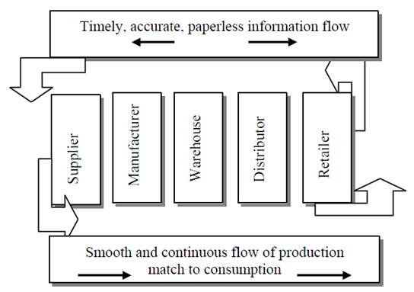
Information Flow System:
Information Requirements
To ensure that valuable, actionable knowledge readily flows across the supply chain, information must be
Accessible
Relevant
Accurate
Timely
Transferable

Slide 68
Information Flow System:
Information Sharing at NBC Company
To ensure that valuable, actionable knowledge readily flows across the supply chain, information must be
Accessible
Relevant
Accurate
Timely
Transferable

Slide 69
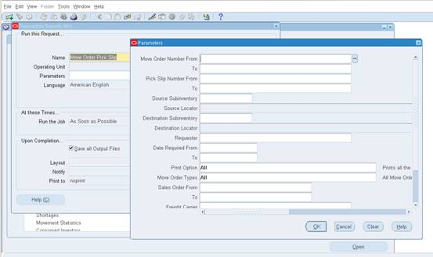
Information Flow System:
Suggested Improvements
1- Electronic pick slip report for the warehouse/ transportation

Slide 70
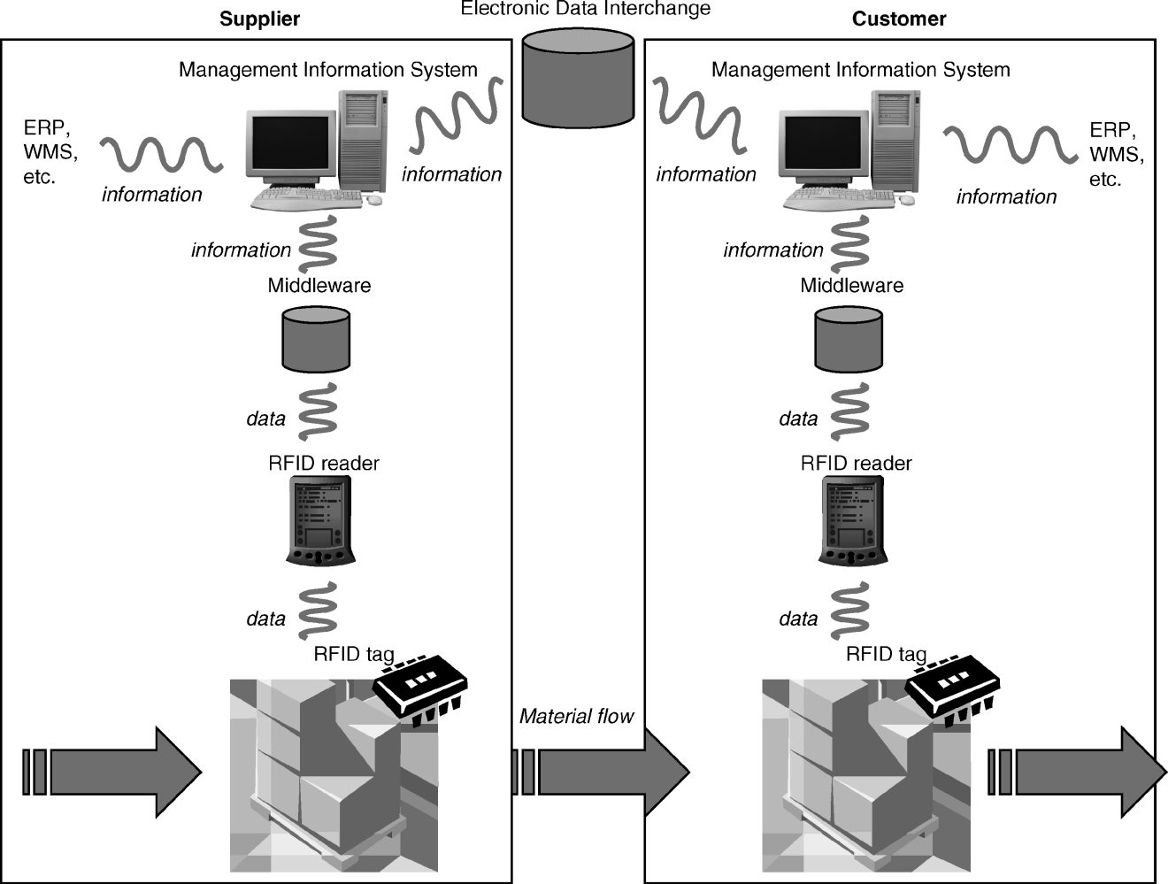
Information Flow System:
Suggested Improvements
2- Radio frequency identification (RFID)

Slide 71
Information Flow System:
Suggested Improvements
3- Creating a visionary Department

Slide 72


