Slide 1

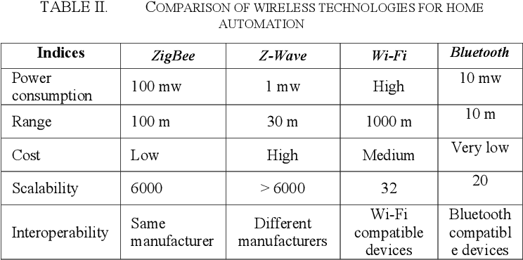
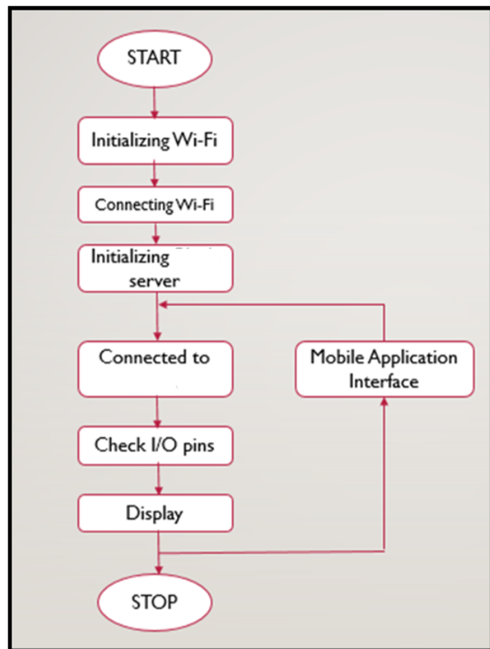
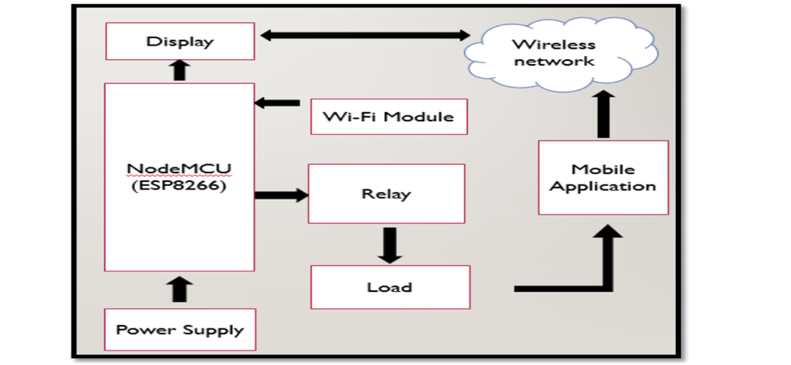
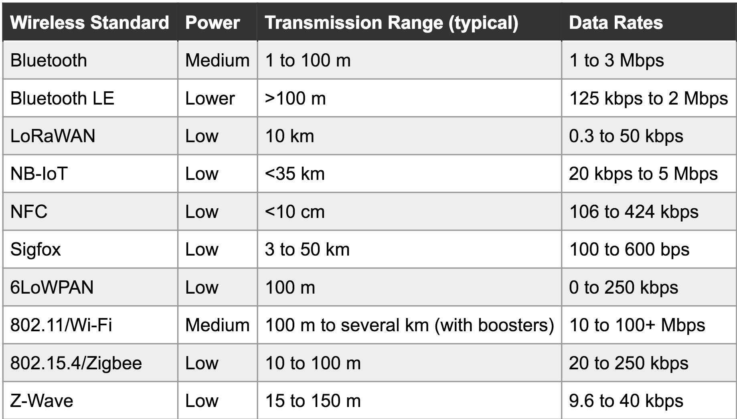
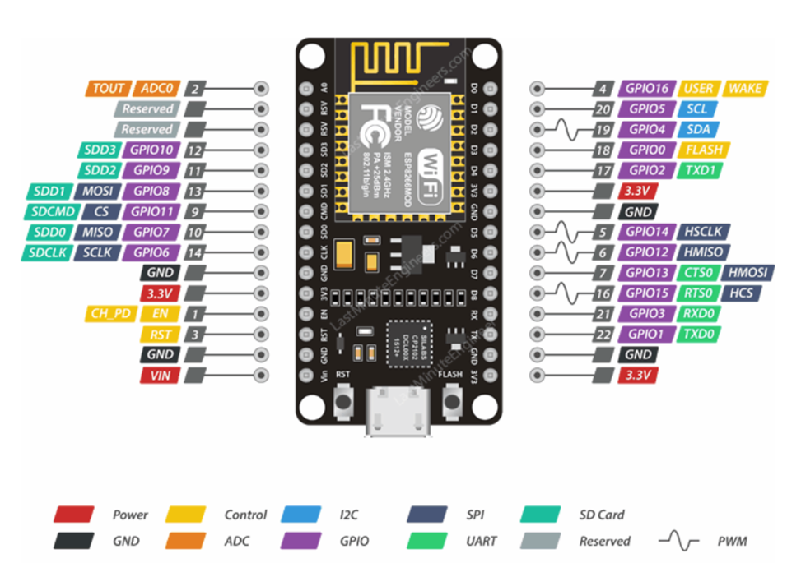
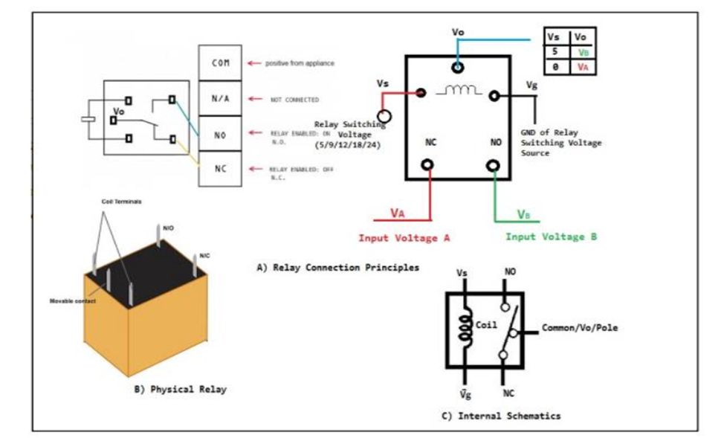
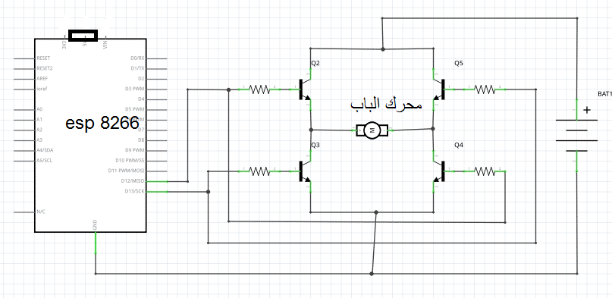
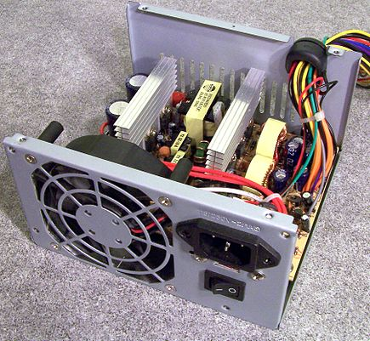

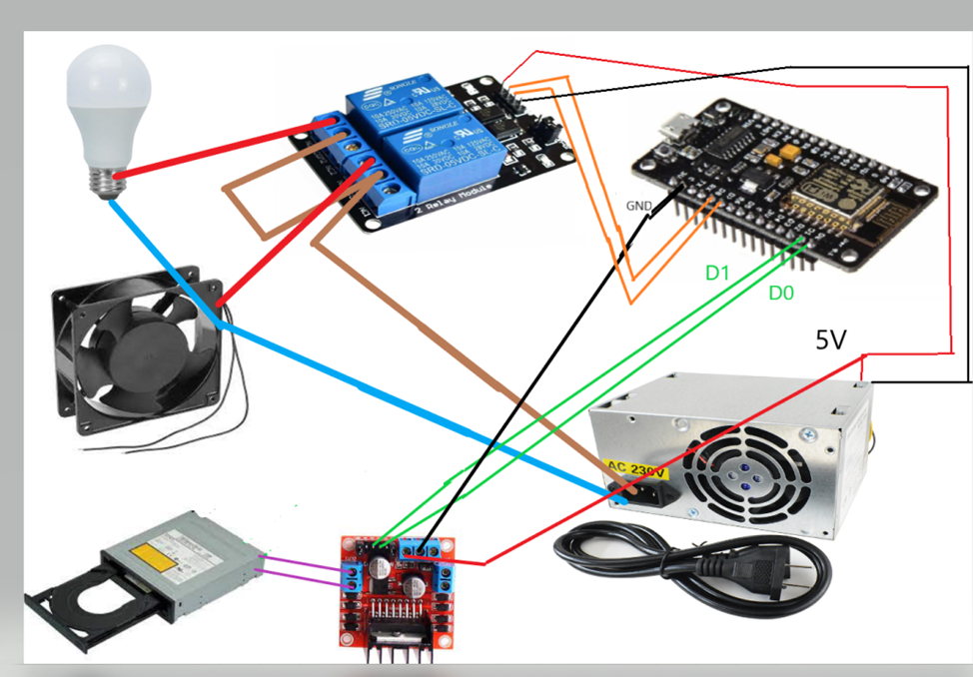
SMART HOME BASED ON IOT
Prepared By: Osama Badran, Khaled Najjar, Mustafa Albahar, Abdullah Hewwari
Supervisor: Dr. Jamal Kharousha
Objectives
•The main objective of the functions is to improve the quality of life and convenience in the home.
•Wireless control of home appliances
•Controlled by any device capable of Wi-Fi
•Monitoring status of appliances
IOT Technologies and Protocols
OPERATION FLOW CHART AND Block diagram of proposed system
Bluetooth
• Zigbee
• Z-Wave
• Wi-Fi
• Cellular
• NFC
• LoRaWAN
The basic element that we used in this project
Uploading code to Node MCU
•RELAY
• NodeMCU is connected to PC using a USB cable.
• Now, we’ll set up the Arduino IDE by changing some settings. So, open up the Arduino IDE. Select Tools > Board and select ‘NodeMCU 1.0 (ESP-12E Module)’ as the board. And that’s all the settings we need to change. So now we begin writing the code.
• Select Files > Examples > app > Boards_WIFI > ESP8266_Standalone.
A new file with some prewritten code opens. The following changes to the code are made.
1. The line which says ‘char auth[] = “YourAuthToken”, replace YourAuthToken part with your app authentication token that was generated by the app server.
2. The line which says char ssid[] = “YourNetworkName”, replace YourNetworkName part with the name of Wi-Fi network that the Node MCU must connect to.
3. The line where it says char pass[] = “YourPassword” and replace the YourPassword part with the password of the Wi-Fi network
ESP8266
•Stepper Motor With Motor Driver Module
•power supply unit (PSU)
Code
CIRCUIT DIAGRAM
#include <ESP8266WiFi.h>
#include <BlynkSimpleEsp8266.h>
// You should get Auth Token in the Blynk App.
// Go to the Project Settings (nut icon).
// You should get Auth Token in the Blynk App.
// Go to the Project Settings (nut icon).
char auth[] = "uXyhdjPzjnNgZOjWTkYX4Q2ZWhy2IsmH";
// Your WiFi credentials.
// Set password to "" for open networks.
char ssid[] = "salem";
char pass[] = "092664492";
void setup()
{
// Debug console
Serial.begin(9600);
Blynk.begin(auth, ssid, pass);
// You can also specify server:
//Blynk.begin(auth, ssid, pass, "blynk-cloud.com", 80);
//Blynk.begin(auth, ssid, pass, IPAddress(192,168,1,100), 8080);
}
void loop()
{
Blynk.run();
// You can inject your own code or combine it with other sketches.
// Check other examples on how to communicate with Blynk. Remember
// to avoid delay() function!
}
Conclusion
It is evident from this project work that an individual control home automation system can be cheaply made from low-cost locally available components and can be used to control multifarious home appliances ranging from the security lamps, the television to the air conditioning system and even the entire house lighting system. And better still, the components required are so small and few that they can be packaged into a small inconspicuous container. The designed home automation system was tested a number of times and certified to control different home appliances used in the lighting system, air conditioning system, home entertainment system and many more . Hence, this system is scalable and flexible.

