Slide 1



E-Governance in Palestine and the MENA region (INDIGO) Project
Baladiyati

Slide 2
Done by:
Marah An-Najjar | Computer Engineering Department
Menna Khayyat | Computer Engineering Department
In cooperation with:
Mohammad Younes | Urban Planning Department
Israa Amro | Urban Planning Department
Seema Hammouri | Urban Planning Department
Supervisors:
Dr. Emad Natsheh | Computer Engineering Department
Dr. Ihab Hijazi | Project Specialist / Urban & Regional Planning Unit
Eng. Saleh Qanazi | Project Coordinator / Urban Planning Department
Dr. Samah Abu Assab | Human Centered Design Expert
This Project done in cooperation between:
Computer Engineering Department
Urban Planning Department
Urban & Regional Planning Unit
Nablus Municipality
GIZ

Slide 3
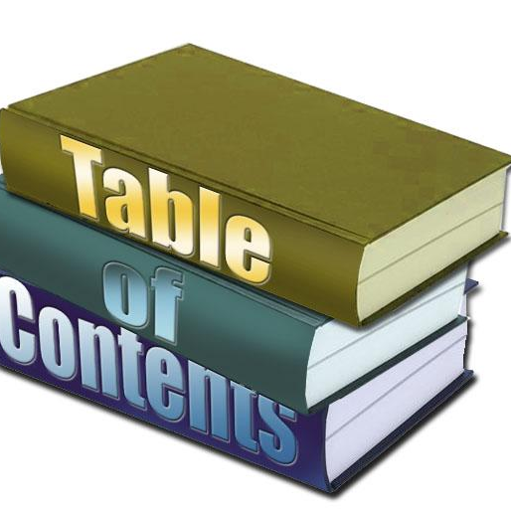
Contents:
Introduction
Objectives
Constraints and Limitations
Literature review
Human-centered design Methodology
Tools, Methods and Programming Languages
Features and Design
Future work
Conclusion

Slide 4
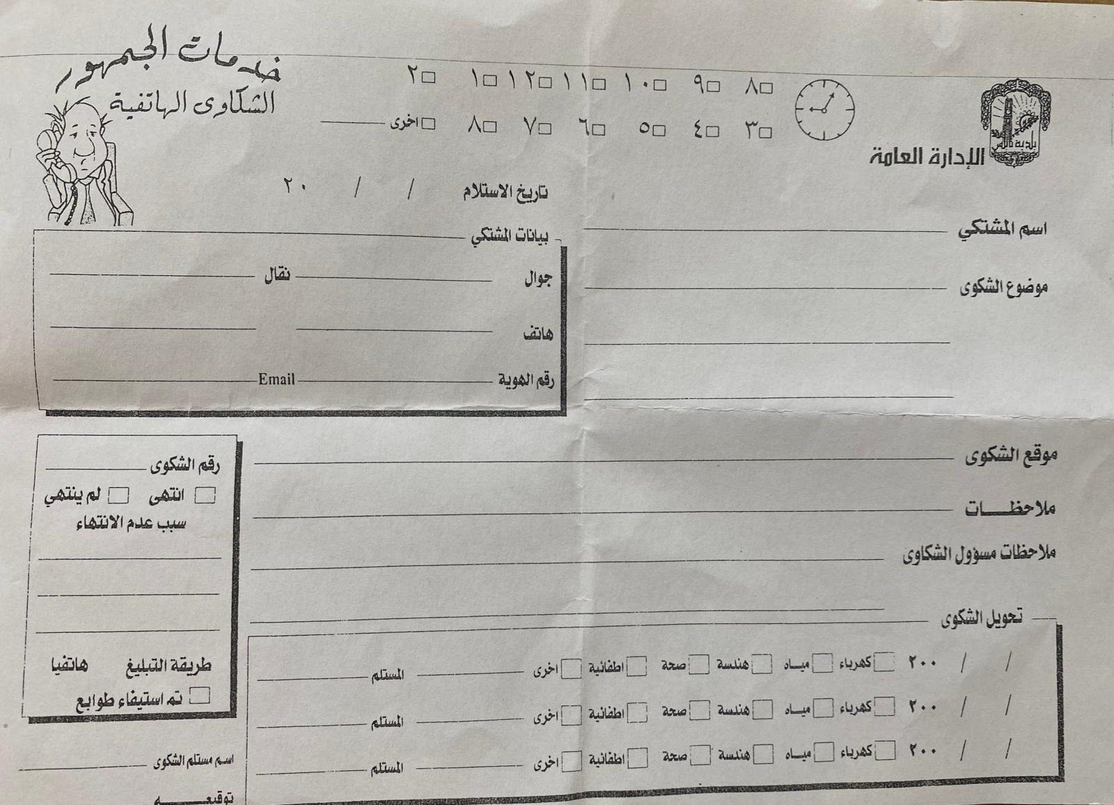
INTRODUCTION
The residents of Nablus city in general, and the beneficiaries of its municipal services in particular always seek to speed up the process of having answers to their complaints.
This project affords help for Nablus citizens who surely have constant complaints or demands from the municipality by providing a customized mobile application facilitated and built based on the human centered design approach.
And also, for employees who work in the public services department.

Slide 5
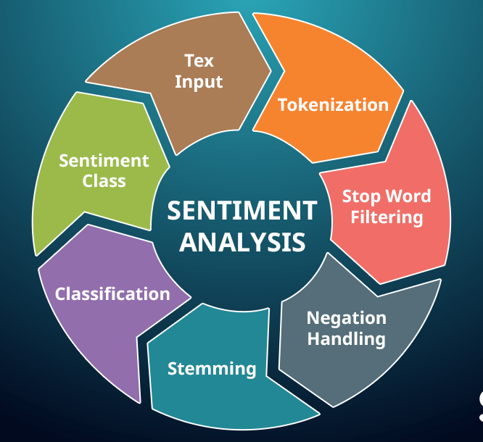
OBJECTIVES
Providing smooth and easy sequence of procedures on a mobile application that enhances the efficiency of filing a complaint process by any citizen living in Nablus city.
Creating a 100% automatic and reliable filtering complaints process and redirect them to specific department in Nablus municipality using sentiment analysis in artificial intelligence.

Slide 6
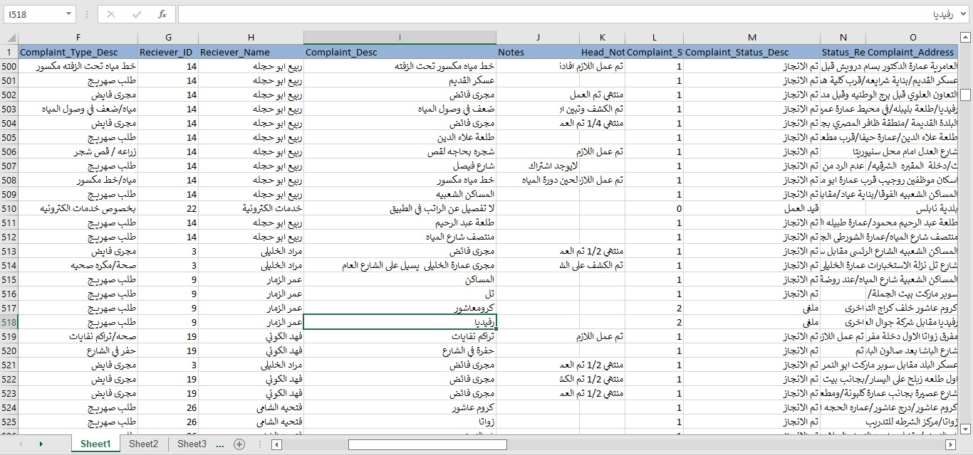
CONSTRAINTS AND LIMITATIONS

Slide 7
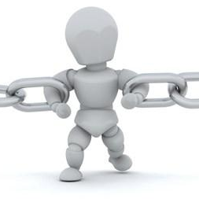
CONSTRAINTS AND LIMITATIONS
Data collection: We have used real data of 4000 unfiltered complaint form Nablus municipality as the previous picture showed.
Time: 3 consecutive months were needed to design and test the whole application.
Fixed Cost.

Slide 8
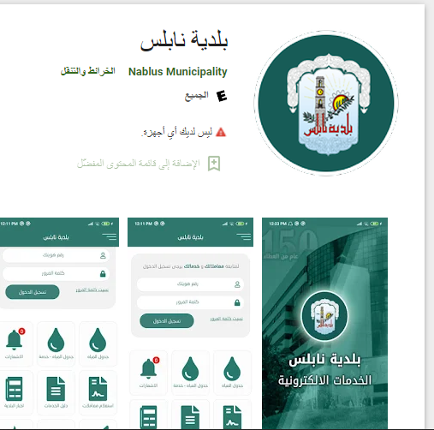


LITERATURE REVIEW
NABLUS MUNICIPALITY MOBILE APPLICATION
BALADIYATI MOBILE APPLICATION FOR PUBLIC SERVICES DEPARTMENT
Nablus Municipality mobile application | Decision
Dynamic filtering? | No
Specific? | No
Easy to use? | No
Baladiyati | Decision
Dynamic filtering? | Yes
Specific? | Yes
Easy to use? | Yes

Slide 9

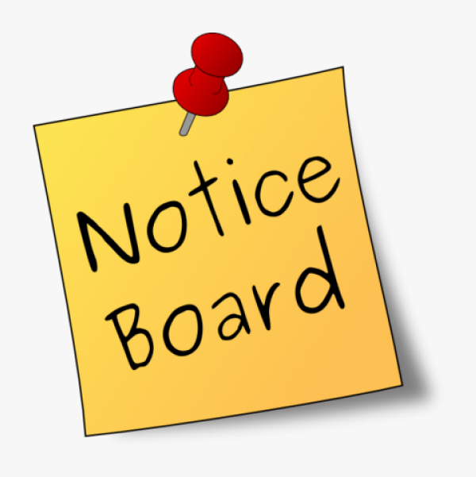
HUMAN-CENTERED DESIGN METHODOLOGY
We noticed the gap of communication between the municipality and citizens due to the stress on employees that caused by ununiformed manual filtering complaints and the large number of them they get daily.
Furthermore, several citizens stated that they do not want to waste their time doing paperwork for some transactions when they could be doing it online.
INSPIRATION PHASE
Many interviews were done online and in real life among the municipality’s employees and citizens. With total of 18 interview with citizens, 2 of them are with special needs. 9 interviews with the municipality’s employees.
Total number of interviews | 27
Number of interviews with municipality employees | 9
Number of interviews with citizens | 16
Number of interviews with citizens with special needs | 2
WHAT WE HAVE NOTICED?

Slide 10
INSPIRATION PHASE QUESTIONNAIRE

Slide 11
INSPIRATION PHASE QUESTIONNAIRE

Slide 12
INSPIRATION PHASE QUESTIONNAIRE

Slide 13
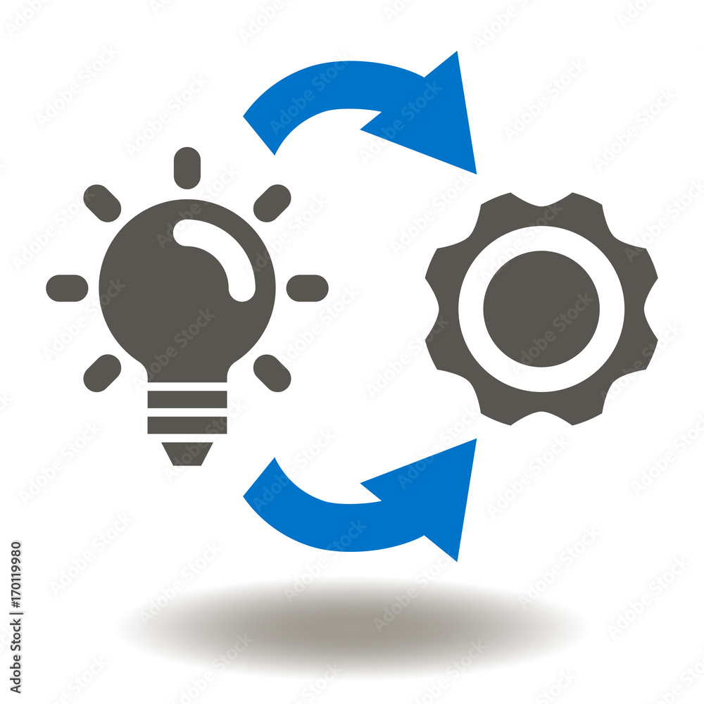
HUMAN-CENTERED DESIGN METHODOLOGY
IDEATION PHASE
Citizens’ time will be saved by allowing them to file their complaints online through the application.
Citizens can describe complaints with any terminologies they want.
Complaints filtering will be done automatically through the application.
Supporting a hot line calls for urgent situation.
Finalizing and developing.
IMPLEMENTATION PHASE

Slide 14



TOOLS, METHODS AND PROGRAMMING LANGUAGES
FLUTTER
PHP
PYTHON
Frontend programming language
Backend programming language
For chatbot

Slide 15
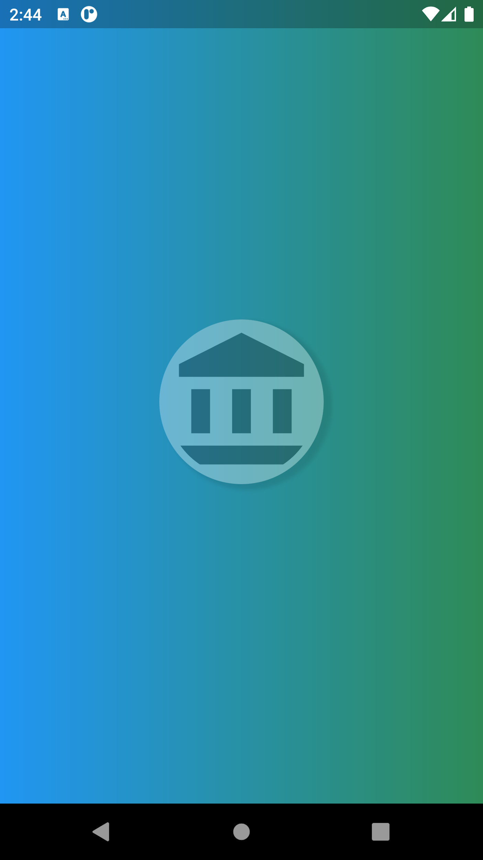
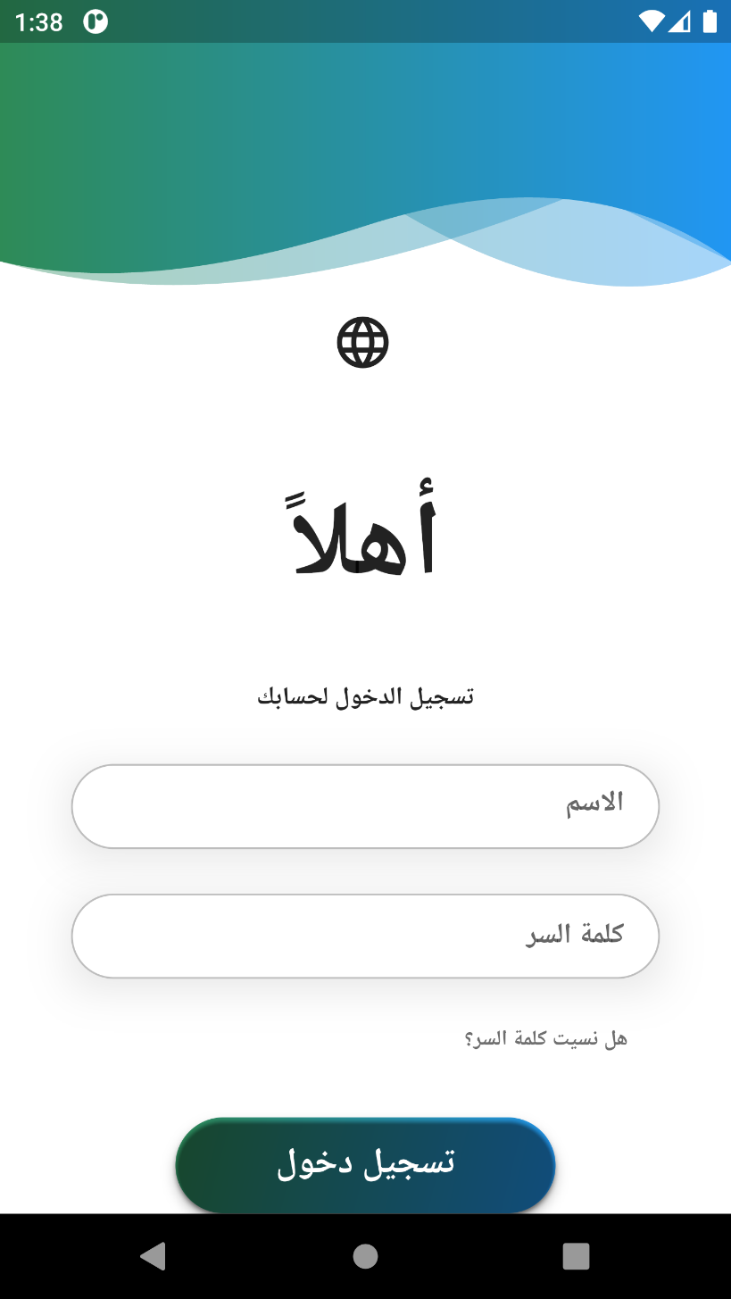
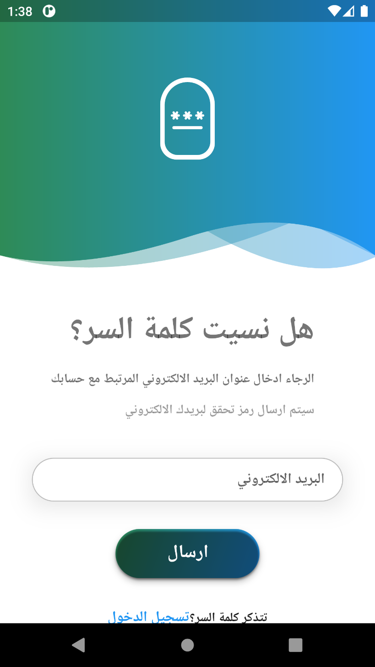
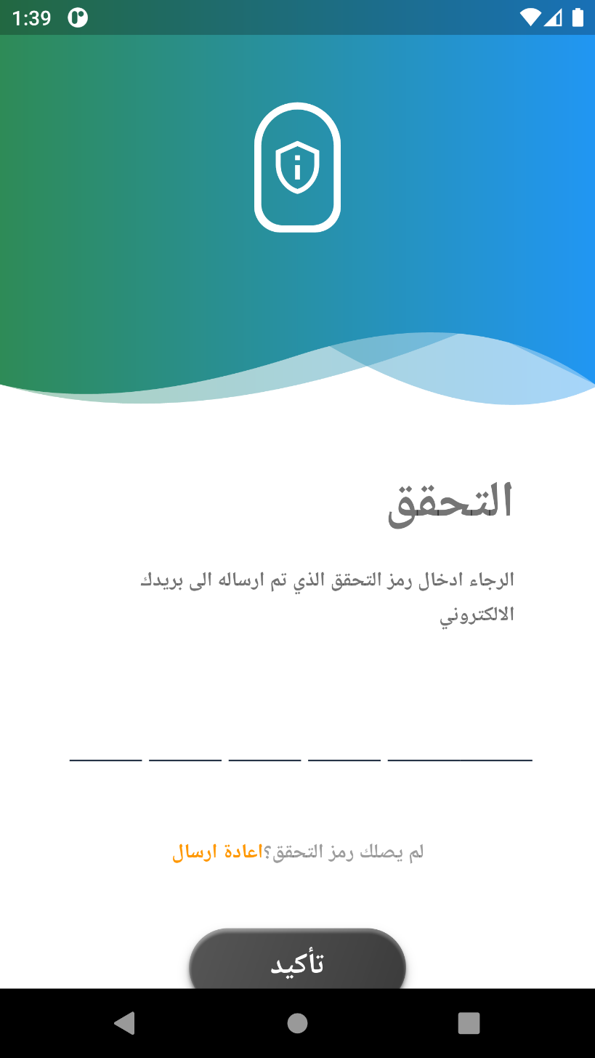
  Features and Design

Slide 16
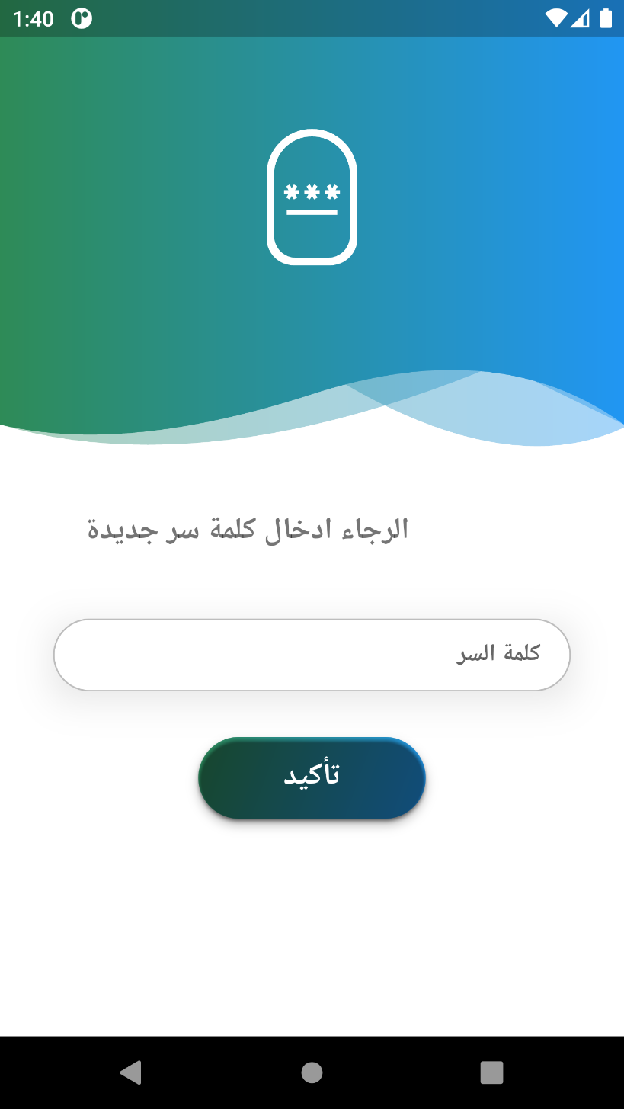
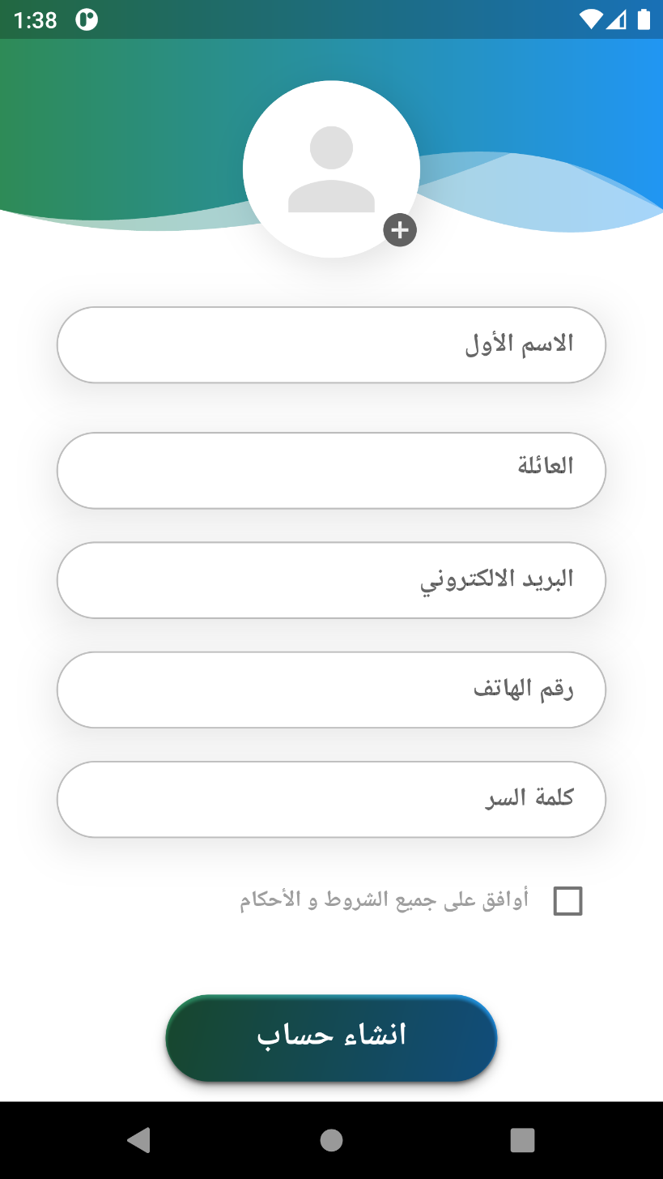
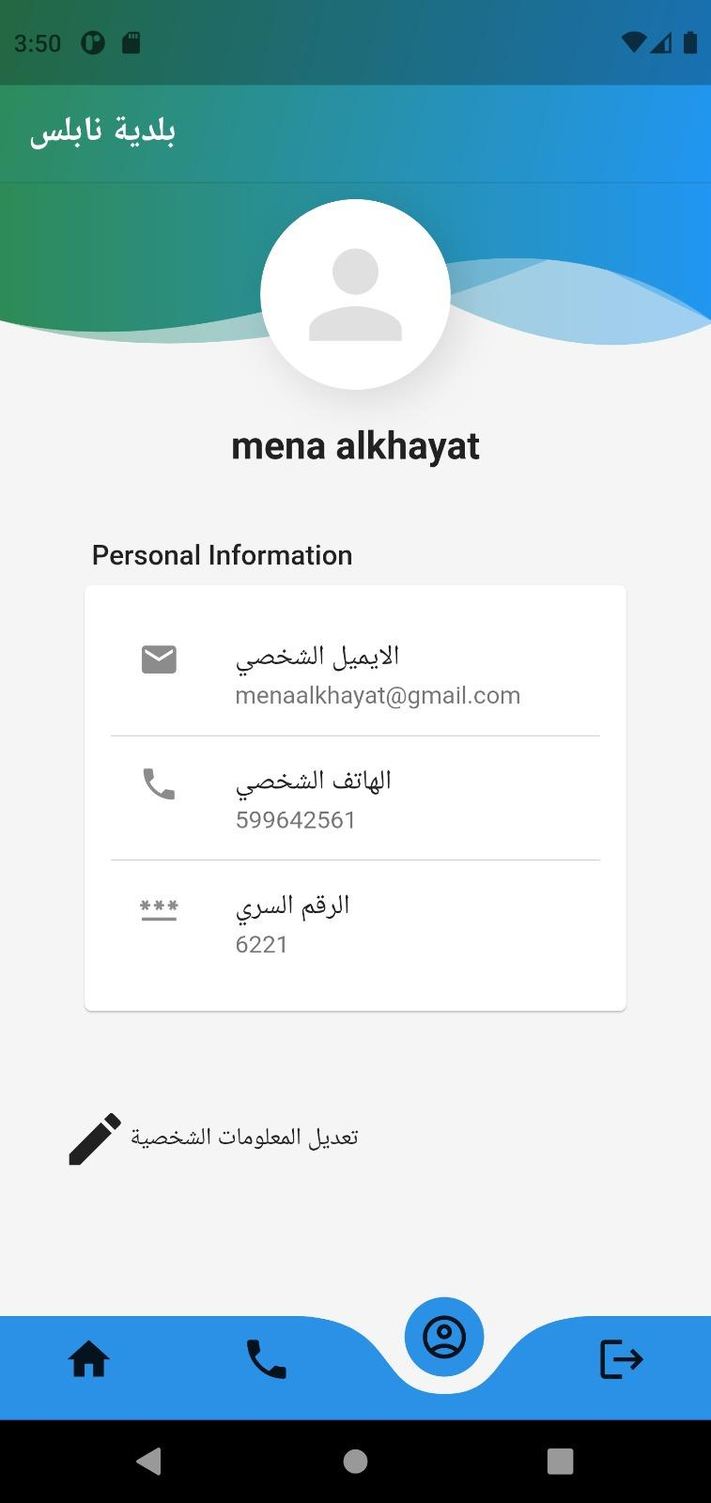
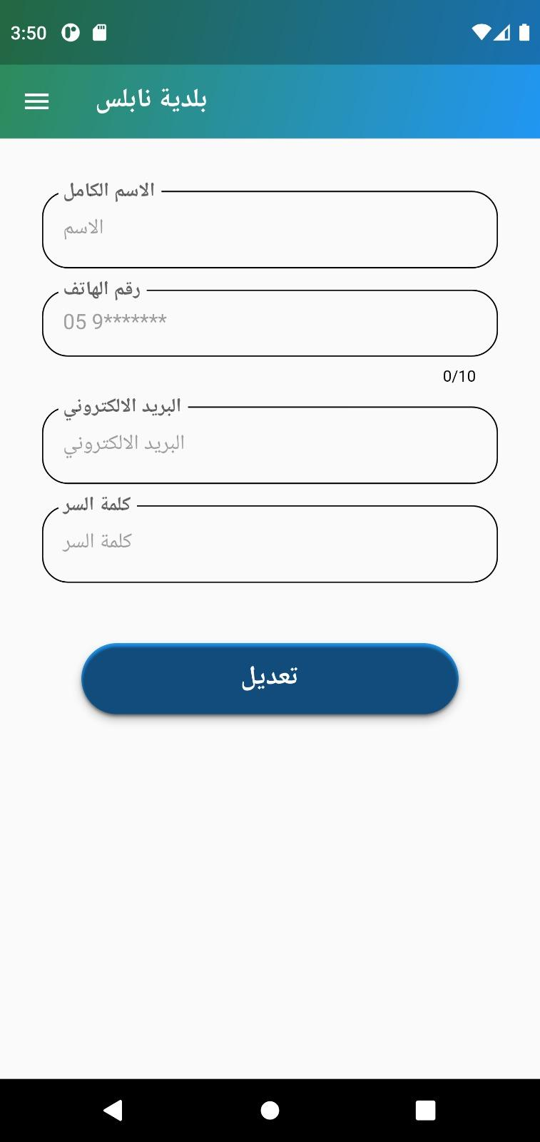
  Features and Design

Slide 17
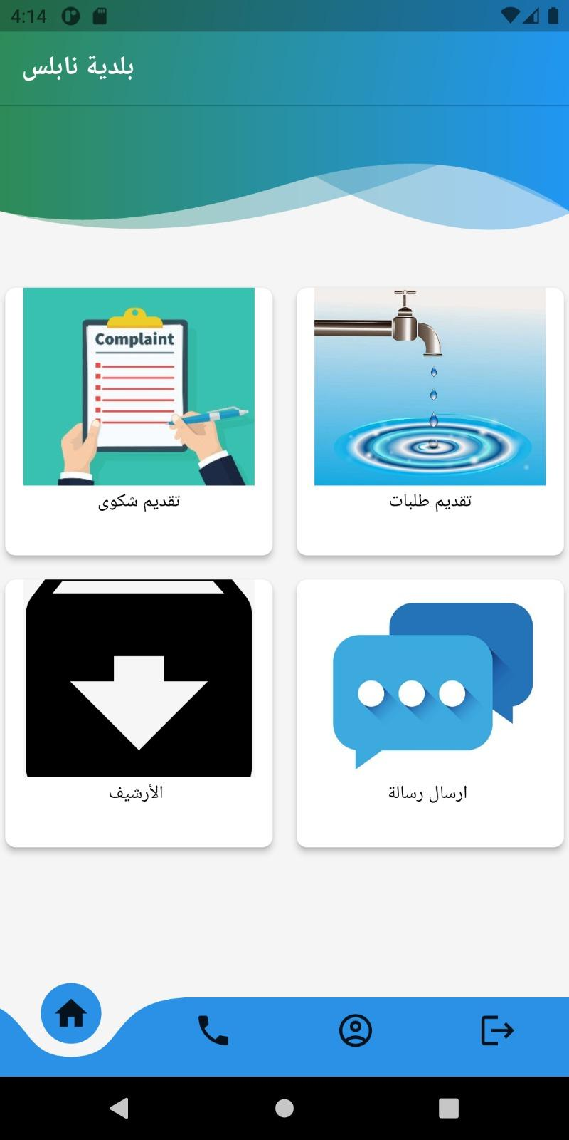
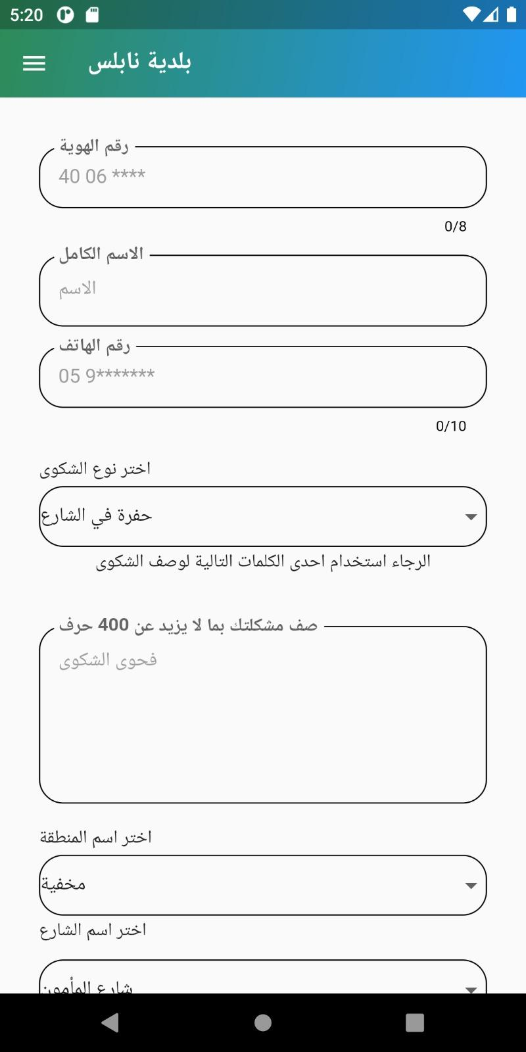
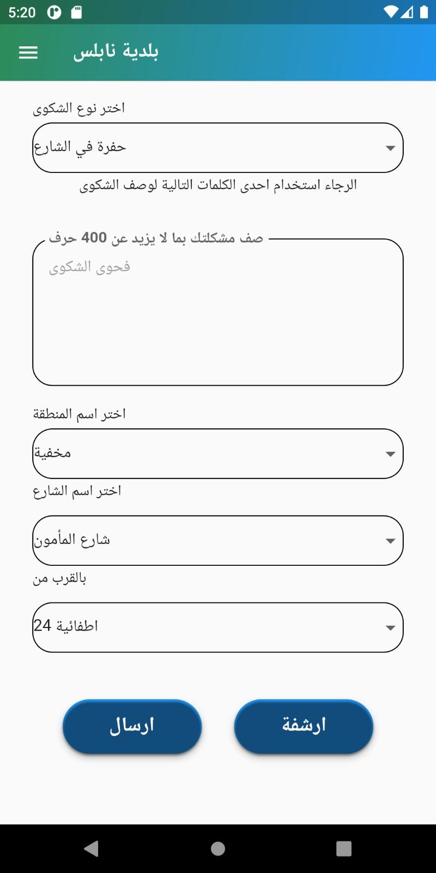
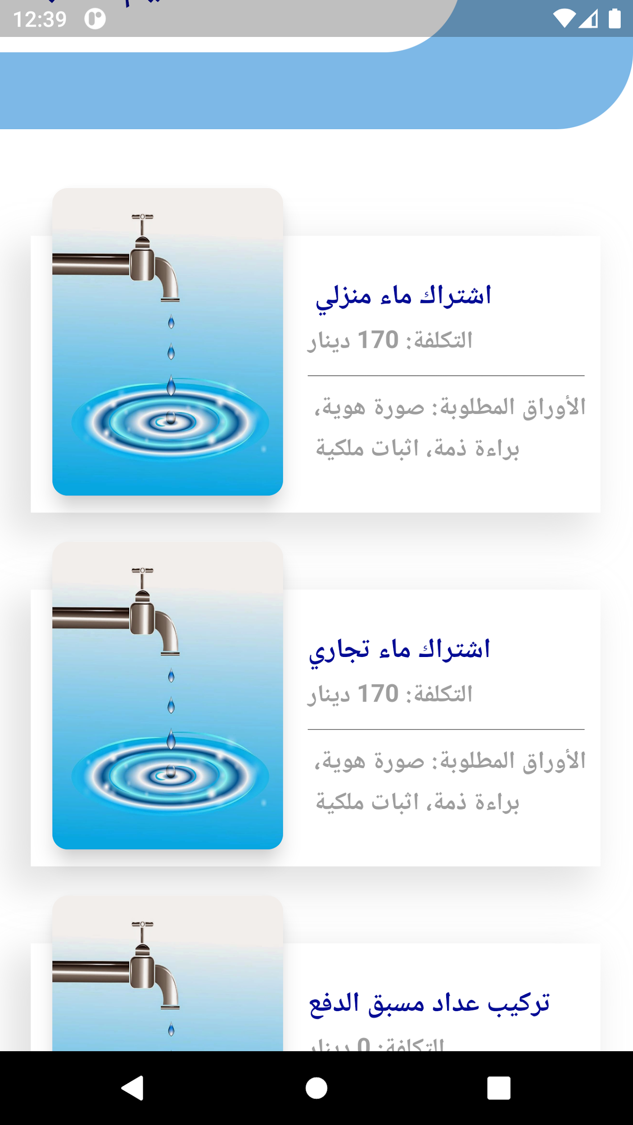
  Features and Design

Slide 18
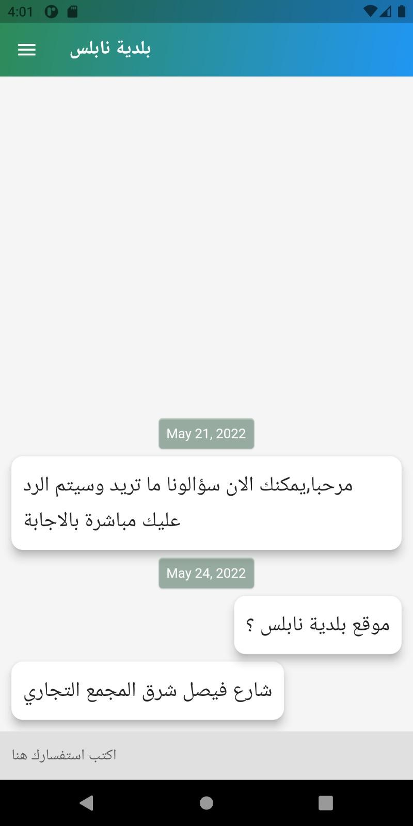
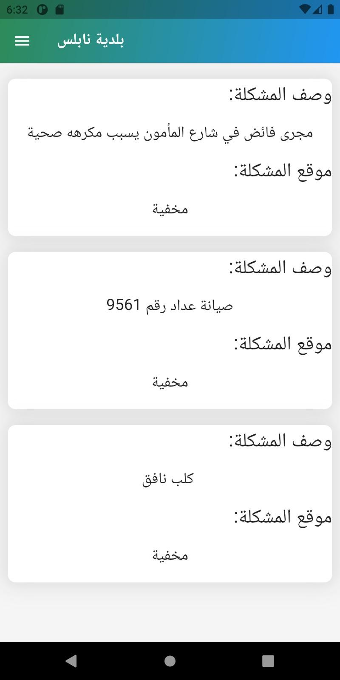
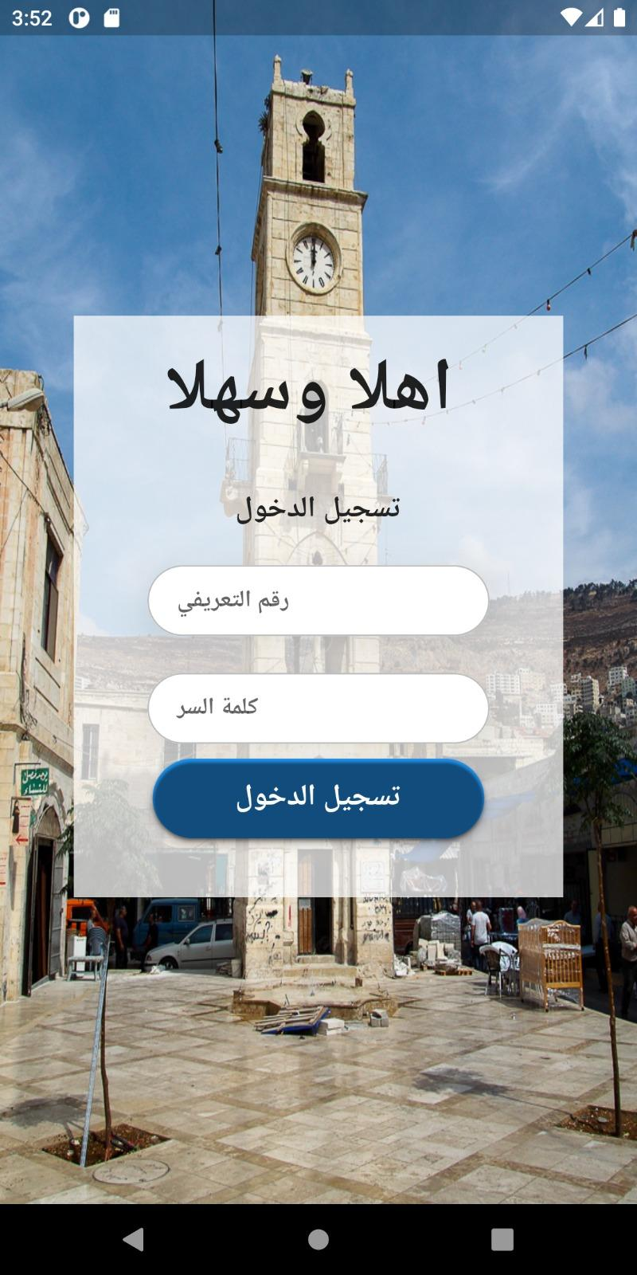
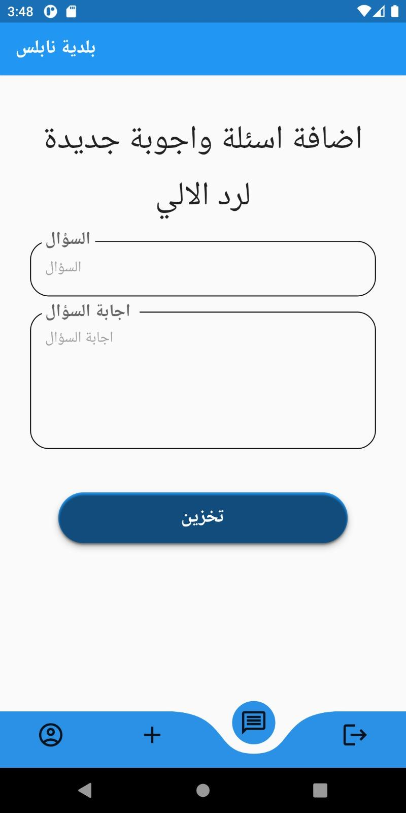
  Features and Design

Slide 19
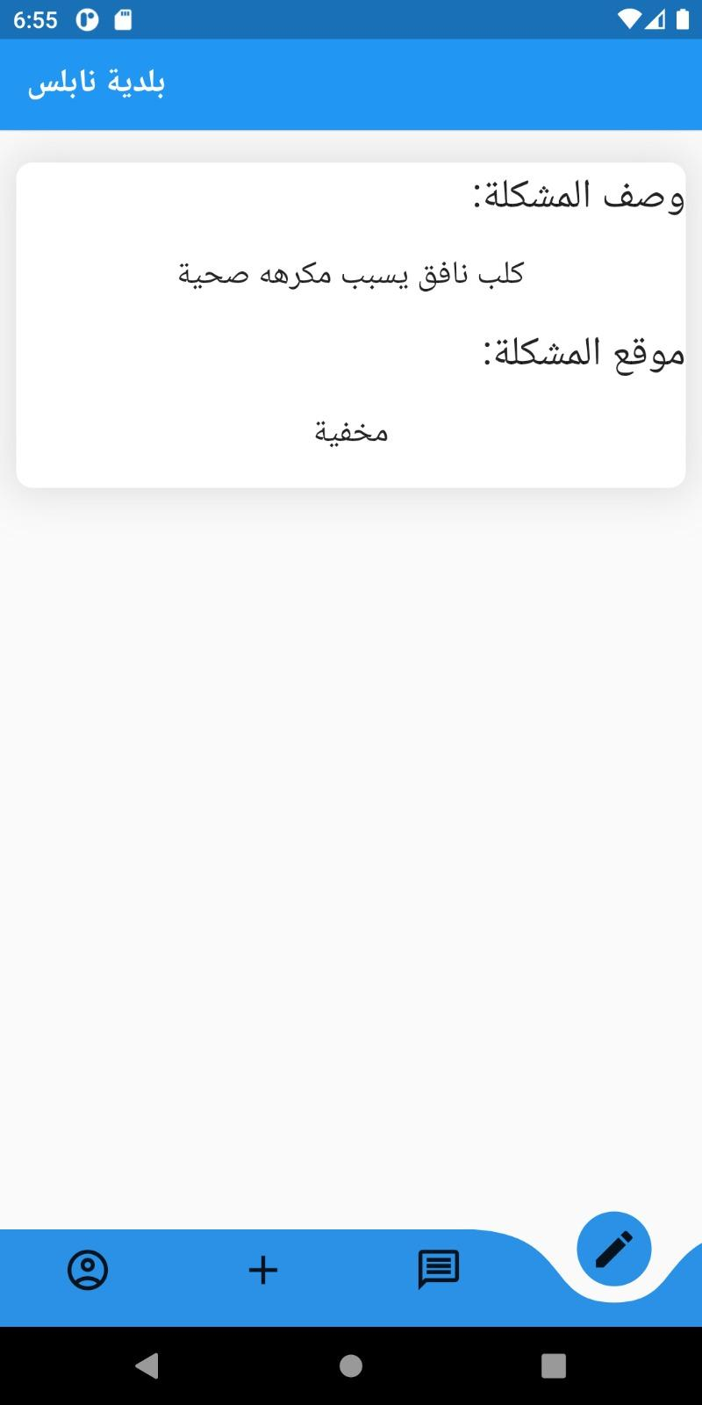
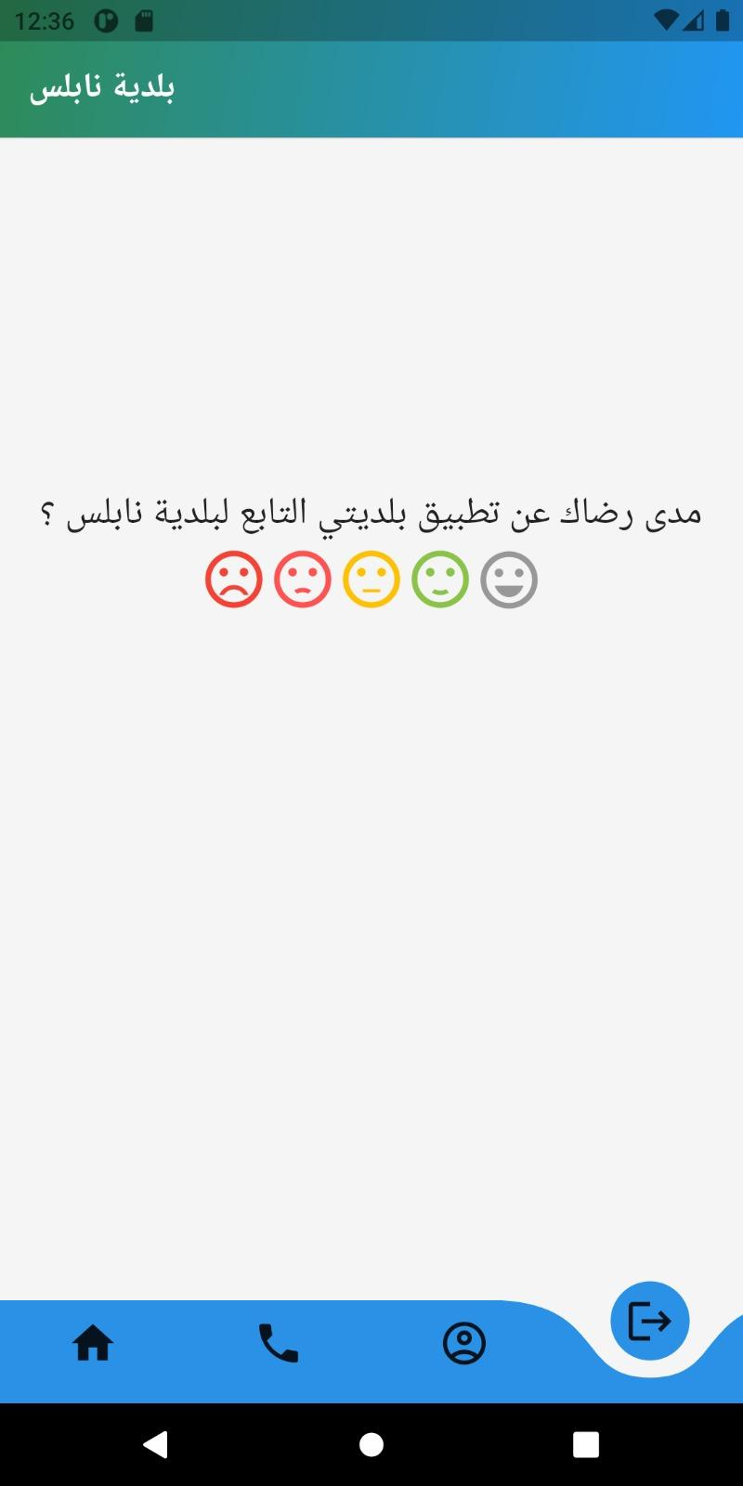
  Features and Design

Slide 20
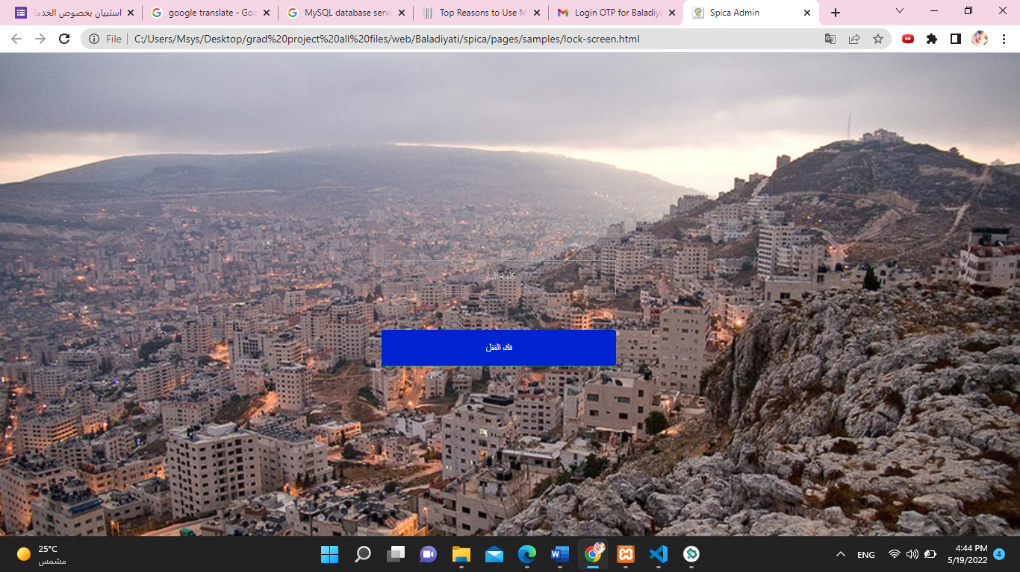
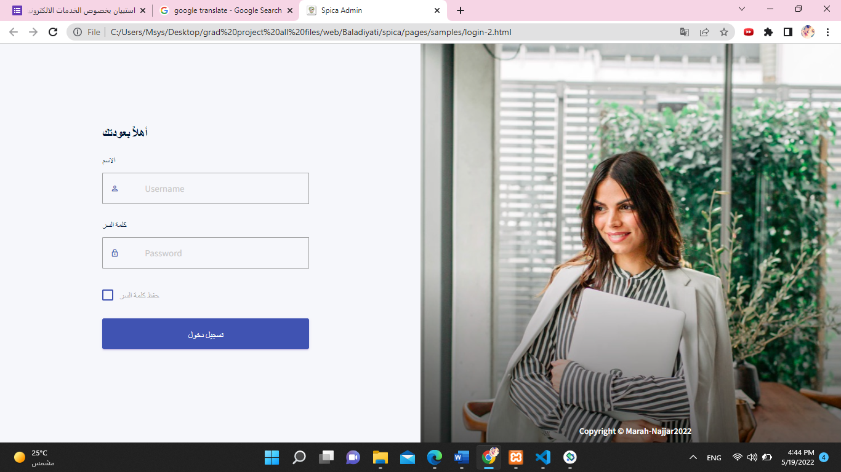
  Features and Design-future vision

Slide 21
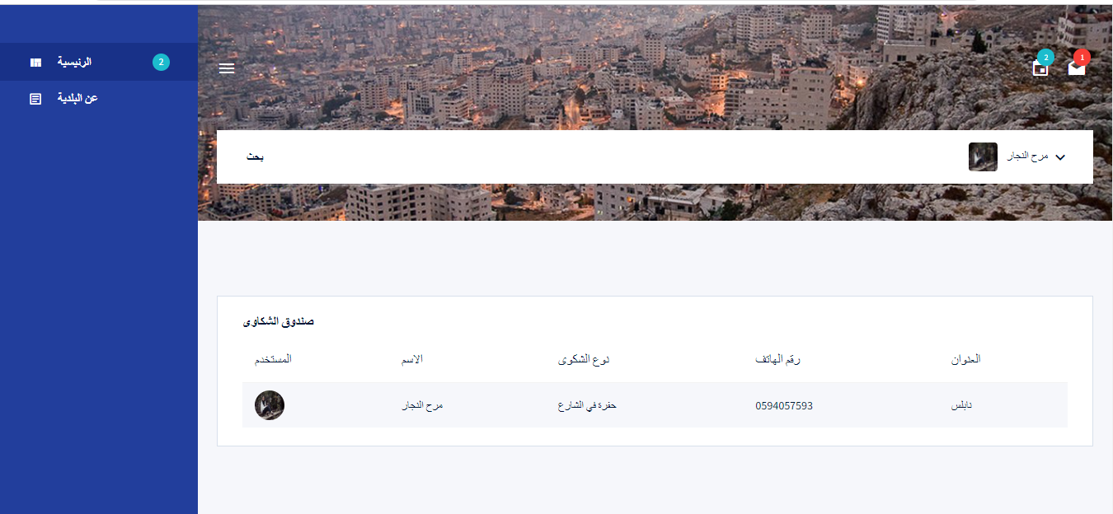
  Features and Design-future vision

Slide 22
FUTURE WORK
We aim to expand project aspects so it can cover all municipality services.
We seek to add google maps services to the application.
Taking feedbacks from users and develop the application according to it.
Use artificial intelligence in all possible parts.
Activating employees website.

Slide 23
CONCLUSION
Baladiyati mobile application is a unique application that has been designed to facilitate the services which provided by the public complaints services department in the municipality of Nablus, and based on the human centered design methodology as it facilitates the process of submitting complaints electronically by citizens without the need of visiting the municipality or perform any extra activities.

Slide 24
THANK YOU!
NAJJAR.MARAH@GMAIL.COM, MENAALKHAYYAT@GMAIL.COM
HTTPS://WWW.LINKEDIN.COM/IN/MARAH-AN-NAJJAR-979957195

