Slide 1


Slide 2

GP2-24/12/2016
Structural Design and Surveying of Quantities of Law and Media College at An-Najah National University – Nablus
Prepared By :
Mulook Shqeqat
Submitted to :
Dr. Imad Al-Qasem
Mrs. Reema Nassar

Slide 3
Outline
Objectives
Project Description.
SAP 3D model .
Design and Details .
Surveying of Quantities .

Slide 4
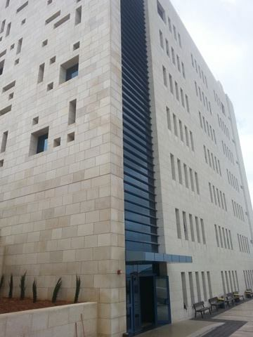
College of Law and Media

Slide 5
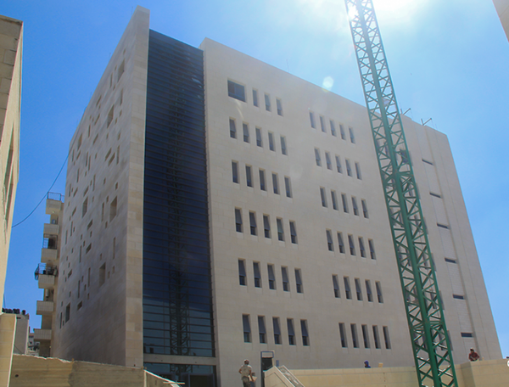

Slide 6
Objectives of Graduation Project
To build a 3D model for the structure using SAP2000 .
To design the structure based on ACI code .
To make a Surveying of Quantities for the structure.

Slide 7
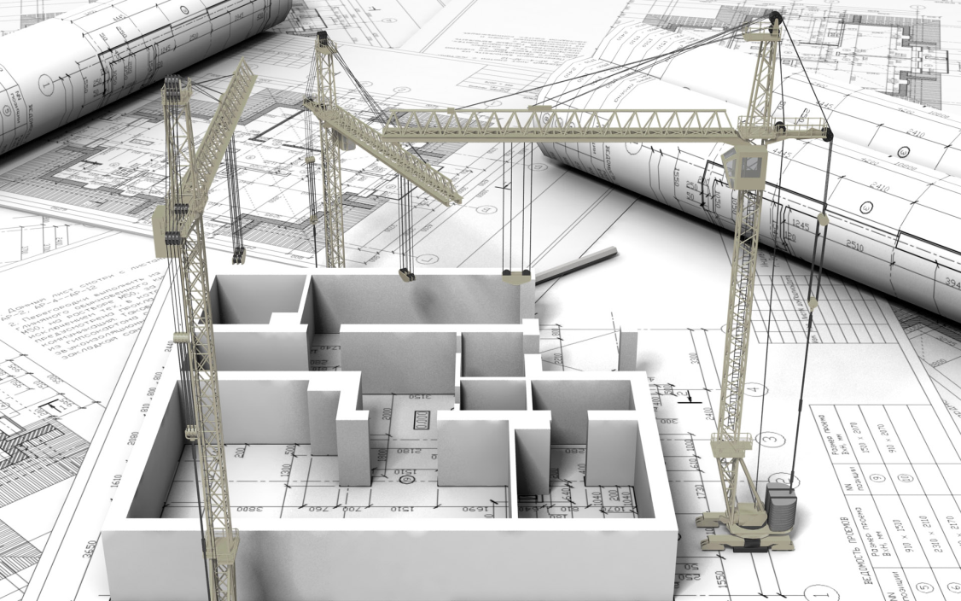
PART A : STRUCTURAL DESIGN

Slide 8
Project Description
The Faculty of Law and Media is one of the projects that are constructed in An-Najah National University in Nablus . This college consists of one basement floor, ground floor and five top floors .
Use of floor | Height (m) | Area (m2) | Floor
Computer labs ,storage, control room and stadium | 4 | 1303.6 | Basement
Large and small classrooms with micro teaching lab | 4 | 554.32 | Ground
Large and small classrooms with psychology lab | 4 | 554.32 | First
Large and small classrooms with education technology lab | 4 | 554.32 | Second
Large classrooms with Dean Office, waiting and meeting halls | 4 | 554.32 | Third
Open offices space | 4 | 554.32 | Forth
Open offices space | 4 | 554.32 | Fifth
 |  | 448.72 | Roof
 | 28 | 5078.24 | Total

Slide 9
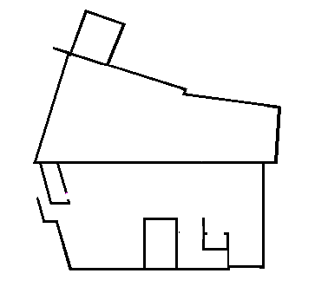
The building is divided into two blocks in the basement floor and one block in the other floors .
Here are the two parts of the structure in the basement floor.

Slide 10
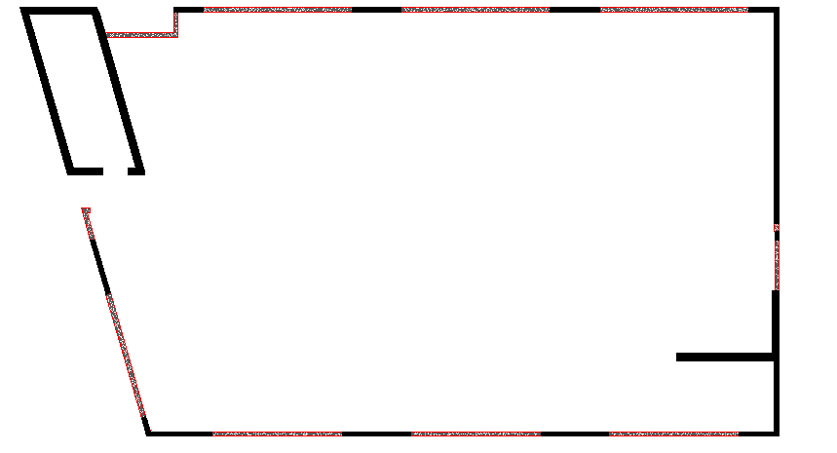
Here are the block of the other floors

Slide 11
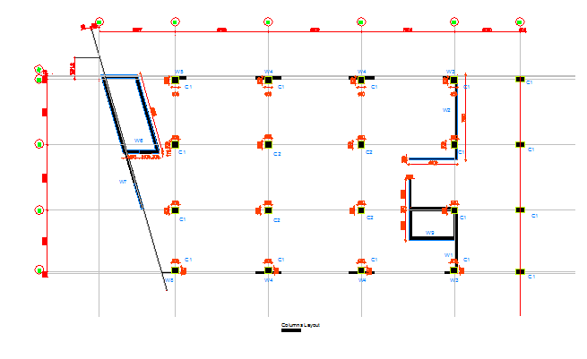
System : Two Way Solid Slab
Thickness of slab = 20 cm for all slabs but 25 cm for roof slab .

Slide 12
Material:
Are divided to :-
*Structural material
*Non- Structural Material

Slide 13
Structural Material :
1-Concrete
Value | Property
28 Mpa | Compressive strength of concrete (f'c)
24.87 * 10³ Mpa | Modulus of Elasticity (Ec)
23 KN / m³ | Unit weight of plain concrete (γ)
25 KN / m³ | Unit weight of reinforced concrete (γ)

Slide 14

2-Reinforcement Steel :

Slide 15
Non – Structural Material
*Aggregate
*Blocks
*Masonry Stone
*Tiles
*Plaster
*Concrete Mortar

Slide 16
Material unit weight
Material | γ in KN/m³
Block | 12
Tiles | 26
Plastering | 23
Masonry stone | 26
Aggregate | 18
Concrete mortar | 23

Slide 17
Soil Properties
The soil in the site area for our structure is mainly rocky where footings shall be laid on natural excavated ground , where the bearing capacity of the soil based on the nature of the soil in the site is 350 KN/m² .

Slide 18
Codes
* ACI 318-11 ( American Concrete Institute ) : building code requirements of structural concrete and commentary .

Slide 19
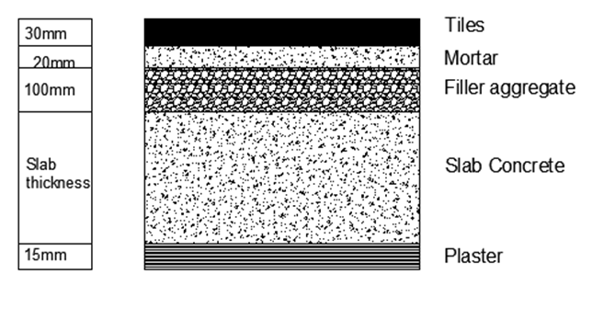
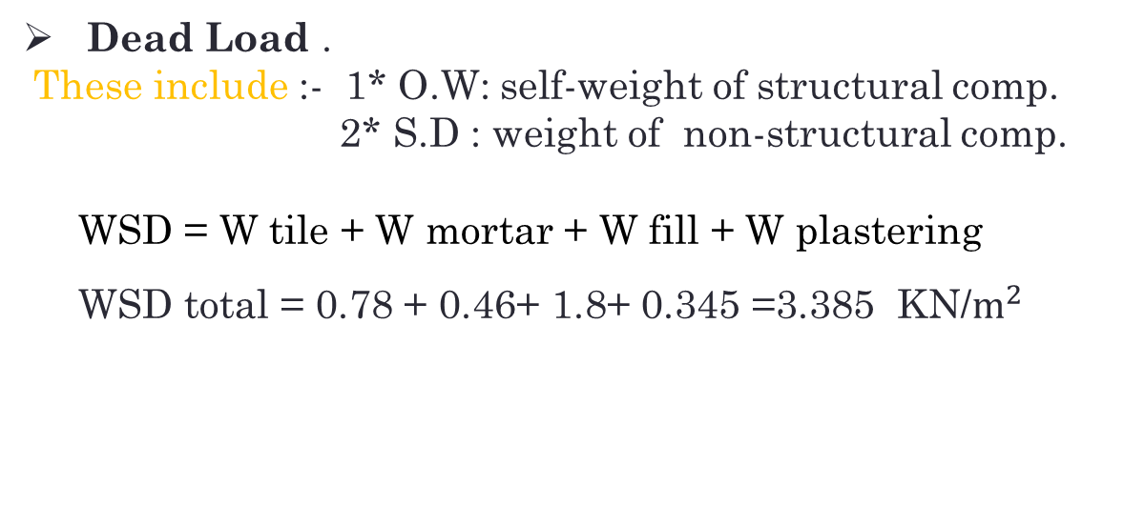
Loads
Dead Load .
These include :- 1* O.W: self-weight of structural comp.
2* S.D : weight of non-structural comp.
WSD = W tile + W mortar + W fill + W plastering
WSD total = 0.78 + 0.46+ 1.8+ 0.345 =3.385 KN/$m^{2}$

Slide 20
Live Load .
Live Load ( kN/m^2) | Floor
4.79 | Basement
4.79 | Ground
4.79 | First
4.79 | Second
4.79 | Third
4.79 | Fourth
4.79 | Fifth
10 | Roof

Slide 21
Load Combinations
Equation | Load combinations
(9-1) | U = 1.4D
(9-2) | U = 1.2D+1.6L+0.5(Lr or S or R)
(9-3) | U = 1.2D+1.6(Lr or S or R)+(1.0L or 0.5W)
(9-4) | U = 1.2D+1.0W+1.0L+0.5(Lr or S or R)
(9-5) | U = 1.2D+1.0E+1.0L+0.2S
(9-6) | U = 0.9D+1.0W
(9-7) | U = 0.9D+1.0E

Slide 22
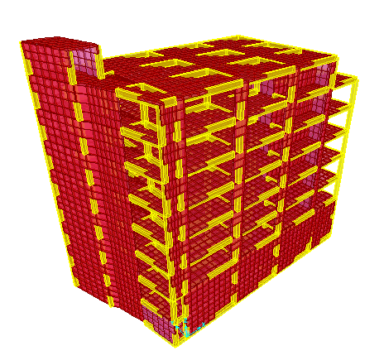

Slide 23
3D model represent a physical body using a collection of points in 3D space and it's a process of developing a mathematical representation of any three-dimensional surface of an object (either inanimate or living) via specialized software, in this project we use sap 2000 for modeling.
This part includes the analysis and design of each element structural ( slabs, beams, shear wall and column). The modeling building using SAP2000 by first definitions: : materials , sections as one-dimensional element (columns and beams )and two dimensional elements (slabs and shear wall ),and loads . Then draw each element relative to specific grade system on SAP2000.

Slide 24
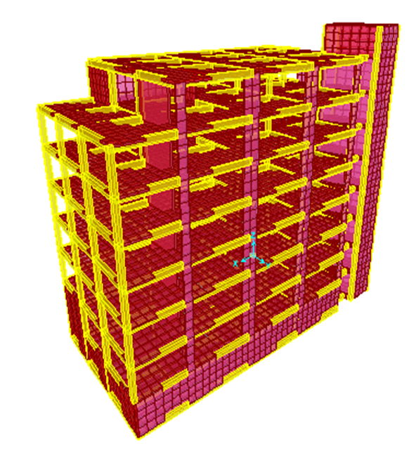
Block one in 3D

Slide 25
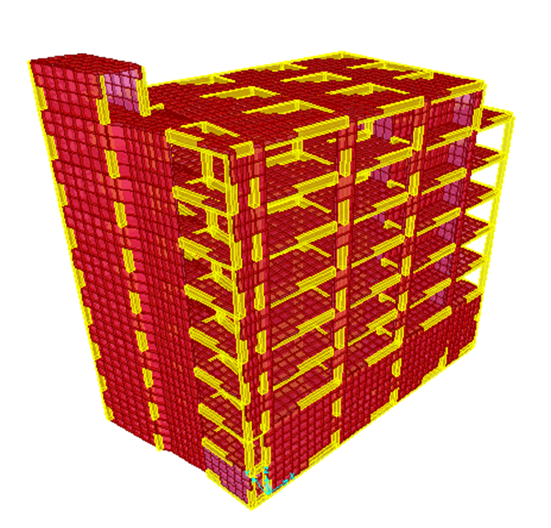
Block one in 3D

Slide 26
Sections of the members of the structure:-
Dimensions | Type | Section
Thick. 20 cm | Area | All slabs
Thick. 25 cm | Area | Roof slab
(40*70) | Rectangle | Beam
(50*50) & (65*65) | Square | Column
Thick. 20 cm | Area | Shear wall

Slide 27
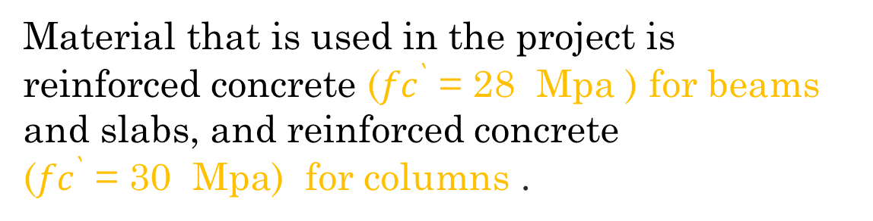
Material
Material that is used in the project is reinforced concrete (${fc}^{`}$ = 28 Mpa ) for beams and slabs, and reinforced concrete
(${fc}^{`}$ = 30 Mpa) for columns .

Slide 28

Modifier | Element
0.25 | Slab
0.35 | Beam
0.7 | Column
0.7 | Shear wall

Slide 29
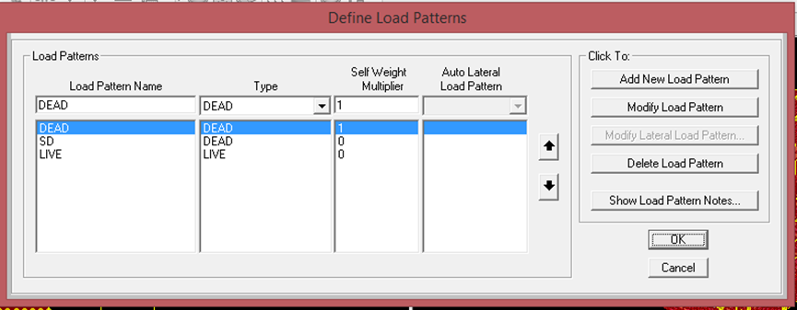
Loads on sap
* Load pattern definition

Slide 30
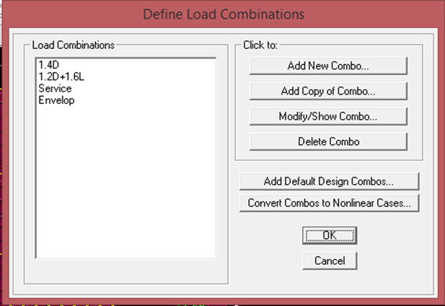
* Load Combination

Slide 31
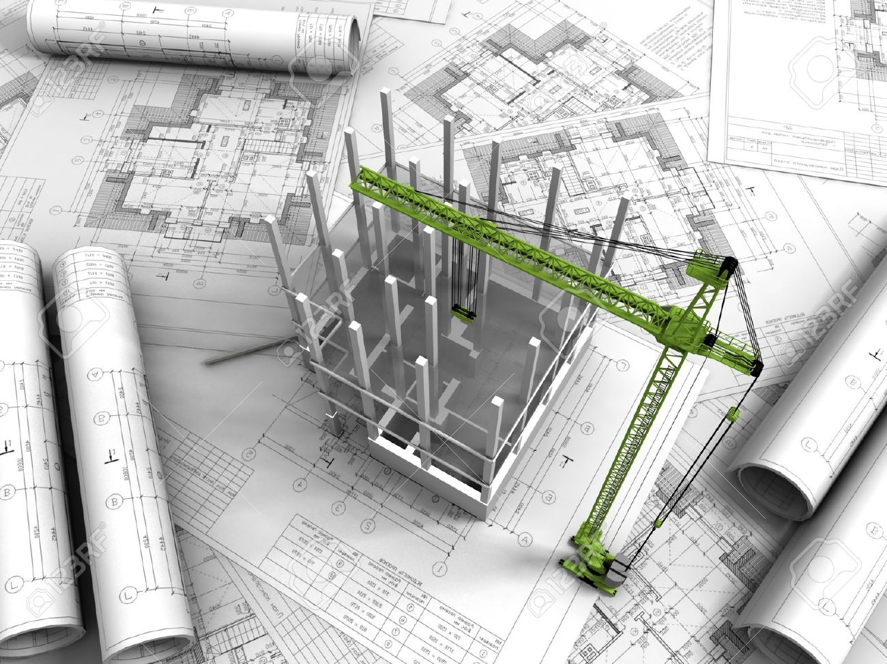
Design and Details

Slide 32
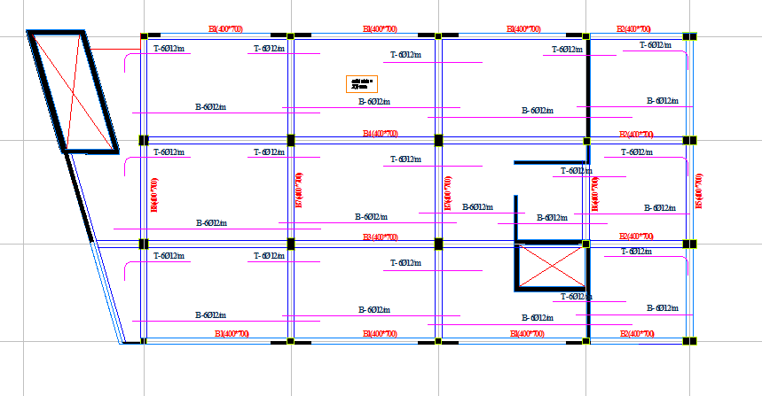
All Slabs on X – direction

Slide 33
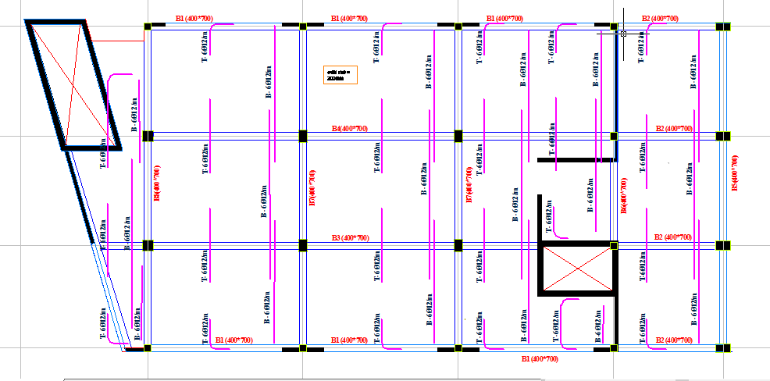
All Slabs on Y – direction

Slide 34
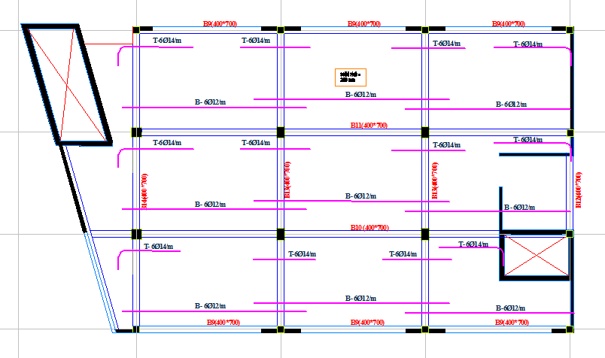
Roof Slab on X – direction

Slide 35
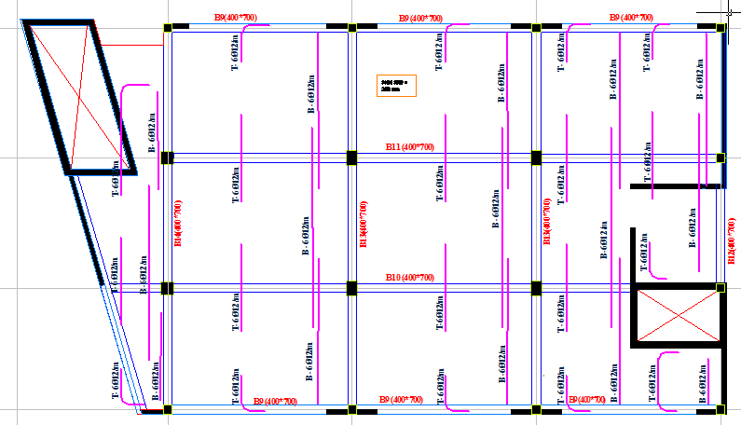
Roof Slab on Y – direction

Slide 36
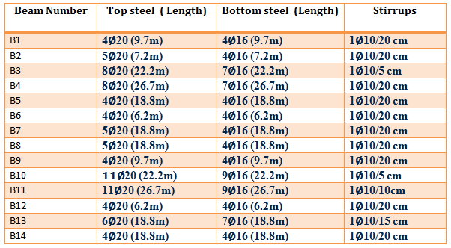
Beams Details

Slide 37
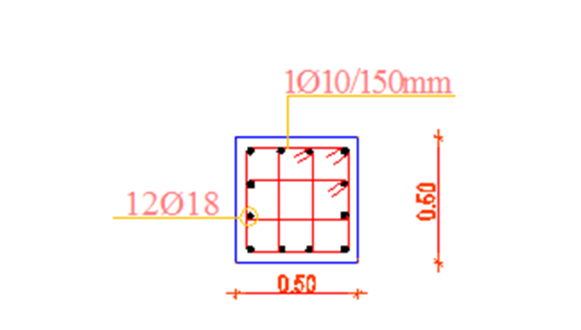
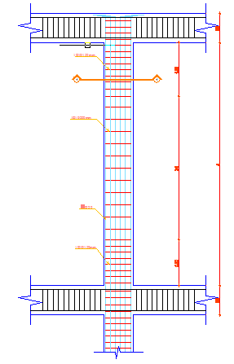
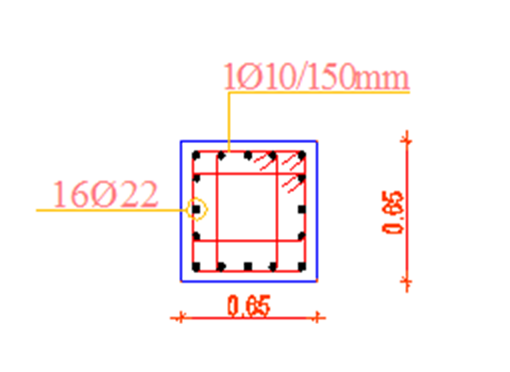
Columns Details
Column 1
Column 2

Slide 38
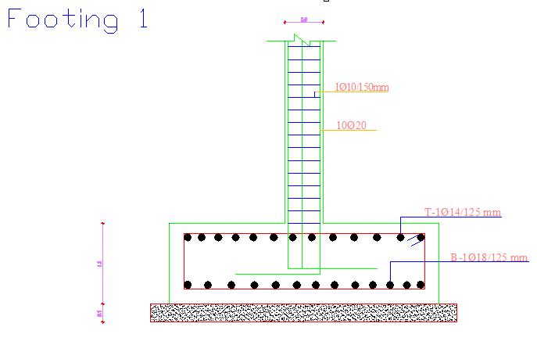
Footings Details

Slide 39
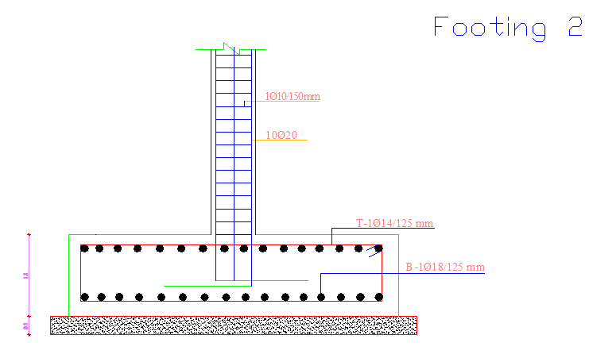

Slide 40
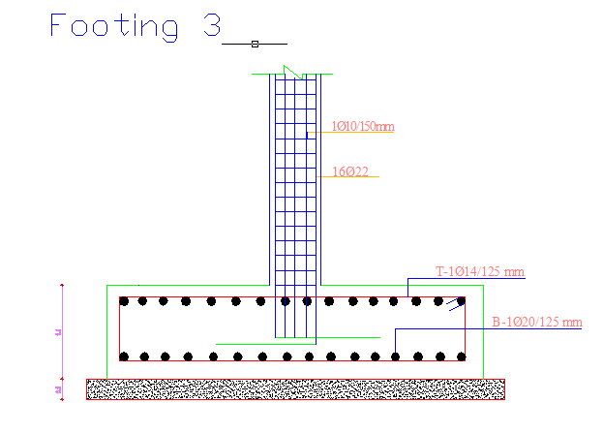

Slide 41
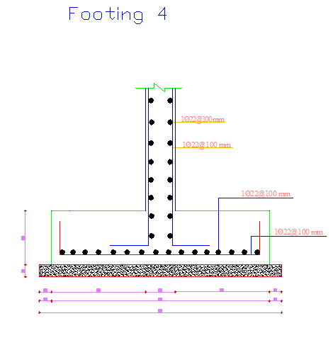

Slide 42

PART B : SURVEYING OF QUANTITIES

Slide 43
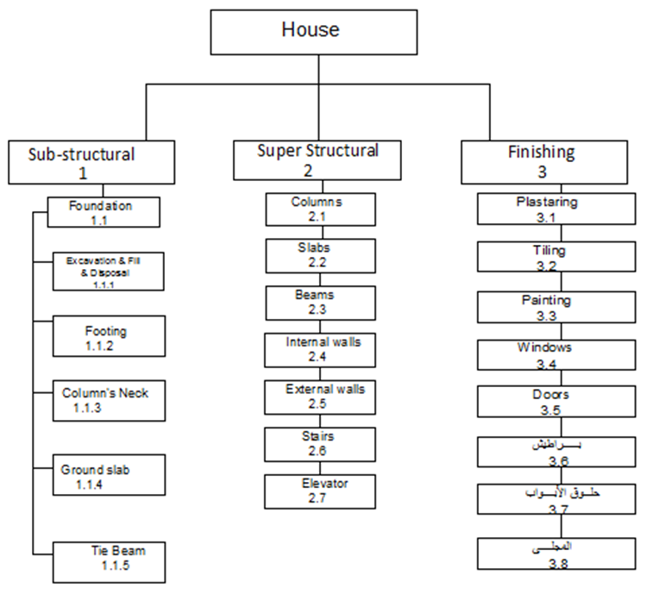
Methodology:
Work break down structure:

Slide 44
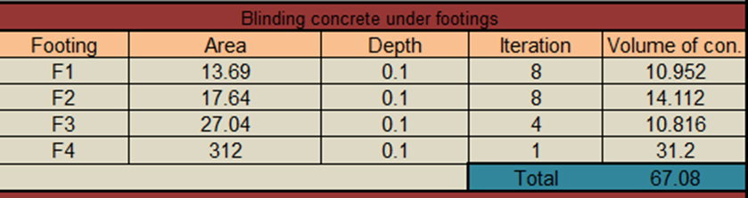
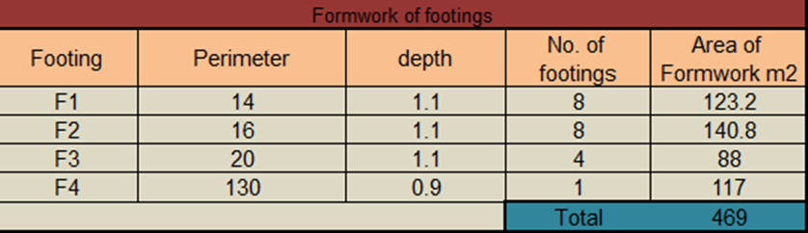
1- Sub-Structural
1.1: Footing.
1.1.1 Blinding concrete under footings
1.1.2: Formwork for footing

Slide 45
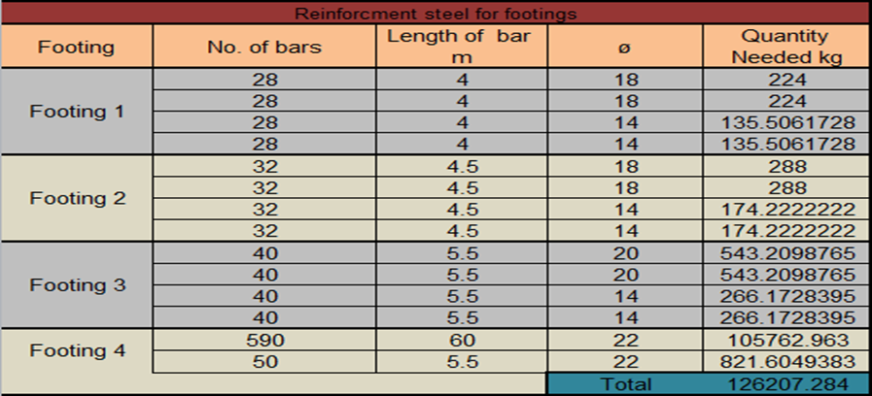
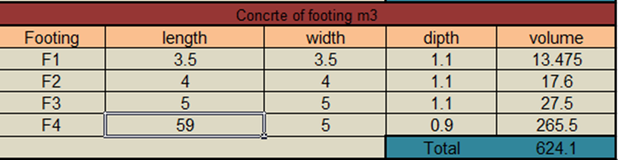
1.1.3: Steel reinforcement for footings
1.1.4: Concrete for footing

Slide 46
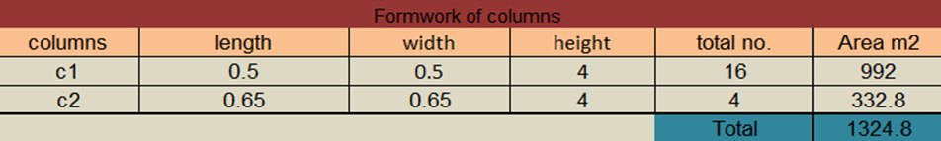
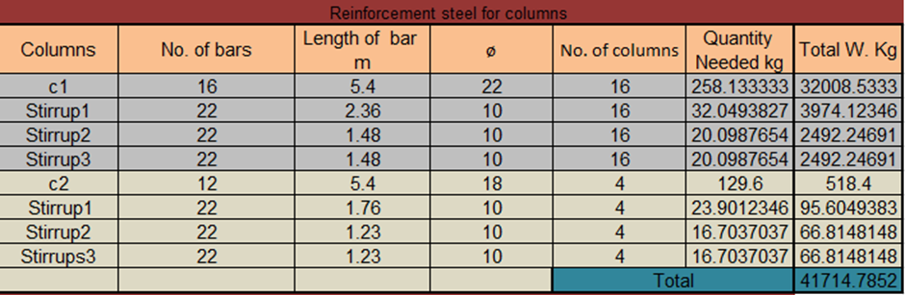
2- Super-Structural.
2.1: Columns.
2.1.1: Formwork for columns
2.1.2: Steel reinforcement for columns.

Slide 47
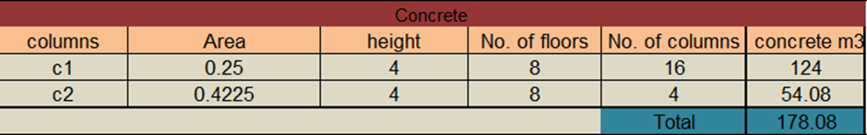
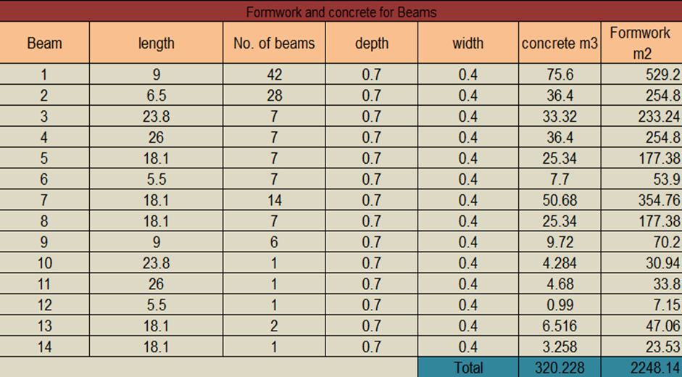
2.1.3: Concrete for columns.
2.2: Beams.
2.2.1: Formwork and concrete for Beams.

Slide 48
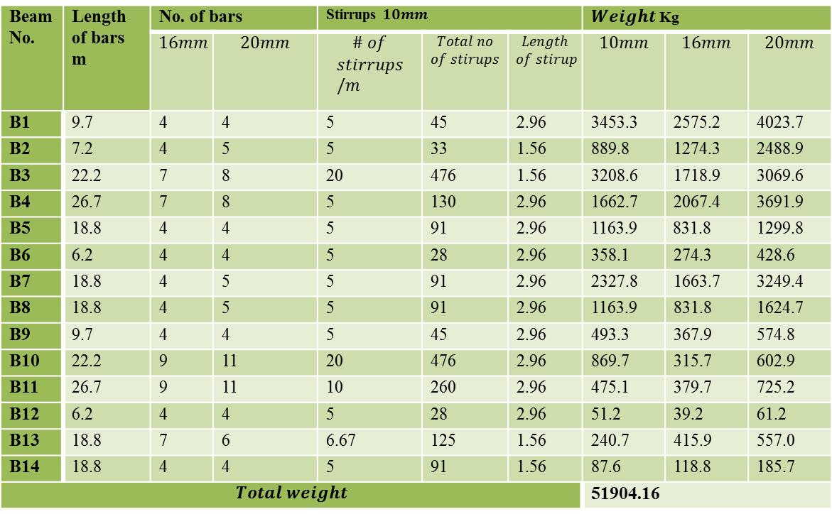
2.2.2: Steel Reinforcement for Beams.
Beam No. | Length of bars m | No. of bars |  | Stirrups $10mm$ |  |  | $Weight$ Kg
 |  | $$16mm$$ | $$20mm$$ | $$\# of$$ $$stirrups/m$$ | $$Total no$$ $$of stirups$$ | $$Length$$ $$of stirup$$ | $$10mm$$ | $$16mm$$ | $$20mm$$
B1 | 9.7 | 4 | 4 | 5 | 45 | 2.96 | 3453.3 | 2575.2 | 4023.7
B2 | 7.2 | 4 | 5 | 5 | 33 | 1.56 | 889.8 | 1274.3 | 2488.9
B3 | 22.2 | 7 | 8 | 20 | 476 | 1.56 | 3208.6 | 1718.9 | 3069.6
B4 | 26.7 | 7 | 8 | 5 | 130 | 2.96 | 1662.7 | 2067.4 | 3691.9
B5 | 18.8 | 4 | 4 | 5 | 91 | 2.96 | 1163.9 | 831.8 | 1299.8
B6 | 6.2 | 4 | 4 | 5 | 28 | 2.96 | 358.1 | 274.3 | 428.6
B7 | 18.8 | 4 | 5 | 5 | 91 | 2.96 | 2327.8 | 1663.7 | 3249.4
B8 | 18.8 | 4 | 5 | 5 | 91 | 2.96 | 1163.9 | 831.8 | 1624.7
B9 | 9.7 | 4 | 4 | 5 | 45 | 2.96 | 493.3 | 367.9 | 574.8
B10 | 22.2 | 9 | 11 | 20 | 476 | 2.96 | 869.7 | 315.7 | 602.9
B11 | 26.7 | 9 | 11 | 10 | 260 | 2.96 | 475.1 | 379.7 | 725.2
B12 | 6.2 | 4 | 4 | 5 | 28 | 2.96 | 51.2 | 39.2 | 61.2
B13 | 18.8 | 7 | 6 | 6.67 | 125 | 1.56 | 240.7 | 415.9 | 557.0
B14 | 18.8 | 4 | 4 | 5 | 91 | 1.56 | 87.6 | 118.8 | 185.7
$$Total weight$$ |  |  |  |  |  |  | 51904.16

Slide 49
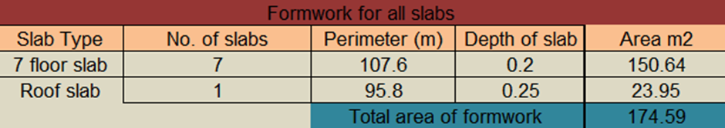
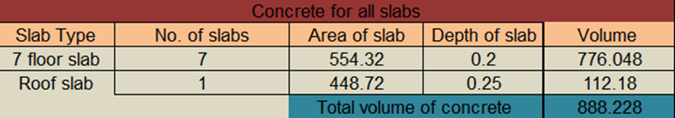
2.3: Slabs.
2.3.1: Formwork for Slabs.
2.3.2: Concrete for Slabs.

Slide 50
2.3.3: Reinforcement steel for Slabs.
Type | Weight of steel kg
7 floors on x-direction | 40962.76
7 floors on y-direction | 42346.56
Roof floor on x-direction | 5426.61
Roof floor on y-direction | 4973.39
TOTAL | 93709.33

Slide 51
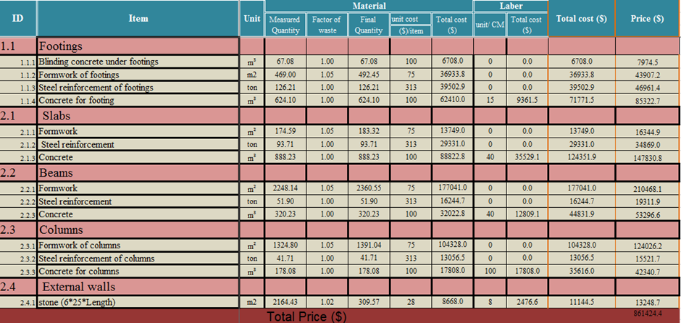
Price Calculations :

Slide 52
FINAL PRICE = 861 424 . 4 $

Slide 53


