Slide 1






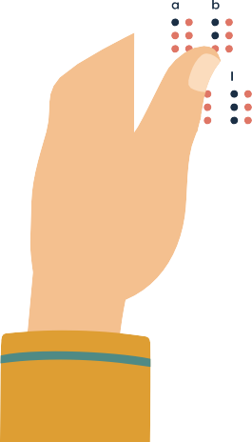
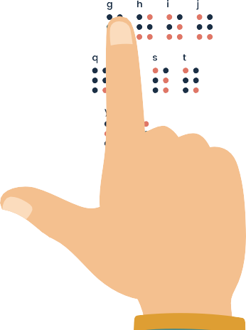




Braille
Printer
Hardware Graduation Project 2025

Slide 2





Our Team
Supervisor
Dr. Saed Tarapiah
Sami Haji
Faiq Bakri

Slide 3
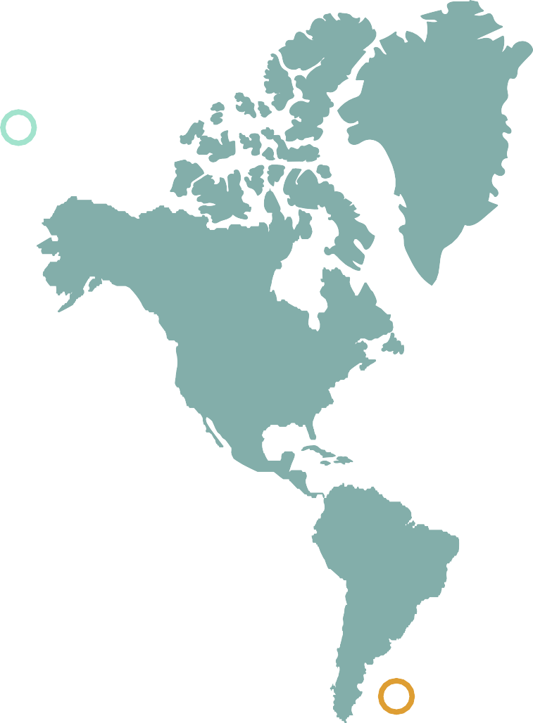


Table of contents
01
02
03
04
05
06
Problem Statment Our Solution
Project Implementation Project Components
Challenges and Constraints Future Work

Slide 4




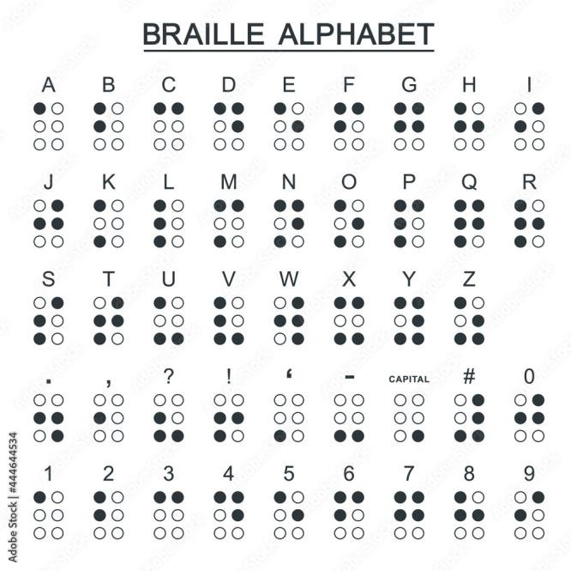

The Mechanism of converting text to braille
Braille representation:
It is a tactile code enabling blind
and visually impaired people to read by touch

Slide 5







What ‘s the problem?
People with visual disabilities face several challenges when they need to possess text-written material in Braille.
Publishing houses do not take their needs into consideration
High costs of Commercial Braille Printers
Limited Ease of use.

Slide 6

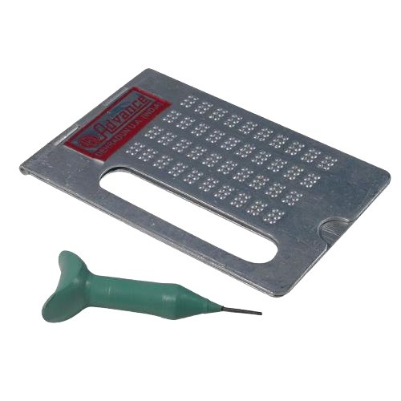
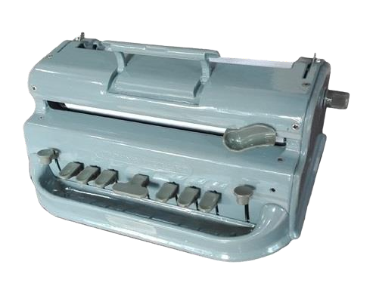
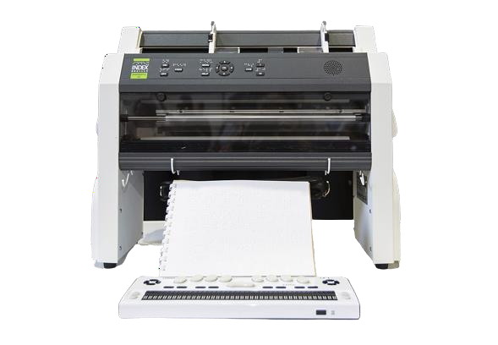
Evolution of Braille Printers

Slide 7
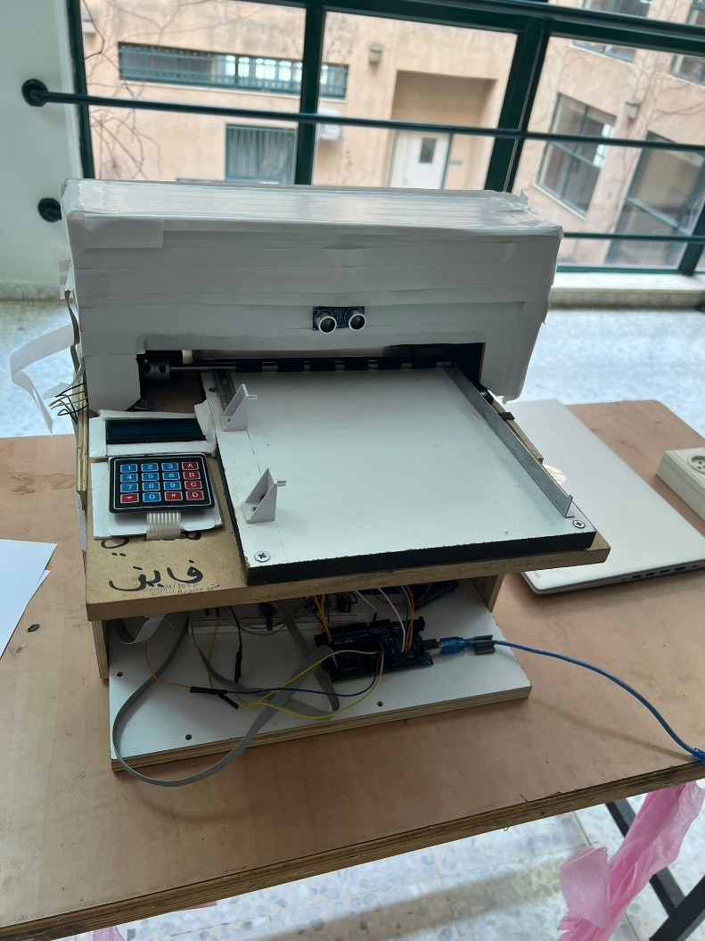
Our Solution
We have developed a Braille printer which is:
affordable .
easily accessible .
Made to be user-friendly, you don’t have to understand Braille to write with it.
This creative solution enables people with visual impairments to conveniently obtain the resources they need.

Slide 8
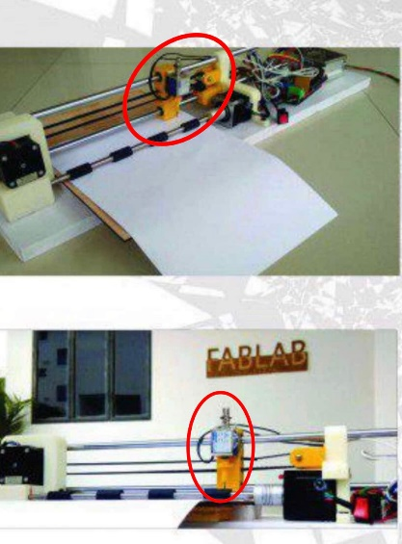
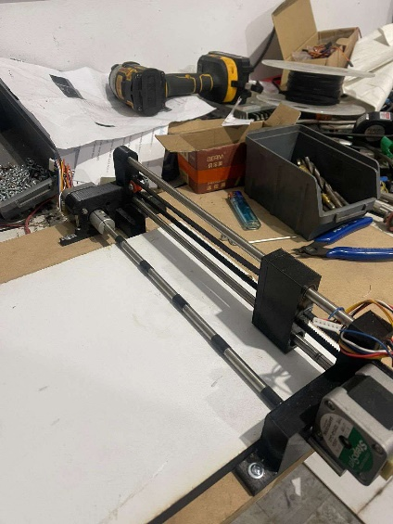
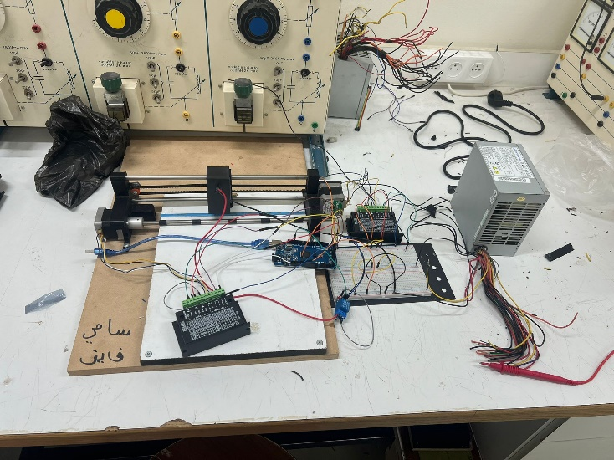
Project Implementation
1. Looking up DIY Braille printers’ designs online
We looked up designs of DIY Braille printers for inspiration
2. Design the Braille printer’s body
We bought our project’s components, structured the design of it’s main and inner body
3. Started roughly
After connecting our project, we started making our way thorough, implementing our algorithms, starting by printing one letter in braille

Slide 9
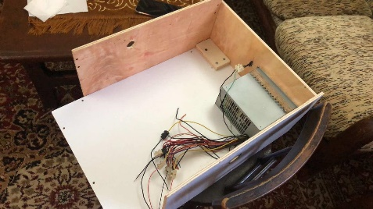
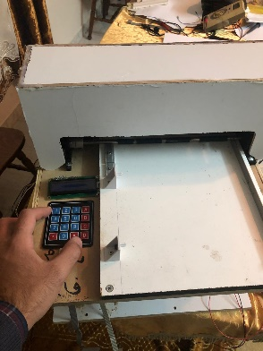
Project Implementation
4. Compounding algorithms, and optimization
We started by printing one single Braille letter, afterward we aimed on printing a whole string, inheriting what we did with printing one letter and upscaling it. Then we wrote our word-wrapping algorithm (last space/ new line) algorithm, for long text strings, thus aiming for PDF files.
5. Building a container (base) and an upper case
Built a base to contain most of the hardware components, and an upper case for safety and aesthetic

Slide 10
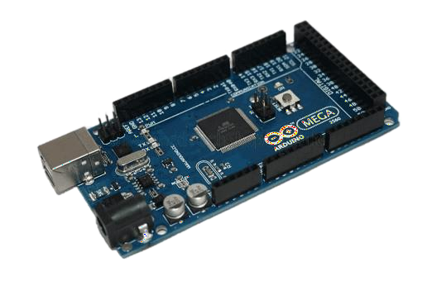
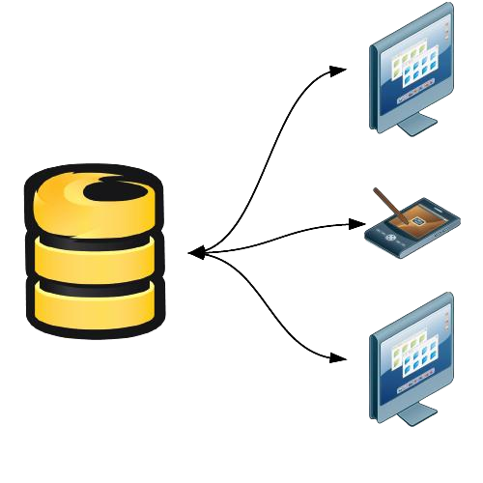
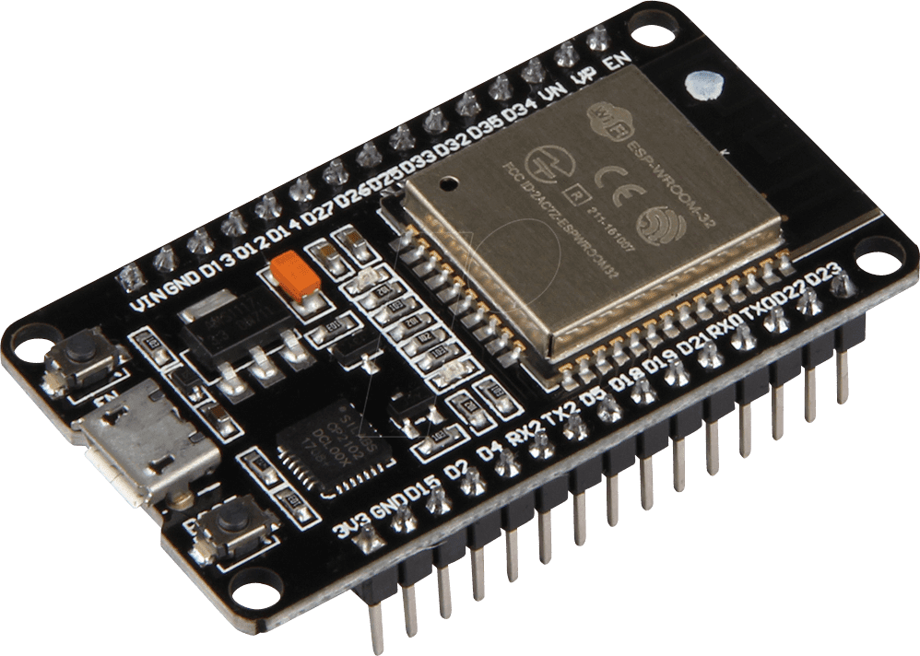

Project Implementation
6.1 Connect printer with WiFi
Serial connection
Arduino Mega
WiFi connection
Server & Web Interface
ESP32

Slide 11
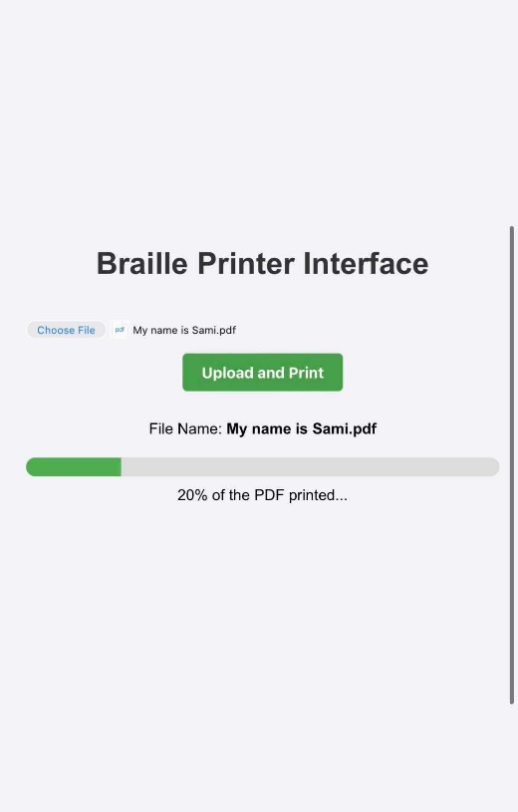
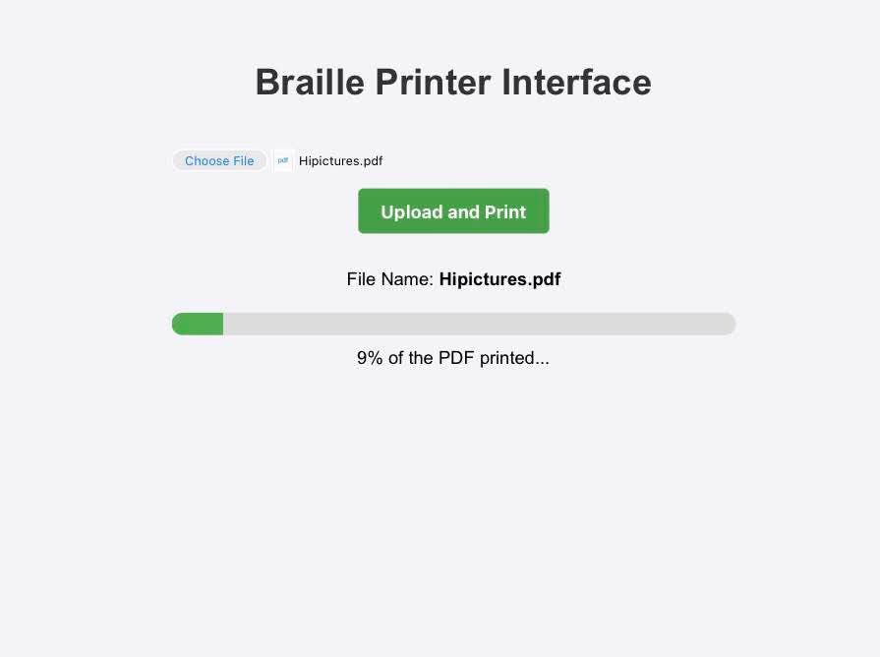
Project Implementation
6.2 Build Web Interface using Python

Slide 12


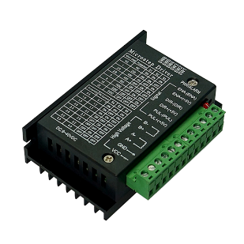
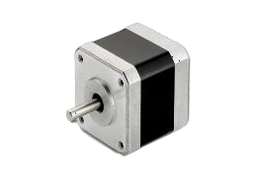

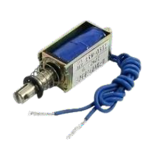
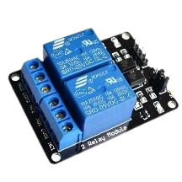

Project Components
Hardware components
Arduino Mega
ESP32
Stepper motor
Stepper motor driver
Solenoid
2 channel Relay

Slide 13
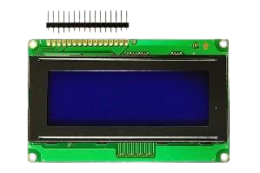
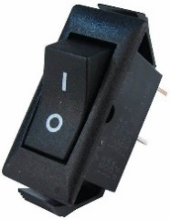
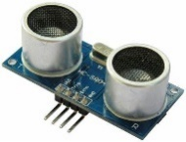
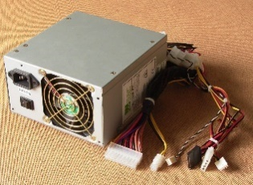
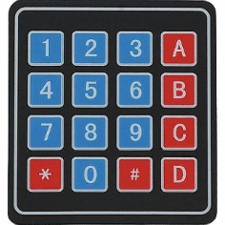
Project Components
On/Off Switch
LCD 16*2
Ultrasonic
Power supply
4x4 Keypad

Slide 14
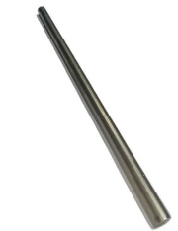
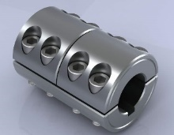

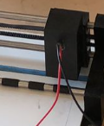
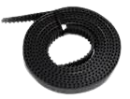

Project Components
Mechanical component
Metal rod
Rigid coupling
GT2
Braille Pen
MGN12C
Timing Belt

Slide 15



Challenges and Constrains
The Solenoid Not Embossing:
although the relay was being triggered: The first mechanical relay we have used in the design was a One-channel 5V relay. Sometimes It was “clicking”, but the solenoid wasn’t being triggered, while it was on other “clicks”. We have fixed this by using a Two-Channel Relay.

Slide 16
Challenges and Constrains
2. The Y-axis not taking the bait:
The problem happened when the paper wasn’t being pulled forward as it should have, in the beginning, we were using normal black-tape for friction and paper-pulling. We tried to make the black-tapped rolls thicker, which unfortunately did not work either. After thinking it thoroughly, comparing our roller (Y-axis) to the one used in printers, we determined that the usual black-tapped rolls cause as minimum of a friction as possible, and that they were too soft on paper, so we bought special tape with hard texture, measured the circumference of the Y-axis’ rod, cut them evenly and equally and replaced them. Which has fixed the problem.

Slide 17
Future Work
Adding another pin for embossment, and dividing the X-axis in half, making both work their half of the row, which doubles speed ideally.
Make the printer achieve an automated paper-feed system, and accept different sizes of papers such as A5, A3.
Make the printer multilingual.
Add a scanner that scans the text from papers then send it to printer to print in in Braille.

Slide 18


⠞⠓⠁⠝⠅ ⠽⠕⠥
T H A N K Y O U

