Slide 1

Redesign for Al Qaneer office building in Nablus city
An-Najah National University
Faculty of Engineering
Building Engineering Department
Prepared By:
Deyaa Zyoud
Hamed Baniowda
Sameeh Mahmood
Abdul hameed Ghanem
Supervisor:
Eng. Haitham Sawalha

Slide 2
Contents
Introduction
Site analysis
Architectural Design
Environmental Design
Structural Design
Electro Mechanical Design
Conclusion

Slide 3
Site Analysis

Slide 4
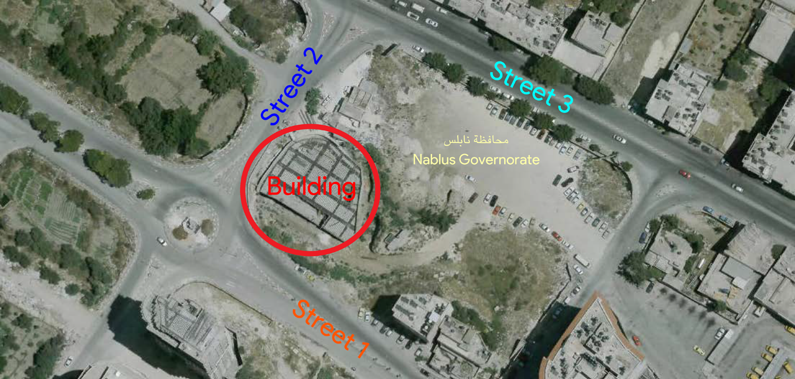
Site Location
The site is located in Nablus city in AL- Bassateen area near Sufian street, Nablus is about 569 m above sea level.
Area of the land 955 m^{2.}

Slide 5
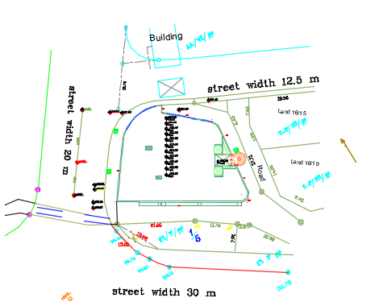
Site

Slide 6
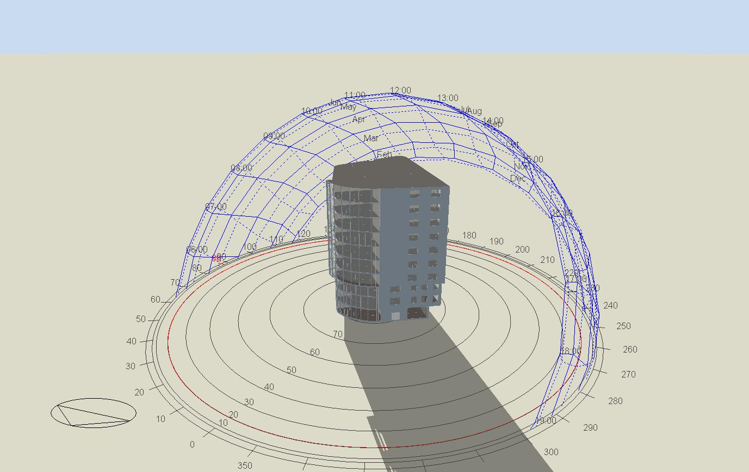
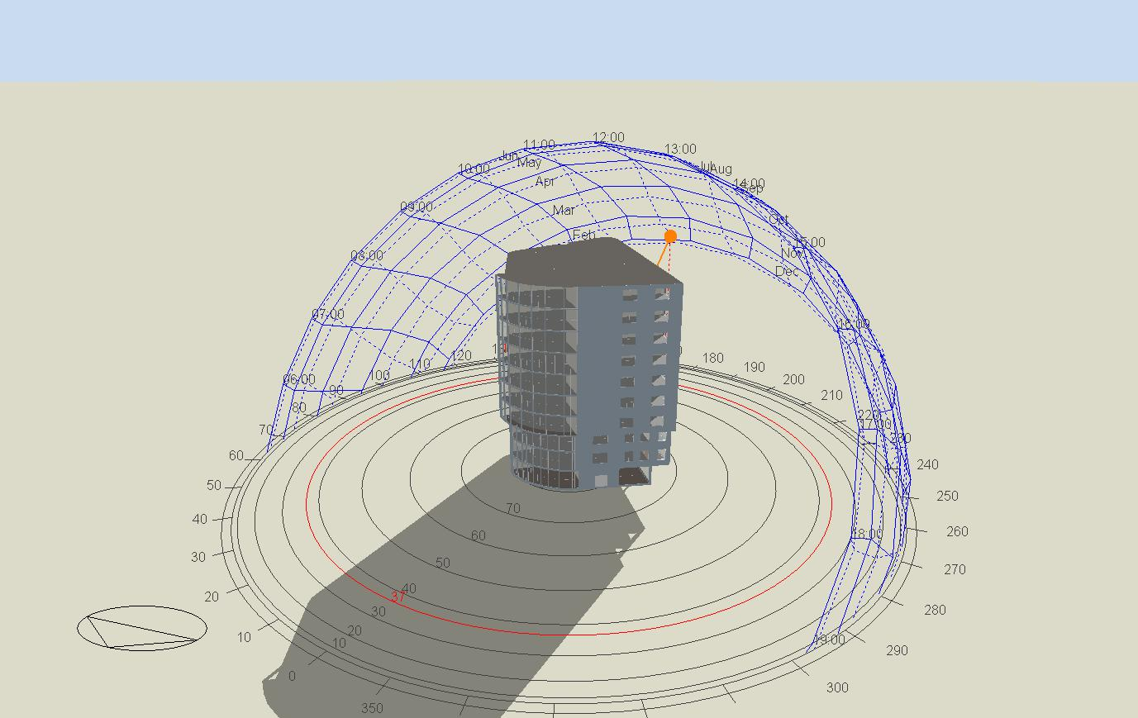
Sun path
Winter
At 9:00 am on 21/January
At 12:00 am on 21/January

Slide 7
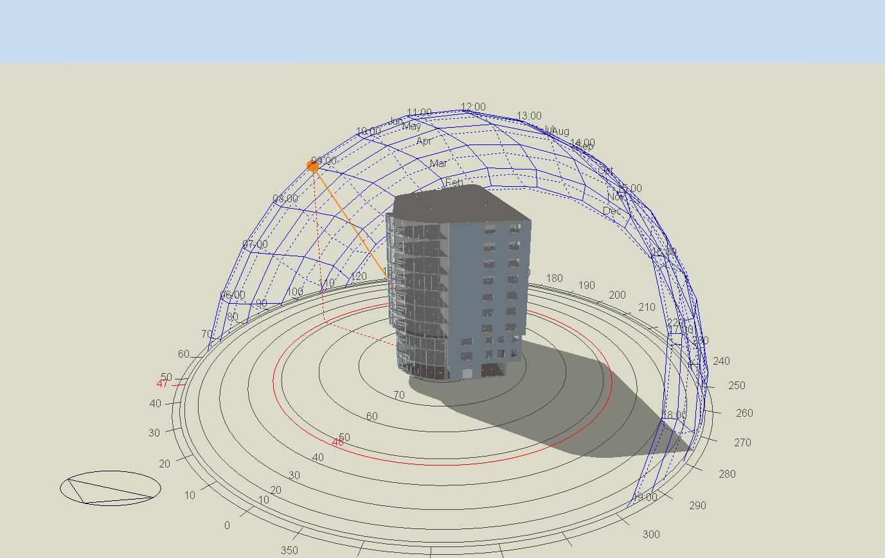
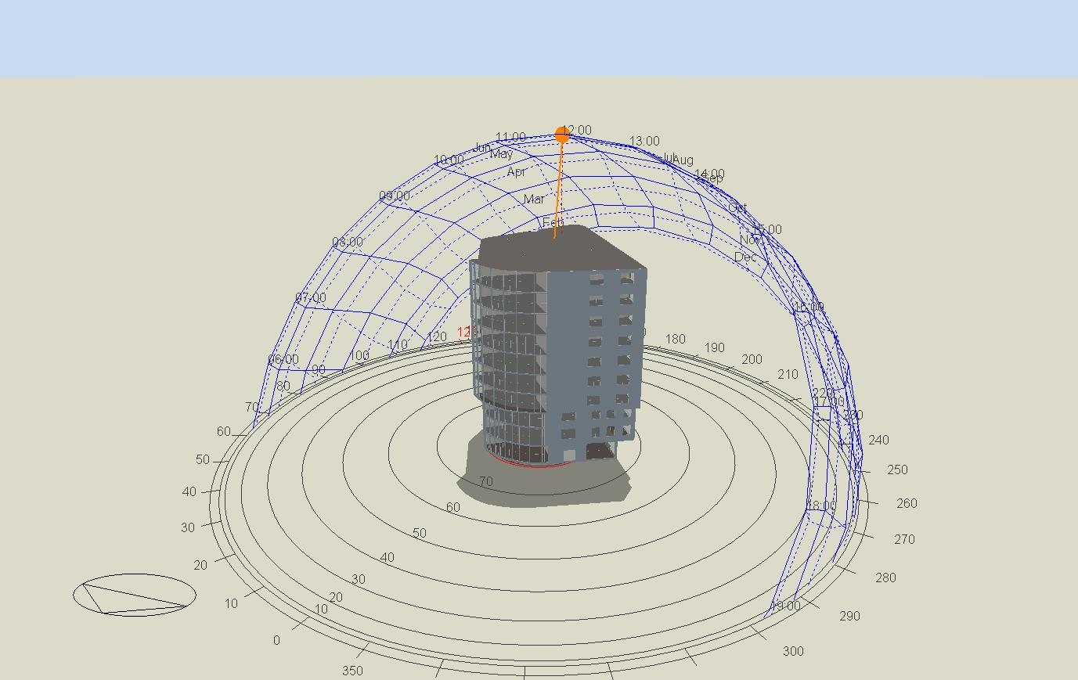
Sun path
Summer
At 9:00 am on 21/July
At 12:00 am on 21/July

Slide 8
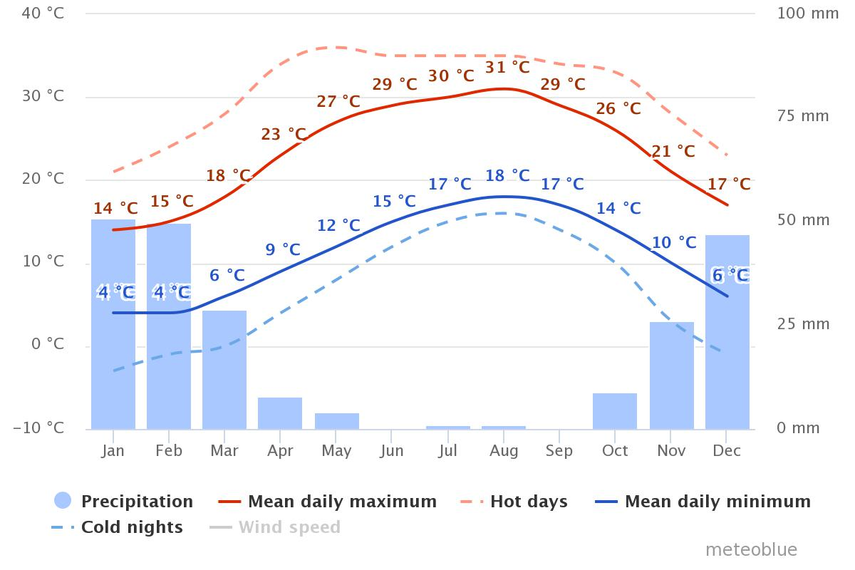
Site Analysis
Temperature

Slide 9
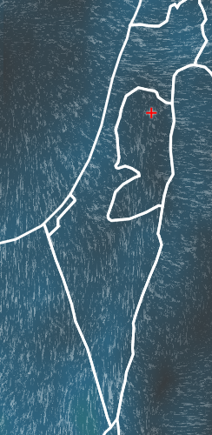
Wind direction and speed
Direction of wind northern and north west and average wind speed 3.5 m/s

Slide 10
Architectural Design

Slide 11
Architectural Design
Al Qaneer commercial office building main spaces
Offices
Manager rooms
Meeting rooms
Cafeteria
Al Safa bank branch
Exhibitions
Parkings
Water closets
Lounge, corridors and circulation paths
Staircases
Lifts
Security room

Slide 12
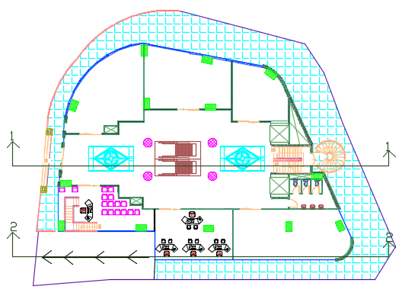
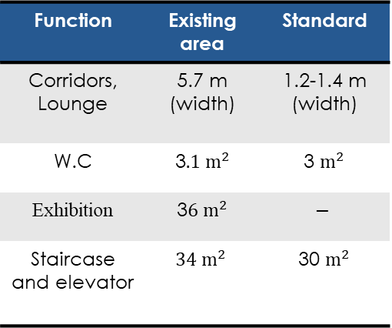
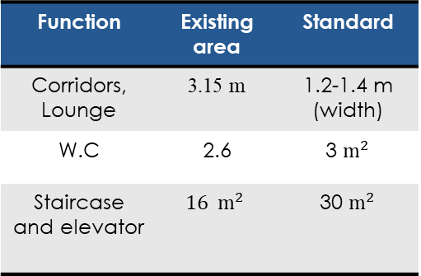
Function | Existing area | Standard
Corridors, Lounge | 5.7 m (width) | 1.2-1.4 m (width)
W.C | 3$.1 m^{2}$ | 3 $m^{2}$
Exhibition | 3$6 m^{2}$ | $$−$$
Staircase and elevator | $$34 m^{2}$$ | 30 $m^{2}$
For old design
Function | Existing area | Standard
Corridors, Lounge | 3.15 m | 1.2-1.4 m (width)
W.C | 2.6 | 3 $m^{2}$
Staircase and elevator | $$16 m^{2}$$ | 30 $m^{2}$
Ground floor

Slide 13
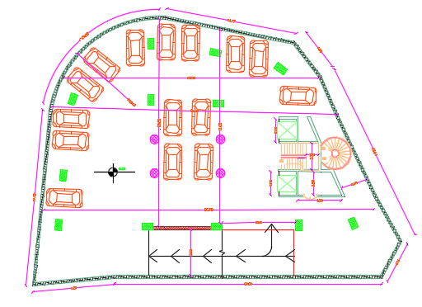

Total area = 960 $m^{2}$
Plan for basement 3, basment2 and basment1

Slide 14
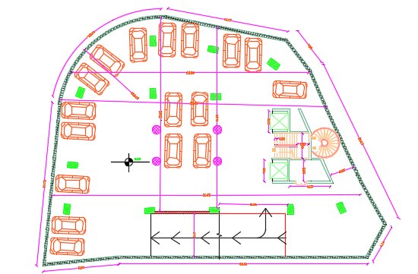

Total area = 960 $m^{2}$
Forth basement

Slide 15
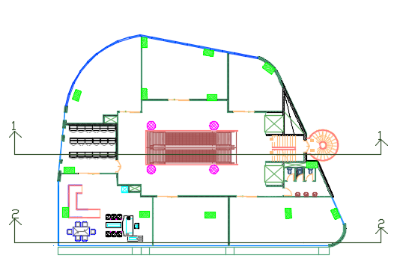
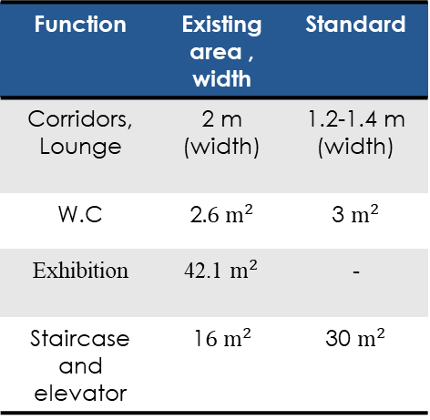

Function | Existing area , width | Standard
Corridors, Lounge | 3.7 m (width) | 1.2-1.4 m (width)
W.C | 3.1$m^{2}$ | 3 $m^{2}$
Exhibition | 36 $m^{2}$ | -
Staircase and elevator | 34$m^{2}$ | 30 $m^{2}$
For old design
Function | Existing area , width | Standard
Corridors, Lounge | 2 m (width) | 1.2-1.4 m (width)
W.C | 2$.6 m^{2}$ | 3 $m^{2}$
Exhibition | 42.1 $m^{2}$ | -
Staircase and elevator | 1$6 m^{2}$ | 30 $m^{2}$
First floor

Slide 16
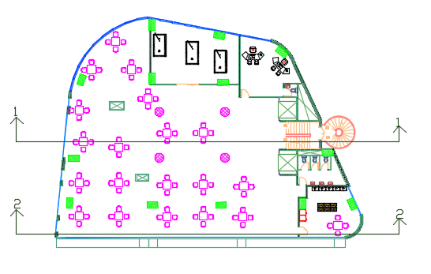
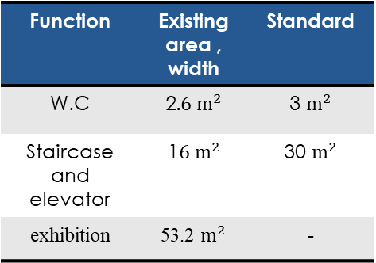
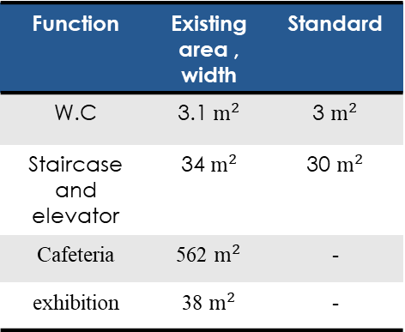
Function | Existing area , width | Standard
W.C | 3.1$m^{2}$ | 3 $m^{2}$
Staircase and elevator | 34$m^{2}$ | 30 $m^{2}$
Cafeteria | 562 $m^{2}$ | -
exhibition | 38 $m^{2}$ | -
For old design
Function | Existing area , width | Standard
W.C | 2$.6 m^{2}$ | 3 $m^{2}$
Staircase and elevator | 1$6 m^{2}$ | 30 $m^{2}$
exhibition | 53.2 $m^{2}$ | -
Second floor

Slide 17
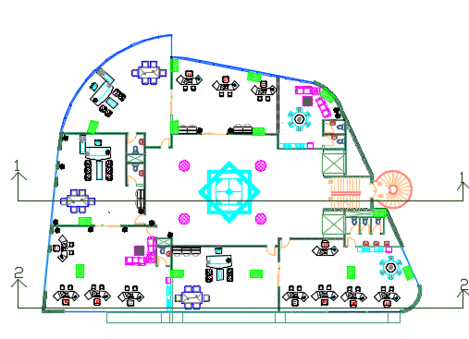
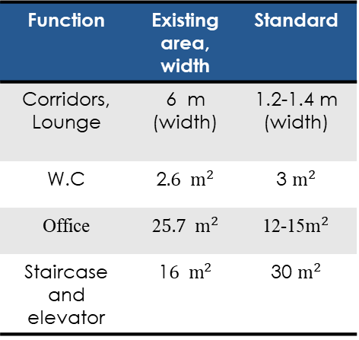
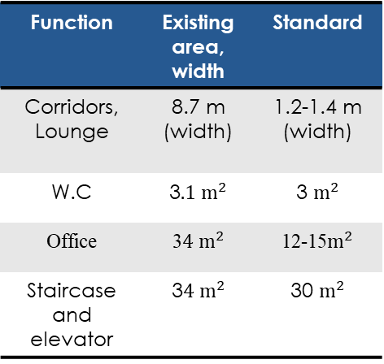
Function | Existing area, width | Standard
Corridors, Lounge | 8.7 m (width) | 1.2-1.4 m (width)
W.C | 3$.1 m^{2}$ | 3 $m^{2}$
Office | 3$4 m^{2}$ | 12-15$m^{2}$
Staircase and elevator | 3$4 m^{2}$ | 30 $m^{2}$
Function | Existing area, width | Standard
Corridors, Lounge | 6 m (width) | 1.2-1.4 m (width)
W.C | 2$.6 m^{2}$ | 3 $m^{2}$
Office | 2$5.7 m^{2}$ | 12-15$m^{2}$
Staircase and elevator | 1$6 m^{2}$ | 30 $m^{2}$
Typical floor

Slide 18
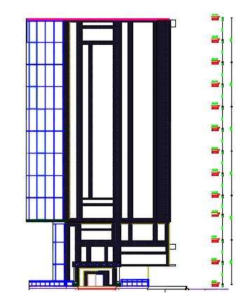
West Elevation

Slide 19
East Elevation

Slide 20
  North Elevation

Slide 21
South Elevation

Slide 22
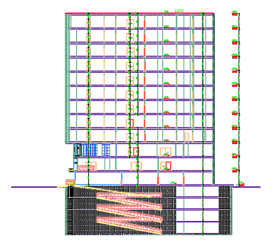
Section 1-1

Slide 23
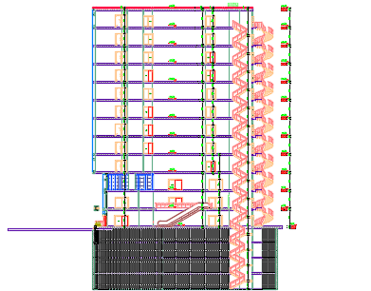
Section 2-2

Slide 24
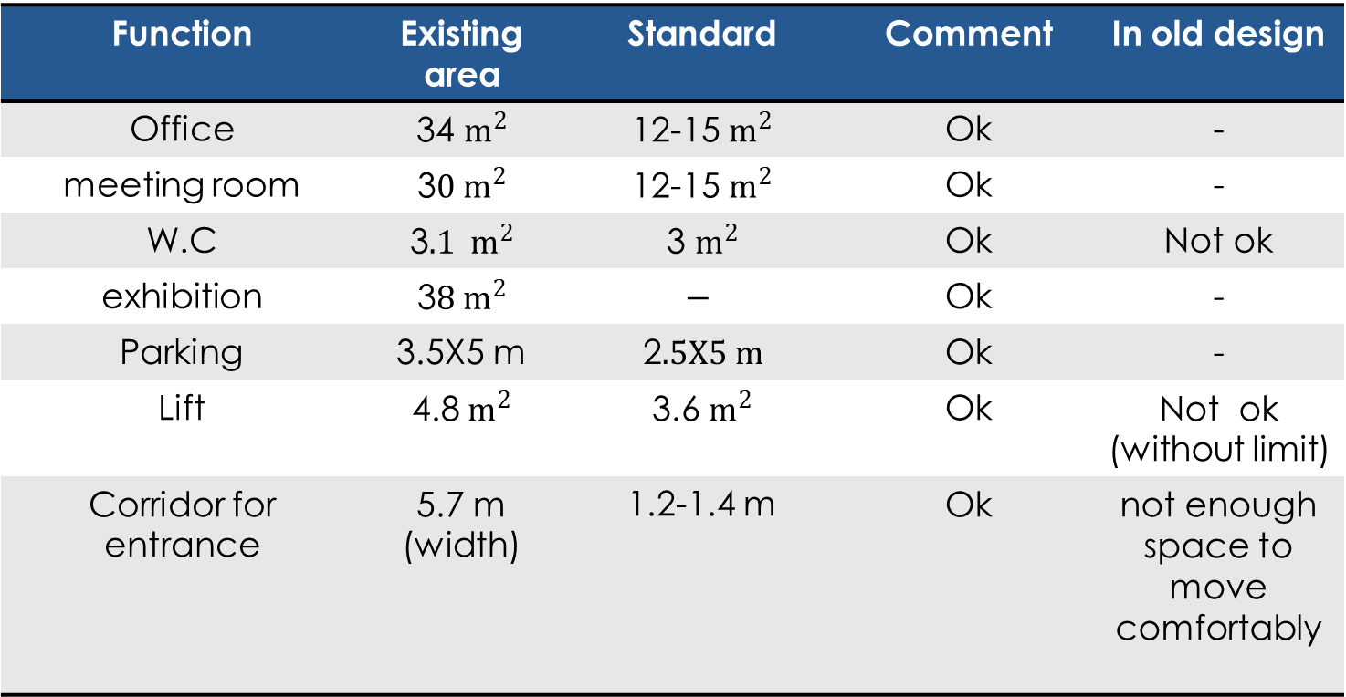
Evaluation for building
Function | Existing area | Standard | Comment | In old design
Office | 34 $m^{2}$ | 12-15 $m^{2}$ | Ok | -
meeting room | 3$0 m^{2}$ | 12-15 $m^{2}$ | Ok | -
W.C | 3$.1 m^{2}$ | 3 $m^{2}$ | Ok | Not ok
exhibition | 3$8 m^{2}$ | $$−$$ | Ok | -
Parking | 3.5X5 m | 2$.5X5 m$ | Ok | -
Lift | 4.8$m^{2}$ | 3.6 $m^{2}$ | Ok | Not ok (without limit)
Corridor for entrance | 5.7 m (width) | 1.2-1.4 m | Ok | not enough space to move comfortably

Slide 25
    Environmental Design

Slide 26
    Acoustical analysis

Slide 27
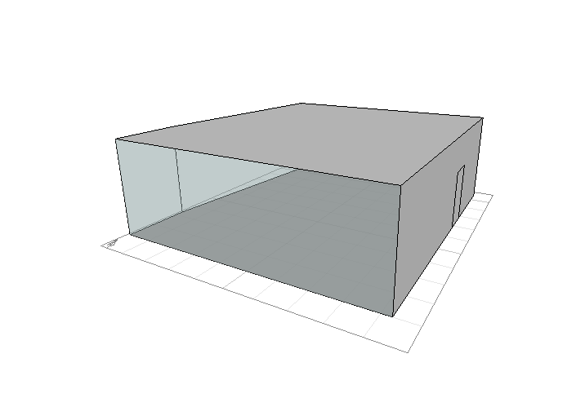
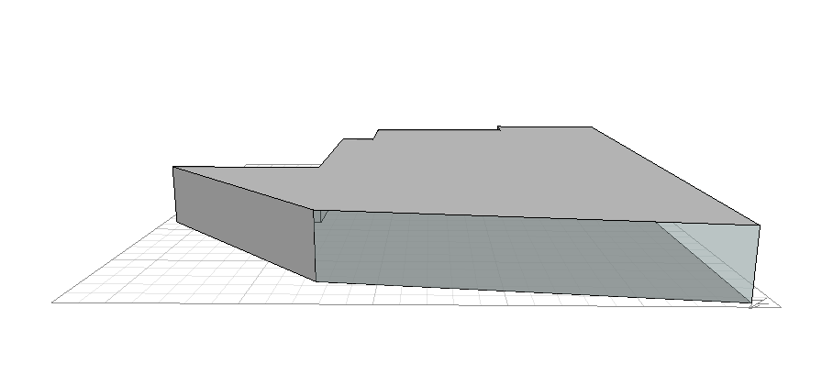
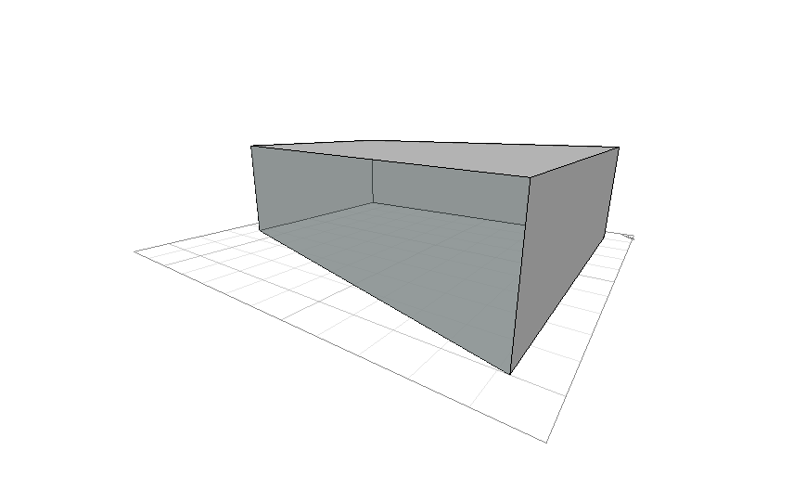
Reverberation time (RT60)
cafeteria
office

Slide 28
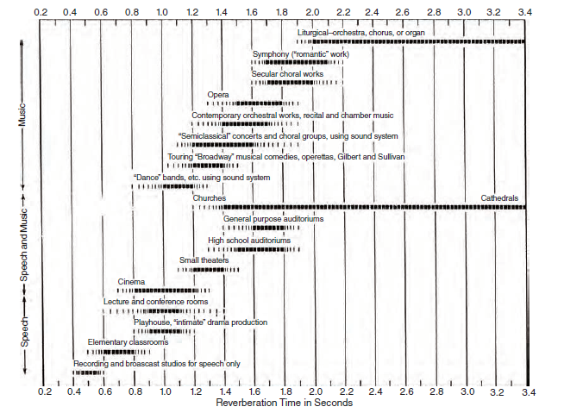
Recommended values of RT60 in office buildings

Slide 29
Reverberation time (RT₆₀)
At 95% occupancy
FREQ. | RT₆₀
63Hz: | 0.94
125Hz: | 0.96
250Hz: | 0.89
500Hz: | 0.97
1kHz: | 0.65
2kHz: | 0.46
4kHz: | 0.47
8kHz: | 0.43
16kHz: | 0.40
Manager office
Room
(0.6-1.2)sec
RT60 recommended for office between (0.6 – 1.2)

Slide 30
Reverberation time (RT₆₀)
At 85 % occupancy
FREQ. | RT(60)
63Hz: | 0.96
125Hz: | 0.99
250Hz: | 0.94
500Hz: | 1.03
1kHz: | 0.68
2kHz: | 0.48
4kHz: | 0.48
8kHz: | 0.44
16kHz: | 0.41
Exhibition
(1.4-2)sec

Slide 31
Reverberation time (RT₆₀)
At 85 % occupancy
FREQ. | RT(60)
63Hz: | 1.14
125Hz: | 1.02
250Hz: | 0.95
500Hz: | 1.09
1kHz: | 0.72
2kHz: | 0.52
4kHz: | 0.55
8kHz: | 0.62
16kHz: | 0.59
Cafeteria
(0.6-1)sec

Slide 32
STC for internal wall between offices
STC standard =38

Slide 33
STC for external façade curtain wall
Curtain wall STC standard =35

Slide 34
  Passive Analysis

Slide 35
  Passive Analysis
Shading
Thermal analysis
Daylight

Slide 36
Shadows from building in 21/1 at 9:00 am

Slide 37
shadows from building in 21/7 at 9:00 am

Slide 38
shading on the building from others
The closest building is about 30m apart
No shading on the building from others

Slide 39
    Envelope construction details for the building
External Wall layers
U-value =0.52w/m²-k

Slide 40
Internal Wall
U-value =1.67w/m²-k

Slide 41
Floor layers
U-value =0.389w/m²-k

Slide 42
Roof layers
U-value =0.389 w/m²-k

Slide 43
Glazing
U-value =2.2 w/m²-k
properties | value
Total Solar transmission (SHGC) | 0.268
Direct Solar transmission | 0.16
Light transmission | 0.20
U-value | 2.2

Slide 44
Thermal analysis

Slide 45
Thermal analysis

Slide 46
Thermal analysis

Slide 47
Thermal analysis
Load | Value
Cooling load | 480 KW
Heating load | 161.1 KW

Slide 48
Thermal analysis

Slide 49
Thermal analysis
 | Total energy | Energy per total Building area(KWh/m2 ) | Energy per conditioned building area(KWh/m2 )
Total site energy | 64277.76 | 107.00 | 107.00
Total source energy | 979115.06 | 162.99 | 162.99

Slide 50
      Daylight

Slide 51
  Structural Aspect

Slide 52
Design data
Cods and Standard
  ACI -318-14 for reinforced concrete structural design
  UBC -97 for seismic design.
  ASCE for load combinations.

Slide 53
Design data
Loads
  Dead load.
  Super imposed dead load =6 kN/m² .
  Live load = 5 kN/m² .

Slide 54

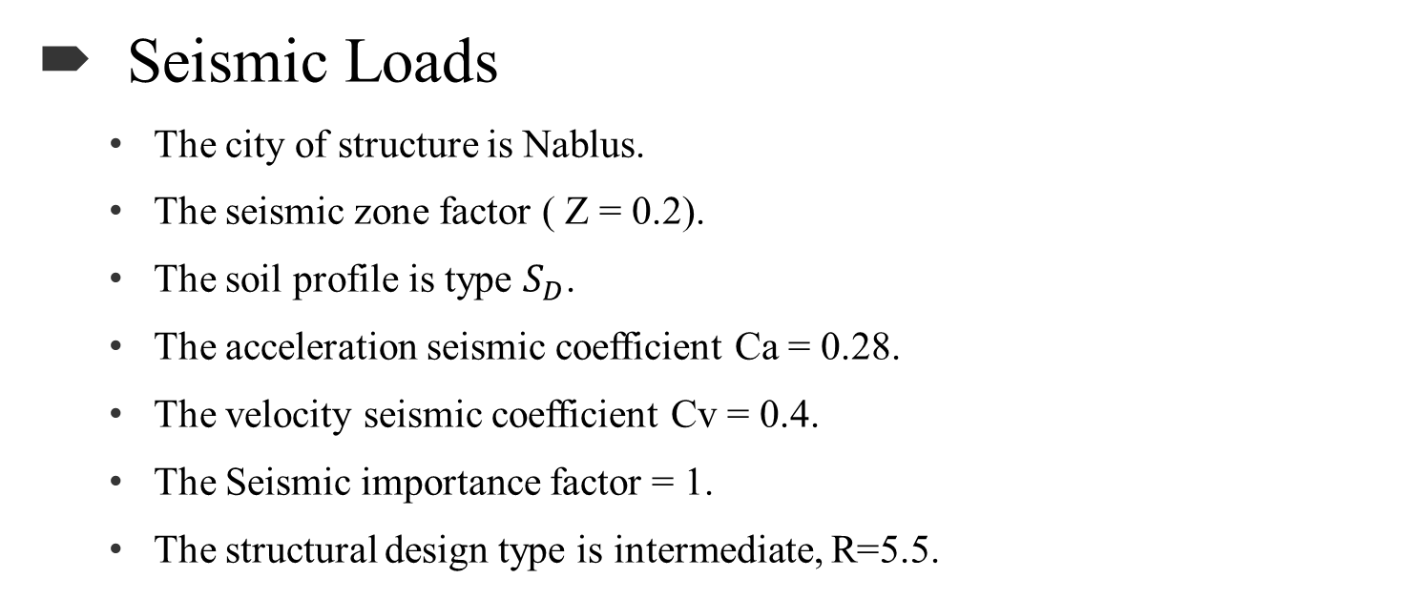
Design data
Seismic Loads
  The city of structure is Nablus.
  The seismic zone factor ( Z = 0.2).
  The soil profile is type $S_{D}$.
  The acceleration seismic coefficient Ca = 0.28.
  The velocity seismic coefficient Cv = 0.4.
  The Seismic importance factor = 1.
  The structural design type is intermediate, R=5.5.

Slide 55
Design data
Materials
  Concrete strength for slab, beams and columns f′c= 28MPa and f′c= 40MPa for footing.
  Steel yield strength Fy= 420MPa.
  Bearing capacity for soil = 250 kN/m²

Slide 56
3D Model form ETABS

Slide 57
Model Checks
Compatibility check.
ناقص صورة

Slide 58
Model Checks
Equilibrium Check.
Load Case | ETABS | Manual | Error % | Status
 | KN
Dead | 132261 | 131944 | 0.5 | ok
Live | 43519 | 44980 | 3.35 | ok
SID | 55370 | 58155 | 4.3 | ok

Slide 59
Model Checks
Internal forces check.
  Done for 2 samples of slab strip, beams and columns within difference less than 10%

Slide 60
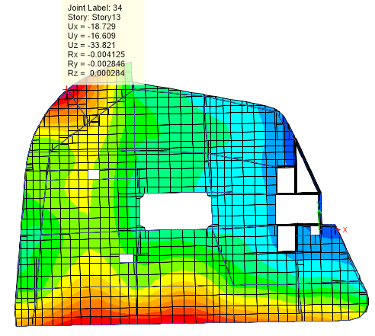
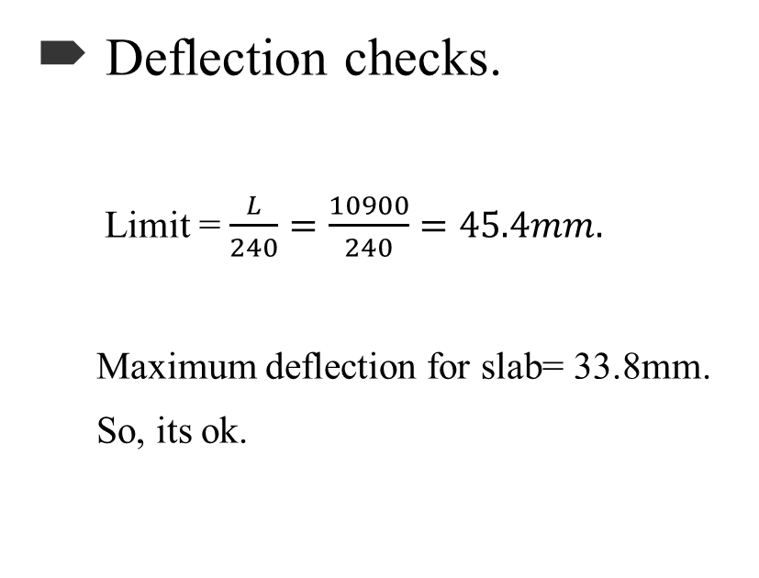
Model Checks
Deflection checks.
  Limit = $\frac{L}{240}=\frac{10900}{240}=45.4mm.$
  Maximum deflection for slab= 33.8mm.
  So, its ok.

Slide 61

Model Checks
Modal participation mass ratio checks.
Period check.
Period from ETABS = 1.1 sec. / Period from hand calc.= 0.71sec
T from ETA BS < 140% from hand calc.
1.1 sec. > 0.997 sec.
NOT OK.

Slide 62

Model Checks
Base shear check.
V manual = 15047
Vx =15735.67 kN > 15047 kN ➔ Ok.
Vy= 15216.71 kN > 15047 kN ➔ Ok.
Drift check.
#STORY | $$∆m$$ | Limitation | state
10 | 65.45 | 70 | OK

Slide 63
Structure Design (Results)
Sections Dimensions.
Member | Width | Depth
Slabs (Solid) | 25cm
Sabs (Ribbed) | 40cm
Beams (Main) | 90cm | 40cm
Beams (secondary) | 50cm | 40cm
Columns (rectangular) | 120cm | 70cm
Columns (circular) | 100cm
Shear Walls | 30cm

Slide 64
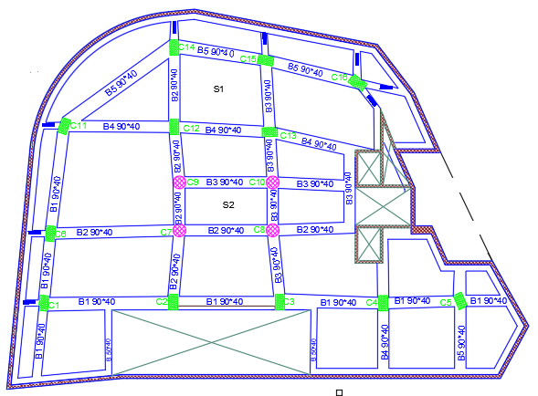
Structure Design (Results)
Basement floor for slab & beams distributions.

Slide 65
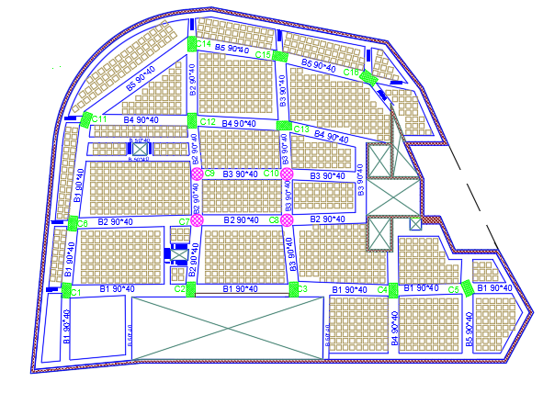
Structure Design (Results)
Ground floor slab & beams distributions.

Slide 66
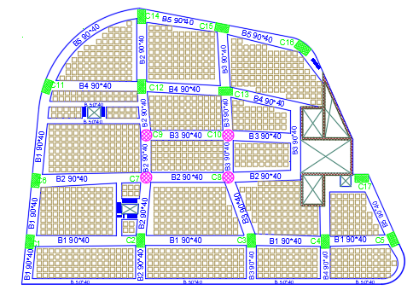
Structure Design (Results)
First floor for slab & beams distributions.

Slide 67
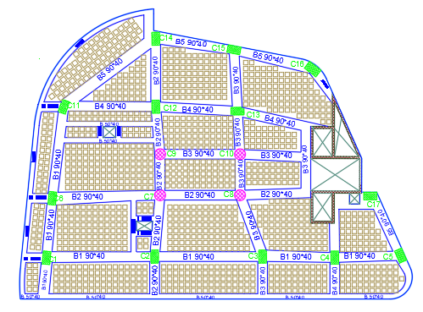
Structure Design (Results)
Typically floor for slab & beams distributions.

Slide 68
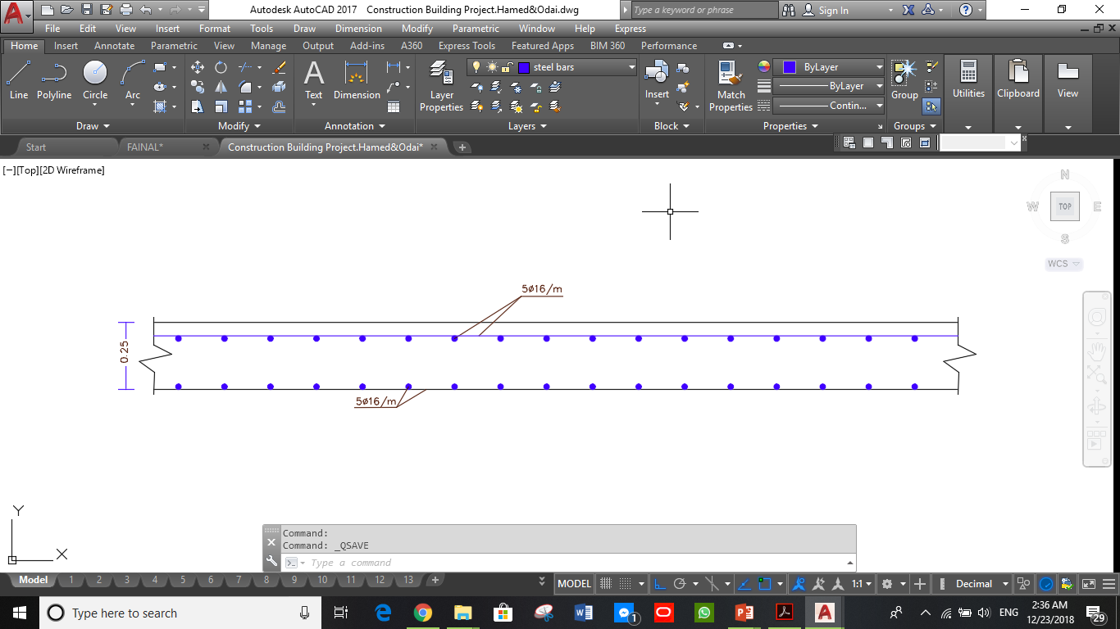
Structure Design (Results)
Section for tow way solid slabs.

Slide 69
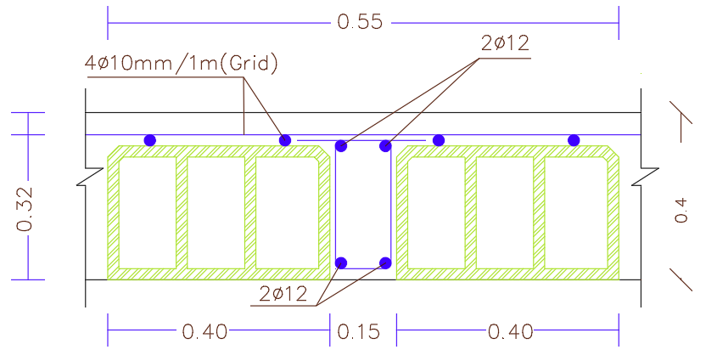
Structure Design (Results)
Section for tow way ribbed slabs.

Slide 70
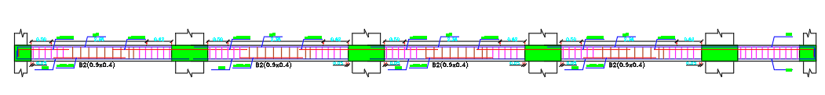
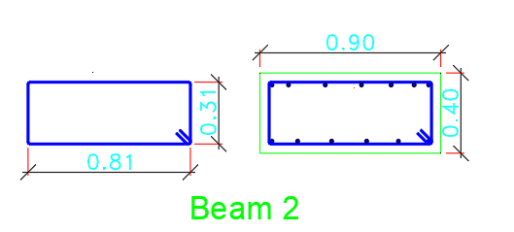
Structure Design (Results)
Beam reinforcement for B.F.(Y direction)

Slide 71
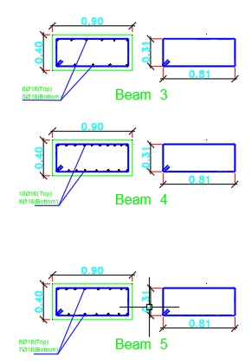
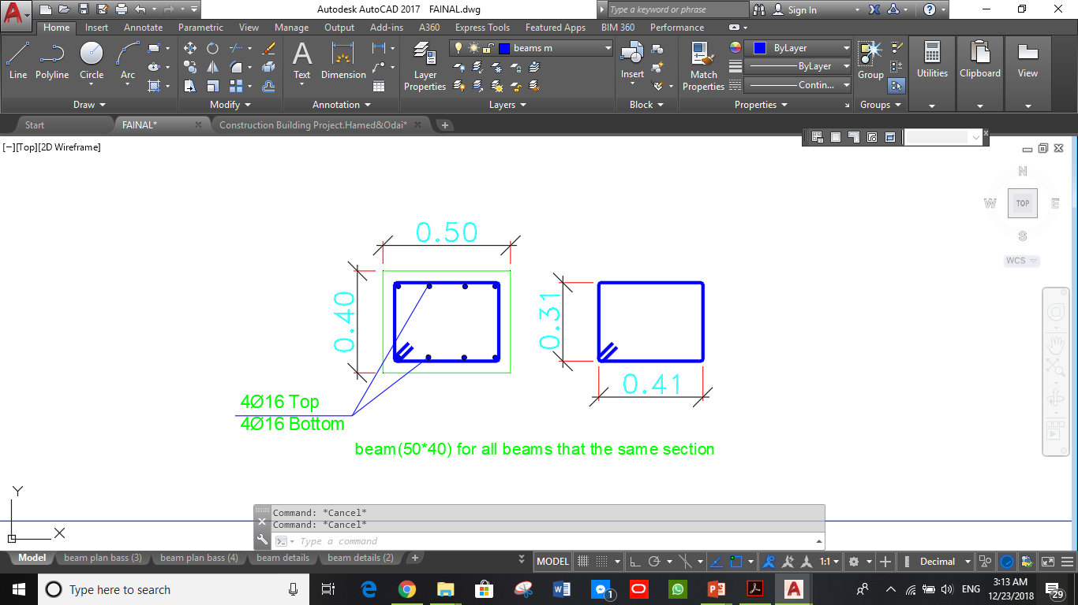
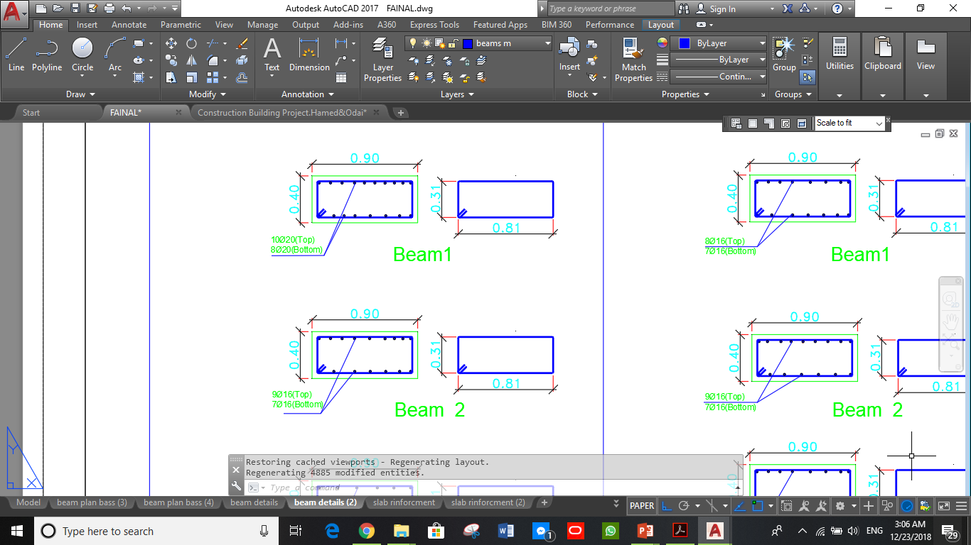
Structure Design (Results)
Beams reinforcement for G.F, F.F and T.F.(X direction)

Slide 72
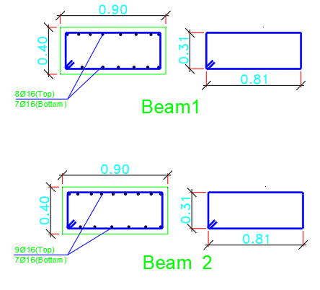
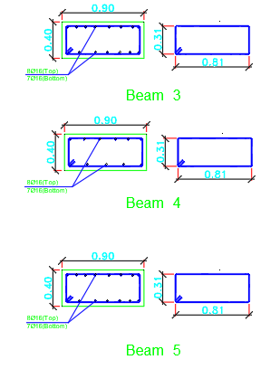
Structure Design (Results)
Beams reinforcement for G.F, F.F and T.F.(Y direction)

Slide 73
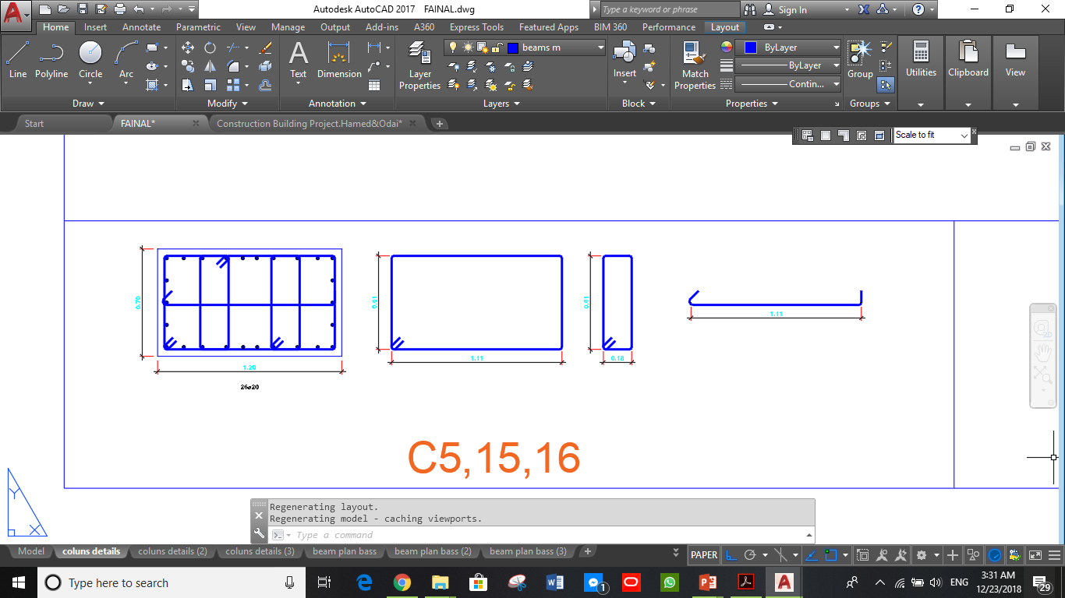
Structure Design (Results)
Columns reinforcement for B.F & S1,2,3.

Slide 74
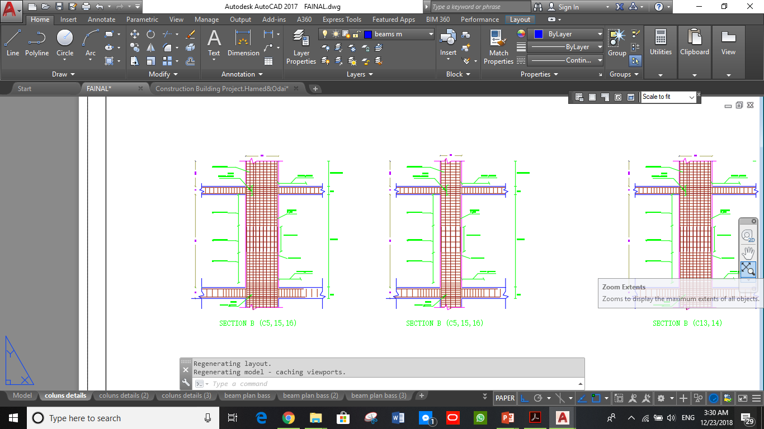
Structure Design (Results)
Columns reinforcement for B.F & S1,2,3.

Slide 75
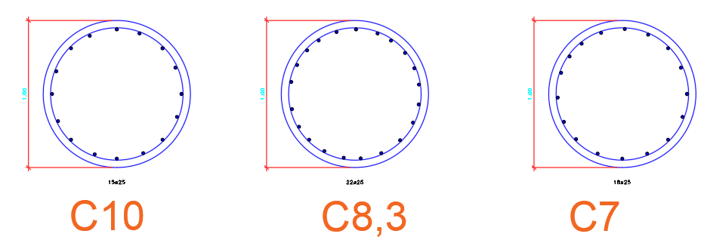
Structure Design (Results)
Columns reinforcement for B.F & S1,2,3.

Slide 76
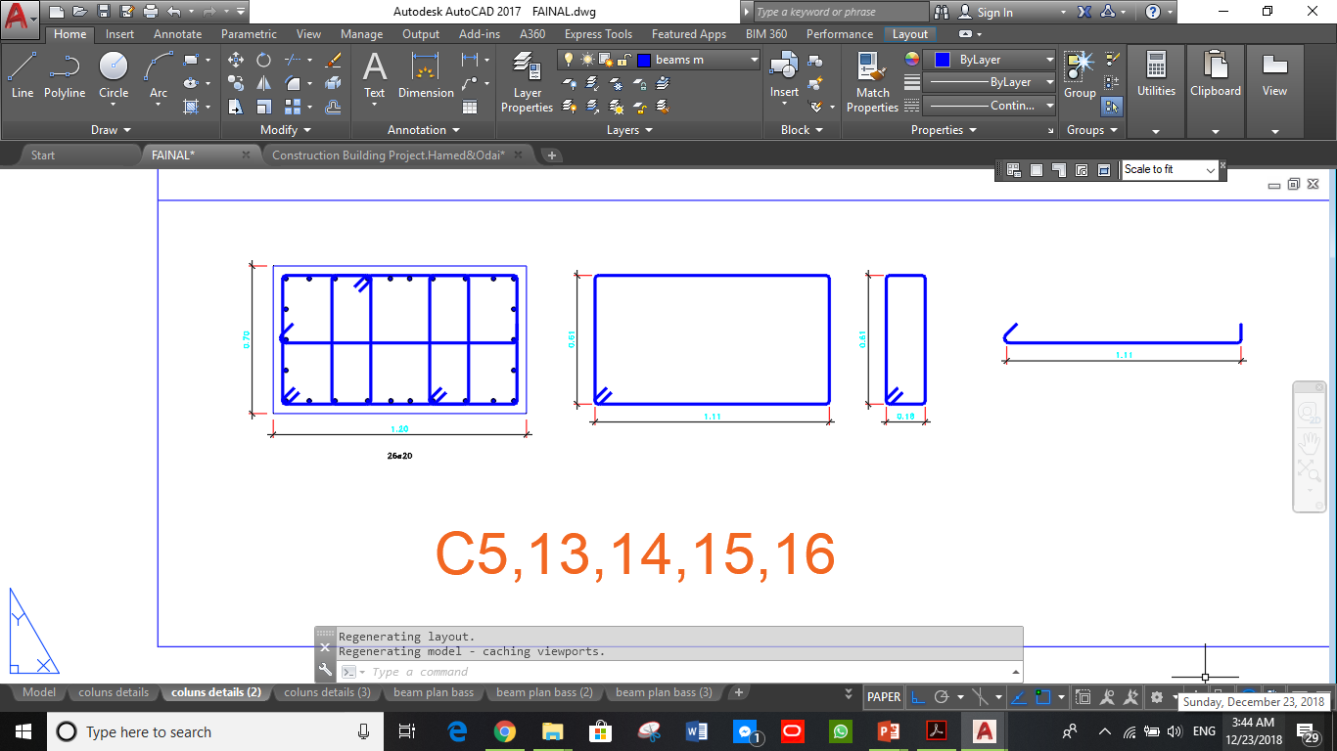
Structure Design (Results)
Columns reinforcement for S4,5,6.

Slide 77
Structure Design (Results)
Footing.

Slide 78
Electro mechanical system analysis

Slide 79
Mechanical Design
Water supply system
Water consumption
Drainage system
HVAC system
Firefighting system
Elevator system

Slide 80
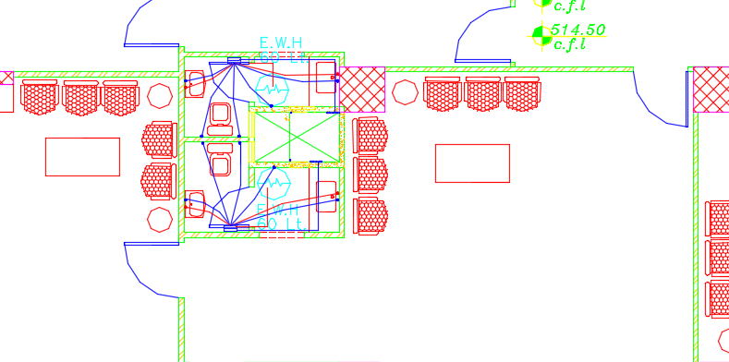
    Water supply system
  Old water supply system
Pipe | Required diameter | Actual diameter
Vertical feeder | 2.5" | 3/4"and 1/2"
Horizontal pipe | 2" | 3"
Branch pipe | 0.75" | 0.62"

Slide 81

    Water supply system
  New water supply system
Pipe | Diameter
Vertical feeder | 1.5"
Horizontal pipe | 1"
Branch pipe | 1/2"

Slide 82
    Water consumption
    Water consumption by people 45-70 litter for cold water
    Water consumption by people 10 litter for hot water
    Total number of people 500 person /day
    Total amount of cold fresh water 35 CM
    Total amount of hot water 5CM
    Water consumption by firefighting 10.5 CM

Slide 83

    Water drainage system
    Old Water drainage system
Pipe | Diameter
Vertical pipe | 4"
Horizontal pipes (lavatory) | 2"
Horizontal pipes (kitchen sink) | 2"
Horizontal pipes (W.C) | 4"
Pipes between manhole | 6"

Slide 84

    Water drainage system
    New Water drainage system
Pipe | Diameter
Vertical pipe | 4"
Horizontal pipes (lavatory) | 2"
Horizontal pipes (kitchen sink) | 2"
Horizontal pipes (W.C) | 4"
Pipes between manhole | 6"

Slide 85

    Water drainage system

Slide 86

    Rainwater drainage system

Slide 87

    HVAC system
VRF system was used.
Main component of VRF system is:
1. Outdoor unit
  2. Fan coil (indoor units)
  3. Ducts
  4. Diffusers
  5.Colector

Slide 88
    HVAC system
VRF Design
Cooling load for building = 480 kW
Outdoor unit was selected from Samsung Company.
It was chosen four outdoor unit with capacity of total building capacity 137 ton DVM S, each outdoor unit 36 ton.

Slide 89

    HVAC system
VRF Design:
Balance pressure drop method was used to find duct sizing.
For cafeteria, cooling load = 32.6KW so that the volumetric flow rate =1.71m³/s
So that, the Fan coil unit selected from TROX UK (FCU) Type PWX with volumetric flow rate 1.75 m3/s.
Kvadra diffuser was selected from Systemair Company with volumetric flow rate 0.1m³/s.

Slide 90
    HVAC system
Size of duct
Duct | ύ | v | Dimeter | ΔP/El
AB | 1.71 | 5 | 0.65 | 0.35
BC | 1.41 | 3.5 | 0.56 | 0.35
CD | 1.31 | 3.3 | 0.52 | 0.35
DE | 1.11 | 3 | 0.49 | 0.35
EF | 1.01 | 2.8 | 0.46 | 0.35
FG | 0.81 | 2.5 | 0.41 | 0.35
Size of branch duct
Duct | ύ | v | Dimeter | ΔP/El
BI | 0.1 | 3 | 0.22 | 0.9
B1 | 0.1 | 2.8 | 0.2 | 0.88
C2 | 0.1 | 3 | 0.23 | 0.98
D6 | 0.1 | 3.1 | 0.23 | 1.13
D3 | 0.1 | 3.3 | 0.22 | 1.2
E4 | 0.1 | 3.3 | 0.2 | 1.17
F5 | 0.1 | 3.4 | 0.19 | 1.25
F7 | 0.1 | 3.4 | 0.19 | 1.28
GH | 0.1 | 3.7 | 0.17 | 1.41

Slide 91

    HVAC system
Distribution of HVAC system at second floor

Slide 92
Firefighting system

Slide 93




Automatic sprinkler system
Extinguisher
Hose station
Warning signs
Heat detectors

Slide 94


Distribution of fire suppression system
Ground floor
Typical floor

Slide 95


Distribution of fire alarm system and egress sign
Ground floor
Typical floor

Slide 96
Elevators design
Previous number of elevator = 2
New number of elevators = 4
Car capacity = 2000 Lb
Car speed = 600 fpm
PHC (%) = 11
I = 29.7 sec

Slide 97
Electrical and lighting system

Slide 98


  Luminaire used

Slide 99
Lighting Results
Office assessment | Illuminance (Lux) | glare | uniformity
Standards | 500 | 19 | 0.6
Result | 1300 | 10.4 | 0.65
exhibition assessment | Illuminance (Lux) | glare | uniformity
Standards | 500 | 19 | 0.6
Result | 621 | 18.1 | 0.7

Slide 100

  3D – rendering view (office)

Slide 101

  3D – rendering view (exhibition)

Slide 102

  3D – rendering view (parking)

Slide 103

  Artificial Lighting
Luminaries distribution in Basement lighting

Slide 104

  Artificial Lighting
Luminaries distribution in Ground floor lighting

Slide 105

  Artificial Lighting
Luminaries distribution in First floor lighting

Slide 106

  Artificial Lighting
Luminaries distribution in Second floor lighting

Slide 107

  Artificial Lighting
Luminaries distribution in Typical floor lighting

Slide 108

  socket
Socket distribution in Ground floor

Slide 109

  socket
Socket distribution in First floor

Slide 110

  socket
Socket distribution in Second floor

Slide 111

  socket
Socket distribution in typical floor

Slide 112

    Reflected ceiling plan

Slide 113
Quantity Survey
Stage | Cost
Structural work | 5748883.84 NIS
Finishing | 4664908.8 NIS
Mechanical work | 2602628 NIS
Electrical work | 237608NIS
Total project cost | 13254028.64 NIS
Unit cost | 1190.83 NIS/m²

Slide 114
Conclusion

Slide 115
THANK YOU

