Slide 1
Rick
Presented by: Ameen Kharma
Sohaib Shayeb
Supervisor: Dr.Luai Malhis

Slide 2
Outline
What is Rick.
Motivation.
How does it work.
Technical choices.
Methods & Techniques.
Constraints.
Future work.

Slide 3

What is Rick ?
Rick is a robot that helps people in their jobs by carrying their tools.
It can respond to their voice commands to give them a specific item.
Move wherever they desire by just moving their wrist.

Slide 4
Motivation
People tend to use more technology in order to save time and effort.
Craftsman or carpenter uses much equipment frequently every day.

Slide 5
How does it work?
By moving your hand you can move the robot.
The robot avoids colliding with obstacles while moving.
The robot carries the tools in a packet of 5 rooms.
It handles the tools to the user by responding to his voice commands.
The user has the option to use the mobile app to move the robot and for tools selection.

Slide 6
Technical choices
Reading the hand movements:
  Accelerometer sensor.
Moving the wheels:
  DC Motors.
  Dual H-Bridge
Obstacles avoidance:
  IR sensors.

Slide 7
Moving the tools packet:
  Stepper motor.
Send the hand movements signs (transmitter):
  Arduino Nano.
Data Receiver:
  Arduino Mega.
Send data from the transmitter to the receiver:
  HC-12 wireless serial port communication module.
Bluetooth module.

Slide 8
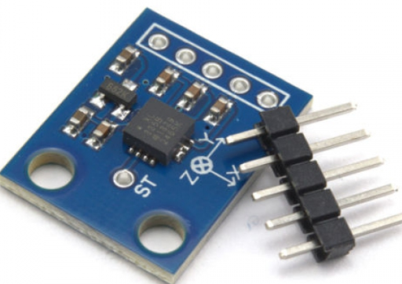
Reading Hand Movements:
Accelerometer sensor:
Control the movement of the robot.
It will detect the movement of the user’s wrist, then send the right command to the robot to move in the applied direction.

Slide 9
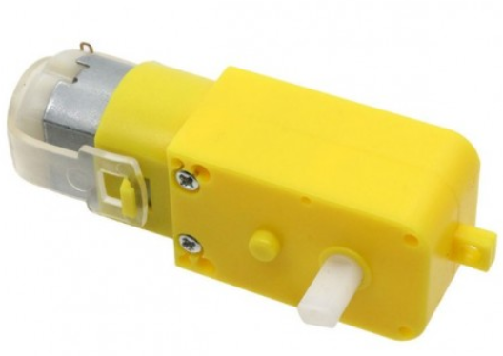
Moving the wheels:
DC-motor:
  Two DC motors to move the wheels of the robot.
  The direction of movement will be determined by detecting the movement of the user’s wrist by using the accelerometer sensor.

Slide 10
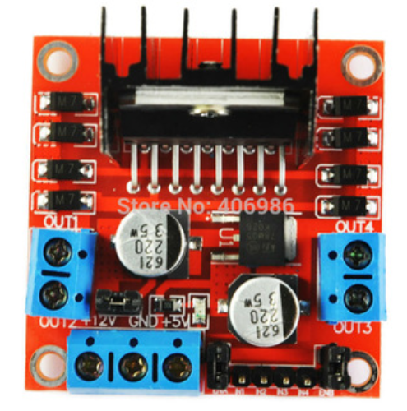
Dual H-Bridge:
  Two DC motors to move the wheels of the robot.
  The direction of movement will be determined by detecting the movement of the user’s wrist by using the accelerometer sensor.

Slide 11
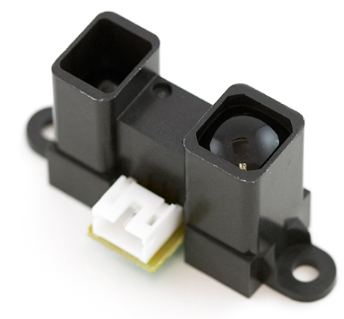
Obstacles avoidance
  Sharp IR Sensors:
  Sense certain characteristics of its surroundings.
  Locates in the both sides of the robot, so that it can avoid hitting with walls or random obstacles.

Slide 12
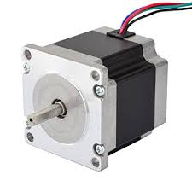
Moving the tools Packet
  Stepper Motor:
  Divides a full rotation into a number of equal steps. Its position can then be commanded to move and hold at one of these steps.

Slide 13
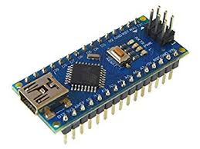
Send the hand movements signs (transmitter):
Arduino Nano:
  Send the user’s command “Hand signs” from the accelerometer Sensor to the Arduino Mega.

Slide 14
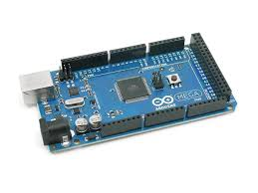
Data Receiver:
  Arduino Mega:
  Data from Arduino Nano, Mobile Bluetooth and the IR sensors will be stored in the serial port of the Arduino Mega.

Slide 15
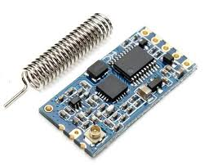
Send data from transmitter to receiver:
  HC-12 wireless serial port
  communication module:
Send the accelerometer data from the Arduino Nano to Arduino Mega in order to make the robot perform the right movement.

Slide 16
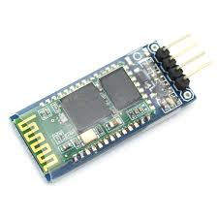
Bluetooth module:
  Connected to UART of Arduino Mega.
  To send voice commands, tools selection options and DC Motor movement commands to the Arduino Mega.

Slide 17
Constraints
Shortage of Time.
Mechanical problems.
Some electronics parts were unavailable.

Slide 18
Future work
Enhance the selecting algorithm.
More voice commands.
Enhance the model design.
Make the robot follows the user automatically.
Apply slave-master by making a new robot, Morty.

Slide 19


